Slide 1
Development of the
Artemis Distributed Simulation FOMs
2025-SIW-Presentation-006
Paige Whittington, NASA Johnson Space Center, USA
Edwin Z. Crues, NASA Johnson Space Center, USA
Keaton Dodd, CACI International, USA

Slide 2
Outline
NASA’s Artemis Program
Artemis Distributed Simulation (ADS)
Simulation Interoperability Standards
ADS FOMs
ADS FOMs Object Classes
ADS FOMs Interaction Classes
Future Work
Conclusion

Slide 3

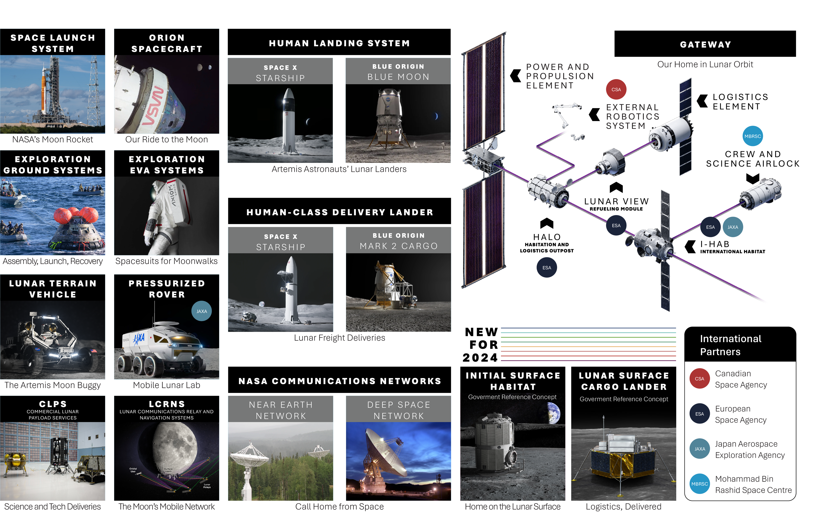
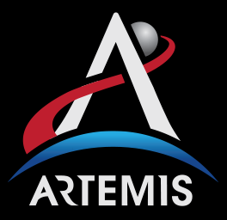
NASA’s Artemis Program
The Artemis Program is a complex system of systems problem and represents the most complex series of missions ever attempted
The numerous Artemis elements must be integrated for NASA to establish a long-term human presence on the Moon and pave the way to Mars

Slide 4



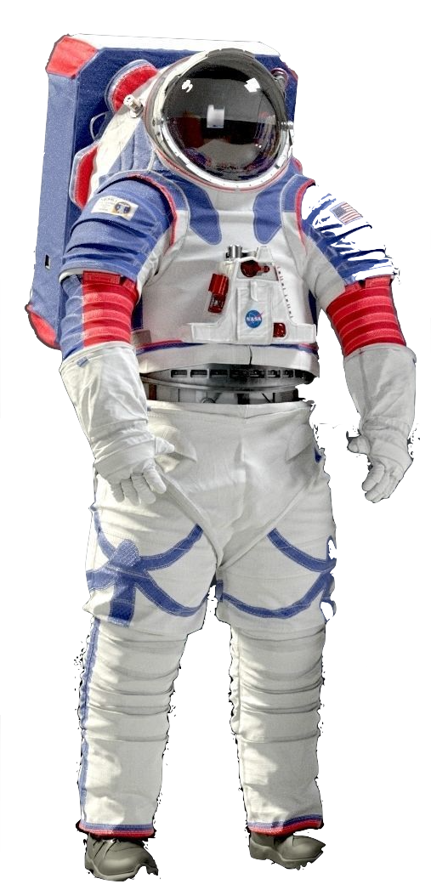

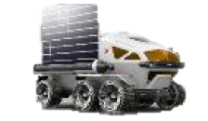
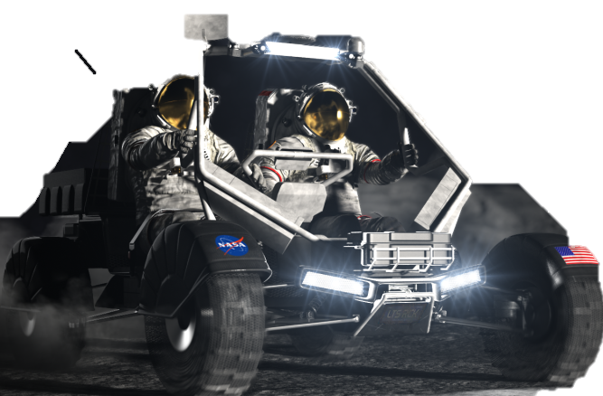
Artemis Distributed Simulation (ADS)
NASA is responsible for
  The Artemis architecture
  Defining Artemis missions
  Integrating the partner provided elements
  Successful execution of Artemis missions
To study the integrated performance of the architecture and this complex system of space systems, The Artemis Distributed Simulation (ADS) is being developed
  Serves as an integration framework to support the development and testing of the Artemis architecture
  Currently uses government reference simulation that are intended to be replaced by vendor simulation as they become available
  Artemis elements are being delivered by different domestic and international partners, and ADS allows for integration while limiting exposure of proprietary data
Data
Mission Control
COMM
EVA
Artemis Distributed Sim
Lander
Pressurized Rover
Environment
Unpressurized Rover

Slide 5
Simulation Interoperability Standards
HLA and SpaceFOM provide the interoperability and base definitions for ADS
  HLA
    Each large Artemis element is represented as an individual federate
    Individual Artemis elements are added/removed so each federation represents an individual Artemis mission profile
    Objects and interactions are used to exchange information between Artemis elements
  SpaceFOM
    Data is exchanged between Artemis element sims via data definitions in the FOMs
    ADS leverages the SpaceFOM upon which all additional ADS FOMs are built
Federate: Mission Control
Federate:
Pressurized Rover
Federate:
Unpressurized Rover
FOM
Runtime Infrastructure - RTI
Federate:
Habitat
Federate:
Lander
Federate:
Data-Logger

Slide 6
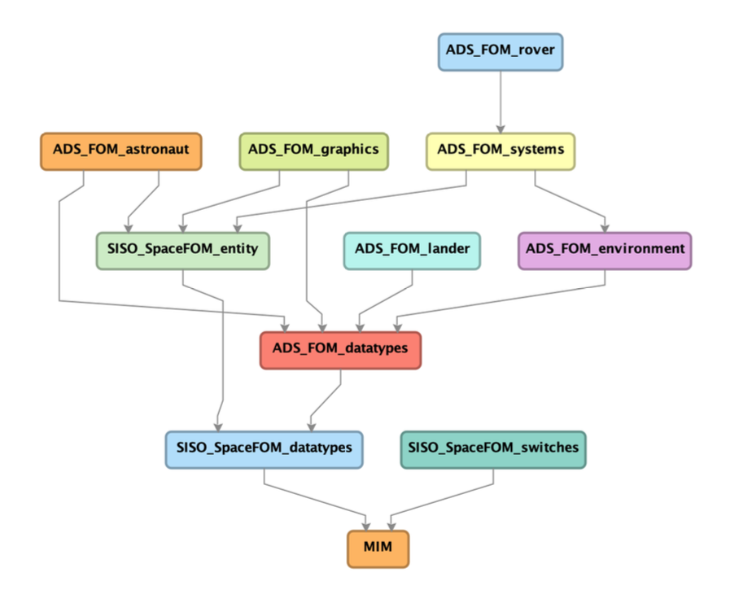
ADS FOMs
To meet the data exchange needs of the Artemis architecture, additional ADS FOM modules were developed
  To maintain SpaceFOM compliance, ADS FOM rely largely on SpaceFOM datatypes, Object Classes, and Interaction Classes
  Following SpaceFOM convention, ADS FOMS are segmented into roughly hierarchal modules
    etc
Datatypes
Environment
Systems
Graphics
Astronaut
Lander
Rover

Slide 7
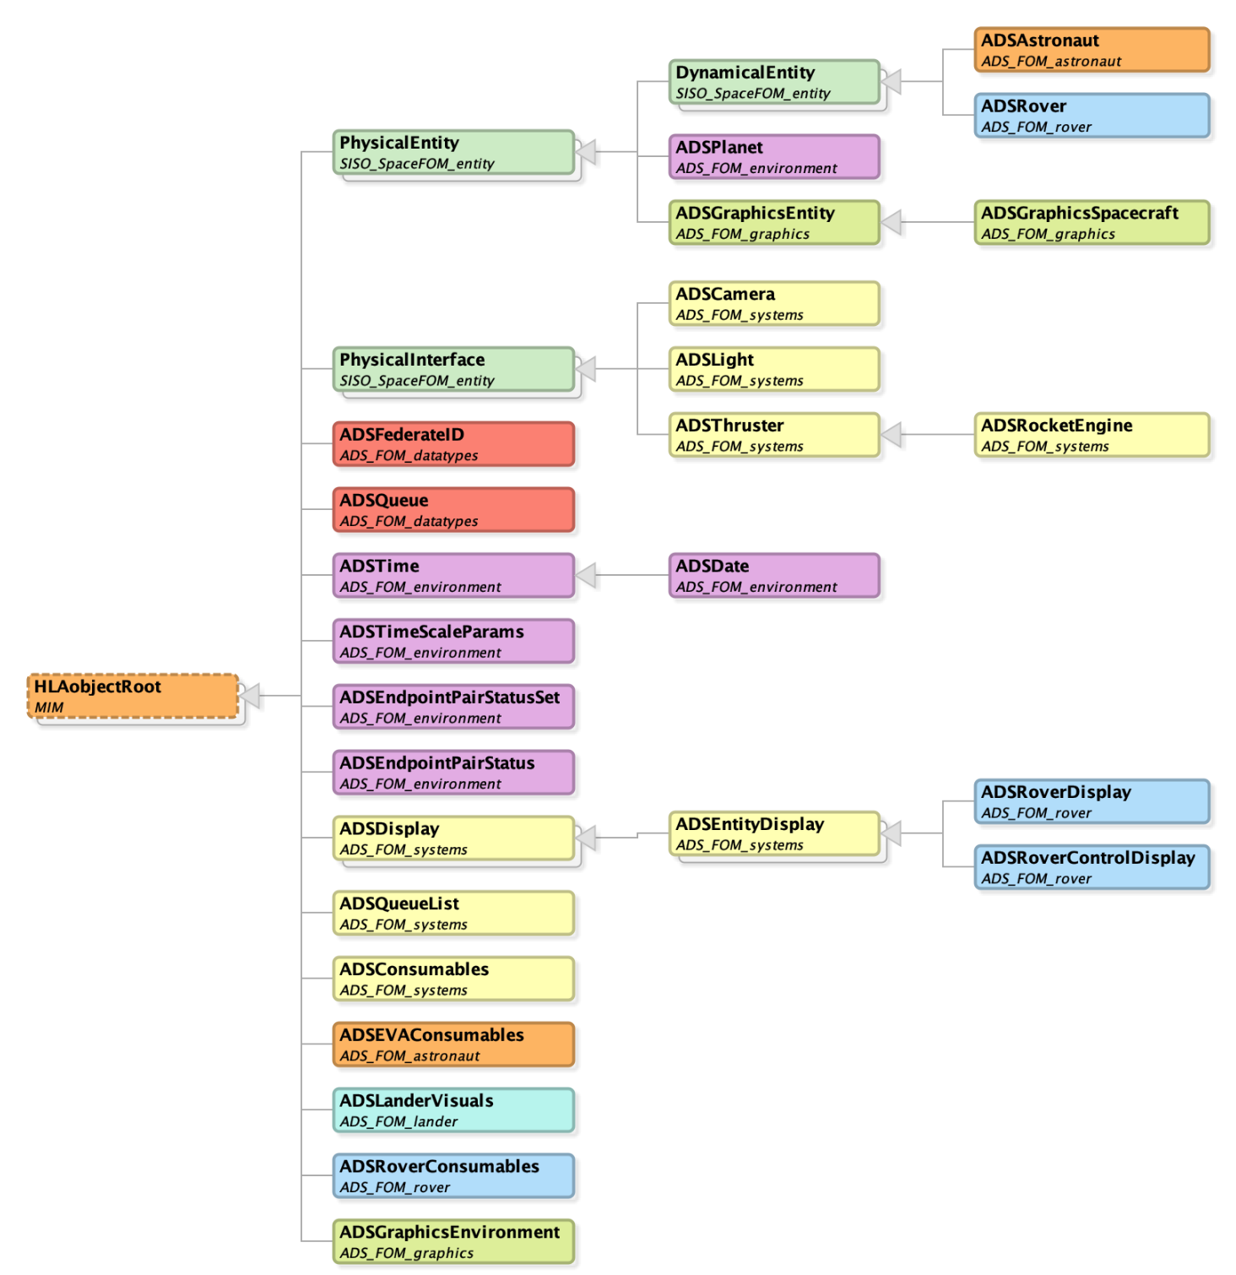
ADS FOMs Object Classes
ADS FOMs specify the base datatypes, Object Classes, and Interactions required for Artemis-based federations.
  ADS FOMs and dependent SpaceFOM Object Classes are shown
  Next few slides will give an overview of the individual ADS FOMs Object Classes

Slide 8
ADS Object Classes - Datatypes Module
The ADS Datatypes Module creates new datatypes and Object Classes for the needed Artemis space systems modeling that are not provided in SpaceFOM
  2 new Object Classes
    ADSFederateID – ID joining federate, version, and contact info
    ADSQueue – Managing resource queues

Slide 9
ADS Object Classes - Environment Module
To simulate space-based missions, it is required to model planetary surfaces and the space environment
  6 new Object classes
    ADSTime – Scale and epoch definitions
    ADSDate – Calendar date extending ADSTime
    ADSTimeScaleParams – Provides needed time offsets (ex: leapsecond offset from UTC to TAI)
    ADSEndpointPairStatus - Line-of-sight blockage status and mapping
    ADSEndpointPairStatusSet - Line-of-sight array characteristics
    ADSPlanet – extends SpaceFOM PhysicalEntity with descriptive planet parameters

Slide 10
ADS Object Classes - Systems Module
To model spacecraft and spacecraft systems, the ADS Systems Module was developed
  8 new Object Classes
    ADSCamera – General camera description
    ADSLight – Status and traits of a light source
    ADSThruster – Thruster design and performance parameters
    ADSRocketEngine – Extends ADSThruster with gimbal parameters
    ADSDisplay – Base data for generalized displays used in ADS
    ADSEntityDisplay – Extends ADSDisplay to associate it with a physicalEntity
    ADSQueueList – Manage logistic flow
    ADSConsumables – Consumable data exchange

Slide 11
ADS Object Classes - Graphics Module
In addition to physics-based simulations, ADS supports the visualization of Artemis elements and mission scenarios
  3 new Object Classes
    ADSGraphicsEnvironment – Used to manage planetary surface graphics environment, including sun and rock parameters
    ADSGraphicsEntity – Extends SpaceFOM PhysicalEntity, general graphical object
    ADSGraphicsSpacecraft – Extends ADSGraphicsEntity with thrust attribute to display rocket engine plumes

Slide 12
ADS Object Classes - Astronaut Module
Since Artemis is focused on human space exploration, ADS supports human-in-the-loop and Extravehicular Activity (EVA) simulations
  2 new Object Classes
    ADSAstronaut – Extends SpaceFOM DynamicalEntity with astronaut ID and metabolic information
    ADSEVAConsumables – Contains parameters for EVA consumables including gas levels and consumption rates

Slide 13
ADS Object Classes – Lander Module
Landing systems are required in order to land on other planetary bodies for human exploration
  1 new Object Class
    ADSLanderVisuals – Collection of lander states used for visual display of a general landing vehicle

Slide 14
ADS Object Classes – Rover Module
Planetary surface mobility systems, typically rovers, are required of the Artemis architecture
  4 new Object Class
    ADSRover – Extends SpaceFOM DynamicalEntity to provide planetary surface system state date
    ADSRoverConsumables – Consumables for planetary surface systems
    ADSRoverDisplay – Extends ADSEntityDisplay for a two person unpressurized rover
    ADSRoverControlDisplay – Extends ADSEntityDisplay for control data of a human operated rover

Slide 15
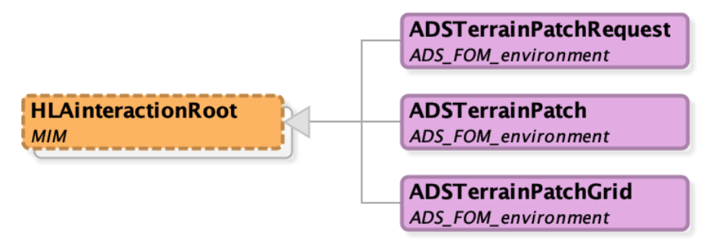
ADS Interaction Classes – Environment Module
ADS Interactions are still in development with current interactions located in the Environment module
  3 new Interaction Classes
    ADSTerrainPatchRequest – Request specific terrain
    ADSTerrainPatch - Provide terrain from ADSTerrainPatchRequest
    ADSTerrainPatchGrid - 3x3 of digital terrain data

Slide 16
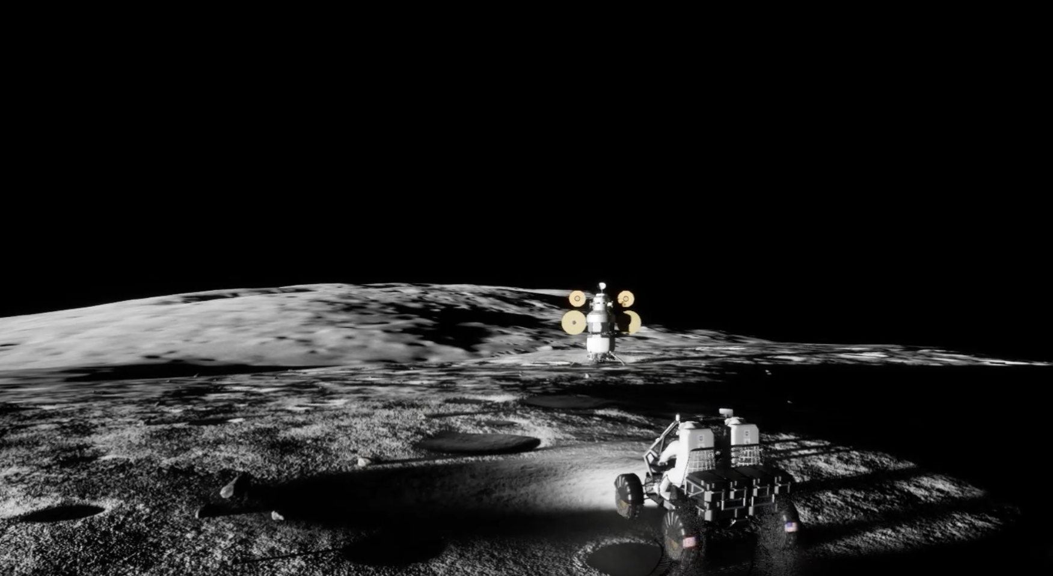
Future Work
ADS and ADS FOMs are in ongoing development as the Artemis architecture evolves
  As new Artemis elements are added, additional simulations and/or FOM modules may be needed
  Current additions include FOMs for the Human Landing System (HLS) vendor systems and the Lunar Terrain Vehicle (LTV) systems
Credit: NASA

Slide 17
Conclusion
ADS was created to simulate various end-to-end Artemis missions and perform integrated system of space system analysis, verification, and testing
ADS leverages HLA and SpaceFOM interoperability standards
ADS FOMs extends SpaceFOM to add new datatypes, object classes, and interaction classes needed for ADS
Participating ADS federates will base their interactions and objects on ADS FOMs in order to increase the likelihood of a priori interoperability with existing federations
  Facilitates implementation of new federates as the Artemis architecture evolves

