Slide 1


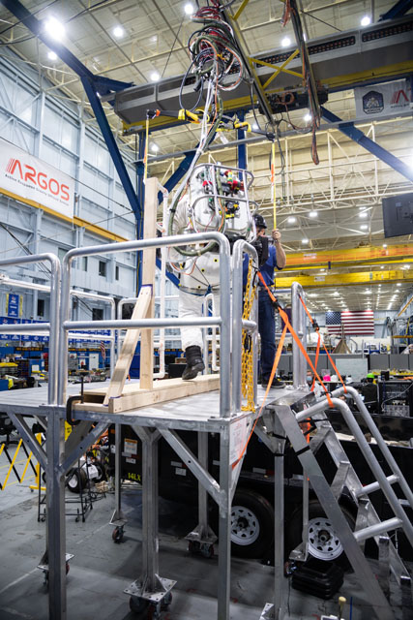
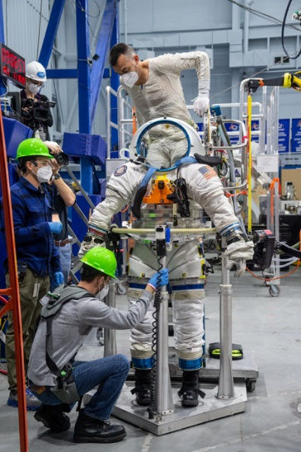
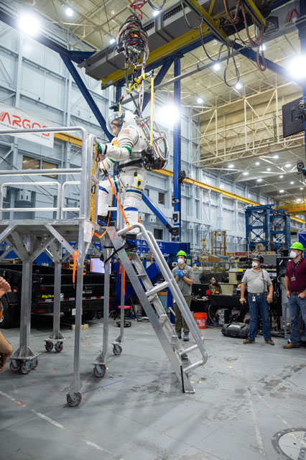
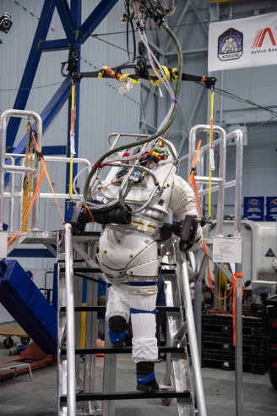
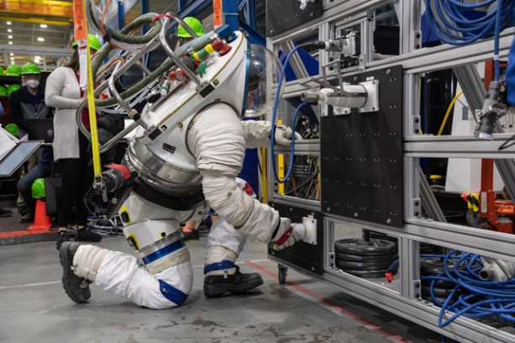
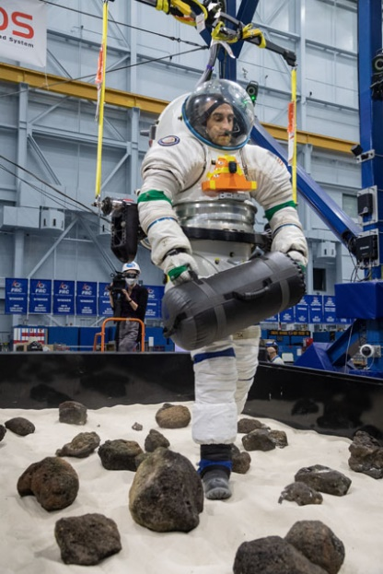
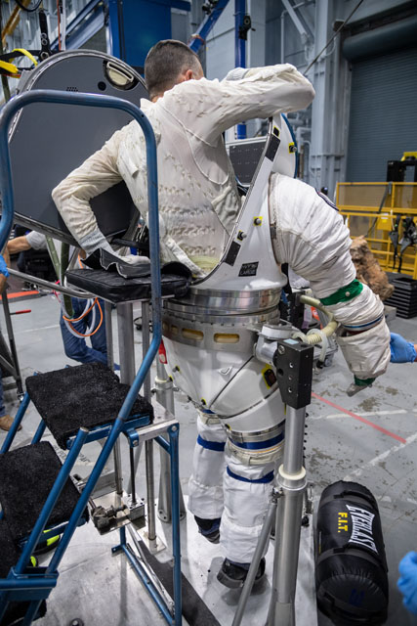
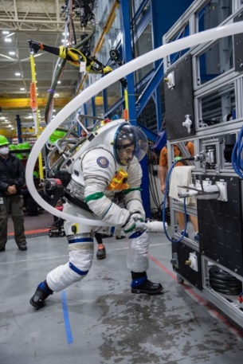
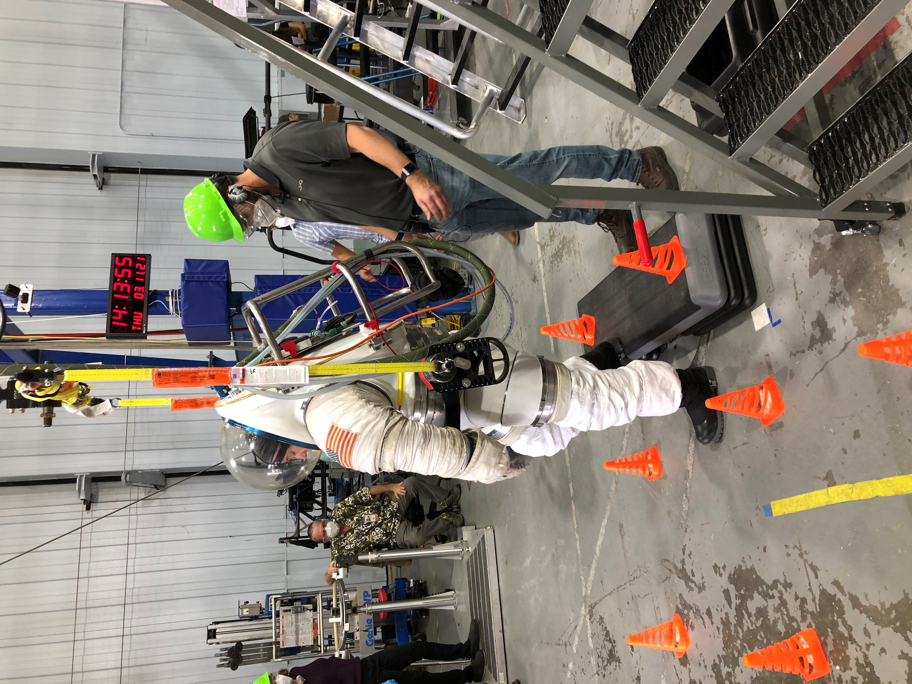
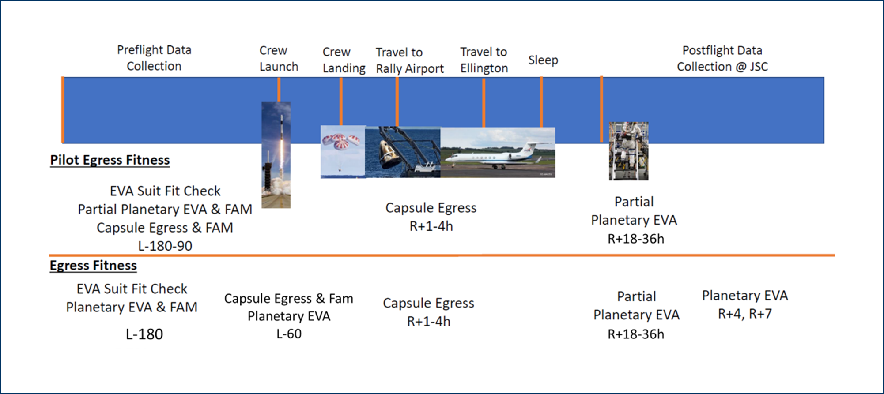
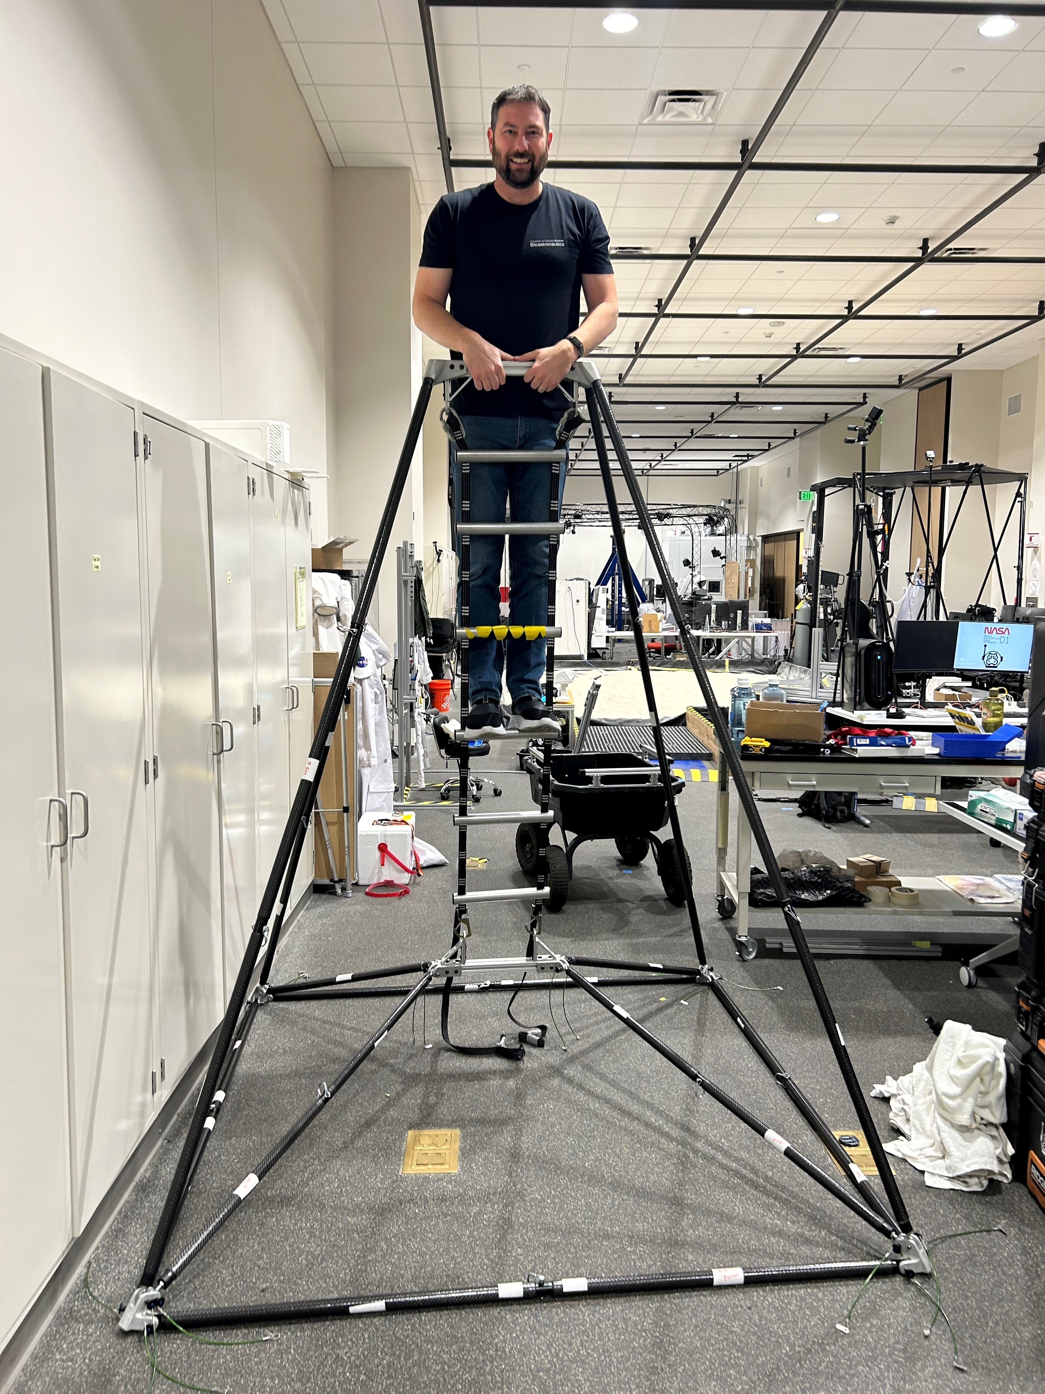
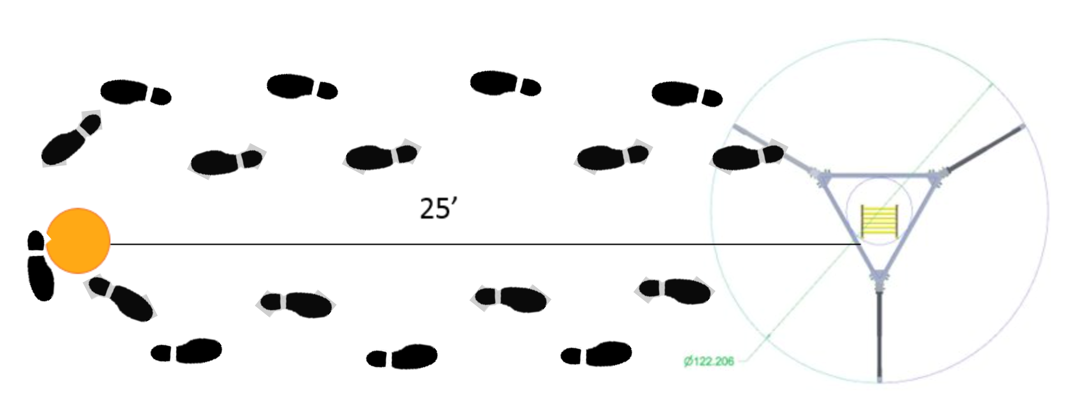

CIPHER: Egress Fitness
Jason Norcross¹, Taylor Schlotman¹, Lauren Cox², Brian Peters¹, Richard Rhodes³, Nicole Strock¹,
Millennia Young³, Karina Marshall-Goebel³
¹KBR, ²JES Tech, ³NASA Johnson Space Center
Background
Simulated Partial Planetary EVA
Physiological response and adaptation to both microgravity and re-entry into a gravity environment can result in significantly reduced functional capacity
Quantification of astronauts’ post-landing functional, mission-relevant performance is necessary to design concepts of operation for exploration missions and assess readiness to respond to emergency/contingency scenarios
There are two high-risk tasks that may have to be performed soon after gravity transitions:
  Unassisted capsule egress task after landing
  Planetary extravehicular activity (EVA) soon after landing on the Moon or Mars
The Simulated EVA is conducted at the NASA Active Response Gravity Offload System (ARGOS) in a pressurized suit offloaded to Martian gravity (3/8 G)
Planetary EVA circuit consists of functional tasks that represent a realistic post-landing EVA scenario
Performed in MKIII or xEMU suit @ 4.3 psid
Task evaluation includes
  Ability to complete the task
  Time to completion
  Metabolic energy expenditure
  Heart rate
Objectives
Simulated EVA Test Timeline
  Pre-test brief, LCG Don, Suit Exposure Survey
  “Self” ingress and pressurize EVA suit
  ARGOS calibration & float to top of lander
  Translate through a hatch
  Descend a ladder
  Supply umbilicals task board
  Perform object relocation
  Geology Sampling*
  Treadmill Traverse*
  Align with rear entry port sim
  “Self” egress EVA suit
* CIPHER Preflight, R+4, R+8 only
The overall objectives of the Egress Fitness study include:
  To quantify postflight (after a mission on the ISS) time course changes in unassisted capsule egress and planetary EVA task performance
  To characterize the recovery to acceptable planetary EVA task performance as a function of EVA task type, time in space, time post-landing, and other potential determinants of performance (e.g., sleep, nutrition, exercise, sensorimotor performance)
Figure 2: EVA Tasks completed during the Simulated Partial Planetary EVA
Experimental Design
Results and Study Status
This study includes a Pilot arm as well as the full study as part of the Complement of Integrated Protocols for Human Exploration Research (CIPHER)
Pilot Egress Fitness objective: To determine the feasibility of performing simulated capsule egress tasks at different landing sites
  Includes preflight data collection (partial simulated EVA and capsule egress, L-180-90) and postflight capsule egress (R+0) and partial simulated EVA (R+1)
CIPHER Egress Fitness:
  Data collection preflight at L-180 and L-60, postflight capsule egress on R+0, and postflight partial simulated EVA on R+1, R+4, R+8
Unassisted Mock Capsule Egress
Pilot Egress Fitness completed N = 4 subjects
    Pilot testing showed feasibility to complete this study giving valuable lessons learned to carry into the expanded CIPHER study.
    Upcoming testing in collaboration with SpaceX to complete capsule egress on the Dragon Recovery Ship
        This will be the first attempt to complete this task on the recovery ship, earlier postflight compared to the current nominal protocol in the rally airport locations.
CIPHER Egress Fitness began in 2023
    To date, we have completed N = 3 subjects
        Increased postflight testing load has been successful, including the additional geology and traverse tasks
    Currently have N = 4 subjects enrolled
  Capsule egress is performed using a capsule simulator mockup:
    Egress from “recumbent seat” (lying on your back)
    Deploy and secure ladder
    Ascend the ladder with survival pack
    Hand survival pack out of the top of the hatch to operator
    Descend ladder
    Retrieve survival pack and walk to a safe waypoint (medical tent or around cone ~50ft)
Travel to
Houston
R+8
Figure 3: Left, mock capsule rig. Right, capsule walk task.
Figure 1: Experimental design and test timing for Pilot and CIPHER Egress Fitness.
This work is funded by the NASA Human Research Program.

