Slide 1
The Nancy Grace Roman Space Telescope’s Attitude Control System
47th Rocky Mountain AAS
GN&C Conference
January 31st – February 5th, 2025
Eric Stoneking, Oscar C. Hsu, Gary Welter, Lia Lewis, Blair Carter, Bryce Doerr, Jean-Etienne Dongmo, Matt Heron, Jacob Shapiro

Slide 2
Agenda
Mission Overview
ACS Hardware
  Sensors
  Actuators
Fine Guidance System (FGS)
  Overview
  Imaging Mode
  Spectroscopy Mode
Control Laws and Estimators
  FGS Acquisition Control Law
  Attitude Estimators
Wheel Nullspace Management
High-Gain Antenna (HGA) Pointing
Conclusion

Slide 3
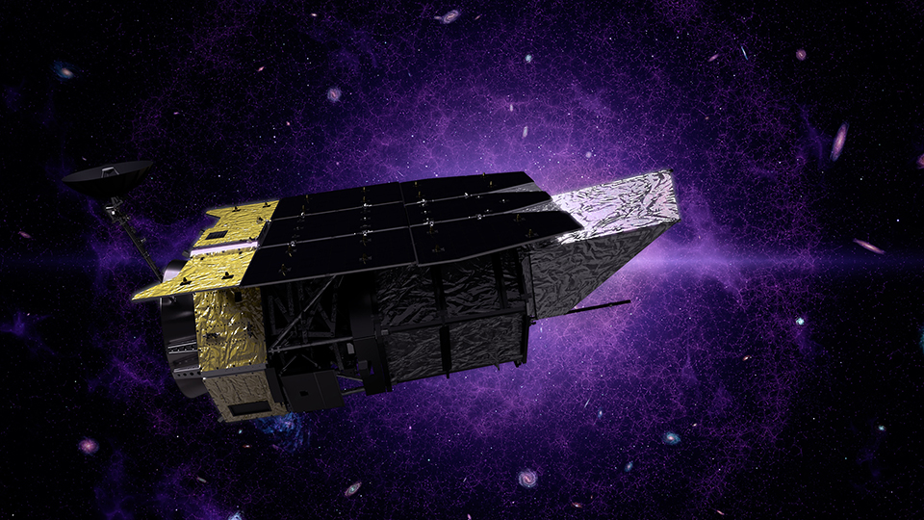
Mission Overview (1 of 2)
Renamed in 2020 after Dr. Nancy Grace Roman
  NASA’s first Chief of Astronomy
  “Mother of the Hubble Space Telescope”
Mission status (as of January 2025):
  Design phase completed
  Currently in integration and testing (I&T) phase
  Targeted launch readiness date: October 2026
Mission objectives: Investigate dark energy, dark matter, exoplanets, and general infrared astrophysics
Mission orbit: Quasi-halo orbit about Sun-Earth L2
Pointing requirements:
  Stability: 8 milli-arcsec, 1σ
  Jitter: 14 milli-arcsec, 1σ
The Nancy Grace Roman Space Telescope. *
* https://roman.gsfc.nasa.gov

Slide 4
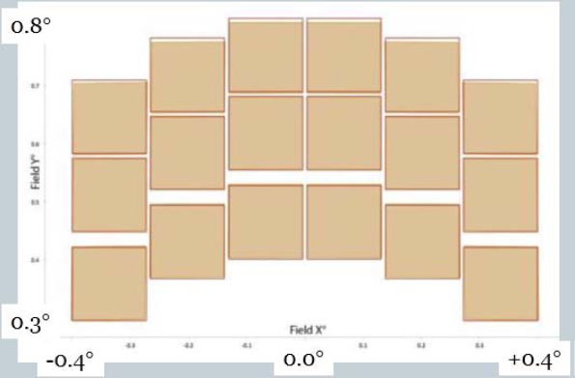
Mission Overview (2 of 2)
Science instruments:
  Wide Field Instrument (WFI)
    Similar angular resolution as the Hubble Space Telescope’s Wide Field Camera, with a 200x larger field of view (FOV)
    Used to conduct large-area surveys
      Map weak gravitational lensing
      Detect and observe supernovae and exoplanet microlensing events
  Coronagraph Instrument (CGI)
    Technology demonstration of exoplanet coronograph observations
    Fast Steering Mirror (FSM), internal to CGI, used for additional stabilization
Relative size and position of WFI’s 18 Teledyne HAWAII-4RG 4K×4K detectors. *
* Pasquale et al., “Optical Design of the WFIRST-AFTA Wide Field Instrument”, (SPIE-OSA 929305-1), SPIE-OSA/ Vol. 9293, 2014.

Slide 5
ACS Hardware
Sensors | Quantity | Custom-built? | Manufacturer
Coarse Sun Sensors (CSS) | 24 | Yes | Adcole Space
Space Scalable Inertial Reference Unit (IRU) | 1 | No | Northrop Grumman
Astro APS Star Sensors (ST) | 3 | No | Jena Optronik
High-Gain Antenna (HGA) gimbal encoders | 2 | Yes | Honeybee
Wide-Field Instrument (WFI) | 1 | Yes | Ball Aerospace, Teledyne, NASA GSFC
Coronograph Instrument (CGI) | 1 | Yes | NASA JPL
Actuators | Quantity | Custom-built? | Manufacturer
HR18-250 Constellation Series Reaction Wheels | 6 | Yes | Honeywell
5-N Thrusters | 16 | No | Moog
22-N Thrusters | 8 | No | Aerojet Rocketdyne
High-Gain Antenna (HGA) system | 1 | Yes | Honeybee, NASA GSFC
Note: ACS is designed such that a single sensor/actuator failure does not result in mission failure.

Slide 6
Fine Guidance System (1 of 2)
FGS overview
  WFI data processing
    FGS receives guide window (GW) data from each of the 18 WFI detectors.
    FGS tracks, centroids, and combines up to 18 guide stars (1 per detector) to form attitude error measurements.
    FGS passes attitude error measurements to ACS for estimation and control.
  WFI & FGS operating modes
    Imaging
    Spectroscopy
  Submodes (within each operating mode)
    GW acquisition
      Objective: Transition from attitude estimation & control from using ST and IRU measurements to FGS measurements.
      Initial GW sizes are large enough to accommodate ST/IRU-level attitude error.
      When pointing performance is sufficiently tight, FGS transitions to smaller, tracking-level GWs.
    GW tracking
      Used for settling attitude errors and performing science exposures.

Slide 7
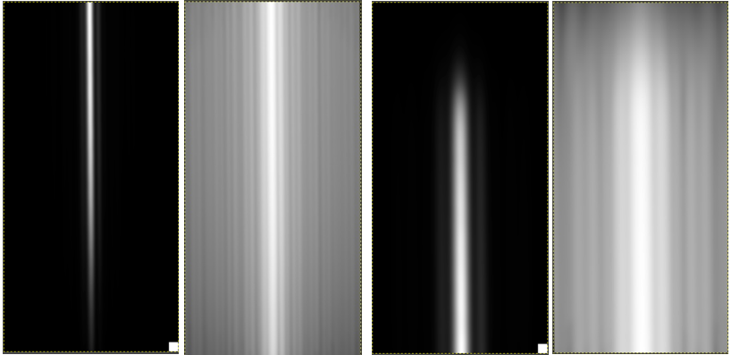
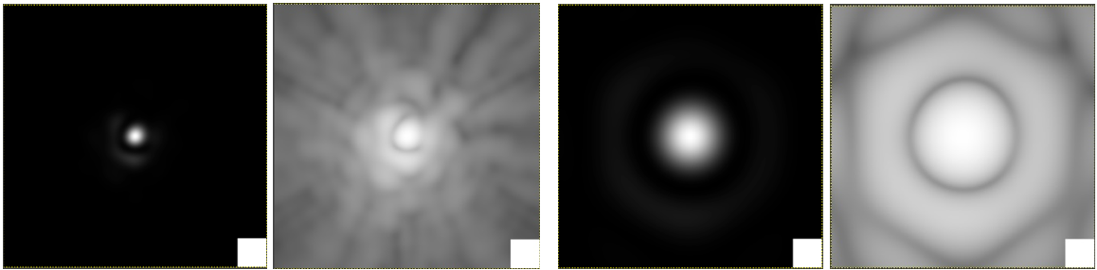

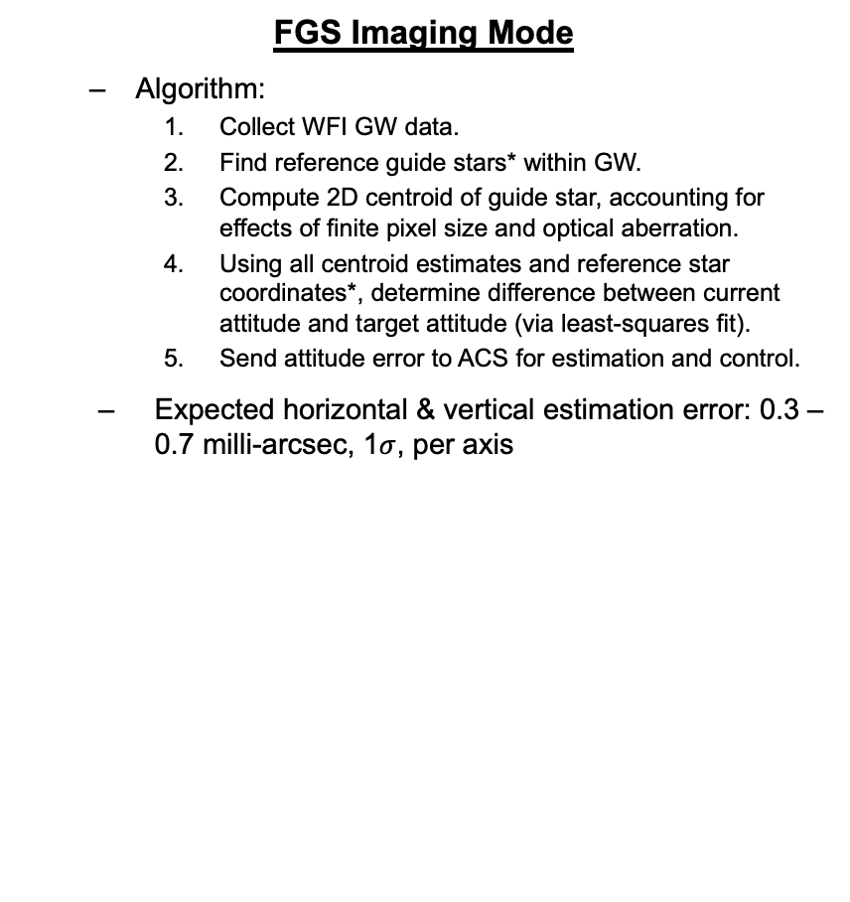
Fine Guidance System (2 of 2)
FGS Imaging Mode
  Algorithm:
    Collect WFI GW data.
    Find reference guide stars* within GW.
    Compute 2D centroid of guide star, accounting for effects of finite pixel size and optical aberration.
    Using all centroid estimates and reference star coordinates*, determine difference between current attitude and target attitude (via least-squares fit).
    Send attitude error to ACS for estimation and control.
  Expected horizontal & vertical estimation error: 0.3 – 0.7 milli-arcsec, 1$σ$, per axis
FGS Spectroscopy Mode
  Dispersion elements: Grism & Prism
  Algorithm:
    Parallels Imaging Mode algorithm, with 1 major exception
    Instead of computing center of light in dispersion direction, observed spectrum edge region is fitted to a spectrum model to determine edge location
  Expected estimation error:
    Horizontal: <10 milli-arcsec, 1$σ$
    Vertical: <20 milli-arcsec, 1$σ$
0.19
sec
FGS Imaging Mode: Simulated linear and logarithmic point spread functions (PSF) of guide star in GW. White square is size of single WFI pixel.
FGS Spectroscopy Mode: Simulated linear and logarithmic dispersed PSFs of guide star in GW. White square is size of single WFI pixel.
* For each science target, reference stars provided by Science Operations Center (SOC) using Guide Star Selection System (GSSS).

Slide 8
Control Laws and Estimators
FGS Acquisition & Settling
  Background
    Science exposure operations:
      Slew to target attitude
      Acquire FGS
      Settle attitude errors
      Perform science exposure
    > 800,000 science exposures over 5-year mission lifetime
    To achieve required observational efficiency, FGS acquisition & settling must complete within 10 seconds, on average, after slew exit
  Settling control law
    Combines elements of linear and bang-bang control
      For small angle errors, control law behaves like linear control law
      For large angle errors, control law behaves like bang-bang control law
    Designed to minimize settle time
Attitude Estimators
  ACS uses three attitude estimators
    ST/IRU-based attitude & rate estimator
    FGS-based attitude & rate estimator
    ST misalignment estimator
      Thermal effects result in ST-WFI alignment drift
      If alignment drifts too much, the reference stars will be outside the initial GW used for FGS acquisition
      Estimator uses both ST and FGS measurements to continuously update ST alignment on-board
  All estimators are Multiplicative Extended Luenberger Observers (MELO)
    Similar structure to Multiplicative Extended Kalman Filter (MEKF)
    Uses fixed gains instead of variable gains
      Sufficient performance to meet all knowledge requirements
      Less complex than MEKF
FGS acquisition & settling

Slide 9
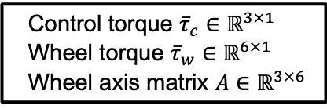
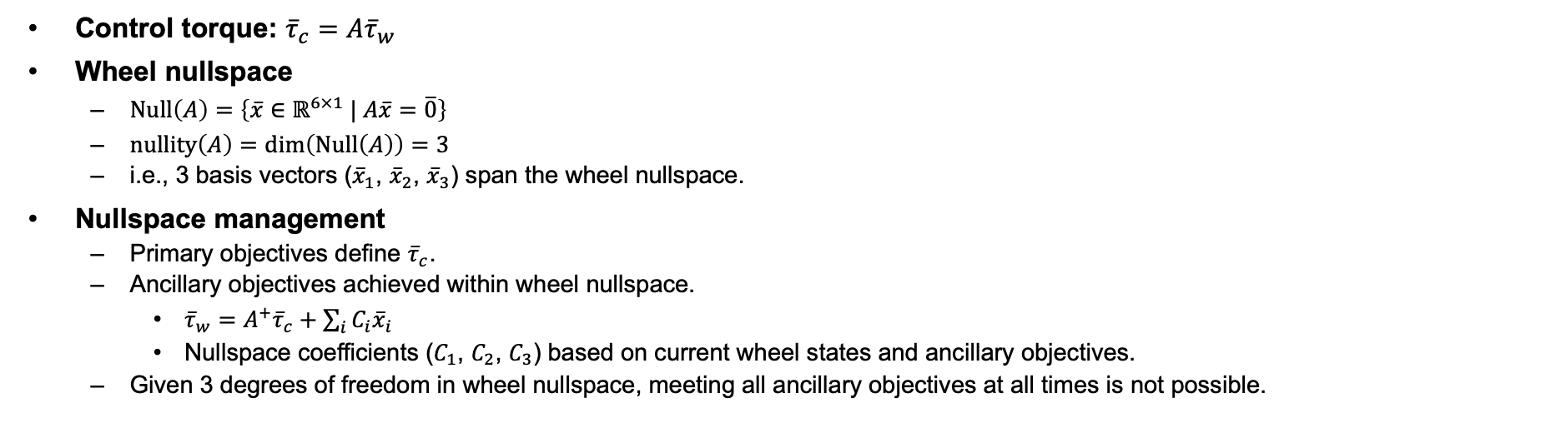
Wheel Nullspace Management
Primary Objectives | Rationale
1. Provide three-axis attitude control. | Meet mission objectives.
2. Absorb angular momentum due to solar radiation pressure.
Ancillary Objectives | Rationale
1. Push through zero wheel speed. | Reduce wheel stiction disturbance.
2. Maintain 1-Hz wheel speed separation. | Reduce structural mode excitation.
3. Avoid wheel speeds below 5 Hz.
Control torque: ${\overline{τ}}_{c}=A{\overline{τ}}_{w}$
Wheel nullspace
  $\operatorname{Null}\left(A\right)=\left\{\overline{x}∈ℝ^{6×1} | A\overline{x}=\overline{0}\right\}$
  $\operatorname{nullity}\left(A\right)=\dim\left(\operatorname{Null}\left(A\right)\right)=3$
  i.e., 3 basis vectors (${\overline{x}}_{1}$, ${\overline{x}}_{2}$, ${\overline{x}}_{3}$) span the wheel nullspace.
Nullspace management
  Primary objectives define ${\overline{τ}}_{c}$.
  Ancillary objectives achieved within wheel nullspace.
    ${\overline{τ}}_{w}=A^{+}{\overline{τ}}_{c}+\sum_{i}{C_{i}{\overline{x}}_{i}}$
    Nullspace coefficients ($C_{1}$, $C_{2}$, $C_{3}$) based on current wheel states and ancillary objectives.
  Given 3 degrees of freedom in wheel nullspace, meeting all ancillary objectives at all times is not possible.
Control torque ${\overline{τ}}_{c}∈ℝ^{3×1}$
Wheel torque ${\overline{τ}}_{w}∈ℝ^{6×1}$
Wheel axis matrix $A∈ℝ^{3×6}$

Slide 10
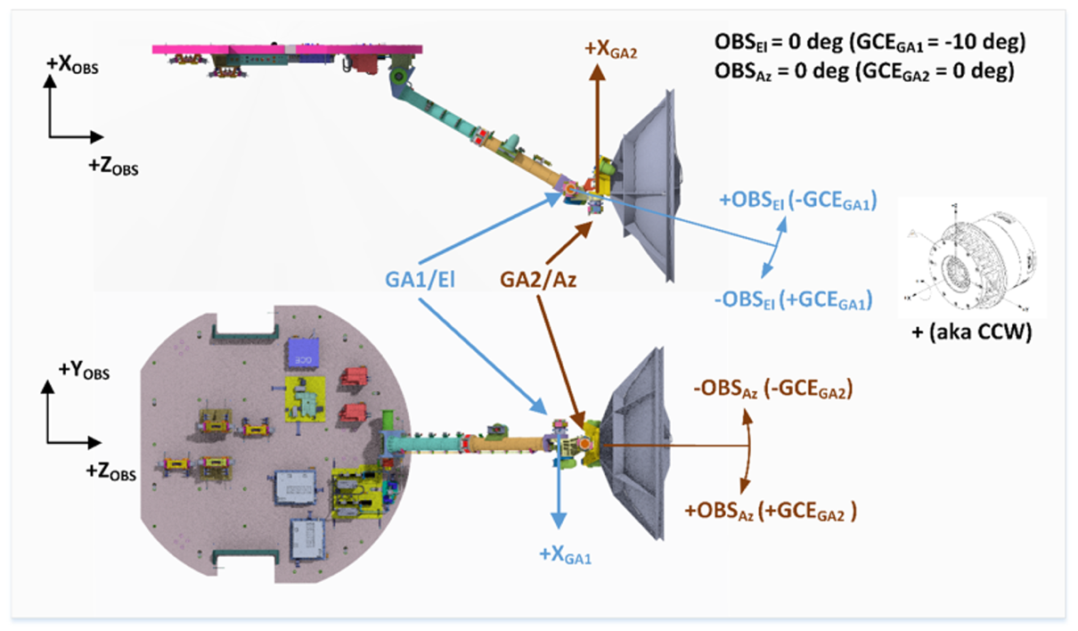
High-Gain Antenna (HGA) Pointing
Actuator: Two-axis gimbal system
Pointing algorithm
  Inputs: Ground station position & velocity
  Outputs:
    Current ground station vector
    Target boresight vector & gimbal angles
HGA control modes
  PARK: Park antenna at safing gimbal angles
  STOP: Stop antenna at current gimbal angles
  TRACK: Track ground station
  SCIENCE: Stop antenna at current gimbal angles unless angle between ground station and HGA boresight is greater than threshold required for HGA communication
HGA pre-pointing
  Target boresight vector can be set ahead of ground station in direction of ground station drift vector
  Used in SCIENCE mode
    Maximizes time between HGA moves
    Minimizes HGA-induced pointing jitter

Slide 11
Conclusion
Roman ACS design based on two key design priorities:
  Meet mission requirements.
  When possible, reduce algorithm complexity.
Two sources drive Roman ACS algorithm complexity:
  Science pointing performance requirements
  Observational efficiency requirements
Roman ACS design meets all mission objectives.

