Slide 1
Constructing a Dataset Using NASA’s Human Data Repositories – It’s Not Always the “Easy Button”
Devan Petersen, MPH¹
Jacqueline Charvat, PhD¹
Diedre Thomas²
Katie Breslin, MPH¹
Ruth Reitzel, PhD³
¹KBR, ²Leidos Innovations, ³NASA Johnson Space Center

Slide 2
Topics to Cover
Background on Human Data Repositories
Constructing Datasets: Use Cases of Disparate Sources
Our Lessons Learned
How You Can Help Us

Slide 3
NASA’s Human Data Repositories
Background on LSDA & LSAH

Slide 4


Human Data Repositories at NASA
The Life Science Data Archive
Houses human research data collections
Collections cover the history of human spaceflight from Mercury to ISS
Makes data available/findable for reuse via the NASA Life Sciences Portal (NLSP)
The Lifetime Surveillance of Astronaut Health
Custodian of data derived from medical records
Compiles and analyzes astronaut medical data to create products that support:
Clinical care
Occupational monitoring, surveillance
Risk mitigation efforts
Research
2025 NASA HRP IWS | Constructing a Dataset Using NASA’s Human Data Repositories – It’s Not Always the “Easy Button”
Notes:
As NASA transitions its focus to travel back to the moon and Mars, coupled with the anticipated retirement of the International Space Station, the Human Research Program (HRP) based at NASA’s Johnson Space Center (JSC) recognizes the need to extract the greatest possible amount of information from the data already captured, secondary analysis of archived data. The Life Sciences Data Archive (LSDA) is the repository that houses archived research data. The Lifetime Surveillance of Astronaut Health Repository (LSAH) is the archive that contains astronaut medical data collected during medical monitoring work. Together, LSDA and LSAH support researchers in effective and efficient re-use of data for secondary analysis.

Slide 5
Human Data Repositories at NASA, cont.
The Life Science Data Archive
Data are sent to LSDA from research teams for archiving
Data are archived in a file-based format
Each file must be downloaded and read to understand its contents
The Lifetime Surveillance of Astronaut Health
Data from different medical operation sources are stored in IMPALA
Information Management Platform for AnaLytics & Aggregation
Data in IMPALA are accurate; however, not all medical operations data are in IMPALA
To request data from NASA’s human data repositories, please submit a data request through NLSP:
https://nlsp.nasa.gov/explore/lsdahome/datarequest
2025 NASA HRP IWS | Constructing a Dataset Using NASA’s Human Data Repositories – It’s Not Always the “Easy Button”
Notes:
Both LSDA and LSAH contain archived astronaut data from the early programs and Apollo era to present day data collected on the ISS. Data in the repositories are archived in various medias (paper records, tapes, digitized and electronic files, etc.), as well as in various stages of readiness for reuse. While some of the medical data are queryable, the majority of the research data are archived in electronic files that need to be manually compiled. Both medical and research data from early programs are often handwritten, paper records.
A DR could potentially have research, medical, and/or a combination of the two

Slide 6
Dataset Construction
Reusing Data to Help Support Agency Goals

Slide 7
Constructing a Dataset from Disparate Sources: Apollo G_{Z}
Apollo Mission G_{Z} Acceleration During Descent to and Ascent from the Lunar Surface
Objective: Summarize cardiovascular data during the lunar descent and ascent phases of the five Apollo missions that landed on the Moon
Astronaut Medical & Training Records
Flight Surgeon Logs
Biomedical Engineer Logs
Lunar Module Engineering Documents
Publicly Available Data
2025 NASA HRP IWS | Constructing a Dataset Using NASA’s Human Data Repositories – It’s Not Always the “Easy Button”
Notes:
One example of using a variety of disparate data sources to create a dataset is the re-use of Apollo medical records during lunar descent and ascent to provide insight into cardiovascular stress associated with landing on the moon in a standing position. To compile the most complete dataset possible, LSAH epidemiologists spent approximately 840 hours reviewing more than 5,000 50-year-old paper records from at least >5 disparate sources – including the astronauts’ medical records, reports from the biomedical engineers and flight surgeons, engineering documents to calculate vehicle acceleration, and publicly available data to provide context for the cardiovascular responses observed during mission specific events. Once an assessment of what is available was completed, epidemiologists narrowed their dataset to data associated with the Apollo Commanders’ heart rates during lunar descent and ascent.

Slide 8
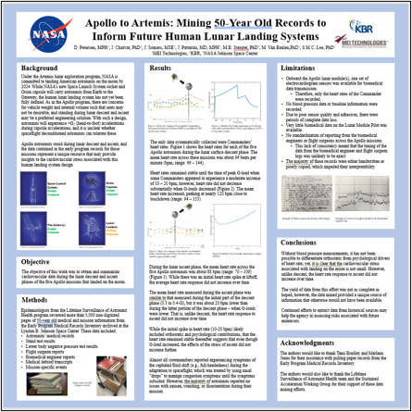
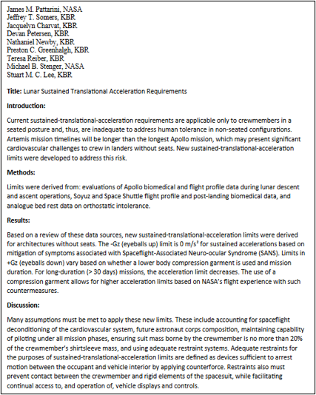
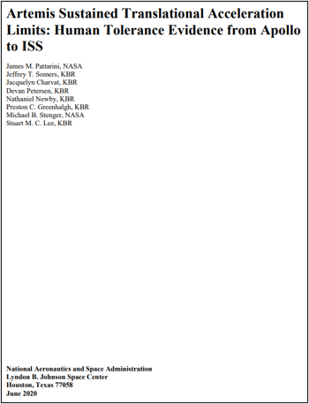
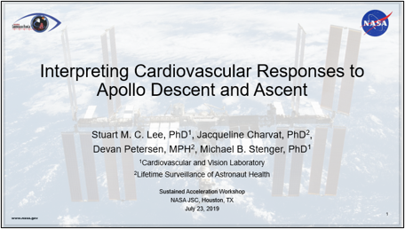

Benefits of a Reuse Dataset: Apollo G_{Z}
Datasets – like the Apollo Mission G_{Z} dataset – are available for additional reuse once assembled.
2025 NASA HRP IWS | Constructing a Dataset Using NASA’s Human Data Repositories – It’s Not Always the “Easy Button”
Notes:
While this dataset was very labor intensive and manual to compile, it has been used for multiple purposes including 3 publications/presentations, one white paper, and contributed to acceleration and decelerations limit requirements for NASA’s Human Landing System. Additionally abstracted data contained in this dataset is available for additional re-use.

Slide 9
Constructing a Dataset from Disparate Sources: EDDIE
The Extended Duration Data Investigation & Evaluation (EDDIE) Project
Objective: Understand if health status indicators change across the mission duration spectrum (i.e., long duration fliers vs. extended duration fliers)
Health Status Indicator | Clinical Care: Medical Evaluation Documents Volume B (MED B) | Research
Fracture | DXA Measurements | QCT Measurements
 | Bone Assays | Bone Assays
Spaceflight-Associated Neuro-Ocular Syndrome (SANS) | OCT Measurements | --
 | Phoropter
 | Optical Biometry
2025 NASA HRP IWS | Constructing a Dataset Using NASA’s Human Data Repositories – It’s Not Always the “Easy Button”

Slide 10
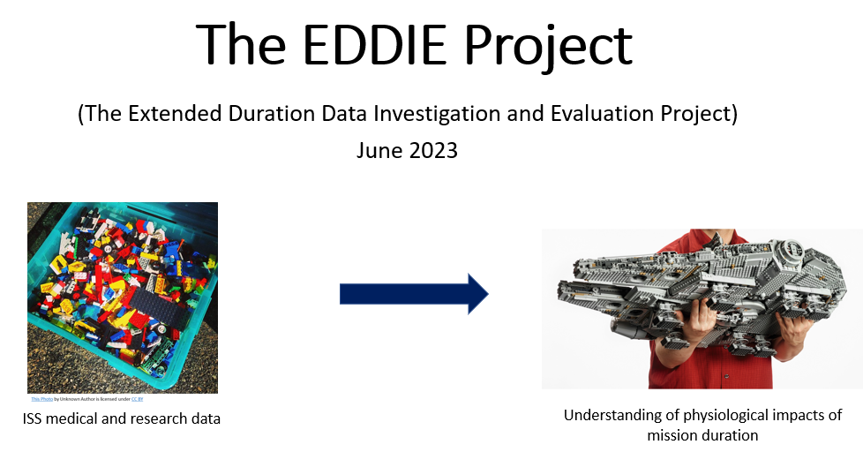
Benefits of a Reuse Dataset: EDDIE
Proof-of-concept exploratory data assessment
Successfully combined Research data and Clinical Care data into a comprehensive dataset
Developed visualizations comparing health status indicators for:
Long Duration fliers vs. Extended Duration fliers
Single Mission ISS crew vs. Multiple Mission ISS crew
Served as the genesis for the Individual Variability Impacting Exploration (IVIE) study
Understand individual variability on Landing Day health status indicators
Datasets – like the EDDIE dataset – are available for additional reuse once assembled.
2025 NASA HRP IWS | Constructing a Dataset Using NASA’s Human Data Repositories – It’s Not Always the “Easy Button”

Slide 11
Lessons Learned
No “Easy Button”

Slide 12

Our Lessons Learned
Think “outside the box” to compile most complete dataset
Explore nontraditional data sources for reuse
Collaborate with subject matter experts to help contextualize data
Archivists, historians, biostatisticians, vehicle engineers, etc.
Allocate enough time and other resources to the effort
Manual data extraction is an extensive process
Communicate transparently with data requestor
Scope and breadth of data sources being included in dataset creation
Share newly assembled datasets for future reuse
Data products can be applied to additional research questions
2025 NASA HRP IWS | Constructing a Dataset Using NASA’s Human Data Repositories – It’s Not Always the “Easy Button”
Notes:
Potential solutions that LSDA and LSAH utilize to reduce manual processes for compiling datasets include re-use of compiled datasets, use of IMPALA to query medical data, Apollo Records Synthesis Project, and LSDA research data harmonization project to create queryable research data.

Slide 13
How You Can Help Us

Slide 14
Help Us, Help You!
The Life Science Data Archive
Submit research data for archiving in a timely manner
Format research data using the tidy format
Provide detailed data requests
The Lifetime Surveillance of Astronaut Health
Keep medical records updated
Private Medical Conferences, pre-/post- exams, etc.
Submit lab results in a timely manner
Provide detailed data requests
Data accessible by LSDA & LSAH are only as good as the data that get inputted.
LSDA & LSAH are data repositories – not data creators.
To request data from NASA’s human data repositories, please submit a data request through NLSP:
https://nlsp.nasa.gov/explore/lsdahome/datarequest
2025 NASA HRP IWS | Constructing a Dataset Using NASA’s Human Data Repositories – It’s Not Always the “Easy Button”

Slide 15
Questions? Thank You!
Devan Petersen, MPH
devan.k.petersen@nasa.gov

