Slide 1
TEAMS IN SPACE
Lauren Blackwell Landon, Ph.D.
Behavioral Health & Performance (BHP) Laboratory
Human Factors and Behavioral Performance (HFBP) Element
KBR at NASA Johnson Space Center
lauren.landon@nasa.gov
Photos: NASA unless otherwise indicated

Slide 2
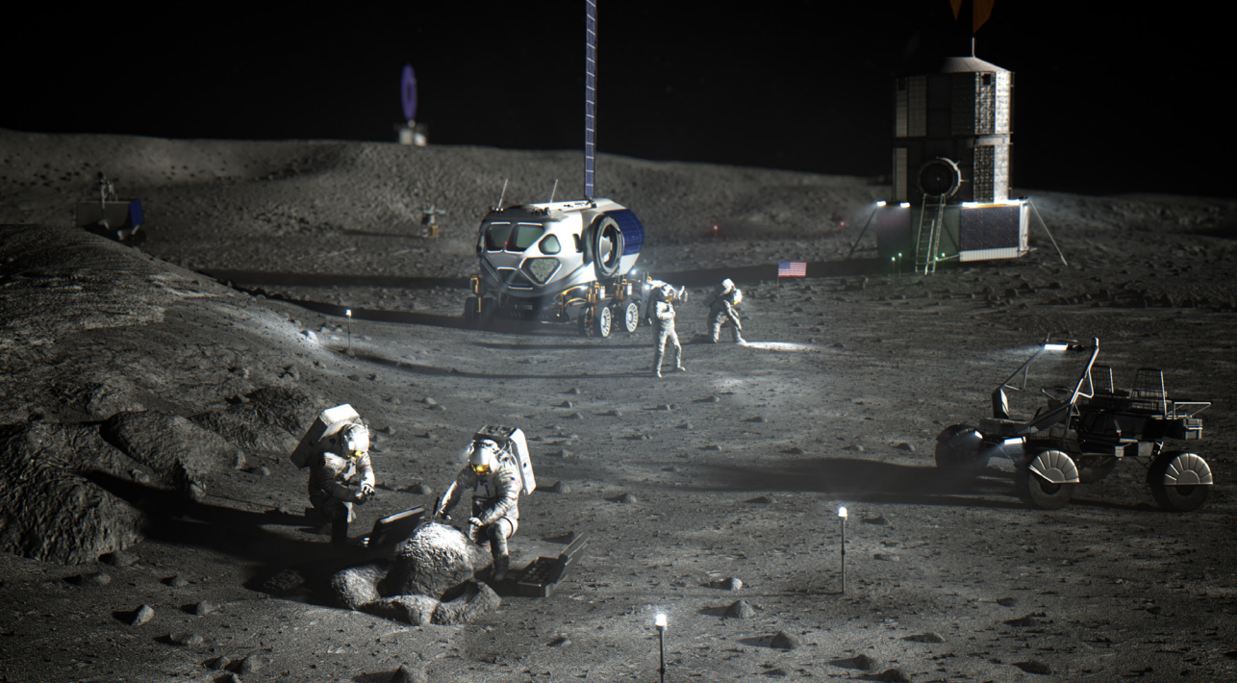
For effective teams, 2 + 2 = 5
Notes:
Effective teams overcome individual-level issues to achieve goals
Ineffective teams have increased vulnerability and may decline in performance, even if they have the “best” individuals
Fighter pilot study – high-high ability pairs have a synergistic gain in performance (they do better together than either individual by himself), whereas high-low and low-low pairs didn’t

Slide 3
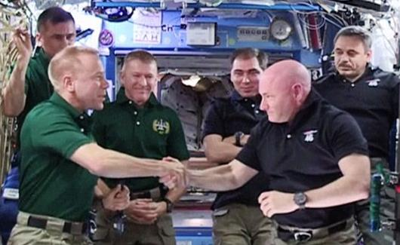


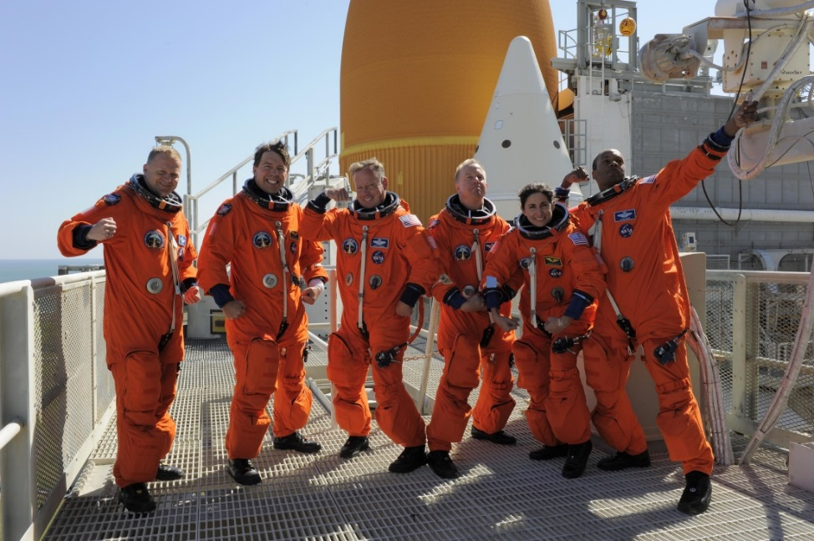
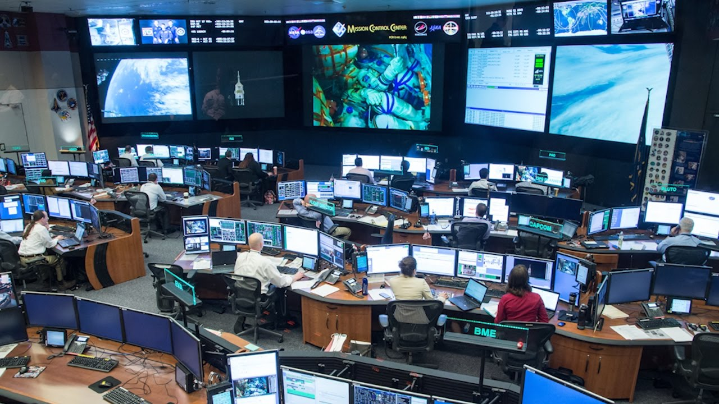
Spaceflight Teams
Crew in space
Launch
Pre-flight
MCC in Houston

Slide 4

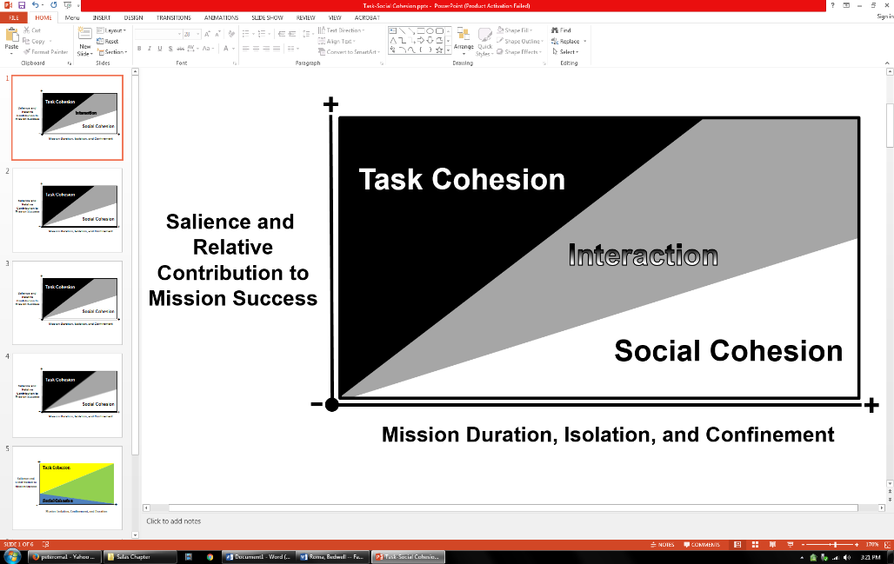
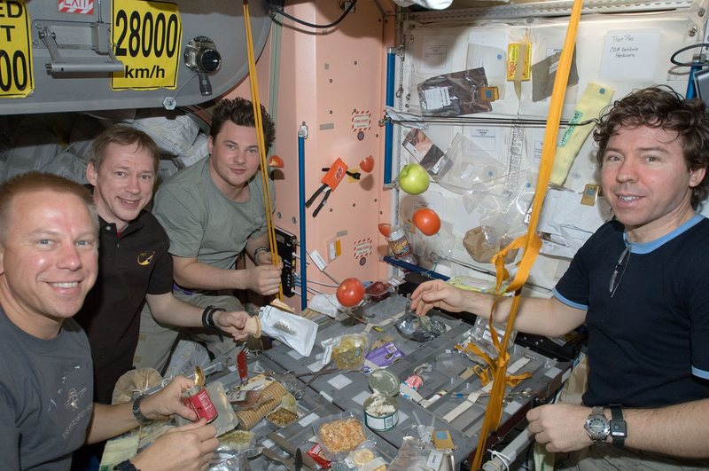
Team Task and Social Functioning – duration matters
(Roma & Bedwell, 2017)
More cohesive teams perform better
  Cohesion and team performance → reciprocal over time
  Demonstrate better individual performance
  More resilient to stress
(Baker et al., 2006; Shapiro et al., 2004; Arthur et al., 2003; Baker et al., 2006; Grice & Katz, 2005; Podsakoff et al., 1997; Palinkas, 1991; Halbesleben & Bowler, 2007; Rasmussen & Jeppesen, 2006)

Slide 5

Team Task and Social Functioning
Team skills support team and task performance
Meta-analysis: Teamwork in healthcare (r=0.28)
(Schmutz, Meier, & Manser, 2019)
Teamwork
Performance Improved:
Technical domain (e.g., providing care)
Team domain (e.g., decision-making)
Outcomes Improved:
Routine tasks (e.g., planned surgery)
Non-routine tasks (e.g., emergencies)

Slide 6
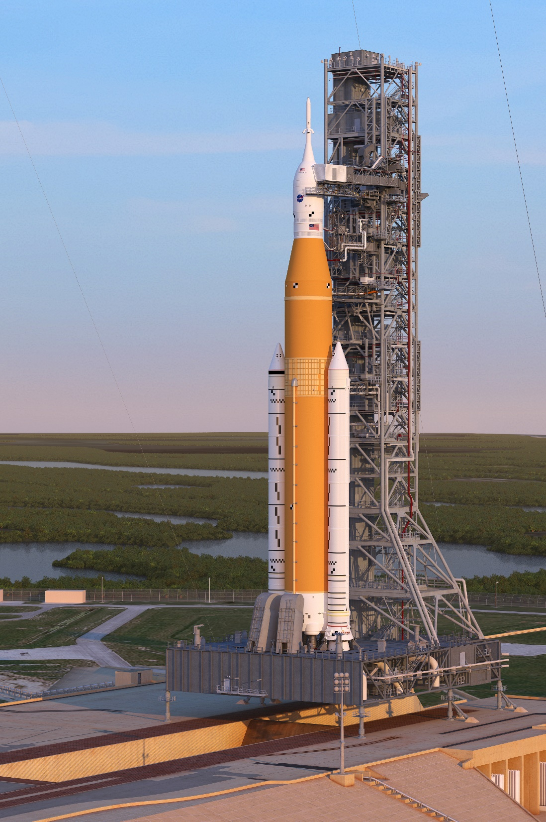
Spaceflight Environmental Stressors
Space radiation
Altered light/dark cycles
High C0₂
µgravity
Acceleration/vibration
Geochemical properties of destination (g, volatiles, dust)
Sensory deprivation
Noise
Tasks/workload
Isolation
Confinement
Comm delay
Lack of privacy
Interdisciplinary Research is Key

Slide 7
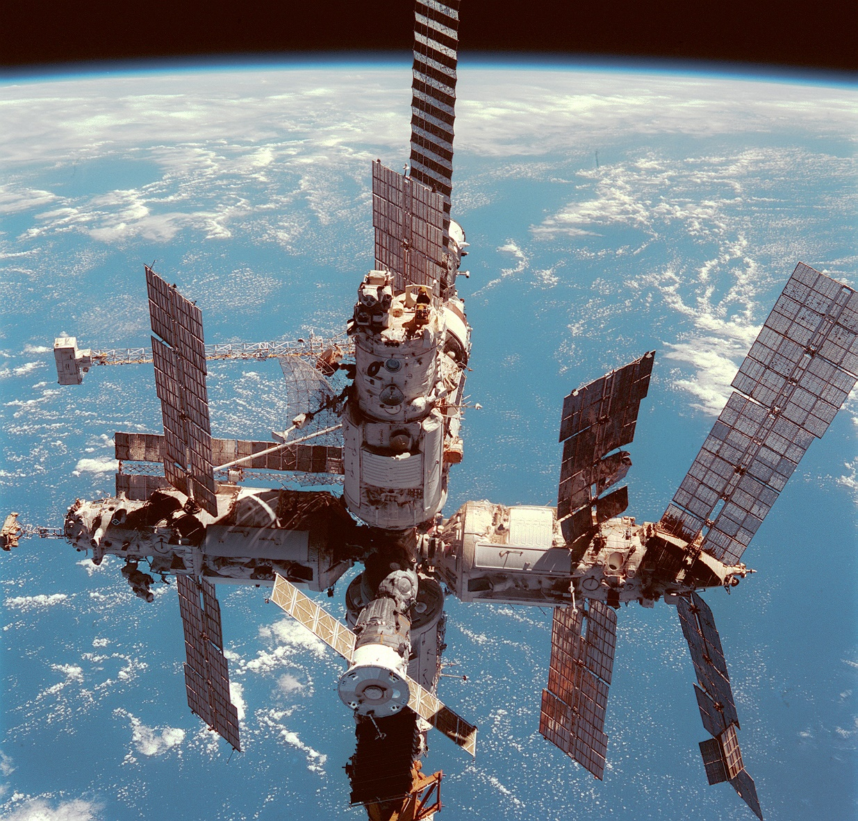
Historic Spaceflight Teams
Previous space station incidents related to teamwork and conflict
Evacuation
Loss of power generation
Crew work stoppage
“All the conditions necessary for murder are met if you shut two men in a cabin measuring 18 feet by 20 and leave them together for two months.” – Valery Ryumin, Salyut 6
Mir Space Station
Mir
(Aldrich, 2008; Buckey, 2006; Kanas & Manzey, 2008; Rogers, 1986; Stuster, 2010; Troitsyna, 2011)

Slide 8
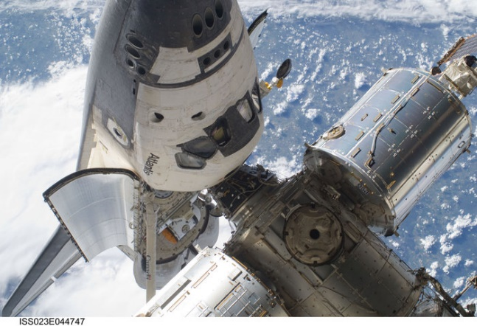
Historic Spaceflight Teams
Minimal operational impacts from team issues
  Enhanced team training in recent years
Ground/Org teams: <5% of errors attributed to team factors. Team decision-making and comm cited as a significant contributing factor to Challenger.
(Beven et al., 2018; Helmreich, 2000; Whitson, 2013; Challenger report)

Slide 9
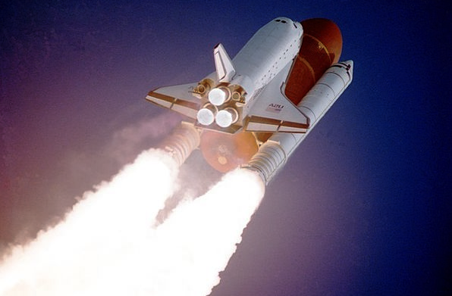
Historic Spaceflight Teams
“You can live with anyone for two weeks...”
Operational assessments interviews with former astronauts
  Ignore or suppress conflict on short duration missions
  “Technical problems are less the challenge than interaction and how the organizational components work together.”
  “Crew friction and skewed dynamics could over time lessen operational productivity.”
Findings from ground analog studies mimic trends observed in spaceflight
  ICE vs non-ICE teams

Slide 10
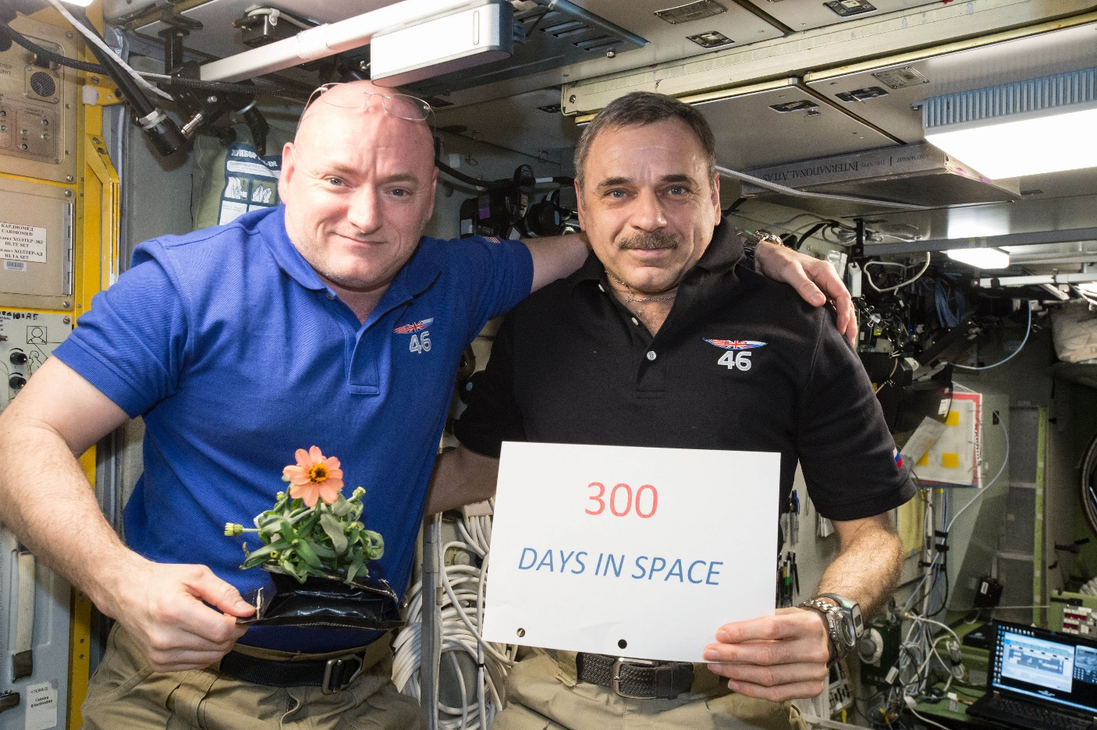
Scott Kelly’s 1-year Mission
“Every day, I was exposed to ten times the radiation of a person on Earth, which will increase my risk of fatal cancer for the rest of my life. Not to mention the psychological stress, which is harder to quantify and perhaps just as damaging.”
  Scott Kelly, excerpt from “Endurance: My Year in Space and our Journey to Mars”

Slide 11
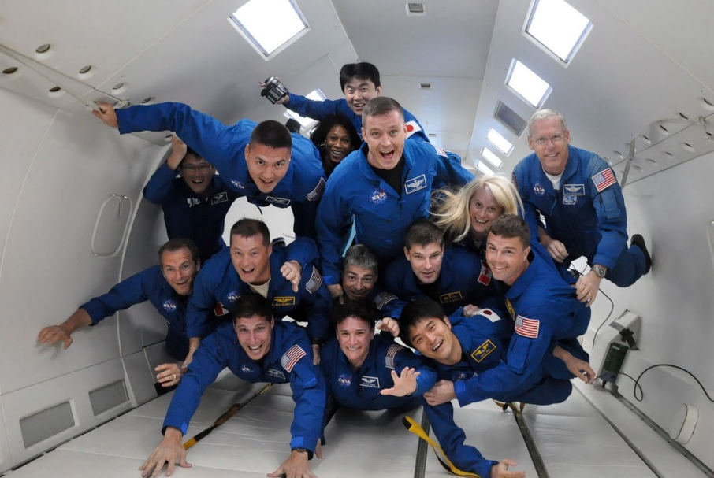
Select
Compose
Train
Self-Correct
Monitor
Counter-measures

Slide 12

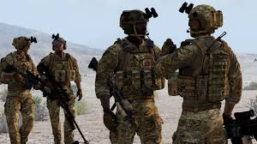
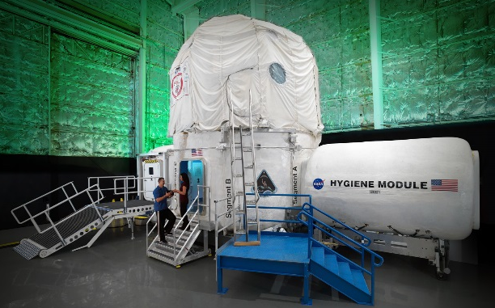
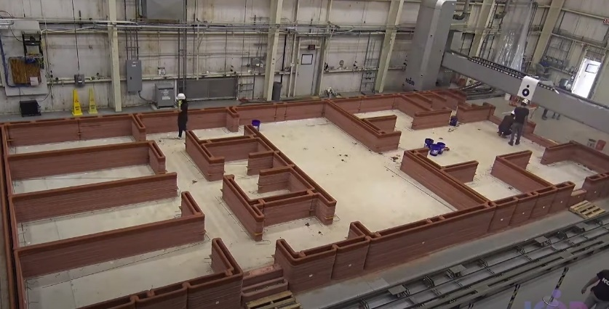

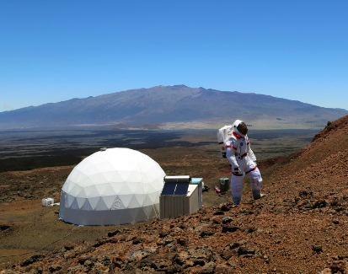
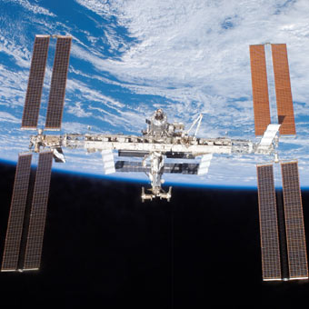
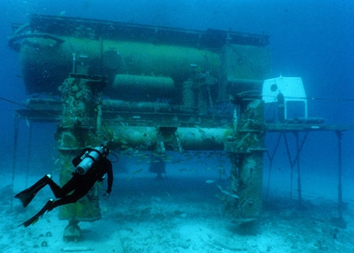
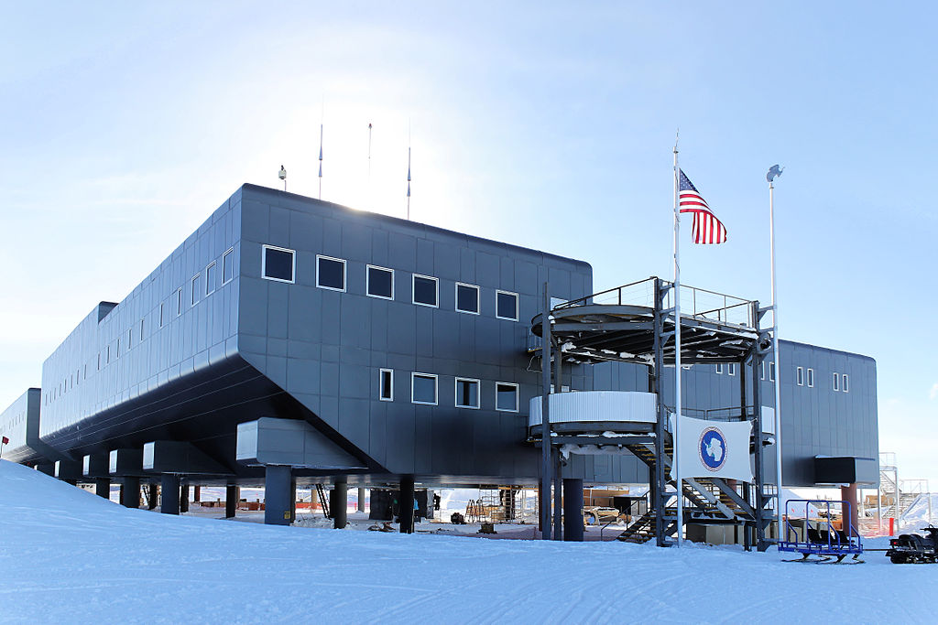

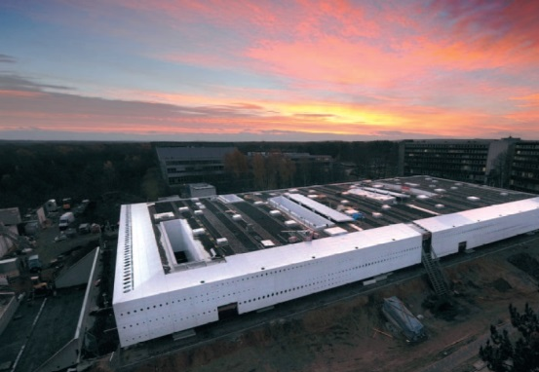

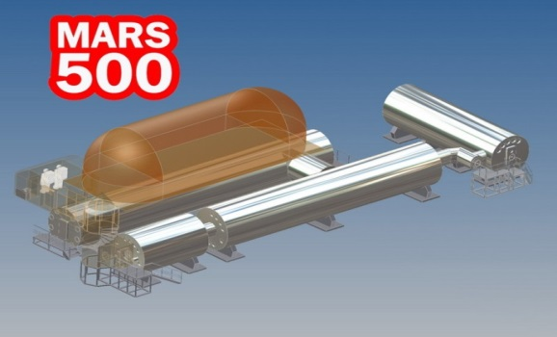
Analogs
Military
HERA
CHAPEA
Aviation
ISS
HI-SEAS
NEEMO
Antarctica
:envihab
Healthcare
NEK

Slide 13
Astronaut Selection for Team-Oriented Missions
 | Mission Type: Mars | M
1 | Self-Care | 95.14
2 | Technical | 94.21
3 | Small Group Living | 94.07
4 | Judgment | 92.57
5 | Motivation | 92.00
6 | Teamwork | 91.50
7 | Adaptability | 91.00
8 | Autonomous Worker | 89.59
9 | Communication | 88.86
10 | Leadership | 87.64
11 | Emo Independence | 86.00
12 | Sociability | 85.79
13 | Ops Orientation | 84.14
14 | Emotion Mgmt | 83.71
15 | Followership | 83.29
16 | Learner/Teacher | 81.93
17 | Confidence | 81.00
18 | Family | 75.86
Astronaut job analysis 2015 update (Barrett et al., 2015)
  Ranked by importance ratings
10 competencies “needed at hire” vs. enhance with training
Avoid personality extremes; be team-oriented

Slide 14
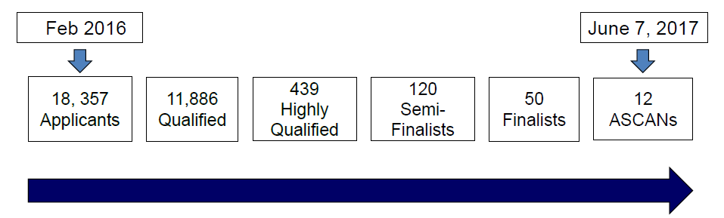
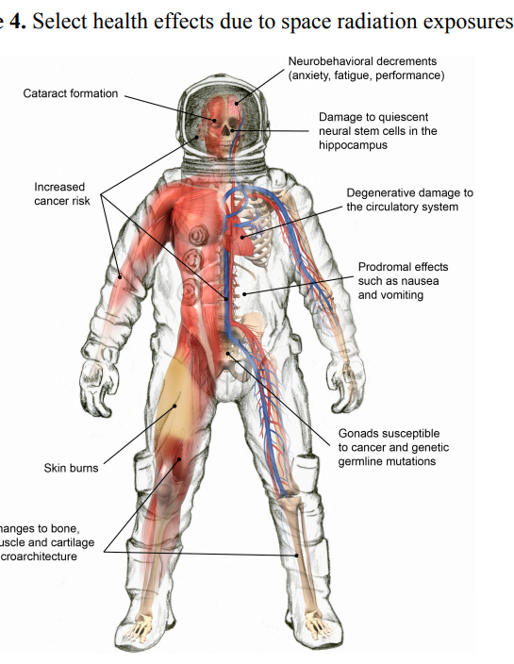
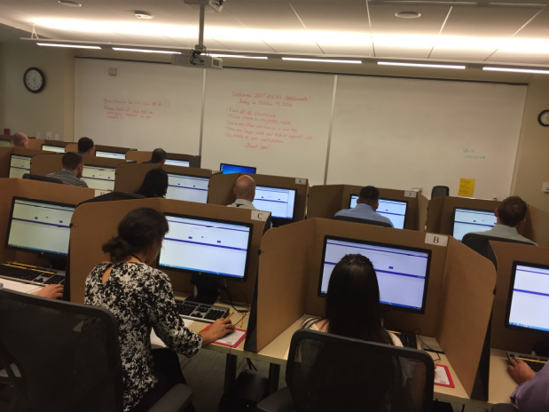
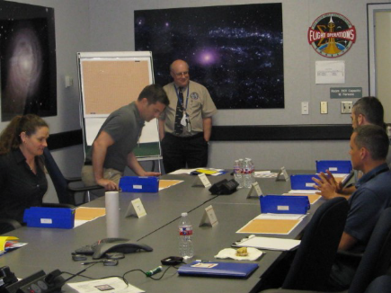
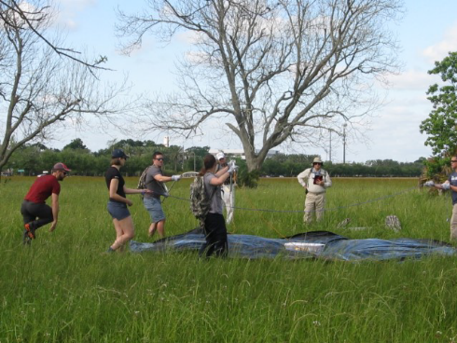
Astronaut Selection
.065% selection rate in 2017
Psychiatric qualification + psychological suitability + medical qualification
(Beven et al., 2018, AsMA)

Slide 15


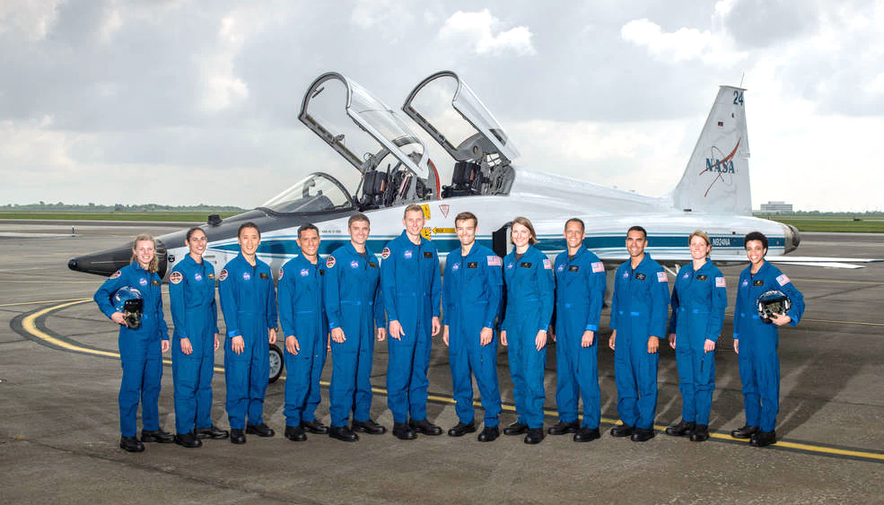
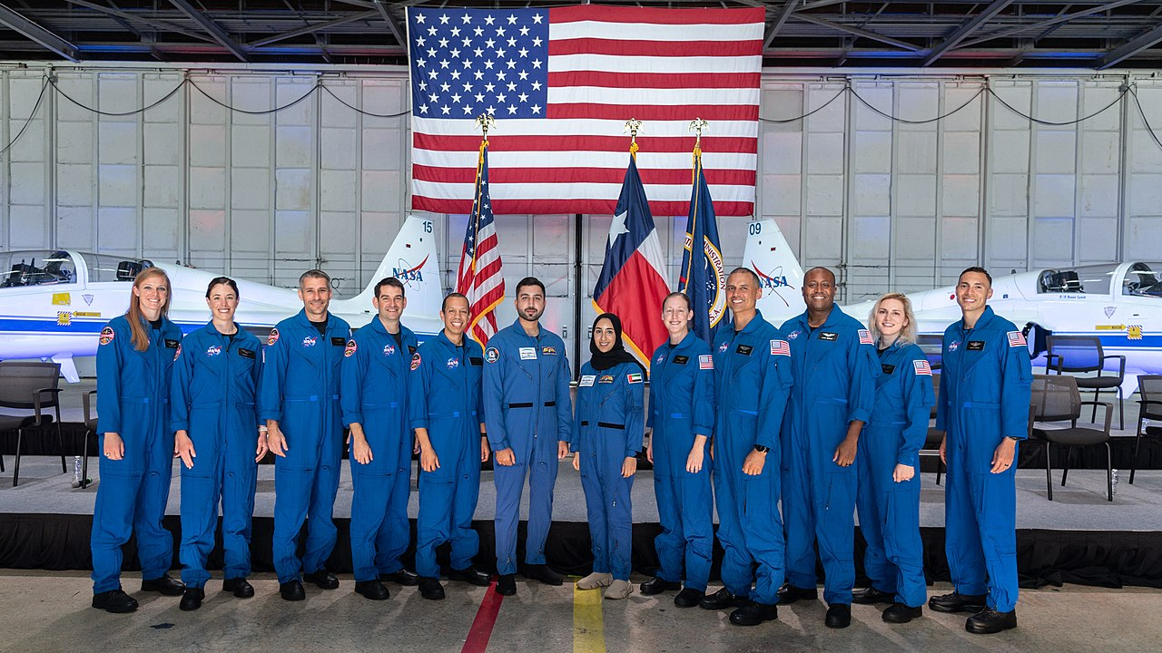
Astronaut Selection: Recent ASCAN classes
2017 – the “Turtles”
2021 – the “Flies”
with UAE partners

Slide 16
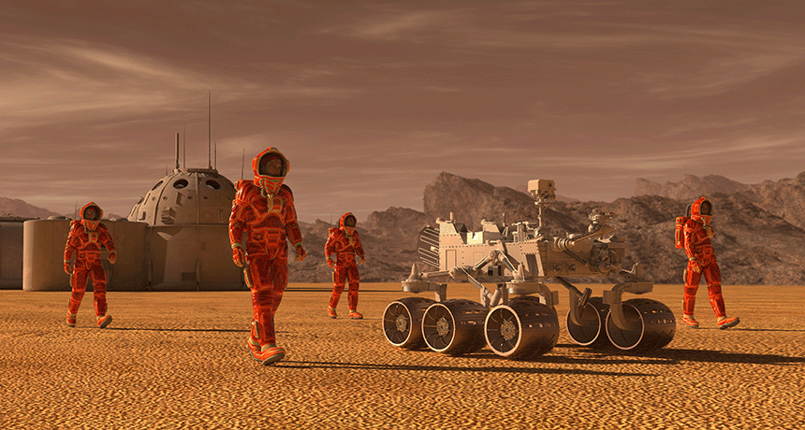

Team Composition: There is no perfect crew!
Use holistic approach to both technical needs and living and working together team needs
Political influences, radiation/physio limits
Practically, identify red flags, but focus on monitoring
  Agent-based modeling
  Identify friction points
  Composition at the task level
  Readiness
(Bell et al., 2015; Contractor et al., 2017; Fiore et al., 2015; Schmidt, 2015)

Slide 17
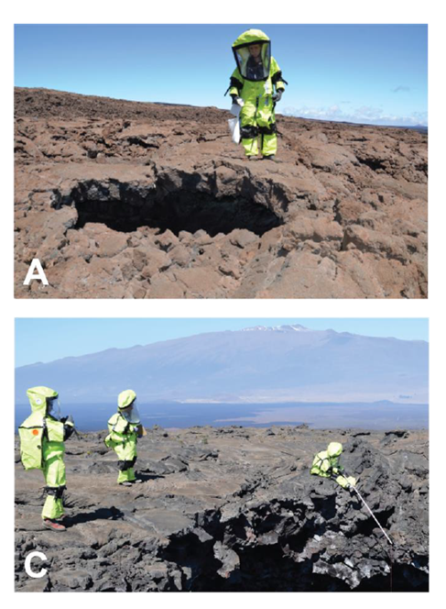
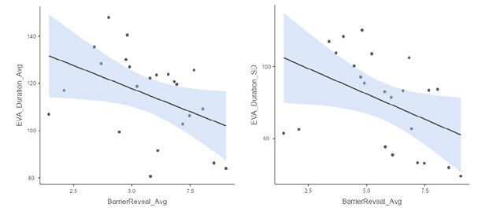
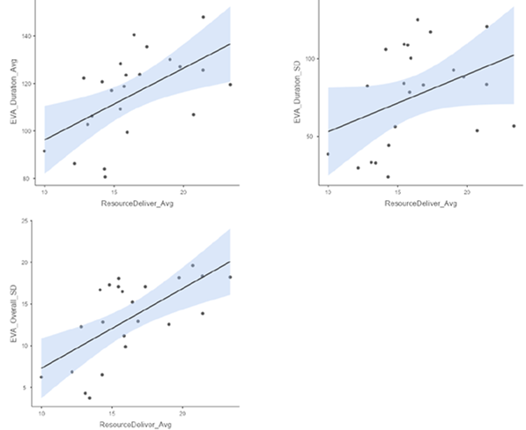
Selection and Composition
Personality and team composition affect enactment of team skills, performance
HI-SEAS missions 2-5 (Binsted et al., 2021, 2022; NASA IWS conference; data from Co-Is B. Schiro, P. Roma)
EVAs with more self-serving individuals were less efficient, less stable in efficiency, and less stable overall performance of geology tasks.
EVAs with more cooperative individuals were more efficient and more stable in efficiency.

Slide 18
Interpersonal Relationships
ISS Astronaut Journals Studies, PI Jack Stuster, PhD
Journal entries on conflict by mission quarter (Stuster, 2010, 2016)
Group interaction positivity ratings by mission quarter
(group interaction comments- red n=718, blue n=244)
Conflicts
Positivity

Slide 19
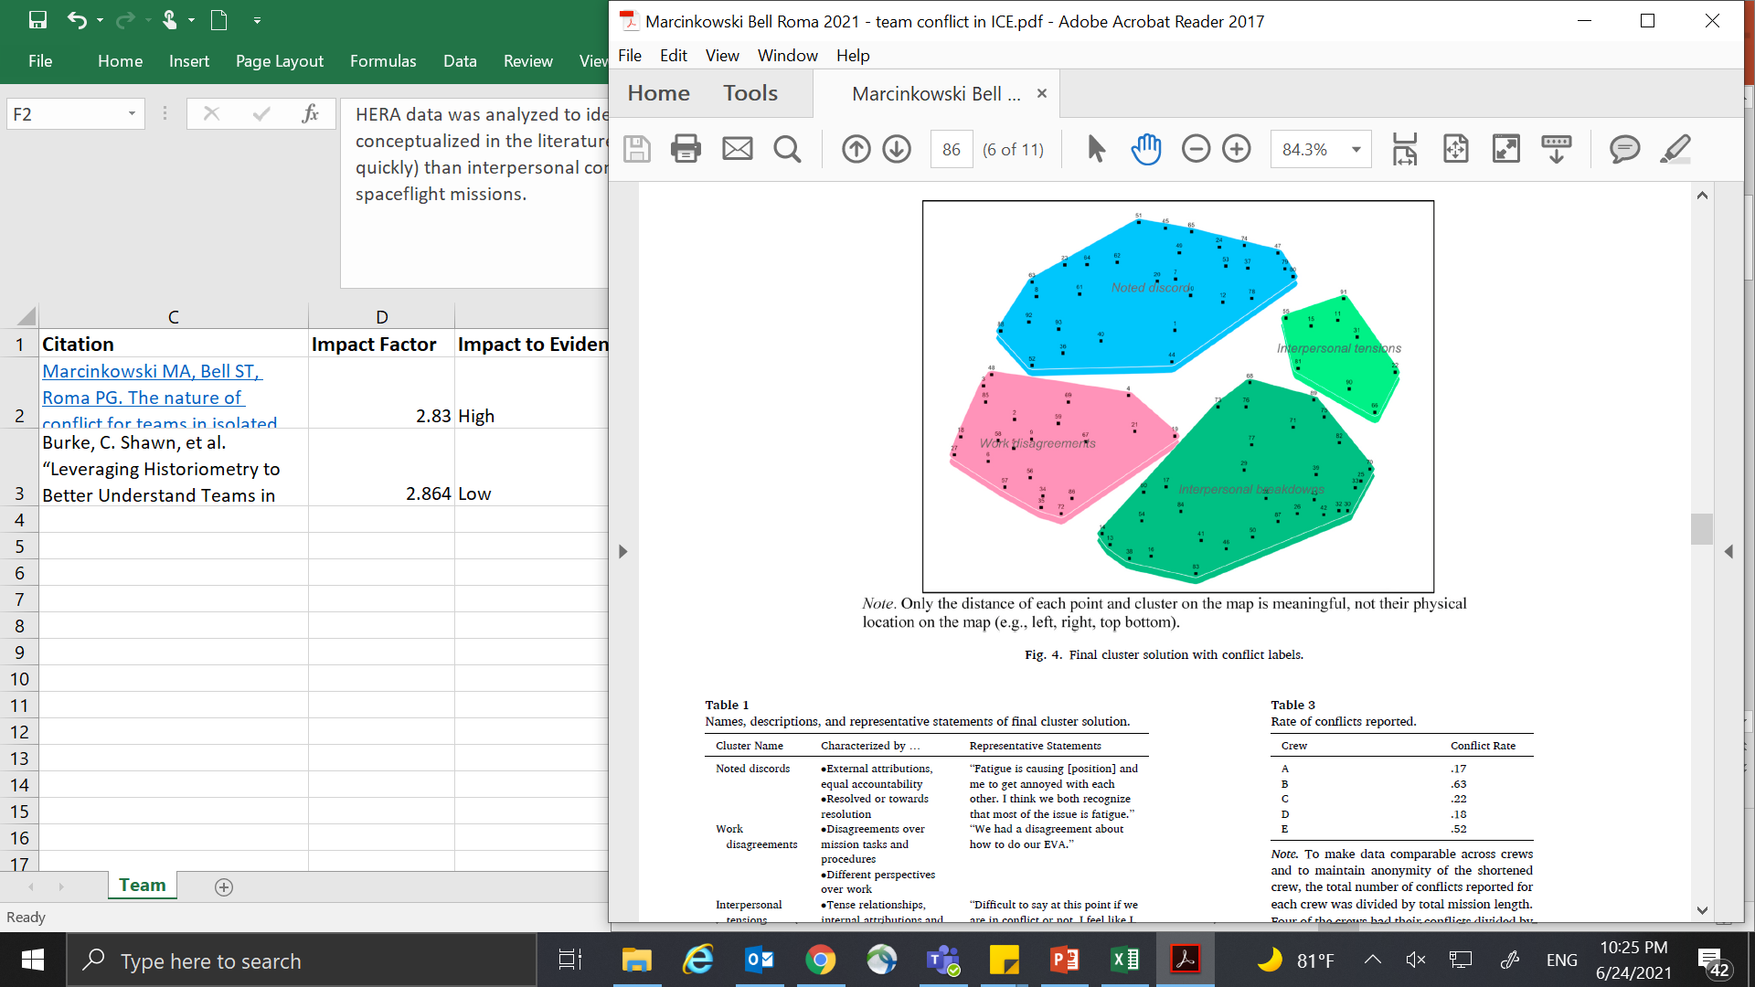
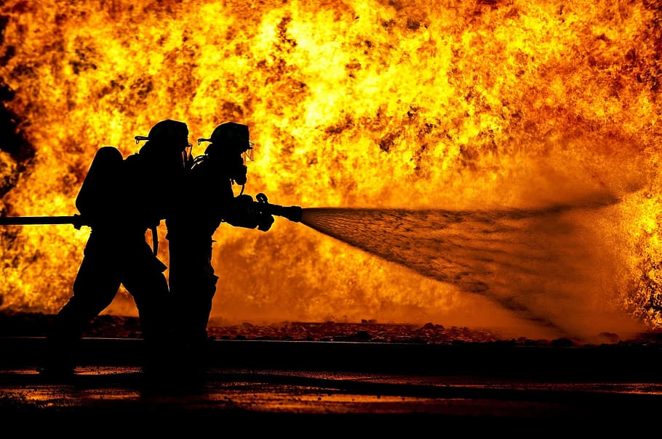

Interpersonal Relationships & Cohesion
Conflict will happen on every mission. Focus on prediction, prevention, and repair. - Psy Ops SMEs
Review of older analog research
  All teams had conflict
  Longer mission → less social time together
  Consistent team efficiency over time was typical
  Psychological closing
HERA 45-day missions - all crews had conflict
  Conflict in ICE/ICC differs
  Early minor tensions -> bigger conflicts later
  Work conflict vs. interpersonal conflict
HERA conflict clusters
Noted discords
Interpersonal tensions
Work disagreements
Interpersonal breakdowns
HERA
NEK
(Marcinkowski, Bell, & Roma, 2021)
(Bell, Brown, & Mitchell, 2019)

Slide 20
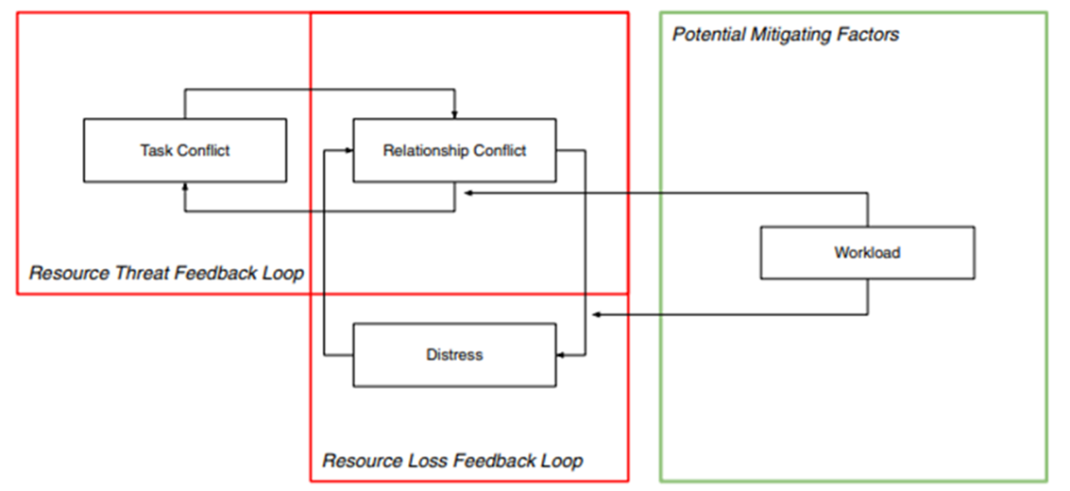
Interpersonal Relationships & Cohesion
Conflict can spiral over time, especially in stressful job conditions
HERA C3,C4
(Somaraju, et al., Kozlowski, 2021)

Slide 21
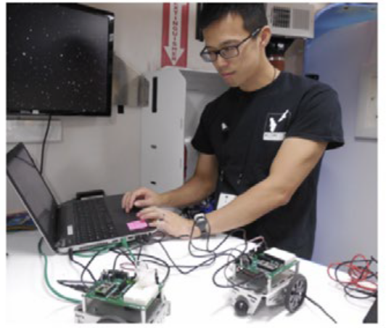
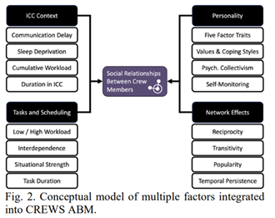
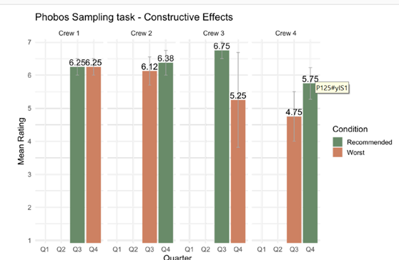
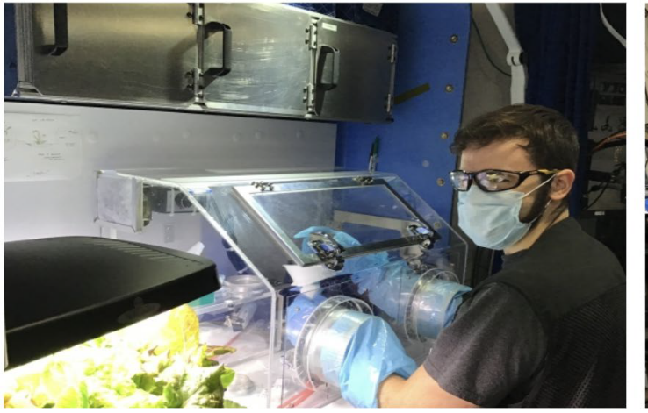
Interpersonal Relationships & Cohesion
Data-driven, dynamic team composition can support interpersonal relationships
HERA C3/C4/C5
Finding: ‘Best’ pairings increased constructive, decreased destructive effects to relationships
Rover
Geology sampling
(Antone et al., Contractor, 2021, IAC proceedings)
Notes:
‘Worst’ pairing reported better relationships when paired

Slide 22
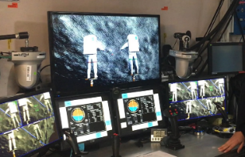
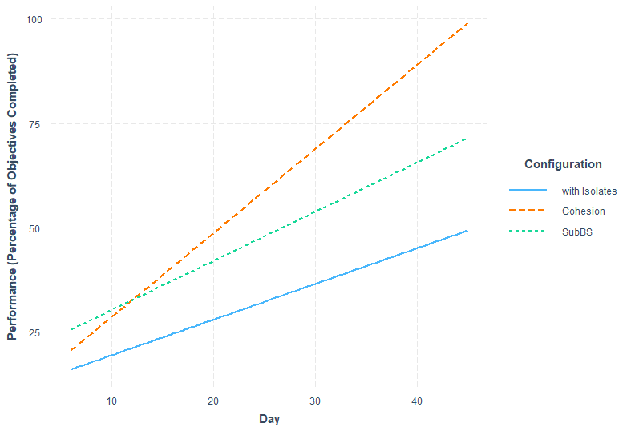

Interpersonal Relationships & Cohesion → Performance
Cohesion predicts objective performance
cohesive teams
Performance (percent of objectives completed)
subgroups
HERA Multi-Mission Space Exploration Vehicle (MMSEV) task
PI S. Bell, NASA,
with Institute of Biomedical Problems (IBMP) Co-Is V. Gushin, A. Vinokhodova
with isolates
Day
(Bell, Nyberg, et al., 2021, IWS)

Slide 23
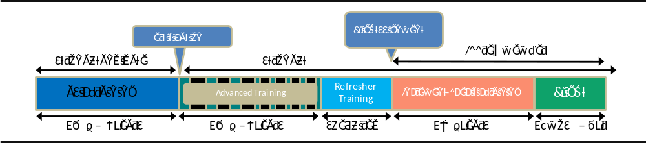
Astronaut Training Flow
ASCAN
  Highly technical
  Some specific BHP and team skills training
  Analogs
    NOLS, team events, etc.
  Team skills becoming more prominent
    SFRM
    Expeditionary Skills
Pre-Assignment
  Advanced Training
  Analogs
Assigned
  Technical, but more focused on specific tasks
  BHP
    Psychological support
    Psychological preparedness
(Slack, 2016, SIOP)

Slide 24
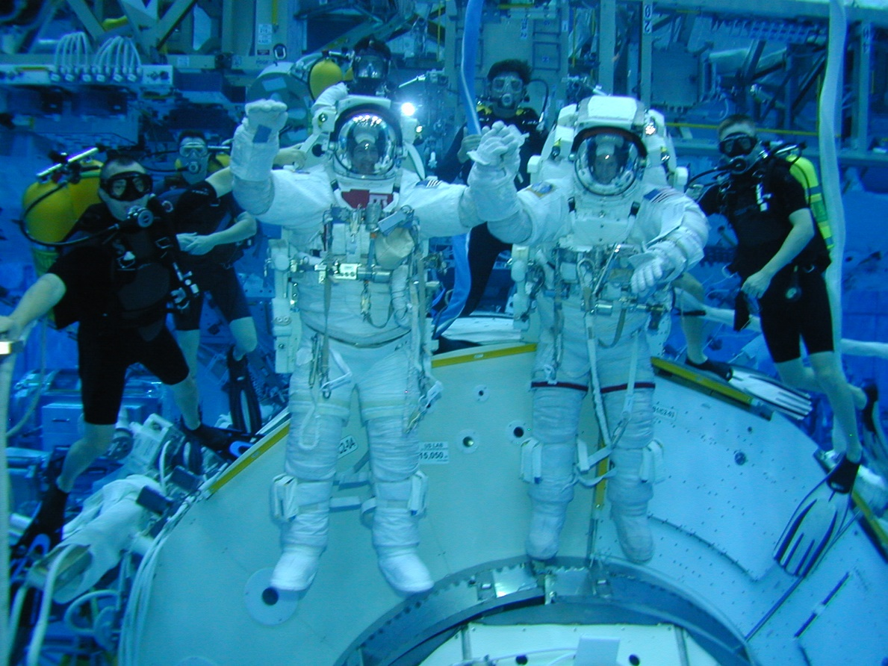
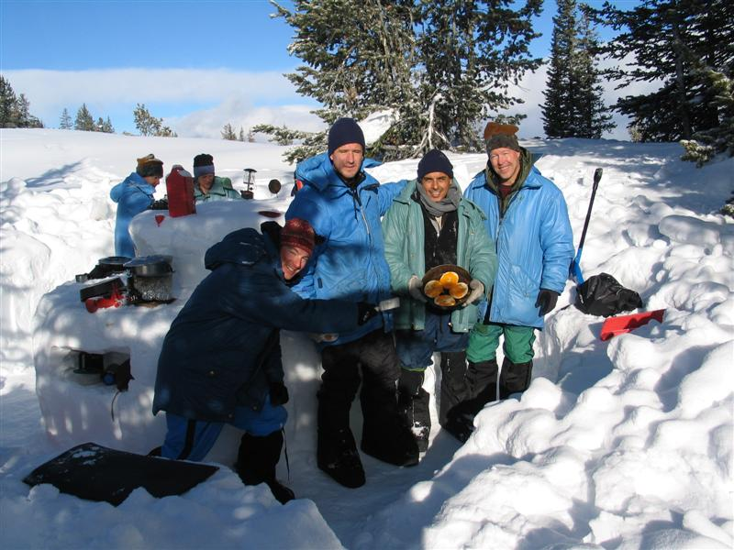

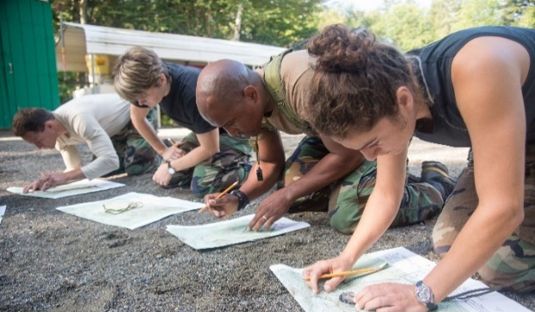
Astronaut Training: Expeditionary/Crew Office Skills
    5 Key Skills
      Self-Care/Self-Management
      Leadership/Followership
      Communication
      Team Care
      Teamwork and Group Living
(Landon & Paoletti, 2021)

Slide 25


Astronaut Training: Expeditionary/Crew Office Skills
Group Living Skills (GLS) Survey.
Please rate your level of agreement with the following statements about [selected teammate] (if you are [selected teammate] please answer the questions about yourself).
 | Clean and tidy with personal items
 | Clean and tidy with work items
 | Uses humor appropriately
 | Appreciates others' knowledge, skills, and abilities
 | Considerate of others' preferences
24 crews in ISS, HERA, SIRIUS
Group living skills related to cohesion, team viability, team performance in extreme environments
Also provides “Roommate Quality” score
(Landon, Miller, Bell, & Roma, in press, Frontiers in Psychology)

Slide 26
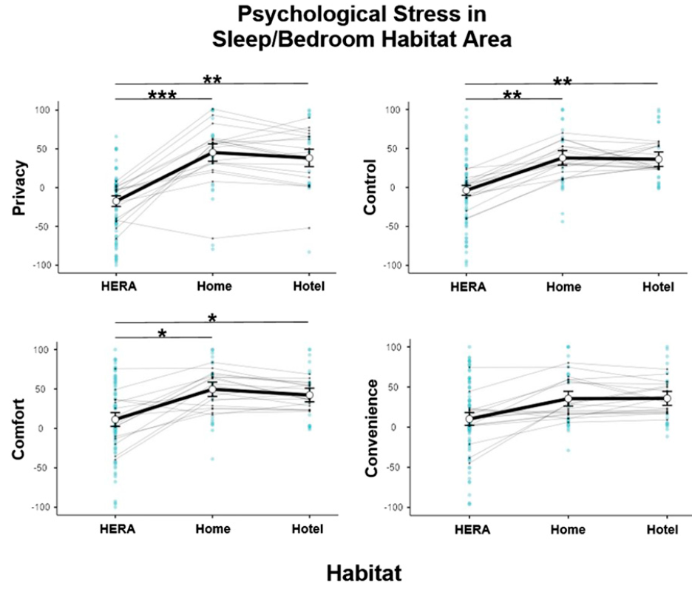
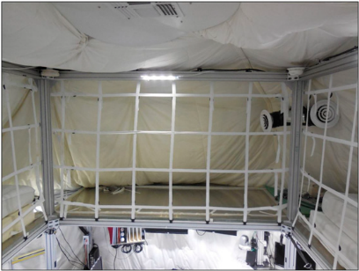
Habitability
Isolation and confinement are a major hazard
SHAQ: behavioral health and habitability
  Multiple hab areas
  6 Moderators: privacy, comfort, control…
  6 Outcomes: stress, performance, social…
HERA crew quarters
HERA
(Roma et al., 2023, SHAQ)

Slide 27
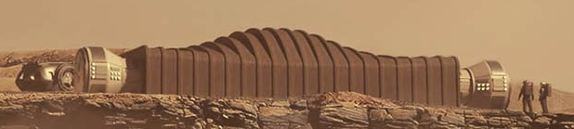
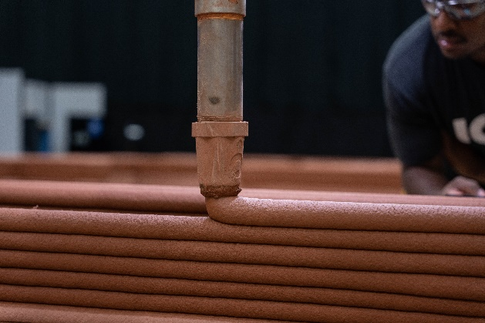
Habitability
Long-duration habitability:
SHAQ: behavioral health and habitability
  Hab areas, hab features, outcomes
NASA Modified System Usability Scale: human factors
ICON
3D printed habs
CHAPEA
(Roma et al., 2023; Holden & Robertson, 2022, NASA TM; Miller et al., 2024, IWS pres.)

Slide 28
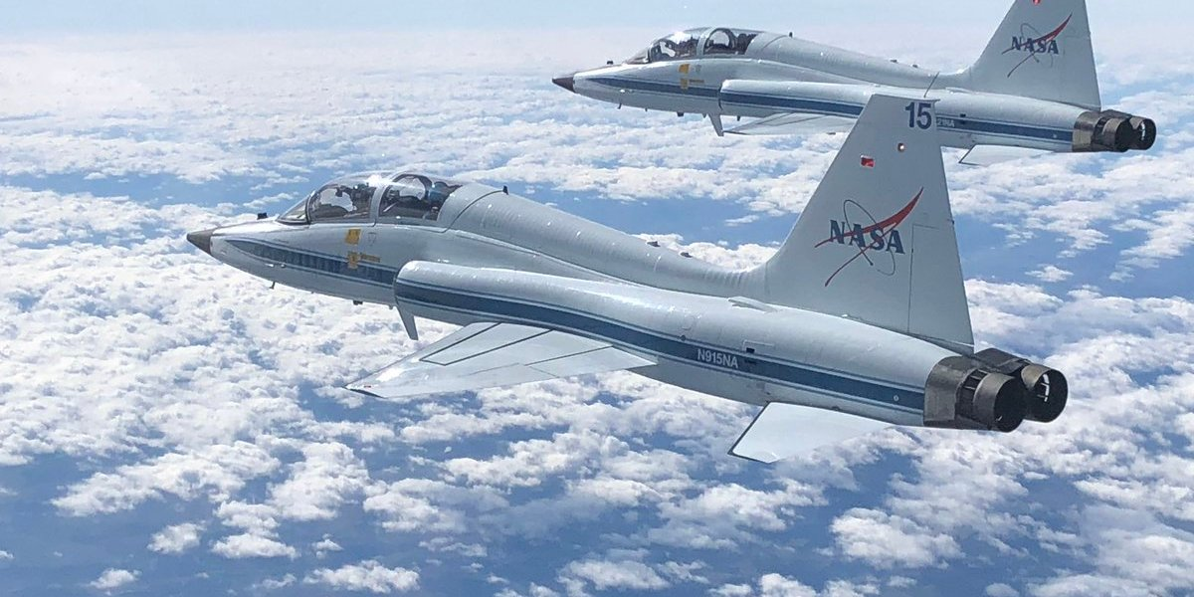




Astronaut Training: Other Behavioral Health & Performance
Expectations of Spaceflight
Stress Management
Conflict Management
Cross-Cultural Training
Field Geology (integrated)
T-38 jet training (integrated)
Future: more training with intact assigned team; immersive; in-mission refreshers
(Sipes et al., 2021; Hughlett et al., 2021)

Slide 29






Countermeasures: Meaningful Work
Meaningfulness, perceived value of job, learning, enjoyment
Improved mood, team cohesion and performance, personal change, and fewer depressive symptoms
ICC – HERA (NASA JSC)
ICE – Neumayer Stn. (Antarctica)
ICE – Navy Officers
(Landon, Baxley, et al., 2024, Meaningful Work Scale, IWS presentation)
Photos: NASA, Navy, A. Stahn

Slide 30


Countermeasures: Meaningful Work
Teamwork
Mission objectives
Individualization
Team processes in SIRIUS-19
lunar landing
Bell et al., 2022, harmonization
Joint EVA Test Team (JETT)
Future: lunar high-tempo EVAs?
Photo: NASA

Slide 31





CMs: Ops Psych & Family Support
ISS cupola
movie night
family call
(Beven et al., 2018, AsMA)
care packages
cognitive monitoring

Slide 32




Multi-Team Systems
Global network
Plug and play, 24/7 operations
Focus on key boundary spanners
MCC at JSC

Slide 33


Multi-Team Systems
MCC + MER (Mission Evaluation Room) | Astronauts (estimated Mars team)
85 system experts | 4 crew members
660 years combined specific systems experience | 91 years combined relevant work experience
~2 years to operator cert | 2 years ASCAN training
Additional years to specialist cert | ~2 years flight-assigned training
In-depth understanding of a single system | I&S, C&T, EPS, ETCS, ECLSS, ITCS, Emergency, MCS, OOM, Struc & Mech, Crew Systems, VV, Orb Mech, CMO, Med Ops, EVA, ROBO, Ops LAN, Photo/TV
Training builds academic engineering background
Constantly using skills and studying flight rules | Time gap between training and flight; degradation of knowledge may be significant
MCC (top), MER (bottom)
(McTigue et al., 2021)
“4 people with 25 years experience each on 4 console positions cannot replace 10 people with 10 years of experience on 10 console positions even though both groups have 100 years total experience. It’s not just the experience, it’s the experience in unique console positions.”
- training expert and former crew trainer

Slide 34


Multi-Team Systems
Data evaluated by single flight control station (ISS, current)
Team skills and cognition enable problem-solving across MCC multi-team system and across comm delays
Level of ground support experience/expertise cannot be replicated wholesale on-board

Slide 35

Multi-Team Systems under Comm Delay
Areas of concern:
  Individual well-being and performance
  Team cohesion and performance
  Family connectedness
Individuals and teams
Individuals
Team
Notes:
Individual well-being – stress, frustration
Individual performance – cognitive load, errors, reduced situation awareness
Team performance – reduced comm quality and quantity, reduced shared mental models, coordination decrements, reduced cohesion, errors, LOMO and task objectives
Team cohesion – reduced social support, conflict, in-group/out-grouping, performance decrements
Family connectedness

Slide 36


Multi-Team Systems under Comm Delay
(Goemaere et al., 2019)
So identify opportunities for autonomy and plan for critical multi-team tasks

Slide 37


Slide 38


Slide 39

Multi-Team Systems under Comm Delay
L u n a r

Slide 40


Multi-Team Systems under Lunar Comm Delay
Anticipated one-way delay of ~2.5 to 10 seconds
  Voice delay 5 to 7.4+ seconds
Decrements at shorter (<1.5s) one-way delays
  Apollo: 1.25s one-way delay
  Telesurgery: effects at .5s one-way delay
(Eppler, 2012; Panontin et al., 2024, IWS presentation on BLEO comm delay lit review; Syed et al., 2022, HRP medical clerk project; personal communication with FOD, 3/1/24)

Slide 41

Expedition 61 astronaut about the AMS EVAs: “We had to work together as a team very, very closely with each other, real time, and also with the ground teams. We would literally call to the ground and say, ‘hey, we were thinking of this plan.’ It was literally down to the centimeter.”

Slide 42







Human Systems Integration Architecture
3D printed habs
automated/augmented systems
VR
human-computer, human-robotics integration
(Wu et al., 2016; ANSIBLE)

Slide 43



Behavioral Biology of Teams
Past studies: fatigued teams had increased errors and processing time at the individual level, but effects were attenuated by team membership
HERA
  Acute sleep deprivation (awake 36 hours): leadership
  Chronic fatigue (5hrs sleep M-F): cognition, support
HERA crew quarters
(Landon, …, Roma, 2019, Frontiers in Psychology)
(Baranski, Thompson, et al., 2007; Burke, 2017; DeChurch, 2017; Bell, 2017; Roma, 2020; Banks, Landon, et al., 2019)

Slide 44




Behavioral Biology of Teams
Bed rest brains
Space brains
exercise
habitability
nutrition

Slide 45



Next Era: Commercialization & Private Astronaut Missions
All private astronaut crew of Axiom Space Mission to ISS, Ax-1
April, 2022
Actor/Director Kim Shipenko and Actress Yulia Peresild on ISS Expedition 65, Oct. 2021
(Landon et al., 2022; NASA IWS conference)

Slide 46


Next Era: Commercialization & Private Astronaut Missions
PAMs = largely unquantified risk
Different selection, training, support?
Different approach to design?
Government and private partners?
Future: private space stations

Slide 47



Questions?
2-volume series
lauren.landon@nasa.gov

