Slide 1
Transformational Tools and Technologies (T³) Project
Battery Research Overview
Dr. Azlin Biaggi
Event: ASM Cleveland Chapter 2025 Symposium - Materials in Battery and Energy Storage
Location: Case Western Reserve University
Date: 29 January 2025

Slide 2

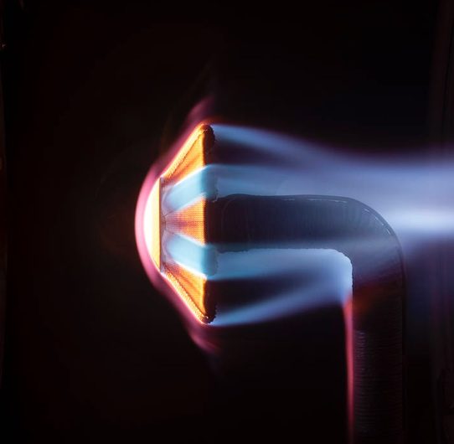


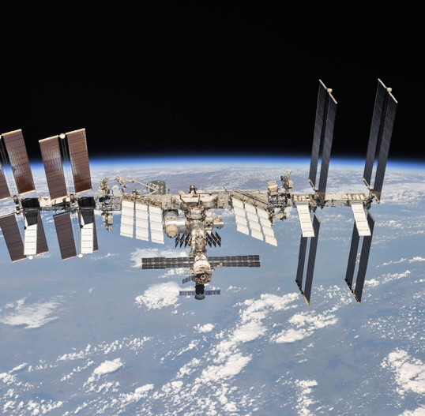
NASA Aeronautics is One of Five Mission Directorates
Exploration Systems Development
Aeronautics
Space Technology
Science
Space Operations
NASA explores technologies that reduce aircraft noise and fuel use, get you gate-to-gate safely and on time, and transform aviation into
an economic engine at
all altitudes.
NASA technologies developed for spaceflight benefit our everyday life. The Artemis program proves and matures what those technologies can do and reduces risk for exploration of Mars
and beyond.
NASA and the nation’s science community use space observatories conduct scientific studies of the Earth from space
to visit and return samples from other bodies in the solar system, and to
peer out into our galaxy and beyond.
NASA's Artemis program
is defining and creating the steps path from Earth back to the Moon and on to Mars, including the Orion capsule, the Space Launch System, Exploration Ground Systems, the Gateway, and Human Landing System.
NASA's work in beyond low-Earth orbit includes commercial launch services to the International Space Station, exploration systems, space transportation systems, and broad scientific research on orbit.
Notes:
Aeronautics research is one of NASA’s five missions.

Slide 3
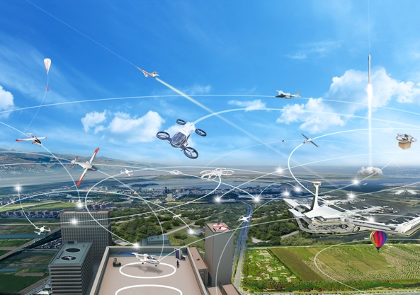
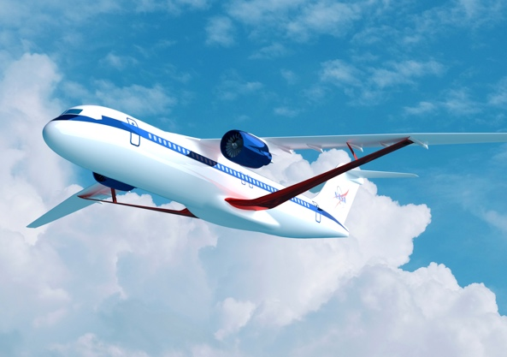
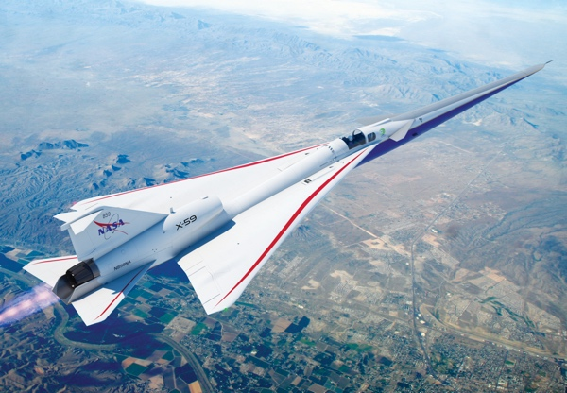












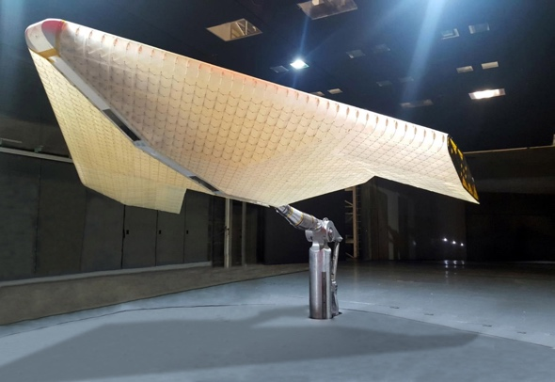
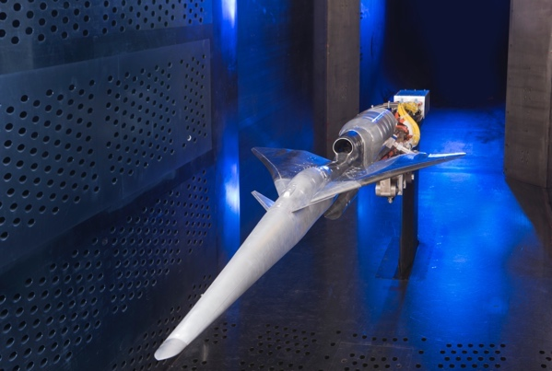









ARMD
PROGRAMS
Airspace Operations and Safety Program
Advanced Air Vehicles
Program
Integrated Aviation Systems Program
Transformative Aeronautics Concepts Program
Aerosciences Evaluation and Test Capabilities Portfolio
Notes:
ARMD programs contribute to strategic thrusts
ARMD’s programs and projects are all cross center and cross discipline. We leverage the best people from across the NASA enterprise to enable us to be agile in our execution.
[elaborate]

Slide 4
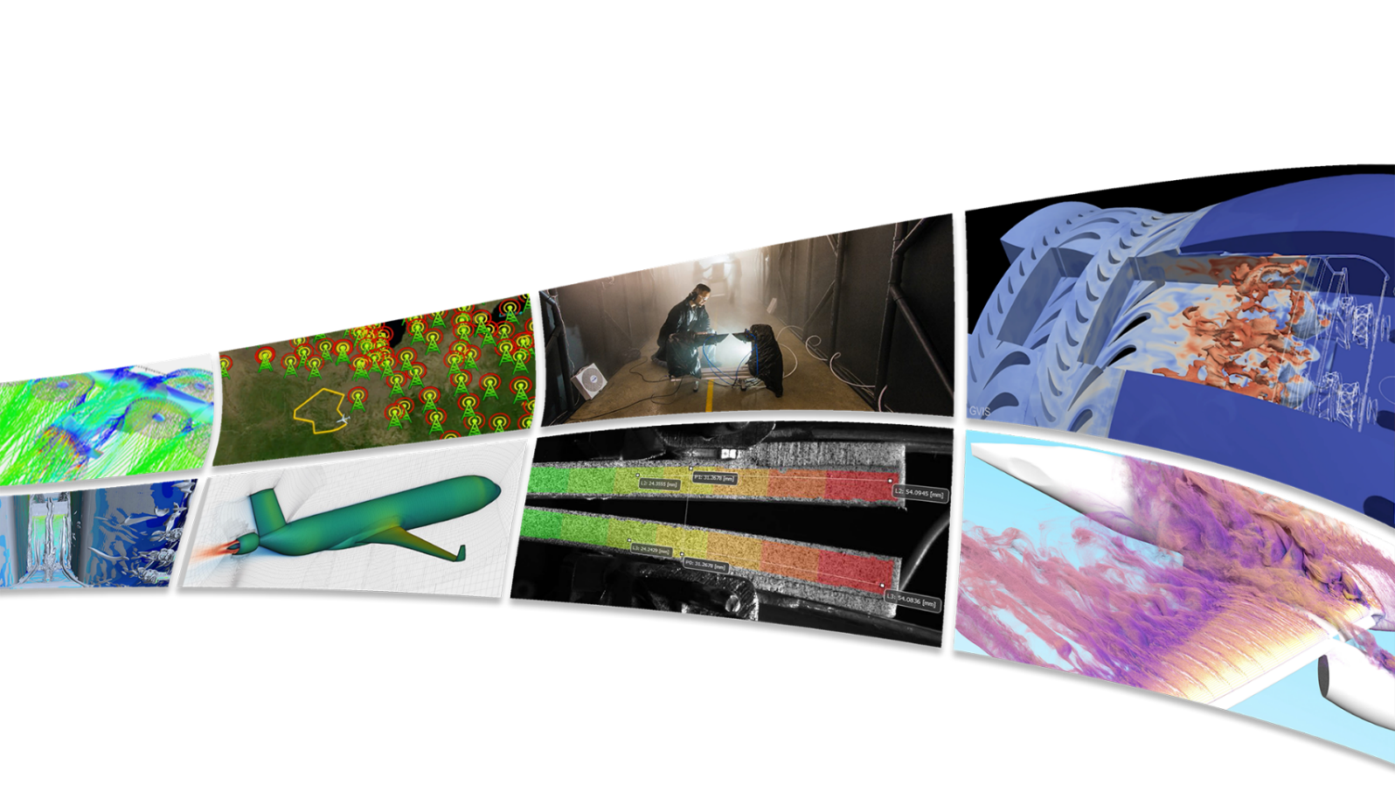
Transformational Tools & Technologies (T³) Project
Discover, develop, and transition innovative solutions through foundational research and
cross-cutting tools and technologies for the aviation community
T³ is the home of enduring research within the ARMD portfolio,
undertaking research that often focuses on longer-term challenges.
We sustain critical aeronautics core competencies for the Nation and
conduct exploratory research with breakthrough potential.
Our tools and technologies provide innovations that impact aeronautics research
throughout the community and revolutionize air transportation.
Delivering cutting-edge research, leading community vision studies, and providing valuable data and innovations

Slide 5
T³ FY25 Organizational Structure
Resource & Project Support
Business Lead and GRC Analyst: Gene Storer (GRC)
Center Analysts: Cecelia Town (ARC),
Alee Pacheco (AFRC), Tracey Frisby (LaRC)
NRA Manager: Tracey Frisby (LaRC)
Risk Manager: Ramel Panaguiton (LaRC)
Strategic Comm Specialist: Diana Fitzgerald (LaRC)
Project Support Specialist/Scheduler: Marie Mion (GRC)
Executive Team
Project Manager – Michael Rogers (ARC)
Deputy Project Manager – Dale Hopkins (GRC)
Associate Project Manager – Vanessa Aubuchon (LaRC)
Project Center Liaisons
ARC Andrew Meade
AFRC Robert Navarro
GRC Azlin Biaggi-Labiosa
LaRC Melissa Rivers
Disciplines | Tech Leads
Autonomous Systems (AS)
George Gorospe (ARC)
Sub-projects
(Aligned with ARMD Priorities)
Communications, Navigation & Surveillance (CNS)
Eric Knoblock (GRC)
Multidisciplinary Design, Analysis & Optimization (MDAO)
Ben Phillips (LaRC)
Foundational Electrified Aircraft Propulsion
MDAO
Controls
M&S
Azlin Biaggi-Labiosa Sub-project Manager
Revolutionary Aviation Mobility
AS
CNS
MDAO
Controls
Siena Whiteside
Sub-project Manager
Reduced Life Cycle Cost
IM
RCA
M&S
Icing
Melissa Rivers
Sub-project Manager
Sheida Hosseini ​
Deputy SPM​
Controls – Propulsion
Controls – Flight
Dennis Culley (GRC)
Mike Acheson (LaRC)
Icing
Chris Porter (GRC)
Enduring Disciplines Research Areas
Discipline Strategy Management
Dale Hopkins & Vanessa Aubuchon
Innovative Measurements (IM)
Mark Wernet (GRC)
Revolutionary Computational Aerosciences (RCA)
Mujeeb Malik (LaRC)
Materials and Structures (M&S)
Steve Arnold (GRC)
T³ conducts foundational research with its discipline-based expertise to enable innovation in aeronautics & executes multidisciplinary projects to apply concepts in a system-level context
Combustion
Jeff Moder (GRC)

Slide 6
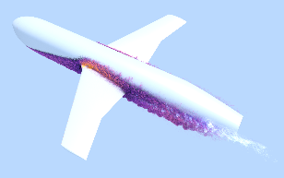
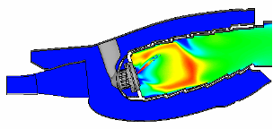
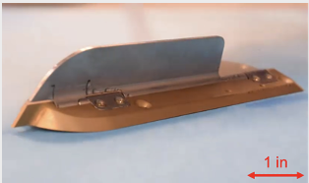
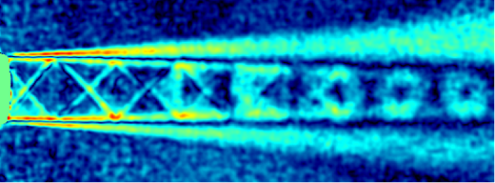
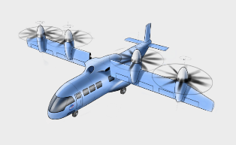
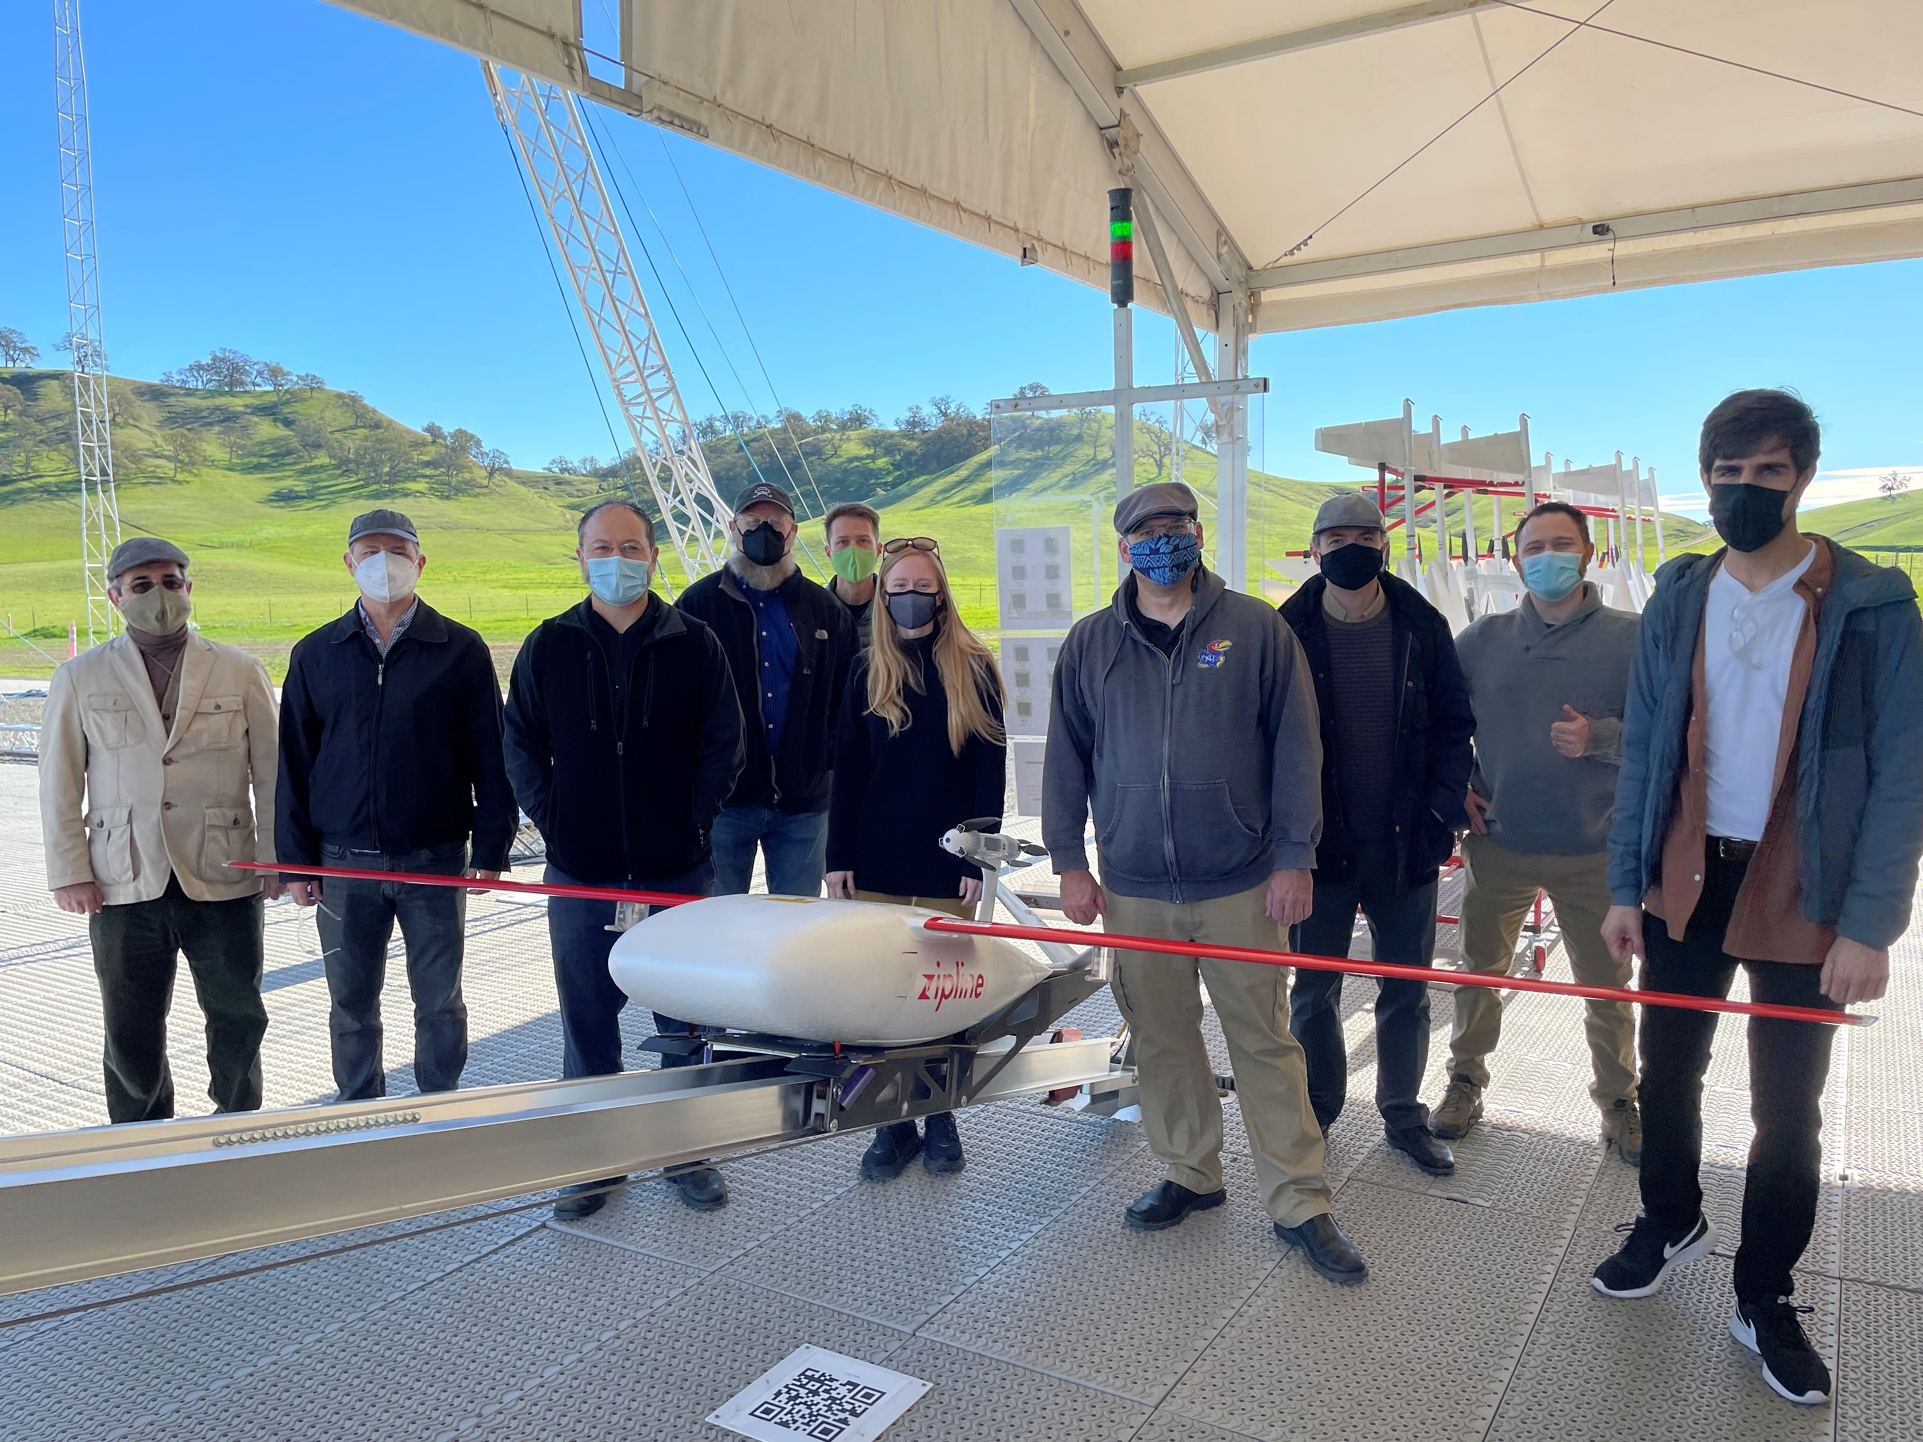
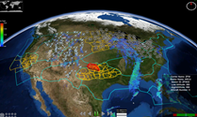
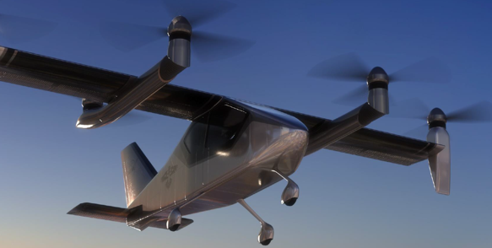
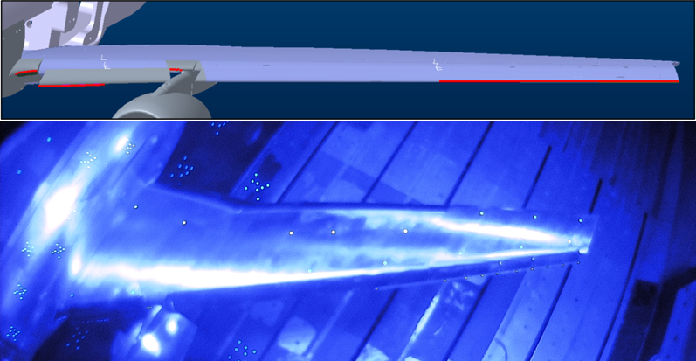
Nine Disciplines Focused on Foundational Research
Sustaining Critical Core Competencies for the Nation
Revolutionary Computational Aerosciences
Algorithms, modeling and validation experiments, transition, aeroelasticity
Combustion
Modeling & Experiments
Materials & Structures
Fit for purpose materials, metals, composites, additive manufacturing
Innovative Measurements
Cutting-edge measurement techniques
Multidisciplinary Design, Analysis, Optimization
Foundational tools, uncertainty quantification
Autonomous Systems
Advancing capabilities throughout the aviation system
Communications, Navigation, Surveillance
Novel spectrum & antenna capabilities [RAM]
Controls
Flight [RAM] & Propulsion [FEAP]
Icing
Address icing for new vehicles [RLCC]

Slide 7
Three Sub-projects Aligned with ARMD Priorities
Executing multidisciplinary projects to apply concepts in a system-level context
Foundational Electrified Aircraft Propulsion
Reduced Life Cycle Cost
Revolutionary Aviation Mobility
Enable the performance, reliability, and durability of electrified propulsion systems by conducting enduring research and developing innovative materials, components, tools, and methods
Reduce the life cycle cost of aircraft to enable the U.S. aircraft industry to stay competitive worldwide
Provide leading edge tools, technologies, and research findings to enable increasingly autonomous AAM transportation in the UML-4+ timeframe
Sub-project Research
Battery system architecture design and testing
Potential battery materials identification
Aviary open-source aircraft design tool
High voltage power cables model for electric materials
Propulsion controls – energy management control hardware-in-the-loop
Sub-project Research
Certification by Analysis (CbA) with computational fluid dynamics tools
Community-sourced resources for High Lift Common Research Model (CRM-HL)
Icing tools to validate simulation
Computational Materials-informed Qualification and Certification (Q&C) of additive manufacturing (AM) materials
Researching materials to reduce weight and improve performance
Sub-project Research
m:N operational roadmap and critical tool and technique research
Human autonomy teaming
Intelligent contingency management
Crowdsourcing aviation sensing data
Efficient design & testing of AAM vehicles
Distributed sensing
Communication, navigation & surveillance
  MDAO – M&S – Propulsion Controls
  IM – RCA – Icing – M&S
  AS – CNS – MDAO – Flight Controls

Slide 8


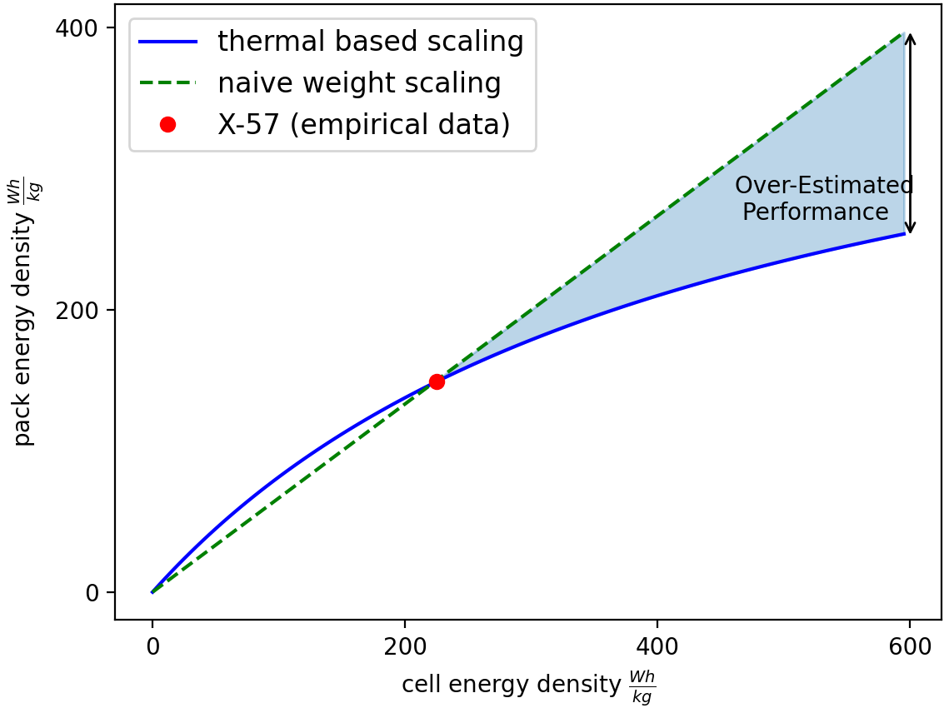
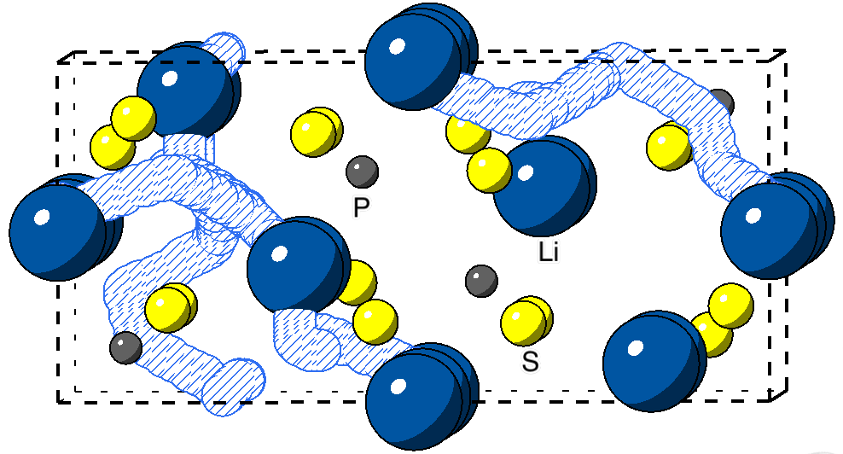
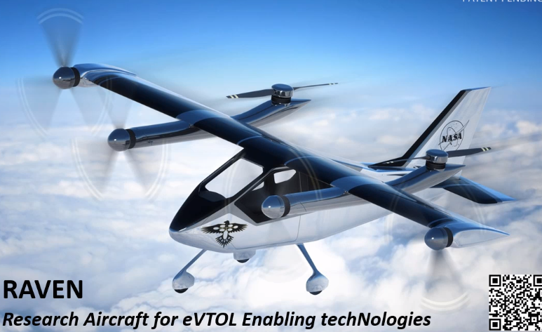
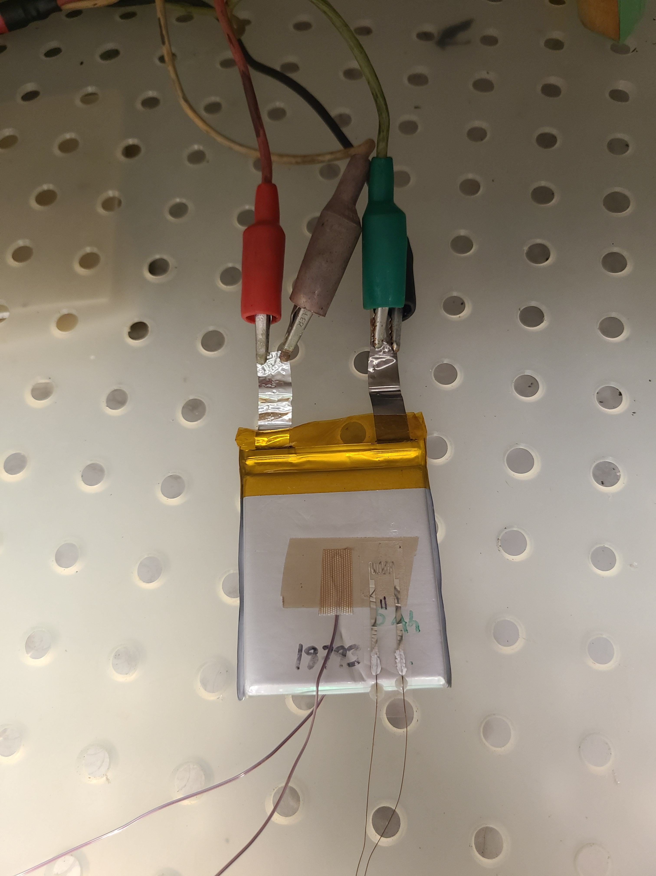
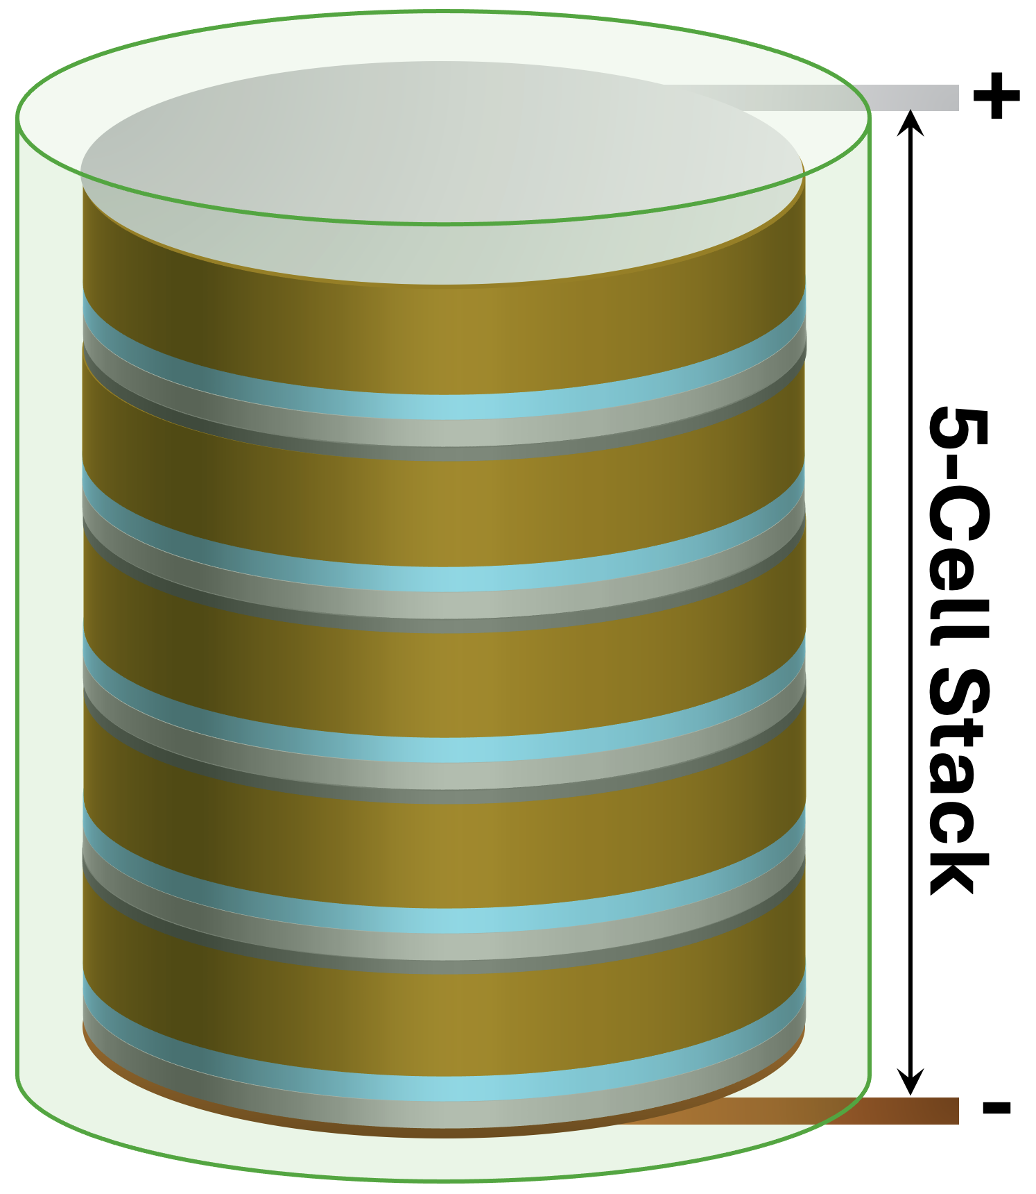
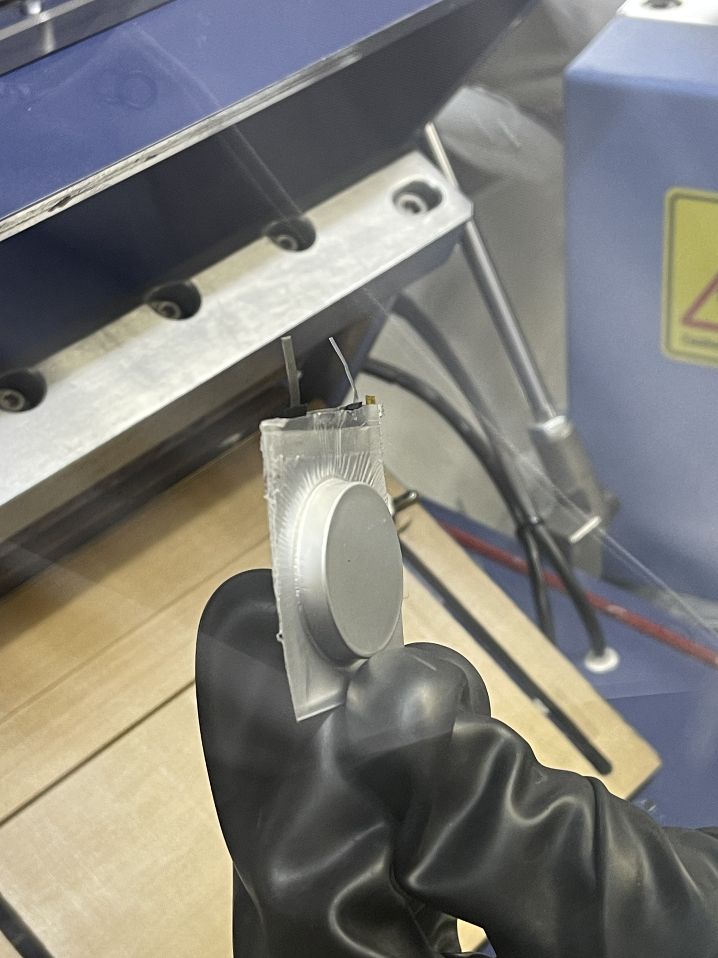
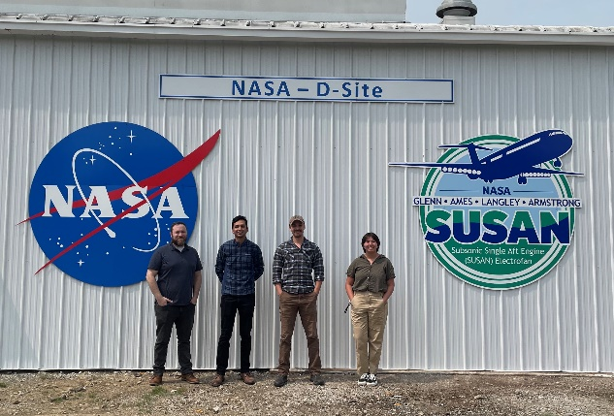
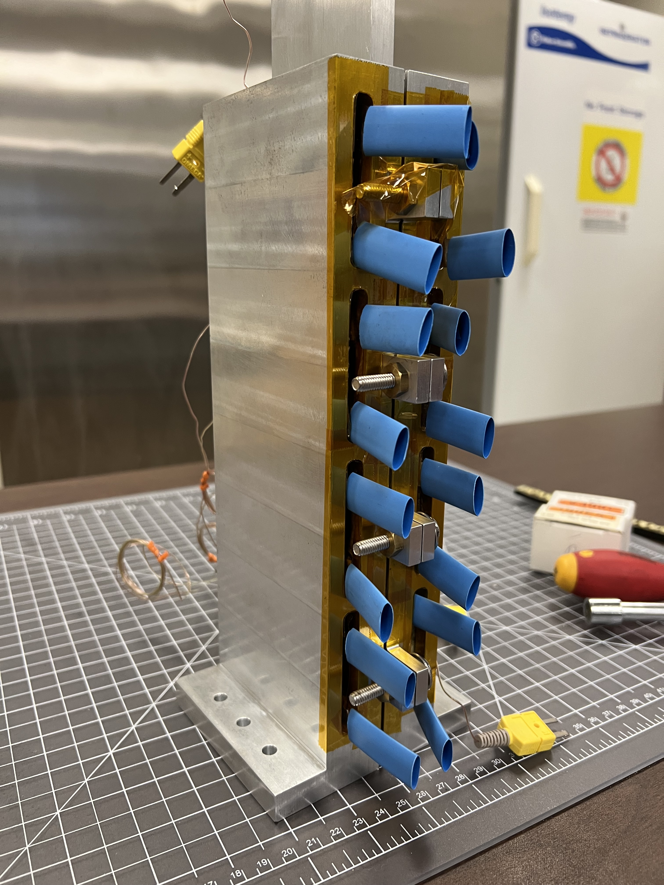
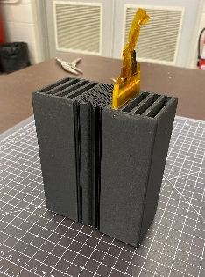
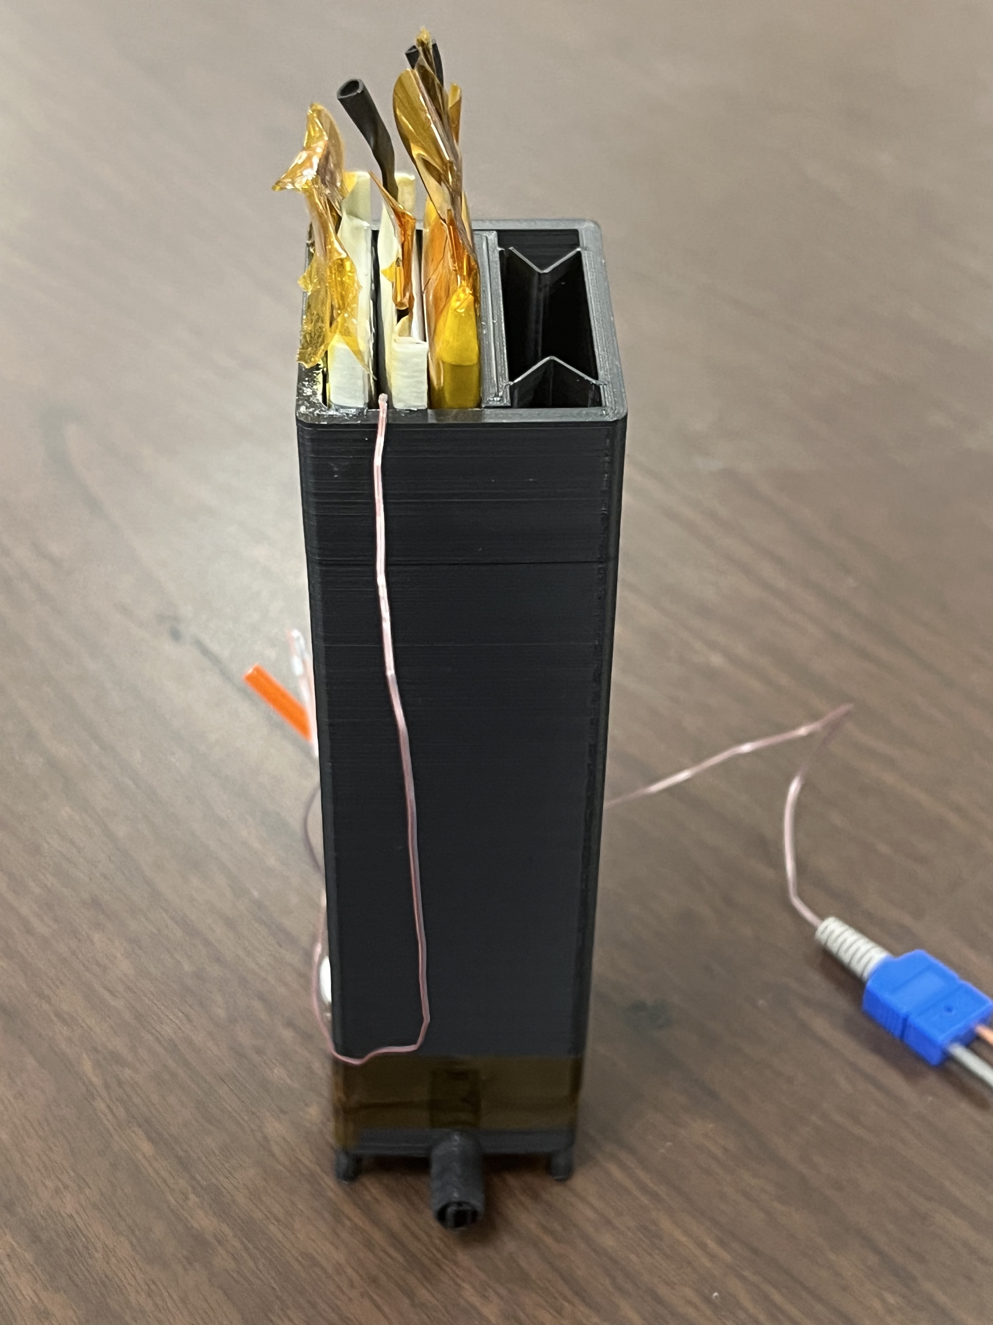
Evolution of Battery Research to Higher TRLs
Collaborations across ARMD advancing battery research for electric aviation
Battery Enclosures for Advanced Safety and Thermal (BEAST) (started in FY23)
Motivation
400
Thermal based scaling
Naive weight scaling
X-57 (empirical data)
Overestimated Performance
Modeling (FY20)
Pack Energy Density (Wh/kg)
Batteries for High Performance and Safety
Sensors (FY24)
0
CAS transitions
0
200
400
600
Cell Energy Density (Wh/kg)
Open eVTOL Subproject – Flight Demonstration and Capabilities (FDC) Project
Improved scaling laws from cell to pack level are needed (FY20)
Solid State Electrolytes (FY24)
Advanced thermal management materials and lightweight, strong packaging concepts (FY21)
Evolution of packaging concepts
NASA D-Site – Future site for aircraft battery testing
Graduating research from cell level to battery pack to vehicle integration design and modeling

Slide 9
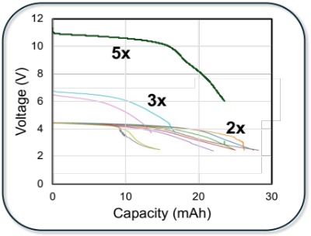
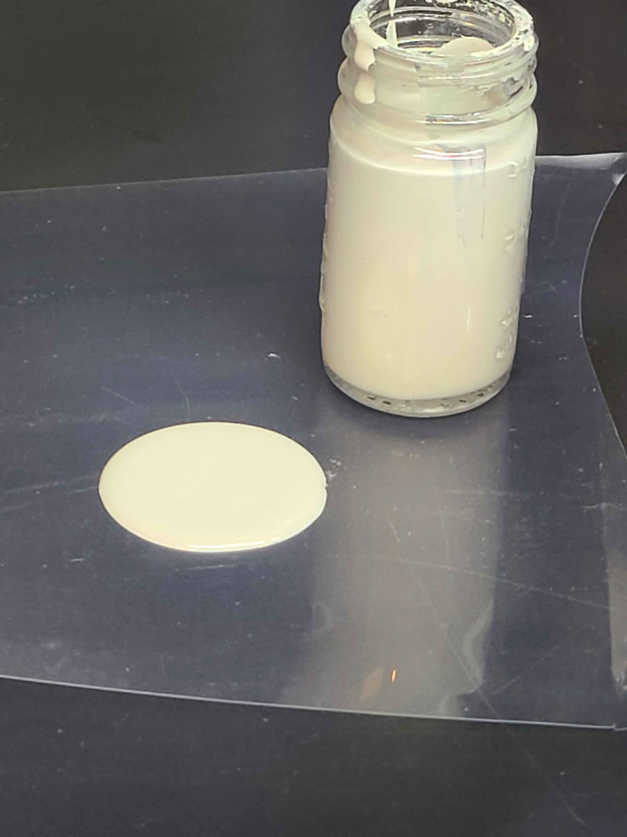
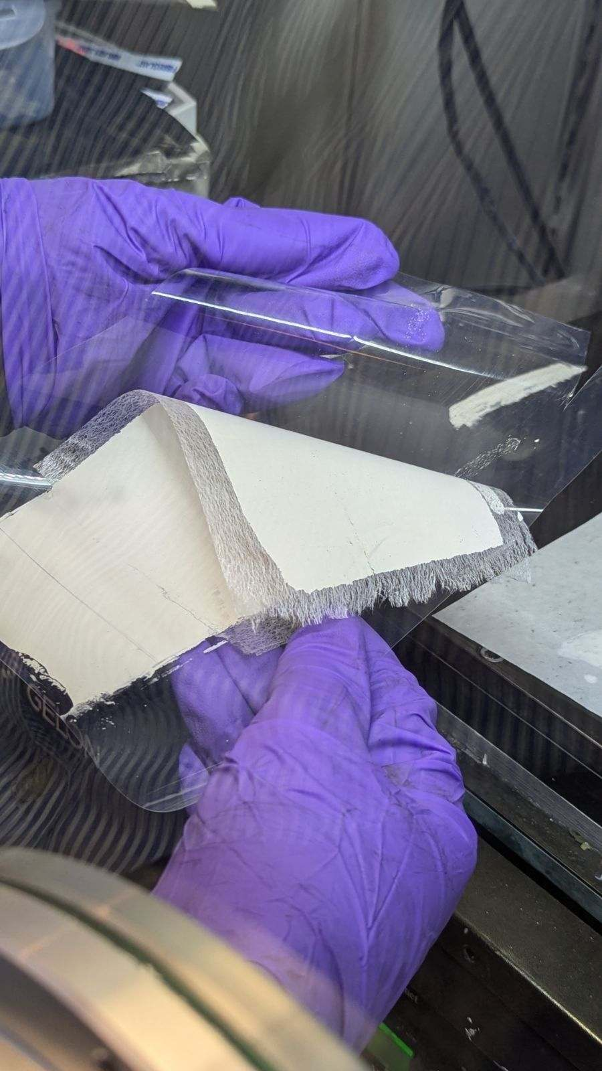
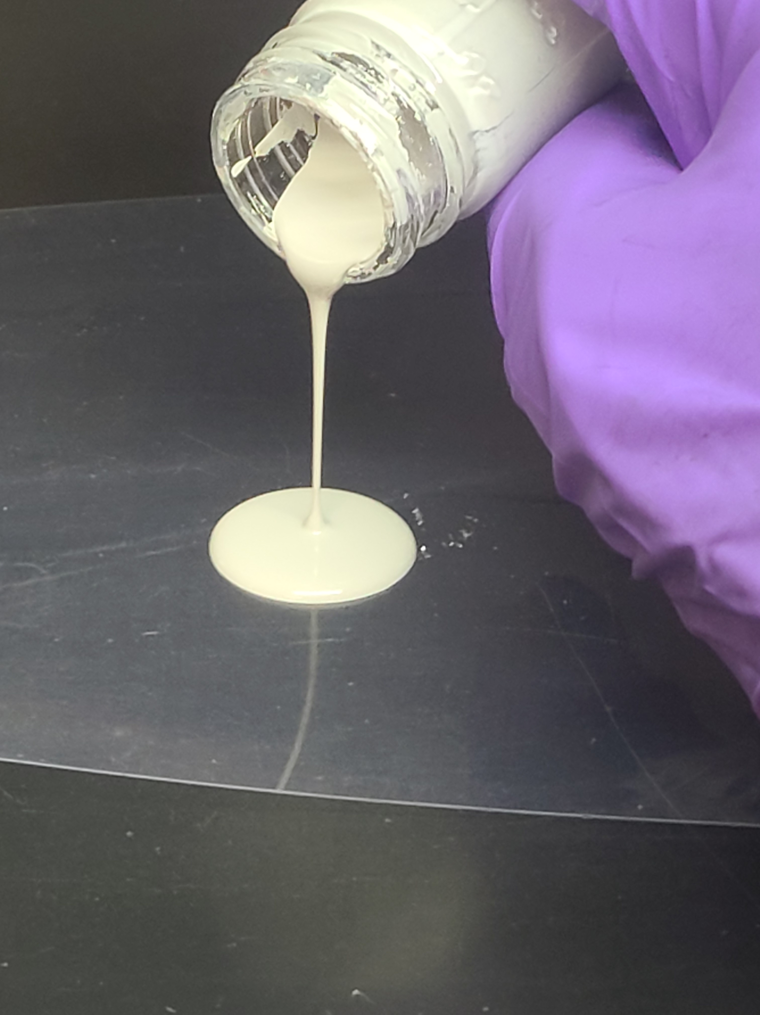
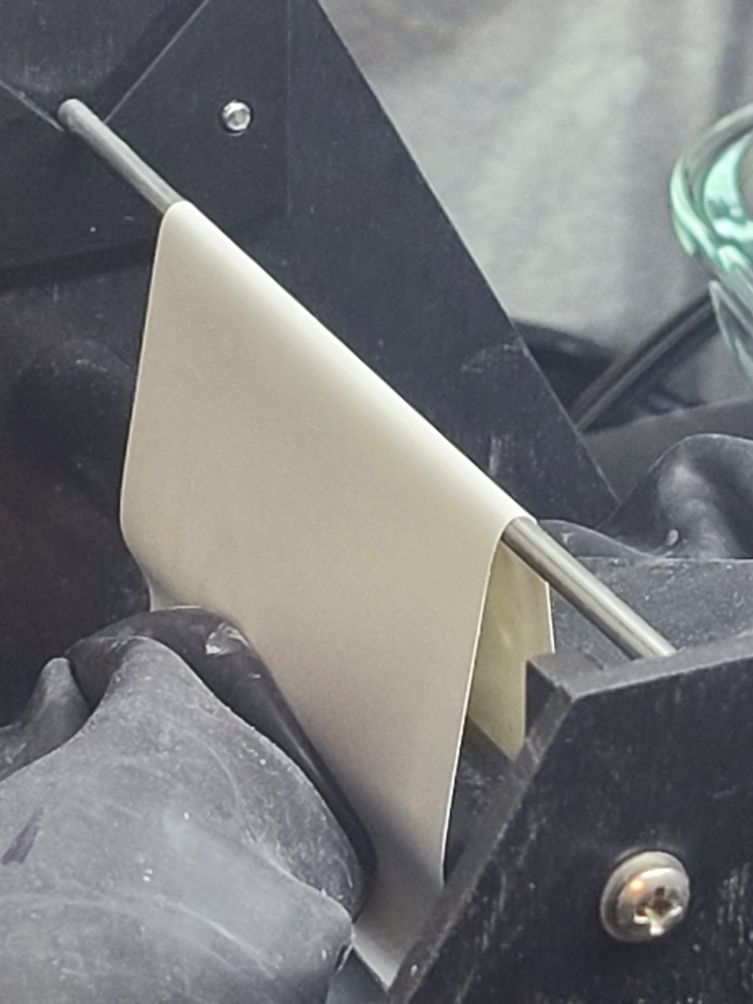
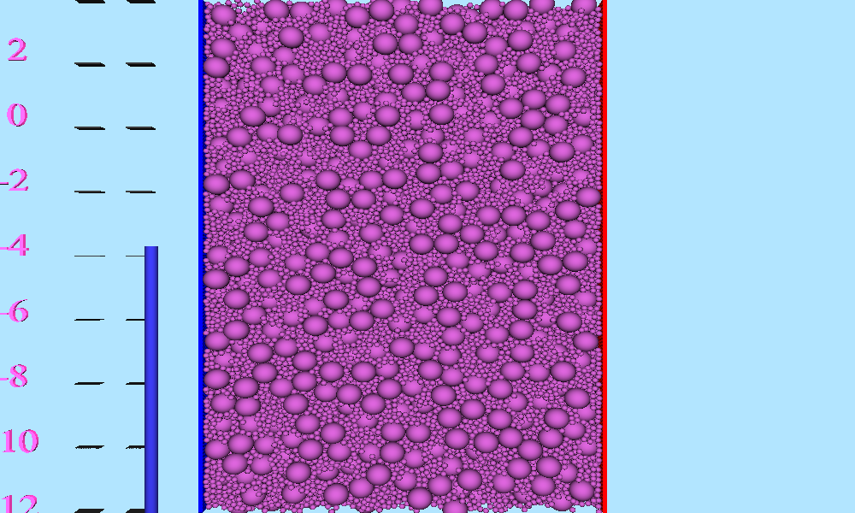
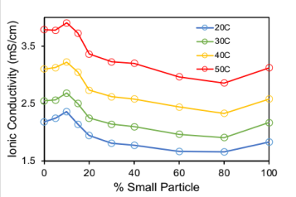
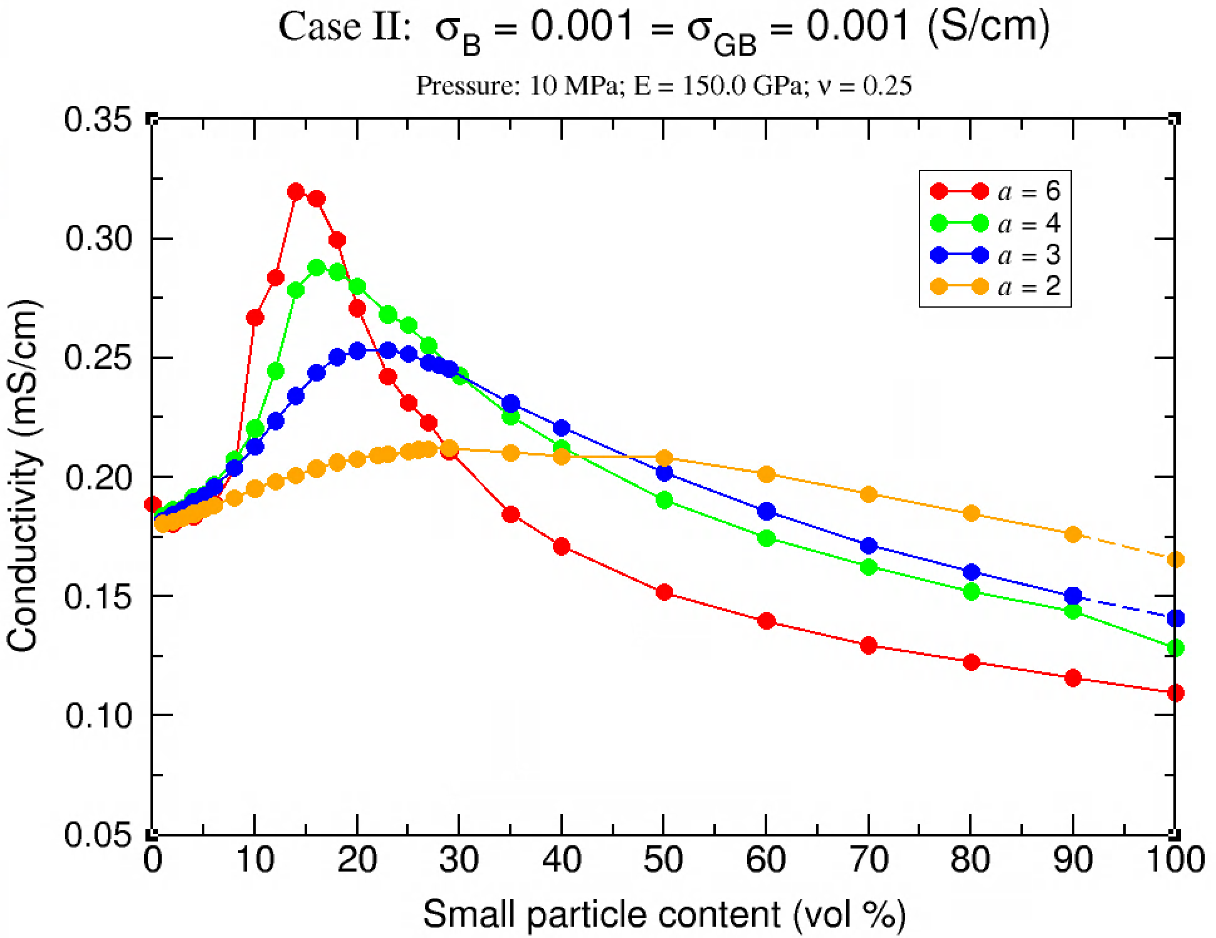
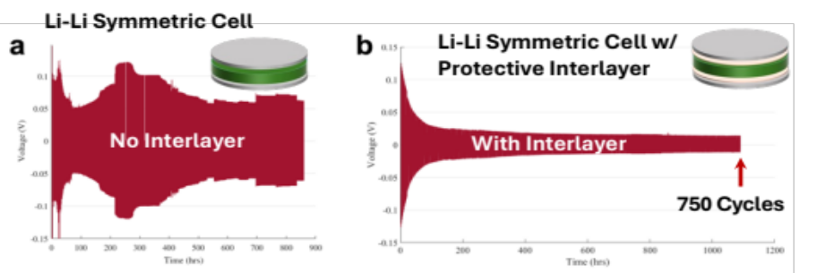
Aviation Battery R&D
Solid State Energy Storage Research
Advanced, high performance chemistries to extend range and overall system performance
Bipolar Stacks
  Bipolar stack architecture allows convenient packaging with potentially improved energy density and power of solid-state batteries
Scalable Processing Techniques
  Reinforced, flexible, lightweight films for improved manufacturability and energy/power
Particle Dynamics Model
  Integrated particle dynamics model informs experimental design towards accurate performance prediction
Improving Cyclability
  Li metal anode engineering is key toward highly cyclable solid-state batteries
Simulation
Experiment
Example: Bimodal Solid Electrolyte Ionic Conductivity
Notes:
Chart Guidance & Items to Consider
Alternative format to describe compelling deliverables (completed example on next chart)
Follow descriptions on the chart for guidance
Results section can include numbers or short statements (can be made into bullets if necessary for type of content)
You can include existing charts with additional technical details/context in a back-up section for reference.

Slide 10
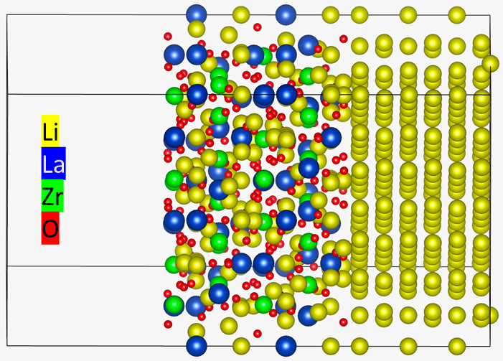
Aviation Battery R&D
Atomistic model of solid electrolyte (left)-lithium anode (right) interface. Interfacial stability is crucial for battery material design.
Solid State Energy Storage Research
Improved Prediction Methods for Solid-State Battery Interfacial Stability
Problem Statement: Establishing a computational approach to accurately predict electrochemical stability of interfaces is key to rapid designing of next-generation of all-solid-state Li-battery configurations. The state-of-the-art (SOA) method (vacuum-slab model) is less than reliable.
Goal: Benchmark a new computational approach on well-known, stable battery interface of Li and LLZO, an emerging solid-state electrolyte.
Approach: Generate low-energy LLZO structures, generate an ensemble of Li-LLZO interfacial structures, and ensemble-average electronic energy level alignment to predict stability and its margins.
Current Accomplishments:
  Demonstration of capability to rapidly generate low-energy structures and low-energy interfaces.
  Demonstration of more reliable stability prediction of Li-LLZO.
  Manuscript nearing submission
Significance:
  The new approach will more accurately predict interfacial stability.
  The new insights will guide toward battery designs
 | High Fidelity (this work) | SOA
LLZO stability vs Li | 1.5 eV | 0.3 eV
Cathode voltage allowed | 4.9 eV | 6.1 eV
Comparison of methods (high fidelity vs SOA) shows significant differences which highlights the need for more accurate and more efficient methods for computational design of battery materials.
Notes:
Chart Guidance & Items to Consider
Alternative format to describe compelling deliverables (completed example on next chart)
Follow descriptions on the chart for guidance
Results section can include numbers or short statements (can be made into bullets if necessary for type of content)
You can include existing charts with additional technical details/context in a back-up section for reference.

Slide 11
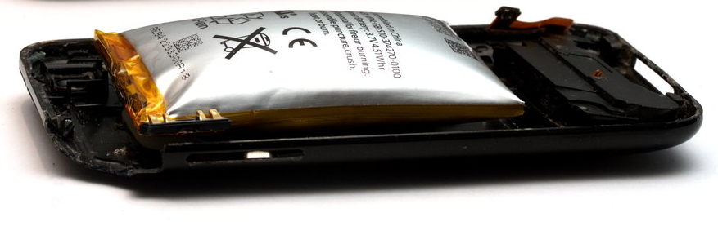
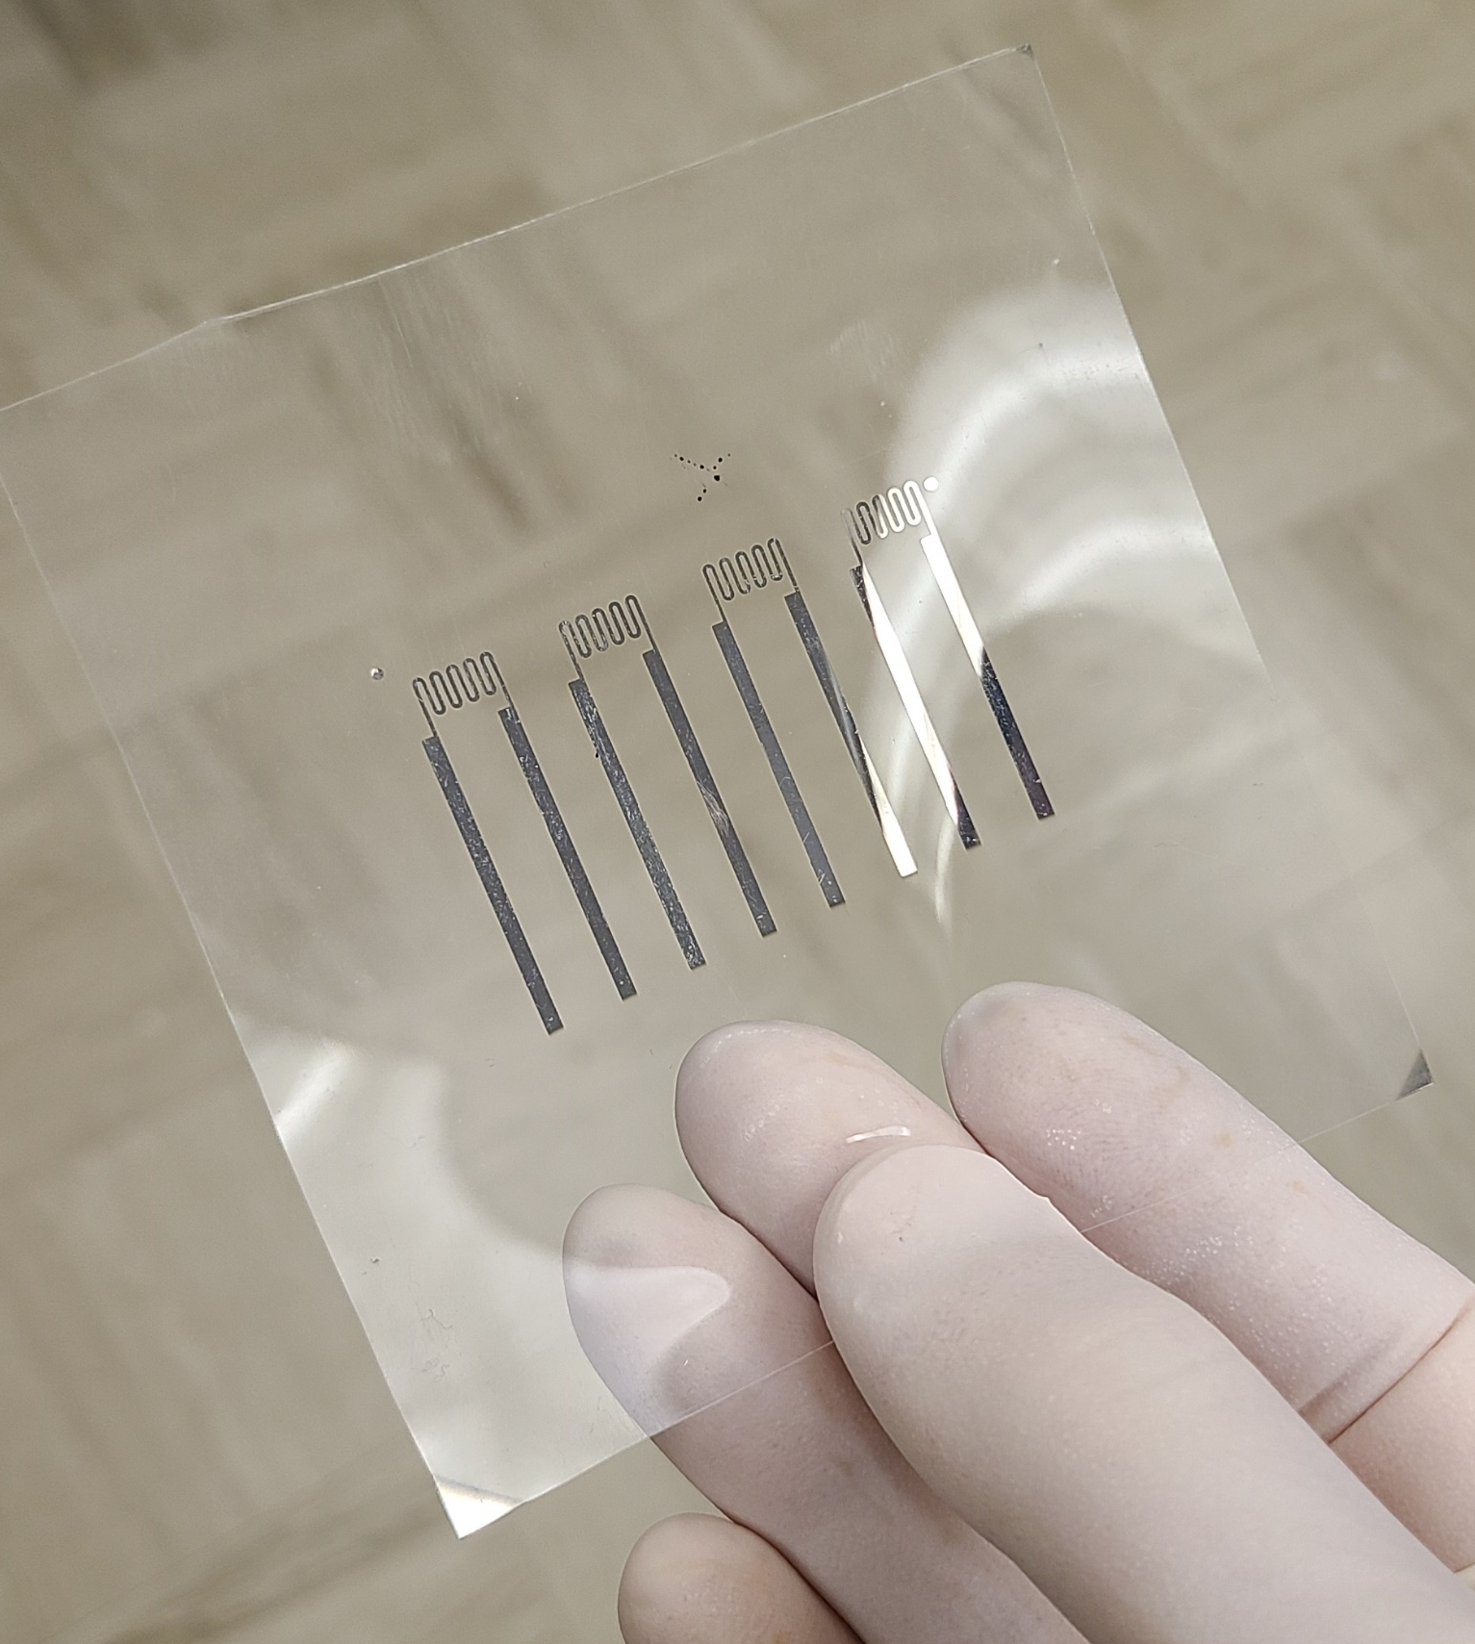
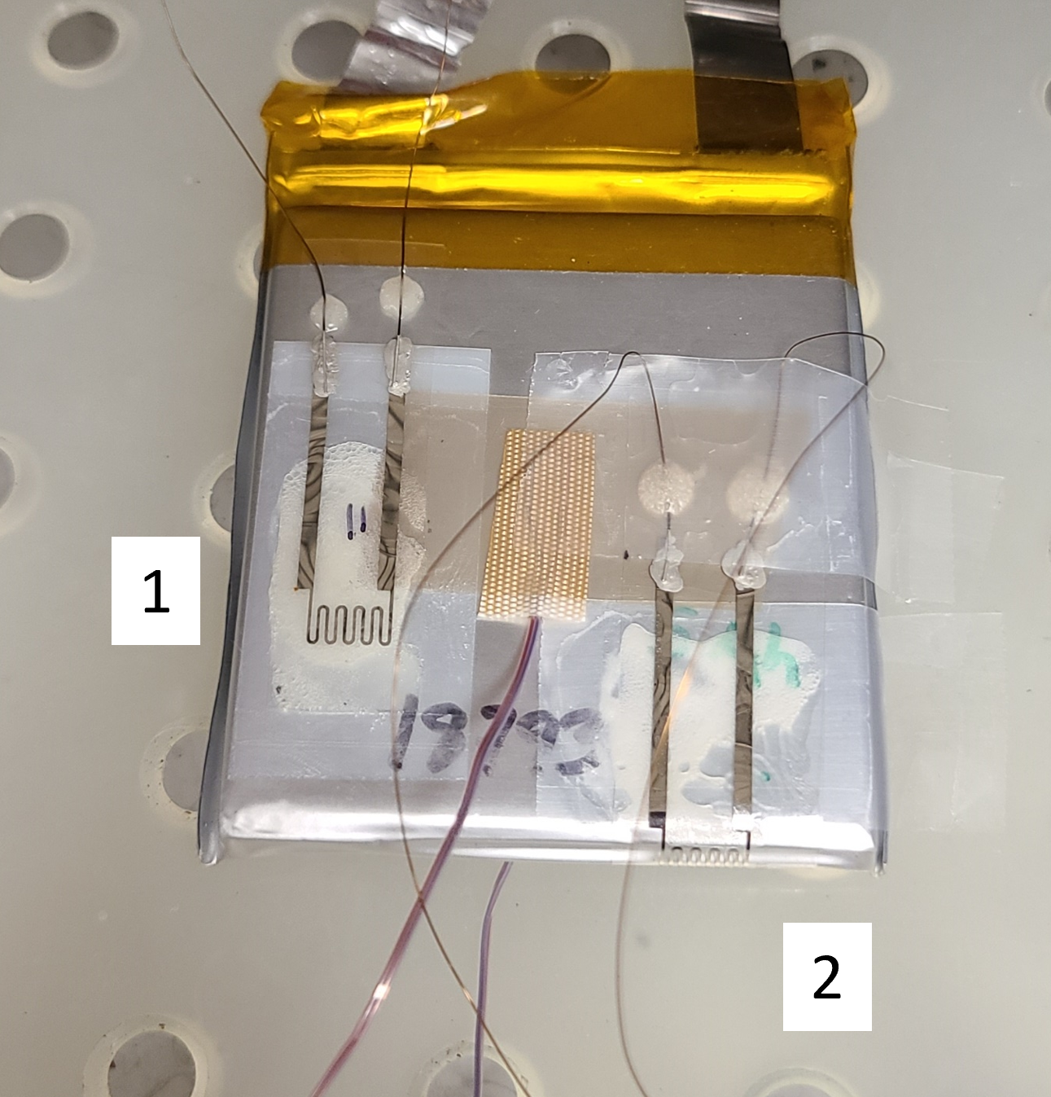
Aviation Battery R&D
Development of embedded sensors and prognostics to detect failures
Volumetric/Strain Sensor
Problem Statement: Li-ion cells undergo non-negligible volumetric changes during cycling. Anode swells during intercalation, ranging from ~3-300% depending on material. Monitoring volumetric changes over lifetime adds a useful variable in predicting cell state of health and lifetime prognosis.
Goal: Develop a custom designed sensor we can adhere to any off-the-shelf battery cell, pack, or module, to prognose state of health and any anomalous aging behavior, to avoid any potential catastrophic events.
Approach: Thin film sensors deposited directly onto pouch cell material as well as on patch material to be applied various battery module locations
Current Accomplishments:
  Initial testing of a battery cell with an advanced strain sensor attached to assess expansion and contraction of the cell.
  Longevity flexile testing of sensor design and substrate
BEAST (Battery Enclosures for Advanced Safety and Thermal) continues rapid, iterative experimentation.
Notes:
Chart Guidance & Items to Consider
Alternative format to describe compelling deliverables (completed example on next chart)
Follow descriptions on the chart for guidance
Results section can include numbers or short statements (can be made into bullets if necessary for type of content)
You can include existing charts with additional technical details/context in a back-up section for reference.

Slide 12
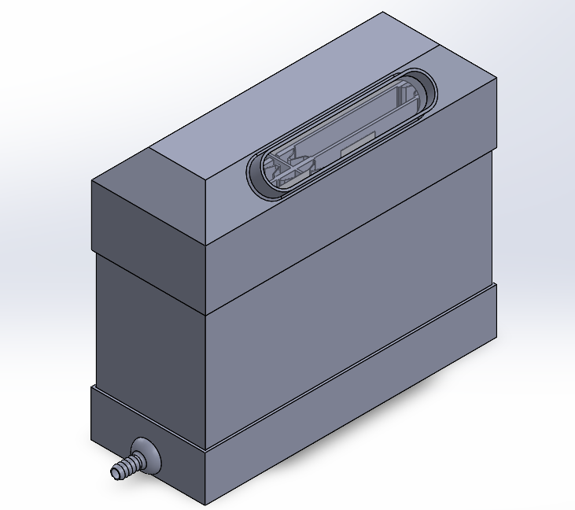
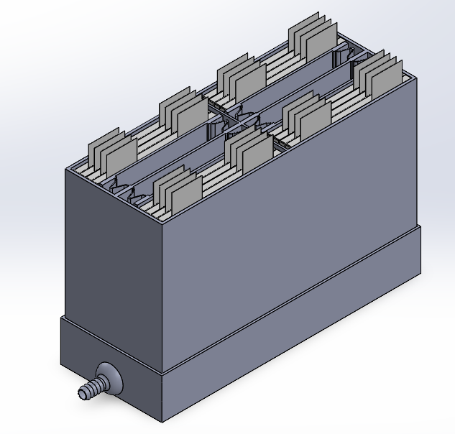
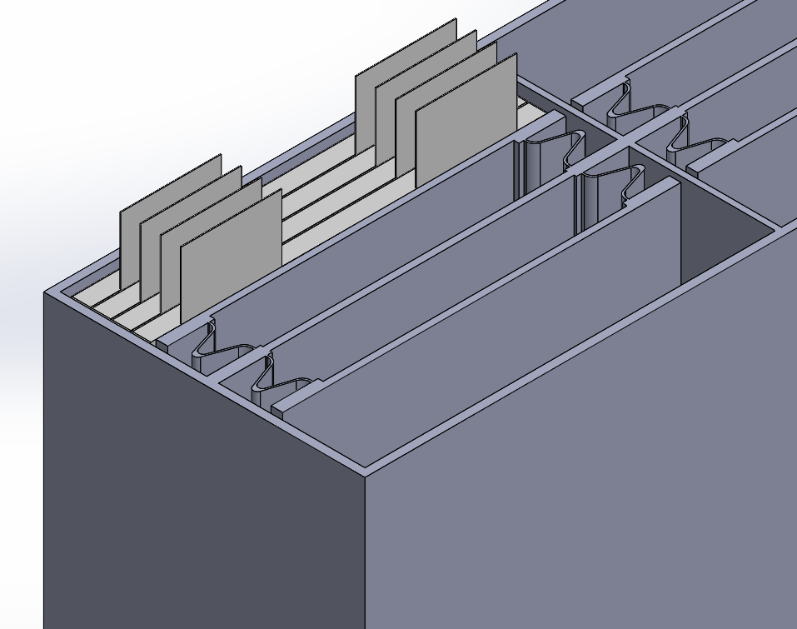
Aviation Battery R&D
Development of advanced thermal management materials and lightweight, strong packaging concepts
BEAST (Battery Enclosures for Advanced Safety and Thermal)
Design approach incorporates a passive/active thermal control approach. Passive materials will be used to move the thermal waste heat away from the cells into a cooling reservoir (shown at the bottom) where coolant can be actively circulated to remove the waste heat and transfer it to the vehicle thermal system.
Battery pouch cells generally require some level of compression to achieve optimum performance. A potential approach to provide consistent compression relies on compliant mechanisms to apply compression without the need for plates or screws (shown to the right of the top of the cells). This approach may also have the ability to move with the cells as they expand and contract with cycling, providing a consistent level of compression.
Compliant Mechanisms
Evolution of battery packaging concepts
Notes:
Chart Guidance & Items to Consider
Alternative format to describe compelling deliverables (completed example on next chart)
Follow descriptions on the chart for guidance
Results section can include numbers or short statements (can be made into bullets if necessary for type of content)
You can include existing charts with additional technical details/context in a back-up section for reference.

Slide 13
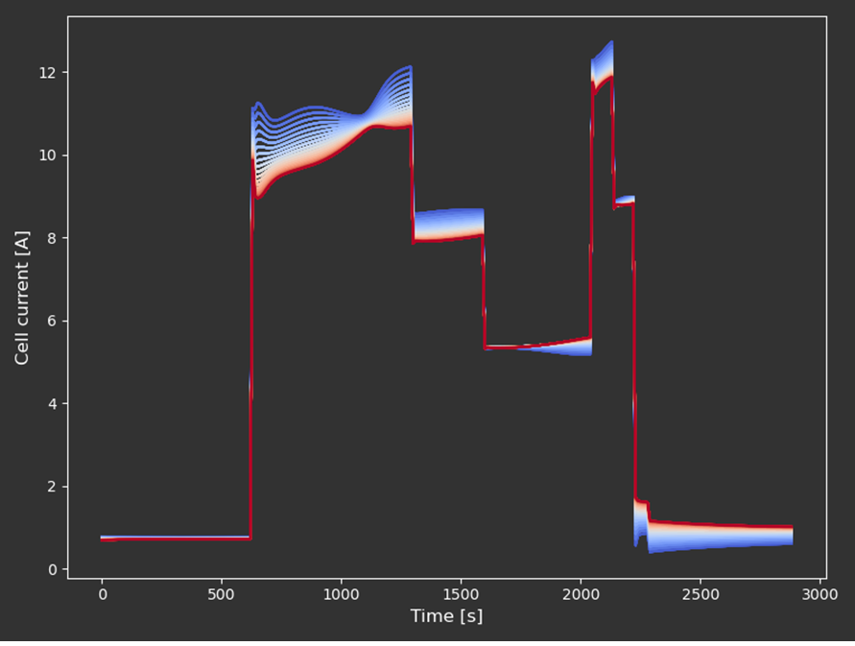
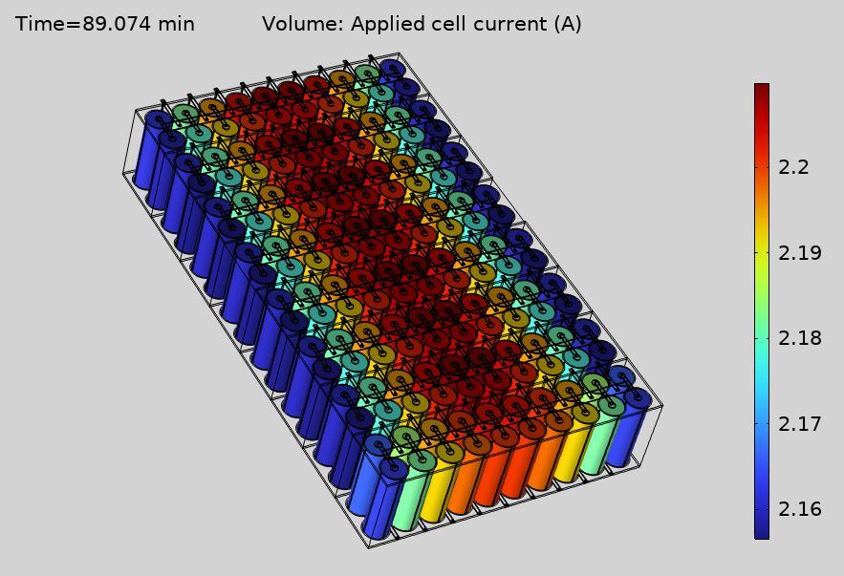
Aviation Battery R&D
Development of advanced thermal management materials and lightweight, strong packaging concepts
Simulated in PyBaMM
High-fidelity simulations for the design and safety of battery packs
Problem Statement: The effect of cell current variability on battery safety in a battery pack with many parallel cells
Goal: Identify the threshold on the number of parallel cells or current sensors for the safe operation of a battery pack upon aging
Approach: Simulate the X-57 battery pack, which has a brick with 20 cells in parallel; such 128 bricks are connected in series to form a pack.
Current Accomplishments:
  Tested 1D electrochemical model with 180 cells in PyBaMMwith the X-57 flight profile
  PyBaMM shows most of the variability comes from contacts and welds
  Similarly, a COMSOL model with 3D cells to simulate thermal response and a 0D lumped electrochemical model
Significance: Current battery designs for aircraft have several cells in parallel, and their currents are not monitored; thus, state-of-safety cannot be monitored.
160 cells in parallel
Current variability
Simulated in COMSOL
Notes:
Chart Guidance & Items to Consider
Alternative format to describe compelling deliverables (completed example on next chart)
Follow descriptions on the chart for guidance
Results section can include numbers or short statements (can be made into bullets if necessary for type of content)
You can include existing charts with additional technical details/context in a back-up section for reference.

Slide 14
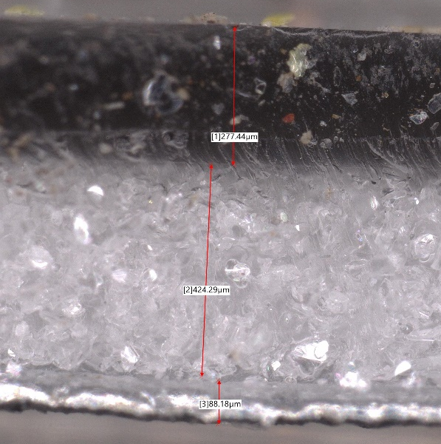
Aviation Battery R&D
Development of advanced thermal management materials and lightweight, strong packaging concepts
Hexagonal Boron Nitride (hBN) as a Potential Heat Transfer Solution for Batteries
hBN may enable the efficient removal of battery waste heat out of the battery module but not transmit the heat from cell to cell
Use a high temperature polymer to help maintain layer integrity for longer time in a thermal runaway situation.
Create a gradient of high loading of hBN to just polymer.
Use the advantage of hBN directional settling that will preferentially transfer heat in one direction
The team has successfully deposited onto battery pouch cell material
Hexagonal Boron Nitride (hBN)
Good Electrical Insulation Properties
Good Mechanical Strength and Rigidity
Low Density
High Thermal Conductivity
Stability
  Chemically stable, oxidation in air above 1000 °C, and hydrophobic
Polymer
h-BN, 2-D
In-plane
TC > 100 W/(m∙K)
20% hBN in Polymer
Through-plane
TC ~ 30 W/(m∙K)
Pouch Material
Modeling is being explored to help identify the best gradient and polymer for this challenge.
Notes:
Chart Guidance & Items to Consider
Alternative format to describe compelling deliverables (completed example on next chart)
Follow descriptions on the chart for guidance
Results section can include numbers or short statements (can be made into bullets if necessary for type of content)
You can include existing charts with additional technical details/context in a back-up section for reference.

Slide 15

THANK YOU!
azlin.biaggi@nasa.gov

