Slide 1
AAS-25-152
Cumulative Distribution Overlap Technique for Artemis Mission Public Entry Risk Assessment
HUMAN EXPLORATION & OPERATIONS
MISSION DIRECTORATE
Greg Holt
Mark McPherson
Brandon Wood
NASA Johnson Space Center
47th Annual AAS Guidance, Navigation and Control Conference Feb 1-5, 2025

Slide 2
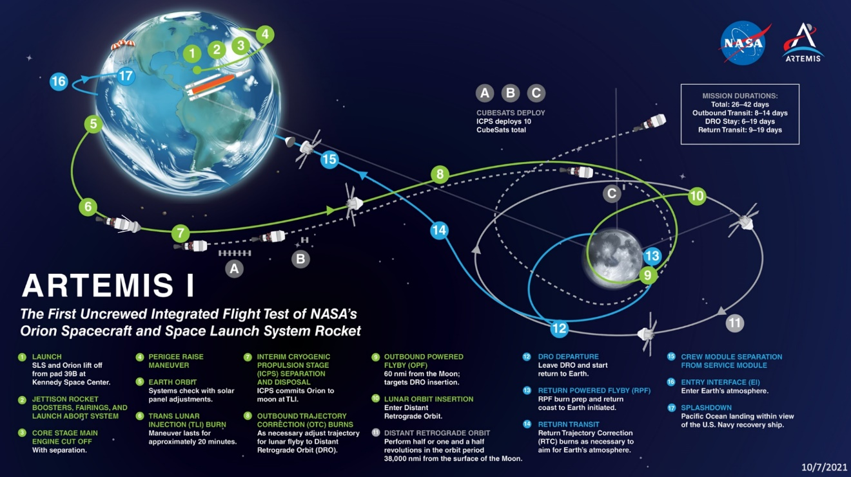
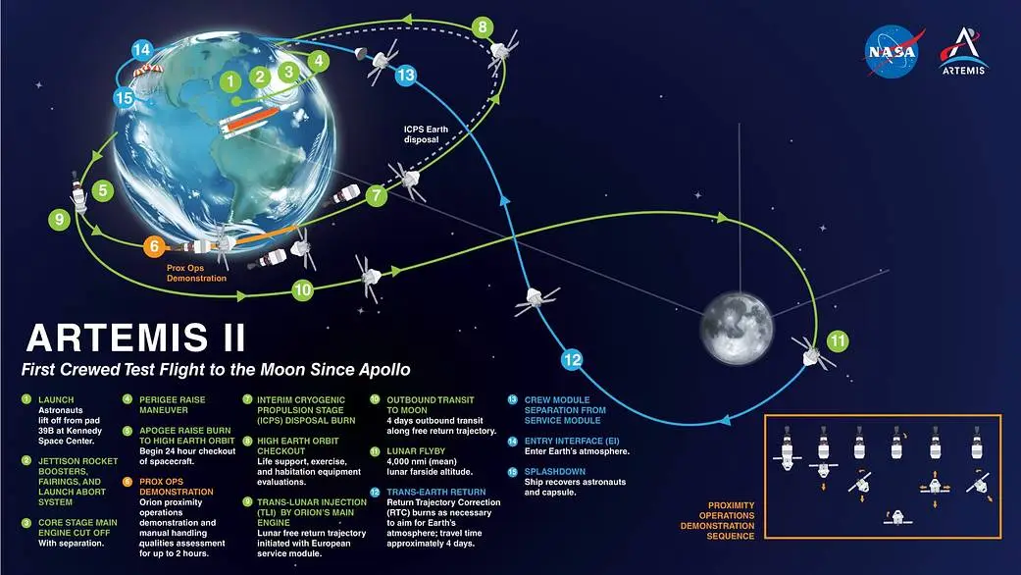
Artemis Mission Overviews

Slide 3
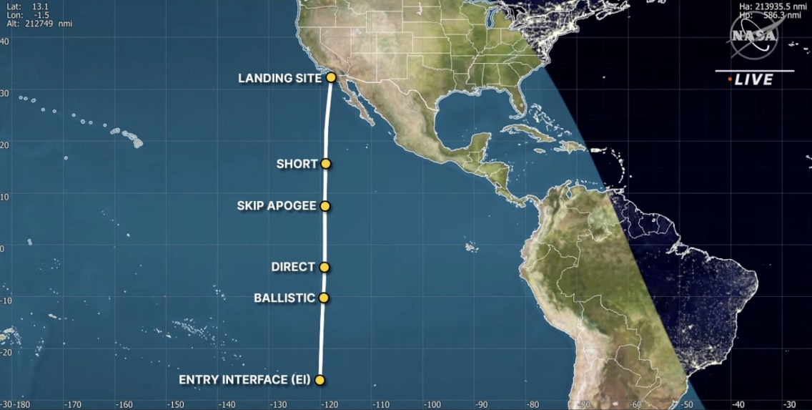
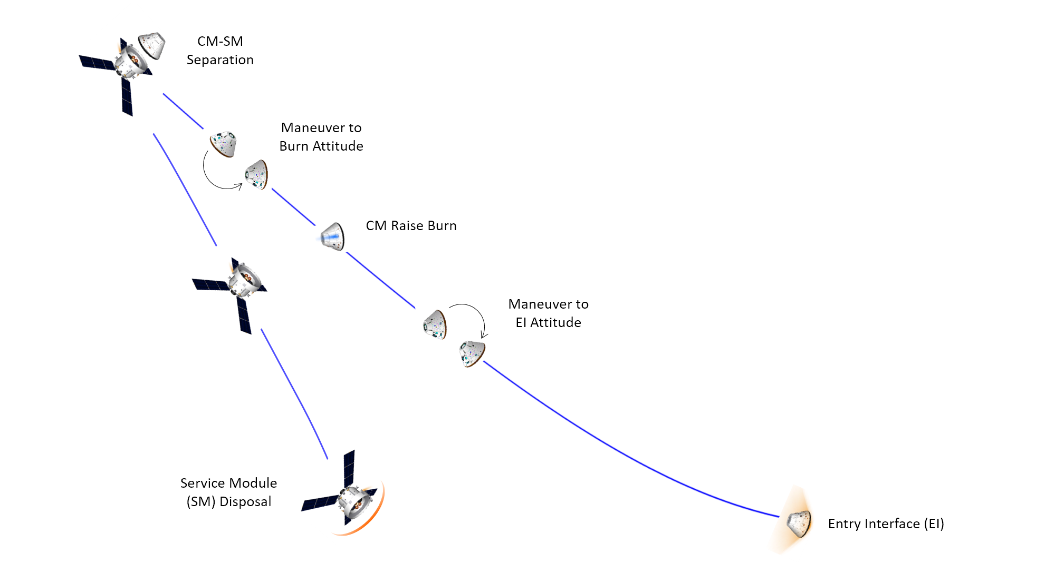
Artemis Entry Corridor – where does the Service Module go? Don’t overshoot!
Courtesy: NASA TV
Flight Path Angle too
Shallow: Land Long
Flight Path Angle too
Steep: Land Short

Slide 4
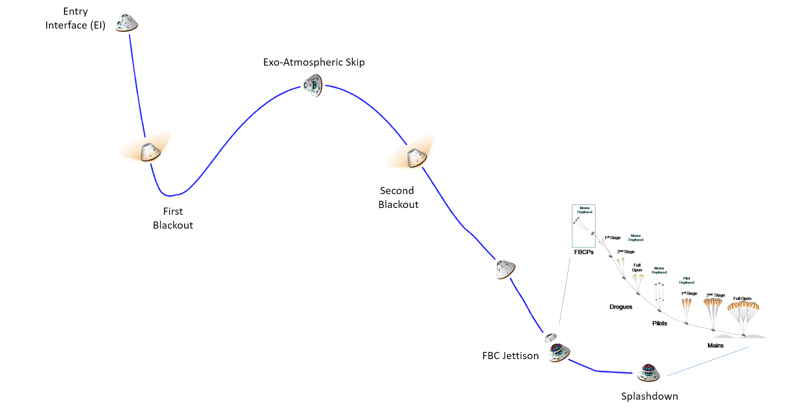
Entry, Descent, and Landing

Slide 5
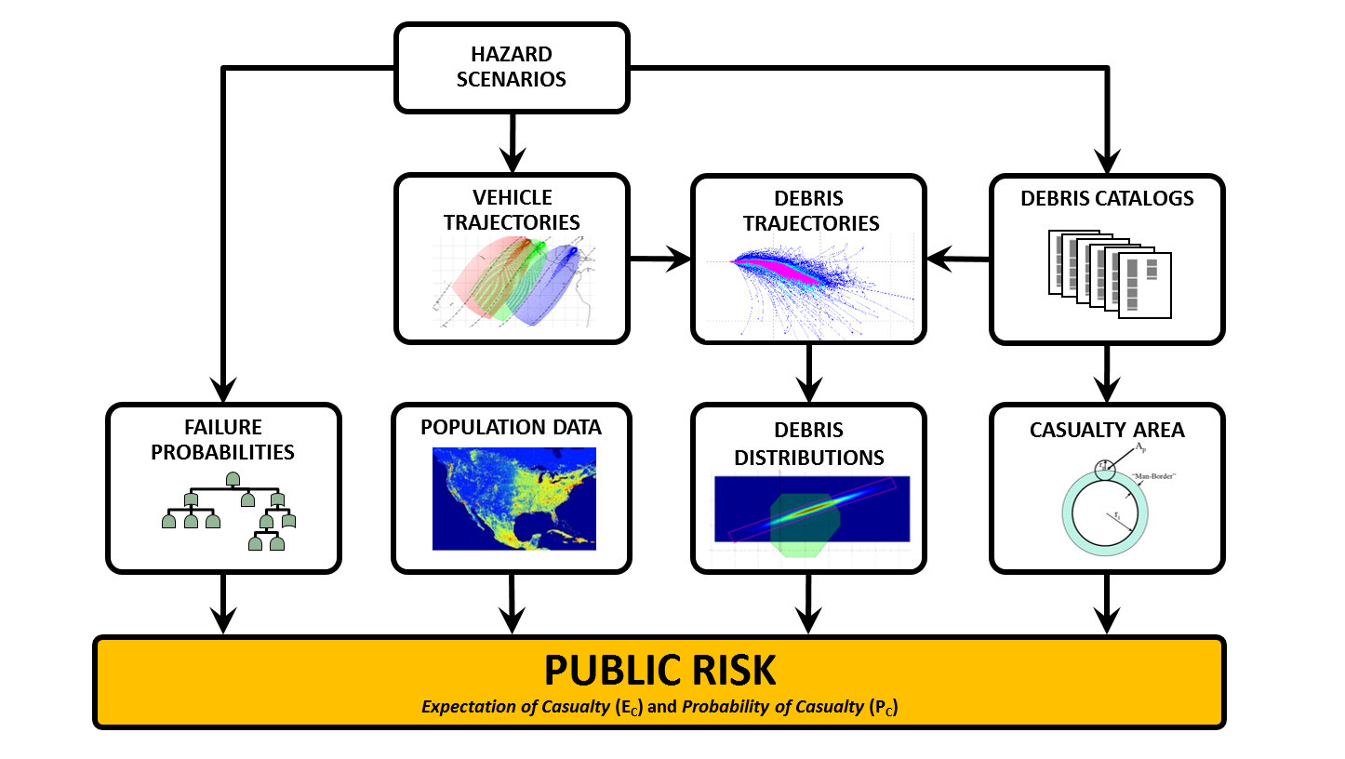
Public Entry Risk Assessment
(PERA) Process

Slide 6
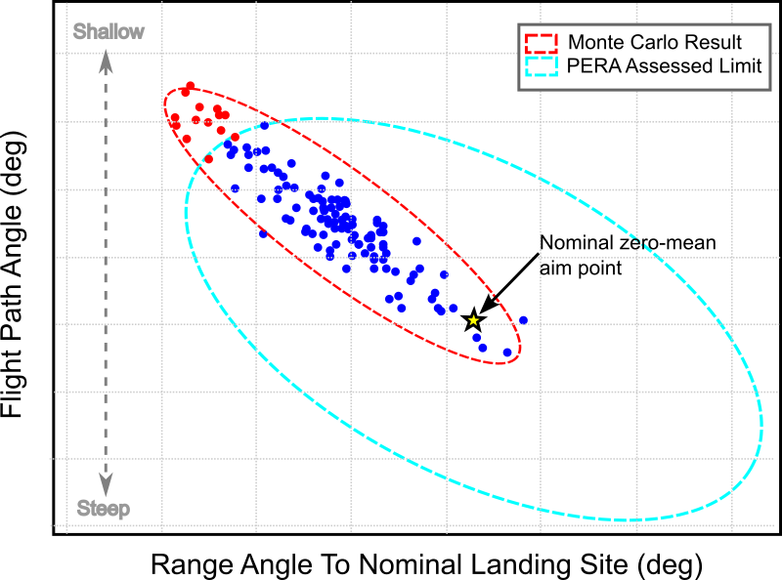
Entry Corridor Ellipses

Slide 7
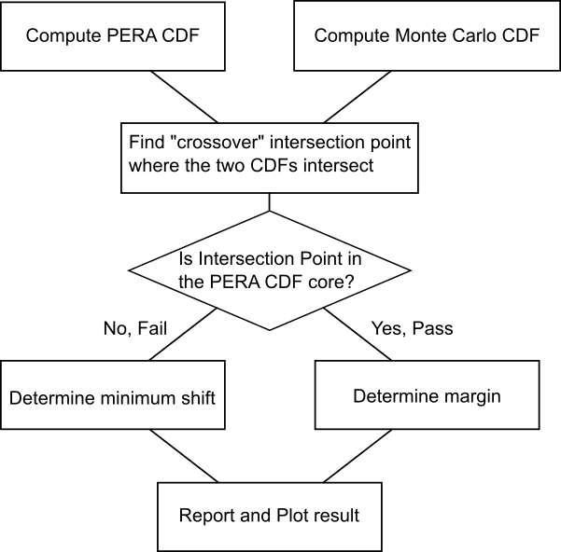
Flowchart

Slide 8
Cumulative Distribution Function
Shallow
Flight Path Angle (deg)
Steep

Slide 9
Failing

Slide 10
Passing

Slide 11
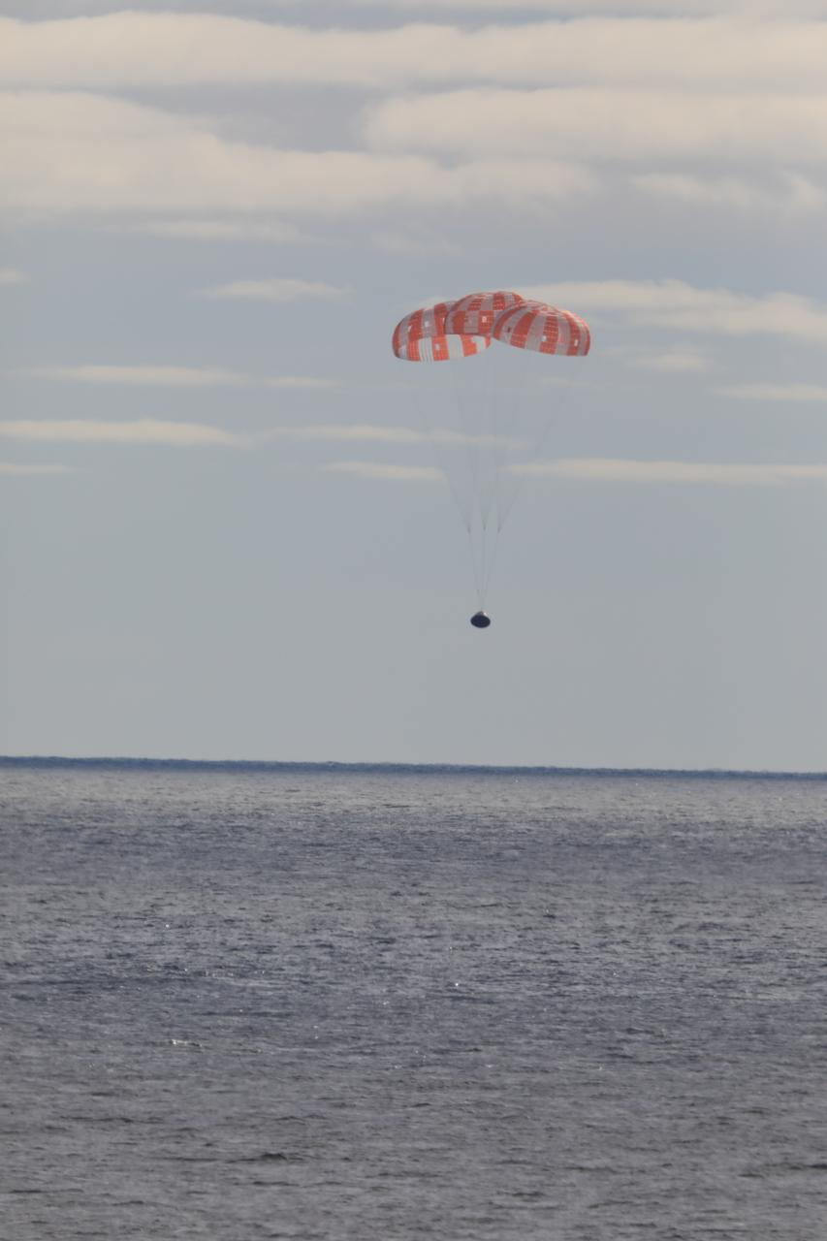
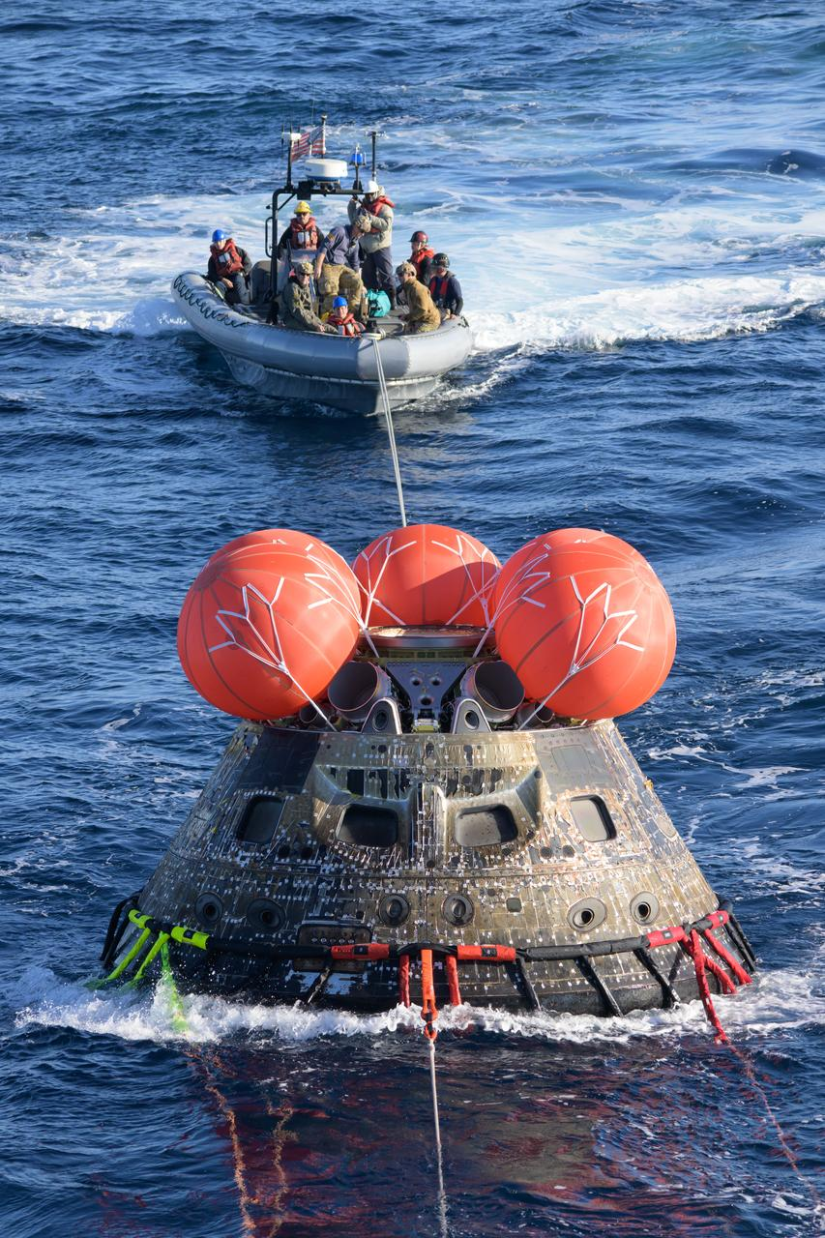
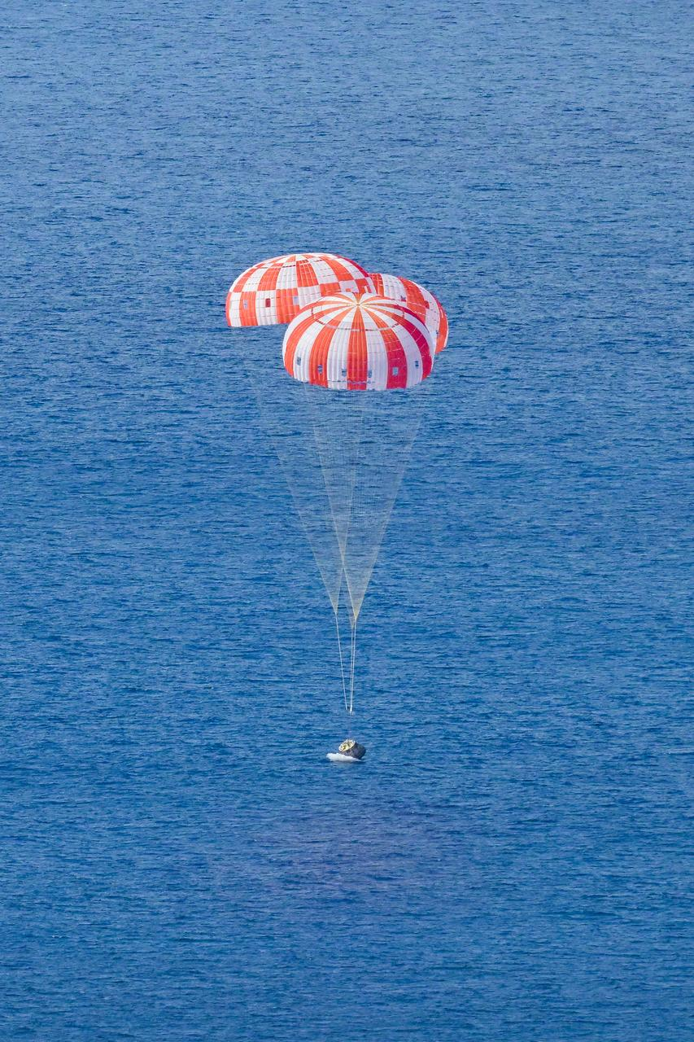
Splashdown

Slide 12
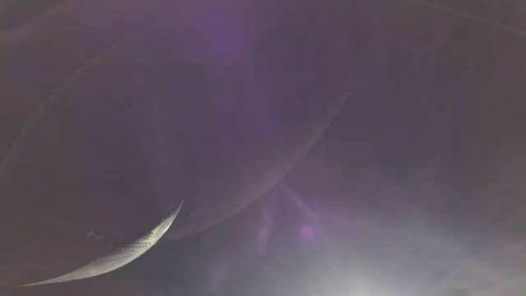
Questions

