Slide 1
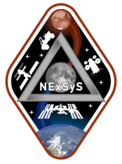
Using Distributed Simulation Capabilities To Support
Studies and Mission Operations for NASA Artemis
Program
Presenter: Keaton Dodd
5 March 2025
Presentation to the IEEE Conference, Big Sky, MT 2025
Keaton Dodd, CACI International, USA
Paige Whittington, NASA Johnson Space Center, USA
Edwin Z. {Zack} Crues, Ph.D., NASA Johnson Space Center, USA
James Gentile, NASA Johnson Space Center, USA
Nicolas Trevino, CACI International, USA

Slide 2
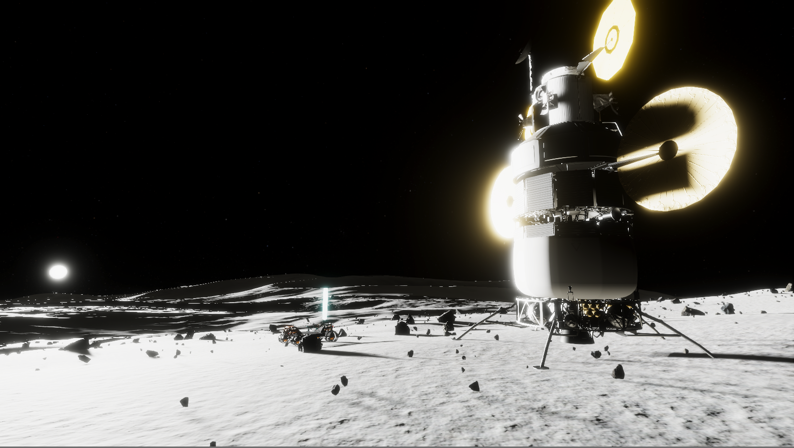
Overview
Introduction
Terminology
Federated Architecture
Federation Setup
Facilities
Visualization and Results
Studies and Products
Future Work
Conclusion
Credit: NASA

Slide 3
Introduction
The Artemis Distributed Simulation is a federated simulation infrastructure that allows data transfer, communications, and time synchronization between multiple simulations
  Current capability involves stand-in government reference design simulation and vehicles
  Designed to allow vender simulations to be connected in place of current simulations
Designed to simulate end-to-end missions, support studies, and assist in timeline verifications
  Can be autonomously controlled and run in a monte carlo style execution for extended studies
  Able to have human control over large elements to enhance realism in studies
Customizable federation and “plug-and-play” style simulation inclusion
  Simulations can be added or removed with minimal additional work needed
  Users can specify elements, objects, interactions necessary for the mission

Slide 4
Terminology
ADS | Artemis Distributed Simulation
SpaceFOM | Space Reference Federation Object Model
HLA | High Level Architecture
TrickHLA | High Level Architecture Implementation for Trick Base Simulation
PR | Pressurized Rover
UPR | Un-Pressurized Rover
HLS | Human Landing System
EVA | Extravehicular Activity
COMM | Communications
MCC | Simulated Mission Control Center

Slide 5
Federated Architecture
HLA and SpaceFOM provide simulation interoperability and base data definitions for space domains
FOMs define objects and interactions between federates in the federation
  Each federate brings unique objects and interactions that can be interpreted by any SpaceFOM compliant federate
  All federates in federation must reference same version of FOM modules that contain the information of all other federates
Federate role identification is necessary for a SpaceFOM compliant federation
  Master: Manages federation execution
  Pacing: Regulates time advancements in federation
  RRFP: Root Reference Frame Publisher
MCC
(master, pacing)
PR
(RRFP)
FOM
Runtime Infrastructure - RTI
UPR
HAB
HLS
Data-Logger
Notes:
Talk more about FOMs

Slide 6
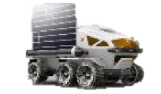
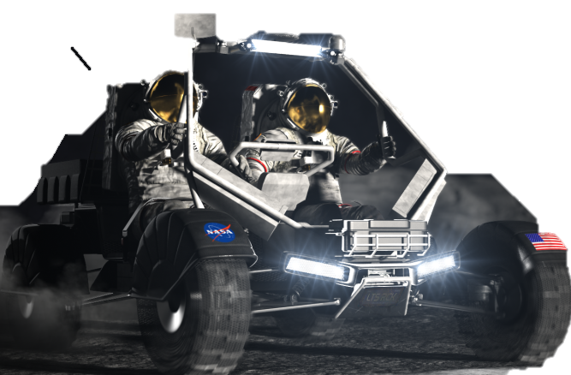

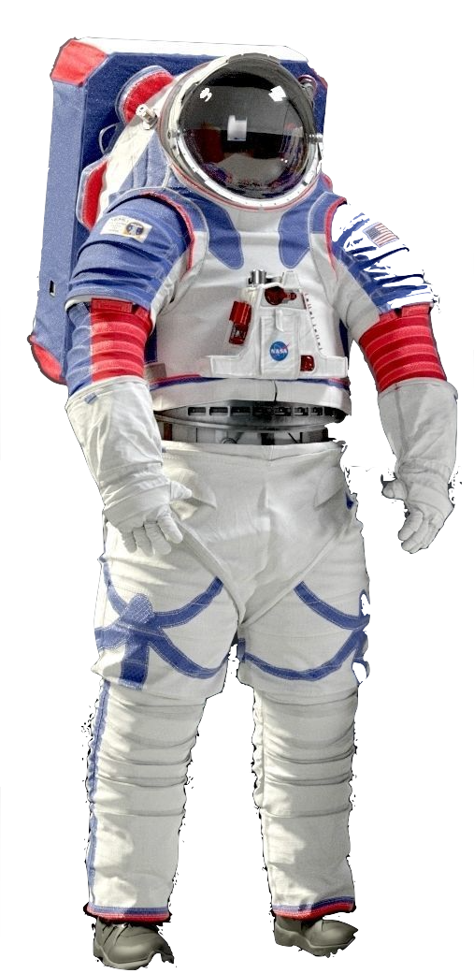




Federation Setup
PR
- Autonomous
- Human
(Video Wall)
UPR
- Autonomous
- Human
(Video Wall)
HLS
- Autonomous
- Human (SEAL)
ADS
EVA
- Human
(VR)
COMM
MCC
- Master
Data
Environment

Slide 7
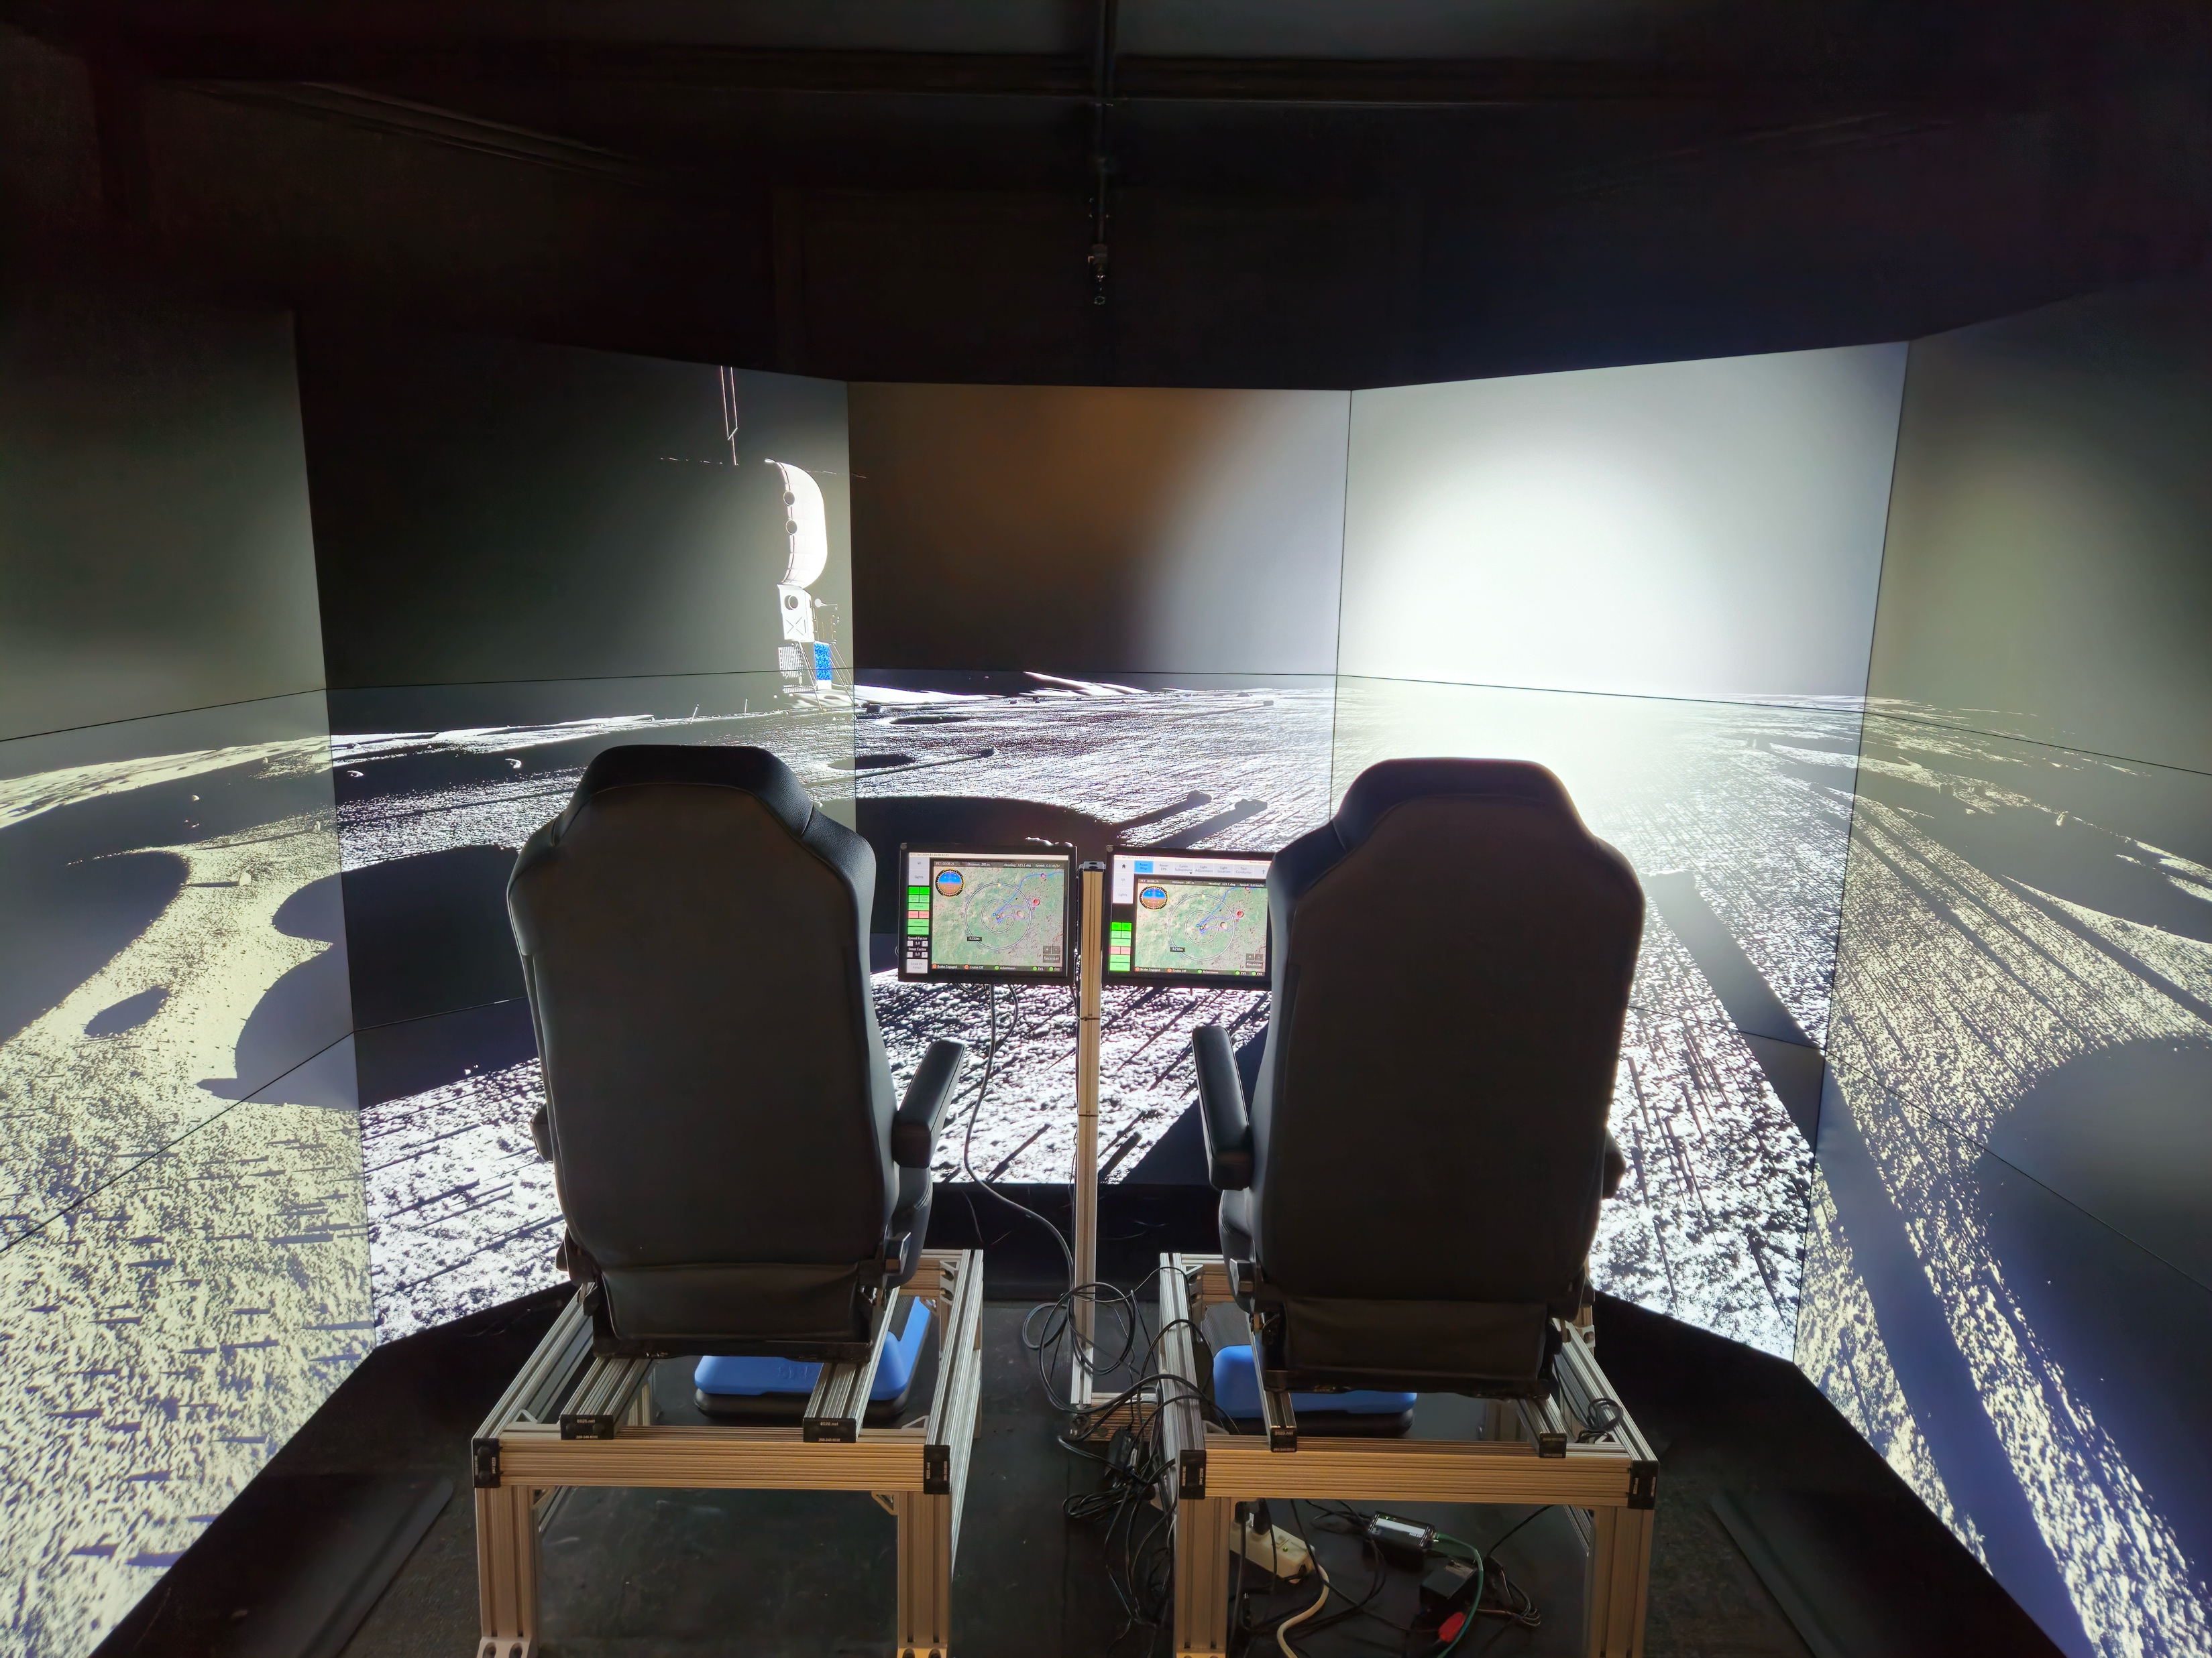
Facilities
Systems Engineering Simulator (SES)
  Video Wall
    Multi-screen array to simulate vehicle cockpit
    Used for rover simulations
  Concept Exploration Lab (CEL)
    MCC stand-in for element data tracking
    Remote operations capabilities
  Virtual Reality (VR)
    Simulated EVA environment using Unreal Engine 5 and the latest VR headsets
    Collect samples, complete task, etc.
Credit: NASA

Slide 8
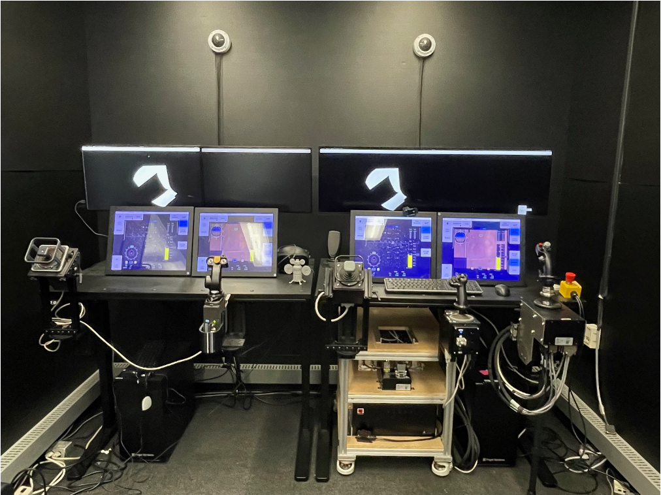
Facilities
Simulation Exploration and Analysis Lab (SEAL)
  Primarily used for HLS studies
  Includes two crew stations with touchscreen displays, multiple crew controls, and monitors used for out-the-window views
  Can support lunar rover remote operation studies
External Facilities
  Shared FOM and common RTI allow for external facility connections
  Remotely run federates connect to JSC Virtual Private Network (VPN) and can connect into ADS federation
Credit: NASA

Slide 9
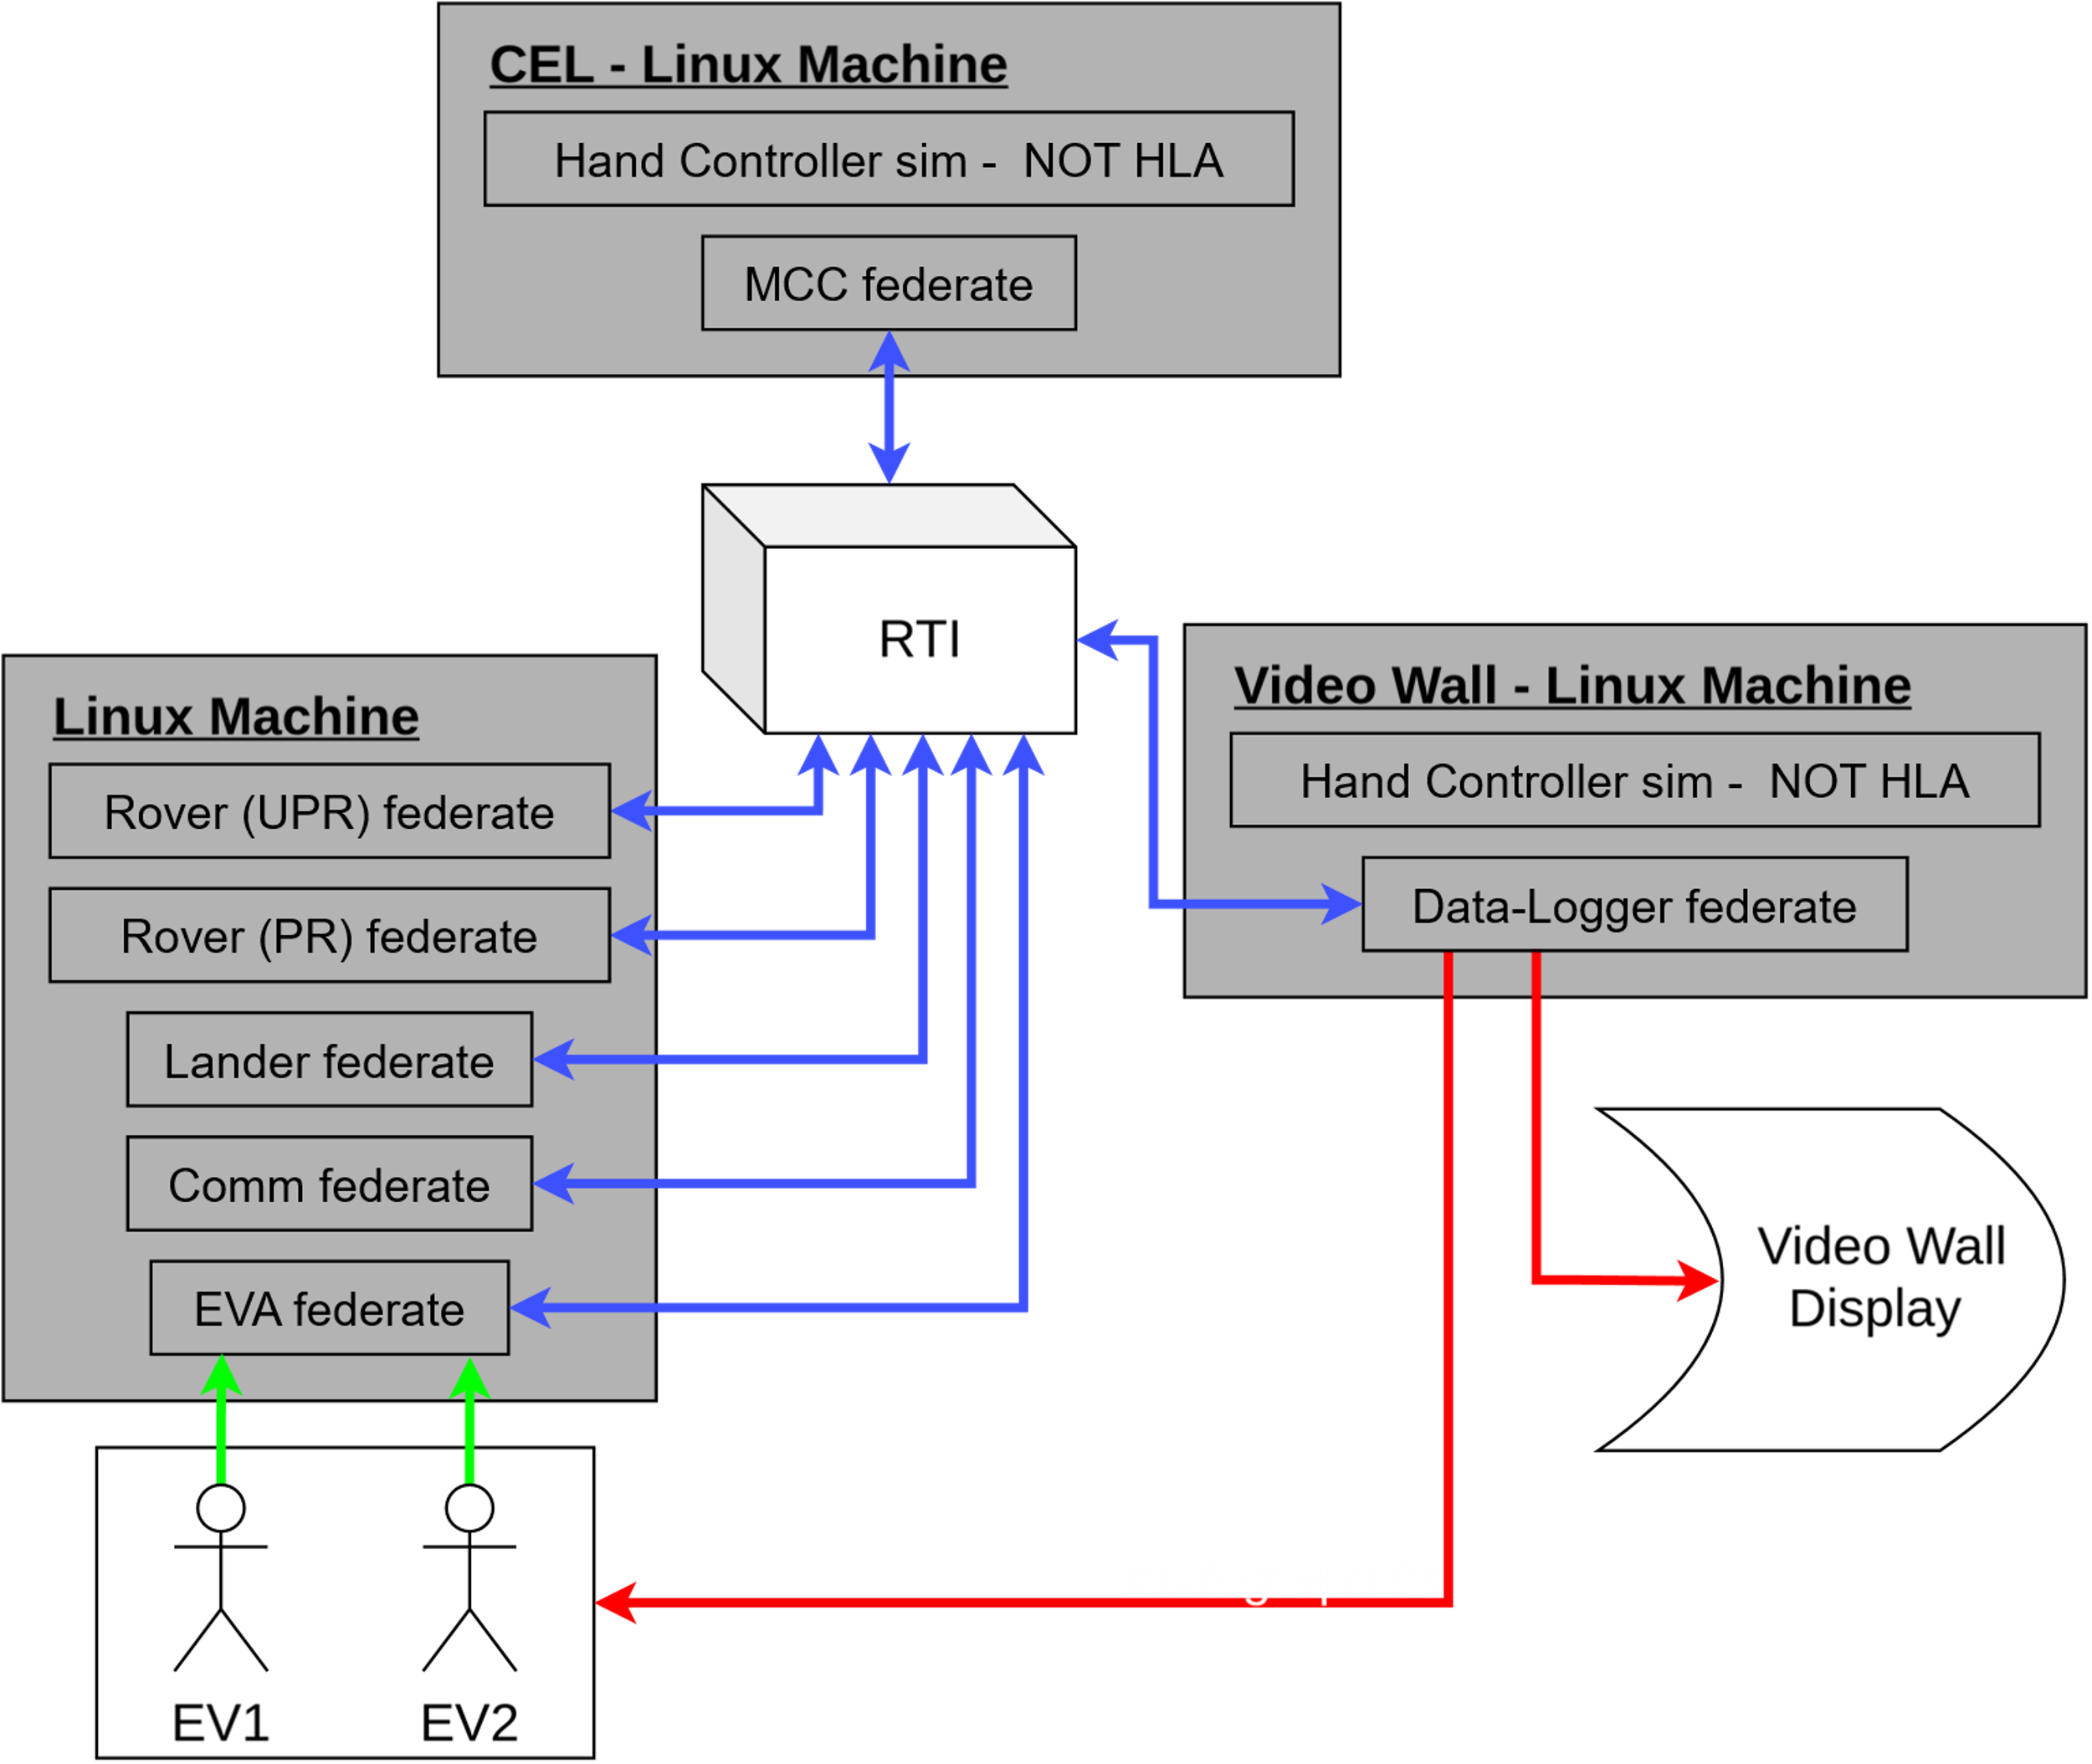
Facilities
Execution Coordination
  Mock MCC primary control of execution
  Starts MCC federate, sends command to start other federates
  Wait for federation connection, execute hand controller simulations for remote and normal driving
  Automatic connections to visuals (EV1, EV2, Video Wall Display)

Slide 10
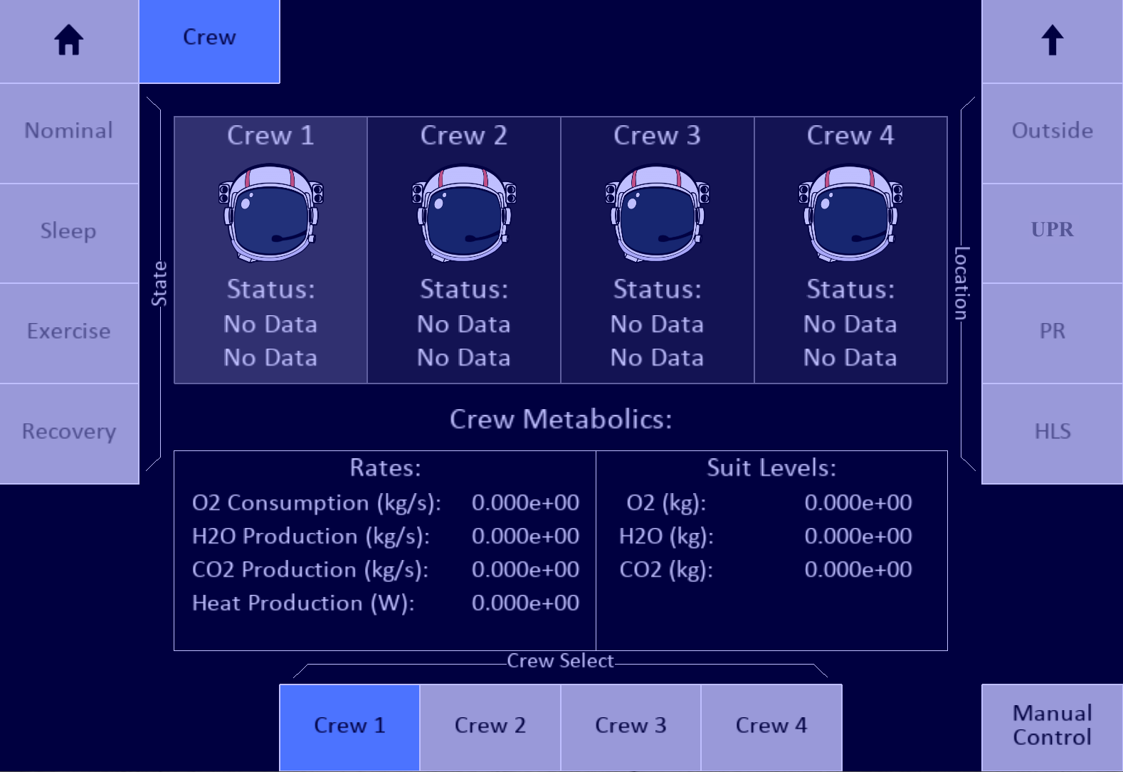
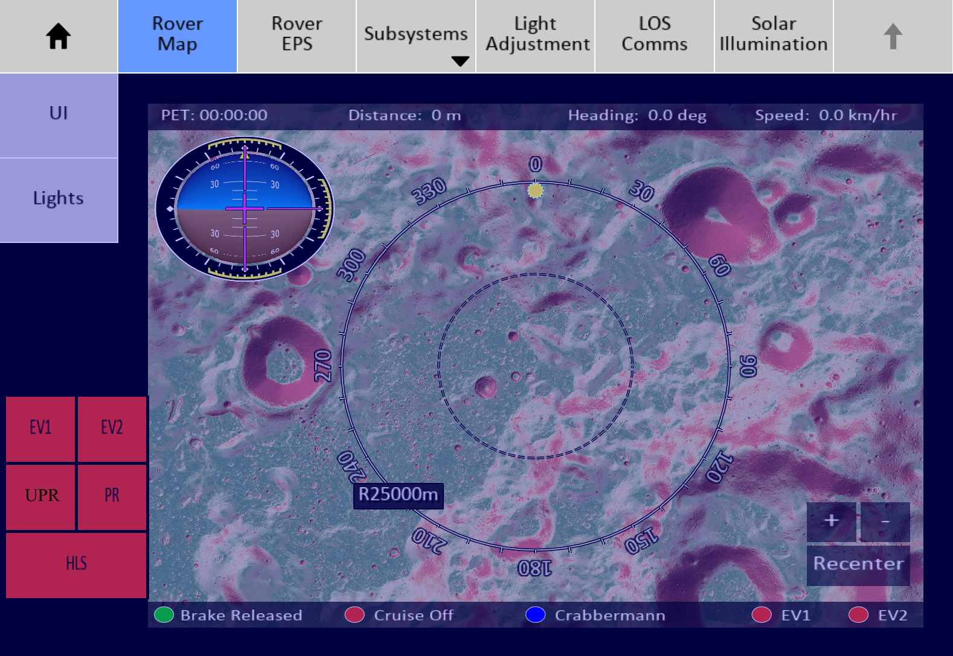
Visualizations and Results
Simulated MCC
  Map view shows location of Astronauts, UPR, PR, and lander
  UPR and PR power systems tracked
  Light controls and subsystems monitored
  Line of sight communications for all elements in federation
  Solar illumination
EVA metabolic and consumable tracking
Live and delayed data visuals for HITL and remote operations

Slide 11
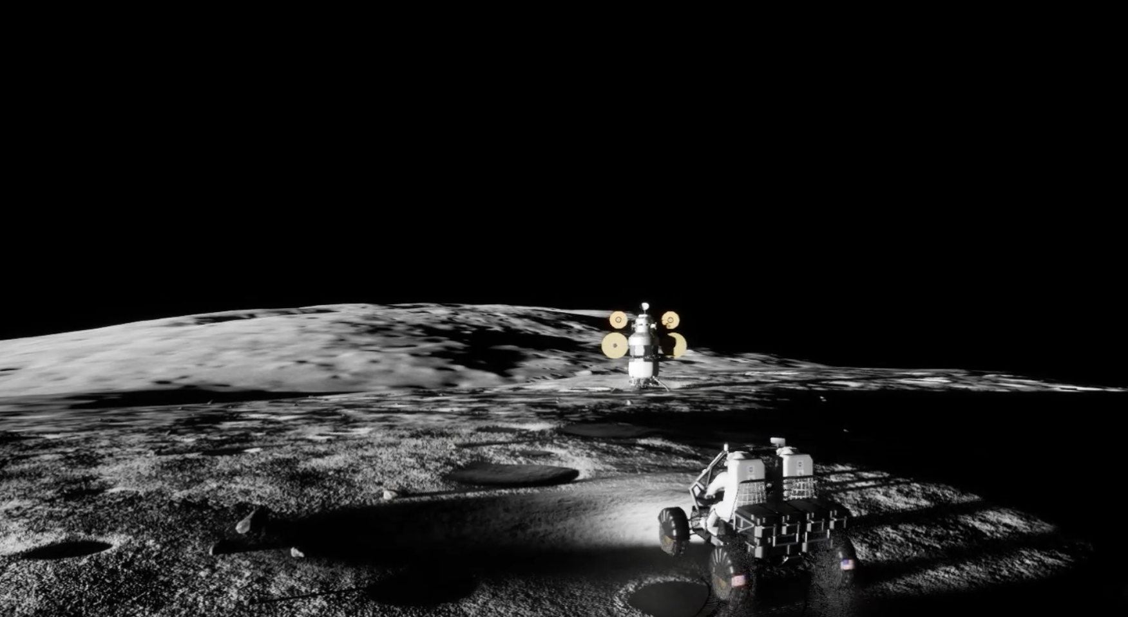
Studies and Products
Architecture Concept Review (ACR) and Strategic Analysis Cycle (SAC)
  Support Artemis architecture and analysis studies including but not limited to landing locations, traverses, charging locations, or EVA capabilities
  ADS gives realistic mission data for varying asset configuration and traverses
Power Studies
  Both UPR and PR studied for power data over certain traverses
  Autonomous charging and traverse following in a monte carlo style run
Joint Operations
  Study contingency lead/chase support traverses
  Study capable velocities, charge locations, direct and indirect comms
Human-in-the-Loop (HITL)
  Current upgrades allow facilities to be used in ADS federation
  All facilities link together, simulating an Artemis mission
Credit: NASA

Slide 12
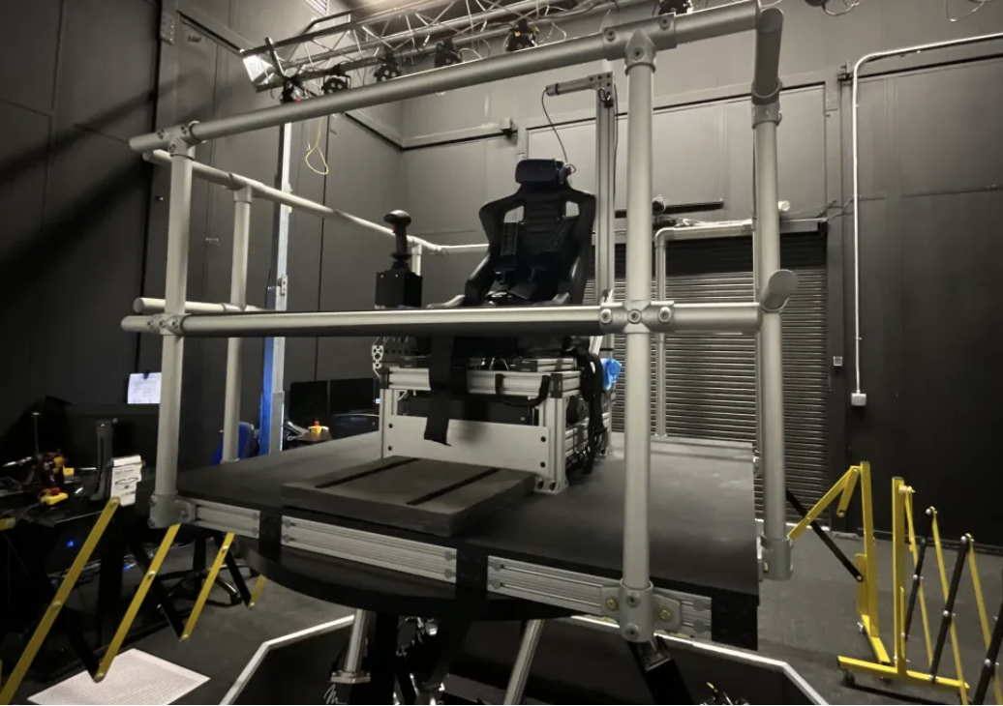
Future Work
Enhanced Communication Modeling
  Current line of sight calculation is difficult to track
    Each asset has a pairing with the other assets, causing many line of sight values to track
  Later stage Artemis mission can have many assets thus many LOS paths to track
  Compile all LOS paths into single array of LOS values
  Interested federates can request certain pairs, and watch that value in the array
Motion Table Integration
  6 degree of freedom table used for standalone rover and lander sims
  Integrates VR capabilities for immersion into vehicle command
  Better approximation of real world control and can increase fidelity of ADS federation
Credit: NASA

Slide 13
Conclusion
  ADS has the ability to integrate a variety of simulations provided internally or from partners, both international and domestic
  Running autonomously with set timeline or with human in the loop allows for a variety of study and mission verification support
  The ability to connect over VPN allows any simulation or facility to connect into ADS sharing the same SpaceFOM and standards
  ADS allows standalone simulations to be connected together in a variety of facilities and accurately represent a true Artemis mission

Slide 14
References
SpaceFOM
  https://www.sisostds.org/DesktopModules/Bring2mind/DMX/API/Entries/Download?Command=Core_Download&EntryId=50971&PortalId=0&TabId=105
TrickHLA
  https://github.com/nasa/TrickHLA
Trick
  https://github.com/nasa/trick

Slide 15
Questions?

