Slide 1
Venus Probe Architecture
IEEE Aerospace Conference 2025
Robin Ripley – NASA Goddard Space Flight Center
Colby Goodloe – NASA Goddard Space Flight Center

Slide 2

Venus: A planet of extremes
Clouds: ~75% sulfuric acid / 25% water
Surface Temperature ~ 800 F
Surface pressure = 92 bars
Notes:
But before I launch in, I want to talk about the basic properties of Venus to orient the folks in the audience who don’t think much about this planet. It’s an extreme place! The clouds are made of not water but instead a concentrated solution of water and sulfuric acid. Sulfuric acid is an extremely good desiccant, so any water vapor in the atmosphere – of which there is some – gets sucked up into the cloud droplets. Surface so hot the faint incandescent glow would be visible to your naked eye if you were unlucky enough to be standing on the dark side Equivalent to being about 900 m underwater on Earth.

Slide 3
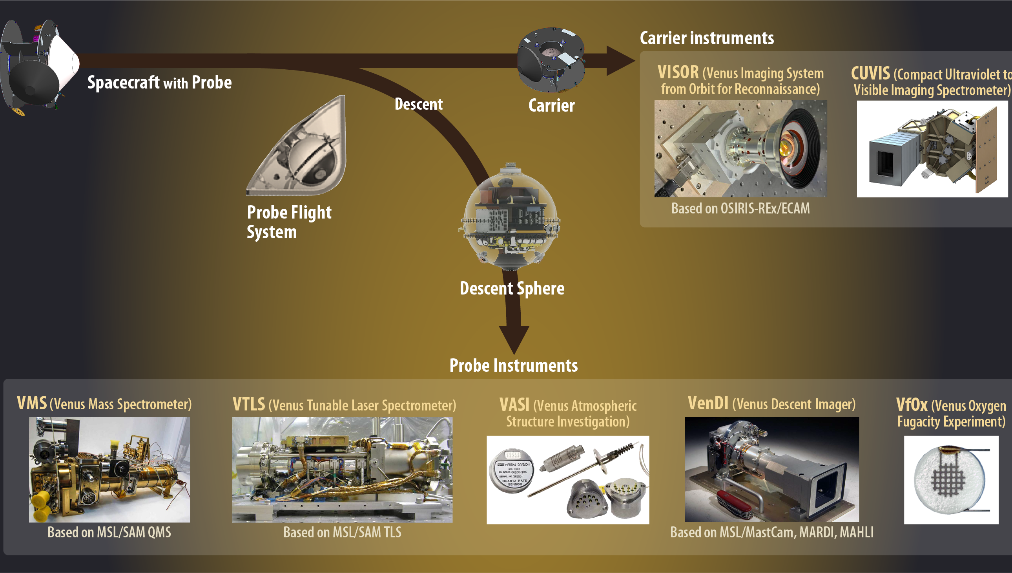
DAVINCI Probe and Instruments
Notes:
Let’s talk about our payload. VASI port is 3D printed. To answer the big unknowns about Venus, and to complement the radar and remote sensing objectives of NASA’s upcoming VERITAS mission to Venus which was also recently selected in NASA’s Discovery Program, we will plunge an analytical and imaging payload into the atmosphere on our descent sphere to comprehensively investigate the upper and lower composition and the surface. (CLICK) The descent sphere contains five instruments I’ll speak through over the next few slides. (CLICK) On the way to dropping off the probe, as I mentioned, our spacecraft will conduct two flybys. (CLICK)

Slide 4
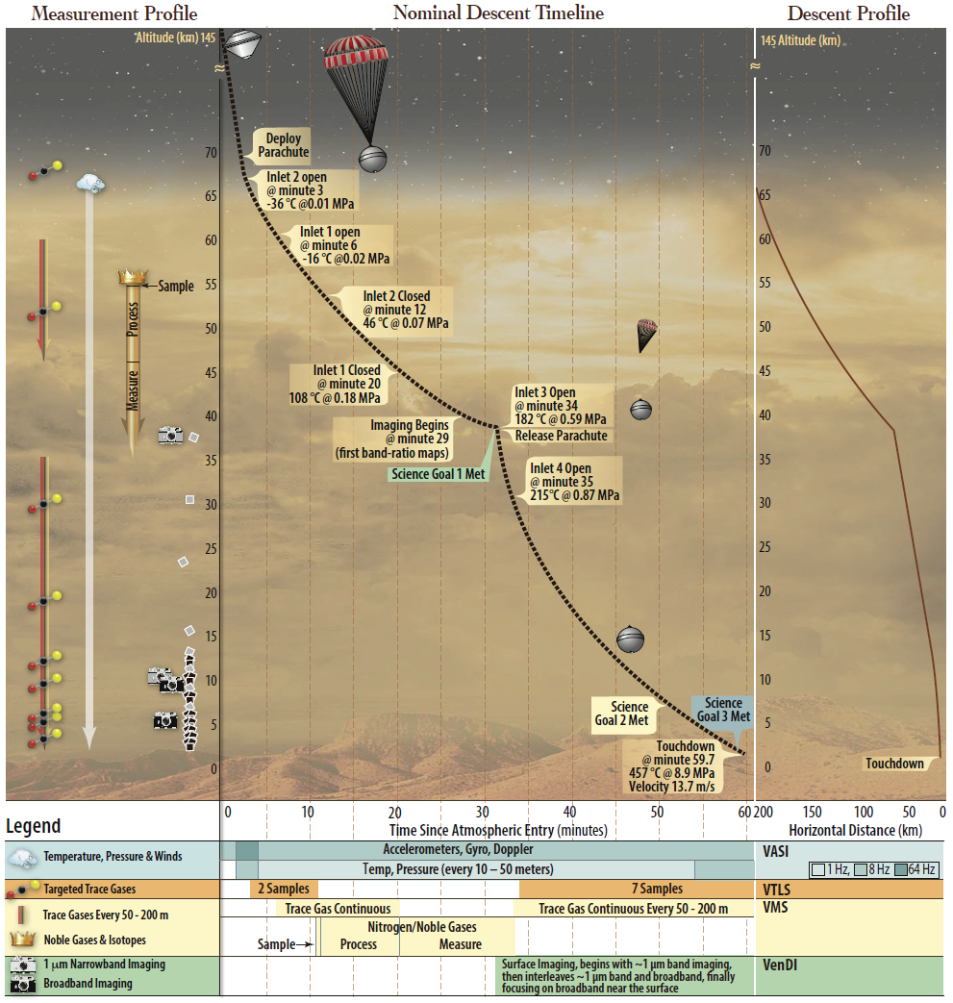
Notes:
During the one hour descent, the DS will deploy a parachute and separate from the heat shield, exposing the probe to the Venus atmosphere. At higher elevations, the VMS and VTLS will start taking samples of the atmosphere. Once below the cloud layer, VenDI will start taking images. Once the parachute is release, the spins veins will allow the probe to fall gently the rest of the way to the surface.

Slide 5
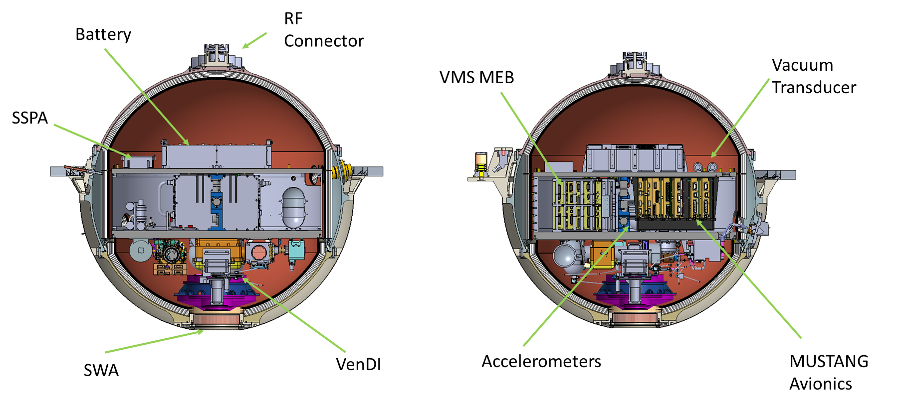
Descent Sphere Overview
Notes:
The DS is a single-string probe with select redundancy and resiliency designed to support all five instruments during the one-hour descent. To ensure mission success, most science measurements are taken multiple times. Those that aren’t oversampled are transmitted multiple times to the spacecraft during descent. The battery has XX% margin on the required capacity. Commands to fire pyros are sent multiple times. Philosophy is to fail operational so that a “safe mode” doesn’t put the sphere in a stand-by state that will not collect data during descent.

Slide 6

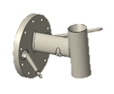
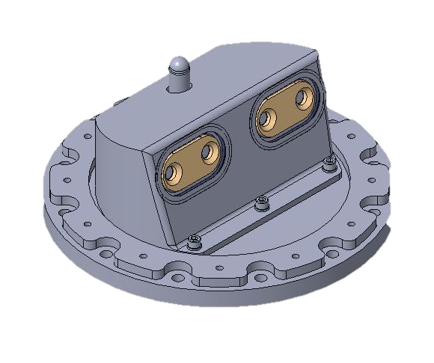
Instrument Accommodations
The sapphire window on the forward hemisphere allows visible light to pass through while rejecting infrared (heat). Sapphire’s high melting point gives the VenDI instrument a literal window on to Venus’ surface during descent.
The VASI port allows the VASI instrument to take take temperature and pressure
measurements throughout descent
The VMS port protects the inlets of both on-board spectrometers until they are needed.
Once the inlet valves are opened, the inlets allow gases from the Venus atmosphere to pass
through the VMS and VTLS tubing and into the instruments for measurement without putting
the rest of the components inside the sphere at risk.
Notes:
In order to measure the Venus atmosphere, the DS must allow the instruments inside to “see”, “smell”, and “touch” the atmosphere.

Slide 7
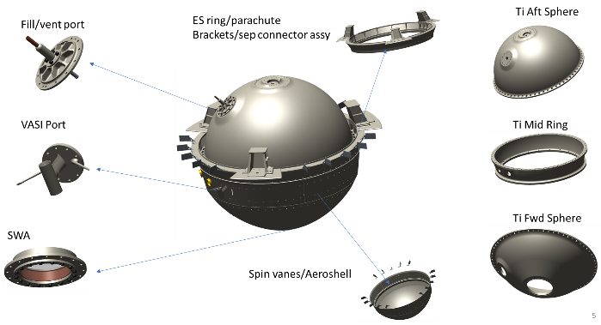
External Components and Ports

Slide 8
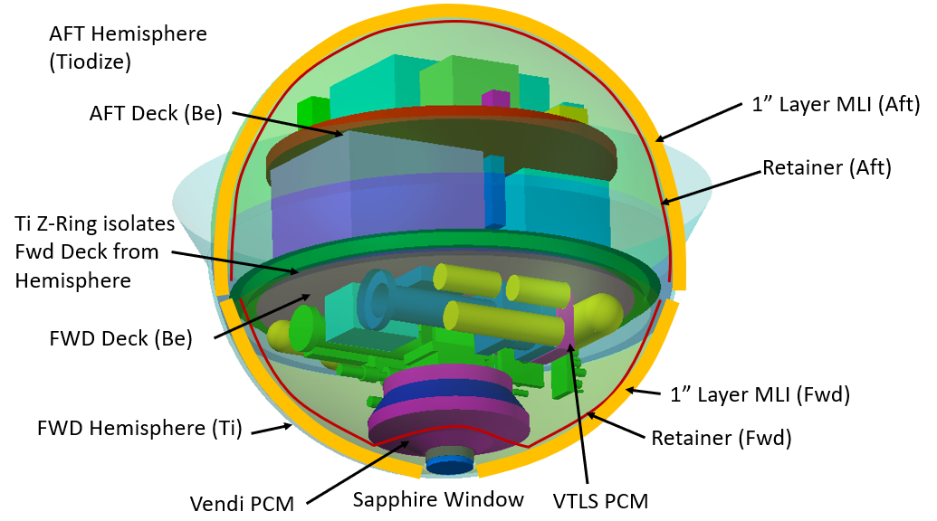
Thermal
Notes:
Thermal considerations are key to surviving the Venus atmosphere after a 2 year cruise to Venus. The outer layer of the DS consists of a titanium shell. Titanium’s properties include a high melting point, high strength to weight ratio, and resistance to sulfuric acid. Inside the sphere, a layer of MLI protects internal components from the outside temperature. The beryllium decks also serve as a heat sink to protect the components. One deck is mounted directly to the outer titanium shell. The second deck is connected to the other deck via a support structure.

Slide 9
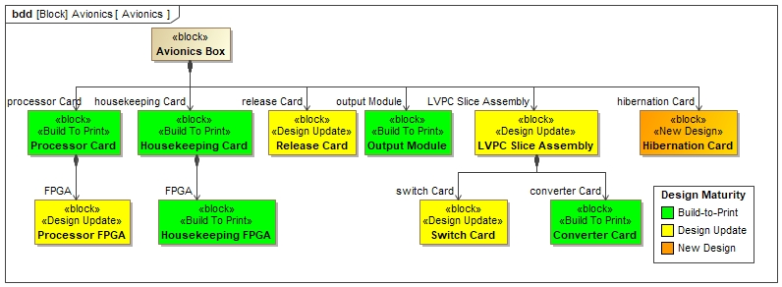
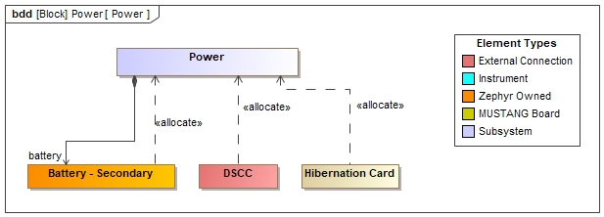
Avionics and Power
Notes:
The avionics takes advantage of existing architecture developed at GSFC.
The power group is building a single additional card that will live inside the avionics that was developed to reduce power usage during coast and improve timing accuracy.
A rechargeable battery was chosen to reduce risk during ground testing and integration. The DS Charge Card is considered to be part of the probe system but is physically located on the spacecraft since it is only needed to charge the DS battery while it is still attached to the spacecraft. This was due to the limited space available in the probe.

Slide 10
Data Collection and Transmission
Data will be collected on the probe and transmitted to the spacecraft for later transmission to Earth, allowing for higher data rates
Use of Adjustable Data Rate (ADR) radio allows for even more data transmission since it can adjust to current conditions
Data is prioritized within the probe before transmission
  Highest priority data is transmitted multiple times to ensure receipt
  Lowest priority data may not be transmitted on a “bad day”
Notes:
Direct transmission to Earth is slow, limiting the amount of scientific data that could be received from the probe. So the probe transmits directly to the spacecraft as it passes overhead. Additionally, fix-rate communications limit the data transmission to the anticipated worst-case scenario bandwidth. ADR was selected to adapted to conditions throughout descent and maximize the data received by the spacecraft for later transmission to Earth.
Data prioritization and retransmission ensures that that critical science data is sent back to Earth without missing the opportunity to send much more data in the event of a “good day”.

Slide 11
Balancing Power, Thermal, Mass, and Volume
Sphere Volume
  Increased volume provides more room for instruments and support architecture for the probe
  Increased volume increases the surface area exposed to the atmosphere and increases mass
Power Management
  Primary vs Secondary Battery
  Hibernation
  Tightly coupled with thermal
Thermal Extremes
  Survive cold of space until AEI
  Survive heat of atmosphere until end of descent
  Pressure vessel vs evacuated sphere
Notes:
In addition to the usual mass constraints, there are also limited power and volume resources and a unique thermal challenge. Falling thermos vs flying submarine

