Slide 1
LunaNet AFS Properties and Signal Band
  Presented by: Floor Melman, ESA / Juan Crenshaw, NASA GSFC / Masaya Murata, JAXA
  Contributors:
  Cheryl Gramling, NASA HQ
  Philip Dafesh, NASA / Aerospace
  Brian C. Peters, NASA GSFC
  Richard Swinden, ESA
  Cosimo Stallo, ESA
11-13 February, 2025
ICG-IOAG Cislunar PNT Workshop
Vienna, Austria

Slide 2



Topics
AFS Frequency Modulation
AFS Spreading Codes
AFS Navigation Message

Slide 3
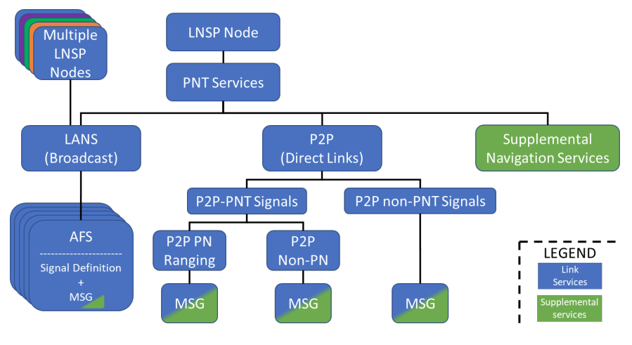
Augmented Forward Signal

Slide 4
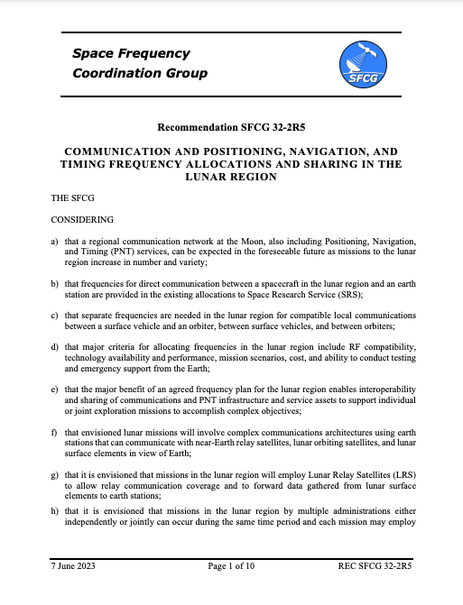
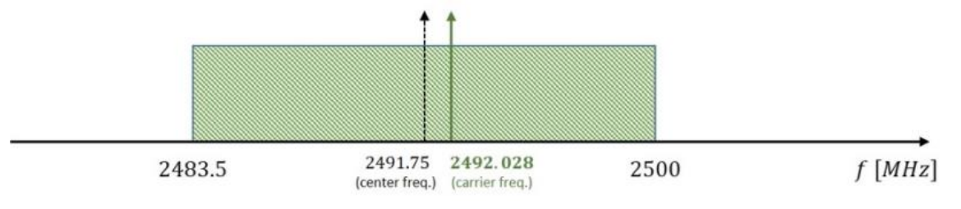
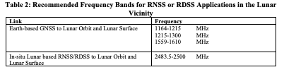

Frequency Selection
AFS Band: 2483.5 – 2500 MHz
AFS Carrier: 2492.028 MHz (closest multiple of $f_{0}$ = 1.023 MHz)
Reference Bandwidth: 15.944 MHz
15.944 MHz

Slide 5
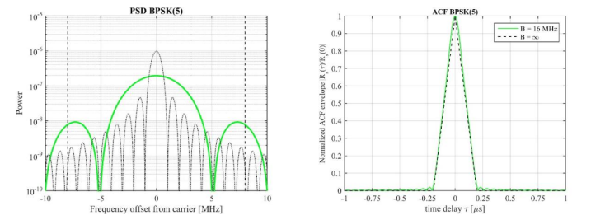
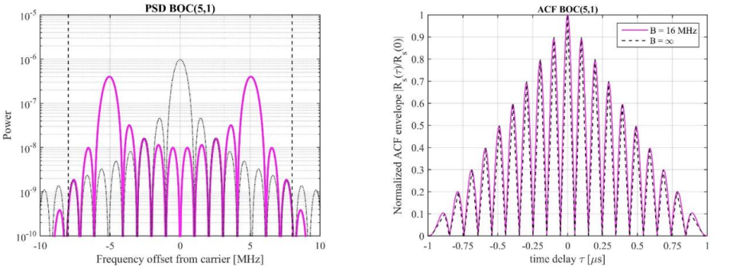
Modulation Candidates
Data Channel
  Ensuring signal energy to be concentrated around carrier
  Limit OBUE for given receiver bandwidth
  Selected candidate: BPSK(1)
Pilot Channel
  Optimizing optimized tracking performance
  Candiates: BPSK vs BOC
    BPSK(4)
    BPSK(5)
    BOC(2,2)
    BOC(5,1) -> Large number of peaks (18)
    BOC(5,2) -> Large number of peaks (8)
High Number of Peaks

Slide 6
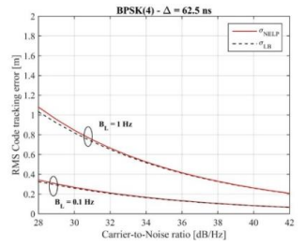
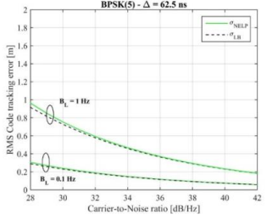
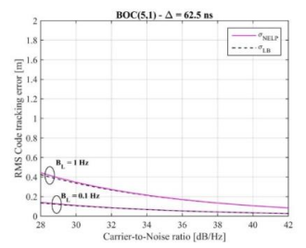

Acquisition and Tracking Performance
BPSK(4)
BPSK(5)
BOC(5,1)
Best Performance for BOC(5,1) but reasonable for BPSK(4)/BPSK(5)
Data/Pilot Power Share
25% power on Data would compromise data rate objective

Slide 7
Modulation Trade-Off
 | BPSK(4) | BPSK(5) | BOC(5,1)
Auto Correlation Function | No side peaks | No side peaks | Large number of side peaks (18) inrease probability of false tracking
Acquisition Search Space (vs BPSK(5) | 80% | 100% | 62.5%
Tracking Performance (CRLB) @C/N0 = 30 dB-Hz | 0.82 meter | 0.73 meter | 0.34 meter
Intersystem interference SSC [BPSK(1)] | -69.47 dB/Hz | -70.36 dB/Hz | -84.85 dB/Hz
Multipath impact | Until 300 ns (~90 meter) | Until 250 ns (~75 meter) | Until 850 ns (~255 meter)
WiFi Interference (Ch 12) C_{WiFi}/C_{AFS} (-3 dB-Hz) | 87.3 | 86.4 | 76.2
In-band interference (Rectangular BW) | 3.89 MHz | 4.79 MHz | 2.04 MHz

Slide 8
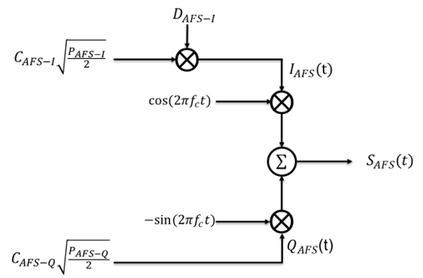
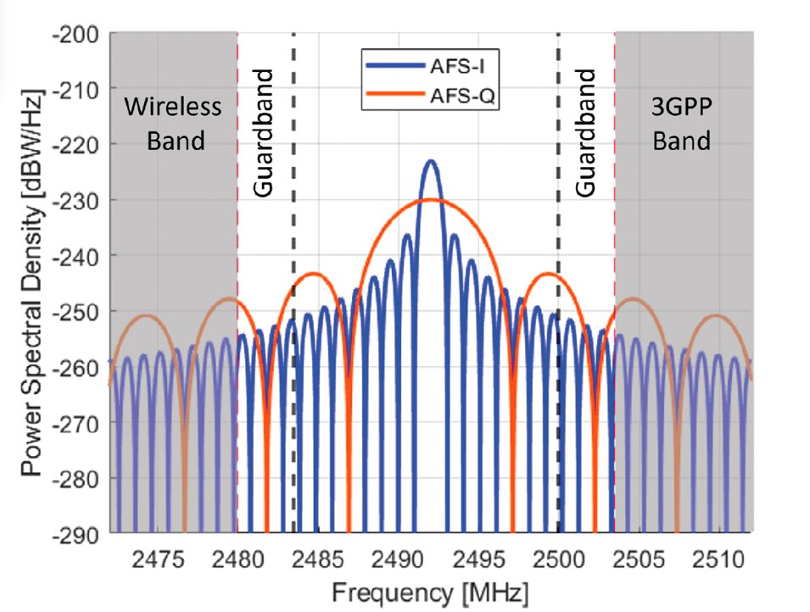
AFS Modulation
AFS Signal Design
Data-channel with 500 symb/second
Pilot-channel with BPSK(5) for accurate robust ranging
Power share 50/50 to enable high data-rate and robust ranging
 | Power Share | Modulation | Data Rate
AFS-I (Data) | 50% | BPSK(1) | 500
AFS-Q (Pilot) | 50% | BPSK(5) | n/a

Slide 9
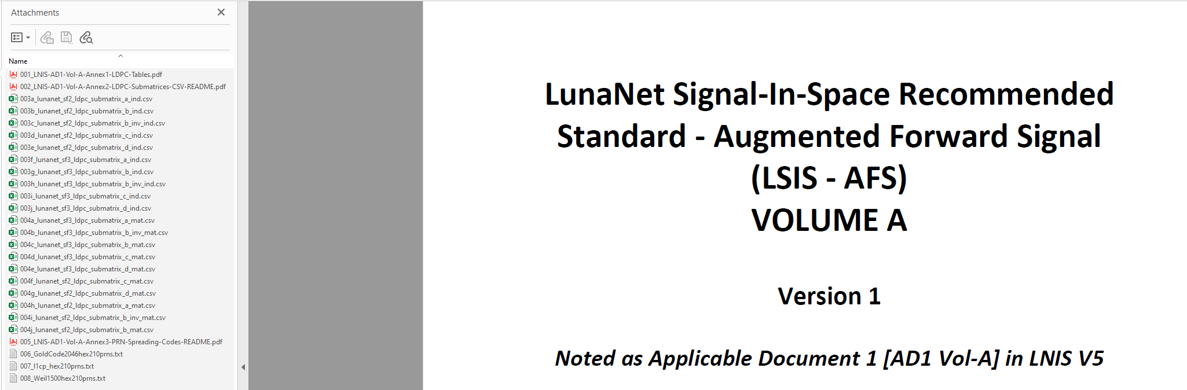
LNIS AD1 Vol-A Attachment Files
LNIS AD1 Vol-A includes attachment files with detailed artifacts in different formats for interpreting
  Data coding,
  PN Sequences.

Slide 10
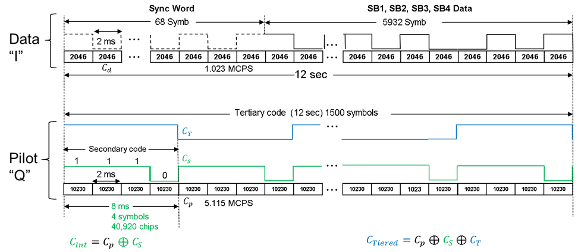
Signal Overview

Slide 11
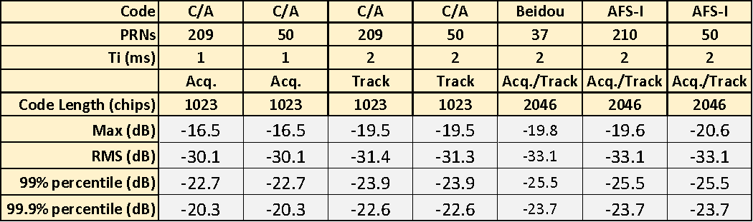
Data Channel Ranging Code (I)
The I channel employs a 1.023 Mchip/sec BPSK spreading code,
  Its period matched to the 2 ms symbol period.
    Unlike C/A code, this permits immediate bit Sync.
210 Length 2046 Spreading codes were selected from a 2047 length Gold Code family short cycled by 1 chip.
  A 2046-chip short cycled 2053-length Weil sequence was also constructed but found to have comparable correlation performance.
  Ultimately, the Gold code was selected to simplify implementation.
The 2046-chip AFS I channel spreading code was found to provide a 3 dB improvement 99.9 % of the time during acquisition, compared to the GPS L1 C/A spreading code and over 1 dB while tracking.
The 210 AFS Gold codes have performance that is comparable to BeiDou’s 37 Length 2046 gold codes.

Slide 12

Dataless Pilot Channel (Q)
The Q channel employs a 10230-chip, 5.115 Mchip/sec BPSK primary ranging code, $C_{p}$.
  Like the I channel code, the 2 ms duration of the code aligns with the data symbols, therefore bit Sync is immediate.
The primary code is modulated by a 4-chip secondary Barker sequence, $C_{s}$, assigned to each transmitter.
  This forms an intermediate code $C_{Int}=$ $C_{p}$+ $C_{s}$ that provide flexibility in signal acquisition and an improved cross-correlation.
  The 4-chip code enables users to improve antijam by 6 dB relative to the AFS primary code and L5
    Its complexity is twice that of acquiring L5’s primary code
    Longer codes would be too complex for practical use during acquisition (e.g., L5’s Neuman Hoffman codes)
A tertiary code further extends the 8 ms intermediate code so the tiered code matches the 12 second data frame
  This enables tertiary code to be used for robust frame Sync and determining absolute time to arbitrarily low C/N0,
    Only limited by the minimum C/N₀ required for code and carrier tracking.
 | Binary Representation |  |  |  | NRZ Representation
 | B₄ | B₃ | B₂ | B₀ | N₄ | N₃ | N₂ | N₁
C₀ | 1 | 1 | 1 | 0 | -1 | -1 | -1 | 1
C₁ | 0 | 1 | 1 | 1 | 1 | -1 | -1 | -1
C₂ | 1 | 0 | 1 | 1 | -1 | 1 | -1 | -1
C₃ | 1 | 1 | 0 | 1 | -1 | -1 | 1 | -1

Slide 13

Comparing AFS Acquisition Alternatives
The AFS signal provides flexible acquisition alternatives that allow trade of complexity and performance.
  Acquisition complexity $∝L×R_{c}×$ Number of sidebands (for all data or all pilot)*.
The comparison below assumes that the processing gain, PG, of a signal is proportional to $R_{c}×T_{i}$
  Ti is limited to the repeating code duration.
Acquisition Code | Complexity Relative to L5 Primary | Processing Gain Relative to L5 (dB)
2046 chip I Primary | 2% | -7.0
10230 chip Q Primary | 50% | 0.0
40920 chip Q Intermediate | 200% | 6.0
10230 chip L5 Primary Code | 100% | 0.0
The Q channel intermediate code provides 6 dB more processing gain than the L5 signal
for a factor of 2 increase in complexity relative to L5
*L = code length, Rc = chip rate

Slide 14
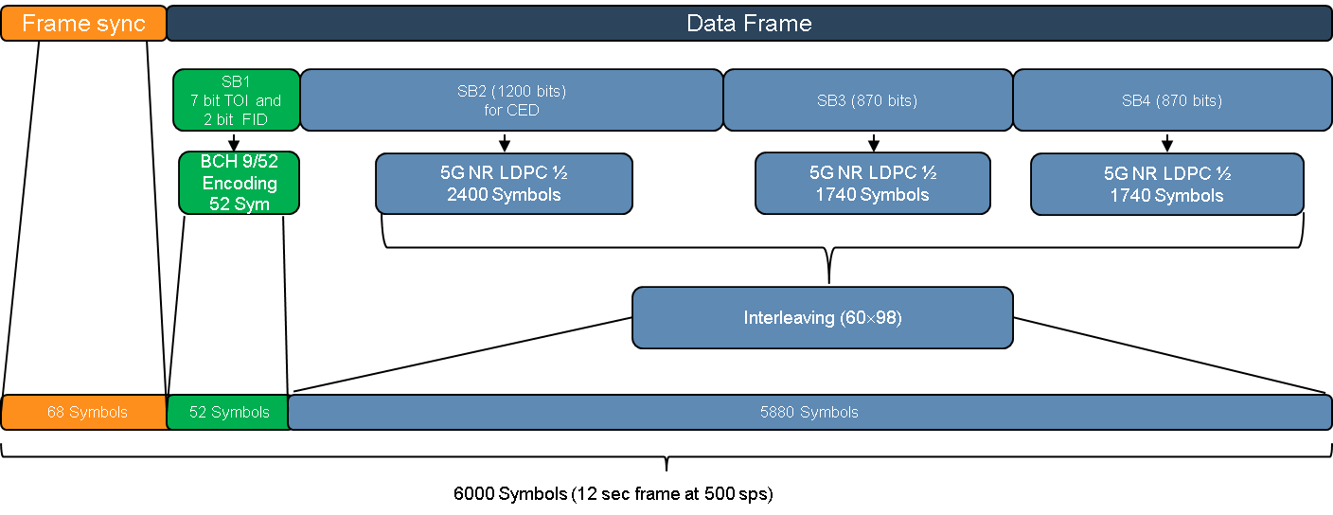
Data Message Structure
The AFS Data message frame structure begins with a sync word for lightweight “data only” receivers.
The structure was optimized to maintain the subframe block (SB) sizes as large as possible for future growth.
  The 5G NR LDPC encoding was selected to leverage a commercial standard for the the forward error control coding design.
500 sps allows lunar providers frequent navigation message updates compared to Earth GNSS systems, with flexibility to maintain accuracy.
In addition, other LunaNet information forwarded via message.

Slide 15
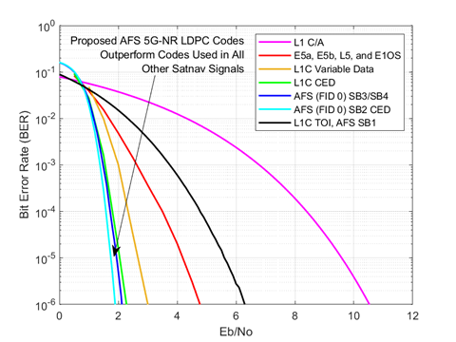
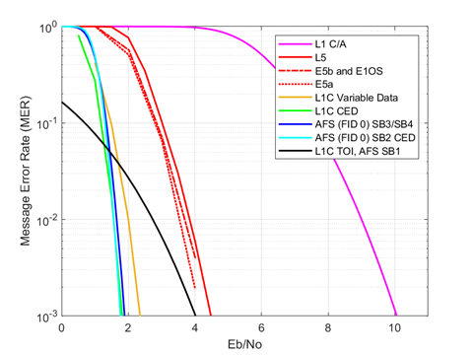
Data Message Performance
Rate ½ LDPC codes were designed using methodology specified for 3GPP*,
Exceeding performance of all other nav messages in terms of Eb/No.
Balanced design with similar sensitivity target for sync, tiered code and data coding.
CED combining further improves sensitivity.
*3rd Generation Partnership Project (3GPP) (Jul. 2020). Technical Specification Group Radio Access Network; NR; Multiplexing and Channel Coding, Release 16, V16.2.0, 3GPP Standard TS 38.212.

Slide 16
AFS Data Frame Sync.
Frame sync of 68 symbols provides balance between No. symbols, C/N0 and data interleaver factorization

Slide 17
AFS Message (SB1)
SB1 is composed of 9 BCH code bits.
  2 bits assigned to the frame identifier (FID), enabling future data frame structure flexibility (default FID = 00).
  7 bits are used for the Time of Interval (TOI) count over a 20 min interval.

Slide 18
AFS Message (SB2)
SB2 shall contain at least clock and ephemeris data (CED), time of transmission (ToT), health and safety, time conversions, and cyclic redundancy check (CRC)

Slide 19
AFS Message (SB3)
SB3 is a dynamic subframe that may be used for multiple purposes, including specific custom messages from the LNSP that are not specified in the LNIS AD1 (e.g., proprietary messages). Proprietary messages are not interoperable and require the LNSP to establish a SISICD for user implementation.
SB3 shall contain multiple orbit almanac, coordinate frame conversions, multiple antenna properties (optional), maneuver (optional), single attitude state/ ephemeris (optional), augmentation differential corrections (optional), custom messages defined by the LNSP.

Slide 20
AFS Message (SB4)
Similar to SB3, SB4 is also a dynamic subframe and shall contain LunaNet network access information, user schedule notice (information for Point-to-Point services), ancillary info (optional), custom messages defined by the LNSP.

Slide 21
Summary and Conclusions
LunaNet’s AFS was designed to provide an interoperable standard for future PNT services currently under development by NASA, ESA, and JAXA.
The signal leverages lessons learned from terrestrial GNSS, and will service both high performance and low-SWaP users in the lunar vicinity.
The AFS provides several enhancements compared to other GNSS signals:
  Employs 5G-NR Forward Error Control coding with the best decoding performance of any GNSS signal.
  Three-tiered ranging codes permit receivers to trade acquisition complexity with sensitivity.
  Tertiary overlay code that enables rapid time dissemination, high integrity code acquisition, and frame Sync.
  A high integrity data sync word is provided to enable low-SWaP single-channel decode data without a pilot overlay.
  The signal structure also supports future changes through the robust BCH encoding of the FID field without sacrificing the ability to improve data message performance using CED combining.
  Overall, the AFS provides ample flexibility and performance by accommodating a range of use cases and operational modes.

Slide 22
Backup

Slide 23
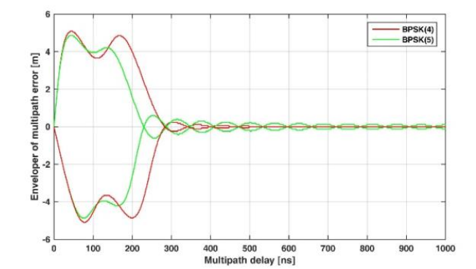
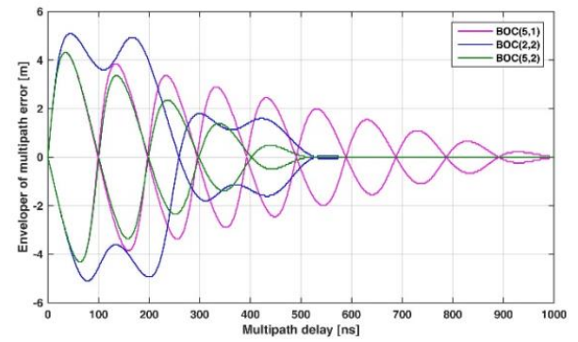
Multipath Performance
Multipath Error Envelope (MEE)
General Trends are similar
BPSK is affected until ~300 ns
BOC is affected until ~500-800 ns

Slide 24
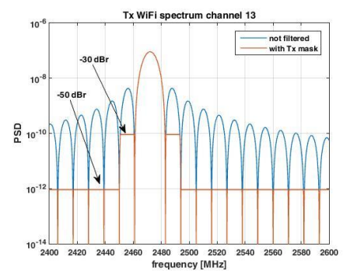
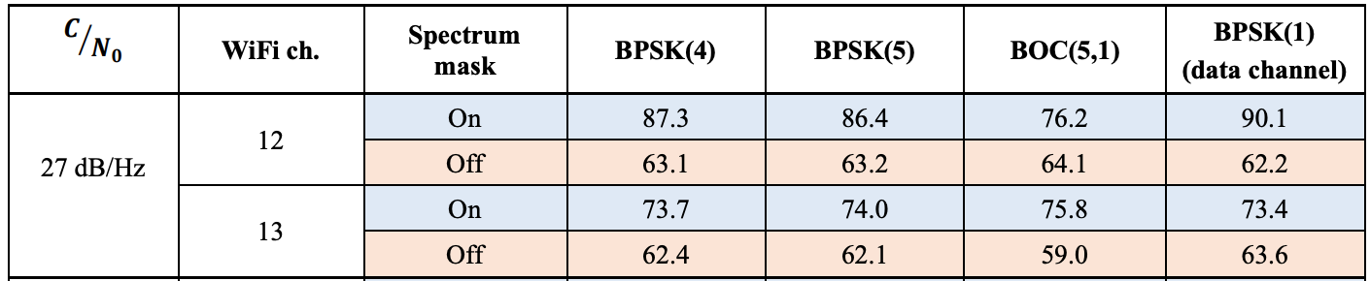
WiFi Interference
Impact of WiFi on different AFS Modulations
Assuming WiFi DSSS modulation (in channel 12/13)
Implementing WiFi 801.11 transmission mask
BPSK(5) shows lowest impact for channel 12

Slide 25

Data Message Design Tradeoff
Select a sync word length that met the desired performance of L1C’s Rate 9/52 BCH code (25 dB-Hz), and I channel carrier tracking thresholds.
  Constrained by Interleaver factorization, C/No performance and data utilization
  $\frac{E_{b}}{N_{0}}=5.61$ for BER =1E-05 ⇒ $\frac{C}{N_{0}}=\frac{E_{b}}{N_{0}}+10\log_{10}\left(500 \frac{sym}{sec}× \frac{9}{52}\frac{bits}{sym}\right)=25 dB Hz$
68 Symbol provides the best balance between No. of data symbols, C/N₀ and interleaver factorization.
Two out of 9 BCH code bits are assigned to the FID, permitting the flexibility to change the data frame structure in the future, with the default structure identified by FID = 00.
The remaining 7 bits are used for the TOI count over a 20 min interval in which the CED data is unchanged.
*Assumed sync word detection and false alarm probabilities: $P_{d}$ = 0.99 and $P_{fa}={10}^{−6}$
CED = Clock and Ephemeris Data

