Slide 1
Evolving the SpaceFOM:
Lessons Learned and Future Development
2025-SIW-009
Björn Möller, Pitch Technologies, Sweden
Edwin Z. Crues & Daniel E. Dexter, NASA, USA
Alfredo Garro, University of Calabria, Italy
Alberto Falcone, Institute for High Performance Computing and Networking, Italy

Slide 2
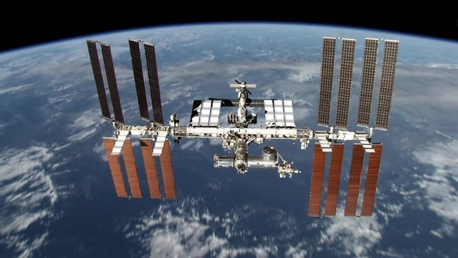
Agenda
SpaceFOM background
Scope of SpaceFOM 1.0
Practical experiences
Towards SpaceFOM 2.0
Proposed updates
Discussion and conclusion

Slide 3
SpaceFOM Background
Spaceflight is inherently challenging, hazardous, and costly, with human spaceflight being even more demanding.
To mitigate these challenges, the space industry extensively employs computer simulation, including distributed simulation, across all stages of mission development, including concept design, engineering, training, and operations.
To streamline integration, reduce development effort, promote interoperability and reuse, the need for a standard was identified.
A first version of the SpaceFOM was thus developed and released by SISO in 2020.

Slide 4
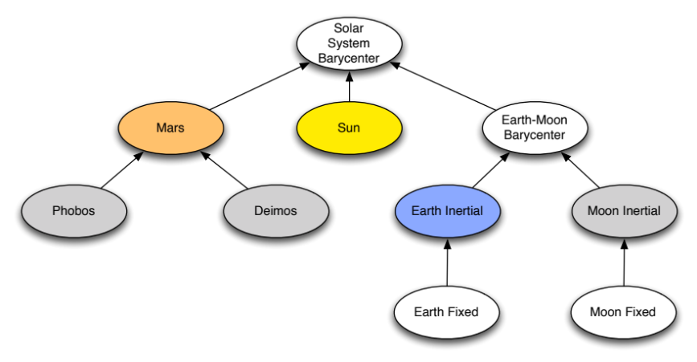
Scope of SpaceFOM 1.0
Physical entities
Data types
Flexible reference frames
Time management
Synchronized execution control
Federate role and responsibility
  Master, root reference frame publisher, early/late joiners
Document templates for specifying
  Federation execution information
  Federate capabilities
Sample reference frame tree

Slide 5

Practical Experiences from SpaceFOM 1.0 at NASA
NASA is making plans to return humans to the surface of the Moon, and ultimately Mars, with the Artemis program.
  Moon-to-Mars Architecture
  Multi-agency, multi-corporation, multi-national program
The NASA NExSyS team has been developing modeling and simulation technologies, digital spacecraft systems models, integrated vehicle simulations, and large-scale distributed simulations.
  An integration framework for simulation interoperability based on openly available international standards.
  Includes mission analysis, testing, integration, verification, training, and mission support.

Slide 6

Practical Experiences from SpaceFOM 1.0 in Europe
The HRAF3 project at the Harwell Robotic and Autonomy Facility in the UK, funded by the European Space Agency (ESA), has developed a federation to support the development and testing of complex autonomous systems for Solar system exploration.
  Sample scenario: autonomous rendezvous and capture of a passive object in Mars orbit in support of a sample return mission.
The REALM project: Virtual Reality Aided Spacecraft Refueling for In-Orbit Servicing and Manufacturing (IOSM) Verification & Validation, funded by the UK Space Agency.
SpaceFOM integration with the SIMULUS-NG simulation platform, funded by ESA.

Slide 7

Practical Experiences from SpaceFOM 1.0 in Academia
Since 2011, SISO, in collaboration with NASA and industrial and academic organizations, has hosted the annual Simulation Exploration Experience (SEE) event. SEE 2025 is currently ongoing.
An international initiative for undergraduate and postgraduate students.
Provides practical, hands-on experience in Modeling and Simulation techniques.
The initial SpaceFOM 1.0 draft was tested during 2017 SEE and experiences were fed back to the development group.
A variety of tools from industry, government and academia are used by the student teams.

Slide 8
Towards a SpaceFOM 2.0
The SpaceFOM 1.0 covers the core elements of interoperability for the space domain. It was delivered in a timely manner and is already having an impact.
Additional general and domain specific extensions can be added.
A Product Support Group (PSG) was formed when the SpaceFOM 1.0 was released to respond to questions, such as requests for interpretation, provide guidance, promote the standard and collect experiences from users.
The group is already collecting Product Change Requests (PCRs) in preparation of a SpaceFOM 2.0 PDG. Topics include object classes and data types, time management, execution control, robustness, clarifications and editorial updates.

Slide 9
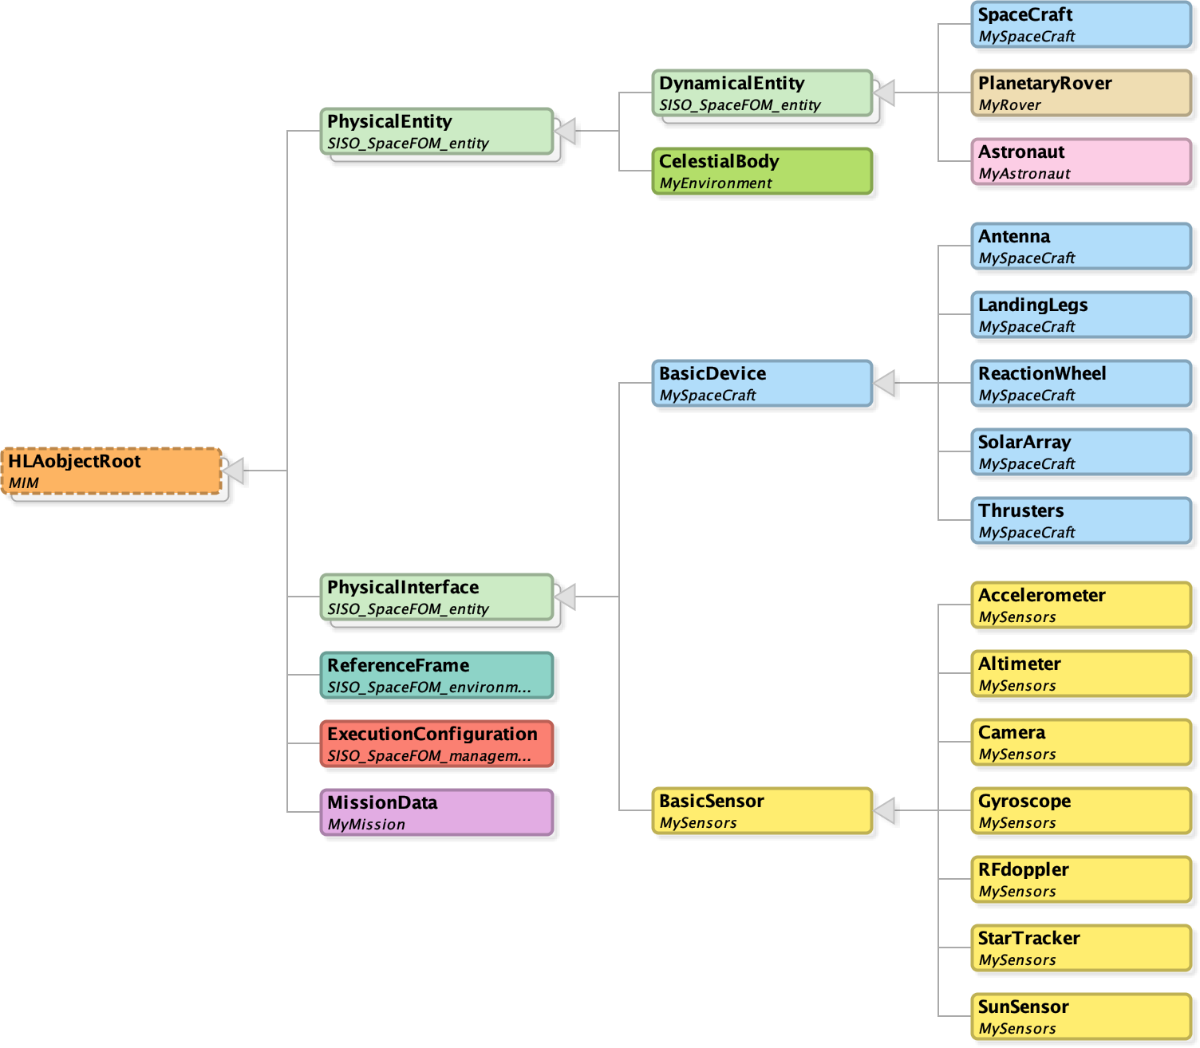
Object Classes – HRAF3 (ESA)
HRAF 3 is an engineering
oriented federation

Slide 10
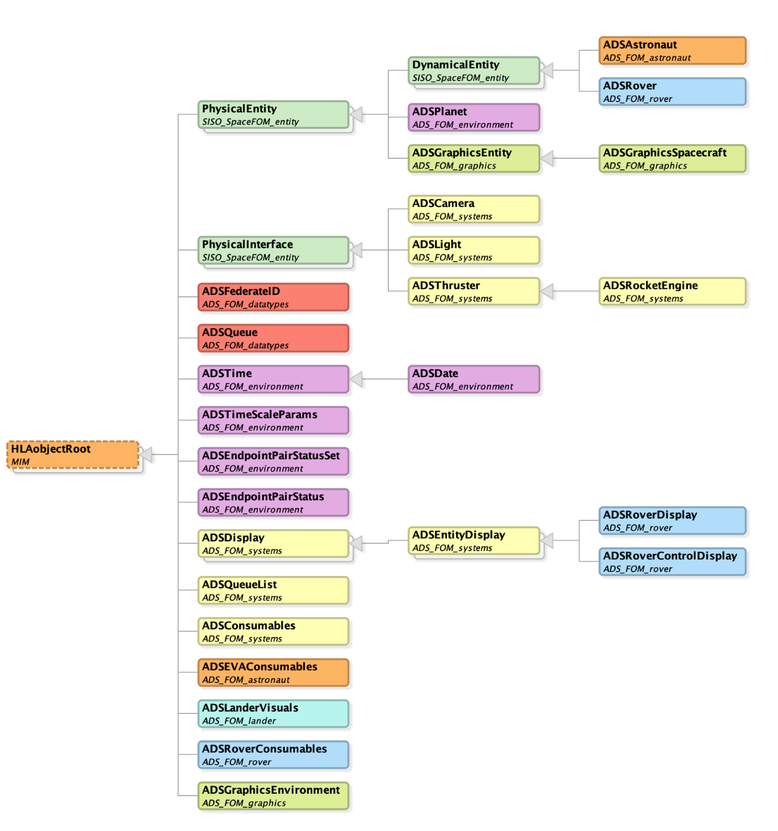
Object Classes – Artemis (NASA)
Artemis Distributed Simulation Extensions
  Data types
  Environment
  Systems
  Graphics
  Astronaut
  Lander
  Rover

Slide 11


Dynamically Variable Federation Time Steps
Small steps
Big steps
Big steps
Small steps
The current SpaceFOM version has a significant limitation that affects the simulation of interplanetary missions: the federation time step is fixed and cannot be modified during execution.
  Critical operations like launches, orbit insertions, and dockings require fine-grained time steps.
  Less dynamic phases, such as interplanetary cruise or deep-space transit, can be adequately represented with coarser time steps, significantly reducing computational overhead.
A variable federation time step is proposed.

Slide 12
Configurable Time Resolution
SpaceFOM 1.0 represents time using an HLAinteger64BE interpreted as microseconds past the Epoch, which is specified for a scenario.
  ±292,271 (Julian) years can be represented.
Some applications may use high time resolutions.
  A commonly used scheduling cycle is 128 Hz
  This means that time stamps are increments by 7812.5 microseconds/cycle.
  Higher resolution required!
Solution: Make time resolution configurable
  The interpretation of the HLAinteger64BE time stamp should be configurable.
  If resolution is set to be interpreted as nanoseconds, the range is still ±292 years.
  All federates need to support this.

Slide 13
Save and Restore
Native HLA Save and Restore functionality provides a baseline functionality, but not enough to provide a reliable and repeatable result for a SpaceFOM federation.
  The exact set of federates at Save need to be present at Restore.
  Adequate mode transition synchronization is required.
  Time homogeneity is required. Federates with potentially different time step must reach a common HLA Logical Time Boundary (HLBT).
Several aspects need to be covered
  How to ensure the right set of federates before restore. Wait? Prune?
  Programmatically verifying all required conditions adds complexity. Manual verification may add unreliability.
  Error recovery.

Slide 14
Loss of the Execution Configuration Object (ExCO)
A SpaceFOM federation uses a singleton Execution Configuration Object (ExCO) to provide key data, static and dynamic, for the federation execution.
  Epoch, execution mode, etc
What if it is lost (removed)?
A shared approach for loss of the ExCO object is required.
  The simplest solution is to resign.
Execution Control
Epoch = 2024-02-18 00:00:00
Mode = FREEZE
RootRefFrame = EarthMoon Barycenter
Federate
Federate
Federate
Runtime Infrastructure – RTI

Slide 15
Designated Late Joiners
Depending on when a federate joins, with respect to the shared initalization phase, it is considered an early or a late joiner.
Not all federates are required to be early joiners and need not implement the shared initialization steps.
A simplified pattern for late joiners is proposed.
Start
Early
Initialization
Late
Sync
Sync
Run
Freeze
Sync
Shutdown
End

Slide 16
Summary and Conclusions
SpaceFOM standard represents a significant milestone in the advancement of distributed simulation in the space domain.
It builds on proven solutions and practical, real-world experiences.
The first version has been successfully applied in various scenarios and extended to address evolving needs.
The SISO SpaceFOM Product Support Group (PSG) is committed to further improving the standard and broadening its scope.
A number of PCRs, based on practical requirements, are already under development.
The authors are excited to contribute to the development of the next version of SpaceFOM alongside the expanding user community.

