Slide 1
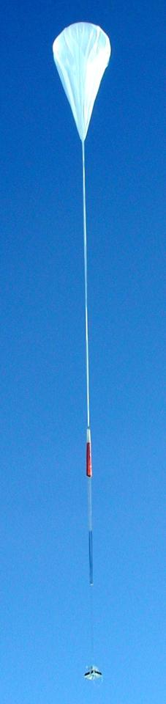
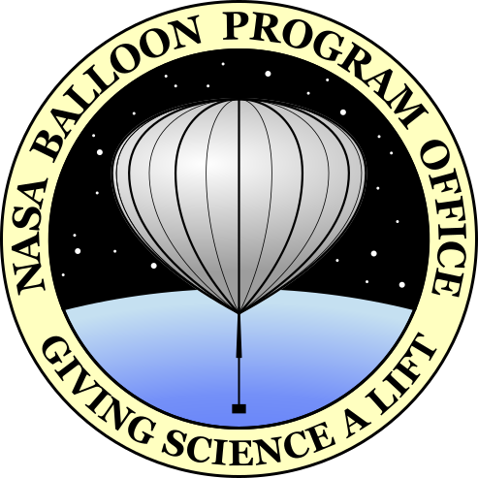
NASA Balloon Program
Andrew Hamilton
BPO Deputy Chief
NASA Wallops Flight Facility
Goddard Space Flight Center

Slide 2
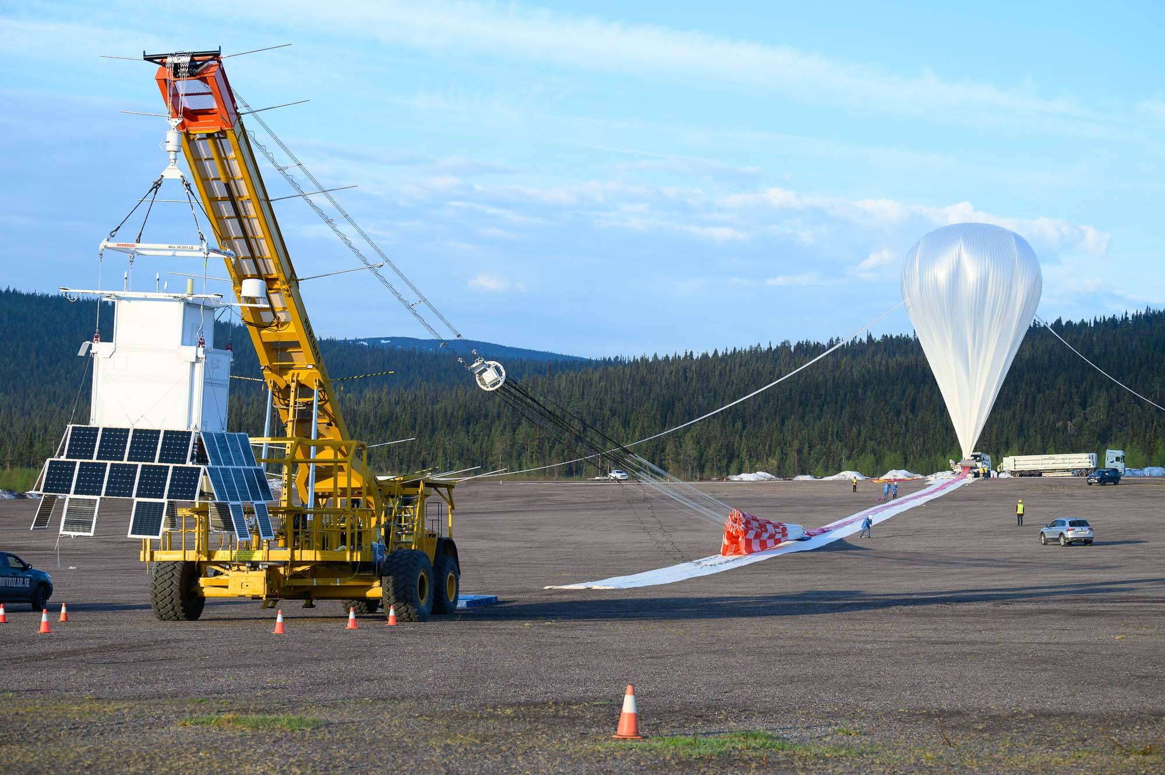
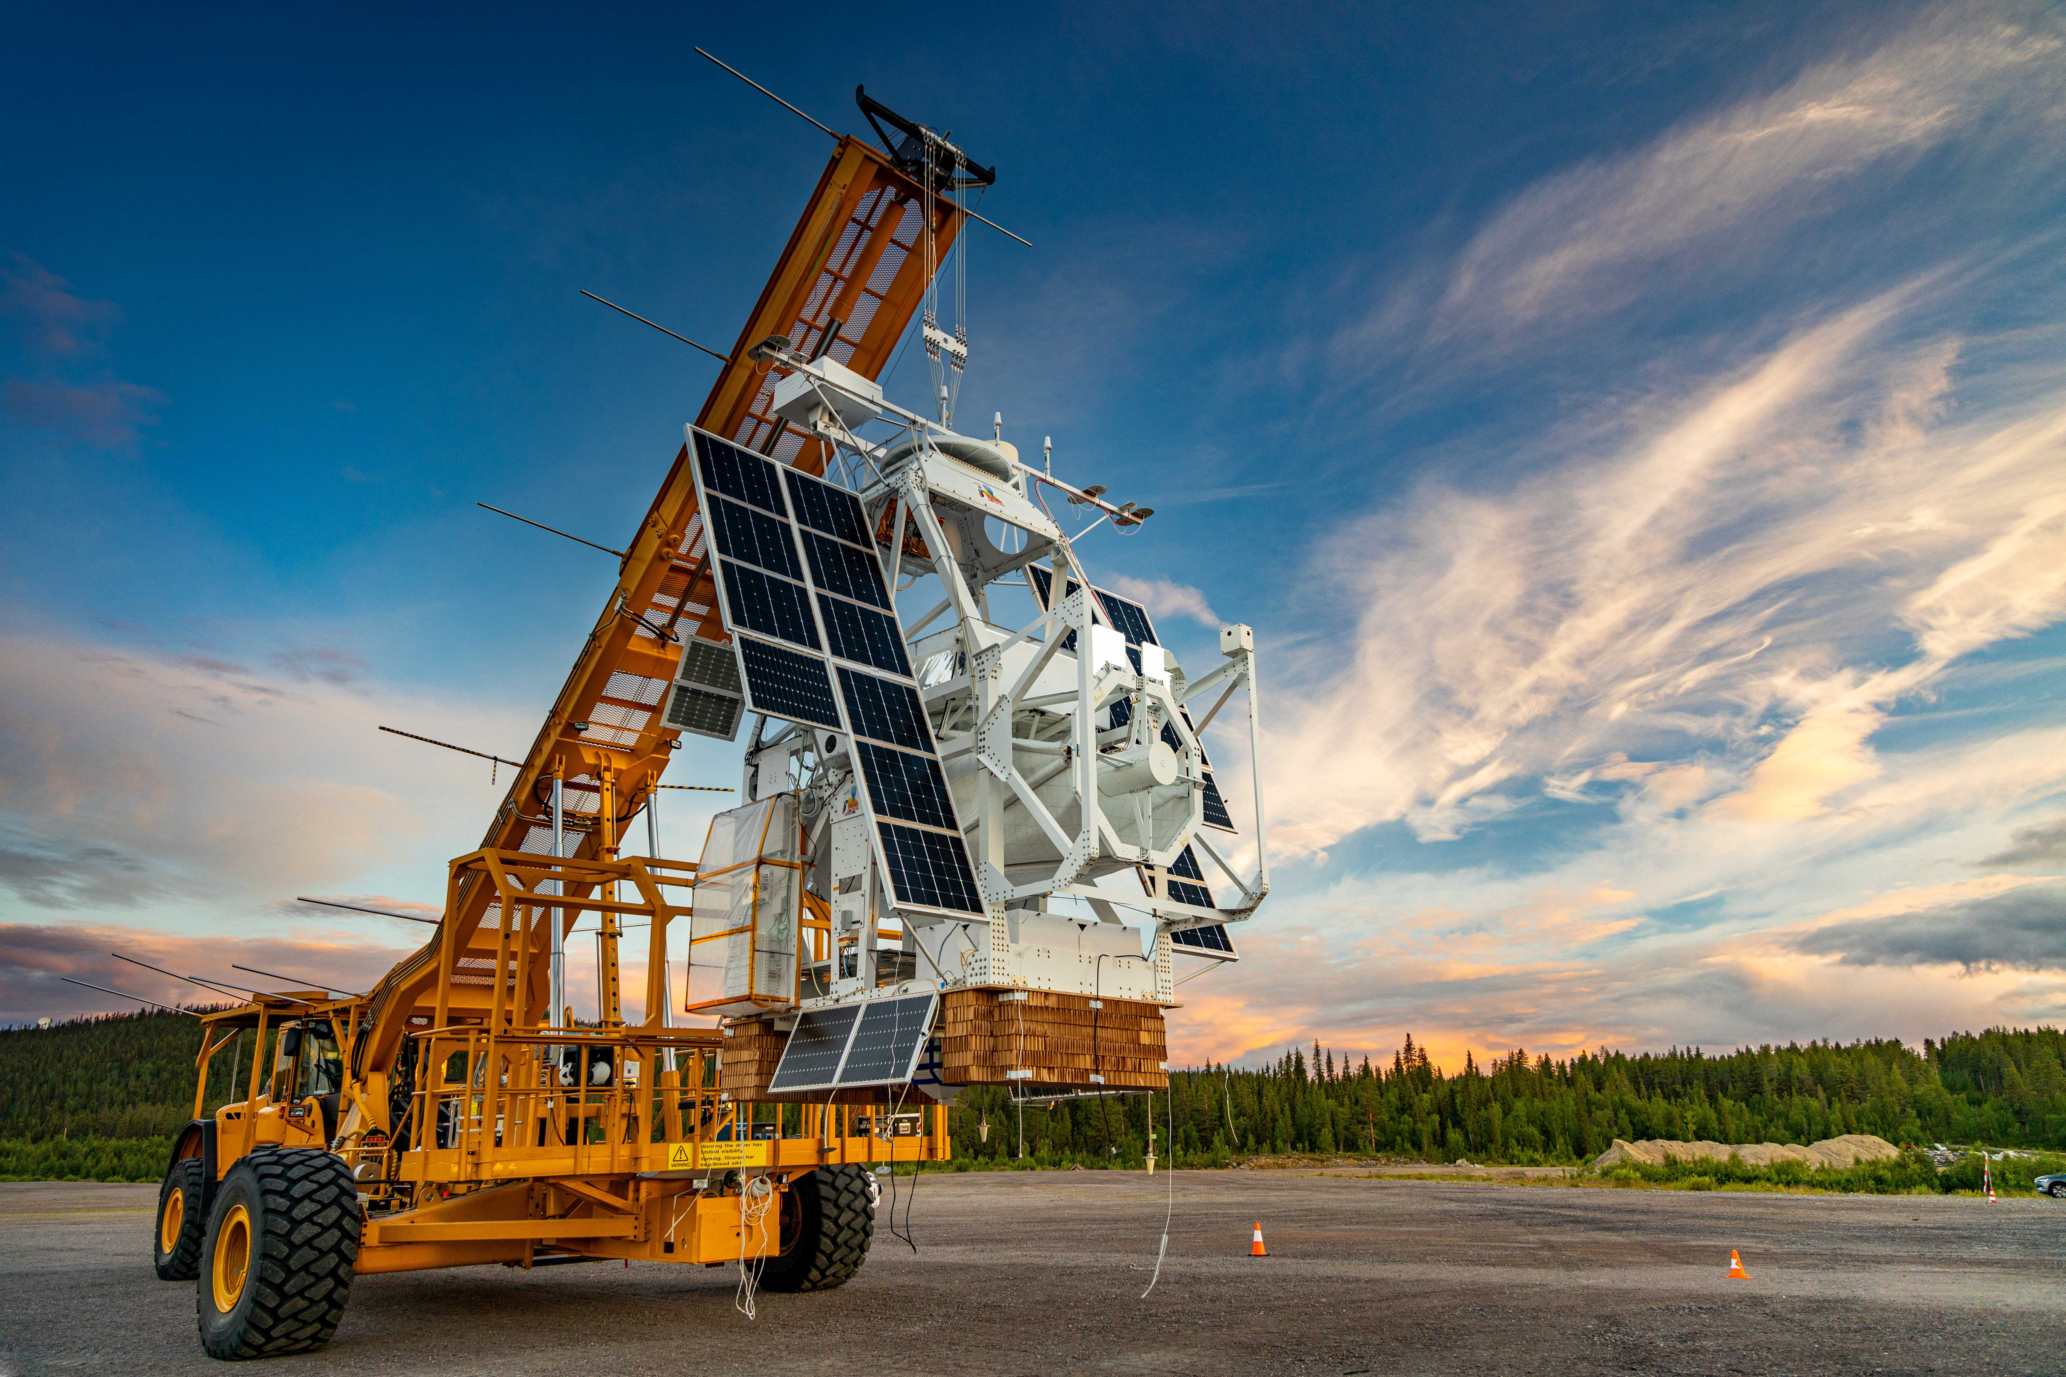
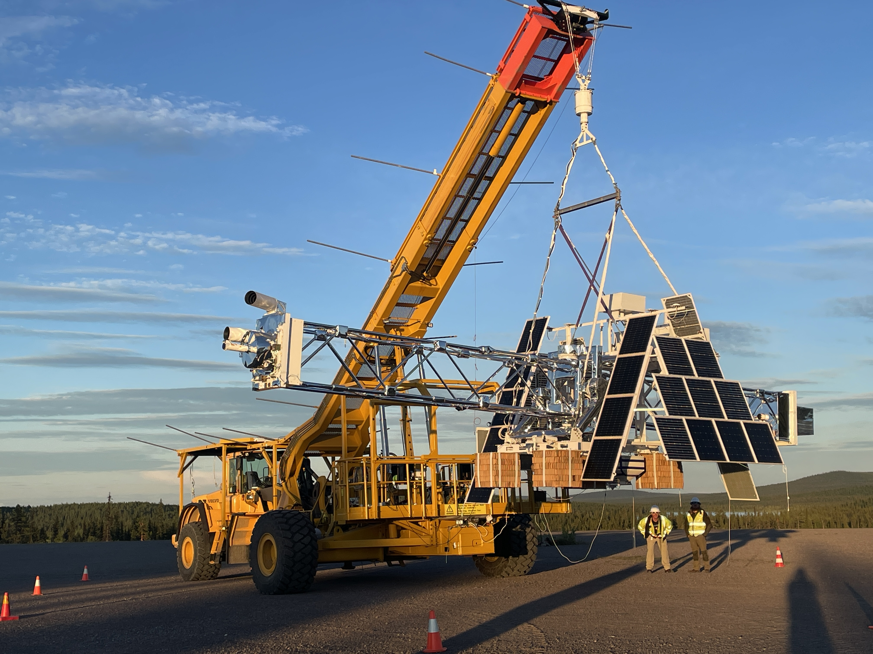
Mission of the NASA Balloon Program
The NASA Balloon Program provides low-cost, quick response, near space access to NASA’s Science Community for conducting Cutting Edge Science Investigations
  Observatory-class Payloads With Advanced Technologies and Large Aperture/Mass
HELIX
Serve as a technology development platform for future space missions
  Instrument & Subsystem development for NASA Flight Projects
SUNRISE
Provide hands-on training of Students, early career Engineers and Scientists
XL-CALIBUR

Slide 3
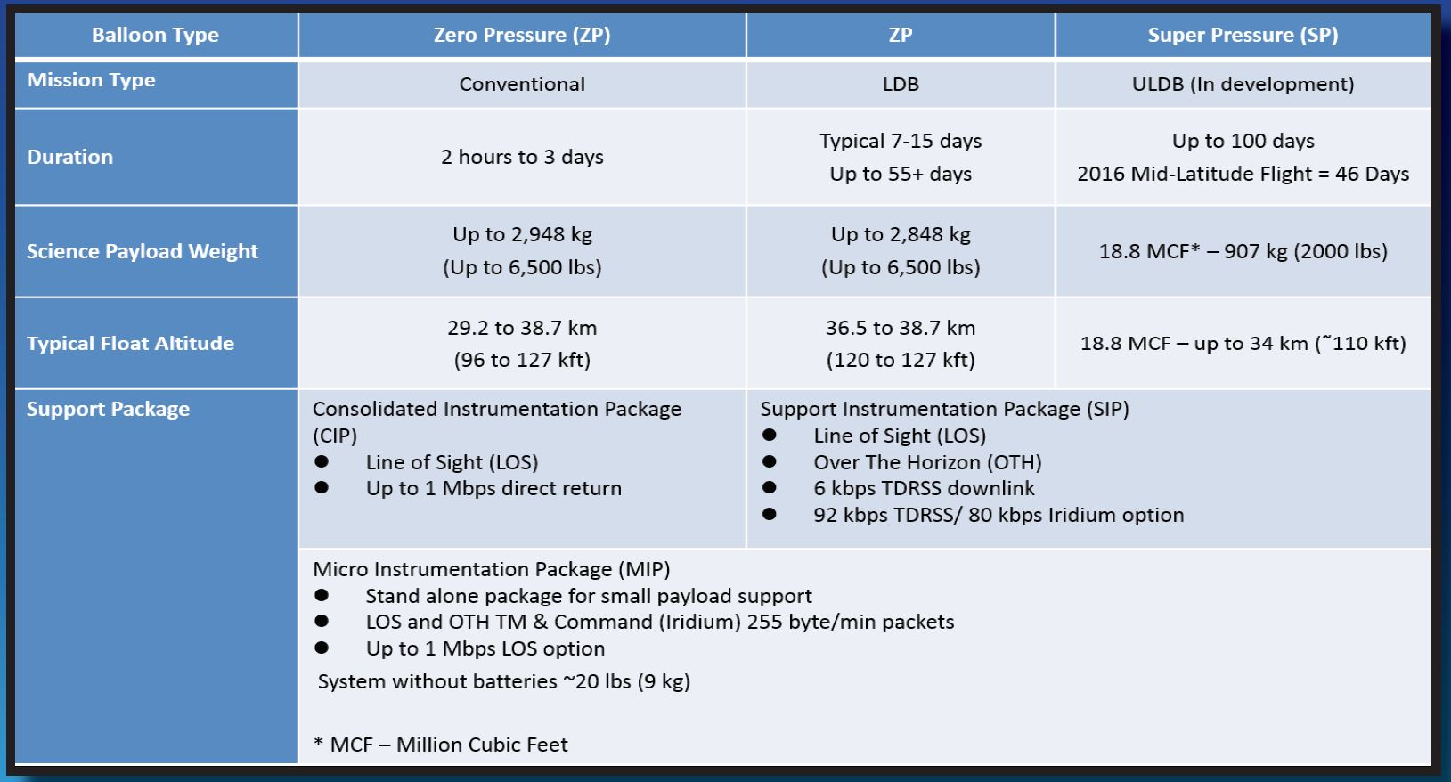
Mission Capabilities

Slide 4
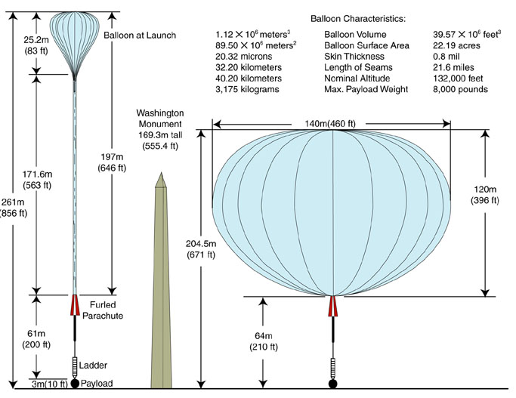
39 MCF Size Comparison

Slide 5
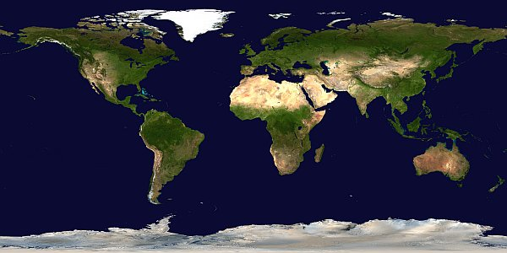
Launch Locations
Esrange, Sweden
Fort Sumner, New Mexico
Palestine, Texas
Alice Springs, Australia
= Conventional Missions
= Long Duration Missions
= LDB/ULDB (Super Pressure) Missions
Wanaka,
New Zealand
McMurdo, Antarctica

Slide 6
Programmatic and scientific value of Esrange
Launching from Esrange provides valuable scientific conditions
  Extended flight durations - 4-7 days as the mission crosses the Atlantic
  Stable altitude - Continuous (or near-continuous) sunlight at float altitude
  Proximity to the polar region
  Astronomical view from the northern hemisphere - sole established location
Good location for developmental test flights
  Established range, low safety risk
  Super Pressure Balloon test flights
  60MCF (1.7x10⁶ m³) test flight
Institutional Support
  Superior facilities and accommodations
  Excellence in technical, logistics, and range support
Relatively long window of opportunity to launch.
Multiple launch opportunities throughout the campaign window
Wide range of termination locations in Canada
  Increased likelihood of recovery

Slide 7
Mission History - Esrange
Total of 29 missions launched since 1999
Year | Number of Missions launched | Total Time aloft
1999 | 2 | 0 days, 12.0 hours
2000 | 2 | 0 days, 9.6 hours
2005 | 1 | 4 days, 4.9 hours
2006 | 3 | 4 days, 3.6 hours
2007 | 3 | 0 days, 9.2 hours
2009 | 4 | 14 days, 1.8 hours
2011 | 3 | 13 days, 10.0 hours
2012 | 1 | 0 days, 6.5 hours
2013 | 1 | 5 days, 7.1 hours
2018 | 3 | 17 days, 6.3 hours
2022 | 2 | 6 days, 14.0 hours
2024 | 4 | 21 days, 21.5 hours

Slide 8
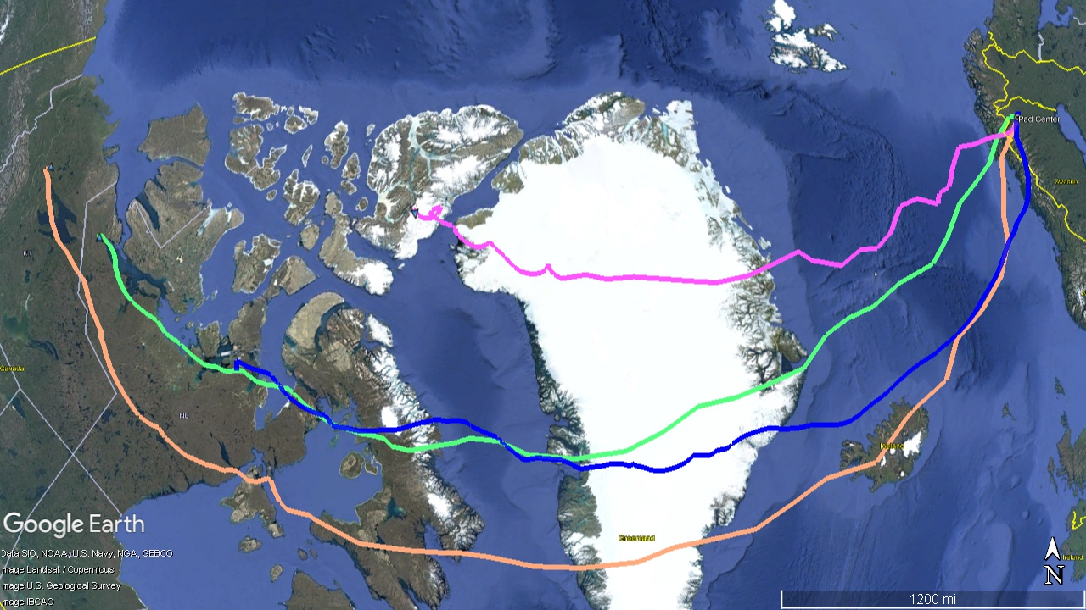
2024 Campaign
SUNRISE – IV
XL-CALIBUR
HELIX
60 MCF
Test flight

Slide 9
2024 Sweden Campaign Summary
Challenges
  Range conflicts
    CNES performing balloon launches in June
  Weather
    One launch early in the campaign followed by a long wait for weather and range availability
Successes
  Launched four missions
  Mission teams obtained a lot of valuable science
  Set a new altitude record for a launch from Sweden ( 160,667 feet / 49 Km)
Success of the campaign can be attributed to SSC support
  Facilities were ideal for mission preparation
  Logistics were responsive to our needs
  Range deconfliction key to allowing all launch operations to be performed
  SSC staff showed great flexibility on schedule and support. Committed to the campaign
  NASA BPO is highly motivated to continue biannual cadence and seeks to continue partnership with SSC and Esrange and its partners.

Slide 10
2024 Flight Summary
Mission | Flight Time
HELIX | 6 days 8.5 hours
XL-CALIBUR | 5 days 20.2 hours
SUNRISE | 6 days 14.8 hours
60 MCF | 3 days 2.0 hours
Total | 21 days 21.5 hours
Items of interest:
This was the most successful campaign in terms of missions completed and time aloft.
SUNRISE was an active collaboration between NASA and ESA and is an example of the kind of collaborations and partnership we continue to pursue for our investment in science.

