Slide 1
Using AIA Emission Measure Inversion Failures to Track Interesting Flare Physics
A. R. Winebarger¹, L. Mallett², P. S. Athiray^{1,3}
¹NASA MSFC, ²Harvey Mudd College, ³ University of Alabama - Huntsville

Slide 2
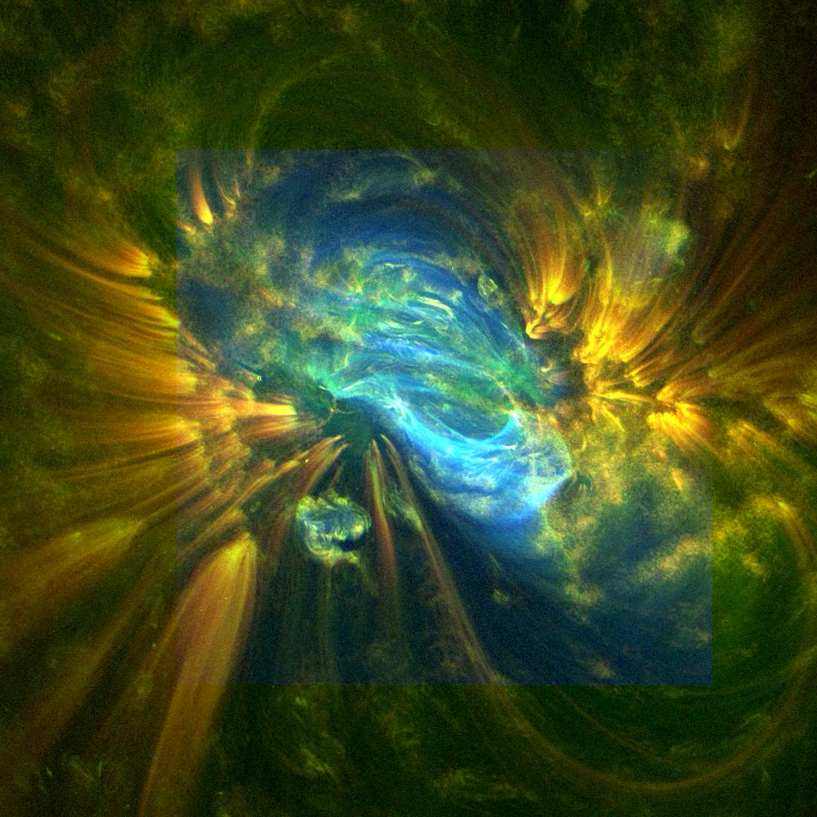
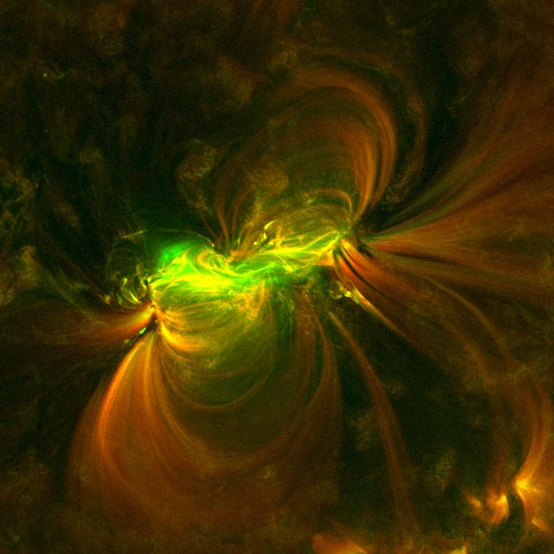
Can AIA be used to determine the evolution of high temperature plasma in solar flares?

Slide 3
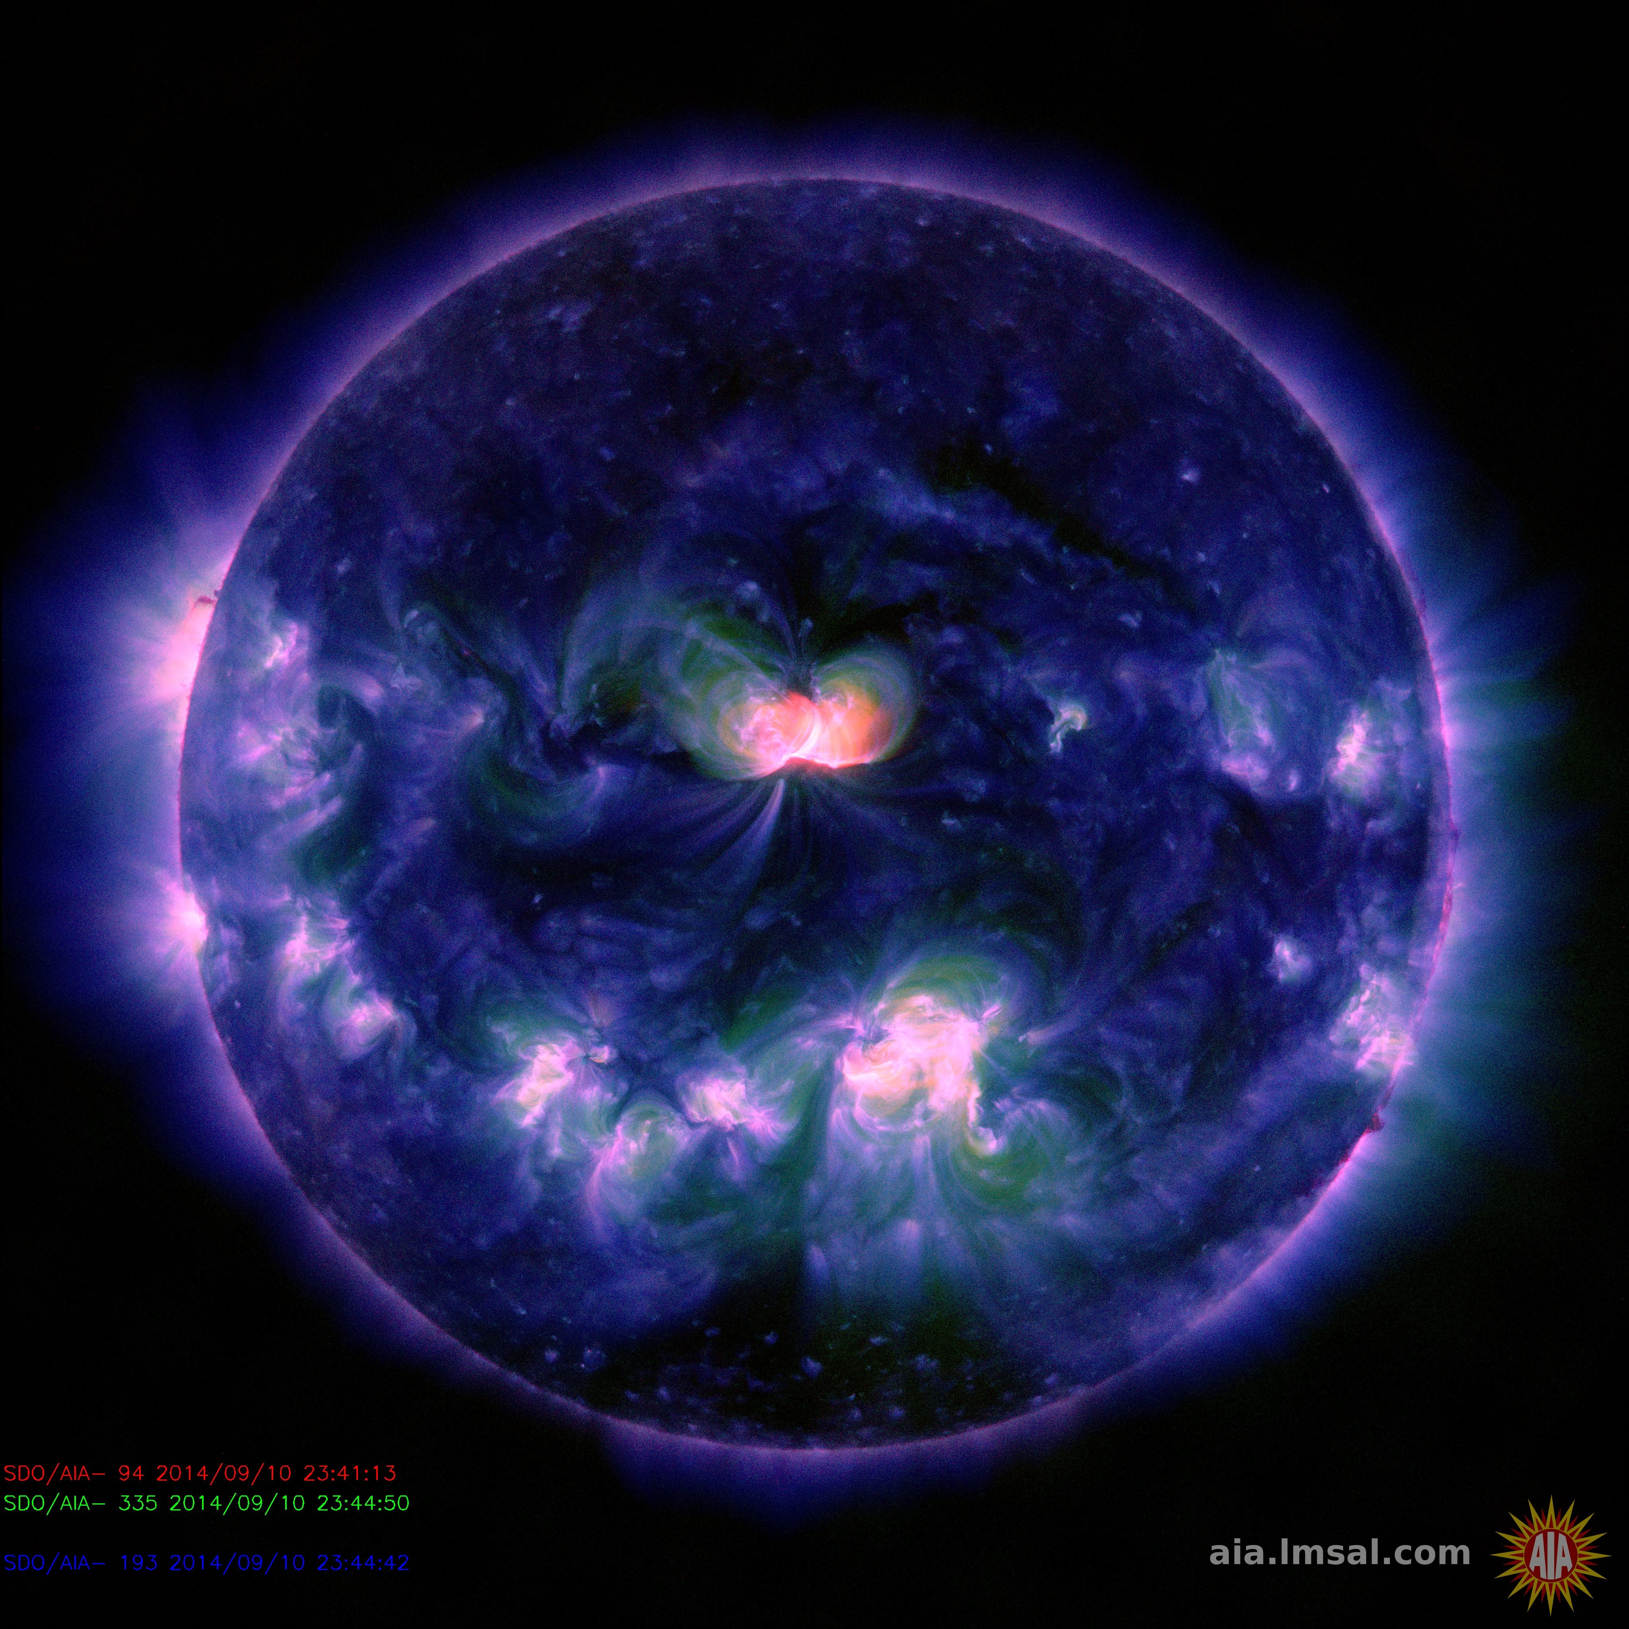
Case study – X1.6 flare
Data summary & preprocessing
X1.6 : 10 Sep 2014 (~17:00 to 19:00 UT)
Select data with shortest exposure in 171Å and gather data within +/- 12 sec
Apply dark current subtraction
Apply PSF deconvolution via Richardson Lucy method
Apply aia_prep for coalignmnet
Flare 1 X1.6 : 10 Sep 2014

Slide 4
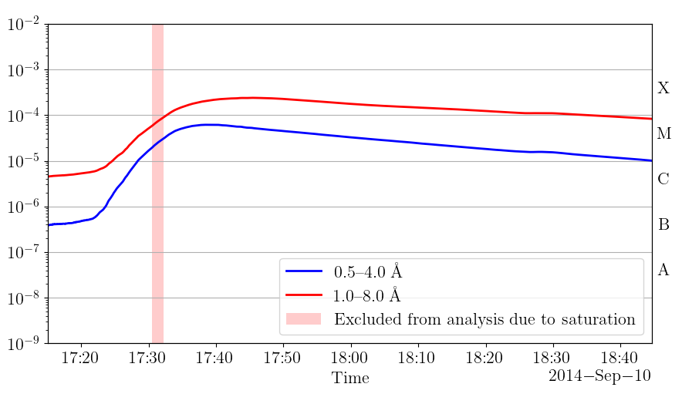
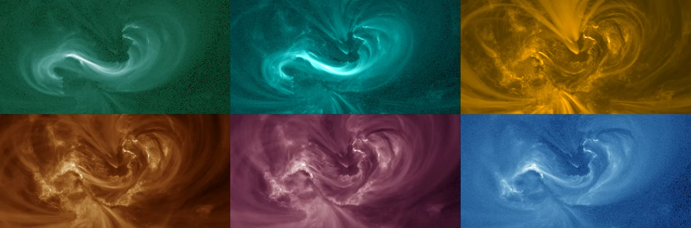
Case study – X1.6 flare
AIA data
94 Å
131 Å
171 Å
193 Å
211 Å
335 Å

Slide 5
EM inversion
SPARSE EM inversion employs SIMPLEX algorithm with IDL implementation (Cheung et al. 2015)
SIMPLEX algorithm results in four possible outcomes of the inversion status
Here, we study the status of the inversion and examine ‘when and where’ successful and unsuccessful inversions occur during a flare evolution.
Status | Description
0 | Successful completion.
1 | The objective function is unbounded.
2 | No solution satisfies the given constraints.
3 | The routine did not converge.

Slide 6
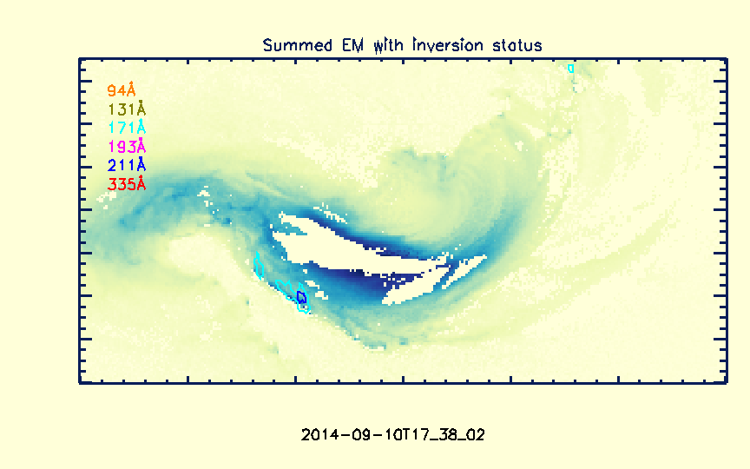
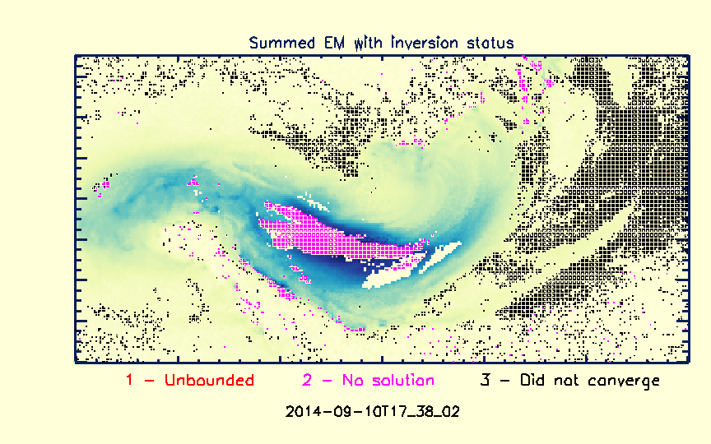
EM inversion results
Summed EM maps compared with pixel saturation map suggest EM failures do not ‘always’ occur at these pixels
Unsuccessful inversion occurs over different parts of the flaring loop at different times during the evolution
  Inversion status 1 rarely occur over the loop structures
  Inversion status 2 chiefly occur over the flaring loops
  Inversion status 3 chiefly occur at the periphery of the AR.

Slide 7
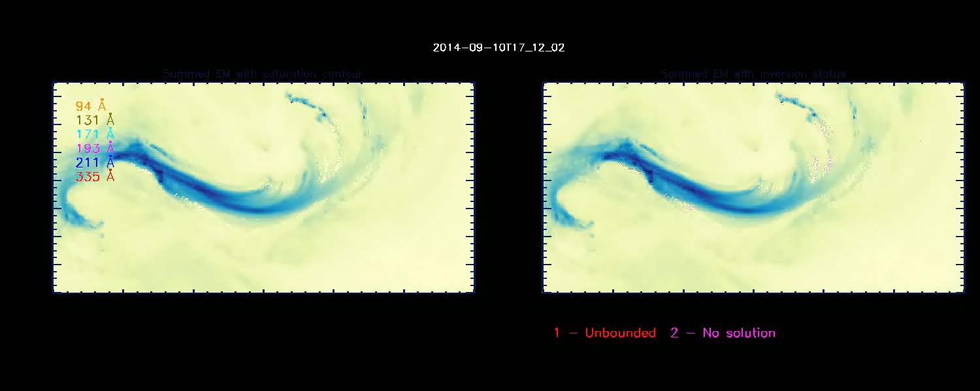
EM inversion results

Slide 8
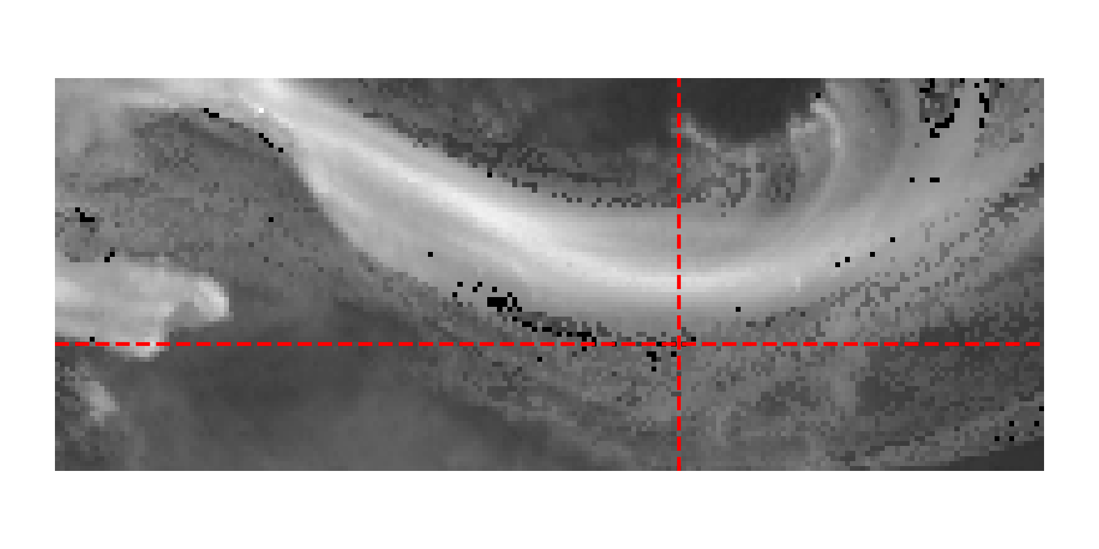
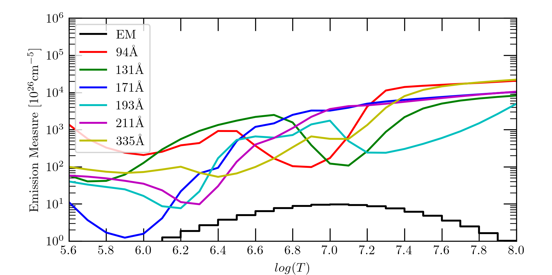
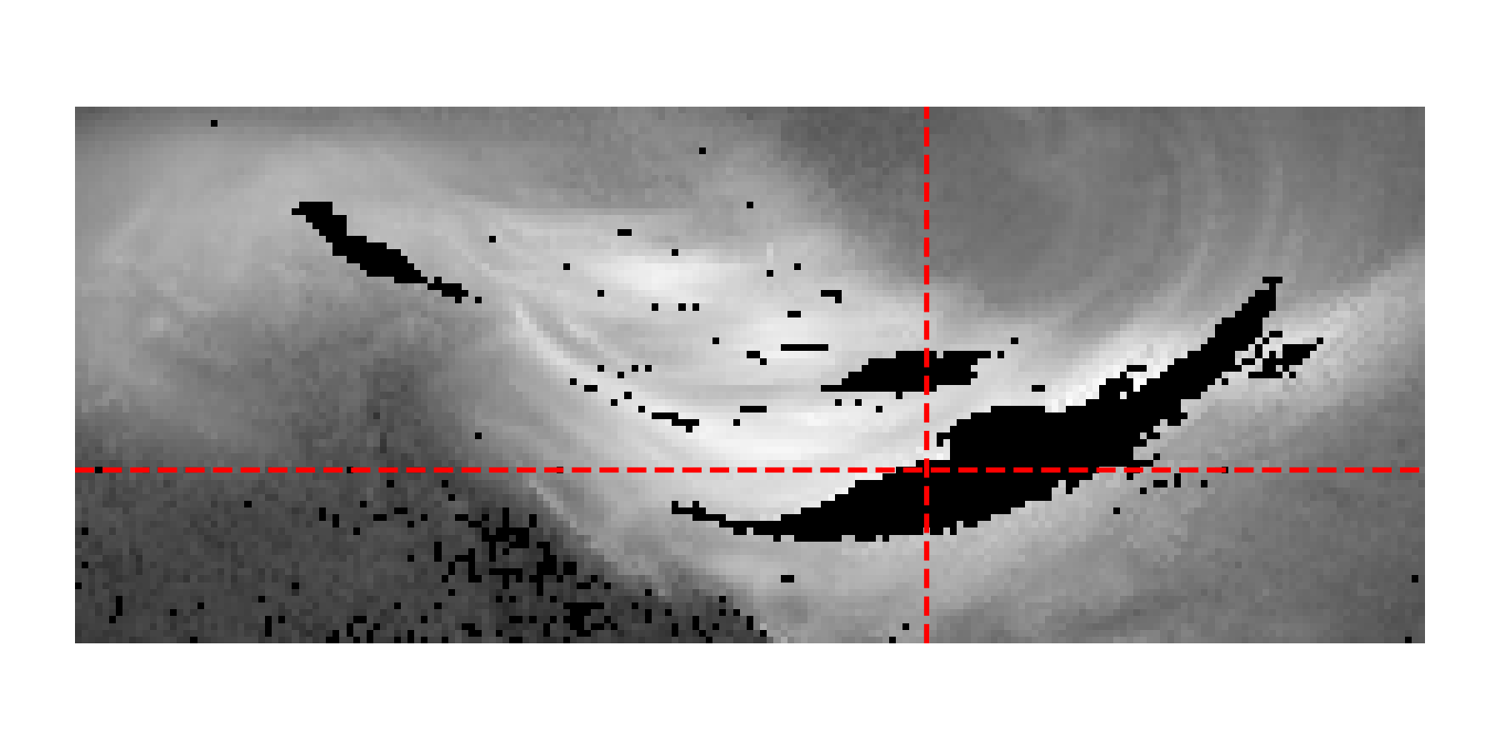
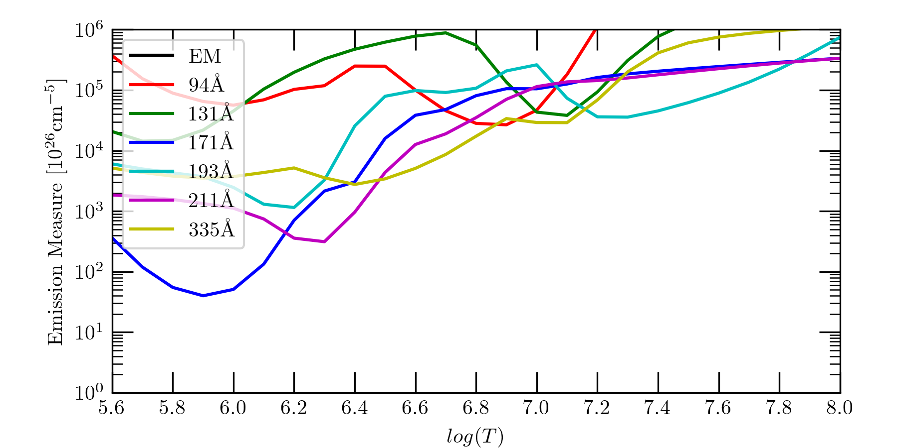
Why do the EM inversions fail?
Converging Example
Failed Example

Slide 9
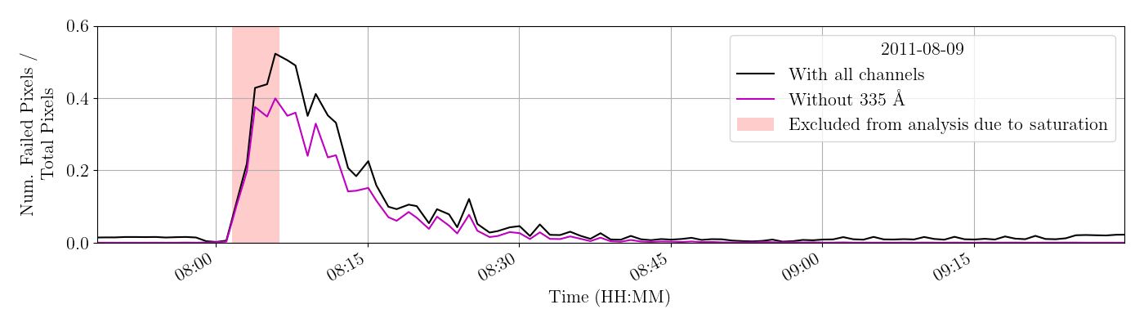
What happens when we leave out 335?

Slide 10
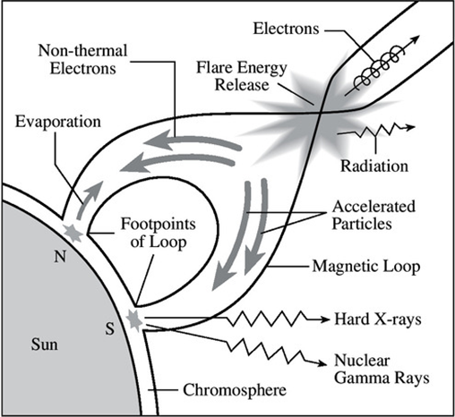
Why are these failures interesting?
Failure of EM inversions are primarily at loop tops and footpoints
Failures are not at the brightest pixels
Failures could be
  A signature of non-thermal electrons
  Due to departure from ionization equilibrium
  Due to the presence of high bulk velocities shifting lines in AIA passbands
  Due to rapid changes in the plasma (non-simultaneous AIA data in all channels)
  Due to an instrumental effect, such as cross-talk between AIA channels (335 vs 131)
Failures may be used to trace interesting physics! More to come.
Chernov et al, 2016, Research in Astronomy and Astrophysics, Vol 16, Issue 2, article ID 28.

