Slide 1
From Research to Reality
Challenges and Opportunities in Complex System Design
Dr. Ian Levitt
University of Minnesota Institute for Mathematics and its Applications Industrial Problems Seminar
Feb 14, 2025

Slide 2
My Motivation
20.5%
110x
Deployment &
Site Acceptance
Needs and
Shortfalls
0%, 9%
40x
Operational
Tests
ConOps
70%, 3.5%
10%, 50.5%
System
Testing
1x
16x
Ops & System
Requirements
Integration
Testing
20%, 16%
System/
Software
Design
Subsystem
& Unit Test
5x
Color Key for Vee:
Sources:
NIST Planning report 02-3, The Economic Impacts of Inadequate Infrastructure for Software Testing, May 2002.
D. Galin, Software Quality Assurance: From Theory to Implementation, Pearson/Addison-Wesley (2004)
B.W. Boehm, Software Engineering Economics, Prentice Hall (1981)
Where faults are introduced
Code
Development
Where faults are found
The estimated nominal cost for fault removal
Shift Left V&V

Slide 3



False Detection of ATCRBS Messages
Air Traffic Control Radar Beacon System (ATCRBS)
$$X=number of arrivals in time interval t$$
$$\operatorname{Pr}\left(X>0\right)=1−e^{−λt}$$

Slide 4
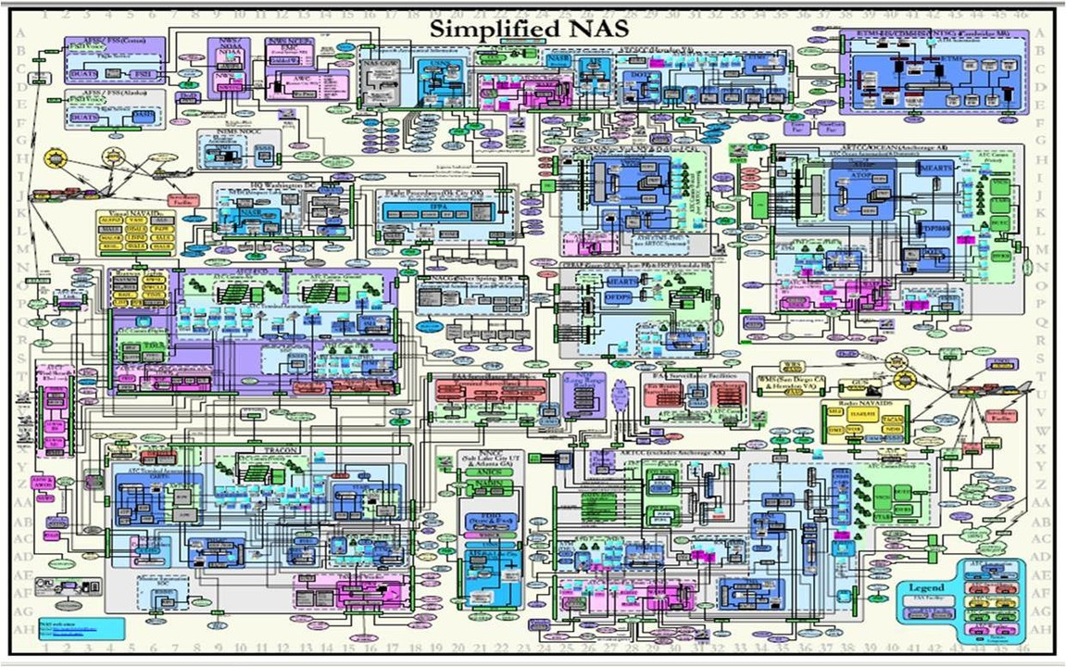
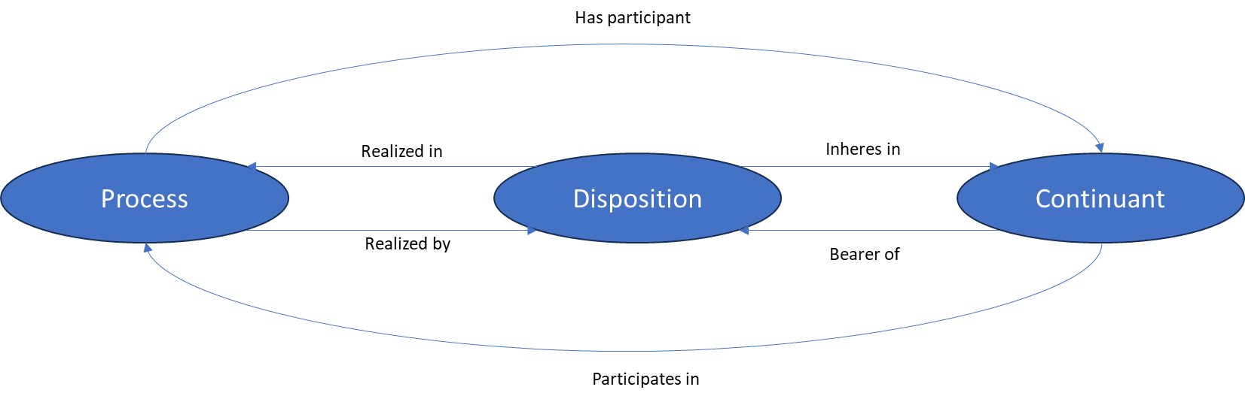
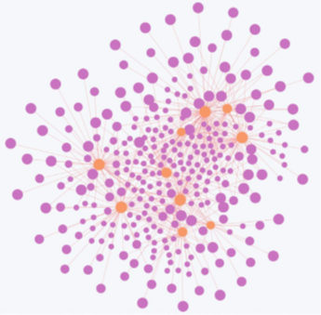

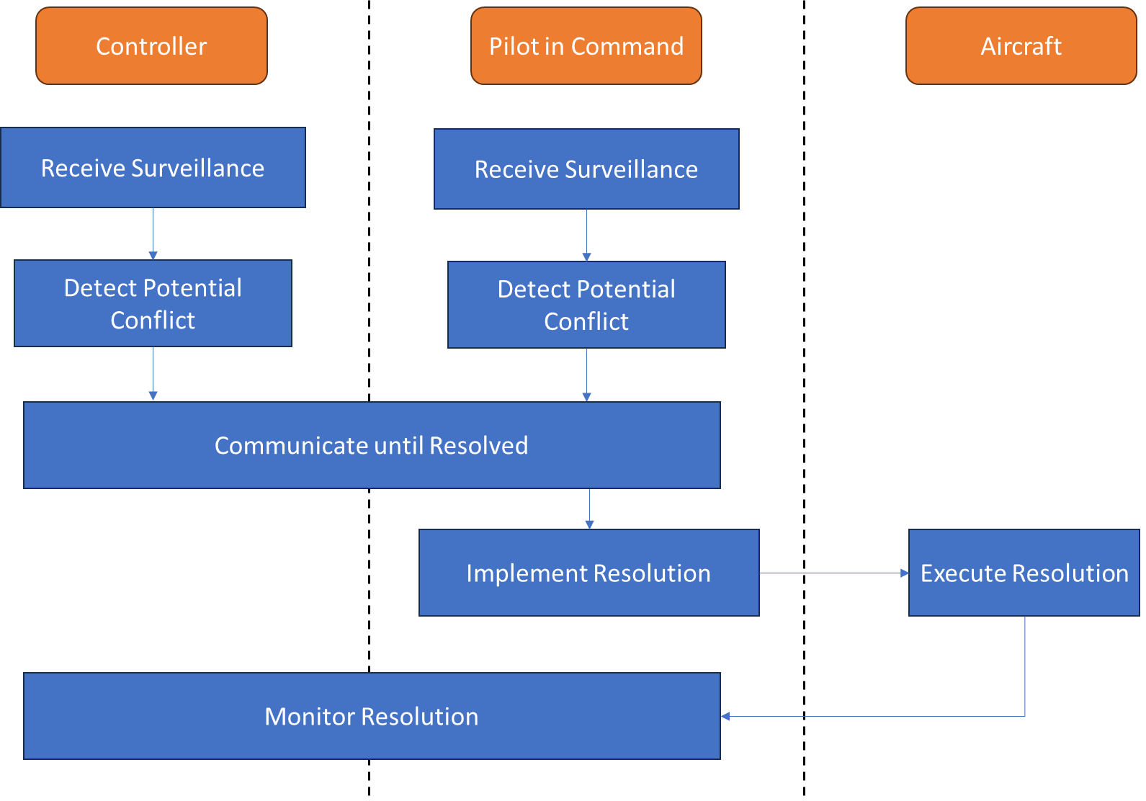
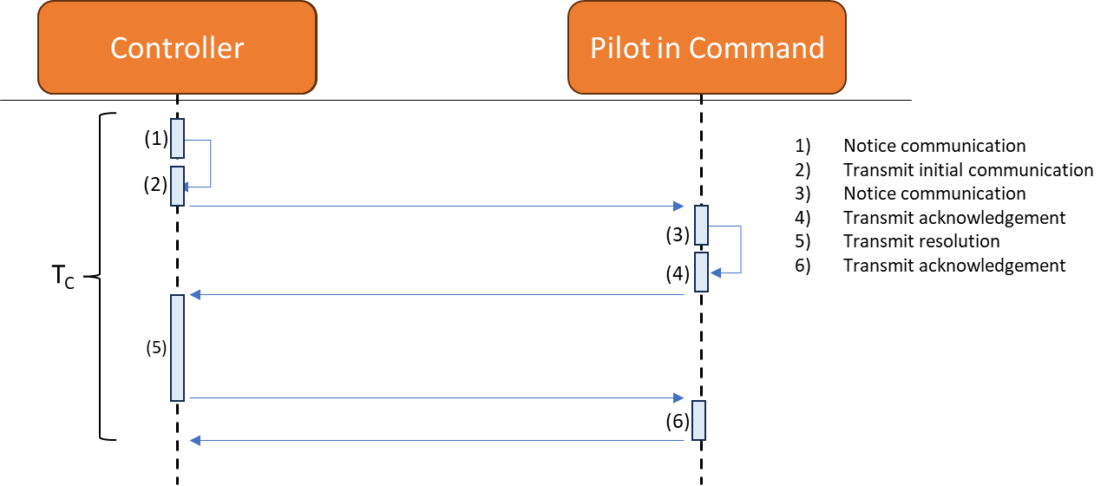
Aviation System Architecture
Basic Formal Ontology (BFO)
Separation Provision Intervention Capability
Communication Time

Slide 5
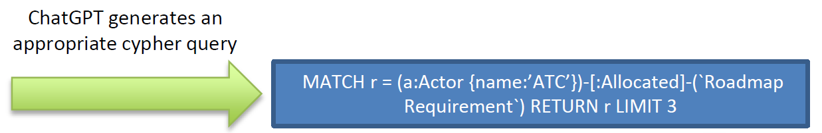
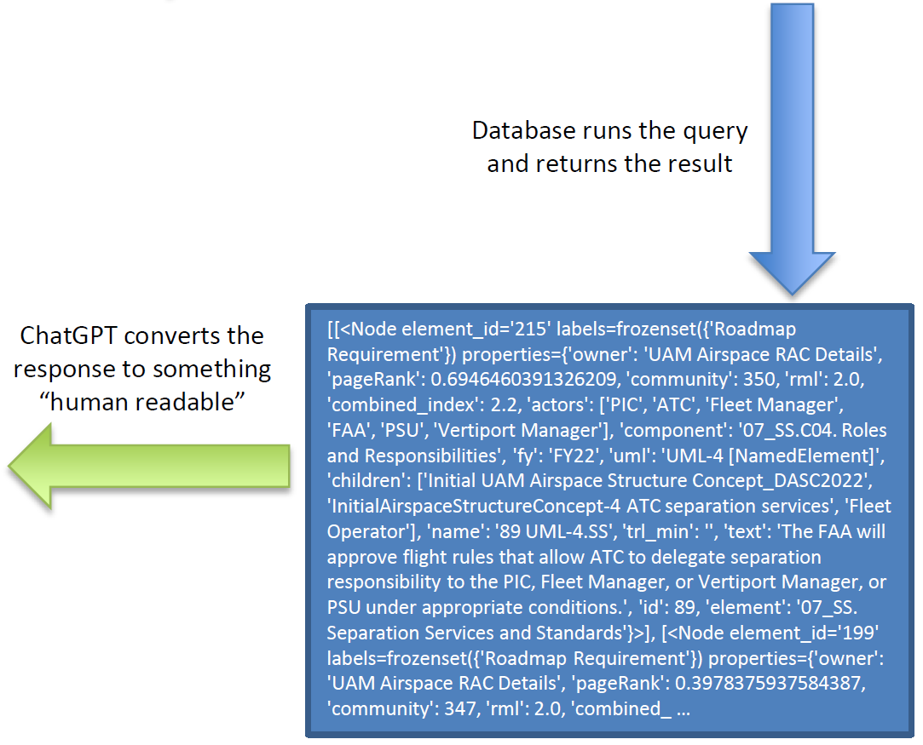
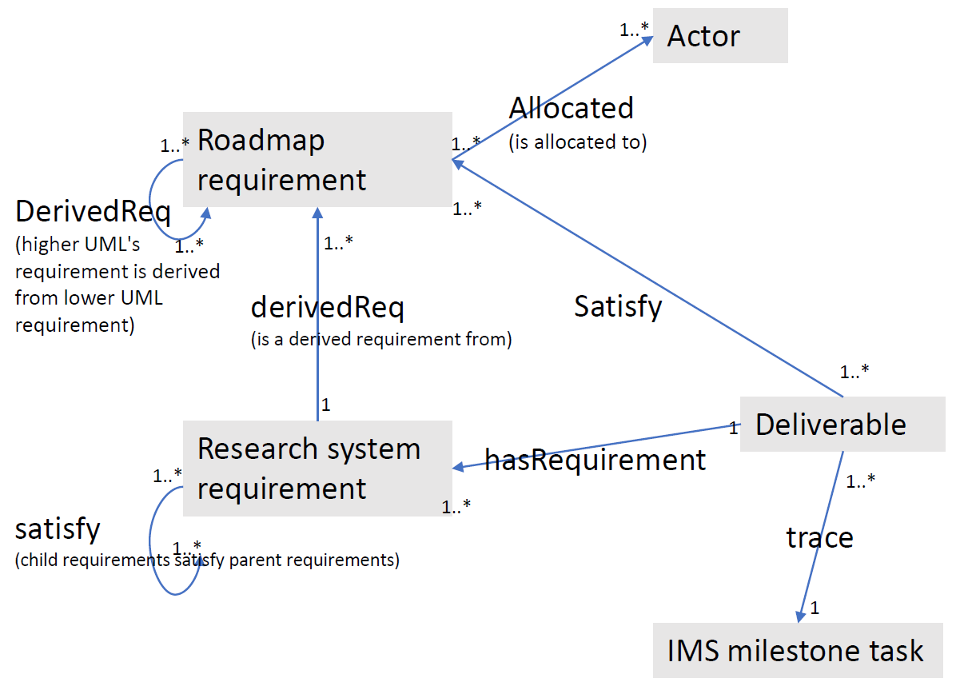
Chat GPT for Requirements Discovery

Slide 6
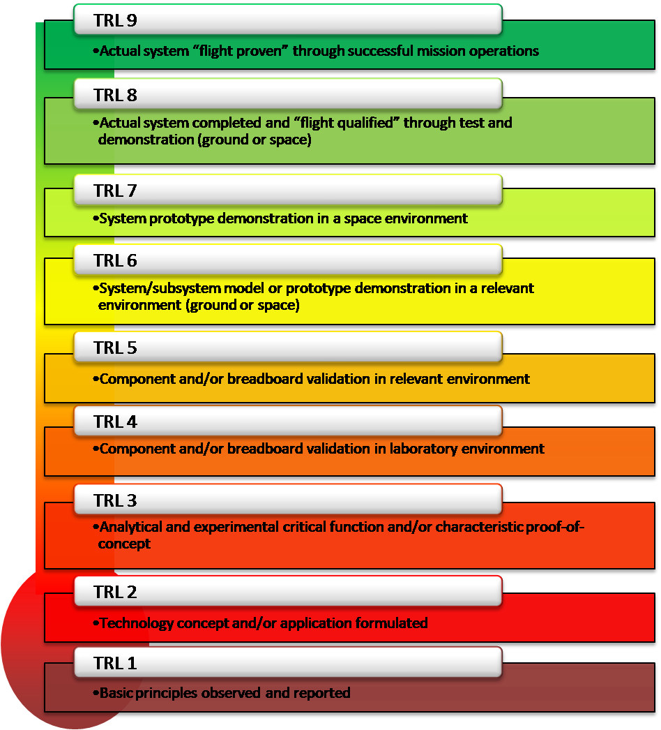
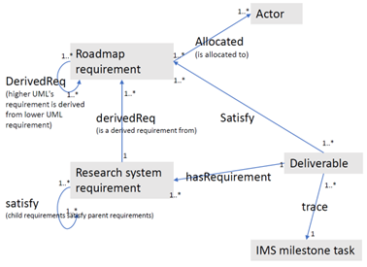


Validation Metrics – Requirements Maturity Level
Requirement
Test Deliverable
Want a measure of Requirement Maturity Level which tracks with the TRL of the deliverables that have tested it with following properties:
More testing means higher RML
RML cannot exceed the maximum TRL over all testing
Low-TRL deliverables count less than high-TRL deliverables
$m=$ Max TRL of all deliverables
Taken from: https://www.nasa.gov/directorates/somd/space-communications-navigation-program/technology-readiness-levels/
$n_{i}=$Number of deliverables with TRL =$i$

Slide 7
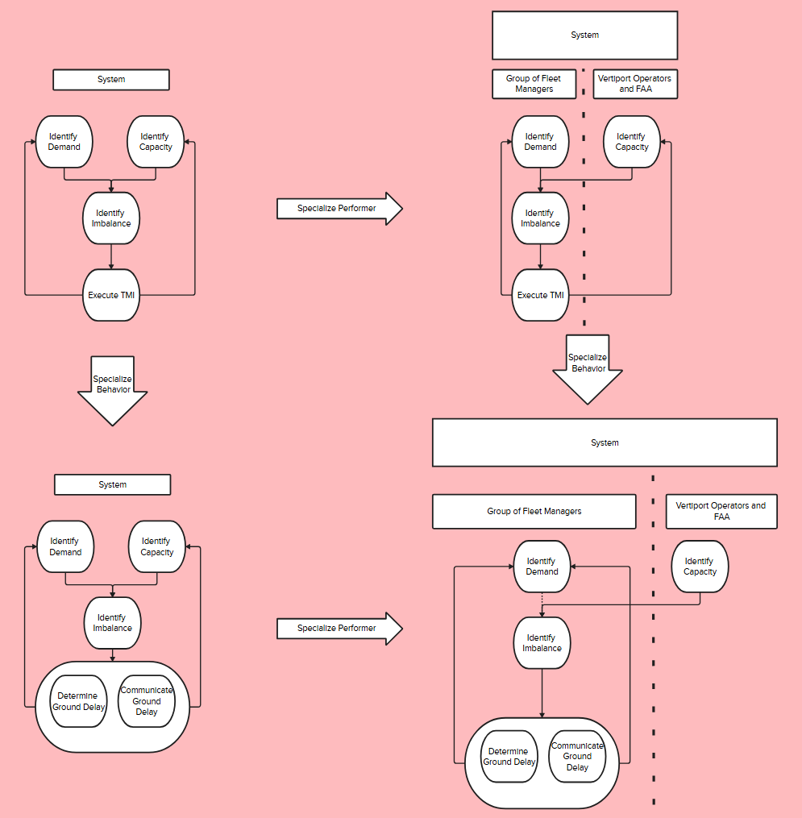
Applied Category Theory
Abstraction: Logical and physical architectures
Compositionality: Composing sub-systems
Formalism: Ensure correctness, apply AI/ML
Promising applications
Producing Architecture Views
Transforming between Models
Transforming between Views
Collaborative design
System dynamics
System evolution
Potential tools
Wiring Diagrams
Monoidal Categories
Functorial Data Migration
Profunctors
Enriched Categories
Polynomial functors
Coalgebras

