Slide 1
Automation of Mission Operations & Testing with Digital Twins
D. Cody Cutright, Systems Engineer, TMC Technologies
February 12, 2025

Slide 2
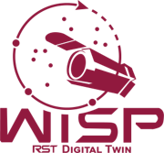
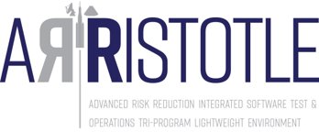

Who is NASA IV&V?
NASA Katherine Johnson Independent Verification and Validation Program
Ensuring Class A Mission success since 1993
Full Development Lifecycle
Software Requirements, Design, Code, Test, I&T
Located in West Virginia
JSTAR Team
The Jon McBride Software Testing & Research Laboratory
Named for WV’s first astronaut
Specialized subset of IV&V Facility
Experts in modeling, simulation, and digital twins of NASA missions

Slide 3
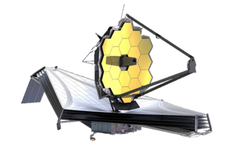


What Does JSTAR Do?​
Experts in software only simulation of hardware
Experts in hardware emulation
We provide simulated hardware so flight binaries can be executed, unmodified, on commodity hardware
This enables unique, challenging, and otherwise difficult to create test cases
Virtual testbeds allow development to proceed without immediate access to a flatsat
In some cases, code can essentially be finalized prior to hardware integration
Shortens development timelines
FSW, Physics, Avionics

Slide 4
How do you design, test, and operate efficiently?

Slide 5
Traditional NASA Life-Cycle Phases
Pre-Phase A: Concept Studies
A: Concept & Technology Development
Traditionally, sub-system software begins here.
B: Preliminary Design & Technology Completion
FSW integration with sub-systems and system-wide testing here.
C: Final Design and Fabrication
D: System Assembly, Integration & Test, Launch & Checkout
E: Operations & Sustainment
Based on NPR 7123.1
F: Closeout
Notes:
For mission testing and operations, where is the bottleneck?

Slide 6
C & D Overviews
C: Final Fabrication & Design “To complete the detailed design of the system (and its associated subsystems, including its operations systems), fabricate hardware, and code software.”
D: System Assembly, Integration and Test, Launch
“To assemble and integrate the system (hardware, software, and humans), meanwhile developing confidence that it is able to meet the system requirements. Launch and prepare for operations. Perform system end product implementation, assembly, integration and test, and transition to use.”

Slide 7
Why not start mission operations and testing in phase C?
Working towards a finalized design
Have a good idea of subsystems that will be selected early on in Phase C
Definite list of subsystems and manufacturers at the end of Phase C
You know the basics of everything, including flight software
Start with a skeleton framework of subsystem applications and simulators, and iterate as more information becomes available
There’s no need to wait for hardware to begin software, if you have an ICD and specifications!

Slide 8
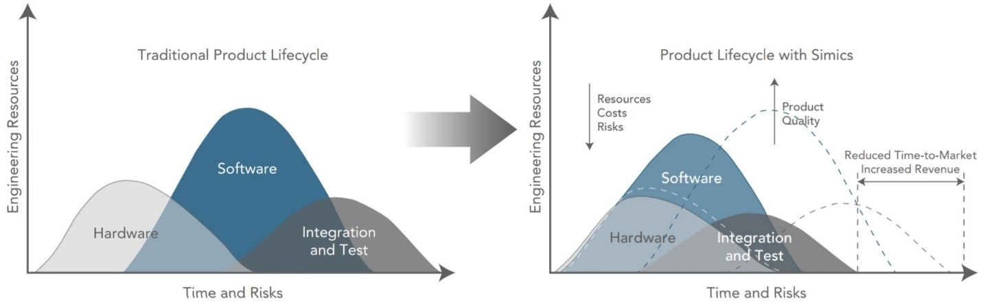
Benefits of starting early
Digital twins shift the traditional software development cycle
Greatly increase test resources and opportunities
Shifting Left—Building Systems & Software Before Hardware Lands (intel.com)

Slide 9
More benefits
Digital twins allow for earlier…
operator competency
fault detection & correction scenario testing
nominal concepts of operations / DITL
system-wide integration for data products that drive additional software (e.g. ML for representative spacecraft data)

Slide 10
Which disciplines can benefit?
Developers
Software development environment
Early development opportunities before hardware arrives
I&T
Enables end-to-end testing early
Manipulate hardware models
Operations
Dry-run scenarios
Day in the life testing
V&V
Increases available test resources
Code coverage
Exploratory testing
New Personnel
Training platform that you cannot break
Easily run lab tests to demonstrate faults
IV&V
Risk reduction testing and mission assurance
Hardware modeling and fault injection
Researchers
Integrate and demonstrate new technologies
New uses and users reported regularly!

Slide 11
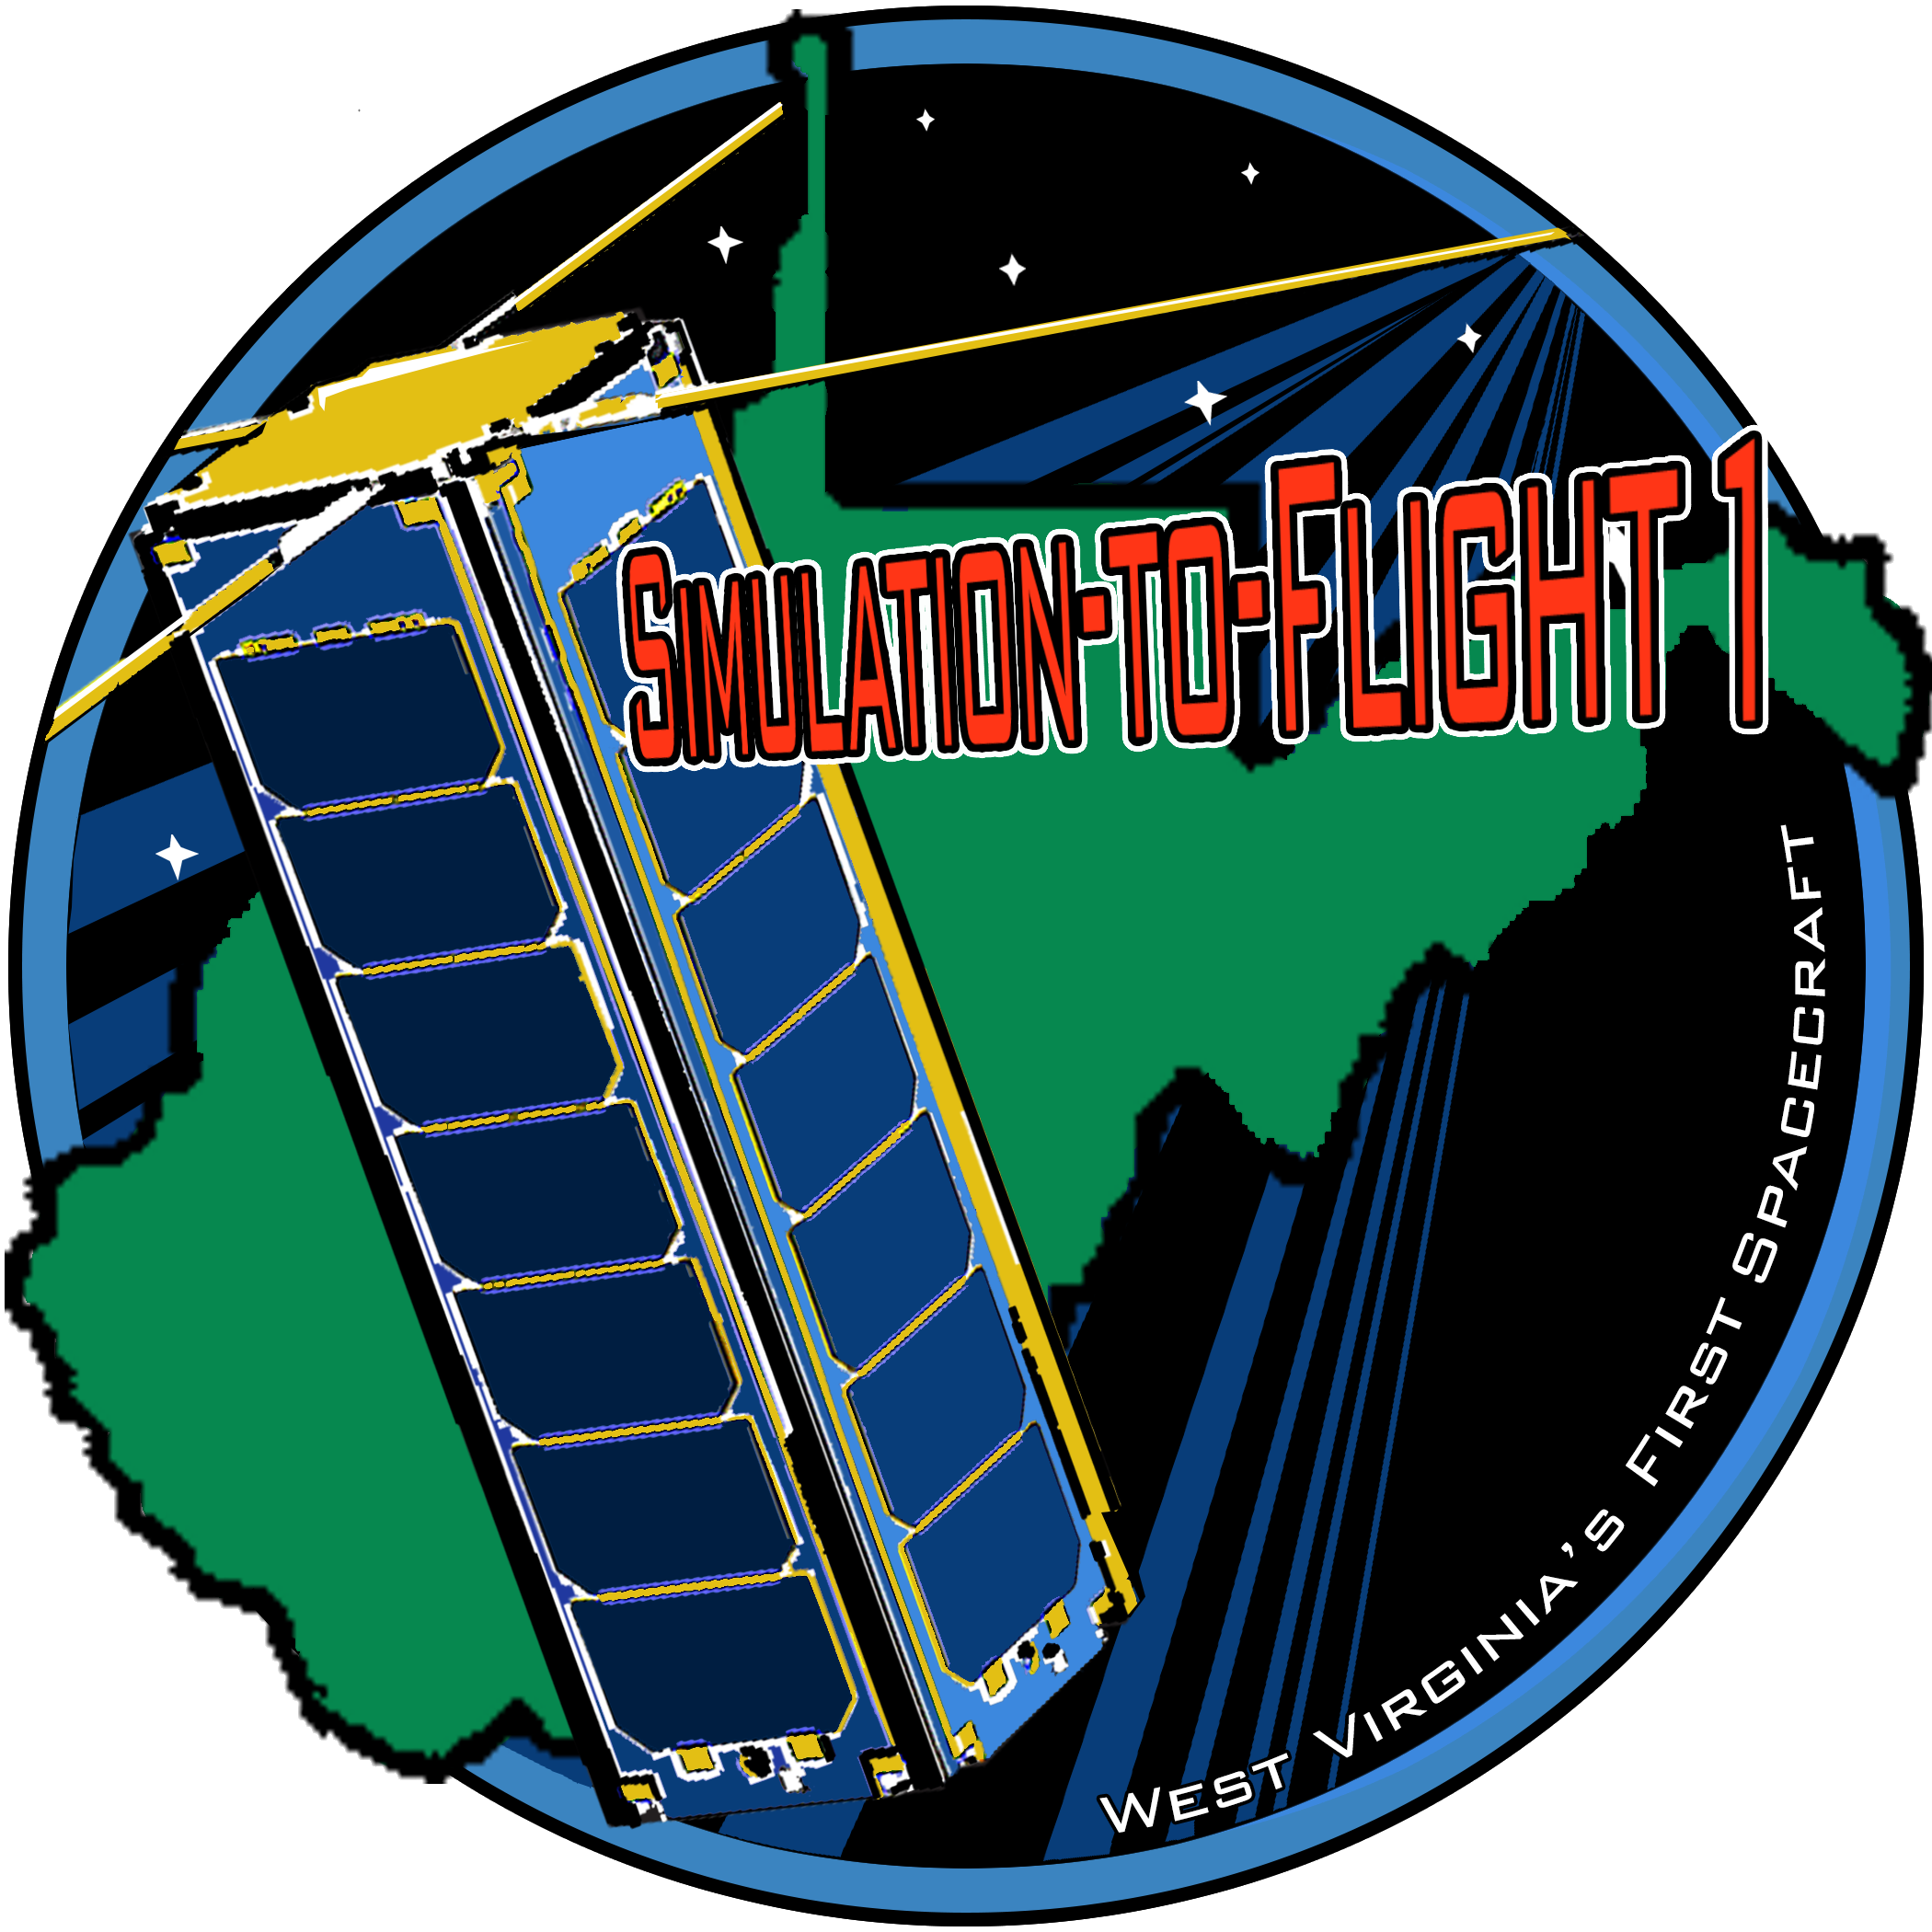
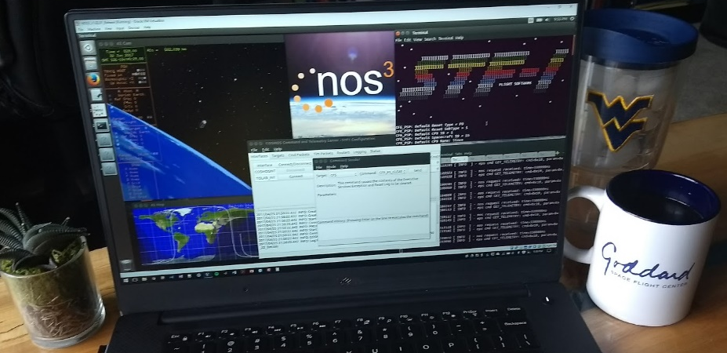
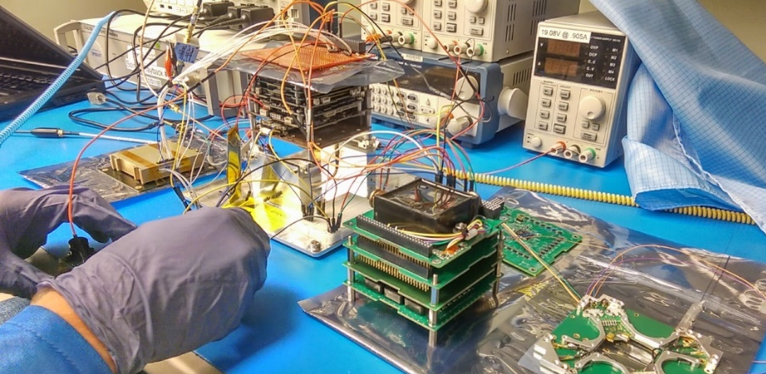
Simulation To Flight 1
Born of Simulation To Flight 1 (STF-1)
West Virginia’s first spacecraft
Partnered with WVU and leveraged existing NASA GSFC efforts
Demonstrated digital twin capabilities to improve mission processes
Provided an open-source solution for researchers and technology development
Resulted in the NOS3 platform
Initially a framework
Now a design reference mission
De-orbited in 2024, after 5 operational years

Slide 12
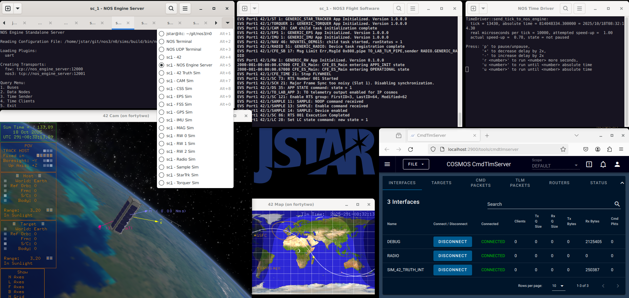
NOS3 Simulation Example
Flight Software
Hardware Models
Flight Software
Hardware Model
Time Sync
Time Sync
Ground Software
Ground Software
Dynamics
Dynamics

Slide 13
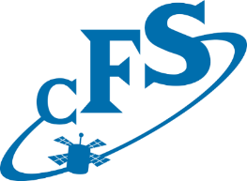
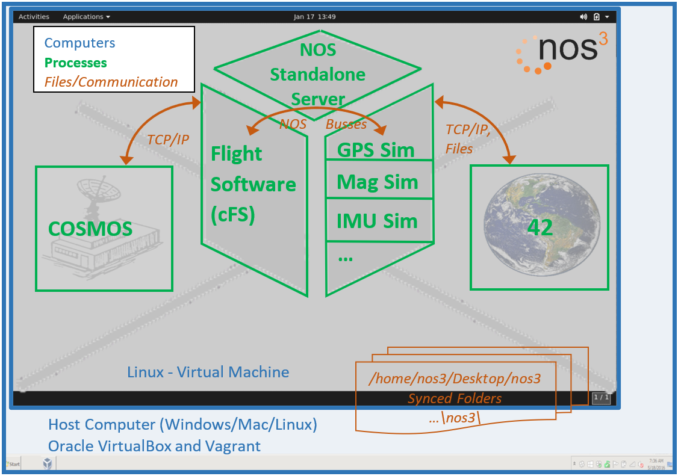


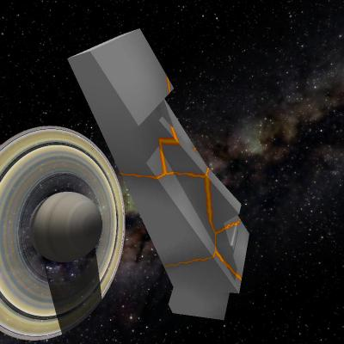

NOS3 Architecture
Combination of multiple pieces of open-source software
A virtual spacecraft!
Learn on, do research, baseline as your own
Flight Software
Core Flight System (cFS)
F’
Ground Stations
Ball Aerospace COSMOS
JPL AMMOS Instrument Toolkit
OpenC3 COSMOS
YAMCS
Dynamics / Visualization
42
NOS Engine
Communication protocols
Hardware abstraction layer
Component simulators

Slide 14
NOS3 Architecture
NOS3 enables cross compiling for your flight and simulation targets
HWLIB enables selection of build type via flags at compile time
FSW
SIM
NASA Operational Simulator (NOS)
Time synchronized across all modules
Software Bus
CAM
Hardware Library
CAM
Engine
Sim Terminal
Time
GPS
GPS
NOS
Engine
UDP
Data Providers
Inst.
Inst.
42 Spacecraft Dynamics Simulator
Radio
Radio
UDP
Ground Station Software

Slide 15
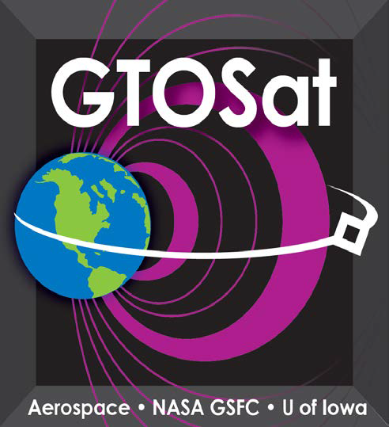
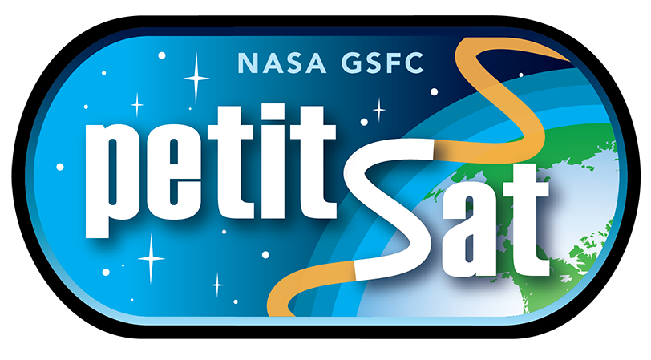

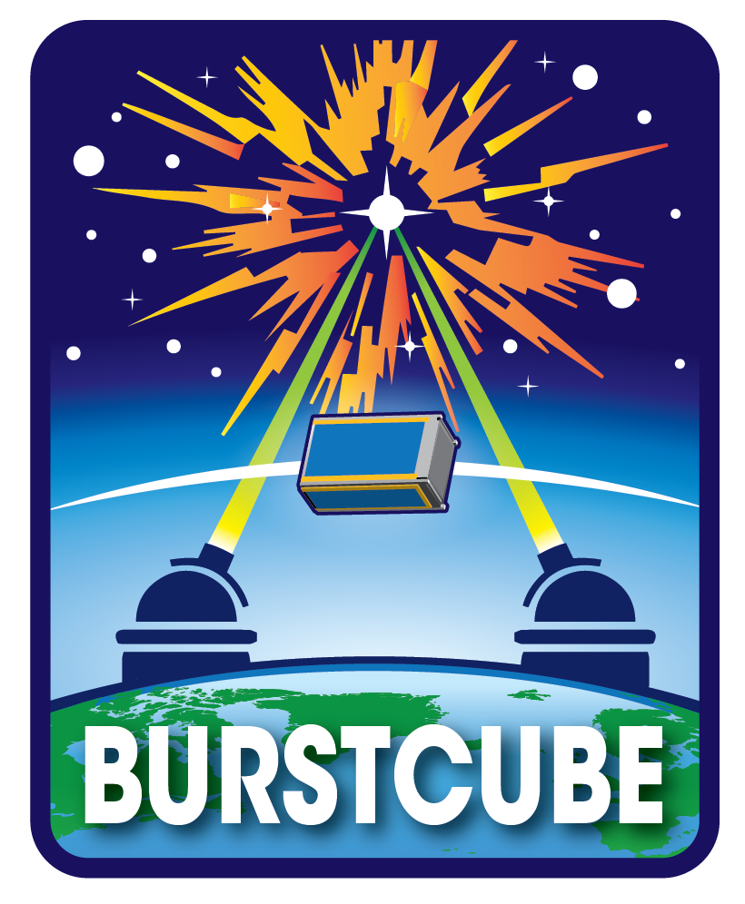
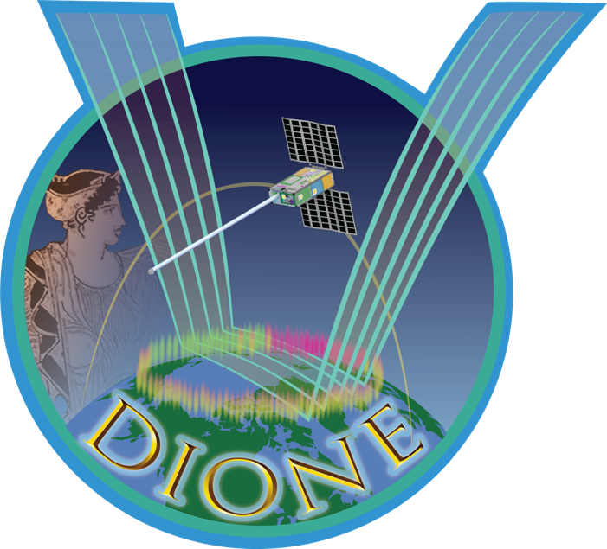
Design Reference Mission
NOS3 benefits have been proven across multiple missions
Each mission develops several hardware specific applications
Due to licensing concerns these are not available outside of NASA for re-use
Missions often become so specific that implementations require a complete understanding
No easy method of training or baselining for new efforts
To provide a baseline for advanced development in NOS3 a complete mission is required
Generic components and interfacing was the first step to resolve this

Slide 16
NOS3 Development Flow
Template
README
Review
Checkout
Checkout HW Testing
Simulator
Checkout w/ Simulator
Application
Application w/ Simulator
Application HW Testing

Slide 17
Developers
Robert J. Brown, Systems Engineer, TMC Technologies, NASA IV&V
D. Cody Cutright, System Engineer, TMC Technologies, NASA IV&V
Donovan R. Ice, Systems Engineer, TMC Technologies, NASA IV&V
John P. Lucas, Systems Engineer & JSTAR Deputy Lead, NASA IV&V
Justin R. Morris, Computer Engineer & JSTAR Lead, NASA IV&V
Scott A. Zemerick, Chief Engineer, TMC Technologies, NASA IV&V

Slide 18
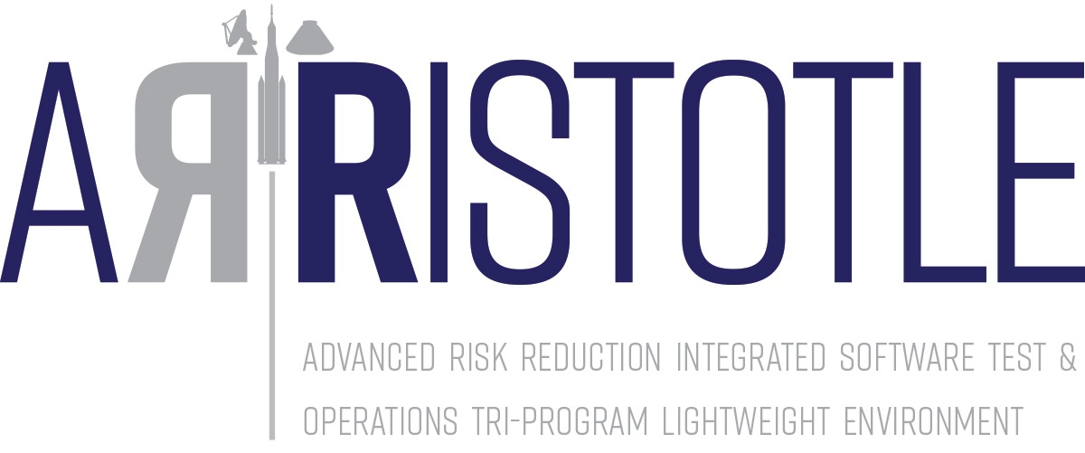
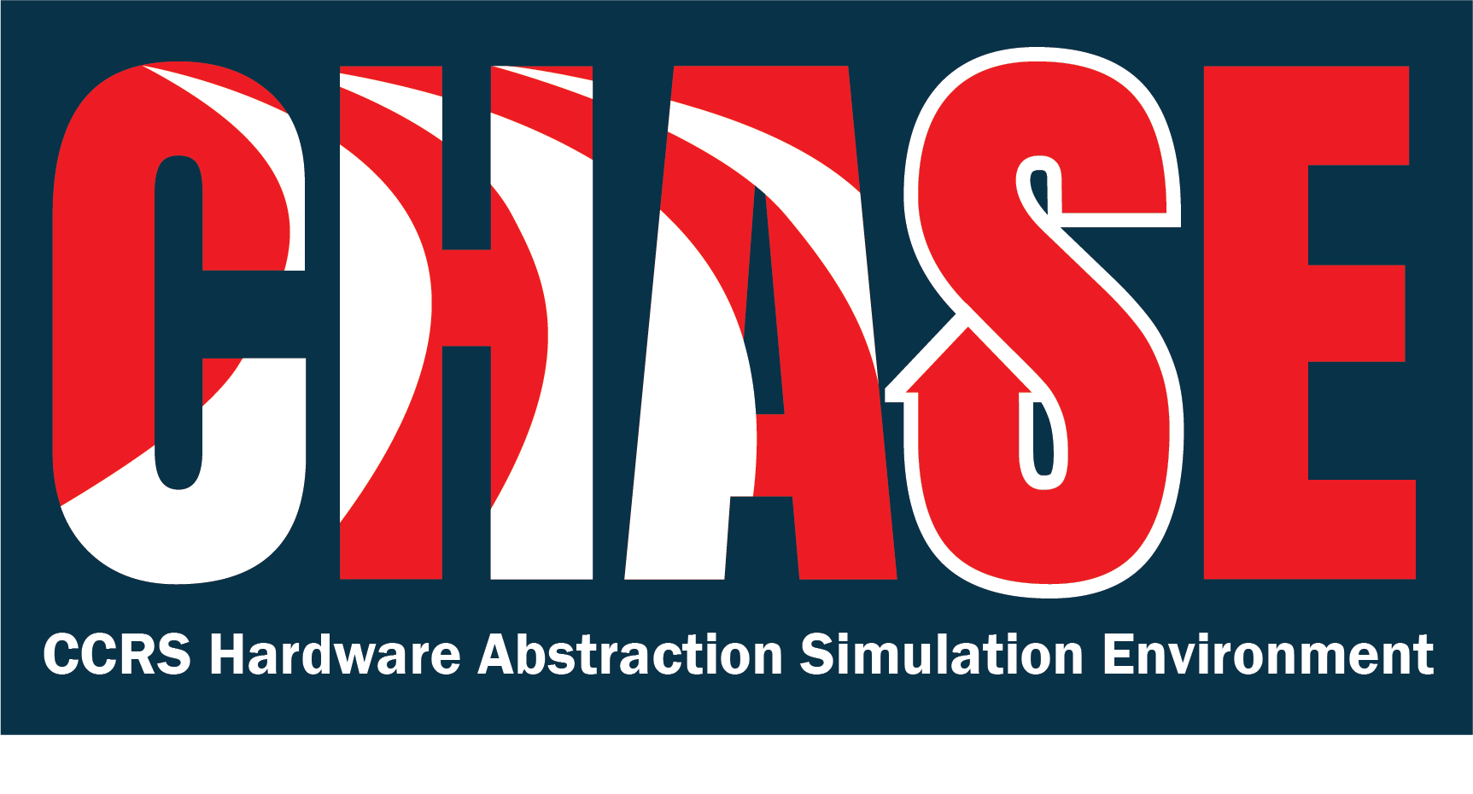

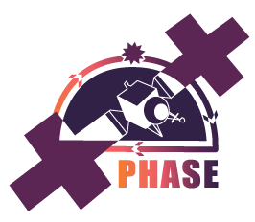

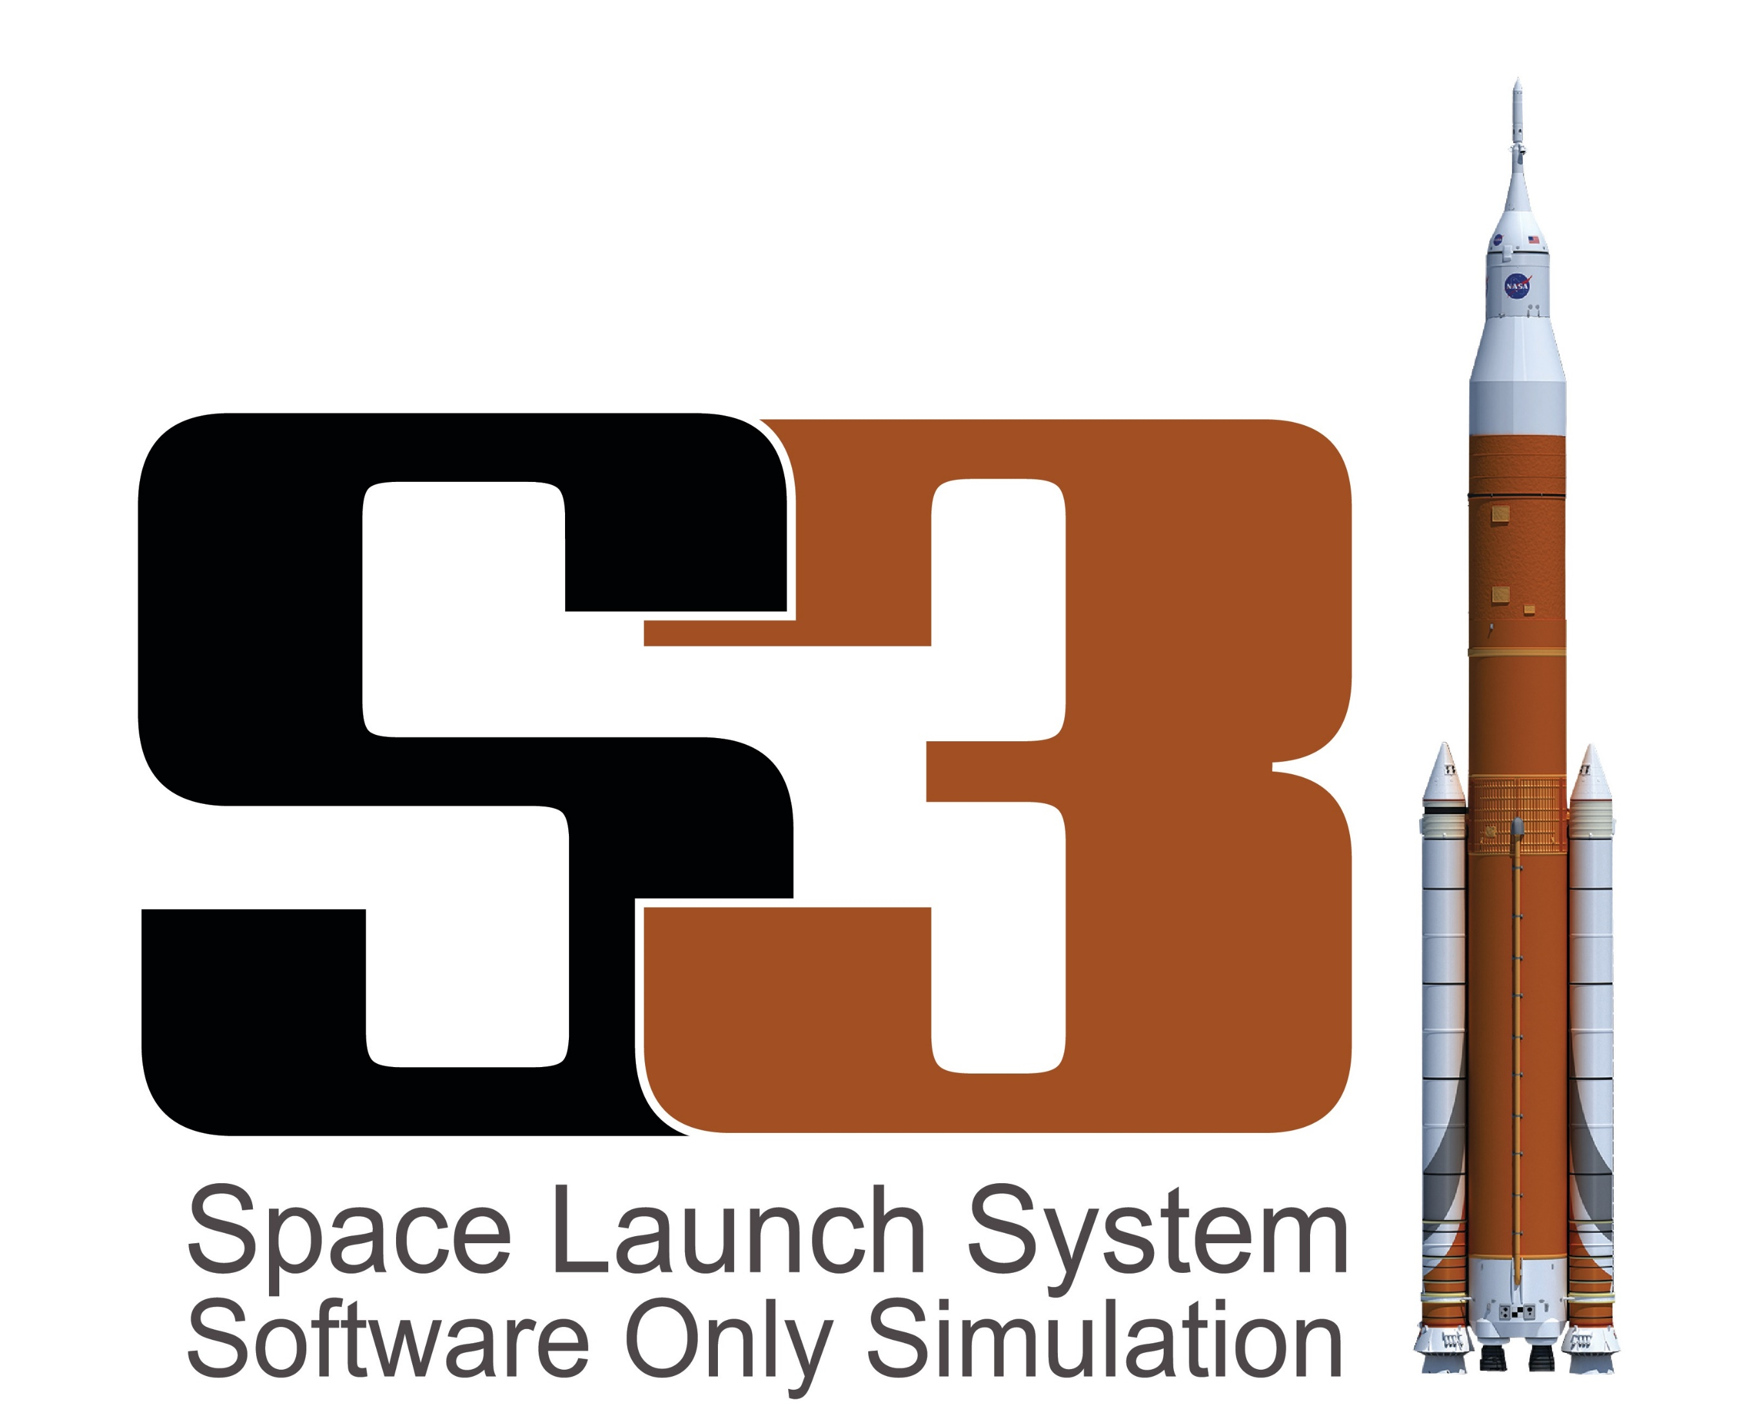
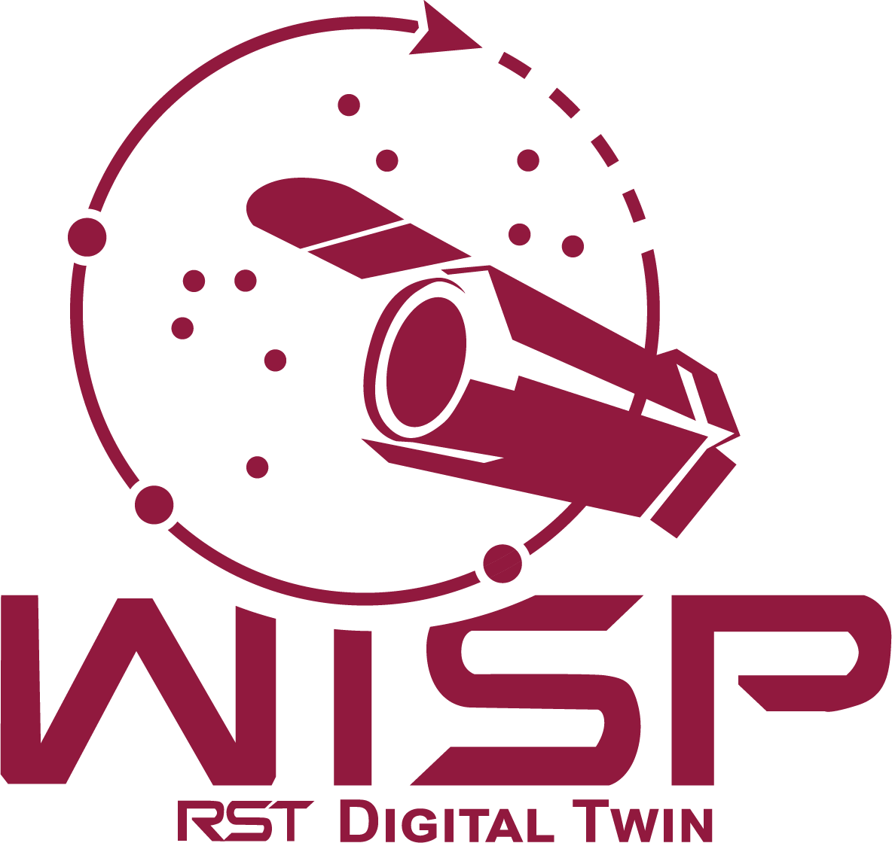
JSTAR In Review
JSTAR is a Digital twin factory
Digital twins provide a capability
Highly flexible environments to support development and risk reduction testing
Digital twins shift the software timeline
Less reliance on hardware schedules
Increased test opportunities and resources
Points of Contact
David.C.Cutright@nasa.gov
Justin.R.Morris@nasa.gov

