Slide 1
Evaluating Crewed Lunar Landers
Steven Carothers (NASA)
Mark Updegrove (Intuitive Machines)
March 2025

Slide 2
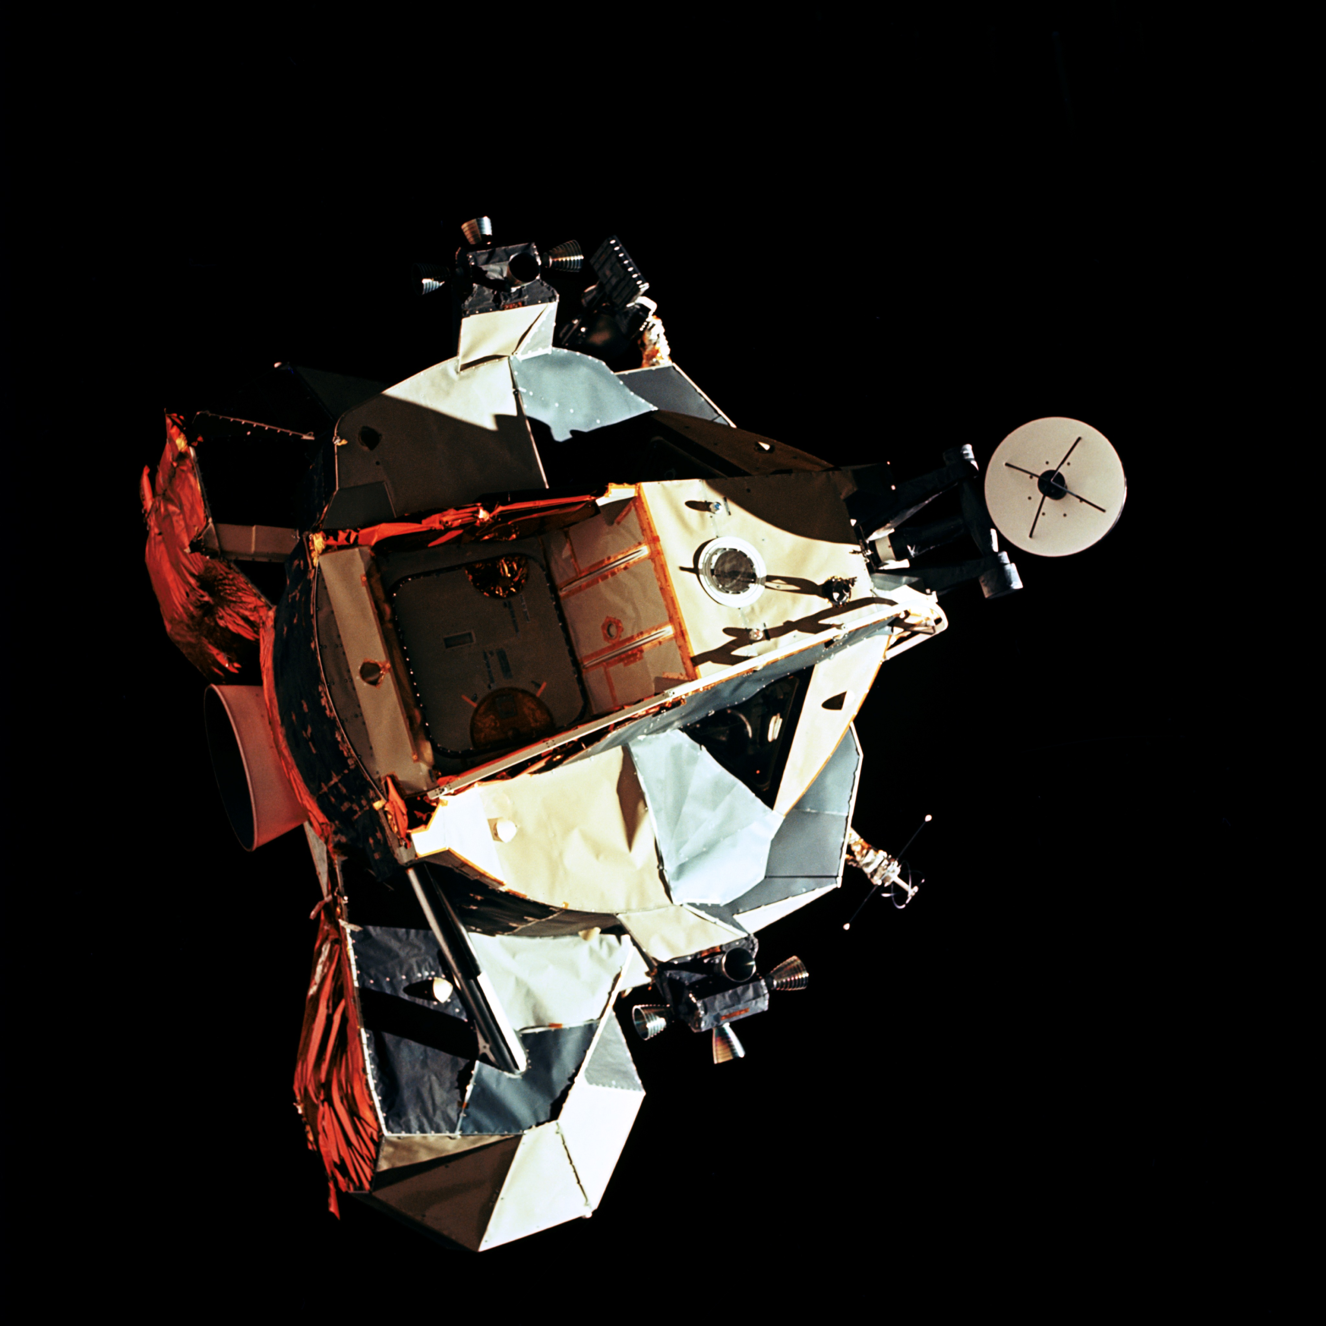
Agenda
Apollo
Lunar Landing Overview
Lunar Flying vs Aircraft Flying
Artemis
Architecture and Overview
HLS and the HCLS
Lunar Lander Simulation
Vehicle Evaluation
Flying Qualities vs. Handling Qualities
Handling qualities evaluations with test pilots
Cooper-Harper Chart
Performance Criteria
Key Findings
Summary

Slide 3

APOLLO

Slide 4
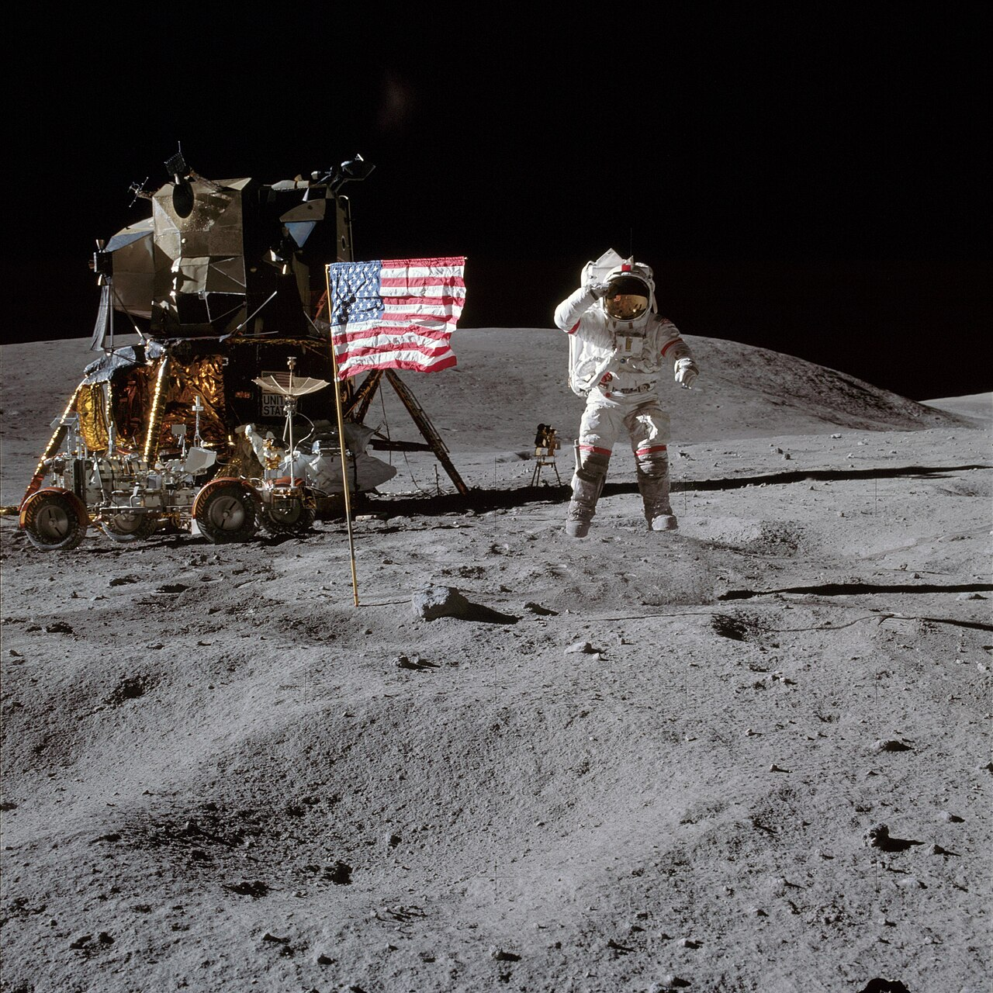
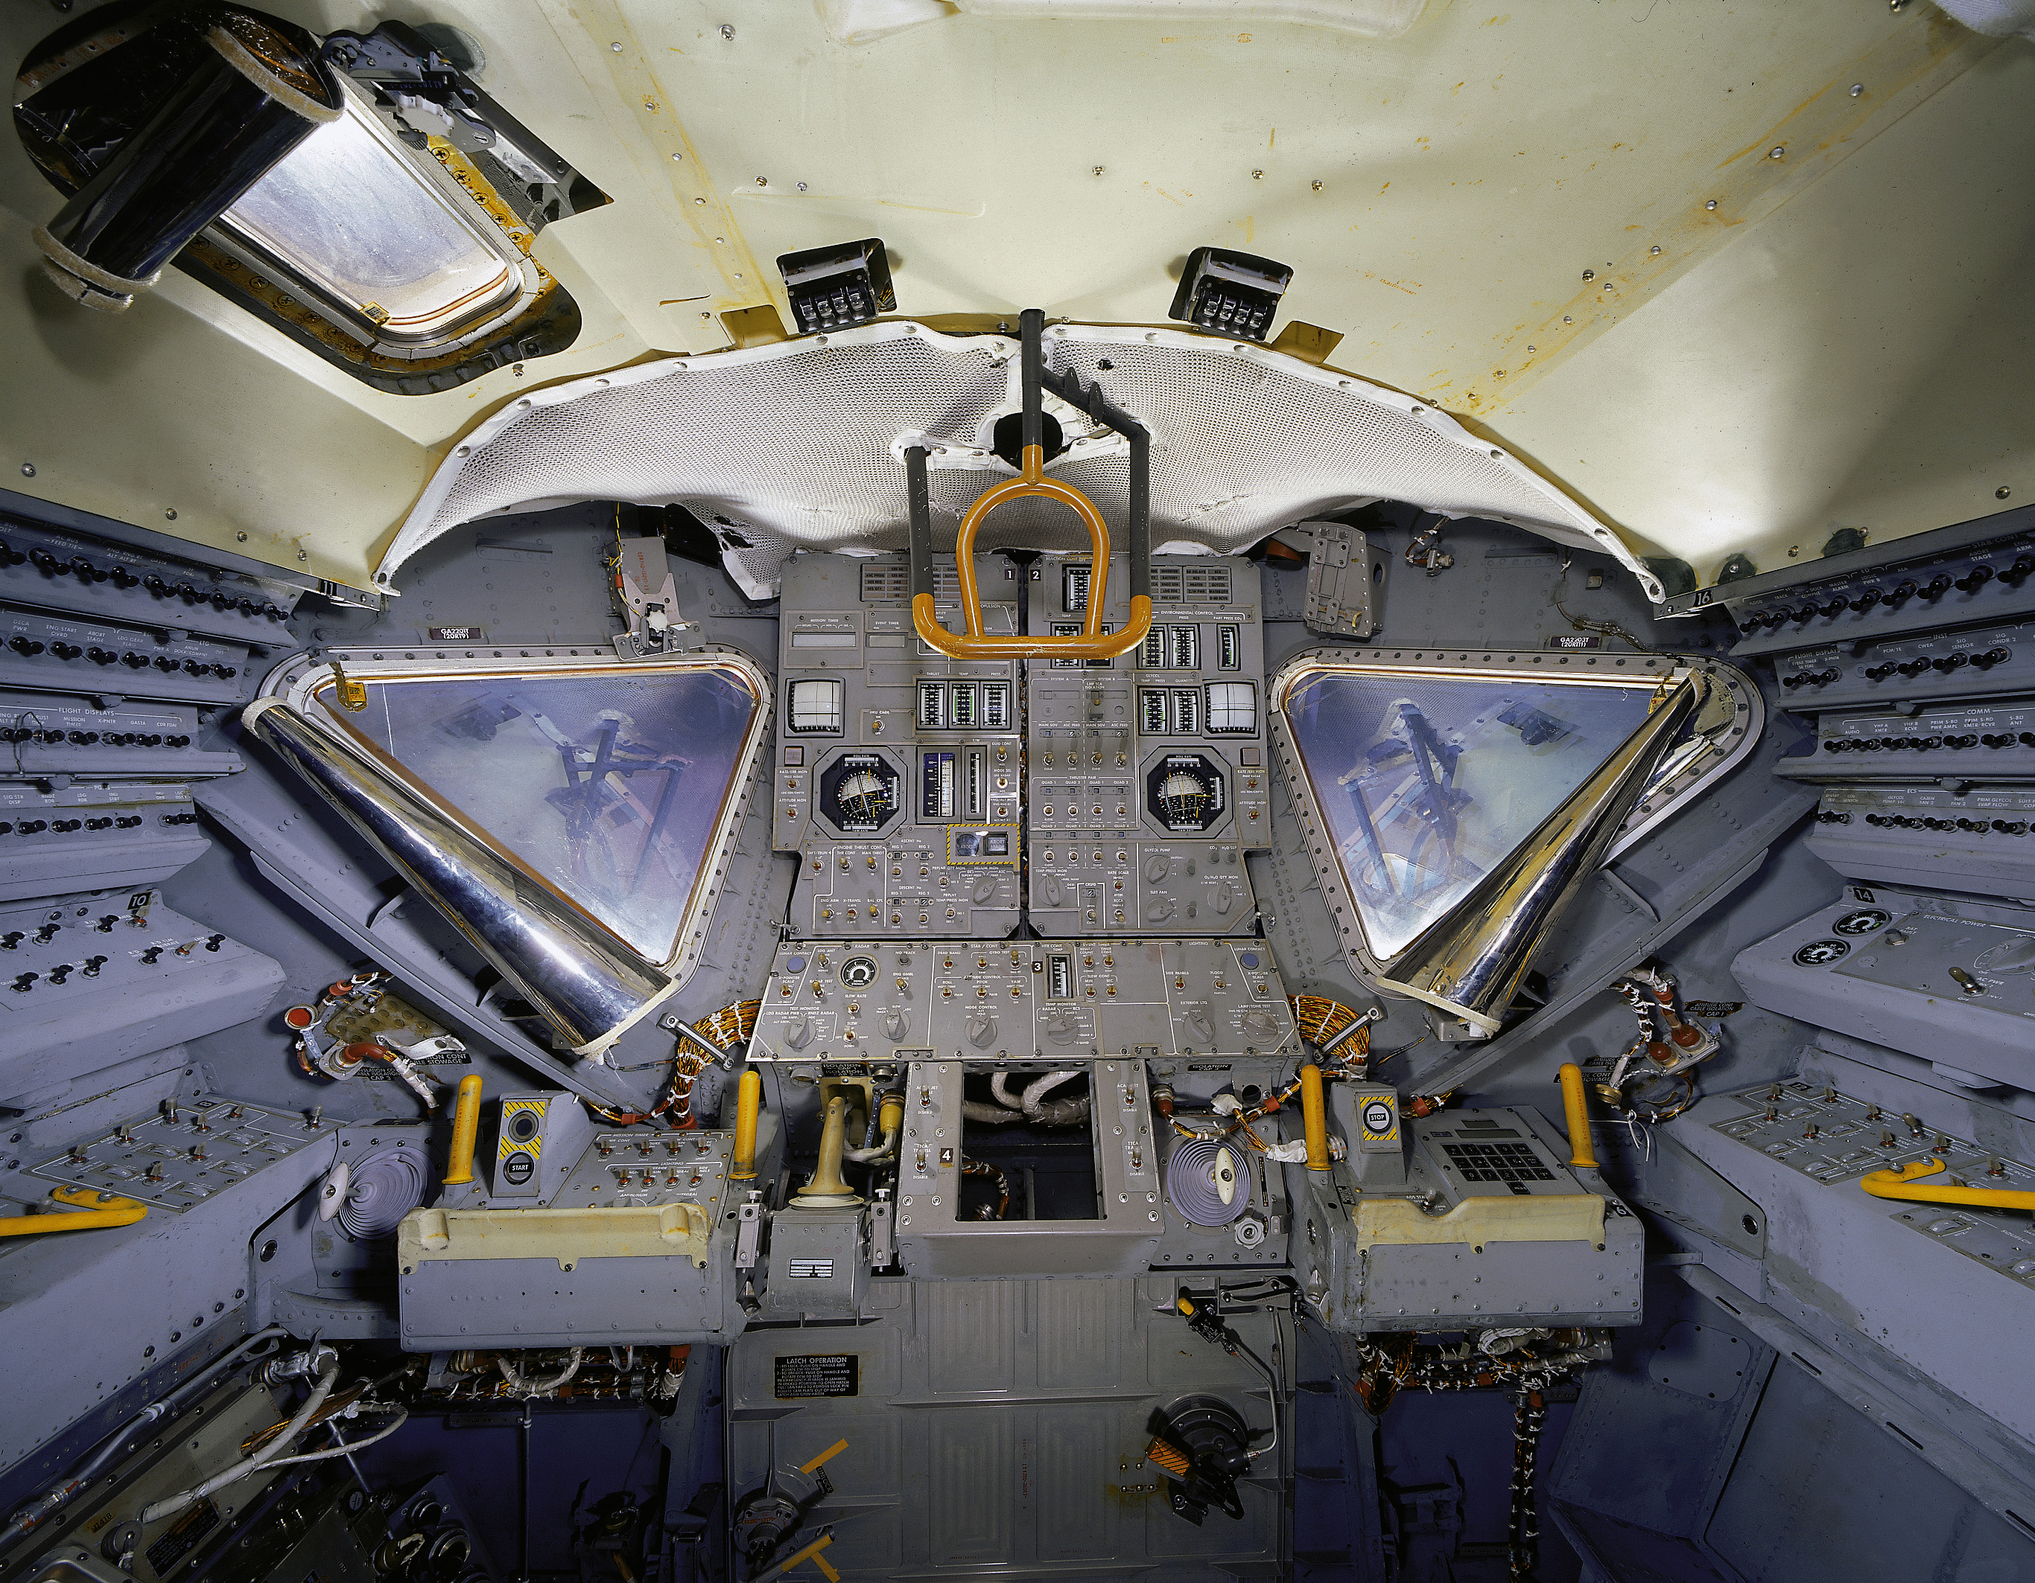
Lunar Landing Overview
Apollo 16
Flight Deck

Slide 5
Lunar Landing Overview

Slide 6


Lunar Landing Overview
Manual Control:
100 ft altitude
36 ft range
Ignition:
50,000 ft
Mach 6.5
Dallas
Wichita
Dallas to Wichita in 11.5 minutes!

Slide 7
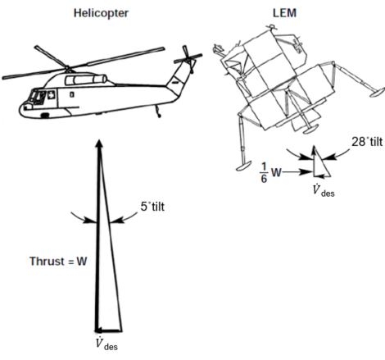
Lunar Flying vs Aircraft Flying
Ways to fly terrestrial aircraft
Constant altitude
Constant airspeed
Constant climb/descent rate
Constant flight path angle
Usually land on prepared surface at a controlled location
None of the above are true with a lunar lander

Slide 8

ARTEMIS

Slide 9
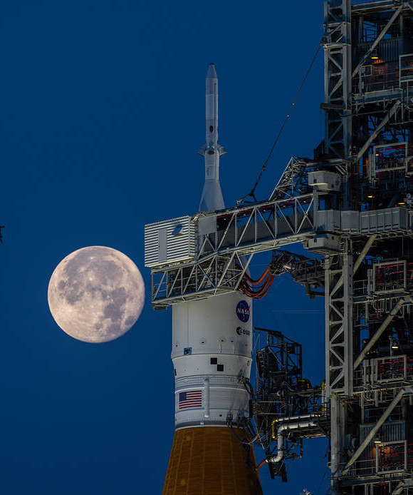

Artemis
Moon to Mars Architecture
Ultimate goal: access to Mars via the Moon
Lunar outposts in South Pole Region
Access to surface via Near Rectilinear Halo Orbit (NRHO)
Multiple Elements
Orion – Transport crew between Earth and NRHO
Gateway – Small Station in NRHO
HLS – Transport crew between NRHO and Lunar surface
Others – Launch systems, rovers, suits, etc.

Slide 10
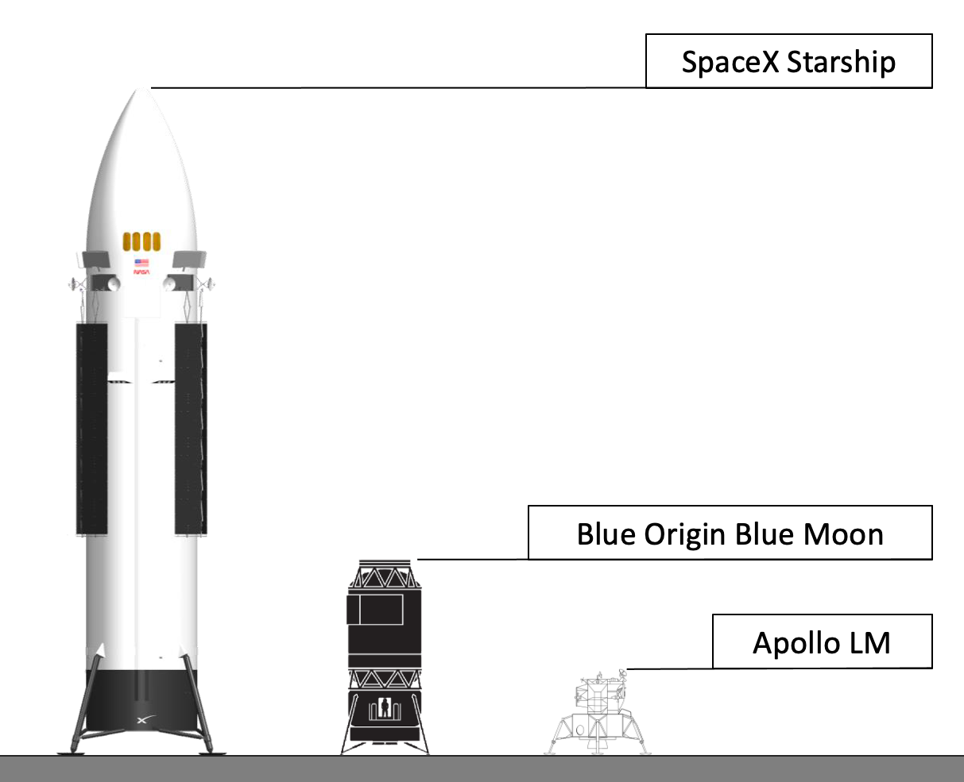
Artemis
Multiple Vehicle Providers
SpaceX
Blue Origin
Modern lander designs leveraging modern technology
Emphasis on reusability
No size constraints
Fuel optimal trajectories
Advanced avionics
What are the impacts to piloting?

Slide 11
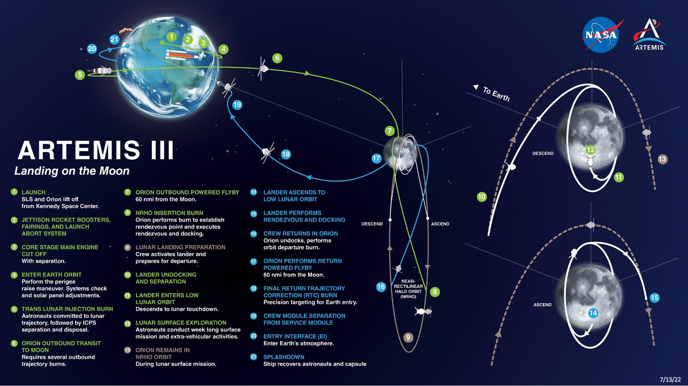
Mission Overview

Slide 12


HLS and the HCLS

Slide 13
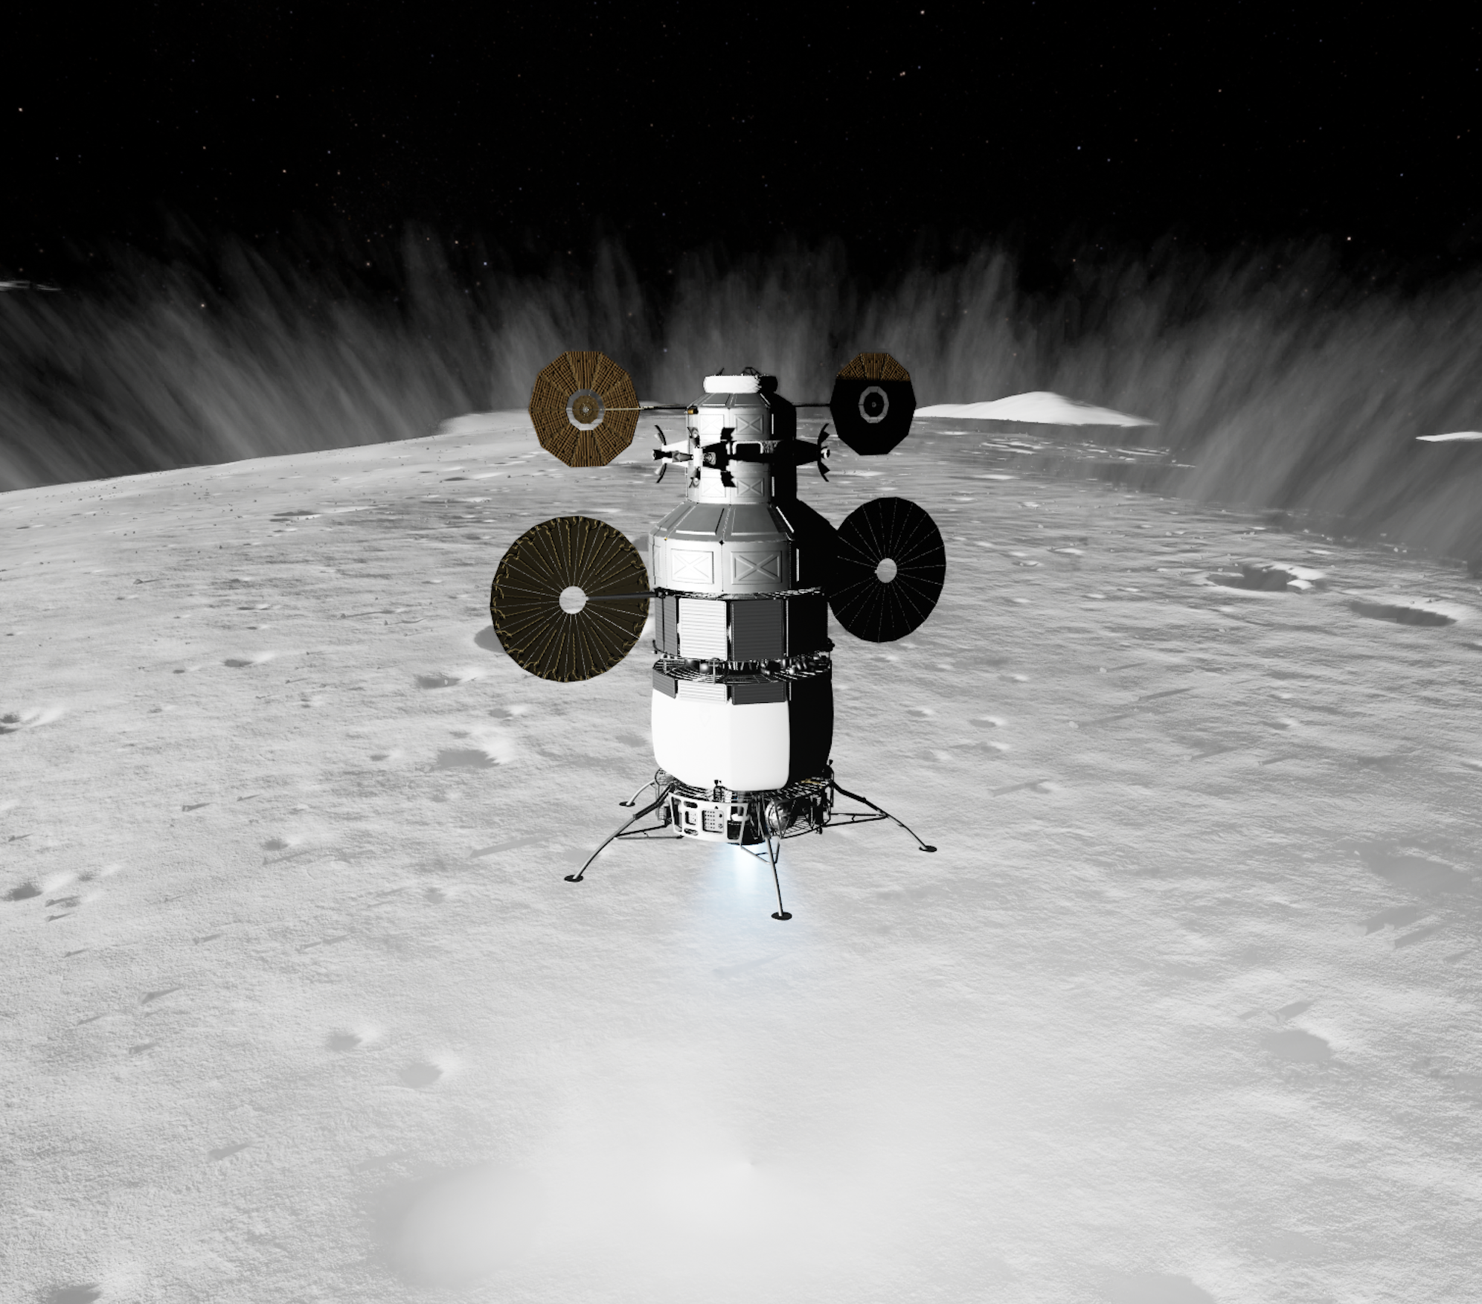
Purpose
HCLS = HLS Crew Compartment Office Lander Simulation
Evaluate handling qualities of potential lunar lander designs
Prototype crew displays
Evaluate inceptor types and characteristics
Evaluate control modes
Evaluate effects of propellant slosh
Evaluate different trajectory designs
Develop processes and tools for evaluating handling qualities
Notes:
Evaluate ≈ Explore

Slide 14
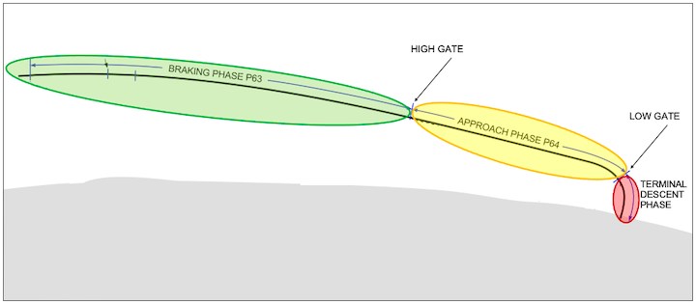






Descent Guidance
Fully automated descent from a Low Lunar Orbit (LLO) through touchdown
Primary Phases of Flight
Braking
Approach
Terminal Descent
Automated Guidance
Apollo
Reference Trajectory Tracking
Translational Guidance
$$a_{cmd}$$
Steering
$$θ_{cmd}$$
$$θ_{err}$$
PID
$$α_{cmd}$$
Plant
+
-
$$r_{meas,}v_{meas}$$
$$θ_{meas}$$

Slide 15
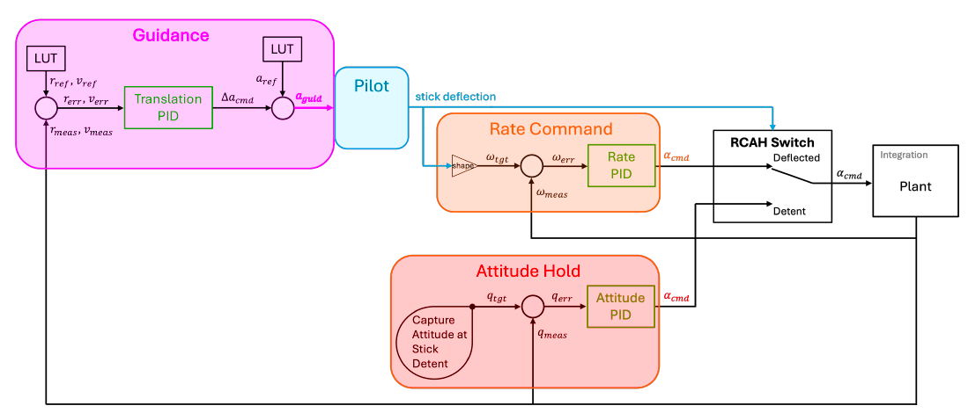
Manual Control
Manual control available at any point during descent
Planform Guidance Modes
Rate Command with Attitude Hold (RCAH)
Attitude Command with Velocity Hold (ACVH)
Translation Rate Command with Position Hold (TRCPH)
Vertical Guidance
Auto Rate of Descent (ROD) uses a look-up-table based on the reference trajectory altitude
Manual Control via Translational Hand Controller (THC)

Slide 16
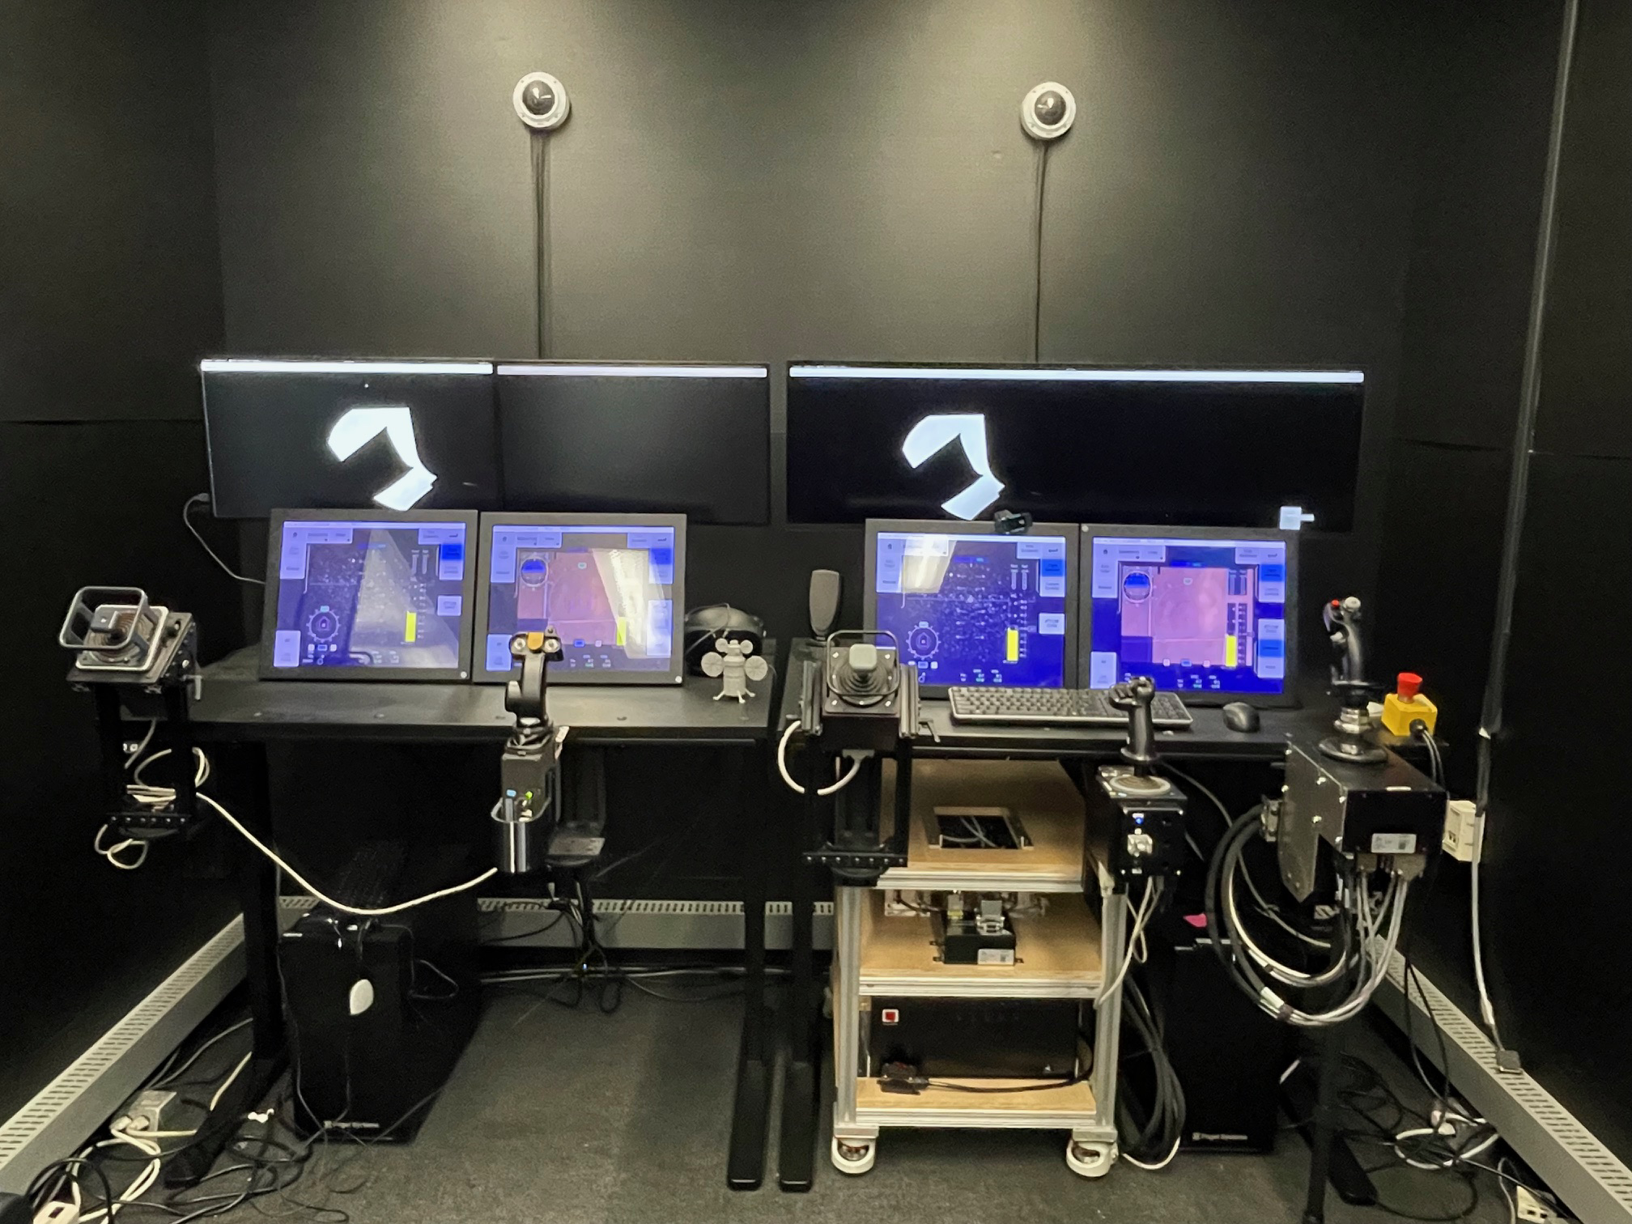
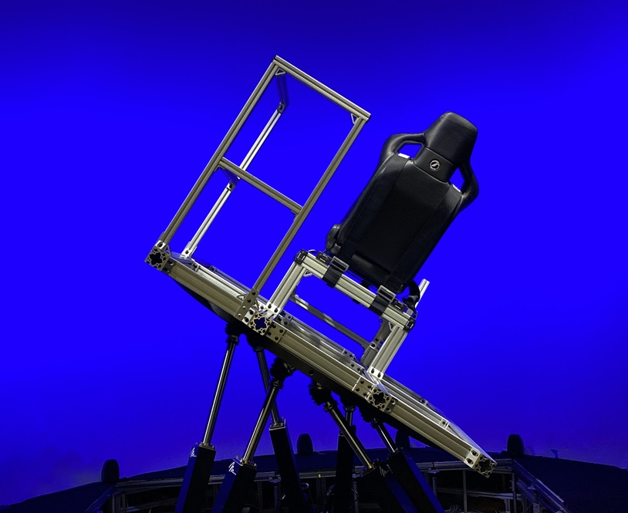
Facilities
Simulation, Exploration, and Analysis Lab (SEAL)
Motion Table

Slide 17
Facilities
SEAL Workstation (1 of 2)
External Views
Primary Flight Display
Navigation Display
THC
RHC

Slide 18
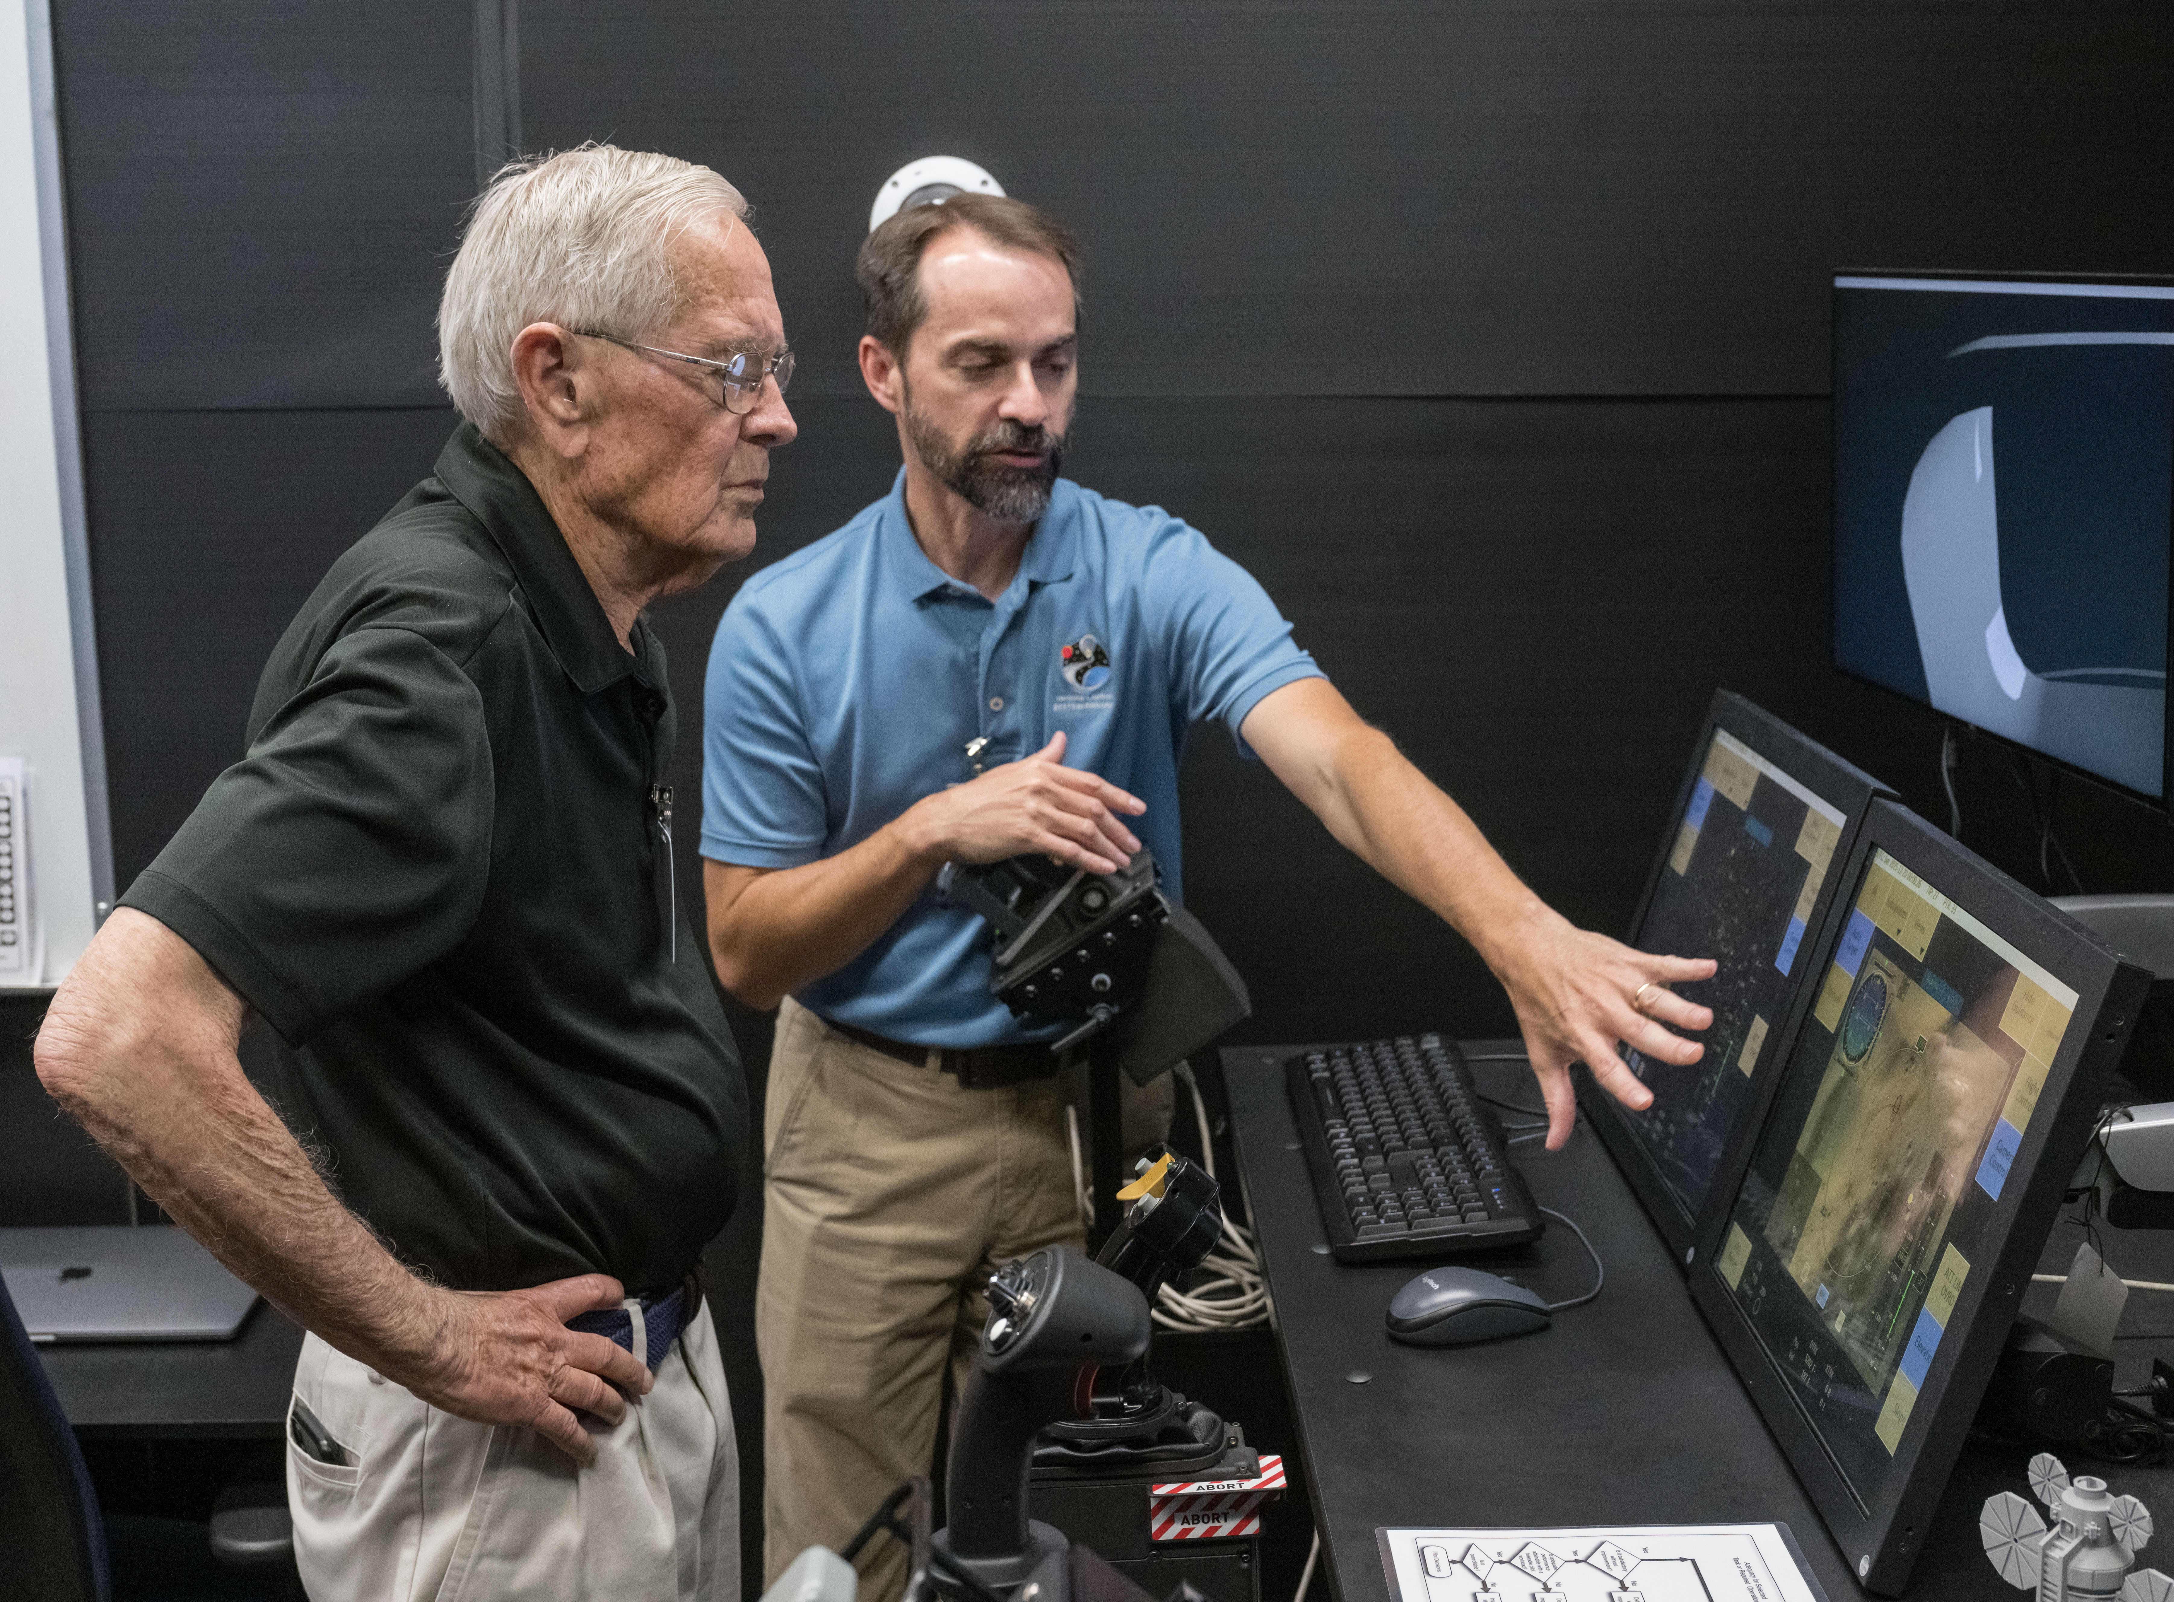
Capabilities
Customize control power, bandwidth, and max attitude rate
Customize rotational hand controller characteristics
Customize propellant slosh parameters
Force landing site redesignation
Add navigation biases to vehicle
Set lighting conditions for a specific day
Simulate terrain based on Lunar Reconnaissance Orbiter data
Add extra large rocks to landing zone
Immediate analysis via detailed reports

Slide 19
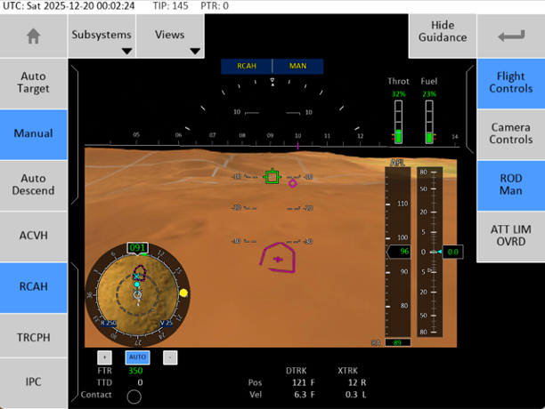
Primary Flight Display
Guidance Diamond
Boresight
Guidance Diamond
Available in auto and manual control
Visual pitch and roll guidance
Fly-to symbology
Multiple methods to drive diamond
Altitude Above Field Level tape
Altitude rate scale
Mini-map
Notes:
Trajectory Following PID
Calculates acceleration required to track reference trajectory
Uses feedforward acceleration term
Fades to time-based constant acceleration command
Explicit Constant Acceleration
Calculates constant acceleration at each time step
Explicit Cubic Solution
Calculates cubic polynomial solution at each timestep

Slide 20
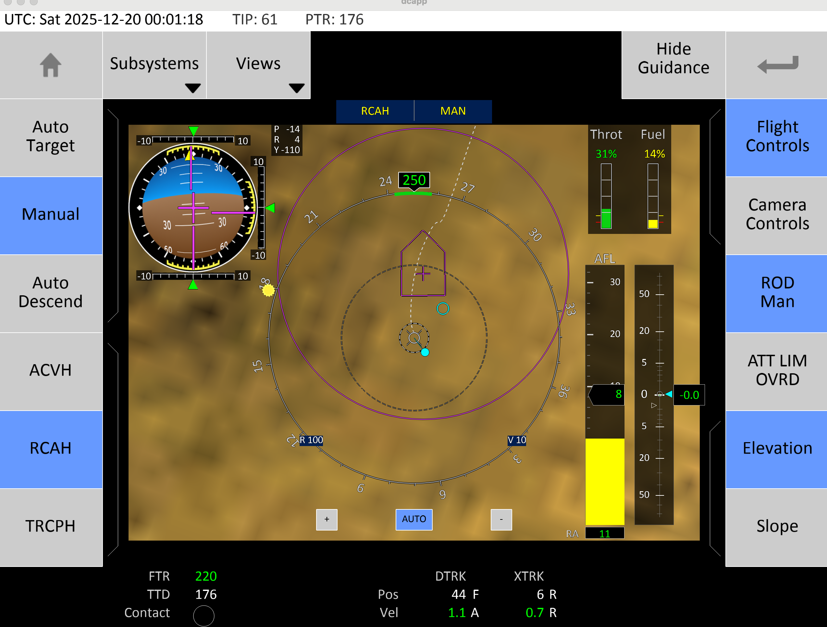
Navigation Display
Landing Target
Position Predictor
Overhead view centered on ownship
Predictive position symbology
Based on rotorcraft displays
Decoupled from the guidance system
Pilot uses the RHC to position the cue over the desired landing point
Altitude Above Field Level tape
Altitude rate scale
Attitude Determination Indicator ball
Velocity Vector

Slide 21
Navigation Display
Landing Target
Position Predictor
Overhead view centered on ownship
Predictive position symbology
Based on rotorcraft displays
Decoupled from the guidance system
Pilot uses the RHC to position the cue over the desired landing point
Altitude Above Field Level tape
Altitude rate scale
Attitude Determination Indicator ball
Velocity Vector
Notes:
Explain this example describing the situation to help them picture the relationship between the symbols.

Slide 22
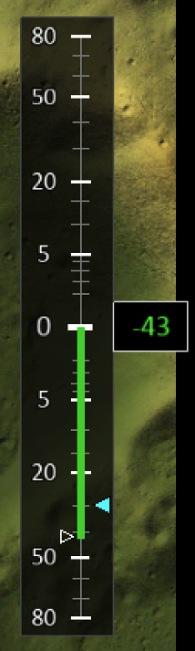
Vertical Rate Command
Discrete THC inputs change the commanded vertical velocity by 10% of the current vertical velocity
For small vertical rates, discrete THC inputs change the commanded vertical rate by a minimum of 0.1 m/s
Continuous THC inputs slew the commanded vertical rate indicator along the vertical rate scale
Slewed commanded rate will stop at zero
Release THC and resume inputs to cross zero
Can return to vertical rate command to auto

Slide 23
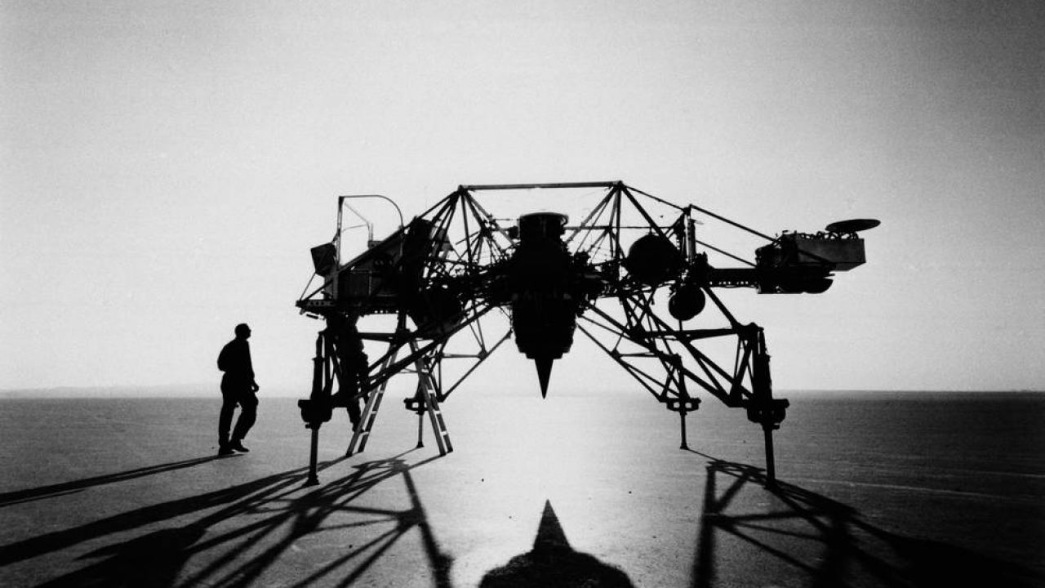
VEHICLE EVALUATION

Slide 24
Flying Qualities vs. Handling Qualities
Flying Qualities
Stability and control of vehicle (flight control system, structure, aerodynamics)
Quantitative measurement of vehicle response to specific pilot inputs
Handling Qualities
Flying qualities plus task demands, pilot controls, and crew displays
Qualitatively evaluated by test pilots via comments and ratings
We’ll address Handling Qualities in this presentation.

Slide 25
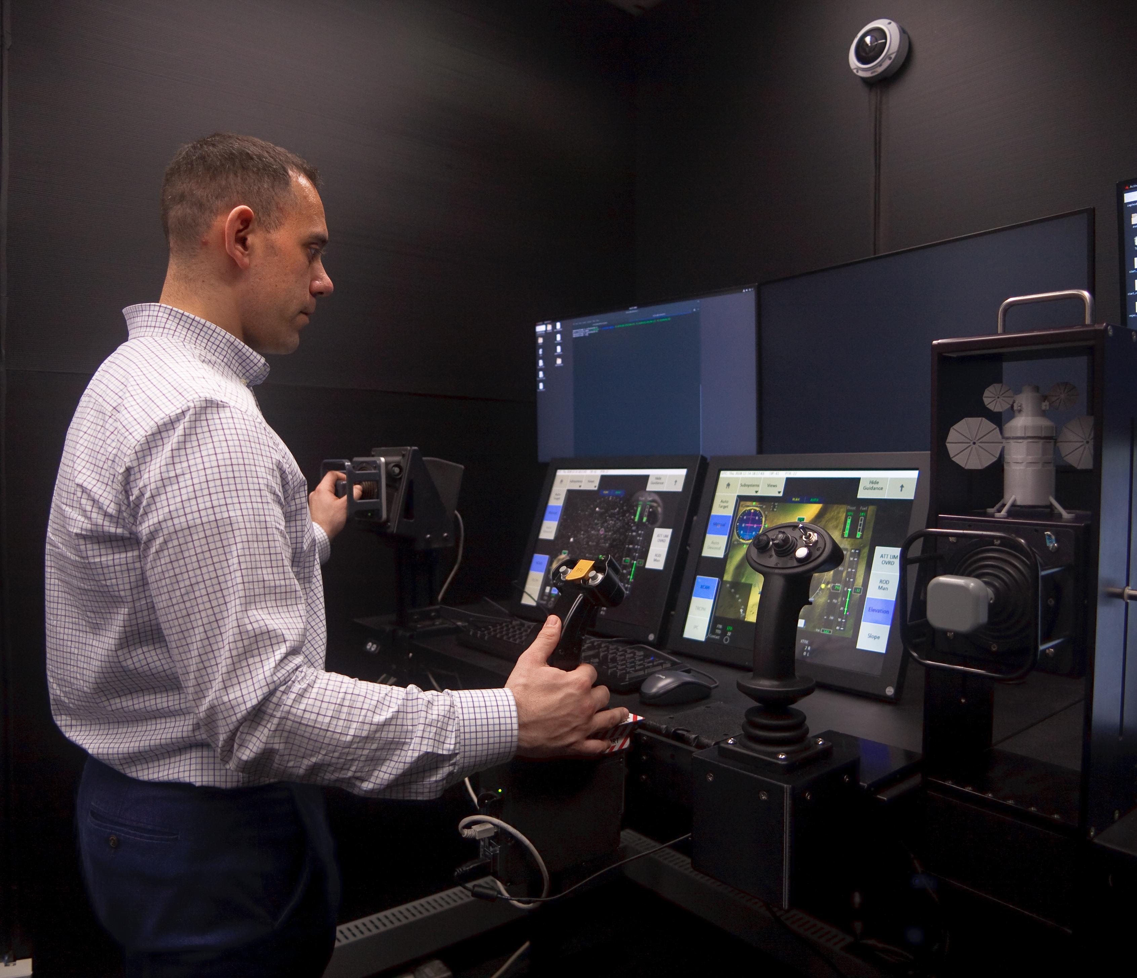
Evaluators
HLS astronauts (pilots and non-pilots)
Military test pilots
Test Pilot School graduates
Fixed-wing, rotary-wing, tilt-rotor, vectored thrust
US Coast Guard helicopter pilots
MQ-9 Reaper operators
HLS team members from all disciplines
Private pilots, non-pilots, VIPs
Moonwalkers: Jack Schmitt and Charlie Duke

Slide 26
Execution: Formal Evaluation Sessions
Begin only when pilots no longer getting significantly better at the task
Evaluate similar scenarios seen in familiarization session
Get pilot comments during and immediately after each run
Compare performance to desired and adequate performance criteria
Get more pilot comments
Get Cooper-Harper rating

Slide 27
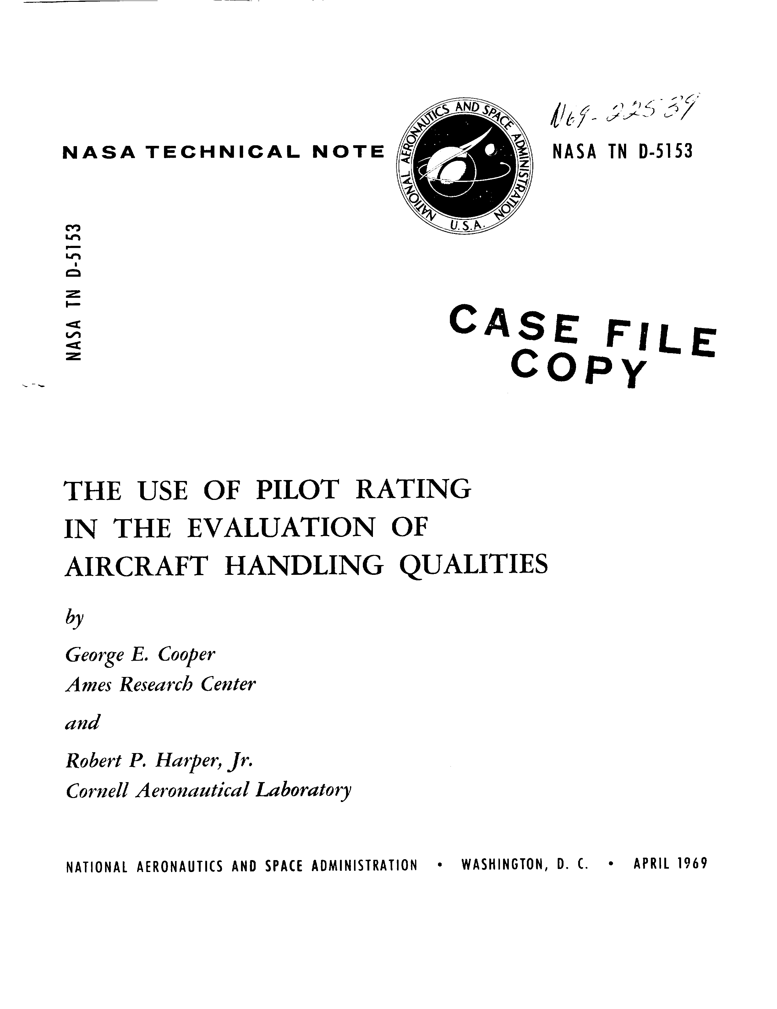
Cooper-Harper Chart
Level 1
Level 2
Level 3

Slide 28
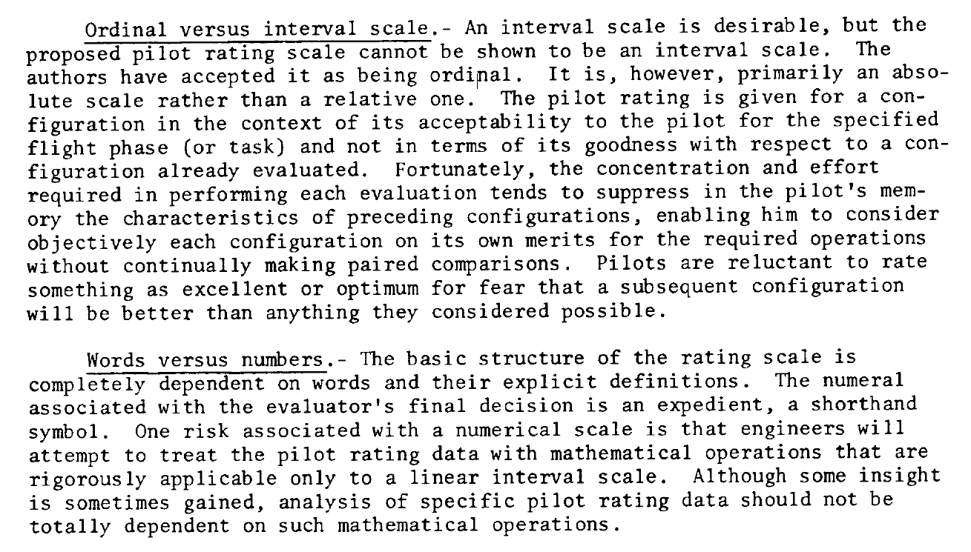
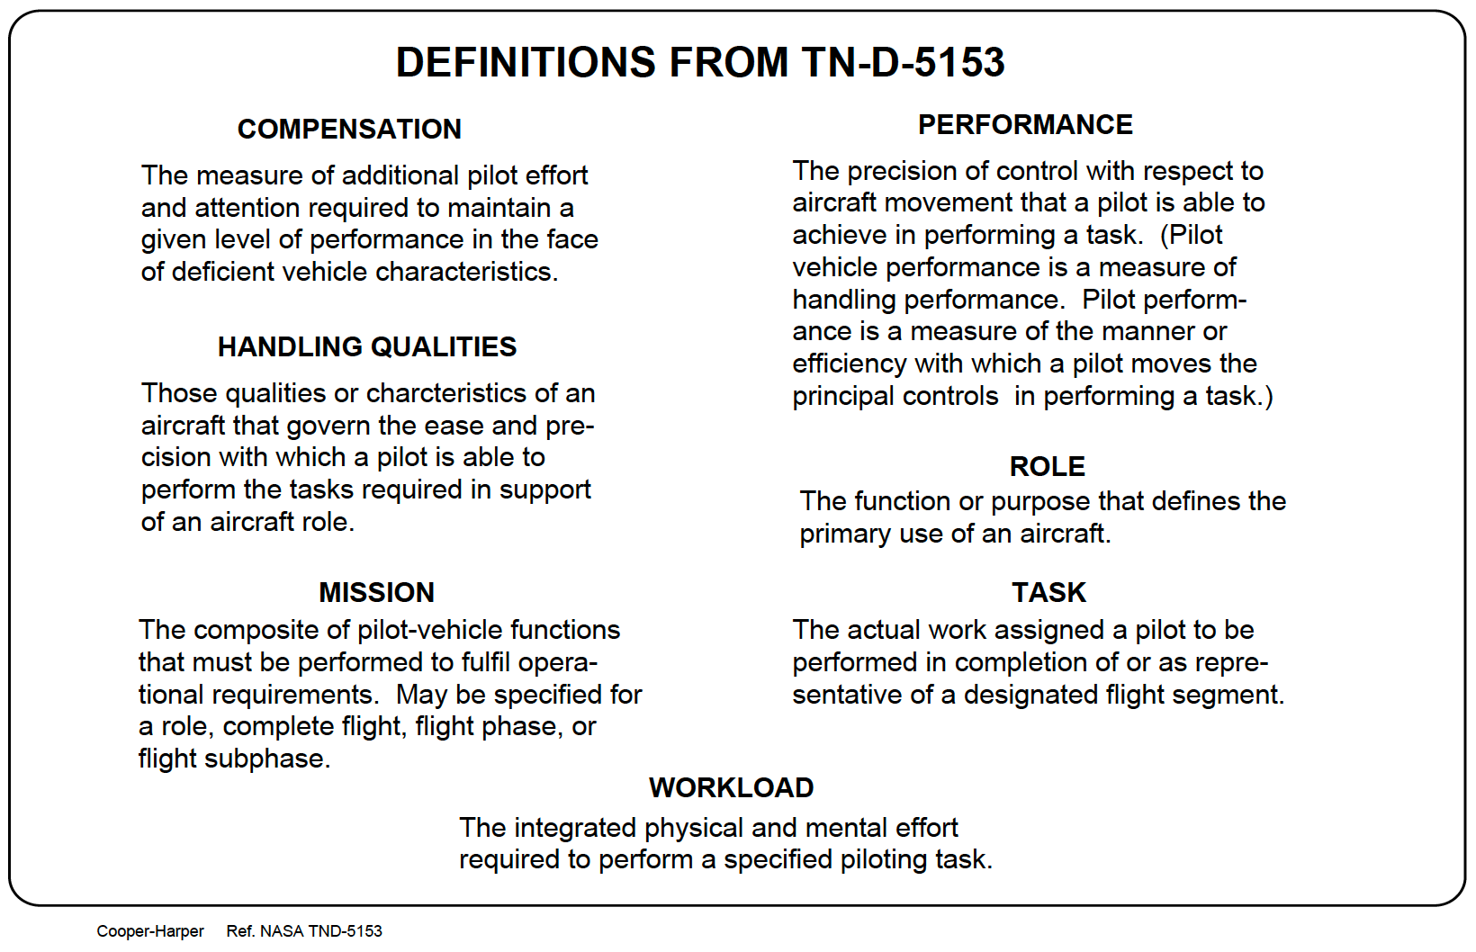
Cooper-Harper Guidance & Definitions

Slide 29
Cooper-Harper Ratings: Misuses
Evaluating too many things at once
No clearly defined initial conditions
Poorly defined task
Poorly defined (or undefined) performance criteria
No way for pilots to know how well they’re performing in real-time
No feedback after task regarding how well performance criteria was met
No “recalibration” runs (i.e., frog in the boiling pot)
Giving half ratings, especially between Levels
Averaging ratings

Slide 30
Lunar Lander Performance Results
Guidance Diamond
Task: Guidance Tracking
Keep boresight on diamond
“Thing on the thing”
Primarily in pitch axis
Follow to landing
Performance Criteria
Desired
≤3 deg of cue ≥90% of the time
Adequate
≤ 6 deg of cue ≥90% of the time
Boresight
Notes:
Trajectory Following PID
Calculates acceleration required to track reference trajectory
Uses feedforward acceleration term
Fades to time-based constant acceleration command
Explicit Constant Acceleration
Calculates constant acceleration at each time step
Explicit Cubic Solution
Calculates cubic polynomial solution at each timestep

Slide 31
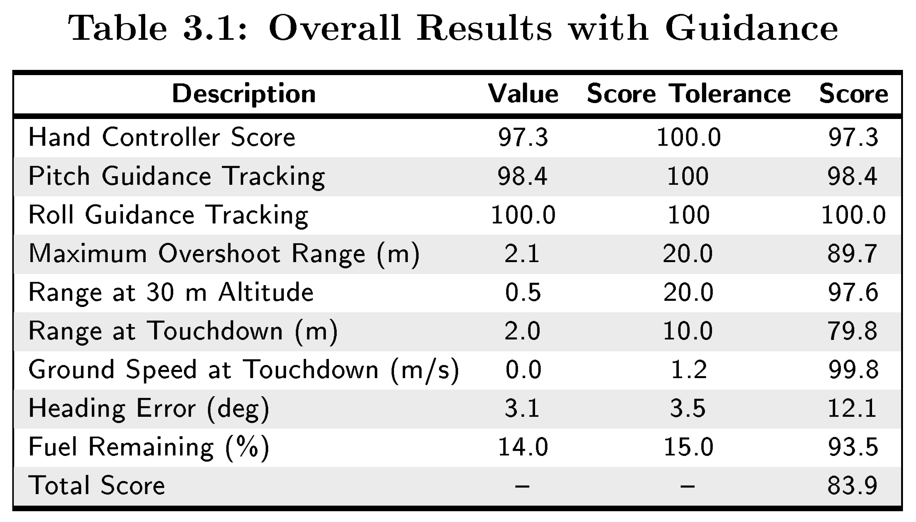
Lunar Lander Performance Results
Pilot Compensation
Tracking test throughout trajectory
Arrival for Terminal Descent
Touchdown Conditions
Average of all scores

Slide 32
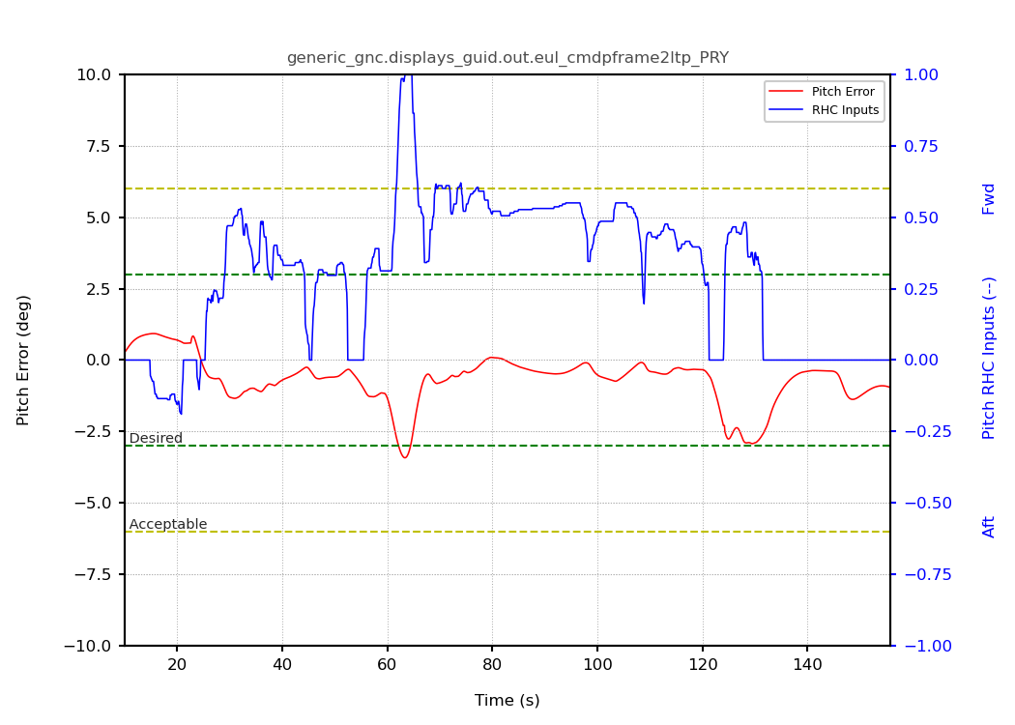
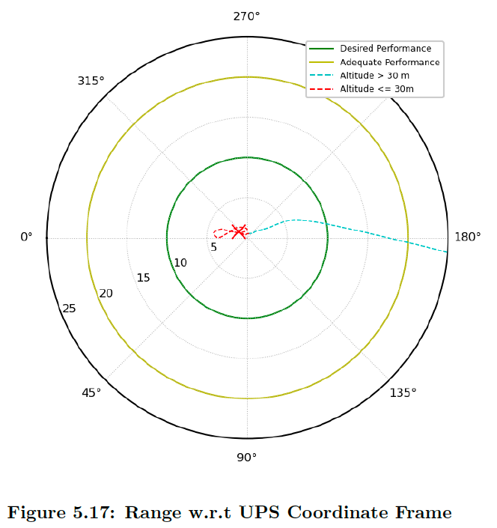
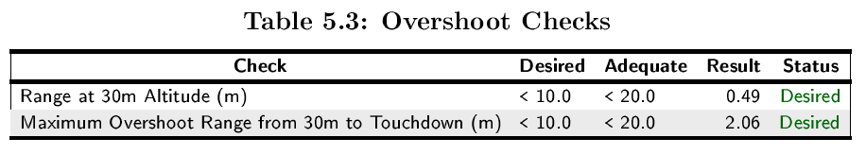
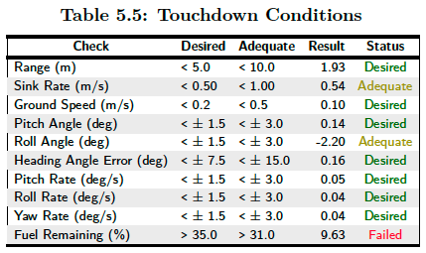
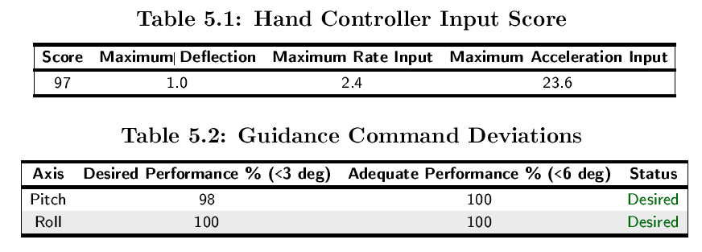
Lunar Lander Performance Results
Quickly generate report for pilot evaluations
40+ page PDF generated in less than a minute

Slide 33
Lunar Lander Key Findings: Overall
Flying credentials are not a good predictor of lunar lander performance.
Correct mental model of vehicle dynamics is critical.
Correct understanding of display symbology is critical.
A good position-predictor cue is critical for a manual landing.
Rotary-wing pilots generally did better than fixed-wing, single seat fixed-wing pilots.
Low gain pilots had better results.

Slide 34
Lunar Lander Key Findings: Manual Piloting
Manual piloting requires most of the pilot’s attention.
Once off trajectory, it is increasingly difficult to get back on trajectory.
PIO manifests with 20-30 second periods (overshoot landing site).
Controlling translation and vertical rates simultaneously requires extra practice.
Lunar lander flying techniques are counter to fixed-wing techniques.
Lunar lander stick input techniques are not like rotary-wing techniques.
Landing is mainly a heads-down activity.
It is possible to land without guidance attitude cues.

Slide 35
Summary
Define desired and adequate performance criteria beforehand.
Define performance criteria for the entire run, not just the end.
Pilots need a way to evaluate their performance in real-time. This drives pilot compensation.
Quickly generate reports after each run.
Main benefit of Cooper-Harper ratings is to elicit comments from pilots.
Ask for ratings for specific tasks, not one rating for the whole trajectory.
Use multiple evaluation pilots with various backgrounds.
Displays can have a huge impact on handling qualities.
Practice the process before conducting formal evaluations for certification.

Slide 36



