Slide 1
Mouse models and characterization of space-radiation-induced cancer
Janapriya (JP) Saha Ph.D.,
Deputy Element Scientist
NASA Space Radiation Element
Occupational Flight Exposure
and Cancer Risk Symposium
March 3-4, 2025

Slide 2




Space Radiation Element
Mission: Characterize and facilitate the management of the human health outcomes associated with space radiation exposure to protect astronaut health and wellbeing to enable human spaceflight
Science Team
Janice (JZ) Zawaski, Ph.D., Element Scientist
Janapriya (JP) Saha, Ph.D., Deputy Element Scientist
Gregory Nelson Ph.D., CNS Discipline Lead
Diana Cruz-Topete Ph.D., Degenerative Tissues Discipline Lead
Marshleen Yadav, Ph.D., Cancer Discipline Lead
Angela Kubik, Ph.D., Omics Specialist
Jordan Rhone, MBA, Science Integrator
Management Team
Jason Weeks M.S., Element Manager
Aaron Allcorn, MBA, Deputy Element Manager
Keli Woolery, Financial Analyst
jsc-hrp-space-radiation-element@mail.nasa.gov
Janice
Janapriya (JP)
Jason
Aaron

Slide 3
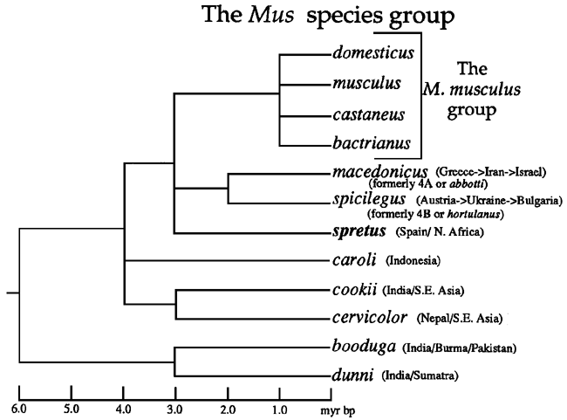
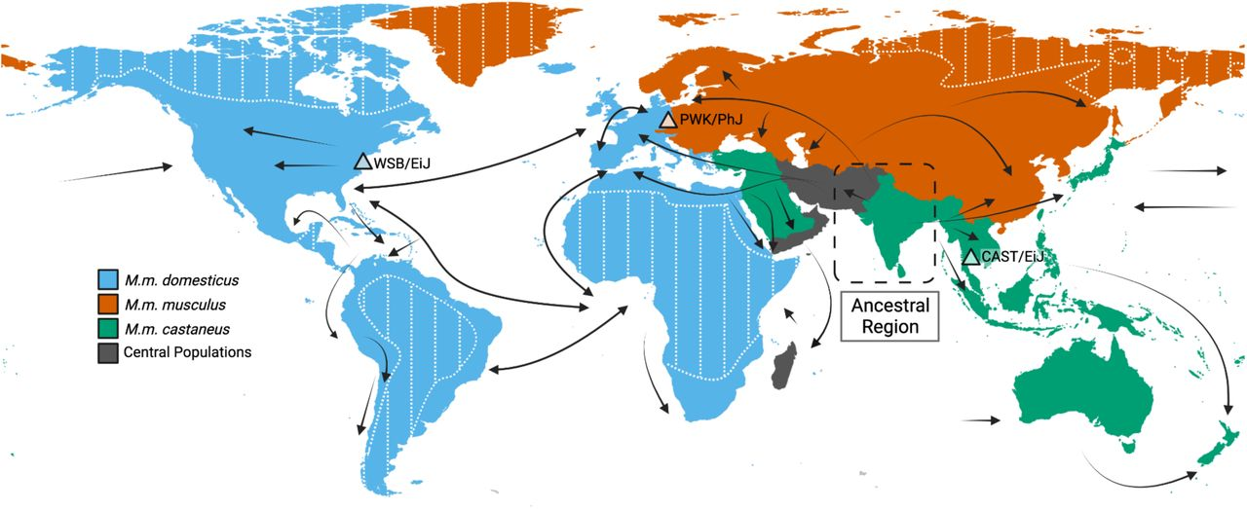
Laboratory Mouse – Geographical Origins
Courtesy: Mouse Genome Informatics, Jackson Lab
(Garretson et al. BioRxiv. Adapted from Guénet et al. 2012; Didion and Pardo-Manuel de Villena 2012; and Phifer-Rixey and Nachman 2015)
Notes:
In this slide, I point out that the laboratory mouse doesn't exist in nature.. It's a mixture of number of different mice of a number of different species in the Mus group. And most of what we have is descended from musculus domesticus and must musculus musculus with perhaps a little bit of castaneus.
This is just the geographical distribution of those various subspecies.
Figure 2.2 A phylogenetic tree of the Mus species group. All of the extant species within the Mus subgenus of the Mus genus are shown. Table 2.1 lists the other subgenera in the Mus genus. Domesticus, musculus, castaneus, and bactrianus are all subspecies within the M. musculus group. All other lines represent well-defined species. The geographical distributions of M. musculus subspecies are illustrated in Figure 2.3. The general distributions of all other species are indicated next to their names here. The indicated times of divergence between evolutionary lines in millions of years before present (myr BP) are consensus estimates based on data from various sources (Ferris et al., 1983b; Bonhomme, 1986; Berry and Corti, 1990; Boursot et al., 1993; Hammer and Silver, 1993).
Inferred colonization history of house mice and current range map.Rough regions for each subspecies are as follows: M.m. castaneus is shown in green, M.m. domesticus is shown in blue, and M.m. musculus is shown in red. Importantly, this map does not include precise delineations of the boundaries of each subspecies and omits known hybrid zones. Subspecies locations may be actively in flux due to active migration and introductions. (Adapted from Guénet et al. 2012; Didion and Pardo-Manuel de Villena 2012; and Phifer-Rixey and Nachman 2015)

Slide 4
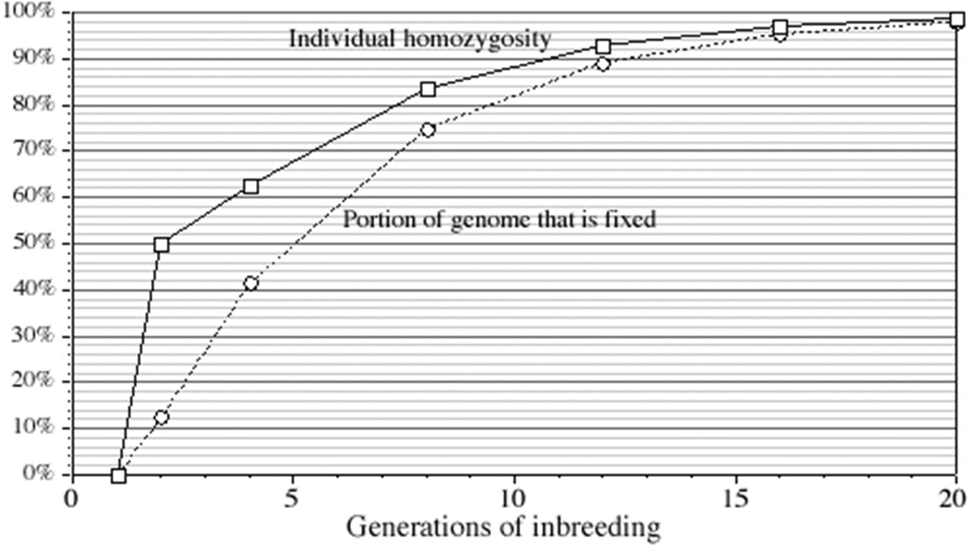
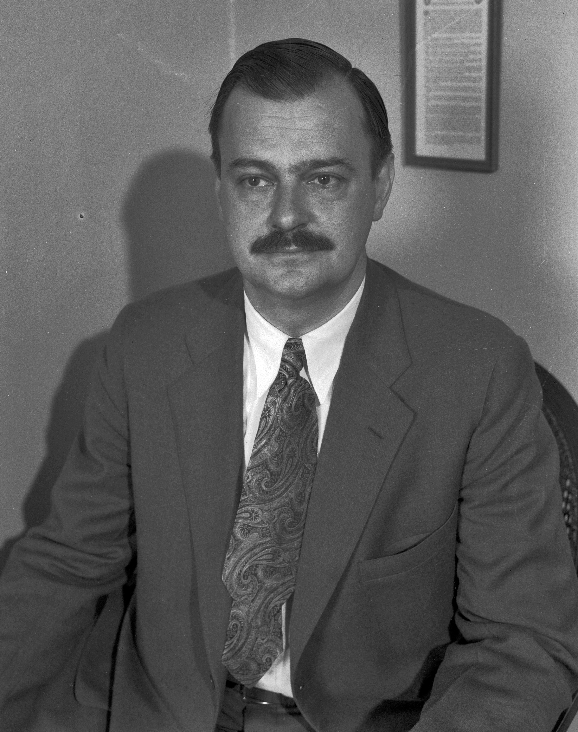
Creation of Inbred Strains
Clarence Cook Little
Courtesy: Los Angeles Times Photographic Collection at the UCLA Library.
Courtesy: Mouse Genome Informatics, Jackson Lab
Notes:
And then inbred strains. This is important because around the turn of the 20th century, so around 1900 or so actually Mendel's laws are rediscovered. And they want to know, does it apply to animals? Mendel worked with garden peas. The question is, does this extend to animals? And they needed an experimental system. And so they turned to mice. Mice and people had been keeping mice as pets in the fancy mouse tray in Europe for a couple 100 years, and in Asia, probably for over 1000 years. And so they'd pick out animals that had different cult colors and things like that. So you already had a trait you could look at things like coke colors and you had these animals that bred very quickly. Didn't take up any space and were cheap to keep.
If you're going to do genetics research in those days, you needed something that would breed true. Which means that if you had a pea plant with wrinkled peas and you crossed it with a pea plant with sprinkled peas, you always got a plant with wrinkled peas. And so the way you can do that with plants is by inbreeding through self fertilization. You can't do that in mice. What you have to do is brother, sister matings and the first person to successfully inbreed mice was Clarence Cook little and the strain he inbred was dba and DBA comes from Dilute Brown Non-Agouti Duluth. Brown agouti, which was the coat color.
This just shows the inbreeding process? How many generations of Brother, sister matings you have to do. It's generally considered about 20 generations of brother sister matings. You end up with an inbred strain.

Slide 5
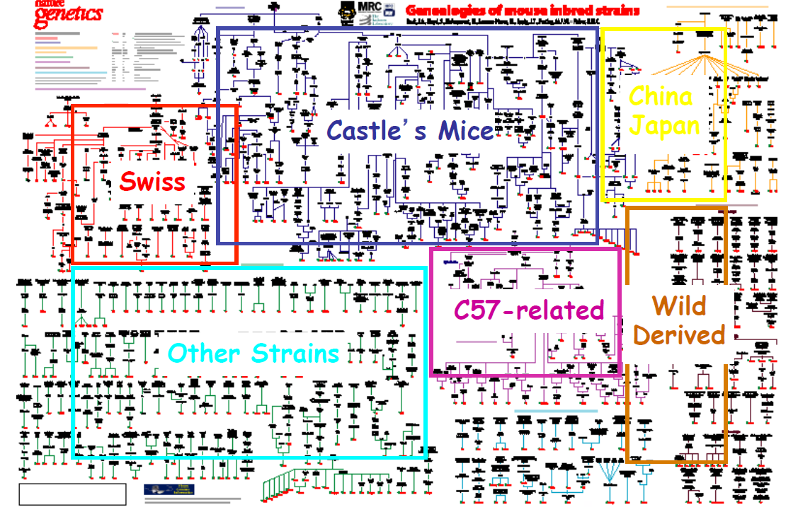
Mouse Genealogies
Elizabeth Fisher et al. nature genetics
volume 24 • january 2000
Notes:
So there are now hundreds of different inbred strains, and this was a genealogy of inbred strains put together by Lizzie Fisher a number of of years ago. And you know you you can't read all of it. But trust me, if you could blow it up, you would see where these animals came from. So the inbred strains have various traits. So if you want to find a list of the traits of a particular inbred strain, you can go to the festing list.

Slide 6
M. Festing's Listing of Inbred Strains of Mice and Rats
A
Inbr: More than F150. Albino. Genet: a, b, c. Origin: Dr L. C. Strong, 1921, from a cross between the Cold Spring Harbor and Bagg albino random-bred stocks (and therefore related to BALB/c). Internationally distributed, Strain A was the third most widely used strain in cancer and immunology research (Festing, 1969), though its popularity has probably declined recently. Although it may be classified as a general-purpose strain, it is well known for a high susceptibility to induction of congenital cleft palate by cortisone and a high spontaneous incidence of lung adenomas, as well as developing a high incidence of lung tumours in response to carcinogens. Shimkin and Stoner (1975) suggest that this response may be used as a rapid in vivo assay for carcinogenesis. The strain also suffers from a defect in macrophage function somewhat resembling the mutant lps found in C3H/HeJ (Vogel et al 1981).
The following main substrains are recognised, though they have not been defined by genetic markers:
A/St
Maintained by Strong.
A/He
Strong to Heston, 1938.
www.informatics.jax.org/external/festing/search_form.cgi
https://www.informatics.jax.org/inbred_strains/mouse/REFS.shtml
Notes:
So if you want to find a list of the traits of a particular inbred strain, you can go to the Festing list. And that's a URL for it. And so These are the traits of strain A. And so it's telling you that it's been inbred for 150 generations. And it's telling you the coat colors and then it tells you a number of other things. So for instance, if you go down further in the list, you'll see behaviour. And I always like behaviour because they have such weird things. Low alcohol tolerance. There's another one in here, long latency to attack crickets. All of these things, if you go back and you look at the paper. Mean it sounds weird, but there were actually reasons to do these experiments and.
Weil,Michael 6 minutes 58 secondsOf course.

Slide 7
M. Festing's Listing of Inbred Strains of Mice and Rats
Behavior
Low intra-strain aggression (13/14) (Southwick and Clark, 1966), low food drive (15/15) and exploratory activity (15/15) (Thompson, 1953). Low spontaneous bar pressing activity (12/14), low open-field activity (13/14 and 14/14 in J and He substrains), low social grooming during aggressive encounters (12/14 in He substrain) and high tail rattling score (3/14 and 5/14 in J and He substrains) during aggressive encounters (Southwick and Clark, 1968). Low spontaneous locomotor activity (2/9) (Nikulina et al 1991). High shock avoidance learning (3/9) (Bovet et al., 1966., 1966), high avoidance conditioning (2/9) (Royce, 1972), and (2/6 males, 1/6 females) (Royce et al., 1971., 1971), but poor shock avoidance learning (8/8) (Wahlsten, 1973), poor T-maze learning (6/6) (Stasik, 1970). Long latency to attack crickets (7/7) (Butler, 1973). Long latency to emerge from home cage (7/7), low exploration in Y-maze (6/7), low rearing (6/7), long latency to climb barrier (7/7), low hole-in-the-wall entry (7/7), low stair climbing (6/7) (McClearn et al., 1970., 1970). Poor shock avoidance conditioning (6/7 and 7/7 in He and J substrains) and rapid extinction (1/7 and 2/7 in J and He substrains) (Schlesinger and Wimer, 1967). Poor performance in a food-seeking task (6/6) (Henderson, 1970). High social dominance of males in competition for females (1/6) (De Fries and McClearn, 1970). High open-field defaecation (1/5) in both sexes (Bruell, 1969). Low open- field activity (12/13) (Bruell, 1964). Low proportion of paradoxical sleep (6/7) (Pagel et al., 1973., 1973), low incidence of tail rattling (5/5) (St. John, 1973). High shuttle box avoidance (1/5) (Messeri et al., 1972., 1972). Low wheel activity (5/5) (Messeri et al., 1972., 1972), low alcohol preference (15/18) (Rodgers, 1966).
Notes:
So for instance, if you go down further in the list, you'll see behaviour. And I always like behaviour because they have such weird things. Low alcohol tolerance. There's another one in here, long latency to attack crickets. All of these things, if you go back and you look at the paper. Mean it sounds weird, but there were actually reasons to do these experiments.

Slide 8
M. Festing's Listing of Inbred Strains of Mice and Rats
Life-span and spontaneous disease
Primary lung tumours 6% in male, 32% in female and 26% in virgin females in J substrain; 44% in males, 23% in females and 30% in virgin females in He substrains (Hoag, 1963). Zero incidence of lymphatic leukaemia in He substrain, 1% in J substrain. Mammary adenocarcinomata zero in males, 1% in virgin females, 28% in breeding females of J substrain and 54% in breeding females of He substrain (Hoag, 1963). Pulmonary tumours 90% in mice at 18 months (Heston, 1963). Leukaemia 3% in HeJ substrain (Myers et al., 1970., 1970). A high proportion of the mammary tumours are of the acinar type (3/7) (Tengbergen, 1970). Lung adenomas 53-64% in BrA and A substrains, but mammary tumours zero (Muhlbock and Tengbergen, 1971). Lung tumours 4-31% and lymphatic leukaemia 10-43% (Festing and Blackmore, 1971). Spontaneous lung tumours occur at rate of 0.21 tumours/mouse at 24 weeks (Poirier et al., 1975., 1975). Rare spontaneous myoepitheliomas arising from myoepithelial cells of various exocrine glands have been observed in the J and HeJ substrains (Sundberg et al 1991)
And much more, including Anatomy, Drugs, Immunology, Infection, etc.
www.informatics.jax.org/external/festing/search_form.cgi
Notes:
This is precisely it. If you're going to be doing research, first of all, don't automatically go to mice, go to the species that's most useful for that particular research. And it might not be mice if you do go to mice, then try and select the strains. Don't just use a strain because everybody uses it, OK?
So what we're really interested in for carcinogenesis is this area or life-space and pontaneous disease. So it's telling us a primary lung tumors arise in 6% of the males and 32% of the females, OK and you can switch to a different database

Slide 9
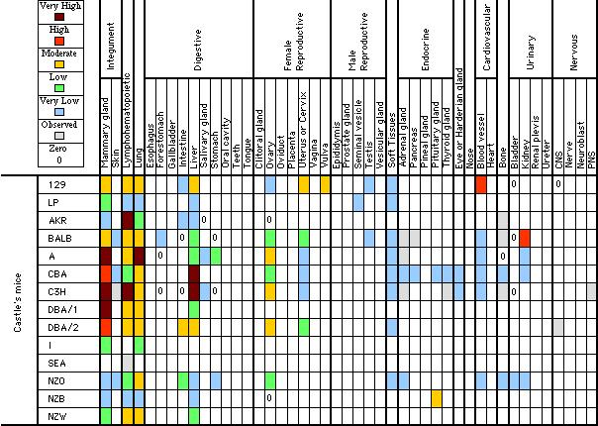
Mouse Tumor Biology Database
Tumor Frequency Grid (Inbred Strain Family x Organ)
Notes:
This is a mouse tumor biologic database and it'll provide you with a heat chart for first of all what you're looking at here Is various strains of mice. And this list goes down to the basement. I mean, I've just truncated it and then you're looking at the various tissues along here and it's a heat chart. So, for instance, if you're interested in lung cancers, strain A gets a lot of lung cancers. If you're looking for a control LP doesn't get many lung cancers at all. So you could use those two strains in your research. And what's even more is when you go to this site on the web and you click on those little heat map squares, it'll take you to the original references that describe finding those particular tumors at that particular frequency.

Slide 10
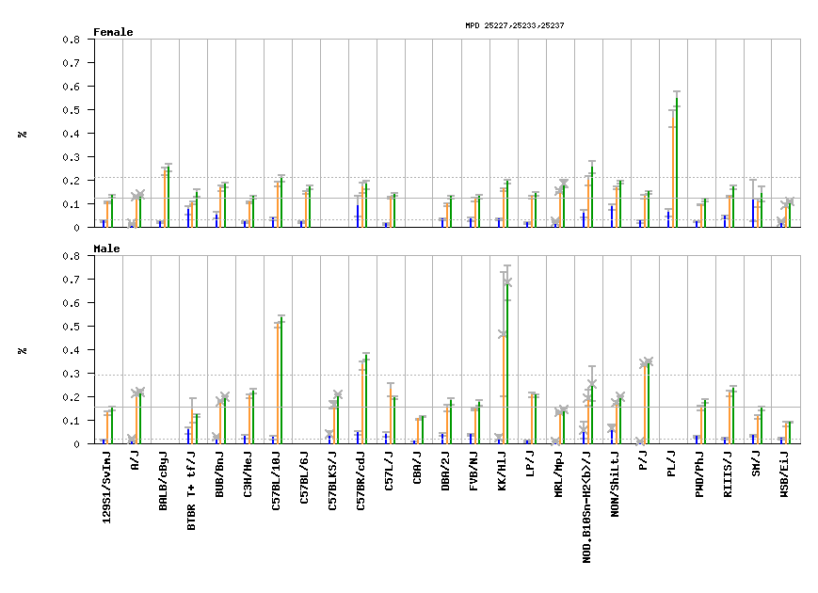

Mouse Phenome Database
Spontaneous micronuclei in peripheral blood
https://phenome.jax.org/
Notes:
And another place that you can go to look for which mouse you're going to use is the mouse phenome database. So what they've done is they've taken about 32 different Strains and I don't list them all along here, but they take these strains at the Jackson Labs and they send it to various researchers who have expertise in doing certain assays. So for this particular case, they've sent out these different strains to people who do spontaneous micronuclei in peripheral blood, which might be a sign of genomic instability. So you can go through and you can look at females for the number of micronuclei that you find in each individual strain, and you can look at males as well. So if you needed a strain and sex that had a lot of micronuclei, you'd go right over here. And this is your strain. And there are a couple of different Ways to measure micronuclei in blood so you can look at reticulocytes, Rbcs or non nucleated peripheral blood cells. And so you know can pick the assay that you think would be most useful. So this is another place that you can go. OK. And they have many, many different phenotypes. So bone mineral density. You know, a lot of the behavioral stuff and all.

Slide 11

Mouse Genome Informatics
Mouse Phenome Database
https://www.informatics.jax.org/
Notes:
And another place that you can go to look for which mouse you're going to use is the mouse phenome database. So what they've done is they've taken about 32 different Strains and I don't list them all along here, but they take these strains at the Jackson Labs and they send it to various researchers who have expertise in doing certain assays. So for this particular case, they've sent out these different strains to people who do spontaneous micronuclei in peripheral blood, which might be a sign of genomic instability. So you can go through and you can look at females for the number of micronuclei that you find in each individual strain, and you can look at males as well. So if you needed a strain and sex that had a lot of micronuclei, you'd go right over here. And this is your strain. And there are a couple of different Ways to measure micronuclei in blood so you can look at reticulocytes, Rbcs or non nucleated peripheral blood cells. And so you know can pick the assay that you think would be most useful. So this is another place that you can go. OK. And they have many, many different phenotypes. So bone mineral density. You know, a lot of the behavioral stuff and all.

Slide 12
Genetically Engineered Mouse Models (GEMMs)
Genetically Engineered Mice
Transgenic
Oocyte injection
Add a gene (randomly integrated into the genome)
Inducible promoters available
Knockout
Inactivate a gene by homologous recombination with a targeting vector in embryonic stem (ES) cells
Stem cells injected into blastocyst that is implanted in a psedopregnant female
Chimeric offspring (always male) are mated and germline transmission confirmed
Conditional knockout
Inactivate a gene in a tissue or time specific manner
Use Cre recombinase and LoxP sites (FLP/FRT also can be used)
Knock-in
Modify a gene
Use Cre/Lox system in ES cells or founder animals
CRISPR/Cas9
Notes:
So then I go into the different types of genetically engineered mice. And so the various types here and I don't talk about non targeted induced mutations simply because I don't have the time in the class. And OK, this is their overview of genetically engineered mice.
So a transgenic mouse is made by OSI injection.
You're adding a gene and it's randomly integrated into the genome.
And you can put indiscernible promoters on it. So you can make it come up at a particular time.
And these are just other versions of genetically engineered mice.

Slide 13
SUMMARY
Mice develop cancer spontaneously and following exposures to carcinogens.
Different inbred strains develop different tumor types which is evidence for genetic susceptibility.
Mouse tumors can often be transplanted between syngeneic mice and this has been used for drug screening.
Some human tumors can be grown in immunodeficient Nude or Scid mice.
Some normal human tissues can be propagated in immunosuppressed mice and rats.
Mice can be genetically engineered to study mechanisms of carcinogenesis and generate tumors that closely mimic those in humans.

Slide 14
Relative Biological Effectiveness
RBE is defined as the ratio of doses of a known type of low LET radiation (historically, 250 kVp x-rays were the standard, but 60Co γ-rays also can be used) to that of a higher LET radiation, to yield the same biological endpoint.
RBE = dose for given end point(reference radiation)
dose for given end point(test radiation).
RBE does not increase indefinitely with increasing LET however, but it reaches a maximum at approximately 100 keV/µm, and then decreases again, yielding an approximately bell-shaped curve
Notes:
RBE reaches a maximum at an LET of approximately 100 keV/µm is that at this ionization density, the average separation between ionizing events corresponds roughly to the diameter of the DNA double helix (approximately 2 nm). As such, radiations of this LET have the highest probability of producing DSBs in DNA, the putative lethal lesion, by the passage of a single charged particle.

Slide 15
Topics
Purpose
Rats
Inbred mice
Genetically engineered mice
Heterogeneous stock (outbred) mice
Other models
Humanized mice
Other species
Notes:
Here are the topics we’ll cover. I’ll tell you why rodent carcinogenesis studies are of interest and tell you about select experiments with mice and rats. Time permitting I’ll tell you about humanized rodent models and urge you to consider studies with non-rodent species.

Slide 16
Purpose
More accurately assess risk
Radiation quality effects
Dose rate effects
Individual risk
Identify underlying carcinogenic mechanisms
Test potential countermeasures
Notes:
Mouse and rat radiation carcinogenesis studies have been run to provide empiric data on radiation quality effects and dose rate effects that can be used in risk modeling and also to better understand differences in risks between individuals. Some studies were designed to identify underlying carcinogenic mechanisms or to test potential countermeasures.

Slide 17
Tumor models
Rat
Skin tumors
Mammary tumors
Mouse
Harderian gland
Acute myeloid leukemia
Hepatocellular carcinoma
Mammary tumors
Ovarian cancer
Lung cancer
Intestinal neoplasia
Glioblastoma
Notes:
This is a partial list of some of the tumor types that have been studied in rats, inbred and engineered mice.

Slide 18
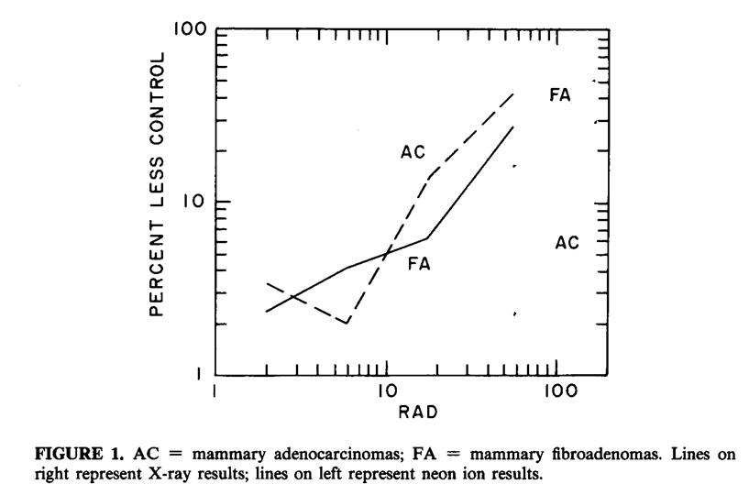
Mammary Tumor Induction in Rats
²⁰Ne doses
2 cGy
6 cGy
18 cGy
54 cGy
X-ray doses
60 cGy
180 cGy
Female Sprague-Dawley rats
Irradiated 6 – 7 weeks of age, monitored to ~1 year of age
6.6 GeV ²⁰Ne (LET ~33keV/μm) at BEVALAC or 230 kVp X-rays
C. J. Shellabarger, J. W. Baum, S. Holtzman, and J. P. Stone, Neon-20 ion- and X-ray-induced mammary carcinogenesis in female rats. Ann. N. Y. Acad. Sci. 459, 239-244 (1985).
Notes:
I’d like to start with rat a mammary cancer study done by Clair Shellabarger at the BEVELAC which was a particle accelerator at the Lawrence Berkeley National Laboratory. Shellabarger irradiated female Sprague Dawley rats with various does of 6.6 GeV neon ions or 230 kVp x-rays and monitored them to around a year of age for the development of mammary tumors.
Here are the results. But before looking at them there are some things you should know about the model. Rats have 12 mammary glands. Sprague Dawley rats are cancer prone and females have a lifetime risk of 2-3 mammary tumors per rat. Those tumors are adenocarcinomas and fibrosarcomas. Lifespan for a rat is typically 2½ to 3 years. At the 1-year time point used in this study background tumor prevalence in unirradiated control rats is 8% for fibroadenomas and 0% for adenocarcinomas.
This figure shows prevalence in irradiated rats minus background in unirradiated rats versus dose for fibroadenoma (FA) and adenocarcinoma (AC) and has results for x-rays in red and neon in black. It is immediately obvious that per unit dose neon ions are more effective in causing tumors than x-rays. At a tumor prevalence of 20%, the relative biological effectiveness (RBE) for fibroadenomas is less than 2, for adenocarcinomas >5. That means that the RBE is dependent on the tumor type being studied.
The rats were irradiated facing the beam in the plateau region of the beam, so the dose increased from anterior to posterior as the Bragg peak was approached. Not surprisingly, there were more tumors in the posterior glands than the anterior glands. With x-rays, where the dose is uniformly distributed, the tumors were uniformly distributed between the anterior and posterior glands.
Another finding was that the “distribution of the number of rats with a specified number of mammary neoplasms departs from a poisson distribution.” Shellabarger raised the possibility that multiple tumors in the same rat were not independent. There are a couple of ways that could occur which I won’t go into. Another interpretation which I put forward in a review article is that Sprague-Dawley rats are not an inbred strain, they are an outbred stock with some remaining genetic heterogeneity. So, the unequal distribution of tumors per rat may indicate that some rats are more susceptible to HZE ion induced tumors than others.

Slide 19
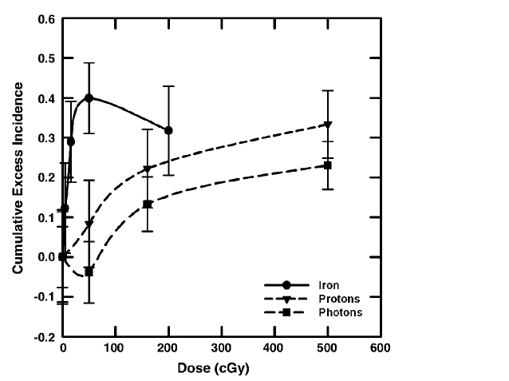
Mammary Tumor Induction in Rats
Female Sprague-Dawley rats
1 GeV/n ⁵⁶Fe (155 keV/μm) at BNL AGS
250 MeV protons at Loma Linda
Doses 0.5 to 5 Gy for γ-rays and 0.05 to 2 Gy for ⁵⁶Fe
Mammary adenocarcinoma incidence study
Cumulative excess lifetime incidence of mammary tumors as a function of dose for 250 MeV proton and 1 GeV ⁵⁶Fe irradiated rats.
J. F. Dicello, A. Christian, F. A. Cucinotta, D. S. Gridley, R. Kathirithamby, J. Mann, A. R. Markham, M. F. Moyers, G. R. Novak and others, In vivo mammary tumorigenesis in
the Sprague-Dawley rat and microdosimetric correlates. Phys. Med. Biol. 49, 3817-3830 (2004).
Notes:
Next, let’s look at some work from John Dicello also using Sprague Dawley rats. This is a lifespan incidence study for mammary adenocarcinomas. If a rat develops a tumor it is surgical excised and the rat remains on the study to develop additional tumors. The endpoint in the study was tumors per rat over the life of the rat. The rats were irradiated with 1 GeV 56Fe ions at the Brookhaven National Laboratory (BNL) alternating gradient synchrotron (AGS).
Iron ions were more efficient in inducing excess mammary tumors than either protons or gamma-rays. The RBE was estimated to be 10 or less for these exposures. The tumor incidence increased rapidly with dose up to 0.5 Gy, then plateaued or decreased. Dicello suggested that the reduced slopes at higher doses may have occurred because those rats with many mammary tumors are likely to have poor survival and, in addition, the higher doses are associated with increased risk of other lethal diseases.

Slide 20
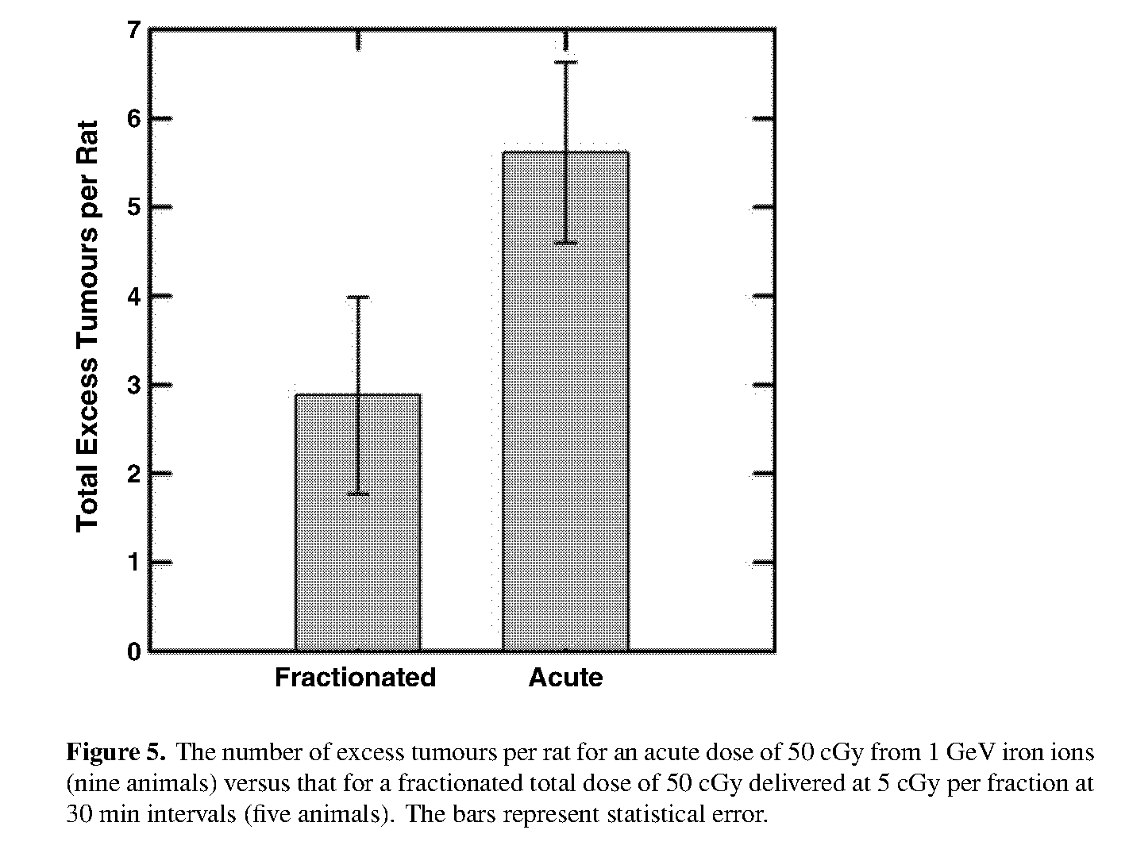
Mammary Tumor Induction in Rats
Notes:
Small expt – 9 rats acute and 5 fractionated
50 cGY delivered acutely or as ten 5 cGy fractions at 30 min intervals

Slide 21
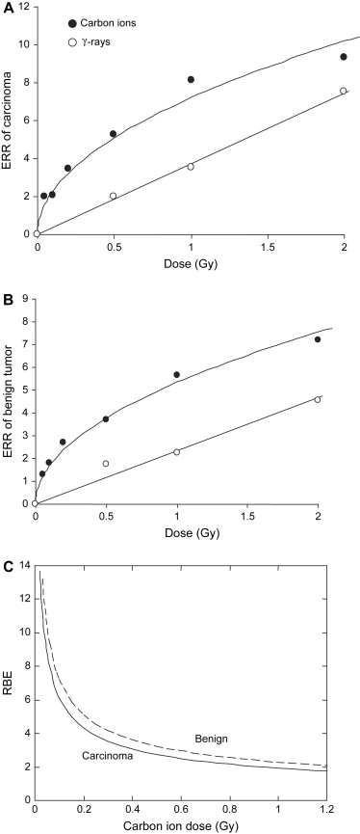
Mammary Tumor Induction in Rats
Carbon ion 290 MeV/n SOBP (40-90 keV/μm), HIMAC
0, 0.05 to 2.0 Gy
Monitored to 1 year
Female rats
Sprague-Dawley (non-inbred stock)
F344 (inbred)
ACI (inbred)
Wistar (non-inbred stock)
Linear dose response for γ-rays; concave downwards for carbon ions
Sprague-Dawley
T. Imaoka, M. Nishimura, S. Kakinuma, Y. Hatano, Y. Ohmachi, S. Yoshinaga, A. Kawano, A. Maekawa, and Y. Shimada, High relative biologic effectiveness of carbon ion radiation on
induction of rat mammary carcinoma and its lack of H-ras and Tp53 mutations. Int. J. Radiat. Oncol. Biol. Phys. 69, 194-203 (2007).
Notes:
Tatsuhiko Imaoka
The different shapes of the dose-response curves result in RBEs that are dose dependent, ranging from 8.6 at 0.05 Gy to 1.9 at 1 Gy

Slide 22
Mammary Tumor Induction in Rats
Strain/stock dependence of radiogenic mammary adenocarcinomas
Sprague-Dawley - sensitive
F344 - resistant
ACI and Wistar - some sensitivity
Strain/stock dependence of benign fibroadenomas and adenomas
Tumor characterization
Erα positive by IHC (78% of tumors)
H-ras wt by RFLP codon 12 junction
Tp53 wt by sequencing exons 5-12
Lung metastases in 7% of carbon ion group; none in γ-ray controls (caveat: may not be significant if limited to tumor bearing rats)

Slide 23
Comment on Use of Rats
Underutilized due to cost and space
Repeated sampling
Readily engineered
Omics databases
Heterogeneous stock available

Slide 24
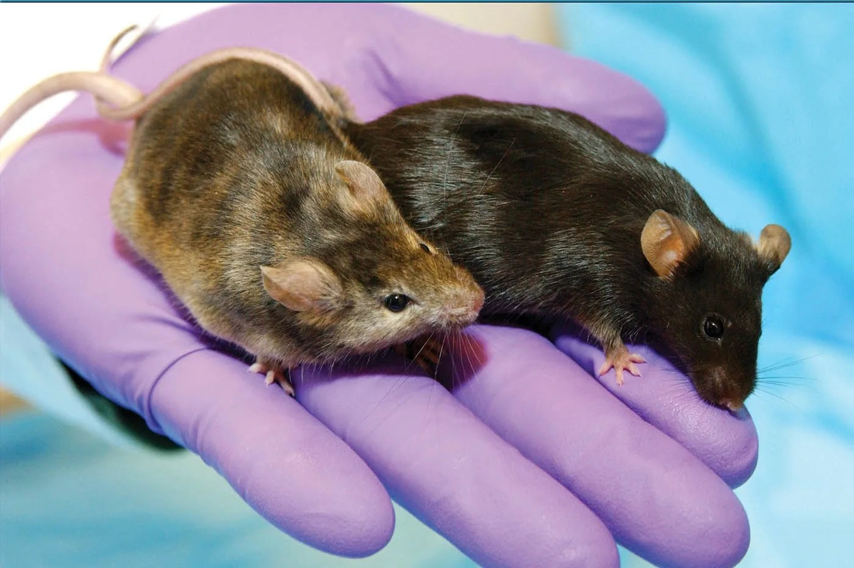
Can We Help?
https://science.nasa.gov/biological-physical/focus-areas/developmental-productive-biology/experiments/

Slide 25





Why mouse models for cancer study?
Inbred strains of mouse, Mus musculus, present high number of molecular and physiological similarities with humans
Recapitulate complex underlying complex process of radiation induced carcinogenesis in human.
Cancer is a major health risk in deep space missions due to chronic exposure of Galactic cosmic radiation (GCR). Radiation quality effect present even larger uncertainties in risk estimation.
Genetically engineered models
Wide availability of strains
Tissue-specific effect
Well defined model= Risk Estimation
Studies using high energy protons and heavy ions (HZE particles), and Low LET gamma available
Small size, high rate of breeding, complete genome sequenced benefits logistically
Limitations
Biological response to radiation may differ due to species difference
Simulating complete spectrum of space radiation may be challenging in laboratory settings
Mutant mouse models may alter responses to radiation as compared to WT

Slide 26
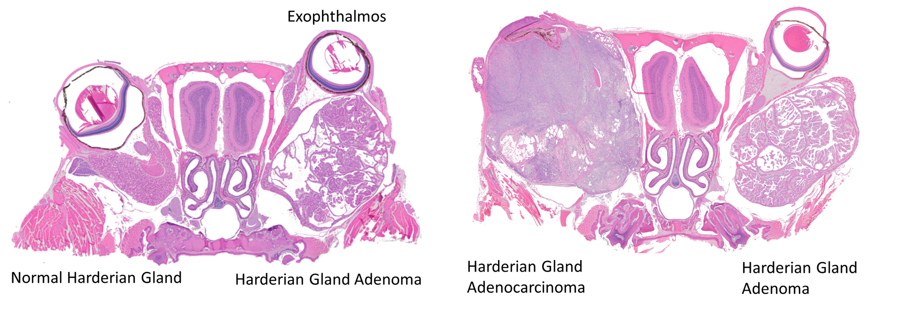
Harderian Gland Tumors R.J.M. Fry and E.L. Alpen
Various HZE ions
B6CF1 (C57BL/6JAnl x BALB/cJAnl)F1 female mice
Partial body irradiation
Monitored 600 days
Pituitary gland isografts (↓ latency, ↑ incidence, ↑ metastases)
R. J. Fry, P. Powers-Risius, E. L. Alpen, E. J. Ainsworth, and R. L. Ullrich, High-LET radiation carcinogenesis. Adv. Space Res 3, 241-248 (1983).
Notes:
The most extensive data set available for determining the effect of LET on carcinogenic efficacy comes from studies of murine radiation-induced Harderian gland tumors by Michael Fry, Ed Alpen, and their coworkers.
(Jump ahead) Humans lack Harderian glands (they are found in species with a third eyelid) and consequently do not develop Harderian gland tumors. This tumor type was selected to model typical epithelial tumors and, as a model, has some noteworthy features. Both benign and malignant Harderian tumors can arise. Their background incidence in unirradiated mice is relatively low, about 1 to 2.5% in the hybrid strain used, while the prevalence in mice irradiated under maximally tumorigenic conditions can reach up to about 70%.
Fry et al. (1985) irradiated female C57BL/6 - BALB/c F1 mice with a range of HZE ions at the Bevalac. Partial body irradiation was delivered to the head and thorax with the abdomen shielded to prevent exposure of the ovaries.
Humans lack Harderian glands (they are found in species with a third eyelid) and consequently do not develop Harderian gland tumors. This tumor type was selected to model typical epithelial tumors and, as a model, has some noteworthy features.
Both benign and malignant Harderian tumors can arise. Their background incidence in unirradiated mice is relatively low, about 1 to 2.5% in the hybrid strain used, while the prevalence in mice irradiated under maximally tumorigenic conditions can reach up to about 70%

Slide 27
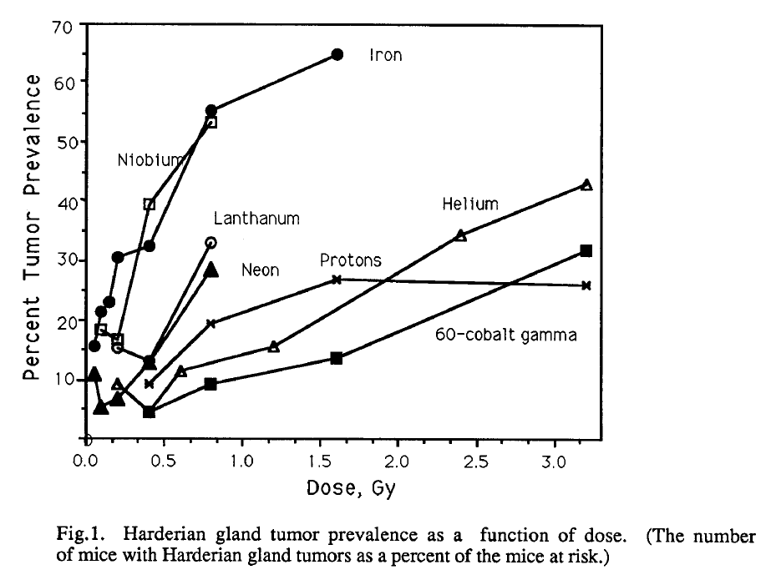
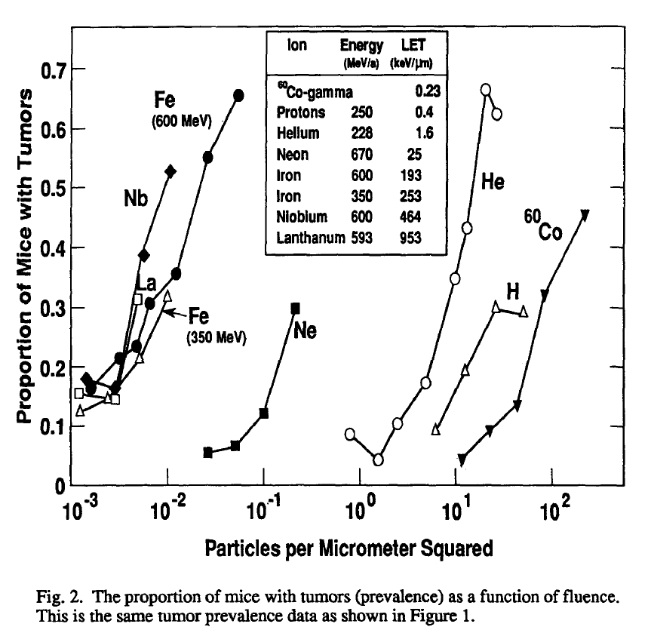
Harderian Gland Tumors
E. L. Alpen, P. Powers-Risius, S. B. Curtis, R. DeGuzman, and R. J. Fry, Fluence-based relative biological effectiveness for charged particle carcinogenesis in mouse Harderian gland. Adv. Space Res. 14, 573-581 (1994).
Notes:
In general, tumorigenic effectiveness increased with increasing LET. The initial slopes of the dose response curves became steeper as LET increased.

Slide 28
Harderian Gland Tumors
E. L. Alpen, P. Powers-Risius, S. B. Curtis, R. DeGuzman, and R. J. Fry, Fluence-based relative biological effectiveness for charged particle carcinogenesis in mouse Harderian gland. Adv. Space Res. 14, 573-581 (1994).
Notes:
Plotting tumor prevalence against particle fluence in place of dose reveals increasing effectiveness per particle, with ions of increasing LET up to 600 MeV iron with an LET of 193 keV. Ions with higher LETs, 350 MeV iron (253 keV), 600 MeV niobium (464 keV), and 593 MeV nucleonj1 lanthanum (953 keV) were no more effective on a per particle basis than 600 MeV iron ions.
Alpen also did a dose fractionation study using the Harderian gland model. He compared a single 0.4 Gy of 600 MeV Fe to about the same dose split among 6 fractions spaced at 2 week intervals. The fractioned exposure was about 1.5 times as effective as the single dose, an example of an inverse dose rate effect.

Slide 29
Leukemogenesis/Carcinogenesis NSCOR
CBA/CaJ male mice
1 GeV/n ⁵⁶Fe (150 keV/μm) 0, 0.2, 0.4 and 1 Gy at NASA Space Radiation Laboratory
¹³⁷Cs γ-rays 0, 1, 2 and 3 Gy
Monitored to 800 days of age
Acute myeloid leukemia and hepatocellular carcinoma
Notes:
Next, I’ll cover work by the Leukemogenesis and Carcinogenesis NSCOR on acute myeloid leukemia and hepatocellular carcinoma. The initial study was designed to establish the effectiveness of 1 GeV Fe ions for myeloid leukemogenesis. It used CBA mice – no background leukemia unirradiated. Male mice used because they are more susceptable to radiation-induced AML than female mice.

Slide 30
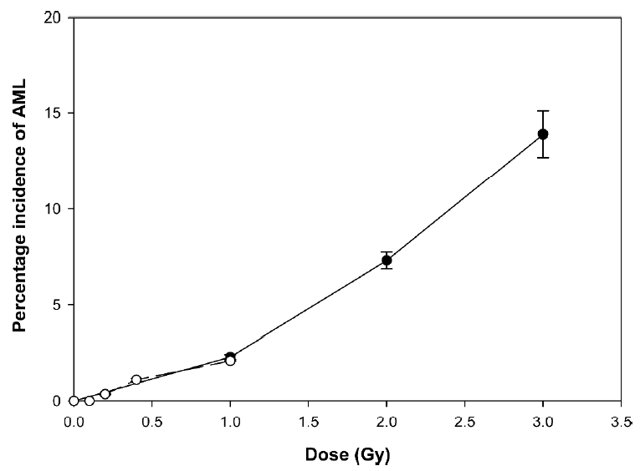
Acute myeloid leukemia incidence
Male CBA/CaJ
Radiation
¹³⁷Cs γ-rays
1 GeV/n ⁵⁶Fe
Monitored to 800 days of age
Weil et al Radiat. Res. 172, 213-219 (2009)
Notes:
an RBE of about 10 was expected but actual RBE was about 1

Slide 31
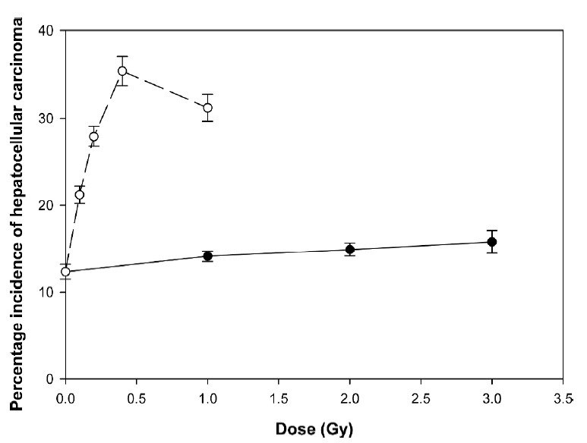
Hepatocellular carcinoma incidence
Male CBA/CaJ
Radiation
¹³⁷Cs γ-rays
1 GeV/n ⁵⁶Fe
Monitored to 800 days of age
Weil et al Radiat. Res. 172, 213-219 (2009)
Notes:
unexpected finding was HCC with an RBE in the 50 to 70 range, background is around 15% but doesn’t increase with gamma rays

Slide 32
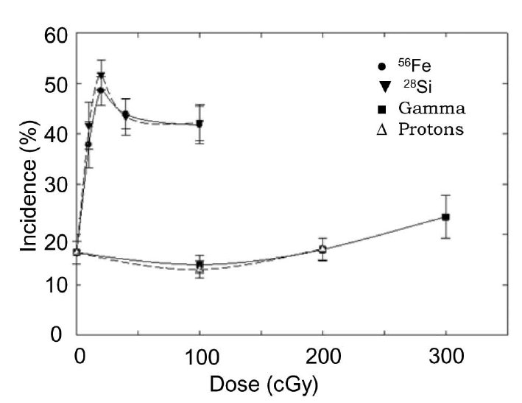
Hepatocellular carcinoma incidence
Hepatocellular carcinoma incidence
Male C3H/HeNCrl
Radiation
¹³⁷Cs γ-rays
1972SPE protons
300 MeV/n ²⁸Si (64 keV/μm)
600 MeV/n ⁵⁶Fe (181 keV/μm)
Monitored to 800 days of age
Weil et al. PLoS One. 2014 Aug 15;9(7):e104819.
Notes:
this work was extended to include 600MeV iron, 300 MeV Si and an energy spectrum of protons to simulate the 1972 solar particle event. The mouse strain was switched to C3H for logistical reasons. C3H is very similar to CBA with regards to AML and HCC.
These are the results for HCC. The HZE ions had a high RBE and while the results for protons overlap those for gamma rays.

Slide 33
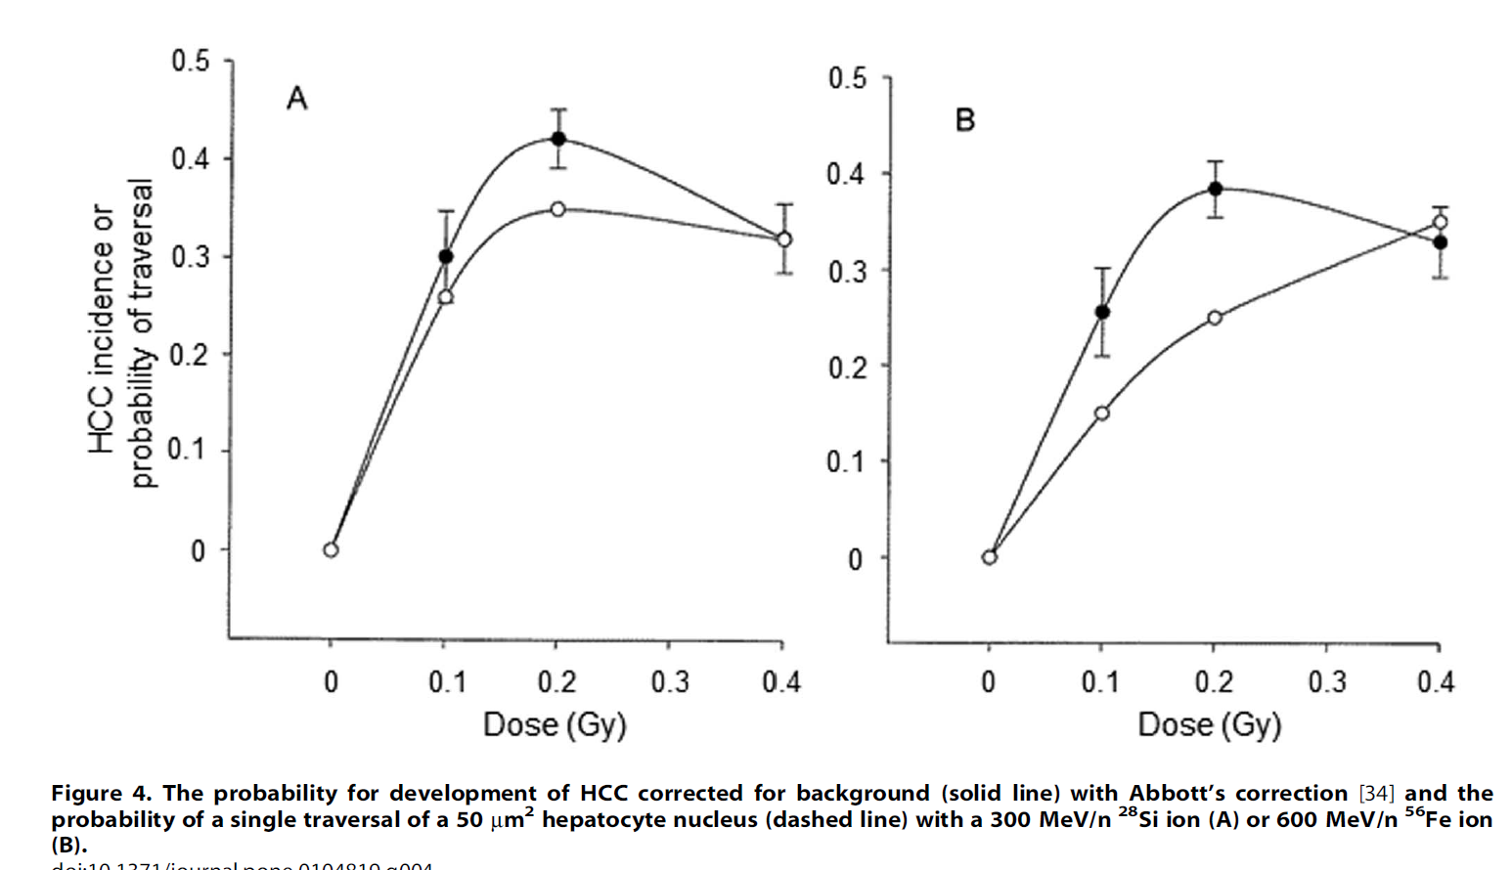
HCC incidence and particle traversal
²⁸Si
⁵⁶Fe
Notes:
the results raise the question of why the RBE should be low for acute myeloid leukemia and high for hepatocellular carcinoma and that could be due to different underlying tumorigenic mechanisms. The driver mutation in AML is inactivation of a specific tumor suppressor gene through a radiation induced chromosome deletion that should scale with dose to individual target cells. In humans at least, HCC is a consequence of inflammation from hepatitis virus infection, alcohol abuse or obesity. The induction of inflammation is at the tissue level rather than individual target cells so it would not scale with individual cells traversed by HZE ions. This figure plots HCC incidence along with the proportion of hepatocyte nuclei traverse by a single HZE ion for various doses. You can see, particularly for iron ion, that HCC incidence increases more rapidly than the number of cells actually hit, suggesting an indirect effect.

Slide 34

Heterogeneous Stock HS/Npt Mice
Progenitor strains*
A/J
AKR/J
BALB/cJ
C3H/HeJ
C57BL/6J
CBA/J
DBA/2J
LP/J
*All of these strains have been completely sequenced.
Image Courtesy: Schmidt CW. Science Selection. 24 July 2017 https://doi.org/10.1289/EHP2100
Notes:
The models that I’ve described so far use inbred animals or stocks with limited genetic diversity. What I’ll describe now is a model with genetically diverse mice of the HS/Npt stock. This is a deliberately outbred population with genetic contributions from 8 founder strains which are listed here.

Slide 35

Experimental Design
HS/Npt mice
600/group
7-12 weeks old
♀ and ♂
0.4 Gy HZE
240 MeV/n ²⁸Si
600 MeV/n ⁵⁶Fe
3 Gy ¹³⁷Cs gamma rays
Unirradiated
Monitor to 800 days of age
Classify tumors
Compare tumor types between groups
Genotype each mouse for 78,000 SNPs
Map responsible QTLs
Notes:
Female and male HS/Npt mice were irradiated with HZE ions, specifically silicon or iron, or gamma irradiated or left unirradiated as controls. The dose for HZE ions was 0.4 Gy and for gamma rays 3 Gy. The mice were monitored until they were 800 days old. And any tumors that arose were classified by histopathology. These same mice were also monitored for cataract formation and neurobehavior effects and they were also genotyped for genome wide association studies. We will focus on the carcinogenesis part of the project.

Slide 36
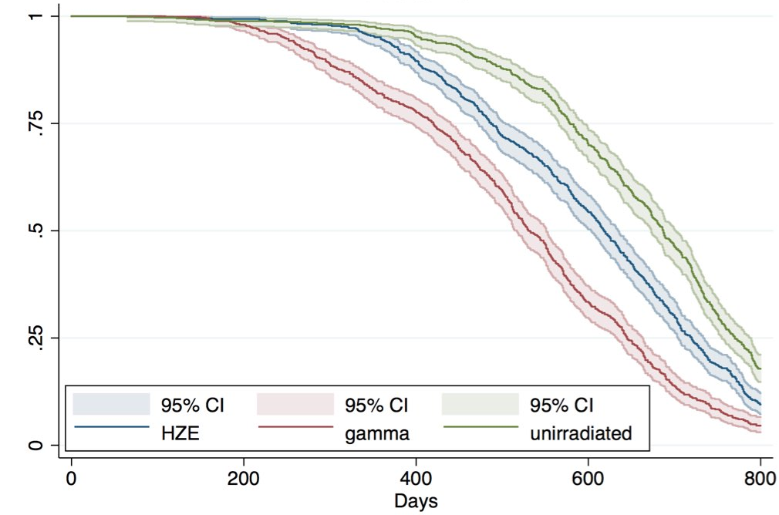
Results: Radiation decreases lifespan
Notes:
First let’s look at overall survival. Radiation decreased lifespan and 3 Gy of gamma rays decreased it more than 0.4 Gy of HZE ions. Female mice live longer than male mice but lose more of their lifespan due to radiation.

Slide 37
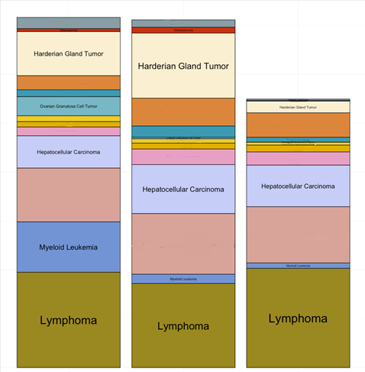
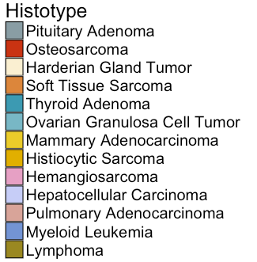
Results: Same tumor types, different proportions
600
400
Number of Tumors
200
0
Gamma
HZE
Unirrad.
Notes:
Many of the mice developed tumors and some of the mice developed more than one tumor. Irradiated mice developed more tumors than unirradiated controls. There were 82 distinct tumor types identified, most of the rare but 18 of them occurring in more than 1% of the mice. The same types of tumors were seen in the irradiated mice and the unirradiated controls, the proportions of the tumor types differed.

Slide 38
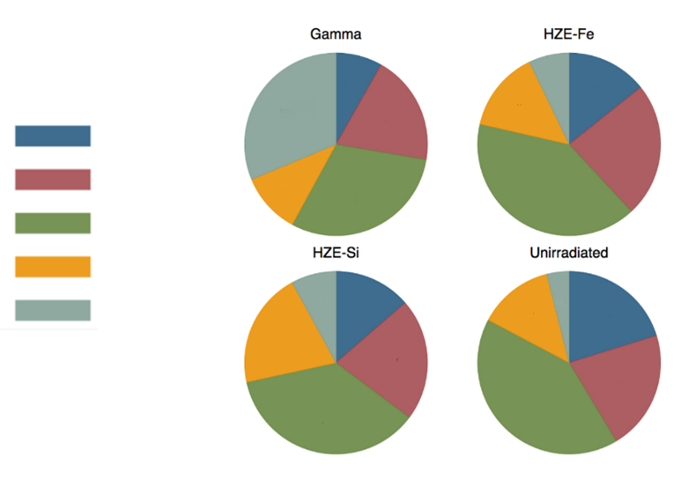
Results: Same tumor types, different proportions
Lymphoma
Subtype
BLL
DLBCL
FBL
Other
Pre-T LL
Notes:
Here is an example. Lymphomas were classified in 5 subtypes: B-cell lymphoblastic leukemia, diffuse large b-cell lymphoma, follicular B-cell lymphoma, precursor T-cell lymphoma and other. All these lymphoma types occurred in each of the radiation groups, but look at for example the proportions of T lymphoblastic lymphomas between groups. Here it is in unirradiated mice and there are proportionally more in the HZE ion irradiated mice and a large proportion in gamma ray irradiated mice. We think we know why gamma rays are so effective in inducing this subtype of lymphoma, but instead of going into mechanism I’ll go into consequence.

Slide 39
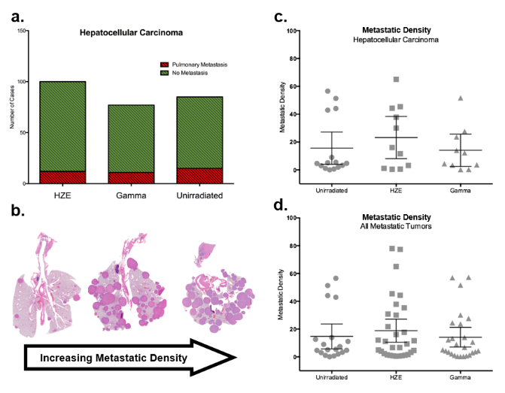
Results: No increase in metastases or metastatic density in HZE ion irradiated outbred mice
Hepatocellular Carcinoma
Metastatic Density
Pulmonary Metastasis
No Metastasis
Hepatocellular Carcinoma
Number of Cases
Metastatic Density
HZE
0 Gy
HZE
γ-ray
Gamma
Unirrad.
Unirrad
HZE
Gamma
Metastatic Density
All Metastatic Tumors
Metastatic Density
0 Gy
HZE
γ-ray
Unirrad
HZE
Gamma
Notes:
Another interesting finding was that tumors arising in HZE ion irradiated mice did not appear to be more metastatic. Whether measure by the number of cases of metastases. Or the density of the metastases if they occurred.

Slide 40
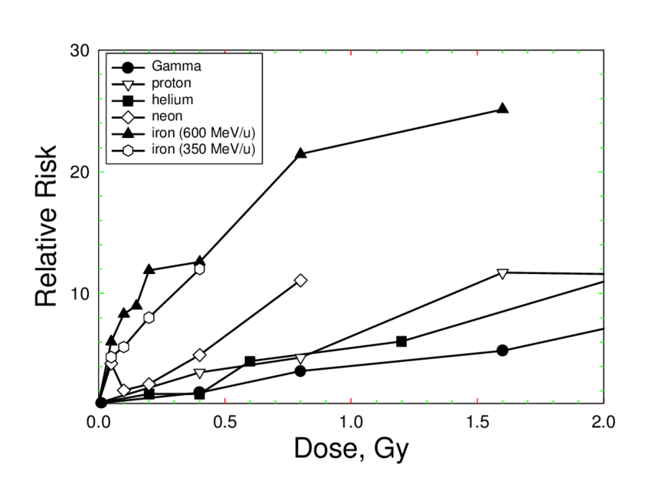
Harderian Gland Tumor Model
Inbred WT: CBA/J HSD
Transgenic: B6CF1/Anl, CB6F1/Hsd
Best-studied normal epithelial tissue system that contains a uniform, non-perturbed cell population of epithelial and secretory cells. Tumor induction depends on genotype and female mice HG tumors data is the most complete for heavy ions.
Radiation | Energy (MeV/u) | Dose (Gy) | Outcomes
Gamma |  | 0.4, 0.8, 1.2, 1.6, 3.2, 7 | Risk analysis performed using particle fluence rather than dose. Harderian gland tumor count per unit increase in particle fluence.
H | 245, 1000 | 0.4, 0.8, 1.6, 3.0, 3.2
He | 244 | 0.2, 0.4, 0.6, 1.2, 2.4, 3.2, 5.1, 7
Fe | 559, 448, 262, 1000 | 0.05, 0.1, 0.15, 0.2, 0.4, 0.5, 0.8,1.6
Si | 296 | 0.04, 0.08, 0.16, 0.32
Ti | 1000 | 0.03, 0.066, 0.13 (fractionated), 0.26 (fractionated), 0.52
Ne | 620 | 0.05, 0.1, 0.2, 2.4, 3.2, 5.1, 7
Nb | 484 | 0.1,0.2, 0.4, 0.8
La | 426 | 0.2, 0.4, 0.8
Relative risks of HG tumors with particle fluence in the studied period (at 600 days)
Alpen et al 1993
Alpen et al 1993; Change et al 2016; Kennedy et al 2008, 2011

Slide 41
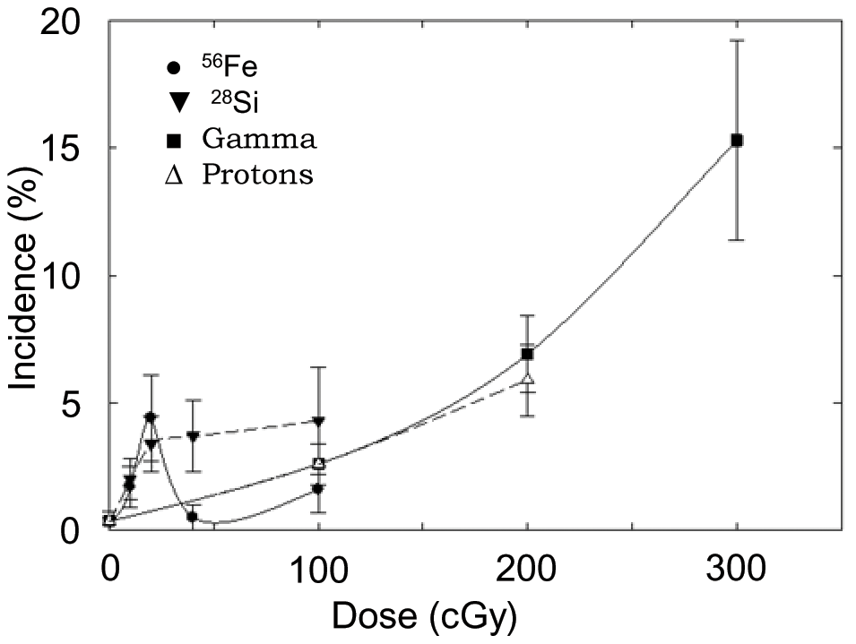
Acute Myeloid Leukemia Model
Inbred WT: RF/J, SJL/J, CBA, C3H, BALB/cByJ
Transgenic: Mlh1+/1 B6.129^{Mlh1tm1Rak/NCI}
Radiation | Energy (MeV/u) | Dose (Gy) | Outcomes
Gamma |  | 0.5, 1.0, 2.0, 2.5, 3.0 | High cancer incidence including leukemia (40-66%), Reduction in tumor free survival, Tumor Incidence (AML, HCC), HCC metastases to lung
Proton | 1972SPE | 1.0, 2.0
Fe | 600, 1000 | 0.1, 0.2,0.4,1.0
Si | 300 | 0.1,0.2,0.4, 1.0
AML % following HZE and gamma exposure
Dose range | Radiation | RBE
0-1 Gy | 600 MeV/n 56Fe | 0.2 ± 0.4
 | 300 MevV/n S28Si | 1.2 ± 0.5
 | 1972SPE Protons | 0.7 ± 0.2
Weil et al 2009, 2014; Patel et al 2018; Bielefeldt-Ohmann et al 2012

Slide 42
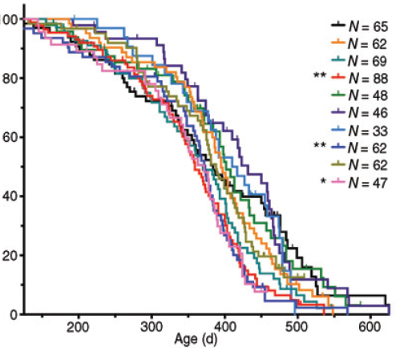
Lung Adenocarcinoma Mouse Model
Inbred WT: RFM, C3H, CBA, BALB/cAnNB, C57BL/6
Transgenic: K-rasLA1^{G12D}, super p53(K-rasLA1^{G12D} with extra p53), Gprc5a, miR21+, Scgb1a1-cre^{ER}
Radiation | Energy (MeV/u) | Dose (Gy) | Outcomes
Gamma |  | 0.4, 0.75, 1, 1.5, 5 | Both acute and fractionated doses causes lung cancer, HZE ions fractionation accelerate the tumor progression, tumor sizes. Airway progenitors lose colony forming ability post high-LET in vitro, however, progenitor clonal expansion recorded in vivo in airway cells. Histological analysis revealed papillary adenocarcinoma as the most commonly observed lung tumor, with some instances showing elevated levels of bronchus-associated lymphoid tissue (BALT), potentially indicating lymphoma.
Neutron |  | 0.025, 0.05, 0.1, 0.5
Fe | 600, 1000 | 0.1, 0.2, 0.5, 1.0 (fractionated and acute), 1, 2.5
Si | 300 | 0.1 (fractionated), 0.1, 0.2, 0.4, 0.5, 1.0, 2.5
X ray |  | 1, 2, 4, 6, 8, and 1, 2, 6 (fractionated)
O | 600 | 1 ( fractionated and acute)
5-ions GCRsim |  | 0.2, 0.4, 0.75
H | 50, 150 | 2
Kaplan–Meier survival HZE/X ray
Significant survival drop vs controls in K-rasLA1 mice exposed to acute or fractionated dose of 1.0 Gy 56Fe-particles. Delgado et al 2014
Asselin-Labat et al 2017; Moding et al 2016; Delgedo et al 2014; Luitel et al 2018; Ulrich et al 1984; Wang et al 2015, 2016; Delgado et al 2014; Farin et al 2015; Werner et al 2017, 2019; Hosseini et al 2025 NASA-HRP-IWS

Slide 43
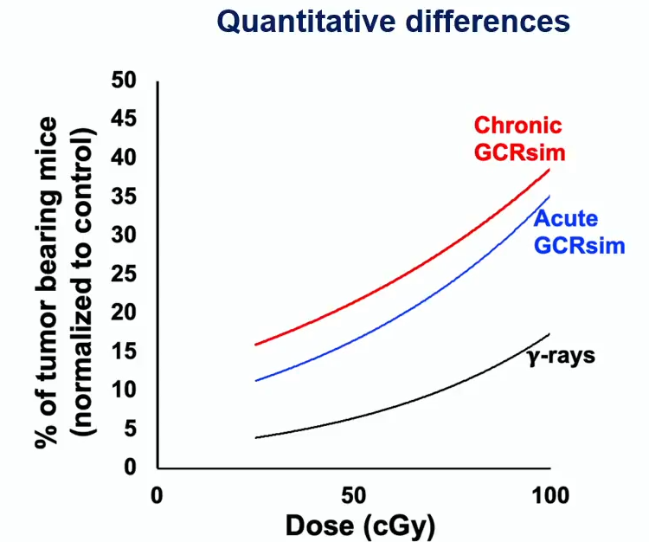
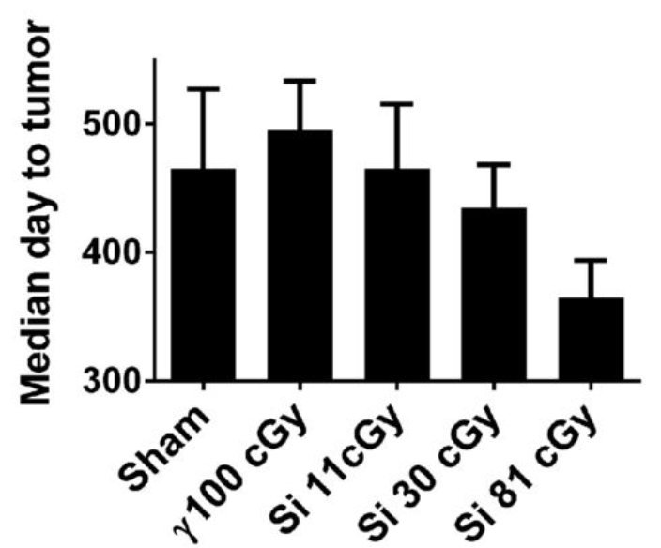
Mammary Carcinoma Mouse Model
Inbred WT: BALB/c, Sprague-Dawley rats
Transgenic: ApcMin/+, BALB/c chimeric (Trp53 null), BALB/c/AnNB, RFMf/Un
Radiation | Energy (MeV/u) | Dose (Gy) | Outcomes
Neutron |  | 0.025, 0.05, 0.1, 0.2, 0.5, 2 | Incidence of solid tumors in fission neutron and incidences of reticular tissue neoplasms. No significant change in the tumor latency or metastasis in Si-irradiated, C-ions induce mammary tumor with 7% lung metastasis in sprague-dawley rats. Acute or chronic GCRsim increases preneoplastic changes and ductal outgrowth in mammary gland. ERRa linked with poor prognosis increases with GCRsim. Higher risk of mammary tumors and invasive cancers with GCRsim vs γ-ray.
Gamma (Cs137) |  | 0,1, 0.25, 0.5, 0.75, 1, 1.5, 2, 3
Si | 240, 300, 350 | 0.11, 0.2, 0.3, 0.4, 0.81
C | 290 | 0.05, 0.1, 0.2, 0.5, 1
Fe | 600 | 0.4
GCRsim |  | 0.75 (acute and chronic)
Mammy tumors in APC^{Min/+}
Kumar et al 2025 NASA-HRP-IWS
Mammy tumors in Trp53-null
Imaoka et al 2007, 2013, 2014, 2018; Illa-Bochaca et al 2014; Ullrich et al 1979, 1983; Edmondson et al 2020; Udho et al 2021; Kumar et al 2025 NASA-HRP-IWS
Illa-Bochaca et al 2014

Slide 44
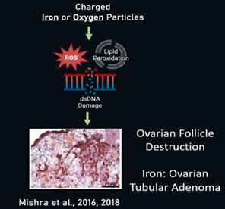
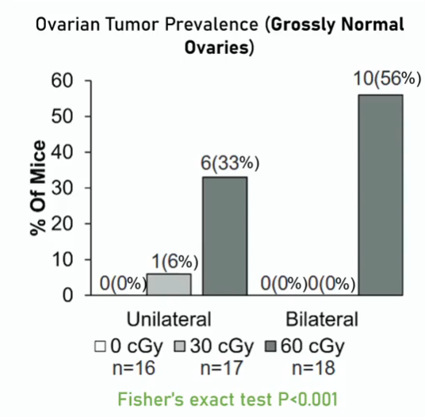
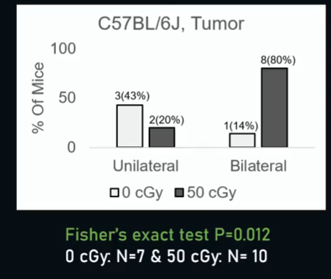
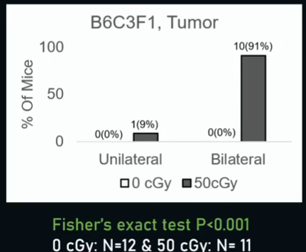
Ovarian Cancer Mouse Model
Inbred WT: C57BL/6
Transgenic: RF/Un, B6C3F1 (C57BL/6NCrj x C3H/HeNCrj)
Ovarian Cancer is 5th leading cause of cancer related death in US women. Space radiation including galactic cosmic rays is a carcinogenic factor and can be hazardous to the cohort of female astronauts and may lead to reproductive organ tumor in longer missions.
Radiation | Energy (MeV/u) | Dose (Gy) | Outcomes
Mixed beam (Si, Ti, Fe) |  | 0.3, 0.6 | Mixed heavy ions beam (Si, Ti, Fe) or single O ion IR potently induce ovarian tumors.
O | 600 | 0.05, 0.3, 0.5 | Tumor incidence unilateral and bilateral.
Fe | 600 | 0.05, 0.3, 0.5 | Ovarian tubular adenoma most prevalent.
X ray |  | 0.5, 5 | Ovarian cyst occurrence, and lipid peroxidation increases in ovarian follicles.
C | 290 | 0.46
Mixed beam
O ion
O ion
Watanabe et al 1998; Mishra et al 2016, 2018; Leon K et al 2025 NASA-HRP-IWS

Slide 45
Colorectal Cancer Mouse Model
Inbred WT: C57BL/6J
Transgenic: APC1638N/+, CDX2P APCflox/+
Radiation | Energy (MeV/u) | Dose (Gy) | Outcomes
Gamma |  | 0.1, 0.5, 2, 5 | Intestinal, colon tumor incidences and crypt number evaluated. Protons induce upregulation of β-catenin/Akt pathways, increased DNA damage and decreased DNA repair factors. Gross distribution of tumors along the intestinal tract with greater number of tumors/unit area in Fe ions vs gamma. GI tumors significantly higher in GCRsim vs gamma, Male mice show higher intestinal tumor frequency.
Si | 300 | 0.1, 0.5, 1.4 (acute and protracted)
Fe | 600, 1000 | 0.1, 0.5, 1.6 (acute and protracted), 4
X ray |  | 2
Protons | 50, 1000 | 2, 1.88
SPEsim | 91.67% @ 50 to 0.14% @ 150) | 2
C | 290 | 0.1, 0.5, 2.0
O | 325 | 0.05, 0.5
SimGCRsim (H, He, Si, O) | 1000 H +250 He +325 O + 300 Si | 0.05, 0.5
Heavy ions-induced intestinal tumor in APC^{Min/+} mice
Dutta et al 2013
Suman et al 2015, 2016, 2017, 2019, 2022a, 2022b; Dutta et al 2013; Kim et al 2016; Trani et al 2010; Cheema et al 2014

Slide 46
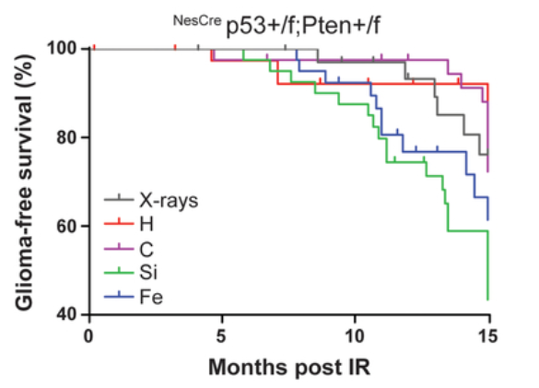
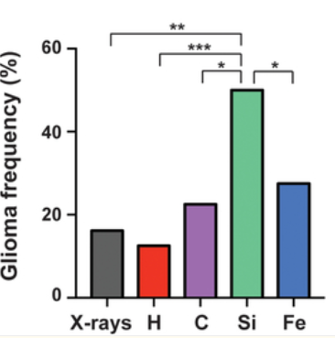
Brain Cancer Mouse Model
Transgenic: FVB/NJ-C57BL6, Ink4ab/Arf^{−/−}
^{NesCre}p53+/f;Pten+/f mice survival post 0.5 Gy IR
Radiation | Energy (MeV/u) | Dose (Gy) | Outcomes
H | 150 | 0.5 | High grade glioma frequencies increased with increasing LET. Maximum tumor development seen with Si. Decreased expression of neuronal marker- NeuN and increased expression of glial markers- Gfap and Olig2, neural stem progenitor marker Sox2 in radiation-induced gliomas relative to normal brain. High levels of amplification of the Met receptor tyrosine kinase (RTK)
C | 293 | 0.5
Si | 238 | 0.5
Fe | 600 | 0.5, 1
X ray |  | 0.5, 4
Todorova et al 2019; Camacho et al 2015
Todorova et al 2019

Slide 47
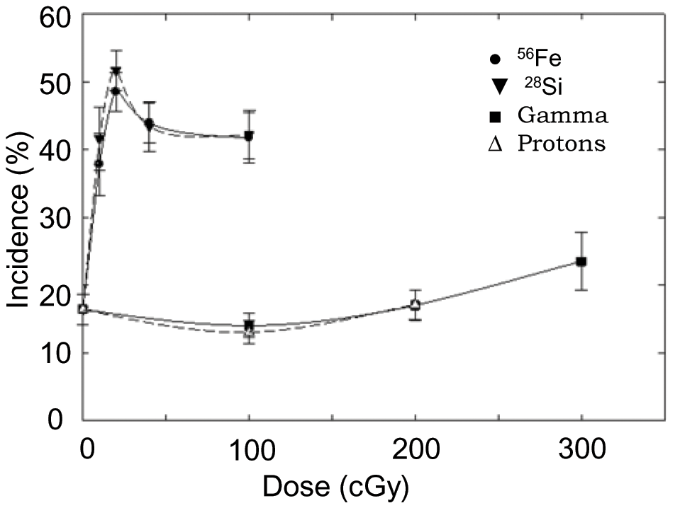
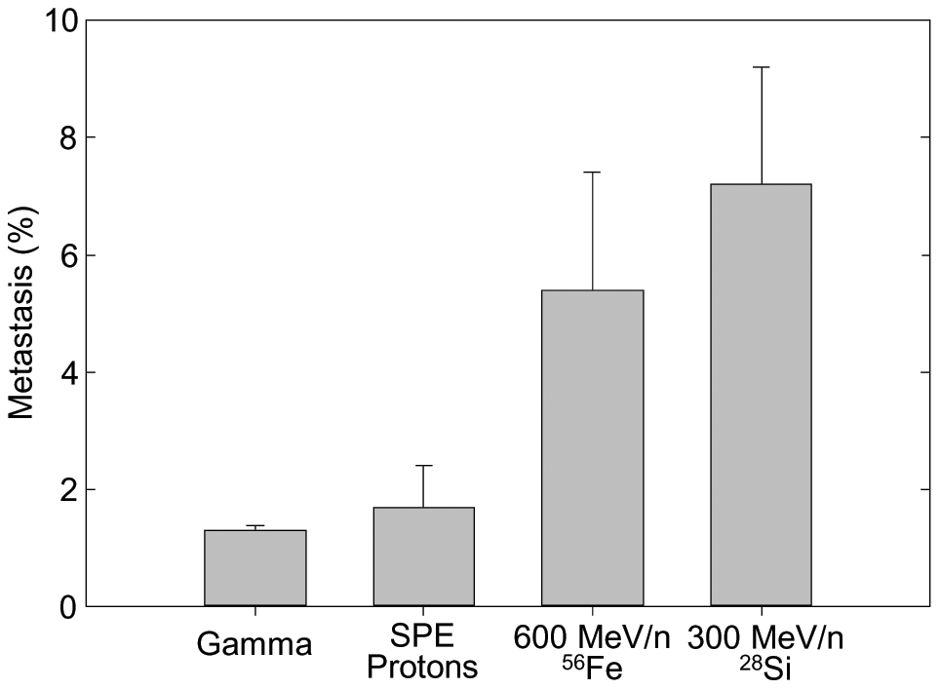
Liver Cancer Mouse Model
Inbred WT: CBA/J, C3H Outbred WT: HS/Npt
Transgenic: C3B6F1
HCC % following HZE and gamma
Radiation | Energy (MeV/u) | Dose (Gy) | Outcomes
Gamma |  | 1, 2, 3 | Induction of HCC as a function of dose of HZE ions and 1972SPE protons. Increase in tumors in HZE-irradiated mice but not more aggressive compared to γ-rays or spontaneously. Several differentially expressed transcripts post-HZE exposure. HZE-HCC enriched with genes associated with organismal and cell death/apoptosis, molecular transport, Rho signaling and small GTPase-mediated signaling transduction. Low-LET/spontaneous-HCC enrich with molecular transport linked genes.
Fe | 600 | 0.1, 0.2, 0.4, 1
Si | 300, 240 | 0.1, 0.2, 0.4, 1
1972SPE protons | 30-80 | 1, 2
O | 1000 | 0.2
HCC % with metastases to the lung as a function of radiation type
Dose range | Radiation | RBE
0-0.2 Gy | 600 MeV/n Fe56 | 67 ± 41
 | 300 MevV/n Si28 | 74 ± 47
 | 1972SPE Protons | 1 ± 10
Weil et al 2014
Weil et al 2009, 2014; Edmondson et al 2020; Udho et al 2021; Ding et al 2021; Nia et al 2020

Slide 48
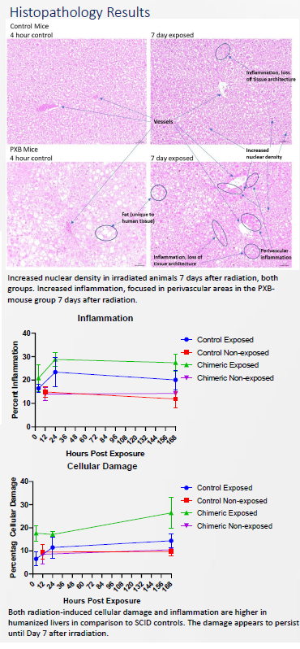
Chimeric Mouse Model of Human Liver
Animals: PXB mice with chimeric livers and control (Fox Chase SCID) mice, 24 Male, 70 days old
Timeline: 7 days environmental acclimation, 3 days restraint device acclimation, 1 day treatment (table
below), tissue collection day 0-7 post-treatment
Radiation: Gamma rays at a whole body dose of 2 Gy, with 1 Gy delivered from each side acutely, expose from side
▪ Analysis of DNA damage markers and transcriptomics will be performed on the humanized and mouse
livers
Data: Dr. Honglu Wu, NASA
Notes:
Then I describe humanized mice.
Two different types, so you can take these immunosuppressed types and you can put human tissues. Into them, some of them and actually develop a mouse with a human hematopoietic system or a human liver.
the second type of humanized mice is mice with human genes. So what you can do is you can replace sections of the mouse P53 gene with the human homolog of that. So you can look at variations in the human gene, but you can do it in mice where you can actually induce tumors

Slide 49
Summary
RBE for HZE ion-induced carcinogenesis is dependent on:
Tumor type
Dose
LET
Microdosimetry
The tumor histotypes that arise in HZE ion irradiated animals are the same as those that occur spontaneously or following low LET radiation exposures.
Protraction may increase (or decrease) tumor incidence.
Induction by HZE ions may enhance malignancy of some tumor types.
Genetic background is critical in determining tumor incidence.
the tumor types induced in HZE irradiated mice depends on their strain background
the extent of HZE induced mammary carcinogenesis in the rat is strain dependent.
Notes:
In summary no universal RBE for HZE ions…
Finally, this short presentation has barely scratched the surface of the work that’s been done on heavy ion carcinogenesis or the models that have been used. I’ve skipped over work with genetically engineered mice done by Jeff Bacher, Rich Halberg, Mary Helen Barcellos Hoff, Mike Story, Jerry Shay, Al Fornace and Sandeep Burma, and work on ovarian cancers done by Ulrike Luderer. I’ve also skipped over work being done with humanized mice by Chris Porada, Paul Wilson and Honglu Wu. For those of you who want to learn more about this work, don’t hesitate to contact me.

Slide 50
Mouse models and characterization of space-radiation-induced cancer
Thank You
Janapriya.saha@nasa.gov
Notes:
Finally, this short presentation has barely scratched the surface of the work that’s been done on heavy ion carcinogenesis or the models that have been used. I’ve skipped over work with genetically engineered mice done by Jeff Bacher, Rich Halberg, Mary Helen Barcellos Hoff, Mike Story, Jerry Shay, Al Fornace and Sandeep Burma, and work on ovarian cancers done by Ulrike Luderer. I’ve also skipped over work being done with humanized mice by Chris Porada, Paul Wilson and Honglu Wu. For those of you who want to learn more about this work, don’t hesitate to contact me.

