Slide 1
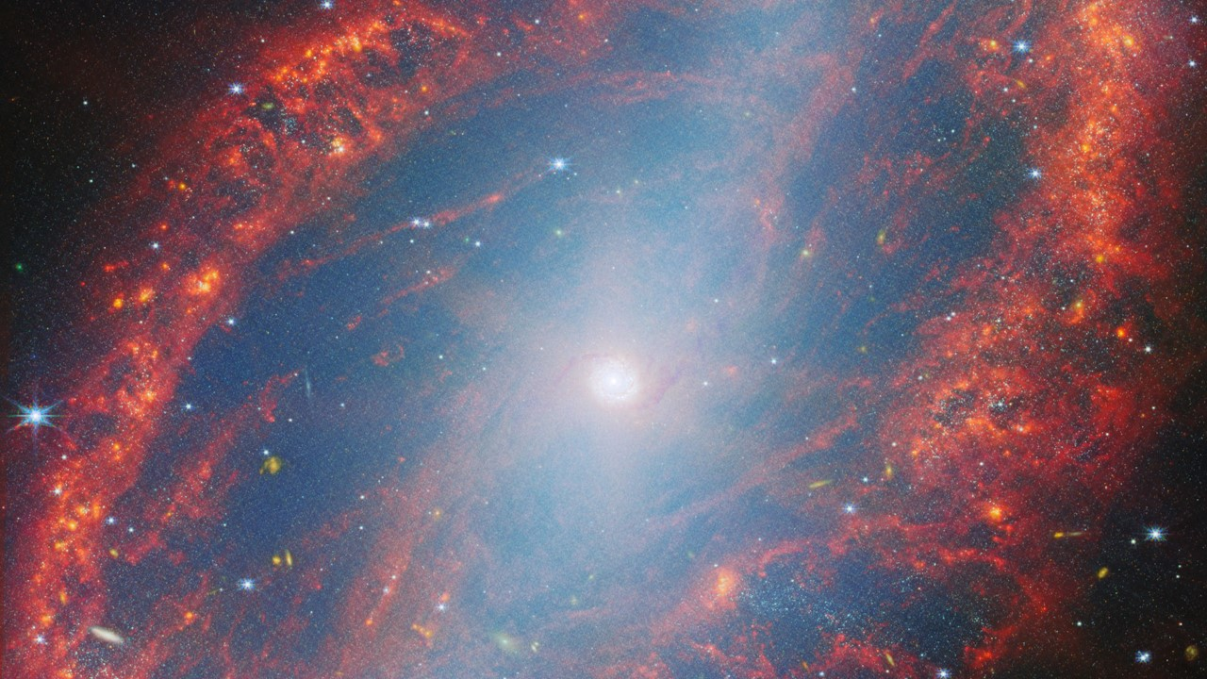
Astrophysics Technology Development, PhysCOS/COR programs
Jason Derleth/Goddard Space Flight Center, PhysCOS/COR Chief Technologist
Opher Ganel/McCallie Associates Inc., PhysCOS/COR Technologist
1

Slide 2
Astrophysics Technology Enables (and Limits) Science
Science enabled by current technologies has already been done (or will be “soon”)
However, our SOTA technologies also limit us; to reach next-level science we need to push the technological envelope
To have a chance of going beyond that next level will require new ways of thinking, new approaches, and new synergies
Let’s start with a look at our current plans…

Slide 3
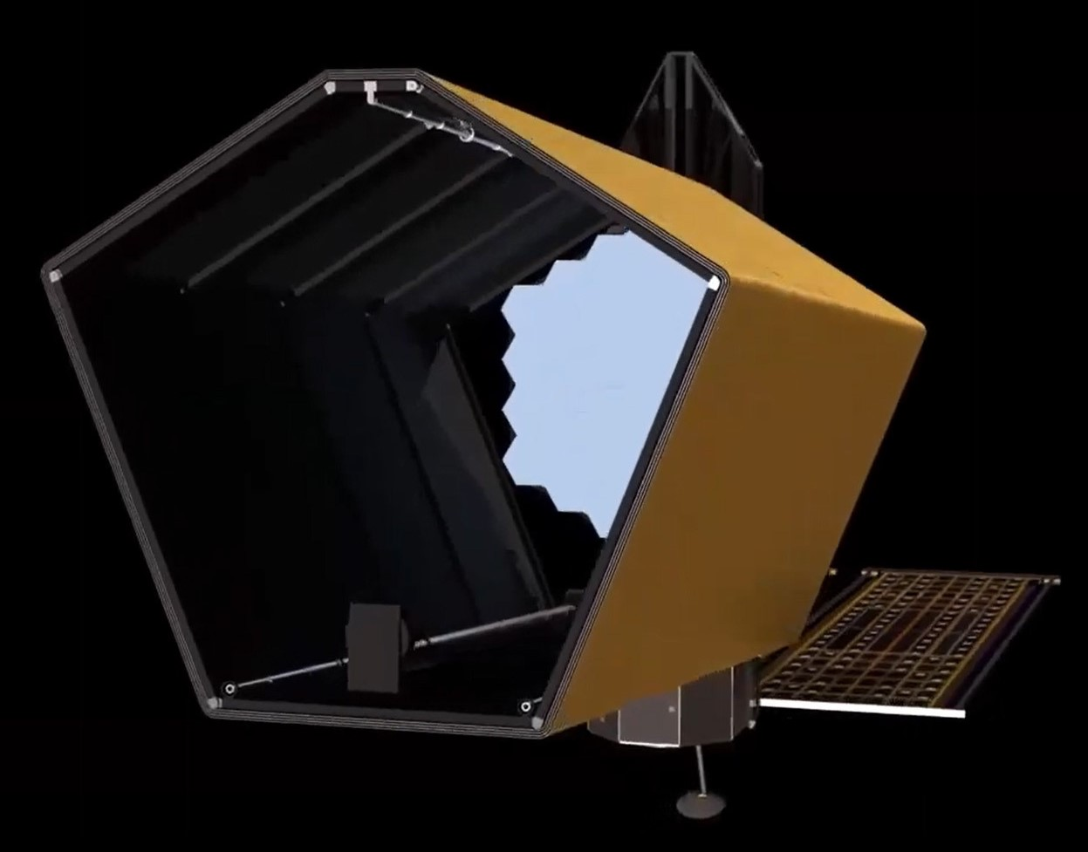
Strategic Astrophysics Missions:
Habitable Worlds Observatory (HWO)
Capabilities needed
Large telescope optics
Broadband coatings (down to Lyman α)
Large-format detector arrays
High-contrast imaging (for exoplanet science)
Extreme stability (for exoplanet science)
An initial HWO architecture under study

Slide 4
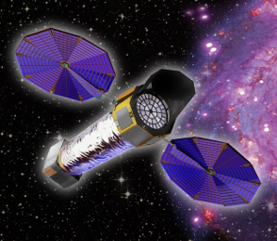
Strategic Astrophysics Missions: X-Ray Flagship
Capabilities needed
Low-density, high-precision X-ray optics
Cryogenics
Large-format, low-noise X-ray detector arrays
An X-ray Probe may fly in the coming decade that could also benefit from these capabilities

Slide 5
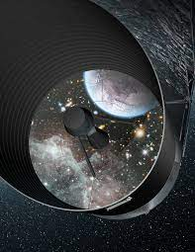
Strategic Astrophysics Missions: Far-IR Flagship
Capabilities needed
Cryogenic optics
Large-format cryogenic detector arrays
Cryogenic coolers
A far-IR Probe may fly in the coming decade and a CMB Probe may fly in the following decade; each could also benefit from some of these capabilities

Slide 6
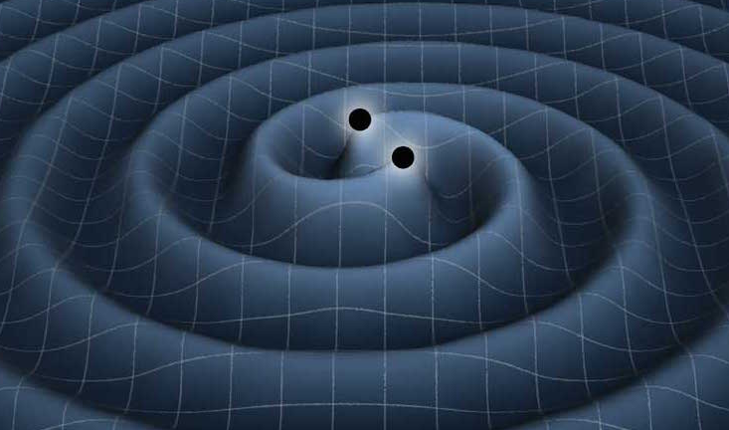
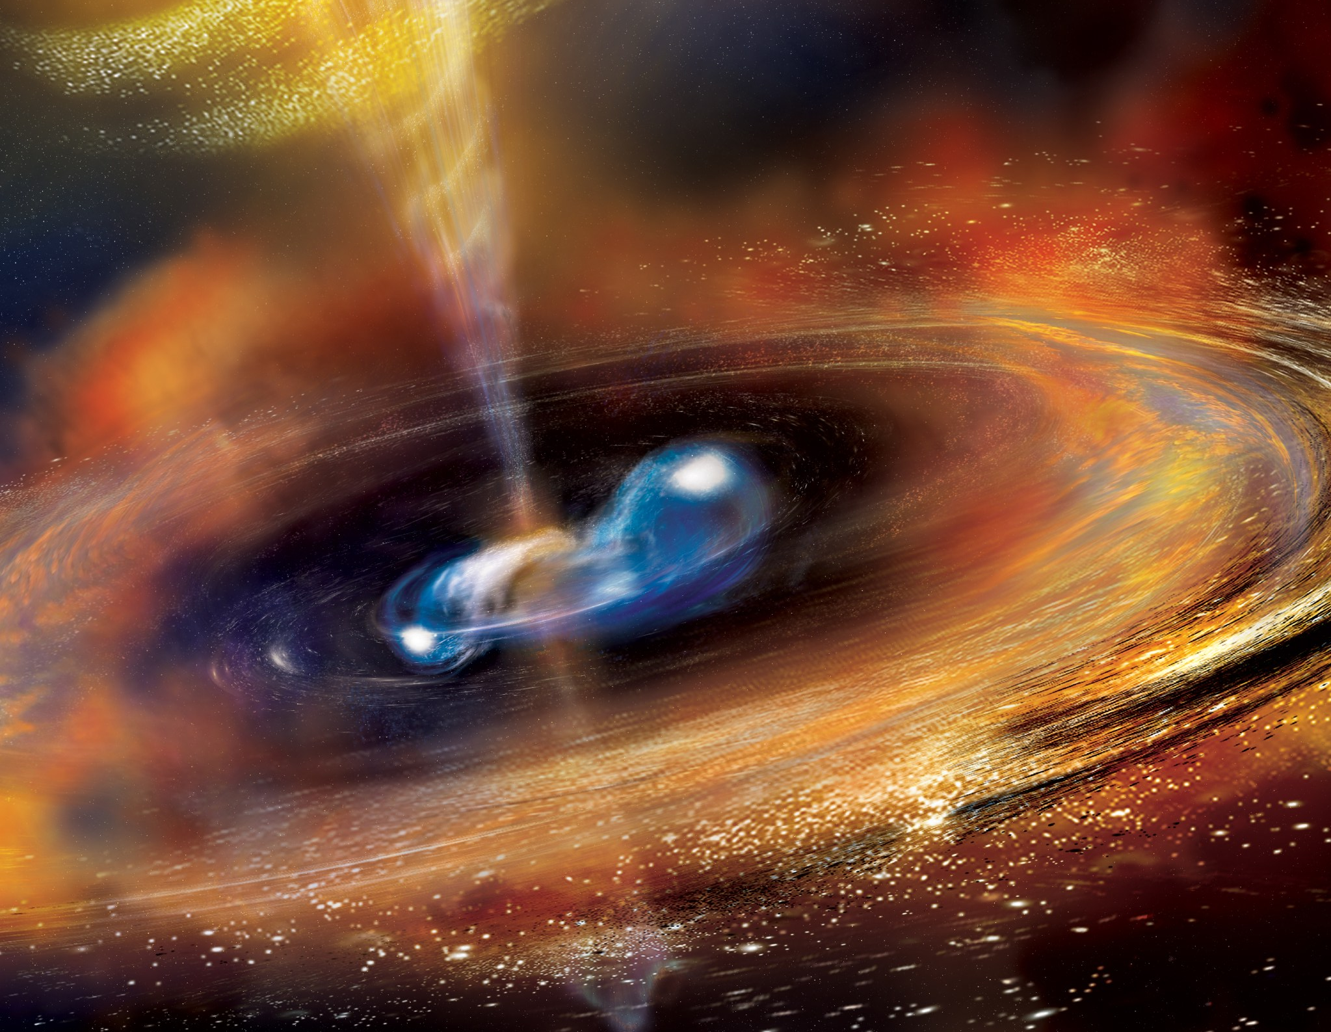
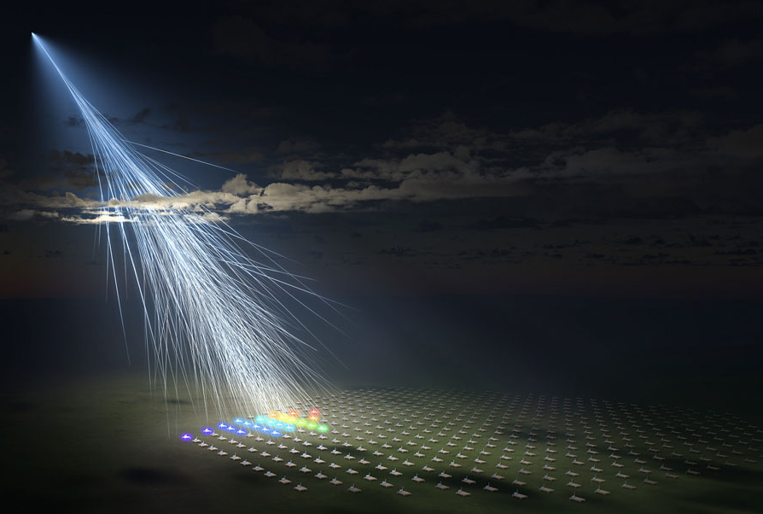
Strategic Astrophysics Activities:
Time-Domain and Multi-Messenger (TDAMM) Science
Capabilities needed
Precision timing and advanced onboard computing
Gamma-ray optics
Low-noise high-energy detector arrays & electronics
Cryogenics
AI/ML for coordinating observations and reviewing existing datasets

Slide 7
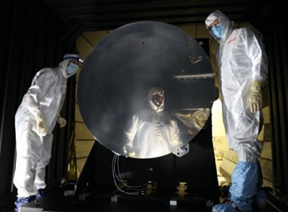
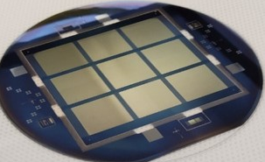
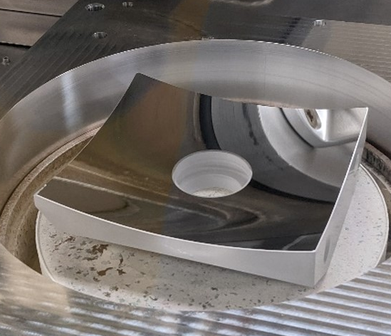
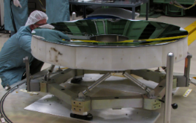
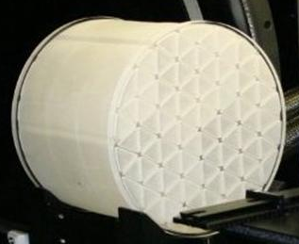
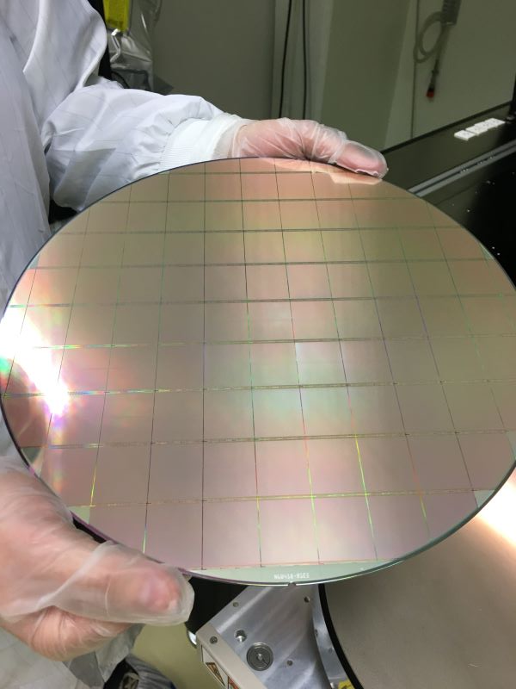
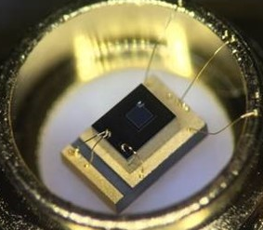
From Capabilities to Gaps: HWO General Astrophysics
Large telescope optics
High-Efficiency, Low-Scatter, High- and Low-Ruling-Density, High- and Low-Blazed-Angle UV Gratings
High-Throughput, Large-Format Object-Selection Tech for Multi-Object and Integral-Field Spectroscopy
Mirror Technologies for High Angular Resolution (UV/Visible/Near IR)
High-Throughput UV Bandpass Standalone and Detector-Integrated Filters and Bandpass Selection
Broadband coatings (down to Lyman α)
High-Reflectivity Broadband Far-UV-to-Near-IR Mirror Coatings
Scaling and Metrology for Advanced Broadband Mirror Coatings for HWO
Large-format detector arrays
Large-Format, High-Resolution Far-UV (100 - 200 nm) Detectors
Large-Format, High-Resolution Near-UV (200 - 400 nm) Detectors
UV Multi-Object Spectrograph Calibration Technologies
UV Single-Photon Detection Sensitivity
Visible/Near-IR Single-Photon Detection Sensitivity
UV/Optical/Near-IR Tunable Narrowband Imaging Capability
Key: Strategic Technology Gaps
Priority Tier 1 gaps
Priority Tier 2 gaps
Priority Tier 3 gaps
7

Slide 8
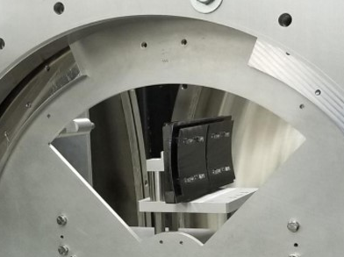
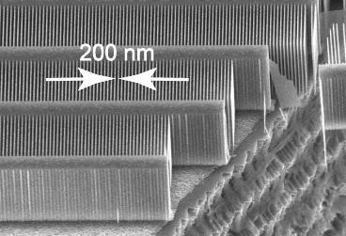
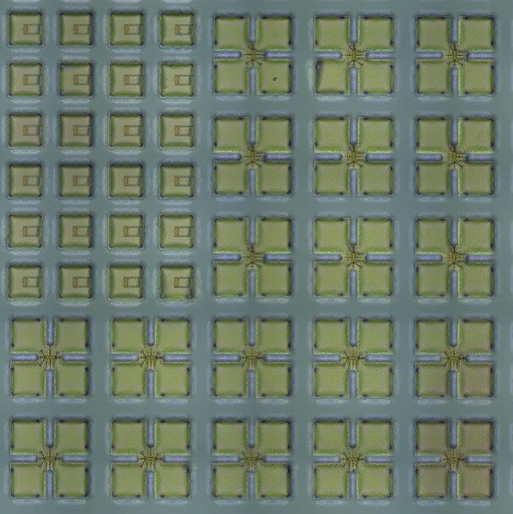
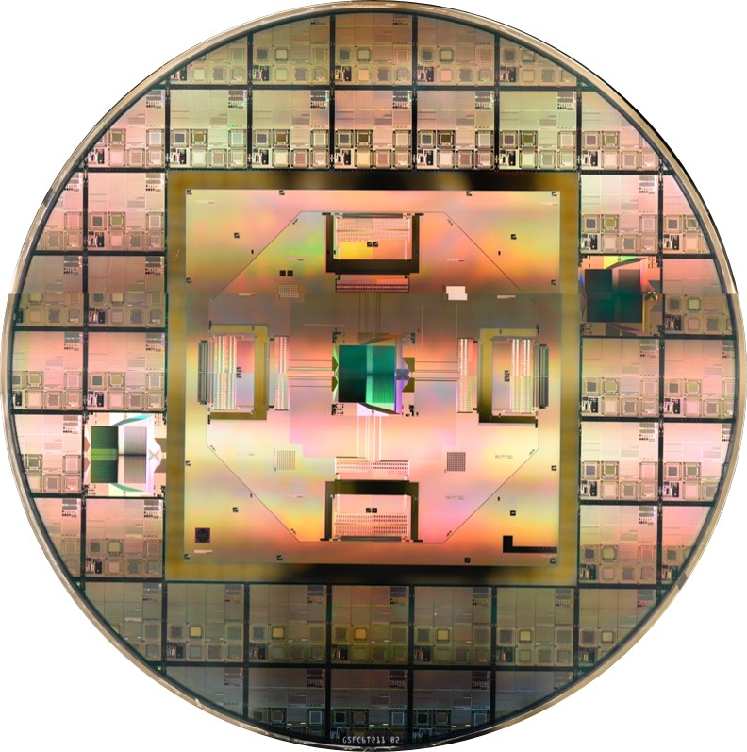
From Capabilities to Gaps: X-Ray Flagship*
Low-density, high-precision X-ray optics
High-Resolution, Lightweight X-ray Optics
High-Efficiency X-ray Grating Arrays for High-Resolution Spectroscopy
Low-Stress, Low-Roughness, High-Stability X-ray Reflective Coatings
Optical Blocking Filters for X-ray Instruments
Cryogenics
Advanced Cryocoolers
Large-format, low-noise X-ray detector arrays
Fast, Low-Noise, Megapixel X-ray Imaging Arrays with Moderate Spectral Resolution
High-Bandwidth Cryogenic Readout Technologies for Compact and Large-Format Calorimeter Arrays
Broadband X-ray Detectors
Imaging Capability Broadband X-ray Polarimeter
* Flagship: NASA Astrophysics term for a multi-billion-dollar space observatory such as Hubble or James Webb

Slide 9
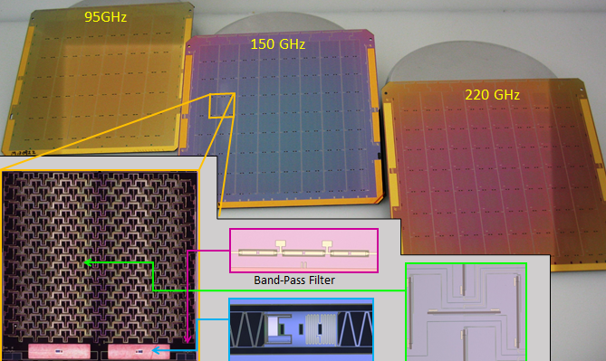
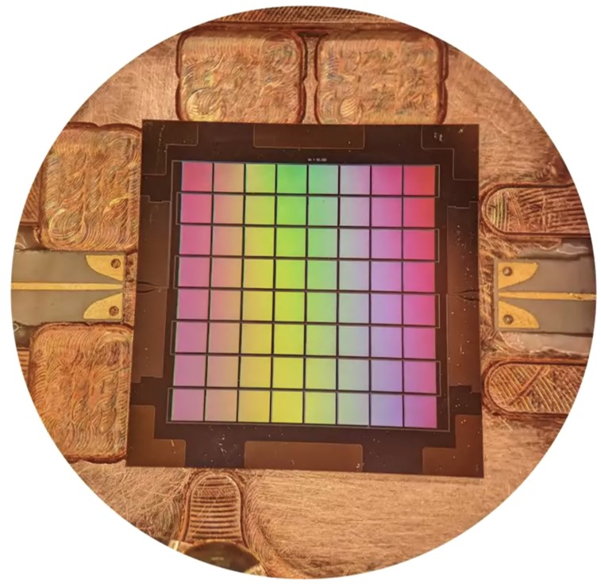
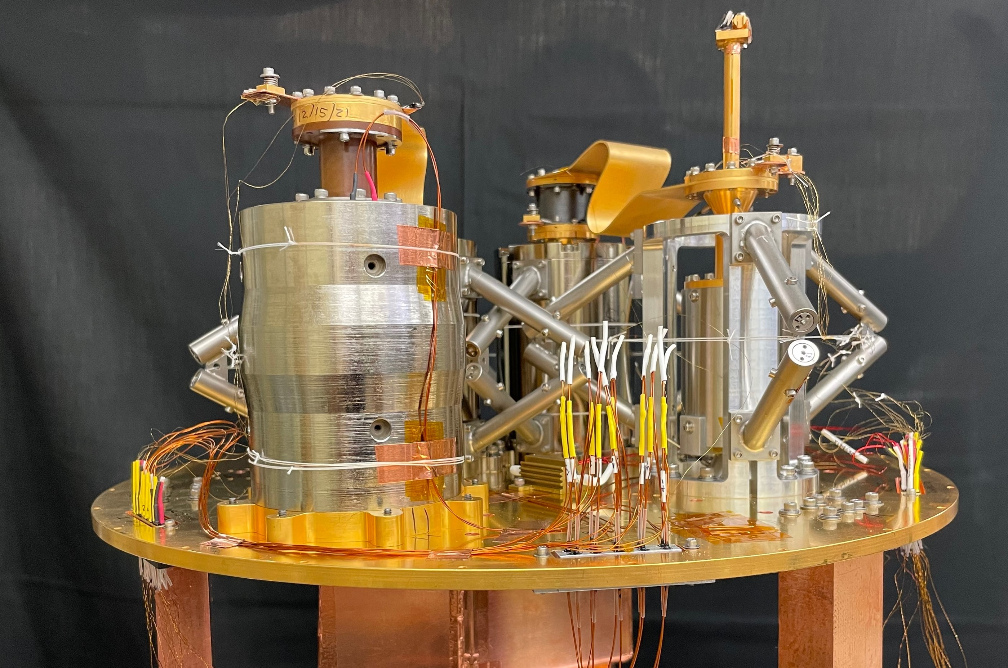
From Capabilities to Gaps: Far-IR Flagship
Large-format cryogenic detector arrays
Compact, Integrated Spectrometers for 100 to 1000 μm
Cryogenic Far-IR to mm-Wave Focal-Plane Detectors
Cryogenic Readouts for Large-Format Far-IR Detectors
Far-IR Imaging Interferometer for High-Resolution Spectroscopy
Far-IR Spatio-Spectral Interferometry
Heterodyne Far-IR Detector Systems
High-Resolution, Direct-Detection Spectrometers for Far-IR Wavelengths
Improving the Calibration of Far-IR Heterodyne Measurements
Large-Format, Low-Noise and Ultralow-Noise, Far-IR Direct Detectors
Low-Power Readout and Multiplexing for CMB Detectors
Millimeter-Wave Focal-Plane Arrays for CMB Polarimetry
Warm Readout Electronics for Large-Format Far-IR Detectors
Sensitive Spectrometer for CMB Spectrum Measurement
Cryogenic optics
Optical Elements for a CMB Space Mission
Large-Aperture Deployable Antennas for Far-IR/THz/sub-mm Astronomy for Frequencies Above 100 GHz
Large Cryogenic Optics for the Mid IR to Far IR
Cryogenic coolers
High-Performance Sub-Kelvin Coolers
Advanced Cryocoolers

Slide 10
From Capabilities to Gaps: TDAMM
Precision timing and advanced onboard computing
High-Performance Computing for Event Reconstruction
Precision Timing Measurement Technology
Gamma-ray optics
High-Throughput Focusing Optics for 0.1-1 MeV Photons
Low-noise high-energy detector arrays & electronics
Charged-Particle-Discriminating X-ray/Gamma-Ray Detectors
High-Energy-Resolution Gamma-Ray Detectors
Large Field-of-View and Effective-Area Gamma-Ray Detectors
Low-Power, Low-Cost Semiconductor Detectors
Radiation-Tolerant, Photon-Counting Light Detectors
Low-Power Readout for Silicon Photomultipliers
Photometric and Spectro-Photometric Precision of Time-Domain and Time-Series Measurements
Dynamic Switching for Ultra-Low-Power, High-Resolution Charge Readout
Cryogenics
Advanced Cryocoolers

Slide 11
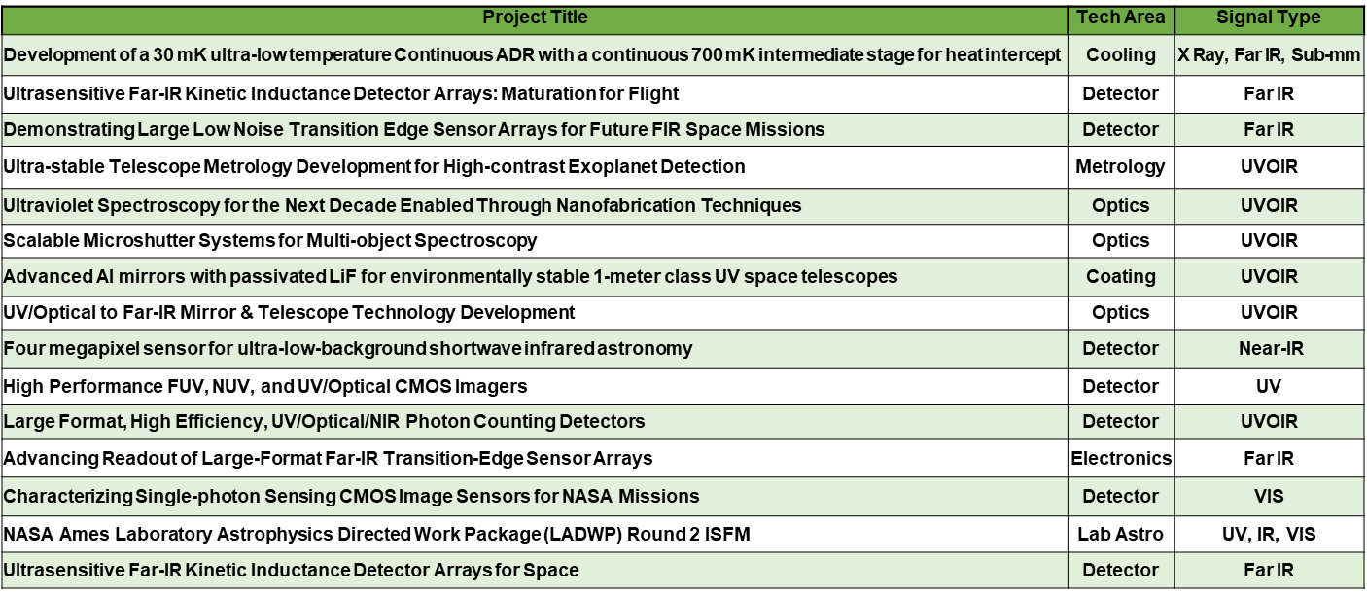
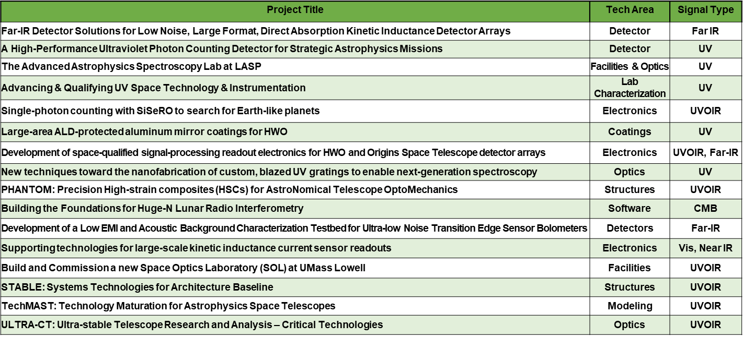
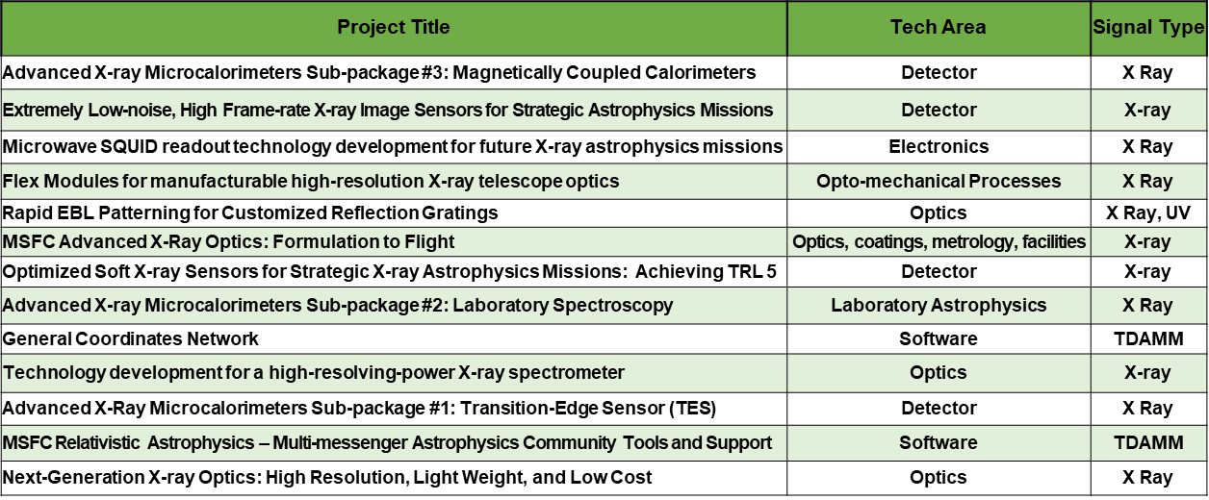
From Gaps to Investments: Current Tech Project Portfolio

Slide 12
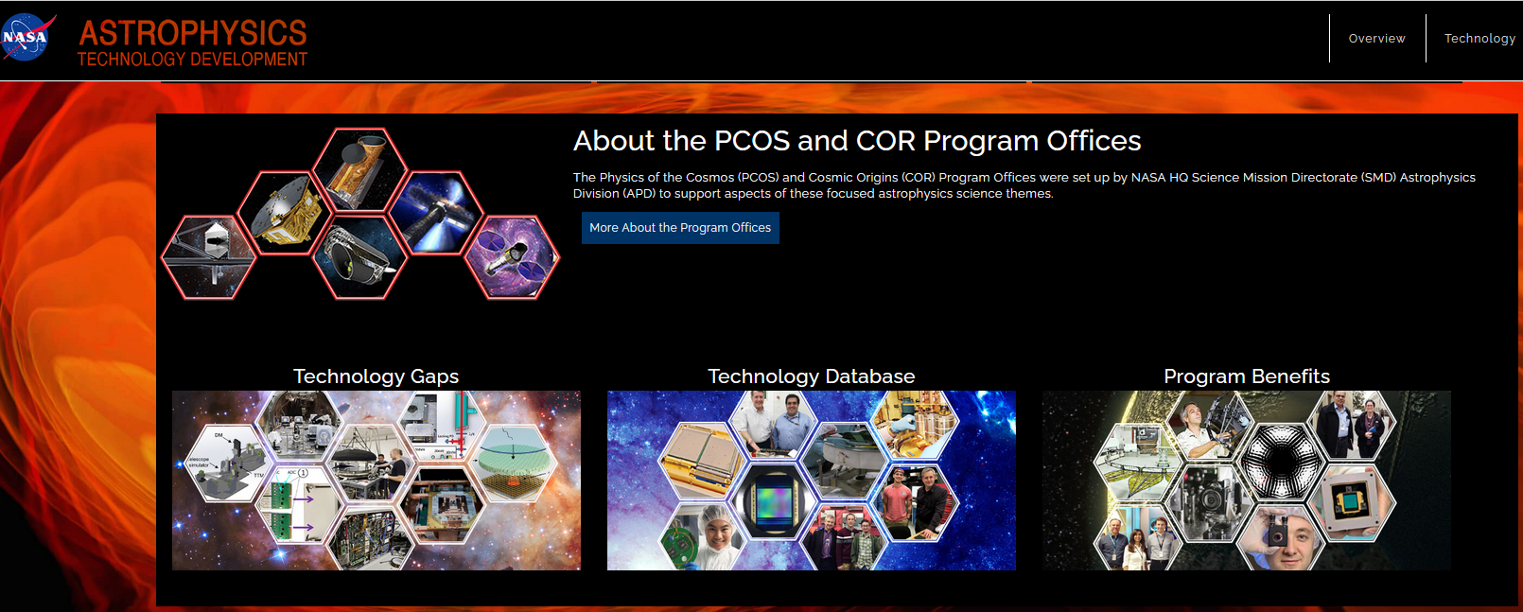
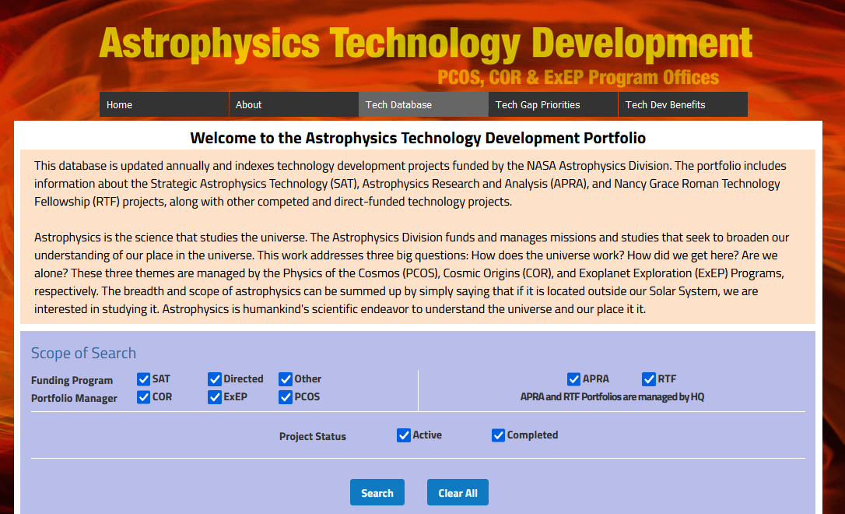
Additional Material
The Physics of the Cosmos (PhysCOS)/Cosmic Origins (COR) technology website (https://apd440.gsfc.nasa.gov/technology.html) provides more details, including:
Description of our technology development process
Full details of the current technology gaps and their priority ranking
AstroTech database (in process of move to NASA URL) with abstracts, PI reports, quad charts, etc. of PhysCOS, COR, and Exoplanet Exploration Program (ExEP) past and current strategic tech investments

Slide 13
Final Words (for Now…)
We’ve seen our currently planned path to enable breakthrough science
The challenges are extreme, as in “Miracles we provide immediately; the impossible takes a little longer”
Sometimes, impossible-seeming problems become easy when you look at them differently
Our invitation to you: Where you can, disrupt our assumptions, approaches, and plans, if it enables even more inspiring science – in short, help us find better paths…
Contact information for questions and comments:
Jason Derleth, PhysCOS/COR Chief Technologist: jason.e.derleth@nasa.gov
Opher Ganel, PhysCOS/COR Technologist: opher.ganel@nasa.gov

Slide 14
Backup

Slide 15
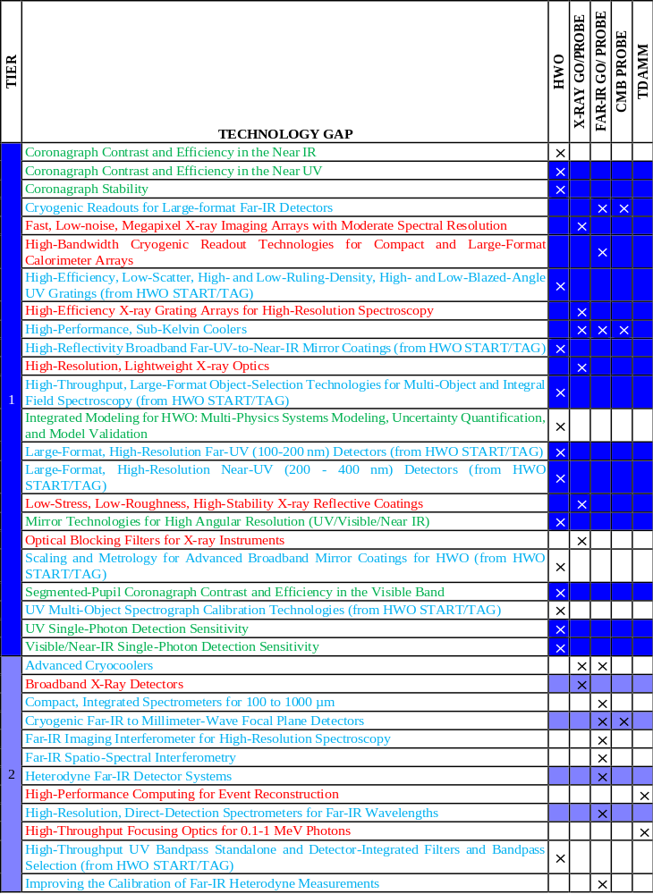
From Missions to Gaps (Tier 1 Gaps)

Slide 16
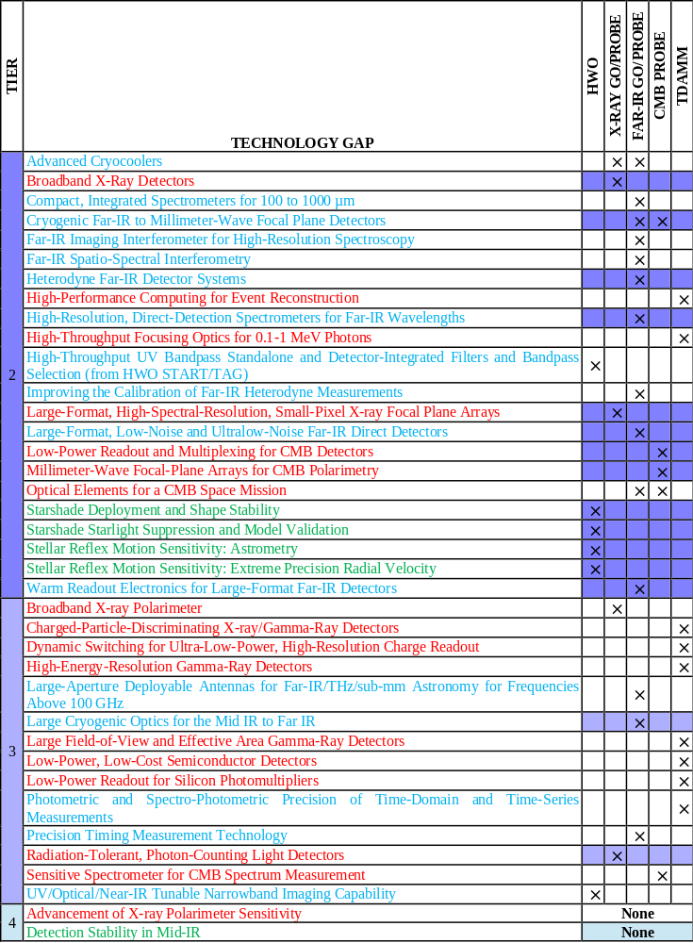
From Missions to Gaps (Tier 2 Gaps)

Slide 17
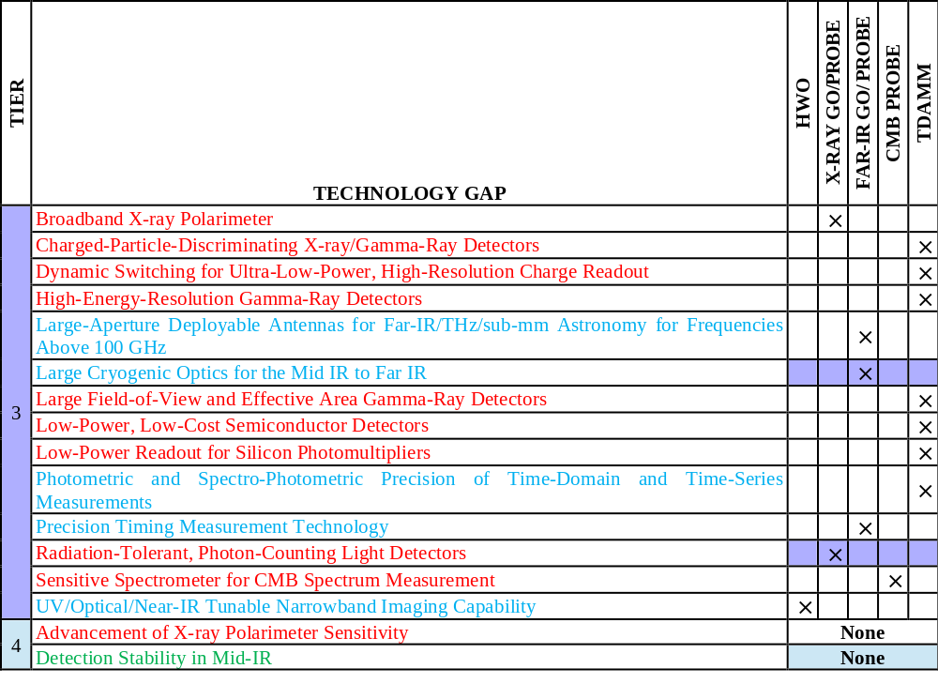
From Missions to Gaps (Tier 3 Gaps etc.)

Slide 18
Current COR Technology Portfolio
Program | Project Title | PI Name | PI Inst | Technology Area | Signal Type
SAT2021 | Development of a 30 mK ultra-low temperature Continuous ADR with a continuous 700 mK intermediate stage for heat intercept | Kimball, M | GSFC | Cooling System | X Ray, Far IR, Sub-mm
SAT2021 | Ultrasensitive Far-IR Kinetic Inductance Detector Arrays: Maturation for Flight | Bradford, C | JPL | Detector | Far IR
SAT2021 | Demonstrating Large Low Noise Transition Edge Sensor Arrays for Future FIR Space Missions | Staguhn, J | JHU | Detector | Far IR
SAT2021 | Ultra-stable Telescope Metrology Development for High-contrast Exoplanet Detection | Saif, B | GSFC | Metrology | UVOIR
SAT2021 | Ultraviolet Spectroscopy for the Next Decade Enabled Through Nanofabrication Techniques | McEntaffer, R | PSU | Optics | UVOIR
SAT2022 | Scalable Microshutter Systems for Multi-object Spectroscopy | Scowen, P | GSFC | Optics | UVOIR
SAT2021 | Advanced Al mirrors with passivated LiF for environmentally stable 1-meter class UV space telescopes | Quijada, M | GSFC | Optical Coating | UVOIR
ISFM22 | UV/Optical to Far-IR Mirror & Telescope Technology Development | Stahl, H P | MSFC | Optics | UVOIR
SAT2022 | Four megapixel sensor for ultra-low-background shortwave infrared astronomy | Bottom, M | UH | Detector | Near-IR
SAT2021 | High Performance FUV, NUV, and UV/Optical CMOS Imagers | Hoenk, M | JPL | Detector | UV
SAT2021 | Large Format, High Efficiency, UV/Optical/NIR Photon Counting Detectors | Nikzad, S | JPL | Detector | UVOIR
SAT2021 | Advancing Readout of Large-Format Far-IR Transition-Edge Sensor Arrays | Rostem, K | GSFC | Electronics | Far IR
SAT22 | Characterizing Single-photon Sensing CMOS Image Sensors for NASA Missions | Figer, D | RIT | Detector | VIS
ISFM22 | NASA Ames Laboratory Astrophysics Directed Work Package (LADWP) Round 2 ISFM | Sciamma-O'Brien, E | Ames | Lab Astrophysics | UV, IR, VIS
SAT22 | Ultrasensitive Far-IR Kinetic Inductance Detector Arrays for Space | Hailey-Dunsheath, S | Caltech | Detector | Far IR
SAT22 | Far-IR Detector Solutions for Low Noise, Large Format, Direct Absorption Kinetic Inductance Detector Arrays | Austermann, J | NIST | Detector | Far IR
SAT22 | A High-Performance Ultraviolet Photon Counting Detector for Strategic Astrophysics Missions | Nikzad, S | JPL | Detector | UV
RTF23 | The Advanced Astrophysics Spectroscopy Lab at LASP | Vorobiev, D | LASP | Facilities & Optics | UV
RTF23 | Advancing & Qualifying UV Space Technology & Instrumentation | Hoadley, K | Univ of Iowa | Lab Characterization | UV
SAT23 | Single-photon counting with SiSeRO to search for Earth-like planets | Estrada, J | U. of Chicago | Electronics | UVOIR
SAT23 | Large-area ALD-protected aluminum mirror coatings for HWO | Hennessy, J | JPL | Coatings | UV
SAT23 | Development of space-qualified signal-processing readout electronics for HWO and Origins Space Telescope detector arrays | Jamison-Hooks, T | ASU | Electronics | UVOIR and Far-IR
SAT23 | New techniques toward the nanofabrication of custom, blazed UV gratings to enable next-generation spectroscopy | Miles, D | Caltech | Optics | UV
SAT23 | PHANTOM: Precision High-strain composites (HSCs) for AstroNomical Telescope OptoMechanics | Silver, M | MIT/LL | Structures | UVOIR
RTF24 | Building the Foundations for Huge-N Lunar Radio Interferometry | Pober, J | Brown | Software | CMB
RTF24 | Development of a Low EMI and Acoustic Background Characterization Testbed for Ultra-low Noise Transition Edge Sensor Bolometers | Connors, J | GSFC | Detectors | Far-IR
RTF24 | Supporting technologies for large-scale kinetic inductance current sensor readouts | Szypryt, P | Colorado | Electronics | Visible, Near IR
RTF24 | Build and Commission a new Space Optics Laboratory (SOL) at UMass Lowell | Mendillo, C | Umass Lowell | Facilities | UVOIR
CT4LT | STABLE: Systems Technologies for Architecture Baseline | Glassman, T | NG | Structures | UVOIR
CT4LT | TechMAST: Technology Maturation for Astrophysics Space Telescopes | Carrier, A | LM | Modeling | UVOIR

Slide 19
Current PhysCOS Technology Portfolio
Funding Program | Project Title | PI Name | PI Inst | Technology Area | Signal Type
ISFM22 | Advanced X-ray Microcalorimeters Sub-package #3: Magnetically Coupled Calorimeters | Bandler, Simon | GSFC | Detector | X Ray
SAT2021 | Extremely Low-noise, High Frame-rate X-ray Image Sensors for Strategic Astrophysics Missions | Bautz, Mark | MIT | Detector | X-ray
SAT2021 | Microwave SQUID readout technology development for future X-ray astrophysics missions | Bennett, Douglas | NIST | Electronics | X Ray
RTF24 | Flex Modules for manufacturable high-resolution X-ray telescope optics | Chalifoux, Brandon | ASU | Opto-mechanical Processes | X Ray
RTF23 | Rapid EBL Patterning for Customized Reflection Gratings | DeRoo, Casey | Univ of Iowa | Optics | X Ray, UV
ISFM22 | MSFC Advanced X-Ray Optics: Formulation to Flight | Gaskins, Jessica | MSFC | Optics, coatings, metrology, facilities | X-ray
SAT22 | Optimized Soft X-ray Sensors for Strategic X-ray Astrophysics Missions: Achieving TRL 5 | Leitz, Christopher | MIT/LL | Detector | X-ray
ISFM22 | Advanced X-ray Microcalorimeters Sub-package #2: Laboratory Spectroscopy | Porter, Scott | GSFC | Laboratory Astrophysics | X Ray
ISFM22 | General Coordinates Network | Racusin, Judith | GSFC | Software | TDAMM
SAT23 | Technology development for a high-resolving-power X-ray spectrometer | Schattenburg, Mark | MIT | Optics | X-ray
ISFM22 | Advanced X-Ray Microcalorimeters Sub-package #1: Transition-Edge Sensor (TES) | Smith, Stephen | GSFC | Detector | X Ray
ISFM22 | MSFC Relativistic Astrophysics – Multi-messenger Astrophysics Community Tools and Support | Wilson-Hodge, Colleen | MSFC | Software | TDAMM
ISFM22 | Next-Generation X-ray Optics: High Resolution, Light Weight, and Low Cost | Zhang, William | GSFC | Optics | X Ray

