Slide 1
2023 General Mission Analysis Tool (GMAT)
Training Slides
Darrel Conway [Thinking Systems, Inc / NASA GSFC]
Jairus Elarbee [Emergent Space Technologies / NASA Goddard Space Flight Center (GSFC)]
Steve Slojkowski [OMITRON / NASA GSFC]
Peter Candell [Pearl River Technologies / NASA GSFC]

Slide 2
Introduction to GMAT Project (101)
Jairus Elarbee
Emergent Space Technologies/NASA Goddard Space Flight Center
October 2023

Slide 3
Training Objectives
Learn About
  The GMAT Project
  Software Capabilities
  GMAT’s Architecture
  How to use GMAT with Script, the GUI, and the API interface
Use GMAT to:
  Propagate an Orbit
  Perform measurement simulation and orbit determination

Slide 4






Introduction to the GMAT Training Team
GMAT is developed and run by a team consisting of a combination of civil servants and contractors from private industry

Slide 5
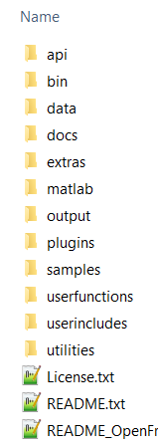
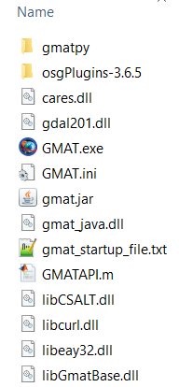
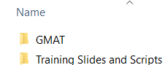
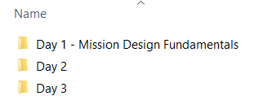
Walkthrough of Training Packet
All attendees should have access to the following on their computers:
  GMAT R2022a
  Tutorial Scripts
  Copies of the Presentation Material

Slide 6
GMAT Project Overview

Slide 7

What is GMAT?
GMAT is the General Mission design and Analysis Tool
Key characteristics:
Open source
High fidelity
Feature rich
Publicly developed
Operationally certified

Slide 8
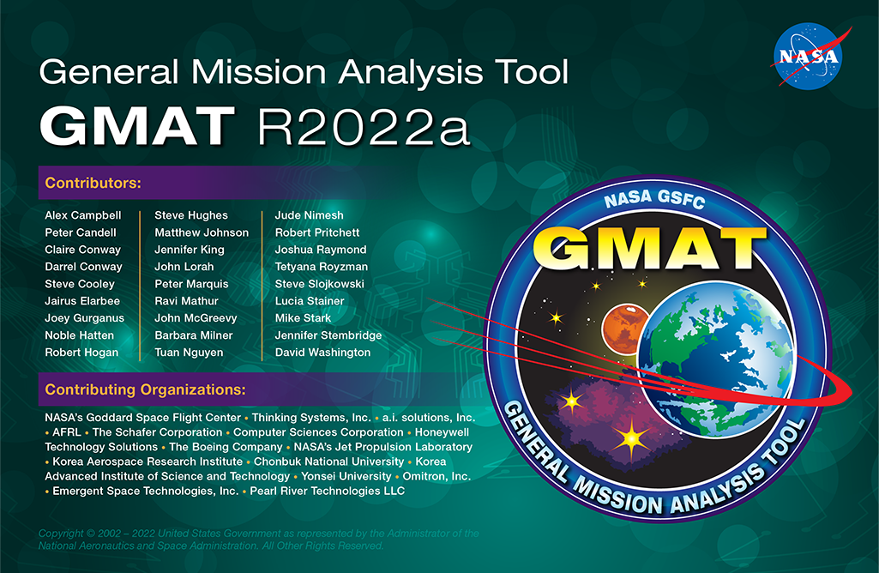
Project History
2016 – First production navigation release (R2016a) Supporting SOHO
2013 – First production Release (R2013a) Supporting ACE
2001 – Requirements gathering
2010 – Decision to move towards operational use
2002 – Architectural Design
2003 – Implementation of System Core
2007 – First Public Release on 08/23/07

Slide 9
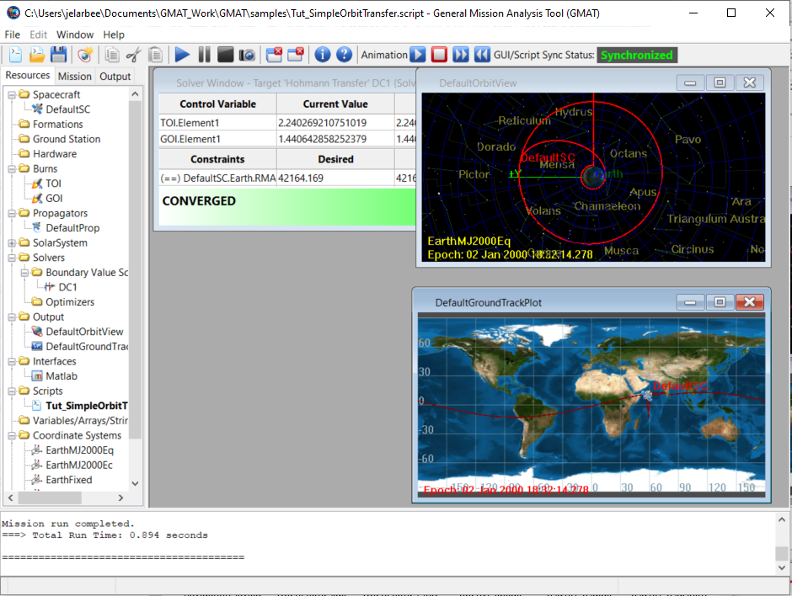
System Overview
Applications
  Mission Analysis/Optimization
  All orbital regimes
Comparable to
  AGI STK/Astrogator
  A. I. Solutions FreeFlyer
Functionality
  Full-featured GUI
  Custom script infrastructure
  Cross-platform core
  Precision orbit propagation
  Built-in targeting and optimization
  Signal/measurement simulation

Slide 10
Mission Design and Navigation Applications
Orbit design, optimization, and selection
Control design
Visualization
Orbit product generation and delivery
Event detection/prediction
Fuel bookkeeping & lifetime analysis
Propulsion system sizing
Measurement Simulation
Contact and Access Location Reporting
Launch window analysis
Sensitivity and Monte Carlo analysis
Navigation data simulation
Orbit determination
Maneuver planning and calibration
Maneuver Support and reconstruction
End-of-Life modelling
Ephemeris prediction

Slide 11







System Features
Multiple platforms supported:
  Windows
  MacOS
  Linux (Ubuntu and Red Hat)
Integration with Python, MATLAB, and Java
  Ability to reach out of GMAT using Interface Plugins
  Ability to reach into GMAT using API
Development Approach: Modified Open Source
  Developed Behind a NASA Firewall
  Periodic Public Releases of Builds and Code
  Supports a Robust Plugin Framework
  Licensed under Apache 2.0
Extensive automated testing via MATLAB
  16000+ core script/API Tests
  3000+ GUI Tests

Slide 12
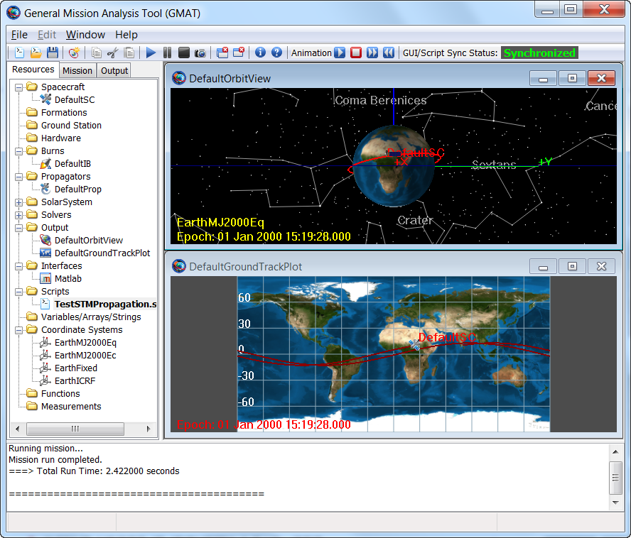
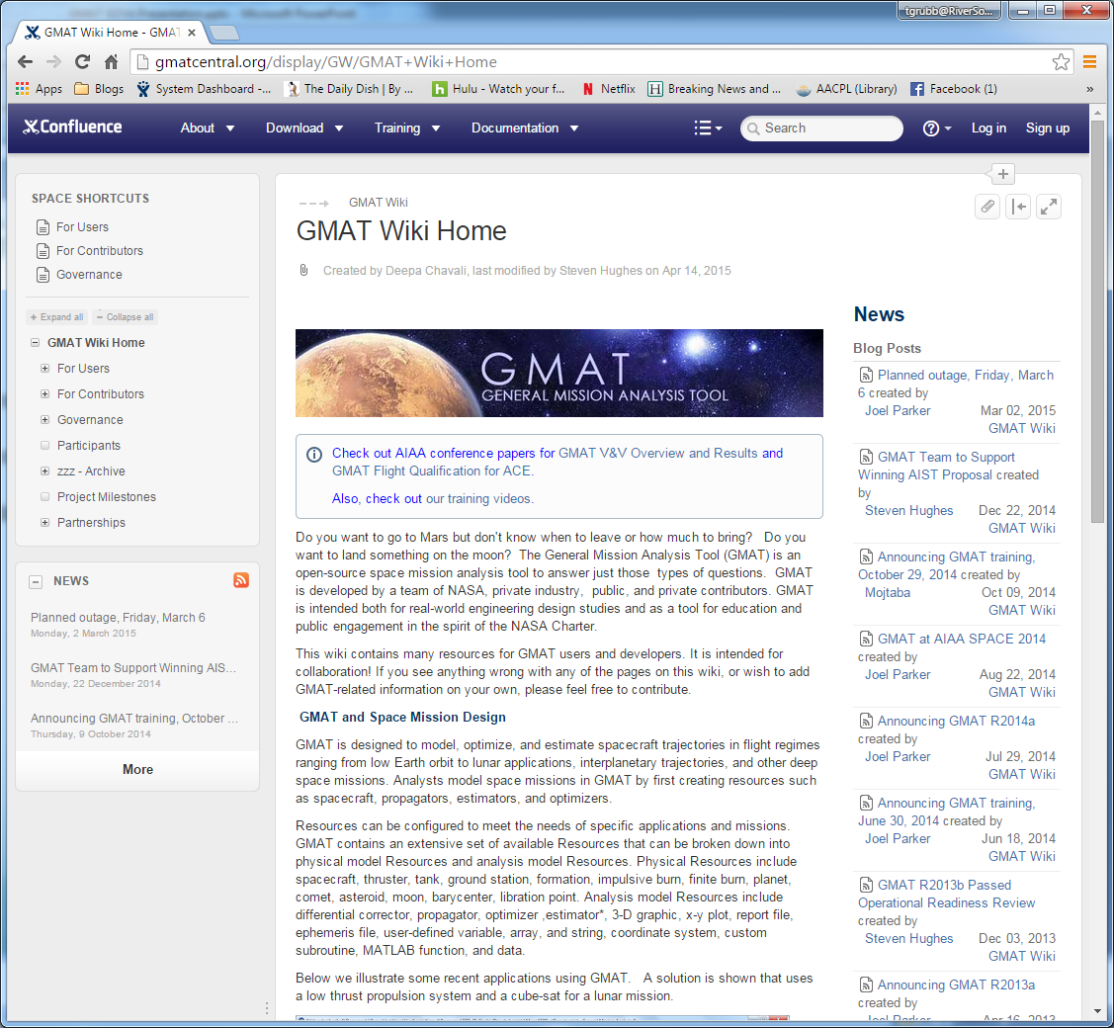
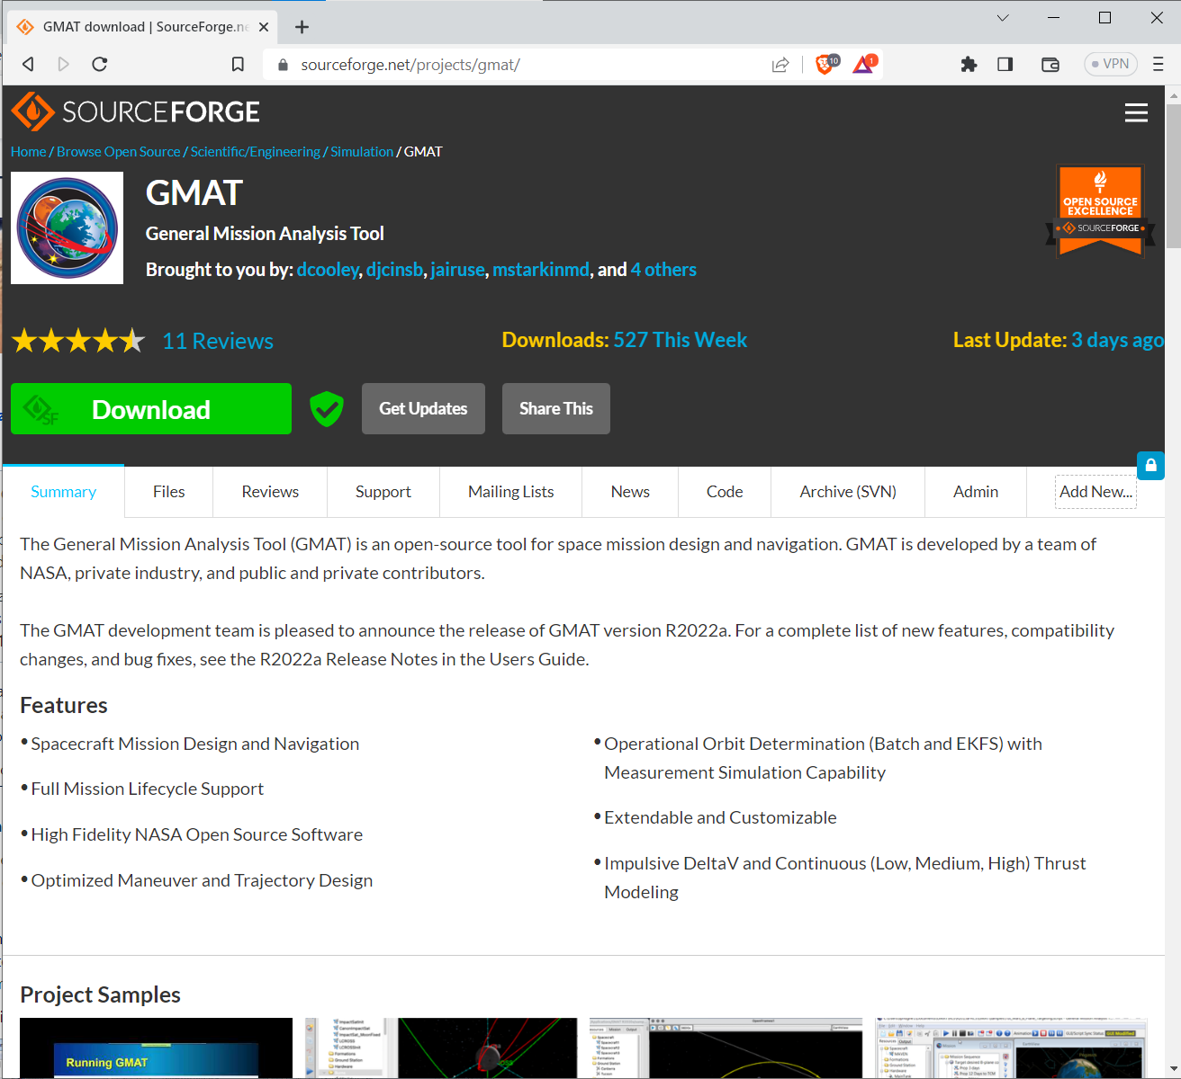
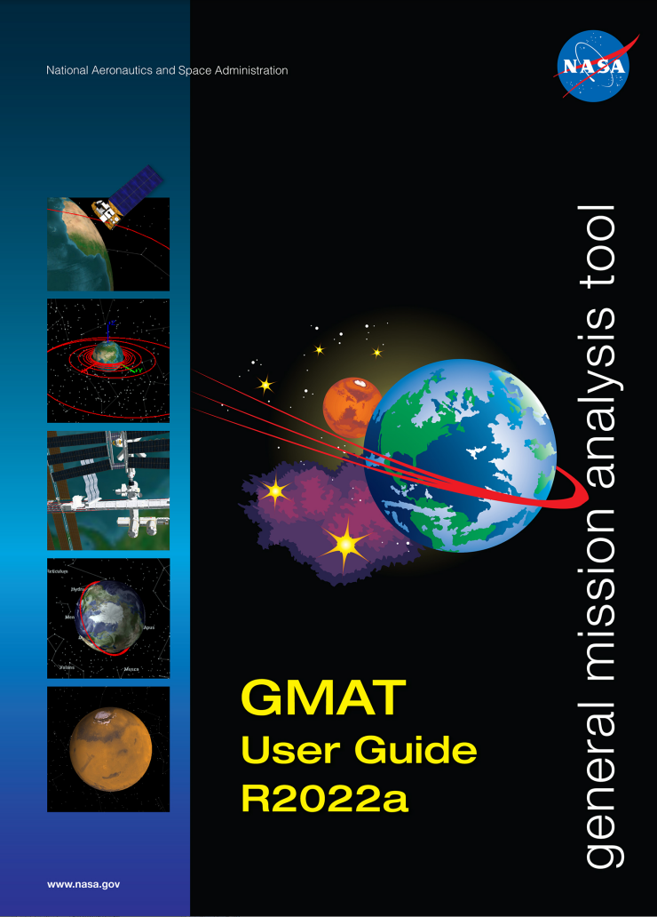
System Characteristics
World-class quality software
  TRL 9, Class B, (Part of Center-wide CMMI Accreditation)
Large system with extensible design
  760k C++ LOC Core – Script, GUI, API, and plugin interfaces
  Over 1 million LOC from other libraries (SNOPT (Stanford Business Software). SPICE (JPL NAIF), WxWidgets, VF13ad (Harwell), TSPlot Plotting Package (Thinking Systems, Inc.), Mars-GRAM model (MSFC)
Online, publicly accessible:
  Wiki (Confluence)
  Issue tracker (Jira)
  Downloads (Sourceforge)
Extensive Documentation
  1200+ page User Guide and Reference Manual containing hundreds of pages of step-by-step tutorials
  100+ Page API users guide
  Specification documents for features and mathematics
  Dozens of sample and tutorial scripts demonstrating a GMAT’s capabilities

Slide 13

















Usage Summary
9+ NASA missions
5+ Discovery proposal efforts
15 domestic and international universities
6 OGAs
12 contributing commercial firms
13 commercial firms using in open literature
30+ independent peer reviewed publications citing analysis performed using GMAT
Over 270,000 lifetime downloads
GMAT is used
world-wide

Slide 14
Orbital Mechanics 101

Slide 15
Common Terms Glossary
State – The Position and Velocity of an object at a given time
Propagation – The calculation of an object’s state as a function of time
Orbital elements – values that can be used to describe an orbit geometrically
Equatorial plane – Plane described by the equator of the body
Ecliptic plane – Plane described by the orbit of the body about the sun
Vernal Equinox – Intersection of the equatorial plane with the ecliptic plane
Apoapsis and periapsis – points on the orbit where the object is furthest and closest to the central body respectively (Apogee and perigee refer to these points on an Earth orbit)
Notes:
references to useful books:
BMW, To Rise From Earth, Spacecraft Mission Design 2nd Edition, Charles Brown

Slide 16
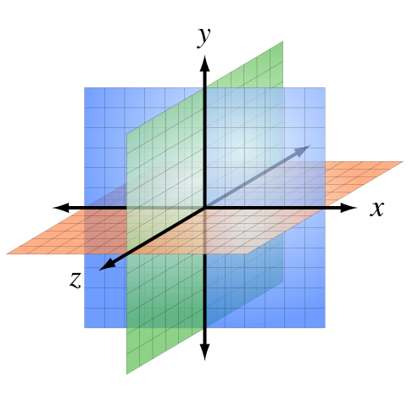
Representing the State – Cartesian and Keplerian
The two primary ways GMAT will represent the state of an object are through Cartesian and Keplerian elements
The Cartesian State consists of the X,Y, and Z components of the position and velocity at a given time in a specified coordinate system
The six classical Keplerian Elements are as follows
  Eccentricity – e
  Semi-major Axis – a
  Inclination – i
  Right-Angle of Ascending Node/RAAN – Ω
  Argument of Periapsis/AOP – ω
  True Anomaly - ν, θ, or f
GMAT is able to freely convert between the Keplerian elements and the Cartesian state

Slide 17
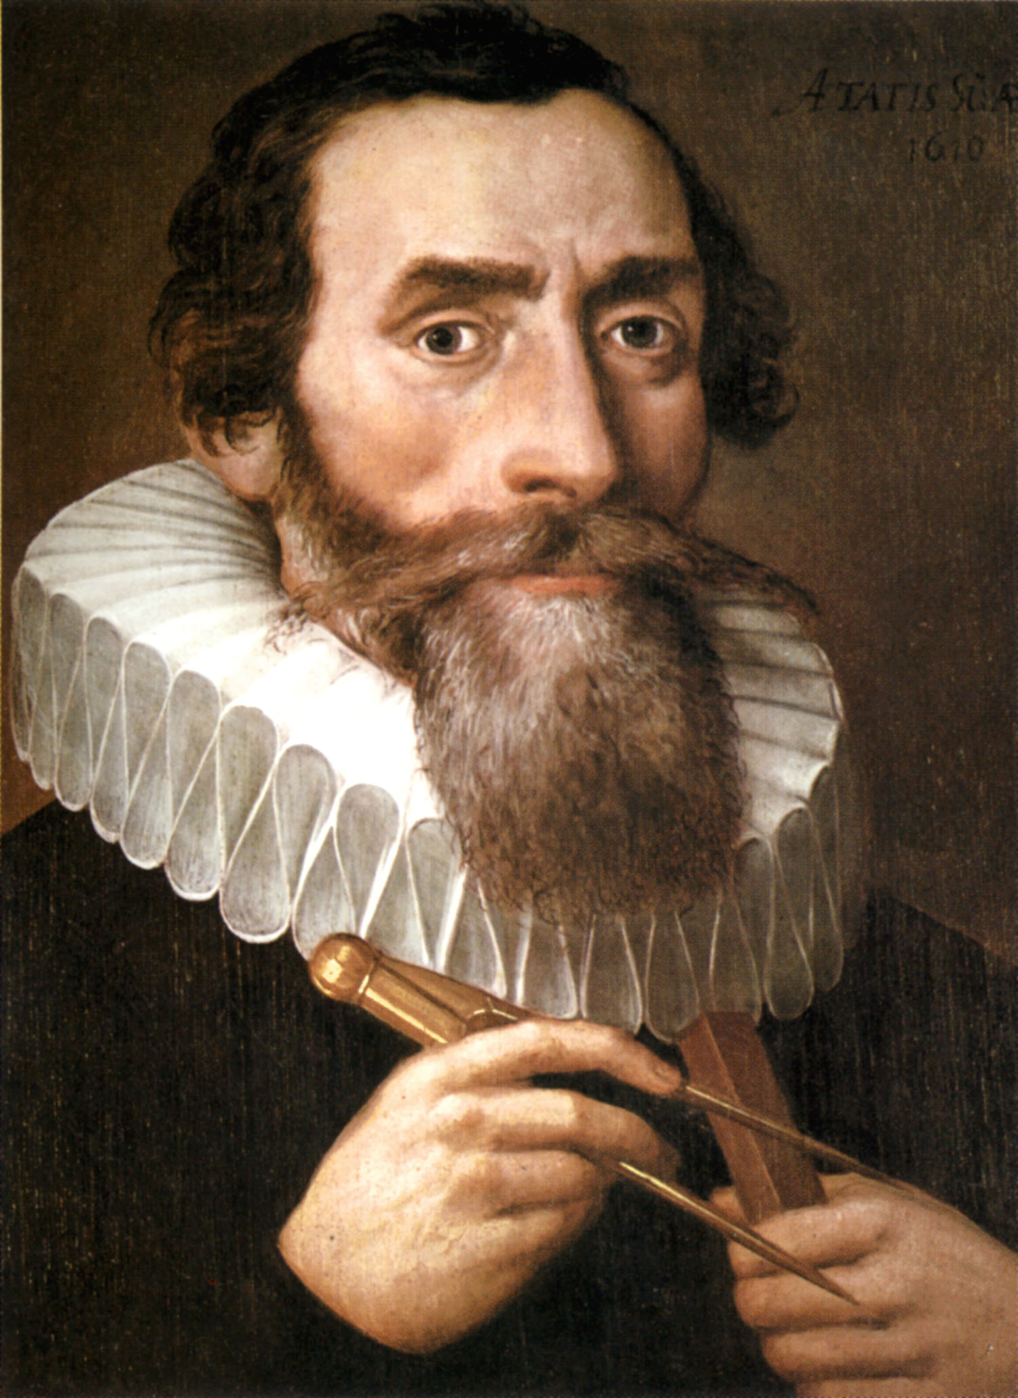
Keplerian Elements Overview
Keplerian orbital elements are the most common state representation for objects in orbit
Derived in Kepler’s laws of Planetary Motion (1609-1619)
Keplerian elements describe a Keplerian orbit, which has the following properties
  Composed of two bodies (typically a central body and an orbiting object)
  Describes a perfect geometrical orbit without perturbations
Keplerian elements are useful for describing the state of an object, but force model integration is preferred for propagation rather than using a Keplerian orbit

Slide 18
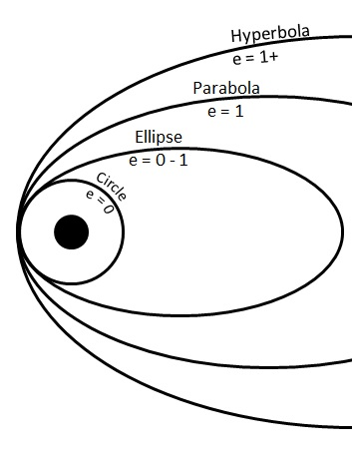
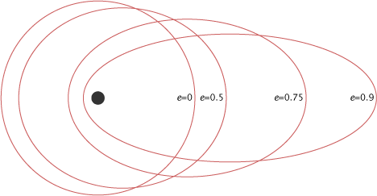
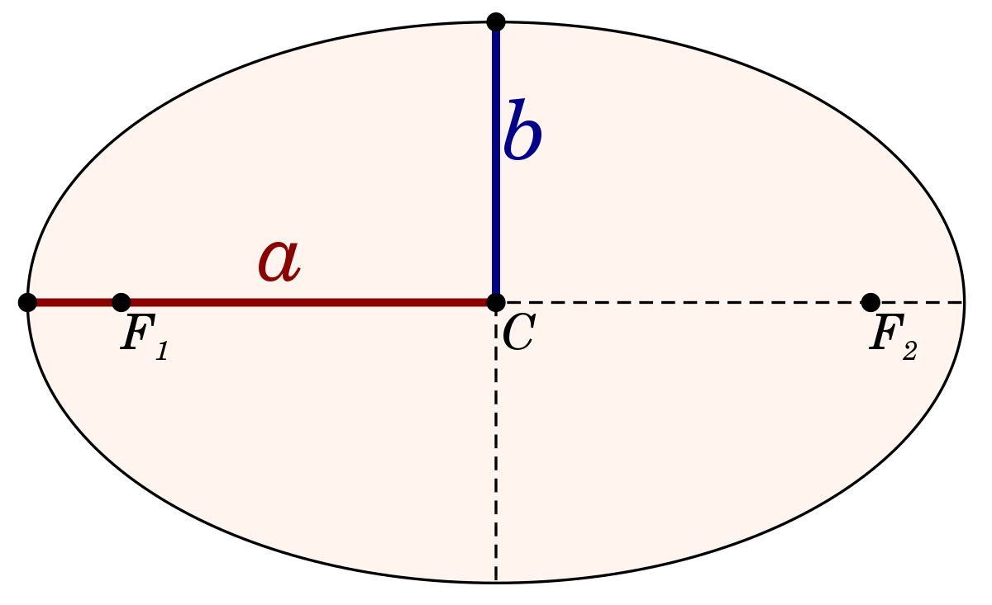
Keplerian Elements – Eccentricity and Semi-Major Axis
The first two elements describe the shape and size of the orbit
Eccentricity (e) is the term that determines the shape of the orbital ellipse
  e = 0 describes a perfectly circular orbit
  0 < e < 1 describes an elliptical orbit
  e = 1 describes a parabolic orbit
  e > 1 describes a hyperbolic orbit
The Semi-major axis (a) determines the size of the orbit
  a > 0 when describing an elliptical orbit
  a < 0 when describing a hyperbolic orbit
Notes:
Top left image note: https://www.polyu.edu.hk/proj/gef/index.php/glossary/orbit-eccentricity/
Top right image note: https://earthobservatory.nasa.gov/features/OrbitsCatalog/page1.php
Bottom image note: https://en.wikipedia.org/wiki/Semi-major_and_semi-minor_axes

Slide 19
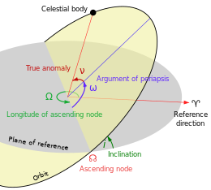
Keplerian Elements – Inclination, RAAN, and AOP
These three elements describe the orientation of the orbital ellipse about the central body’s equatorial plane
Inclination (i) is a measurement of the angle between the equatorial plane and the orbital plane
  i = 0 describes an orbit aligned with the equatorial plane
  I = 90 describes an orbit perpendicular with the equatorial plane, called a polar orbit
RAAN (Ω) is the right angle of the ascending node, or the longitude of the ascending node, and measures the angle between the vernal point and the ascending node
AOP (ω) is the argument of periapsis, which measures the angle between the ascending node and the periapsis
Notes:
Image note: https://en.wikipedia.org/wiki/Orbital_elements

Slide 20
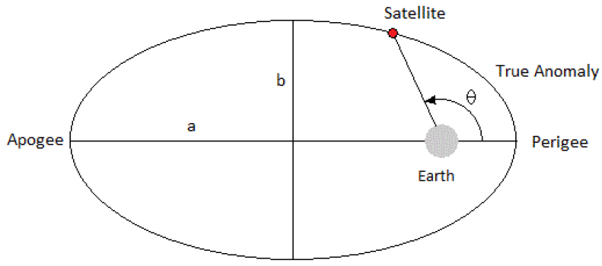
Keplerian Elements Overview –True Anomaly
True anomaly (ν, θ, or f) describes the angle between the periapsis and the object, as measured from the central body
While the previous elements can be used to describe the Keplerian orbit itself, true anomaly is the final piece that allows for calculation of the state
Note that while these are the classical elements and are the most common, other orbital elements with different definitions exist and see use
Notes:
Image note: https://www.astronomicalreturns.com/p/section-45-orbital-position-and-velocity.html

Slide 21
Tutorial: Simulating an Orbit

Slide 22
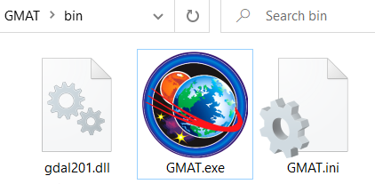
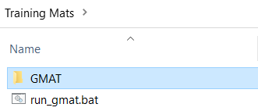
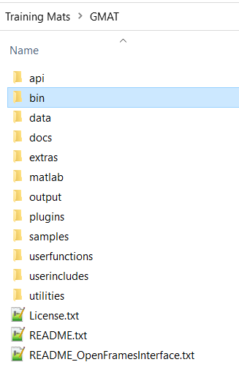
Simulating an Orbit – Starting GMAT
    Navigate to the GMAT /bin directory and double-click on GMAT.exe

Slide 23
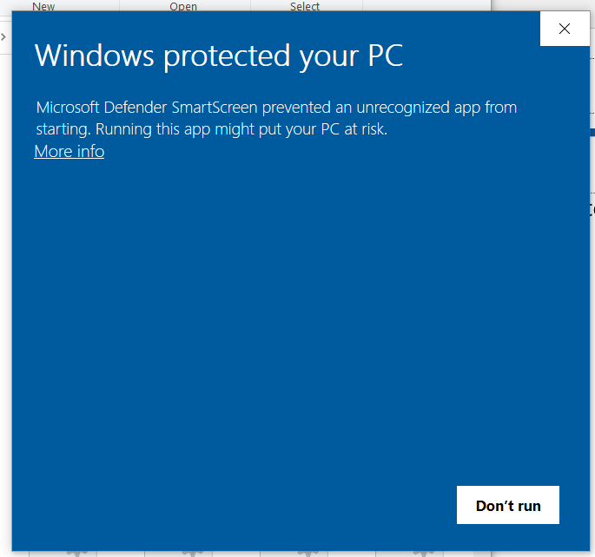
Simulating an Orbit – Windows Defender Issue
GMAT.exe may be flagged by windows defender as an unrecognized app and prevented from running
This is a known issue and GMAT has been submitted to Microsoft for recognition
There are three options to circumvent this depending on the user’s permissions:
  Click “More Info” and click “Run Anyways”
  Right click on GMAT.exe, select properties, then click “Unblock” at the bottom right
  Run the included run_gmat.bat file, which contains the single line below:

Slide 24
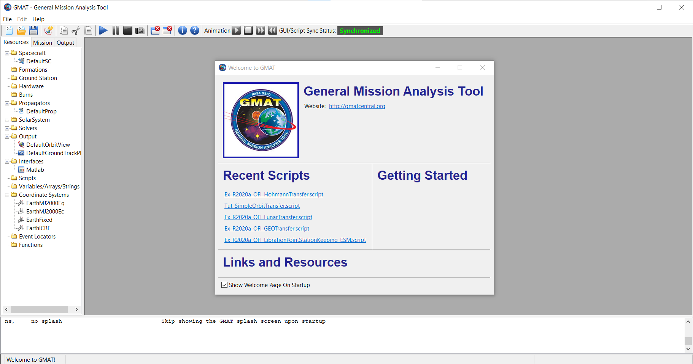
Simulating an Orbit – Running the Default Mission
Click

Slide 25
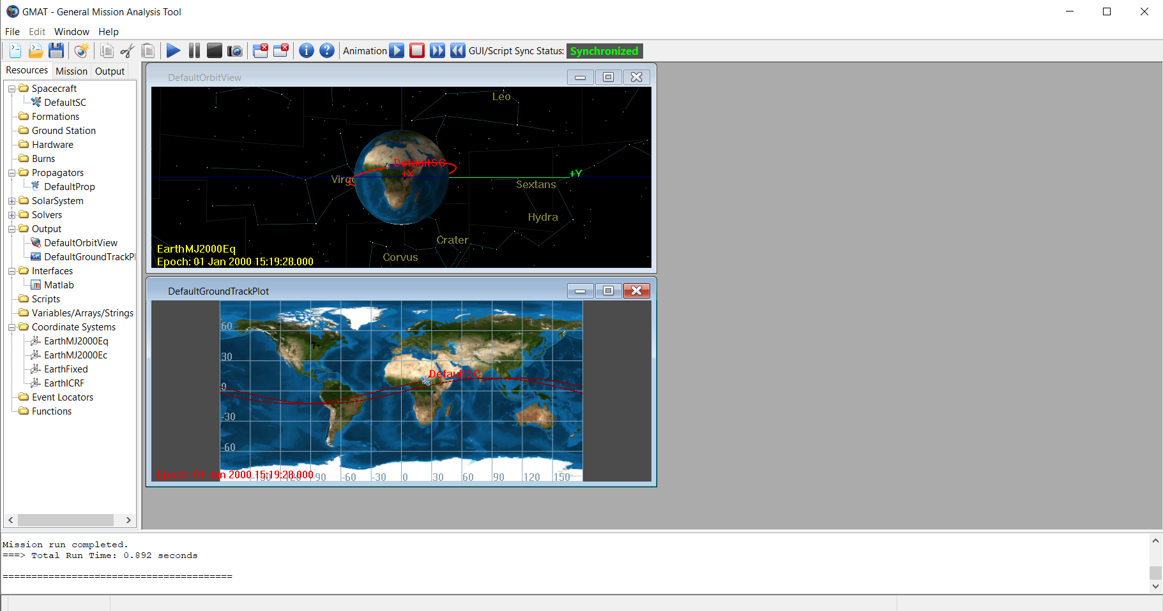
Simulating an Orbit – Assessing the Results

Slide 26
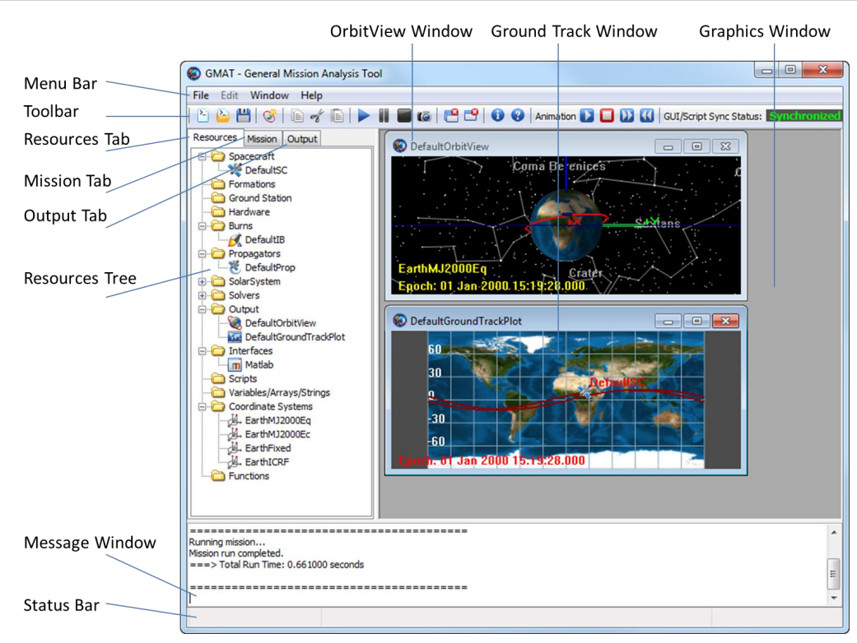
Simulating an Orbit – Overview of GUI Components

Slide 27
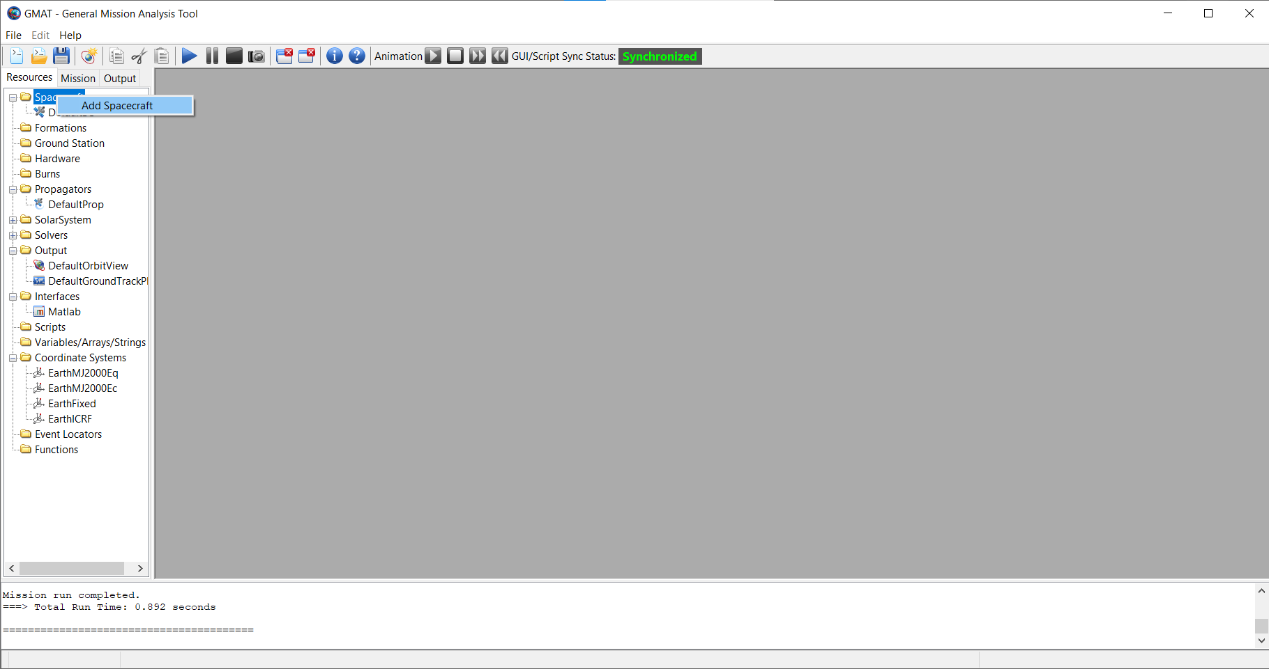
Simulating an Orbit – Adding a Spacecraft
2. Click
1. Right Click

Slide 28
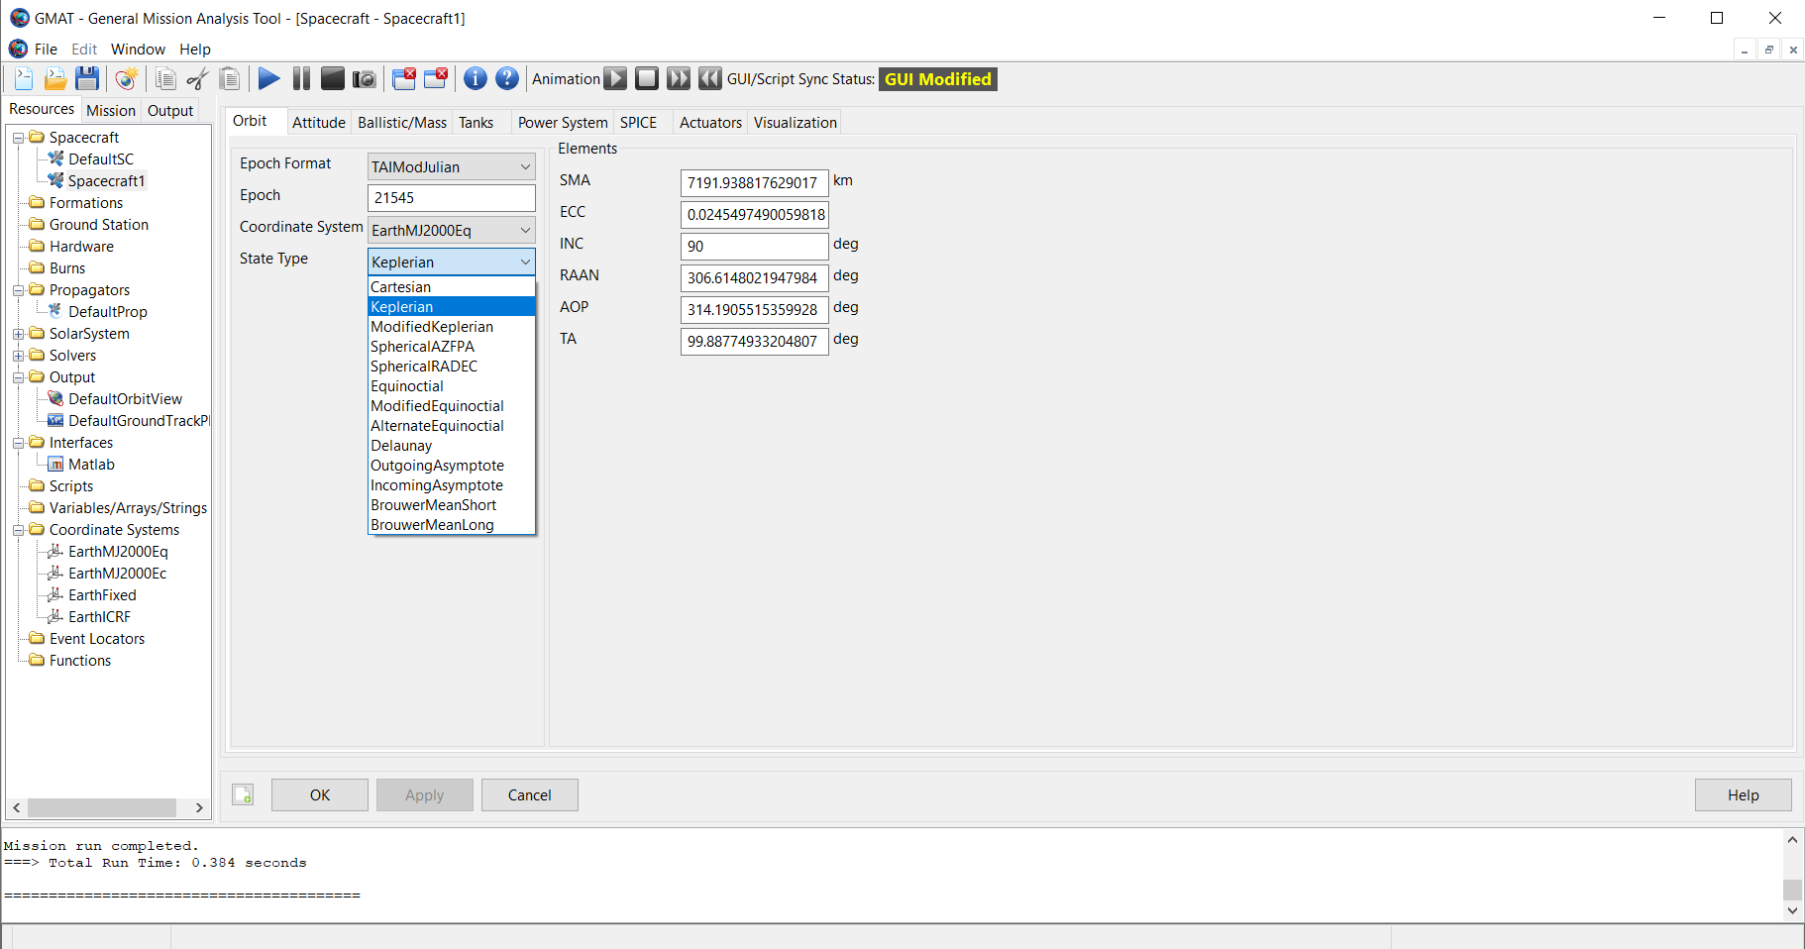
Simulating an Orbit – Editing the Inclination
3. Set inclination
to 90 degrees
2. Click state type
and select Keplerian
1. Double Click
4. Click OK

Slide 29
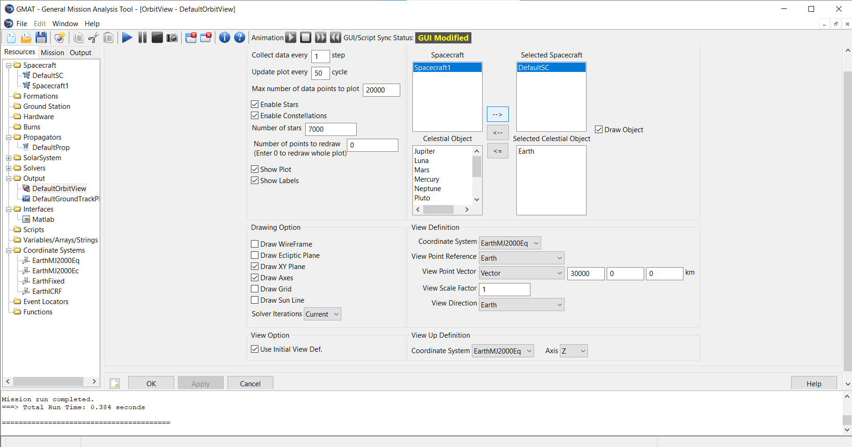
Simulating an Orbit – Adding it to OrbitView
3. Click “→” to add it to
the visualization list
2. Select the New Spacecraft
1. Double Click
4. Click OK

Slide 30
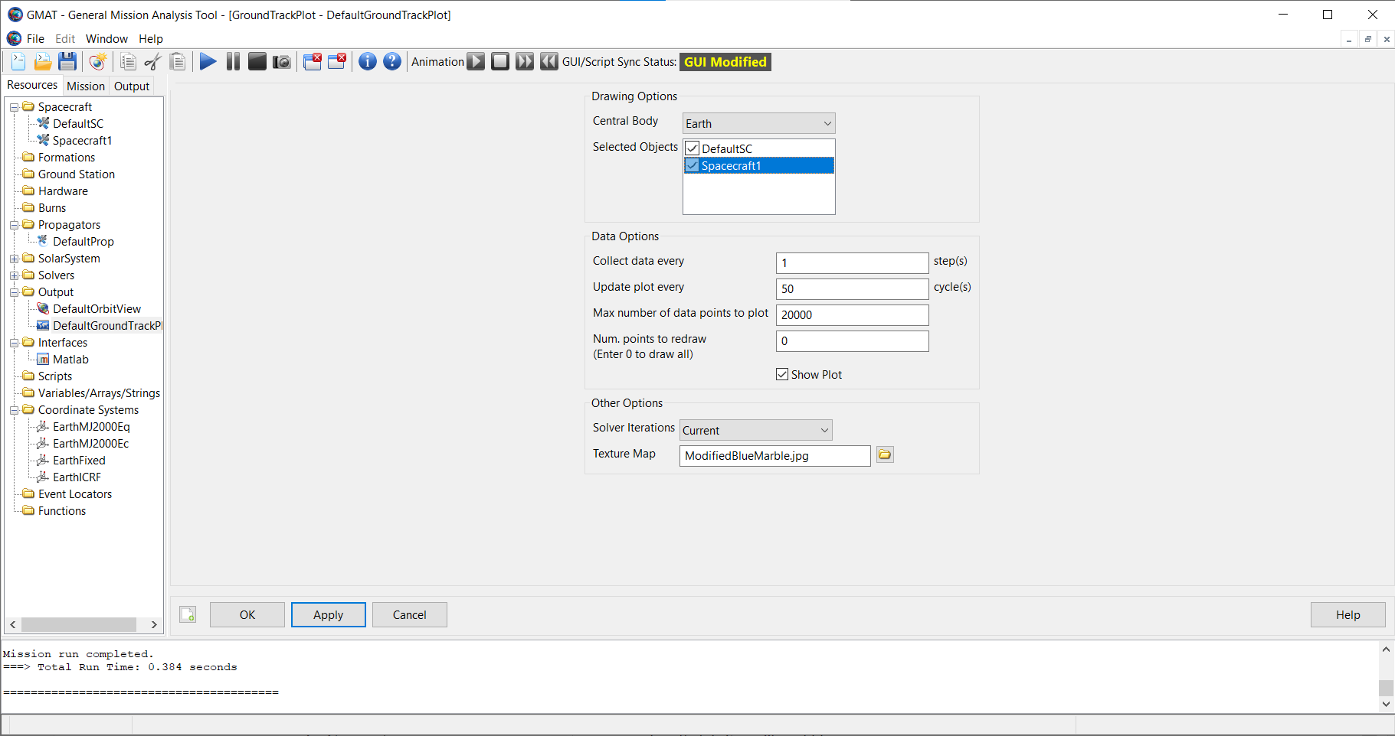
Simulating an Orbit – Adding it to GroundTrackPlot
2. Click checkbox to add it
to the visualization list
1. Double Click
3. Click OK

Slide 31
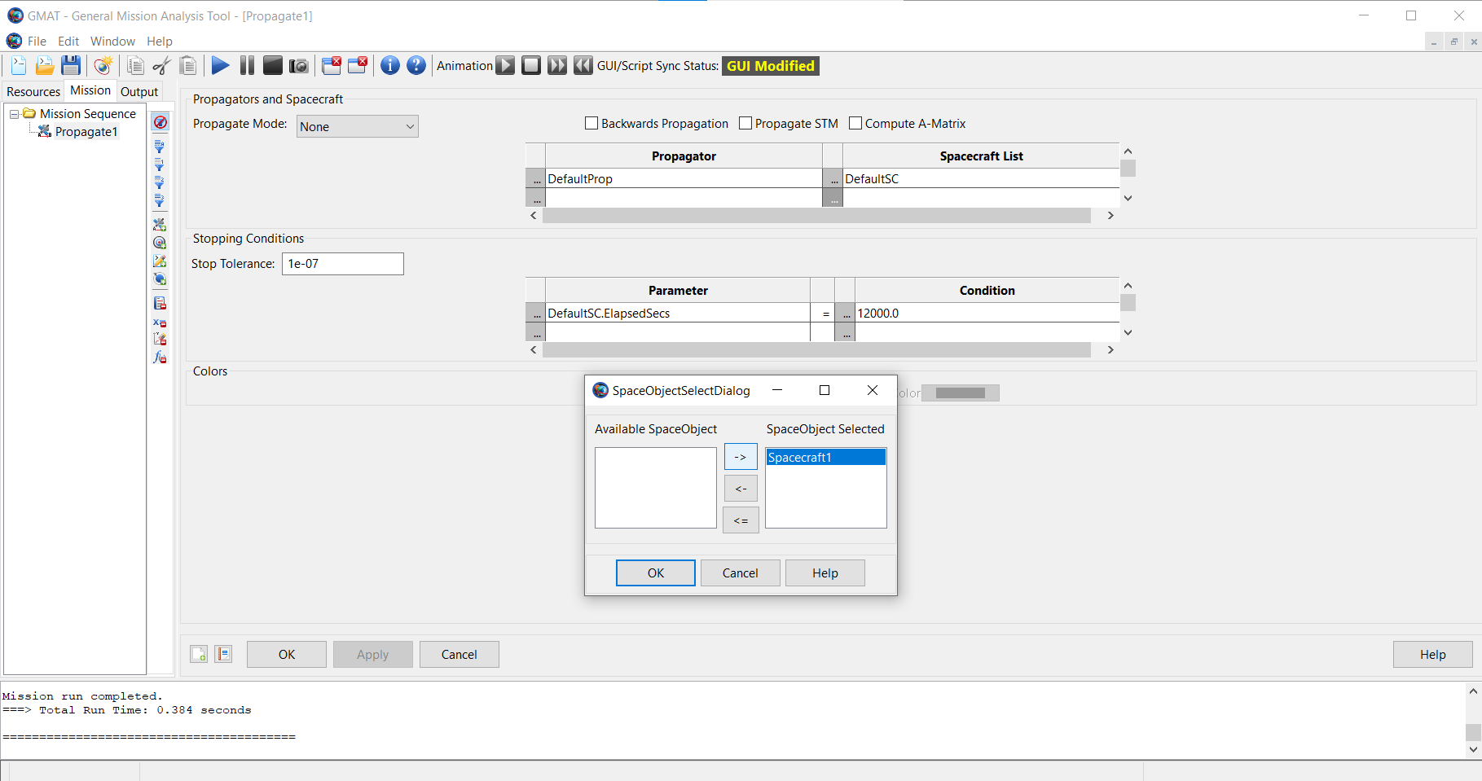
Simulating an Orbit – Editing the Propagate Command
2. Click “…” under
Spacecraft list
1. Click Mission and Double click Propagate1
3. Click “→” to add it to the
SpaceObject Selected
list and click OK

Slide 32
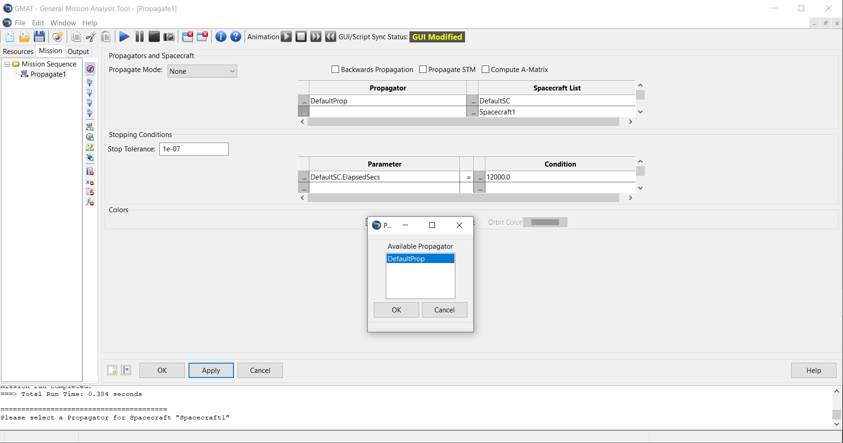
Simulating an Orbit – Editing the Propagate Command
2. Click “…” under
Propagator list
1. Click Mission and Double click Propagate1
3. Click OK to assign it as the Propagator to the Spacecraft
4. Click OK

Slide 33
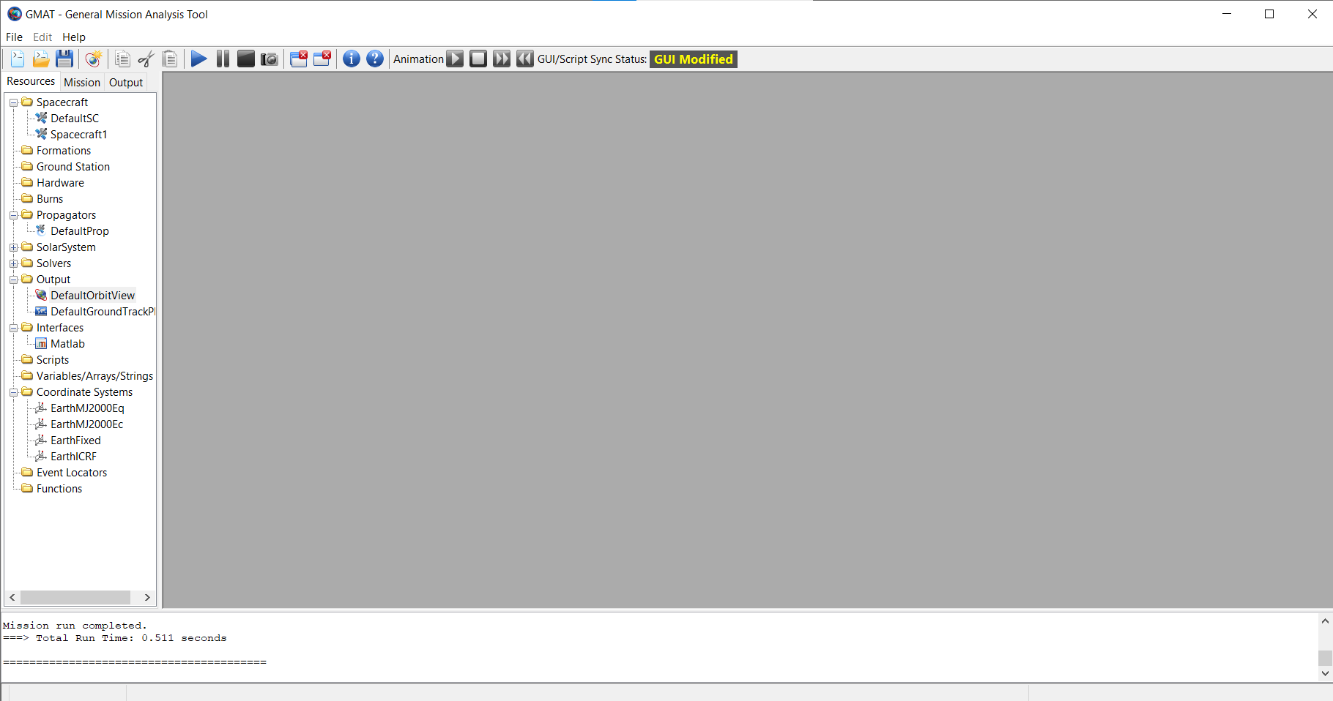
Simulating an Orbit – Running the Modified Mission
Click

Slide 34

Simulating an Orbit – Assessing the Results

Slide 35
Introduction to GMAT Software (102)
Jairus Elarbee
Emergent Space Technologies/NASA Goddard Space Flight Center
October 2023

Slide 36
Intro to GMAT Software - Outline
Key Concepts
  Execution Model
  GMAT’s Three Interfaces
  Resources and Commands
  Fields and Parameters
Tour of the Graphical User Interface
  Toolbar and Menu Bar
  Resources Tree
  Mission Tree
  Output Tree
  Graphical Visualization Tools
Tour of the Scripting Interface
  Basic Concepts
  Identifying Commands
  Identifying Resources
  Identifying Fields
  Identifying Parameters
  Other Components
  Math Operations
  Script Editor
Working Between The GUI and Scripts
GMAT Structure
  Data Files and Configuration
  Plugins
  Getting Help

Slide 37
Key Concepts

Slide 38
Key Concepts
Execution model
Why GMAT is more like MATLAB than Excel
GMAT’s Three Interfaces
How do they interact?
Resources and commands
What are they? What types exist?
Fields and parameters
What’s the difference? How do I use them?

Slide 39
Key Concepts – Execution Model
GMAT is like MATLAB:
  You write a program (a “mission”), then run it to generate output
Not like Excel
  Cannot generate output or manipulate results without rerunning

Slide 40
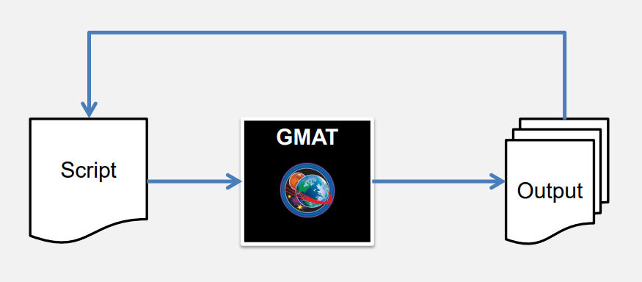
Key Concepts – Execution Model
Below is a nominal example of following the execution model
  A user will configure the parameters and contents of their scenario, specifying the objects and algorithms they wish to utilize and the sequence of events for their mission
  GMAT will use the configured objects and specified commands to “Run” the mission and perform the actions in the order of the mission sequence
  The user may then evaluate the results of the mission run, examining charts and reading reports. Based on the outcome, the user may choose to change some settings and run the mission again

Slide 41
Key Concepts – GMAT’s Three Interfaces
GMAT provides three interfaces for the user:
  GUI
  GMAT Scripting
  API
While the interfaces have significant overlap, they do not maintain full parity in all capabilities
Users should select the interface most appropriate to the mission they are designing and their level of experience with GMAT
Note that current and projected feature development is focused on expanding capability through the Script and API interfaces, which are preferred over the GUI for advanced features
Discussion of the API will be handled more on Day 3 of the training

Slide 42
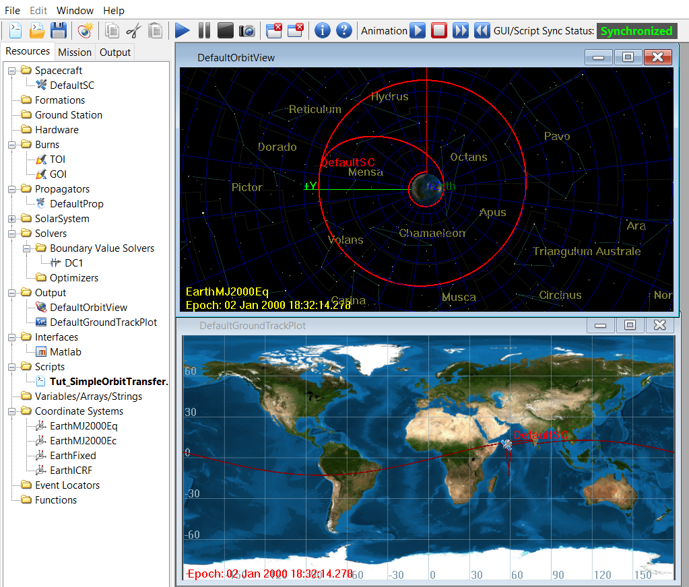
Key Concepts – GMAT’s Three Interfaces
GUI
GMAT’s GUI is designed to be informative without being overwhelming
Useful for learning various options each resource and command permits
Contains numerous visualization tools, including 3D plots, GroundTrackPlot, and data plots
Can be exported to a GMAT script via the save script functionality
Users can create most resources and modify most parameters, but not all features are supported via the GUI

Slide 43
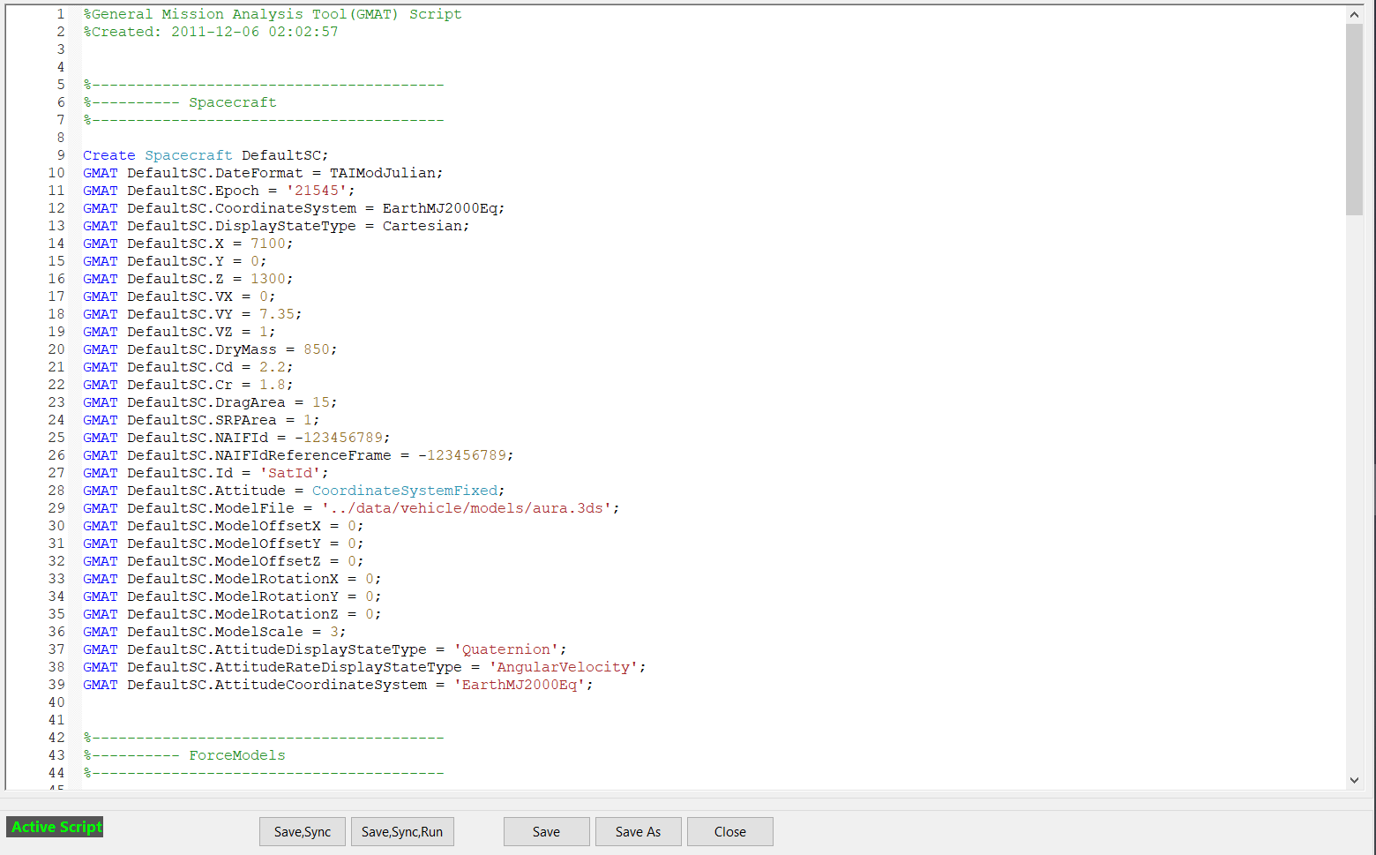
Key Concepts – GMAT’s Three Interfaces
Script
Advanced functionality, containing features and fields not accessible via the GUI
Lightweight text files allow for easy sharing, copying, and quick modification of properties and parameters
Built around syntax similar to MATLAB
  Resource.Property = ‘Value’;
  Arrays start at 1
May be modified within the GUI using the GMAT script editor
  Note: When using both script and GUI, GMAT must be synchronized after changes are made

Slide 44
Key Concepts – GMAT’s Three Interfaces
API
Uses SWIG to wrap GMAT source code, giving access via Python, MATLAB, and Java to the native C++ functions
Can be used to operate individual functions within GMAT’s code or used to load and run GMAT scripts
More information and tutorials will be on given Day 3

Slide 45
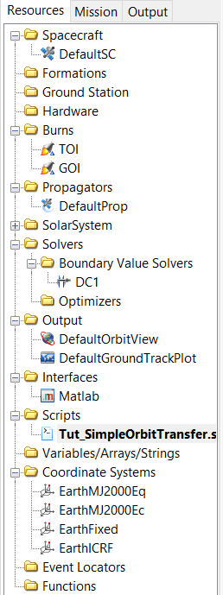
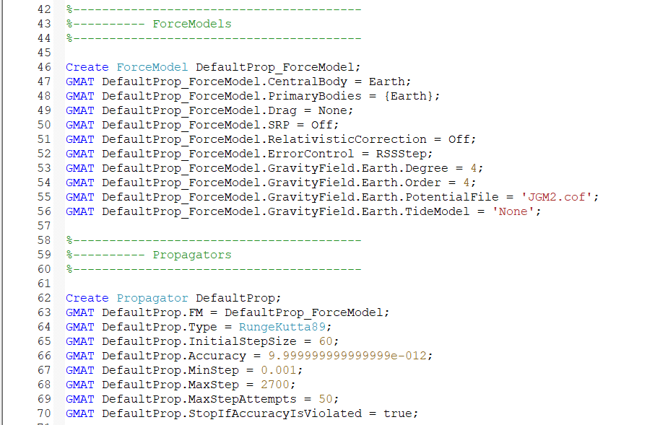
Key Concepts – Resources
Resources
Resources are the building blocks for your mission and contain a variety of types of objects with definable properties
  Simulated Objects and Hardware (Spacecraft, Ground Stations, Celestial Bodies)
  Measurement and affiliated components (Tracking data sets, simulators, error models)
  Mathematical models (Force models, propagators, estimators and differential correctors)
  Visualization and reporting components (ground track plots, 3D graphics, ephemeris and report files)
  Scripting software objects (arrays, strings, variables)
Think of Resources as the parts of a car – you have an engine, tires, headlights, etc.

Slide 46
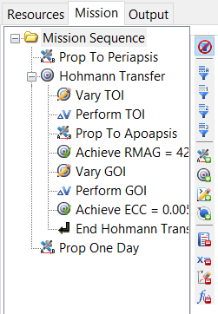
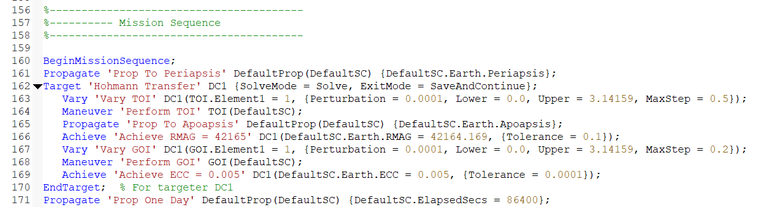
Key Concepts – Commands
Commands
Commands are the series of actions performed by GMAT during the Mission Sequence when a scenario is run
  Instructions for modeling physical actions (propagation, impulsive burns, finite thrust)
  Commands to initiate simulation and estimation
  Controls for optimization and targeting
  Control flow statements (if/else, for,
  while)
  Output controls (Report, toggle)
  Math operations (Assignment “=“, sin, log)
Building on the previous analogy, commands and the mission sequence are taking your car on a trip with directions

Slide 47
Key Concepts – Fields and Parameters
Fields
Parameters
Properties you can set on a resource
May be assigned during initialization
Examples:
  Spacecraft.Epoch
  Groundstation.CentralBody
  ReportFile.Filename
Properties you can calculate during the mission
Parameters often have dependencies, such as a central body or coordinate system
Examples:
  Spacecraft.Earth.Altitude
  Spacecraft.EarthMJ2000Eq.BVectorAngle
Sometimes a property is both a field and a parameter
Examples: Spacecraft.SMA, FuelTank.FuelMass

Slide 48
Tour of the GUI

Slide 49
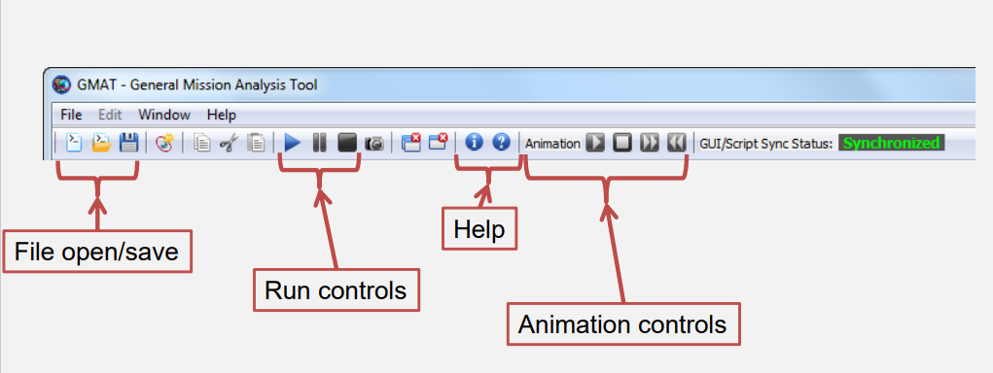
Tour of the GUI – Toolbar and Menu Bar
Copy/Cut/Paste
Window Manager
Sync Status
New Mission

Slide 50
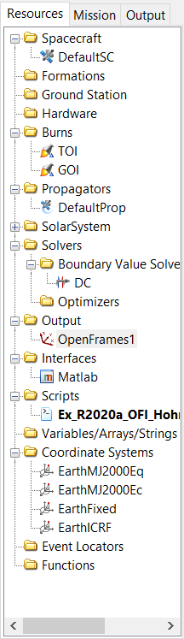
Tour of the GUI – Resource Tree
Contains all configured resources in the mission
Grouped into folders by type:
  Spacecraft
  Hardware
  Burns
  Output
  SolarSystem
To add new resources, right click on the folder for options
With an existing resource, you can double-click it to access its fields and parameters, or right-click it to rename or delete it

Slide 51
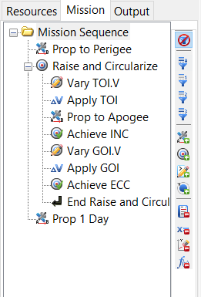
Tour of the GUI – Mission Tree
Contains the Mission Sequence
  Sequence of all configured commands
Special features:
Docking & undocking
  Filtering controls
  Command Summary
To add commands, right click on “Mission Sequence” and append, or on any command to insert before or after it

Slide 52
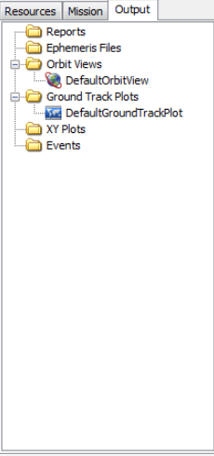
Tour of the GUI – Output Tree
Contains the output products
  Reportfiles
  Ephemeris Files
  Plots
Populated after mission execution

Slide 53
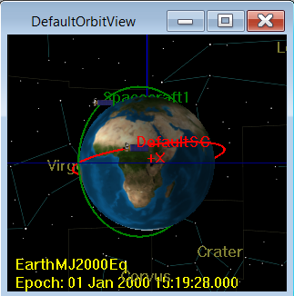
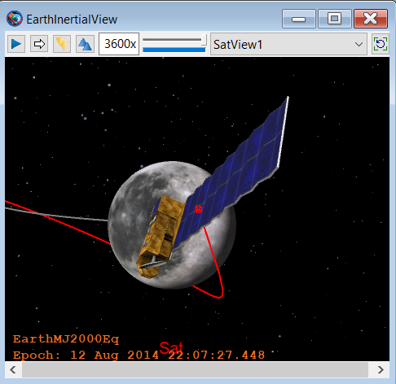
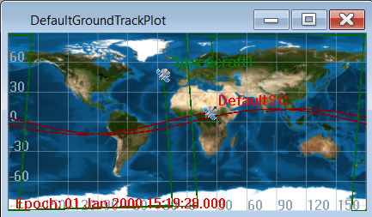
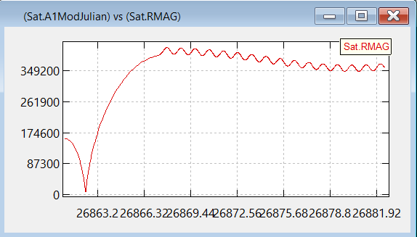
Tour of the GUI – Graphical Visualization Tools
OpenFrames
  Modern 3D visualization tool, added for R2020a,
  Can visualize trajectories and FOV vision cones in addition to planets and bodies
  Allows users to change time, animate the scenario, and define various custom viewing reference frames
OrbitView
  Older 3D visualization tool for trajectories
  Found in older sample and tutorial scripts, but is less featured than OpenFrames
GroundTrackPlot
  Works for various central bodies and can support custom surface textures
XYPlot
  2D data plot

Slide 54
Tour of the Scripting Interface

Slide 55
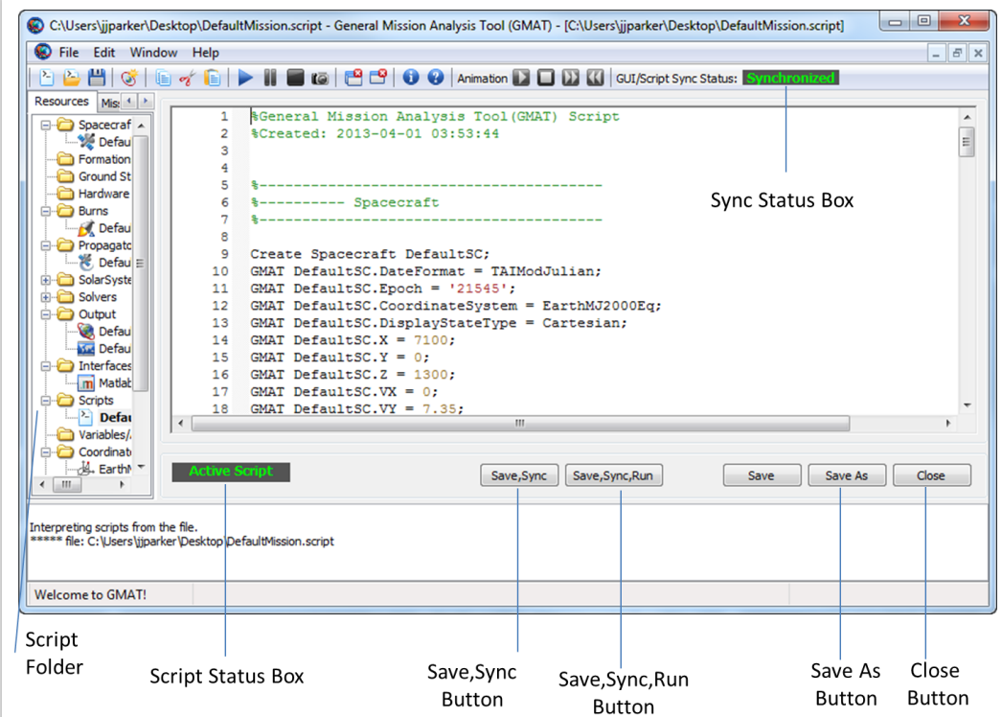
Tour of the Scripting Interface – Script Editor

Slide 56
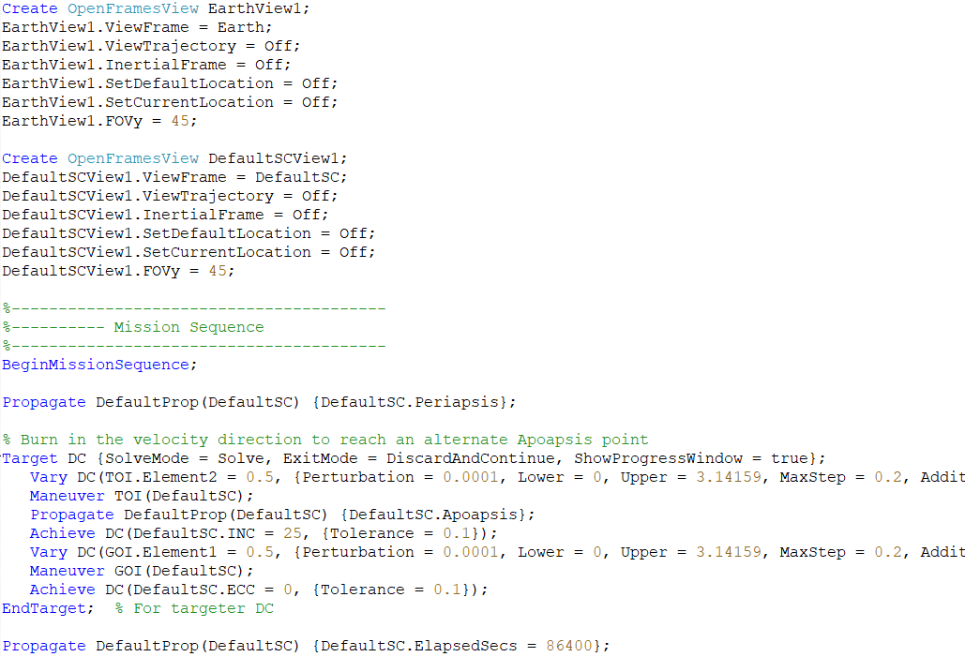
Tour of the Scripting Interface – Basic Concepts
Syntax is based on MATLAB
  Single-line statements w/ optional line continuations
  Case sensitive
  Loosely typed
Script is divided into two sections:
  Initialization (at the top)
  Mission Sequence (at the bottom)
  Divided by the BeginMissionSequence command

Slide 57
Tour of the Scripting Interface – Identifying Commands
Commands are colored blue in the script editor
BeginMissionSequence is a special command that is required in scripts to divide the Initialization and Mission Sequence sections
Most commands will be the first word on their line and are only available during the mission Sequence
The “Create” command will be the only command present in the initialization section
Math operations beyond assignment are considered commands and must occur during the Mission Sequence

Slide 58
Tour of the Scripting Interface – Identifying Resources
Resources are colored Teal in the script editor
Resource Vs. Instance
  OpenFramesView is the Resource Class
  EarthView1 is an instance of the OpenFramesView Resource Class

Slide 59
Tour of the Scripting Interface – Identifying Fields
Note: Fields are properties you set during initialization
Fields can only be set to static values before the mission sequence

Slide 60
Tour of the Scripting Interface – Identifying Parameters
Parameters are properties that are calculated
Format:
  Object.Dependency.Parameter
Dependencies define how or “to what” a parameter is calculated
  Example: Earth vs Luna (Earth’s Moon) for altitude calculation
If a dependency is not defined, GMAT will use a default, which may not match the user’s assumptions
Note that some parameters are also fields that may be set during initialization

Slide 61
Tour of the Scripting Interface – Other Components
Comments are green, with comment prefixed by ‘%’
Numerical values are beige
String values are red and surrounded by single quotes

Slide 62
Tour of the Scripting Interface – Math Operations
Math syntax is based on MATLAB and operators are matrix aware
Math operations correspond to the assignment command in the GUI and are only available during the mission sequence
Can be set in the GUI by adding an Equation to the Mission Sequence
Scalar Math Functions
sin | cos
tan | asin
acos | atan
atan2 | log
log10 | exp
DegToRad | RadToDeg
abs | sqrt
Operators and Functionality
+ | Plus
- | Minus
* | Multiply
/ | Divide
‘ | Transpose
^ | Power
Matrix Manipulation Functions
abs | det
cross | inv

Slide 63
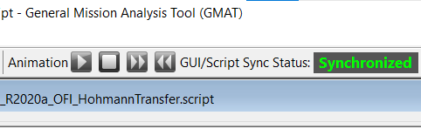
Tour of the Scripting Interface – Script Editor
Built-in editing control
Includes code folding, syntax highlighting
GUI/script synchronization indicators:
Status | Meaning
 | GUI and script are identical
 | GUI or script has modifications
 | GUI AND script have modifications – fix manually
 | Script couldn’t be loaded

Slide 64
Working Between the GUI and Scripting

Slide 65
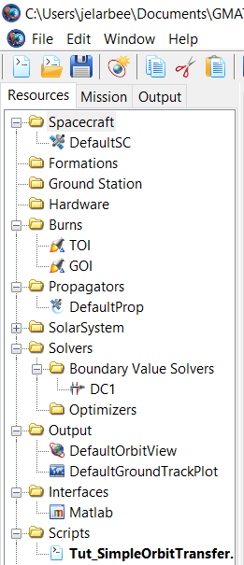

Working Between The GUI and Scripts
GUI
Script
GUI and Script are largely interchangeable (But not totally)

Slide 66



Working Between The GUI and Scripts
Initialization
Mission Sequence

Slide 67



Working Between The GUI and Scripts
The script version of a GUI object can be accessed via the show script button on its GUI panel
The full script of a mission can be generated from the mission Tree by right clicking the mission sequence and selected “Show Script”
To label a script command in the, Mission Tree add ‘YourCommandLabel’ directly after the command in the script

Slide 68
GMAT Structure

Slide 69

GMAT Directory Structure - Data Files and Configuration
API Config files and load_gmat.py
Configuration (gmat_startup_file.txt)
Gravity models
Planetary Orientation parameters (EOP)
Planetary Ephems (de & SPICE)
Leap Second files
Documentation (User Guides, math specs)
Output Files
Sample and Tutorial Scripts

Slide 70
GMAT Plugins
Plugins allow for adding new capabilities to GMAT without requiring modification of core GMAT code
GMAT ships with several default plugins of varying scope, including alpha/beta plugins that are by default disabled
Plugins may be enabled and disabled by modifying the GMAT startup file

Slide 71
Where to Find Help
Offline Resource
Online Resources
For feature-specific information:
  Help button on feature panel
For scripting help:
  “Show Script” button on feature panel
Documentation Included with R2022a:
  GMAT User Guide (pdf and html)
  GMAT API User Guide (pdf)
  GMAT Architectural and Math specs (pdfs)
GMAT Wiki
  https://gmat.atlassian.net/wiki/spaces/GW/
Sourceforge Public Releases
  https://sourceforge.net/projects/gmat/
GMAT Jira
  https://gmat.atlassian.net/jira/

Slide 72
Tutorial: Simple Hohmann Transfer

Slide 73
Tutorial: Simple Hohmann Transfer
Scenario: Transfer a Spacecraft from LEO (low earth orbit) orbit to a higher altitude orbit
Goals:
  Gain better familiarity and comfort navigating GMAT’s GUI
  Practice creating resources and mission sequence commands

Slide 74

What is a Hohmann Transfer?
Published by Walter Hohmann in 1925, a Hohmann transfer is the technique used to transfer between two co-planar orbits using the minimum change in velocity
The most efficient place to change the apoapsis is at the periapsis, and vice-versa
To perform the Hohmann transfer to an orbit with a higher altitude, we perform the following steps
  At periapsis of our initial orbit, perform a maneuver to raise the apoapsis to our desired orbital radius
  Propagate the satellite along the new elliptical transfer orbit until it reaches the apoapsis
  Perform an additional maneuver at the apoapsis to raise the periapsis to the desired altitude
Notes:
Image note:
Vallado, David A. Fundamentals of Astrodynamics and Applications

Slide 75



Simple Hohmann Transfer – Create a New Mission
To set up a new mission, click the New Mission button at the top of the window to load the default mission and clear out any additional items that may have been added
Your resource and mission tabs should appear as they are seen on the right
Note: The Matlab interface may not be present depending on the configuration of your machine

Slide 76

Simple Hohmann Transfer – Building Your Own
What you will need to add for the mission core:
  2 Impulsive burns
    Transfer Orbit Maneuver with ΔV = 2.25
    Final Orbit Maneuver with ΔV = 1.5
  One OpenFramesInterface output with a CoordinateSystem centered view
  A Mission Sequence with at least two Propagate commands and two maneuvers
    Remember – Transfer Maneuver occurs at Periapsis, Final Maneuver occurs at Apoapsis
    Adding a final propagation will let you see the final orbit you achieve
Try it on your own before proceeding to the following slides
  The next slides show you how to do it using one of the GMAT sample scripts

Slide 77
Simple Hohmann Transfer – Opening the Sample Script
The sample script we will be loading is Ex_R2020a_OFI_HohmannTransfer.script found in ‘GMAT/samples/NeedsOpenFramesInterface’
To load a script, click the folder icon on the toolbar, click file->Open, or use the keyboard shortcut Ctr+O

Slide 78

Simple Hohmann Transfer – The Spacecraft

Slide 79

Simple Hohmann Transfer – Propagator and ForceModel

Slide 80

Simple Hohmann Transfer – The Impulsive Burns

Slide 81

Simple Hohmann Transfer – The Differential Corrector

Slide 82

Simple Hohmann Transfer – The OpenFrames Interface

Slide 83

Simple Hohmann Transfer – The Mission Sequence

Slide 84

Simple Hohmann Transfer – Running the Script​
1. Click
2. Click

Slide 85

Simple Hohmann Transfer – Assessing the Results
Thrust required to achieve solution
Targeted Values
vs.
Solution Values
Visualization of solver iterations (blue) and the final solution (red)

Slide 86

Additional Exercises – Changing the Target
Suppose instead of a GEO orbit, you wanted to achieve reach GPS orbit (DefaultSC.Earth.RMAG = 20,180). How would you change the script?
Instead of transferring to a GEO orbit, can you target the burn to achieve a circular orbit at a 25 degree inclination? (Hint: DefaultSC.INC = 25)
Putting both together, could you perform an inclination change and a Hohmann transfer?

Slide 87


Solution for Reaching GPS Orbit

Slide 88

Solution for Changing Inclination

Slide 89

Solution for Changing Inclination and Reaching GPS

Slide 90
Overview of GMAT Resources (103)
Jairus Elarbee​
Emergent Space Technologies/NASA Goddard Space Flight Center​
October 2023​

Slide 91
Outline
Spacecraft
  State and epoch options
  Parameters of Interest
Propagators, Integrators, and ForceModels
  Propagator Overview
  Numerical Integrators
  Runge-Kutta and Other Integrators
  Considerations when selecting an Integrator
  ForceModels
  Ephemeris Propagation
  TLE Propagation
Reporters and Subscribers
  EphemerisFiles
  OpenFramesInterface
  GroundTrackPlot
  ReportFiles
  Write and Toggle commands
Coordinate Systems
Differential Correctors
Lunar Orbit Insertion Tutorial and Exercises

Slide 92
Spacecraft

Slide 93

Spacecraft Resource
Spacecraft is the resource for modeling artificial objects in space
  Larger, natural objects such as planets, moons, comets, and asteroids are modeled as CelestialBodies
Spacecraft can be modelled individually or in groupings using Formations
Primary resource that basically every GMAT mission contains

Slide 94
Spacecraft – Parameters of Interest
Time Parameters
  Spacecraft.DateFormat – Specifies the time system the epoch from options such as UTCGregorian and TAIModJulian
  Spacecraft.Epoch – The time of the Spacecraft state, which can be entered in Gregorian or MJD
State Parameters
  Spacecraft.DisplayStateType
  Spacecraft.X/Y/Z/Vx/Vy/Vz – Cartesian state parameters in the Spacecraft’s coordinate system
  Spacecraft.Ecc/INC/RAAN/SMA/TA/AOP
Hardware
  Spacecraft.Tanks/Thrusters – List of hardware used for finite maneuvers
  Antenna, Transponders, and Receivers will be discussed in more detail Day 2
Ballistics Properties
  Spacecraft.Mass – Mass in Kg
  Spacecraft.DragArea – Area used to calculate drag force in non-SPAD modeling
  Spacecraft.Cd – Coefficient of drag
  Spacecraft.Cr – Coefficient of Reflectivity used to calculate Solar Radiation Pressure

Slide 95
Propagators, Integrators, and ForceModels

Slide 96

Propagator Overview
GMAT Propagators are the resource used to model Spacecraft motion
This resource has different configuration steps in GUI vs scripting
Propagators can be used in a number of different applications in GMAT:
  Direct propagation via command in the Mission Sequence
  May be assigned to a Simulator for creation of simulated tracking data
  Can be assigned to an Estimator (BLS or EKFS) for use during OD
Propagators take two approaches to modeling motion
  Numerical integration
  Ephemeris interpolation

Slide 97
Numerical Integration
Propagation with a numerical integrator models the forces applied to the spacecraft mathematically and determines the change in state by solving the differential equations
Primary method of propagation in GMAT and is the most versatile
Propagators contain various fields that let you tune the settings of the integration, such as desired accuracy, step size, and error control

Slide 98

Runge-Kutta and Other Integrator Options
GMAT Contains a number of different Runge-Kutta based integrator options, including:
  RungeKutta89 (Default)
  RungeKutta68
  RungeKutta56
  PrinceDormand45
  PrinceDormand78
Two other numerical integrators are also available in GMAT that are based on different mathematical approaches
  PrinceDormand853
  AdamsBashfordMulton

Slide 99
Selecting an Integrator
No one integrator is appropriate for all situations
Selection should be based conditions of the mission
  What sort of mission is being simulated? Are you modeling a simple, uninterrupted orbit or are there complex maneuvers that require high precision, such as swing-bys?
  What regime of orbit will the craft be in? LEO, GEO, Interplanetary?
  What are the error tolerances of the mission?
  What is the length of the mission? For longer scenarios, the performance speed of the integrator will have a larger impact

Slide 100

Force Models
ForceModels are used to define the physical forces to implement in each propagator
Only necessary when using numerical integration and only separately defined when using scripting rather than the GUI
Contains the following main capabilities
  Definition of propagator’s central body, which will be the origin of the Coordinate system GMAT uses during integration
  Specification of atmospheric modeling method, if any, and associated settings
  Enumeration of additional bodies and point masses to be considered for perturbing forces, such as other celestial bodies
  Configuration for calculating SRP and its associated settings
  Settings for configuring harmonic gravity models

Slide 101
Ephemeris Propagation
Propagation with Ephemeris files interprets the state from the data and interpolates the position for a given time
Different interpolation settings available depending on the type of Ephemeris
Limited to propagation within the bounds of dataset
Compatible with four different ephemeris formats:
  STK “*.e”
  SPICE/SPK “*.bsp”
  CCSDS OEM V1
  Code 500 (Deprecated)

Slide 102
TLE Propagation
GMAT supports TLE propagation using the SPICE’s implementation of the updated SGP4 algorithm
Users add the path to a text file contain a TLE to a Spacecraft object using the Spacecraft.EphemerisName field, then set the Spacecraft.ID field to a value that either matches the name in line 0 of the TLE or a value that matches the satellite catalogue number of the object in lines 1 and 2 of the TLE
Note that TLEs by definition are Earth centered, so the changes to the CentalBody resource will not influence calculation

Slide 103
Reporters and Subscribers

Slide 104
GMAT Subscribers – Ephemeris Files
GMAT can generate Ephemeris Files in four formats
  CCSDS-OEM V1
  SPICE SPK .bsp
  STK .e (STK-TimePosVel)
  Code-500 (deprecated)
Output will be a text or binary file constructed after the mission sequence has completed, and is constructed by interpolating the mission data to match the specified Ephemeris step size
By default, will record over the full time span of the mission, but can be configured to only log a specified sub-set
Users may modify the way in which the data is recorded, including using a specified Coordinate System, selecting the format for the time values, and the output filename

Slide 105


GMAT Subscribers – Open Frames Interface
Open frames is the primary GMAT 3D visualization tool as of GMAT R2020a
Capabilities include interactive timeline for visualizing change in conditions over the course of the mission, specification of multiple perspectives and viewpoints for tracking, and rendering of sensor masks

Slide 106
GMAT Subscribers – GroundTrackPlot
Tool for drawing the latitude and longitude history of a spacecraft
By default will use an earth texture map, but a user specified texture can be loaded for other bodies
Can support multiple spacecraft simultaneously, with colors specified with the Spacecraft.OrbitColor field

Slide 107
GMAT Subscribers – ReportFile
The GMAT ReportFile resource allow users to write mission data to a text file over the course of the mission sequence
Capable of logging user-created variables, arrays, and strings, as well as Object parameters (e.g. Spacecraft state parameters, such as Spacecraft.X)
Highly configurable to match precise output user specifies, including settings such as:
  Column width
  Comma, semicolon, space, or tab delimiters
  Left vs right justification
  Precision with or without zero-fill
  Header information
Information can be set to be logged whenever an update occurs by adding it to the ReportFile’s tracking list, or data can be delivered at specified points directly via the Write command

Slide 108

GMAT Subscriber – XY Plot
XYPlots let you chart data on a 2D plot along an X and Y axis
Typical usage includes tracking time varying parameters
Any number of parameters can be plotted against any single independent variable

Slide 109
GMAT Subscriber Commands – Write and Toggle
Write
Toggle
Write allows you to record data via command to one of three locations:
  The GMAT Message Window
  The GMAT Log File
  A ReportFile resource
Useful for QA and script debugging or cases in which the user only desires output at specific mission points
Allows user to toggle data delivery to different GMAT subscribers
Useful for cases where data collection should only cover a specific span, such as a delayed start
Toggle Subscriber On or Toggle Subscriber Off
Can be used to toggle a resource On and Off multiple times during a mission sequence

Slide 110
Other Resources of Interest

Slide 111
CoordinateSystem
GMAT Coordinate systems are defined as an Axis and an Origin
Some built in Axis options:
  MJ2000Eq
  MJ2000Ec
  ICRF
  TODEq
  TODEc
  ObjectReferenced
  BodyFixed
  BodyInertial
  GSE
Origins can be selected from the following set of resources:
  CelestialBody
  Spacecraft
  LibrationPoint
  Barycenter
  SolarSystemBarycenter
  GroundStation
GMAT coordinate systems will be discussed further on Day 3

Slide 112
Differential Corrector
A numerical solver for a boundary value problem
Commonly used in GMAT to solve for maneuvers required to meet desired orbital conditions
Operation occurs during the mission sequence, but can set the maximum number of iterations, reporting options, and selection of algorithm during initialization

Slide 113
Tutorial: Lunar Orbit Insertion

Slide 114
Tutorial: Lunar Orbit Insertion
Scenario: Transfer a Spacecraft from Earth orbit to a Lunar orbit using B-plane targeting
Goals:
  Practice using different force models and integrators
  See how to create different reference frames and coordinate systems
  Create a mission entirely using the script interface
Remember: If you’re not sure how to format a resource in the script editor, you can create it through the GUI and use the show script functionality. This is particularly helpful with the OpenFramesInterface
Will spend 15-30 minutes with self-guided work to set up scripts on your own, then will walk through a guided example of how to create the mission

Slide 115

What is B-Plane Targeting?
B-Plane Targeting is a technique used in inter-planetary mission design to assist in arriving at another body at specified conditions
If you have precise orbital requirements upon arrival at another body, such as inclination, altitude and arrival time, these parameters vary in highly non-linear fashion when considered from point of view of trajectory adjustments
If these conditions are converted to the B-Plane, they vary linearly when trajectory adjustments are applied, which greatly simplifies the mission design process
B-Plane targeting can be used for setting up gravity assists/flybys, orbit insertion, or entry states for landers
GMAT Calculates parameters such as BdotR, BdotT, BVectorAngle, and BVectorMag which may all be used with B-Plane targeting
Notes:
Image Note:
Vallado, David A. Fundamentals of Astrodynamics and Applications

Slide 116
Lunar Orbit Insertion – Create a New Script
To set up a new mission, click the New Mission button at the top of the window to load the default mission and clear out any additional items that may have been added
Your resource tab should appear as it is seen on the right
Once you’ve done this, click the left-most button on the tool bar to create a new script
With your blank script, save it as Tut_LOI_OFI.script

Slide 117
Lunar Orbit Insertion – Resources you will need
1 Spacecraft
  Epoch = '22 Jul 2014 12:00:00.000’
  Sat.DisplayStateType = Keplerian
  Sat.SMA = 83474
  Sat.ECC = 0.9
  Sat.INC = 12.5
  Sat.RAAN = 112
  Sat.AOP = 219
  Sat.TA = 180
2 Force Models
  One Earth Centered
  One Moon Centered
1 Lunar centered Coordinate System using MJ2000Eq Axes
2 Impulsive Maneuvers
  One VNB TOI with Origin Earth
  One VNB LOI with Origin Moon
2 OpenFramesInterface outputs
  One with EarthMj2000Eq CS
  One with Custom Lunar CS
1 Differential Corrector with default settings

Slide 118

Progress check – Resource Tree
Save and sync the script. Looking at the resource tree in the GUI, you should see the following items added:
  Sat
  TOI
  LOI
  EarthFull
  MoonFull
  DC1
  EarthIntertialView
  MoonInertialView
  Tut_LOI_OFI.script
  MoonMJ2000

Slide 119
Lunar Orbit Insertion – Mission Sequence
Your command sequence will need to perform the following steps
  Propagate to Periapsis
  TOI Targeting
    Needs Vary commands for Element 1 and 2 of the TOI maneuver
      Element 1 (V) should have bound between 0.125 and 0.5
      Element 2 (B) should have bounds between -0.5 and 0.5
    Needs a propagation close to the Lunar Sphere of Influence (Sat.Earth.RMAG = 325000), then to Lunar Periapsis
    Need to achieve the following
      Sat.MoonMJ2000Eq.BdotT = 15000
      Sat.MoonMJ2000Eq.BdotR = 4000
  LOI Targeting
    Needs Vary commands for Element 1 of LOI maneuver
      Bounds should be between -3 and 0
    Need to achieve an eccentricity of 0
  Final Propagation of 15 Days
Notes:
  Try building the mission one targeter at a time. Build the TOI targeter first, and test settings until the script converges before adding the LOI targeter
  If your script is failing to converge, try a larger max step size or different initial values
  Make sure to call the appropriate propagator for the sphere of influence the spacecraft is within

Slide 120

Progress check – Mission Sequence
Save and sync the script. Looking at the Mission tree in the GUI, you should see a similar sequence as the image on the right
If all are present, try running the script!

Slide 121


LOI Results and Output
Once the mission runs successfully, there will be four windows created
  Two are solver windows for the two targeters, which shows the converged values for the B-Plane and the LOI maneuvers
  The other two are the OpenFrames visualizations showing the motion of the craft in an earth inertial view and in a moon inertial view
Depending on your targeter settings, your number of iterations may be different

Slide 122
Spacecraft - Creation
Create Spacecraft Sat

Slide 123
Spacecraft - Epoch
Create Spacecraft Sat
Sat.DateFormat = UTCGregorian
Sat.Epoch = '22 Jul 2014 12:00:00.000'

Slide 124
Spacecraft - State
Create Spacecraft Sat
Sat.DateFormat = UTCGregorian
Sat.Epoch = '22 Jul 2014 12:00:00.000'
Sat.DisplayStateType = Keplerian
Sat.SMA = 83474
Sat.ECC = 0.9
Sat.INC = 12.5
Sat.RAAN = 112
Sat.AOP = 219
Sat.TA = 180

Slide 125
Earth Force Model - Creation
Create ForceModel AllForces

Slide 126
Earth Force Model – Central and Primary Body
Create ForceModel AllForces
AllForces.CentralBody = Earth
AllForces.PrimaryBodies = {Earth}

Slide 127
Earth Force Model – Harmonic Gravity & External Forces
Create ForceModel AllForces
AllForces.CentralBody = Earth
AllForces.PrimaryBodies = {Earth}
AllForces.PointMasses = {Sun, Luna, Jupiter}
AllForces.Drag.AtmosphereModel = MSISE90
AllForces.SRP = On
AllForces.GravityField.Earth.Degree = 20
AllForces.GravityField.Earth.Order = 20
AllForces.GravityField.Earth.PotentialFile = 'JGM2.cof'

Slide 128
Lunar Force Model – Creation
Create ForceModel MoonAllForces

Slide 129
Lunar Force Model – Central and Primary Body
Create ForceModel MoonAllForces
MoonAllForces.CentralBody = Luna
MoonAllForces.PrimaryBodies = {Luna}

Slide 130
Lunar Force Model – Harmonic Gravity & External Forces
Create ForceModel MoonAllForces
MoonAllForces.CentralBody = Luna
MoonAllForces.PrimaryBodies = {Luna}
MoonAllForces.PointMasses = {Sun, Earth, Jupiter}
MoonAllForces.Drag = None
MoonAllForces.SRP = On
MoonAllForces.GravityField.Luna.Degree = 20
MoonAllForces.GravityField.Luna.Order = 20
MoonAllForces.GravityField.Luna.PotentialFile = 'LP165P.cof'

Slide 131
Earth and Lunar Propagators - Creation
Create Propagator EarthFull;
Create Propagator MoonFull;

Slide 132
Earth and Lunar Propagators – ForceModel and Integrator
Create Propagator EarthFull
EarthFull.FM = AllForces
EarthFull.Type = RungeKutta89
Create Propagator MoonFull
MoonFull.FM = MoonAllForces
MoonFull.Type = RungeKutta89

Slide 133
LOI and TOI Maneuvers – Creation
Create ImpulsiveBurn TOI
Create ImpulsiveBurn LOI

Slide 134
LOI and TOI Maneuvers – Fields
Create ImpulsiveBurn TOI
TOI.CoordinateSystem = Local
TOI.Origin = Earth
TOI.Axes = VNB
Create ImpulsiveBurn LOI
LOI.CoordinateSystem = Local
LOI.Origin = Luna
LOI.Axes = VNB

Slide 135
Coordinate System And Differential Corrector
Create CoordinateSystem MoonMJ2000Eq
MoonMJ2000Eq.Origin = Luna
MoonMJ2000Eq.Axes = MJ2000Eq
Create DifferentialCorrector DC1

Slide 136
Subscribers – OpenFramesInterface – Creation and CS
Create OpenFramesInterface EarthInertialView
EarthInertialView.CoordinateSystem = EarthMJ2000Eq
Create OpenFramesInterface MoonInertialView
MoonInertialView.CoordinateSystem = MoonMJ2000Eq

Slide 137
Subscribers – OpenFramesInterface – Objects and Views
Create OpenFramesInterface EarthInertialView
EarthInertialView.CoordinateSystem = EarthMJ2000Eq
EarthInertialView.Add = {Sat, Earth, Luna, Sun}
EarthInertialView.View = {EarthView, SatView}
Create OpenFramesInterface MoonInertialView
MoonInertialView.CoordinateSystem = MoonMJ2000Eq
MoonInertialView.Add = {Sat, Earth, Luna, Sun}
MoonInertialView.View = {MoonView, SatView}

Slide 138
Subscribers – OpenFramesView - EarthView
Create OpenFramesView EarthView;
EarthView.ViewFrame = CoordinateSystem;
EarthView.ViewTrajectory = Off;
EarthView.InertialFrame = Off;
EarthView.SetDefaultLocation = Off;
EarthView.SetCurrentLocation = On;
EarthView.CurrentEye = [ 900000 -600000 300000 ];
EarthView.CurrentCenter = [ 0 0 0 ];
EarthView.CurrentUp = [ 0 0 1 ];

Slide 139
Subscribers – OpenFramesView - MoonView
Create OpenFramesView MoonView
MoonView.ViewFrame = CoordinateSystem
MoonView.ViewTrajectory = Off
MoonView.InertialFrame = Off
MoonView.SetDefaultLocation = Off
MoonView.SetCurrentLocation = On
MoonView.CurrentEye = [ 5000 -10000 22000 ]
MoonView.CurrentCenter = [ 0 0 0 ]
MoonView.CurrentUp = [ 1 0 0 ]

Slide 140
Subscribers – OpenFramesView - SatView
Create OpenFramesView SatView
SatView.ViewFrame = Sat
SatView.ViewTrajectory = Off
SatView.InertialFrame = Off
SatView.SetDefaultLocation = Off
SatView.SetCurrentLocation = Off

Slide 141
Progress check
Save and sync the script. Looking at the resource tree in the GUI, you should see the following items added:
  Sat
  TOI
  LOI
  EarthFull
  MoonFull
  DC1
  EarthIntertialView
  MoonInertialView
  Tut_LOI_OFI.script
  MoonMJ2000

Slide 142
Mission Sequence – Start Mission and Initial Propagation
BeginMissionSequence
Propagate 'Prop to Perigee' EarthFull(Sat) {Sat.Periapsis}

Slide 143
Mission Sequence – B-Plane Targeting
Target 'Target B-Plane' DC1 ;
Vary 'Vary TOI.V' DC1(TOI.Element1 = 0.1, {Perturbation = 1e-005, Lower = .13, Upper = .5, MaxStep = .01});
Vary 'Vary TOI.B' DC1(TOI.Element3 = 0.1, {Perturbation = 1e-005, Lower = -.5, Upper = .5, MaxStep = .01});

Slide 144
Mission Sequence – B-Plane Targeting
Target 'Target B-Plane' DC1 ;
Vary 'Vary TOI.V' DC1(TOI.Element1 = 0.1, {Perturbation = 1e-005, Lower = .13, Upper = .5, MaxStep = .01});
Vary 'Vary TOI.B' DC1(TOI.Element3 = 0.1, {Perturbation = 1e-005, Lower = -.5, Upper = .5, MaxStep = .01});
Maneuver 'Apply TOI' TOI(Sat);
Propagate 'Prop to Moon SOI' EarthFull(Sat) {Sat.Earth.RMAG = 325000, StopTolerance = 1e-005};
Propagate 'Prop to Periselene' MoonFull(Sat) {Sat.Luna.Periapsis, StopTolerance = 1e-005};

Slide 145
Mission Sequence – B-Plane Targeting
Target 'Target B-Plane' DC1 ;
Vary 'Vary TOI.V' DC1(TOI.Element1 = 0.1, {Perturbation = 1e-005, Lower = .13, Upper = .5, MaxStep = .01});
Vary 'Vary TOI.B' DC1(TOI.Element3 = 0.1, {Perturbation = 1e-005, Lower = -.5, Upper = .5, MaxStep = .01});
Maneuver 'Apply TOI' TOI(Sat);
Propagate 'Prop to Moon SOI' EarthFull(Sat) {Sat.Earth.RMAG = 325000, StopTolerance = 1e-005};
Propagate 'Prop to Periselene' MoonFull(Sat) {Sat.Luna.Periapsis, StopTolerance = 1e-005};
Achieve 'Achieve BdotR' DC1(Sat.MoonMJ2000Eq.BdotT = 15000.4401777, {Tolerance = 3});
Achieve 'Achieve BdotT' DC1(Sat.MoonMJ2000Eq.BdotR = 4000.59308992, {Tolerance = 3});
EndTarget;

Slide 146
Mission Sequence – LOI Targeting and Final Propagation
Target 'Target Lunar Insertion' DC1 ;
Vary 'Vary LOI.V' DC1(LOI.Element1 = -0.65198120104, {Perturbation = 1e-003, Lower = -3, Upper = 0, MaxStep = .3});

Slide 147
Mission Sequence – LOI Targeting and Final Propagation
Target 'Target Lunar Insertion' DC1 ;
Vary 'Vary LOI.V' DC1(LOI.Element1 = -0.65198120104, {Perturbation = 1e-003, Lower = -3, Upper = 0, MaxStep = .3});
Maneuver 'Apply LOI' LOI(Sat);
Achieve 'Achieve ECC = 0' DC1(Sat.Luna.ECC = 0, {Tolerance = 0.0001});
EndTarget;

Slide 148
Mission Sequence – LOI Targeting and Final Propagation
Target 'Target Lunar Insertion' DC1 ;
Vary 'Vary LOI.V' DC1(LOI.Element1 = -0.1, {Perturbation = 1e-003, Lower = -3, Upper = 0, MaxStep = .3});
Maneuver 'Apply LOI' LOI(Sat);
Achieve 'Achieve ECC = 0' DC1(Sat.Luna.ECC = 0, {Tolerance = 0.0001});
EndTarget;
Propagate 'Prop 15 days' MoonFull(Sat) {Sat.ElapsedDays = 15};

Slide 149
LOI Results and Output
Once the mission runs successfully, there will be four windows created
  Two are solver windows for the two targeters, which shows the converged values for the B-Plane and the LOI maneuvers
  The other two are the OpenFrames visualizations showing the motion of the craft in an earth inertial view and in a moon inertial view
Based on the settings we have for our targeters, the B-Plane targeter converges in 15 iterations and the LOI targeter converges in 5 iterations

Slide 150
LOI Additional Exercises
Can you make the targeters converge with fewer iterations?
Can you add a moon centered view to the EarthInertial Open Frames visualization window?

Slide 151
Extra Slides

Slide 152




Runge-Kutta Overview
Runge-Kutta integration is a single step method to solve differential equations
  Breaks the interval of integration into a number of smaller, intermediate stages and calculates the estimate of the integration at each stage with later stages use the results of the earlier stages
  The cumulative effect is an approximation of the total step accurate to a given order in the series expansion of the differential equation
  The stages, k, may be calculated via the adjoining formula, form which the total step, r, may be calculated from the formula that follows
  Error control is performed by comparing the results of two orders of integration each using different c coefficients, with the difference in the steps providing an estimate of the step’s accuracy
  With the error calculated, the integration step can be adapted to a size more appropriate to the desired accuracy, reducing the step size as appropriate to increase accuracy
GMAT Contains six different implementations Runge-Kutta approach

Slide 153
Runge-Kutta Integrators Part 1
RungeKutta89
PrinceDormand78
RungeKutta89 is the default GMAT integrator and is highly versatile
Adaptive step 9th order integrator with 8th order error control
Coefficients selected were derived by J. Verner
  J. Verner derived various coefficients for an 89 integrator, GMAT’s selected the most robust set but not necessarily the most efficient
Adaptive step 8th order integrator with 7th order error control
Coefficients selected were derived by Prince and Dormand

Slide 154
Runge-Kutta Integrators Part 2
PrinceDormand853
PrinceDormand45
Adaptive step 8th order integrator with 5th order error control incorporating a 3rd order correction
Correction approach is described in section II.10 of "Solving Ordinary Differential Equations I: Nonstiff Problems" by Hairer, Norsett and Warner
Coefficients selected were derived by Prince and Dormand
Strong performance even with loose accuracy settings
Adaptive step 5th order integrator with 4th order error control
Coefficients selected were derived by Prince and Dormand

Slide 155
Runge-Kutta Integrators Part 3
RungeKutta68
RungeKutta56
A second order Runge-Kutta-Nystrom type integrator with coefficients developed by by Dormand, El-Mikkawy and Prince
A 6th order integrator and 5th order error control
Coefficients selected were derived by E. Fehlberg

Slide 156
AdamsBashforthMoulton Integrator
Solves using a fourth-order Predictor/Corrector approach as described in Fundamentals of Astrodynamics by Bate, Mueller, and White
Predicts the next state by extrapolating from the current state and the previous three steps
Corrects using the derivatives of this state, the current state, and the previous two states to tune the prediction and produce a final, corrected state
Uses the RungeKutta89 integrator to solve for the first 3 steps before starting the prediction process
The ABM is a low order integrator and should not be used for precise applications

Slide 157
Planetary Ephemeris and Celestial Bodies (104)
Jairus Elarbee​
Emergent Space Technologies/NASA Goddard Space Flight Center​
October 2023​

Slide 158
Overview
Celestial Bodies in GMAT
GMAT’s default solar system
Types of CelestialBody
  Planet
  Moon
  Asteroid
  Comet
  Sun/Star
The Planetary Ephemerides
  DEnnn
  SPICE
Considerations for selecting ephemerides

Slide 159
Celestial Bodies in GMAT
The CelestialBody category of object is the resource type which GMAT uses to track and model the properties of non-artificial objects in space
Celestial bodies include objects such as stars, planets, moons, asteroids, and comets
GMAT allows users to create and configure custom bodies to match specific shape or orientation models

Slide 160


GMAT’s Default SolarSystem
CelestialBody objects are packaged together in GMAT within a SolarSystem, which contains fields allowing the user to modify their properties and motion
GMAT’s default SolarSystem include default bodies for the Sun, the classical nine planets, and the Earth’s Moon, and the solar system barycenter, all modeled using the DE405 ephemerides
The SolarSystem can also contain Special Points, such as barycenters or libration points
SolarSystem primarily will dictate the motion of the bodies and their locations over time as well as some of their physical properties

Slide 161

Types of CelestialBody
Note that CelestialBody is not a resource, but a category containing different object types
  Planet
  Moon
  Comet
  Asteroid
  Star
To create a body in the GUI, right click on the object the body you are creating will orbit in the Solar system. Moons can be created by selecting a planet, while the other body types are created by clicking the Sun
Star is a special type that can’t be created by the user. Instead, changes to the star are made by modifying the Sun.
Note that when adding a new celestial body, the default properties do not make physical sense (mu = 0, radius = 0 km, etc.) and must be filled in by the user

Slide 162
The Planetary Ephemeris
A “planetary ephemeris” is a file containing the orbits of the planets
  Commonly used to provide point-mass gravity modeling for “third bodies”
  The world-standard source for this data is JPL
Over the years, this data has been provided in various formats, and GMAT supports a couple of options for this data
  See the SolarSystem resource
GMAT planetary ephemeris options
  DE(405, 421, 424) or SPICE
  These two options utilize different format files
There is some potential confusion in terminology
  People will often speak of both types of files as “DE files”, but they have different formats and can have different content
It will be useful to acquaint yourself with the SPICE subsystem and toolkit
  JPL’s Navigation and Ancillary Information Facility (NAIF) https://naif.jpl.nasa.gov/naif/
  https://naif.jpl.nasa.gov/naif/self_training.html
  https://naif.jpl.nasa.gov/pub/naif/self_training/individual_docs/04_spice_overview.pdf

Slide 163
GMAT Planetary Ephemeris Options - DEnnn
DE stands for “development ephemeris”
Selected by assigning DE405 (the default), DE421, or DE424 on the SolarSystem EphemerisSource parameter
  nnn refers to the “series” or release version (higher numbers are newer)
The source files for these options are in data/planetary_ephem/de
  These are generated and provided by the GMAT team and probably cannot be independently generated by users
  We don’t have current plans to produce any more files in this format
The latest available file is DE424, which is no longer the latest planetary ephemeris
  Planetary ephemeris data does not change much for the current era in each new release
  DE421 is more than adequate for lunar OD and is currently used for FDF LRO operations
This format is generally unavailable now and the SPICE option is recommended instead
  With some caveats, to be described shortly

Slide 164
GMAT Planetary Ephemeris Options - SPICE
SPICE stands for Spacecraft, Planetary, Instrument, C-matrix, Events
SPICE planetary ephemeris files are found on the JPL NAIF website
  https://naif.jpl.nasa.gov/pub/naif/generic_kernels/spk/planets/
  They are named dennn.bsp; nnn refers to the “series” or release version (higher numbers are newer)
Selected by assigning SPICE on the SolarSystem EphemerisSource parameter
  The path to the desired file is assigned on SolarSystem SPKFilename
Many planets are modeled at their barycenter location with a collective GM value
  You might need seek out alternate SPICE files if you want the location of Jupiter itself or Saturn’s moons for example
JPL provides a toolkit for reading and performing computations using this format of planetary ephemeris
  Available for C, FORTRAN, IDL, MATLAB, Java
SPICE/BSP is a generic ephemeris format supported by JPL for spacecraft as well as planets, comets, and other bodies
New planetary ephemeris files are released as SPICE/BSP files, not the “DE” format

Slide 165
Considerations Regarding Choice of Planetary Ephemeris Source
The Moon is special, and the choice of planetary ephemeris source affects the Moon orientation model available in GMAT
If you choose one of the DE options (only DE405, DE421, or DE424), GMAT will use the lunar orientation model provided by the chosen DE file
  The orientation model is provided by data in the DE files
  Per the User’s Guide “The orientation of Earth's Moon is modeled using lunar librations from the DE file.”
If you choose the SPICE option and assign a BSP file, GMAT will use the DE405 lunar orientation model regardless of the choice of SPICE SPKFilename
The “event location“ components will always use orientation and physical parameters in the data/planetary_coeff/SPICEPlanetaryConstantsKernel.tpc
  This includes resources like ContactLocator, EclipseLocator
 | EphemerisSource DEnnn | EphemerisSource SPICE
Moon-fixed frame for coordinate transformation | Lunar orientation from the selected DE file | Lunar orientation from DE405
Moon-fixed frame for event location | SolarSystem planetary constants kernel and Luna.SpiceFrameID | SolarSystem planetary constants kernel and Luna.SpiceFrameID

Slide 166
Defining Planetary Orientation
A distinction must be made between planetary orientation for gravity modeling and coordinate transformations, and event locators (for example ground station view period computation)
Planetary orientation for gravity modeling and coordinate transformations
  Earth uses the GMAT EOP data file
  Moon/Luna uses the DEnnn (DE file input) or DE405 (SPICE planetary ephemeris)
  Other bodies use the GMAT built-in orientation (for built-in bodies) or the user-defined orientation model (for user-defined bodies)
Planetary orientation for event location
  Uses planetary orientation model identified on the body SpiceFrameId and defined in the loaded SPICE kernel files

Slide 167
Introduction to Orbit Determination and Batch Least Squares Estimation (201)
GSFC Navigation and Mission Design Branch
October 2023
* Scripts not included in public release slide package

Slide 168
Outline for Today
GMAT Navigation/Orbit Determination (OD) background
Data files for Orbit Determination
Tracking Data for Orbit Determination
  Introduction to spacecraft tracking
  Tracking data input formats
Batch Least Squares Orbit Determination
  Batch Least Squares mathematical background
  Configuring Batch Least Squares OD
  Special topics in BLS OD (if time permits)
Kalman Filter Orbit Determination
  Kalman Filter mathematical background
  Configuring Extended Kalman Filter OD
  Filter tuning
Additional topics (if time permits)
  Measurement data simulation
  Multi-spacecraft estimation and crosslink tracking
  Others if time permits

Slide 169
GMAT Navigation/Orbit Determination (OD) Background

Slide 170
GMAT Navigation
GMAT has been in development for more than 20 years, and the orbit determination (in GMAT parlance “navigation”) capabilities have been in active development since about 2008
A primary motivation for the development of navigation capabilities is the movement in the GSFC Flight Dynamics Facility (FDF) to replace the Goddard Trajectory Determination System (GTDS)
  GTDS is FORTRAN-based, uses old software development methods, and is difficult and costly to update, test, and maintain
  In January 2016, the GSFC Navigation and Mission Design Branch (NMDB) completed a trade study to identify a replacement for GTDS
  This study considered GMAT and GEODYN, ultimately selecting GMAT as the future replacement for GTDS
Following this selection, the SOHO mission was chosen as the first candidate mission for transition to GMAT
  GMAT replaced GTDS for SOHO operations in Spring of 2017
LRO was selected as the second mission for transition to GMAT
  GMAT replaced GTDS for LRO operations in June 2018
The term “navigation” is synonymous with orbit determination (OD)
  “Mission design” or “trajectory design” is the terminology used to refer to other capabilities of GMAT such as flight path optimization and maneuver planning

Slide 171
GMAT Navigation Technical Sources
GMAT shares a lineage derived from the Goddard Trajectory Determination System (GTDS) and GEODYN
  GTDS has been used since the 1970s as the primary orbit determination tool in the FDF for numerous missions and orbit regimes
  GEODYN is a venerable high-fidelity geoscience tool
GMAT Technical References
  Schutz, B., Tapley, B., & Born, G. (2004). Statistical Orbit Determination. Elsevier.
  Carpenter, R., & D'Souza, C. (2018). Navigation Filter Best Practices. Hampton, VA: NASA Engineering and Safety Center.
  Moyer, Theodore D. (2000). Formulation of Observed and Computed Values of Deep Space Network Data Types for Navigation. JPL Publication 00-7.
  Montenbruck, O., Gill, E. Satellite Orbits – Models, Methods and Applications. Springer-Verlag, Berlin, 2000.
  Vallado, David A., and Wayne D. McClain. Fundamentals of Astrodynamics and Applications. Hawthorne (California): Microcosm, 2013.
Schutz, et. al. and Carpenter et. al. are the primary sources for GMAT estimation mathematical specifications
Moyer is the primary source for measurement modeling algorithms
Vallado is a readable and comprehensive textbook covering much of flight dynamics and estimation

Slide 172
General Orbit Determination Capabilities
GMAT R2022a has both batch least-squares (BLS) and extended Kalman Filter/Smoother (EKFS) capabilities
Batch estimator capabilities
  State estimation in Cartesian or Keplerian representation
  Estimation of Cd, Cr, atmospheric density scale factor, and observation biases
  Ability to estimate multiple spacecraft simultaneously (for example user and relay spacecraft)
  Ability to apply a priori covariance constraints to the initial state
Filter/Smoother capabilities
  State estimation in Cartesian representation
  Estimation of Cd and atmospheric density scale factor as first-order Gauss-Markov processes (with process noise)
  Estimation of Cr and biases as “random constant” processes (without process noise)
  Fraser-Potter smoother
  Multi-spacecraft estimation not yet supported
Both estimators support the same set of observation types

Slide 173
Testing and Verification of GMAT Orbit Determination
GMAT has passed rigorous Operational Readiness Reviews (ORR) for SOHO, LRO, and Fermi orbit determination support
  Replacing GTDS and ODTK for these missions
The GMAT test system has over 2000 regression tests targeting orbit determination capabilities
New GMAT orbit determination features are tested against existing capabilities in GTDS using actual mission flight data

Slide 174
GMAT Data Files for OD

Slide 175

The GMAT Installation Directory Tree
High-accuracy OD requires the routine maintenance of a collection of files describing Earth orientation, media models, and other environmental data
  The utilities/python/GMATDataFileManager.py script can be run periodically to update these files
  The update script requires access to the internet
Most of these can be found in the GMAT data/ directory
data/
  Atmospheric density models (atmosphere)
  Gravity model files (gravity)
  Ionospheric model inputs (IonosphereData)
  Leap second files (time)
  Earth orientation parameters (planetary_coeff)
  Solar system ephemeris (planetary_ephem)
output/
  Default directory for tracking data input and GMAT output files
  You can override the locations for these files
The User’s Guide is docs/help/help-letter.pdf
  Also Windows CHM and HTML versions

Slide 176
More on the data/ directory
The data/ directory contains a lot of important files
  Some of these files need to be kept up to date
  Most files are in source “native” format, not special GMAT formats
Earth orientation parameters
  A default EOP file is in data/planetary_coeff/
  GMAT uses the IERS-format file (ftp://hpiers.obspm.fr/iers/series/opa/eopc04)
  The path to this file can be overridden in the script via the Earth.EopFileName parameter
Leap second files
  GMAT and SPICE leap second files are in data/time/
  GMAT leap second file is USNO format (http://maia.usno.navy.mil/ser7/tai-utc.dat)
  The SPICE leap second file is NAIF format (http://naif.jpl.nasa.gov/pub/naif/generic_kernels/lsk/)
  The path to the leap second file is not assignable in script at this time, but can be assigned in the GMAT startup file
  The SPICE leap second file is only relevant for the event locator resources

Slide 177
Brief Interlude on Time Scales for OD
The most relevant time scales to be aware of are UT1, UTC, and TAI
  UT1 “Universal Time”, a non-monotonic time scale measuring Earth rotation
  UTC “Coordinated Universal Time”, a monotonic time scale based on atomic time but periodically re-synchronized to Earth rotation time by leap seconds (for a little while longer)
  TAI “International Atomic Time”, a monotonic atomic time
There are some other time scales for other specific purposes, and GMAT can perform transformations to these time scales
  A.1, Terrestrial Time, Barycentric Dynamical Time
Most flight dynamics systems use atomic time as their internal time scale
  GMAT employs A.1 (an atomic time scale) internally, so be aware that API calls normally require A.1 instead of TAI
  A.1 = TAI + 0.0343817 sec

Slide 178
Brief Interlude on Time Scales for OD
UT1 is Earth-rotation time and is derived from UTC by use of tables provided by the International Earth Rotation Service (IERS) and US Naval Observatory
  The transformation is a single daily offset specifying UT1-UTC, and GMAT gets this from the EOP file
  The EOP file should be routinely updated, or you risk degrading Earth orientation modeling
  Some staleness of data is generally no problem, due to the quality of short-term predictions
The transformation between TAI and UTC is provided by the leap second table
  Leap seconds only occur rarely, but the leap second table MUST ALWAYS BE UP TO DATE
  Leap seconds are going away by 2035
A good background reference on time scales and coordinate frames
  The IAU Resolutions on Astronomical Reference Systems, Time Scales, and Earth Rotation Models: Explanation and Implementation
  https://aa.usno.navy.mil/publications/Circular_179

Slide 179
Space Weather Data
“Space weather” refers to the state of the space environment around the Earth
  For OD, the most relevant space weather phenomena are those affecting atmospheric density and the ionosphere
  The solar flux at 10.7 cm (“F10.7”) and geomagnetic indices (Ap, Kp) are inputs to both the atmospheric density and ionosphere correction models
The space weather data file is in data/atmosphere/earth/
GMAT uses the CSSI/AGI/STK format file
  ftp://ftp.agi.com/pub/DynamicEarthData/SpaceWeather-v1.2.txt
The path to this file can be overridden in the script via the ForceModel.Drag.CSSISpaceWeatherFile parameter
It is a “best practice” to have an automated process that updates the EOP and SpaceWeather files daily
Since the EOP and space weather file locations can be assigned in the GMAT script, an additional best practice is to place these files in a common area accessible to all users
For more on space weather, see the NOAA Space Weather Prediction Center
  https://www.swpc.noaa.gov/

Slide 180
Ionosphere and Troposphere Modeling
Ionosphere model files
  Ionosphere model files are in data/IonosphereData/
  GMAT uses the IRI2007 ionosphere model
  This model requires a collection of input files, but only two need to be maintained
    ap.dat, containing past and future predicted values of geomagnetic activity
    ig_rz.dat, containing monthly solar flux and sunspot numbers
  Some versions of these files may be found online at the IRI model website (https://irimodel.org/indices/)
  For best accuracy, the ap.dat file should be kept up to date regularly, but the ig_rz.dat file is typically only updated yearly
  The GMATDataFileManager.py Python utility will automatically update the ionosphere ap.dat file using Ap data retrieved from the AGI space weather file
  The path to the ionosphere model files is hard-coded and cannot be changed in script or the startup file
Troposphere modeling
  GMAT has two troposphere models: HopfieldSaastamoinen and Marini
  The HopfieldSaastamoinen model requires local weather data to be specified in the script on each GroundStation object; default parameters may be used, but accuracy is poorer
  The Marini model uses an external file which specifies refraction coefficients on a global grid
  Marini is the model used in the FDF

Slide 181
Gravity Models for OD
GMAT supports a few gravity file formats: the .cof format, .tab format, and the STK .grv format
GMAT comes with a number of models for the Earth, Moon, and other bodies
  See the data/gravity folder
An excerpt of a sample cof-format file is shown below
  POTFIELD contains the field maximum degree/order, GM value, equatorial radius
  RECOEF contains the associated S (sine) and C (cosine) coefficient for each term
  Proper column-formatting is critical
The STK grv-format is more forgiving and easier to interpret
  https://help.agi.com/stk/#stk/importfilesGravity.htm
GMAT supports gravity tide models
  Need to be careful that the user tide modeling selection is consistent with the gravity model, to avoid double-counting the effect
COMMENT 4
C GRAIL GSFC Lunar gravity model GRGM900C, from gggrx_0900c_sha.tab.
C This file contains coefficients and related data for the GSFC Lunar gravity
C field GRGM900C, a degree and order 900 spherical harmonic model.
C This is a 900x900 model, but it has been truncated to 360x360.
POTFIELD360360 0 4.90279996708864e+12 1.73800000000000e+06 1.00000000000000e+00
RECOEF 2 0 -9.08866163613439e-05 0.00000000000000e+00
RECOEF 2 1 -1.94959323612596e-10 1.07333253873312e-09
RECOEF 2 2 3.46733340854267e-05 1.09084628698355e-10
RECOEF 3 0 -3.19735296100717e-06 0.00000000000000e+00

Slide 182
The GMAT Startup File
The startup file (bin/gmat_startup_file.txt) specifies the default paths for many OD-related files
  Only a few of these paths may be overridden explicitly in the script
The most useful OD-related items in the startup file are shown below, with script overrides, where available
  There are others besides these; these are the most frequently used
 | Description | Script Override
PLANETARY_SPK_FILE | Default SPKFilename when SolarSystem.EphemerisSource is SPICE | SolarSystem.EphemerisSource = SPICE SolarSystem.SPKFilename = <your file>
DE405_FILE DE421_FILE DE424_FILE | Default paths for planetary ephemeris files when SolarSystem.EphemerisSource is DEnnn | SolarSystem.DEFilename
EOP_FILE | Earth orientation parameters (UT1-UTC, pole X,Y) | Earth.EopFileName
LEAP_SECS_FILE | Path to non-SPICE leap seconds (TAI-UTC) file | Not available
CSSI_FLUX_FILE | Default space weather file (for JR and MSIS Earth atmospheric density models) | ForceModel Drag.CSSISpaceWeatherFile

Slide 183
Tracking Data for Orbit Determination

Slide 184
Introduction to Spacecraft Tracking

Slide 185
Tracking Observations for Orbit Determination
Orbit determination of any type requires observation data
  These observations usually aren’t directly of the state (position and velocity), but instead of quantities that are derived from and depend on the state
  For example, the range between a tracking antenna and the satellite, or the angles representing the antenna pointing during a tracking pass
The most common and easy to understand measurement types are angles, range, and Doppler
These measurements only scratch the surface of all the types of possible measurements which could be used for orbit determination
  There are many variations on just range and Doppler, and in addition other measurement types like altimeter readings can be used for OD in some systems

Slide 186
Ground Antenna Pointing Angles
Azimuth and Elevation
  These are the simple azimuth and elevation of the direction of the antenna relative to the local horizon
  One axis of rotation is vertical (the azimuth axis) and one horizontal (elevation)
  Az/El antennas have difficulty tracking accurately when the target is nearly overhead (this condition is called “keyhole” or “gimbal lock”)
  Since the elevation axis cannot exceed 90 degrees, the azimuth must rapidly swing 180 degrees around when tracking over zenith
X/Y
  An X/Y mount is an alternative antenna gimbal scheme
  Both axes are horizontal; this ameliorates the problem with tracking overhead
  There is still a gimbal lock direction, but it is at the horizon (along the X-axis) where it has less of an impact on tracking and communications
Pointing angles can only be used for orbit determination when the antenna is in “auto-track” mode
  In auto-track mode, the antenna autonomously follows the signal transmitted by the target satellite and the pointing angles are true measurements of the satellite angular position
  In “program-track” mode, the tracking antenna pointing proceeds along the arc that is determined by the prediction data driving the antenna and therefore the angles are not true measurements of the satellite angular position, and should not be used in the orbit determination process
  Program track angles are typically flagged invalid at the site

Slide 187
Range
In the most general sense, a range measurement is the distance from the tracking site (on the ground or in space) to the target satellite
In practice, there are many different methods of obtaining this observation
  Passive ranging (like C-band or laser retro-reflector ranging) does not require the participation of the tracked object; the signal reflects off the target and the range observation is the round-trip light-time between transmission and receipt of the signal
  Coherent ranging requires the modulation of a ranging signal onto the up- (or forward-) link, which the spacecraft then receives and retransmits back to the ground
  The coherent range is still essentially the round-trip light time, but now the spacecraft transponder delay must be accounted for
There are different methods of coherent range
  The DSN can perform both Sequential Ranging and Pseudo-Noise ranging

Slide 188
Range-Rate and Doppler
Range-rate and Doppler data are typically derived from phase count measurements
  The Doppler tracking system starts a counter which records the number of wave peaks it sees in a given time interval (think of counting the peaks of a sine wave as they go by)
  The Doppler observable is the accumulated number of peaks counted by the end of each Doppler count interval (usually something like five or ten seconds)
  The number of peaks observed in each count interval is related to the spacecraft velocity along the line-of-sight to the tracker
Doppler tracking may be coherent or non-coherent
In coherent tracking schemes, the ground tracker sends an uplink signal, which is received and locked-on at the satellite, multiplied by a frequency ratio, and then retransmitted back (in a “coherent” fashion) to the ground station
  Coherent Doppler tracking is often also called “two-way” Doppler tracking because it has both an uplink and downlink leg
  Ground-based frequency references are well-known and usually more stable than satellite on-board oscillators and coherent Doppler tracking normally is usable for orbit determination

Slide 189
Range-Rate and Doppler
In non-coherent tracking, the target satellite sends only a downlink carrier which is derived from the satellite on-board frequency reference
  There is no uplink from the ground station (or the spacecraft did not lock to it)
  Satellite operators use one-way passes for downlink of science and telemetry data when tracking or commanding is not needed
  Since non-coherent tracking is downlink-only, it is sometimes also called “one-way” Doppler tracking
  Most on-board satellite oscillators (with some exceptions) are not stable enough to permit use of non-coherent tracking for orbit determination; oscillator noise and drift may swamp the Doppler dynamics
  Non-coherent tracking may provide useable autotrack angles
Depending on the source of the observations and the orbit determination system, range-rate and Doppler data may be represented in velocity units or Hertz
  The terms “range-rate” and Doppler are often used interchangeably

Slide 190
GPS Tracking
Many low-Earth orbiting satellites now utilize the Global Positioning System to perform OD
  In most instances, these satellites perform autonomous on-board OD using the signals from GPS satellites
In the simplest sense, the satellite can obtain a range measurement between itself and each GPS satellite currently in view
  GPS range measurements are usually called “pseudorange” measurements; “pseudo-” because they are affected by a timing bias between the receiving satellite and GPS satellite
  If there are at least four of these range measurements, combined with knowledge of the GPS satellite positions, the satellite can perform a triangulation operation to eliminate the timing bias and obtain its absolute position in space
  These triangulation solutions are sometimes called “point solutions” and usually come in the form of position vectors (X, Y, Z)
This triangulation solution may be of sufficient accuracy for mission planning and science data
  Some missions downlink the point solutions and perform filtering or smoothing of the states on the ground, to improve both definitive and predictive orbits
  Some missions have the capability to perform filtering on-board
This type of tracking can be very dense, in fact continuous or nearly continuous

Slide 191
Media Corrections
Nearly every tracking data measurement type is affected in some way by the “medium” through which the signal passes
  For most missions, the only media corrections that need to be considered are due to Earth’s troposphere and ionosphere
For example, a range measurement received from a LEO satellite is inevitably larger than the straight-line path length from the ground station to the satellite, due to refraction (bending) of the signal in the Earth’s atmosphere
  Other measurement types like angles and Doppler are also affected by these effects
  The troposphere correction depends on local weather conditions at the tracking site
  The ionosphere correction depends on signal frequency and ionosphere total electron count
  All corrections tend to get very large as the signal path approaches the horizon and cuts through larger slices of atmosphere
  This is why it’s undesirable to use tracking data below about 10 degrees elevation in OD
The ionosphere correction is frequency-dependent and rapidly diminishes at higher frequencies
  Ionosphere corrections are significant at S-band, but mostly negligible at K-band

Slide 192
Media Corrections
Media corrections are generally the responsibility of the operator and the OD software
  OD software typically includes a few choices of analytical troposphere and ionosphere models
Some tracking sites provide weather data reports, for use in troposphere models that require weather data
  The relevant indices are temperature, relative humidity, and barometric pressure
The DSN has a service which computes ionosphere and troposphere corrections based on media conditions at the time of each pass
  This is called TRK-2-23 data
  The DSN network is the only one (that I know of) that provides this service

Slide 193
Other Corrections and Calibrations
Tracking data measurements are affected by a few other factors
On-board transponder delay
  Accounts for the time the ranging signal is on-board the spacecraft before returning to the ground
  May be meters to kilometers in magnitude
  The spacecraft transponder delay is usually measured on the ground before launch, but is sometimes estimated as part of the OD process
  The transponder delay must be included in the round-trip range computation for OD
  “Skin track” (radar) range is not affected by transponder delay
  Doppler measurements are mostly independent of transponder delay
Ground equipment calibrations
  The ranging measurement is also affected by the cabling and other equipment through which it travels on the ground
  Stations normally perform routine range calibrations to measure these effects and remove (subtract) them from the measurement prior to formatting and sending the tracking data
  This calibration process is sometimes called performing a “range-zero set”
  However, in some instances, calibrations get stale or are not performed as needed and the tracking data is impacted, resulting in unwanted biases
Angle corrections
  The accuracy of angle measurements (azimuth and elevation) depends on correction coefficients, which compensate for systematic angle measurement errors
  Angle data is normally very noisy and is not preferred for OD

Slide 194
Tracking Data Formats
Different networks often provide tracking data in different formats
The NASA Direct-to-Earth and Space Relay networks provide a binary format called Universal Tracking Data Format (UTDF)
  Documentation of this format can be found online at http://imbrium.mit.edu/LRORS/DOCUMENT/453_HDBK_GN.PDF
The Deep Space Network provides a binary format called TRK-2-34
  Documentation online as well
Other networks have other formats
  46-character ASCII format for C-band, for example
The CCSDS Tracking Data Message (TDM) format is a standard which is gaining adoption
  ASCII, human-readable
  “Keyword/Value” and XML options
  The DSN can provide this format
  New networks are adopting this format
  https://public.ccsds.org/Pubs/503x0b2c1.pdf
We can provide tools for converting UTDF, TRK-2-34, and CCSDS TDM to GMAT format

Slide 195
GMAT Tracking Data Input Formats

Slide 196
Tracking Data Input Formats
GMAT employs a custom ASCII tracking data format called a “GMD” (GMAT Data) format file
Details of the format can be found in the GMAT User’s Guide under the TrackingFileSet resource help, and under Reference Guide > Orbit Determination > System > Tracking Data Types for OD
Currently supported (R2022a) measurement types include
  Azimuth/Elevation, XEast/YNorth, XSouth/YEast angles
  Two-way coherent range tracking
  Two-way coherent range-rate tracking
  Radar/skin range tracking
  Deep Space Network Sequential Range and Total Count Phase (TCP)
  Earth-fixed Cartesian X-Y-Z (typical output from a GPS on-board navigation system)
  Tracking and Data Relay Satellite System (TDRSS) user range and Doppler tracking
Two-way coherent range and range-rate are supported for both ground-to-space and space-to-space (crosslink) tracking
  The DSN data types also support this capability

Slide 197
Supported Measurement Types
 | GMAT Type Name | Units | Crosslink?
Azimuth and Elevation Angles | Azimuth, Elevation | Degrees | No
C-Band/Radar Range | Range_Skin | Kilometers | No
DSN Sequential Range (Type 7) | DSN_SeqRange | Range Units | Yes
DSN TCP (Doppler, Type 17) | DSN_TCP | Hertz | Yes
Two-way Coherent Range | Range | Kilometers | Yes
Two-way Coherent Doppler/Range-Rate | RangeRate | Km/sec | Yes
Earth-fixed Cartesian Position | GPS_PosVec | Kilometers | No
X-East, Y-North Angles | XEast, YNorth | Degrees | No
X-South, Y-East Angles | XSouth, YEast | Degrees | No
TDRS User Range | SN_Range | Kilometers | No
TDRS User Doppler | SN_Doppler | Hertz | No
BRTS Range (dev build) | BRTS_Range | Kilometers | No
BRTS Doppler (dev build) | BRTS_Doppler | Hertz | No

Slide 198
Example GMAT Tracking Data File
23430.5052314814814814814820 Range 9002 GDS EstSat 4.7593624114056220e+03
23430.5052314814814814814820 RangeRate 9012 GDS EstSat 1 10 -1.0764654103985226e+01
23430.5059259259259259259262 Range 9002 GDS EstSat 4.1352147259306539e+03
23430.5059259259259259259262 RangeRate 9012 GDS EstSat 1 10 -1.0102155432181027e+01
23430.5066203703703703703701 Range 9002 GDS EstSat 3.5635165837582013e+03
23430.5066203703703703703701 RangeRate 9012 GDS EstSat 1 10 -9.0497749620959542e+00
23430.5073148148148148148142 Range 9002 GDS EstSat 3.0753358172855064e+03
23430.5073148148148148148142 RangeRate 9012 GDS EstSat 1 10 -7.3788381001354857e+00
23430.5080092592592592592594 Range 9002 GDS EstSat 2.7171807611448162e+03
23430.5080092592592592592594 RangeRate 9012 GDS EstSat 1 10 -4.8271168388570400e+00
23430.5087037037037037037036 Range 9002 GDS EstSat 2.5450072180275611e+03
23430.5087037037037037037036 RangeRate 9012 GDS EstSat 1 10 -1.3685375780223918e+00
23430.5093981481481481481488 Range 9002 GDS EstSat 2.5958603905498135e+03
Multiple data types may be combined in a single file
  Transmit frequency ramp records, used for DSN tracking, must be in a separate file
The measurement time tag (first column) is GSFC Modified Julian Date of TAI
Columns are space-delimited and insensitive to the amount of whitespace
The record format differs slightly for each measurement type
  See the User’s Guide Reference Guide > Orbit Determination > System > Tracking Data Types for OD for all the details

Slide 199

GMAT’s Modified Julian Date
Please note the following with respect to the modified Julian date of TAI used for the GMD record time tag

Slide 200
GMAT Batch Least Squares OD

Slide 201



Orbit Determination (OD) Problem Illustration
Truth Trajectory ( ): where spacecraft orbits, unknown
Nominal Trajectory ( ): the path navigation planners command and expect the spacecraft is following. It is likely different from the truth.
Tracking Data:
  Range
  Range rate
  Elevation
  Azimuth
OD
Estimated Trajectory ( ) Best estimate of the truth based on tracking data

Slide 202
Batch Least Squares OD Mathematical Background

Slide 203
Batch Least Squares Orbit Determination
At the simplest level, a BLS estimator is a box that takes in an initial state estimate and tracking data and outputs a single new estimate of the state
Tracking data
BLS
New State Estimate at t₀
Initial State Estimate at t₀
The BLS estimator seeks the best possible fit to the tracking data given the dynamical model
The best fit is generated by performing an iterative process to find a new state, via small adjustments (differential corrections) to the initial state, with the goal of achieving a state that has the smallest (least) sum of squared residuals with the input tracking data observations
For this process to succeed, the initial state must be “close” to the best fit final state such that the final state can be achieved by application of small differential corrections to the initial state

Slide 204
Batch Least Squares Orbit Determination
At the next level down, the BLS process looks like this
User input initial state guess (“a priori”) and tracking data
Propagate anchor state at a given epoch to the time of each tracking data measurement
Determine predicted tracking data measurement values
Calculate residuals, the difference between the predicted and computed measurements “O-C”
Determine the weighted root mean square (WRMS) of residuals
Apply the differential correction to the initial state
Compute a differential correction to the initial state
WRMS convergence test
Not Converged
Converged
Done!

Slide 205
Batch Least Squares Iterative Differential Correction
Best Fit
Measurement (e.g., range)
2nd
Iter.
1st iteration
a priori state
time

Slide 206

Compute a Differential Correction to the State
At each iteration, a state differential correction is computed by the following equation
$$∆x={(H^{T}WH)}^{−1}H^{T}Wy$$
$∆x$ is the differential state correction such that if $x_{i}$ is our current state estimate at the start of iteration i, then $x_{i+1}=x_{i}+∆x$ is the new state estimate at the start of iteration i+1
$W$ is the measurement weighting matrix
$y$ is a column vector of residuals
${(H^{T}WH)}^{−1}$ is the covariance matrix P
  If this is not invertible (is singular or close to singular) the estimation will abort
$H$ is a matrix of partial derivatives of the observations $ρ$ at each observation time with respect to the initial state x₀ at the initial epoch t₀
$H=\frac{∂ρ(t)}{∂x_{0}}=\frac{∂ρ(t)}{∂x(t)}$ $\frac{∂x(t)}{∂x_{0}}$
The first factor on the RHS represents how variations in the state at time t affect the observation ($ρ$) at time t, and is given algebraically by the measurement model
The second factor on the RHS (the “variational equations”) describes the variation in the state at observation time t with the initial state at t₀

Slide 207
Iterative Behavior of WRMS and State Differences
The plot shows the total WRMS at the end of each iteration and the total state change (Delta-R) between each iteration
  This represents the total correction in position to the state estimate at each iteration

Slide 208

Residual Sigma Edit Test
GMAT implements an autonomous measurement editing capability
  Outer Loop Sigma Editing (OLSE)
This method automatically rejects measurements that are likely to be bad measurements, so that they don’t have an adverse effect on the solution
Given a residual y_{i}, the measurement noise R, and a multiplicative factor σ, the following test is performed:
$$\frac{y_{i}}{\sqrt{R}}≤σ∗WRMS$$
If this test passes, the measurement is presumed to be “good”, and the residual will be used in computing the state correction
If this test fails, the residual is ignored and will not be used to compute the state correction
  GMAT will still show the computed residual to the user in the output file, marked with an OLSE edit flag
σ is usually taken equal to 3, meaning a “three-sigma” edit criteria is used
The user setting of BatchEstimator OLSEInitialRMSSigma determines the value used for this test on the first iteration
  This is a critical BLS tuning parameter; a value that is too small will reject too much data on the first iteration
There is also an “inner loop sigma editor” which we won’t get into right now

Slide 209

DC Termination Conditions
Iterative differential correction may terminate on any of the following conditions
  Relative WRMS tolerance
  Absolute WRMS tolerance
  Maximum number of iterations
  Maximum number of consecutive diverging iterations
Best practice is to rely on the relative tolerance for convergence
  Note however, that all conditions are always tested, so be sure to configure the OD properly to make termination on relative WRMS the most likely trigger
Data, configuration, or estimation errors resulting in a singular “normal matrix” may also yield abnormal termination
The relative tolerance test is the following
$$\frac{\left|WRMS−{WRMS}_{best}\right|}{{WRMS}_{best}}<RelativeTolerance$$
WRMS_{best} is the lowest WRMS achieved on any prior iteration
WRMS may be either the current end of iteration WRMS or current end of iteration “predicted WRMS”, depending on the setting of BatchEstimator OLSEUseRMSP
  This option is by default True (use predicted WRMS), but as a best practice it is recommended to consider setting it to False, as the predicted WRMS is often too optimistic and can result in over-aggressive data editing

Slide 210
Configuring Batch Least Squares OD

Slide 211
GMAT Resources for BLS OD
Spacecraft
  Antenna
  Transponder
  Receiver
ForceModel
Propagator
TrackingFileSet
AcceptFilter
RejectFilter
GroundStation
Antenna
  Transmitter
  Receiver
ErrorModel
BatchEstimator

Slide 212
Spacecraft
Create Spacecraft LRO
LRO.DateFormat = UTCGregorian
LRO.Epoch = '16 Aug 2010 00:00:00.000'
LRO.CoordinateSystem = MoonMJ2000Eq
LRO.DisplayStateType = Cartesian
LRO.X = 1763.4395987
LRO.Y = 245.0454292
LRO.Z = 19.5556602
LRO.VX = 0.0625258271
LRO.VY = -0.6569983118
LRO.VZ = 1.5264120433
LRO.DryMass = 1194.62
LRO.Cd = 2.0
LRO.Cr = 1.67
LRO.DragArea = 14.0
LRO.SRPArea = 14.0
LRO.Id = 59
LRO.NAIFId = -085
LRO.AddHardware = {LROTransponder, HGA}
LRO.SolveFors = {CartesianState}
Models a satellite’s initial state and physical configuration
There are built-in coordinate systems, and you can create custom ones
Note the AddHardware parameter
  You need to at least have a Transponder, if you need to model the transponder delay
Estimated spacecraft variables are specified on the SolveFors parameter
A few area model options for drag and solar radiation pressure are available (set on ForceModel however)
  Sphere/cannonball
  Multi-plate model (use the Plate resource)
  Solar Pressure and Aerodynamic Drag (SPAD) model
The Spacecraft Id will need to match the ID used in the tracking data

Slide 213
Spacecraft Antenna and Transponder
Create Antenna HGA
Create Transponder LROTransponder
LROTransponder.PrimaryAntenna = HGA
LROTransponder.HardwareDelay = 0.0
LROTransponder.TurnAroundRatio = '240/221'
The transponder delay for ranging is specified, in seconds, on the Transponder HardwareDelay parameter
The delay is round-trip
The antenna must be specified, but doesn’t currently have any functionality for OD

Slide 214
Spacecraft Receiver
Create Antenna GpsAntenna
Create Receiver GpsReceiver
GpsReceiver.Id = 800
GpsReceiver.PrimaryAntenna = GpsAntenna
GpsReceiver.ErrorModels = {PosVecModel}
GMAT supports Earth-fixed Cartesian states as an observation data type
  These are usually derived from an on-board GPS OD system
  Use the GPS_PosVec data type in GMAT
When using this data type, a Receiver must be a part of the Spacecraft AddHardware list
  A spacecraft does not require a Receiver for any other data type
This receiver object specifies the receiver ID and ErrorModel to be used for the Cartesian states
  The antenna must also be specified, but doesn’t currently have any effect for OD
A Spacecraft only needs a Receiver if GPS_PosVec tracking is to be processed

Slide 215
ForceModel
Create ForceModel FM
FM.CentralBody = Luna
FM.PrimaryBodies = {Luna}
FM.PointMasses = {Sun, Earth, Venus, Mars, Jupiter}
FM.GravityField.Luna.Degree = 270
FM.GravityField.Luna.Order = 270
FM.GravityField.Luna.PotentialFile = 'grgm900c.cof'
FM.GravityField.Luna.TideFile = 'grgm900c.tide'
FM.GravityField.Luna.TideModel = 'Solid'
FM.SRP = On
FM.SRP.SRPModel = 'Spherical'
FM.SRP.Flux = 1358.0
FM.ErrorControl = 'None'
There are more parameters available than listed here; refer to the User’s Guide
The ErrorControl parameter specifies whether the integration is fixed-step (ErrorControl = ‘None’) or adaptive (ErrorControl = ‘RSSStep’, other...)
  GMAT currently requires fixed-step propagation for OD
Choice of spacecraft area model for SRP and drag are specified here
By the way, Earth’s moon is called “Luna” throughout GMAT

Slide 216
Propagator
Create Propagator RK4
RK4.FM = FM
RK4.Type = RungeKutta4
RK4.InitialStepSize = 5
RK4.Accuracy = 1e-13
RK4.MinStep = 0
RK4.MaxStep = 5
RK4.MaxStepAttempts = 50
The force model is linked to the propagator (assigned on the Propagator FM parameter)
There is a collection of integrator Types to choose from
For fixed-step integration (ForceModel.ErrorControl = ‘None’)
  Step size for fixed-step integration is configured on the Propagator InitialStepSize and Propagator MaxStep fields
  The smaller of the two values assigned to these parameters will be the integration step size; it is usually convenient to set both to the same value, to avoid confusion
  Choose an integration step size that is appropriate for the force model and integrator
A variety of considerations drive the choice of integrator step size
  For most LEO OD, using gravity modeling of 30x30 to 50x50, we typically use a 60-second step size
  For GEO OD using 8x8 gravity modeling, we use 300 seconds
  For LRO OD using 270x270 gravity modeling, we use 5 seconds

Slide 217
TrackingFileSet
Create TrackingFileSet TrackingData
TrackingData.FileName = {'G:\GMAT\Testing\Missions\LRO\gmd\lro.20100815-20100816.gmd'}
TrackingData.UseLightTime = True
TrackingData.UseRelativityCorrection = True
TrackingData.UseETminusTAI = False
TrackingData.DataFilters = {ThinData, DeleteRange}
A TrackingFileSet encapsulates one or more input tracking data files
  It also represents an output tracking data file when running the simulator
You may specify one or more input GMD files on a single TrackingFileSet
You may use one or more TrackingFileSets with a single estimator
TrackingFileSets are also used to specify global tracking data corrections
Tracking data accept/reject criteria are specified on the TrackingFileSet DataFilters parameter
All needed TrackingFileSets are provided to the estimator on the BatchEstimator or ExtendedKalmanFilter Measurements parameter

Slide 218
AcceptFilter and RejectFilter
Create AcceptFilter ThinData
ThinData.ThinMode = 'Time'
ThinData.ThinningFrequency = 10
These specify data selection criteria
You can select data based on time span, station name, and data type, and you can thin data by frequency (1:10 for example) and time interval (for example, accept an observation every 10 seconds)
Using one or more accept filters admits only the specified data
You may specify multiple accept and reject filters simultaneously in the TrackingFileSet DataFilters field
GMAT supports data editing on both the TrackingFileSet and estimator (BatchEstimator and ExtendedKalmanFilter)
  Specifying a data filter on the TrackingFileSet (“first-level” data editing) determines the data visible to the estimator; discarded data is not passed to the estimator at all
  Specifying a data filter on the estimator (“second-level” data editing) determines the data the estimator considers for the state correction; residuals are calculated for rejected data, but the rejected data will not be used in the state correction
The same filter instance can be assigned as a “first-level” or second-level” filter

Slide 219
GroundStation
Create GroundStation KU1S
KU1S.CentralBody = Earth
KU1S.StateType = Cartesian
KU1S.HorizonReference = Ellipsoid
KU1S.Location1 = 2246.85161
KU1S.Location2 = 865.44085
KU1S.Location3 = 5886.83851
KU1S.Id = 126
KU1S.AddHardware = {SSCTransmitter, SSCAntenna, SSCReceiver}
KU1S.MinimumElevationAngle = 7.0
KU1S.IonosphereModel = 'IRI2007'
KU1S.TroposphereModel = 'Marini'
KU1S.ErrorModels = {Range, RangeRate}
Specifies a tracking station’s location and ID
  Station location is Earth-fixed Cartesian, other options are available
Also specifies troposphere and ionosphere modeling options, and error models to be applied to the tracking data from that station
A recommended “best practice” is to store all the station configurations in a single external script file for common use, and use the #Include statement to reference this file in scripts
  Will show an example of this in the sample OD run

Slide 220
Antenna, Transmitter, Receiver
Create Antenna SSCAntenna
Create Transmitter SSCTransmitter
Create Receiver SSCReceiver
SSCTransmitter.Frequency = 2066.866000
SSCTransmitter.PrimaryAntenna = SSCAntenna
SSCReceiver.PrimaryAntenna = SSCAntenna
This is hardware assigned to the GroundStation on the AddHardware field
The frequency here is only used for observation media corrections (ionosphere) and for measurement simulation when a ramp table is not provided on the TrackingFileSet
For orbit determination, GMAT gets frequency information for tracking data from the GMD files

Slide 221
ErrorModel
Create ErrorModel Range
Range.Type = 'Range'
Range.NoiseSigma = 0.020
Range.Bias = 0.0
Range.SolveFors = {}
Create ErrorModel RangeRate
RangeRate.Type = 'RangeRate'
RangeRate.NoiseSigma = 0.000006
RangeRate.Bias = 0.0
RangeRate.SolveFors = {Bias}
Each GroundStation must be assigned an ErrorModel for each data type that the station provides
  Each data type has a special name, see the GMAT User’s Guide
The ErrorModel specifies the applicable data type, the measurement noise, and any measurement bias to apply
  The NoiseSigma provides the data weight for estimation
  In a simulation run, the NoiseSigma specifies the amount of random error to add to the simulated measurement, and the bias will be added to the simulated measurement
You can also optionally request estimation of a measurement bias
  Use the keywords ‘Bias’ or ‘PassBiases’ in the SolveFors list

Slide 222
BatchEstimator
Create BatchEstimator BLS
BLS.ShowProgress = True
BLS.Measurements = {TrackingData}
BLS.DataFilters = {DeleteRange}
BLS.AbsoluteTol = 0.0001
BLS.RelativeTol = 0.0005
BLS.MaximumIterations = 10
BLS.MaxConsecutiveDivergences = 5
BLS.Propagator = RK4
BLS.ShowAllResiduals = On
BLS.OLSEInitialRMSSigma = 3000
BLS.OLSEMultiplicativeConstant = 3
BLS.OLSEAdditiveConstant = 0
BLS.OLSEUseRMSP = False
BLS.ReportFile = './output/lro.bls.out'
This is the estimator object
  The typical BLS estimation parameters, like convergence tolerance, sigma-edit, initial WRMS, are specified here
  There are other parameters (not shown) – see the User’s Guide
Specify one or more TrackingFileSets on the Measurements field
Specify the output estimator report file path on the ReportFile field

Slide 223
Running the Estimation
%
% Mission sequence
%
BeginMissionSequence
RunEstimator BLS
Execution of the estimator is invoked in the Mission Sequence
You use the RunEstimator command to invoke your instance of BatchEstimator
All object creation must take place outside of (before) the Mission Sequence
You can perform mathematical operations (and other operations on variables) in the mission sequence, as well as operations on the objects you have created before or after running the estimator
There are often other useful things to do in the mission sequence before or after running the estimation
  Advance the epoch of the estimated spacecraft before estimation
  Generate an ephemeris file after estimation
  Perform ephemeris comparisons

Slide 224
GMAT OD Output
If you are running the GUI and have BatchEstimator ShowAllResiduals = ‘On’, you will get residual plots
GmatLog.txt
  This file contains some output from the interpreter and execution
  By default, it goes to <GMAT Install Dir>/output/
  You can change this location in the gmat_startup_file.txt and on the GMAT command line
  Another option is to use command-line parameters for specifying the log file and startup file
BatchEstimator ReportFile
  User-specified file name for the complete estimation report with all residuals, covariance, and estimated parameters
  If you don’t specify a full path, this files goes to <GMAT Install Dir>/output/
A MATLAB data file may optionally be generated
  Requires a licensed MATLAB installation on the machine running GMAT
  Specify the file on the BatchEstimator MatlabFile parameter
The OD process may also generate an ephemeris file and solution state vector report, depending on how the user chooses to configure it
  We’ll see examples in the sample OD run

Slide 225
Evaluate the BLS OD Results
Did the run converge?
Did it converge on the WRMS relative tolerance?
Did it achieve a reasonable WRMS?
Did it take a reasonable number of iterations?
Are the values of additional estimated parameters (bias, Cr, Cd) consistent with expectations?
Did it use “most” of the good data?
Is data acceptance consistent across the entire data arc (start, middle, and end)?
  Having residual plot utilities is very useful
Are residuals (mean and standard deviation) for all data types consistent with expectations?
Are any individual stations or data types exhibiting anomalies?
Are ephemeris comparisons (definitive overlap and predictive accuracy) consistent with expectations?

Slide 226
Ephemeris Comparisons - Definitions
Ephemeris comparisons are an important part of OD QA
Definitive span
  This is the span of the ephemeris (always in the past) that covers the tracking data used in the OD run
  Also sometimes called a “fit span”
Predictive span
  This is the span of the ephemeris starting at the end of the definitive span
  It represents the prediction of the orbit into the future, based on the new OD
Definitive overlap compare
  If two ephemeris files share a definitive span, they have a “definitive overlap”
  This comparison establishes the OD “definitive accuracy”, which is taken as a measure of absolute OD accuracy and is often relevant to mission requirements
Predictive accuracy compare
  Comparison between the definitive span of the current solution and the predictive span of a previous solution
  This measures how accurate a prior prediction was and is also typically relevant to mission requirements
Predictive consistency compare
  This is a comparison between the predictive span of two ephemeris files and measures how different the predictions are

Slide 227
Ephemeris Comparisons for BLS OD
Predicted Consistency
Predicted Consistency
In this example, we are doing a daily OD using the past two days of tracking data each time
  In each run, we generate an ephemeris file covering the two-day fit span and predicting five days into the future
Each solution yields a 1-day definitive overlap compare, a 1-day predicted accuracy compare, and a 4-day predicted consistency span

Slide 228
Break

Slide 229
Special Topics in BLS OD
A grab-bag of BLS tips and trick, if time permits

Slide 230
Data Editing for Orbit Determination
The AcceptFilter and RejectFilter were introduced previously
  These are extremely useful, so let’s go into a little more detail; here are some more examples
Create AcceptFilter AF
% Accept all data from any station starting from 15 Aug
% 2010 01:21:50 until the end of the run; ignore all data
% before then
AF.EpochFormat = 'UTCGregorian'
AF.InitialEpoch = '15 Aug 2010 01:21:50.000'
% Accept all data from any station starting from the
% beginning of the run until 15 Aug 2010 01:21:50; ignore
% all data after then
AF.EpochFormat = 'UTCGregorian'
AF.FinalEpoch = '15 Aug 2010 01:21:50.000'
% Accept all data from any station between 15 Aug 2010
% 01:21:50 and 06:21:50; all other data is ignored
AF.EpochFormat = 'UTCGregorian’
AF.InitialEpoch = '15 Aug 2010 01:21:50.000'
AF.FinalEpoch = '15 Aug 2010 06:21:50.000’
% Accept only RangeRate data from any station between
% 15 Aug 2010 01:21:50 and 06:21:50; all other data is
% ignored
AF.EpochFormat = 'UTCGregorian’
AF.InitialEpoch = '15 Aug 2010 01:21:50.000'
AF.FinalEpoch = '15 Aug 2010 06:21:50.000’
AF.DataTypes = {RangeRate}
Create RejectFilter RF
% Reject all data from any station between 15 Aug 2010
% 01:21:50 and 06:21:50; all other data is accepted
RF.EpochFormat = 'UTCGregorian’
RF.InitialEpoch = '15 Aug 2010 01:21:50.000'
RF.FinalEpoch = '15 Aug 2010 06:21:50.000'
% Reject all data from only WS1S between 15 Aug 2010 01:21:50
% and 06:21:50; all other data is accepted, including from any % other station during this span
RF.EpochFormat = 'UTCGregorian’
RF.InitialEpoch = '15 Aug 2010 01:21:50.000'
RF.FinalEpoch = '15 Aug 2010 06:21:50.000’
RF.Trackers = {WS1S}
% Reject RangeRate data from only WS1S between 15 Aug 2010
% 01:21:50 and 06:21:50; all other data is accepted, including
% from any other station during this span
RF.EpochFormat = 'UTCGregorian’
RF.InitialEpoch = '15 Aug 2010 01:21:50.000'
RF.FinalEpoch = '15 Aug 2010 06:21:50.000’
RF.Trackers = {WS1S}
RF.DataTypes = {RangeRate}

Slide 231
Data Editing for Orbit Determination
Remember that applying data filters on the TrackingFileSet affects what data appears in the run, and applying them on the estimator affects what data is used for estimation
You can combine multiple Accept and Reject filters on either instance
There are often multiple ways to do the same thing
In this example
  AcceptRange brings in all of the Range data
  ThinRangeRate brings in RangeRate data, but thins it to a 1 observation per 10 seconds rate
  RejectSomeRange eliminates all range data from the USPS and USHS stations
  The rejected data is gone, and does not appear at all in the solution
Data filters on the estimator are especially useful for troubleshooting data
  If you suspect some station or data set has a problem, reject the data on the estimator so that you can evaluate its quality versus a solution incorporating only trusted data
  This makes it easier to identify biases and bad data
Create AcceptFilter AcceptRange
AcceptRange.DataTypes = {Range}
Create AcceptFilter ThinRangeRate
ThinRangeRate.ThinMode = 'Time'
ThinRangeRate.ThinningFrequency = 10
ThinRangeRate.DataTypes = {RangeRate}
Create RejectFilter RejectSomeRange
RejectSomeRange.Trackers = {USPS, USHS}
RejectSomeRange.DataTypes = {Range}
Create TrackingFileSet TFS
TFS.DataFilters = {AcceptRange, ThinRangeRate, RejectSomeRange}
GMAT can’t estimate a measurement bias if no data affected by the bias is used in estimation
  In this example, GMAT cannot solve for a range bias on USPS or USHS, even if the filters were specified on the estimator; if the filters were on the estimator, the analysts can potentially visually identify a bias

Slide 232
Estimated Parameters
GMAT can estimate the following spacecraft state parameters
  CartesianState (BLS and EKF) or KeplerianState (BLS only)
  Coefficient of solar reflectivity (Cr, for spherical area model only)
  Coefficient of Drag (Cd, spherical area model only)
  Atmospheric density scale factor (AtmosDensityScaleFactor, all area models)
  Solar Pressure and Areodynamic Drag (SPAD) model drag and SRP scale factors (SPADDragScaleFactor, SPADSRPScaleFactor, SPAD area model only)
GMAT can estimate the following N-Plate SRP model parameters
  A plate area scale factor (AreaCoefficient)
  The plate specular coefficient of reflectivity (SpecularFraction)
  The plate diffuse coefficient of reflectivity (DiffuseFraction)
  These parameters can be solved for each individual plate (very hard to do) or for the collective model (better)
  In any case, all three are highly correlated and it’s difficult to estimate more than one at a time
What is the difference between estimating Cd and AtmosDensityScaleFactor?
  They are highly correlated, and you can’t estimate both simultaneously in the BLS (the normal matrix will be singular), but you can in the EKF
  Estimating them as separate values in the EKF can allow you to model spacecraft area variations and atmospheric density model variations as effects with different time scales for variation

Slide 233
Estimated Parameters
GMAT can estimate the following measurement model parameters
  A single bias across the entire BLS data arc (ErrorModel Bias solve-for)
  An independent bias for each tracking pass (ErrorModel PassBias solve-for, in combination with TrackingFileSet TimeGapForPassBreak)
Single bias estimation
  This was the configuration used in estimating the LRO example script
  You can solve for a separate Range bias (for example) on every station, but each will only be a single bias across the entire data arc
  You can solve a separate bias for each station, and can solve biases for multiple data types on each station (solve both a Range and RangeRate bias for the same station)
PassBias estimation
  By specifying (on the TrackingFileSet) some time interval that defines a gap between passes, you can solve an individual bias on each pass across the data arc
  This is nice for soaking up things that may be time dependent like poorly modeled media corrections
  Not allowed for EKF; EKF bias estimation is already dynamic
You can’t estimate a bias that you don’t have data for
  If you have accidentally edited out the tracking data for which you are trying to estimate a bias, bias estimation is not possible
  This can also happen if all the data from the station is bad and is sigma-edited
  GMAT will detect this condition and remove the unobservable bias from estimation, avoiding the matrix inversion error (“normal matrix reduction” message in the output file)

Slide 234
Epoch Advance for BLS OD
Create String StrEpochUTCG StrEpochUTCModJulian
Create Variable EpochUTCModJulian
BeginMissionSequence
% Select the estimation epoch
StrEpochUTCG = '16 Aug 2010 00:00:00.000'
% Advance the epoch for OD
StrEpochUTCModJulian = ConvertTime('UTCGregorian', 'UTCModJulian', StrEpochUTCG)
EpochUTCModJulian = Str2num(StrEpochUTCModJulian)
Propagate RK4(LRO) {LRO.UTCModJulian = EpochUTCModJulian}
% Run the estimator
RunEstimator BLS;
When running OD on a routine basis, it’s common practice to move the solution epoch along with each run
  The solution epoch should always be within the tracking data arc/fit span
To do this, we propagate the state forward to the desired epoch before running the estimator
  UTCGregorian epoch is not currently available as a stopping condition, so we use the code shown above
If the OD cadence is fixed, you can also just propagate a fixed number of elapsed days instead
  For example, for daily OD just Propagate RK4(LRO) {LRO.ElapsedDays = 1} without the string manipulation

Slide 235
Epoch Advance for BLS OD
Day-1 0h
Day-2 0h
Day-1 OD
Tracking Data
Day-2 0h
Day-3 0h
Day-2 OD
Tracking Data
Day-3 0h
Day-3 OD
Tracking Data
Example: Every day we do an OD using 36 hours of data and desire to set our BLS OD epoch to 0000 of each run day
On Day-1 we run ops using data from Day-0 0h to Day-1 12h and set the OD epoch to Day-1 0h
  Remember, the OD epoch should be inside the data arc
On Day-2
  Our initial vector is the solution vector from Day-1 at 0h but we want our new OD epoch to be Day-2 at 0h
  Before running the BLS, we need to propagate the initial vector forward from Day-1 -0h to Day-2 0H

Slide 236
Generating an Ephemeris from BLS OD
Create EphemerisFile Ephem
Ephem.EpochFormat = UTCGregorian
Ephem.Spacecraft = LRO
Ephem.Filename = './output/lro.bls.oem'
Ephem.FileFormat = 'CCSDS-OEM'
Ephem.StepSize = 60.
Ephem.CoordinateSystem = MoonMJ2000Eq
Ephem.WriteEphemeris = False
The ephemeris is attached to the spacecraft as a “subscriber”
GMAT supports a number of ephemeris file formats
  CCSDS-OEM, SPICE, STK
Choose a coordinate system for the ephemeris
WriteEphemeris allows you to choose when to start writing data to the ephemeris file (next slide)

Slide 237
Generating an Ephemeris from BLS OD
%
% Generate the ephemeris file - back-propagate to the start of the definitive
% arc prior to generating the output ephemeris.
%
Propagate BackProp RK4(LRO) {LRO.ElapsedDays = -1}
Toggle Ephem On
Propagate RK4(LRO) {LRO.ElapsedDays = 5}
In the case of BLS OD, output to the ephemeris must be “off” during the estimation process
  Set WriteEphemeris to False
  This prevents the ephemeris from writing data during the multiple iterations
  An ephemeris must have only one monotonic record of states
After the estimation is complete (converged), we generate an ephemeris from the new estimated state vector
  If we want the ephemeris to start before the epoch of the solution vector, we must first back-propagate while ephemeris output is still toggled off
  Toggle ephemeris output “On” to being sending data to the ephemeris file
The EKF process is different
  Ephemeris output is on during the EKF estimation and the ephemeris can be automatically generated by the EKF process

Slide 238
BLS Constrained State Estimation
Batch Least Squares OD normally doesn’t carry any a priori covariance information from one solution to the next
  The initial state is provided, but the uncertainties of the components of the state are not provided, and the estimator has total freedom to vary the state
  This is usually not a problem, especially if the initial state is good, the tracking data is ample, and the orbit is well-constrained by the observations
  This is true not only of the initial state (XYZ), but also of biases and other estimated parameters like Cr
There are circumstances when providing initial covariance information to a BLS estimator can be advantageous
  We can “constrain” the possible variation in the state during the estimation process
For example, when estimating Cr, we could require the BLS OD to stay near to our initial value of Cr
  Set the Spacecraft CrSigma parameter to a small value (for example 0.02)
  You must also specify UseInitialCovariance = True on the estimator
You can also constrain estimation of the orbit state itself
  Typically, you choose KeplerianElements in the SolveFors list, and then specify a Spacecraft InitialOrbitCovariance
  In this case, the orbit covariance provides the a priori uncertainties of the initial Keplerian elements
This technique is not applicable to the filter, as the filter always uses the covariance

Slide 239
BLS Constrained State Estimation
%%% Before BeginMissionSequence
% Choose estimation of Keplerian elements
LRO.SolveFors = {KeplerianState}
% Don’t forget to tell the estimator to use the initial uncertainty
BLS.UseInitialCovariance = True
%%% In the mission sequence
BeginMissionSequence
% Set the initial covariance in Keplerian elements; here we constrain INC and RAAN
KeplerianCovariance = diag([1e140, 1e140, 3.2828E-09, 3.2828E-09, 1e140, 1e140])
LRO.OrbitErrorCovariance = KeplerianCovariance
% Run the estimation
RunEstimator BLS

Slide 240
BLS OD Troubleshooting
Common modes of failure
  The OD fails to run
  The solution fails to converge
  The solution converges, but displays poor quality on QA metrics
The OD fails to run
  Most commonly a script misconfiguration, typo, unassigned variable, or similar
  May also be caused by missing or insufficient input data (for example when using ionosphere modeling, but the ionosphere ap.dat file does not cover the run span)
  Review the GmatLog.txt (in the output directory) and the GMAT console window for any syntax errors, warnings, or other messages

Slide 241
BLS OD Fails to Converge
Symptoms
  Run diverged, all data edited out, or singular normal matrix
  You have output from the estimator, but it is incomplete
Common causes
  Poor initial state
  Insufficient tracking data
  Improper estimator configuration
  Unmodeled dynamic effects like maneuvers
  Excessive unusable tracking data
Steps to take
  Review the run configuration (tracking data arc, OD epoch within arc and close to initial epoch if needed, estimated parameters, mass, area, force modeling, etc.)
  If you made any manual edits to the run, confirm that they performed as intended
  Plot all residuals (if any are available), and look for bad tracking or evidence of a maneuver in the run
  If you trust the data and initial state, increase the initial weighted root-mean-square to admit more data on the first iteration

Slide 242
My Solution Won’t Converge!!
Was all data edited out on the first iteration?
Fix and rerun
Any problems with initial conditions? Review:
Initial state, epoch, reference frame
Spacecraft mass, area, CD, CR
All force modeling options and parameters
Found an error
Updated initial state
Looks good
Get a new initial state from other sources
Post-maneuver prediction or launch vehicle telemetry
Current two-line element
How much confidence do you have in the quality of the a priori state?
Not much
A lot
Or…
Increase Initial Weighted Root Mean Square until most first iteration data is accepted

Slide 243
My Solution Won’t Converge!!
Was all data edited out on a latter iteration?
Fix and rerun
For initial OD solutions, keep the epoch near the separation state;
for other situations, keep the epoch inside the arc
Is the OD epoch inside the tracking arc?
No
Yes
Review plots of residuals
Look for evidence of:
Maneuvers
Bad tracking data
Excessive amounts of one-way or anomalous tracking
Looks like a maneuver
Cut OD tracking arc before or after maneuver, as appropriate
Tracking data issues
Identify problematic stations or data.
Apply appropriate biases or exclude the bad data.

Slide 244
Solution Converged But Has QA Metric Failures
Symptoms
  Run converged
  QA metrics are unsatisfactory (WRMS too high, too much measurement editing, poor ephemeris compares, etc.)
Common causes
  Improper estimation configuration
  Arc length or data types are insufficient to estimate parameter
  Bad tracking data
  Unmodeled events like maneuvers
  High solar activity or other environmental disturbance
  Poorly established QA metrics
Steps to take
  Apply parameters like CR, CD, or biases which cannot be properly estimated
  Cut arc around any maneuvers
  If the tolerance failures are expected or have well-understood explanations, they may often be passed without further action
Trend all QA metrics to establish “reasonable” expectations for values

Slide 245
End of the BLS Training Material
Doing the OD tutorials in the User’s Guide is also useful
Lots of sample scripts in the GMAT samples\Navigation folder too
Questions?

Slide 246
Introduction to Kalman Filter Estimation (202)
GSFC Navigation and Mission Design Branch
October 2023
* Scripts not included in public release slide package

Slide 247
Outline for Today
GMAT Navigation/Orbit Determination (OD) background
Data files for Orbit Determination
Tracking Data for Orbit Determination
  Introduction to spacecraft tracking
  Tracking data input formats
Batch Least Squares Orbit Determination
  Batch Least Squares mathematical background
  Configuring Batch Least Squares OD
  Special topics in BLS OD (if time permits)
Kalman Filter Orbit Determination
  Kalman Filter mathematical background
  Configuring Extended Kalman Filter OD
  Filter tuning and troubleshooting
Additional topics (if time permits)
  Measurement data simulation
  Covariance propagation

Slide 248
GMAT Extended Kalman Filter

Slide 249
Extended Kalman Filter Orbit Determination
The Kalman Filter is a sequential estimator
  It does not iterate on the data arc like the BLS, but processes the measurements only once, in forward time order
Like BLS, the user must provide an initial state, but for a filter some estimate of the initial uncertainty (covariance) must also be provided
You can think of the EKF as a two-step process
  The “time update” propagates the current state estimate and covariance forward in time to the next available measurement
  The “measurement update” adjusts the state at a single point in time using the measurement at that time
  After the measurement update, the time update again advances the filter to the next measurement, and the process repeats for all measurements provided
The EKF provides time-dependent estimates of both the state and its covariance
Once converged, a filter can, in principle, run continuously into the future with minimal intervention
If a filter is well-tuned, all that is required is to keep the filter well-informed about maneuvers
  A filter can generally process straight through a maneuver as long as it is given a reasonable estimate of the expected maneuver delta-v and its uncertainty
The “Kalman Filter” computes estimates relative to the initial trajectory state
The “Extended Kalman Filter” computes estimates relative to the current filter state estimate

Slide 250
Major Differences Between BLS and EKF OD
BLS OD yields a single state estimate and covariance at the chosen epoch, KF OD yields a new state estimate and covariance at every observation time (and times in between)
Filters account for process noise
  Process noise is the error in your dynamic (force) model
  For BLS systems this error is assumed to not exist, but filters have a natural way of modeling such error, which of course must exist
KF OD yields a time-dependent covariance (state uncertainty)
  BLS OD covariance is only associated with the anchor epoch, KF covariance is updated at every time and measurement step
  The KF covariance has the possibility of being more “realistic” than the BLS covariance, because the KF incorporates process noise
  This is particularly useful for conjunction assessment and awareness of the accuracy of the estimated state for science data processing
KF provides dynamic estimation of bias, drag, SRP, and other parameters
  For example, a KF updates the drag estimate at every measurement, which allows the filter to compensate for time-dependent errors in the drag model, like sudden changes in solar activity or spacecraft area profile
  This often yields a better definitive orbit estimate than the BLS can provide since a BLS can only compute one correction applicable across the entire arc of data
KF OD can run faster than BLS since it only processes the measurements once, instead of iterating multiple times on the data arc
Filters are generally harder to “tune” and operate continuously than BLS

Slide 251
Batch Least Squares versus Sequential Filter
Batch Least Squares
first
iteration
Sequential Filter
final iteration
& vector
filter steps
measurement
measurement
a priori
Observed Measurements
restart
record
uncertainty
time
time
Iteratively fits an orbit through a batch of data, seeking to minimize the distance of the data points from the fit orbit.
Diverges if the Initial orbit is too far away from the data, and if the iterations keep getting further and further away.
Sequentially steps through the data ‘one point at a time’. Computes state uncertainty in addition to other state information.
Diverges if the incremental steps walk too far away from the data.

Slide 252
Kalman Filter OD Mathematical Background

Slide 253
Outline of Filter Algorithm
Begin with an initial state estimate and initial uncertainty (covariance)
Perform a time update to propagate the initial state and covariance to the time of the first observation
Test the predicted residual against the sigma edit criteria
  If the scaled residual exceeds the sigma edit gate, ignore the observation
  If the predicted residual passes the sigma edit test, perform a state measurement update using the observation
Return to Step 2 to propagate to the time of the next available observation
In the following slides we present the mathematics of a Kalman filter for a linear dynamical system
  Orbit determination is a non-linear dynamical problem, so this methodology is not exactly what is implemented in GMAT, but the simplification to a linear system provides an understanding of the structure of the more complex non-linear extended Kalman filter
  The lessons-learned about filter behavior in the linear case provide the intuition needed to understand how the OD filter behaves
  Please refer to the recommended references for all the details on the non-linear extended Kalman filter

Slide 254


Filter Time Update
When a filter takes a step forward in time without processing any observations, this is called a time update step
A time update step is simply a propagation step forward, mostly identical to the way a forward propagation step is performed in a simple propagation
$$x(t+dt)=Φ\left(t\right)x(t)$$
$Φ\left(t\right)$ is the state transition matrix
Repeated application of $Φ\left(t\right)$ propagates the state forward into the future
The time update also propagates the covariance $P\left(t\right)$ forward simultaneously with the state vector
$$P\left(t+dt\right)=Φ\left(t\right)P\left(t\right)Φ^{T}\left(t\right)+Q(t)$$
$Q(t)$is the process noise
  Process noise quantifies the errors of commission and omission in the dynamical model
Process noise increases the covariance (state uncertainty) across the time update

Slide 255

Filter Measurement Update
At each measurement, the filter formulates a new state estimates as a linear combination of the state before the measurement (x⁻) and the measurement residual (y⁻)
$$x^{+}\left(t\right)=x^{−}\left(t\right)+Ky^{−}\left(t\right)$$
$y^{−}\left(t\right)$ is the residual at time t before any measurement update, also known as the pre-fit, or predicted residual
  The residual is computed using the same measurement models as in the BLS
  A post-fit residual, after the measurement update, also exists, but is usually ignored and is not relevant to the estimation algorithm
$\text{K}$, the Kalman gain, is a scale factor which controls how much the state changes due to the residual
$$K=P^{−}H{[HP^{−}H^{T}+R]}^{−1}$$
  H is the matrix of partial derivatives of the measurement with respect to the state
The covariance is also updated at the measurement time
$$P^{+}\left(t\right)=P^{−}\left(t\right)−KHP^{−}\left(t\right)$$
The measurement update reduces the covariance
Note that all these operations are happening at the measurement time t
  The measurement update does not advance the filter forward in time

Slide 256
Time Update and Measurement Update
Time Update
Time Update
Measurement Update
Time Update
Measurement Update
Measurement Update
A priori state
& uncertainty
Definitive state
& uncertainty
Definitive state
& uncertainty
Definitive state
& uncertainty
Measurement Update
Measurement Update
State uncertainty
Time Update
Measurement Update
Time Update
Time Update
time
t0
observation
observation
observation

Slide 257

Filter Data Editing
Prior to the measurement update, the following is computed
$$S\left(t\right)={HP}^{−}\left(t\right)H^{T}+R$$
The quantity S is essentially the sum of the state uncertainty and the measurement noise
  This should make intuitive sense as a sigma-edit metric
  If all is going well, we should expect any reasonable measurement residual to be within the sum of the state uncertainty and the measurement noise
In practice, the test is performed by dividing the predicted residual $y^{−}\left(t\right)$ by the square root of S to obtain a scaled residual
  The scaled residual is unitless – both the residual and the square root of the variance have the same units, so dividing them produces a unitless quantity
  This scaled residual is then compared to a user-selected sigma edit criteria, usually the value 3, representing a 3-sigma edit criteria
  If the scaled residual exceeds the edit criteria, the filter will ignore the measurement and not use it to update the state estimate
The notion of the scaled residual is very important to filter QA and we’ll come back to it later

Slide 258

Developing Filter Intuition
Understanding a few equations can help you develop a good intuition for how to troubleshoot and resolve most filter performance issues
The Kalman Gain (K) determines how the state and covariance change when a new measurement is incorporated
The state after the measurement update is a linear combination of the state before the measurement update and the residual (y) at time t
$$x^{+}\left(t\right)=x^{−}\left(t\right)+Ky^{−}\left(t\right)$$
The state covariance after the measurement update (P⁺) is reduced by a factor dependent on the Kalman Gain
  $$P^{+}\left(t\right)=P^{−}\left(t\right)−KHP^{−}\left(t\right)$$
The Kalman Gain, K, is a combination of the state uncertainty before the measurement update (P⁻) and the measurement noise R
$$K ≈ \frac{P^{−}(t)}{P^{−}\left(t\right)+R}$$

Slide 259


Developing Filter Intuition
$$K ≈ \frac{P^{−}(t)}{P^{−}\left(t\right)+R}$$
$$x^{+}\left(t\right)=x^{−}\left(t\right)+Ky^{−}\left(t\right)$$
If the state estimation error (P) is very small or the measurement is noisy (R >>P), then K is small (K→0) and the state adjustment is small
  This is the situation if the state is “well-known” (P is small), or the observation is low-quality (R is large)
  The residual contributes very little to adjusting the state and the state after the update is nearly the same as the state before the update
If the state is poorly known or the measurement is very good (P >> R), then K is large (K→1), and the state is strongly corrected by the residual
  The state after the update is the state before the update plus all or nearly all of the residual
  The state jumps to the where the observation would place it
The estimation error covariance after the measurement update is always less than the estimation error covariance before the measurement update
  Using an observation always reduces P, no matter how noisy the observation is
Filter propagation without measurements always increases the state uncertainty and incorporating or using a measurement (no matter how noisy or poor) always decreases the state uncertainty

Slide 260
Developing Filter Intuition
Addition of process noise (denoted Q) always increases the state uncertainty
  There is a balance here – incorporating a measurement always decreases the state uncertainty and process noise always increases the state uncertainty
  Filter convergence and long-term performance depends on this balance
If measurement and process noise are too small, P may become too small, and the filter may reject good measurements
  The filter will eventually diverge
  This is called “smugness” (= the filter is erroneously too confident in its own estimate)
If process noise is too large, the filter will predict poorly and have little “memory” of state information
  The filter state will depend mostly on only the latest measurements and will act continuously like a short-arc BLS OD
  It is necessary for a filter to have a “memory” of prior measurements, since this helps the filter more accurately estimate hard-to-observe parameters like CR or orbital plane (for GEO for example)
  Ideally, the filter “memory” as driven by process noise should not be too short or too long
  A filter with a “long memory” will have difficulty responding to new changes like sudden solar activity

Slide 261

Demonstrating a Simple Kalman Filter for a Linear System
kf_demo_1.py in the scripts folder presents an example of a Kalman filter applied to a simple linear system
  We attempt to estimate the position of a bead moving with a constant velocity on a wire
The dynamics of the system are given by the following equation, and the Kalman filter is implemented exactly as shown in the previous mathematical presentation
This script provides a useful tool for experimenting with filter behavior and performance
Fun and instructive things to try
  Make the initial state uncertainty too small or too large
  Make the measurement noise too small or too large
  Make the process noise too small or too large
  Add a measurement bias to the simulation
  Add a “maneuver” (instantaneous change in velocity) to the simulation
  Thin out the simulated measurements

Slide 262
Configuring Extended Kalman Filter OD

Slide 263
GMAT Resources for Kalman Filter OD
All of the BLS OD resources (except BatchEstimator)
ExtendedKalmanFilter
ProcessNoiseModel
EstimatedParameter

Slide 264
ExtendedKalmanFilter
Create ExtendedKalmanFilter EKF
EKF.Measurements = {TrackingData}
EKF.DataFilters = {}
EKF.Propagator = RK4
EKF.ScaledResidualThreshold = 3
EKF.ReportFile = './output/lro.ekf.out'
EKF.OutputWarmStartFile = './output/lro.ekf.20100816.csv'
Specification of tracking data, data filters, and propagator is identical to BLS
The scaled residual sigma-edit threshold is specified
  3-sigma is most common, but 5- or 6-sigma is also sometimes used
There are other options (measurement deweighting), not shown here, that can aid filter startup when you have a poor initial estimate
The OutputWarmStartFile will be created as the filter runs and will contain records of the full state and covariance at each filter time and measurement step
  This file is used for “warm starting” the filter in subsequent runs (we’ll see an example)
It’s fairly easy to swap a run back and forth between BLS and EKF with a few cut-and-paste operations

Slide 265
ProcessNoiseModel
Create ProcessNoiseModel SNC
SNC.Type = StateNoiseCompensation
SNC.CoordinateSystem = VNB
SNC.AccelNoiseSigma = [1.0e-9 1.0e-8 1.0e-8]
SNC.UpdateTimeStep = 120.
Specification of the dynamic model process noise (the Q matrix)
GMAT currently only implements the State Noise Compensation method
  See Tapley, Schutz, and Born, Statistical Orbit Determination, Section 4.9 and Appendix F
You may choose a frame (even a custom frame) in which to specify the process noise
The components of AccelNoiseSigma are the square roots of the diagonals of the process noise matrix
The update time step defines a grid at which, in union with the measurement times, process noise is compounded
The units of AccelNoiseSigma are km/second^{3/2}
  This is non-intuitive, but there are some methods to guide selection; see the ProcessNoiseModel resource in the User’s Guide
  This is a critical tuning parameter affecting the performance of the filter and it’s common to perform a parametric analysis to determine appropriate values

Slide 266
EstimatedParameter
Create EstimatedParameter FogmCd
FogmCd.Model = 'FirstOrderGaussMarkov'
FogmCd.SolveFor = 'Cd'
FogmCd.SteadyStateValue = 2.1
FogmCd.SteadyStateSigma = 0.1
FogmCd.HalfLife = 600
Implements non-position/velocity solve-fors as stochastic processes, including process noise
The only current modeling option is FirstOrderGaussMarkov
In the absence of measurement data, a first-order Gauss-Markov parameter “decays” back to its steady-state value and steady-state sigma
  The rate of decay is determined by the “half-life”
Only currently implemented SolveFors are Cd and AtmosDensityScaleFactor
  We won’t see an example in the LRO demo coming up
  You can look at samples/Navigation/Ex_R2022a_FilterSmoother_GpsPosVec.script and the tutorial “Filter and Smoother Orbit Determination using GPS_PosVec Data” in the User’s Guide
Cr and biases may be estimated in the filter, but these are modeled as “random constant” parameters without process noise

Slide 267


Gauss-Markov and Random Constant Parameters
Gauss-Markov parameter; tracking ends at 02-24 00:00
Random constant parameter; tracking ends at 02-24 00:00
In the absence of measurement data
  A Gauss-Markov parameter decays back to its nominal value and uncertainty
  A random constant parameter remains at the same value and uncertainty

Slide 268
Evaluate the EKF OD Results
Did the filter “converge”?
  If running from warm start, did the filter remain converged?
  Plotting the covariance is useful
Did it use “most” of the good data?
  Review the Filter Measurement Statistics report
Is data acceptance consistent across the entire data arc (start, middle, and end)?
  Look at scaled residual plots or review the output file
Are the values of additional estimated parameters (bias, Cr, Cd) consistent with expectations?
Are residuals (mean and standard deviation) for all data types consistent with expectations?
Are any individual stations or data types exhibiting anomalies?
Are ephemeris comparisons consistent with expectations?
  Definitive overlap compares between successive filter runs typically aren’t performed because there’s usually no overlap between filter runs
  A definitive/predictive compare can be done against a prior prediction

Slide 269

Scaled Residuals (aka Residual Ratios)
Scaled residual plots are very useful for filter QA
  You can easily see the data usage across the entire estimation arc
  You can also see data acceptance (residuals within the sigma-edit boundary)
  Maneuvers and filter divergence are easy to spot
  You can see if residuals appear to have a zero mean and if they have any other unexpected structure
  Since the scaled residual is unitless, all measurement types can be shown on a single plot

Slide 270
Filter Convergence
Assessing convergence
  “Convergence” is not mathematically defined, it’s generally assessed at least somewhat qualitatively
Convergence is mostly relevant during cold-start/initialization, but needs to be consistently monitored
  Filters can “diverge” if maneuvers are not modeled, or modeled but not modeled well, or other perturbing events occur
Convergence is when the filter reaches a “steady state” performance
  Usually defined in terms of the state error covariance and values of estimated parameters and their uncertainties
Plots are a great tool for assessing filter performance
  It’s helpful if you have MATLAB, so you can generate the MATLAB data file while running the filter
  Even without MATLAB, we can create most of the plots we want using the GMAT output file and warm start files instead

Slide 271
Running the Smoother (EKFS)

Slide 272
GMAT Smoother Algorithm
Here we describe GMAT’s smoother implementation, a Fraser-Potter smoother
  There are other smoother formulations besides this, so don’t take this description as comprehensive of all smoothers
The filter runs forward in time, and each state estimate from the filter depends on and is derived from only measurements prior to the estimate
However, each estimate at time t_{i} is an initial condition to the orbit at t > t_{i} and therefore the measurements in the future of t_{i} can provide useful information about the state at time t_{i}
This motivates the use of a backward filter and smoother
  We can run a “backward filter” backwards in time from the last measurement to the first
  The backward filter computes the state estimate at time t_{i} based on measurements solely in the future of t_{i}
After running the forward and backward filters we have...
  One set of states and covariances from the forward filter
  One set of states and covariances from the backward filter

Slide 273
GMAT Smoother Algorithm
The smoother then formulates a covariance-weighted average of each forward and backward filter state
  Each smoother state estimate is derived from measurements in both the past (from the forward filter) and future (from the backward filter) of the estimate
  Since each smoother state is based on more information than processed by either the forward or backward filter alone, the smoother covariance (state uncertainty) is equal to or smaller than both the forward and backward filter covariance and the smoother estimate should be a “better” estimate
The forward filter and backward filter state estimates are identical at the last measurement
  The covariances at the last measurement differ due to the backward filter initialization conditions
The smoother covariance is equal to or smaller than the forward and backward filter covariance

Slide 274
Forward Filter, Backward Filter, and Smoother Covariance
Backward Filter covariance
Forward Filter covariance
Smoother covariance
t₀
t_{f}
x_{f}
x₀
x_{i}
Tracking measurements

Slide 275
Smoother
Create Smoother FPS
FPS.Filter = EKF
FPS.ShowProgress = True
FPS.PredictTimeSpan = 0.
FPS.DelayRectifyTimeSpan = 16200
FPS.ReportFile = './output/lro.fps.out'
GMAT implements the Fraser-Potter smoother method
  See Carpenter, R., & D'Souza, C. (2018). Navigation Filter Best Practices. Hampton, VA: NASA Engineering and Safety Center.
The smoother requires a reference to the filter object
  This will be used to run the backward filter
Due to its initialization conditions, the backward filter can easily diverge
  The initial covariance for the backward filter is the final covariance of the forward filter multiplied by 1.0e5 (non position/velocity components are multiplied by 1.0e2)
DelayRectifyTimeSpan helps ameliorate this problem
  For the duration of DelayRectifyTimeSpan, the state estimates are computed as corrections to the initial trajectory instead of the corrected trajectory
By default, the smoother output report does not include the backward filter history
  If needed for troubleshooting purposes, you can get the backward filter report by switching to TESTING mode and setting ReportStyle = ‘Verbose’ on the smoother

Slide 276

Filter/Smoother Consistency Tests
Having run the filter and smoother, one should now ask if the states and covariances from each are consistent with one another
The state estimates from the filter and smoother should be within each other’s combined uncertainty

Slide 277
Break

Slide 278
Filter Tuning

Slide 279
What is Filter Tuning?
“Filter tuning” describes the process of adjusting filter parameters for best performance
  Most often one settles for “good enough” performance over truly optimal performance
The issue of tuning is a reason filters are often harder to use than BLS estimators
  It is usually not hard to copy an existing BLS run, make small changes, and get a good solution for a new OD case
  Properly configuring a filter requires more effort and analysis
The problem of tuning a filter involves proper selection of
  Choice of estimated parameters and their modeling
  Measurement noise
  Process noise

Slide 280
Goals of Filter Tuning
What should be considered “optimal” filter performance?
  In operational practice, it is generally achieving a balance between accuracy and robustness
  For instance, you might desire to set measurement noise parameters at their statistical limit, to get a good representation of nominal circumstances and a low estimation covariance (tuning for accuracy)
  However, you run the risk of stressing events like sudden increased solar activity causing filter divergence (lack of robustness)
Tuning often requires detailed analysis
  The filter must of course produce states that meet the mission requirements
  But you also want the filter to run autonomously with minimal user intervention
  Meeting both needs usually means tuning the filter with at least slightly inflated measurement or process noise
  Of course, we’d also like the filter covariance to be realistic

Slide 281
Choosing Estimated Parameters
Filters are often configured to estimate many more parameters than is common in BLS
  Incorporating additional states into the filter helps the filter covariance to be more realistic since the uncertainties of estimated parameters are considered in the filter covariance
  These parameters may also have process noise associated with them
The danger is that many parameters are strongly correlated
  For example, a transponder delay is strongly correlated with any range bias on the same measurement path
  While somewhat dangerous, it is not uncommon to estimate correlated biases on the same measurement path; when doing so it is important to use different models for each

Slide 282
Measurement Noise
Recall how BLS systems handle measurement noise
  Increasing measurement noise tends to decrease WRMS, which results in greater measurement editing
Filters behave more intuitively
  The filter algorithm does not require computation of WRMS
  Increasing measurement noise straightforwardly results in greater likelihood of data acceptance
  The sigma edit gate roughly depends on the sum of the state uncertainty and the measurement noise, which is quite intuitive
Resist the temptation to make measurement noise too small
  If your scaled residual plots show all residuals to be squashed close to zero, you should probably decrease the measurement noise
  A best practice is to leave at least 1-sigma of overhead, meaning use a little more noise than you really need
  Without some margin of overhead, the filter becomes fragile and may diverge more easily
Review scaled residuals/residual ratios plots

Slide 283



Residual Ratios (aka Scaled Residuals)
Residuals are “squashed”
Measurement noise or process noise is too large
All data is accepted, but filter does not perform as well as possible
Pretty good
Noise could be reduced some, but having some room “overhead” is helpful
May be mathematically and statistically ideal, but likely not a “robust” tuning
May diverge if poorly-modeled dynamic events occur
Reminder – think of the scaled residual as the raw residual divided by the sum of the measurement noise and state covariance
  Excessive process noise can also squash scaled residuals
  Scaled residuals outside the 3-sigma (or other ScaledResidualThreshold) boundary are rejected/not used

Slide 284
Process Noise
Process noise
  Accounts for errors of commission and omission in the dynamics model, thereby yielding a more “realistic” covariance
  Keeps the filter running in an autonomous converged state over a long period of time; without process noise, the filter will inevitably become “smug” (“smug” = overconfident in its own estimate)
Process noise is a difficult part of filter tuning
  Each filter seems to have a different implementation of process noise, so it is difficult to make general statements
Selection of process noise often requires experimentation
  A parametric approach of varying process noise and measuring filter performance is often warranted
  When testing, be sure to observe the filter over long periods of time (weeks to months), as smugness due to inadequate process noise may take a long time to take hold and show itself
Process noise drives the growth of orbit uncertainty and affects the scaled residuals
  Excessive process noise squashes the residuals just as excessive measurement noise does
  Excessive process noise results in a filter that just blindly follows the data

Slide 285
Filter Troubleshooting

Slide 286
Difficulty with Cold Start or Initialization
Symptoms
  Little or no data is accepted when initialize/cold-starting the filter
  Scaled residual plots are a good way to review this
Review the initial states and uncertainties
  Make sure they are correct and provide generous (but not excessive) uncertainties
  Keep in mind that the filter should have a “short memory” of the initial uncertainties, and they are soon washed out by the combination of process and measurement noise
  Don’t forget to review mass, area, CD, CR, etc…
Is range represented as one-way or two-way?
  Some systems (like GMAT) perform computations using the complete round-trip range value, while others use a one-way range value which is half the round-trip value
  Range biases, transponder delays, and range noise may have to be doubled when taking such values from other systems into GMAT

Slide 287
Difficulty with Cold Start or Initialization
Review other filter settings
  It is easy to miss something important
  Review measurement noise settings, initial bias settings, media corrections, selection of estimated parameters
  Review initial covariance of all estimated parameters (look at the GMAT Estimation Initial Conditions report); it’s easy to forget to set the initial uncertainty of an estimated bias, for example
Try adding one data type at a time
  You likely have a variety of measurement types available (range, Doppler, maybe angles and other varieties of range)
  Don’t try to process everything at once, get one data type working first (range is a good place to start) and then start adding the others one at a time
Make sure your initial covariance is not too large
  One may be tempted to drastically over-estimate the initial covariance in hope of getting it to accept all the initial measurements
  Making the initial covariance too large can actually cause divergence
  The covariance can collapse too rapidly around a still poorly-estimated state, which will then result in measurement rejection

Slide 288
End of the EKFS Training Material
There is a detailed EKFS tutorial in the User’s Guide
The EKFS is somewhat new, so there aren’t currently a lot of sample scripts in the samples\Navigation folder
Questions?

Slide 289
Additional Topics in Estimation (203)
GSFC Navigation and Mission Design Branch
October 2023
* Scripts not included in public release slide package

Slide 290
Outline for Today
GMAT Navigation/Orbit Determination (OD) background
Data files for Orbit Determination
Tracking Data for Orbit Determination
  Introduction to spacecraft tracking
  Tracking data input formats
Batch Least Squares Orbit Determination
  Batch Least Squares mathematical background
  Configuring Batch Least Squares OD
  Special topics in BLS OD (if time permits)
Kalman Filter Orbit Determination
  Kalman Filter mathematical background
  Configuring Extended Kalman Filter OD
  Filter tuning
Additional topics (if time permits)
  Measurement data simulation
  Multi-spacecraft estimation and crosslink tracking
  Others if time permits

Slide 291
Measurement Data Simulation

Slide 292
Tracking Data Simulation
GMAT can simulate any measurement type that it can process in OD
  Including cross-link tracking
Data simulation is useful for
  GMAT testing
  User script and operations workflow testing
  Monte Carlo analysis for mission planning and OD accuracy
Measurement noise is automatically added according to each ErrorModel in use
  The ErrorModel noise parameter specifies a 1-sigma noise value
  Biases can also be added via the ErrorModel Bias parameter
  You can also choose not to add noise at all
The simulator generates all possible passes
  No current means to input a tracking schedule, but you can post-process the simulated GMD file to thin the views

Slide 293
Simulator
Create Simulator Sim
Sim.AddData = {SimData}
Sim.EpochFormat = 'UTCGregorian'
Sim.InitialEpoch = '10 Jun 2005 00:00:00.000'
Sim.FinalEpoch = '12 Jun 2005 00:00:00.000'
Sim.MeasurementTimeStep = 30
Sim.Propagator = Prop
Sim.AddNoise = On
When running the simulator, the tracking file set becomes an output data file created by the simulator
  The tracking file set measurement corrections and other settings are applied to the simulated data
The MeasurementTimeStep specifies the time interval between simulated observations
Observations are only simulated when they are “feasible”
  The spacecraft is in view of a station and above the station minimum elevation criteria
You can use ephemeris files for the simulation trajectory
  For example, if a mission designer provides a planned trajectory with a complex set of maneuvers
  Specify an “ephemeris propagator” on the Propagator parameter

Slide 294
Tracking File Sets for Data Simulation
Create TrackingFileSet SimData
SimData.AddTrackingConfig = {{SimGDS, SimSat, SimGDS}, 'Range', 'RangeRate'}
SimData.AddTrackingConfig = {{CAN, SimSat, CAN}, 'Range', 'RangeRate'}
SimData.AddTrackingConfig = {{MAD, SimSat, MAD}, 'Range', 'RangeRate'}
SimData.FileName = {‘.\gmd\sim_est_bls.gmd'}
SimData.RampTable = {}
SimData.UseLightTime = True
SimData.UseRelativityCorrection = False
SimData.UseETminusTAI = False
SimData.SimDopplerCountInterval = 10.
Create TrackingFileSet EstData
EstData.AddTrackingConfig = {{EstGDS, EstSat, EstGDS}, 'Range', 'RangeRate'}
EstData.AddTrackingConfig = {{CAN, EstSat, CAN}, 'Range', 'RangeRate'}
EstData.AddTrackingConfig = {{MAD, EstSat, MAD}, 'Range', 'RangeRate'}
EstData.FileName = {‘.\gmd\sim_est_bls.gmd'}
EstData.RampTable = {}
EstData.UseLightTime = True
EstData.UseRelativityCorrection = False
EstData.UseETminusTAI = False
EstData.DataFilters = {}
When simulating data, specify the desired tracking chains and data types on the AddTrackingConfig parameter
If running simulation and estimation in one script use different spacecraft instances for simulation and estimation
  At the end of the simulation run, the spacecraft used in the simulation has been propagated forward to the end of the simulation span
When performing simulation and estimation in the same script, the tracking configs must be enumerated on the TFS for estimation
  This is not needed when using a pre-generated GMD file (when running estimation in a separate script)
If running simulation and estimation in one script, we need two tracking file sets, one for the simulator and one for the estimator
  Both reference the same GMD file; the simulator writes the file, the estimator reads the file

Slide 295
Multi-Spacecraft Estimation and Crosslink Tracking

Slide 296
Simultaneously Estimating Multiple Spacecraft
The GMAT BLS can simultaneously estimate multiple spacecraft
  Not currently available in the EKFS
Why estimate multiple spacecraft?
  In the context of the BLS, the best use case is for a pair (or more) of spacecraft performing “crosslink” tracking, usually in addition to direct ground-to-space tracking for at least one of them
  For example, given a relay constellation like TDRS, and users of that constellation, you can simultaneously estimate the orbits of the relay and user spacecraft
  In GMAT, there’s no motivation for simultaneous estimation unless the spacecraft are linked by some inter-spacecraft measurement data
Crosslink tracking
  “Crosslink tracking” means space-to-space tracking between on-orbit spacecraft
  Crosslink tracking signals originate in space and do not have a node on the ground, they are relayed back to Earth in telemetry contacts
  We should distinguish it from “relay” tracking, where the signal originates on the ground, passes through a relay spacecraft on the way forward to a target spacecraft, returns from the target spacecraft to the relay spacecraft, and then back to the ground

Slide 297
Crosslink vs. Relay Tracking
Relay Spacecraft
forward link
return link
uplink
downlink
Relay tracking
  Uplink -> Forward link -> Return link -> Downlink
  Tracking signal originates and terminates on the ground
Crosslink tracking
  No uplink or downlink
  Tracking signal originates and terminates in space

Slide 298

Example Case – Lunar Tracking Constellation
We’ll simulate a case where we have a constellation of three lunar tracking satellites and a low lunar science mission
  We’ll estimate the orbit of the science mission and one of the tracking satellites
  We’ll use ephemeris files for the other two tracking satellites
The tracking satellites will be tracked from earth for their orbit
The science/target satellite will only receive tracking from the lunar constellation
Using ephemeris files is not required for crosslink or multi-spacecraft estimation, but multi-spacecraft estimation gets difficult without some strong orbit constraints

Slide 299
Configuring Crosslink tracking and Multi-Spacecraft Estimation
...
Create Receiver TrkrRcvr
...
Sat1.AddHardware = {TrkrAnt, TrkrXmtr, TrkrRcvr, TrkrXpndr}
Sat1.SolveFors = {CartesianState}
...
Create ErrorModel Range
Range.Type = 'Range'
Range.NoiseSigma = 0.020
Range.Bias = 0.0
Range.SolveFors = {}
Create ErrorModel RangeRate
RangeRate.Type = 'RangeRate'
RangeRate.NoiseSigma = 0.000001
RangeRate.Bias = 0.0
RangeRate.SolveFors = {}
TrkrRcvr.ErrorModels = {Range, RangeRate}
To configure crosslink tracking
  Add a Receiver object to the spacecraft acting as the on-orbit tracking spacecraft
  Add one or more ErrorModel(s) to the tracking spacecraft receiver
To configure multi-spacecraft estimation
  Assign CartesianState or KeplerianState to the SolveFors list of any spacecraft you wish to estimate

Slide 300
Configuring an Ephemeris Propagator
Create Spacecraft SimTrackSat1
SimTrackSat1.DateFormat = 'UTCGregorian'
SimTrackSat1.Epoch = '2 Aug 2022 00:00:00.000'
SimTrackSat1.CoordinateSystem = MoonMJ2000Eq
SimTrackSat1.EphemerisName = .\ephem\TrackSat1.oem'
SimTrackSat1.Id = 'TrackSat1'
SimTrackSat1.AddHardware = {TrkrAnt, TrkrXmtr, TrkrRcvr, TrkrXpndr}
Create Propagator EphProp
EphProp.Type = 'CCSDS-OEM'
EphProp.StartEpoch = 'FromSpacecraft’
BLS.Propagator = {Prop, TargSat, TrackSat3}
BLS.Propagator = {EphProp, TrackSat1, TrackSat2}
Assign the ephemeris on the spacecraft EphemerisName
  Ephem can be CCSDS-OEM, STK, or SPICE/BSP (for SPICE, use the Spacecraft OrbitSpiceKernelName list)
  Set the ephem start time on the spacecraft
Set the Propagator type to the appropriate value for the ephemeris type
  Set the StartEpoch to ‘FromSpacecraft’
Special syntax for adding multiple propagators to the simulator and estimator
  Simulator/Estimator Propagator = {PropInstance, Spacecraft1, Spacecraft2, Spacecraft3, ...}

Slide 301
Covariance Propagation

Slide 302
Covariance Propagation
When running the EKF and Smoother, you can generate ephemeris files containing covariance from the filter or smoother process
It is sometimes desirable to generate a covariance prediction outside the filter or smoother process
  For example, after running a BLS OD, which does not create a covariance prediction
  You may just have a state vector obtained from an external source and want a covariance prediction
You can run a stand-alone propagation to generate predicted orbit covariance (uncertainty)
  Does not require any OD components, only uses the Propagate command
  You can choose to include or not include process noise
See samples\Ex_R2022a_Propagate_Covariance.script

Slide 303
Covariance Propagation
%
% Mission sequence
%
BeginMissionSequence
EstSat.OrbitErrorCovariance = diag([1.0e-2 1.0e-2 1.0e-2 1e-12 1e-12 1e-12])
Propagate Prop(EstSat, 'Covariance') {EstSat.ElapsedDays = 5}
Add the ‘Covariance’ option to the Propagate command
Don’t forget to also give the Spacecraft an initial OrbitErrorCovariance
To include process noise, create a ProcessNoiseModel and attach it to the Spacecraft ProcessNoiseModel parameter
  Same method as when running the filter
  To omit process noise, don’t specify any Spacecraft ProcessNoiseModel
The realism of the predicted covariance depends on the initial OrbitErrorUncertainty, the process noise, and the process noise UpdateTimeStep
  Analysis should be performed to determine proper values of these settings
You can output the covariance to an ephemeris file (STK only currently) or write it to a report file
  To write a report file, add the spacecraft OrbitErrorCovariance to the report file output parameters list
  CovarianceReport.Add = {EstSat.UTCGregorian, EstSat.OrbitErrorCovariance}

Slide 304
Estimator MATLAB File Generation

Slide 305
Estimator MATLAB Data File
BLS.MatlabFile = './output/bls.mat’
EKF.MatlabFile = './output/ekf.mat’
FPS.MatlabFile = './output/fps.mat’
The batch and EKF estimators can generate a MATLAB-format data file containing a lot of information from the run
  Assign a file on the estimator MatlabFile parameter
  The MATLAB data file has more detail than is available in estimator report files
  Very useful for plotting, especially for the EKF
Requires a licensed MATLAB installation on the machine running GMAT
  The GMAT MATLAB interface must be configured; see the User’s Guide or let us know if you need help
See the User’s Guide BatchEstimator, ExtendedKalmanFilter, and Smoother resources for the content and formatting of the MATLAB file
  Includes all observations, residuals, measurement corrections, partial derivatives, etc...
  For the filter it has the time history of solve-fors and covariance
The MATLAB file can be read by Python (using loadmat from scipy.io)
  But of course you can’t generate the mat-file without MATLAB

Slide 306
Using Write and #Include

Slide 307
Write Command
% Configure the estimated state vector report
Create ReportFile ElementReport
ElementReport.Filename = 'lro.20200609.state'
ElementReport.WriteHeaders = False
BeginMissionSequence
% Run the estimation
RunEstimator Bls
% Save the solution state
Write LRO {ReportFile = ElementReport, Style = Script}
GMAT can write any object to a file or to the log file/console window using the Write command
In the context of batch least-squares OD this is very useful
  Recall that BLS OD requires the user to supply an initial state
  The initial state is usually the final estimated state from the prior OD
The Write command has a number of output options
Here we use the “Script” output style, which produces a format that can be directly read in later
At the end of each BLS OD, Write out the final estimated state to a file

Slide 308
Write Command
In “Script” style the file will contain the complete configuration of the spacecraft object
Since we used the Write command after the BLS completes, we have the new estimated state of the spacecraft
Create Spacecraft LRO;
GMAT LRO.DateFormat = UTCGregorian;
GMAT LRO.Epoch = '09 Jun 2020 00:00:00.000';
GMAT LRO.CoordinateSystem = MoonMJ2000Eq;
GMAT LRO.DisplayStateType = Cartesian;
GMAT LRO.X = -260.1460684367048;
GMAT LRO.Y = 526.5454825088382;
GMAT LRO.Z = -1705.194710652926;
GMAT LRO.VX = -0.930310635159073;
GMAT LRO.VY = -1.344901987058286;
GMAT LRO.VZ = -0.2879072023564456;
GMAT LRO.DryMass = 1043.67;
GMAT LRO.Cd = 2;
GMAT LRO.Cr = 1.67;
GMAT LRO.DragArea = 14;
GMAT LRO.SRPArea = 14;
GMAT LRO.NAIFId = -85;
GMAT LRO.NAIFIdReferenceFrame = -9000001;
GMAT LRO.OrbitColor = Red;
GMAT LRO.TargetColor = Teal;
GMAT LRO.CdSigma = 1e+70;
GMAT LRO.CrSigma = 1e+70;
GMAT LRO.Id = '59';
GMAT LRO.Attitude = NadirPointing;
GMAT LRO.SPADSRPScaleFactor = 1;
GMAT LRO.AddHardware = {LROTransponder, HGA};
GMAT LRO.SolveFors = {'KeplerianState'};
GMAT LRO.ModelFile = 'aura.3ds’;
... etc ...

Slide 309
Importing a State Written by the Write Command
% Spacecraft
#Include 'G:\GMAT\Testing\Missions\LRO\20200610\lro.20200609.state’
% Override values, if needed
LRO.DryMass = 1043.670
LRO.Cd = 2.0
LRO.Cr = 1.67
LRO.DragArea = 14.0
LRO.SRPArea = 14.0
LRO.Id = 59
LRO.NAIFId = -085
LRO.AddHardware = {LROTransponder, HGA}
LRO.SolveFors = {KeplerianState}
At the start of the next OD, read in the state using the #Include command
  #Include is equivalent to cut-and-pasting the code in the file into the script at that location
You can then also override any Spacecraft settings if you want

Slide 310
Writing Formatted Strings
By the way, if you want to write formatted strings to a file, here’s what you do
% Create a String variable
Create String Status
% Create a report file
Create ReportFile ManeuverReport
ManeuverReport.WriteHeaders = False
BeginMissionSequence
% Write a delta-v component to a file
Status = sprintf('Delta-V J2000 X % .8f m/sec', DeltaV(1))
Write Status {ReportFile = ManeuverReport}
% Write a delta-v component to the GUI console window and log file
Write Status {LogFile = True}

Slide 311
GMAT Components and the GMAT API (301)
Darrel J. Conway
Thinking Systems, Inc/GSFC Navigation and Mission Design Branch
October 2023
* Scripts not included in public release slide package

Slide 312

GMAT System Architecture
Goal: A Brief Overview Describing GMAT from a Developer’s Perspective
Terminology:
  The System: GMAT as a whole
  The GMAT Engine: Components that Control how GMAT runs. Script and GUI users are generally only peripherally in contact with the Engine.
  The Simulation: An orbit design or piece of analysis captured in a GMAT script.
  User Objects: The participants in the simulation. These are the resource components that are shown on the Resources tab in the GUI
  The Mission Control Sequence: The ordered activities that are performed to run a simulation. I’ll often call this the mission timeline, because typical GMAT usage is to captures the evolution of the simulation in time using the MCS. These are the entries shown on the Mission tab.
  Serialization: The act of converting GMAT objects into script. The inverse is script interpretation.

Slide 313

GMAT System Architecture
The yellow represents the user’s view of GMAT
Core utilities are shown in pink
The Green is the GMAT Engine
Blue represents the scripted objects (or, more accurately, the object containers)
Orange shows external interfaces:
  MATLAB at the time of the illustration
  Python now included

Slide 314

The GMAT Engine
GMAT is essentially an environment that compiles a domain specific language – GMAT scripts (for typical users) – and then runs the resulting components
The Engine drives how GMAT behaves
The core communications interface in the engine is the GMAT Moderator
A GMAT run is a 2-step process:
  Interpret the Script
  Run the Simulation

Slide 315

GMAT System Architecture: Interpreting Scripts
The core communications and coordination interface is the GMAT Moderator
Resource descriptions are loaded from a script file or the GUI through an interpreter
Resources are created in a factory based on the resource description
The Moderator passes the resulting objects to the Configuration Manager, which stores them in the Configuration
Field values are set on the configured resources
Commands are passed to the current Sandbox and stored as the Mission Control Sequence for that Sandbox

Slide 316

GMAT System Architecture: Running the Simulation
The Simulation runs in 2 steps:
Initialization:
  Configured resources are copied from the configuration into a Sandbox
  Object-to-object connections are built
  The user objects are initialized
  Object connections are made to the Mission Control Sequence
  The MCS is initialized
Execution:
  The first command in the MCS is run
  The next command is retrieved
  The retrieved command is run
  Data is published (displayed/written)

Slide 317
GMAT API Introduction
Background and Setup

Slide 318
The GMAT API
GMAT user objects provide proven and tested capabilities mission analysts can use outside of the tool itself:
  Time system conversions
  Reference frames and coordinate systems
  Element conversions
  Deep space mission design
  Dynamics modeling
  Propagation
  Constellation and formation modeling
  Measurement modeling
  Targeting and Optimization
  Orbit Determination
  …
In 2011, a prototype interface to the GMAT code was developed to explore the possibility of accessing GMAT libraries without using the full GMAT system
API History
  2011: C Interface Plugin developed, released in R2012a, providing C/C++ access
  2016: Prototype Python and MATLAB API explorations, using SWIG
  2019: Component access, initial full API
    Focus on user objects, scripting
    Interface to JPL MONTE demonstrated
    Released in GMAT R2020a as Beta
  2022: Testing completed
    Beta -> production ready
    Dynamics sharing with MONTE
    Prototype external force modeling
    Released in GMAT R2022a

Slide 319

API Setup
Open a Command Prompt Window
  I use the Anaconda Prompt here, set to a Python 3.9 environment
Change directories to your GMAT api folder
Run the command
> python BuildApiStartupFile.py
Check to see it exists
> dir ..\bin\api*
Edit load_gmat.py. e.g. using notepad:
> notepad load_gmat.py
Note: Python Setup and Examples. Java, and MATLAB, are similar

Slide 320

API Setup (cont’d)
Change line 13, GmatInstall, to point to your GMAT install location
  Replace backslashes with forward slashes!
Save the file and exit the editor
Change directory to the folder you will use to run the API
Copy the edited load_gmat.py file into your working directory

Slide 321

API Setup (cont’d)
Change directory to the folder you will use to run the API:
> mkdir ..\..\api-tut
> cd ..\..\api-tut
Copy the edited load_gmat.py file into your working directory:
> copy ..\R2022a\api\load_gmat.py .
Enter the Python environment
> python
Load the GMAT API:
>>> from load_gmat import gmat
List the existing objects:
>>> gmat.ShowObjects()
A listing of the solar system bodies indicates successful configuration!

Slide 322

API Access (Python) vs GMAT Scripting
GMAT Script | GMAT API
Create type Name | n=Construct(“type”,“Name”)
Name.field = value | n.SetField(“field”,value)
Var = Name.field | Str = n.GetField(“field”)
 | Num = n.GetNumber(“field”)
<Show Script> | n.Help()
Object Creation used the Construct keyword, and returns a Python object
API calls are generally similar to GMAT Script
Use SetField to set object settings
Field access can return either a string or number
  GetField() always returns a string
  GetNumber() returns a number for numeric fields
The API provides Help()
  Field ordering is sometimes different between the GUI/Show script and the API
API users initialize the system frequently

Slide 323
Running GMAT Scripts with the API

Slide 324

Script Functions: Loading the script
Preparation:
  Copy the Hohmann transfer script from Day 1 to the Day 3 scripts folder
LoadScript(scriptName)
  Loads the script into the API
  Scripted objects are in the Configuration
  MCS is loaded into the Sandbox

Slide 325

Script Functions: Running
RunScript()
  Runs the loaded script
  Scripted objects are cloned into the Sandbox
  The script executes
  Running a second time also succeeds
  There is little output shown in this mode, but…

Slide 326

Script Functions: Watching the Log
UseLogFile(filename)
  Sets the log file for the run
EchoLogFile()
  Shows the log as it is generated

Slide 327

Script Functions: Accessing Configured Objects
GetObject(name)
  Retrieves the object from the configuration
  Enables object updates between runs from the GUI
GetRuntimeObject(name)
  Retrieves the Sandbox’s copy of the object after a run
  Enables access to run time results

Slide 328

Script Functions: Using Run Results
Example: Run time solutions loaded for a subsequent run
Note: Initial targeting used 12 iterations
Access to the runtime object from the Sandbox enables updating of the configured object for the next run
Since the TOI and GOI burns are targeted, feed those values into the next run

Slide 329

Script Functions: Rerunning
Now the run now converges immediately.

Slide 330

Python Driver Script
The interactions can be scripted in Python
  The ReuseHohmann.py script performs the actions we have been entering manually
  This script is in the python subdirectory
Note the introduction of one new command: SaveScript(filename)
Use this script for the exercise.

Slide 331
Script Functions: An Exercise
Exercise:
  The script used in this walk-through performs a Hohmann transfer to geosynchronous altitude, with a target RMAG of 42165 km.
  Change the script so that the final RMAG is a variable. Then, in the Python driver, add a loop that uses the script to perform transfers to altitudes in 1000 km increments from 30000 km to 50000 km and reports the maneuver costs (TOI and GOI Element1 values) at each altitude.
  Hint: GMAT Variable objects have a real number field named “Value”, used with the SetField() and GetNumber() functions.

Slide 332
API Use: Time Systems, Coordinate Systems, Conversions, and Propagation (302)
Darrel J. Conway
Thinking Systems, Inc/GSFC Navigation and Mission Design Branch
October 2023
* Scripts not included in public release slide package

Slide 333

Direct API Use
GMAT is written in object-oriented code
  Classes define the system
  Core engine elements are explicitly single objects (singletons) accessed via Instance()
  The code is structured around design patterns
GMAT Singleton Objects API users might use
  Moderator
    Access to GMAT core elements
  TimeSystemConverter
    Time formatting
    Time system conversion
API users generally work with Utilities, Models, and occasionally the Engine

Slide 334

Time Systems and the TimeSystemConverter Singleton
Time systems are utility code in GMAT
Access time conversions through a singleton:
tcvt = gmat.TimeSystemConverter.Instance()
Two time converter usages:
  Time formatting
    Gregorian and Modified Julian Formats
  Time System Conversion
    5 time systems supported: A.1, TAI, UTC, TDB, TT
GMAT’s Modified Julian format uses a base reference date set to Julian date 2430000.0 (05 Jan 1941 12:00:00.000)
Internally, GMAT uses A.1 Modified Julian epochs
TimeManipulations.py provides example usage

Slide 335

User Objects
User objects are built using a Factory pattern
GmatBase: GMAT User Object Core Class
  GMAT Factories create GmatBase objects
  Every user object shares core features
    A unique name
    A type
  Serialization Interfaces
    A field count
    Internal fields identified by name and integer ID
API Construct() and script Create build objects from GmatBase subclasses

Slide 336
Coordinate System Introduction
In GMAT, a “CoordinateSystem” (CS) is really a coordinate frame
  Origin
  Orientation, given by an axis system
Based on this framework, different representations are built for the simulation
  State representations: Cartesian, Keplerian, Equinoctial, …
  Transformations in GMAT generally run through a Cartesian representation
The User Object Model provides the core elements used when working with GMAT coordinate systems
Origins and Axes, the building blocks of coordinate systems, are GMAT User Objects.
The GMAT Simulation creates a basic set of objects contained in a default SolarSystem object, consisting of the Sun, nine planets, Earth’s moon (Luna), SS Barycenter
  GMAT’s Solar System has Pluto as a planet
  The default Solar System is accessed using the Moderator:
  ss = gmat.Moderator.Instance().GetSolarSystemInUse()
  Additional Solar System members:
    Moons
    Asteroids
    Comets
Additional CS Points:
  Barycenters
  Libration (Lagrange) Points
  Ground Stations
  Spacecraft

Slide 337

User Object and Coordinate System Construction
User Objects are Constructed using a Type/name syntax:
L2 = gmat.Construct(“LibrationPoint”,”EML2”)
L2.SetField(“Primary”,”Earth”)
L2.SetField(“Secondary”,”Luna”)
L2.SetField(“Point”,”L2”)
These lines define the Earth-Moon L2 point for GMAT
Coordinate Systems use an extended Construct syntax:
myCS = gmat.Construct(“CoordinateSystem”,
“MyCS”, “EML2”, “MJ2000Eq”)
This line builds a coordinate system centered at the Earth-Moon L2 libration point, aligned with the Earth equatorial axes

Slide 338

Coordinate System Conversion Example
Goal: Convert an ECI state to its L2 centered equivalent
Steps:
  Setup the L2 libration point
  Create coordinate systems
  Define the input and output state
  Prepare for conversion
  Convert!
This code is in CoordinateConversion_1.py
There are a few subtleties…

Slide 339

Coordinate System Conversions, Note 1
Coordinate Systems Need Axis Definition at Construction
  Construct(“CoordinateSystem”,”Name”) builds a misconfigured CS
  Recovery: Clear the malformed object from the workspace
Note introduction of API command Clear()
  Clear(name) removes that object from the configuration
  Clear() removes all objects from the configuration
    The solar system remains intact
    If built, default CS’s remain as well
      EarthMJ2000Eq
      EarthMJ2000Ec
      EarthFixed
      EarthICRF

Slide 340


Coordinate System Conversions, Note 2
Coordinate Systems require initialization before use
  CS’s are built using GMAT objects to define the origin and axes
  References are established at initialization
  Uninitialized CS’s cannot compute correctly
The GMAT API will crash when using unitialized CS’s
  See GMT-8064

Slide 341

Coordinate System Conversions, Note 3
Coordinate Converters are not singletons
  Maintain state data from the last conversion
  CS Converters provide access to:
    The rotation matrix from the conversion
    The time derivative of the rotation matrix
CoordinateConversion_2.py demonstrates a conversion from Earth centered inertial coordinates to Earth fixed coordinates
The .py file includes the transformation back to ECI
  The round-trip transformation shows numerical artifacts:
    r: 7000.0 -2.2218e-13 -1.0658e-14
    v: 7.8198e-17 5.4999... 5.4999...

Slide 342
Axis Systems (1 of 2)
Axis Type | Primary Direction | Secondary Direction | Notes
MJ2000Eq | North Earth Spin Axis | Ecliptic/Equator Plane Intersection | Mean Equator and Equinox of date MJ2000, FK5 based
MJ2000Ec | North Ecliptic | Ecliptic/Equator Plane Intersection | Mean Ecliptic and Equinox of date MJ2000, FK5 based
BodyFixed | Body North Spin Axis | Body Prime Meridian | Body dependent
ICRF | North Earth Spin Axis | Ecliptic/Equator Plane Intersection | Mean Equator and Equinox of date MJ2000, ICRF based
TOE | North Earth Spin Axis | Ecliptic/Equator Plane Intersection | True Equator and Equinox of specified epoch
TOD | North Earth Spin Axis | Ecliptic/Equator Plane Intersection | True Ecliptic and Equinox of current simulation epoch
MOE | North Earth Spin Axis | Ecliptic/Equator Plane Intersection | Mean Equator and Equinox of specified epoch
MOD | North Earth Spin Axis | Ecliptic/Equator Plane Intersection | Mean Ecliptic and Equinox of current simulation epoch

Slide 343
Axis Systems (2 of 2)
Axis Type | Primary Direction | Secondary Direction | Notes
ObjectReferenced | User Specified | User Specified | Directions set by primary and secondary objects
Equator | North Body Spin Axis | Ecliptic/Equator Plane Intersection for the body | True of date equator axis system for the celestial body selected as the origin
BodyInertial | North Body Spin Axis | Ecliptic/Equator Plane Intersection for the body | An inertial system referenced to the body’s equator at the J2000 epoch
GSE | Earth to Sun vector | Earth orbit normal | The Geocentric Solar Ecliptic system
GSM | Earth to Sun vector | Earth’s magnetic dipole vector | The Geocentric Solar Magnetic system
Topocentric | Station’s geodetic zenith | Due east | A GroundStation-based coordinate system
LocalAligned Constrained | User Specified | User Specified | See UG text
BodySpinSun | Body to Sun vector | Body spin axis | A celestial body spin-axis-referenced system

Slide 344

Object Referenced Coordinates
Use Case: ObjectReferenced axes
Configuration:
  Set a primary and secondary object
  Specify 2 Cartesian axes for the frame
    Set X to point from primary to secondary
    Set Z to orbit normal
With this configuration, a coordinate conversion for the secondary’s state into the new frame produces the range as the X coordinate value
  The example shows the Sat-Moon range to be 387955.0925 km
See CoordinateConversion_ObjectRef.py
Some useful object referenced frames are available in FrameUtilities.py

Slide 345
Propagation

Slide 346
Numerical Propagation Components
Force Model
Integrators
ForceModel Objects
  Class: ODEModel
  Compute sum of forces
  Provide dynamics to integrators
Forces:
  Gravity
    Point Mass Gravity
    Spherical Harmonic Gravity
    (Beta) Polyhedral Gravity
  Atmospheric Drag
  Solar Radiation Pressure
  Thrust
  Relativistic Corrections
  (Beta) External Forces
Runge-Kutta Integrators
  Adaptive Step
    RungeKutta89
    PrinceDormand78
    PrinceDormand45
    RungeKutta56 (Fehlberg)
    RungeKutta68 (Dormand/ElMikkawy/Prince)
    PrinceDormand853
  Fixed Step
    RungeKutta4
Predictor-Corrector
  AdamsBashforthMoulton
Beta
  BulirschStoer

Slide 347
Ephemeris and Analytic Propagators
Ephemeris Propagators
  STK Propagator (STK .e files)
  SPK Propagators (SPICE epherides)
  CCSDS-OEM (CCSDS Orbit Ephemeris Messages)
  Code500 (GSFC Code 500 binary ephemerides)
Point Solution Propagator
  SPICESGP4 (two-line element sets, or TLEs)
GMAT can write all four ephemeris formats
(Beta) Scripting exists to generate TLEs

Slide 348

Spacecraft Configuration
Force modeling requires a spacecraft configuration for model settings
  Epoch and state
  Mass for non-gravitational forces
  Areas for Drag and SRP
  Hardware for finite burns
EarthOrbiter.py contains the basic configuration used in this walkthrough
  Set using a Keplerian state
  Not configured for maneuvering
Initialization is required to transform the epoch and Keplerian state to the values used for propagation

Slide 349

Force Model Configuration
A ForceModel is a container for forces, computed at a specific origin
Each force is configured individually
Settings are shown here for an 8x8 Earth gravity model
  Each force has an associated body set using BodyName
  Force specific settings – the PotentialFile, Degree, and Order here – provide additional configuration details
Forces are added to the force model
Initialization is required to connect everything together, and to link in the solar system objects
ForceModelExample.py contains the code for this step

Slide 350

Integrator Configuration
The Propagator objects connect integrators to force models
The integrator is built separately
  Using a PrinceDormand78 here
  The integrator is added to the Propagator
Integrator settings are made through the Propagator
  Note the MinStep setting of 0.0; this is a best practice for the adaptive step RK integrators
Initialization is a 3-step process
  gmat.Initialize() connects objects together
  Propagated objects are passed to the propagator
  PrepareInternals sets up the forces and internal vectors for use

Slide 351



Propagation. Finally.
After PrepareInternals(), the integrator pointer must be refreshed
The propagation state vector is accessed using GetState()
Step() is used to perform time evolution
Propagation output can be written to screen, or plotted
PropagationExample.py implements the full procedure
  Set IncludePlot = True to show the XY plots
  Matplotlib is required for the plotting

Slide 352
Using Coordinate Systems and Propagation Together
Example code: Finding Access Angles for a Lunar Orbiter

Slide 353

Problem Statement
Consider a spacecraft in lunar orbit with orbital elements
  SMA = 3000.0 km
  ECC = 0.1
  INC = 78 deg
  RAAN = 45 deg
  AOP = 45 deg
  TA = 180 deg
A lunar base in Clavius crater needs to generate pass data for the spacecraft over a 14 day timespan, and report Acquisition and Loss of Signal (AOS and LOS) for each pass.
Use the GMAT API to generate the required data

Slide 354

Simulation Elements
The following elements are needed to configure the analysis:
  A lunar orbiting Spacecraft
  A force model appropriate for lunar orbits
  A propagator
  A model of the moon base
  A driver for the analysis
These element are built in a set of Python files:
  LunarOrbiter.py configures the spacecraft
  LunarForceModel.py configures the forces
  LunarPropagator.py adds the propagator
  MoonBase.py configures the resources at the Moon
  LunarVisibility.py drives the simulation

Slide 355

Spacecraft Configuration
The spacecraft sate is set using lunar ecliptic coordinates
The coordinate system is retrieved from the lunar environment, in MoonBase.py
The configuration shown is from LunarOrbiter.py

Slide 356

Force Model Configuration
The force model is Moon centered
Lunar gravity is modeled using 150x150 spherical harmonics from the GRAIL gravity model
The Sun and Moon are added as point masses
The force model is configured in LunarForceModel.py

Slide 357

Propagator Configuration
The propagator is configured like those shown earlier
The force model is configured in LunarPropagator.py

Slide 358

Station Configuration
Clavius crater:
  Coordinates: 58.4°S 14.4°W
  Depth: 3.5 km
Configured using a GroundStation object
A new wrinkle:
  Ground stations are implemented in a GMAT plugin
  API users need to tell the system the type of the constructed object:
  clavius = gmat.GroundStation.SetClass(clavius)
  The remaining fields are set as for other GMAT objects

Slide 359

The Simulation (1 of 2)
The simulation is in LunarVisibility.py.
Setup at the top of the file performs these steps:
  The configured objects are loaded into the Python environment
  Settings used for the analysis are configured
  The propagator is initialized
  Data structures are set up for the run

Slide 360

The Simulation (2 of 2)
The analysis is performed in a while loop:
  The current spacecraft state is retrieved
  The state is converted to topocentric coordinates for the lunar base
  If the resulting state is above the horizon, AOS and LOS data is gathered
  When the spacecraft drops below the horizon. The pass timing is reported

Slide 361

The Simulation Run
The system marches through the propagation, reporting passes as they are detected.

Slide 362
Lunar Accesses: An Exercise
Exercise:
The LunarVisibility example calculates accesses for passes at 0 degrees elevation, and reports the A.1 epoch of AOS and LOS over a 14 day span.
Update the script to report the AOS and LOS epochs in UTC Gregorian format.
Add reporting to the azimuth angle at AOS and LOS
Shorten the propagation time, and report the pass data (epoch, azimuth and elevation) for each pass reported as seen from the station

Slide 363
Integration in GMAT (303)
Darrel J. Conway
Thinking Systems, Inc/GSFC Navigation and Mission Design Branch
October 2023

Slide 364


The GMAT Propagation Problem
Given a state for a spacecraft at a specific time t_{i}, what is the state of the spacecraft at some other time t_{n}?
There are multiple ways to solve this modeling problem:
  Use a precomputed solution.
    Ephemeris Propagation
  Use an analytic method
    Two body propagation
    TLE propagation
  Model the dynamics and integrate
    The Runge-Kutta integrators in GMAT are the preferred numerical integration components, and the focus of what follows

Slide 365

The GMAT Integration Problem
Given a state for a spacecraft at a specific time t_{i} and a dynamics model for the spacecraft environment, what is the state of the spacecraft at some other time t_{n}?
State consists of the position and velocity of the spacecraft at a specified time, along with other possible dynamic parameters (e.g. mass, attitude, articulation, etc):
$$\text{s}\text{(}\text{ti}\text{) = [}\text{r}\text{(}\text{ti}\text{), }\text{v}\text{(}\text{ti}\text{), …]}$$
The state evolves over time h following the expansion
$s\left(ti+h\right)=s\left(ti\right)+h{\left.\frac{ds}{dt}\right| }_{ti}+\frac{1}{2!}$ $h2{\left.\frac{d2s}{dt2}\right| }_{ti}$+ $\frac{1}{3!}$ $h3{\left.\frac{d3s}{dt3}\right| }_{ti}$+…
Euler’s method approximates the evolution using
$s\left(ti+h\right)≈s\left(ti\right)+h{\left.\frac{ds}{dt}\right| }_{ti}$
with error of order h²

Slide 366


Euler’s Method for State Evolution
Euler’s method moves the approximated state along the tangent of the true state evolution curve
The step size dictates how close the approximated state is to the true state
As the step size increases, the error in the evolved state increases
For the orbit problem, we know the dynamics from the force model:
$\frac{ds}{dt}$ = f(s, t)
  But not, in general, the derivative of the dynamics
  $$\frac{d2s}{dt2}=???$$
Image from freecodecamp.org

Slide 367

The Runge-Kutta Method (2nd Order)
The Euler step can be used as a first approximation to a better solution
Define the Euler step:
$$s_{i+1}=s\left(ti+h\right)=s\left(ti\right)+hf(si, ti)$$
Approximate the second derivative term over the propagation step h as follows:
$$\frac{df(s, t)}{dt}≈\frac{f\left(s_{i+1},ti+h\right)−f\left(si, ti\right)}{h}+O(h2)$$
Substituting into the series expansion:
$$s\left(ti+h\right)=s\left(ti\right)+hf\left(si, ti\right)+\frac{1}{2} h2\frac{df(si, ti)}{dt} \\ =s\left(ti\right)+hf\left(si, ti\right)+\frac{1}{2} h2\left[\frac{f\left(s_{i+1},ti+h\right)−f\left(si, ti\right)}{h}\right]+O\left(h3\right) \\ =s\left(ti\right)+\frac{1}{2}hf\left(si, ti\right)+\frac{1}{2} h\left[f\left(s_{i+1},ti+h\right)\right]+O\left(h3\right) \\ =s\left(ti\right)+\frac{1}{2}hk1+\frac{1}{2}hk2+O\left(h3\right)$$

Slide 368

The Runge-Kutta Method (2nd Order)
This is (one form of) the 2nd order Runge-Kutta Step:
$$s_{i+1}=s_{i}+\frac{1}{2}hk1+\frac{1}{2}hk2+O\left(h3\right)$$
  where
  $$k1=f(si, ti) \\ k2=f\left(si+h k1, ti+h\right)$$
Note that the error is now of order h³ rather than h²
This process can be repeated, order by order, to produce more fidelity in the numerical integration process.
Note that there is a cost for improved accuracy: Euler’s method required one evaluation of the dynamics model, while the RK step here requires 2 evaluations.
The tradeoff: The step size for the integration step is larger, at the cost of more function evaluations.

Slide 369

Step Size Control
The Runge-Kutta procedure can be constructed order by order to improve state evolution accuracy
One measure of the accuracy is a comparison of two Runge-Kutta steps
There are 2 options:
  Take a step of size h and compare with 2 steps of size h/2
  Compare integration using different order Runge-Kutta implementations
The integration accuracy is estimated to be the difference between these steps:
$∆≈s_{i+1}\left(method 1\right)−s_{i+1}\left(method 2\right)$
Using this estimate, the step size can be controlled to make the error$∆$ smaller than some user defined value $ε$, the maximum desired error in the integration step
Note that this is an estimate of the error. If the steps are close to one another but inaccurate, this approach will not detect inaccuracies

Slide 370
Step Size Control
Error evaluation example: Consider a 4th order RK integrator
  Usual implementation require 4 evaluation of the dynamics functions
Approach 1: Steps of different sizes
  The step of size h requires 4 function evaluations
  The 2 steps of size h/2 require 7 more (evaluation at t_{i} was already performed), for a total of 11
Approach 2:
  Use an RK4 and RK5 implementation
  The RK4 uses 4 evaluations
  The RK5 needs 6 evaluations adding 5 new evaluations, for a total of 9
Approach 2 refined:
  The RK5 algorithm has some leeway in the selection for the coefficients for the k_{i} terms
  With care, the RK5 implementation can reuse the RK4 evaluations
  The typical RK4(5) implementation uses a total of 6 function evaluations, not 9
Note the labeling: The RungeKutta45 integrator in GMAT is a fifth order algorithm with 4th order error control, and is typically labeled as a Runge-Kutta 4(5) implementation

Slide 371

Step Size Control
For a step of size h, the approach that uses 2 differently ordered steps and compares will run faster than the single algorithm 2-step method
Once the error $∆$ is estimated, the estimated error can be used to control the step size
If the user specifies a desired maximum error $ε$, then in GMAT, the step size for the adaptive step schemes follows this recipe for the Runge-Kutta n(m) integrators:
  The adapted step is computed using
  $$h_{new}=Sh_{current}{\left|\frac{ε}{∆}\right|}^{1/m}$$
    Where S is a “safety” factor of 0.9, used to ensure that steps do not grow too large
  If $∆$ < $ε$, a larger step would have been acceptable. The current step of order m is accepted, and the step size for the next step is increased to h_{new}
  If $∆$ > $ε$, the error is too large, and the current step is recomputed at stepsize h_{new}

Slide 372


Control Options
The error $∆$ is measured relative to some quantity:
$$∆=\frac{s_{i+1}^{(order m step)}−s_{i+1}^{(order n step)}}{???}$$
Denominator here can
  The corresponding state element
  The change in the corresponding state element
By “state element” I mean one of:
  The state component
  The Root sum square (RSS) position or velocity
GMAT’s error control options:
  None: No error control. Users must select good step sizes.
  RSS State: Error $≈$ RSS position or velocity over RSS value of the state
  RSS Step: Error $≈$ RSS position or velocity over RSS change in the state
  Largest State: Error $≈$ position or velocity element over value of the state element
  Largest Step: Error $≈$ position or velocity element over change in the state element

Slide 373

GMAT Propagator and Integrators
6 RK integrators and any dynamics configuration:
  RungeKutta89
  PrinceDormand78
  PrinceDormand45
  RungeKutta56
  PrinceDormand853
  RungeKutta4
1 Specialized RK integrators using only 2nd order dynamics:
  RungeKutta68
2 additional numerical integrators:
  AdamsBashforthMoulton
  BulirschStoer (Usually disabled)
4 Ephemeris Propagators:
  SPK
  Code500
  STK
  CCSDS-OEM
One analytic propagator:
  SPICESGP4

Slide 374

Propagator Selection
For precision propagation from a force model
  Use a Runge-Kutta Integrator
  Set the numerical accuracy to 1e-11 or better
  Set the minimum step size to 0.0
  Set the maximum step size to a value appropriate for your orbit
  The settings shown here are my usual set for Earth orbiters
For ephemeris propagation, use the propagator that matches your ephemeris type
Use the SPICESGP4 propagator for two-line element sets

Slide 375
Runge-Kutta Options
Integrator | Source | Order | Evaluations | Notes
RungeKutta89 | Verner | 9 | 16 | GMAT Default; GSFC Swingby legacy integrator
PrinceDormand78 | Prince and Dormand | 8 | 13 | A pretty robust option
PrinceDormand45 | Prince and Dormand | 5 | 7 | From the same source as the PD 7(8)
RungeKutta56 | Fehlberg | 6 | 8 | A pretty commonly implemented integrastor
PrinceDormand853 | Dormand and Prince | 8 | 12 (16) | Includes option for dense output code
RungeKutta4 | Numerous texts | 4 | 4 | No step size control; the user is responsible for setting the step
RungeKutta68 | El Mikkawy, Dormand and Prince | 8 | 9 | 2nd order integrator; this code cannot handle velocity dependent forces (like drag)

Slide 376
Runge-Kutta Comparison
The script PropagatorAccuracy.script compares output from the 6 1st order RK integrators for a LEO spacecraft, with a 16x16 gravity model, Sun and Moon point masses, MSISE90 drag and solar radiation pressure. A LEO spacecraft is forward propagated for one day, then backwards propagated to the starting epoch. The states at the start and end are then compared:
Integrator | Difference in Position (km) | Difference in Velocity (km/s)
RungeKutta4 (10 s steps) | 5.433197e-04 | 6.244331e-07
PrinceDormand45 | 2.322020e-06 | 2.663465e-09
RungeKutta56 | 1.200637e-05 | 1.366973e-08
PrinceDormand78 | 5.045306e-06 | 5.785908e-09
RungeKutta89 | 1.899609e-06 | 2.178853e-09
PrinceDormand853 | 4.472419e-06 | 5.138149e-09

