Slide 1
IEEE Aerospace Conference
13.05 Post-Launch Verification of Lucy Solar Array Deployment
Jessica Lounsbury, Lucy Project Systems Engineer
Michael Sekerak, Lucy Deputy Project Systems Engineer
March 6, 2025

Slide 2
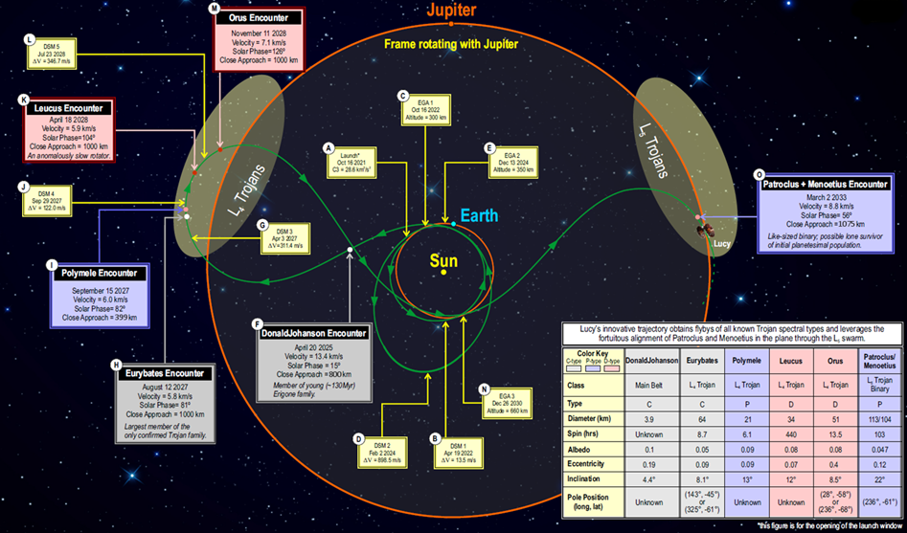
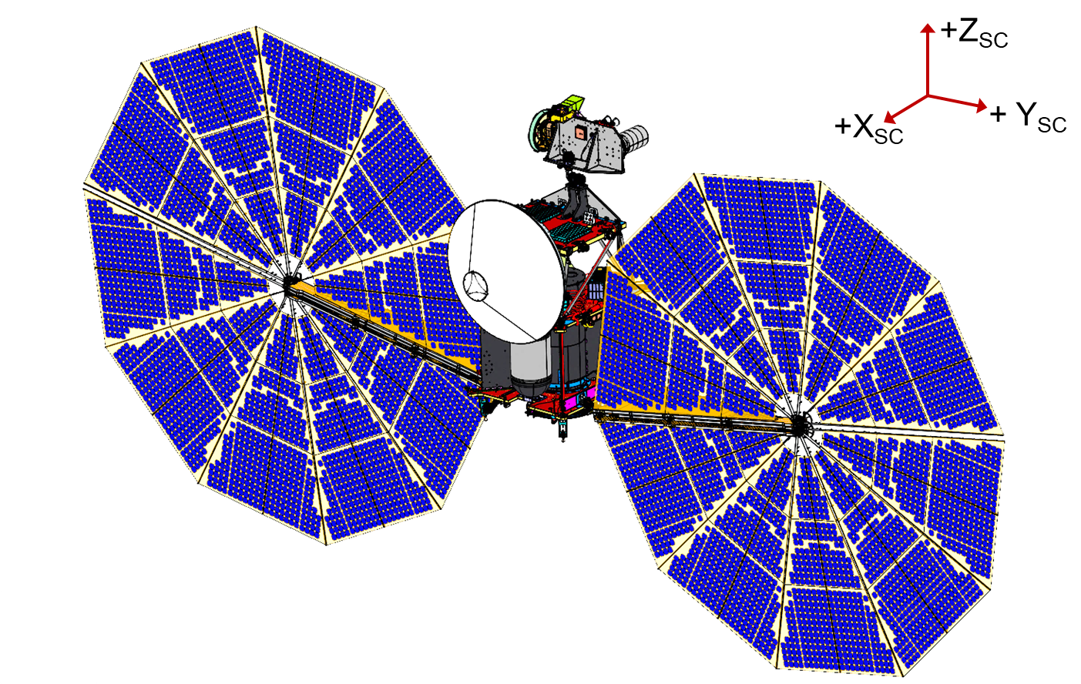
Lucy is a planetary mission to conduct flybys of the Jupiter Trojan asteroids over 12 years of operation

Slide 3
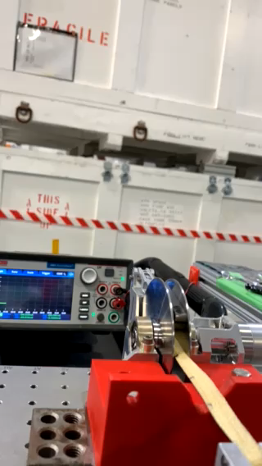
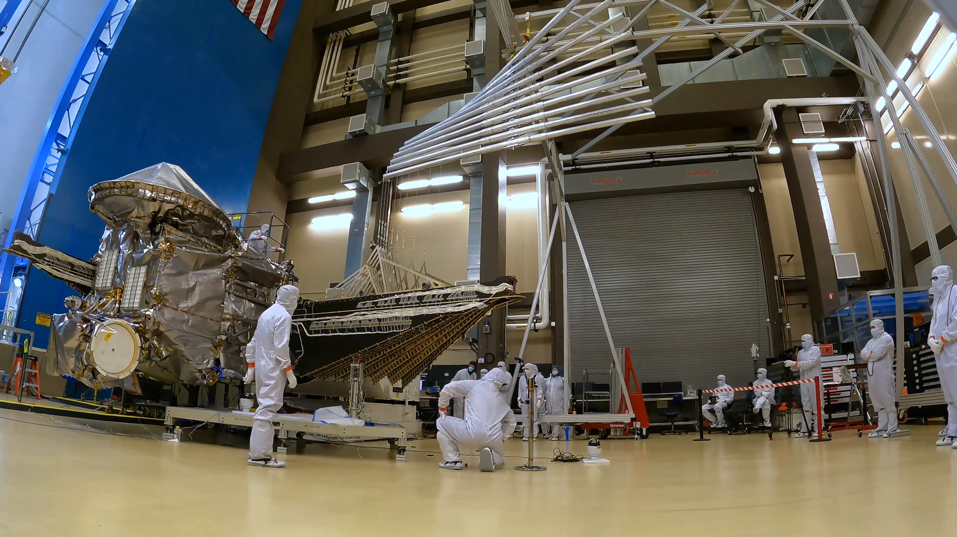
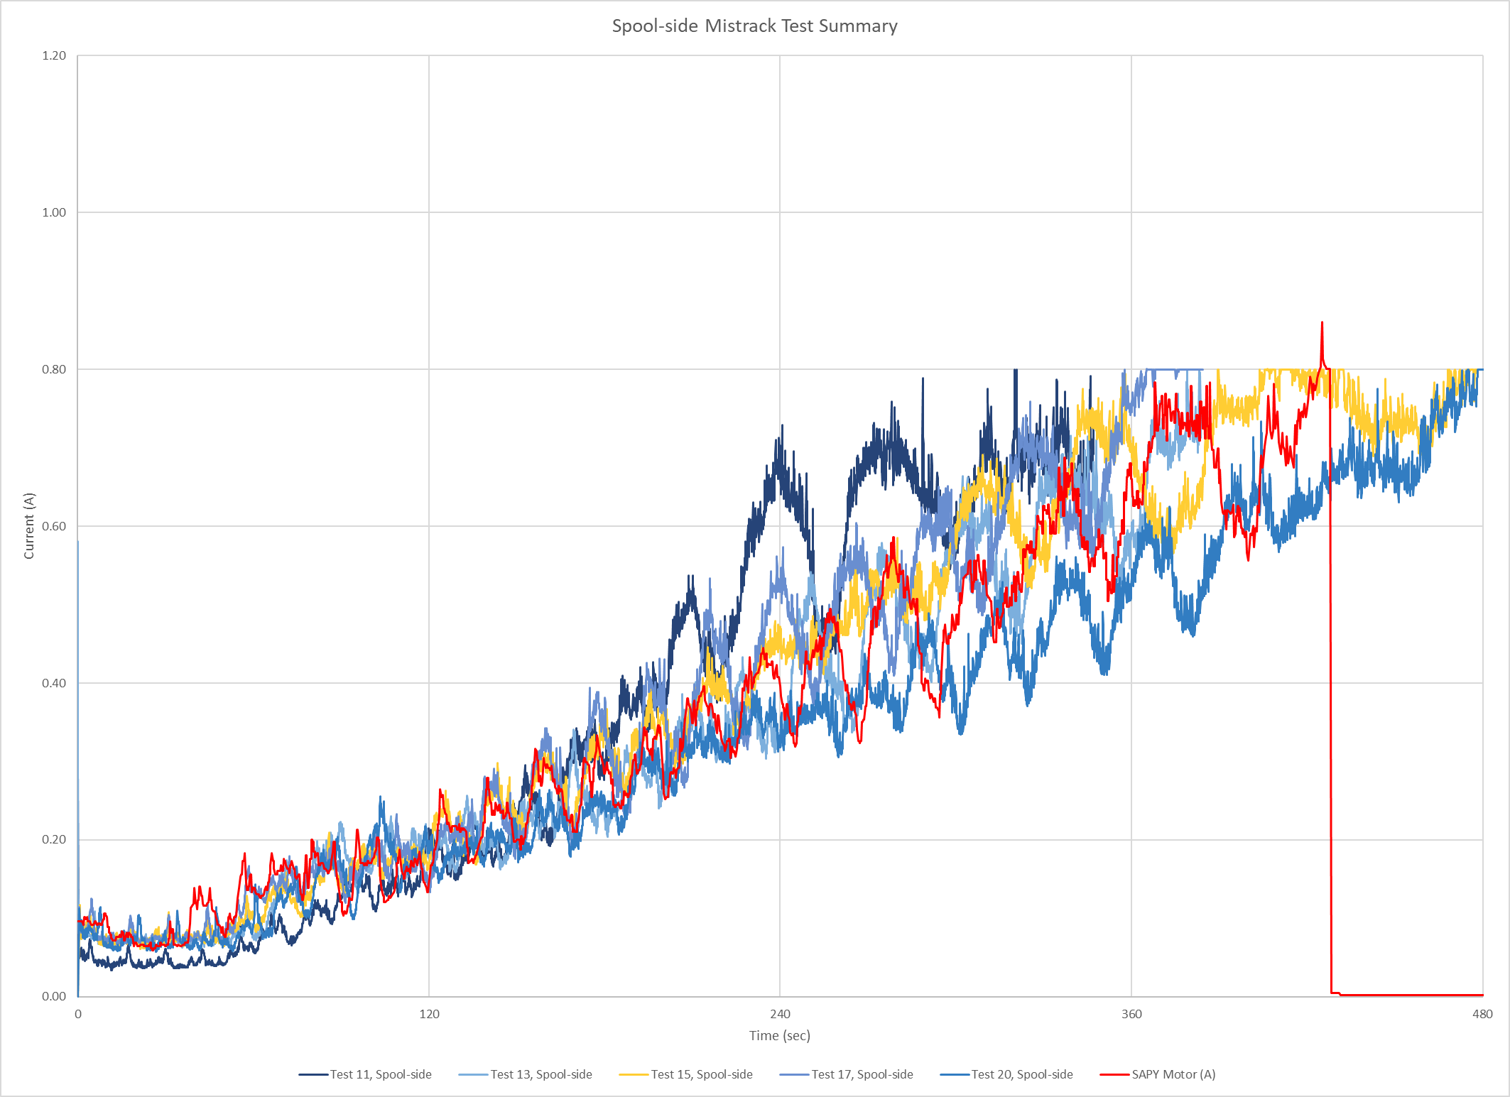
+Y Solar Array (SAPY) Anomalous Deployment
On launch day, +Y solar array did not fully deploy as evidenced by telemetry (i.e. currents, temperatures and microswitch latching)
Ground test results showed the solar array lanyard walked off the spool and continued wrapping with near zero tension on lanyard
As the wing unfurls, the solar array motor mounted on static panel (attached to SC) pulls in lanyard attached to the pivot panel
SA motor current on launch day (red) compared to ground tests

Slide 4
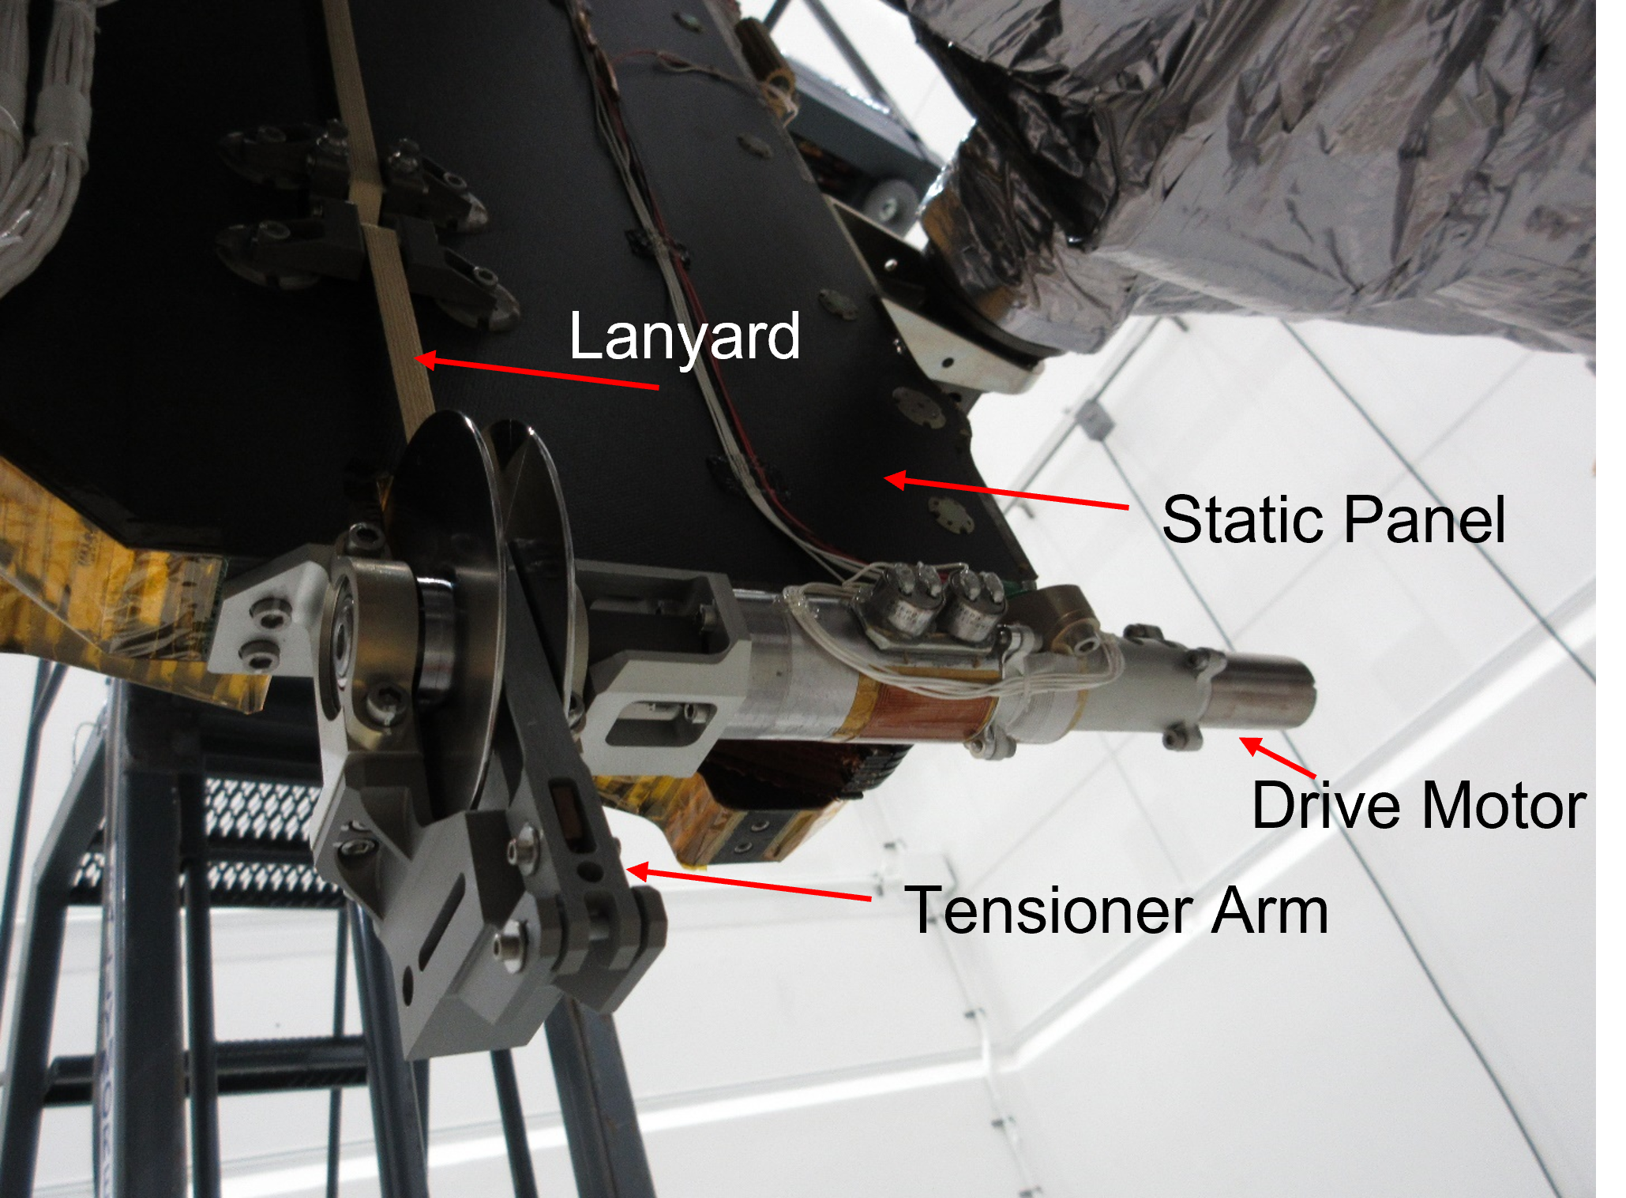
Advantages/Disadvantages
Dual-motor solar array configuration was intended for redundancy only in a fault scenario
  Allowed for increasing torque to further deploy the array (pull in lanyard around the axle)
Lanyard was intended for use only on launch day. Once the solar array is latched, the lanyard is no longer used and is not tensioned

Slide 5
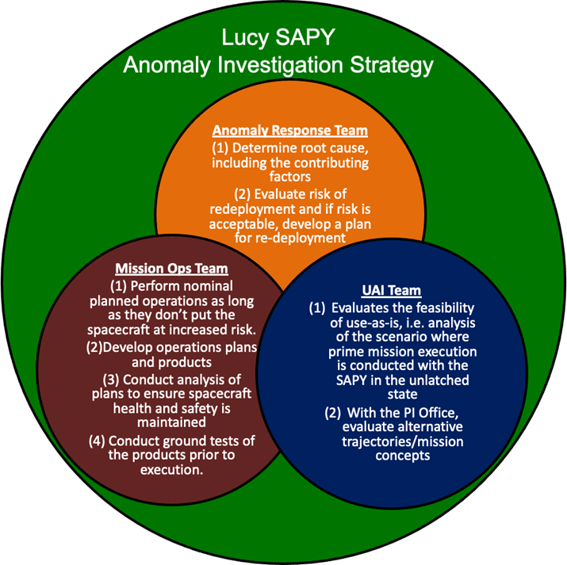
Anomaly Investigation Strategy
Organized the team by risk
Major mitigations across the risk groups included:
  Flight characterization activities to further estimate the state of the array
  Ground test activities to bound worst-case scenarios for redeployment attempts (RDAs) using dual motor configuration
    Tests mimicked launch day anomaly with primary motor and lanyard walking off spool, followed by dual motor re-deployment attempts
  ADAMS analyses to understand the risk of operating the SC in the current configuration (use as is – UAI) to accomplish the deep space maneuvers needed to get to L4 and L5 Trojan swarms
    The most significant risk of an unlatched array to mission success is damage during main engine burns. Deep Space Maneuver 5 is the most demanding because the spacecraft will have the lowest mass.

Slide 6
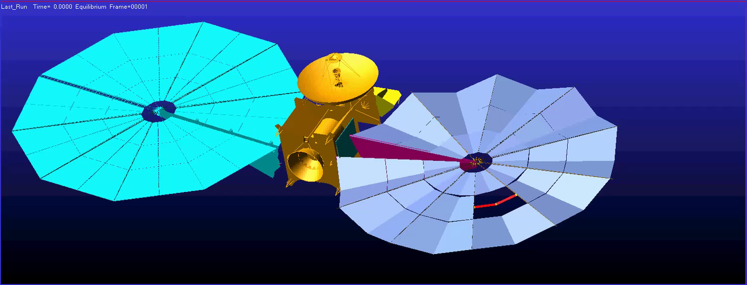
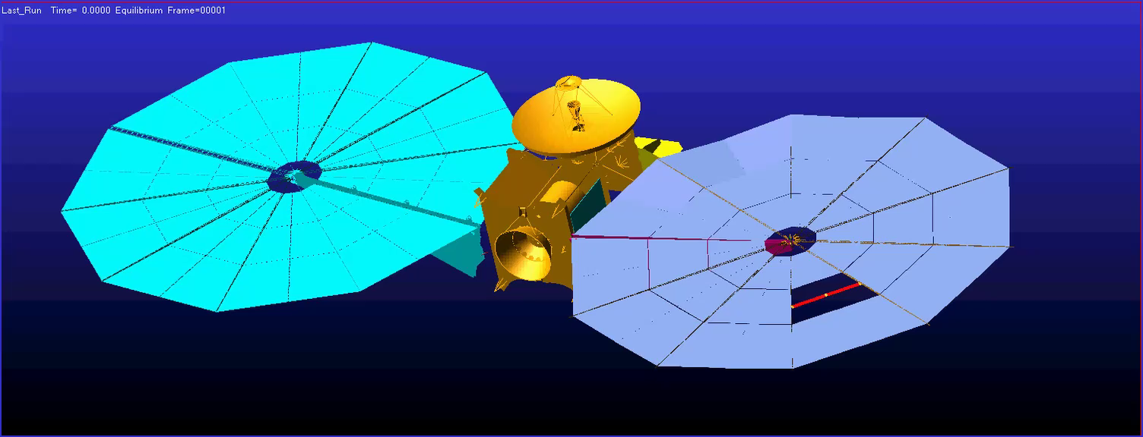
RDA Mitigates Gore Inversion Risk
SAPY Wing at Current Modeled Position of 346 degrees
(32 inches from latch)
SAPY Wing at 358 degrees
(a few inches from latch, 27” of lanyard retracted)
DSM5 : Burn Animation (Worst-Case SA Loading)
Simulated using End-of-Burn S/C Mass: 848 Kg
Starts at t=10 sec with a 30-second settling burn using 6 TCM’s at 50% duty cycle
Main Engine starts at t=40 and shuts down at 80 sec (actual DSM5 burn time is nearly 11 mins)
Steady-state Z-axis G-load is 0.059
Additional Tensioning of SAPY via Further Deployment Mitigates Gore Inversion Risk

Slide 7
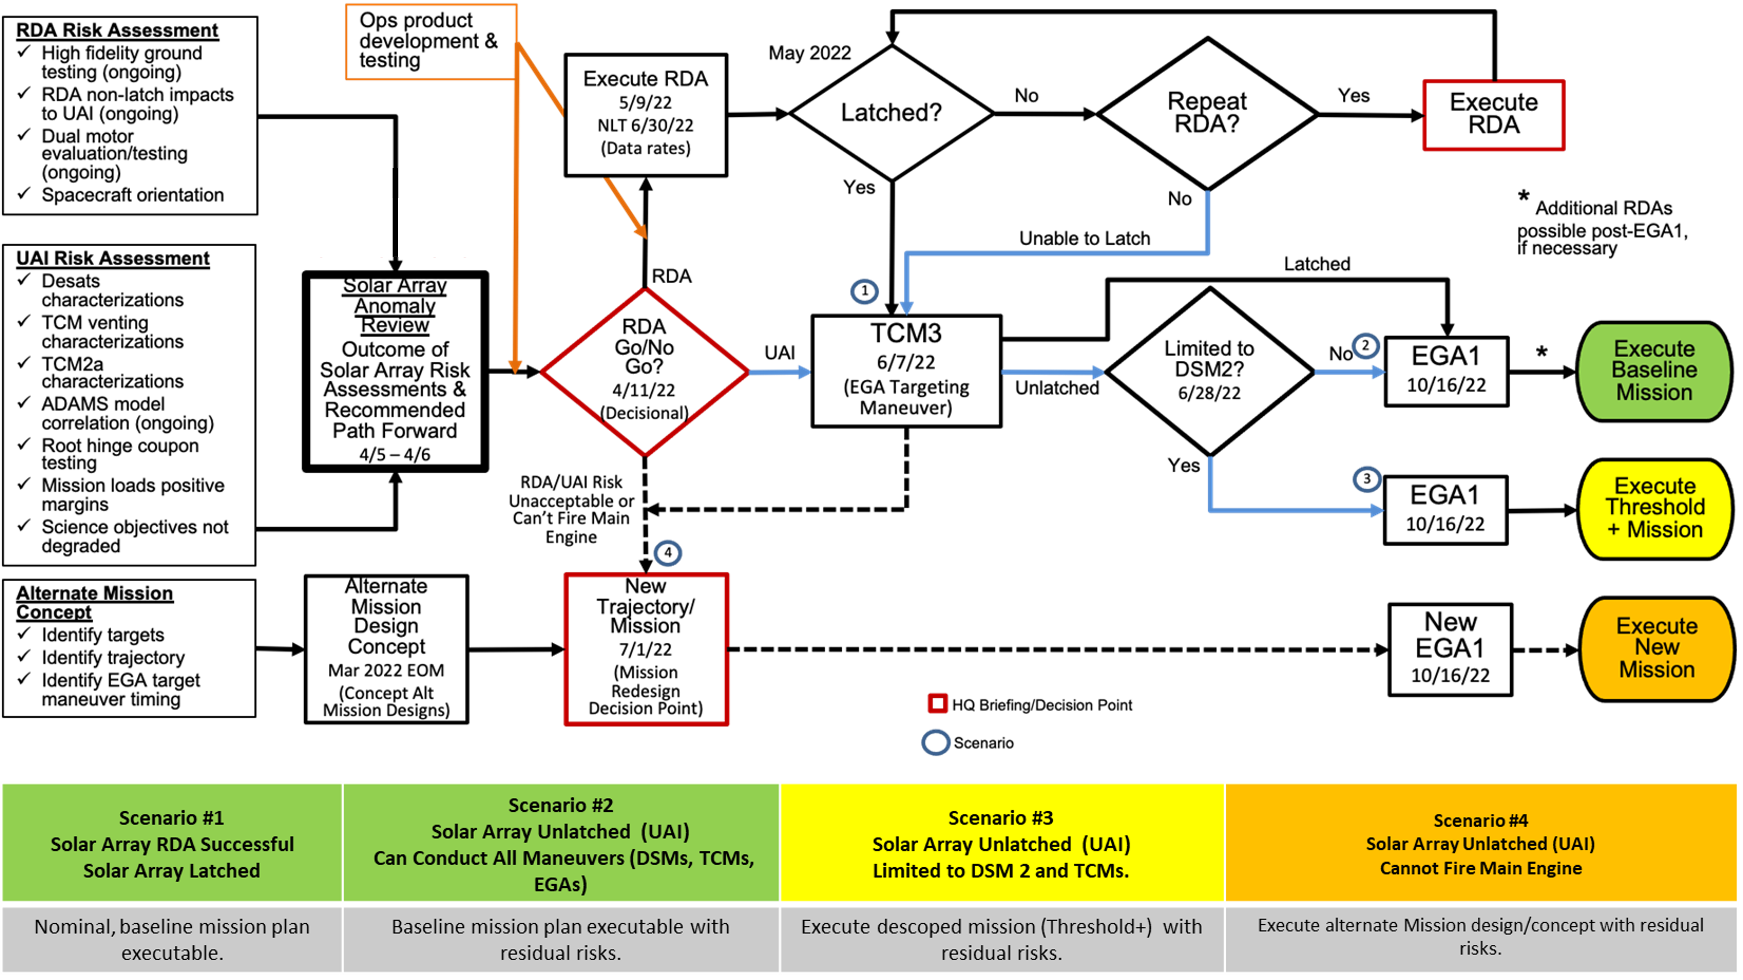
Stakeholder Management is Critical

Slide 8
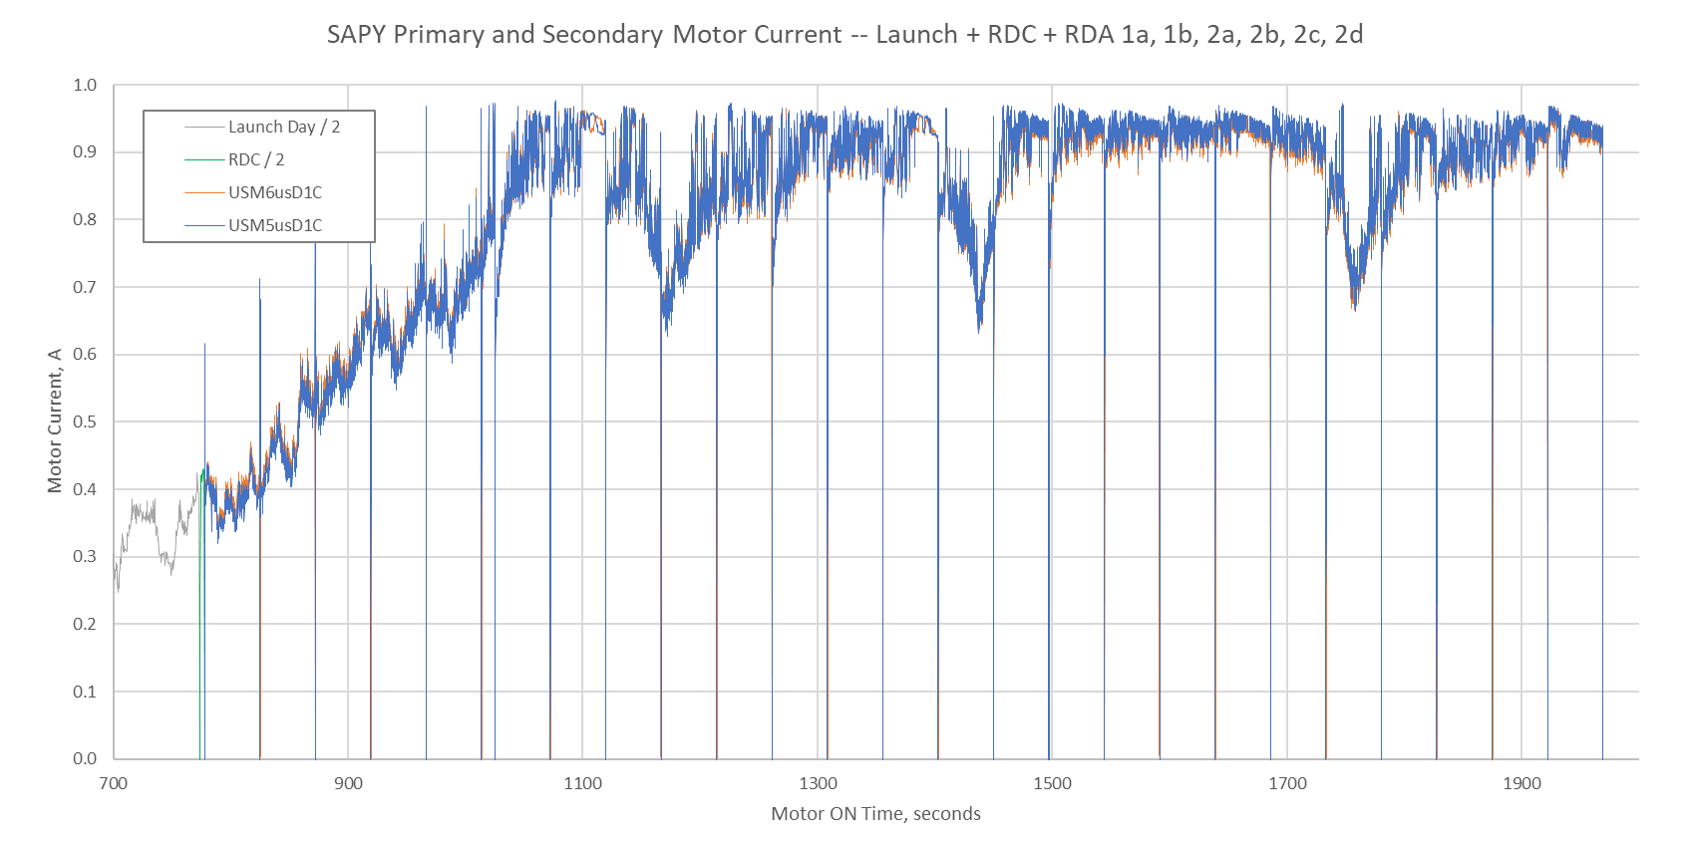
Results from six Redeployment Attempts
(Steps 1a,b and 2a,b,c,d)
Estimates:
  Anomaly total motor run time = 1186 sec (19.8 min)
  Lanyard retracted: >60 inches
  Lanyard remaining: <20 inches
  SAPY deployed angle change: ~20-30 deg
  Spool revolutions: ~12
  Conclusions:
  No panel fracture or other stress relieving events identified in telemetry
  Frequency data showed an increase, leading to Mid-gore tensioning of array
RDA designation
Execution Date
#cycles x 2-motor on time
Lanyard Retracted
Caused by an asymmetric lanyard snarl and can be used to estimate rotations
RDA 1a
5/2
3 x 47s
42.9”
RDA 1b
5/5
2 x 47s
3rd truncated
@11.3 s
12.1”
RDA 2a
5/27
5 x 47s
6.4”
RDA 2b
6/2
5 x 47 s
5.7”
RDA 2c
6/9
5 x 47s
1.5”
RDA 2d
6/16
5 x 47s
3.8”
Lucy RDAs have significantly improved the ability to fly the baseline mission in an unlatched state

Slide 9
Summary & Recommendations
Root cause: Solar array deployment dynamics exceeded system ability to maintain sufficient lanyard tension control, allowing lanyard retraction mechanism to mistrack.
  Ground test and ADAMS simulation results directly informed the root cause
Spacecraft performance to date demonstrate a successful Lucy mission is feasible in the partially deployed +Y solar array configuration.
It is likely that we will continue to discover new UAI risks as we put the flight system in new environments and execute new flight activities that demand higher performance.
There is a risk that not all failure modes will be identified.
Spacecraft should be instrumented to provide robust telemetry on the status of critical deployments to support potential anomalies
Ensure complete environment definition and requirement flow down
Conduct Fault/Failure analysis beyond component level and ensure focus is not narrow (e.g. strength margins only)
Model the expected dynamic environment and the impact to deploying systems
Arrange for knowledge sharing across projects: unaware of JWST lessons learned on spooling mechanisms
Consider subscale or sub-assembly level testing when faced with challenging ground test limitations or significant Test Like You Fly exceptions

Slide 10
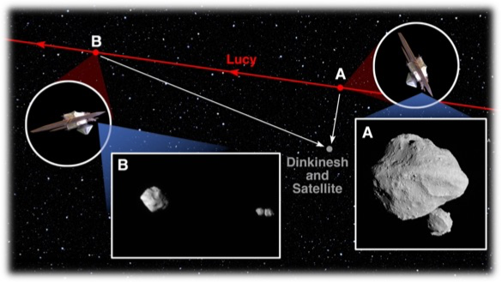
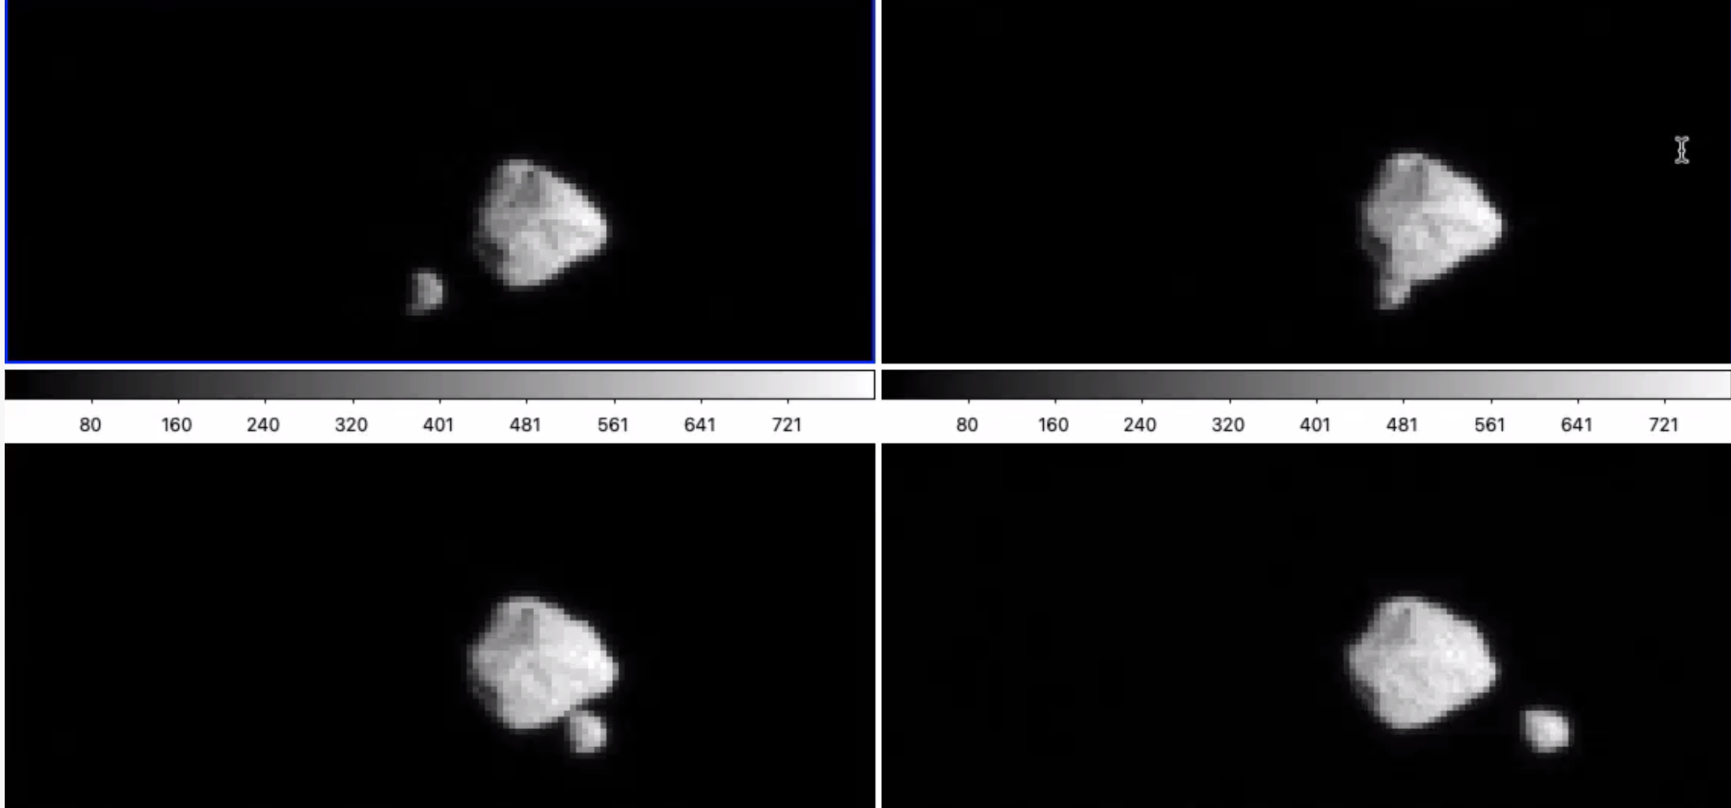
Lucy’s success to date
Lucy successfully completed Deep Space Maneuver 2!
  Divided into two maneuvers (delta-v of 100 m/s and 799.2 m/s)
  Significantly reduced UAI risk posture
Lucy Encounters Dinkinesh Asteroids!
  Lucy’s terminal tracking system was put to the test during the Dinkinesh asteroid encounter – which turned out to be a binary system with a contact binary satellite!
Lucy is ready to fly by the Main Belt asteroid Donaldjohansen on April 20, 2025!

