Slide 1
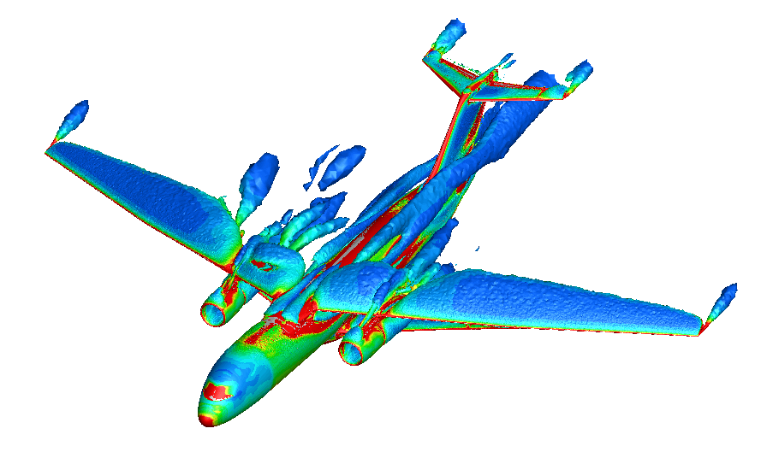

Flight Vehicle Stability and Control
Advanced Control & Evolvable Systems Group
FUN3D CFD Dynamic Yaw Stability Simulation
KEY ATTRIBUTES / COMPETENCY
High-fidelity CFD forced oscillation numerical experiment for S&C prediction of full flight vehicles in complex highly separated flow environments
Accurate estimation of static and dynamic S&C derivatives in high-alpha flight conditions by frequency-domain nonlinear system identification technique
Full high-fidelity CFD-based 6-dof flight dynamic modeling of flight vehicles
Static and dynamic stability assessments of advanced flight vehicle configurations
Aeroelastic effects on S&C are accounted for in CFD prediction
Rotorcraft S&C prediction
TECHNICAL / SCIENTIFIC CHALLENGE ADDRESSED
Stability and control (S&C) of flight vehicles are important design requirements. Accurate prediction of dynamic S&C characteristics in high alpha flight conditions are difficult. Improved predictive capability can reduce design cycle and increase safe operations.
HERITAGE
S&C capabilities ranging from potential flow solvers with transonic and boundary layer corrections to FUN3D CFD
S&C applications to B757, Truss-Braced Wing, Lift-Plus-Cruise eVTOL aircraft
SUMMARY
High-fidelity CFD forced oscillation simulations and advanced frequency domain nonlinear system identification technique are new capabilities recently developed to enable accurate prediction of S&C characteristics of flight vehicles.
S&C prediction of Transonic Truss-Braced Wing configuration has been successfully validated against experimental measurements in NASA Langley 12-Ft wind tunnel.
APPLICATIONS BEYOND
Orion crew capsule dynamic pitch stability problem
Advanced aircraft such as X-66 and X-59

Slide 2
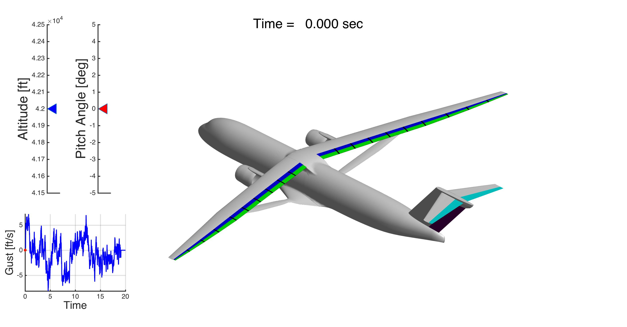
Aeroservoelastic Flight Dynamic Prediction
Advanced Control & Evolvable Systems Group
Aeroservoelastic Flight Dynamic Model of Flexible Aircraft
KEY ATTRIBUTES / COMPETENCY
High-fidelity CFD generalized aerodynamic force computation with moving mesh capability using finite-element mode shapes of elastic airframe
High-fidelity CFD S&C prediction of flexible flight vehicles in complex highly separated flow environments
Frequency-domain nonlinear system identification technique to extract aerodynamic transfer functions
Fully coupled aeroservoelastic 6-dof flight dynamic prediction of flight vehicles
Flutter analysis
TECHNICAL / SCIENTIFIC CHALLENGE ADDRESSED
Aeroelastic interactions with flight vehicle dynamics can adversely affect flight safety and performance. Increased drag penalty in cruise or degraded flight safety and control reversal are negative consequences of aeroelastic interactions.
HERITAGE
Aeroservoelastic flight dynamic prediction of Truss-Braced Wing, B757, Lift-Plus-Cruise eVTOL aircraft
SUMMARY
High-fidelity CFD flight dynamic prediction capability for rigid and elastic flight vehicles is available to support a wide range of aerospace missions. This capability includes accurate generalized aerodynamic force analysis by moving mesh capability, frequency-domain system identification of aerodynamic transfer functions, and stability and control prediction. This represents a state of the art in flight dynamic prediction for flexible flight vehicles.
APPLICATIONS BEYOND
Advanced aircraft such as X-66 and X-59
Space launch vehicles

Slide 3
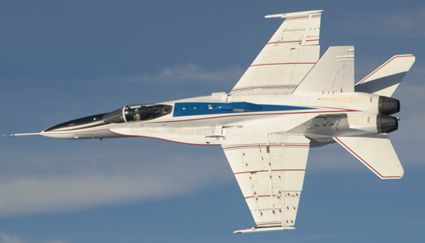
Flight Control Technologies
Advanced Control & Evolvable Systems Group
Adaptive Control Technology on F-18 Aircraft
KEY ATTRIBUTES / COMPETENCY
Patented adaptive optimal control modification technology with verifiable stability margins capable of accommodating vehicle model uncertainty
Flight-proven adaptive optimal control modification on F-18 aircraft
flight-proven machine-learning neural-network intelligent flight control technology on F-15 aircraft
Patented multi-objective flight control technology for modern transports capable of real-time drag optimization, structural mode suppression, gust load and maneuver load alleviation
Structural mode suppression validated in wind tunnel test
Multi-objective flight control technology validation will be conducted in wind tunnel test in the near future.
TECHNICAL / SCIENTIFIC CHALLENGE ADDRESSED
Advanced flight vehicles such as hypersonic vehicles operate in highly complex flight physics environments, which can pose major challenges to flight control systems for mission success. Modern transport aircraft employ highly flexible wings which can cause adverse performance and safety, requiring advanced flight control solution.
HERITAGE
Adaptive and neural-network flight control technology validation on F-15 and F-18 aircraft
Adaptive and multi-objective flight control implementations on B757, Transonic Truss-Braced Wing
SUMMARY
A strong heritage of flight-proven adaptive control technologies deployed on F-15 and F-18 aircraft are available for aerospace and industrial applications.
Ground test-validated aeroelastic control technologies have been developed for high-aspect ratio wing transport applications.
APPLICATIONS BEYOND
Advanced aircraft such as X-66 and X-59
Space launch systems, AAM aircraft, modern transports

Slide 4
Authors/Contacts
Advanced Control & Evolvable Systems Group Lead: Nhan Nguyen – Ames Research Center
https://www.nasa.gov/intelligent-systems-division/

