Slide 1

Raman spectroscopy and reflection methods to evaluate defects in sensor crystals
Jakob Peabody, Lauren Gower, Leslie Scheurer, Eric Bowman, Daniel Gower, Florence Lucey, Ching Hua Su*, Bradley Arnold, Fow-Sen Choa, Brian Cullum and N. B. Singh
* EM31, NASA Marshall Space Flight Center, Huntsville AL 35812
University of Maryland Baltimore County, 1000 Hilltop Circle, Baltimore MD 21250
Email: jakobp1@umbc.edu
Email: singna@umbc.edu
WE thank NASA Marshall Space Flight Center for financial support

Slide 2
Optical Sensing of point and line defects in Fe-doped bulk ZnSe crystals
Outlines
Background
Relevance of microgravity for ZnSe crystals
ZnSe crystals grown by PVT at NASA Marshall Space flight Center
Fabrication
Characterization
  Raman Studies and IR spectral studies
  Reflection studies
Summary
WE thank NASA Marshall Space Flight Center for financial support

Slide 3
Crystals were grown by Physical Vapor Transport (PVT) in closed tubes (many papers published)
  The velocity profile across the circular duct is derived by substituting the general expression for shear stress into Newton’s law of viscosity and integrating by applying the no-slip condition at the wall. The average velocity is defined as:
Tc Pc
α = Volume Flow Rate
η = Viscosity
Number of Moles per second
through cross section
2a
l
  where ΔP = P_{S} – P_{c}, P_{S} and P_{c} are the vapor pressure at the source and crystal interfaces, η is the viscosity, 8η L a result which is Hagen-Poiseuille equation. In spite of the fact that this equation is only applicable to incompressible fluids, one can derive the number of moles, N, flowing each second through the cross sectional area, which is given as:
Ts Ps
ZnSe crystals were grown by PVT method at NASA Marshall Space Flight Center

Slide 4
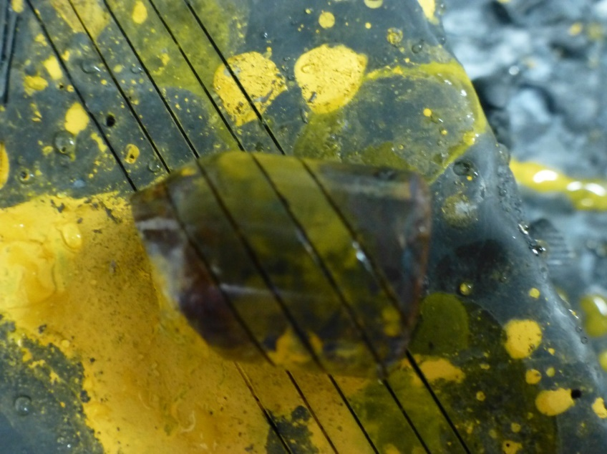
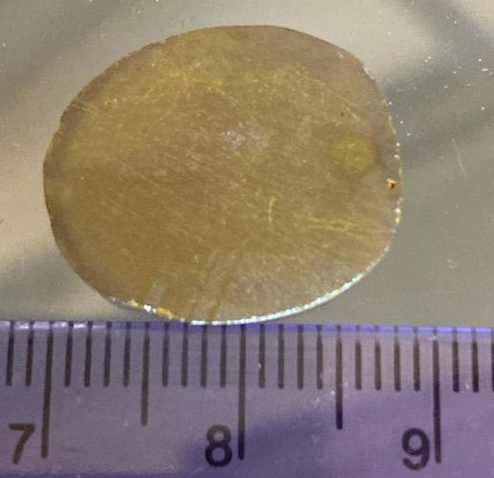
Transition metal doping causes double diffusive convection due to thermal and solutal convection
Fe-ZnSe crystals grown by physical vapor transport method. Crystal were fabricated in parallel slabs for the detailed study.
Slabs were polished by us in the lab
Crystals were free from voids, precipitates and other bulk defects
Notes:
We have a material in hand that can be produced with few defects and has demonstrated a large dielectric
What are some of its limitations?
CCTO has a high dielectric constant, but low resistivity (about 10^5 ohm-cm).
It breaks down at low voltages which limits its useful range and utility as a capacitor
We seek to increase the resistivity several orders of magnitude to about 10^9 ohm-cm.

Slide 5
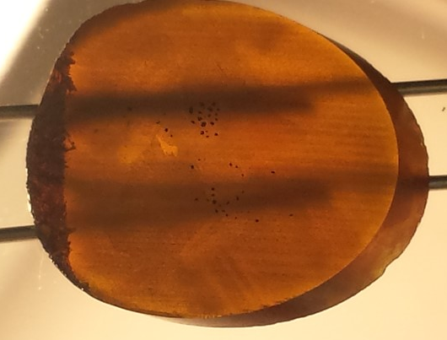
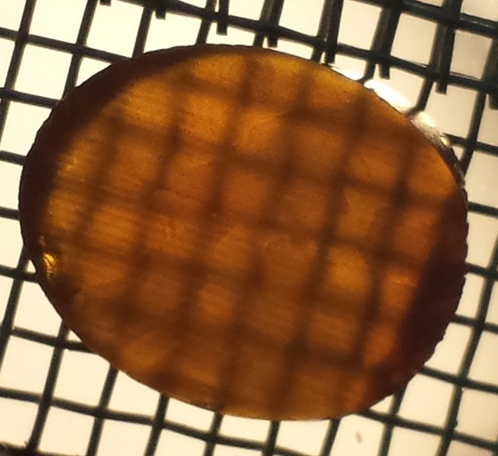
Transparency of Fe-ZnSe bulk crystals
Although bulk transparency was good:
it does not mean that crystals were free from micro and nano defects
SEM studies and X-ray diffraction is time consuming and costly
We chose to develop optical methods to characterize nano defects
ZnSe wafers were used for Raman and reflection studies
Crystals were free from voids, precipitates and other bulk defects

Slide 6
Raman studies with crystals with good quality crystals
Traditional methods such as X-ray diffraction (XRD), X-Ray topography (XRP). scanning electron microscopty (SEM), Atomic force spectroscopy, (AFM), and transmission electron microscopy requires:
  Extensive sample preparation
  Longer time
  Extensive investments
  Cost for evaluation by each methods is very high
Because of these reasons we are investigation faster and cheaper methods
In addition, we are studying emission and photoluminescence studies
Line and point defects in a relatively bad crystal

Slide 7
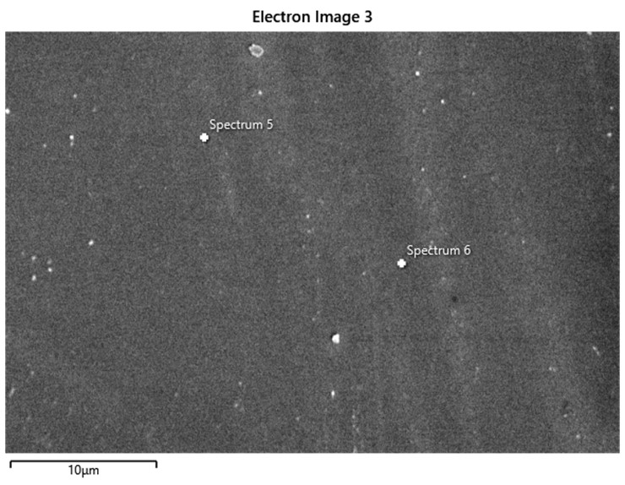
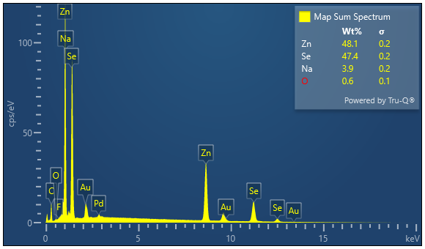
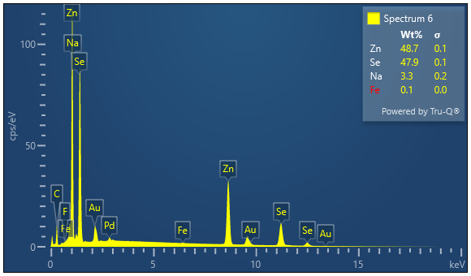
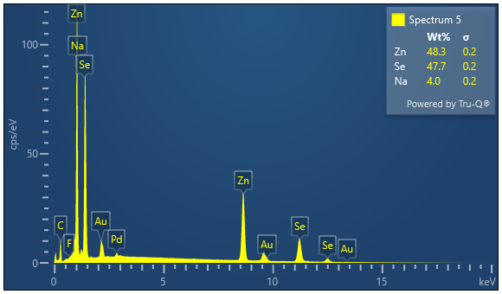
Development Zinc Selenide Crystals: sample 5-1
These are excellent quality and show exact stoichiometry . Do not get confused with Na. It is instrumental. Instrument can not resolve better than this

Slide 8
Development Zinc Selenide Crystals: sample 5-1
These are excellent quality and show exact stoichiometry . Do not get confused with Na. It is instrumental. Instrument can not resolve better than this

Slide 9
Low intensity peaks show different phenomena in Fe-ZnSe crystal
Fluorescence spectra of Fe-ZnSe excited at with a 380 nm filter.
Example: Low intensity peaks were observed due to population of local defects. The peak at 428nm ( 2.89 eV) is for the Fe-ZnSe C_{B}-V_{B} transition. Peaks at 509nm (2.43eV), 605nm (2.04) and 691 nm (1.79eV) are due to different Fe ion transitions.
Study shows peaks due to different phenomena
Notes:
We have a material in hand that can be produced with few defects and has demonstrated a large dielectric
What are some of its limitations?
CCTO has a high dielectric constant, but low resistivity (about 10^5 ohm-cm).
It breaks down at low voltages which limits its useful range and utility as a capacitor
We seek to increase the resistivity several orders of magnitude to about 10^9 ohm-cm.

Slide 10
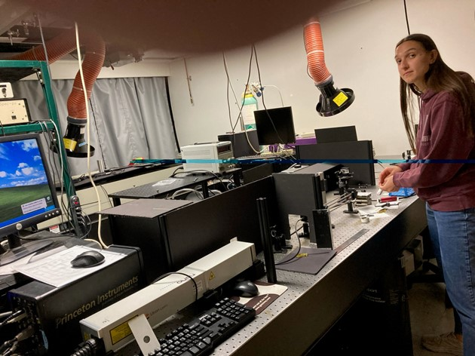
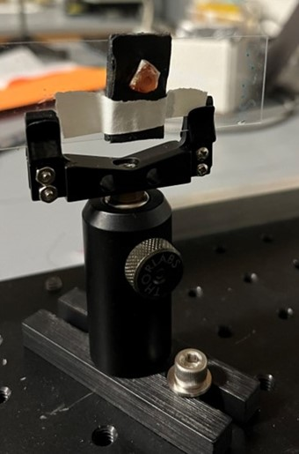
Experimental methods; Raman studies
We set up for system for measuring data in UV, near IR and far IR range
Custom arrangements were made
To accommodate different size samples custom holders were made

Slide 11
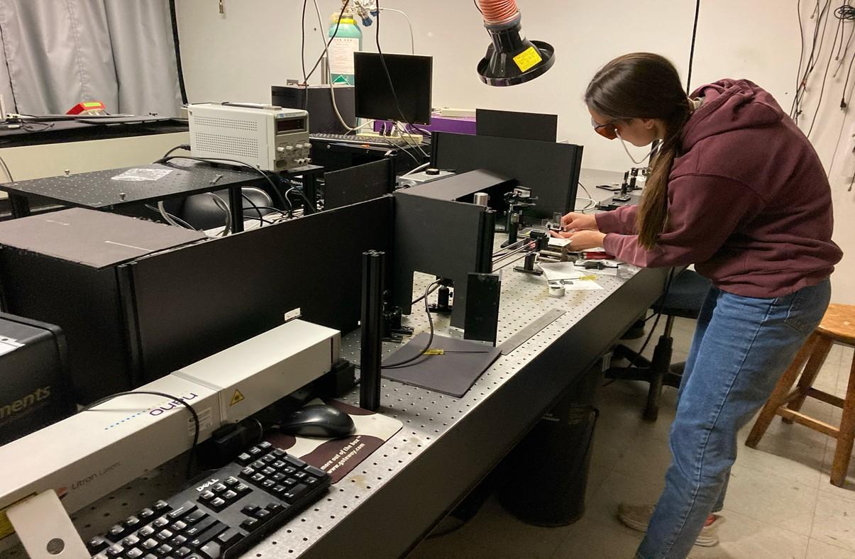
Experimental methods; Raman studies
Several doped crystals were studied for Raman spectra
Notes:
We have a material in hand that can be produced with few defects and has demonstrated a large dielectric
What are some of its limitations?
CCTO has a high dielectric constant, but low resistivity (about 10^5 ohm-cm).
It breaks down at low voltages which limits its useful range and utility as a capacitor
We seek to increase the resistivity several orders of magnitude to about 10^9 ohm-cm.

Slide 12
Caution: Suitable filter is required
If a proper filter (or crystal orientation is not used, IR, emission and other peaks will show up along with Raman peaks

Slide 13
Raman studies with crystals with good quality crystals
Fe-doped ZnSe crystal
Early stage of crystals
Cr-doped ZnSe crystal
Early stage of crystals
Raman studies showed that crystal quality
was not very good

Slide 14
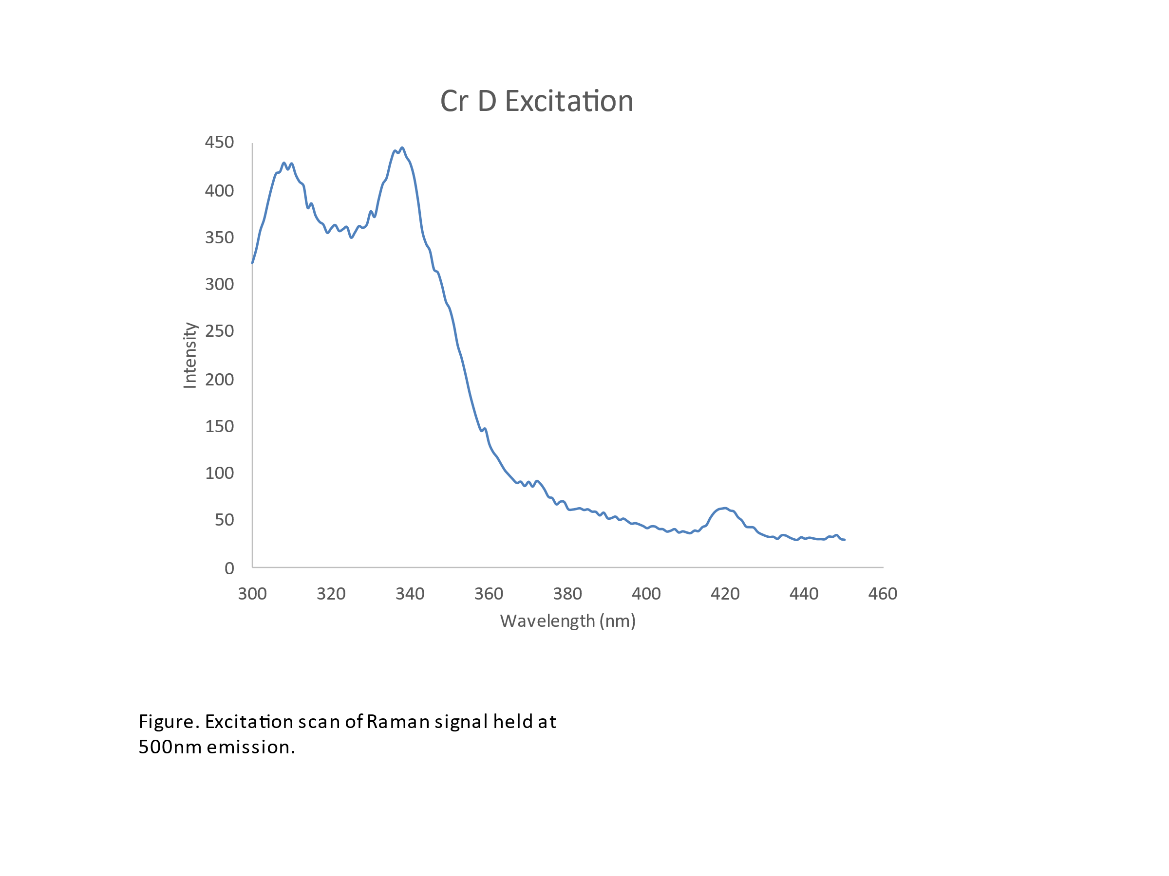
Raman shift using the (a) 266 and (b) 532 nm lasers for Fe-ZnSe and Cr-ZnSe crystals
Raman studies showed different positions for LO and TO
Showing effects of doping and size of dopants
Notes:
We have a material in hand that can be produced with few defects and has demonstrated a large dielectric
What are some of its limitations?
CCTO has a high dielectric constant, but low resistivity (about 10^5 ohm-cm).
It breaks down at low voltages which limits its useful range and utility as a capacitor
We seek to increase the resistivity several orders of magnitude to about 10^9 ohm-cm.

Slide 15
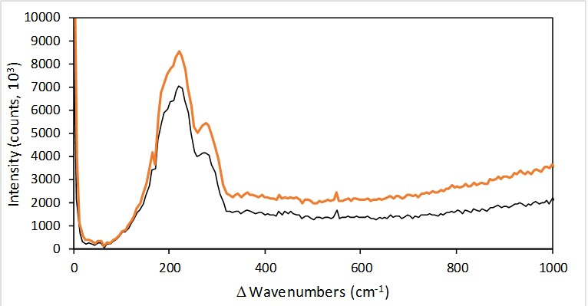
Raman studies with crystals with good quality crystals
FWHM was reasonable
Transverse optical (TO) and Longitudinal optical phonon (LO) at 220 and 280 cm⁻¹ TO wavelength for the first order polarization for ZnSe and ZnS. This means propagation is in X-axis (oscillation is in the direction of wave propagation)

Slide 16
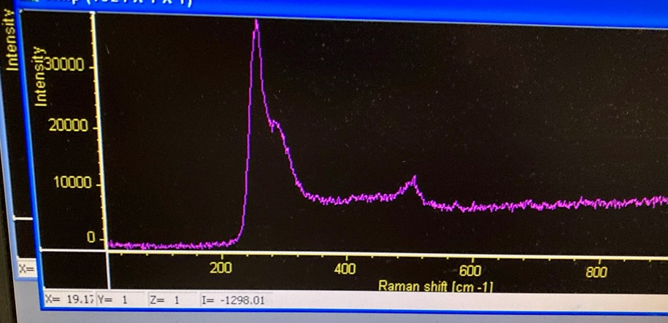
Raman studies with crystals with good quality crtstals
Peaks for the FWHM were observed
Other peak around 560 cm⁻¹ was for 2TO
FWHM

Slide 17
Raman Studies of crystals Zinc Selenide Crystal: 26
FWHM was very small
We used little higher intensity to see is grain causes any problem
LO was perfect at 253.5 cm⁻¹ as good as nanocrystals
TO was at 284 cm⁻¹ excellent for cm size crystal
500 rel.cm⁻¹ was for 2LO, we observed this since quality was giood

Slide 18
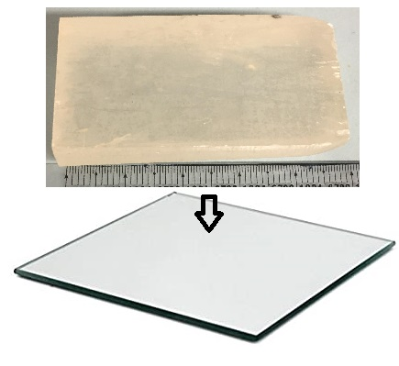
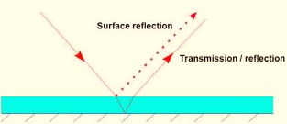
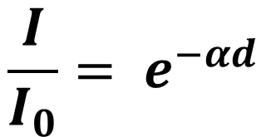

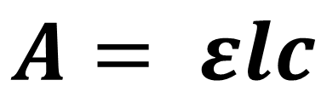
Theory: Absorption Coefficient
?
$$A= εlc$$
$$εc= α, absorption coefficient$$
$$l=d, optical path distance$$
$$\frac{I}{I_{0}}= e^{−αd}$$
Notes:
What about finding the extinction coefficient??
-Beer lambert law, merge the concentration and the extinction coefficient
-modified Beer-Lambert law from a 1992 paper in J of Chem Eduction

Slide 19
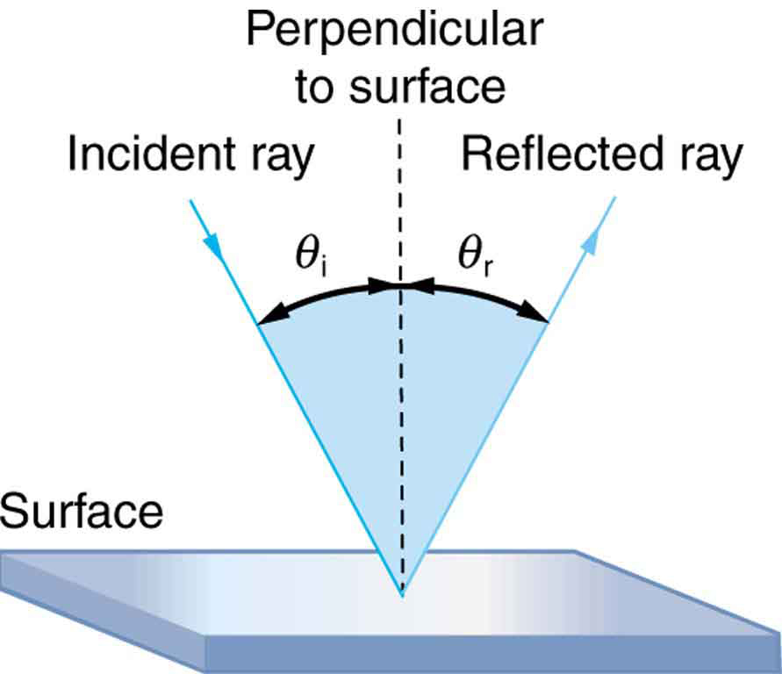
Absorption coefficients were measured by reflection method
Measured absorption coefficient for Fe-ZnSe and (b) Cr-ZnSe crystals for two positions of the crystals.
Values were very different than pure crystals
Notes:
We have a material in hand that can be produced with few defects and has demonstrated a large dielectric
What are some of its limitations?
CCTO has a high dielectric constant, but low resistivity (about 10^5 ohm-cm).
It breaks down at low voltages which limits its useful range and utility as a capacitor
We seek to increase the resistivity several orders of magnitude to about 10^9 ohm-cm.

Slide 20
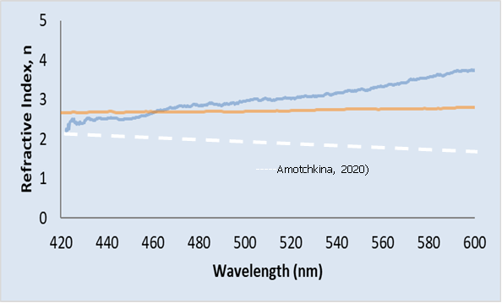
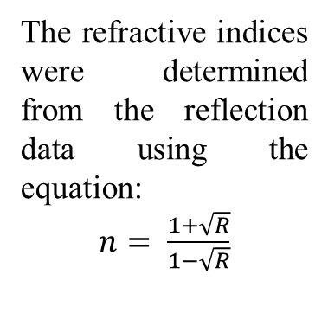
Absorption coefficients were measured by reflection method
The refractive indices were determined from the reflection data using the equation:
$n= \frac{1+\sqrt{R}}{1−\sqrt{R}}$
Refractive indices evaluated for Fe-ZnSe and Cr-ZnSe systems shown by red and blue lines for two crystals
Values were very different than pure crystals due to defects and size of dopants
Notes:
We have a material in hand that can be produced with few defects and has demonstrated a large dielectric
What are some of its limitations?
CCTO has a high dielectric constant, but low resistivity (about 10^5 ohm-cm).
It breaks down at low voltages which limits its useful range and utility as a capacitor
We seek to increase the resistivity several orders of magnitude to about 10^9 ohm-cm.

Slide 21
Summary
Raman studies and FWHM provides very good information about the quality of crystals
Unusual peaks can be only explained on the basis of impurities even if these are less than ppm
A combination of defects and complex formation, vacancy etc. can explain peak observed at larger wavelength
Impurities such as copper, silica generate unusual absorption/reflectance
Reflectance and absorption provides changes in bandgap of materials
Smaller peaks show local line and point defects defects
Notes:
We have a material in hand that can be produced with few defects and has demonstrated a large dielectric
What are some of its limitations?
CCTO has a high dielectric constant, but low resistivity (about 10^5 ohm-cm).
It breaks down at low voltages which limits its useful range and utility as a capacitor
We seek to increase the resistivity several orders of magnitude to about 10^9 ohm-cm.

Slide 22
Thank you very much for your time and attention
Notes:
We have a material in hand that can be produced with few defects and has demonstrated a large dielectric
What are some of its limitations?
CCTO has a high dielectric constant, but low resistivity (about 10^5 ohm-cm).
It breaks down at low voltages which limits its useful range and utility as a capacitor
We seek to increase the resistivity several orders of magnitude to about 10^9 ohm-cm.

