Slide 1
Modal Testing of the NASA VIPER Spacecraft Using Acoustic Excitation
Dale Schick and Daniel Hayes
Acoustic Research Systems, Shepherdstown, WV
Kevin Napolitano, Dr. Peter Kerrian, and Dr. Mike Yang
ATA Engineering, Inc., San Diego, CA
Vince Fogt and Matthew Goit
NASA Johnson Space Center, Houston, TX
2025 ATS

Slide 2
Agenda
Introduction
Background Test
Acoustic Modal Test Process
Results
Conclusions

Slide 3
Introduction

Slide 4
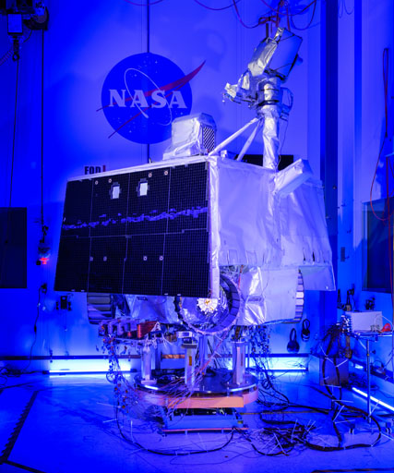
NASA VIPER Information
Volatiles Investigating Polar Exploration Rover (VIPER) is a lunar volatiles detection and measurement mission
Aimed at characterizing volatiles and creating global lunar water resource maps
Will be integrated with a lunar-landing service partner
Designed to receive commands via direct-to earth communications

Slide 5
Vision for Environmental Testing
Analysis
Value proposition of saving time/schedule/costs is too great to ignore
Static Tests
Sine Burst
(Static Loads)
Sine Burst
(Static Loads)
Risk
Vibration Test
(Environmental Loads)
Vibration Test
(Environmental Loads)
Vibration Test
(Environmental Loads)
Time
$$$
Acoustic Test
Acoustic Test
Direct Field Acoustic Noise (DFAN) Test
Test
Insurance
Fixed Base Modal Survey
Fixed Base Modal Survey
FBC Modal Survey Test
Programs factor in schedule, risk, and cost when determining whether to perform a dynamic test

Slide 6
Background Test

Slide 7
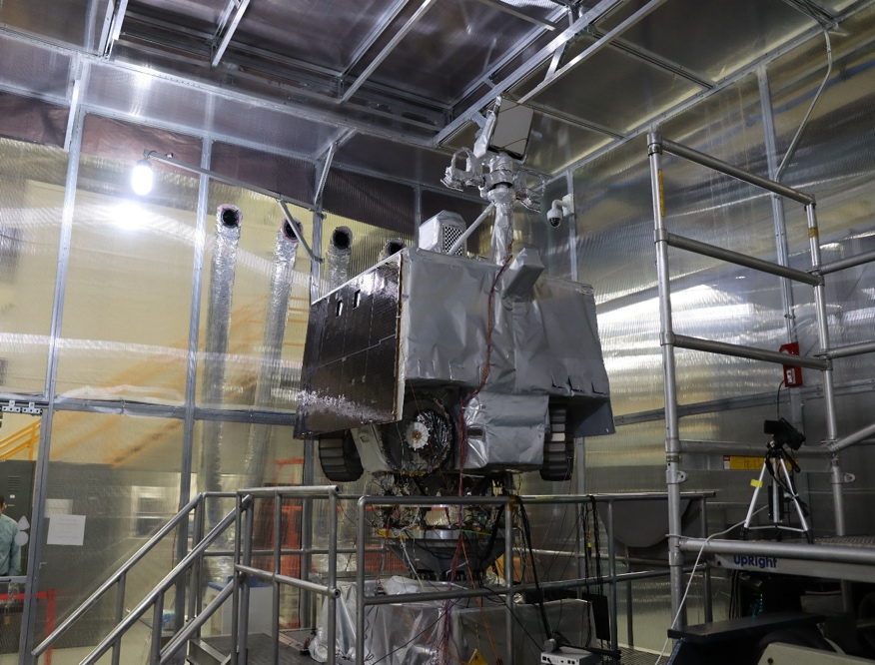
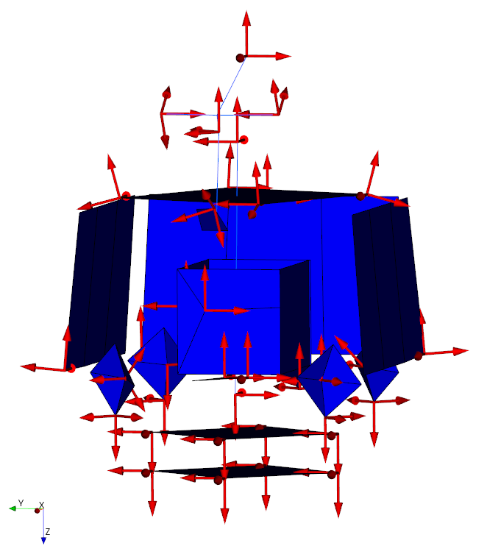
Background Test – FBC Impact Testing
Control method (background test) was a fixed-base-corrected (FBC) test
Impact hammer excitation
Affixed to shaker head expander
Instrumentation optimized for Vibration, not modal

Slide 8
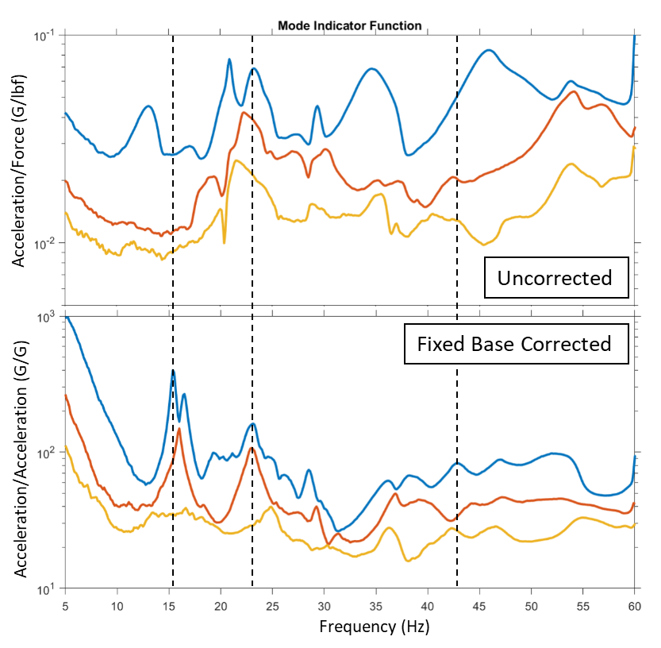
Background Test – FBC Impact Testing
High-level radial, torsional, and vertical impacts were made on the head expander
Standard 2-inch impact hammer was used
Program restricted impact on the structure itself, so background impact data is somewhat comparable to acoustic data
FBC Method transforms flexible or dynamically active boundary conditions into fixed boundaries (References)
This figure shows the CMIF of the uncorrected modes compared to FBC modes

Slide 9
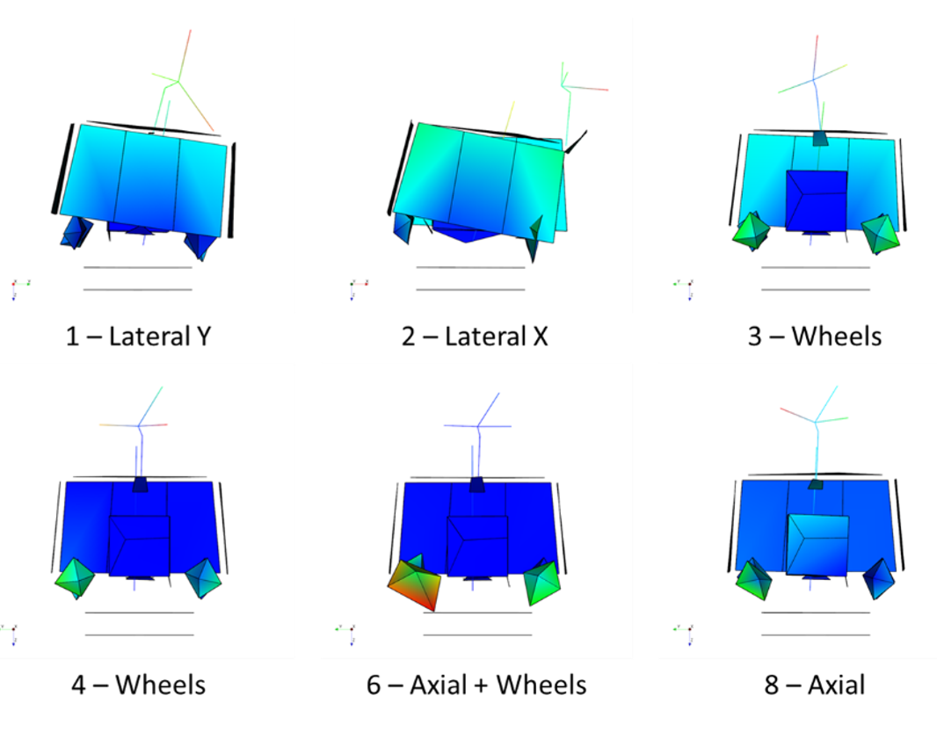
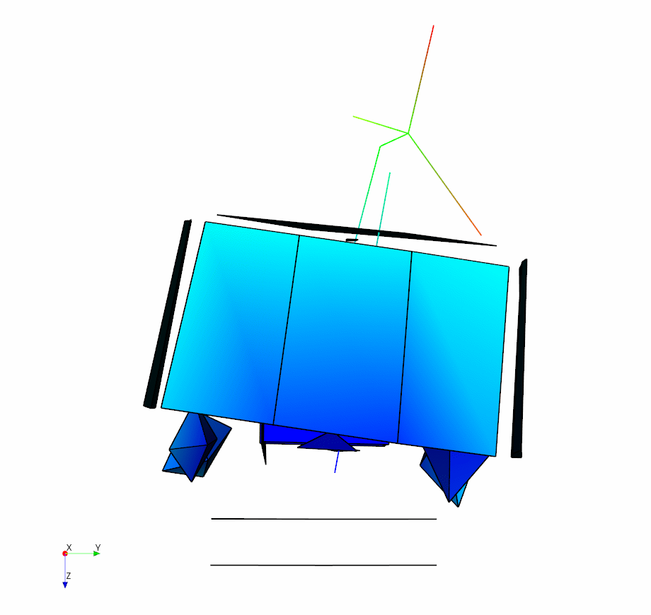
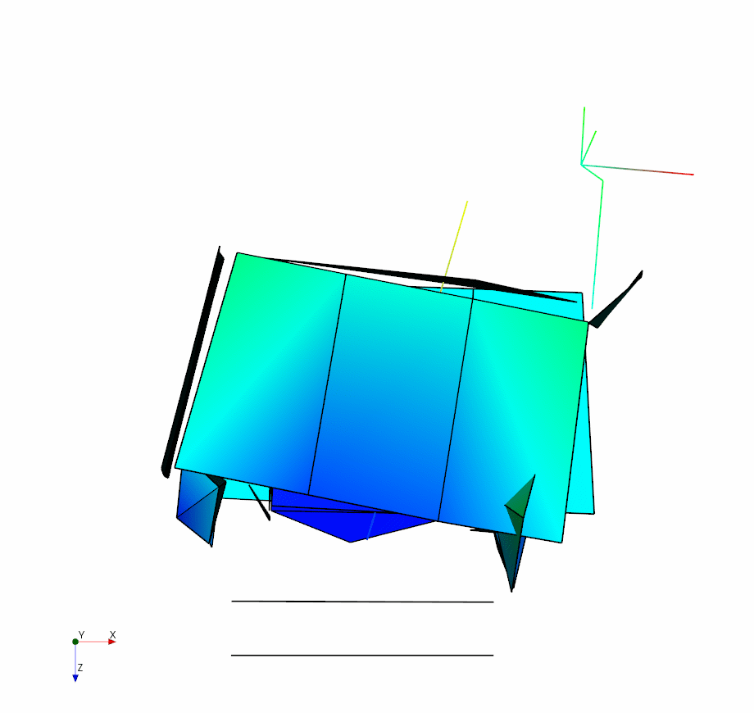
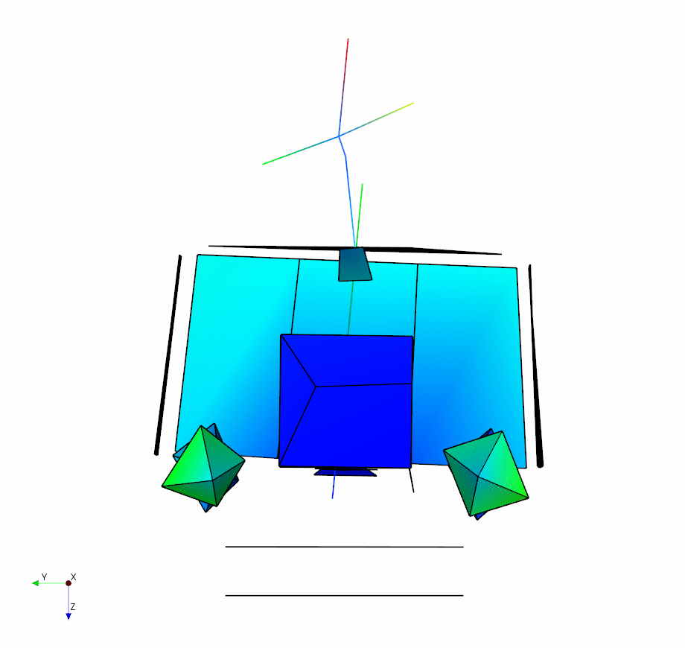
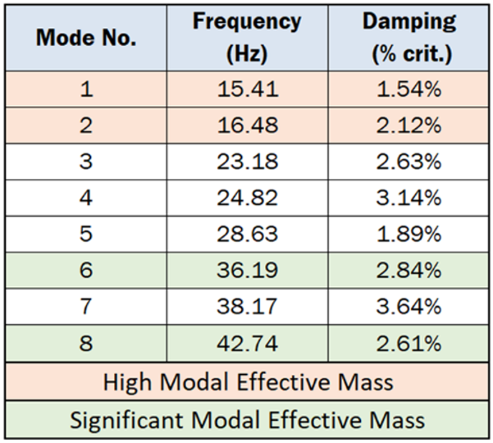
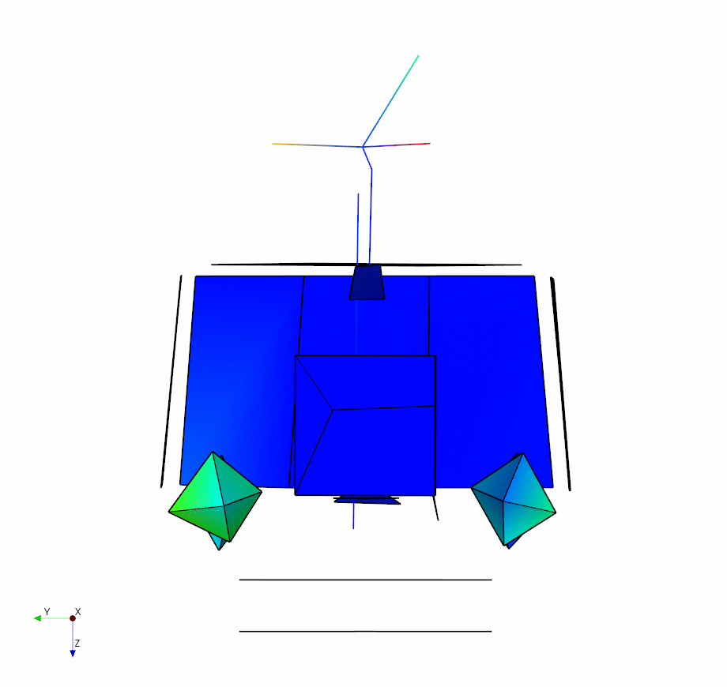
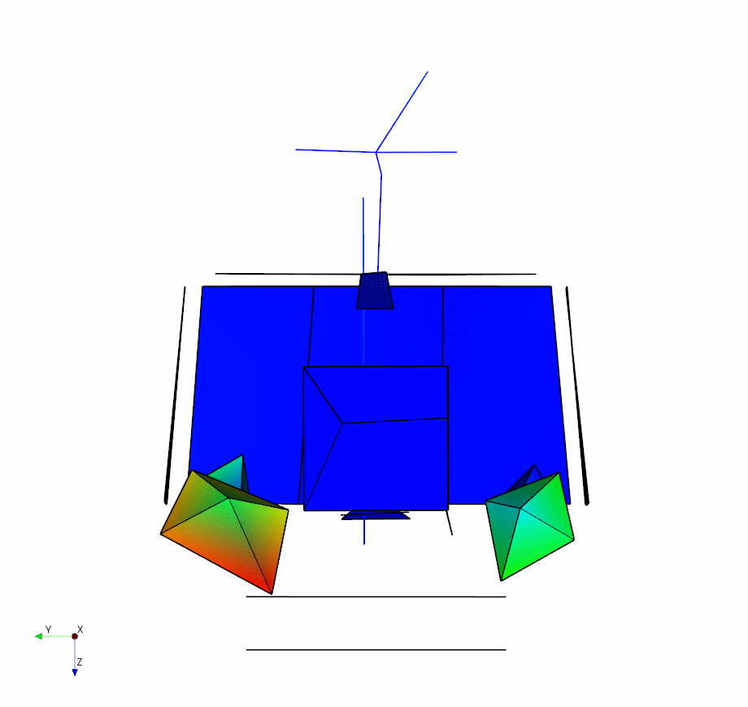
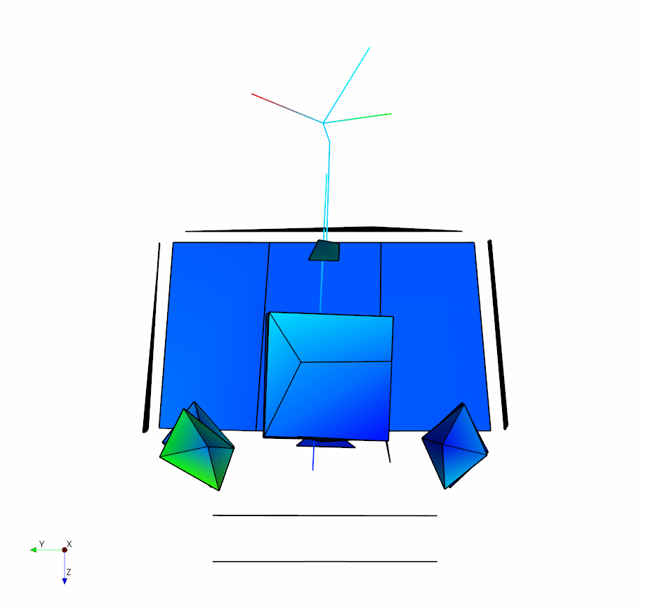
Background Test – FBC Impact Testing
Modal parameters below indicate modes with high modal effective mass.
These modes will become important for comparison later

Slide 10
Acoustic Modal Test Process

Slide 11
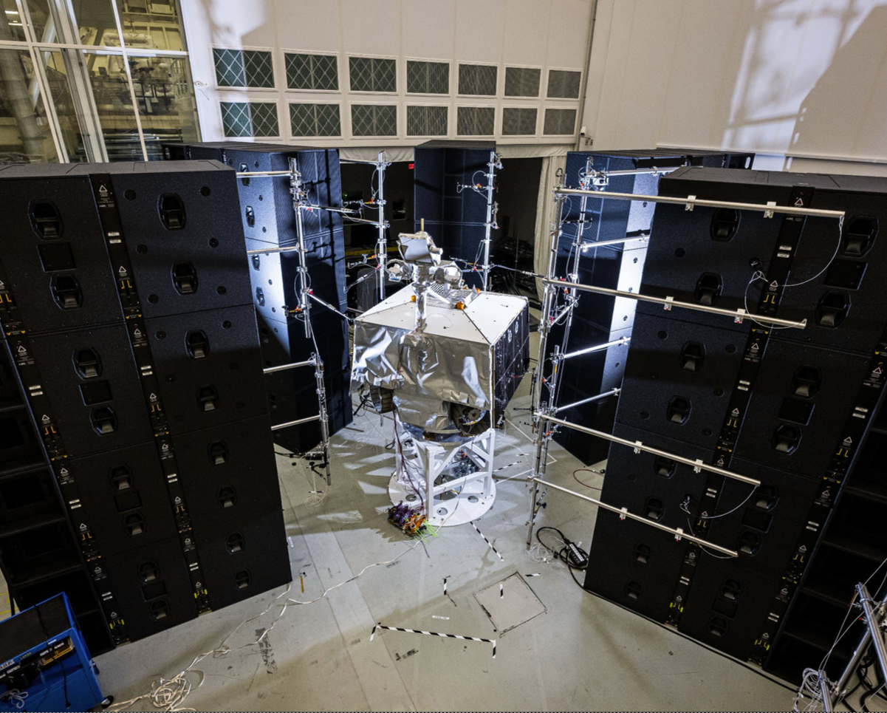
Acoustic Test
Viper required DFAN for launch qualification
138.2 dB OASPL
Acoustic Research Systems was contracted, using 24 Neutron Devices
Modal testing was an opportunity
System is ideal for MIMO excitation
  Doesn’t require constructive interference (coherence)
  Provided 12 uncorrelated sources
  Multiple sources can extract closely-spaced modes
24 Mics mounted on MSS
  No floor stands required
  Odd numbers used for FRF’s.

Slide 12

Acoustic Modal Process
Modal extraction process > 40 Hz
FRF used for acoustically reactive modes with microphones as a reference
  Provides cleaner data
  Risk at higher frequencies of “zero’s” in data, creating fictitious modes
  Fictitious modes can be identified by observing the singular values of the microphone cross-spectrum matrix
To account for phase lag, the FRF data [H_{yx}] is converted to cross spectra
  Assuming the input cross spectrum matrix [S_{xx}] is equal to the identity matris.
  OMA is then used to extract modes from the FRF synthesized output cross-spectrum matrix [S_{yy}]

Slide 13
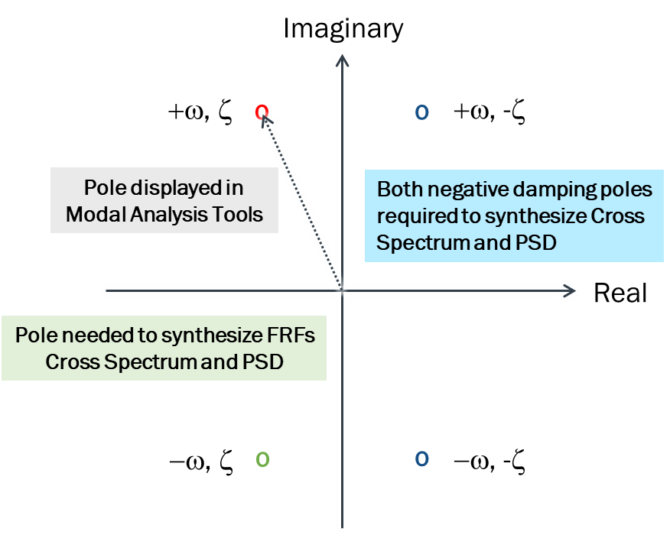
Acoustic Modal Process
Modal extraction process < 40 Hz
Frequencies below the active output were present in the cross-spectrum matrix
At these frequencies, the test-measured cross-spectrum matrix helped extract shapes
Method validation:
  Process simulated and measured cross-spectrum in IMAT™ modal analysis software
  OPoly calculated all four poles
  Typicall FRF only uses the positive two
  Negative two are used for [H_{yx} ]^{H} associated with cross-spectrum matricies

Slide 14
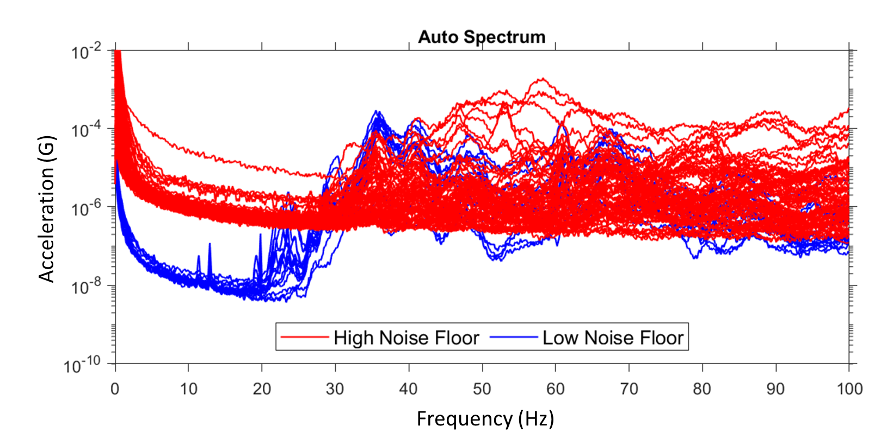
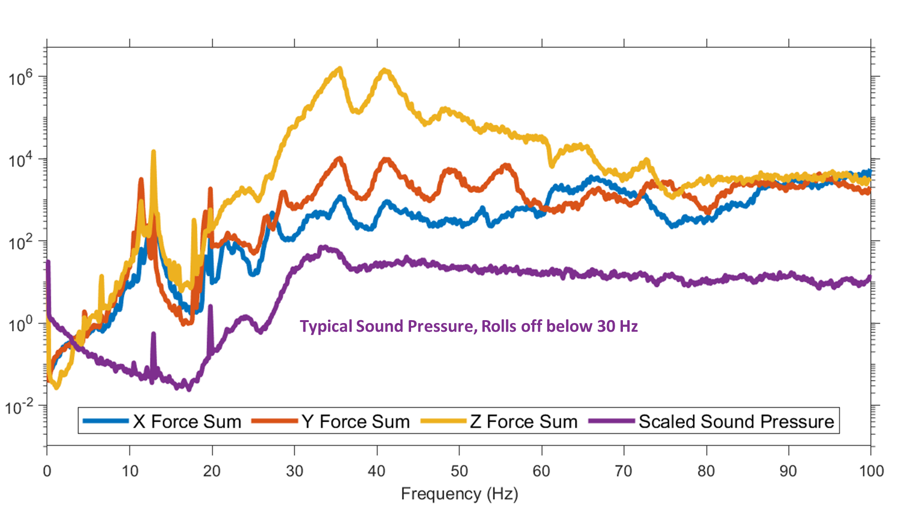
Instrumentation
(24) Dytran 3133D1T
(4) PCB 356A33
(1) Kistler 8763B500BT
(6) Kistler 9367C
  Kistler 5165A Charge Amps
  Scaled to accommodate measurement range
Sensor selection was optimized for vibe
Minor changes to the selection would have made low-frequency data more viable
Force sensors saved the day with noise free data below 30 Hza

Slide 15
Results

Slide 16
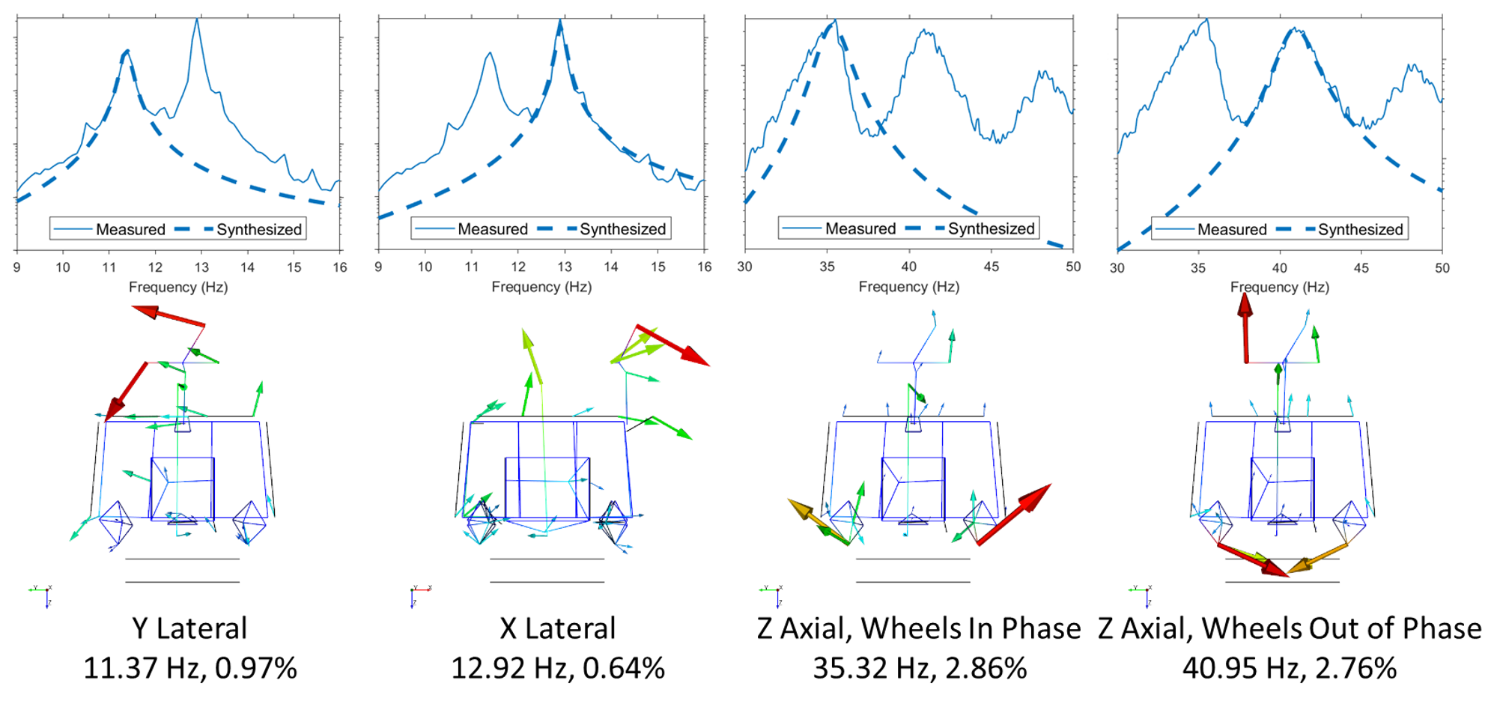
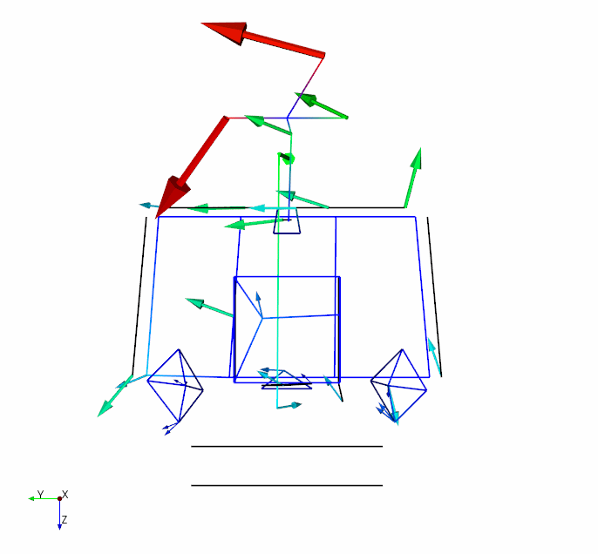
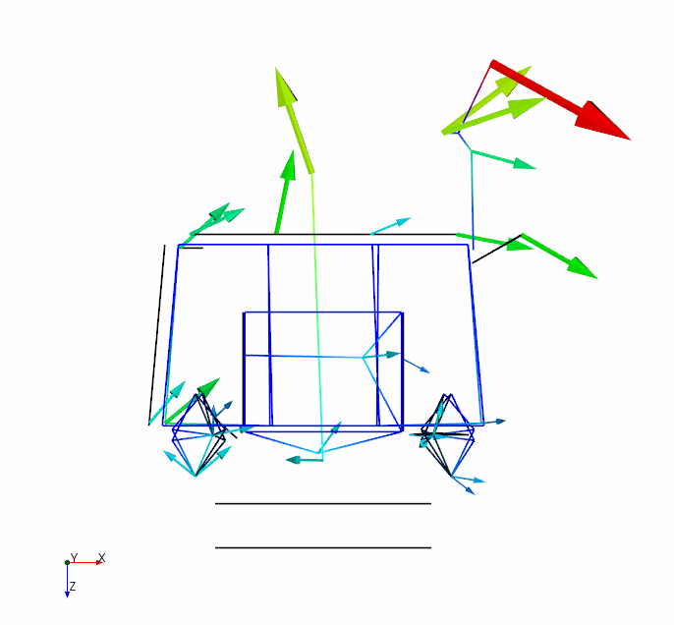
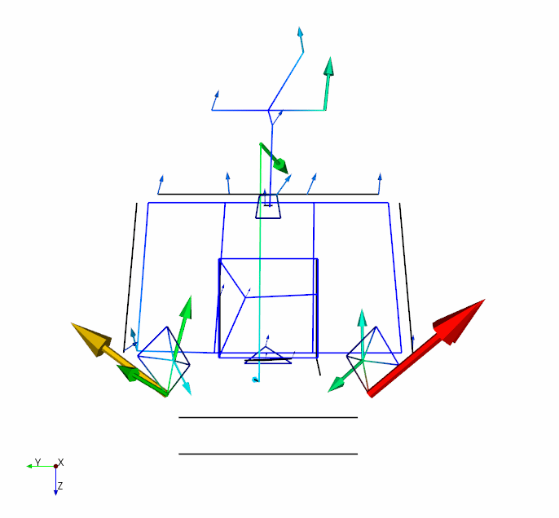
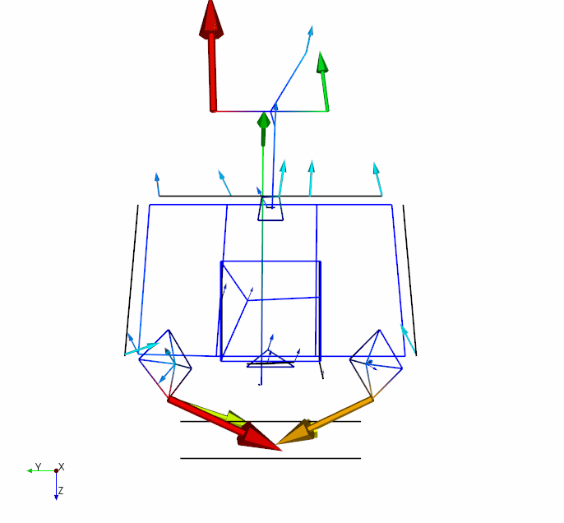
Modes Obtained from Cross-Spectra

Slide 17
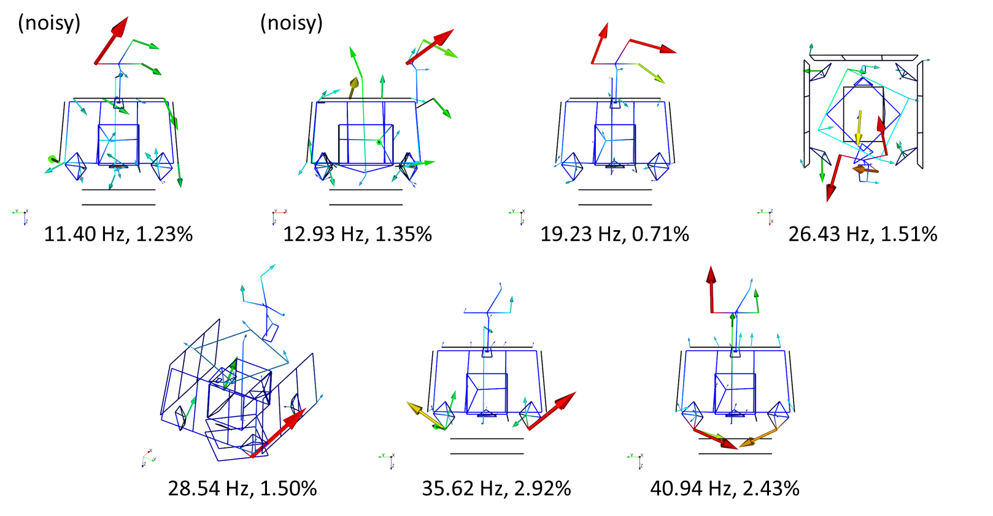
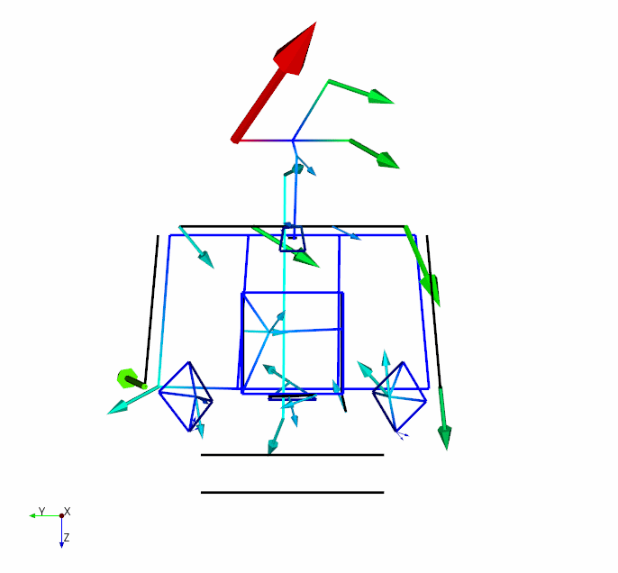
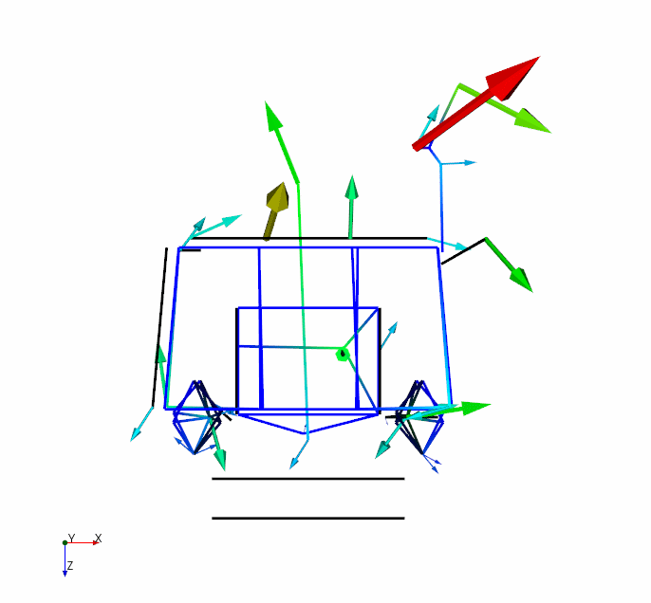
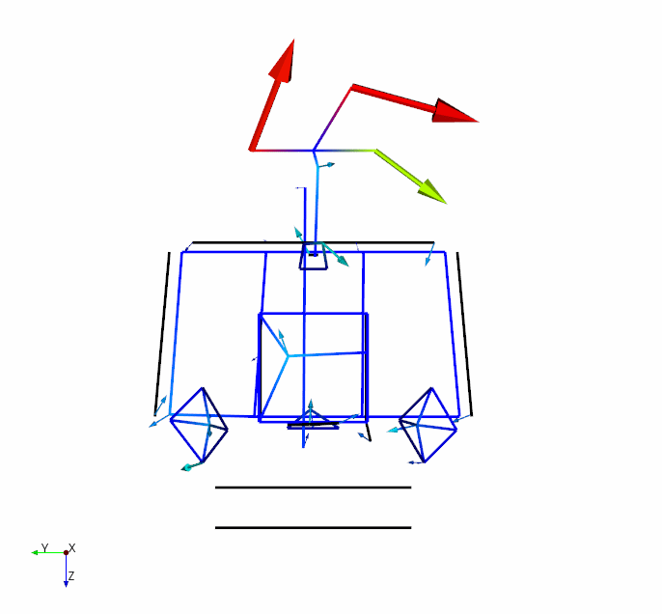
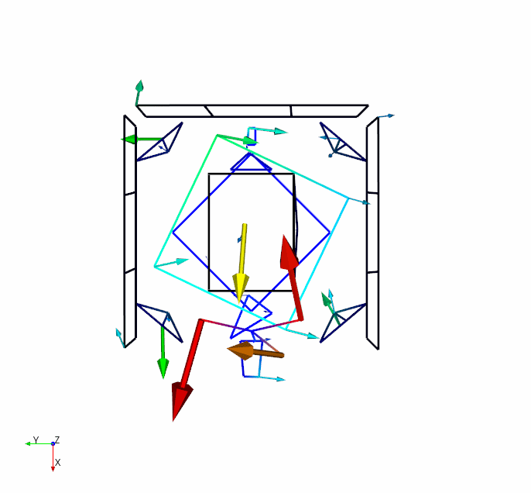
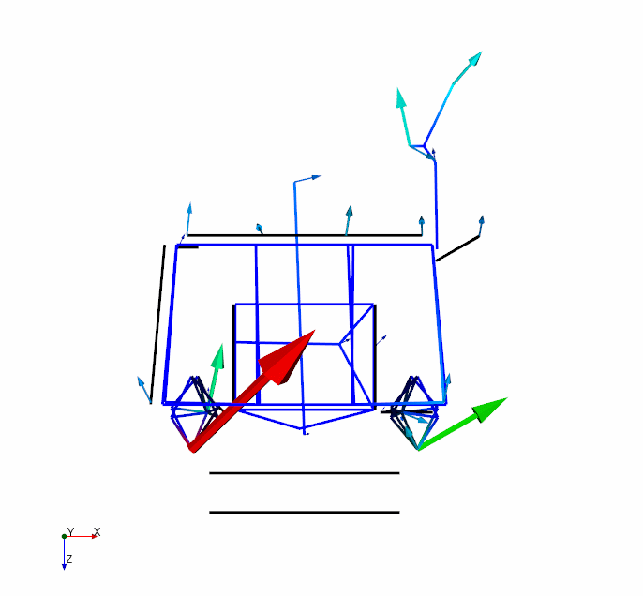
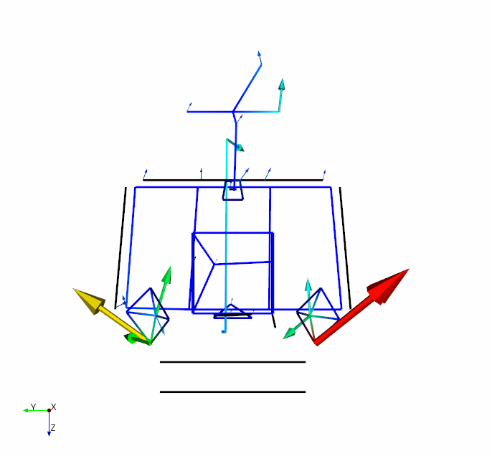
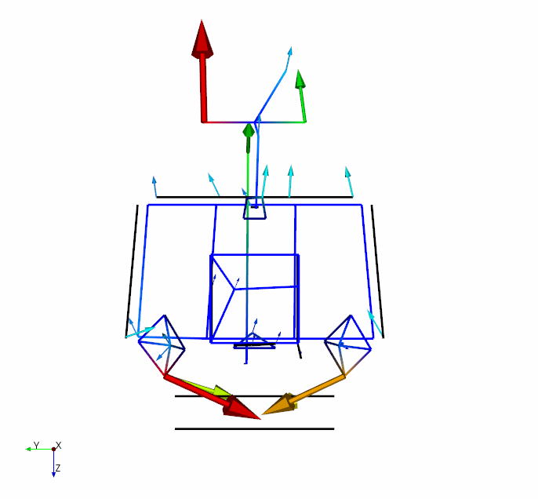
Modes Obtained from FRF

Slide 18
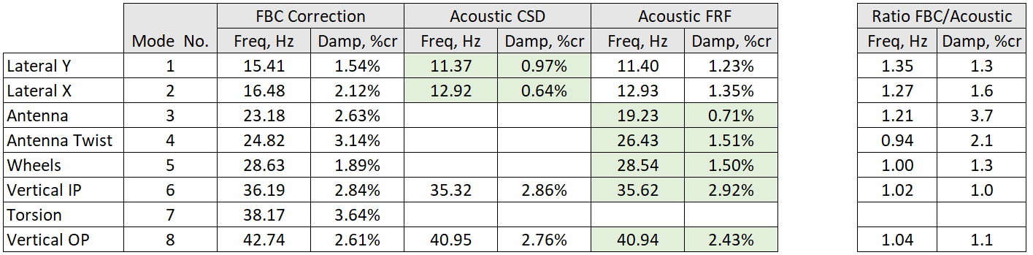
Comparison of FBC, Acoustic CSD, Acoustic FRF Modes
Similar modes can be extracted with Acoustic Excitation as other excitation types
For complicated boundaries:
Include boundary condition in model
Only update modes where boundary doesn’t participate
Combine FBC and Acoustic Modal data to obtain corrected acoustic modes
OR

Slide 19
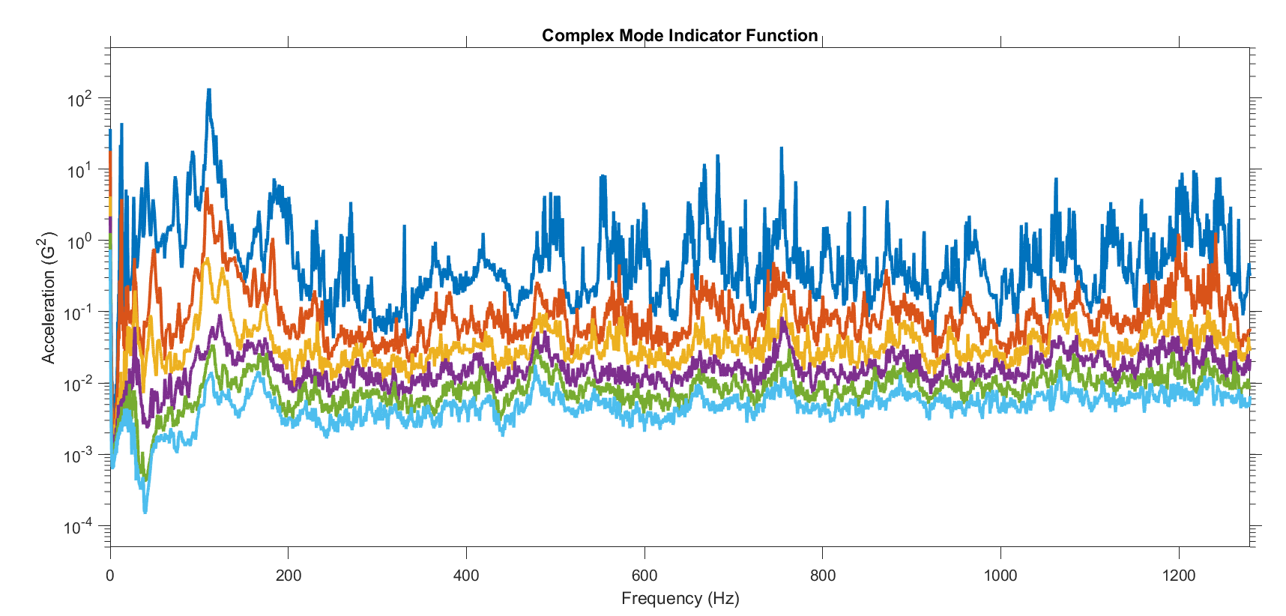
Modes at Higher Frequencies
Frequencies and damping can be extracted at higher frequencies
May help better tune acoustic analysis models

Slide 20
Conclusions

Slide 21
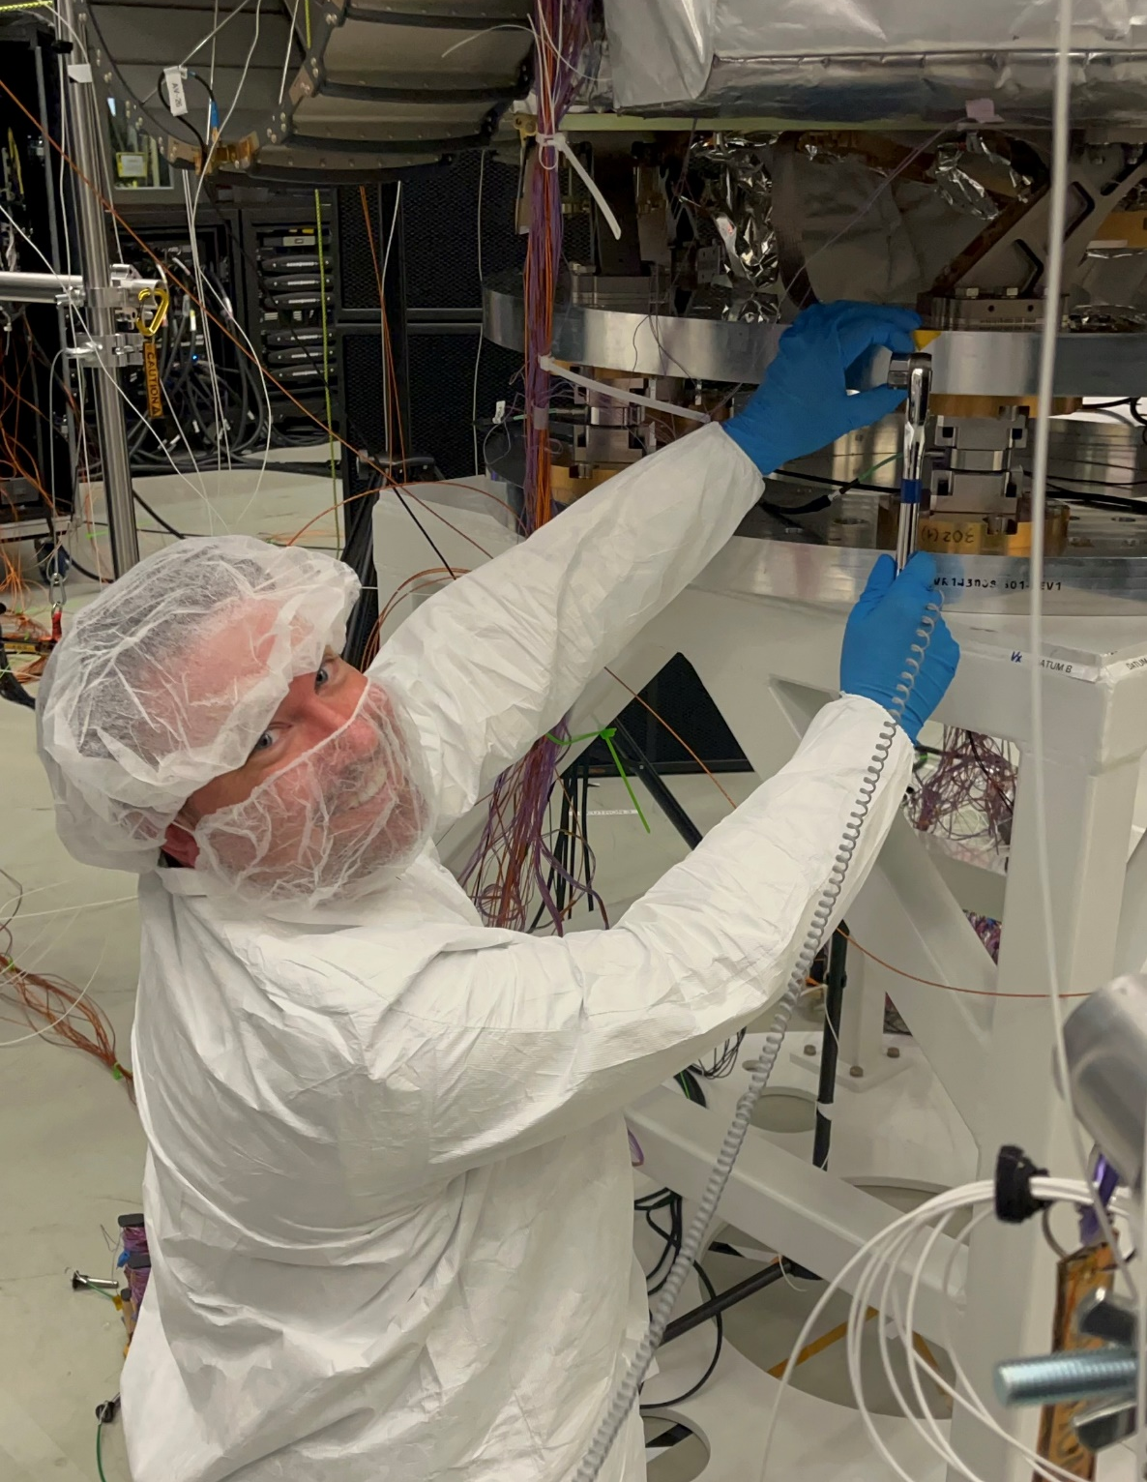
Conclusions
Modal parameters may be extracted to a high quality from acoustic testing
Longer test runs at lower levels can allow better definition for modal extraction
This was a test of opportunity
  Further experimentation with acoustic excitation is warranted
  In-situ modal may be possible with little modification to a typical DFAN test, extending its value
  Optics, mirrors, and other sensitive articles may benefit from this type of testing over traditional methods
Thanks, NASA JSC!

Slide 22
Questions?

