Slide 1
NASA Ames Capabilities/Facilities/Services
(List of Contents)
Author List:
Sharmila Bhattacharya, Matthew C. Napoli, Daniel J. Rasky, Kenneth Cheung, Jose V. Benavides, Liz Wagstaff, David B. Hash, Jessica J. Marquez, Justin Pane, Alan Cassell, Parag A. Vaishampayan, Michael Flynn, Grace A. Belancik, Frances M. Donovan, Jessica A. Lee, Samrawit G. Gebre, Matthew J. Gasch, Sarah N. D’Souza, Paul F. Wercinski, Peter S. Race, Alex Mazhari, Egle Cekanaviciute, Kimberlee H. Shish, Nhan T. Nguyen, Brian J. Glass, Matthew C. Deans, Jeremy D. Frank, Uland Y. Wong.
Affiliation:
NASA Ames Research Center
Moffett Field, CA 94035.

Slide 2
NASA Ames Capabilities/Facilities/Services
(List of Contents)
Hardware, Research Enablers, and Related Technologies……………………………….Pages 3 - 20
Automation, Robotics, Planning Tools, Thermal Protection & Related Tech……Pages 22-33
Facilities & Other Capabilities…………………………………………………………………………Pages 35-40
Please note, this is not necessarily a comprehensive list of Ames’ capabilities/facilities/services. Contact us for more information (Sharmila.Bhattacharya@nasa.gov)

Slide 3
HARDWARE, RESEARCH ENABLERS, & RELATED TECHNOLOGIES

Slide 4
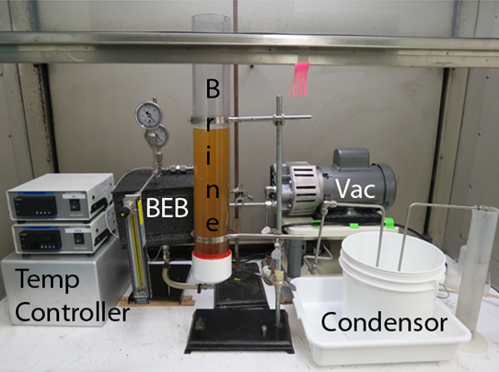
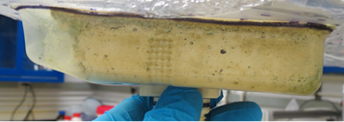
Ames Universal Urine Processor (UUP)
Image and/or Video
KEY ATTRIBUTES / COMPETENCY
Bullet point list
100% water recovery. Proven by elimination of the green chromium hexahydrate evidenced by only white salt solid remaining (see small image)
UUP operates in all gravitational environments (micro, partial, and full), thus only a single processor would be required for a Mars mission, not the three currently proposed (VCD & BPA for transit, and PUP for surface).
No extreme stench released to the cabin, nor complex stench scrubber required.
Could save up to 1 ton of mass for a 3-year Mars mission
Dormancy tolerant as the bags can be replaced between missions.
TECHNICAL / SCIENTIFIC CHALLENGE ADDRESSED
The Universal Urine Processor would be capable to process both humidity condensate and raw urine with 100% water recovery. 100% water recovery.
HERITAGE
Developed, tested, and presented at the technology down select for the brine processor.
SUMMARY
Current Status of the capability, notable achievements, and so forth, including how it compares with the State of the Art
SOA: NASA has no water processor capable of 100% water recovery, and required two processors to get above 85%.
APPLICATIONS BEYOND
UUP is applicable to Gateway and Lunar missions where dormancy tolerant processors are required. Also applicable to Mars for the same dormancy reasons as well as its applicability to both the transit and surface.

Slide 5
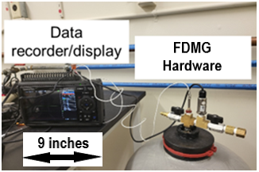
Ames Fluid Dynamic Mass Gauging (FDMG)
Image and/or Video
KEY ATTRIBUTES / COMPETENCY
For tanks up to 75L, volume determination errors are <0.25L and as low as 0.03L (30 mL).
Can operate under a variety of operational conditions making the FDMG applicable to most situations.
  High or low pressure conditions
  Choked flow or non-choked flow conditions
  Operated in fill or vent mode
In-flight recalibration easily done
Not susceptible to drift issues as PVT methods
Temperature effect only 0.15% per degree change.
Automated process
TECHNICAL / SCIENTIFIC CHALLENGE ADDRESSED
FDMG is a technology for determining and monitoring the liquid volume within a tank in all gravitational environments (micro, partial, and full) with in-flight re-calibration capability
HERITAGE
Tested on a 75L Bladder ProSource Tank as is currently on the ISS. Fill conditions ranging from a full to an empty tank were tested. System had been upgraded to an automated system for operations using an NI DAQ system and python programing.
SUMMARY
SOA: NASA has no method of determining the volume of liquid within a tank in microgravity.
FDMG has demonstrated the ability to determine the liquid volume within a rigid bladder tank to <1% error of the tanks volume.
The mass and volume is nominally 1kg and 1L.
APPLICATIONS BEYOND
Applications for Gateway, Lunar, and Mars when knowledge of remaining liquid volume is critical for mission success, i.e., transit, pre-positioned, and dormancy supplies.

Slide 6
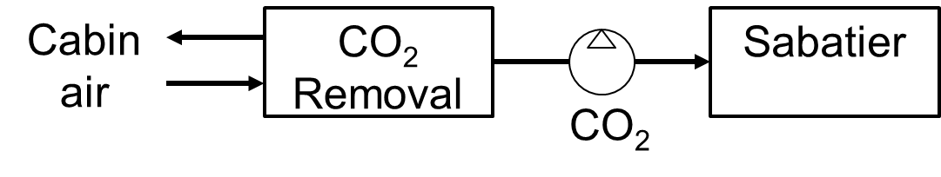
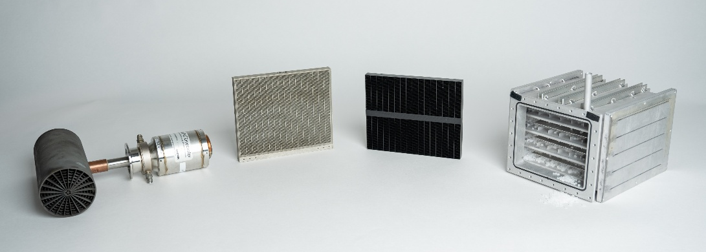
CO₂ Management Systems in Development at Ames
KEY ATTRIBUTES / COMPETENCY
CO₂ cold surface Deposition system (CDep) – sorbentless, thermally-driven CO₂ capture and pressurization https://hdl.handle.net/2346/94760
Liquid Amine CO₂ Removal (LACR) – capillary, passive control of liquid sorbent/air interface enables continuous operation https://hdl.handle.net/2346/98761
Air-Cooled Temperature Swing Adsorption & Compression (AC-TSAC) – passively provides constant pressurized CO₂ for reduction https://hdl.handle.net/2346/98823
In-house capability to simulate crewed cabin environment, dry cabin air, and outlet from CO₂ removal system, including trace contaminants
In-house CO₂/H₂O sorbent synthesis and analysis suite
TECHNICAL / SCIENTIFIC CHALLENGE ADDRESSED
Highly reliable, regenerable CO₂ systems are required to minimize mass for long-duration crewed missions. Three unique methods have been in development to minimize mass, power, volume, and spares.
HERITAGE
CDep uses same coolers that transport samples from ISS
LACR sorbent used to scrub submarines and flue gas, and geometry tested extensively on ISS
AC-TSAC tested with both ISS CO₂ removal systems
SUMMARY
CDep tested at subscale and built at full-scale
LACR tested at subscale and integrated loop with simulant fluid tested on ISS
AC-TSAC full-scale extensively tested over 15 years, never replacing sorbent as never lost performance
APPLICATIONS BEYOND
Direct infusion into CLD, gateway, HLS, MPH, EHP, mars transit, ISRU, etc.

Slide 7
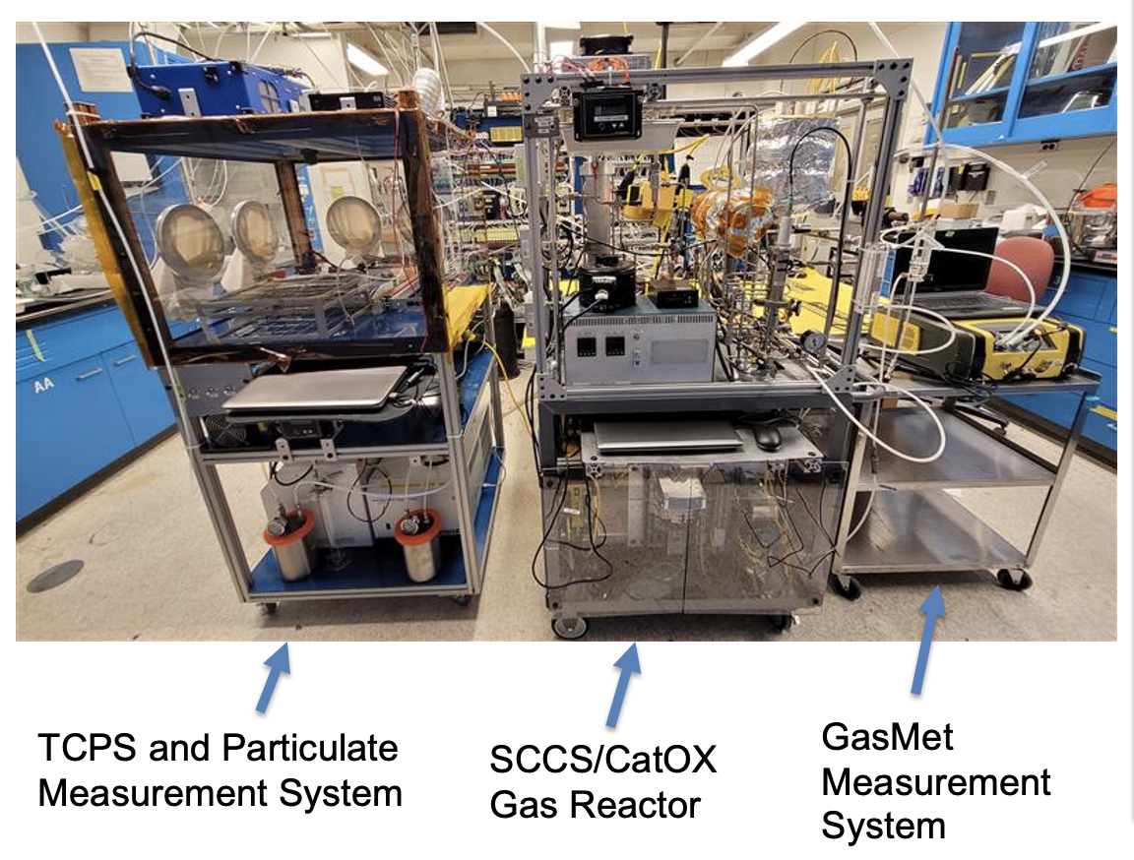
Ames Waste Group - TRASH COMPACTION AND PROCESSING SYSTEM
KEY ATTRIBUTES / COMPETENCY
Trash volume reduction by up to 70%
Trash stabilization to rigid tiles
Reduce smell
Safens trash by heating it to 150C to inhibit biological growth
Water recovery greater than 90%
Treats exhaust gases for toxin removal by using a carbon bed, CatOx reactor, and LiOH bed
500W average power, 750W peak power
2.2 kg trash per load
8 to 12 hours per completed TCPS cycle
Product “tile” can be used for radiation shielding
Trash Compaction and Processing System
Ability to process a day’s worth of non-metabolic trash for a crew of four.
HERITAGE
Concept originated with US Navy to densify trash so it would sink
Space applications and test build commenced in 2003
Over 20 years experience in waste processing technology development
SUMMARY
Through NASA’s Next Space Technologies for Exploration Partnerships (NextSTEP) program, commercial partners have developed 3 generations of test systems. The latest one will be part of an ISS Technology Demonstration in January of 2027.
APPLICATIONS BEYOND
Water recovery from trash. Trash safening systems. Gas processing technologies.

Slide 8
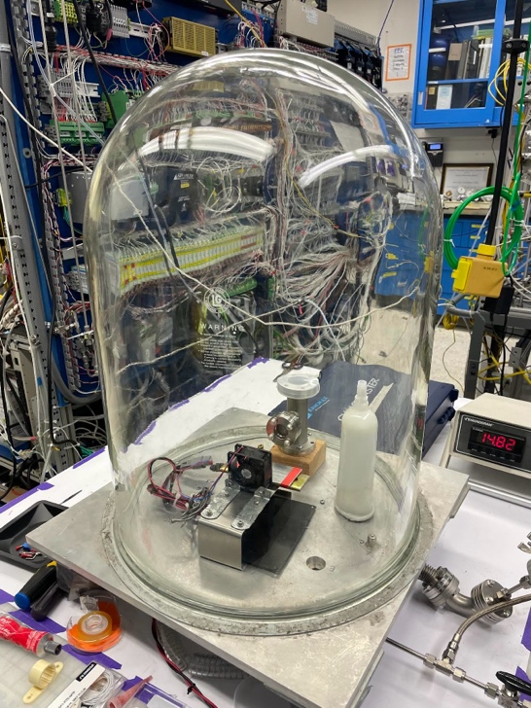
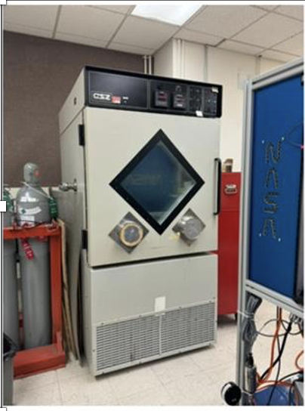
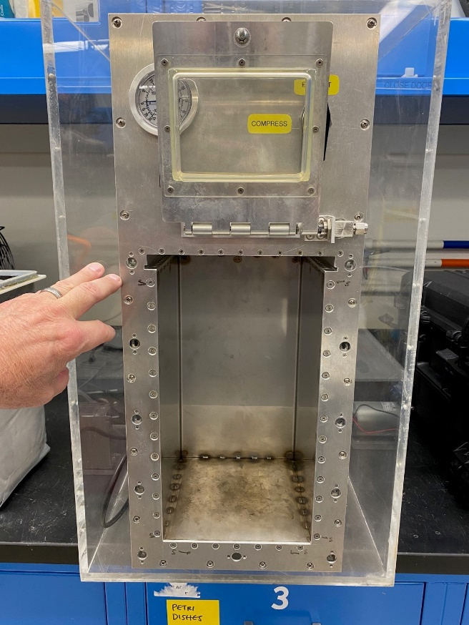
Ames Waste Group
Mechanical Trash Compactor
Filters for Long Term Waste Storage
TECHNICAL / SCIENTIFIC CHALLENGE ADDRESSED
Develop a mechanical, non-heated, low mass, low volume, and easy to use mechanical trash compactor for use while in transit or on a planetary surface.
TECHNICAL / SCIENTIFIC CHALLENGE ADDRESSED
Develop long-term waste storage systems to prevent planetary contamination from terrestrial microbes escaping the waste containers. These microbes can confound planetary scientists in the search for extra-terrestrial life.
SUMMARY
A refurbished benchtop test rig is used to study compaction pressure, dwell time, volume reduction, spring back and system capacity for trash management.
The information obtained will be used to develop a prototype which minimizes mass, power, and volume, leading to a favorable Equivalent System Mass rating. Issues with odor and long-term storage will be investigated.
SUMMARY
Use of a filter is the simplest, direct, and most cost-effective potential solution. The filtration system that allows volatiles to boil off and escape containment but keeps microorganisms contained within
Filtration system is to last for at least 50 years. Filter clogging and phase change present significant challenges
The filter design will be handed over to the logistics container designers. Filters can work with any type of containment system.

Slide 9
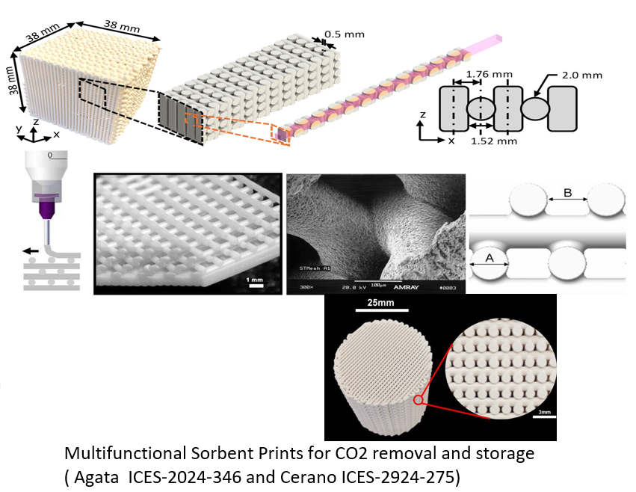
Multifunctional Materials for Contaminant Removal
KEY ATTRIBUTES / COMPETENCY
Custom 3D-printed sorbents for CO₂ removal, thermal control, and contaminant removal
Custom 3D-printed silver doped ceramic lattices for potable water disinfectant.
Integration of machine learning for trade studies and knowledge graph development
Advanced heating systems with 3D-printed titanium water heat pipes and embedded heater wires.
Use of piezoelectric components for solid-liquid separation
TECHNICAL / SCIENTIFIC CHALLENGE ADDRESSED
Spacecraft ECLSS must be compact, energy-efficient, and reliable. NASA faces challenges with sourcing suitable materials, as COTS products may not align with mission timelines or performance needs. This work enables multifunctional, reconfigurable components tailored for long-duration missions and harsh environments.
HERITAGE
Adsorbent beds using COTs adsorbent pellets.
The use of iodine for potable water disinfectant.
SUMMARY
The multifunctional 3D-printed devices that perform CO₂ capture, water recycling, thermal management, and silver ion dosing. Advances include adaptive formulations, integration with ML for automated material screening, and compact hardware designs. Compared to the state of the art, these systems are lightweight, customizable, and offer dual or triple functionality.
APPLICATIONS BEYOND
The developed technologies can be infused into both space mission scenarios and terrestrial applications
Closed-loop water and air systems for planetary bases
Portable water disinfection for disaster relief or remote locations

Slide 10
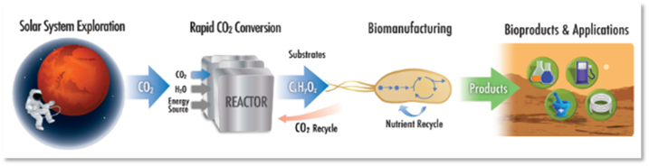
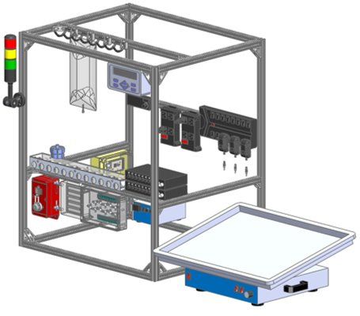
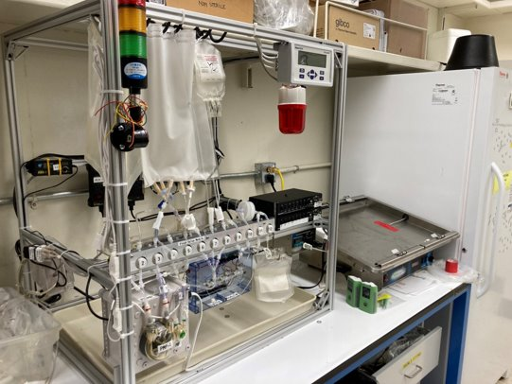
CO₂-Based Biomanufacturing Platform and Facilities at Ames
“Make it there, not take it there”
Image and/or Video
KEY ATTRIBUTES / COMPETENCY
Custom developed bioprocessing platform for use in resource limited environments, variable gravity conditions.
BioManufacturing from waste streams or CO₂ derived feedstocks. Liter scale. His tag purification scheme.
Flexible modified COTS design with reconfigurable, subsystems that are re-usable/replaceable, can be packaged for middeck locker volumes.
Semi-autonomous operation and processing, requiring no tools for assembly and minimal crew time.
Multiple media formulations developed including minimal medias using CO₂-derived feedstocks, formulations based on waste utilization, brine, or salts from regolith.
Genetic engineering and bioprocess development and optimization. Bioreactor materials expertise.
Decades of experience in developing biological platforms for use in space, from concept and requirements,to drawings, build, test, verification and delivery.
TECHNICAL / SCIENTIFIC CHALLENGE ADDRESSED
Reduce logistics, cost and risk of resupply: provide mission consumables from in-situ resources e.g. nutrients, fuels, feedstocks, plastics, pharmaceuticals, addressing NASA shortfalls 1583, 1584, 1518, 1524,1525, 1610.
HERITAGE
Tested using biomanufacturing model organisms, bacteria and yeasts, secreted and cell bound products.
Custom cell lysis units developed with Claremont Biosystems based on units flown on ISS.
SUMMARY The CO₂-Based Biomanufacturing facilities within the Bioengineering Branch at NASA Ames are at the forefront of biomanufacturing in space. Over 2000 sq ft laboratory spaces, standard and custom bioreactors, purification subsystems, in-house analytical capabilities and relationships with vendors allow for rapid engineering of microbes, subsystems, and platform build design through validation.
APPLICATIONS BEYOND: bioreactors and platform subsystems can be integrated into closed loop life support systems, biomining, waste recycling and materials recovery.
Soundararajan, M., Paddock, M. B., Dougherty, M., Jones, H. W., Hogan, J. A., Donovan, F. M., ... & Settles, A. M. (2023). Theoretical design of a space bioprocessing system to produce recombinant proteins. npj Microgravity, 9(1), 78.​

Slide 11
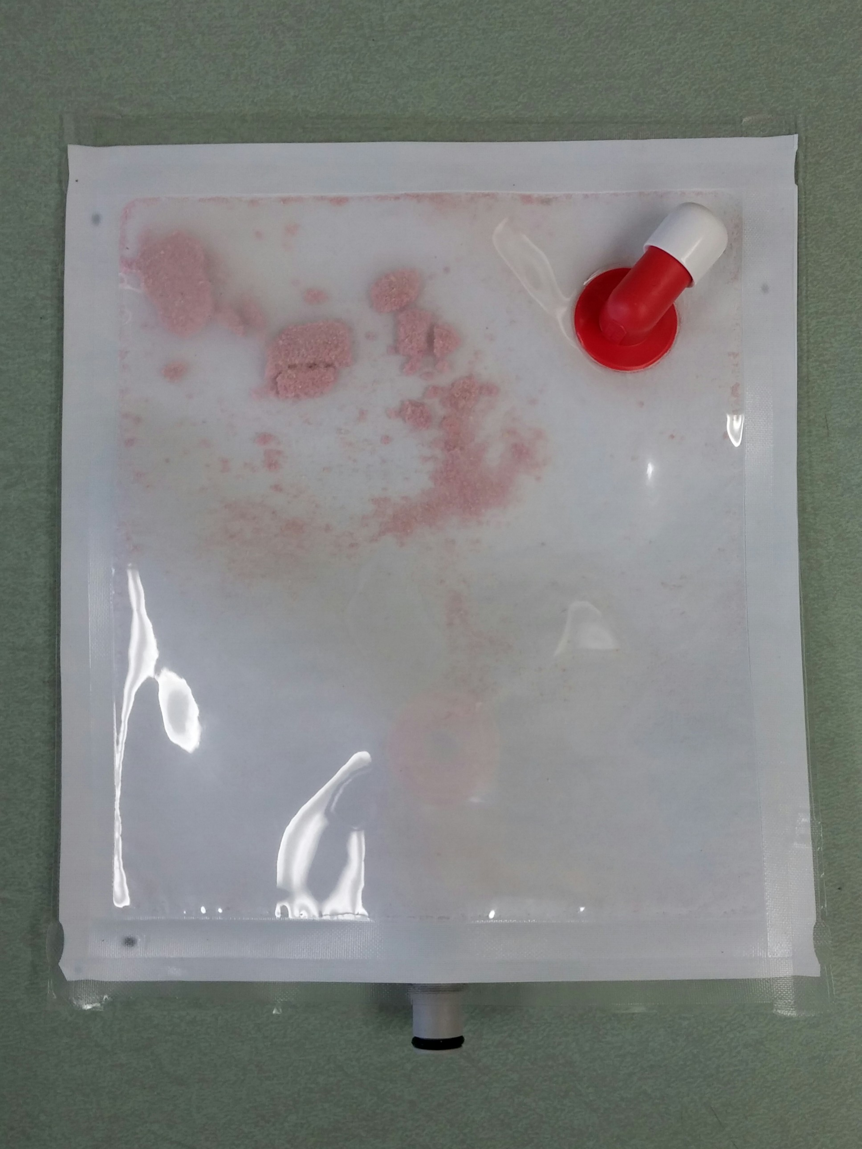
Personal Water Reclamation System at Ames
KEY ATTRIBUTES / COMPETENCY
Personal water treatment
Passive water treatment.
Provides an engineered hydration drink for crew consumption.
Provides hydrated food product for for crew consumption.
Reduces the volume of wastewater.
Reduces risk because it treats an individual crew members urine for their own reuse.
TECHNICAL / SCIENTIFIC CHALLENGE ADDRESSED
Providing water and reducing wastewater volumes on orbit.
HERITAGE
PWRS has been been tested in space.
PWRS has been tested using real human urine and the product been consumed by humans.
SUMMARY
The Personal Water Reclamation System (PWRS) is a passive individual water purification device that provides hydration fluids and reduces the volume of wastewater. The system saves mass the first time it is used.
APPLICATIONS BEYOND
Disaster relief
Disadvantaged communities water purification.

Slide 12
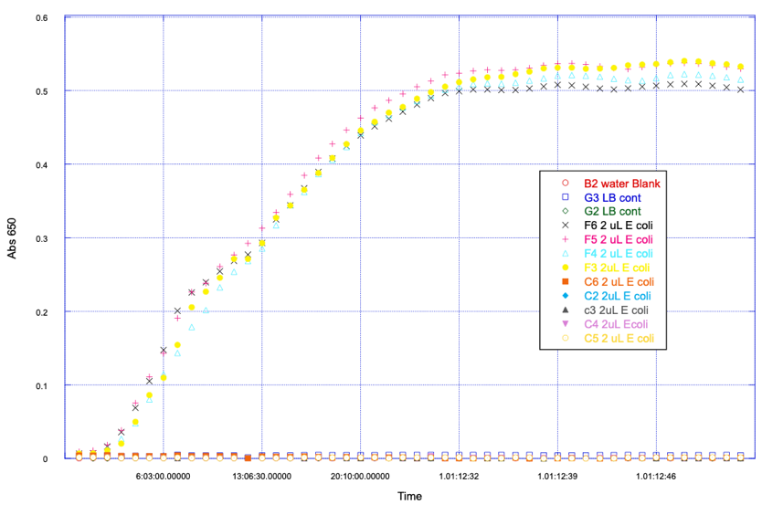
Microbial Control of Stored Potable water
KEY ATTRIBUTES / COMPETENCY
NASA water quality standards address human health concerns
NASA water quality standards do not address long term bacterial growth control. Biocides are used to control growth.
Biocides are consumed when they kill bacteria, so they need to be replaced.
This means that for long term storage of water biocide injection and mixing would be required
Alternatively, water quality specification can be developed that will prevent bacterial growth thus not needing biocide or biocide replenishment.
This task will develop water quality specification and materials of construction require for ground-based preparation of water.
E. Coli growth as a function of time in hours in pure water or LB using a 2 uL of overnight grown culture
TECHNICAL / SCIENTIFIC CHALLENGE ADDRESSED
Storing water for long periods of dormancy on a spacecraft will require reliable microbial control or the use of complex sensors to verify potability. NASA currently has no water quality standards that will guarantee bacteria will not grow in potable water stored for long periods of time.
HERITAGE
NASA water quality standards address human health concerns.
Results by our group and others have shown that bacteria can not grow in 100% pure water.
SUMMARY
This work proposed is to develop a set of laboratory verified water quality specifications and materials of construction standards based on redox potential that will prevent microbial growth in potable water. Maintaining the potability of stored water supplies and plumbing distribution systems is a key challenge for spacecraft. Our work, shown above, has shown that water quality standards can be developed that prevent bacterial growth.
APPLICATIONS BEYOND
Potential applicability scenarios

Slide 13



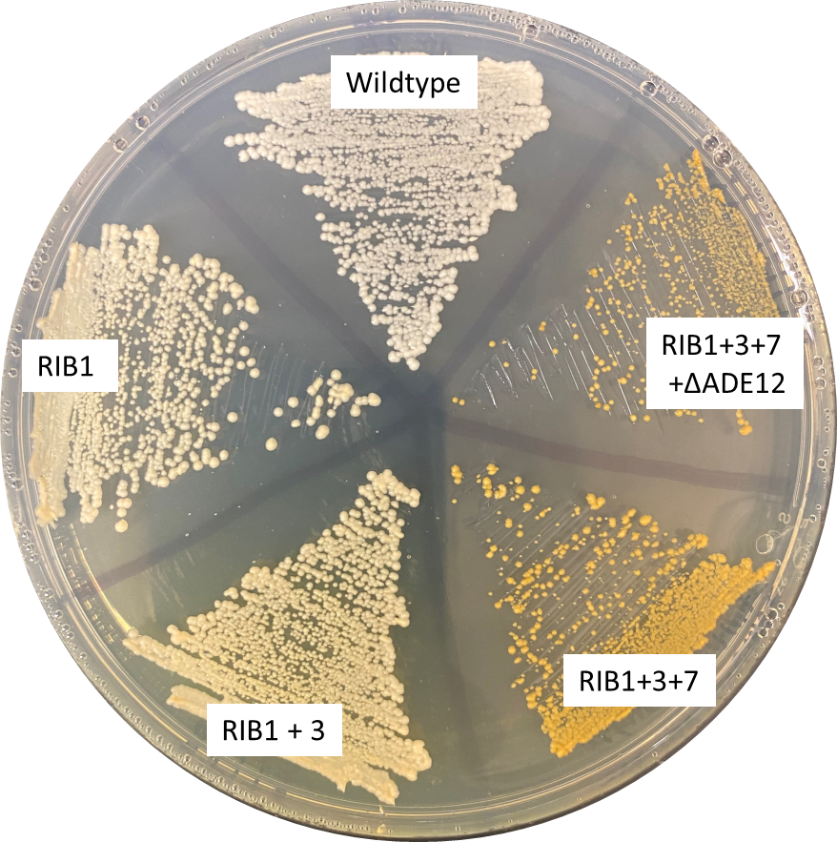
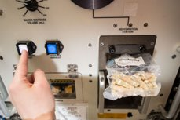
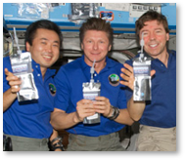
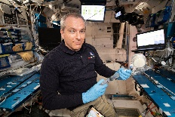
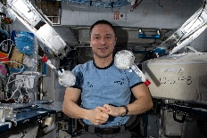
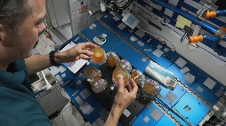
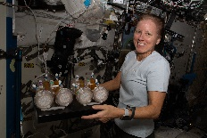
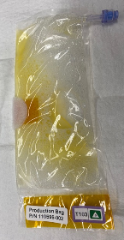
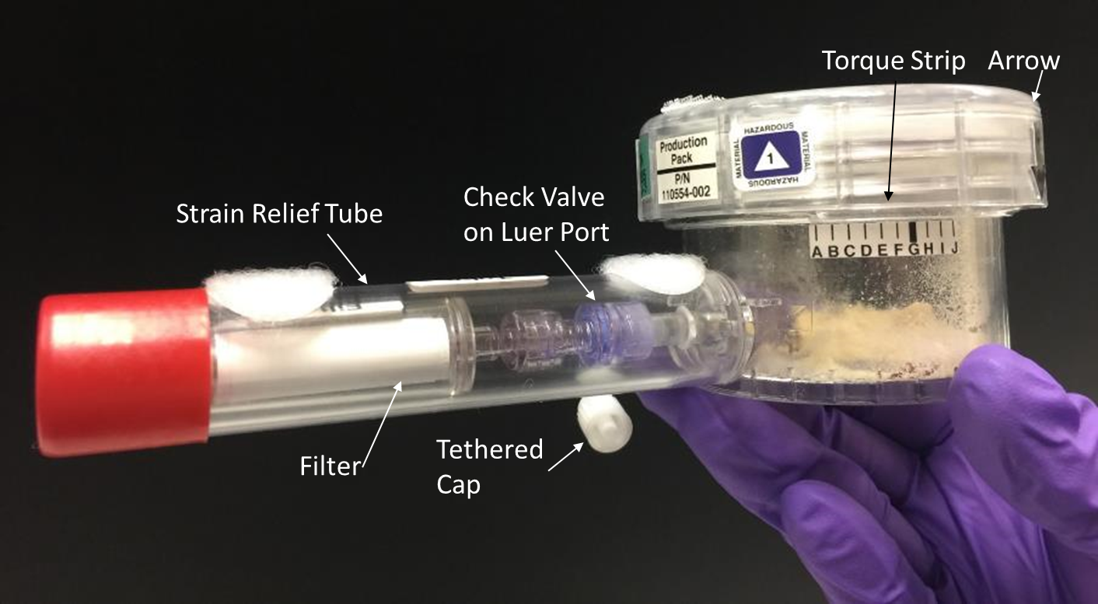
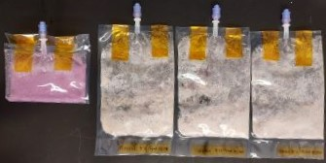
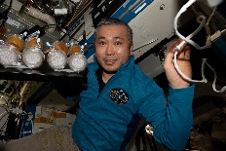
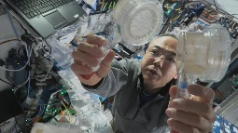
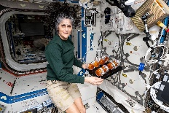
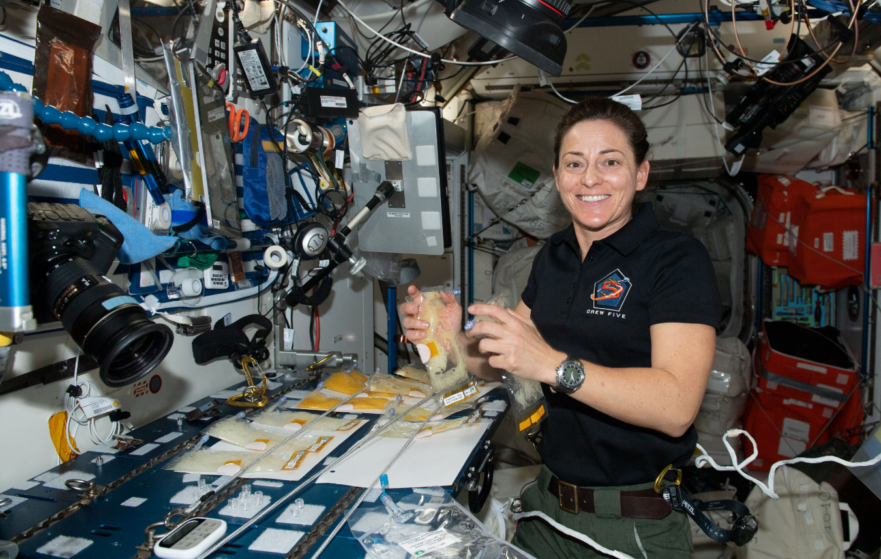
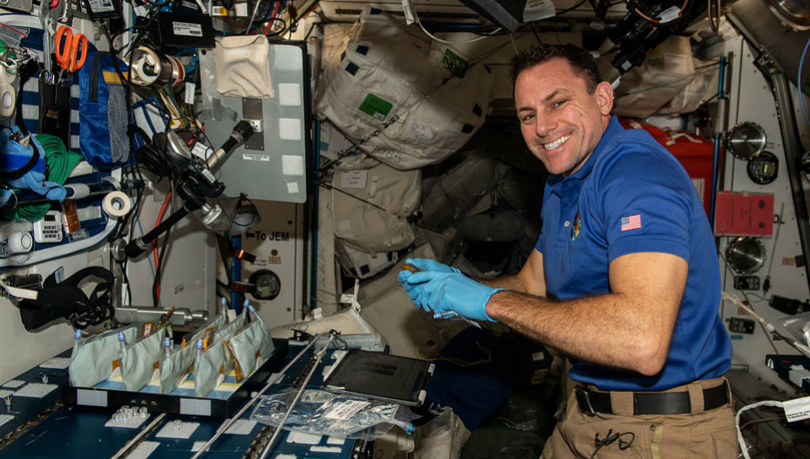
BioNutrients at Ames -Fermented Food, On Demand Nutrients native and genetically improved products
Add water and incubate 12- 48 hours
KEY ATTRIBUTES / COMPETENCY/ HERITAGE
Data on >5years of lyophilized, ambient storage of microbes in ISS – BioNutrients has 7 successful runs with yeast products, 2 runs making yogurt and kefir.​
Additional ISS data: 9 additional strains, multiple treatments, UV irradiated potential novel strains, omics information. Media (YPD/yeast formula), non-fat milk powder, edible pH indicator and additives.
Low volume, low mass “bioreactor” systems/ Materials data​. Space flown bioreactor designs – polycarbonate hardshell with PTFE membrane and FEP flat pack bag designs, up to 6 years shelf life.
Materials test data: gas permeability, biocompatibility, and workability​ for bioreactor development.
2000 sq ft laboratory space, decades of experience
On-demand nutrient production from fully dehydrated system – yeast, yogurt, and kefir fermented foods, with or without GMO.
TECHNICAL / SCIENTIFIC CHALLENGE ADDRESSED
Nutrient supply and nutrient degradation in prepackaged food system is a known challenge for space exploration. Fermented foods (commercial or GMO) can supply needed dietary nutrients and compounds using minimal mass, power and volume for long duration missions.​
Addresses NASA Shortfalls in food/crew health and performance and New technologies for increased shelf-stable food system shelf-life: 1524, 1525, 1610,1620.
APPLICATIONS BEYOND
Microbial cultures can deliver fats, protein, vitamins as well as pharmaceuticals in low mass and volume systems, requiring minimal resources. Future developments will include pasteurization and other safety measures. A future space kitchen may have on demand fermented food and nutrients prepared from microbial cultures. The future medicine may be an engineered ready to eat yogurt or kefir.
Current Products
Yeast: carotenoids (β carotene, zeaxanthin)
Yeast: carotenoids, riboflavin, folate (multi-nutrient cultures)
Yogurt – commercial, yogurt GFP
Kefir – commercial
Serial production - yogurt
Ball, N., Hogan, J., Hindupur, A., Kagawa, H., Levri, J., & Sims, K. (2020, July). BioNutrients-1: Development of an on-demand nutrient production system for long-duration missions. 2020 International Conference on Environmental Systems.
Ball, N., Kagawa, H., Hindupur, A., Kostakis, A., Hogan, J., Villanueva, A., ... & Gresser, A. (2021, July). BioNutrients-2: Improvements to the BioNutrients-1 nutrient production system. 50th International Conference on Environmental Systems.

Slide 14
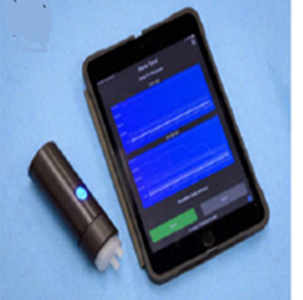
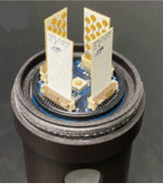
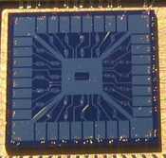
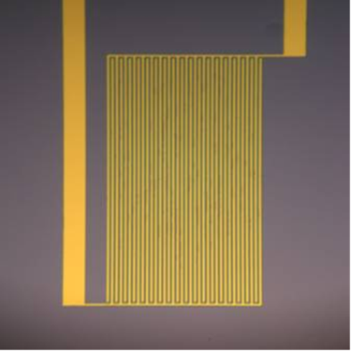
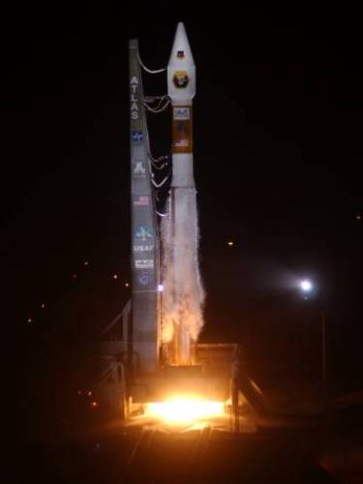
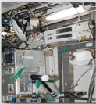

Ames Electronic Nose / Chemical Detection
KEY ATTRIBUTES / COMPETENCY
Individually addressable multi-channel sensing
Integrated temperature, pressure, and humidity sensing
Detection limit range: ppm to ppb
Response time in seconds at room temperature
Reproducible from sensor to sensor
Room temperature operation
Low power: µW to mW/sensor
Easy integration
Sensor chip size is 1x1cm² with 12-256 channels
HERITAGE
  Tested aboard a US Navy Satellite and International Space Station
  Multiple peer-reviewed journal publications and US patents
  This E-Nose technology is licensed by many startups for their applications in health diagnosis (diabetes, flu, cardiovascular disease, various types of cancers, etc.), and environmental monitoring.
TECHNICAL / SCIENTIFIC CHALLENGE ADDRESSED
An intelligent, compact, highly sensitive, low-powered, fast responding analytical tool replicating the human olfactory system capable of identifying and classifying complex mixtures of chemicals and odors.
SUMMARY
NASA Ames spaceflight-proven robust E-Nose technology with its current TRL of 5-6 has been demonstrated for many NASA, DHS, HHS, DoD, and other commercial applications. Integration of sampling, sensing and computing in a one platform allows in-situ, real time, automated measurement compared to other SOA detection systems.
APPLICATIONS BEYOND
E-nose can be utilized for fire detection, crew health and safety, fuel leak detection, food safety and air quality monitoring.

Slide 15
Ames BioSensor instrument
KEY ATTRIBUTES / COMPETENCY
TRL9: Developed for BioSentinel mission to study effect of cosmic radiation on model organism (budding yeast). All instruments validated in LEO (ISS) and in deep space.
Modified for LEIA CLPS mission to study effects of lunar environment on biology and on biomanufacturing.
Proposed for upcoming lunar missions to screen for microgreen crops and algae/cyanobacteria (i.e., in situ food and antioxidant production).
Compact radiation detectors within the same enclosure.
256-288 bio samples in 16-18 fluidic cards. Each card with dedicated fluidic, optical, and thermal subsystems.
Mass: ~5 kg (15.8 x 14.5 x 16.6 cm); Power: 3.55 W; Data: 0.004 GB/day
Microgreens
Cyanobacteria
Algae
TECHNICAL / SCIENTIFIC CHALLENGE ADDRESSED
Versatile flight-validated (TRL9) instrument capable of accommodating and supporting a variety of biological organisms with dedicated microfluidic, optical, and thermal control capabilities.
HERITAGE
Flight heritage from BioSentinel deep space (Artemis I, Nov 2022 – present) and ISS (2021-2022) missions.
LEIA lunar surface mission, launching to the Moon onboard CLPS lander NET 2027.
SUMMARY
Microfluidic-based instrument fully developed at Ames Research Center. The BioSensor has a modular design with up to 18 fluidic cards and hundreds of samples to study the effect of the space environment on biological organisms.
Robust design adaptable to meet a variety of science requirements on different platforms, including low Earth orbit (LEO), ISS, free-flyers, landers, etc.
APPLICATIONS BEYOND
Proposed to perform experiments on different LEO and BLEO platforms and with a variety of organisms (plants, algae, organoids) and observation approaches (microscopy, fluorescence, luminescence).

Slide 16
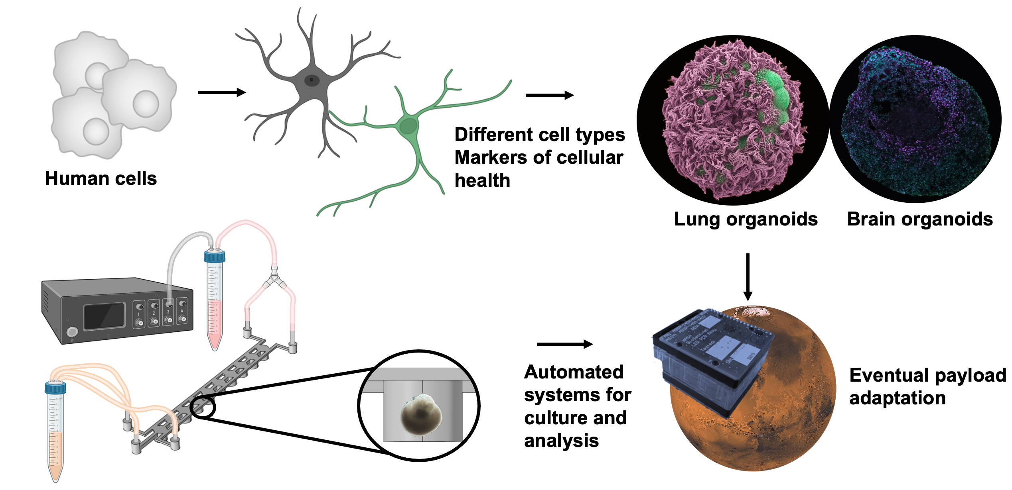
Human organ models at Ames for Human Health in Deep Space
KEY ATTRIBUTES / COMPETENCY
Long-lasting, personalized, human lung and brain organoids
Genetically engineered cellular reporters of biological effects of ionizing radiation
Microfluidic systems for organoid maintenance on bench
Fluorescence, luminescence, absorbance and dissolved signaling molecule-based quantification of biological responses
HERITAGE
Human organ models for space biomedical research
Autonomous biological payloads on small satellites and microfluidic development for biological payloads
Image- and media analysis-based quantification of biological responses
Simulated chronic and acute space radiation
TECHNICAL / SCIENTIFIC CHALLENGE ADDRESSED
1. Precision health to investigate and mitigate astronaut health risks in deep space.
2. Automated payloads for space biology research beyond low-Earth orbit.
SUMMARY
We have developed long-lasting, complex, human organ models for understanding deep space-mediated impairments to central nervous system and respiratory system, as well as a microfluidic system for sustained culture. Our next goal is to adapt our model to a fully automated flight payloads in and beyond low Earth orbit.
APPLICATIONS BEYOND
Individual assessment of astronaut health risk and countermeasure efficacy.
Spaceflight and space radiation as an analog to accelerated aging for benefits to terrestrial biomedical research.

Slide 17
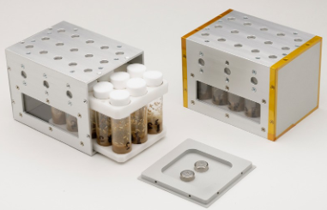
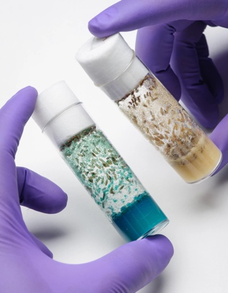
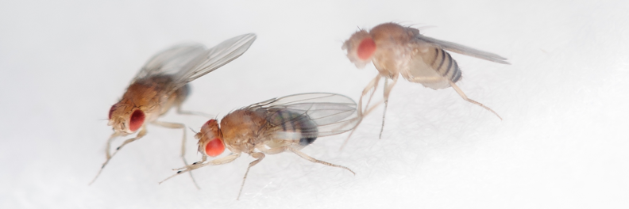
Ames Vented Fly Box Hardware Suite
KEY ATTRIBUTES / COMPETENCY
Vented Fly Box (VFB)
1.5U anodized aluminum box (10cm x 10cm x 14.2cm)
Screened vent holes support passive gas exchange
Internal foam tray secures vials and prevents movement
Accommodates data loggers to monitor temperature and relative humidity (optional)
Sample Vials
15 polystyrene vials with cellulose acetate plugs (commercial off-the-shelf, Drosophila lab standard)
Food composition and initial quantities/life stages of organisms tailored to meet science requirements
Payload Container Foam
Closed cell foam provides secure stowage to minimize effects of launch and landing
Interconnected channels support air-exchange
Accommodates passive or active dosimeter to monitor radiation exposure within the payload container (optional)
TECHNICAL / SCIENTIFIC CHALLENGE ADDRESSED
      Robust hardware suite for fruit fly (Drosophila melanogaster) investigations in space
      Designed to meet a variety of science requirements while minimizing the use of constrained resources (crew time, mass, volume, conditioned stowage)
HERITAGE
      Used successfully for multiple ISS investigations
      Fruit Fly Lab-02/SpaceX CRS-11: effects of microgravity on cardiac function, structure and gene expression
      Fruit Fly Lab-03/SpaceX CRS-14: altered virulence of a natural parasite of Drosophila
      Planned for use in two upcoming investigations
SUMMARY
Full complements of flight- and ground-certified hardware available to support testing, flight and ground controls
Operations require minimal crew time and no prior training
Designed for ambient stowage over full mission duration
Integration and operations products largely reusable between missions
APPLICATIONS BEYOND
      Adaptable for other organisms with similar volume and environmental requirements
      Customizable to support different platforms, sample quantities, and stowage constraints

Slide 18
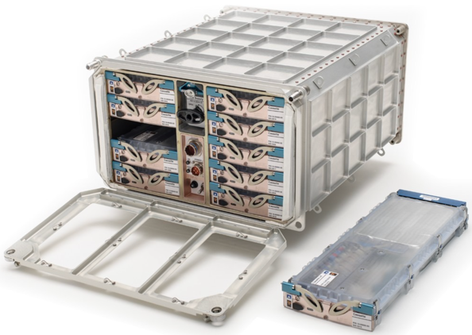
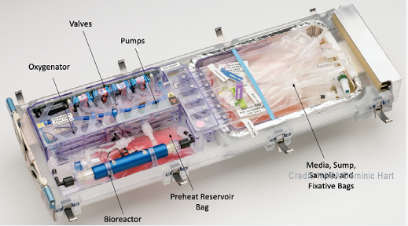
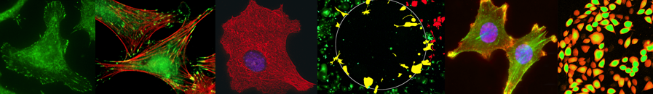
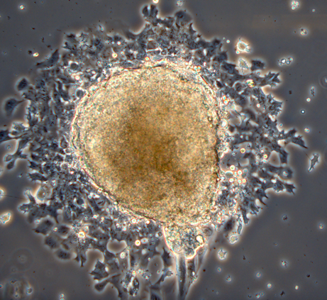
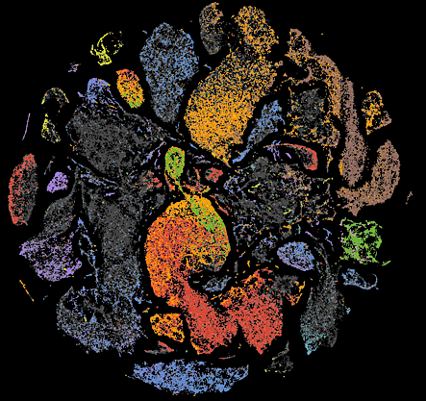
Ames Bioculture System
Automated Bioculture and Sample Preservation in Space
Mammalian Cell and Organoid Culture
Yeast and Microbial Culture
Small Organism Culture (C. Elegans, Tardigrades, etc.)
CO2 or Other Gas Supply and Gas/Liquid Exchanger
Bioreactor Temperature up to 37oC,
Medium Supply Bag, Sump Bag, Sample Bags
Refrigerated Compartment for Medium and Sampling Storage
Variable Flow Rate Pumping
Three Levels of Containment for Hazardous Samples/Reagents
Configurable Valve-Controlled Flow
Remote Monitoring/Operation From Ground or by Astronauts
N=10 Durable Housing Cassettes With Disposable Flowpath
TECHNICAL / SCIENTIFIC CHALLENGE ADDRESSED
The NASA Bioculture System addresses the challenge of growing cells, organoids, microorganisms, and small organisms in microgravity in a highly automated and controlled environment for biological experimentation in space. This hardware specifically supports the ability of NASA HRP and Space Biology to conduct investigations addressing human crew health in deep space.
HERITAGE
Based on the Space Shuttle Cell Culture Module (CCM) Hardware Concept
Newly Re-Designed for ISS Express Rack Interface With Enhanced Features
Successfully Flight Validated and Used with Cell, Organoids, and Small Organism Cultures
APPLICATIONS BEYOND
The NASA Bioculture System ISS form factor can be adapted for deep space and Moon/Mars exploration, using a single cassette unit as a basis for a reduced mass and volume design, where internal number of bioreactors increase from 1 up to 6, and autonomous experimental operation time is increased from 30 to 90 days
SUMMARY
Current Status is flight approved for ISS, with successful spaceflight heritage. The NASA Bioculture System is likely the most advanced and capable spaceflight hardware for microgravity cell biology in existence.

Slide 19
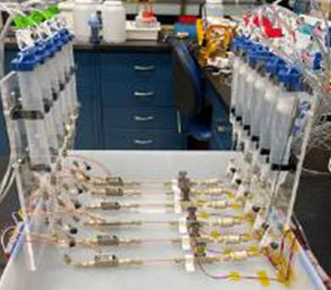
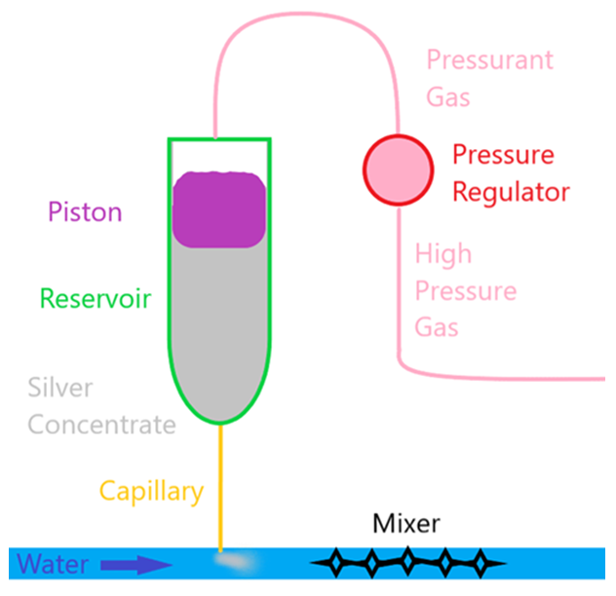
Ames DirectINJECT
Image and/or Video
KEY ATTRIBUTES / COMPETENCY
Bullet point list
Non-mechanical method of dosing for high reliability
Ability to change dosing rates
Average dosing rates can be verified using Fluid Dynamic Mass Gauging technology (submitted separately)
Low ESM system (nominally 1kg and 1L)
A 1 μL/min dosing system demonstrated long term flow stability of 10%
TECHNICAL / SCIENTIFIC CHALLENGE ADDRESSED
DirectINJECT is a method for injecting a controlled volume without the need for mechanical pumps.
HERITAGE
Laboratory testing and development
SUMMARY
SOA: NASA uses mechanical pumps which have largely proven to be unreliable in lifetime and dosing volumes.
Capable of dosing continuously or intermittently at dose rates from low μL to high mL per minute flow rates.
Has demonstrated 40 weeks of dosing with only 10% variation.
APPLICATIONS BEYOND
Applicable to Gateway, Lunar, and Mars missions where dosing is required. Dosing applications include biocide and urine pretreat.

Slide 20
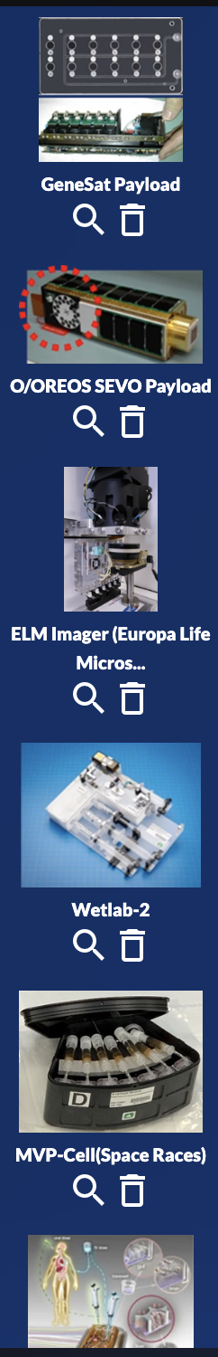
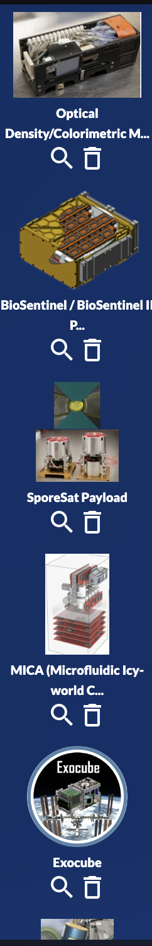
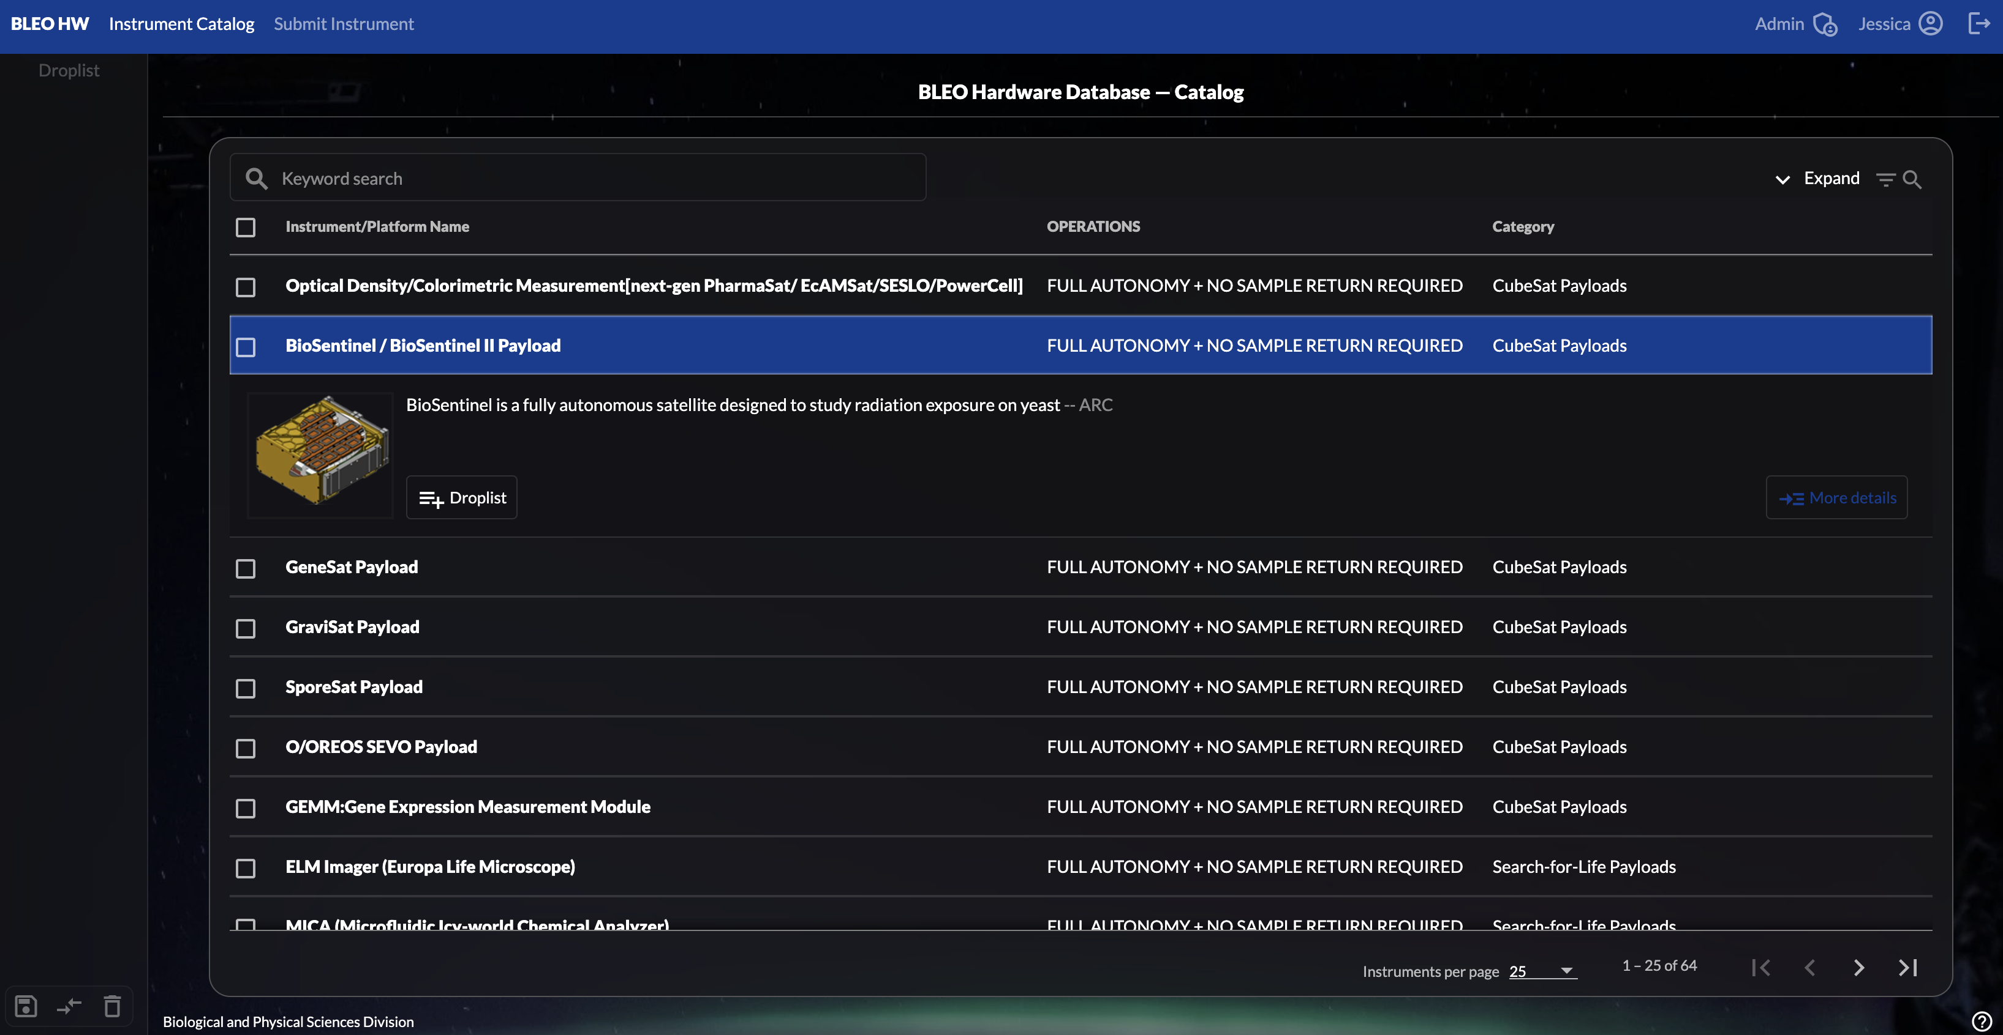

Ames Space Life Sciences Hardware Database
Image and/or Video
KEY ATTRIBUTES / COMPETENCY
SLSHD is currently in development. Initial public release is planned for fall 2025. Community participation will be required to ensure robust content.
Anticipated features of SLSHD:
Individual entries containing technical specifications for dozens of instruments and payloads for the biological and physical sciences in space. Will include instruments that are previously flown or flight-ready, compatible with ISS, CLDs, or beyond-LEO platforms.
Intuitive user interface with Search, Compare Instruments, and Export Data functionality.
Links to related datasets and specimen entries on other OSDR repositories, and to related publications on Space Life Sciences Library.
Built-in mechanism for users to suggest new entries or corrections.
TECHNICAL / SCIENTIFIC CHALLENGE ADDRESSED
To provide to the public a searchable database, integrated into the NASA Open Science Data Repository (OSDR), describing hardware for spaceflight biology and physical sciences experiments, past and current.
HERITAGE
OSDR enables access to diverse forms of space-related data from experiments and missions that investigate biological and health responses of terrestrial life to spaceflight. SLSHD benefits from the existing robust structure and active user community of OSDR.
SUMMARY
SLSHD has two primary goals.
Understanding the past: Provide reference information about the experimental hardware that was used to generate the data and samples present in other OSDR databases.
Shaping the future: Facilitate design of experiments or new hardware by providing users with a comprehensive understanding of what capabilities already exist.
APPLICATIONS BEYOND
SLSHD could serve as the go-to reference for payload developers and researchers designing new experiments for Commercial LEO Destinations.

Slide 21

Ames Open Science Data Repository (OSDR)
KEY ATTRIBUTES / COMPETENCY
Maintain and expand a maximally open-access, FAIR (Findable, Accessible, Interoperable, and Reusable) data repository.
Curate and provide public access to spaceflight and ground analog experiment data, including ‘omics, physiological, behavioral, and environmental telemetry data.
Facilitate streamlined submission processes and foster partnerships to enhance OSDR studies through sample sharing or data augmentation.
Generate new insights by processing preserved spaceflight samples and integrating them into existing studies.
Develop community-driven guidelines for sample processing, metadata curation, and data management to ensure long-term usability.
Provide intuitive public visualization tools for space-relevant datasets, including radiation dosimetry, environmental telemetry, and biological response data.
Foster scientific collaboration through OSDR Analysis Working Groups and educational programs like GeneLab for Colleges, Universities, and High Schools.
NBISC Biorepository: Follows best practices and standards to archive over 100,000 biospecimens from space and ground analog experiments, ensuring accessibility for research and discovery.
https://www.nasa.gov/osdr/
TECHNICAL / SCIENTIFIC CHALLENGE ADDRESSED
NASA OSDR addresses the technical and scientific challenge of ensuring the accessibility, standardization, and long-term usability of complex, multimodal biological and biomedical datasets from spaceflight and ground analog experiments. By implementing FAIR data principles and providing advanced bioinformatics tools, OSDR overcomes barriers to data integration, interpretation, and reuse, enabling researchers to derive new insights into the effects of spaceflight on terrestrial life.
HERITAGE
Over 500 public studies curated for reuse and scientific discovery.
Over 100,000 biospecimens available for request and reuse by global scientific community.
Implementation of 60+ standardized metadata and data processing frameworks.
Integration of commercial astronaut data, including Inspiration4 (I4) mission datasets.
Collaboration with the European Space Agency (ESA) for space omics data standardization and sharing.
SUMMARY
With over 500 public studies curated for reusability, the NASA Open Science Data Repository (OSDR) provides access to space-related data from experiments and missions that explore the biological and health responses of terrestrial life to spaceflight. By enabling over 100 publications, OSDR has maximized scientific return and the return on investment for both spaceflight and ground-based experiments. Recognized globally as the premier space biology and biomedical data repository, OSDR hosts data generated by multiple space agencies, research institutions, and commercially funded experiments.
APPLICATIONS BEYOND
OSDR has demonstrated its ability to share commercial astronaut data through controlled data access, integrate data from other space agencies, and establish international consortiums while enabling the launch of new companies. With established standards and adoption by the global science community, OSDR provides a unified platform that reduces the need for individual companies to develop separate data-sharing systems. Its ability to ensure interoperability accelerates scientific discovery and enhances knowledge by enabling the integration of multiple datasets for deeper insights into space biology and biomedical research.

Slide 22
AUTOMATION, ROBOTICS, PLANNING, THERMAL PROTECTION & RELATED TECHNOLOGIES

Slide 23


Astrobee Free-Flying Robots in LEO
A Proven Platform for Intra-Vehicular Robotics
HERITAGE
Meets strict ISS integration and safety requirements, crew appreciate low acoustic noise
Hundreds of ISS activities flown, over 1000 operating hours
Utilized on ISS by 17 guest science investigations, including hosting educational robotics competitions for thousands of students from all over the world
Designed to host guest science: 3 payload bays with quick-swap capability and independent processor devoted to running guest software
Astrobee API exposes robot commanding and telemetry interfaces to guest software running onboard and on the ground
Well-established on-ramp for easy guest science payload and ops integration
Well-established ISS procedures for payload operations
KEY ATTRIBUTES / COMPETENCY
Autonomously fly throughout station using vision-based localization without artificial landmarks
Holonomic 6-DOF propulsion can simulate any prop configuration
Forward- and aft-facing RGB and depth imagers
2-DOF arm with gripper enables perching on handrails and transporting objects
Operate over two hours on a single battery charge, no consumables, can charge autonomously using dock
Fully autonomous plan execution continues even through loss-of-signal periods; ground operators can oversee ops when space-to-ground link is available
Autonomously collect imagery to build panoramic tour of station interior, or perform close-up targeted inspection
Multiple Astrobees can inter-communicate and fly together
APPLICATIONS BEYOND: Bring to your station!
No station modifications needed
Astrobee itself (9 kg) uses WiFi networking
Optionally upmass multiple Astrobees (3 have flown to ISS and more on the ground)
Optional docking station (20 kg) provides berths for two Astrobees, enabling autonomous dock/undock and recharging.
Dock uses 120VDC power and optional wired Ethernet, mounts to wall with Velcro
Without dock, crew can easily swap and charge batteries using a standalone charger

Slide 24




Planning and Scheduling
KEY ATTRIBUTES / COMPETENCY
Developing automated planning and scheduling software to address NASA’s many and diverse planning and scheduling needs. Automated planning and scheduling systems that are essential components of autonomous spacecraft, deep space probes, planetary rovers, and autonomous vehicles. Current projects include:
Distributed Spacecraft Autonomy: Autonomy technology for Small Spacecraft Swarms
Intelligent Long Endurance Observing System(ILEOS): technology to plan high altitude UAS missions
Gateway Vehicle System Management: automated planner for NASA's Gateway mission
Spaceport Throughput Analytical Resource: throughput analysis for Kennedy Space Center
D-SHIELD: automated planning for fleets of Earth-observing satellites
Gateway
VSM
ILEOS
DSA
TECHNICAL / SCIENTIFIC CHALLENGE ADDRESSED
We build automated planners to solve planning problems with Complex temporal constraints, Limited resources, Over-subscription and optimization, Uncertainty. Applications include Mission Planning, Control and Autonomous Systems.
HERITAGE
Remote Agent: first AI planner in Deep Space
MAPGEN: Activity Planning for Spirit and Opportunity
Autonomous Systems and Operations: human spaceflight autonomy technology development and demonstrations
Autonomy Operating System: automated plan execution for UAS
Solar Array Constraints Engine: ISS Solar Array Operations Planner
SUMMARY
The NASA Ames Planning and Scheduling Group has extensive experience delivering planning and scheduling software to NASA missions involving ground, flight, and surface operations, across the spectrum of NASA endeavors on Earth, in space, and for planetary exploration. Our customers span every NASA mission directorate; we have achieved numerous 'firsts' in both human and robotic spaceflight
APPLICATIONS BEYOND
Helioswarm mission planning, HLS, Lunar Infrastructure, future Mars missions

Slide 25


Collaborative Planning, Scheduling, and Execution Software for Space Operations: Playbook
KEY ATTRIBUTES / COMPETENCY
Activity/plan constraint and resource modeling, as well as real-time checking.
Imports for static profiles / states, graphed alongside the timeline. Real-time calculations of profiles based on activity scheduling/rescheduling.
Multiple views: horizontal timeline, waterfall, table, and calendar (monthly).
Support for defining and scheduling of template activities.
Enables unique crew-centric capabilities: self-scheduling, scheduling of task list activities, and addition of crew notes.
Multimedia chat interface, supporting images, video, audio, and files.
Navigator workspace, supporting multiple schedules.
Planner workflow (in-work > active timelines), API support.
TECHNICAL CHALLENGE ADDRESSED
Enabling completion of highly constrained, operational objectives through a collaborative, web-based planning, scheduling, and execution software for space missions.
HERITAGE
Members of the Human-Computer Interaction Group (Human Systems Integration Division at NASA Ames) have contributed to scheduling software platforms for two decades, supporting Mars, ISS, and Lunar programs.
Playbook is currently used in CLPS and Earth analog missions (HERA, CHAPEA). A variant of Playbook (COCPIT) is currently used for the Mars2020 rover.
SUMMARY
Playbook is a next-generation planning, scheduling, and execution tool that allows collaborative editing, shared activity status, and integrated multimedia chat and procedures. This easy-to-use software checks activity and plan resources and constraints, providing aids to resolve violations. Activity Dictionary flexibility allows for robotic, payload, and/or human activity planning. Playbook is currently provided as a software-as-a-service to NASA customers across different mission directorates.
APPLICATIONS BEYOND
Additional customers enhance and expand capabilities across various types of missions.
POC: J. J. Marquez, jessica.j.marquez@nasa.gov
https://hci.arc.nasa.gov/work/playbook.html

Slide 26


Cross-Program Integrated Data Systems (CPIDS)
KEY ATTRIBUTES / COMPETENCY
Our main product is Mission Assurance Systems (MAS), a platform of ~30 configurable instances based on user needs, ranging from problem reporting to safety data management to work authorization documents.
Other products include Schematics Catalog (securely upload, search, and navigate schematics collaboratively) and Cross-Program Search (search records and surface links across applications while respecting permissions)
All offered applications are in operations and are used by Moon-to-Mars and Artemis programs, ISS, WSTF, etc.
Notable applications include: CP-Hazard, ISS Hazard, CP-LMS, CP-OMS, CP-FMEA, and more.
Notable features include: digital signatures for asynchronous workflow management, version history to support configuration management, and role-based permissions for distributed read, write, and edit access.
TECHNICAL CHALLENGE ADDRESSED
Collaborative, web-based structured data systems to support distributed teams with data management.
HERITAGE
The CPIDS team and MAS applications have been operational for 20+ years. These applications have been used in support of ISS safety engineering, White Sands Test Facility and Arc Jet Test Facility operations, and Artemis I launch operations and will be used to support future Artemis missions.
SUMMARY
CPIDS is a team of Human-Computer Interaction (HCI) professionals using human-centered research methods and design principles to develop web-based, collaborative software for decision support for safety critical missions.
We produce a suite of enterprise date integration applications to capture and associate safety, engineering, and operations data for human spaceflight programs.
APPLICATIONS BEYOND
Any needs for capturing, reviewing, managing, or integrating structured data.
POC: Liz Wagstaff (elizabeth.wagstaff@nasa.gov), NASA Ames

Slide 27



Aerothermodynamics and Thermal Protection Systems (TPS) for Low Earth Orbit (LEO) Return
KEY ATTRIBUTES / COMPETENCY
NASA Ames develops and validates entry system design and analysis tools including: DPLR, a hypersonic flow solver for convective heating prediction; NEQAIR, a spectral radiation transport solver for radiative heating prediction, and FIAT, a material response solver for in-depth temperature prediction. All tools are available for release to commercial space companies.
Conformal PICA is a NASA invented ablative TPS that is more mass/cost efficient than state-of-the-art rigid PICA and fully capable of handling LEO return forebody environments.
SIRCA is a NASA invented ablative TPS fully capable of handling LEO return aftbody environments.
TECHNICAL / SCIENTIFIC CHALLENGE ADDRESSED
NASA Ames assists with aeroshell design and analysis for LEO return and has provided Conformal PICA (Phenolic Impregnated Carbon Ablator) and SIRCA (Silicone Infused Refractory Ceramic Ablator) for the entry aeroshells of emerging commercial space companies. Ames continues to partner with commercial space companies on lower cost TPS options.
HERITAGE
Ames has supported the design of all NASA LEO return missions to date with its aerothermodynamics and TPS expertise.
Rigid PICA flew on Stardust, MSL/M2020, and OSIRIS-REx.
PICA is made by FMI who produces the FiberForm preform for PICA. FiberForm is no-longer commercially available and is only made for NASA (Dragonfly and MSR SRL). Minimum order costs in the $millions.
SUMMARY
LEO down-mass options are of great interest in the growing LEO economy. NASA Ames provides Government expertise and intellectual property to emerging commercial space companies in aeroshell design and analysis.
NASA Ames has expertise in aerothermodynamics and thermal protection system (TPS) materials and integration approaches that can be applied to the selection and sizing of the TPS for aeroshells. NASA developed TPS materials can also easily be tech-transferred to allow companies to make their own material for their missions and further commercial growth.
APPLICATIONS BEYOND
NASA developed tool and TPS technologies can also be leveraged for Lunar Return and Mars missions.
POC: Matt Gasch – NASA Ames Research Center

Slide 28


Non-Propulsive Control Systems for Low Earth Orbit Return
NASA Ames Capabilities
Patented technology, Aerospace Vehicle Entry Flightpath Control (U.S. Patent No. 11,772,828).
Mechanical design and system engineering of different types of non-propulsive control systems that include but are not limited to control surfaces such as flaps or trim tabs, center of gravity shifts via mass movement, aeroshell shape morphing, or any combination of these.
Generation of anchored aerodynamic databases for a high-fidelity understanding of aerodynamics and aerothermodynamic performance of non-propulsive control systems.
Three degree-of-freedom (3-DOF) analysis of trajectory simulations and 6-DOF simulations to understand vehicle stability and control envelope.
Monte Carlo analysis to define solution robustness.
TECHNICAL / SCIENTIFIC CHALLENGE ADDRESSED
Depending on the entry vehicle design, non-propulsive control systems may result in substantial performance gains for ballistic/lifting and guided entries. They may replace entry thruster control systems and offer increases in the amount of payload volume and mass available for missions while maintaining precision targeting of a descent initiation point. This could be advantageous for both heritage rigid entry capsules and unconventional deployable entry systems.
HERITAGE
Leverage control system development achieved for mechanically-deployable entry system architecture and design applications.
SUMMARY
NASA developed guidance and control tools to explore and design non-propulsive control systems and compare against heritage reaction control systems (RCS) to understand advantages that such novel control systems could introduce with respect to volume, mass, and maneuverability. Most recently, the Agency has begun providing precision guidance and control system support to commercial space transportation to advance space transportation applications of mechanically-deployable entry systems.
APPLICATIONS BEYOND
Reentry and aerocapture applications for future space systems.
NASA POC: Sarah D’Souza (TSS)
sarah.n.dsouza@nasa.gov, NASA Ames Research Center

Slide 29

Mechanical Deployables for Low Earth Orbit Return
NASA Ames Capabilities
Design and System Engineering: Operational implementation planning utilizing ADEPT
Aerothermal Environment Predictions: CFD simulations of flight vehicle during hypersonic aerothermal heating
ADEPT TPS Material Selection and Design Support: TPS (Thermal Protection Systems) material trade studies and preliminary TPS sizing (thickness predictions)
Structural Design Support Consultation on deployment system design and stowage leveraging ADEPT lessons
Arc Jet Testing: test planning and execution of initial material screening tests in the NASA Ames Arc Jet Complex
TECHNICAL / SCIENTIFIC CHALLENGE ADDRESSED
Hypersonic deployable decelerators can enable reentry and aerocapture missions by overcoming launch vehicle shroud and secondary payload packaging constraints. NASA Ames has established expertise that is relevant to this novel technology by way of its development of a mechanically-deployable hypersonic ADEPT (Adaptable, Deployable Entry Placement Technology) decelerator.
HERITAGE
Leverage ADEPT TPS architecture and design application
APPLICATIONS BEYOND
Reentry and aerocapture applications for future space systems
SUMMARY
After a decade of developing ADEPT, NASA Ames is now providing support to commercial space transportation development activities, including design and testing, to advance space transportation applications of mechanically-deployable hypersonic decelerators.
NASA POC: Paul Wercinski (TSS) paul.wercinski@nasa.gov

Slide 30




Automated Reconfigurable Mission Adaptive Digital Assembly Systems (ARMADAS)
KEY ATTRIBUTES / COMPETENCY
Algorithmic structural systems and robotics to enable mission adaptive autonomous infrastructure.
Multifunctional meta-materials and structural systems - modular and reconfigurable metamaterials, with reconfiguration energy costs that are orders of magnitude less energy than producing or recycling conventional materials with the same performance.
Cooperative task specific modular robotics, using programmable/reversible assembly and reconfiguration algorithms
building block strategy for autonomous robotic assembly and maintenance of high-performance structures.
TECHNICAL / SCIENTIFIC CHALLENGE ADDRESSED
Autonomous assembly, monitoring, repair, & reconfiguration of high-performance structures that suit demanding static or dynamic structural applications. Autonomous repair and reconfiguration offers manufacturability, scalability, and significant application lifecycle advantages.
HERITAGE
Ground demonstration of the robots and many physical building blocks that are autonomously assembled to multiple structures. https://www.science.org/doi/10.1126/scirobotics.adi2746
Shape morphing aircraft structures, ultralight structural materials w/ tunability & repairability (MADCAT Project).
SUMMARY
Technology to enable robust and scalable autonomous assembly and maintenance of infrastructure. Structural assembly and management system consisting of a composite building block-based structures and algorithmically coordinated teams of simple low-cost robots. Applications include primary structures and as reinforcement for composite methods utilizing low beneficiation local materials (i.e. concrete, lunarcrete, or marscrete).
APPLICATIONS BEYOND
Cost reduction for long-duration missions, autonomous assembly of on-orbit space port structures, increased capability / system robustness / mass savings for lunar surface habitat structures, large aperture instrumentation…

Slide 31




Robots for Human Explorers
Intelligent Robotics
MGRU
KEY ATTRIBUTES / COMPETENCY
Improving efficiency and productivity of missions through use of intelligent robotics technology
Before Crew
  Recon (scouting) and prospecting
  Site preparation, deploy equipment, etc.
Supporting Crew
  Inspection, mobile cameras, and sensor networks for monitoring
  Heavy transport and mobility
After Crew
  Follow-up and close-out work
  Site survey, infrastructure maintenance, etc.
Astrobee
SUPERball v2
TECHNICAL / SCIENTIFIC CHALLENGE ADDRESSED
Increase human productivity
Improve mission planning and execution
Transfer some tasks to robots, e.g. dangerous, tedious, repetitive, and long-duration
HERITAGE
Free-flyers, drones, and rover platforms – MGRU, Astrobee, SUPERball v2, KREX-2
Extensive analog field testing experience in Hawaii, Mojave, Atacama, Devon island, Lava Beds, etc.
SUMMARY
Robots to aid human exploration of extreme environments, remote locations, and uncharted worlds.
Applied research in computer vision, human-robot interaction, mapping, mobility systems, and decision-making.
APPLICATIONS BEYOND
Human-robot teams for defense, civil inspection, and disaster response

Slide 32


Perception and Navigation
Intelligent Robotics
KEY ATTRIBUTES / COMPETENCY
Guidance, navigation and control for dark and gps-denied environments, including hazard identification, localization, and visual odometry; State estimation and statistical decision making
High-quality 3D mapping and modeling of planetary terrain and features for scientific purposes
Observation strategies including intra-vehicular inspection, monitoring of transient phenomena (plumes, clouds, flows), and high-speed flyovers
Sensor characterization and calibration from novel prototypes to spaceflight qualification
Computational imaging and intelligent optics design
Cameras, LIDAR, IMU, star trackers, thermal vision, RADAR, driver lighting systems, and more…
TECHNICAL / SCIENTIFIC CHALLENGE ADDRESSED
Navigation and mapping for robotic exploration of extreme, unstructured, and GPS-denied environments
New measurements and observation approaches to maximize scientific output of missions
HERITAGE
VIPER and Astrobee flight mission GNC
ISS and Gateway inspection and maintenance (ISAAC), riverflow monitoring for earth science (Streamflow RiOS), icy moon EDL (ICICLES), cave exploration
SUMMARY
Novel sensor systems and software enabling safe, efficient, any-time traverse
Range of modalities from software-assisted human ops to sliding autonomy to fully autonomous navigation
Past successes in land, sea, air and space domains
APPLICATIONS BEYOND
Safeguarding and navigation for humans including EVAs and terrestrial disaster response

Slide 33


Exploration User Interfaces
Intelligent Robotics
KEY ATTRIBUTES / COMPETENCY
Design of interfaces and displays; capabilities for visualization of data in 2D and 3D
VERVE framework for developing interfaces to remotely operate robots
Tools for science data visualization (xGDS, OpenMCT) and geospatial processing (Ames Stereo Pipeline)
Many tools and packages are open sourced and maintained at ARC
Operations procedure development and operator training expertise
TECHNICAL / SCIENTIFIC CHALLENGE ADDRESSED
Enable operation of robots across a range of distances and mission cadences: human explorers with robot teammates, remote operation from Earth, and post-exploration science analysis
HERITAGE
Vast experience in operations across missions and modalities: planetary rovers (VIPER, RP, ATHLETE), humanoids (Valkyrie), self-driving cars (Nissan), on-orbit servicing (Dragonfly), freeflyer teams (Astrobee), etc.
Experience across various operational tempos and time delays relevant to Terrestrial, ISS, Lunar, Mars, and Europa.
SUMMARY
Interfaces for human control of robots and robot teams; planning and oversight of mission objectives; and geospatial assessment of instrument and sensor data
Presenting information to maximize situational awareness while balancing cognitive load
APPLICATIONS BEYOND
Commercial autonomous driving, terrestrial applications for human-robot teams

Slide 34



Software Architecture and Simulation
Intelligent Robotics
KEY ATTRIBUTES / COMPETENCY
Reliable architectures and flight software for high-performance missions
Experience with rover, drone, free-flyer, cubesat, and lander architectures with single and multiple robots
Competences include CFE/CFS, ROS, Space ROS, DDS, etc.
Virtual environments for software-in-the-loop simulation to develop navigation capabilities, refine concept of operations, and verify requirements
High-fidelity physical testbeds of space environments, such as the Granite Lab and Lunar Lab, serve as digital twins for simulators, supporting hardware-in-the-loop testing
TECHNICAL / SCIENTIFIC CHALLENGE ADDRESSED
Intelligent robotics software for long duration and mission-critical applications
Use of innovative physical and virtual simulation capabilities for rapid, low-cost developments
HERITAGE
Simulators for Moon (RSim), Europa (OceanWATERS), ISS (Astrobee Sim), UAVs (RiOS)
Physical test environments including Lunar Lab, Roverscape, and Granite Lab
SUMMARY
Flight and ground software for VIPER mission – first NASA rover intended to explore Lunar poles
Astrobee software named NASA Software of the Year Runner-Up (2020)
DSA-Starling demonstration of first fully autonomous distributed space mission with cubesats
APPLICATIONS BEYOND
Commercial autonomous driving, drone swarms for defense, agricultural robotics

Slide 35
FACILITIES & OTHER CAPABILITIES

Slide 36





Arc Jet Test Capabilities
KEY ATTRIBUTES / COMPETENCY
World class thermal protection material testing expertise spanning 60 years
One of a kind test facilities in class
High definition, high fidelity data, imagery, and videographic capabilities to suit any test objective including novel flow characterization capabilities and diagnostics/instrumentation advancement
Experience with novel test configurations including actuated test hardware
200 kW of continuous wave laser irradiance with a max capability of 80 kW/cm² of radiative heating
60 MW, 20MW, 10 MW, and 30kW convective arc heaters supporting stagnation, wedge, and panel test configurations
TECHNICAL / SCIENTIFIC CHALLENGE ADDRESSED
High enthalpy, high temperature reentry testing for ablative, shape-stable, and insulative thermal protection material systems and structures
HERITAGE
Industry, Government, and Academic testing since the Apollo Program
100+ test article tests per year over the past 20 years
SUMMARY
Arc jet facilities, such as those operated by the Thermophysics Facilities Branch at NASA Ames, are critical to any hypersonic or orbital reentry mission. NASA provides world class ground-based simulation of flight entry conditions and holds the experience required for delivery of high quality, meaningful, and actionable arc jet data.
APPLICATIONS BEYOND
The facilities are increasingly supporting commercial space and DoD hypersonic needs. There is also investment in low cost, high throughput capabilities.
Peter Race, NASA Ames Research Center

Slide 37





Multi-Mission Operations Center
KEY ATTRIBUTES / COMPETENCY
Facilities: Two mission operations facilities (N240 & N244). Remote operations available.
Network: Ames Mission Network (AMN), dedicated solely to mission traffic. Connectivity to NASA centers, ground stations, external partners.
Voice System: Mission Next Gen Voice (MNGV), standardized and customizable.
Hardware and Software: Windows and Linux consoles, high-end computing Unix servers, cloud computing. Accommodation of any command and telemetry software. Mission collaboration and issue tracking suite provided.
Services: Sys admin, IT security, database admin, network engineering, software/system design and procurement.
NASA’S MISSION CONTROL IN SILICON VALLEY
Agile and cost-effective operations resource for multiple simultaneous missions. Ready-to-use environment reduces cost and start-up time, shortens provisioning, and allows missions to focus more on science and less on infrastructure.
HERITAGE
ISS (Biology Research, SPHERES/Astrobee), Kepler/K2, LCROSS, IRIS, LADEE, SOFIA, STPSat-5, GeneLab, Starling, BioSentinel, VIPER
SUMMARY
Rooted in a deep history of flying large and small spacecraft, commanding payloads, and performing science data processing. The MMOC attributes allow projects to effectively perform all mission operations functions, including planning, scheduling, commanding, telemetry processing, and science analysis.
APPLICATIONS BEYOND
Increasingly supporting commercial space, providing expertise in areas such as IT security, interconnections, public policy, technical architecture.
POC: Justin Pane, justin.pane@nasa.gov
https://www.nasa.gov/mmoc

Slide 38


Mission Design Center (MDC)
https://www.nasa.gov/ames-engineering/spaceflight-division/mission-design-center/
KEY SERVICES PROVIDED
We utilize the Concept Maturity Level framework to develop your mission concept.
MISSION CONCEPT DESIGN AND DEVELOPMENT
Supporting:
Competed Missions/Projects
Assigned/Directed Projects
Technology Demonstrations
Commercial Partnerships
Idea Development
Architecture Studies
Focused Trade Studies
Hand-off to proposal development teams.
EXPERTISE
Concurrent Engineering
Mission Design & Trajectory Analysis
Launch Vehicles, Flight Systems, & Propulsion Systems
Mechanical Design, Structures & Mechanisms
ADCS, C&DH, Communications, Power, Thermal Analysis
Entry, Descent, and Landing Concept Design
Cost Estimation
Systems Engineering & Risk Analysis

Slide 39




Manufacturing & Test Division, Engineering Directorate
KEY ATTRIBUTES / COMPETENCY
Machining & Instrumentation Branch (RMX): Flight Hardware Manufacturing, Wind Tunnel Models & Instrumentation, Precision Multi-Axis Machining, Additive Manufacturing, Prototypes, Design-For-Manufacturing, Reverse Engineering, Non-Destructive Evaluation, Inspection, Production Planning & Control, AS9100
Metal & Composite Fabrication Branch (RMF): AWS Certified Welding and Inspection, Water-jetting, Laser Cutting, Plasma and Oxy-Fuel Cutting, Sheet Metal Forming and Joining, Design-for-Manufacturing, Production Planning, AS9100
Engineering Evaluation Lab (EEL): Extreme Environmental Testing, Vibration & Shock Testing, Thermal-Vacuum Testing, Strain Measurement, Structural Testing, Modal Analysis, Specialized Calibration, Mass Property Measurement
Flight Processing Center (FPC): Flight system assembly, integration, and test. Class 100k & 10k cleanrooms, assembly and test labs, material control and storage solutions.
TECHNICAL / SCIENTIFIC CHALLENGE ADDRESSED
-Cradle-to-grave support of the engineering manufacturing, integration, test, and qualification process.
-Flight hardware fabrication, design-for-manufacturing, precision instrumentation fabrication and integration, hardware inspection, integration and assembly, environmental evaluation and analysis.
HERITAGE
Thousands of projects over 80 years, ranging from early NACA airfoils to prototypes of the Boeing 777, through supporting flagship programs, such as Apollo, Shuttle, and Artemis.
Hundreds of customers, including those within every NASA center, Air Force, Army, Navy, DoE, USGS, Industry, and Academia.
SUMMARY
Since the founding of Ames, the Manufacturing & Test Division has provided fabrication solutions for research hardware development, prototype exploration and development, consultation in manufacturability and management of fabrication projects. The division has some of the most skilled technicians in the world, transforming abstract ideas into tangible hardware for aeronautics, space flight and the advancement of science.
APPLICATIONS BEYOND
The division has expanded into collaborative manufacturing SAA’s, with familiarity and adaptability to support a wide array of hardware development and testing needs. Current SAA’s even scope manufacturing research, such as for high-rate composites.
PoC: Dr. Alex Mazhari, Deputy Division Chief, Manufacturing & Test. a.mazhari@nasa.gov

Slide 40

NASA Ames Animal Program and Facility
KEY ATTRIBUTES / COMPETENCY
Ground-based capabilities
Rodent Hindlimb Unloading
Singly housed for mouse or rat
Pair-housing for mouse
Ionizing radiation
Animals shipped from NASA Space Radiation Lab @ Brookhaven National Lab
Centrifugation
Combinatorial Stressors
Dietary / Pharmacological Countermeasures
Breeding Colonies
Specialized techniques per PI and Vet team
TECHNICAL / SCIENTIFIC CHALLENGE ADDRESSED
Animal research allows our understanding to move the Countermeasure Readiness Level (CRL) from 1 to 9 and to improve treatments for astronauts. At low CRL, we aim to understand basic biological responsese to environmental stressors. At mid-CRL, we aim to test and validate countermeasures in animals ahead of subsequent tests during a space mission.
HERITAGE
70 years of animal research in space has yielded fundamental and applied understanding of the organism’s response to the spaceflight environment (NASA’s Translational Cell and Animal Research)
SUMMARY
Ground-based facilities and expertise are critical for understanding the mammalian response to spaceflight. At the NASA Ames Animal Facility, scientists can mimic various environmental stressors with rodents and connect with key downstream infrastructure like our behavioral testing core, Imaging Facilities, Biospecimen Sharing Program, and GeneLab and the Open Science Data Repository.
APPLICATIONS BEYOND
Basic biology
Translational science and personalized medicine
Open Science Data Repository

Slide 41

NASA Ames Support of Commercial LEO Destination Companies
Commercial LEO Destination companies have the power to enable discovery, tech development, novel medical tools, bio-manufacturing and revolutionary manufacturing capabilities, to fuel US competitiveness for industries of the future. CLDs are the Supply side of the endeavor. But without Demand--without payloads in CLD launch vehicles and spacecraft, the CLDs cannot achieve commercial success.
NASA Ames proposes to support CLDs to develop the Demand for space goods, services, and products by providing subject matter experts, space test facilities and analytical capabilities (such as GeneLab, and AI analytical support services), to serve multiple agencies and customers. NASA Ames can provide the needed flight technical support (technical and flight integration services), based on Ames’ proven pioneering space flight experience. Likely targets include stem cell applications for terrestrial medicine with special emphasis on cancers, neurodegenerative diseases (including Alzheimers Disease), and medical devices uniquely enabled by space development. Many of these examples are drawn from the success of NASA’s InSpace Production and Applications (InSPA) program, which was originally developed at ARC. NASA’s Commercial Orbital Transportation Services (COTS) program that led to the exceptional success of ISS and SpaceX, (including Dragon’s Heat Shield), enabled the rise of commercial space companies on both the Supply side and the Demand side of the rapidly developing space economy. In addition, NASA Ames was instrumental in initiating and ensuring the success of the International Space Station National Lab.
At a time when China has a space station and an aggressive space biomanufacturing and advanced materials program, Ames will offer a wide range of support to help the US compete and win in industries of the future by developing national skills in “in-space manufacturing,” helping US companies to achieve successful outcomes in space now and during the transition from ISS to CLDs.
Ames support will focus on LEO, the Moon, and Mars for CLD development and already has a number of projects underway to accelerate development of the Space Economy for US leadership in space. NASA Ames is poised to enable the success of these enterprises.
POC. Dan Rasky (daniel.j.rasky@nasa.gov)

