Slide 1
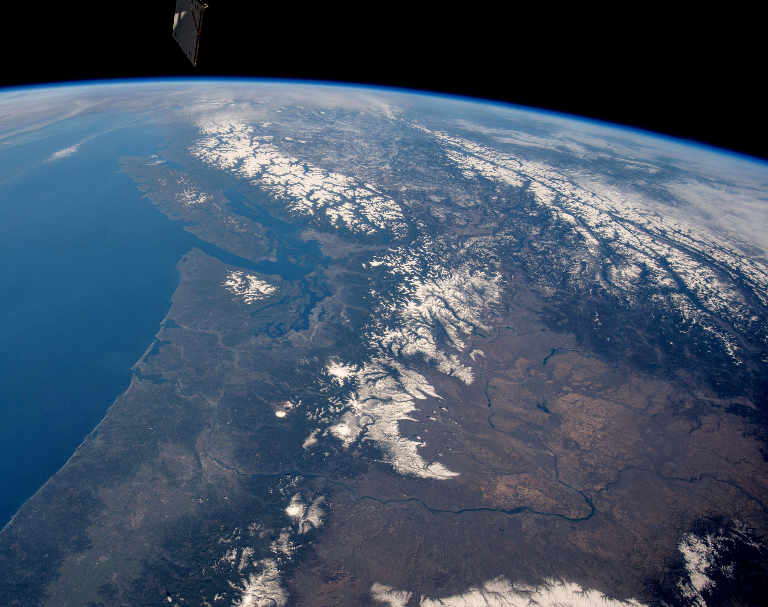

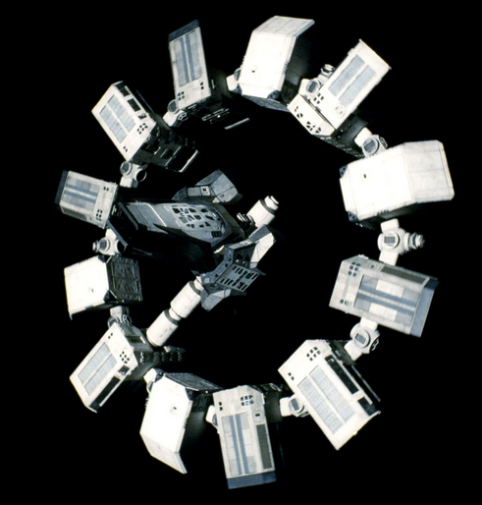

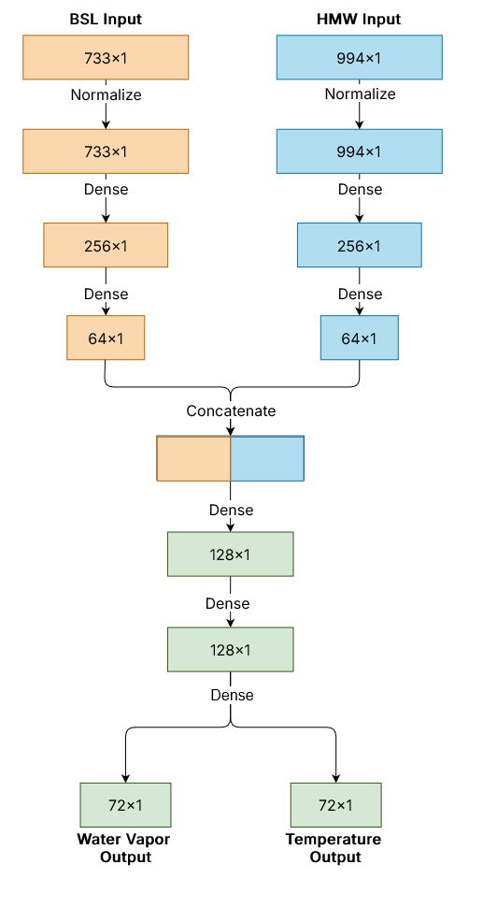
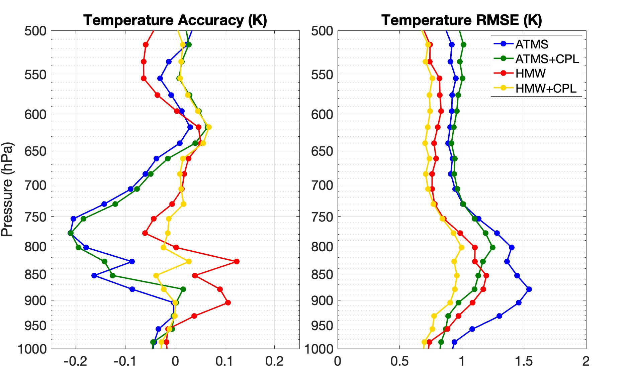
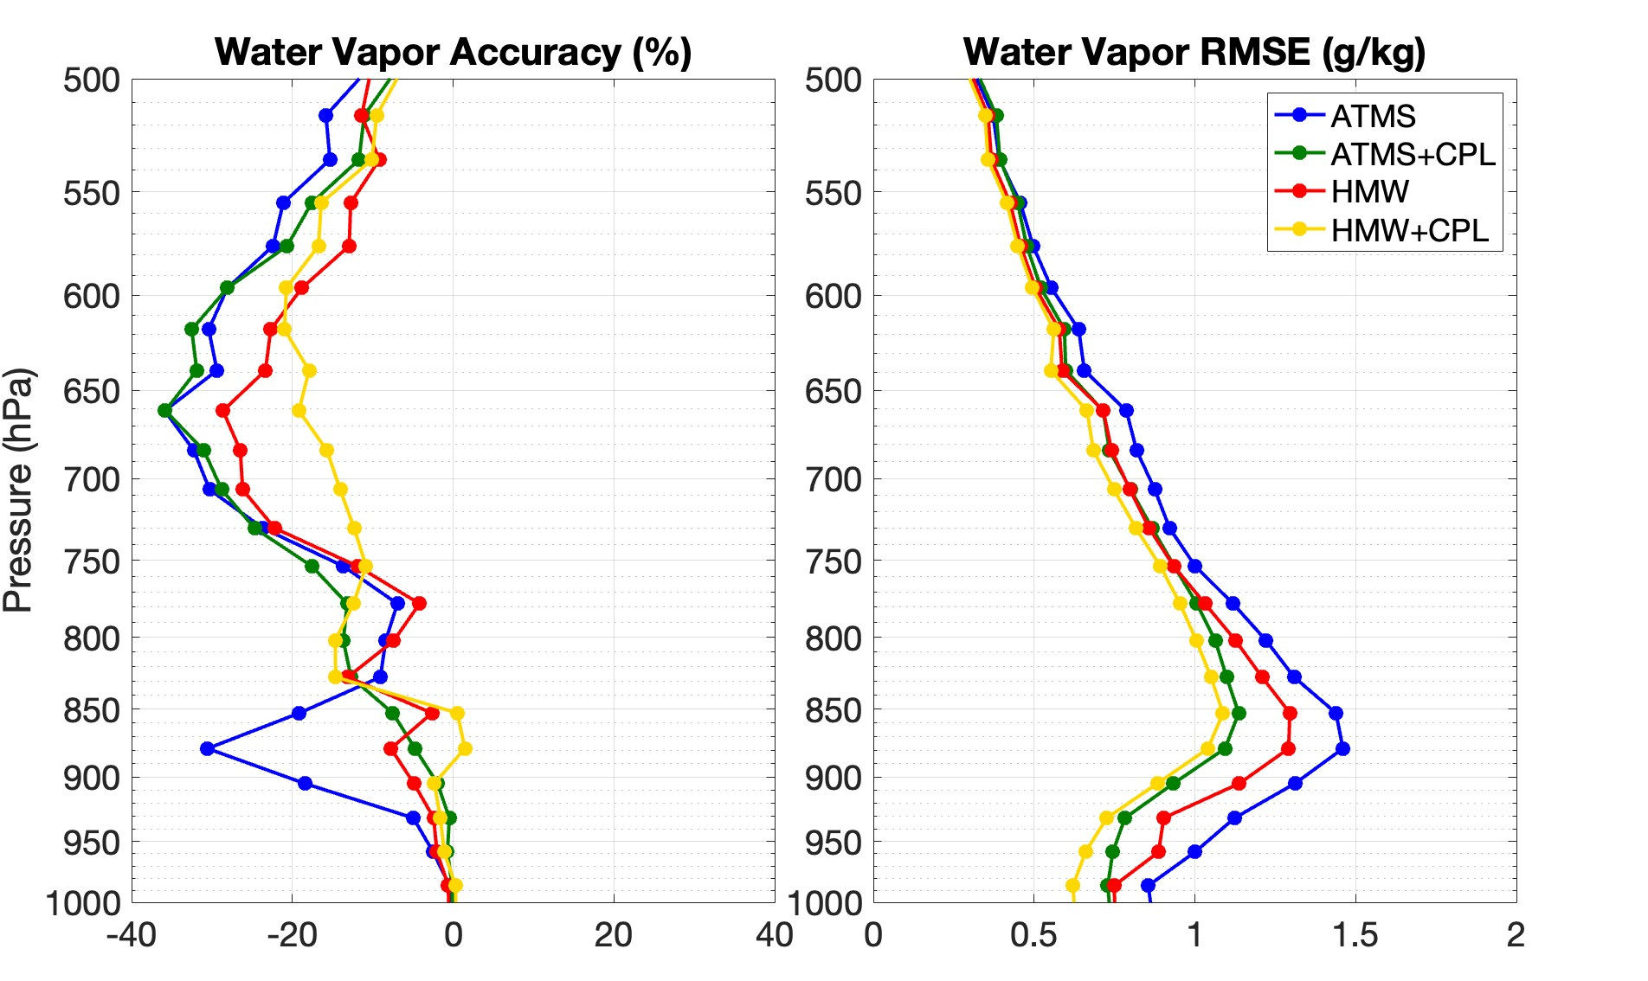
Improved PBL Profiling using AI/ML Data Fusion of Hyperspectral Microwave and Backscatter Lidar Measurements
Dave Gershman¹, Antonia Gambacorta¹, Jordan Caraballo^{1,2}, Alexander Kotsakis^{1,2}, Narges Shahroudi^{1,2}, Kenneth Christian^{1,2}, John Blaisdell^{1,3}, Robert Rosenberg^{1,3}
1: NASA GSFC, Greenbelt, MD; 2: University of Maryland, College Park, MD, 3: SSAI
dave.gershman@nasa.gov
Motivation
Effectively profiling the complex environment of the Planetary Boundary Layer (PBL) represents a continuous challenge for the PBL community at large. There exists a clear need for novel approaches to making these predictions. Artificial Intelligence (AI) and Machine Learning (ML) are well-suited to the for the structural complexity of the PBL and making the connections necessary for profiling temperature and water vapor in this region. This work leverages the unique predictive power of ML using the high-resolution of Hyperspectral Microwave (HMW) data combined with the sensitivity of Backscatter Lidar (BSL) measurements to produce results that take the PBL community one step closer to this goal of effective PBL profiling.
This work displays the powerful retrieval capabilities of these ML models, their architecture, and the various adjustments that led to the successful results shown. Overall, this work demonstrates a need for further model development and research into the fusion of various datasets across the climate science field.
Architecture
The most important aspect of this model is the usage of multiple inputs. As shown to the right, the model consists of two primary paths. One path for the HMW input and another for the BSL input. Each path begins with a normalization layer that ensures each path contains values in a similar range. The paths are then connected densely through multiple layers of decreasing size before concatenating into a final layer that leads to the both temperature and water vapor outputs simultaneously. The truth data used during training is the GEOS-5 Nature Run.
As model tuning progressed, the model architecture was evolved and changed over time. Below are among the most important insights:
1. Normalization Layer
Ensures each data input consists of values in a similar range. This improves model performance and improves support for a vast range of inputs.
2. Reducing Layer Sizes
Each input path consists of progressively smaller layers, this decreases model complexity which reduces overfitting.
3. Predicting Multiple Outputs
Previously, we predicted water vapor and temperature separately. However, our results consistently favored runs that involved both outputs predicted at the same time as they cover similar domains.
Results
The figures to the right display accuracy (closer to zero is best) and RMSE for the Temperature and Water Vapor predictions of our best model.
Each line represents a different model input configuration. We tested MW inputs for both the current program of record (ATMS) and HMW.
The graphs clearly display an improvement when combining BSL measurements with both ATMS and HMW. Notably, the best results were found when working specifically with HMW models versus the ATMS models.
ATMS
ATMS+BSL
HMW
HMW+BSL
ATMS
ATMS+BSL
HMW
HMW+BSL
Future Work
Due to the continuing success of our data fusion efforts, we’ve considered many possible avenues of future work. The primary focus is on newly acquired hyperspectral data from the Conical Scanning Millimeter-wave Imaging Radiometer – Hyperspectral (CoSMIR-H). Our goal is to utilize both simulated and real CoSMIR-H / BSL data for training. This will allow us to test our findings on real instrument data and move beyond the ideal nature of the simulated data we’ve been working with. We are also considering the prediction of more data points such as pressure profiles, surface temperature, and PBL height. Furthermore, we’d like to explore more sensors / instrument combinations that collect data from other parts of the spectrum such as infrared, visible, etc.
Notes:
Picture in the background:
The Pacific Ocean from the ISS - Photo: NASA
https://issnationallab.org/iss360/studying-earths-oceans-from-space/

