Slide 1


Requirement
Architectures
Application to Space Missions
Examples from: BioSentinel, MSR-EEV-TPS, HelioSwarm
Spaceflight Division, Systems Engineering Integration & Testing
Z.Young
April 17th, 2025

Slide 2
Introduction & Agenda
Welcome…
Brief Introduction, a little about me
Requirement Architectures, What are they…
  System Functional Breakdown
  Traceability / Allocation
  System Interfaces
  Project Organization (Operating)
Applied Examples
  BioSentinel Mission
  Mars Sample Return – Earth Entry Vehicle – TPS
  HelioSwarm
Summary / Conclusions
Requirement Architectures – Systems Engineering Integration & Test
April 17th, 2025

Slide 3


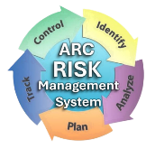
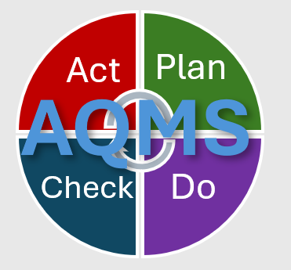
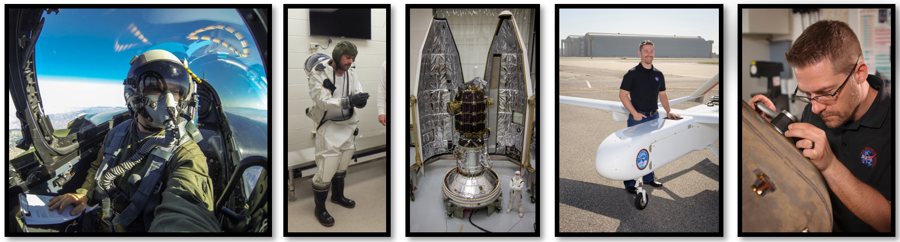
A Little About Me
Zion Young
~17 Years @ NASA Ames
Senior Mechanical Engineer
Senior Systems Engineer
B.S. Aerospace Engineering, SJSU
M.S. Mechanical Engineering, SJSU
Project System Engineer / Project Chief Engineer (Current)
Joined the Team in Feb 2025
Associate Director, Safety & Mission Assurance,
Management Operations (Previous)
Institutional Systems Engineering
Requirement Architectures – Systems Engineering Integration & Test
April 17th, 2025

Slide 4
A Little About Me
HelioSwarm
Project Systems Engineer
Supervisory / Operations
Discipline Engineering
Supporting Projects and Missions
Engineering Team Leadership
Leading Technical Teams for Project or Mission Elements
Engineering Technical Authority
Project or Mission Chief Engineer
Engineering Technical Authority
Project or Mission Chief Engineer
Line Management
Requirement Architectures – Systems Engineering Integration & Test
April 17th, 2025

Slide 5
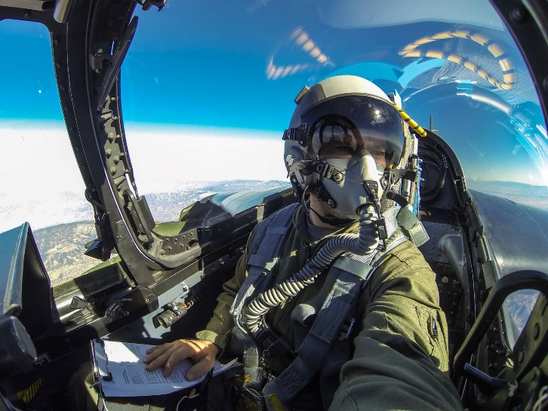
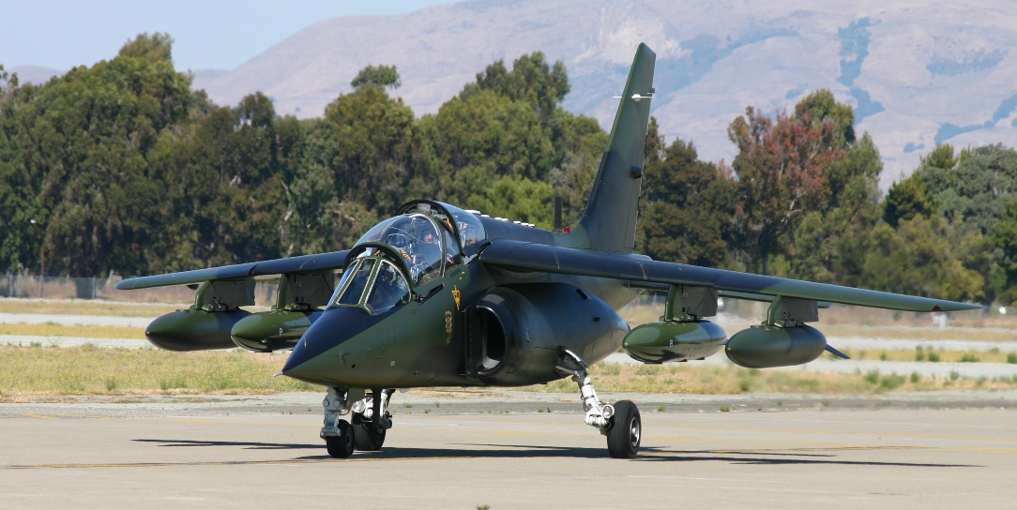
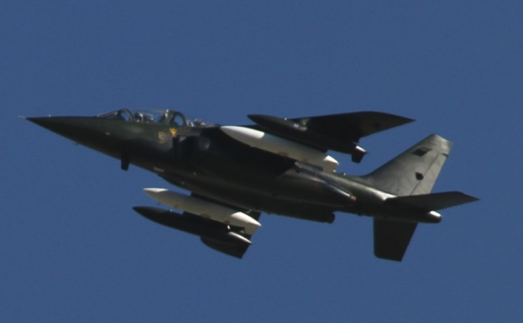
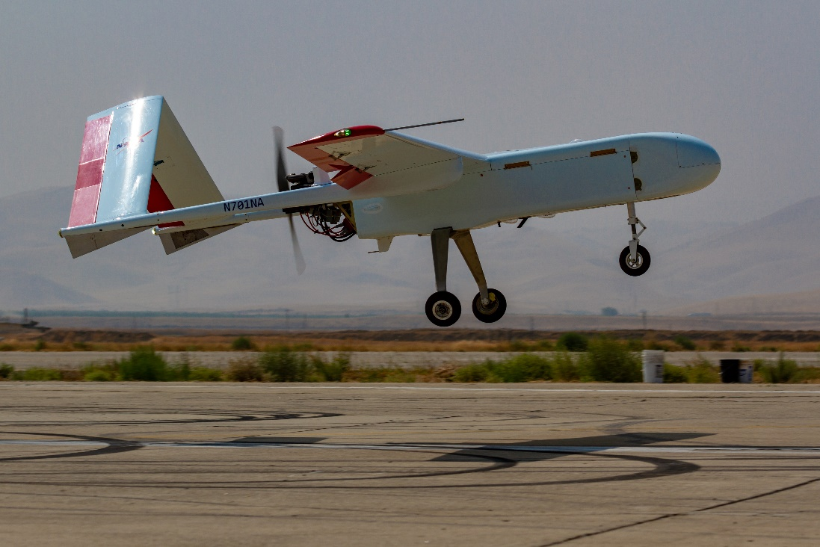
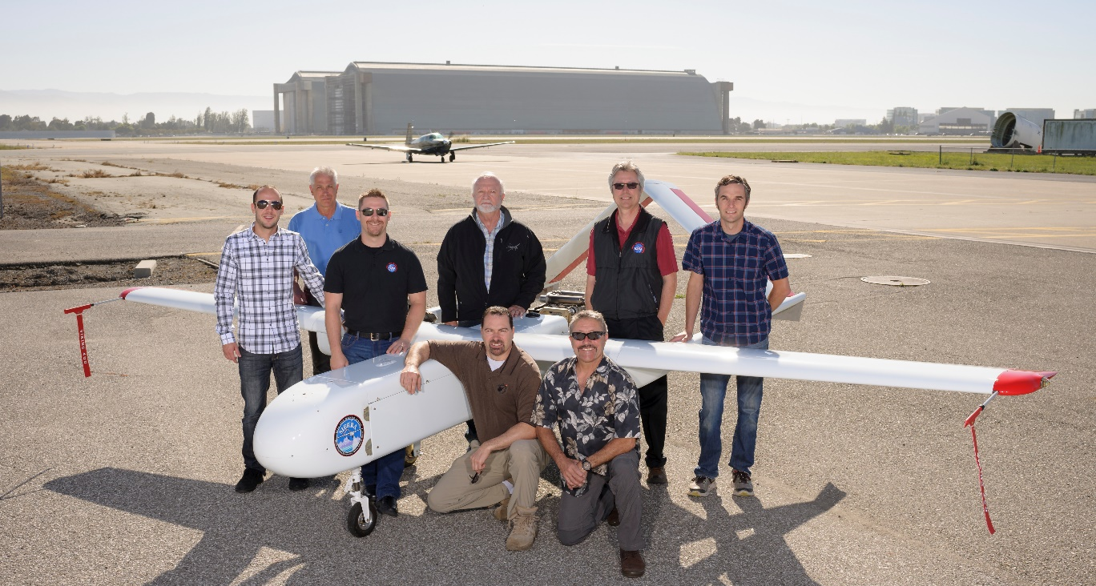
A Little About Me
Alpha Jet – AJAX Mission
Airborne Science Mission Support
Mechanical Systems/Structural Design, Analysis & Verification/Testing
Large Scale UAS Development & Certification
SIERRA-B UAS (CAT-III)
Requirement Architectures – Systems Engineering Integration & Test
April 17th, 2025

Slide 6
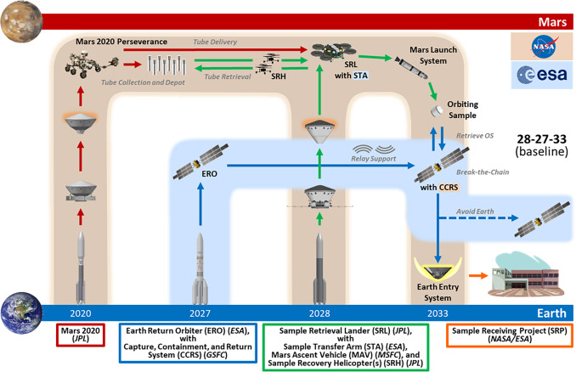
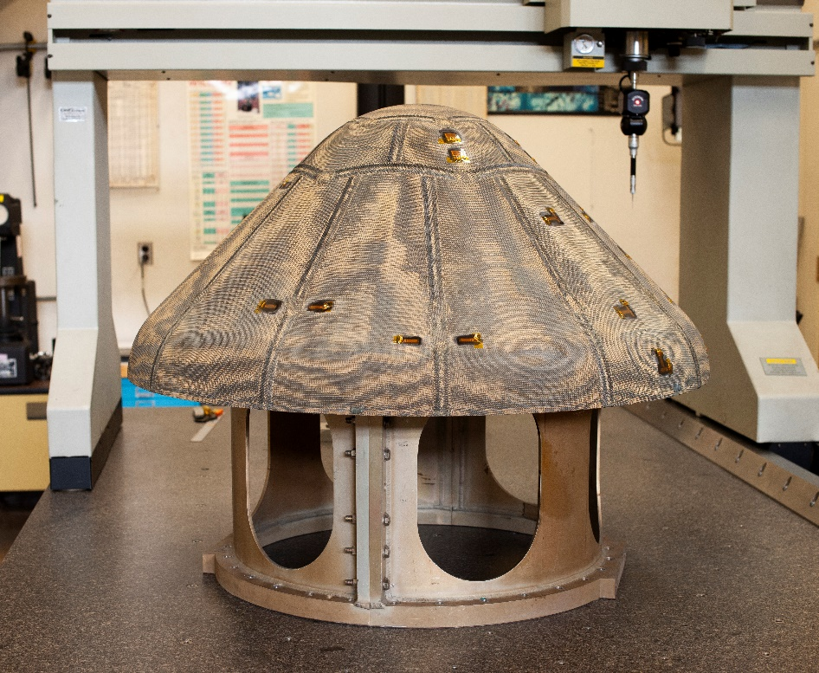
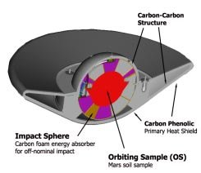
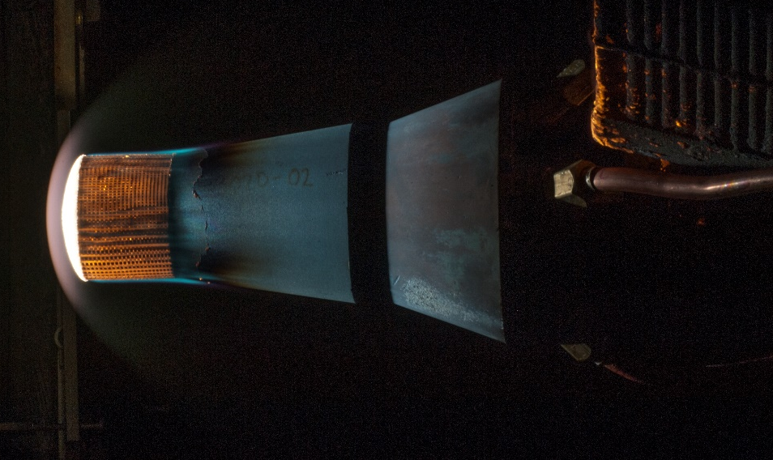
A Little About Me
HEEET
Entry System Technology Development, Advanced Manufacturing, Processing, Integration & Testing
Entry System Mission – Systems Engineering
MSR-EEV-TPS
Requirement Architectures – Systems Engineering Integration & Test
April 17th, 2025

Slide 7
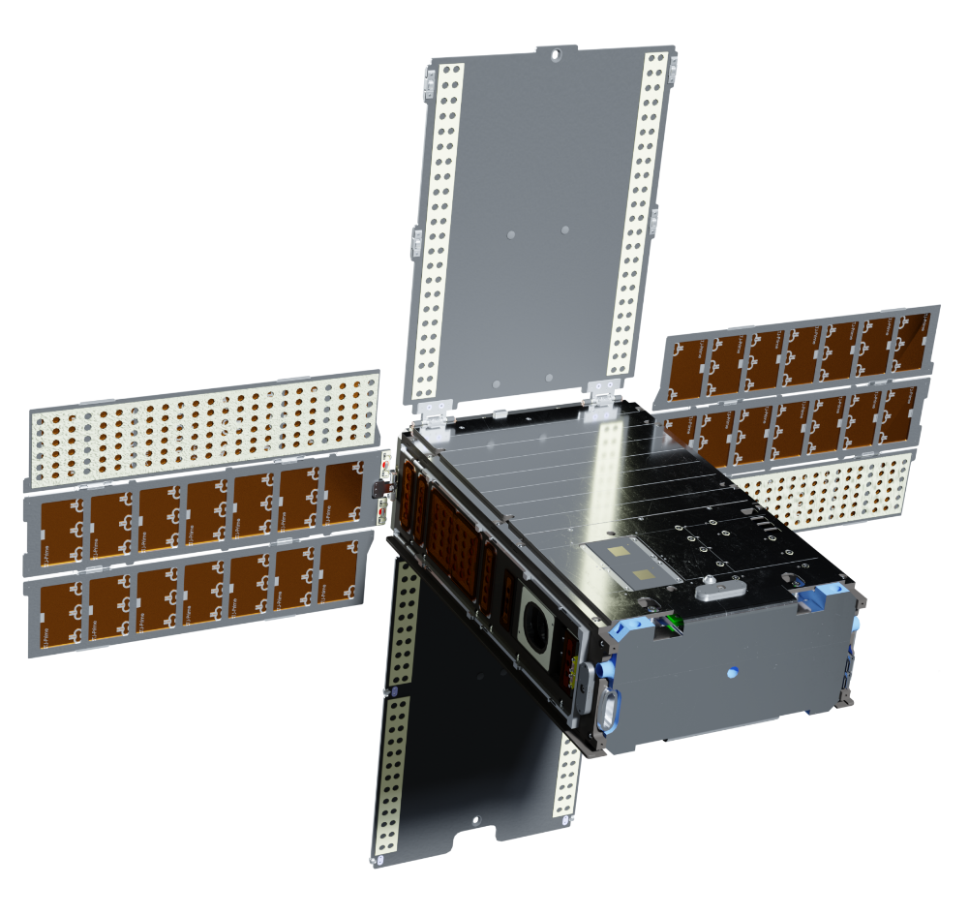
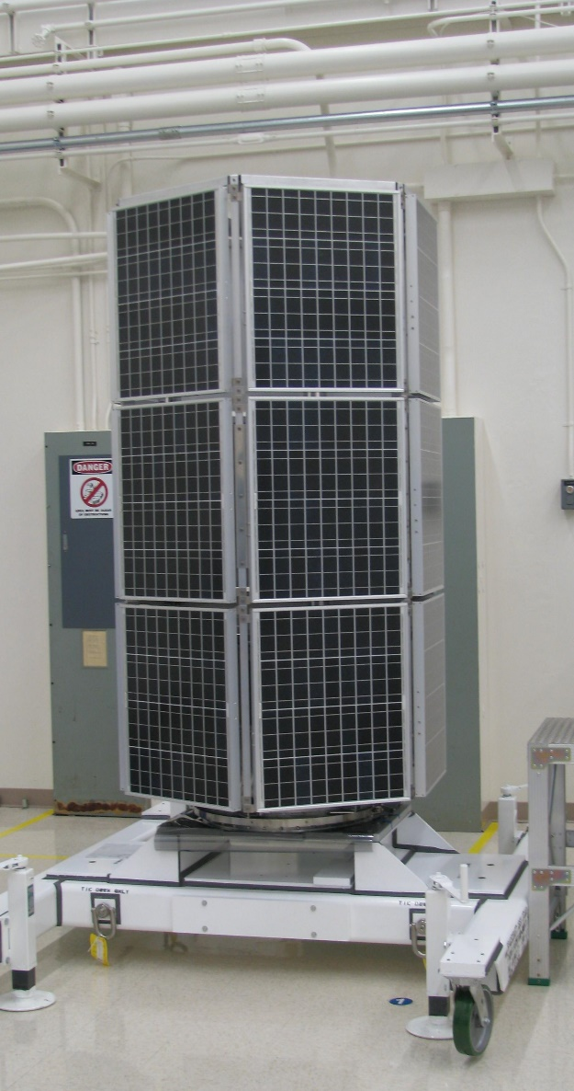
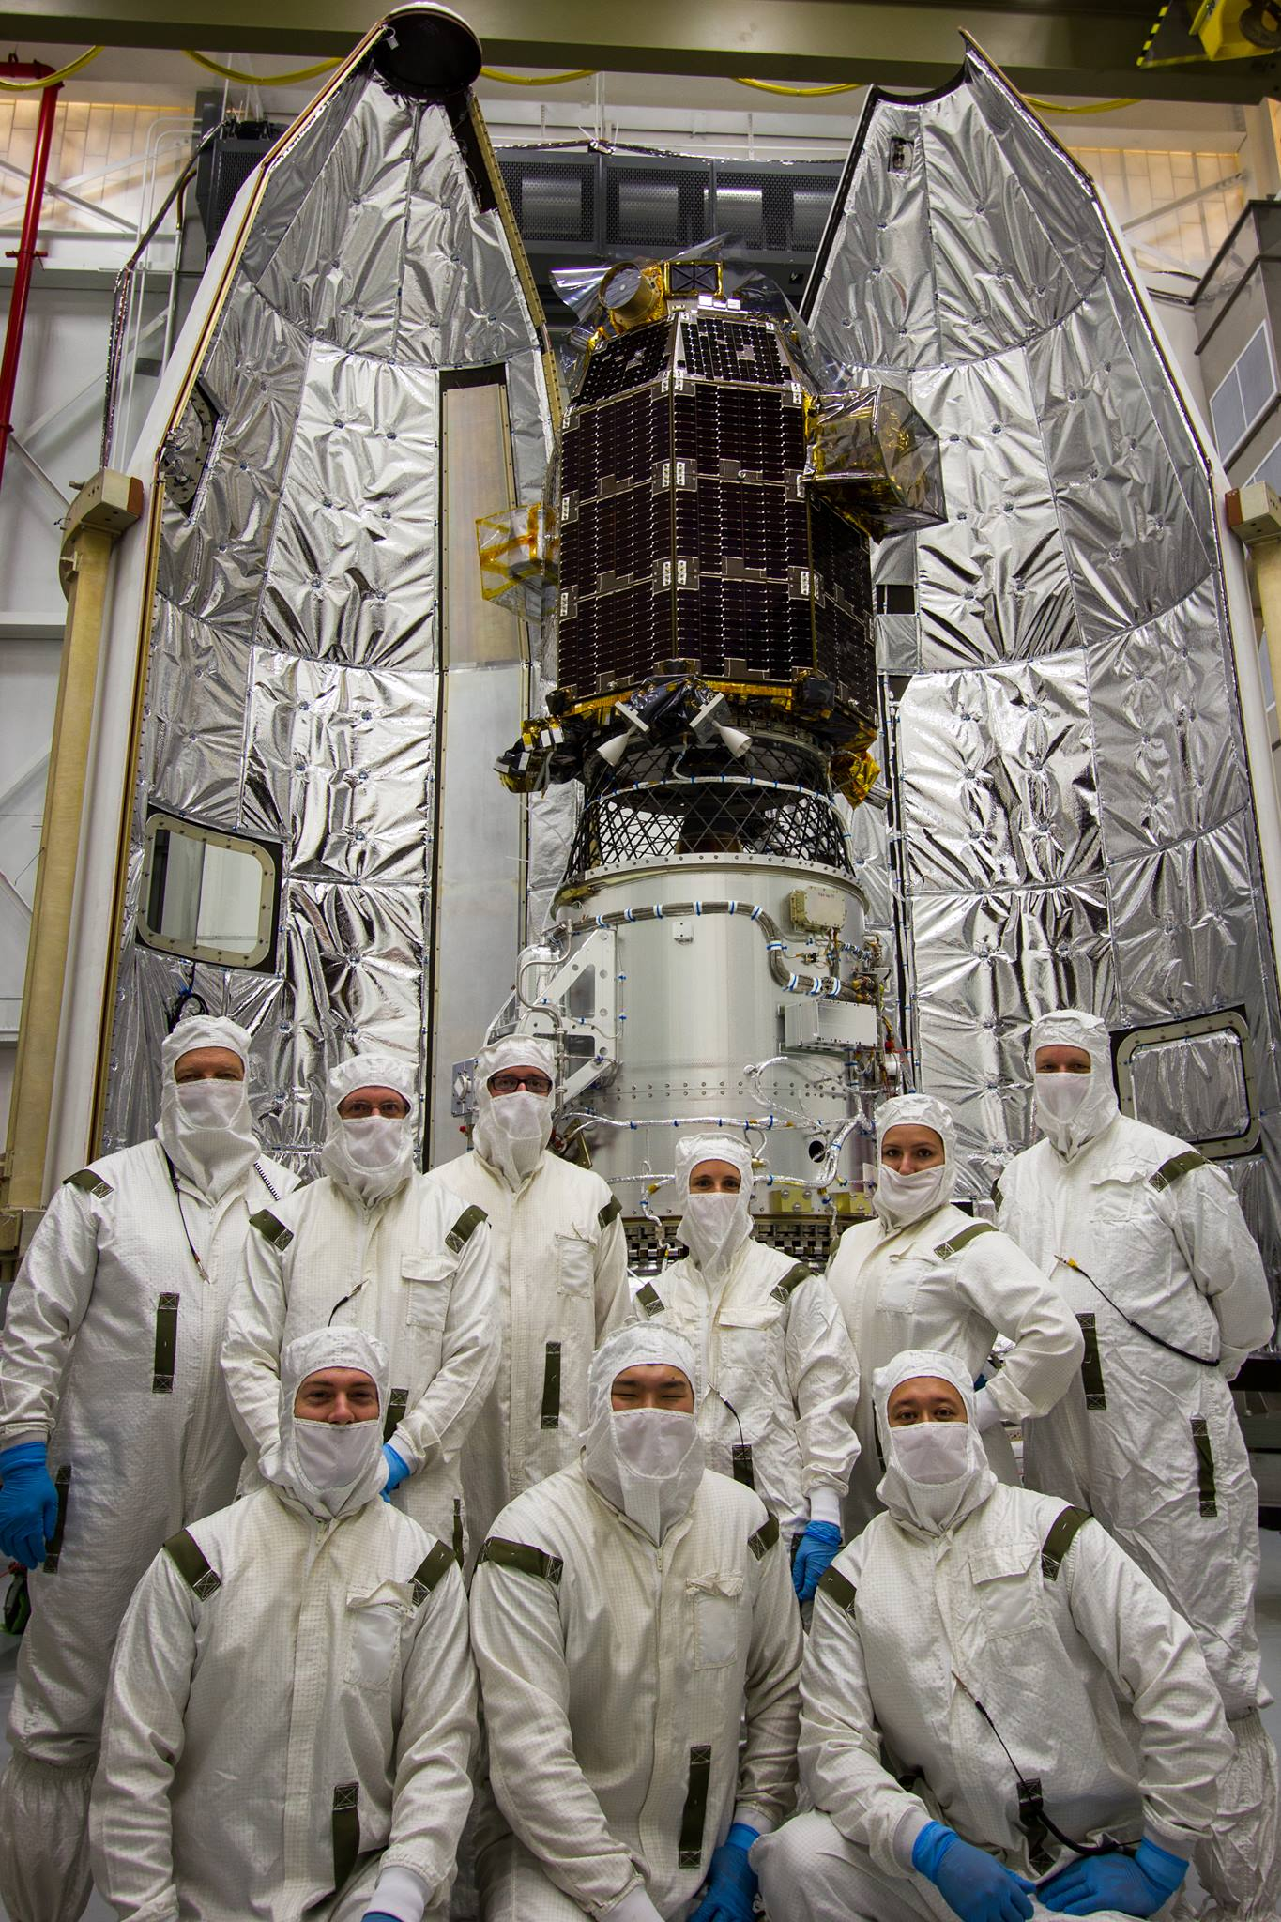
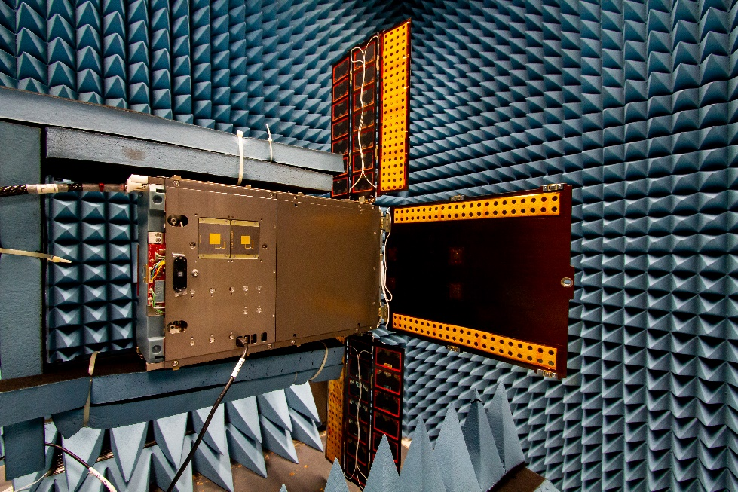
A Little About Me
LADEE
Spacecraft & Mission Systems Engineering
BioSentinel
COTSAT
Space Vehicle Design, AI&T
Space Vehicle Design, Manufacturing, AI&T, Launch Processing
Requirement Architectures – Systems Engineering Integration & Test
April 17th, 2025

Slide 8
Requirement Architectures
What Are They? …

Slide 9
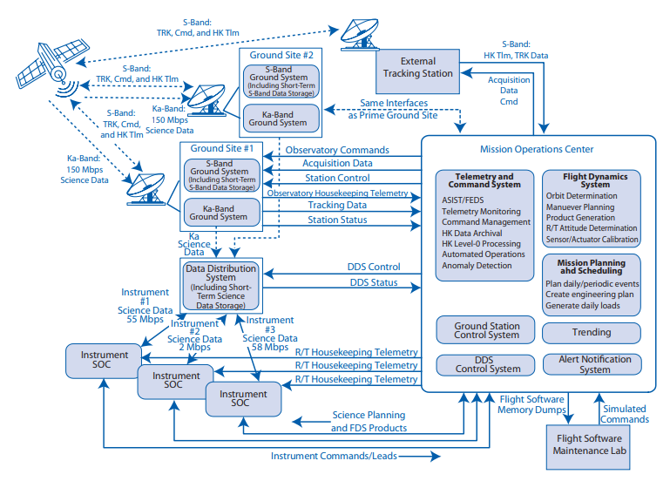
Requirement Architectures - Basics
So, you want to do something challenging…
While spacecraft themselves are very complex, execution of the spaceflight mission requires interacting with multiple external system, facilities, teams, and organizations.
Example Space Mission End-to-End Operational Architecture
Requirement Architectures – Systems Engineering Integration & Test
April 17th, 2025

Slide 10
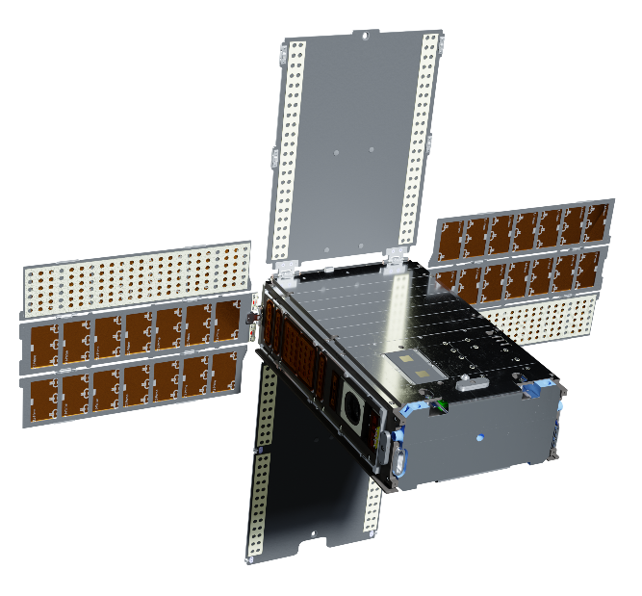
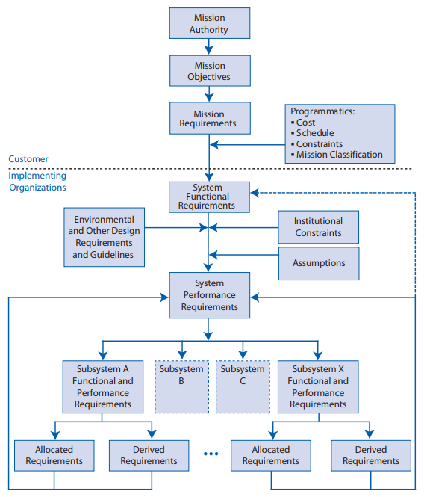
Requirement Architectures - Basics
Flowdown of requirements process
Example Resulting Requirements Architecture
Strategic Development Requirements
Mission Requirements / Customer Requirements
Level 1
ConOps
Operational Requirements
What the System must do to be successful in meeting mission Requirements
Level 2
Flight Segment/System Requirements
What the System must be capable of to carry out the operational requirements.
Level 3
Functional Decomposition
Sub-System Requirements
What the Sub-System must be capable of to enable the flight segment system capabilities
Level 4
Part or Element Requirements
Part or Element functional capabilities that enable the subsystem capabilities
Level 5
Requirement Architectures – Systems Engineering Integration & Test
April 17th, 2025

Slide 11
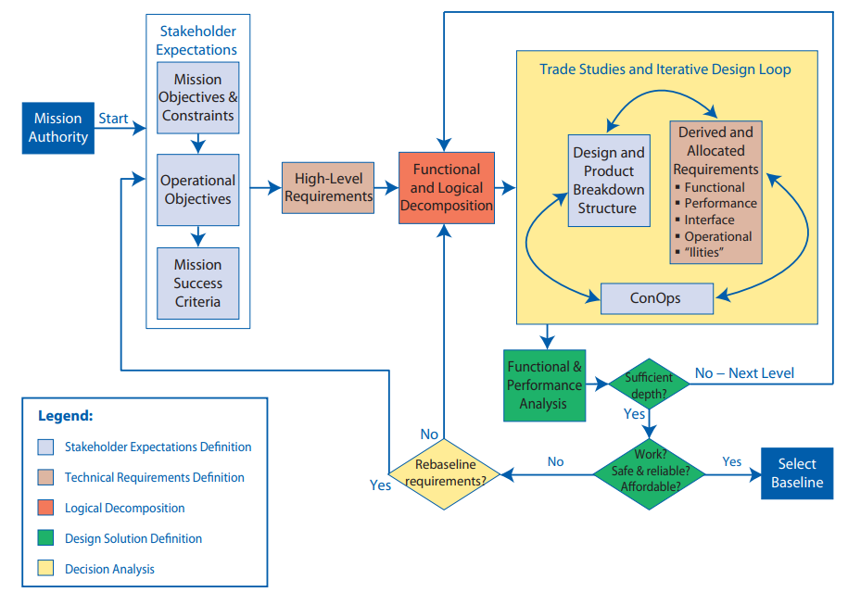
Requirement Architectures - Basics
A requirements architecture combines both operational aspects resulting from the concept of operations and system functional decomposition
The development of a good system-level architecture is a creative, recursive, and iterative process that combines an excellent understanding of the project’s end objectives and constraints with an equally good knowledge of various potential technical means of delivering the end products.
Interrelationships among the systems design processes
Requirement Architectures – Systems Engineering Integration & Test
April 17th, 2025

Slide 12
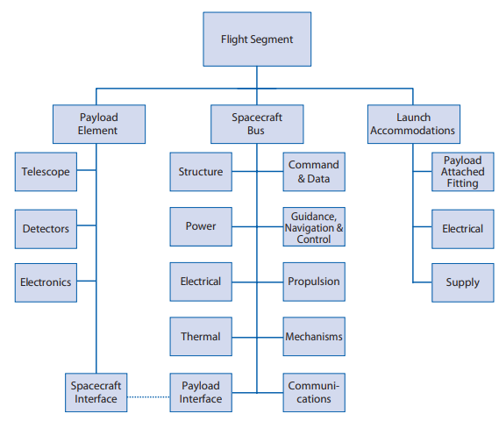
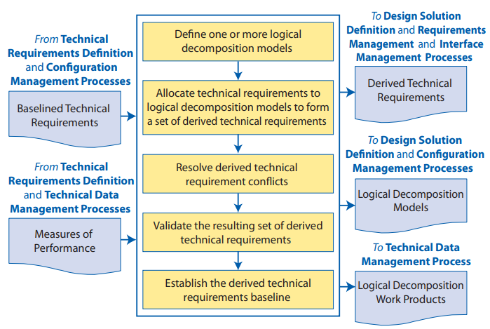
Requirement Architectures - Basics
System Logical / Functional Breakdown
Example Logical Breakdown Structure
Requirement Architectures – Systems Engineering Integration & Test
April 17th, 2025

Slide 13
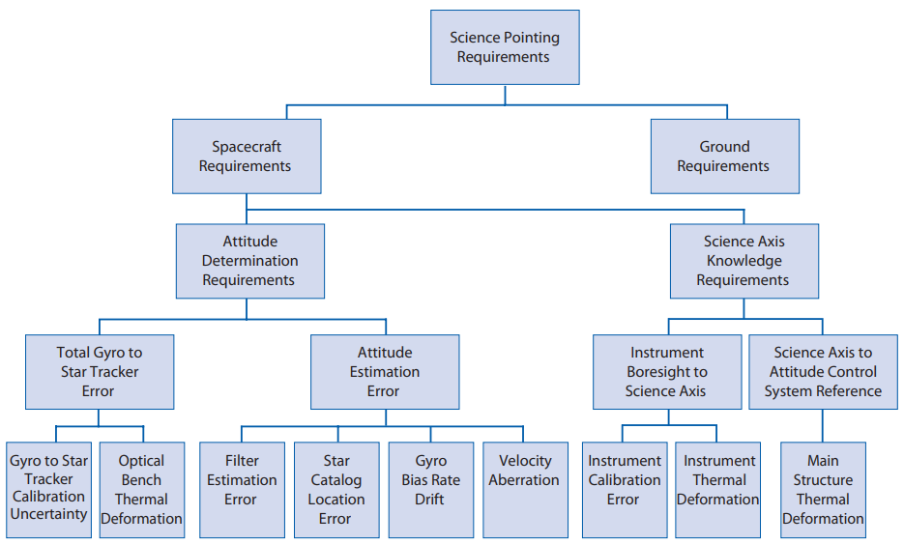
Requirement Architectures - Basics
Traceability / Allocation
Example Allocation and Flow down of Science Pointing Requirements
Operational Requirements
Level 2
Flight Segment/System Requirements
Level 3
Sub-System Requirements
Level 4
Part or Element Requirements
Level 5
Parent / Child Connections between requirements allow flow down/up clarity and clear impact analysis if requirements need to be changed or can not be met
Requirement Architectures – Systems Engineering Integration & Test
April 17th, 2025

Slide 14
Requirement Architectures - Basics
Example Interface Requirements carried in a Requirement Architecture
Level 1
Strategic Development Requirements
Mission Requirements / Customer Requirements
Example:
Communications
Level 2
Operational Requirements
What the System must do to be successful in meeting mission Requirements
Interface Reqs.
Interacting System Operational Requirements
Support System Operational Requirement to Meet Customer Requirements
Example:
Launch Vehicle / Payload
Level 3
Flight Segment/System Requirements
What the System must be capable of to carry out the operational requirements.
Interface Reqs.
Interfacing System Requirements
Support System Requirement to support operations
Sub-System Requirements
What the Sub-System must be capable of to enable the flight segment system capabilities
Level 4
Level 5
Part or Element Requirements
Part or Element functional capabilities that enable the subsystem capabilities
Requirement Architectures – Systems Engineering Integration & Test
April 17th, 2025

Slide 15
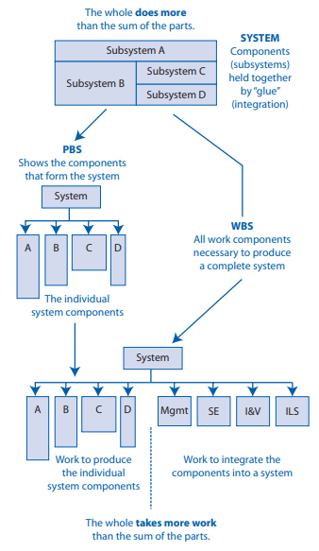
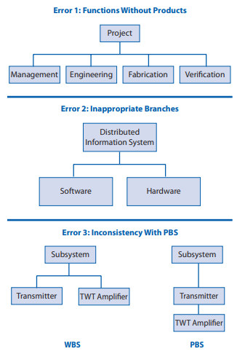
Requirement Architectures - Basics
  Project Organization (Operating)
The Projects Org Chart / Work Breakdown Structure needs to align with the logical and functional decomposition residing in the requirements architecture.
This allows the modules of a requirement architecture to have clear assigned responsibilities and clear reporting paths depending within the project organization.
WBS = Work Breakdown Structure
PBS = Product Breakdown Structure
Relationship between PBS and WBS
Examples of WBS Development Errors
Requirement Architectures – Systems Engineering Integration & Test
April 17th, 2025

Slide 16
Space Mission Examples

Slide 17
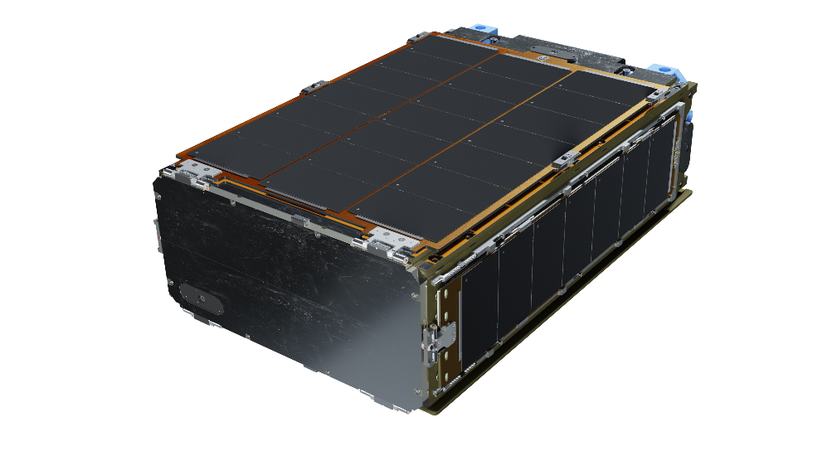
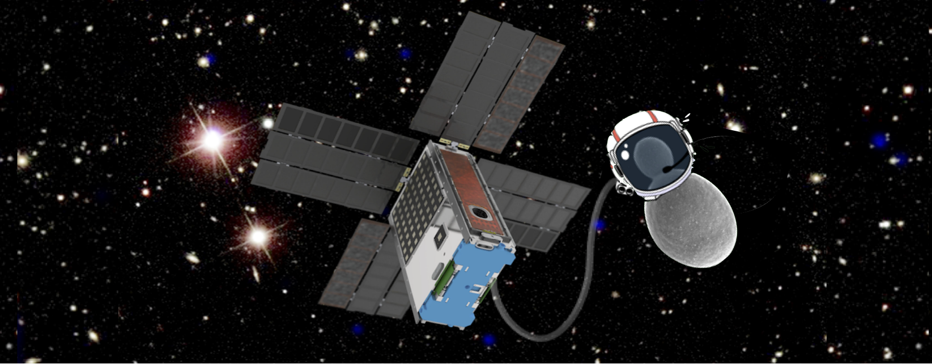

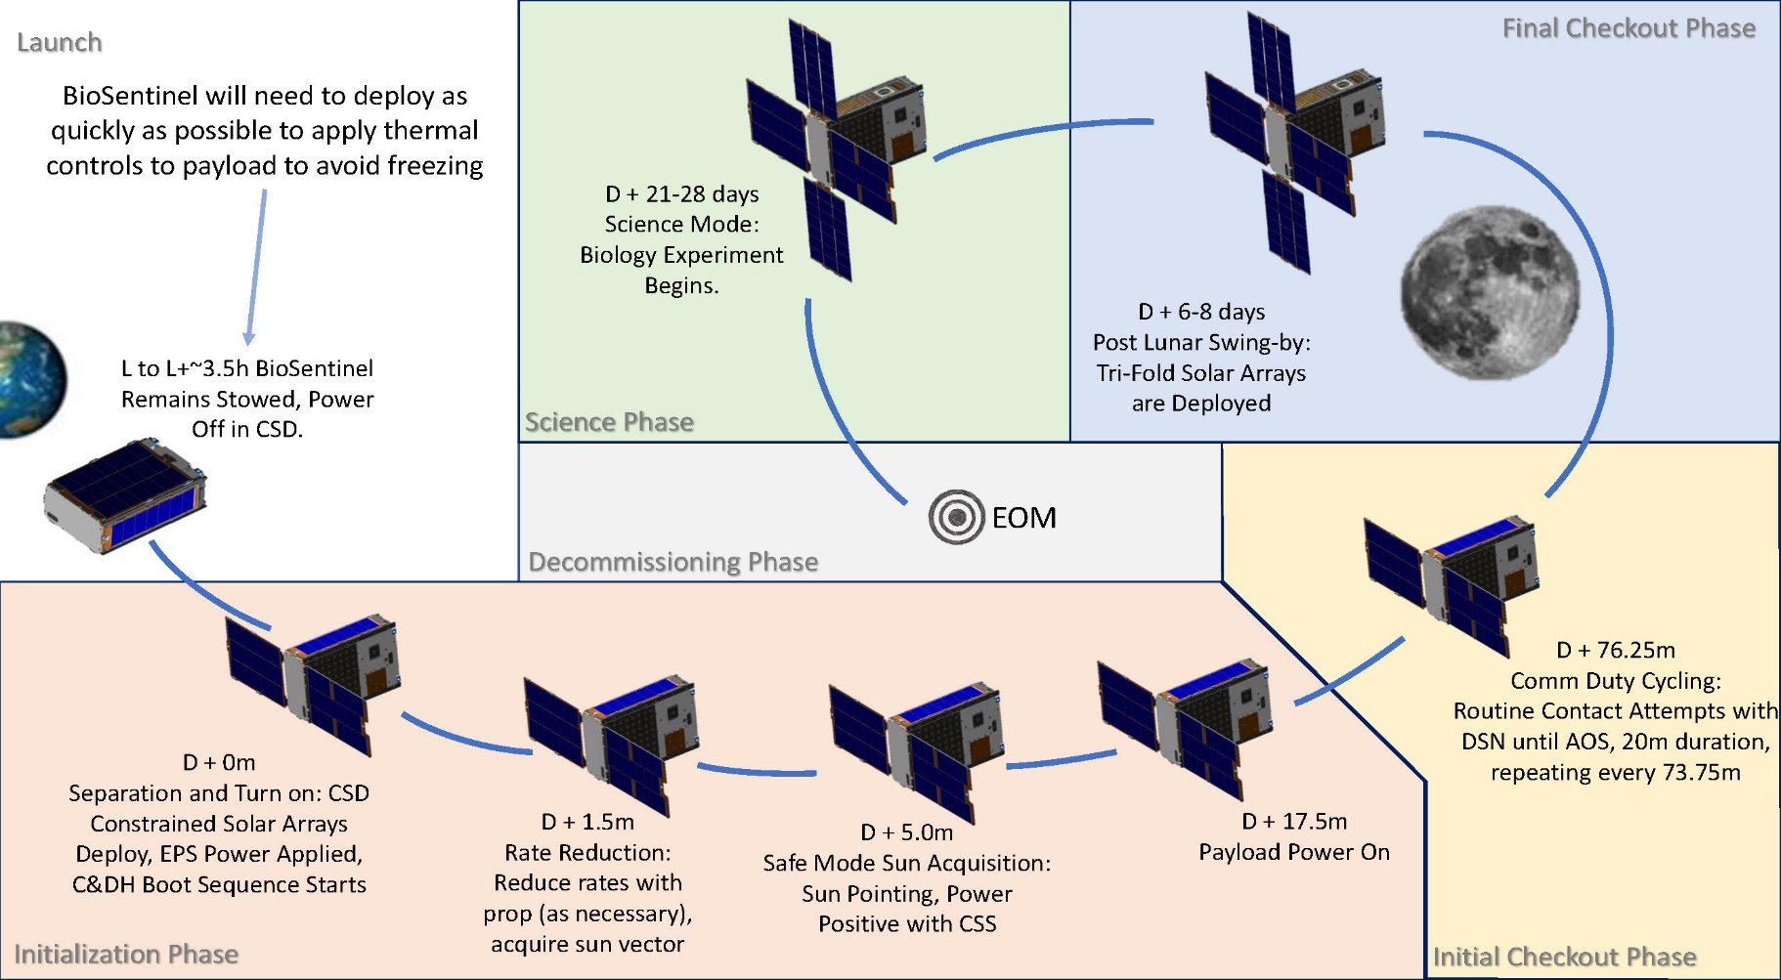
BioSentinel – Mission Overview
Currently Operational!
(Launched on SLS: Nov 16, 2022)
> 60M Kilometers Away from Earth
Requirement Architectures – Systems Engineering Integration & Test
April 17th, 2025

Slide 18
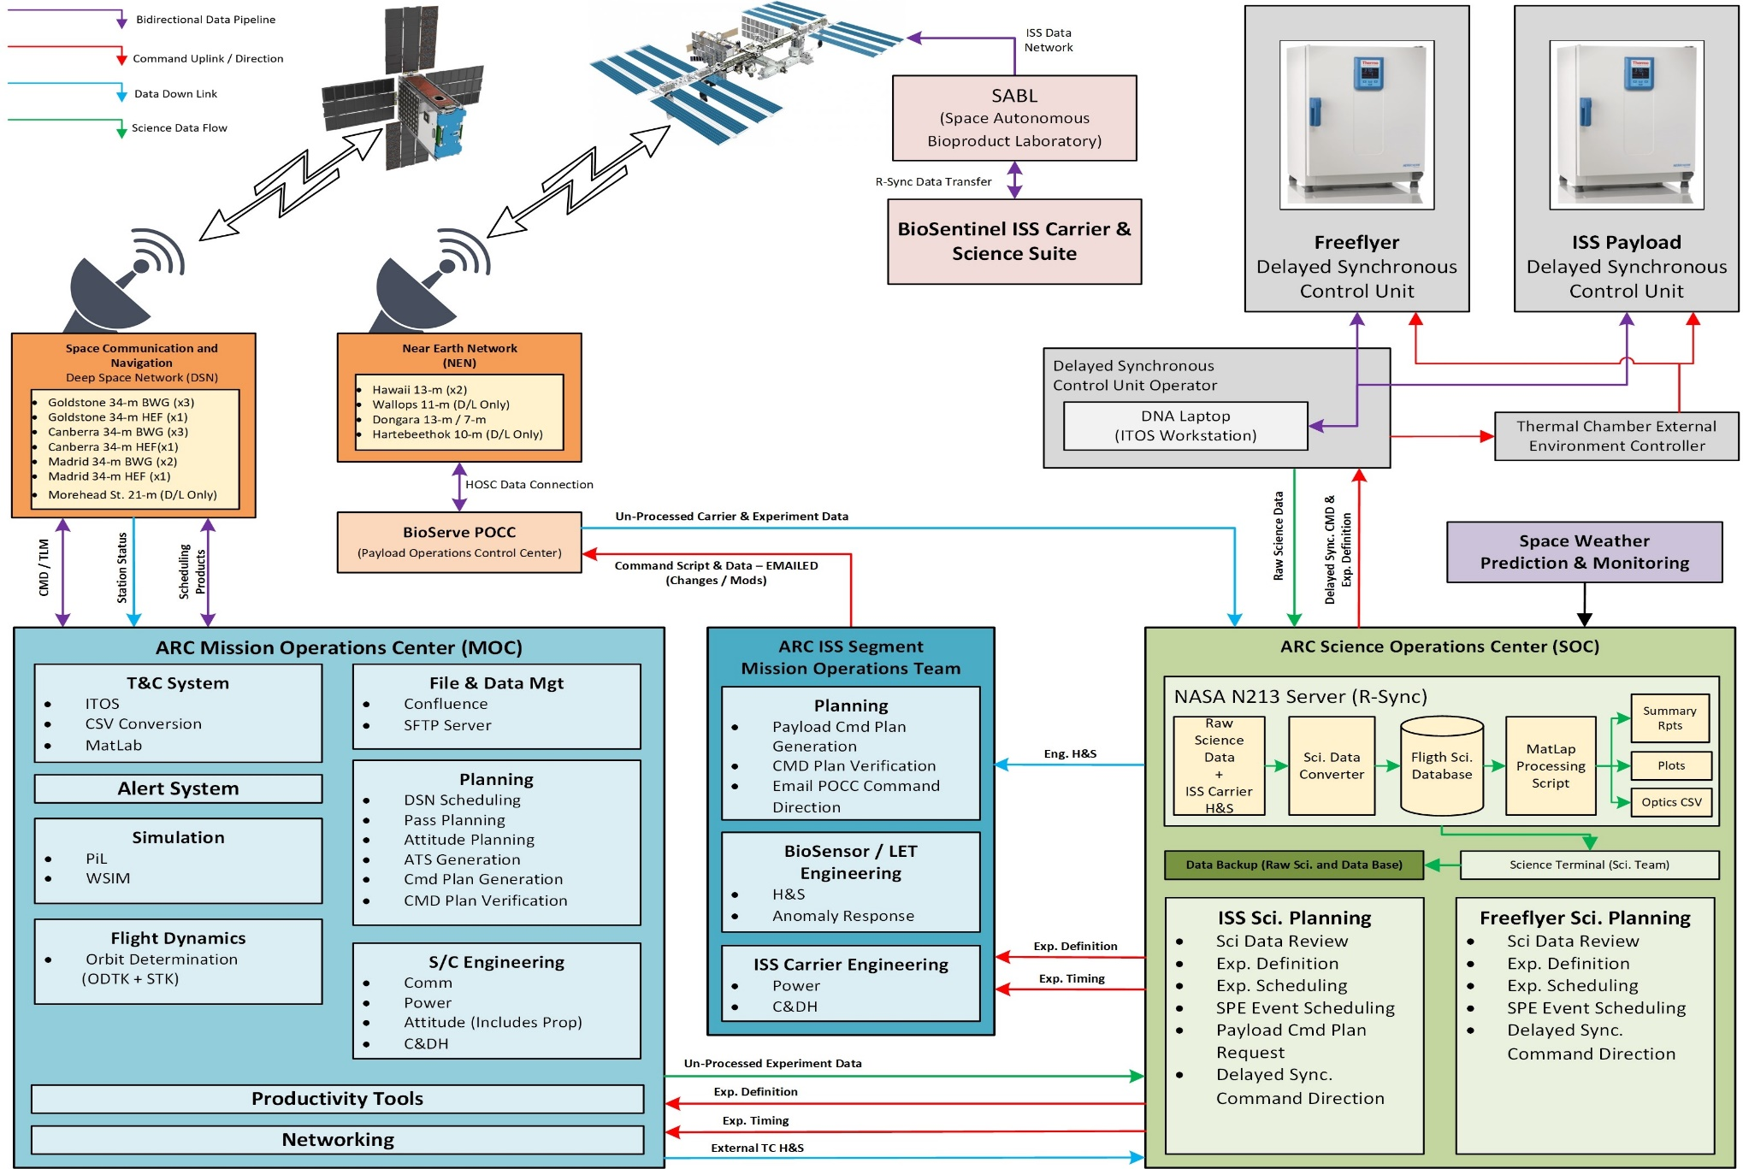
BioSentinel – Mission Overview
During the course of the BioSentinel Mission the scope of the science mission expanded from:
Evaluating the effects of deep space radiation living organisms
to: the above + controlled against null G environment and null radiation environment.
Requirement Architectures – Systems Engineering Integration & Test
April 17th, 2025

Slide 19
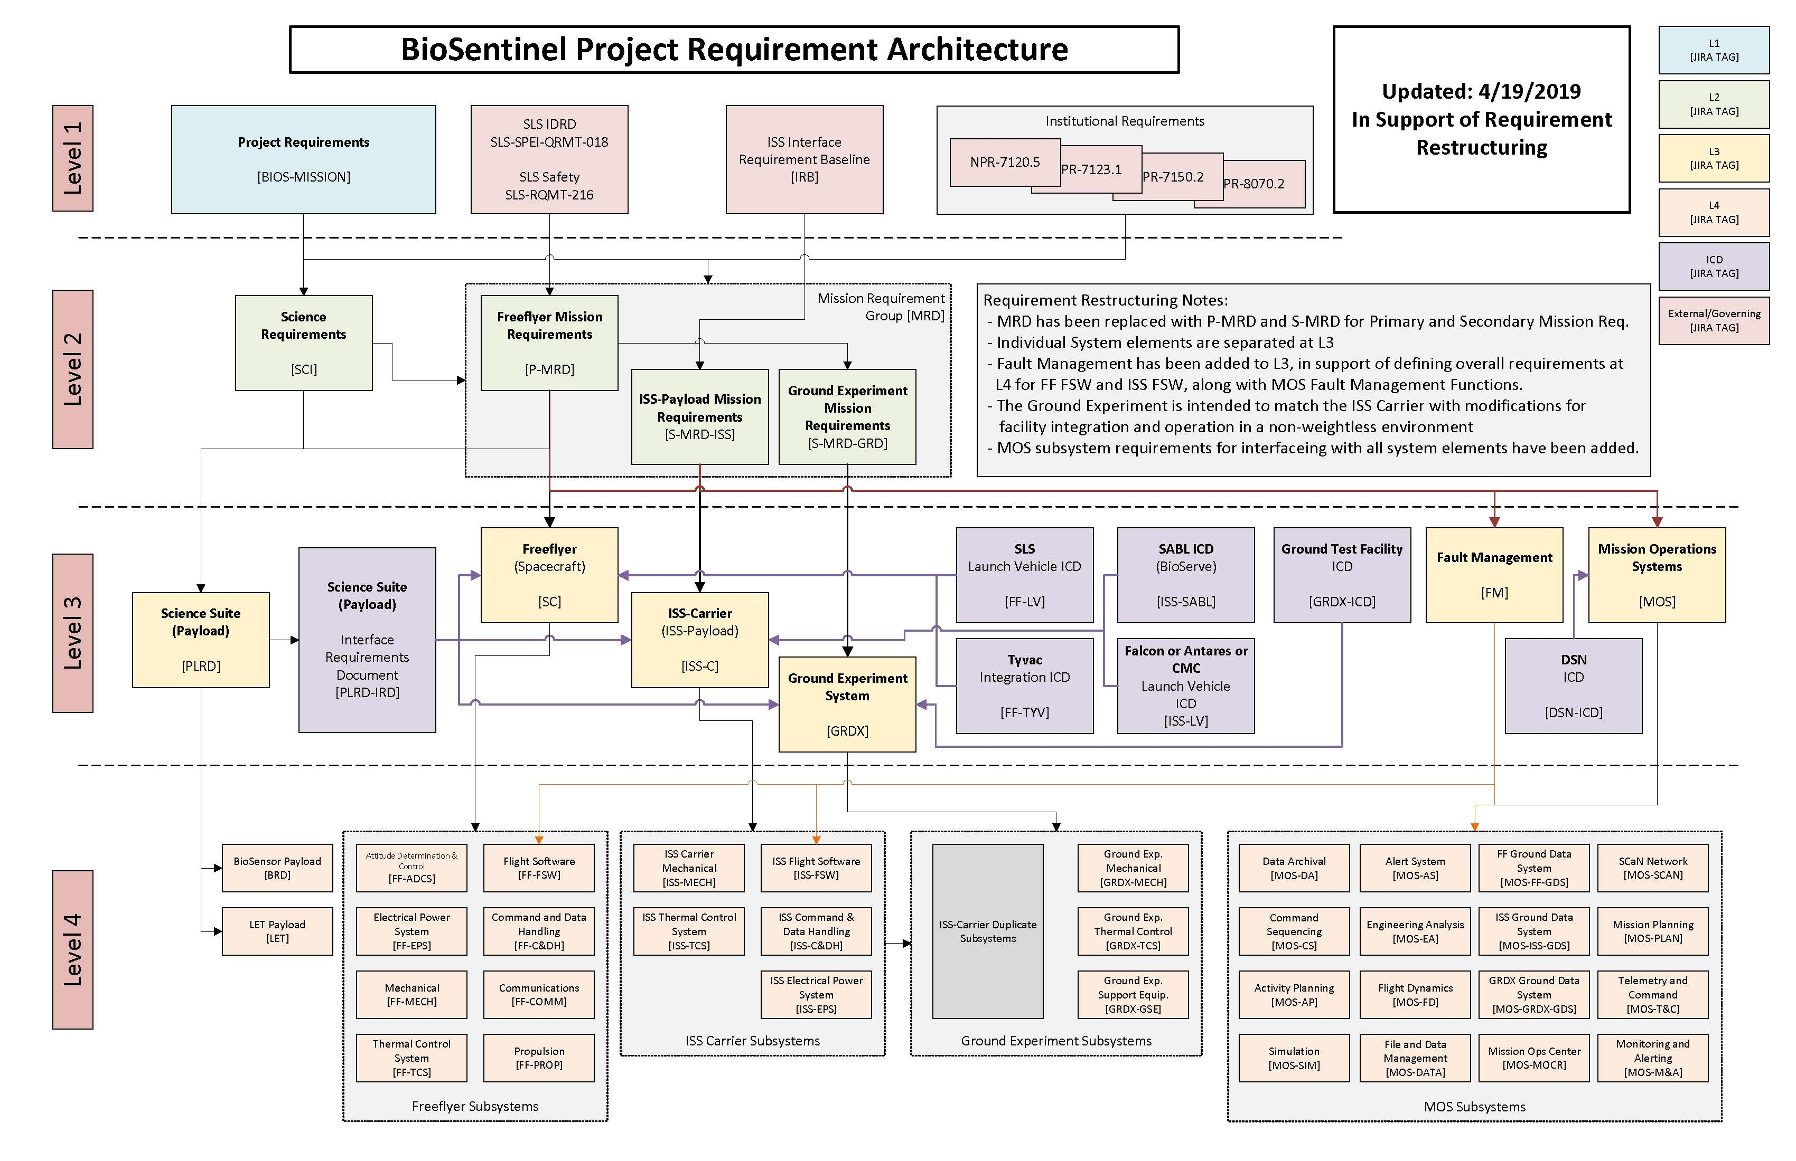
BioSentinel – Requirement Architecture
Requirement Architectures – Systems Engineering Integration & Test
April 17th, 2025

Slide 20

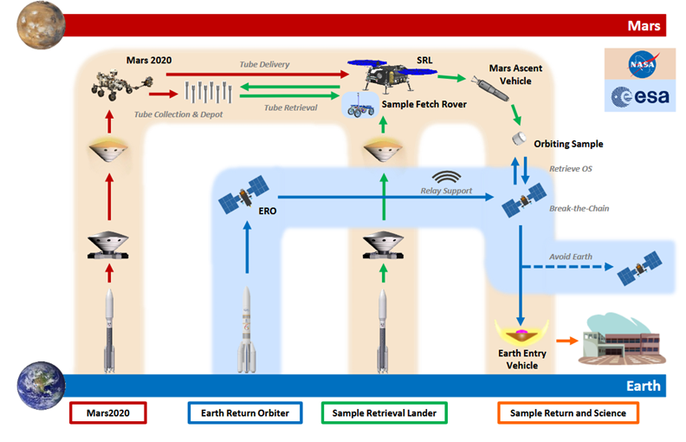
Mars Sample Return – Mission Overview
Requirement Architectures – Systems Engineering Integration & Test
April 17th, 2025

Slide 21
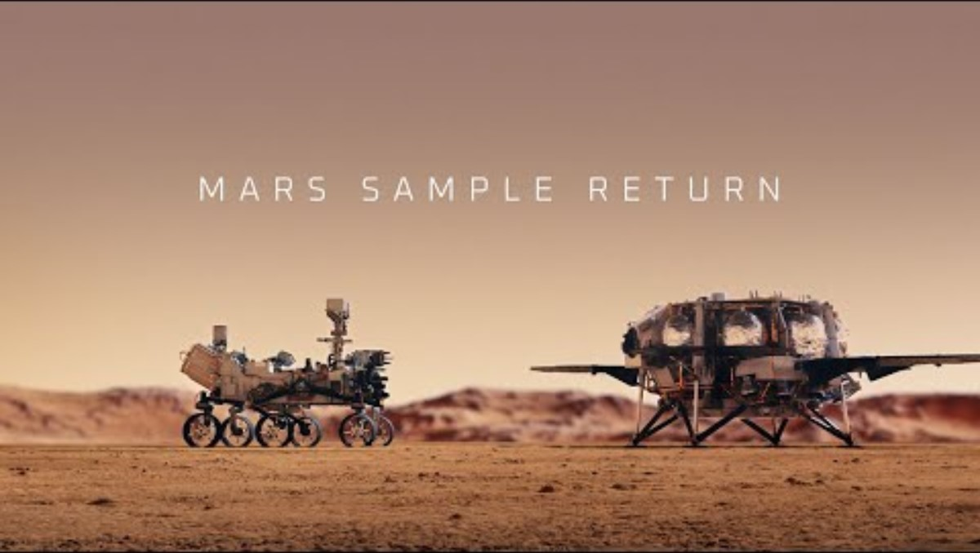
Mars Sample Return – Mission Overview
Requirement Architectures – Systems Engineering Integration & Test
April 17th, 2025

Slide 22
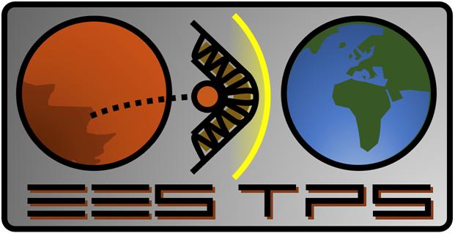
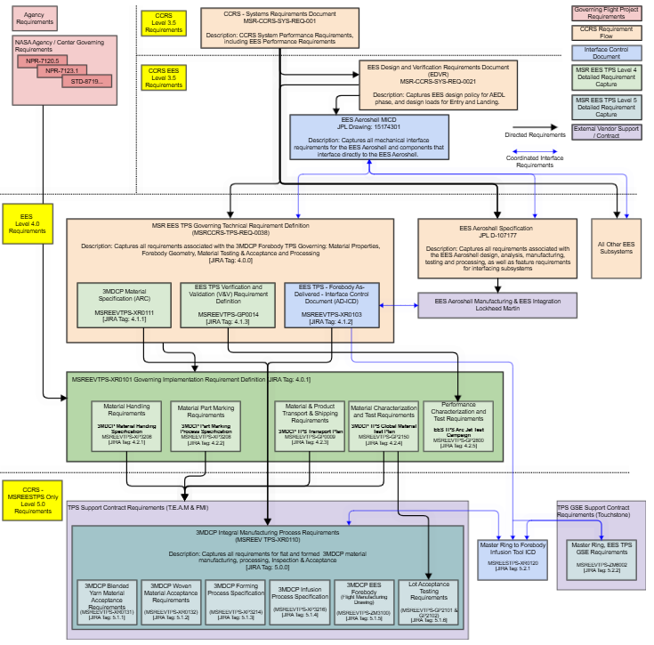
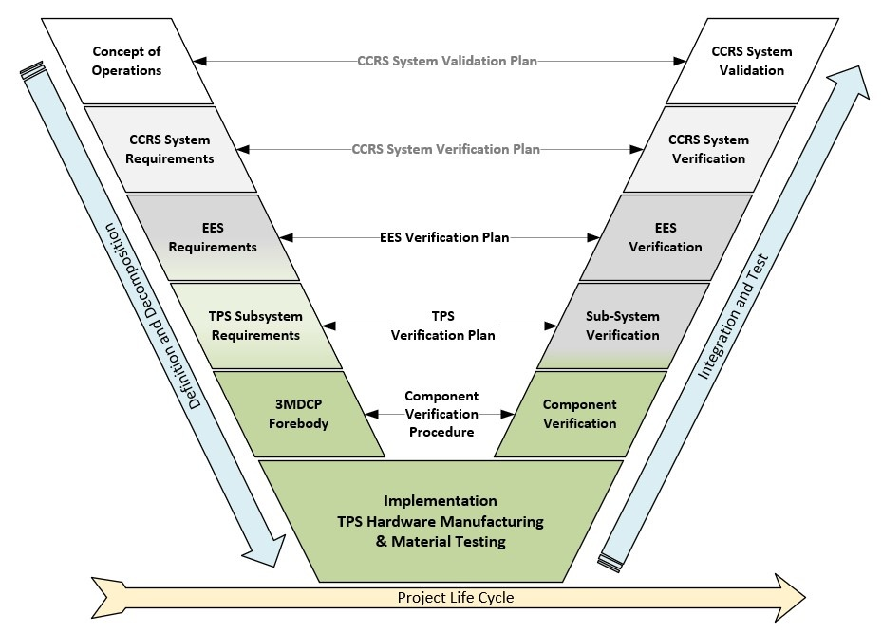
MSR-EEV-TPS – Requirement Decomposition
Detailed Process
Detailed Process
Detailed Process
Detailed Process
Detailed Process
Detailed Process
Requirement Architectures – Systems Engineering Integration & Test
April 17th, 2025

Slide 23
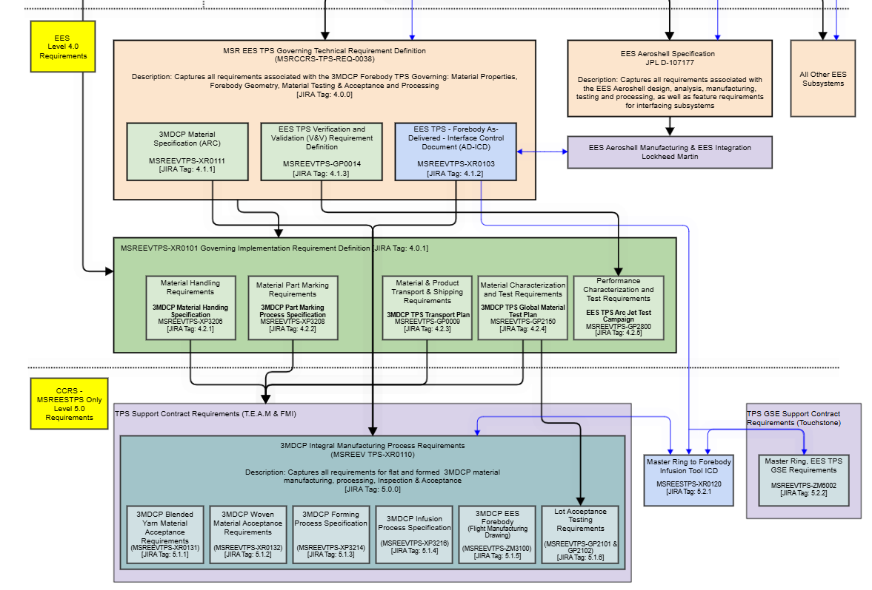
MSR-EEV-TPS – Requirement Architecture
Detailed Process
Detailed Process
Detailed Process
Detailed Process
Detailed Process
Detailed Process
Requirement Architectures – Systems Engineering Integration & Test
April 17th, 2025

Slide 24
HelioSwarm – Mission Overview
NASA Science Mission Directorate (SMD) Explorers Program
Heliophysics Medium-Sized Explorer class (aka “MIDEX)
Science: The Nature of Turbulence in Space Plasmas
Turbulence is Multiscale Disorder
Turbulent flow is one in which a gas, fluid, or plasma undergoes irregular fluctuations and mixing
Turbulent flows are multiscale; energy injected at largest size scale cascades to smaller scales, eventually converting the kinetic energy in the flow into thermal energy of the constituent medium.
Turbulence is considered by many to be the last unsolved mystery of classical physics.
Turbulence plays a fundamental role driving the transport of mass, momentum, and energy in a wide variety of kinds of plasmas.
Mission Timeline:
Step-1 Proposal: September 2019
Step-2 Proposal: July 2021
Selection: February 2022
Phase A – Q1 2022 – Q3 2024
Phase B – Q4 2024 – Q4 2025
Phase C – 2025 – 2027
Phase D – 2027 – 2029
Launch – 2029
Operations: 18 Months
(12 Months of Science)
Requirement Architectures – Systems Engineering Integration & Test
April 17th, 2025

Slide 25
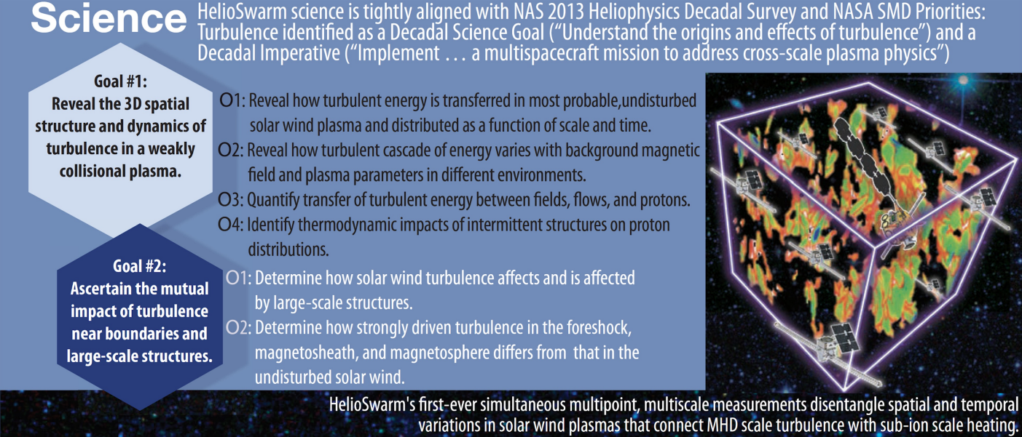
HelioSwarm – Mission Overview
Requirement Architectures – Systems Engineering Integration & Test
April 17th, 2025

Slide 26
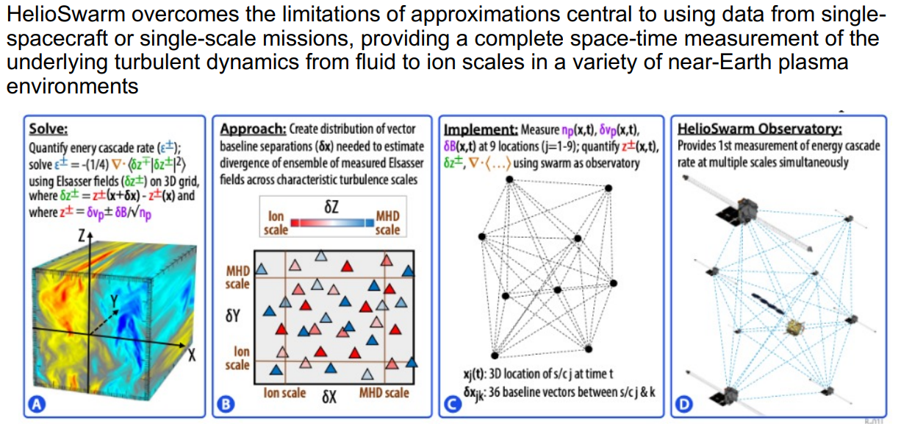
HelioSwarm – Mission Overview
Requirement Architectures – Systems Engineering Integration & Test
April 17th, 2025

Slide 27
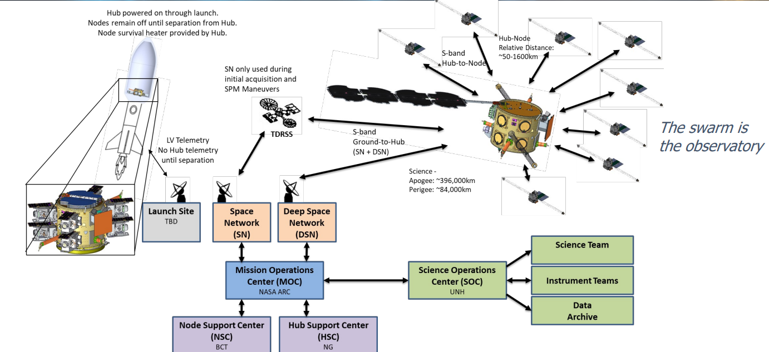
HelioSwarm – Mission Overview
Requirement Architectures – Systems Engineering Integration & Test
April 17th, 2025

Slide 28
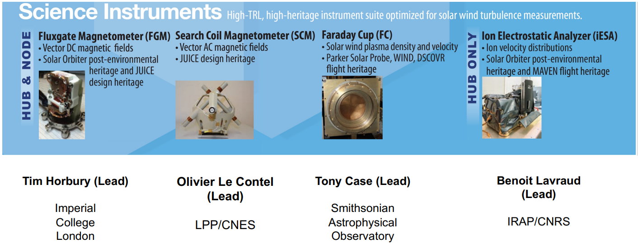
HelioSwarm – Mission Overview
Requirement Architectures – Systems Engineering Integration & Test
April 17th, 2025

Slide 29
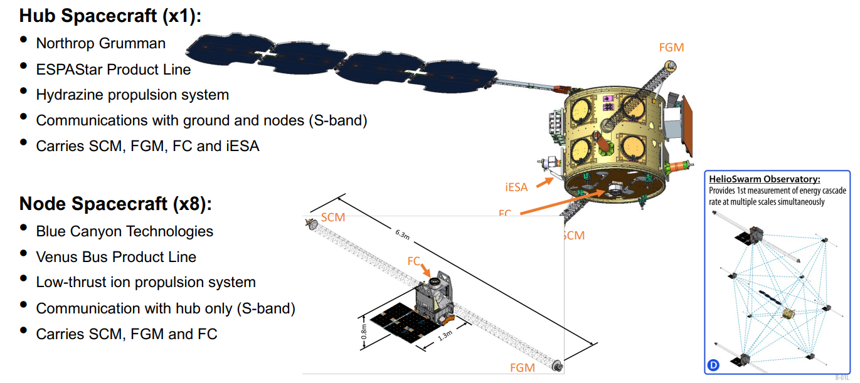
HelioSwarm – Mission Overview
Requirement Architectures – Systems Engineering Integration & Test
April 17th, 2025

Slide 30
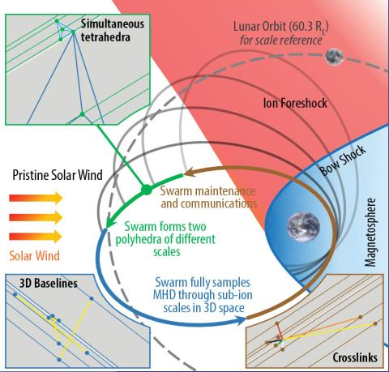
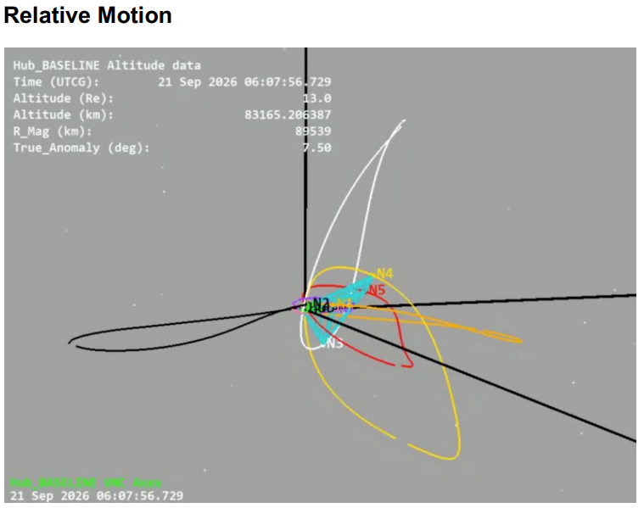
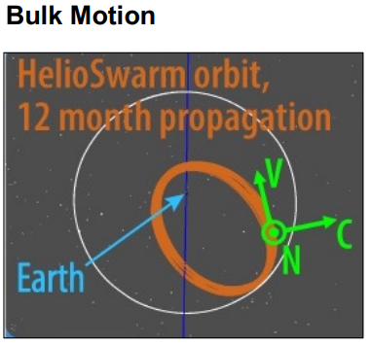
HelioSwarm – Flight Dynamics
Requirement Architectures – Systems Engineering Integration & Test
April 17th, 2025

Slide 31
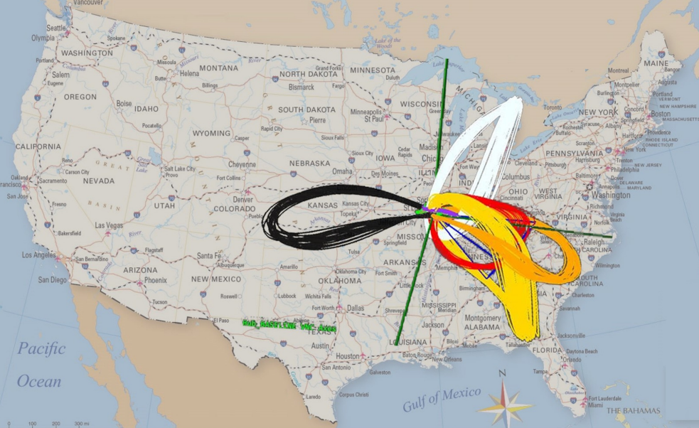
HelioSwarm – Flight Dynamics
Requirement Architectures – Systems Engineering Integration & Test
April 17th, 2025

Slide 32
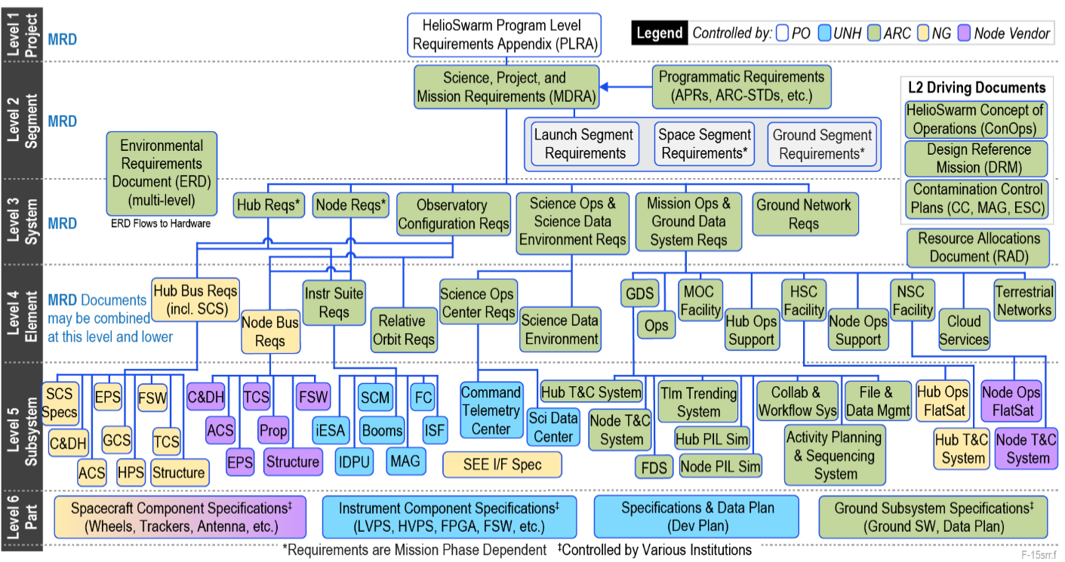
HelioSwarm – Requirements Architecture
Requirement Architectures – Systems Engineering Integration & Test
April 17th, 2025

Slide 33
Summary / Conclusions

Slide 34
Summary / Conclusions
Variation in complexity drives the requirement architecture level design/approach, the approach is flexible.
BioSentinel – Complexity on Science Data return, requiring multiple operational segments.
MSR – Complexity due to phased mission execution requiring multiple systems.
HelioSwarm – Complexity due to Science acquisition, requiring a system of systems.
The Requirement Architecture is a valuable tool in the SE’s tool box to: Develop, communicate, refine and execute complex projects.
Example Resulting Requirements Architecture
Strategic Development Requirements
Mission Requirements / Customer Requirements
Level 1
ConOps
Operational Requirements
What the System must do to be successful in meeting mission Requirements
Level 2
Flight Segment/System Requirements
What the System must be capable of to carry out the operational requirements.
Level 3
Functional Decomposition
Sub-System Requirements
What the Sub-System must be capable of to enable the flight segment system capabilities
Level 4
Part or Element Requirements
Part or Element functional capabilities that enable the subsystem capabilities
Level 5
Requirement Architectures – Systems Engineering Integration & Test
April 17th, 2025

