Slide 1


Aeronautics Research Mission Directorate
Real Progress. Real Value.
National Aeronautics and Space Administration
John Koelling
NASA Aero Overview
April 3, 2025
www.nasa.gov

Slide 2

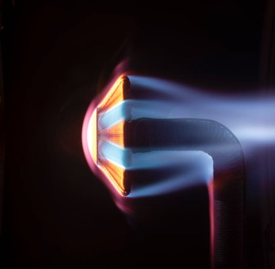


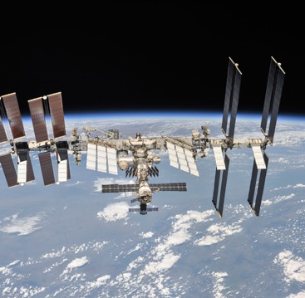
NASA Aeronautics is One of Five Mission Directorates
Exploration Systems Development
Aeronautics
Space Technology
Science
Space Operations
NASA explores technologies that reduce aircraft noise and fuel use, get you gate-to-gate safely and on time, and transform aviation into
an economic engine at
all altitudes.
NASA technologies developed for spaceflight benefit our everyday life. The Artemis program proves and matures what those technologies can do and reduces risk for exploration of Mars
and beyond.
NASA and the nation’s science community use space observatories conduct scientific studies of the Earth from space
to visit and return samples from other bodies in the solar system, and to
peer out into our galaxy and beyond.
NASA's Artemis program
is defining and creating the steps path from Earth back to the Moon and on to Mars, including the Orion capsule, the Space Launch System, Exploration Ground Systems, the Gateway, and Human Landing System.
NASA's work in beyond low-Earth orbit includes commercial launch services to the International Space Station, exploration systems, space transportation systems, and broad scientific research on orbit.
Notes:
Aeronautics research is one of NASA’s five missions.

Slide 3


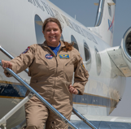

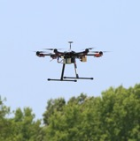
Where Does NASA Aeronautics Research Happen?
Aeronautics research takes place at four of NASA’s centers.
AMES
Airspace Management, Simulations,
Tech Integration
GLENN
ARMSTRONG
Flight Research and Support, Aerodynamics
GODDARD
AMES
HQ
LANGLEY
GLENN
ARMSTRONG
JPL
Propulsion Research, Flight Communications
Major Areas of
Inter-Center Collaboration
Langley/Glenn: Propulsion-Airframe Integration
Ames/Langley: Flight Deck and Ground-Based Automation Integration; Flight Mechanics; Aerodynamics
Armstrong/Other Research Centers: Flight Experiment Integration
MARSHALL
STENNIS
JOHNSON
LANGLEY
KENNEDY
Airspace Ops, Vehicle Aerodynamics and Integration, Mobile Testing, Autonomous Flight Research
Notes:
Updated center thumbnails 6/8/23

Slide 4

Aviation is Vital to our Nation’s Economy
$1.37 trillion economic impact from commercial aviation in 2023*
$77.3 billion positive manufacturing trade balance in 2022**
8.97 million flights by U.S. carriers worldwide in 2022***
24 million tons of freight transported by U.S. airlines in 2022***
2.2 million aerospace/defense jobs; 603,000 in aeronautics/aircraft in 2022**
* From Airlines for America
** From Aerospace Industries Association
*** From Bureau of Transportation Statistics
Notes:
Updated 3/7/24​
​
How important is aviation to the U.S. economy? ​
​
​
$1.25 trillion of economic impact from commercial aviation in 2022.​
(From Airlines for America. https://www.airlines.org/impact/#:~:text=Commercial%20Aviation%20is%20a%20Critical,of%20%241.25%20trillion%20in%202022.)​
​
$77.3 billion positive manufacturing trade balance in 2022.​
2.2 million aerospace/defense jobs; 602,000 in aeronautics/aircraft in 2022.​
(From Aerospace Industries Association. https://www.aia-aerospace.org/news/aia-releases-2023-facts-figures-data-highlighting-ad-industrys-return-to-pre-pandemic-levels/)​
​
8.97 million flights by U.S. carriers worldwide in 2022.​
24 million tons of freight transported by U.S. airlines in 2022.​
(Statistics from Bureau of Transportation Statistics ​
​
​
​

Slide 5
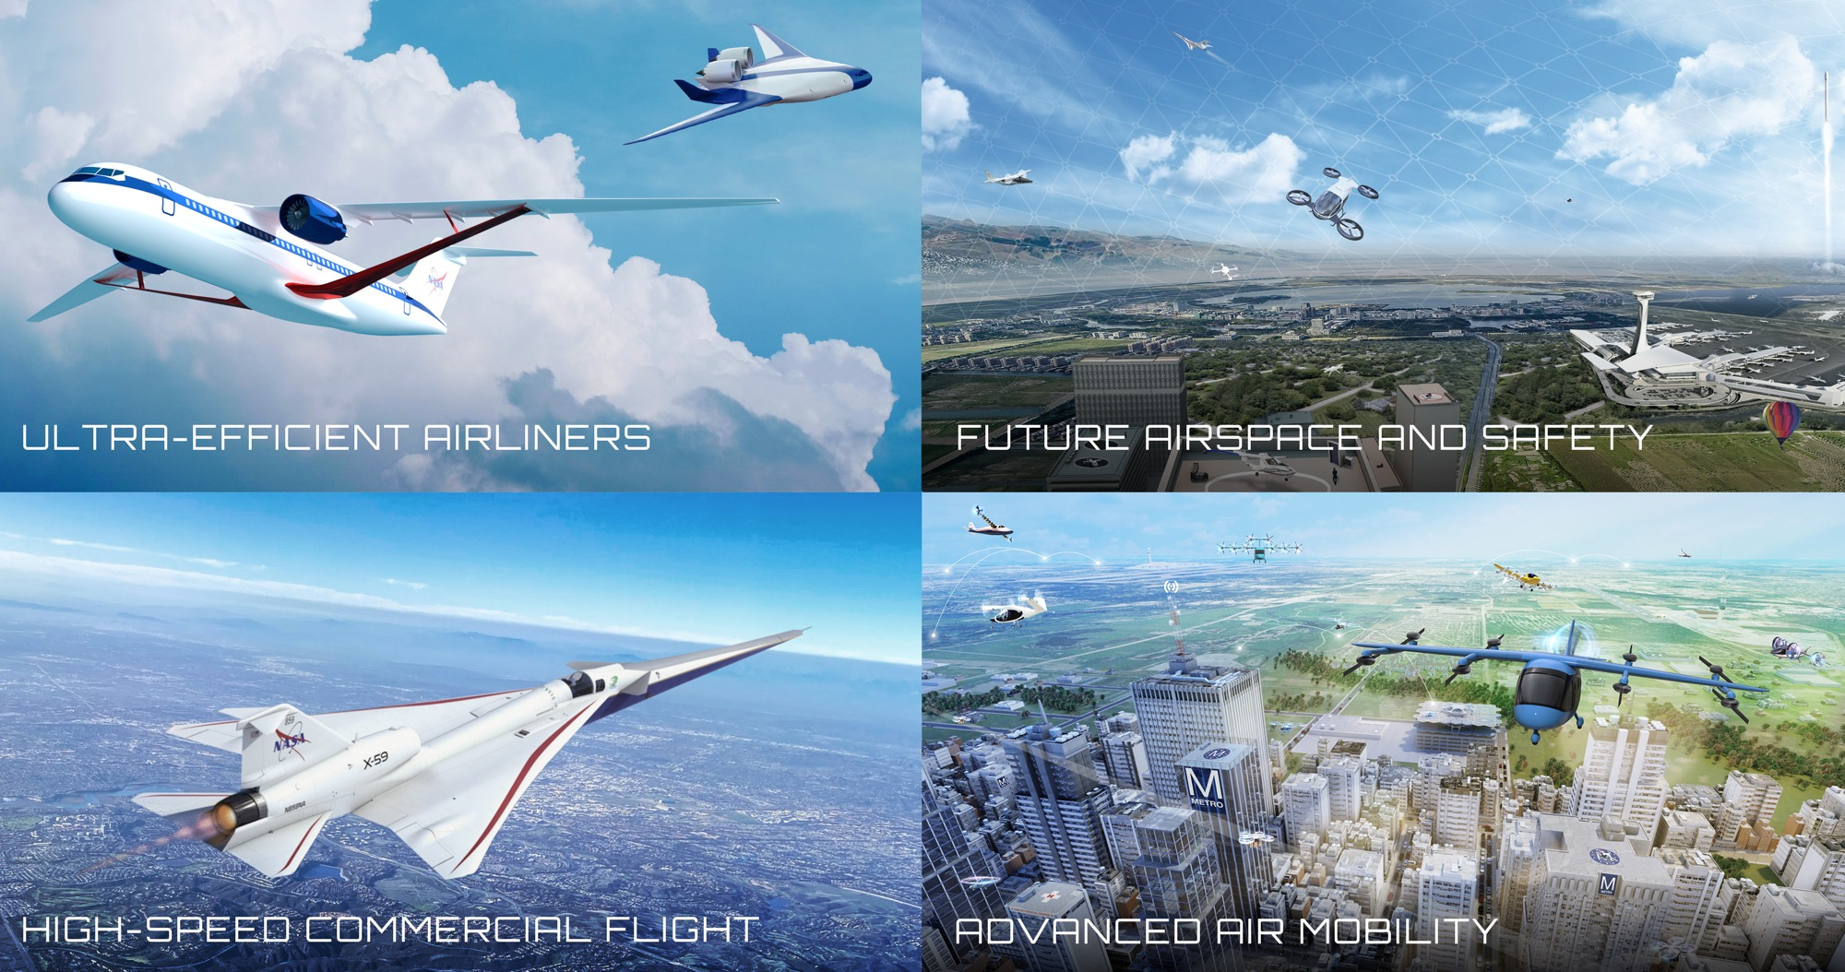
Four Transformations for Sustainability, Greater Mobility, and Economic Growth
Four Transformations for Sustainability, Greater Mobility, and Economic Growth
Notes:
Updated 3/26/2024
​
NASA is leading transformation of aviation in four technical areas. ​
Each of these transformation areas is enhanced and advanced by our Innovation Ecosystem, which produces new knowledge/ideas to lead to new transformation areas.​
​
Ultra-Efficient Airliners: We are accelerating the ability of the next generation of large commercial aircraft to use less energy and use cleaner energy. Our work is a major contribution to the U.S. goal for net-zero greenhouse gas emissions by 2050. ​
​
Future Airspace and Safety: We are working with partner FAA to continue evolution of our national airspace system to safely integrate all types of air vehicles in an increasingly complex environment, and to do so more sustainably – using digital technologies on the ground and onboard vehicles to enable more efficient trajectories that use less energy.​
​
Advanced Air Mobility: With nearly 100 industry partners, we are working to enable an economically viable and safe system in which aircraft from drones to air taxis can fly new missions over the most rural countryside to the dense urban landscape – missions such as passenger transport, medical deliveries, utility inspections, disaster response. Our Advanced Air Mobility mission is working with the aviation community to solve challenges in vehicle development and operations, airspace design and operations, and community integration.​
​
High-Speed Commercial Flight: We are potentially removing a key barrier to commercial supersonic flight over land by proving that we can get rid of the sonic boom, while also exploring solutions to local noise and emissions associated with supersonic flight. With our federal partners we are also investigating the potential of even higher speed flight such as high-supersonic and hypersonic speeds. ​
​

Slide 6
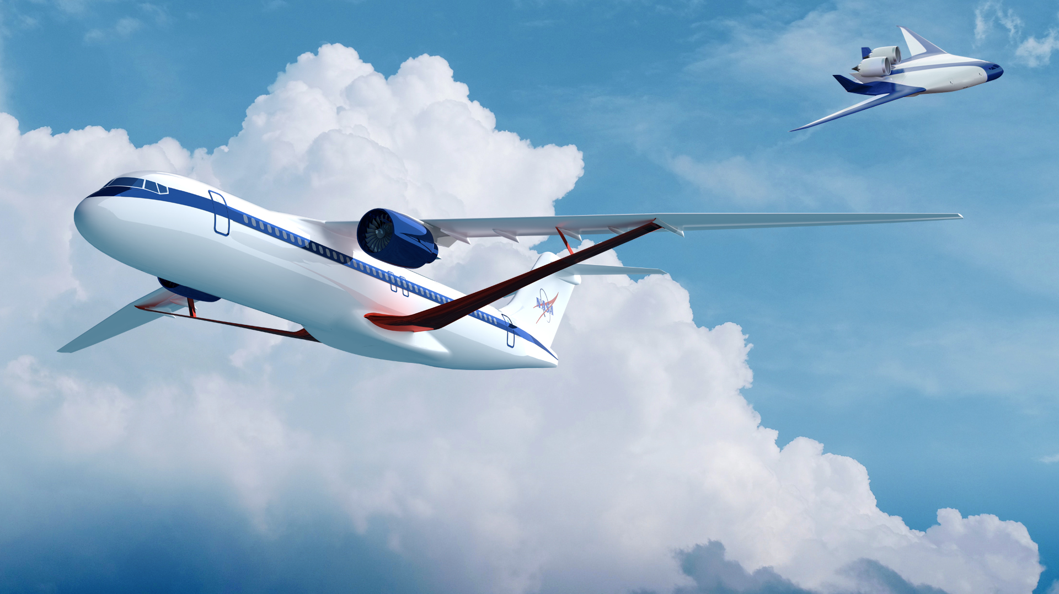
Ultra-Efficient Airliners
Real Progress. Real Value.
www.nasa.gov |
6
Notes:
​Note of explanation: the airframe configuration to be demo-ed by the SFD Project will get the 5-10% reduction. The collection of technologies (across all of SFNP) are expected to get to the 30%.
​NASA’s Sustainable Flight National Partnership (SFNP) will mature new green technology by late 2020s to maintain U.S. leadership as builders of next-generation commercial transports – the heart of the aviation system. Sustainable aviation system growth, increased airline travel, excellent engineering and manufacturing jobs, and economic growth will all result from achieving SFNP objectives and benefits. ​
Aviation GHG emissions include life cycle carbon dioxide (CO₂), nitrous oxide (N₂O), and methane (CH4) emissions. Aircraft engines produce negligible amounts of nitrous oxides and methane, so this plane has a focus on aviation combustion CO₂ emissions and well-to-tank life cycle GHG emissions (CO₂, N₂O, and CH4). The U.S. Aviation 2050 Goal is based on emissions that are measurable and currently monitored. Research is ongoing into the climate impacts of aviation-induced cloudiness and the indirect climate impacts of aviation combustion emissions (see section 7 for details on the climate impacts of aviation non CO₂ combustion emissions).​​
​
This U.S. aviation goal encompasses CO₂ emissions from (1) domestic aviation (i.e., flights departing and arriving within the United States and its territories) from U.S. and foreign operators, (2) international aviation (i.e., flights between two different ICAO Member States) from U.S. operators, and (3) airports located in the United States.​​
​​
NOTE: The U.S. goal states "greenhouse gas emissions," while the international community states "carbon emissions." We make the distinction.​​
Link to US Aviation Climate Action Plan: https://www.faa.gov/sites/faa.gov/files/2021-11/Aviation_Climate_Action_Plan.pdf​​
​
HiCAM
EPFD
From Lee N email. 1/17/24 based on PPBE25 cycle and 1st flight dates
GE 1st flight spiral 2 – late Q2 Y26
magniX 1st flight – late q1 FY26. pdr 2024jan30
HyTEC. Phase 2 Core Demo awarded to GE on 12/14/23

Slide 7

















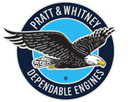







Sustainable Flight National Partnership with ...
www.nasa.gov |
7
As of May 2024
Notes:
NOTE: These are not all “partners”; they are contributors to the work. Some are partners; some are contractors; some are grantees.

Slide 8
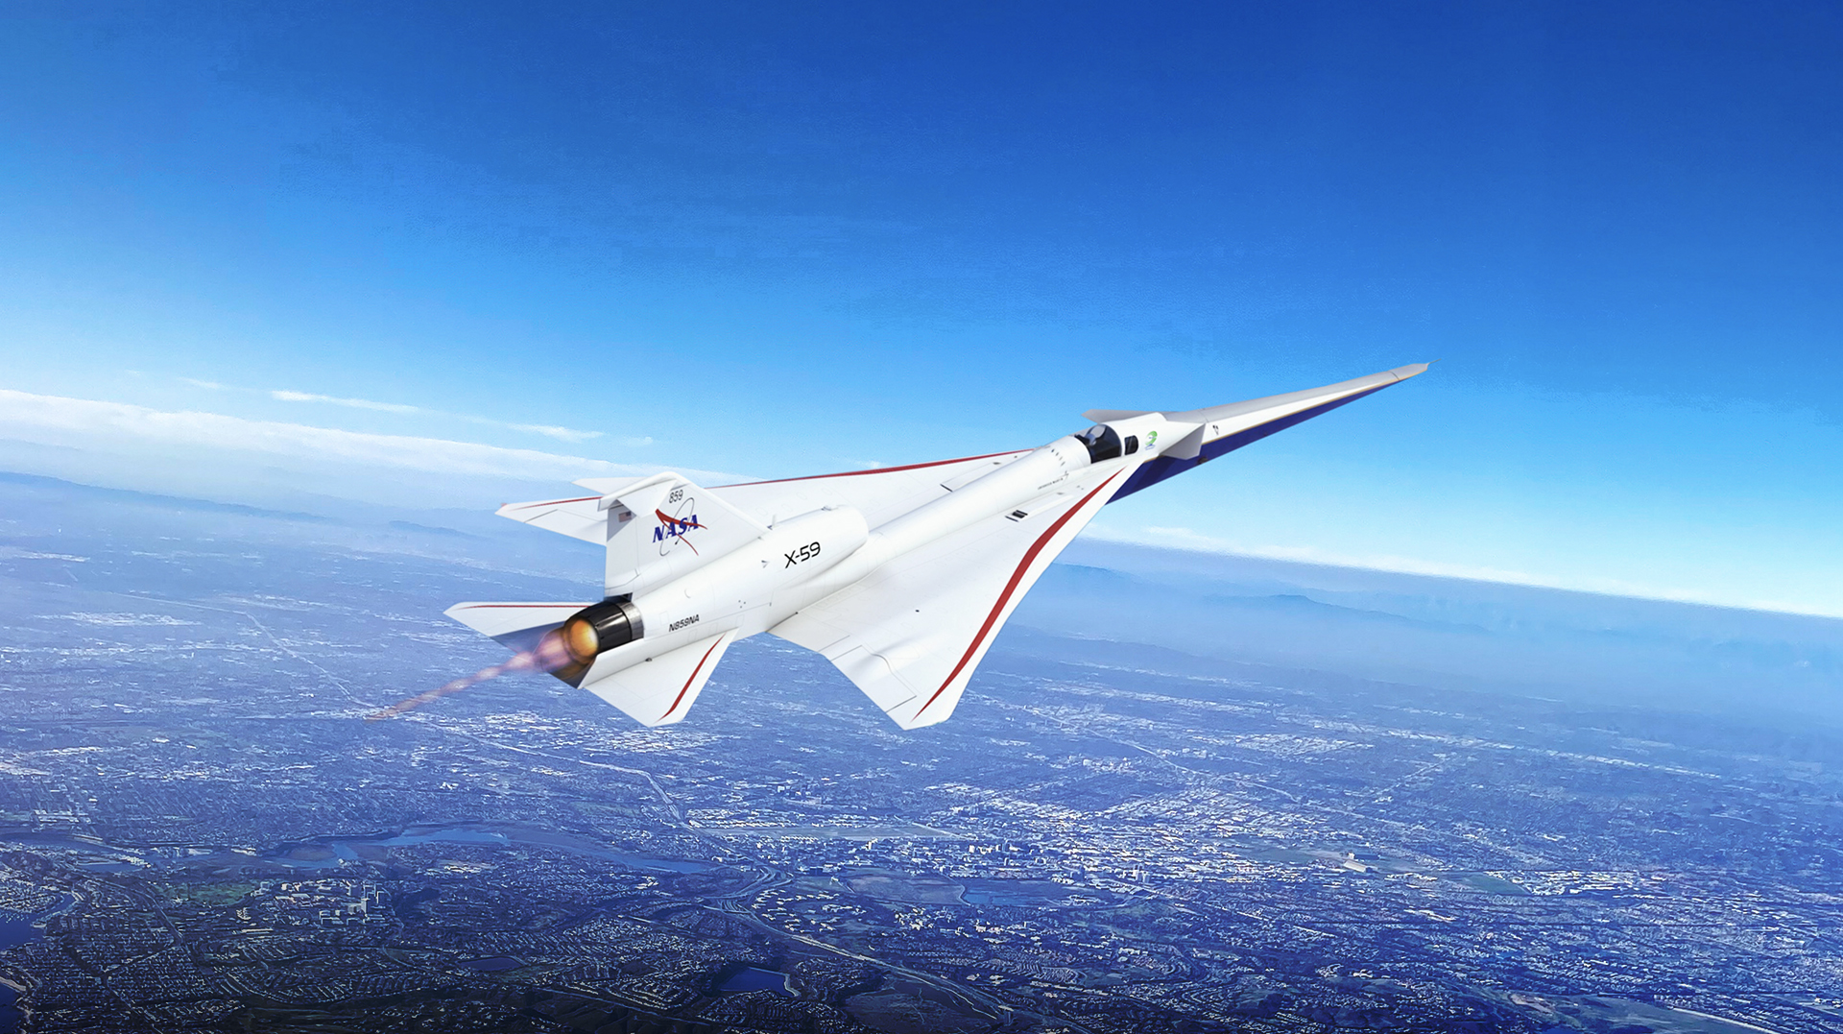

Real Progress. Real Value.
www.nasa.gov |
8
Notes:
​KEY MESSAGE: NASA’s Quesst mission to enable sustainable, commercial supersonic flight over land can be a long-term game changer for U.S. and global mobility, but major hurdles must be overcome.​
· Key focus of recent efforts is preparing for measuring the sounds from the X-59 so that we can prove it is performing as needed in for community testing.​
· These measurements will be made in the air and on the ground.​
· Because the X59 will be so much quieter than aircraft which have been previously studied by NASA, new ground recording systems were required to be developed. In this past year NASA has taken delivery of the first batch of 70 units that will be used during the Phase 2 testing. Several units were subjected to a rigorous field trial to help ensure that they will be robust enough to support the Phase 2 testing in the desert near NASA Armstrong flight Research Center​
Phase 1 – Aircraft Development​
In progress (FY18-25) ​
Design, fabricate a quiet supersonic research aircraft​
Prove performance in test range flights​
Prove safety for flights in normal airspace​
Phase 2 – Acoustic Validation​
Preparation in progress (FY18-26), Execution FY26​
Prove the acoustic characteristics match design targets​
Detailed in-flight and ground measurements in test range​
Phase 3 – Community Response Testing ​
Preparation in progress (FY19-27), Execution FY27-29​
Conduct community tests ​
Select communities ​
Outreach and engagement (including STEM)​
Obtain necessary approvals​
Recruit participants and conduct surveys​
Collect ground measurements​
​
​

Slide 9

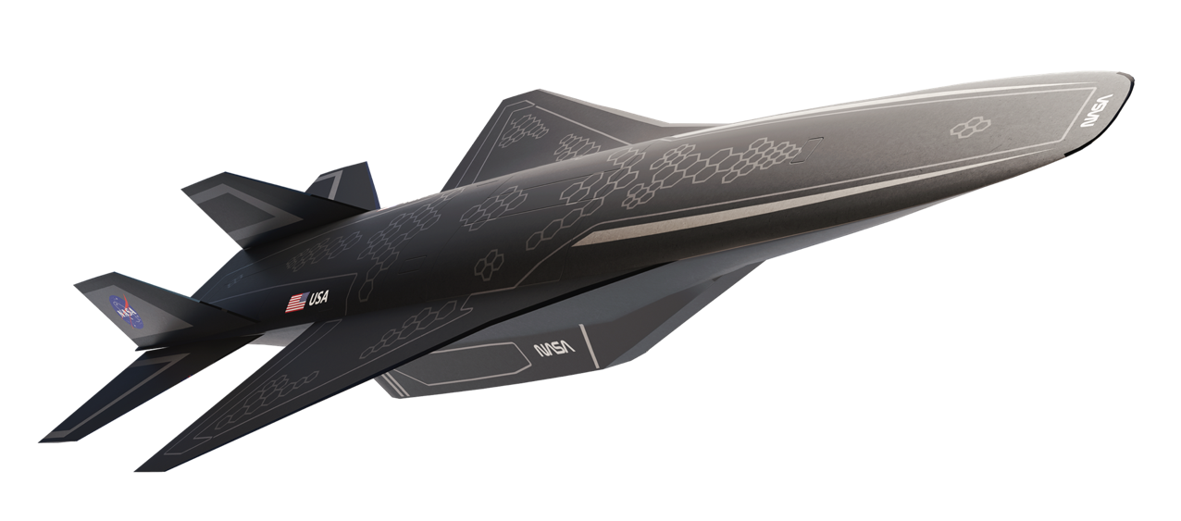

Hypersonics
Hypersonics
Real Progress. Real Value.
www.nasa.gov |
9
Notes:
This slide represents ARMD’s major contributions to hypersonic flight development: 1) our fundamental research is dual-use – commercial and military
2) The CFD image on the right represents our contributions of CFD and analysis, which is a huge part of what we provide
​ADDITIONAL DETAIL ON ACCOMPLISHMENTS​
Recent accomplishments for HTP include​
a. The completion of ground tests (at GRC 10x10) to simulate low- and high-speed combined cycle engine operations and develop a controls methodology for this advanced engine.​
b. Newly-awarded contracts with Boeing and Northrop Grumman for high-speed vehicle conceptual design and technology roadmapping.​
c. The design, fabrication, and testing of a high-speed variable geometry inlet model to compare ground test data with pre-test analysis predictions.​
d. Two workshops with government, industry, and academia on hypersonic boundary layer transition and fluid-thermal-structural interaction for hypersonic vehicles.​
e. Pre-ground test computational validation of a dual-mode ramjet engine to investigate scaling from missile size to aircraft size.​
f. The development of a suite of reference vehicles to prioritize NASA investments and industry engagement in research and software development.​

Slide 10
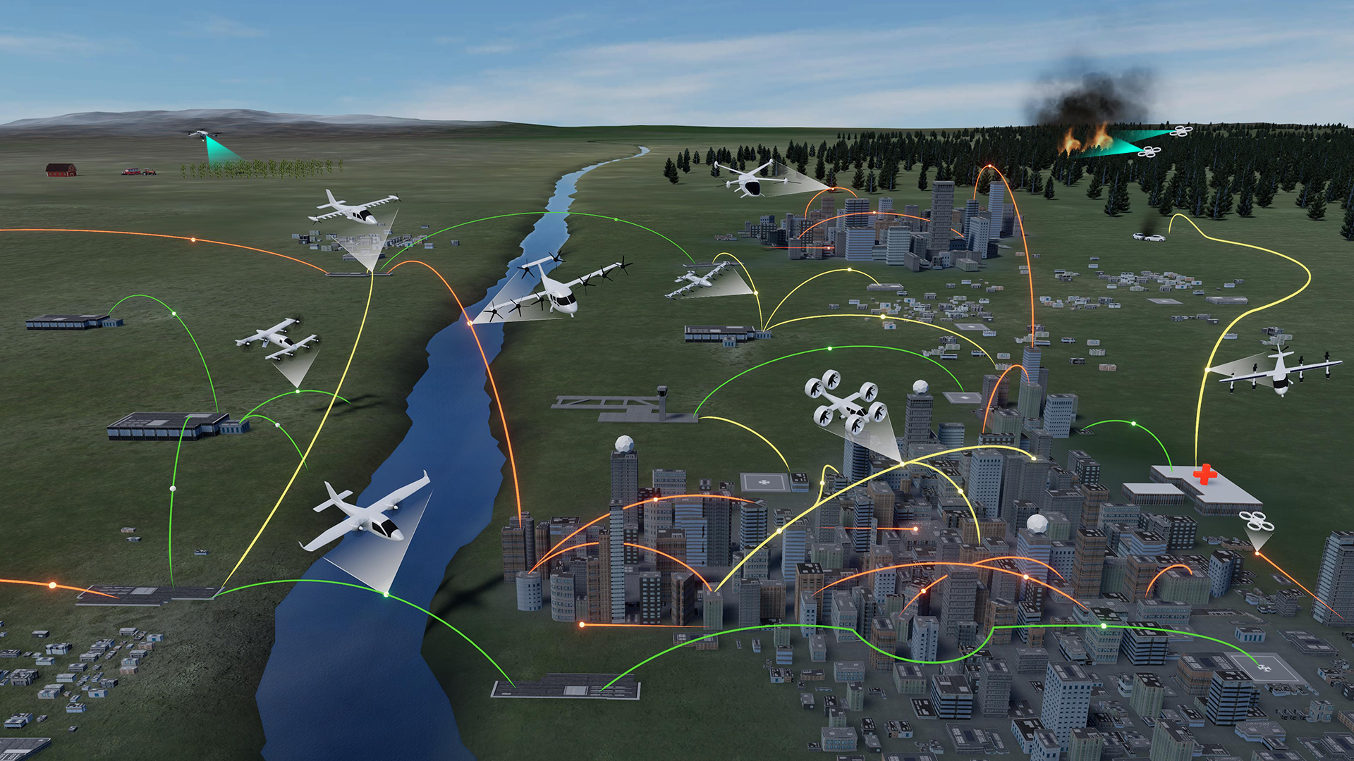
Wildland Firefighting
Operations
Rural Operations
On Demand
Air-Taxi
Urban Operations
Regional
Network
Cargo
Delivery
Inter-City
eC/STOL
Inter-City
eVTOL
Cargo
Delivery
Airport
Transfer
Air
Ambulance
Distribution
Center/Warehouse
Medical
Supply Delivery
Fleet
Operations
Inter-city
eCTOL
Small
Package Delivery
Cross-metro
Transfer
Real Progress. Real Value.
www.nasa.gov |
10
Notes:
KEY MESSAGE: NASA’s work in Advanced Air Mobility will revolutionize urban and regional mobility, economic growth and opportunity. NASA has been and will continue to be a fundamental enabler for this new market, especially in the areas of airspace integration and use of autonomy. ​

Slide 11

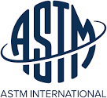







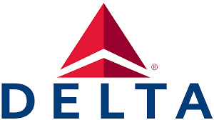








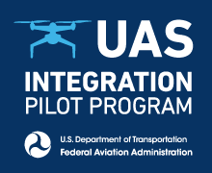


















































Airspace Operations and Safety Program with …
INDUSTRY
EXISTING + EMERGING
DOD and OGA
SDO and NON-PROFIT
ACADEMIA
INTERNATIONAL
As of May 2024
Notes:
Airspace Operations and Safety Program is widely partnered with industry, government and academia to accomplish the AAM and Future Airspace and Safety Missions
Acronyms:
DOD- Department of Defense
OGA- other government agency
SDO – standards development organization

Slide 12



Innovation Ecosystem
Real Progress. Real Value.
www.nasa.gov |
12

Slide 13
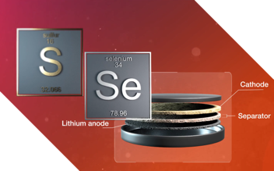
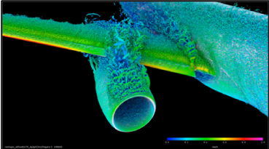
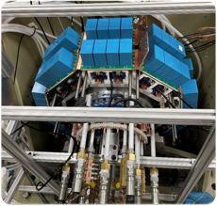
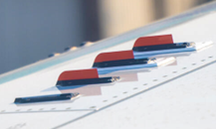
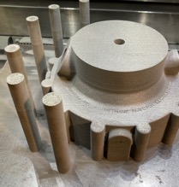
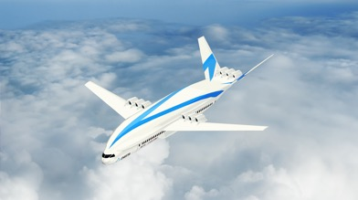
Progress: Delivering Innovative Impact
Accomplishments
GRX-810 Superalloy
New NASA-developed material with 2x the strength, 2500x the durability at high temperatures versus current state-of-the-art superalloys
Ohio State-led ULI Team
Successful test of high voltage,
1-megawatt electric motor at NASA NEAT facility
SMART Vortex Generators (VGs)
Shape Memory Alloys used to retract vortex generators on wings when not needed; improves fuel efficiency (Further test forthcoming)
Ongoing
​University of Illinois-led ULI​ Team
Cryogenic and hydrogen fuel cell technologies for a hydrogen aircraft
Solid-state Architecture Batteries for Enhanced Rechargeability and Safety
Solid-state bipolar battery stack with 2x energy to transform electrified flight
CFD Prediction of High-Lift Performance
Computational tools to accurately predict performance of high-lift takeoff and landing configurations to accelerate flight certification of more fuel-efficient designs
A Look Ahead​
​​Fly AIRVUE pods on helicopters to test sensors for data collection to develop new algorithms for hazard avoidance in more autonomous flight​
​
Fly compact, self-aligned focusing Schlieren tech on NASA F-15 to support Supersonic Boundary Layer Transition flight tests​
Test 2.7%-scale Full-Span High-Lift Common Research Model in National Transonic Facility wind tunnel at turbulent conditions to inform flight certification ​

Slide 14















































































University Innovation Project Expands the Innovation Ecosystem
www.nasa.gov |
14
As of May 2024
Notes:
As of March 2024
Map shows all universities across UI project (ULI, USRC), plus Gateway to Blue Skies competition award winners, and Future Aircraft Maintenance Technician study award recipients
102 universities​
41 states, includes DC​
34 MSI’s: ​
11 HBCU​
1 PBI​
11 HSI​
3 AANAPISI​
7 AANAPISI & HSI​
1 NASNTI​
​

Slide 15




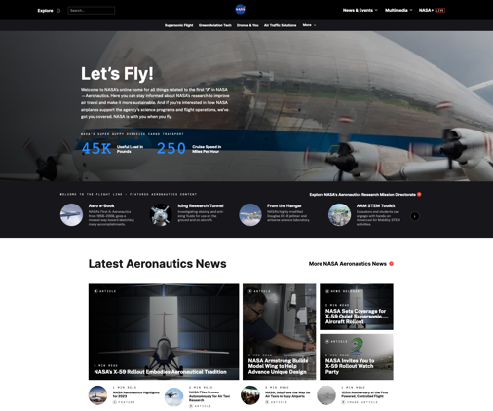
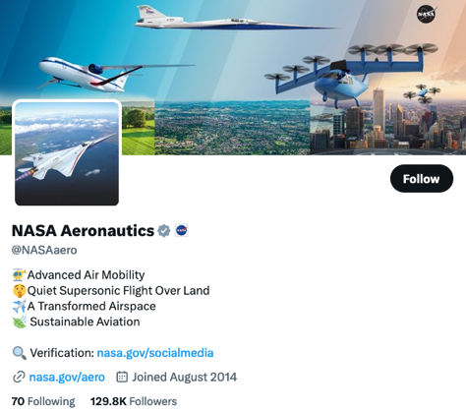
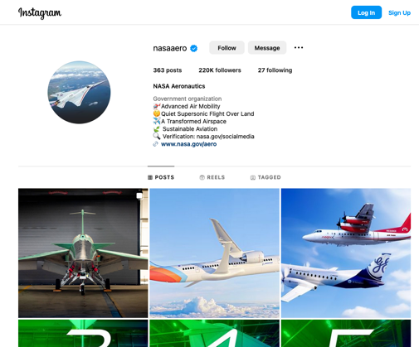
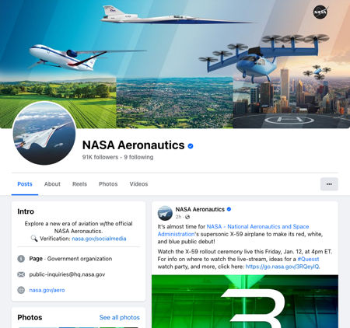
Follow Us
www.nasa.gov/aero
@NASAAero
@NASAAero
@NASAAero
Notes:
Follow NASA Aero on the web and social media for latest stories, news, program/project information, events, conference participation.
NASA's with you when you fly.

Slide 16

Thank You

