Slide 1
Thermoplastics Development for Exploration Applications:
Mantis Composites Summary of AS4/LM-PAEK Coupons and TDEA-300 Collars
William Mulhearn, NASA GSFC/541
March 31, 2025
1

Slide 2
ASTM Coupon Testing
Mechanical testing per American Society for Testing and Materials standards, conducted at the National Institute for Aviation Research. Tested qty. 5 of each specimen.
Compared modulus, strength data for Mantis Composites additively manufactured (AM) coupons against a non-AM literature reference. Both sets are continuous AS4 carbon fiber / low-melt polyaryletherketone (LM-PAEK). Note, this is a rough comparison with different fiber volume for illustrative purposes only. Observe broadly comparable in-plane properties, significant knockdowns for AM interlaminar properties.
National Institute for Aviation Research, Wichita State University, NCAMP Project Number NPN 072001
Intralaminar test geometry
2

Slide 3
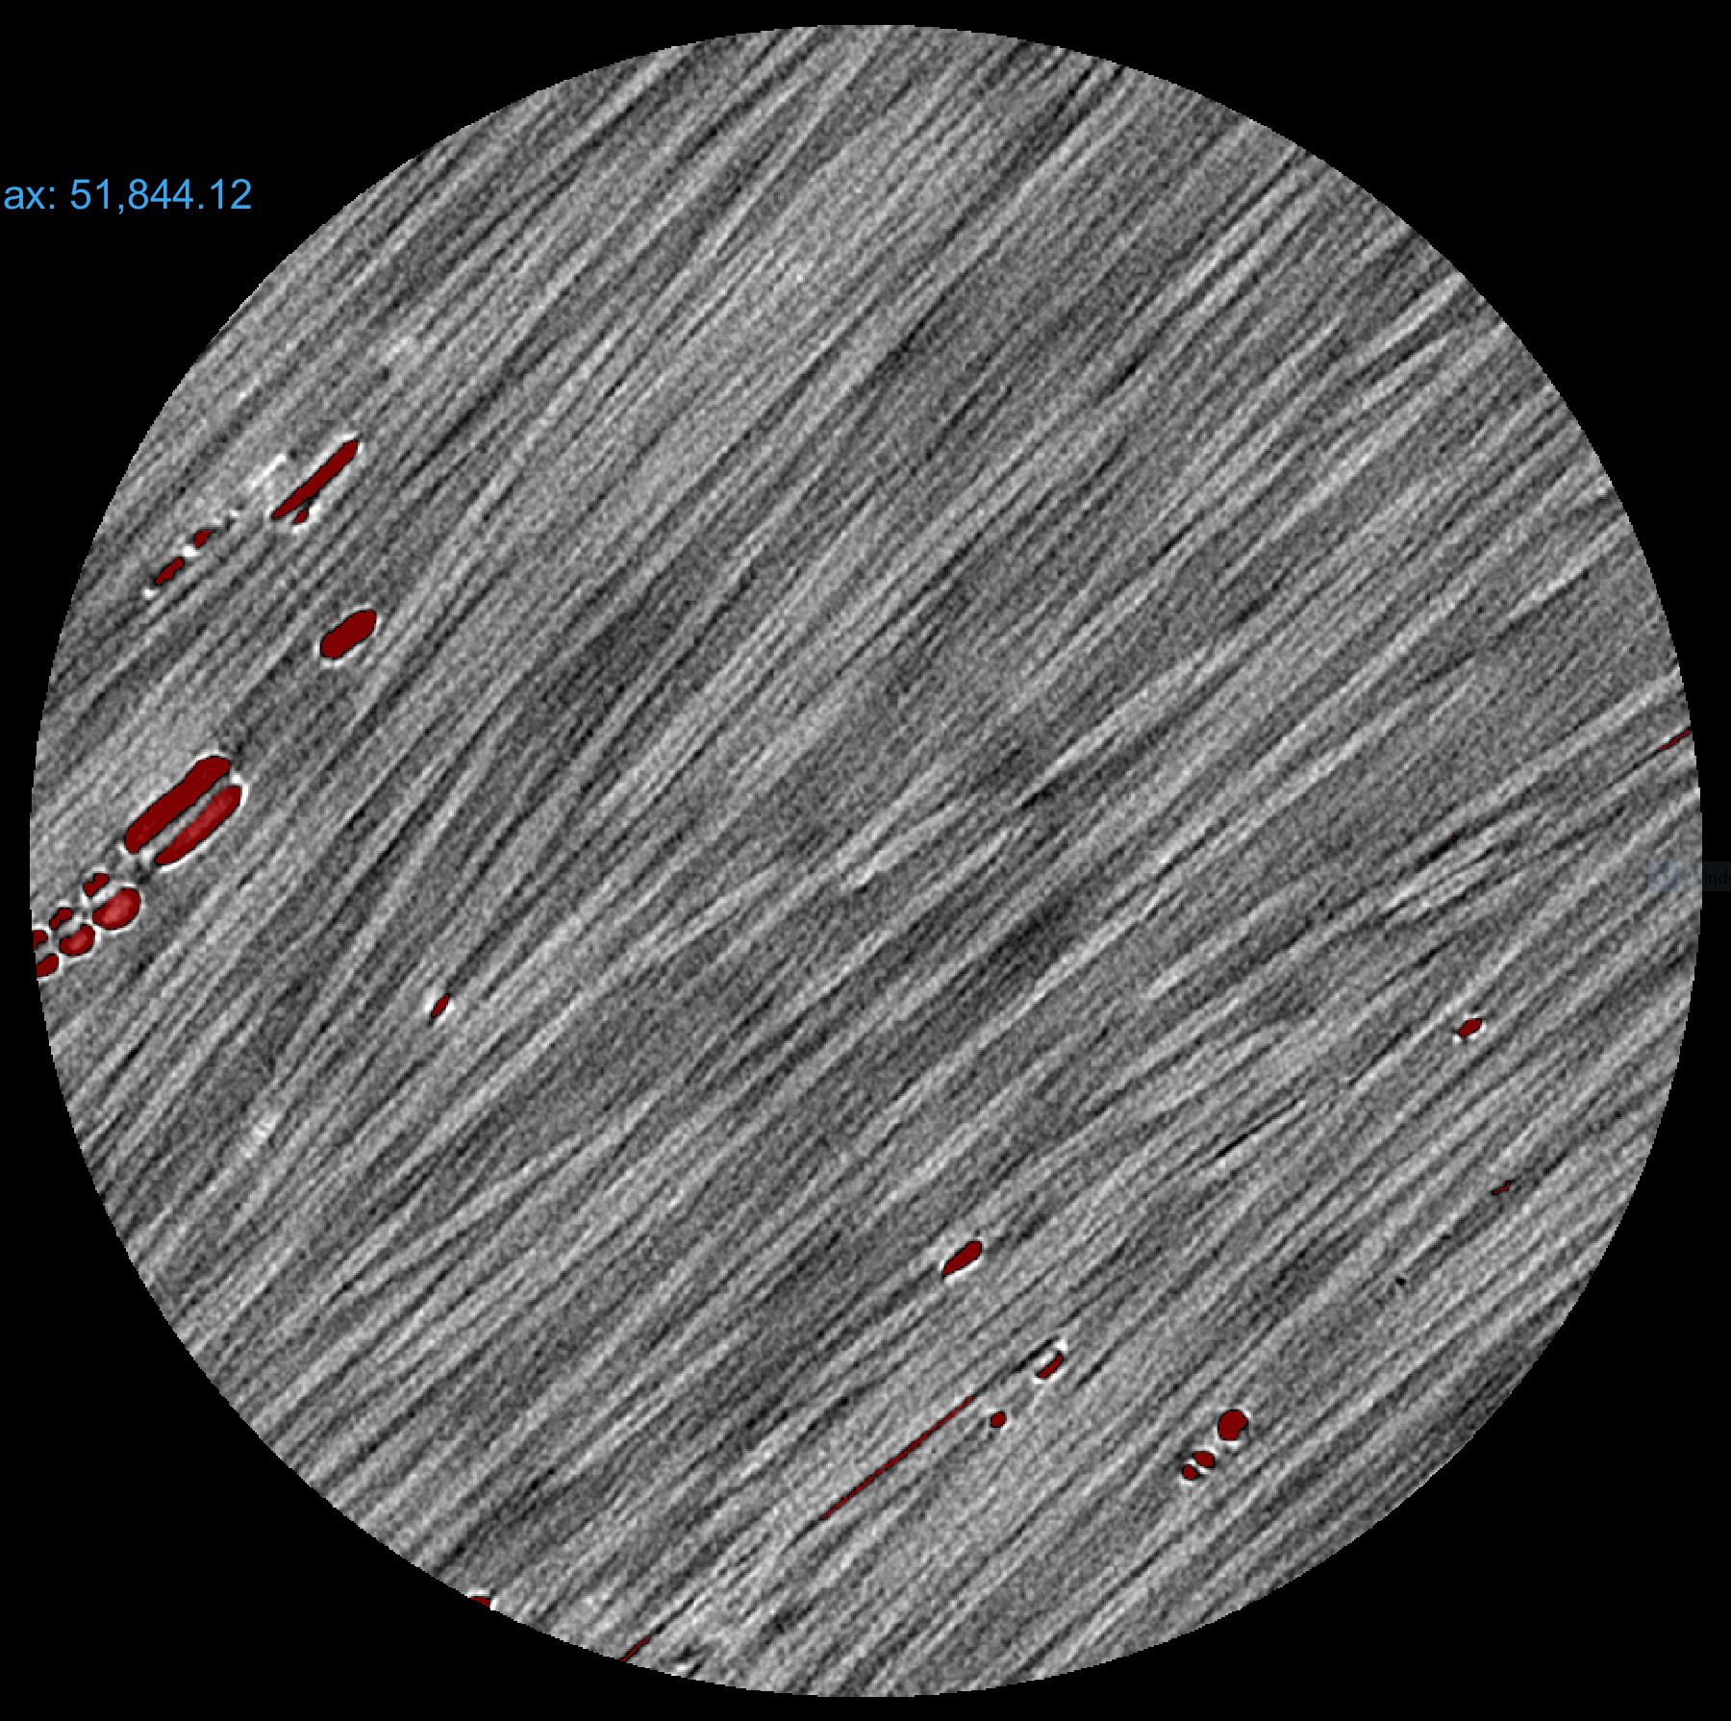
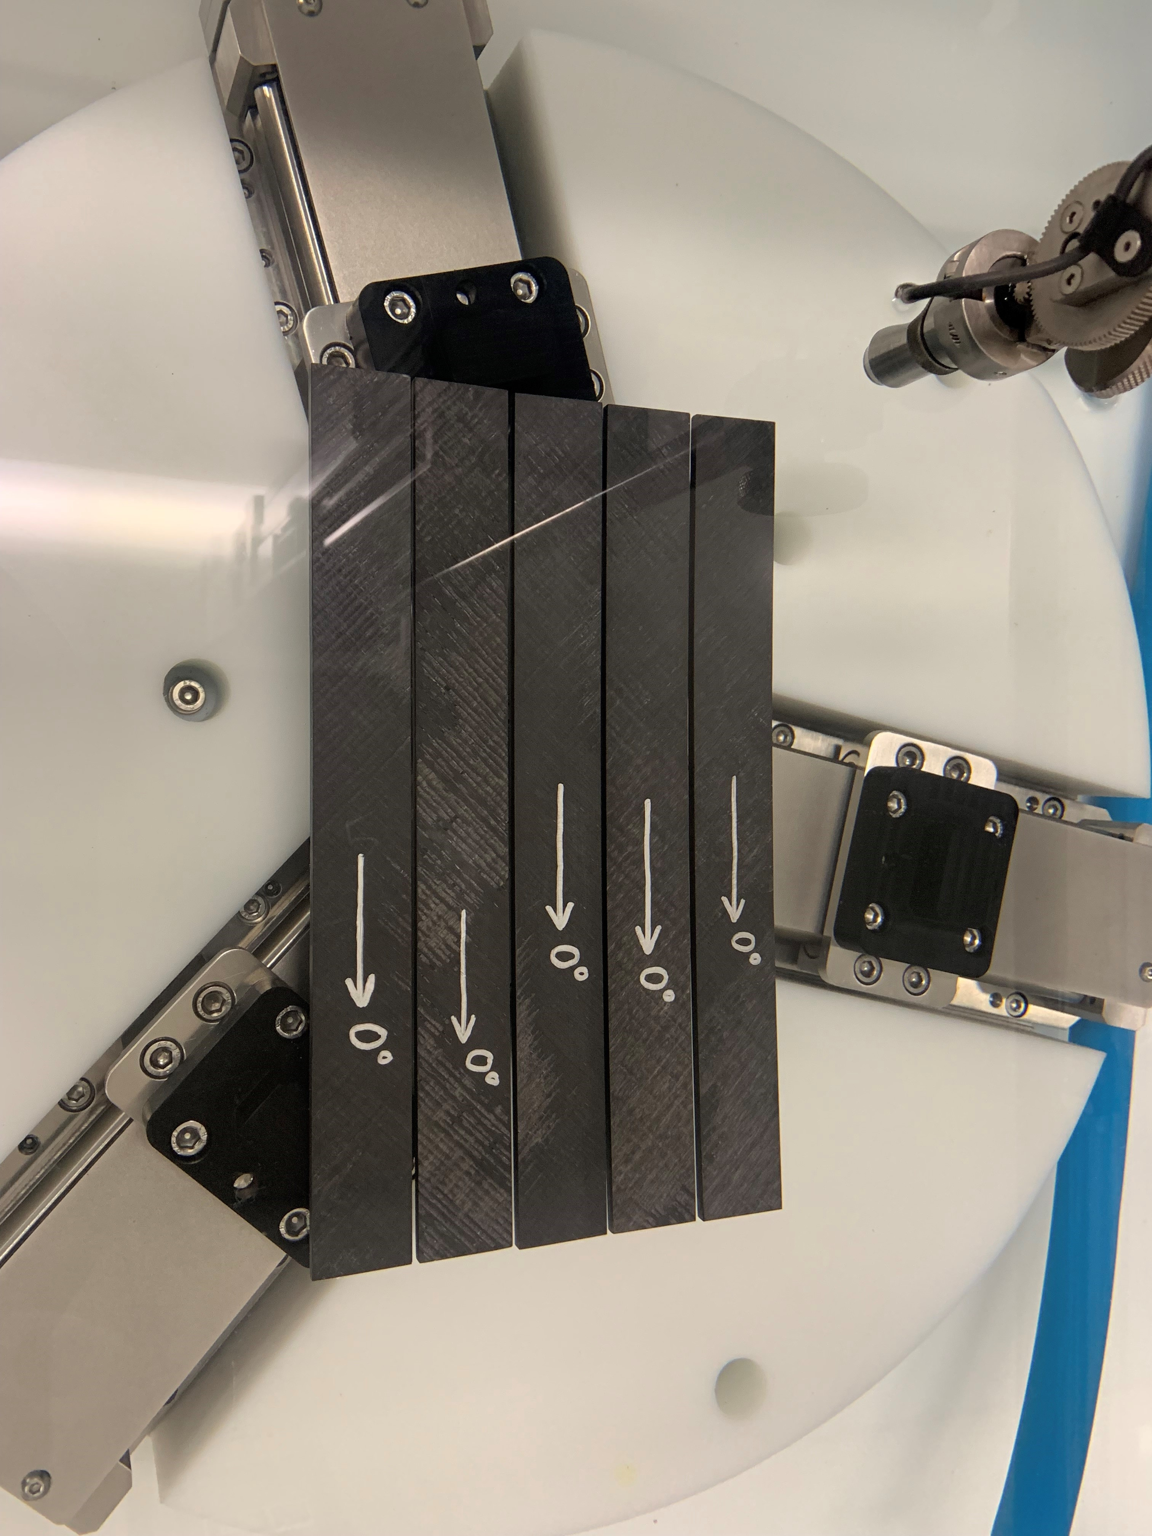
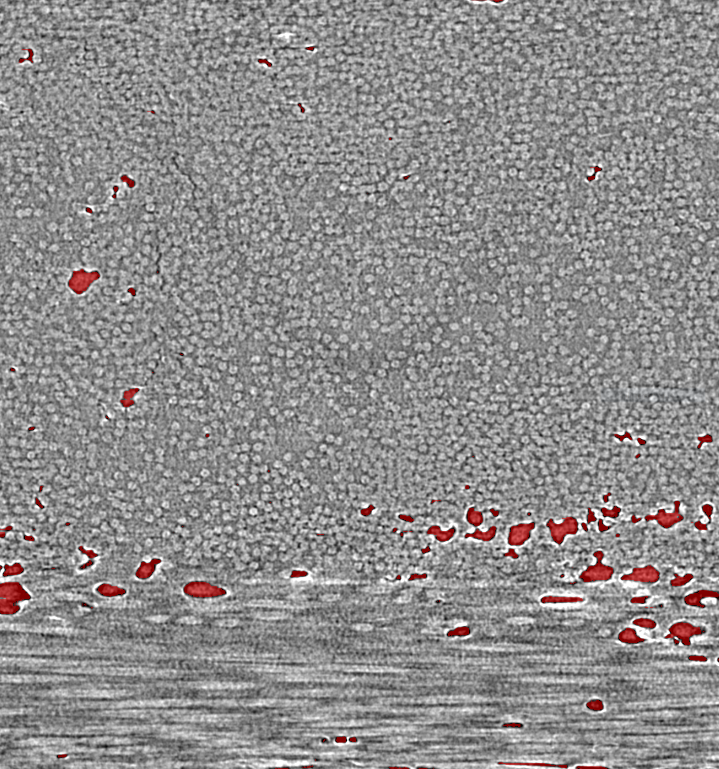
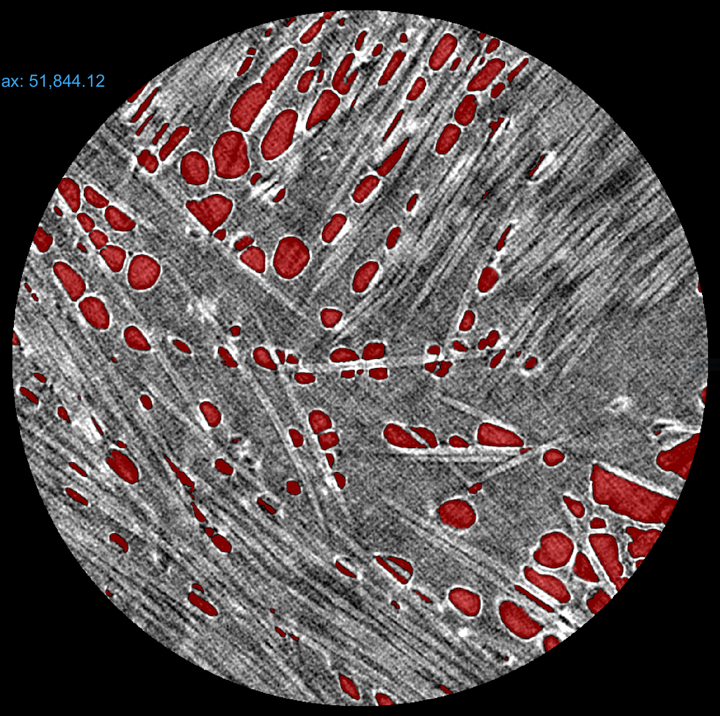
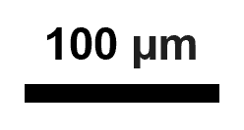
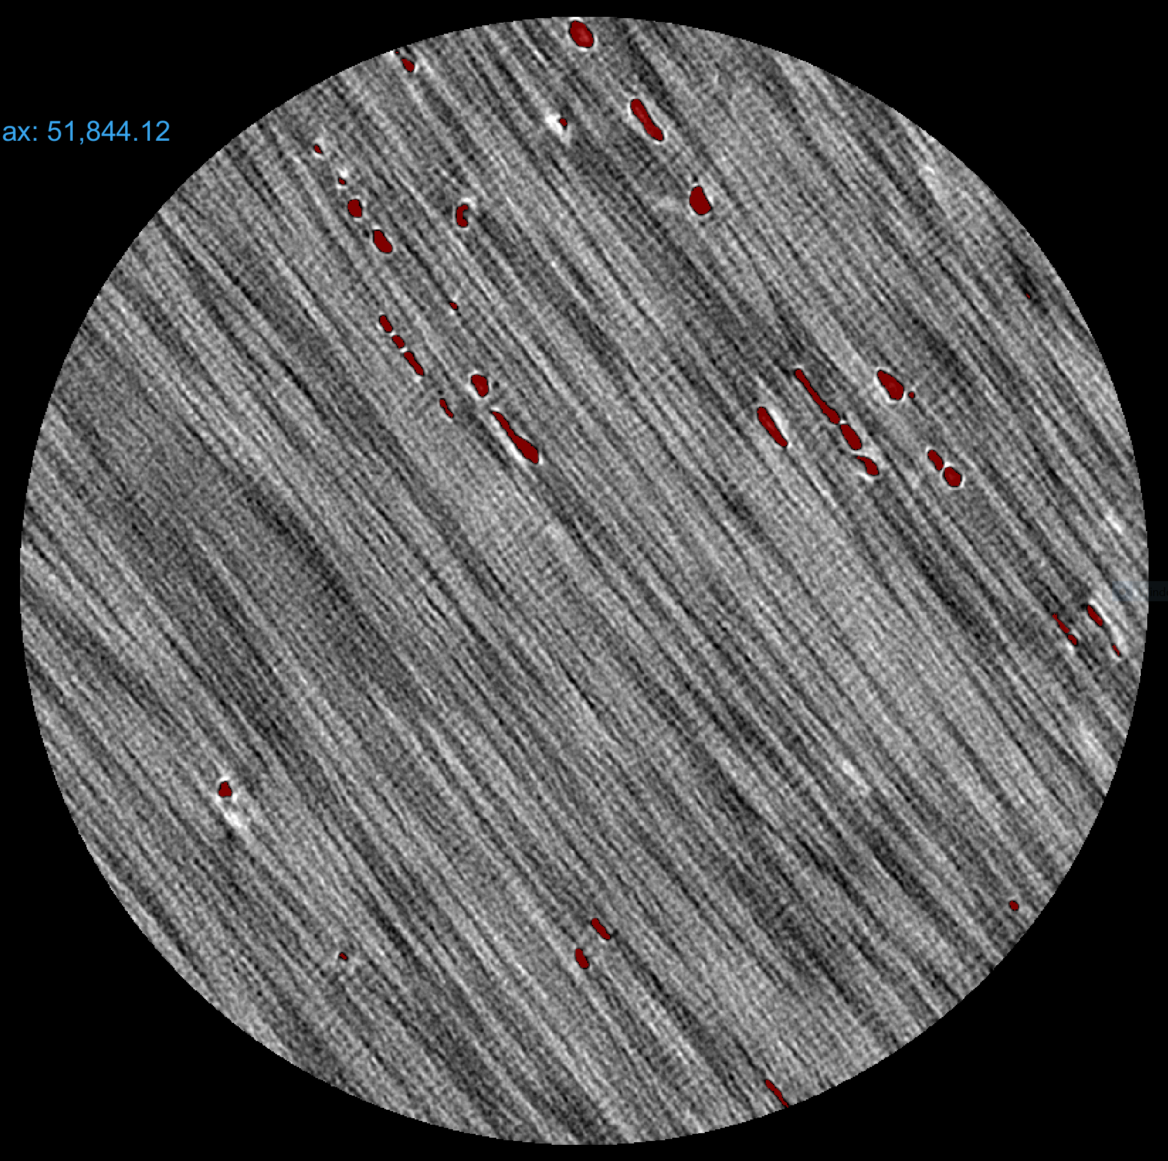
Sub-Micron X-Ray CT on Mantis [45/-45]n Material
High resolution X-ray computed tomography (CT) of Mantis Composites cont. AS4/LM-PAEK [45/-45]n material. Scans conducted at the University of Utah. Image segmentation conducted at Goddard with Dragonfly software.
Strong localization of porosity at layer interface.
Voids = 1.0 vol%
1 cm
Voids = 10.9 vol%
100 μm
Total Matrix + Fibers = 98.1 vol%
Total Voids = 1.9 vol%
Voids = 1.2 vol%
3

Slide 4
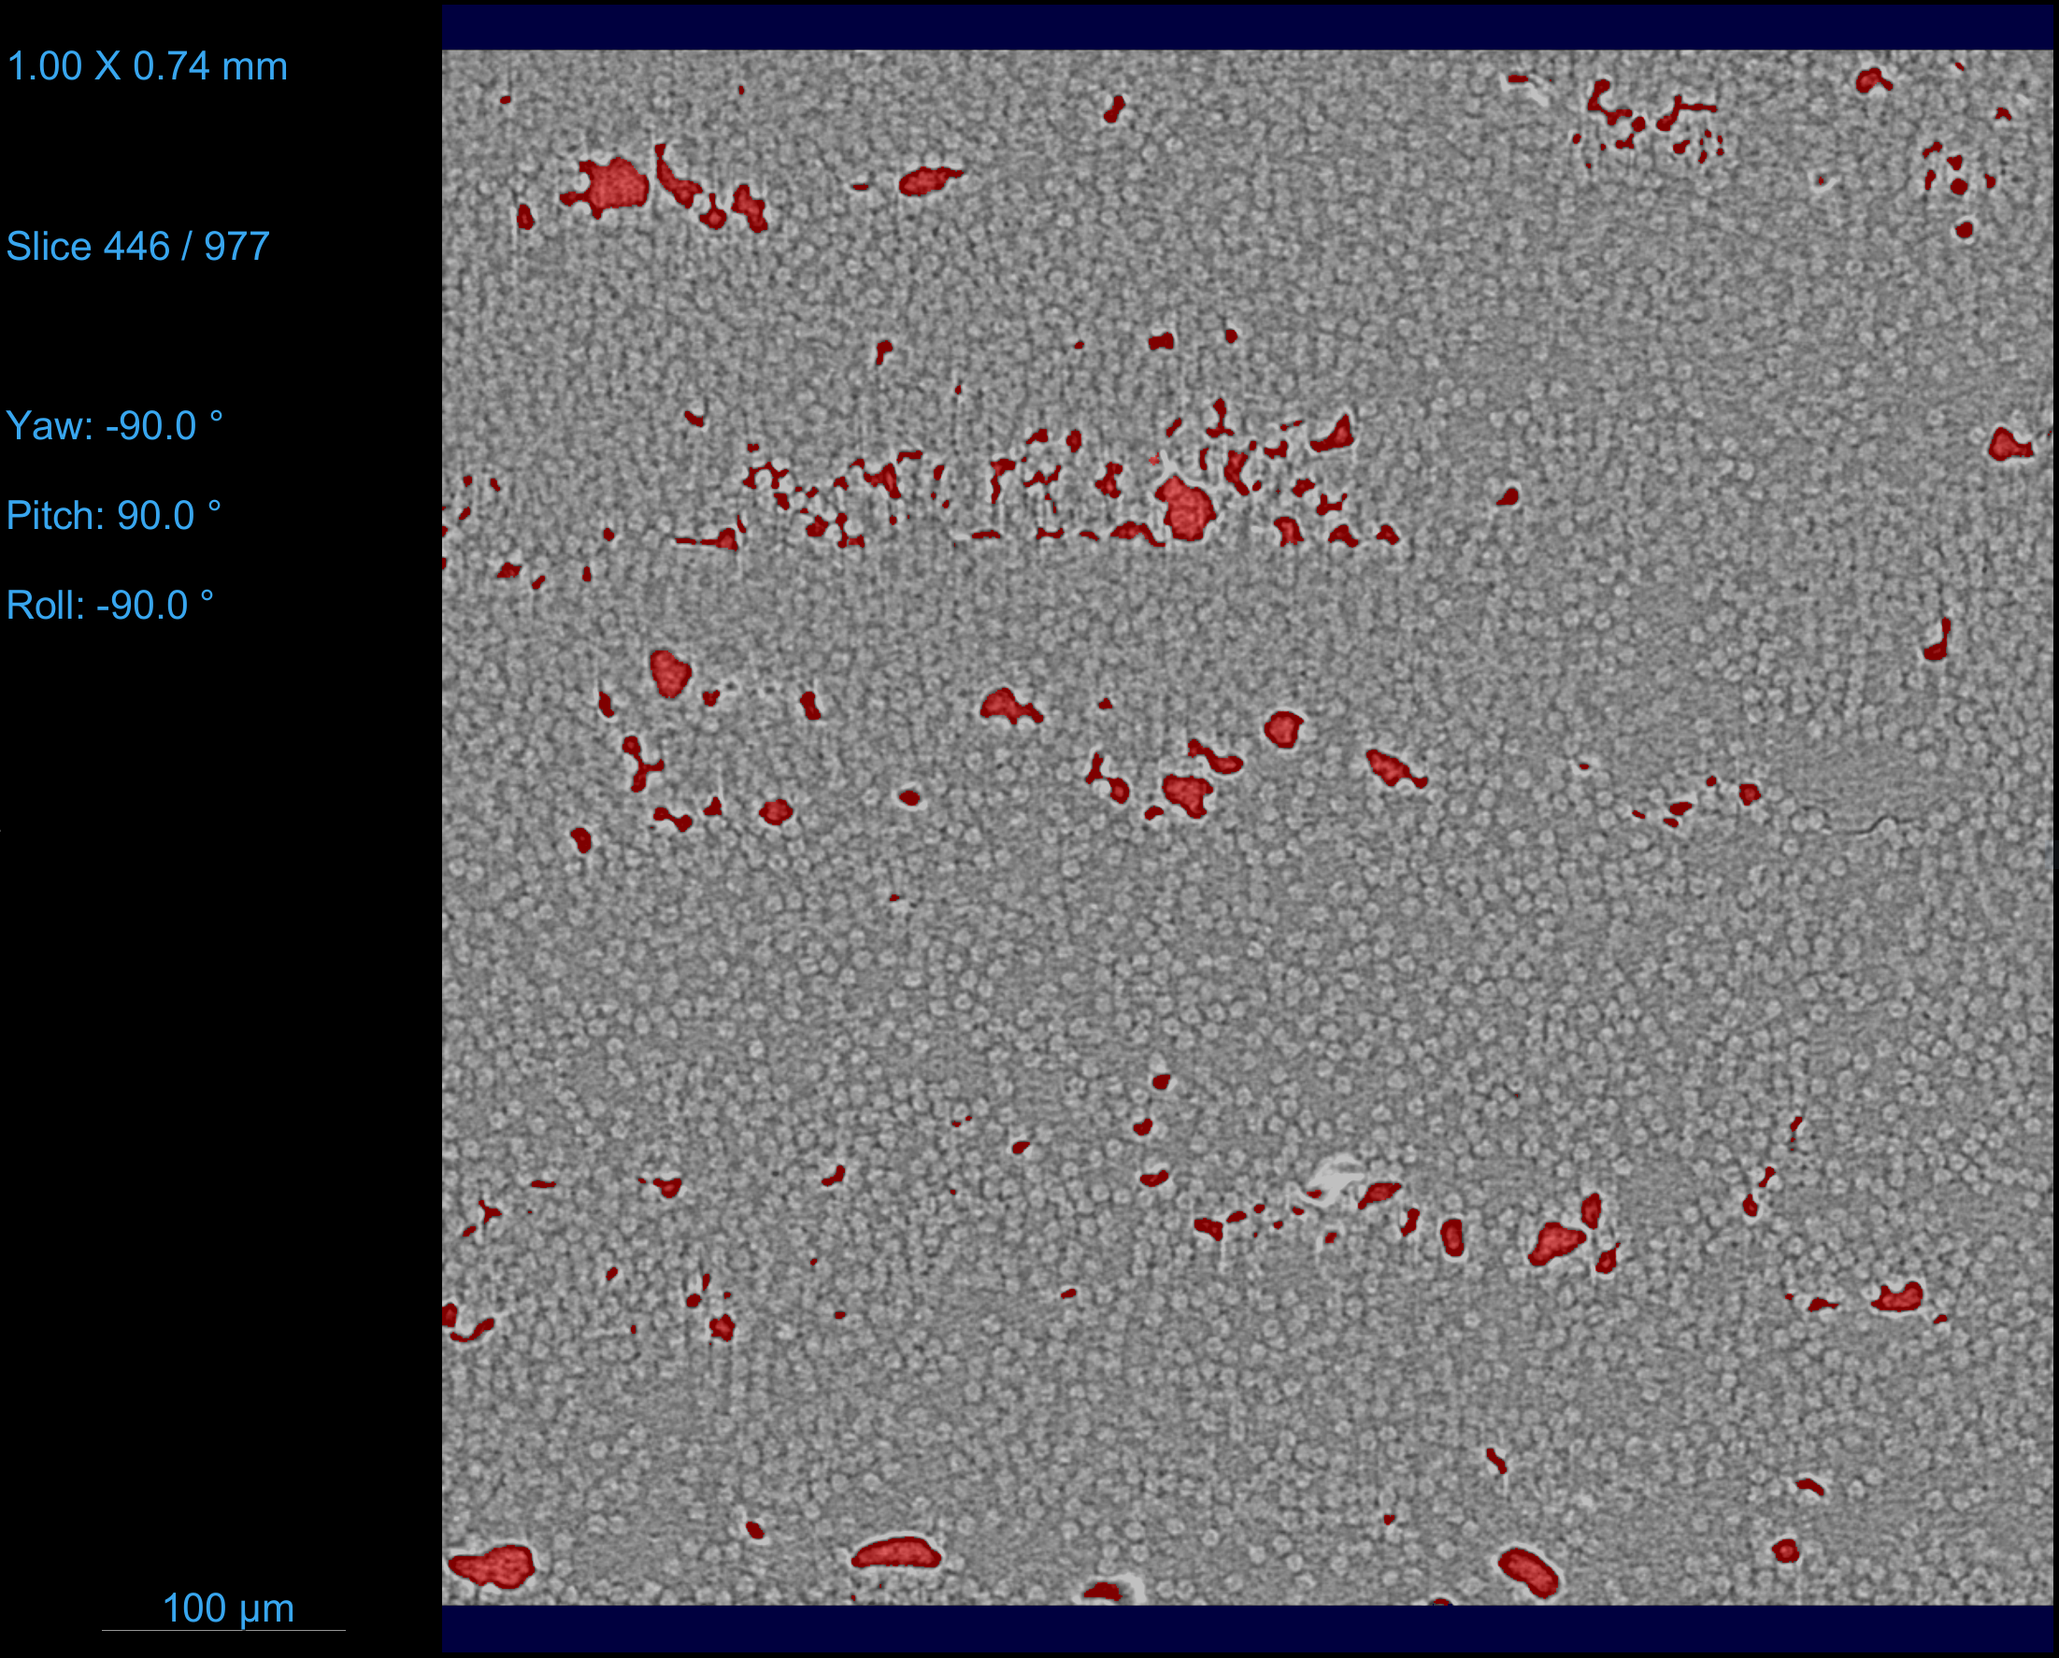
Sub-Micron X-Ray CT on Mantis [0]n Material
High resolution X-ray CT also conducted on Mantis Composites cont. AS4/LM-PAEK [0]n material. These scans were used to acquire microstructure data for our collar modelling effort, because the collar parts are locally unidirectional.
  Void, fiber, matrix volume fractions obtained via segmentation. V_{void} = 2.4%, V_{fiber} = 35.8%, V_{matrix} = 61.8%.
  Fiber orientation obtained “manually”: pick a few representative fibers from the scan and get the (x, y, z) coordinates of the fiber end points near the edges of the CT reconstructed volume.
  Implementation of the microstructure data is shown later.
Point 1 |  |  | Point 2
x (mm) | y (mm) | z (mm) | x (mm) | y (mm) | z (mm)
0.14 | 0.13 | 0.58 | 0.47 | 0.12 | 0.61
0.14 | 0.13 | 0.34 | 0.47 | 0.11 | 0.34
0.14 | 0.12 | 0.07 | 0.47 | 0.10 | 0.10
0.14 | 0.28 | 0.10 | 0.47 | 0.28 | 0.07
0.14 | 0.33 | 0.30 | 0.47 | 0.32 | 0.36
0.14 | 0.32 | 0.62 | 0.47 | 0.32 | 0.60
0.14 | 0.56 | 0.61 | 0.47 | 0.55 | 0.58
0.14 | 0.54 | 0.33 | 0.47 | 0.53 | 0.30
0.14 | 0.55 | 0.09 | 0.47 | 0.53 | 0.10
Manually measured coordinates for 9 fibers randomly selected from the CT volume. Each row corresponds to a fiber. Point 1 and Point 2 are the coordinates of the fiber near the edges of the CT bounding box. The 0° axis is approximately along x.
CT Reconstruction of [0]n specimen. Voids are colored red.
4

Slide 5
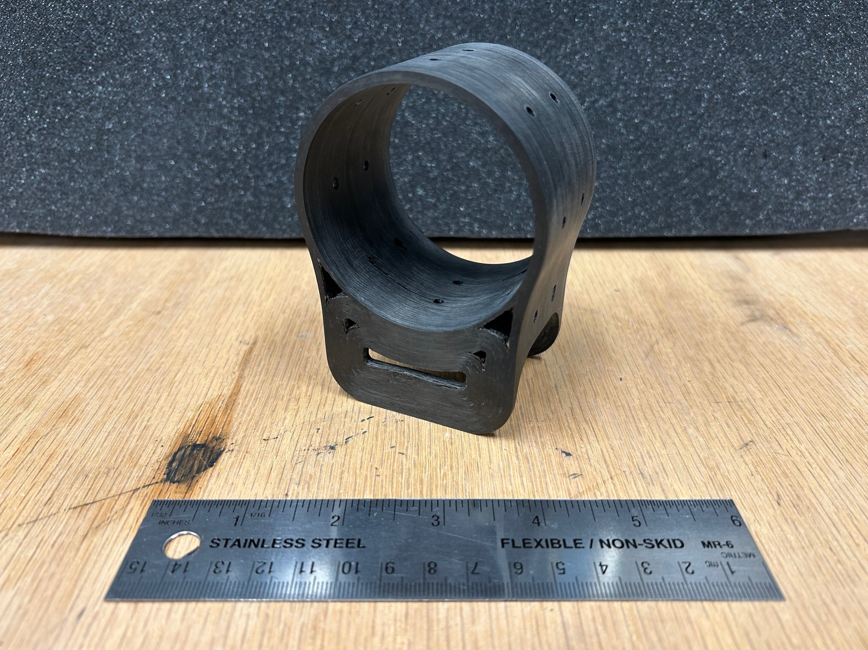
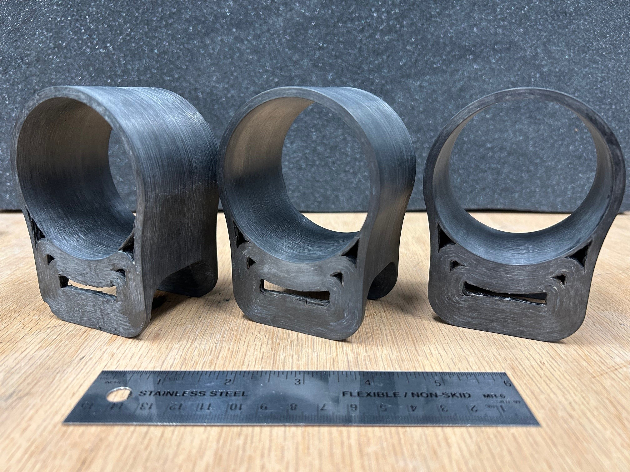
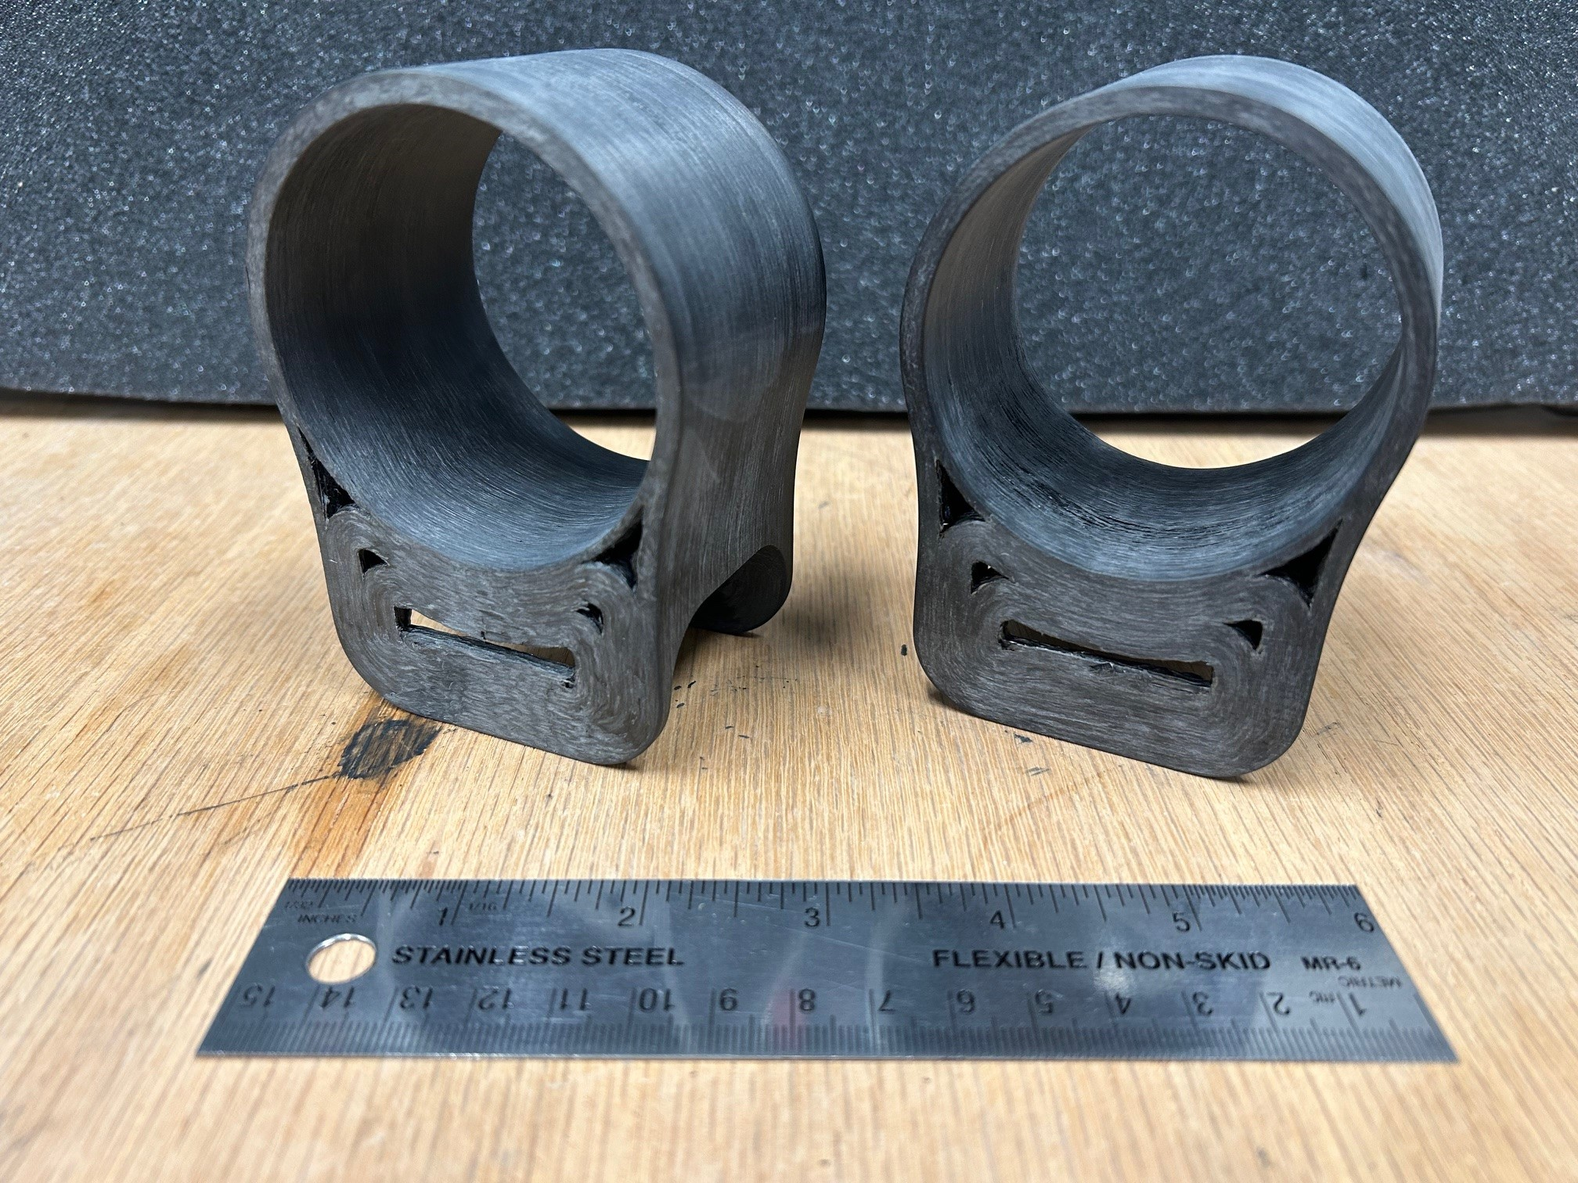
TDEA-300 Collar Delivery
In support of the Thermoplastics Development for Exploration Applications (TDEA) technology development program, qty. 6 cont. AS4/LM-PAEK collar parts were procured from Mantis Composites for inspection and test at NASA Goddard. Collars are identified by design number TDEA-300.
  TDEA-300-A not designated for testing – kept as a demo unit
  TDEA-300-B cross-sectioned
  TDEA-300-C mechanical tested to failure
  TDEA-300-D, -E, -F still available for testing, hope to revisit in a future program
TDEA-300-A
TDEA-300-B, -C, -D
TDEA-300-E, -F
5

Slide 6
TDEA-300 Non-Destructive Inspection
Nominal-Actual Comparison of X-Ray CT Volume.
Deviations between the actual reconstructed volume from X-ray CT and the nominal model file are shown in the color map above for collar TDEA-300-D.
Post-machined surfaces match the nominal model to within 0.4 mm. Non-machined surfaces inside the interior gaps deviate up to 2 mm.
Post-machining reduces surface roughness: ~160 μm as-printed to ~3 μm machined.
Optical Observation of Layer Sagging in Hoop.
Layer sagging in the thin-wall sections adjacent to the interior gaps by the hoop. These wall sections are a single print head pass wide, and sagging results from lack of constraint on the side of the pass to resist material squeezout. Red lines are a guide for the eye.
6

Slide 7
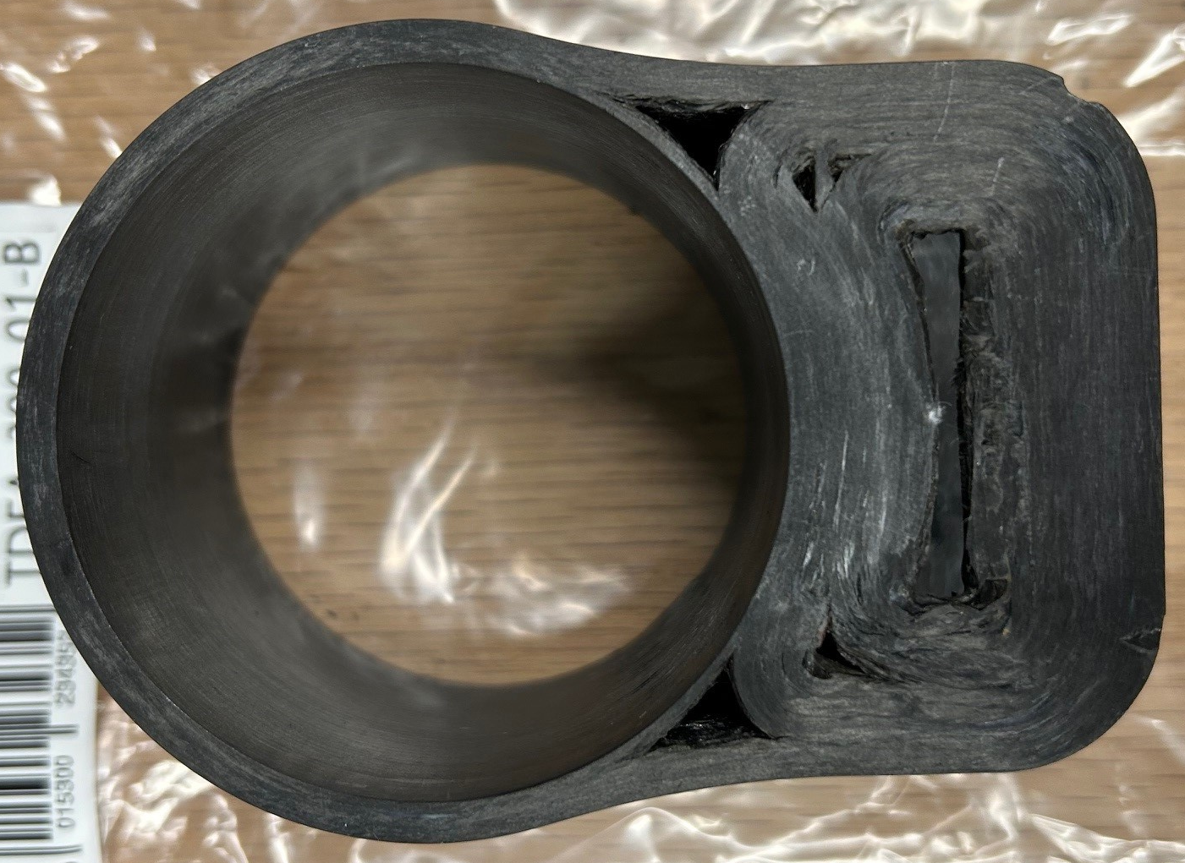
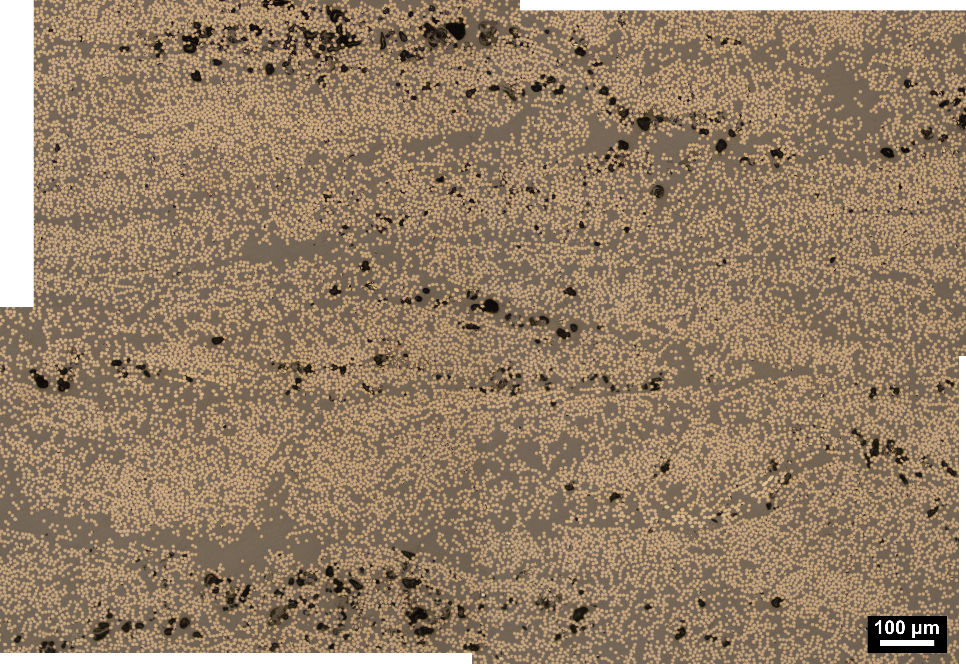
TDEA-300 Cross-Sectioning
Cross-sectioned (CX) collar TDEA-300-B for photomicroscopy.
(a)
(c) CX view
(a)
(d)
(b)
(d)
Large void
(b)
(c) CX view
7

Slide 8
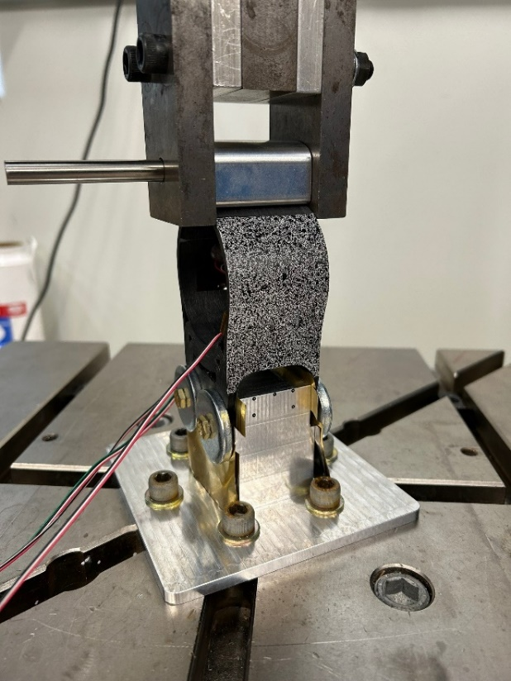
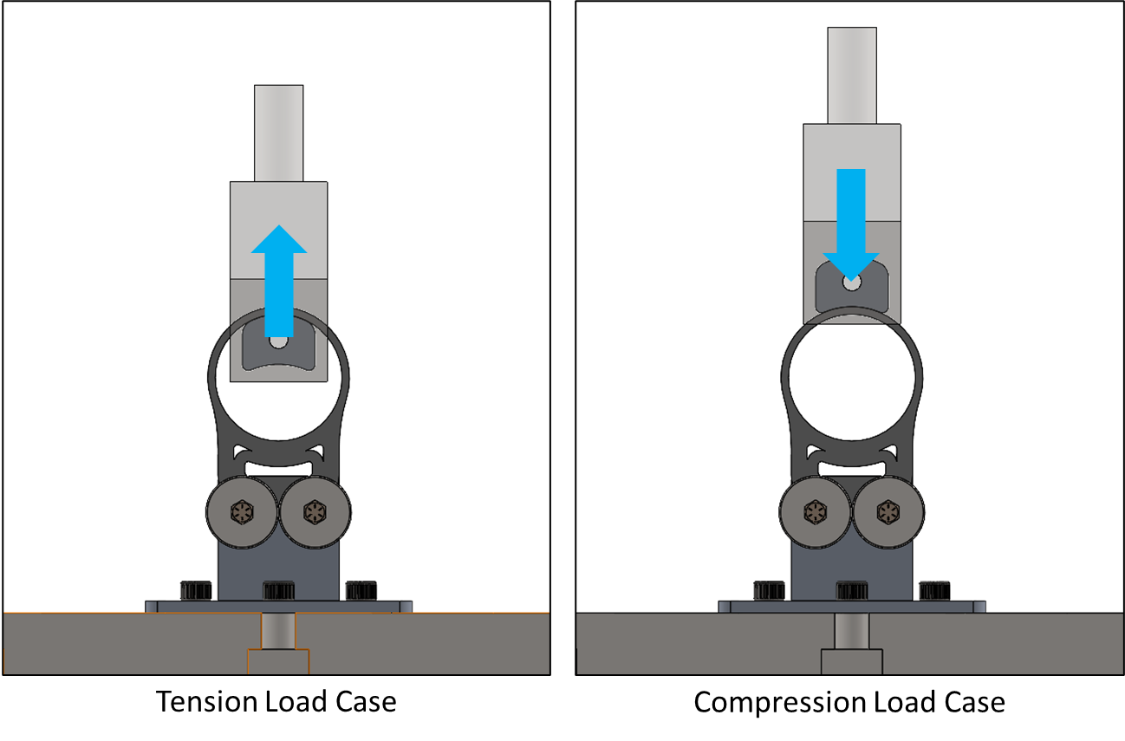
TDEA-300 Mechanical Test Fixture
We targeted simple load cases that would be easy to test and model. Designed and fabricated a saddle/loading block fixture compatible with hoop tension and hoop compression.
Saddle fixturing: shimmed base, lubricated bolts, preloaded fasteners to 100 in-lbf.
Test conditions: Load at 0.01 in/min, data acquisition at 1 Hz (both digital image correlation (DIC) and Instron)​.
8

Slide 9
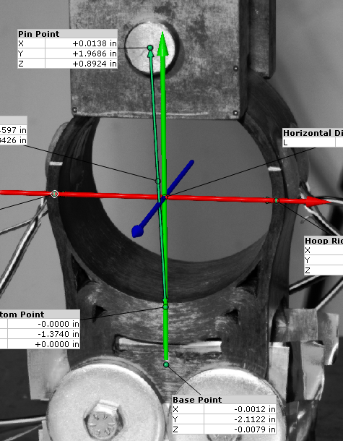
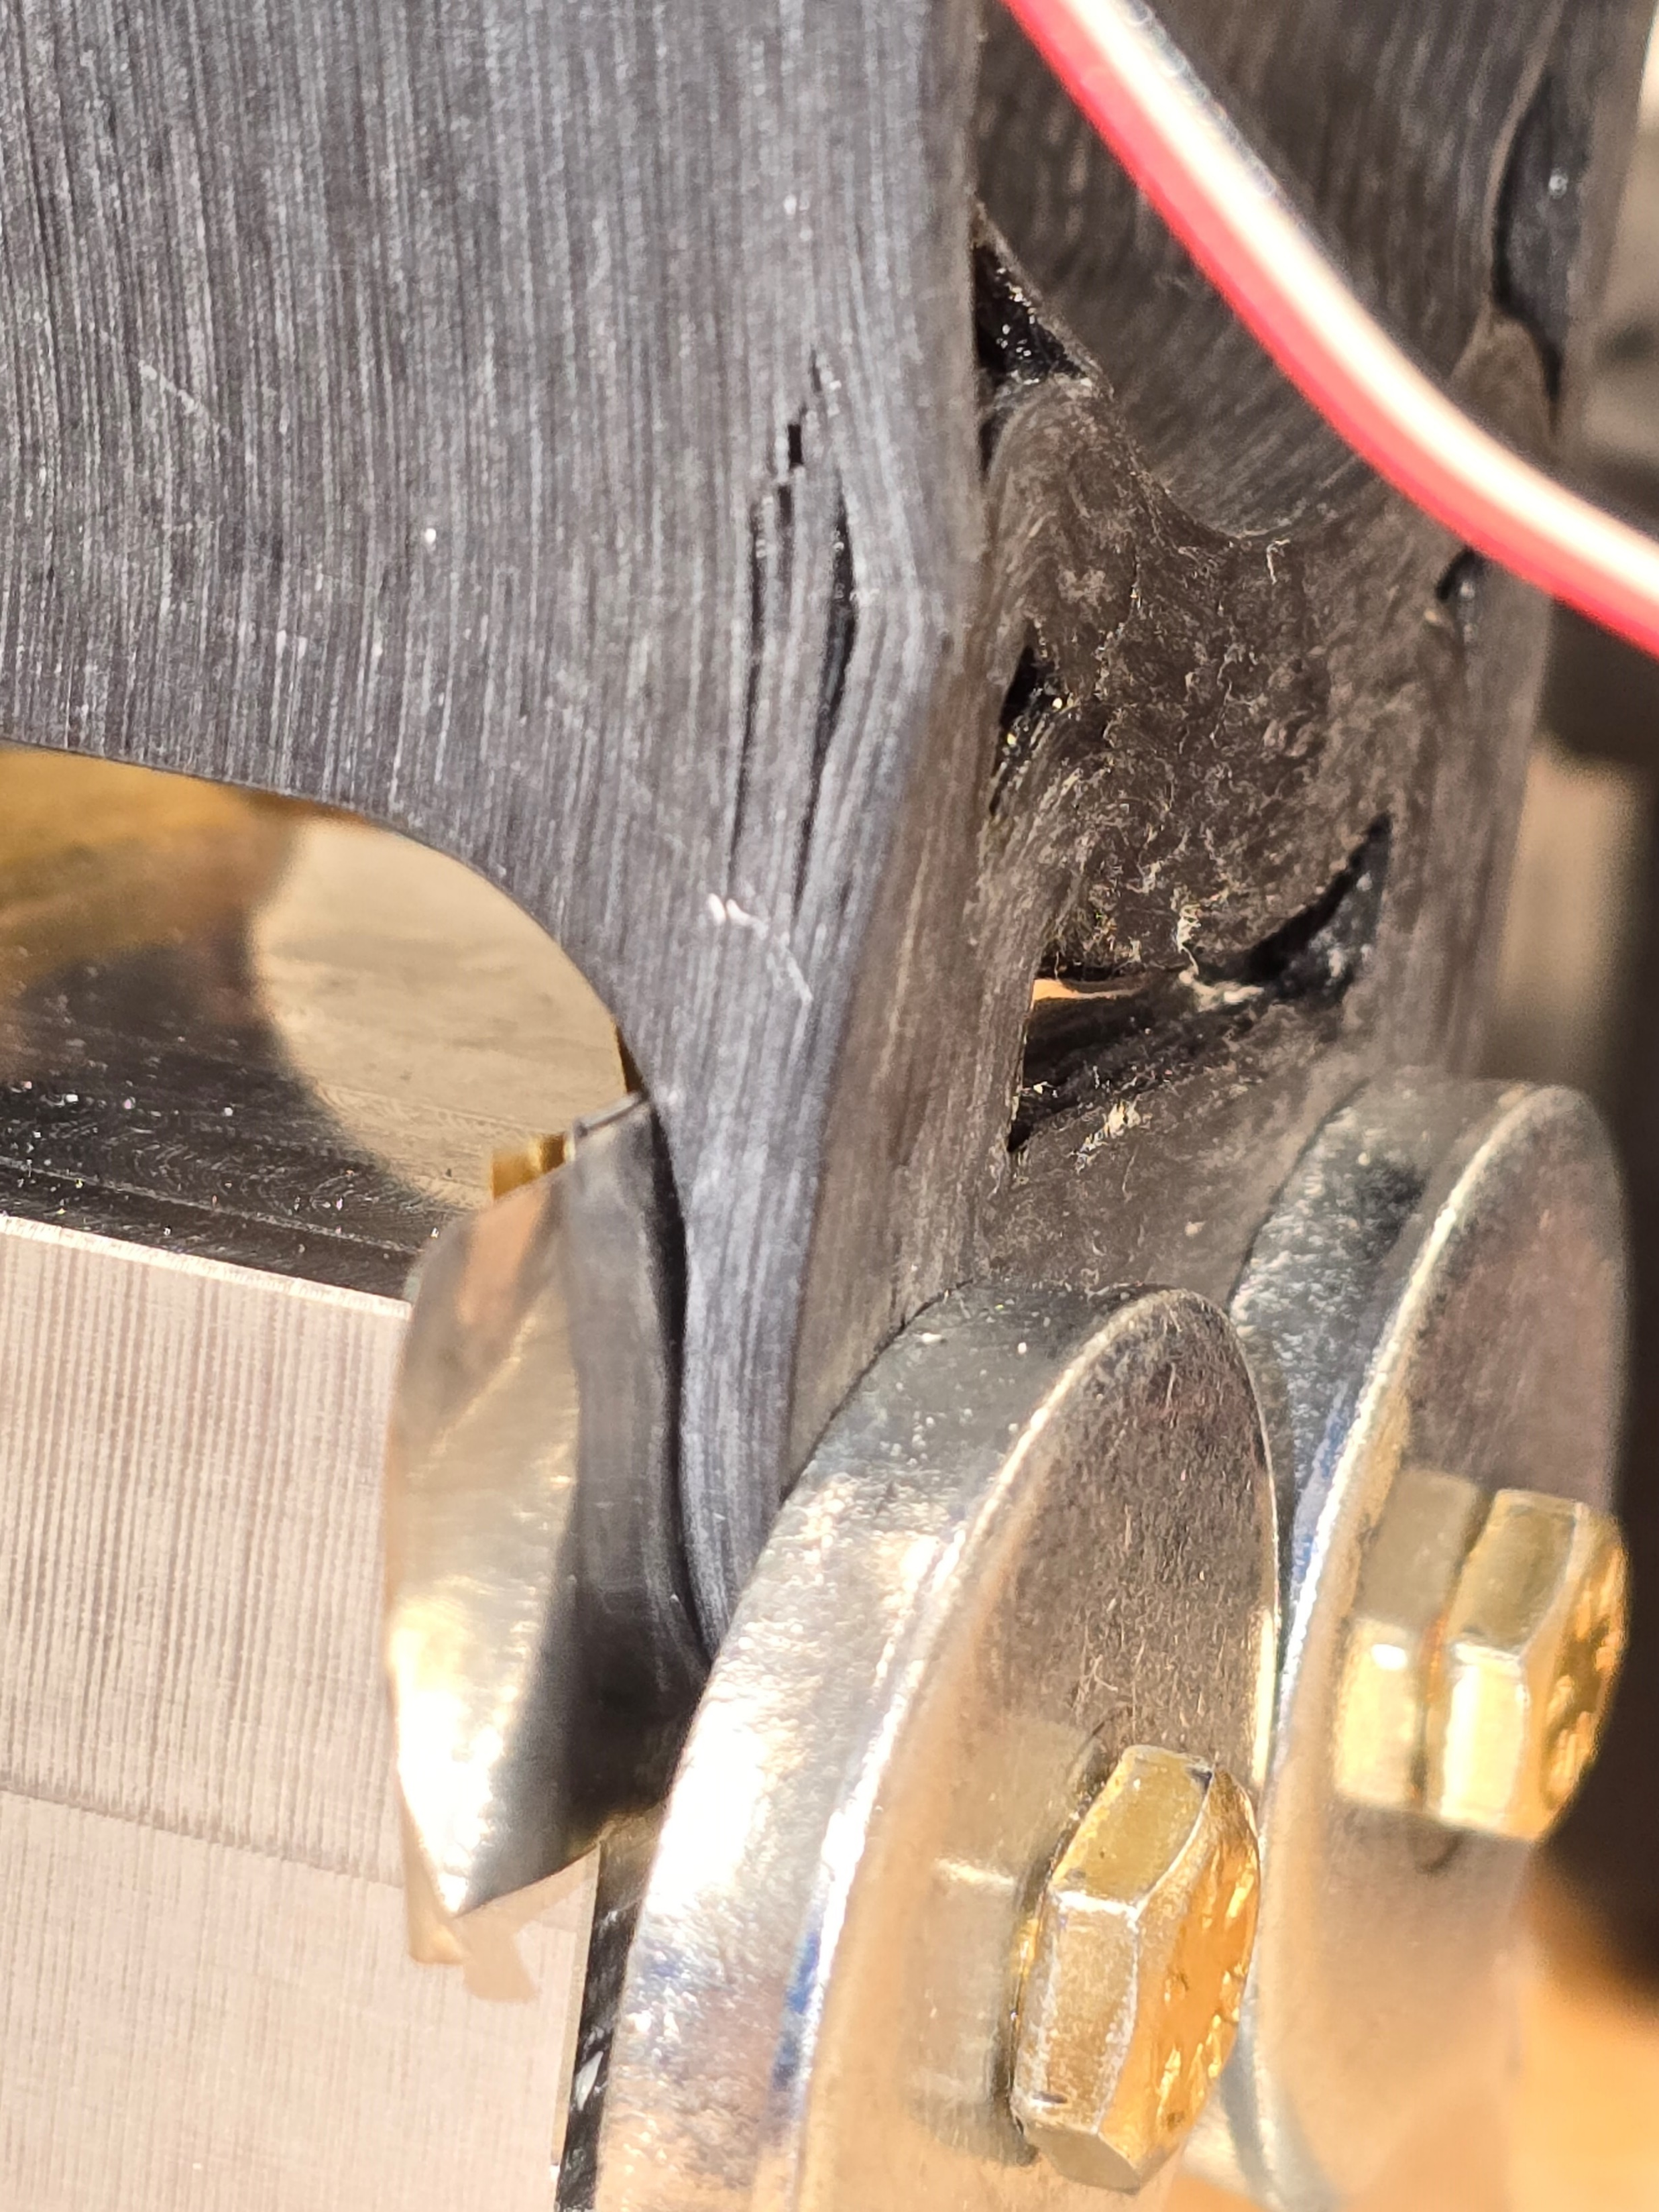
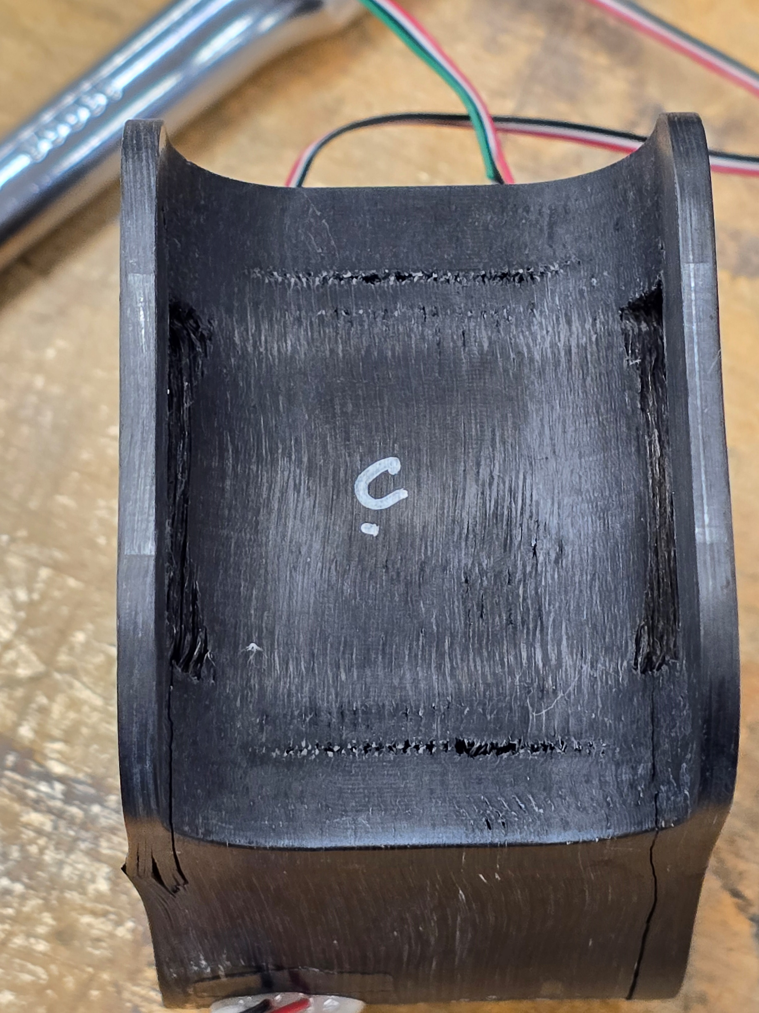
TDEA-300 Mechanical Test
Mechanical tests conducted on TDEA-300-C. Recorded synchronized loads and coordinates of DIC fiducial points around the hoop perimeter. Multi-step test:
  Cyclic loading in compression to 600 lbf. Good repeatability and linearity, data used for model validation.
  Cyclic loading in tension to 600 lbf. Indications of base slip at 340 lbf, tension tests not continued.
  Loading in compression to failure. Failure occurred at 3,900 lbf via layer separation in the base.
DIC Compression Test Image
Compression to failure @ 3,900 lbf
Compression to failure @ 3,900 lbf, Bottom View
Layer Separation
Primary DIC targets
9

Slide 10
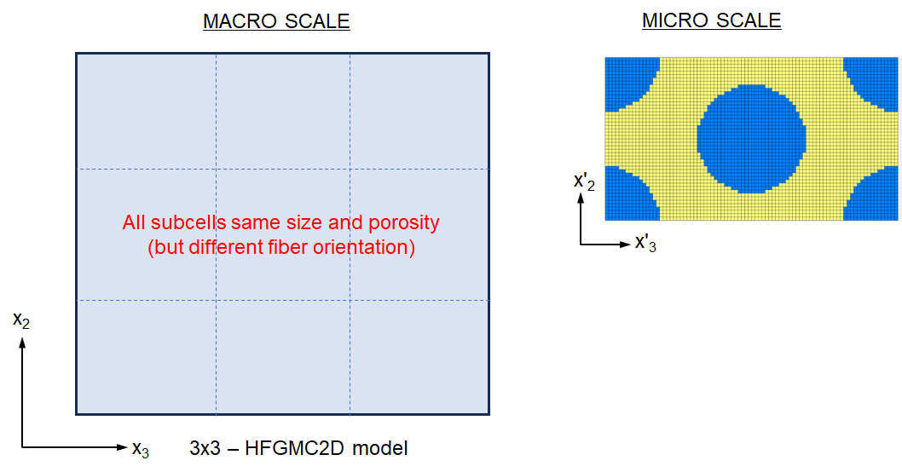
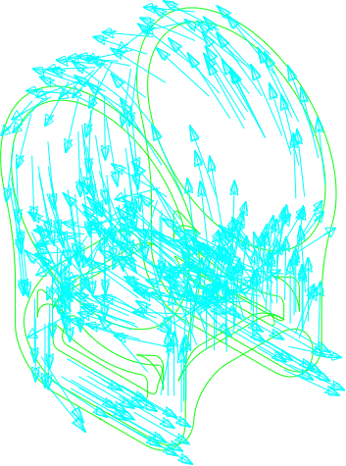


TDEA-300 Modelling (Method)
Multi-scale modelling approach in two steps:
  Generate smeared anisotropic properties based on microstructure data (below, left). High-Fidelity Generalized Method of Cells (HFGMC) and Mori-Tanaka (MT) micromechanics theories used. NASA Multiscale Analysis Tool (NASMAT) used.
  Local coordinate system mapping of engineering constants onto model (below, right). Assume that the nominal print head path is identical to the 0° fiber axis at all points.
VOID SCALE
Spherical Void
MT model
Engineering Constants
E11 (msi) | E22 (msi) | E33 (msi) | v23 | v13 | v12 | G23 (msi) | G13 (msi) | G12 (msi)
11.0 | 0.86 | 0.86 | 0.49 | 0.37 | 0.29 | 0.28 | 0.44 | 0.36
Print Path
(Nominal Fiber Path)
Mapping onto Model
10

Slide 11
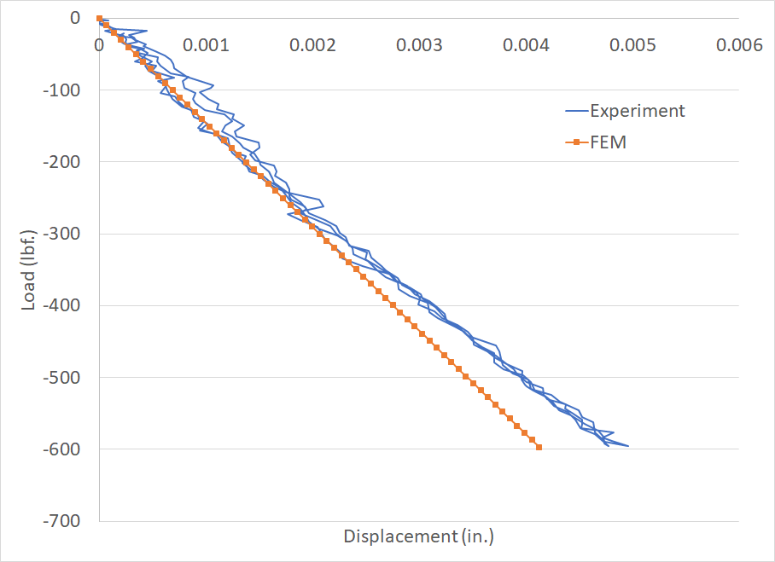
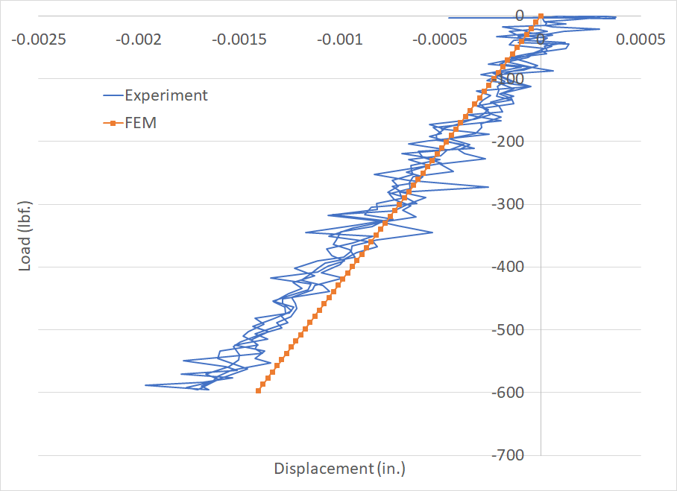
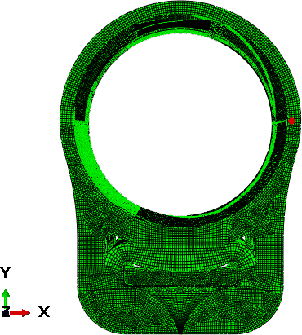
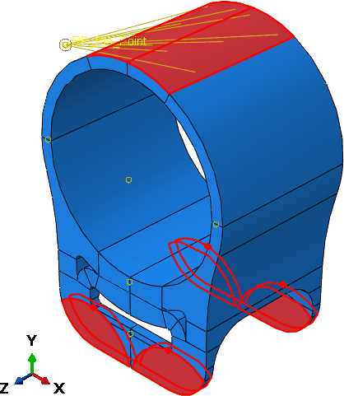
TDEA-300 Modelling (First-Pass Implementation)
Model load introduction:
X, Y displacements of nodes under load block tied to a reference node.
Uniform Y displacement applied corresponding to 600 lbf (max load in test).
Uniform X displacement (10% of Y displacement) applied to account for lateral loading observed in test.
X-Displacement
Y-Displacement
Hoop Right Side
Successful first pass at correlation, modeling approach is promising.
Simplifications were made to the model. Future work to improve correlation:
  Include test fixtures (saddle/block) in model explicitly to capture boundary conditions.
  Verify correspondence between fiber path and print head path. Ideally model directly based on fiber path from X-ray CT.
11

Slide 12
Future of Composite Additive Manufacture for NASA
The NASA composites team presented our additive manufacturing work to the Space Technology Mission Directorate review committee earlier this month. The additive manufacturing work was very well received and there is interest in composite 3D printing for secondary structures.
Some potential areas for engagement between Mantis Composites and NASA:
  Support structures for cryotanks. We are starting to look at thermal management for near zero boiloff cryotanks. Composite struts/attachments can potentially reduce thermal conductivity and mass vs. metallic baseline components. Could explore 3D printing of low thermal conductivity feedstocks.
  Build on our modelling work to develop methods for rapid design. E.g. geometric constraints → print path → strength/stiffness estimates. In addition to more testing, we’d like to better understand the correspondence between nominal print path and actual local fiber orientation.
  Strategies for increasing out-of-plane strength of 3D printed parts for complex load cases. Could be z-axis reinforcement like the 5-axis collar concept, or any other post-processing steps that may help.
  Eventually we’ll be interested in developing composite 3D printing for in-space manufacture. Could leverage GSFC Instrument Design Lab for a systems study on robotic 3D printing on Lunar/Mars surface.
12

