Slide 1
Manufacturing of Aircraft Structures Using Composite Tailoring Techniques
Alana M. Cardona¹, Erin K. Anderson¹, Lauren Simmons¹, Richard A. Larson¹, Brian H. Mason¹, and Jacob Tury²
NASA Langley Research Center, Hampton, VA
¹Structural Mechanics and Concepts Branch
²Manufacturing Applications Branch
May 19-22, 2025
Indianapolis, IN

Slide 2
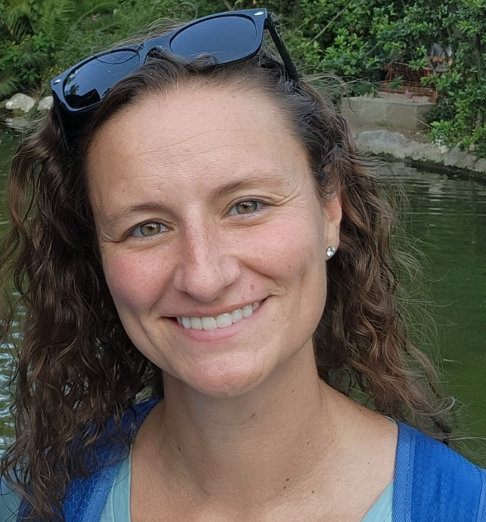
Alana Cardona
Alana Cardona is an aerospace engineer who has been at NASA Langley Research Center in the Structures and Materials group since 2017. She is a subject matter expert in automated fiber placement, composite design, programming, and manufacturing. Additionally, she specializes in nonlinear analysis of composite materials, namely damage progression of thermoset prepreg materials and stitched, resin infused materials. She is currently the Deputy Integration Manager at the Integrated Structural Assembly of Advanced Composites (ISAAC) facility.

Slide 3
Outline
Introduction
Manufacturing
Integral Stiffener Research, Applications
Tow-Steering Research, Applications
Advanced Curing Methods
Conclusions and Future Work

Slide 4
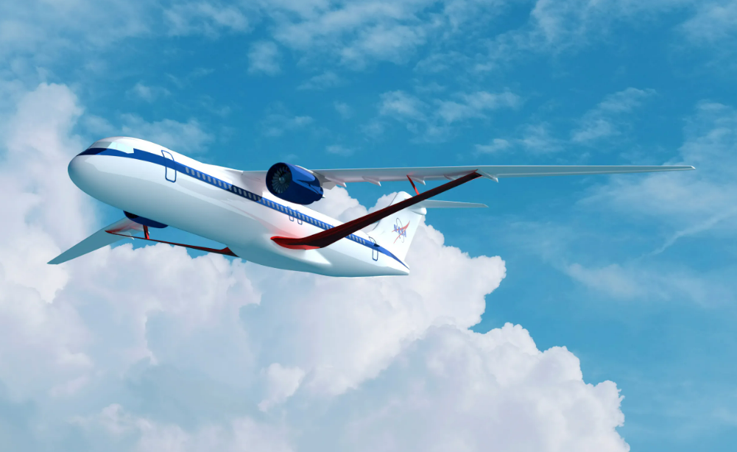
Introduction
Motivation:
Aerospace industry seeking lightweight, fuel-efficient designs that maintain the strength and damage tolerance required for safe flight
Advanced Air Transport Technology (AATT) project, Transonic Truss-Braced Wing (TTBW) concept
Increased efficiency within commercial, single-aisle aircraft
Nontraditional means to reduce weight, including integrating composite techniques into wing cover panels to reduce or remove metallic parts
Wing
Jury strut
Main strut

Slide 5
Introduction
Objective:
Develop and demonstrate advanced composite tailoring techniques that can reduce weight and meet the strength requirements for flight certification
Structural Wing Experiment Evaluating Truss-bracing, 15-Foot (SWEET-15)
Wing cover panels contain tailored composite designs
Wing is supported externally by a stitched resin-infused main strut
Manufacturing and pre-assembly at Langley Research Center, then tested at Armstrong Flight Research Center in the Flight Loads Laboratory

Slide 6
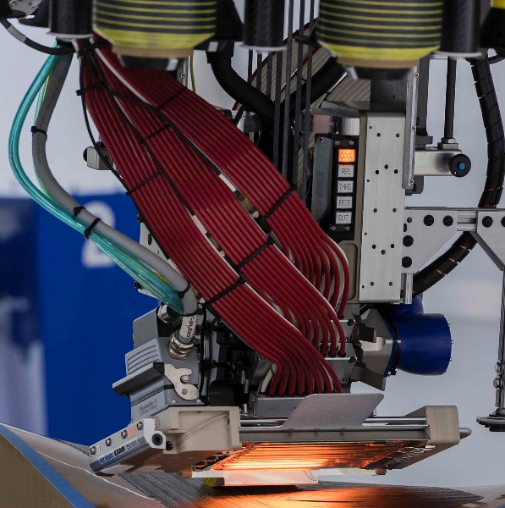
Automated Fiber Placement
ISAAC robot
Automated fiber placement (AFP) at NASA Langley Research Center
Integrated Structural Assembly of Advanced Composites (ISAAC) facility
Places up to sixteen 6.4-mm (¼-in.) composite prepreg tows in multiple courses that make up a ply
Multiple plies create a full laminate
AFP head
Prepreg spools
Placement surface
Spools
Heater
Roller

Slide 7
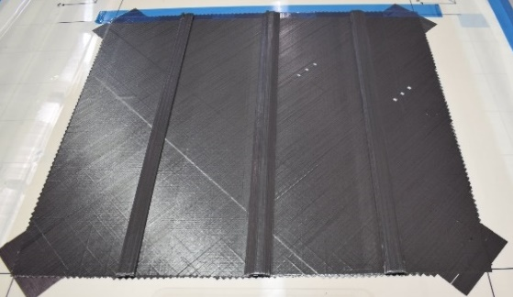
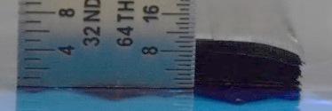
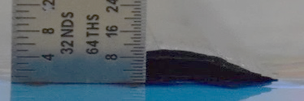
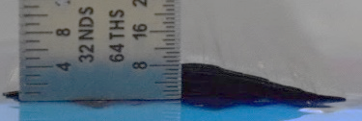
Integral Stiffener Research
Integral stiffener created by adding additional tows in select locations interleaved between skin plies
Interleaving reduces likelihood of stiffener separation from skin
Stiffener widths, stagger, and heights investigated
None
Vertical wall
Tapered wall
Skin
Skin
1.59 mm
(1/16 in.)
3.18 mm
(1/8 in.)
Acreage plies
Interleaved stiffener plies

Slide 8
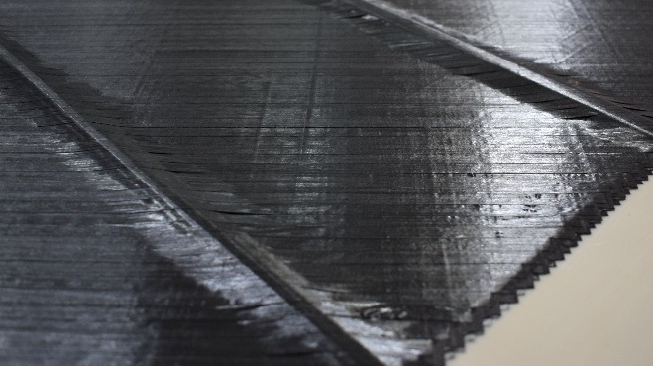
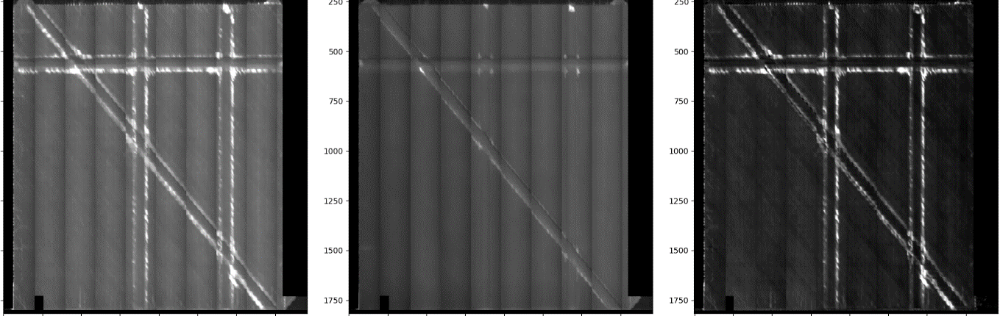
Integral Stiffener Research
Defect reduction
Bridging reduced with staggered stiffeners compared to vertical wall
Fewer stiffener plies between each skin ply
Four-tow stiffener width provides better stiffening impacts and more gradual tapered edge
Regular debulking to reduce compounding bridging effects
3.18-mm stagger
No stagger
Bridging
Pre-Debulk
Post-Debulk

Slide 9
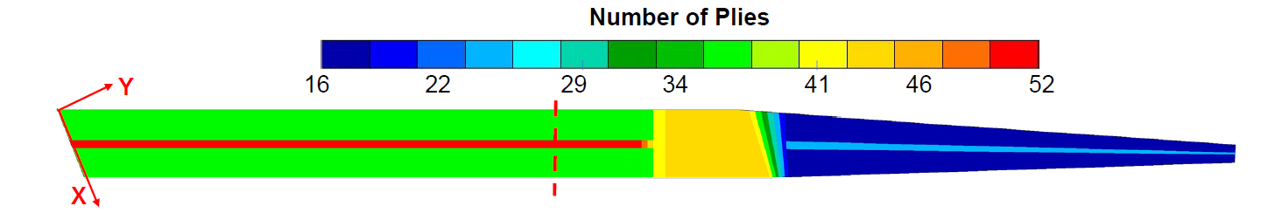
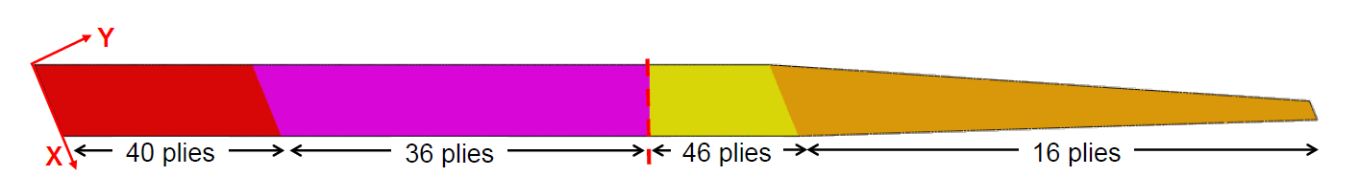
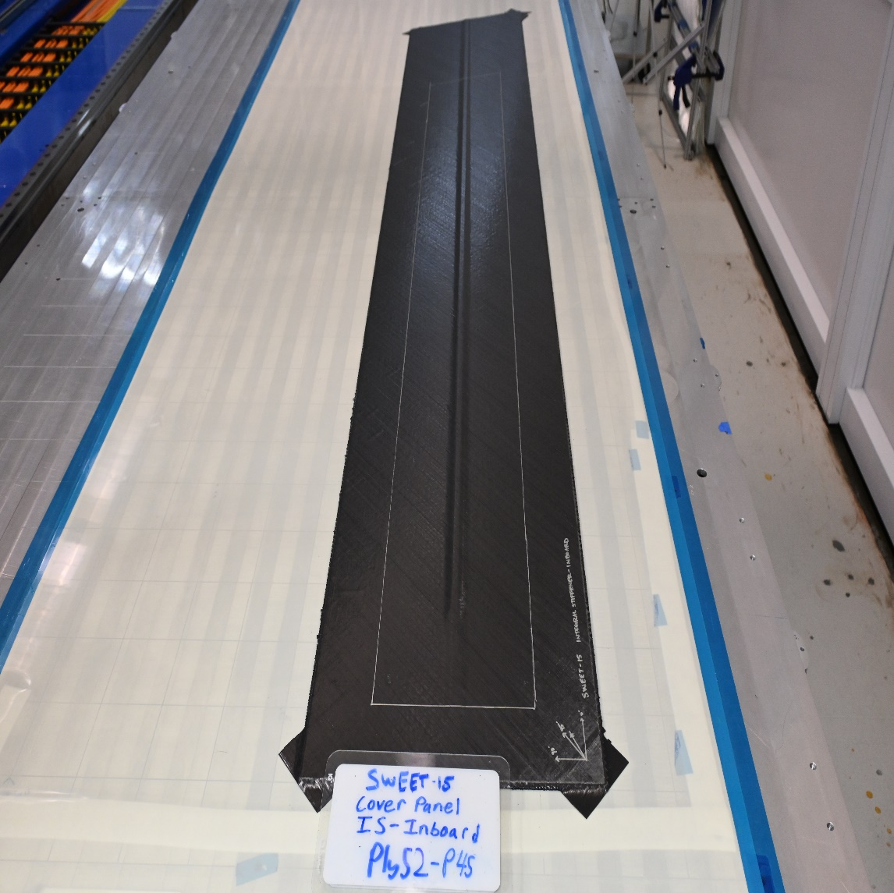
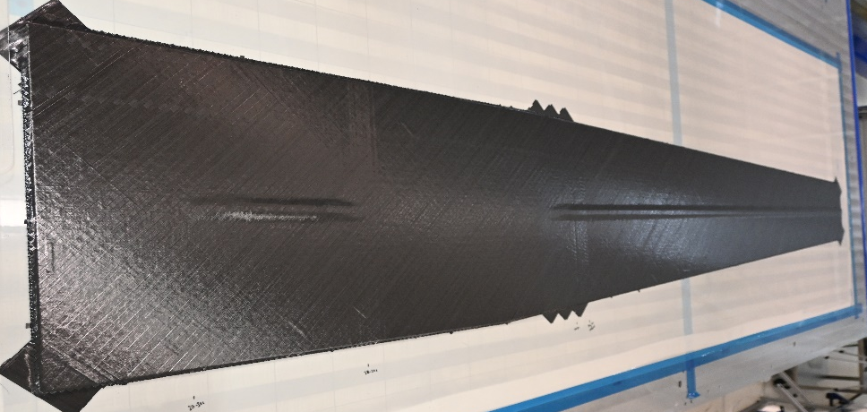
Integral Stiffener Applications
Initial design, unstiffened without ply drops
Final design, stiffened with ply drops
Number of plies
Inboard
Outboard
40 plies
36 plies
46 plies
16 plies
Total skin thickness optimized before adding integral stiffener
Differences between optimization and final laminate based on manufacturing ease and reliability
Panels programmed and manufactured at ISAAC with extra trim area
Inboard
Outboard

Slide 10
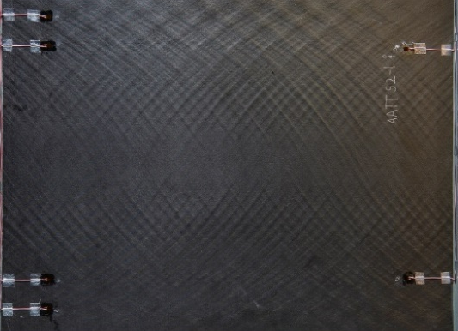
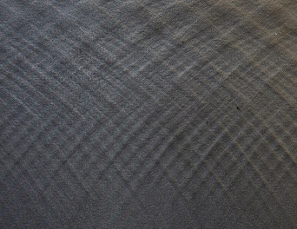
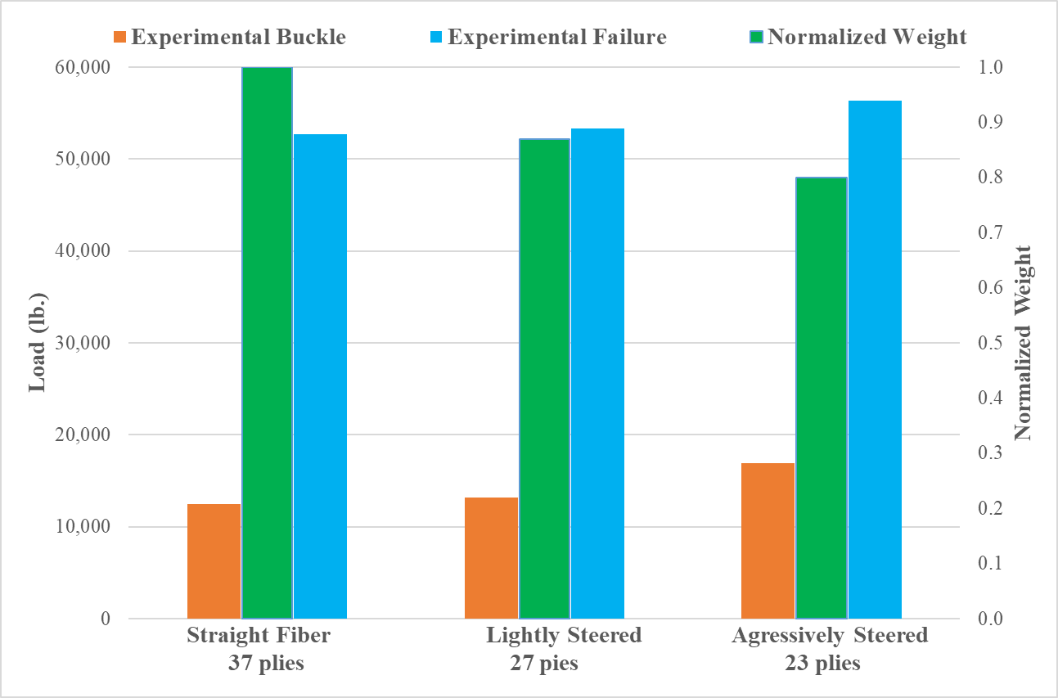
Tow-Steering Research
Three different legacy designs with various extents of tow steering
Straight fiber, lightly steered, and aggressively steered
Tested under compressive load
Aggressively steered panels had 20% lower weight and 35.6% higher buckling load
Automated Tool for Steered COmposite Optimizable Laminates (ATSCOOL)
Investigate more optimal tailoring of steered fiber laminates

Slide 11
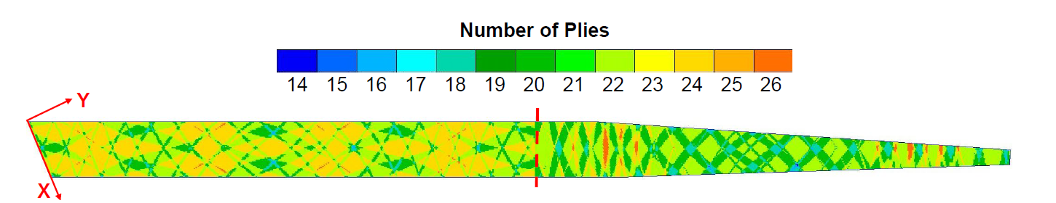
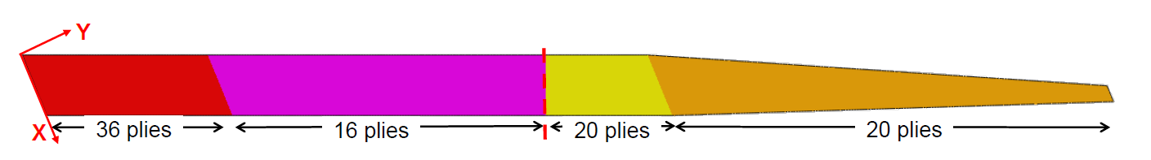
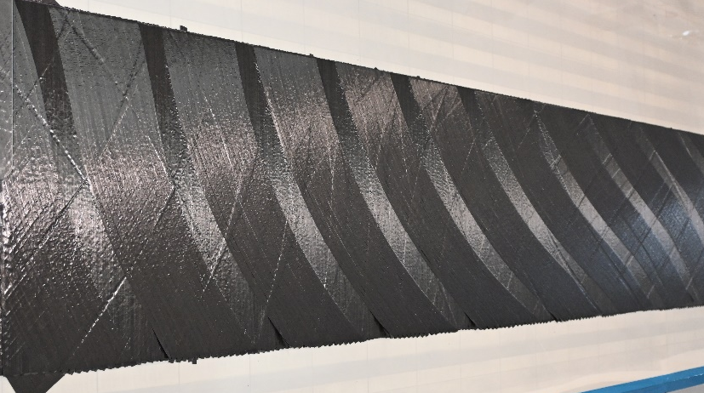
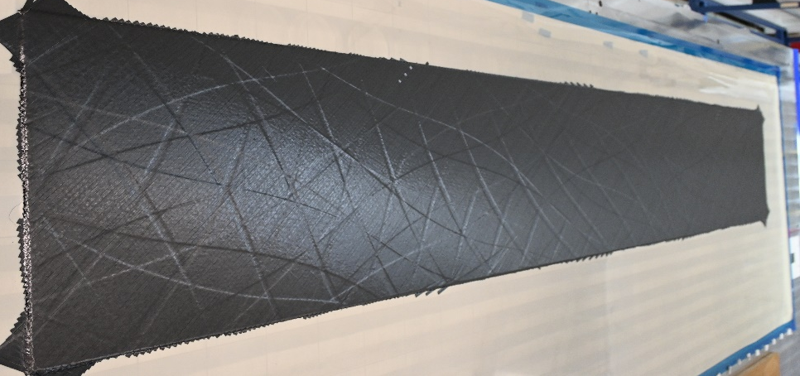
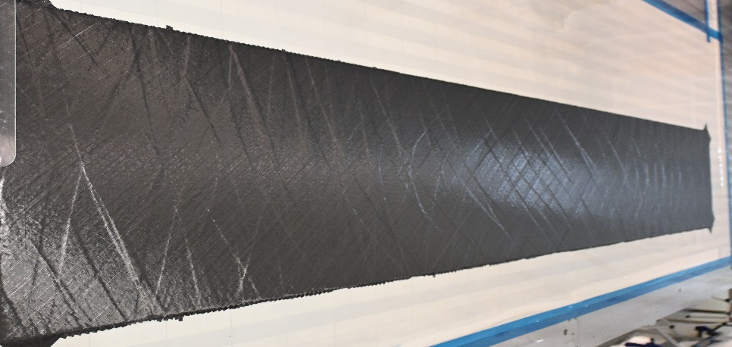
Tow-Steering Applications
Initial design, without tow steering
Final design, with tow steering
Number of plies
Inboard
Outboard
36 plies
16 plies
20 plies
20 plies
Initial skin sizing optimized again, then select straight fiber plies replaced with steered plies with intentional gaps
Panels programmed and manufactured with extra trim area
Inboard
Outboard

Slide 12
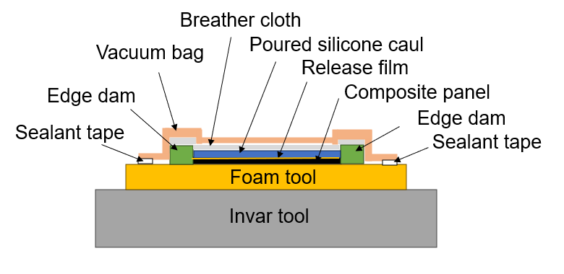
Advanced Curing Methods
All panels thermoset composite prepreg designed for autoclave cure cycle
Flat inboard panels placed on invar tool, angled outboard panels on foam tool then invar tool
Cured under vacuum with silicone caul over top of panel
Heat/pressure cycle between 107-177 °C (225-350 °F) at 690 KPa (100 psi)
Notes:
This cycle consisted of evacuating atmosphere from the vacuum bag via a vacuum pump and ramp heating the autoclave to 107 °C (225 °F) while increasing the pressure to 690 KPa (100 psi) gauge pressure. This pressure and temperature were held before further ramping the temperature to 177 °C (350 °F) and holding this next temperature and pressure for the remainder of the cure cycle. Subsequent cool down and pressure release occurred per workshop best practices.

Slide 13
“Flat” Panel Cure
Integrally stiffened and tow-steered composite panels susceptible to warping
Nonsymmetric coefficient of thermal expansion (CTE) distribution across the thickness
Varying location of the neutral bending axis
Two-part silicone caul material used to match varying outer mold line surface and create flat outer surface for cure

Slide 14
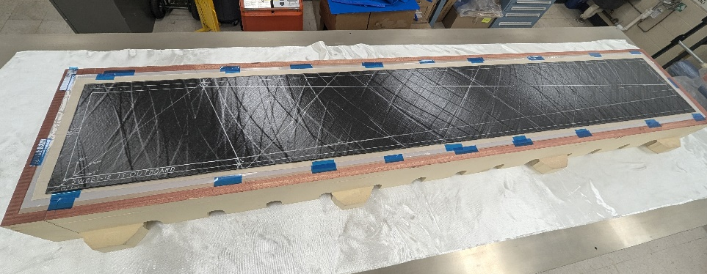
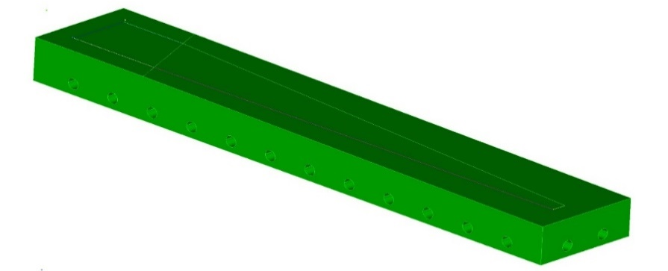
Tapered Height Cure
Outboard panels have inflection point and were not flat
Nonuniform caul surface, but heavy enough to act as a pressure intensifier even in thinnest caul regions
Final part dimensions drawn on (silver) for post-cure trim
Tapered angle change
Foam tooling

Slide 15
Conclusions
Objective was to explore multiple advanced composite manufacturing concepts for integration into a complex truss-braced wing assembly
Full test article advances the state of the art of stitched resin infused composites, integrally stiffened composites, and tow-steered composites
Manufacturing applications can be used for many composite structures that benefit from fiber tailoring, lightweight structures, and increased strength and buckling requirements

Slide 16
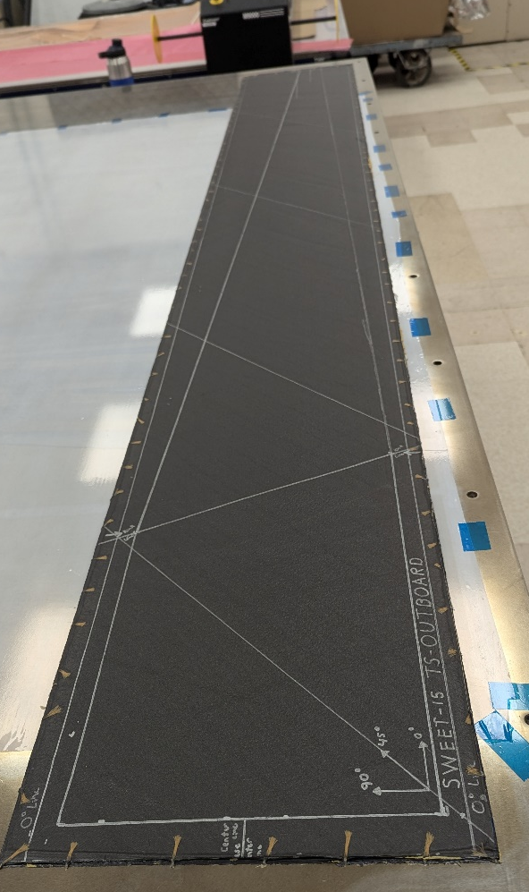
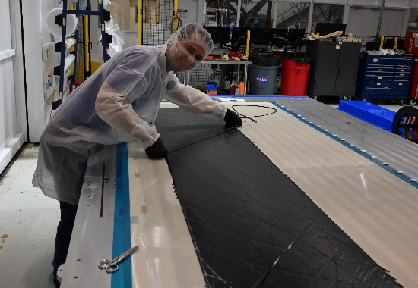
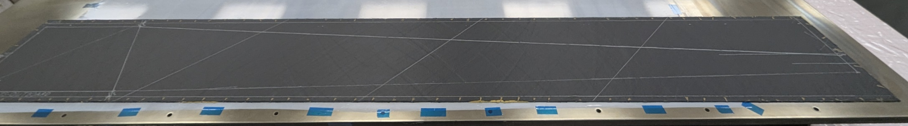
Future Work
Test to take place Fall 2025 at Armstrong Flight Research Center
Plan to display capabilities of fiber optic strain sensing (FOSS) system for strain and damage mapping
Current best practices for AFP at the ISAAC facility continue to push the boundaries and advance capabilities for composite manufacturing
3.05 meters (10 feet)

Slide 17
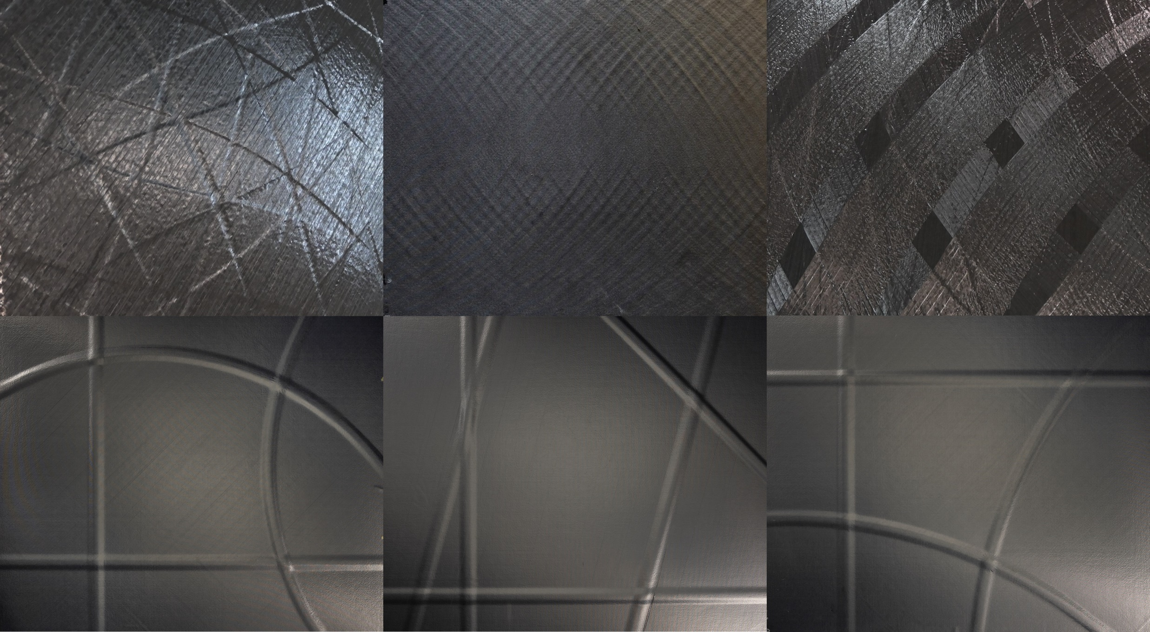

Questions?

