Slide 1


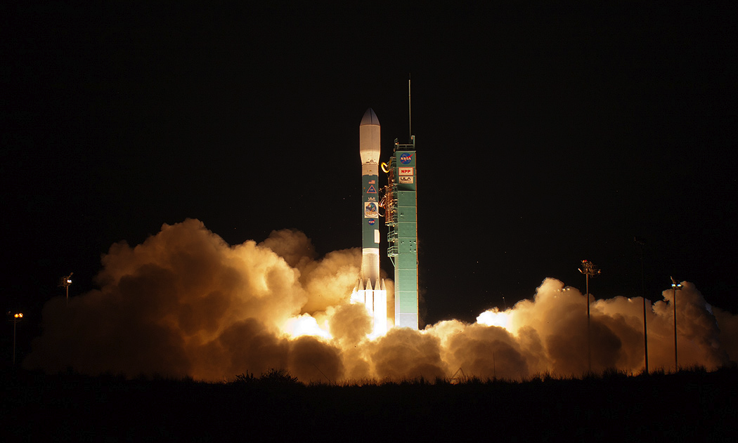
Changes in Earth’s Energy Imbalance Since 2000 As Observed by CERES
N.G. Loeb¹, M. Shankar¹, W.L. Smith¹, L. Liang², S. Kato¹, D.R. Doelling¹, P.W. Stackhouse¹, K. Dejwakh¹
¹NASA Langley Research Center, Hampton, VA; ²Analytical Mechanics Associate
ESA Living Planet Symposium, June 23-27, 2025, Vienna, Austria

Slide 2
Outline
Background: Earth Radiation Budget, CERES, and Earth’s Energy Imbalance
Recent Changes in Top-of-Atmosphere Radiation
Attribution of TOA Radiation Changes

Slide 3
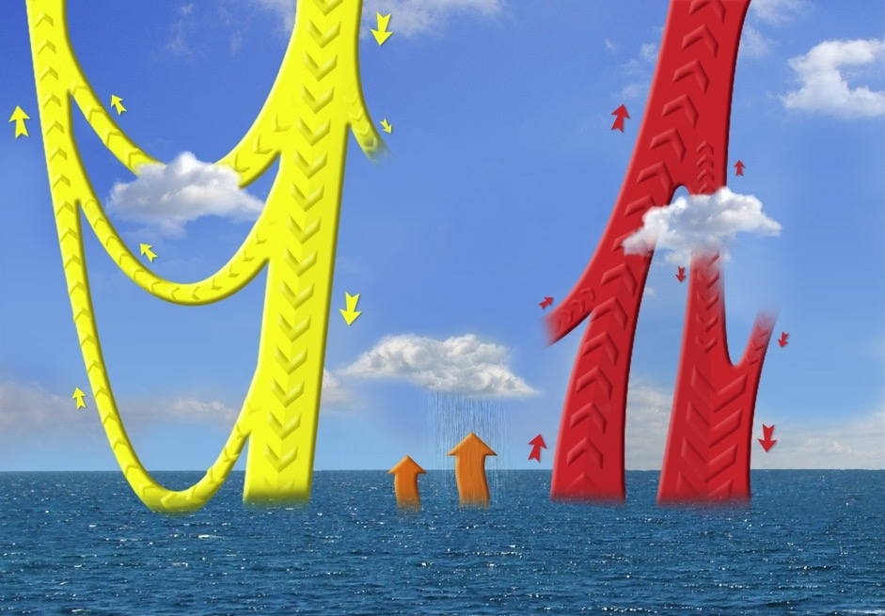
Earth’s Energy Budget (1σ Range): CERES
Reflected Solar Radiation
-99
(-98, -100)
Incoming Solar Radiation
340
(339.9, 340.1)
Outgoing LW Radiation
-240
(-238, -242)
Earth’s energy imbalance: net forcing Earth has yet to respond to.
Earth would be 33∘C colder without the atmospheric greenhouse effect.
Net radiation at surface sets the upper limit for global mean precipitation.
TOA Imbalance 0.71
(0.61, 0.81)
Reflected from Cloudy Regions
Reflected from Clear Regions
Atmosphere LW cooling
-186
(-178, -194)
Absorbed by Atmosphere
77
(72, 82)
Emitted from Clear Regions
Emitted from Cloudy Regions
Emitted from Clear Regions
NET ATM
−109
(-100, -118)
Reflected by Atmosphere
Latent Heat
-88
Sensible Heat
-21
Reflected at Surface
-23
(-20, -26)
Absorbed at Surface
164
(159, 169)
Surface Emission
-398
(-395, -401)
Absorbed at Surface
345
(338, 352)
Surface Imbalance 0.71
(0.61, 0.81)
Units: Wm⁻²

Slide 4
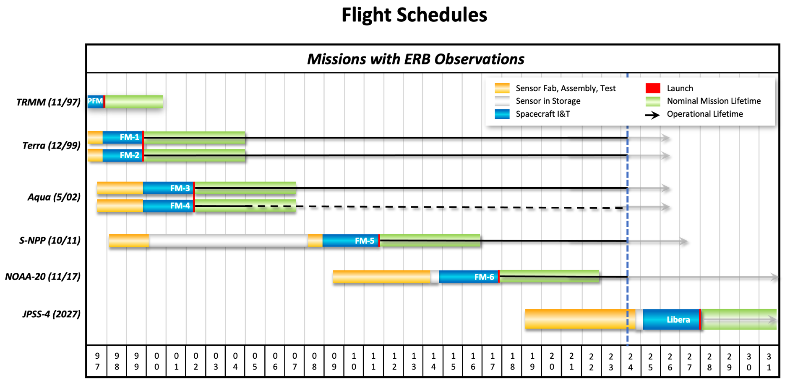
?
Currently, 6 CERES instruments fly on 4 satellites: Terra (L1999), Aqua (L2002), SNPP(L2011), NOAA-20 (L2017)
Libera scheduled for launch in 2027 on JPSS-4

Slide 5
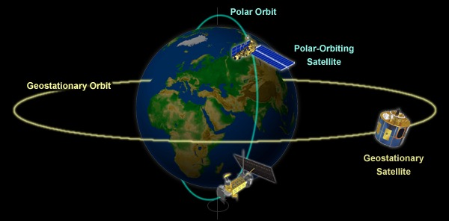
Earth Radiation Budget Data Fusion
Sun-Synchronous Orbit
Sun-Synchronous
Satellite
In order to provide complete spatial coverage of Earth and resolve its diurnal cycle, a high level of data fusion is required.
ERB is an 8-dimensional problem: 3 angular, 3 spatial, temporal, and spectral
During the CERES period, the team has processed data from:
  7 CERES instruments
  1 VIRS imager (TRMM)
  2 MODIS imagers (Terra, Aqua)
  2 VIIRS imagers (S-NPP, NOAA-20)
  22 geostationary imagers
  Solar irradiance measurements
  Meteorological, ozone and aerosol assimilation data
  Snow/ice maps
  All data are integrated to obtain climate accuracy in radiative fluxes from the top to the bottom of the atmosphere.

Slide 6
Recent Changes in Top-of-Atmosphere Radiation

Slide 7
Datasets
EBAF Ed4.2: 07/2000−06/2024
Transition to NOAA-20:
Terra-Only Terra+Aqua NOAA20
(03/2000-06/2002) (07/2002-03/2022) (04/2022-onwards)
Climatology of Terra-Only and NOAA20-Only fluxes and cloud properties are anchored to Terra+Aqua climatology using overlapping periods.
References:
Loeb et al., JCLIM, 2024 (TOA)
Kato et al., JCLIM, 2024 (SFC)

Slide 8
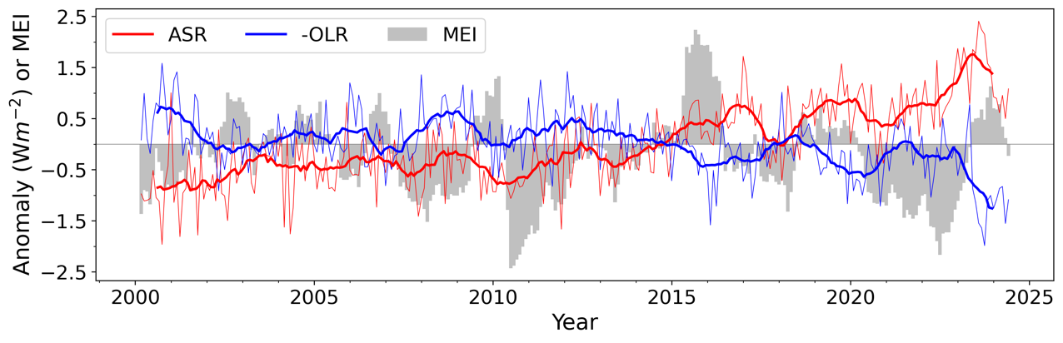
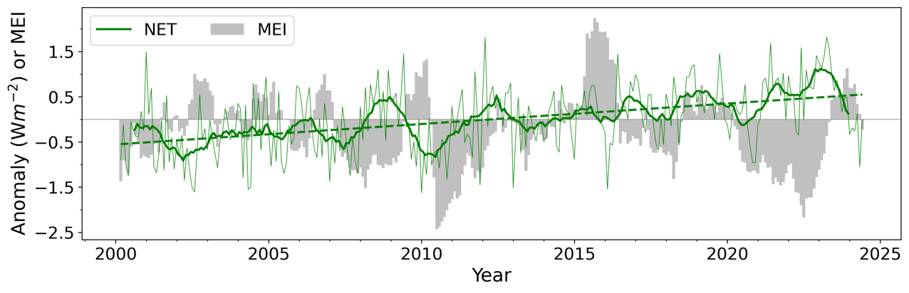
Global Mean All-Sky TOA Flux Anomalies (CERES EBAF Ed4.2; 03/2000–06/2024)
Trends (Wm⁻² per decade; 2.5-97.5% CI)
ASR: 0.81 ± 0.21
−OLR: −0.36 ± 0.20
NET: 0.45 ± 0.18
Units: Wm⁻² | Solar Irradiance | ASR | −OLR | NET
03/2000-02/2010 | 340.14 | 240.7 | −240.2 | 0.53
03/2014-02/2024 | 340.19 | 241.9 | −240.7 | 1.17
Difference | 0.05 | 1.2 | −0.5 | 0.64
Doubling in EEI!

Slide 9
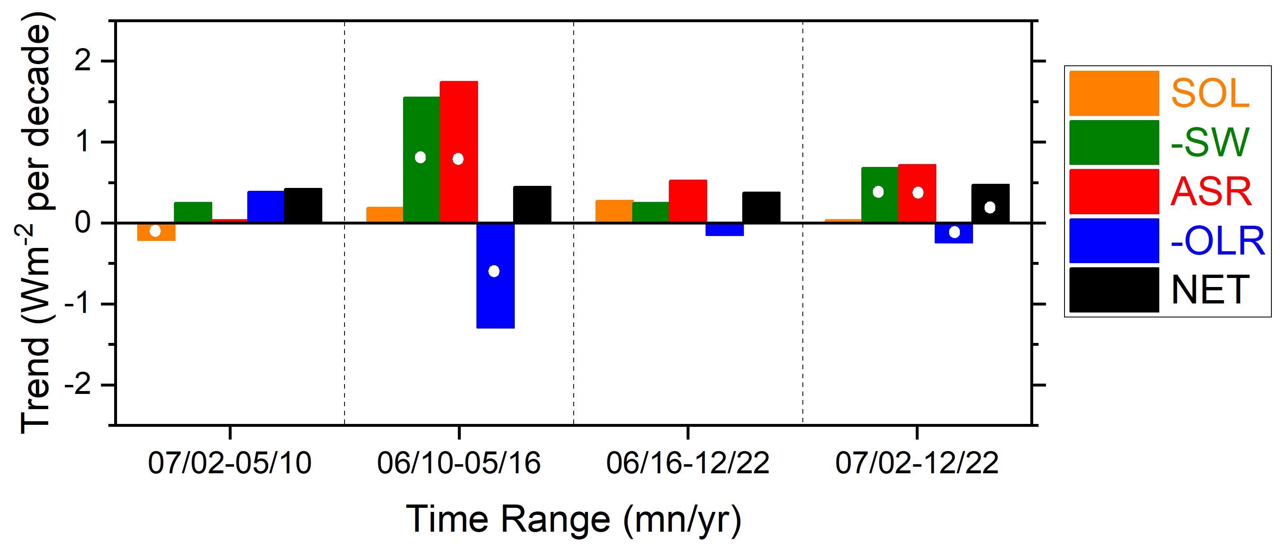
Trends in TOA Radiation by Time Period (07/2002-12/2022)
hiatus transition to El Niño post-El Niño Full period
Despite large variations in ASR and –OLR trends (>1 Wm⁻² dec⁻¹), NET trends are nearly constant (< 0.1 Wm⁻² dec⁻¹ variation).
Rate of increase in planetary heat uptake (i.e., d(NET)/dt) is relatively insensitive to internal climate variability during CERES.

Slide 10
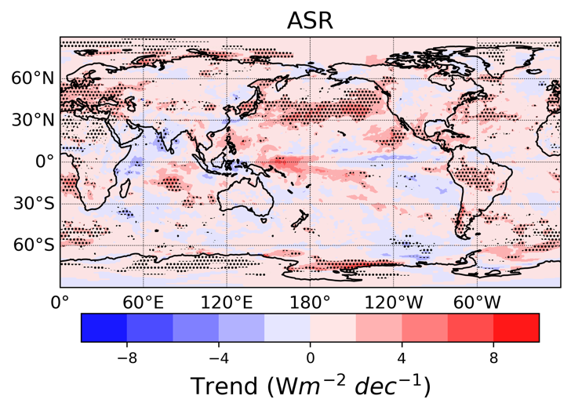
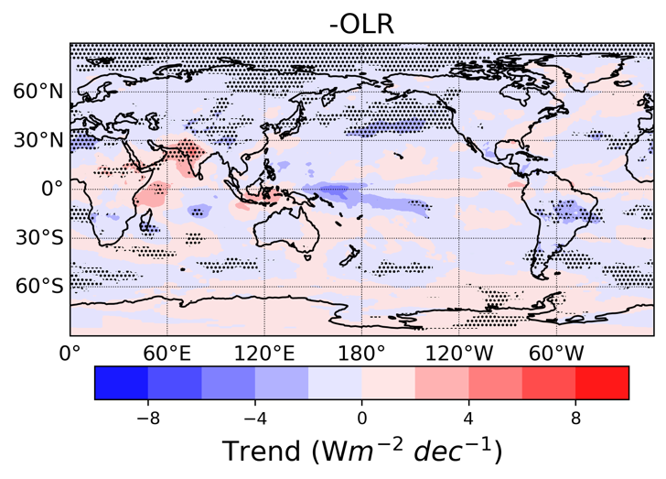
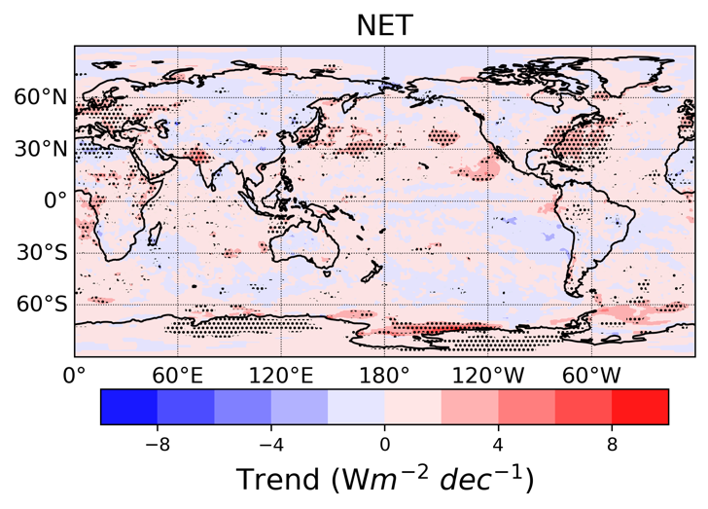
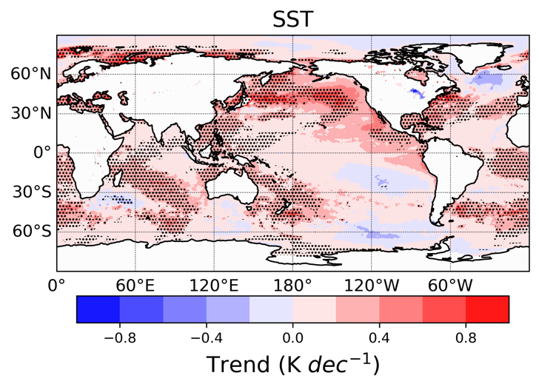
Regional Trends in TOA Radiation and SST (03/2000–06/2024)

Slide 11
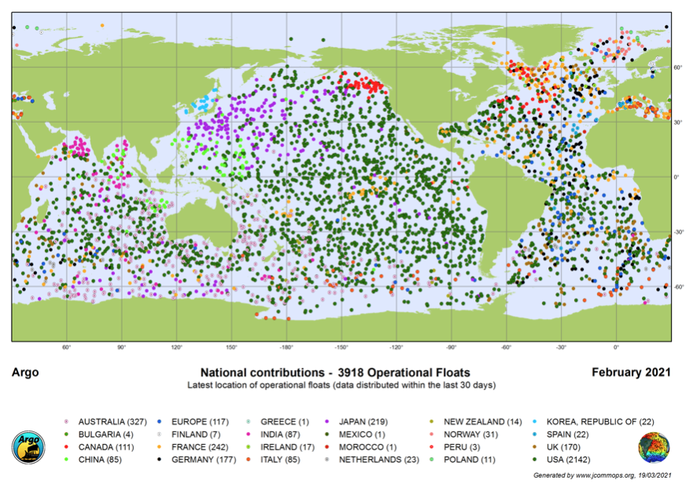
Argo Ocean Profiling Network

Slide 12
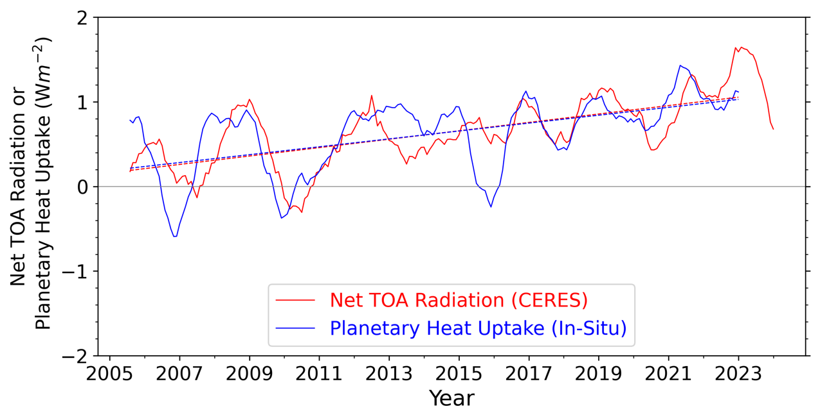
Annual Mean Net TOA Radiation & In-Situ Planetary Heat Uptake
(CERES 07/2005-06/2024; In situ: 07/2005-06/2023)
Ocean: RFROM21 (Lyman & Johnson, 2023)
 | Trend (Wm⁻² dec⁻¹) 07/2005-06/2023
CERES EBAF Ed4.2 | 0.50 ± 0.28
In-Situ | 0.47 ± 0.35
Difference | 0.03 ± 0.30
R^2 | 0.47

Slide 13
Attribution of TOA Radiation Changes

Slide 14
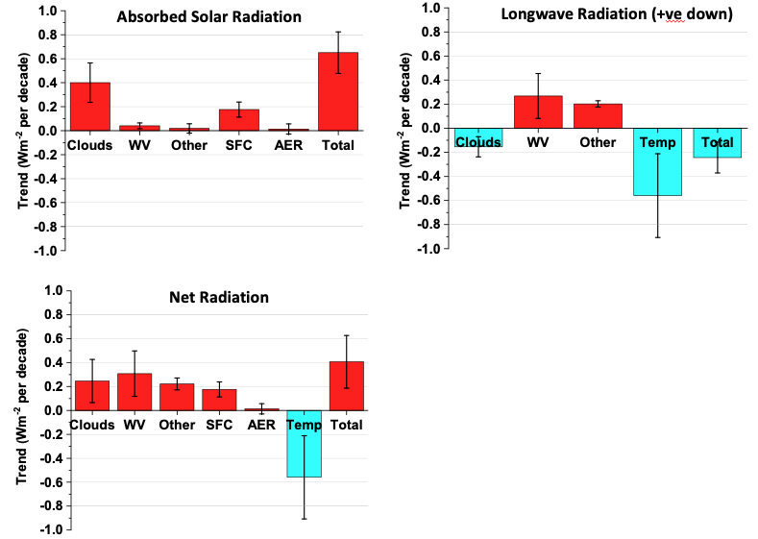
Global Mean Trends (09/2002-03/2020)
Combined changes in clouds, sea-ice, WV and trace gases exceed influence from temperature changes, resulting in a positive overall trend in net TOA flux.

Slide 15
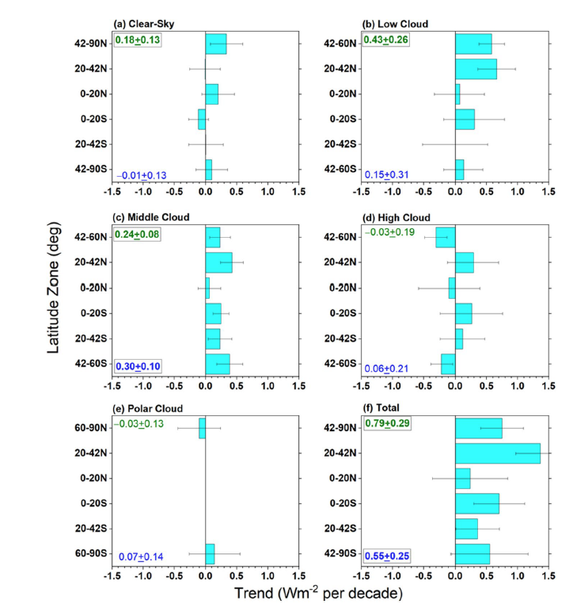
Contribution to Zonal Mean ASR Trend by Cloud Type (07/2002-12/2022; CERES FBCT Product)

Slide 16
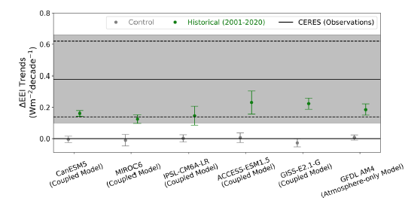
Global Mean Trend in Earth’s Energy Imbalance (2001-2020): GCMs vs CERES
The CERES EEI trend is exceptionally unlikely (<1% probability) to be explained by internal variability alone.
Model simulations only fall within observational uncertainty when anthropogenic radiative forcing and the associated climate response are accounted for.
Model EEI trends are in the lower range of the observed 95% confidence interval (dashed lines).
(Raghuraman et al., Nat. Comm., 2021)

Slide 17
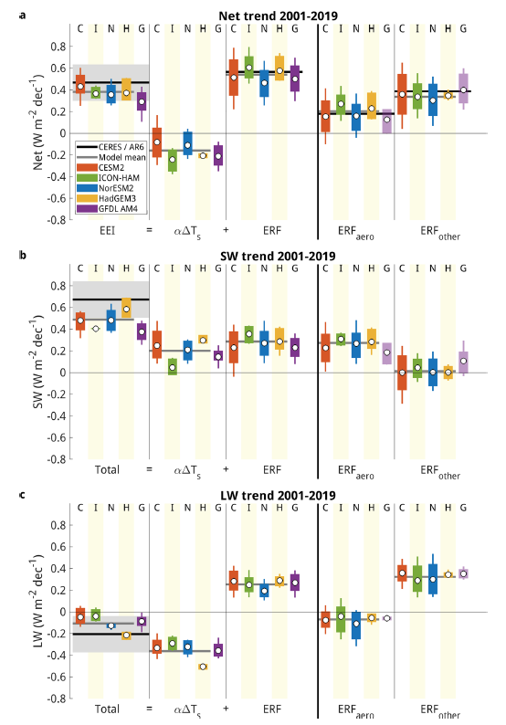
CERES EI Trend Attribution
CMIP6 AMIP Simulations
Forcing-feedback framework
Key Points
CMIP6 EEI trend consistent with CERES within uncertainty
ERF contribution dominates (WMGG, aerosols)
Large CERES ASR trend due to additive positive ERF and feedback contributions
Models suggest large aerosol forcing
Weaker OLR trend due to cancelation between positive ERF and negative feedback contributions
Hodnebrog et al., Nature Comm Earth & Environ, 2024

Slide 18
CERESMIP
The Coupled Model Intercomparison Project (Phase 6) (CMIP6) protocol only uses observed forcings to 2014.
However, climate variability since 2014 is quite pronounced and scientifically interesting (e.g., EEI and SST trends, PDO shifts, 2015/2016 El Nino, Marine Heat waves, etc.).
In addition, many of the model inputs have been updated substantially since the CMIP6 inputs were defined.
So why hasn’t there been a coordinated effort to update climate model AMIP simulations?
Gavin Schmidt (NASA GISS) is leading a new, relatively low cost, model intercomparison, CERESMIP, that will focus on the CERES period, with updated forcings to the end of 2021.
The focus will be on atmosphere-only simulations, using updated SST, forcings and emissions from 1990-2021.
The diagnostic focus will be on the EEI and atmospheric feedbacks, and so diagnostics should include output from the COSP simulator.
A journal article describing CERESMIP has been published. https://doi.org/10.3389/fclim.2023.1202161
New WCRP lighthouse activity on Explaining and Predicting Earth System Change (EPESC) with a focus on Earth's Energy Imbalance has been established.

Slide 19
Summary
Earth’s energy imbalance has been increasing at a near-constant rate of ~0.5 Wm⁻² dec⁻¹ since 2000
  Ten-year average EEI (03/2014-02/2024) ≈1 Wm⁻² (from in-situ and CERES data)
  Difference between CERES and in-situ EEI trend (07/2005-06/2024): 0.03±0.3 Wm⁻² dec⁻¹
  Combined changes in clouds, sea-ice, WV and trace gases exceed influence from temperature increase since 2000, resulting in a positive overall trend in net TOA flux.
  Climate model simulations (AMIP) show that the CERES EEI trend is exceptionally unlikely to be explained by internal variability alone
  ASR trend dominant contribution to EEI trend (just like in the observations)
  In forcing-feedback framework: EEI trend is dominated by effective radiative forcing (WMGG, aerosols)
  Aerosol forcing contributes ≈0.2 Wm⁻² dec⁻¹ to EEI trend.

