Slide 1
Mission Overview, Updates, and Future
Rob Damadeo¹, David Flittner¹, Kevin Leavor^{1,2}, Mary Cate McKee^{1,2}, Robbie Manion^{1,3}
¹NASA Langley Research Center, Hampton, VA
²Analytical Mechanics Associates, Hampton, VA
³ADNET Systems Inc, Bethesda, MD

Slide 2
Overview
SAGE Background and Mission Status
Recent Science Highlights
New Data Version and Products
Future Work
Mission Outlook

Slide 3

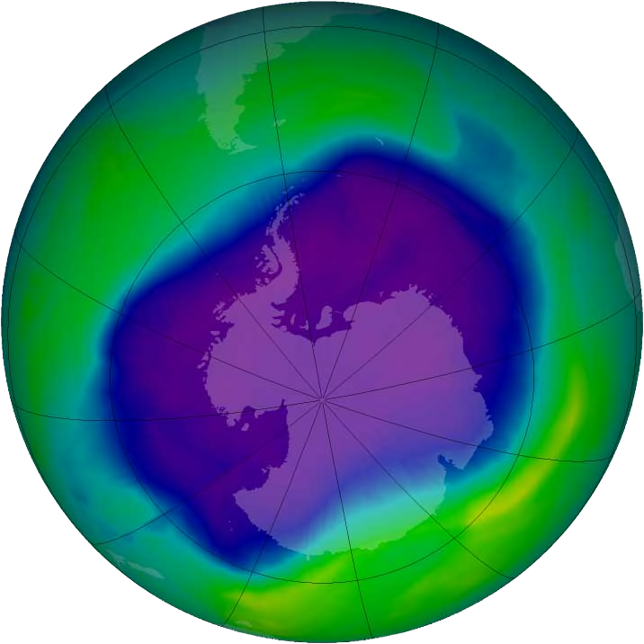
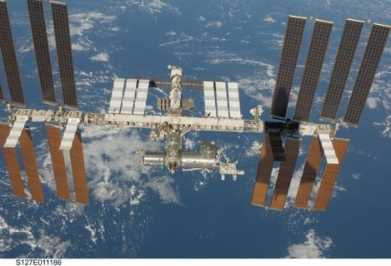
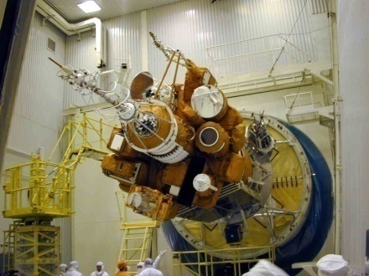
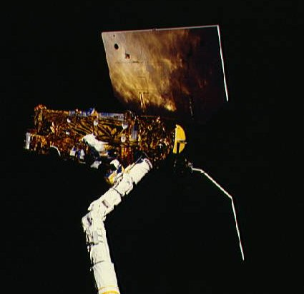
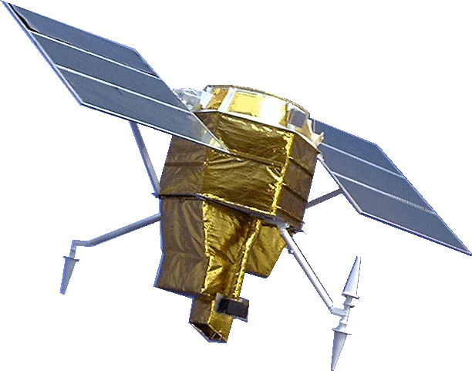
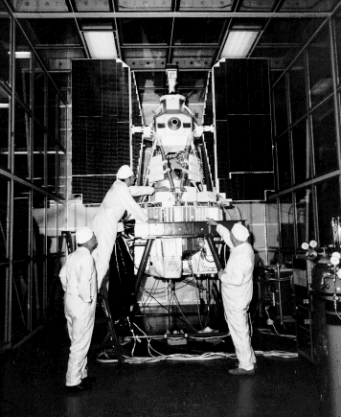
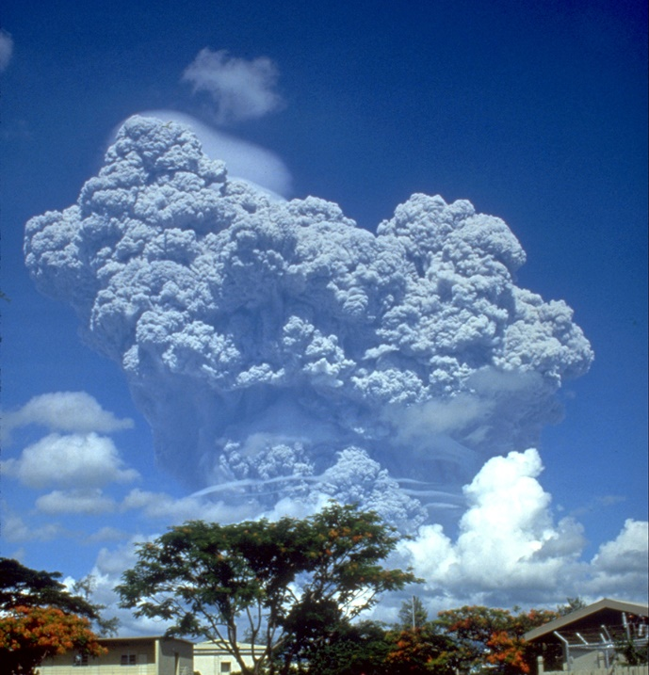
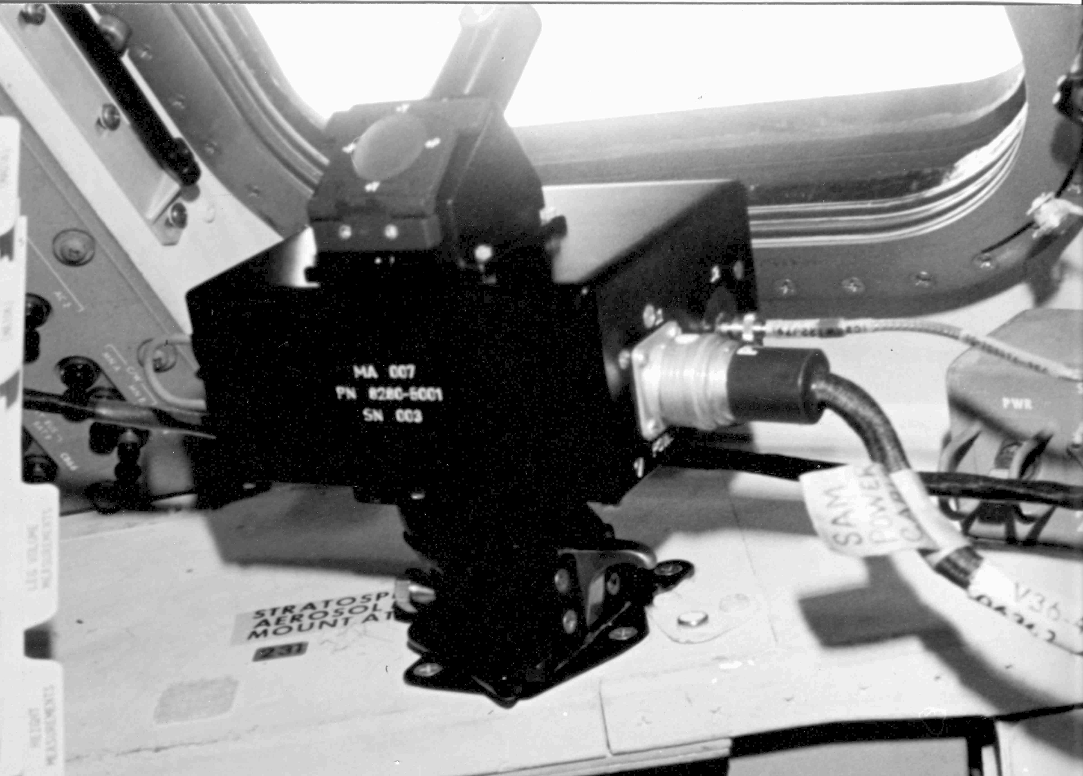
SAGE III ISS
(2017-Present)
SAGE III M3M (2001-2006)
Ozone
SAGE I (1979-1981)
SAM II (1978-1993)
Aerosol
SAGE II (1984-2005)
SAM (1975)

Slide 4
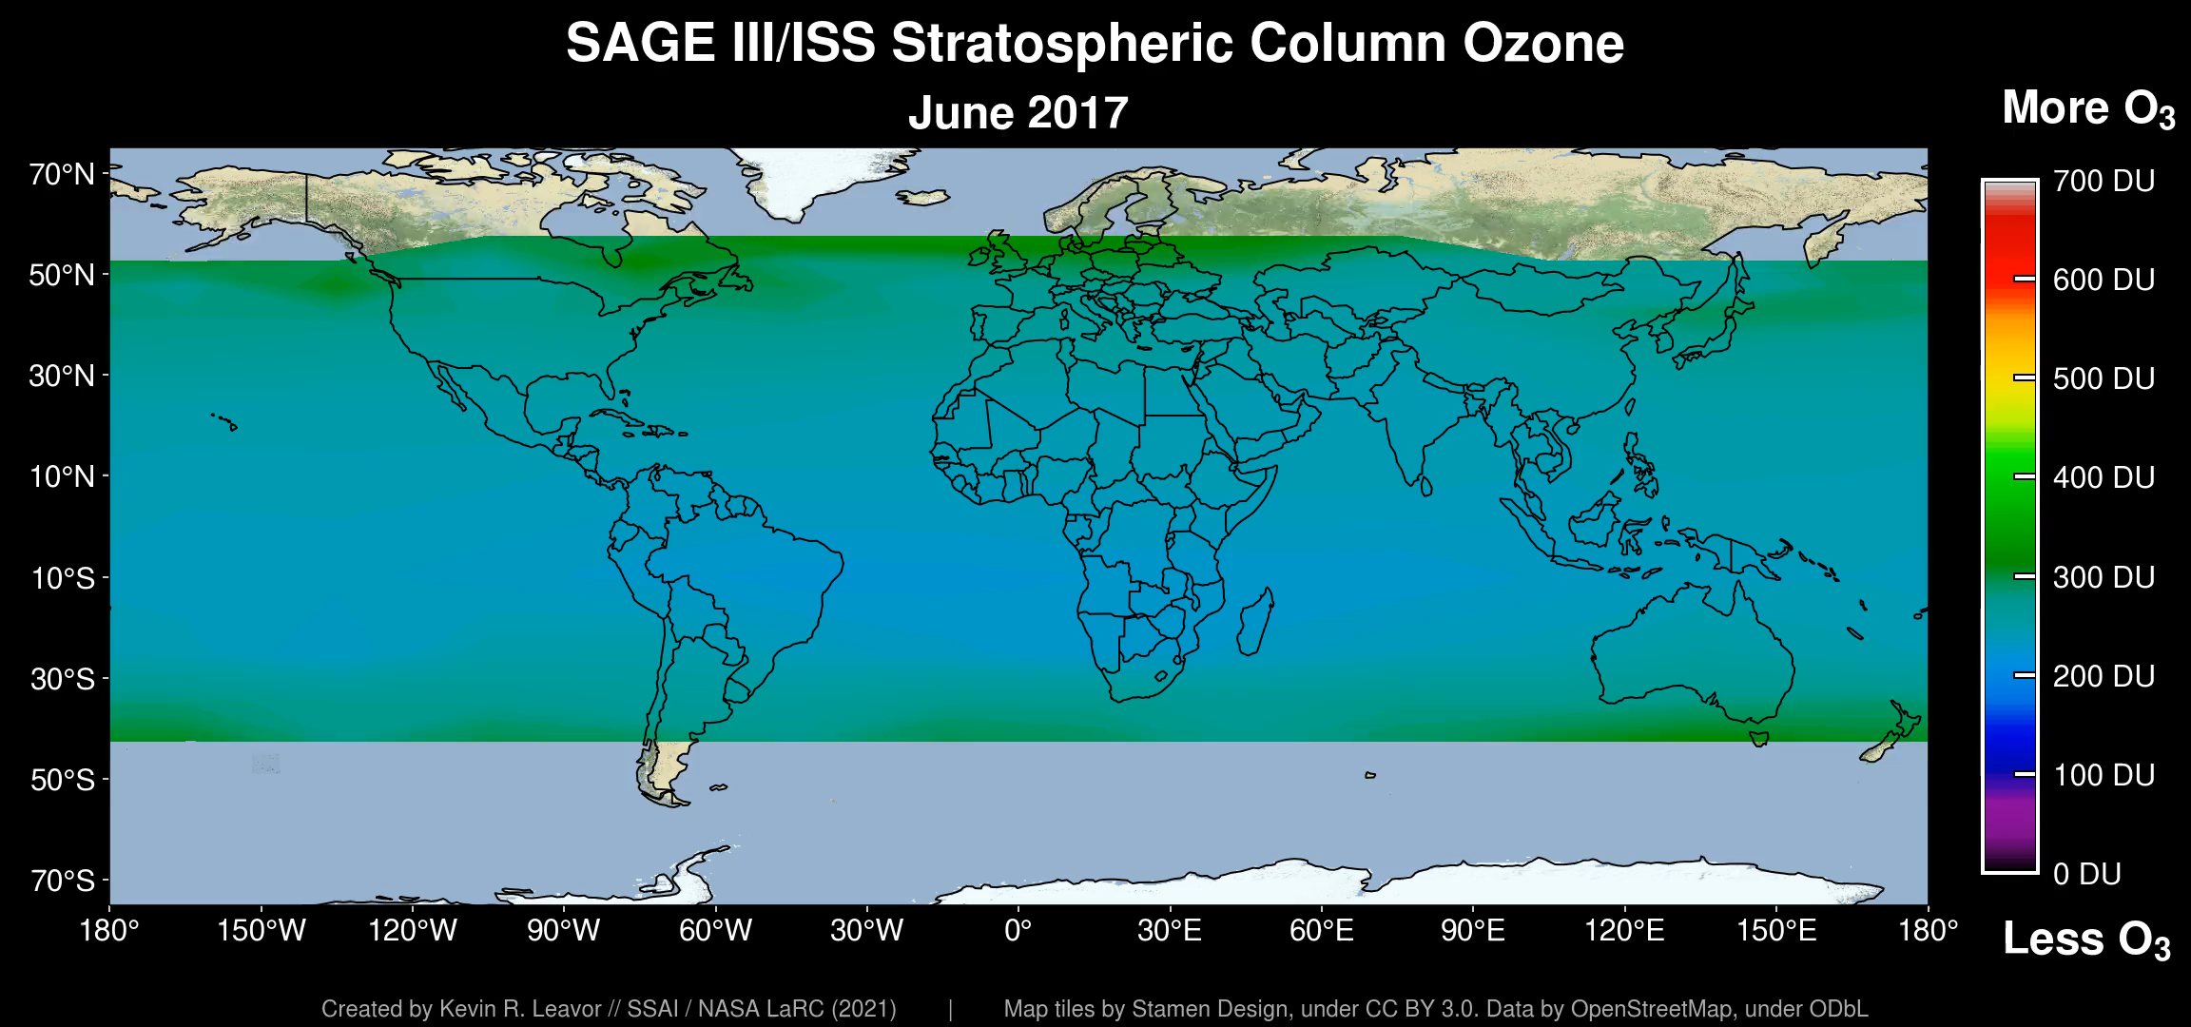
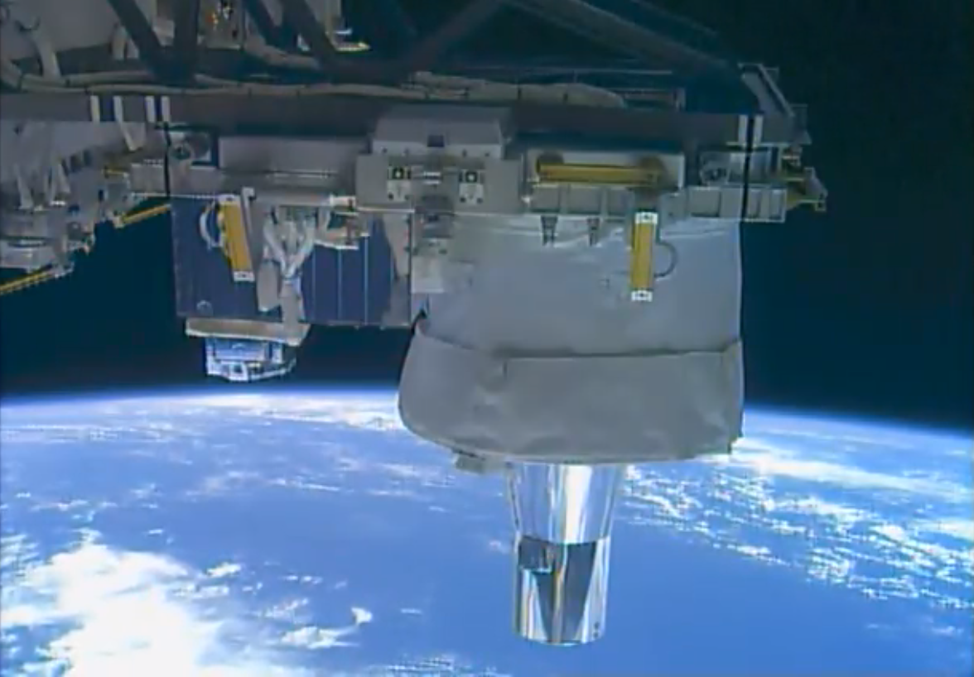
SAGE III/ISS Mission Overview
SAGE produces high vertical resolution profiles of aerosols, ozone, water vapor, and other trace gases in the stratosphere and upper troposphere
Data directly supports WMO International Ozone Assessment and WCRP APARC activities
Acquired >75k occultation events over mission
In 2nd extended mission phase (2024–2026)
Current data products v6.0 (released March 2025)
3rd ROSES science team (3 years) selected 2024
>70 peer-reviewed papers using SAGE III/ISS data
Vibrant internship program with ~4–5 students/yr
Notes:
Occultation collection efficiency is 87% for solar and 53% for lunar. The overall success rate is 83% vs. a requirement of 75%. For the lunar

Slide 5
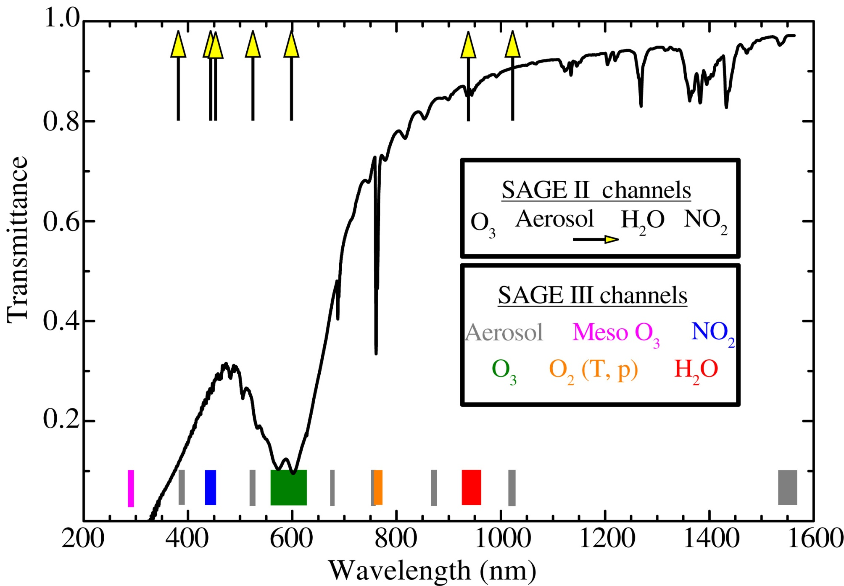
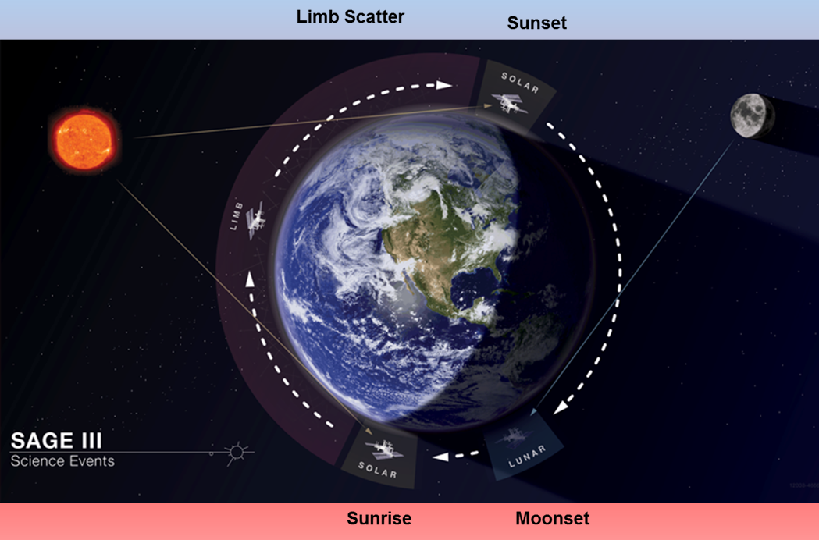
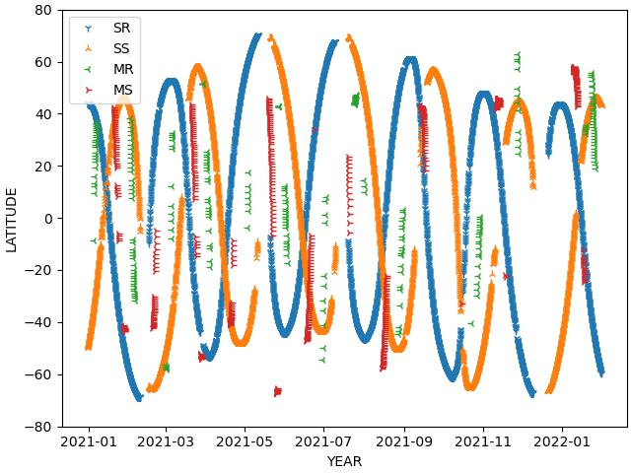
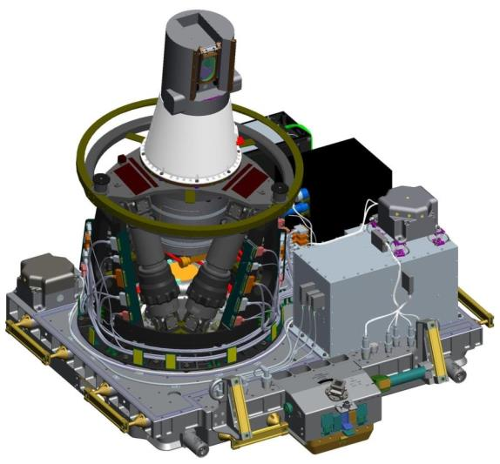
SAGE III/ISS Instrument Overview
Performs solar/lunar occultations and limb scatter
Provides near-global observations about monthly
Spectrometer across 290–1030 nm w/ 2–3 FWHM
and a photodiode near 1545 nm
Auxiliary hardware components:
  Hexapod ensure proper orientation to nadir
  DMP measures platform attitude variations
  during observations
  Quartz contamination door protects telescope
  aperture when needed
  CMP measures local environment to guide
  operations
Most systems operating nominally
  DMP laser intensity dropped below usable level
Sensor Assembly (SA)
Instrument Control Electronics (ICE)
Hexapod Electronics Unit (HEU)
Hexapod Mechanical Assembly (HMA)
Contamination Monitoring Package (CMP)
Contamination Monitoring Package
(CMP)
Interface Adapter Module (IAM)
Disturbance Monitoring Package (DMP)
ExPRESS Payload Adapter (ExPA)

Slide 6
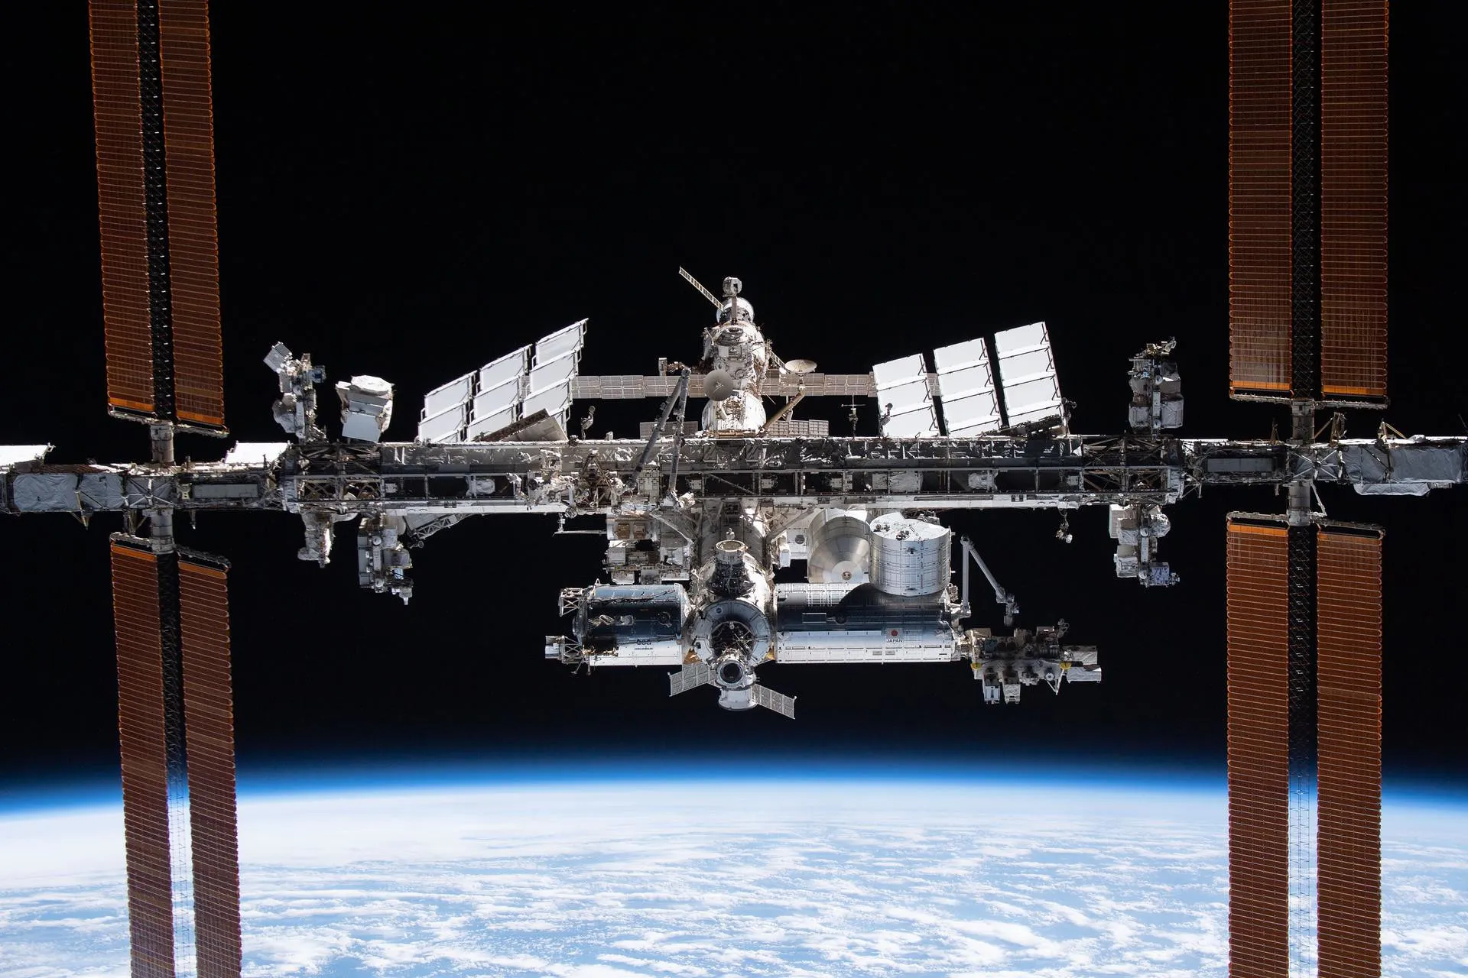

Location of SAGE III

Slide 7
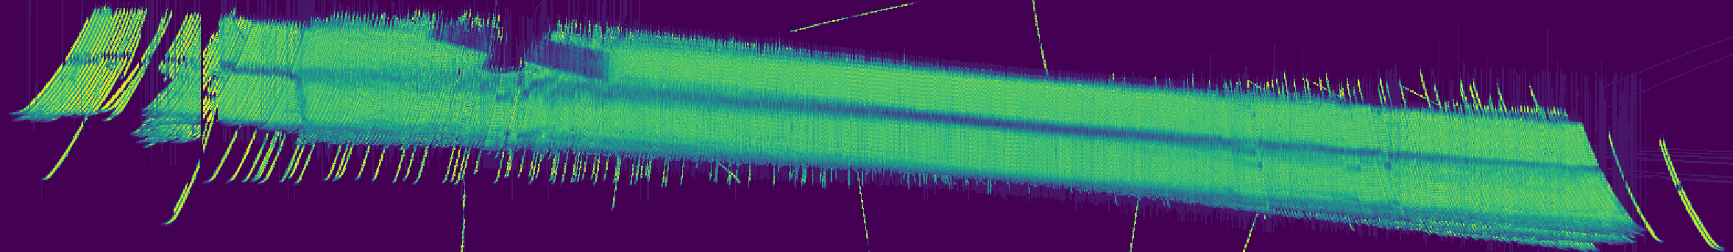
Partial Blockage
ISS is very large with several modules within our potential FOV
SAGE placement was chosen to maximize occultation opportunities – good, but not perfect
Major source of failed sunset events is blockage by ISS
ISS modules can also partially block line-of-sight, causing oddities in retrieved profiles which aren’t always detected by automated QA.
Mosaic of 1.5 µm maximum Signal
ELEVATION
AZIMUTH

Slide 8
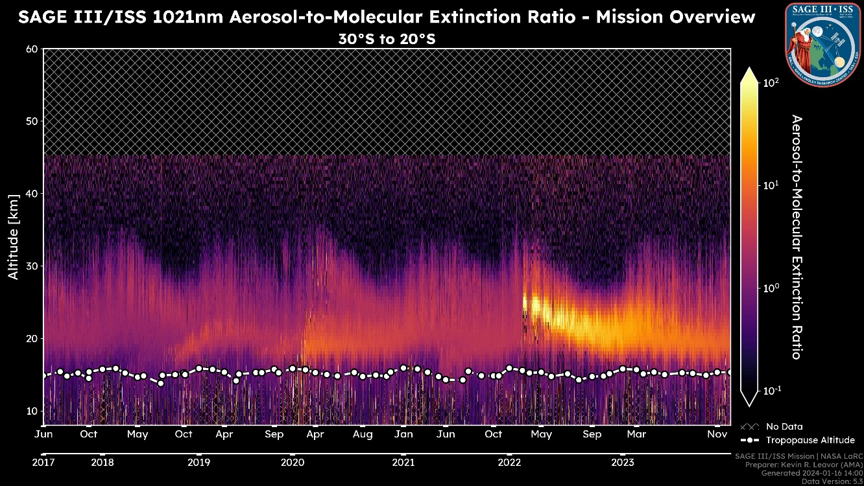
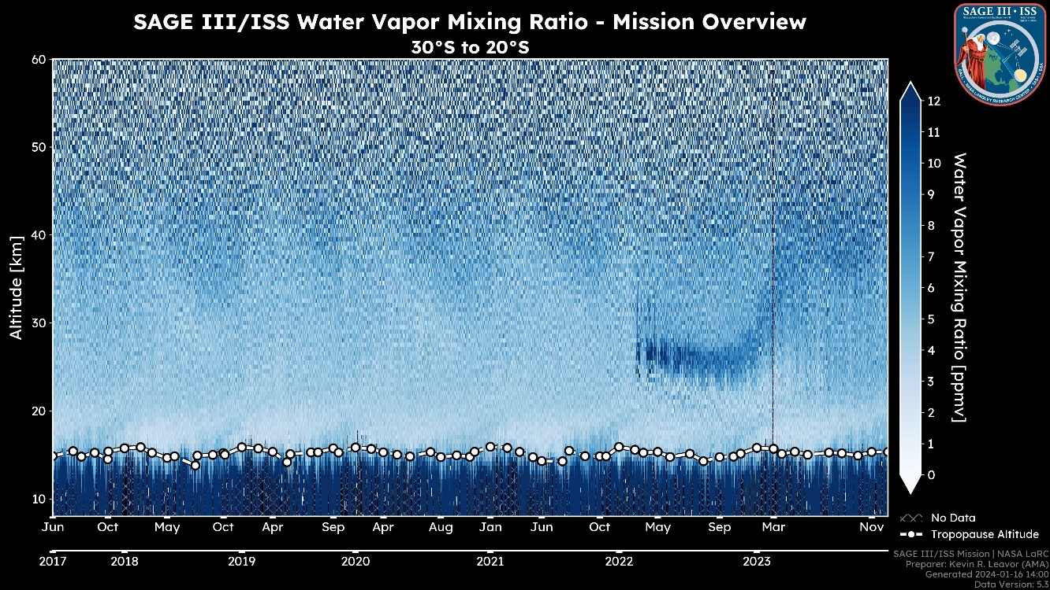
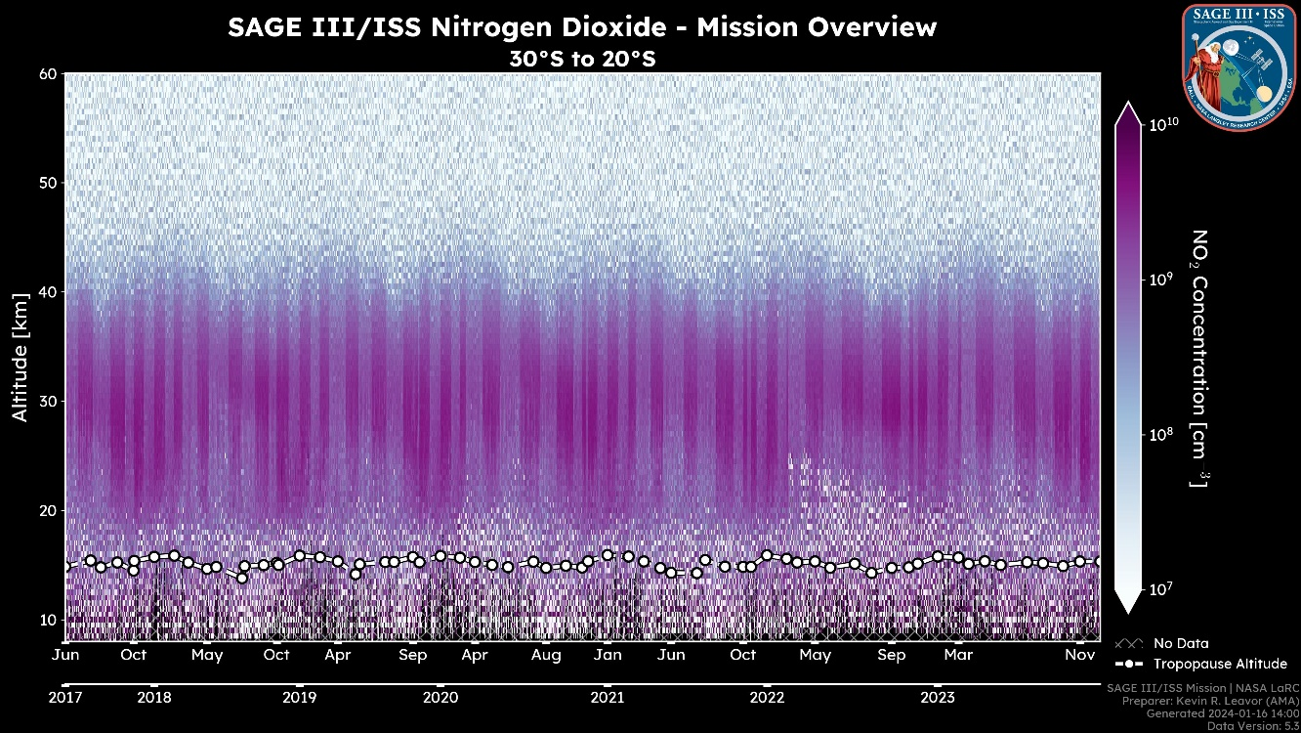
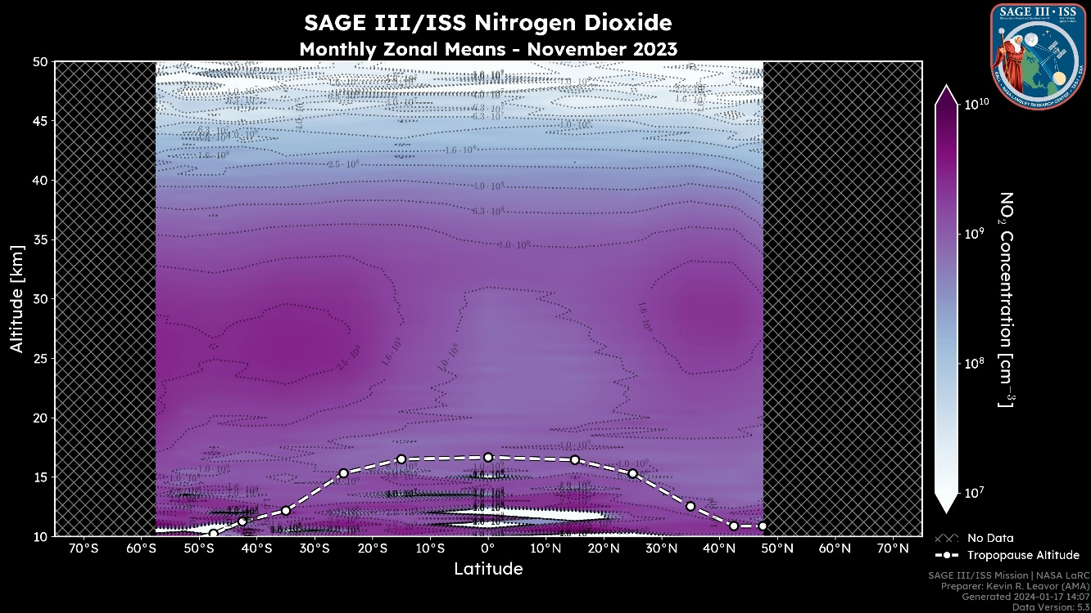
Validation Page: Quicklook / Expedited
AEROSOL
WATER VAPOR
HTHH Aerosol
HTHH WV
NO₂

Slide 9
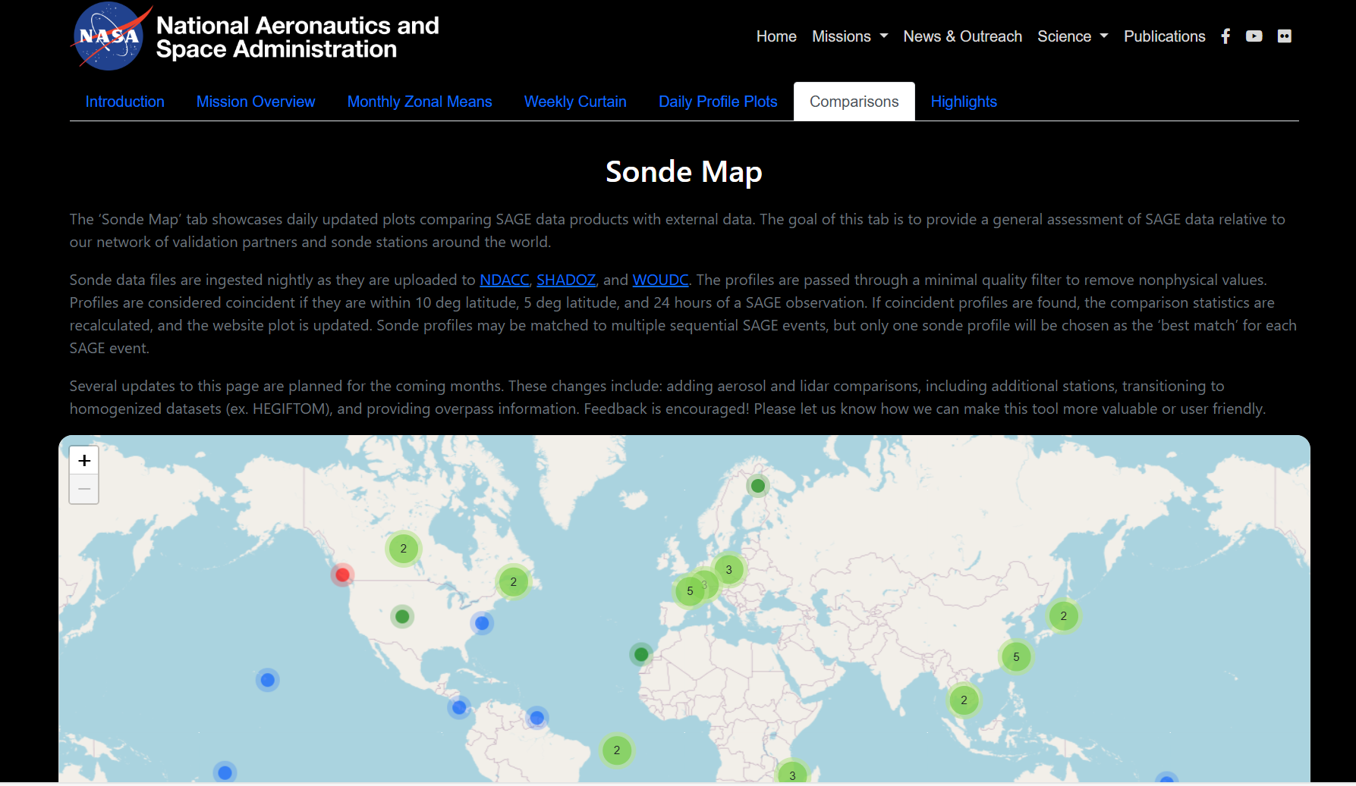
Validation Webpage: Comparisons

Slide 10
Science Highlights: Validation Studies
Aerosol:
  Rozanov et al. (2024) – New OMPS-LP retrieval algorithm
  Kovilakam et al. (2025) – Validity of OMPS-LP multiwavelength data
  Damadeo et al. (2024) – Improvement of aerosol assumptions used for validation studies and intercomparisons
O3 and NO2:
  Jeffery et al. (2025) – Validation of new MAESTRO data version
H2O:
  Knowland et al. (2025) – Applicability of SAGE data for model assimilation

Slide 11
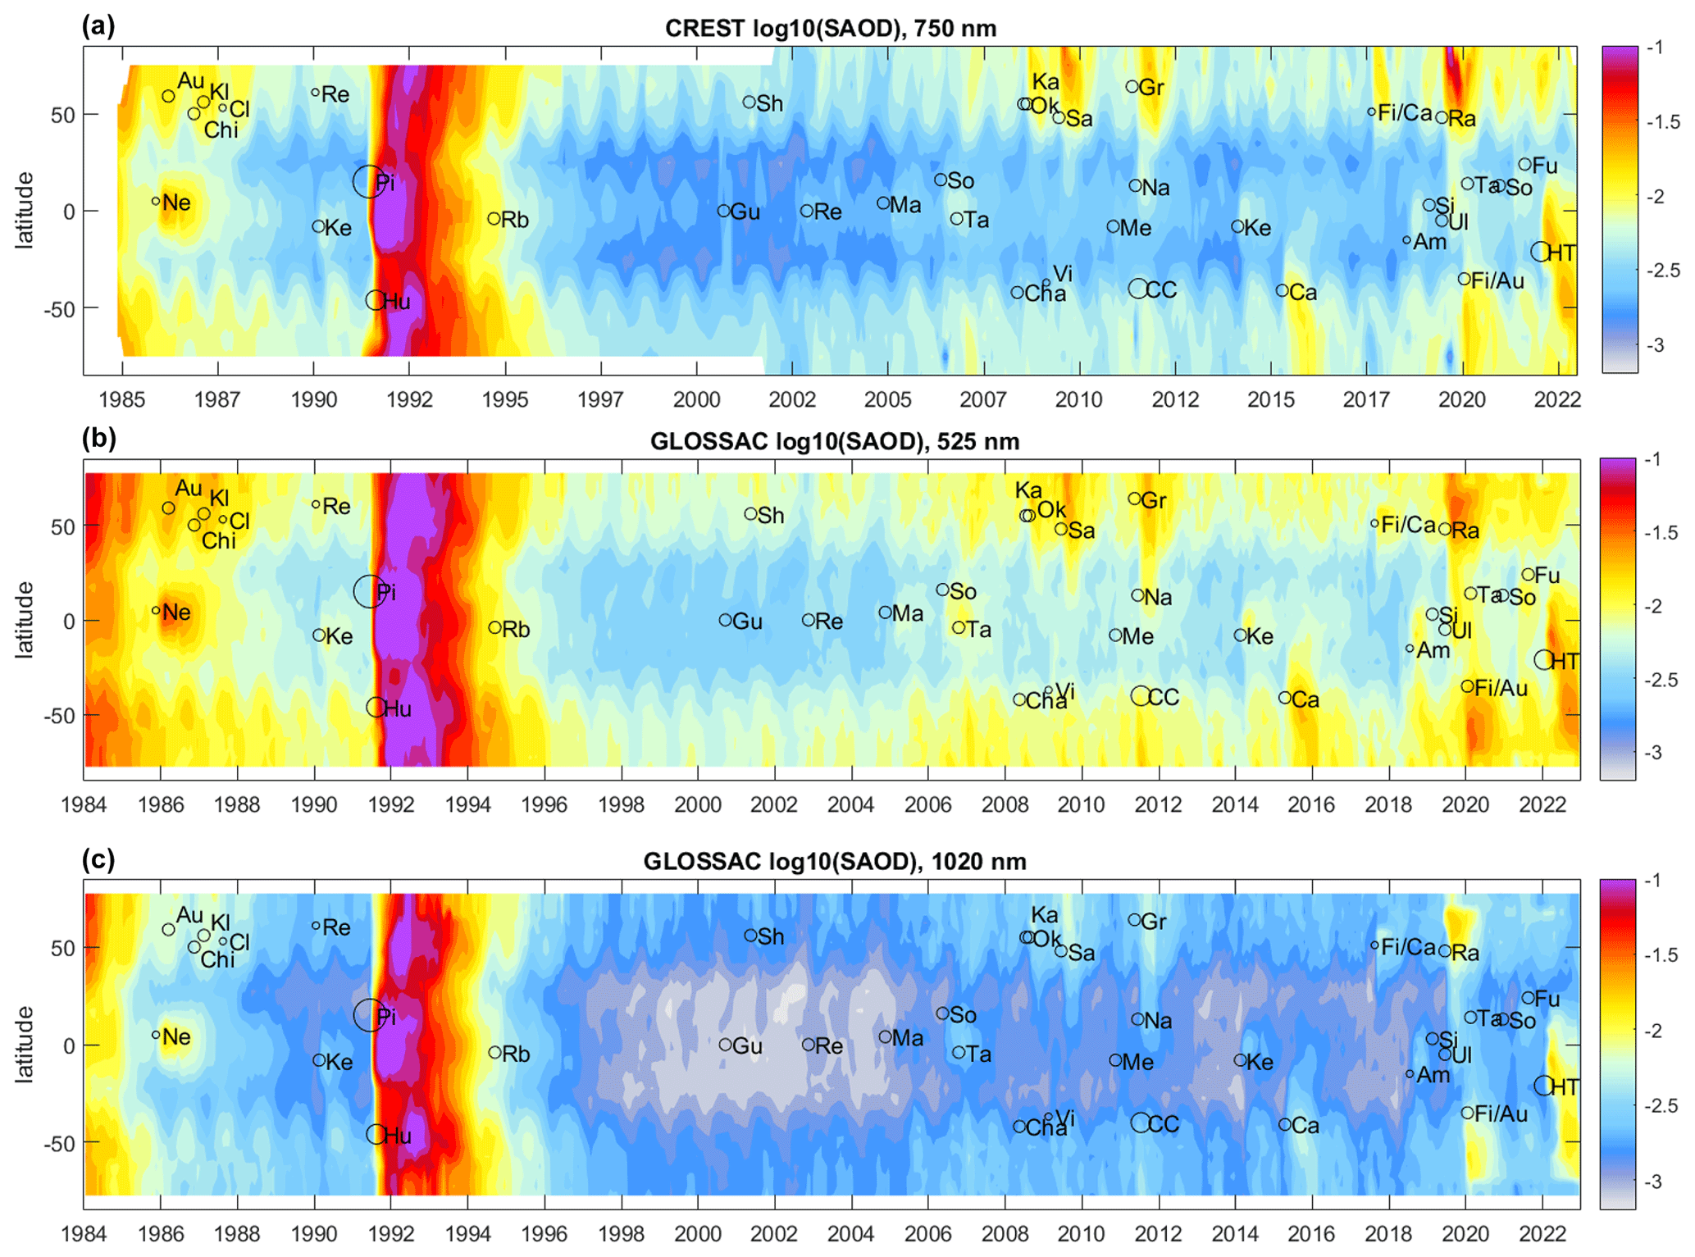
SH: Composite Data Sets
SAGE aerosol data is a
vital component of the
GloSSAC and CREST
data sets
SAGE O3 data will also
be incorporated into
updated merged data
sets (e.g., SWOOSH &
Ozone CCI+)

Slide 12
SH: Hunga Tonga Eruption
Numerous studies showing the impacts of the HTHH eruption
  Duchamp et al. (2023) – Early estimations of particle size parameters
  Bernath et al. (2023) – Combining ACE & SAGE data to improve aerosol composition and particle size estimates
  Li et al. (2024) – Using SAGE aerosol and H2O data to support microphysical modeling of the plume evolution
  Gupta et al. (2025) – Combining multi-instrument observations to assess the radiative cooling of the southern hemisphere

Slide 13
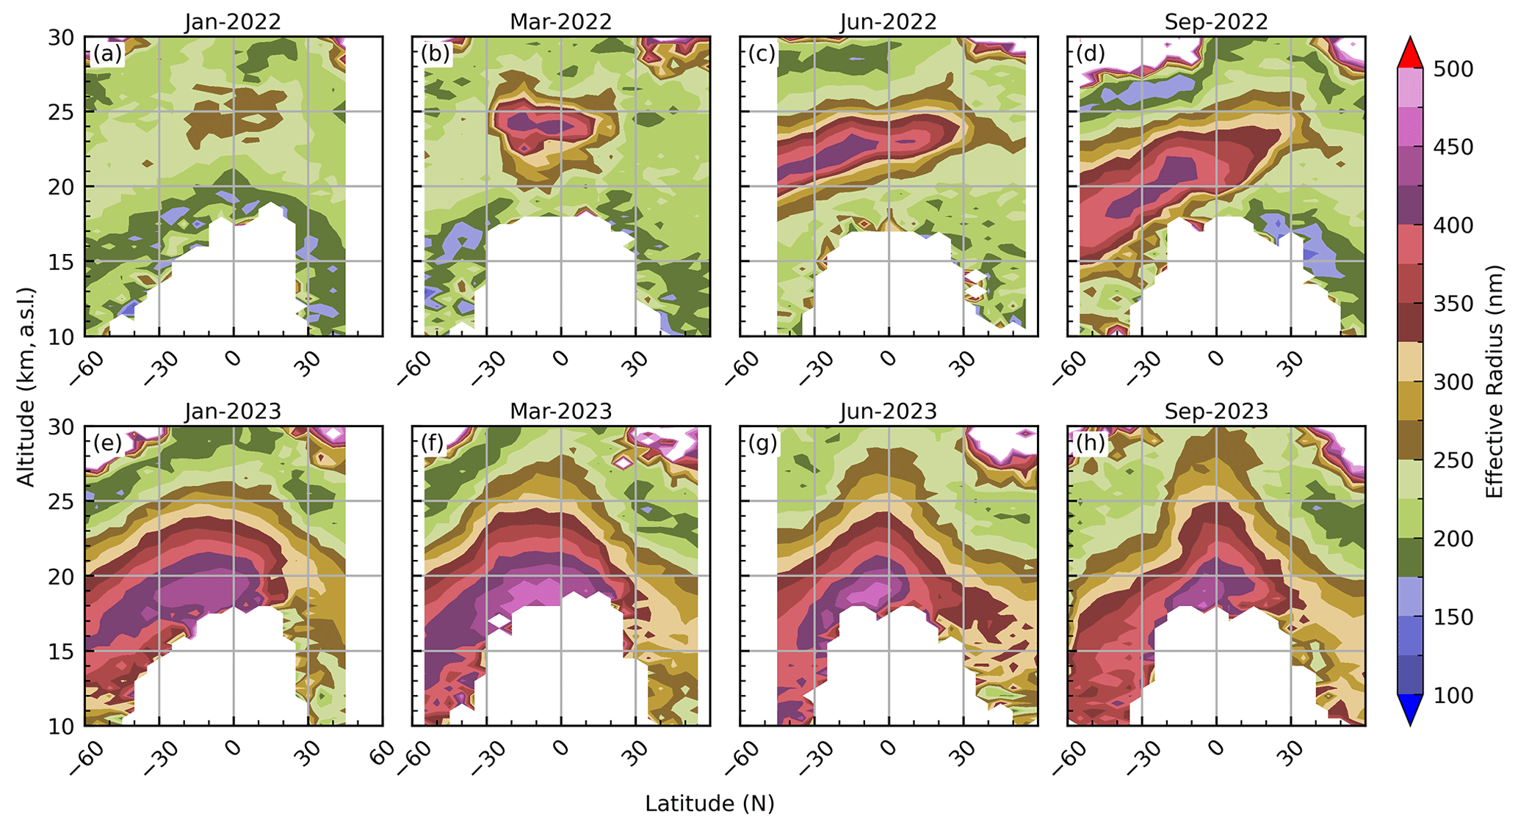
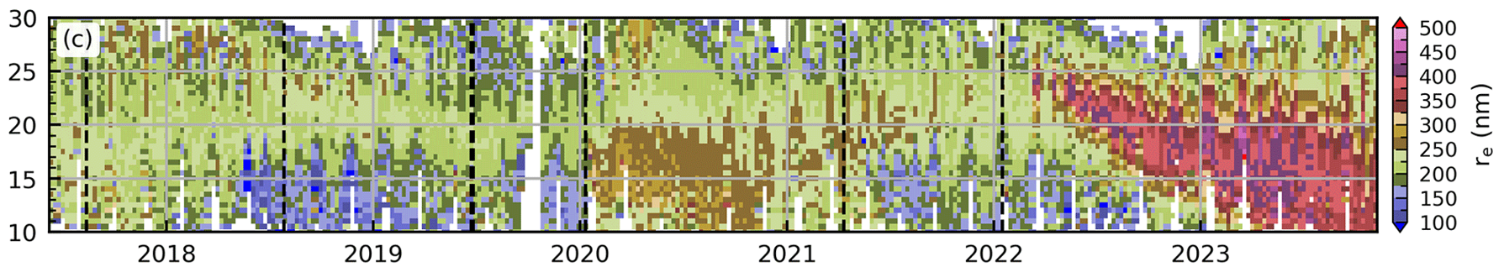
SH: PSD Estimates
Knepp et al., AMT, 2024 used multiwavelength aerosol extinction measurements to derive particle size distribution parameters from SAGE II and SAGE III/ISS data

Slide 14
New Data Version: 6.0
Replaces Version 5.3
Data available: June 2017 – April 2025
Major Changes:
  Recovering profiles lost to observation gaps (ISS modules and sunspots)
  Improved uncertainty calculations
    Up to 1.25x increase in L1 transmission uncertainties
    Up to 1.20x increase in L2 species uncertainties
  Change in source O3 cross-section database
    Bogumil 2004 → Serdyuchenko-Gorschelev 2014
  Inclusion of some ROSES Science Team derived products
    Aerosol categorization flag (Kovilakam et al., AMT, 2023)
    Particle size distribution parameters (Knepp et al., AMT, 2024)

Slide 15
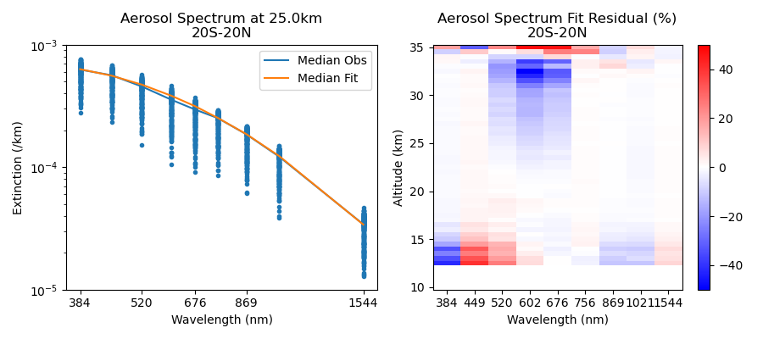
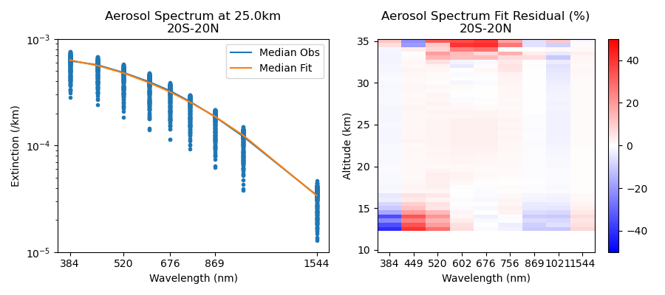
Impact on Aerosol
Aerosol extinctions at 520 nm, 602 nm, and 676 nm have been persistently smaller than would be expected by the power law.
Long assumed to be tied to improper O3 spectroscopy
The retrieved aerosol extinction spectrum now fits much better with the power law model.
June 2021 | 244 events
v5.3
v6.0

Slide 16
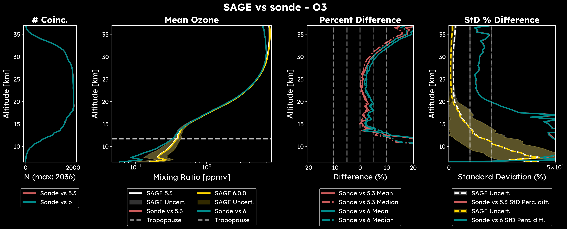
Impact on Trace Gas Species
Minor changes to trace gases commensurate with changes in O3 cross-section databases
  O₃ increased by 2%
  NO₂ increased by 2% (changes in O₃ XS between channels)
  H₂O unaffected appreciably

Slide 17
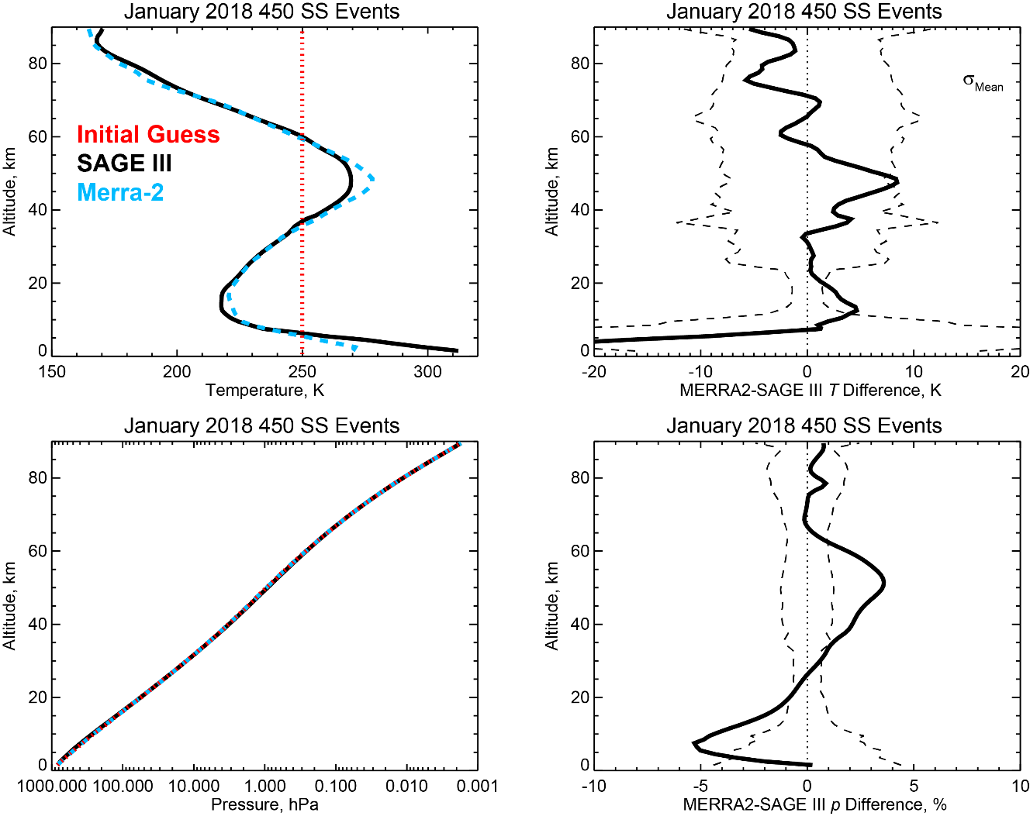
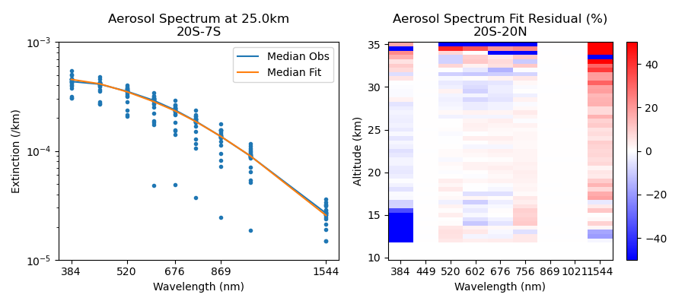
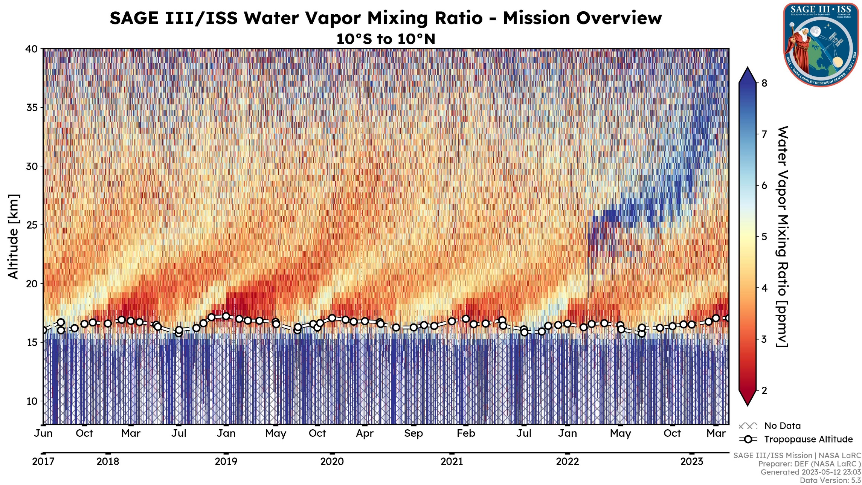
Future Version Work
Pressure / Temperature Retrievals from O₂ A-band
Correction to the 756 nm aerosol extinction bias from O₂ A-band absorption in the aerosol channel
Improve H₂O precision through channel aggregation and smoothing
Implement pressure-dependent NO₂ cross-sections to mitigate biases
Improve mesospheric O₃ by incorporating multi-channel retrieval
Account for atmospheric homogeneity assumptions near clouds and/or across the terminator

Slide 18
Mission Outlook
Outlook for today, may change tomorrow
Currently in extended mission phase through FY26
Next Senior Review begins Q2 FY26 to extend through FY29
SAGE III is manifested on ISS through its end; ISS is planned for deorbit in 2030 via contract with SpaceX
Axiom Space contracted to build new space station off ISS
  Entertaining the idea of transferring some science payloads from ISS

Slide 19
Future Needs
Solar occultation offers:
  High vertical resolution measurements with semi-global coverage at monthly time scales, which is sufficient for most stratospheric processes
  A calibration/validation standard for concurrent, less precise, less stable, high-density samplers to ensure proper continuity of the measurement system ensemble over time
Looking at certain/potential data gaps in the near future
Planned missions will need validation and traceability
  ALTIUS – L1 calibration and L2 validation
  OMPS-LP – L2 calibration
  CAIRT/STRIVE – L2 validation/calibration
  AOS – Aerosol calibration across multiple wavelengths
SAGE III/ISS will need to continue to overlap with new missions

Slide 20
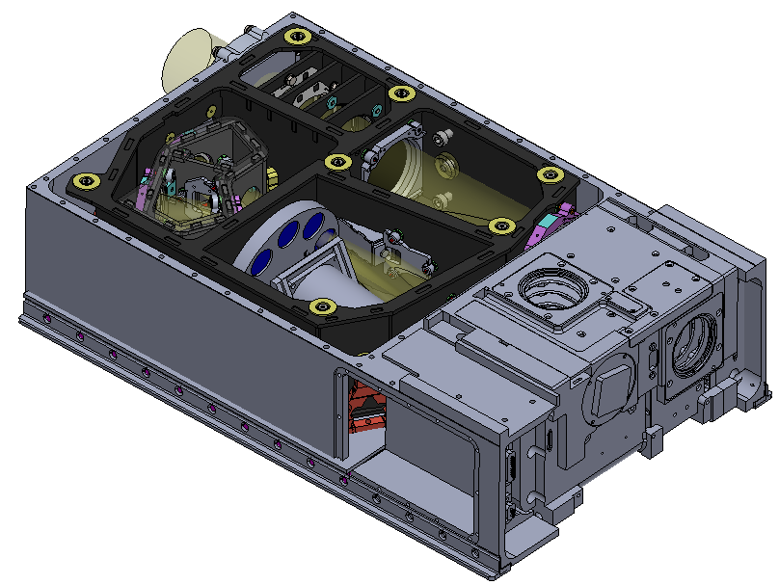
SAGE IV Concept
Atmospheric composition continuity mission concept
Solar occultation imager in a CubeSat framework that reduces development costs by an order of magnitude
Developed with active instrument characterization in mind for long-term stability of data products
Two “Flavors”
  “VIZ”
    Continues measurements of SAGE III/ISS solar products
    in the UV/VIS/NIR spectral range
  IR
    Shifts to the infrared (1–5 µm) to improve H₂O, add new
    species (CH₄, CO₂, N₂O, CO), and differentiate aerosol
    composition

Slide 21
Summary
SAGE III/ISS is a collaborative Earth science mission to study the
recovery of the global ozone layer and the evolving climate.
Payload operating as expected
Data products involved in many recent scientific findings
Version 6 data product released March 2025
  Still more work to be done and new products to create
Instrument capable of operating through end of ISS
Future science / planned mission needs will need solar
occultation and SAGE measurements can meet those needs
Acknowledgement: NASA Langley Research Center manages the mission for NASA Earth Science with major contributions from the ISS Program and the European Space Agency.

Slide 22
Questions?

