Slide 1




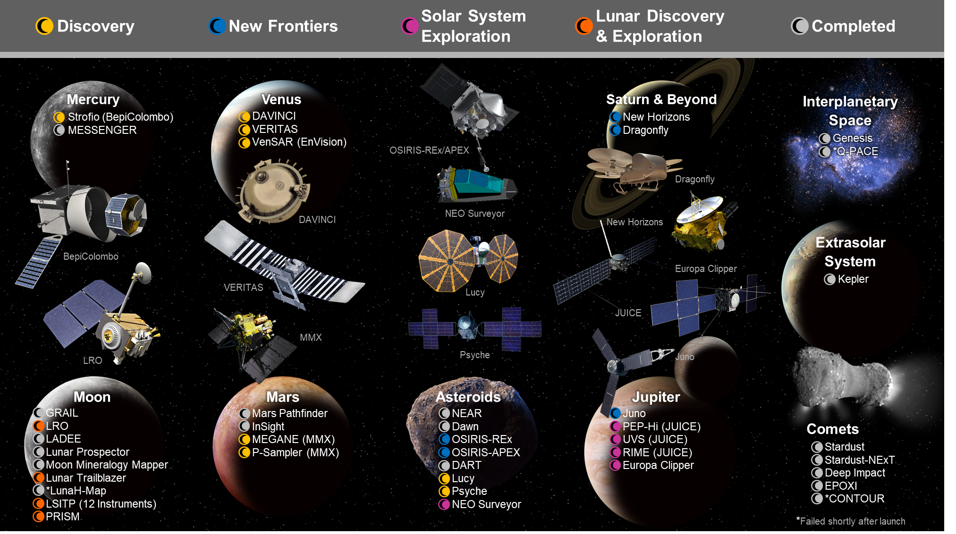
Overview of the Planetary Missions Program Office
Cheryl Alexander, Scott Bellamy, Zach Greenwood, Dennis Harris, Solveig Irvine, Brian Key, Brian Mulac, Kevin Sykes, Brad Zavodsky; NASA Marshall Space Flight Center (ST30)
The Planetary Missions Program Office (PMPO; ST30) is a Level 2 program office that consolidates program management for missions within the NASA Science Mission Directorate (SMD) Planetary Science Division (PSD) Discovery, New Frontiers, and Solar System Exploration Programs and SMD’s Lunar Surface Instrument and Technology Payloads Program (not shown here) into a single management structure. The managed programs are comprised of a series of planetary science missions that are independent and uncoupled but share a common management structure. Missions are selected by SMD as either directed missions or through a competitive process as an Announcement of Opportunity (i.e., stand-alone) or a Mission of Opportunity (i.e., contribution to larger mission). PMPO currently manages a portfolio of projects from medium-class satellite missions to technology demonstrations in various phases of the mission lifecycle from formulation to extended mission operations.
DAVINCI
PI: Jim Garvin (NASA GSFC)
Mission Manager: Kevin Sykes
Destination: Venus
Current Phase: B; Launch NET 2031
Recent Accomplishments: Developing prototype hardware; conducting risk reduction
Upcoming Milestones: PDR early 2028
VERITAS
PI: Sue Smrekar (JPL)
Mission Manager: Zach Greenwood
Destination: Venus
Current Phase: B; Launch NET 2032
Recent Accomplishments: Developing prototype hardware; conducting risk reduction
Upcoming Milestones: PDR NLT 2028
VenSAR (EnVision) †
PM: Sarah Gavit (JPL)
Mission Manager: Brad Zavodsky
Destination: Venus
Current Phase: B; Launch Nov 2031
Recent Accomplishments: Spacecraft selected; ongoing co-engineering meetings
Upcoming Milestones: PDR Nov 2025; KDP-C Feb 2026
OSIRIS-REx
PI: Dante Lauretta (U. Arizona)
Mission Manager: Solveig Irvine
Destination: Asteroid (101955) Bennu
Current Phase: E; Launched Sep 2016
Recent Accomplishments: First U.S. asteroid sample return in Sep 2023; collected 120g of material; identified amino acids and other organic components in sample
Upcoming Milestones: Continue scientific analysis of sample
OSIRIS-APEX
PI: Daniella DellaGiustina (U. Arizona)
Mission Manager: Cheryl Alexander
Destination: Asteroid Apophis
Current Phase: E; Launched Sep 2016
Recent Accomplishments: Survived several recent perihelions
Upcoming Milestones: Arrival at Apophis Apr 2029
Strofio (BepiColombo) †
PI: Stefano Livi (SwRI)
Mission Manager: Cheryl Alexander
Destination: Mercury
Current Phase: E; Launched Oct 2018
Recent Accomplishments: Completed Mercury Flyby #6 Dec 2024; risk reduction at Molecular Beam Facility
Upcoming Milestones: begin prime science mission early 2027
Dragonfly
PI: Zibi Turtle (APL)
Mission Manager: Solveig Irvine
Destination: Saturn’s moon Titan
Current Phase: C; Launch Jul 2028
Recent Accomplishments: Mission CDR Apr 2025
Upcoming Milestones: SIR Apr 2027; PSR Jan 2028; arrive at Titan in 2034
MEGANE and P-Sampler (MMX) †
PI: David Lawrence (APL; MEGANE) / Kris Zacny (Honeybee; P-Sampler)
Mission Manager: Dennis Harris
Destinations: Mars’ moons Phobos & Deimos
Current Phase: D; Launch Sep 2026
Recent Accomplishments: flight hardware integrated to spacecraft; began environmental test campaign
Upcoming Milestones: arrive at Phobos and land in 2027; sample return to Earth in 2031
New Horizons
PI: Alan Stern (SwRI)
Mission Manager: Cheryl Alexander
Destination: Pluto and beyond
Current Phase: E; Launched Jan 2006
Recent Accomplishments: Discovered Kuiper Belt might be larger than originally thought
Upcoming Milestones: Continue search for additional Kuiper Belt Objects
Europa Clipper
PM: Jordan Evans (JPL)
Mission Manager: Scott Bellamy
Destination: Jupiter’s moon Europa
Current Phase: E; Launched Oct 2024
Recent Accomplishments: PLAR Mar 2025; Mars Gravity Assist Apr 2025
Upcoming Milestones: Earth Gravity Assist Dec 2026; Jupiter Orbit Insertion Apr 2030
Lucy
PI: Hal Levison (SwRI)
Mission Manager: Kevin Sykes
Destination: The Trojan Asteroids
Current Phase: E; Launched Oct 2021
Recent Accomplishments: Earth Gravity Assist Dec 2024
Upcoming Milestones: Encounter with asteroid Donaldjohanson Apr 2025; continue Trojan asteroid tour
JUICE
PI: Jeff Plaut (JPL; RIME), Pontus Brandt (APL; PEP-HI), & Kurt Retherford (SwRI; UVS)
Mission Manager: Brad Zavodsky
Destination: Jupiter’s icy moons
Current Phase: E; Launched Apr 2022
Recent Accomplishments: Lunar Earth Gravity Assist Aug 2024
Upcoming Milestones: Venus Gravity Assist Aug 2025; Jupiter Orbit Insertion Jul 2031
NEO Surveyor
Survey Director: Amy Mainzer (UCLA)
Mission Manager: Scott Bellamy
Destination: Lagrange Point L4
Current Phase: D; Launch NET Sep 2027
Recent Accomplishments: Completed Vibe and TVac testing; CDR Feb 2025
Upcoming Milestones: SIR Jul 2026; PSR Mar 2027
Psyche
PI: Lindy Elkins-Tanton (Arizona State University)
Mission Manager: Zach Greenwood
Destination: Unique metal asteroid, 16 Psyche
Current Phase: E; Launched Oct 2023
Recent Accomplishments: Continued cruise
Upcoming Milestones: Mars Gravity Assist May 2026; arrival at Psyche Aug 2029
Juno
PI: Scott Bolton (SwRI)
Mission Manager: Zach Greenwood
Destination: Jupiter
Current Phase: E; Launched Aug 2011
Recent Accomplishments: completed 70 of 76 planned perijoves to map global core and atmosphere with some looks at Jupiter’s moons
Upcoming Milestones: continue perijoves until spacecraft succumbs to Jupiter’s intense radiation environment
International Partners†
BepiColombo is led by ESA
EnVision is led by ESA
JUICE is led by ESA
MMX is led by JAXA

