Slide 1

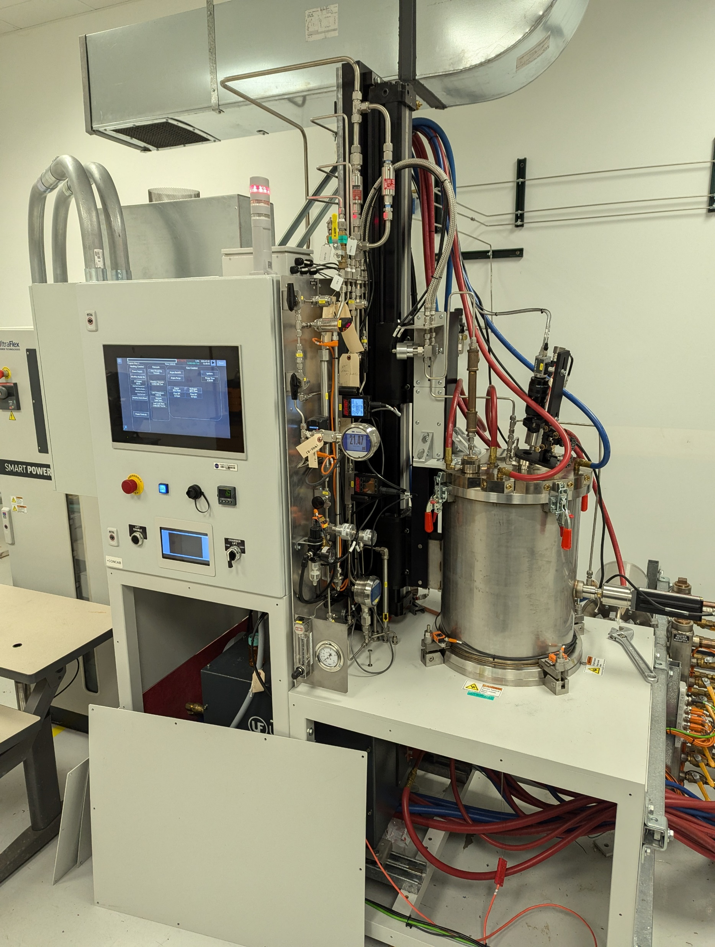
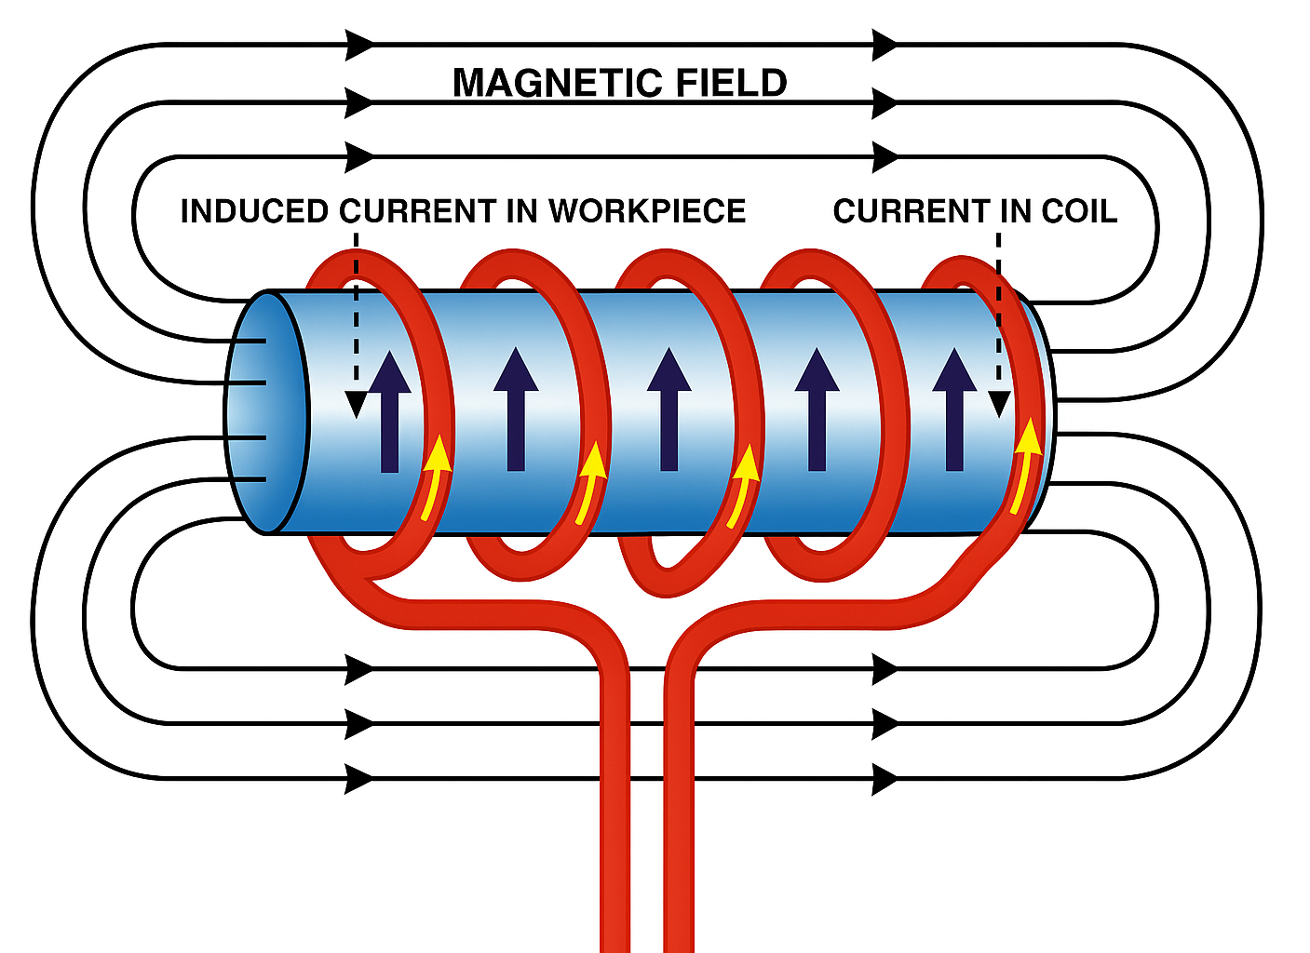
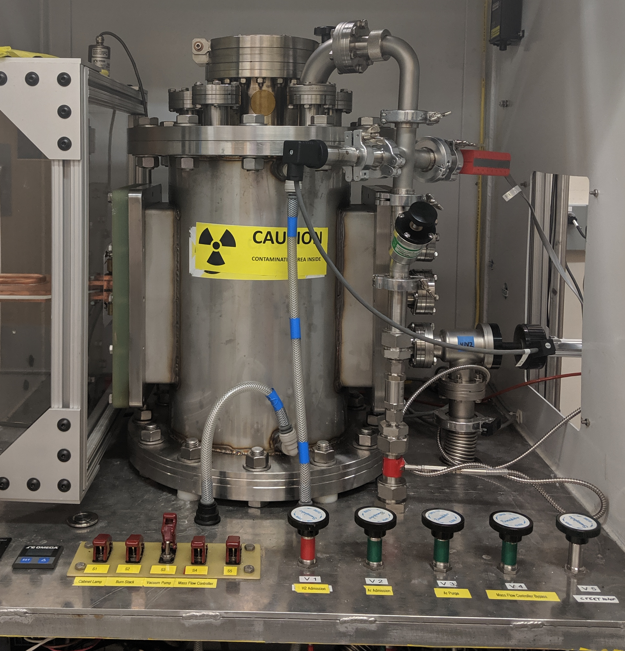
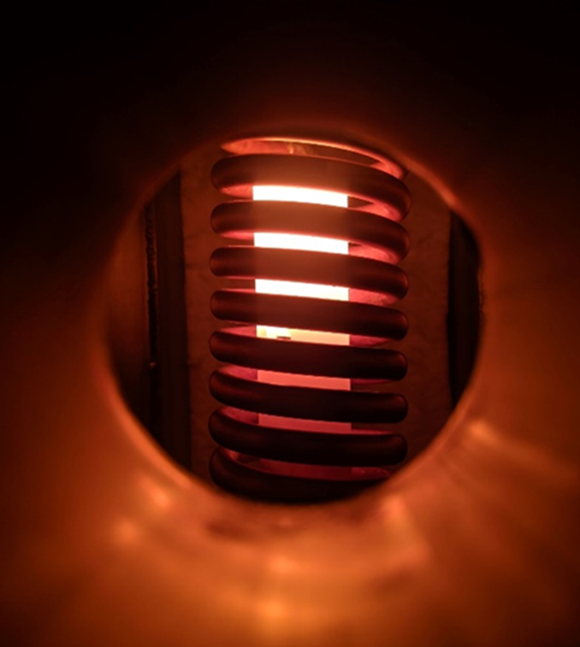
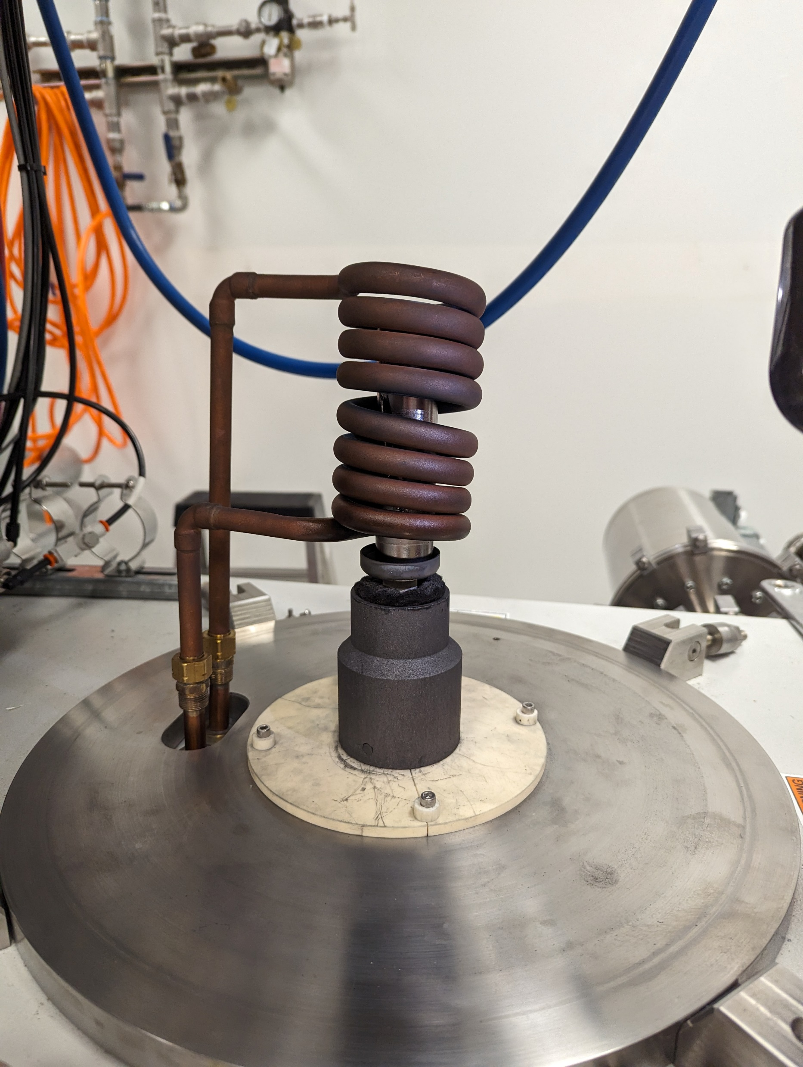
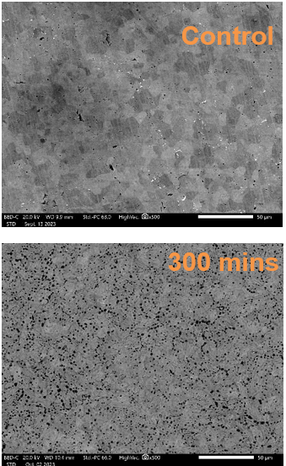
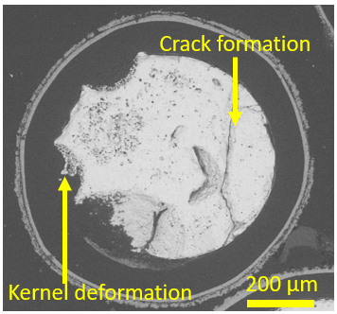
Ultra High Temperature Testing in Hydrogen
Authors/Affiliations [Brian Taylor ER64, Jhonathan Rosales EM32, Jason Reynolds EM32, Jamelle Williams EM31] MSFC and Arne Croell UAH
Induction furnace diagram
Background
Nuclear Thermal Rocket Engines operate at ultra high temperature (approaching 3000 C) and often with H2 as the propellant.
Both high temperatures and hydrogen gas may lead to chemical and microstructural changes that can drastically alter thermophysical properties.
The H2EAT and CFEET hydrogen induction furnace allow us to create a similar environment to study the behavior of fuels and reactor materials under these conditions.
H2EAT – Hot Hydrogen Environmental Atmospheric Test
Characteristic | H2EAT | CFEET
Atmosphere | H2/He/Ar | H2/He/Ar
Pressure | ~1 atm | ~1 atm
Max Temperature | ~3000 C | ~2600 C
Sample size | Diameter: 70 mm Height: 75 mm | Diameter: 20 mm Height: 75 mm
Flow rate | 5 slpm | 6 slpm
Induced currents from magnetic field heat workpiece that radiates to sample.
Rapid heating rates and high temperature capability
Operations in H2 or Inert Gas
CFEET – Compact Fuel element Environmental Test
Example Results
Supporting Analysis Method
Scanning Electron Spectroscopy
Electron Dispersive Spectroscopy
X-ray Diffraction
Precision Mass Measurements
Subscale fuel element segments and material samples
Characterized to determine changes in microstructure and mass loss due to high temperature H2 environment
NASA Marshall Space Flight Center
Materials Laboratory
Space Nuclear Propulsion
Fuel Development Team
Above – view of susceptor at ~1500 C
Right – coil with susceptor and hardware

