Slide 1
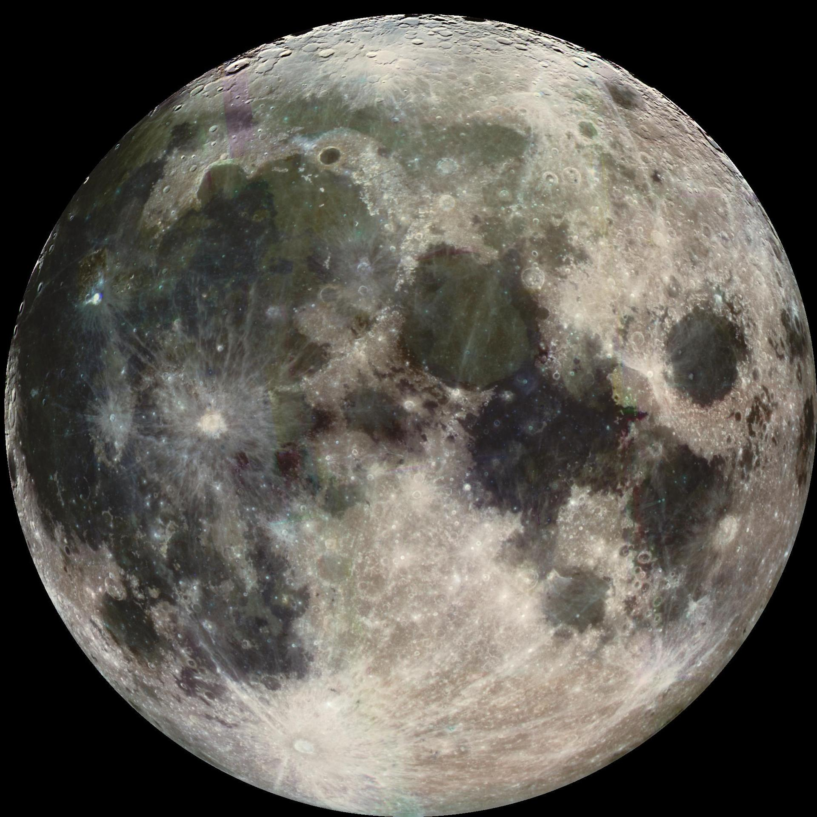

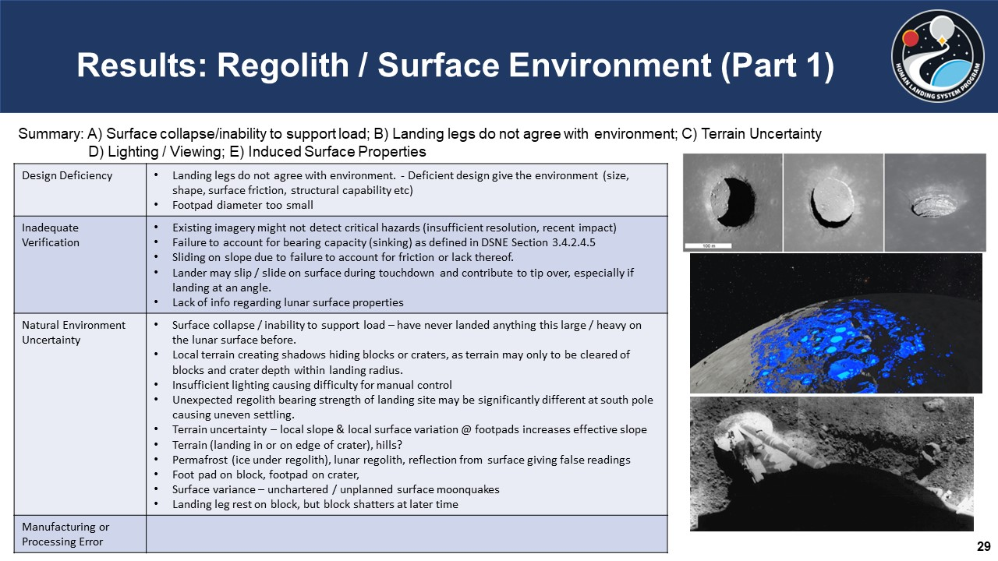
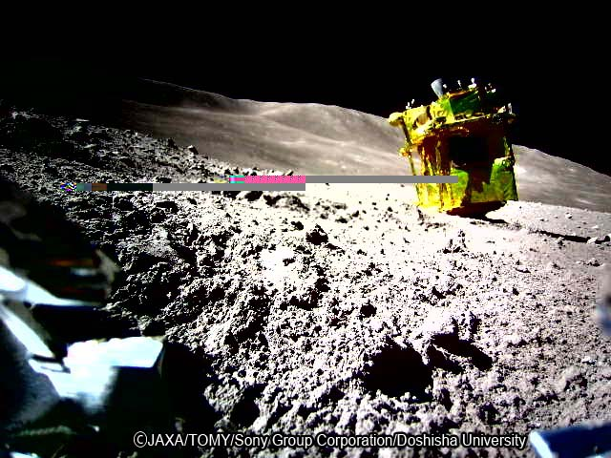
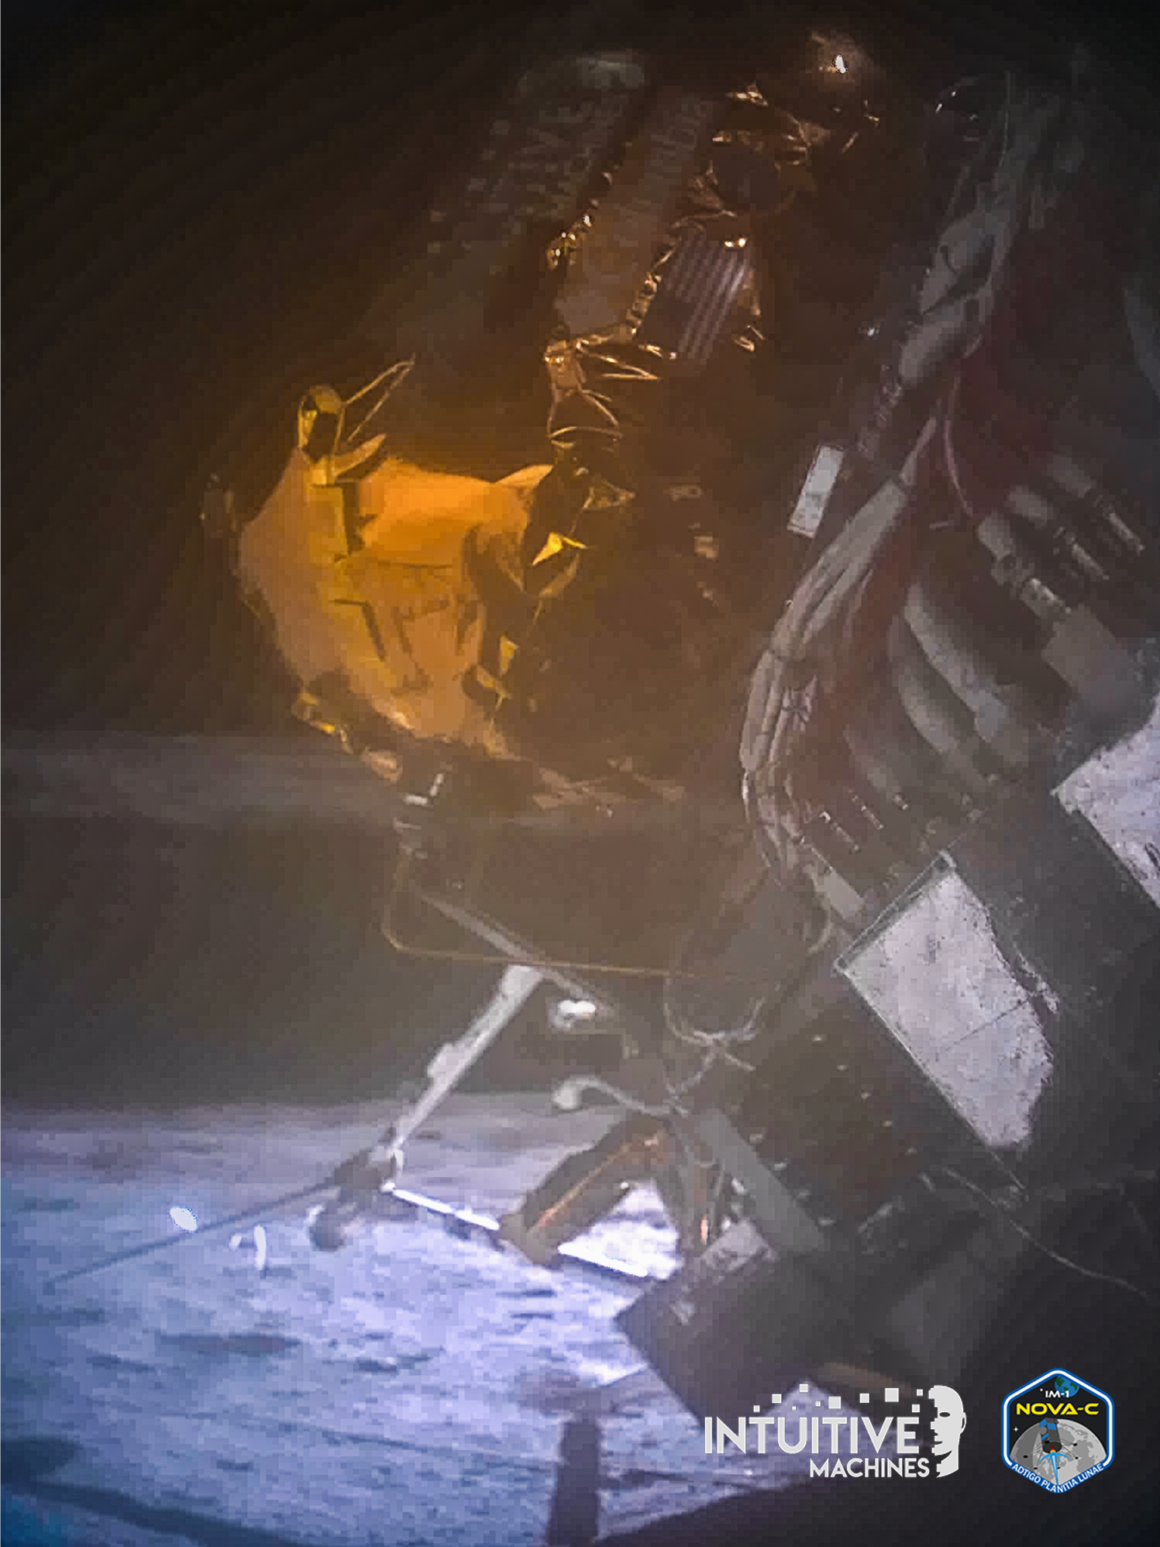
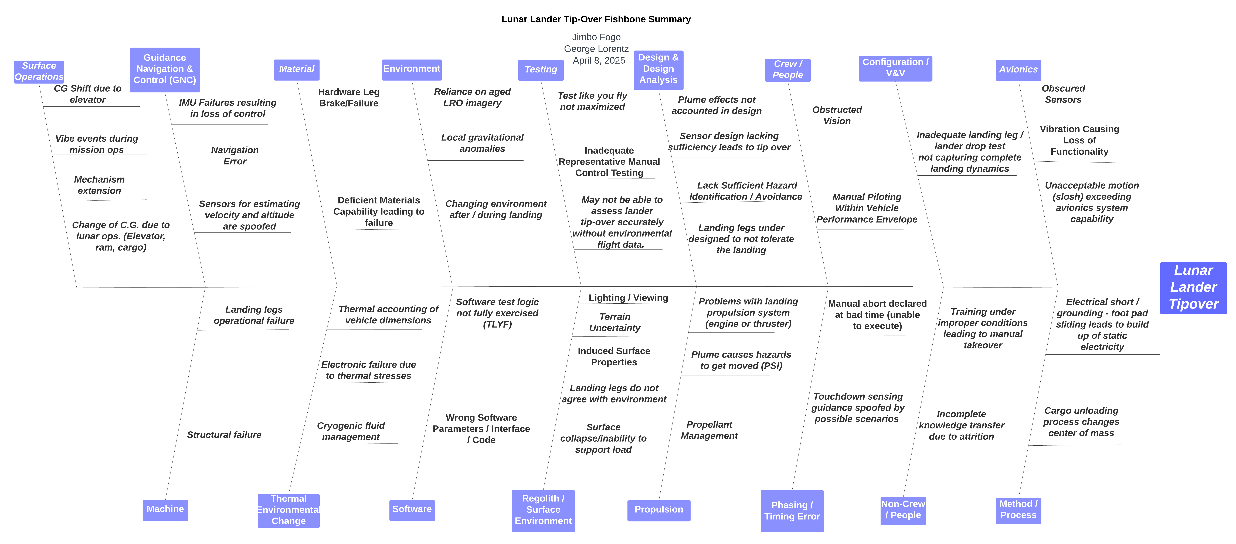
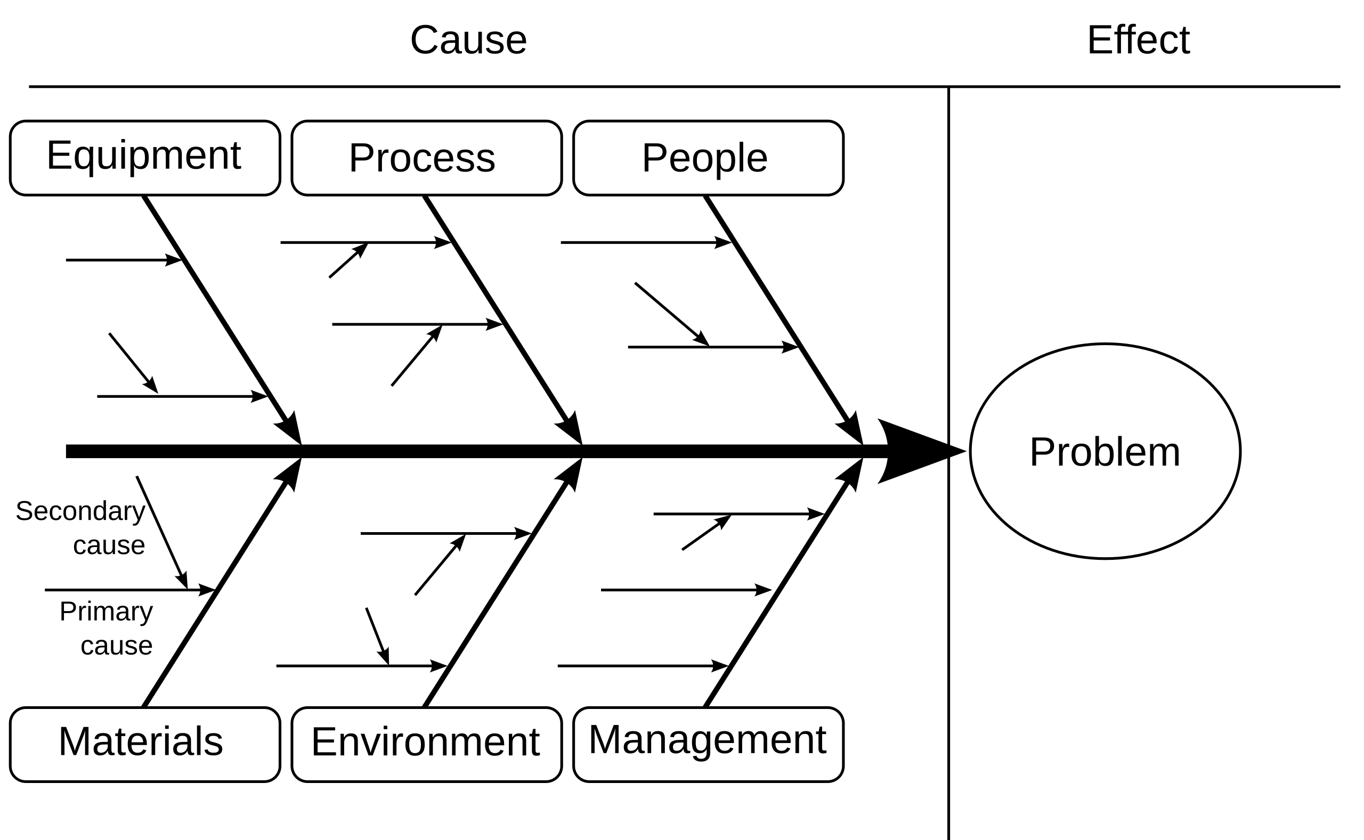
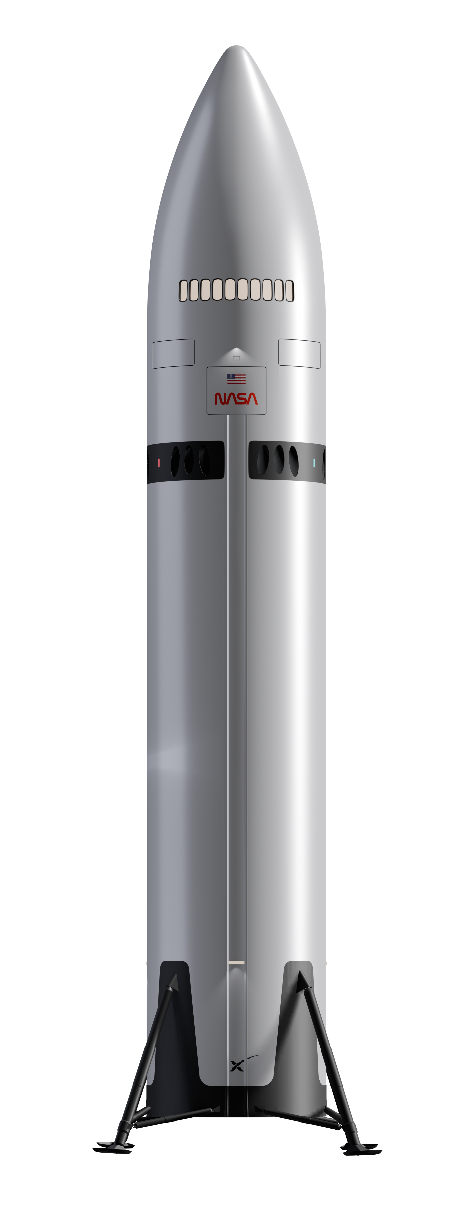
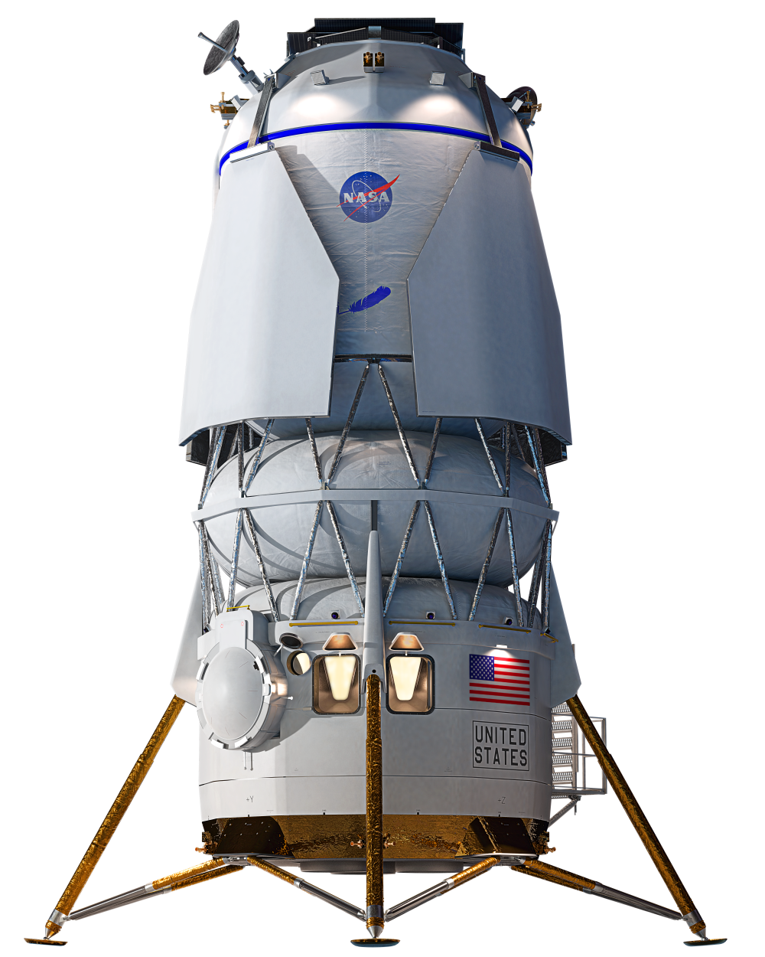
Lunar Lander Tip-Over Causes:
A Fishbone Analysis
John Crisler, NASA Marshall Space Flight Center, Rene Ortega, NASA Marshall Space Flight Center, George Lorentz, Bastion Technologies, Jimbo Fogo, Bastion Technologies, Julee Powers, NASA Marshall Space Flight Center, Peyton Heflin, Bastion Technologies, and additional HLS, NESC, Engineering Subject Matter Experts
PURPOSE OF TIP-OVER STUDY
TIP-OVER STUDY RESULTS
Examine recent lunar landing missions and perform brainstorm activity with SMEs from multiple disciplines to identify as many causes as possible of lunar landers tipping over or landing in a non-upright configuration.
Present this information to providers to inform design, testing, materials analysis, software development, processes, and more to improve mission success.
SMEs identified 340 causes for lander tip-over in 17 major categories (shown in blue boxes on fishbone diagram):
Avionics
Configuration/V&V
Crew/People
Design & Design Analysis
Testing
Environment
Guidance Navigation & Control (GN&C)
Machine & Mechanisms
Material
Method/Process
Non-Crew/People
Phasing/Timing Error
Propulsion
Regolith/Surface Environment
Software
Surface Operations
Thermal Environmental Change
For each of the 17 categories of tip-over causes, SMEs identified seven types of contributing factors in those categories:
Design Deficiency
Inadequate Verification
Natural Environment Uncertainty
Induced Environment Uncertainty
Manufacturing or Processing Error
Operational Error
Management Deficiency
SELECTED RECENT LUNAR LANDER
MISSIONS LANDING OUTCOMES
Mission | Landing Date, Site | Sponsor | Result | Root Cause of Tip Over
Small Lander for Investigating Moon (SLIM) | Jan. 19, 2024 Mare Nectaris (Sea of Nectar), near Shioli crater | JAXA | Partial Success. Demonstrated primary objective of precision landing but landed on its side at a 90-degree angle with solar panels not oriented toward the Sun, resulting in inadequate power generation. | Loss of an engine nozzle during descent.
Intuitive Machines-1 | Feb. 22, 2024 Malapert-A crater, 300 km from south pole | NASA CLPS | Partial Success. Odysseus lander touched down, skidded along the surface, broke one of its six legs, and tipped over 30 degrees. One solar panel still received power; six NASA payloads able to provide data. | Instrument failure. Laser instruments to measure altitude failed during descent, causing the spacecraft to land faster than planned on a 12-degree slope, exceeding design limits.
Firefly Aerospace Blue Ghost Mission 1 | March 2, 2025 Mare Crisium | NASA CLPS | Success.
Intuitive Machines-2 | March 6, 2025 Ridge near Shackleton Crater | NASA CLPS | Partial Success. Landed sideways, with solar arrays facing away from the sun, impacting power generation capability; some payloads able to perform some planned functions. | Plume-surface interaction. Lunar dust plume interfered with navigation systems.
Right is a sample page developed for each of the 17 major causes of tip-over. The team brainstormed tip-over causes and noted that most fell within seven major categories.
FINAL TIP-OVER FISHBONE DIAGRAM
Two recent lunar landing missions demonstrated soft landings but tipped over after touchdown. JAXA’s SLIM lander (left) at 1.5 m × 1.5 m × 2 m and 590 kg wet mass, tipped over at a 90-degree angle. During the attempted landing, an instrument failure caused the lander to descend too fast, skidding, and breaking a leg.
Image Credits: (left) JAXA; (right) Intuitive Machines
WHY ‘FISHBONE’ FORMAT?
Made popular in 1960s by Kaoru Ishikawa, Japanese quality control expert
Technique for brainstorming causes of issues
Objective is to create a list of causes, which can then be analyzed and prioritized to pursue mitigations and preventions
Causes, contributing factors diagrammed in a “fishbone” shape
Above is the final Tip-Over Study diagrammed in the fishbone format. The effect studied – Lunar Lander Tip Over – is listed as the “head” of the diagram on the far right. The effects are listed as the “ribs” of the diagram. Seventeen major categories of contributing factors are identified in the blue boxes. Contributing factors in each category are listed on horizontal lines.
DISPOSITION OF STUDY
FOR MORE INFORMATION
The Tip-Over Study and Fishbone Analysis was provided to HLS and CLPS commercial providers to help inform design, materials, testing, software, instruments, sensors, and processes to reduce chances of lander tip-over and improve chances of mission success. In addition, results of the Tip-Over Study are intended to be used as a tip-over cause outline for establishing controls in HLS Hazard Reports.
John Crisler, HLS CSO
Rene Ortega, HLS CE
George Lorentz, Bastion Technologies, Quality Engineer/Process Improvement, NASA SMA Independent Assessment
Jimbo Fogo, Bastion Technologies, Quality Engineer, HLS
Artists’ concepts of HLS landers courtesy of SpaceX and Blue Origin. Landers roughly to scale.
Notes:
Photo credits:
Background: NASA public use https://images-assets.nasa.gov/image/PIA00405/PIA00405~large.jpg
Generic Fishbone diagram: Wikimedia commons available for public use https://commons.wikimedia.org/w/index.php?curid=6444290
JAXA SLIM lander: Public use attributable to JAXA
IM-1 lander: Public use from Intuitive Machines: https://www.flickr.com/photos/intuitivemachines/53558403230/in/dateposted/
SpaceX Starship HLS: image provided for public noncommercial use
Blue Origin Blue Moon MK-2 HLS: image provided for public noncommercial use
Lunar craters: Public use from NASA LRO: https://moon.nasa.gov/resources/20/lunar-pits/
Visualization of water on the Moon: still taken from public-use ESA video https://www.esa.int/esatv/Videos/2024/03/Destination_Moon_-_Animations/Lunar_water_animation
Surveyor 5 on moon: public use from NASA https://science.nasa.gov/resource/close-up-view-of-the-footpad-of-surveyor-5-on-the-lunar-surface/

