Slide 1

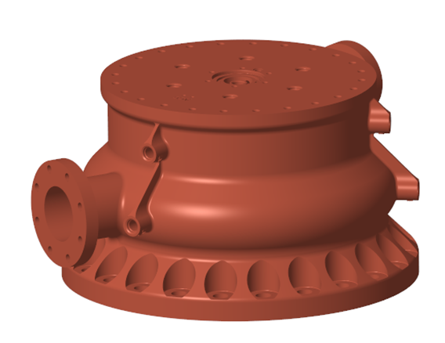
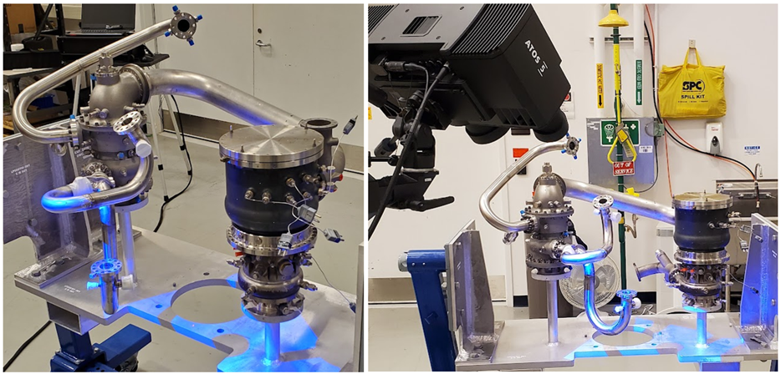
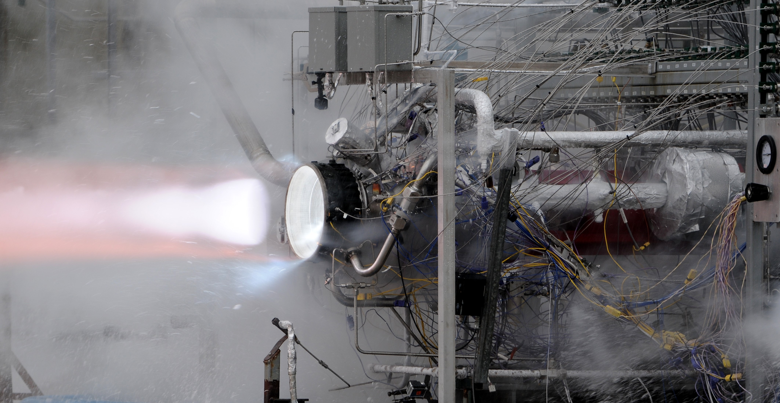
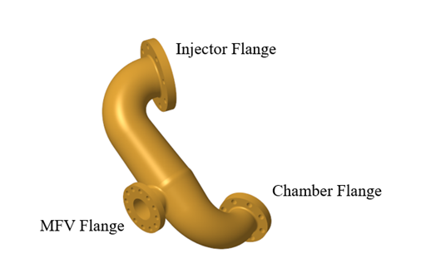
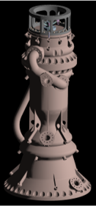
Fully Additively-Manufactured LOX-LH2 Engine (FAMLLE)
Jason Thrasher & Jackson Lusk/Marshall Space Flight Center
Introduction
AMDE Interface Definition
Injector & Mixer Design
The "Fully Additively-Manufactured LOX-LH2 Engine", or FAMLLE, project, between NASA and Aerojet Rocketdyne (AR), an L3Harris Technologies Company, is developing a novel, single-piece thrust chamber assembly (TCA) using additive manufacturing techniques. Aerojet Rocketdyne is designing and manufacturing the TCA for hot-fire testing at MSFC. This TCA is intended to seamlessly integrate into NASA's Additive Manufacturing Demonstrator Engine (AMDE), an 35,000 lbf thrust upper stage engine system that serves as a testbed to assess the practical application of additively manufactured components in actual rocket engine systems.
All interface definitions for flanges, fluids, and loads were collected into a single Interface Definition Document and delivered to Aerojet Rocketdyne to proceed with their development of the thrust chamber assembly. To assist with communication of mechanical interfaces in three-dimensional space, the existing AMDE was reassembled onto the assembly pedestal without the original AMDE TCA and then white light scanned as seen in the figure below.. Though the goal is to fit the new chamber into the existing AMDE chamber interfaces, it was agreed that as the chamber design matured, changes in engine packaging may be needed to address the unique needs of the new chamber. These changes are documented to help guide any future engine integration activities.
AR is designing the injector and TCA as two pieces initially to facilitate component level pressure and waterflow testing. Having individual components will also enable risk reduction activities for the AM process, such as understanding powder removal strategies.
Traditionally, rocket engine injectors require cooling of the faceplate to ensure that it can run effectively at high temp-eratures. This has been historically achieved by joining a porous material, such as Rigi-mesh. With a one-piece additively manufactured design, employing a Rigimesh isn’t feasible. Due to the high temp-eratures, a porous face-plate is required for this TCA. A solution is to take advantage of the additive process and print a Rigimesh like faceplate. AR is in the process of testing a variety of porous face-plates to identify which sizing will be acceptable for thermal analysis.
Part of the TCA system is a fuel mixer that is designed to mix colder bypass fuel with the MCC coolant flow prior to entering the injector. It is a cross-flow mixer composed of an inlet that takes discharge fuel from the MCC, an outlet that feeds the injector, and a mixing chamber filled with ejector orifices that provides the interface in flow from the MCC and the fuel bypass line. This will also be an additively manufactured part sep-arate from the TCA but with the ability to be incorporated in future TCA iterations.
AMDE
The goal of AMDE was to develop a prototype engine using additive manufacturing (AM) to reduce part costs, fabrication times, and overall part counts and to advance the Technology Readiness Level (TRL) of additively manufactured parts through testing in a relevant engine system environment. Though AMDE successfully demonstrated additive manufacturing in the injector, AM technology could not guarantee a regeneratively-cooled chamber of acceptable tolerances, so it was traditionally manufactured, making it the only major component that is not AM. In addition to needing to address AM TRL in a chamber of this size, part count could be further decreased by printing the injector and chamber, collectively known as a thrust chamber assembly (TCA) as a single, monolithic build. In addition to being a prototype engine whose basic design could be used as the first development unit for an upper stage or in-space-propulsion class engine, AMDE has also been envisioned as a testbed for engine components near that same scale. This type of collaboration is a great first example of how the AMDE components and designs can be leveraged to quickly develop and test new hardware.
Thrust Chamber Design
Combining the injector and the combustion chamber into one piece presents challenges. For most LOX-LH2 engines, the combustion chamber is made from a copper alloy due to its high thermal conductivity and then strengthened by either brazing or cladding a nickel jacket to its outer walls. The injector is usually a nickel-based alloy for strength. When printing a one-piece TCA, the materials must be the same.
At the onset of the program, the intention was to use a nickel-based alloy due to its high strength. Unfortunately, the thermal loads produced wall temperatures required the design to use change material. GRCop-42, a NASA designed alloy that is characterized by high thermal conductivity and strength, was chosen. Reanalyzing the thrust chamber using GRCop-42 produced acceptable loads.
Future Work
The next few months will focus on initial testing of the design, including assembly of the test article, integration with the test facility, and hot-fire testing. Hotfire testing is planned for TS116 at MSFC in Fall 2025. Future funding opportunities may allow for integration of the TCA with the rest of the AMDE components in an optimized packaging arrange-ment, enabling full engine system testing.
References
Robertson, E.H., Nelson, G.M., and Case, N.L., Additive Manufacturing Demonstrator Engine, 2015-0001HR, 2015 JANNAF Propulsion Meeting, June 2015.

