Slide 1
JSC Robotics: iMETRO
The Integrated Mobile Evaluation Testbed for Robotics Operations (iMETRO) Facility
Emma Zemler
Software Lead, Dexterous Robotics
NASA Johnson Space Center
Approved for Public Release DAA # 20250003773

Slide 2


NASA Moon to Mars Architecture
NASA’s Moon to Mars Architecture currently comprises four segments:
  Human Lunar Return
  Foundational Exploration
  Sustained Lunar Evolution
  Humans to Mars

Slide 3
Moon to Mars Architecture Recurring Tenets
RT-4: Maximize crew time available for science, research, and technology development activities within planned mission duration.
  Use of tele-robotics, robotic assistance, and autonomous systems to increase crew time and effectiveness for science and utilization. For example, uncrewed operations like pre-positioning an asset can reduce the crew task burden before they arrive.
RT-5: When practical, design systems for maintainability, reuse, and/or recycling to support the long-term sustainability of operations and increase Earth independence.
  Reduce crew time by automating or having robotics perform maintenance tasks where possible
[] Moon to Mars Architecture
Notes:
https://www.nasa.gov/wp-content/uploads/2024/12/esdmd-001-add-rev-b.pdf?emrc=5ffbf4

Slide 4
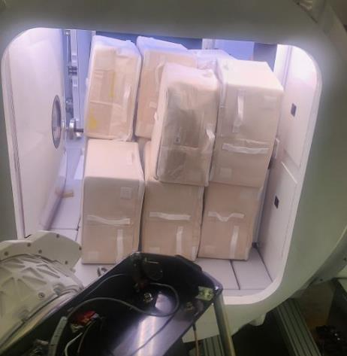
Crew Time Estimates
NASA’s 2023 Moon to Mars Architecture estimates for a crew of 2 members on a 28-day lunar surface mission:
24.7 hours of crew time for maintenance
1500 kg of logistics required
Robots are necessary and we have a massive challenge ahead of us.
Pressurized Rover Resupply Evaluation:
~38 CTBE (2 crew 14 days)
Bags block the hatch for crew to re-enter
Lengthy process (possibly multi-EVA)
Dust mitigation challenge
Notes:
Reference:
https://ntrs.nasa.gov/api/citations/20210026843/downloads/IEEE%20Assessment%20of%20Crew%20Time%20for%20Maintenance%20and%20Repairs%20Activities%20for%20Lunar%20Surface%20Missions.pdf
https://www.nasa.gov/wp-content/uploads/2024/01/lunar-logistics-drivers-and-needs.pdf

Slide 5
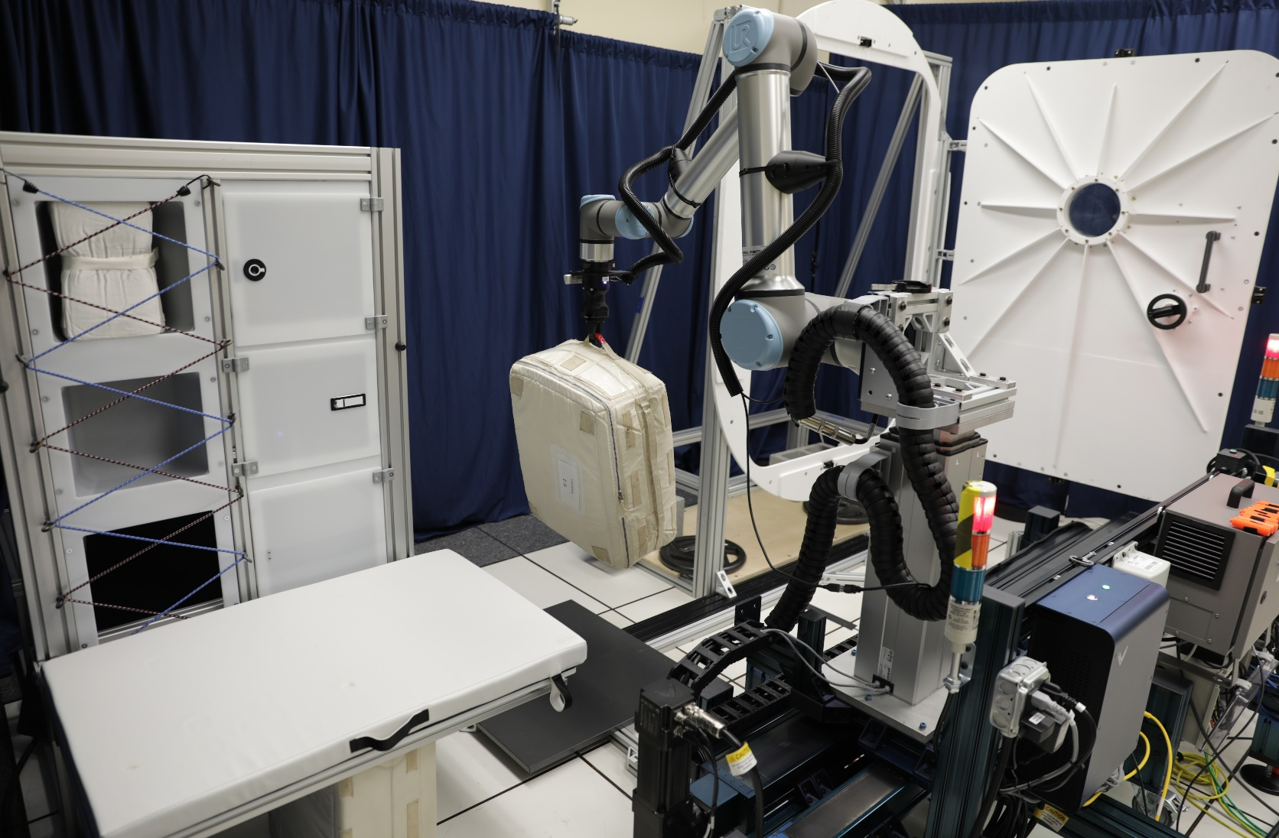
Integrated Mobile Evaluation Testbed for Robotic Operations (iMETRO)
For Space Robotics to be successful – we must advance the Technology Readiness Levels (TRL) of integrated technologies for missions requiring remote space robotics operations.
iMETRO is a test facility at JSC for NASA, Industry, and Academia to develop these technologies
iMETRO provides:
  COTS robots
  Space Applications
  Core open source software for all
  Remote operator consoles (test like you fly)

Slide 6
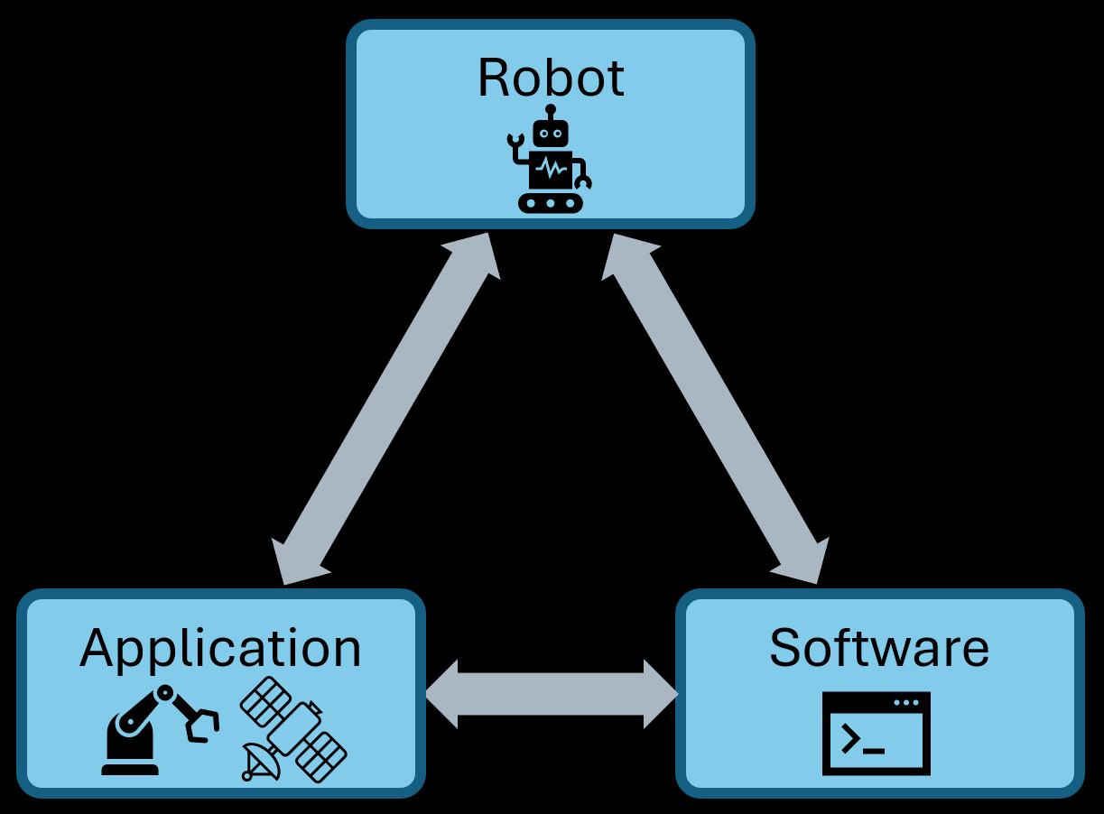
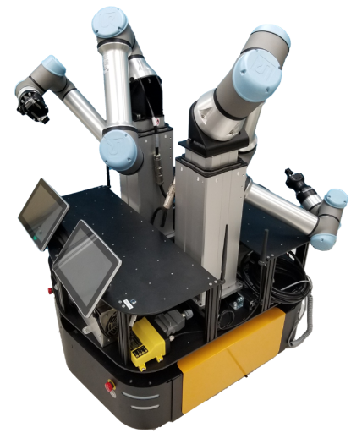
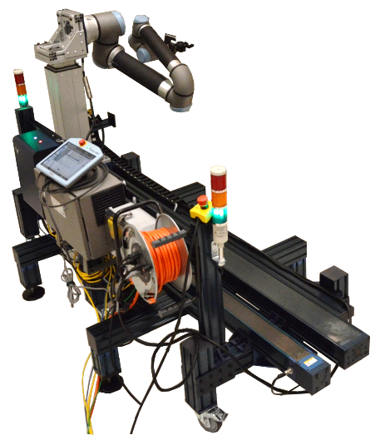
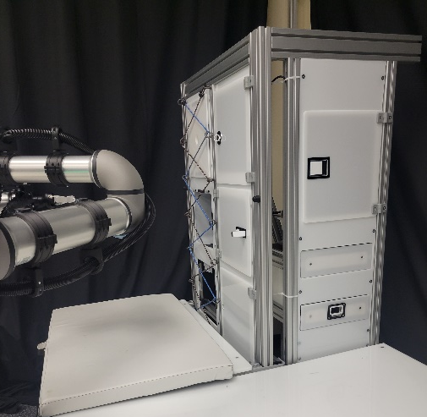
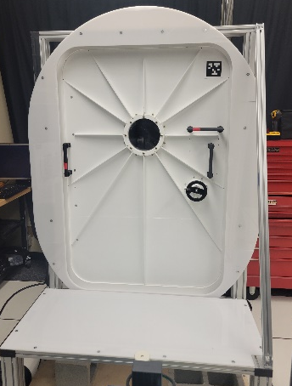
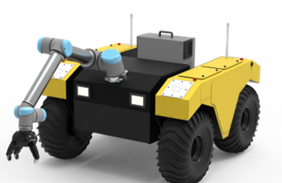
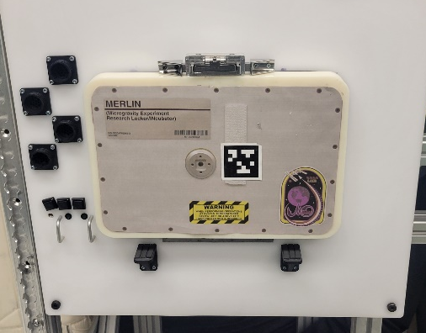

Components of iMETRO Facility
Partners can choose which components to include to meet their testing needs
Notes:
Substitute robots
Substitute application-driven mockups
Standardized software architecture through ROS middleware

Slide 7
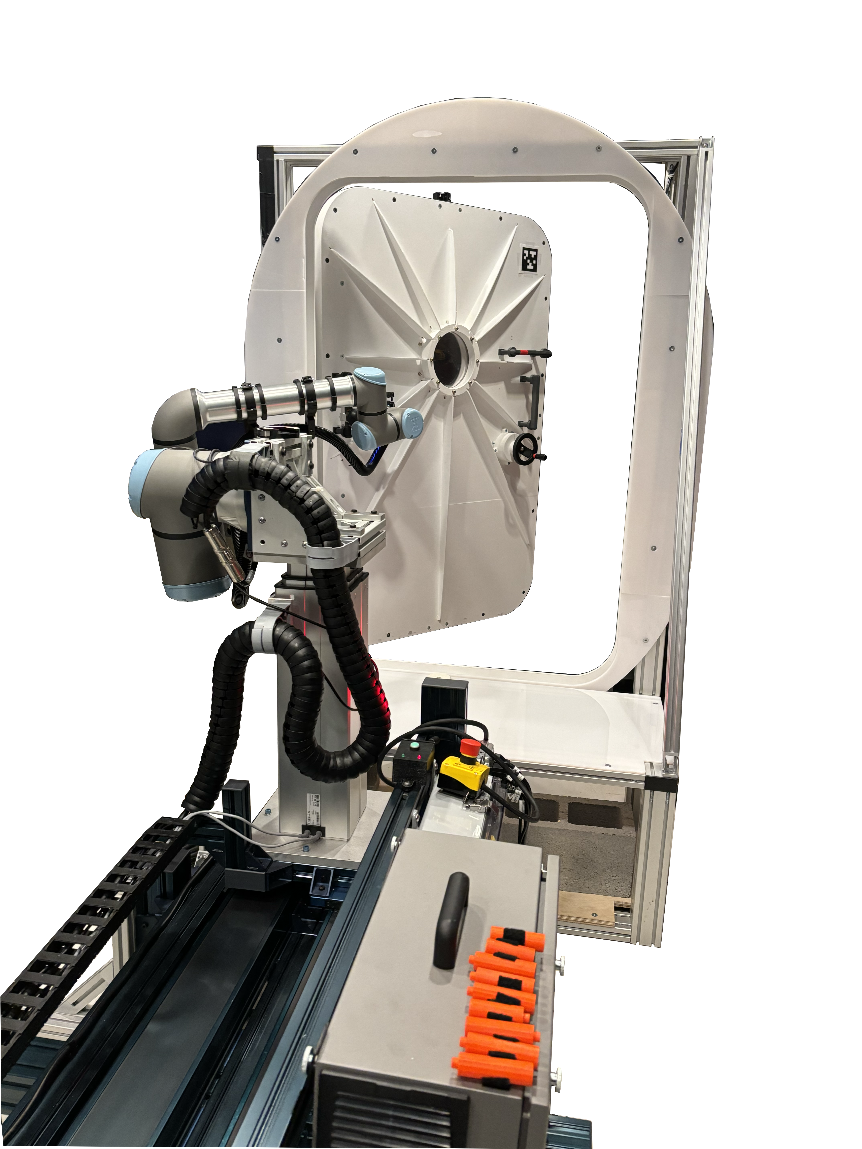
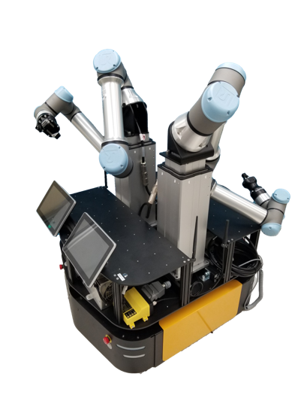
iMETRO Robots
Single Arm on a Rail
IVR Mobile Dual Arm System
EVR Mobile Single Arm System

Slide 8
ROS2 Software Stack
Application Software
Uses standardized ROS interfaces
Ability to pick and choose layers in the software stack
MoveIt 2
Nav2
ROS2 Controllers
ROS2 Control: Hardware Interface
Arm
ROS2 Control: Hardware Interface
Arm
ROS2 Control: Hardware Interface
Arm
ROS2 Control: Hardware Interface
Arm
Sensors

Slide 9
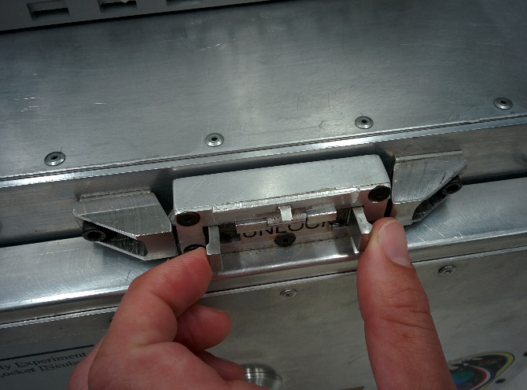
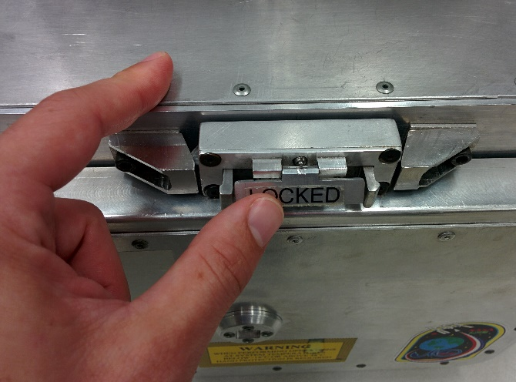
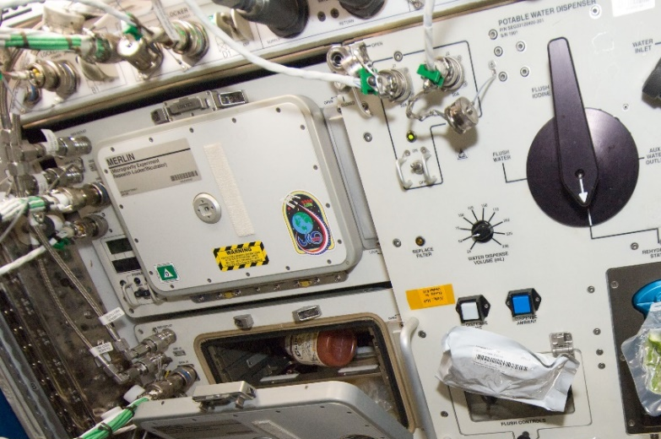
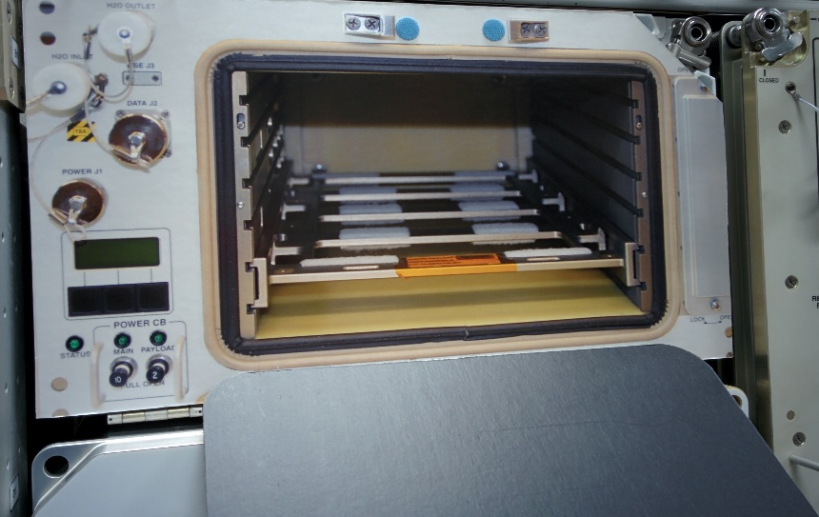
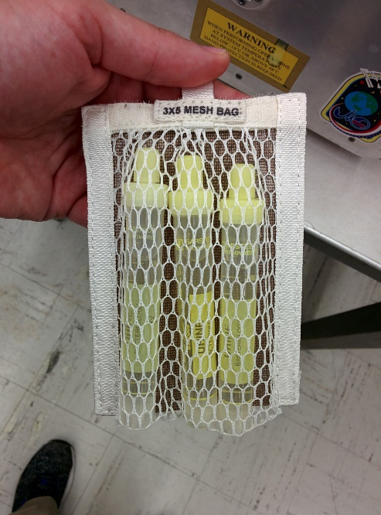
iMETRO Applications: ISS MERLIN Freezer Example
Goal: Provide non-proprietary, realistic, and current space use cases
Focus on:
  High fidelity manipulation interfaces
  Low fidelity body/secondary interfaces
B. Unlatch door 2
A. Unlatch door 1
Actual freezer on ISS
(Current lab demo uses mockup hardware with relevant components built-to-drawing from active ISS payload design)
D. Stow sample
C. Open door

Slide 10
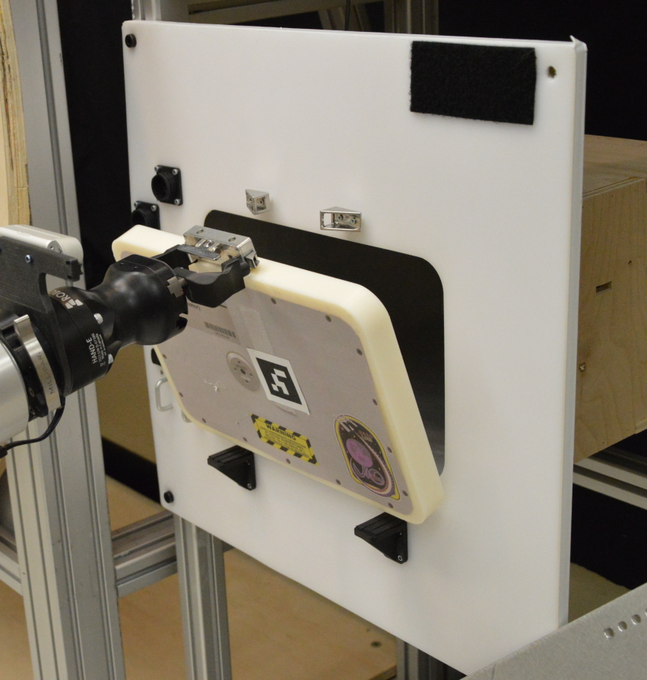
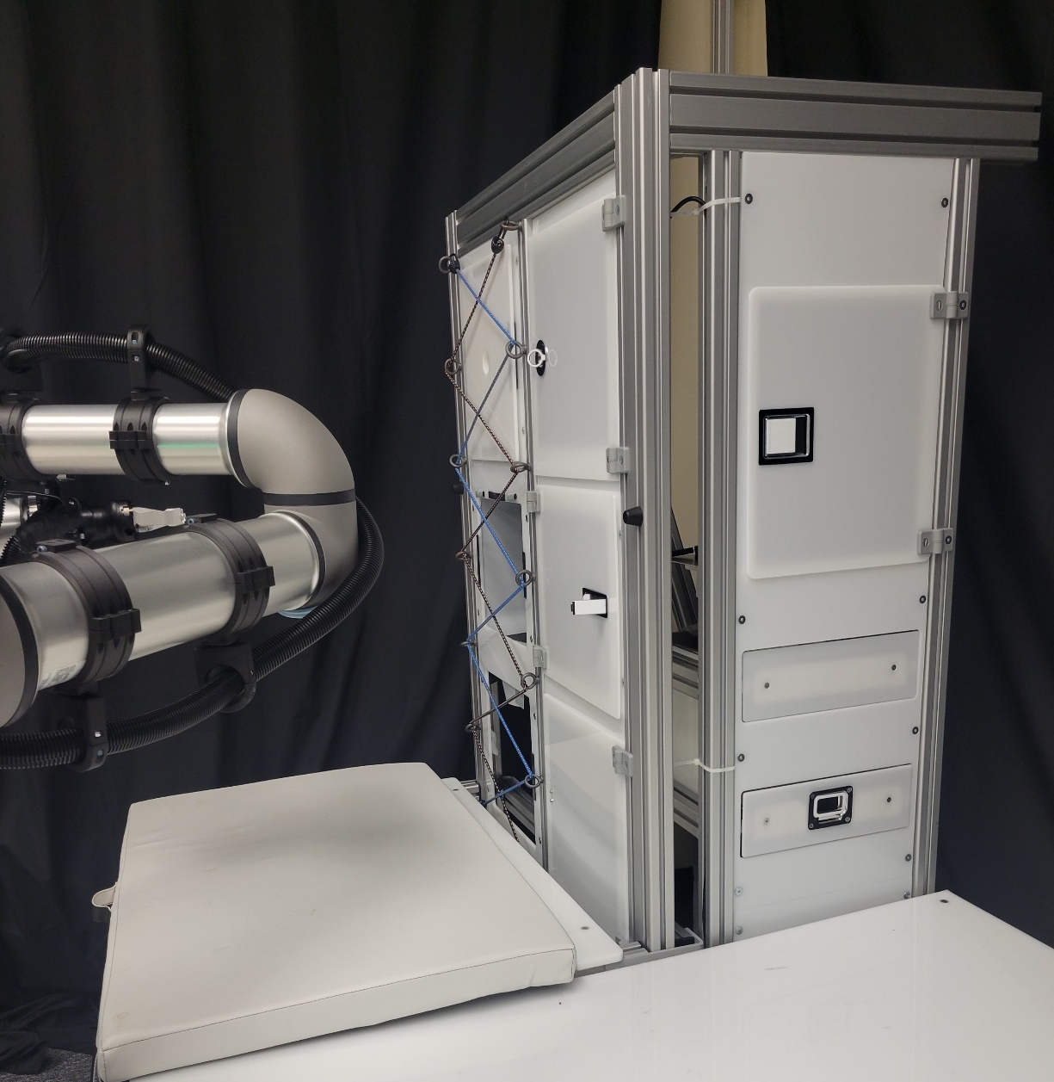
iMETRO Applications
Merlin Freezer
Task Trainer:
Storage bench seat
Cabinets
Drawers

Slide 11
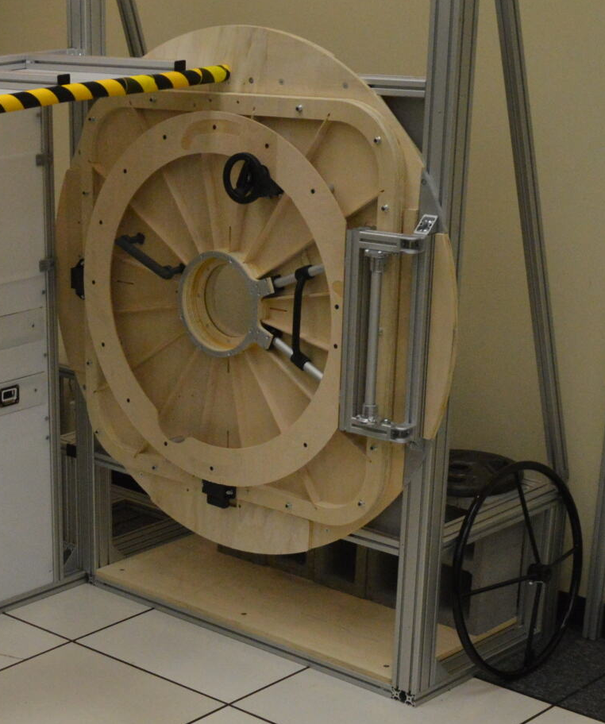

iMETRO Applications: Surface Vehicle Hatch Mockups
40x60 hatch
40x40 hatch

Slide 12
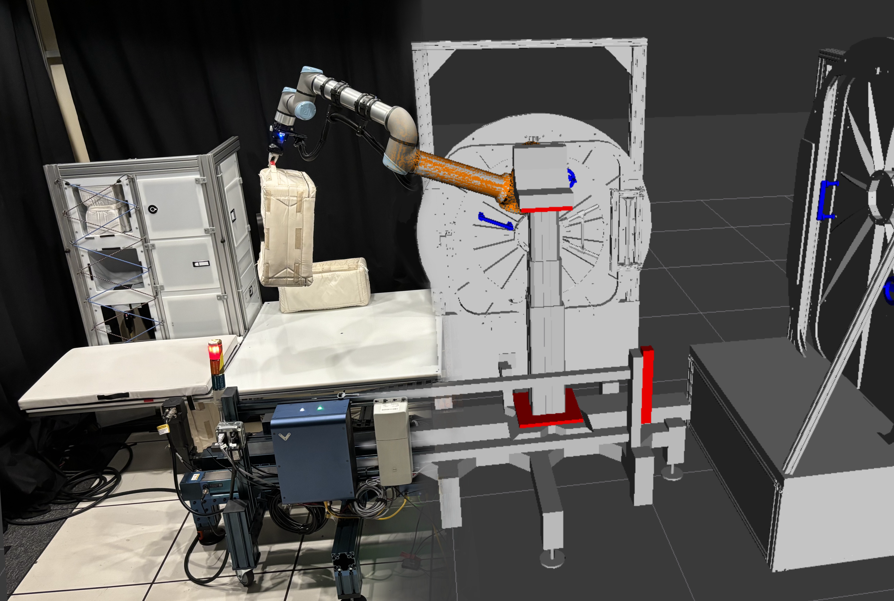
True Digital Twin: Simulation + Hardware in the Loop

Slide 13
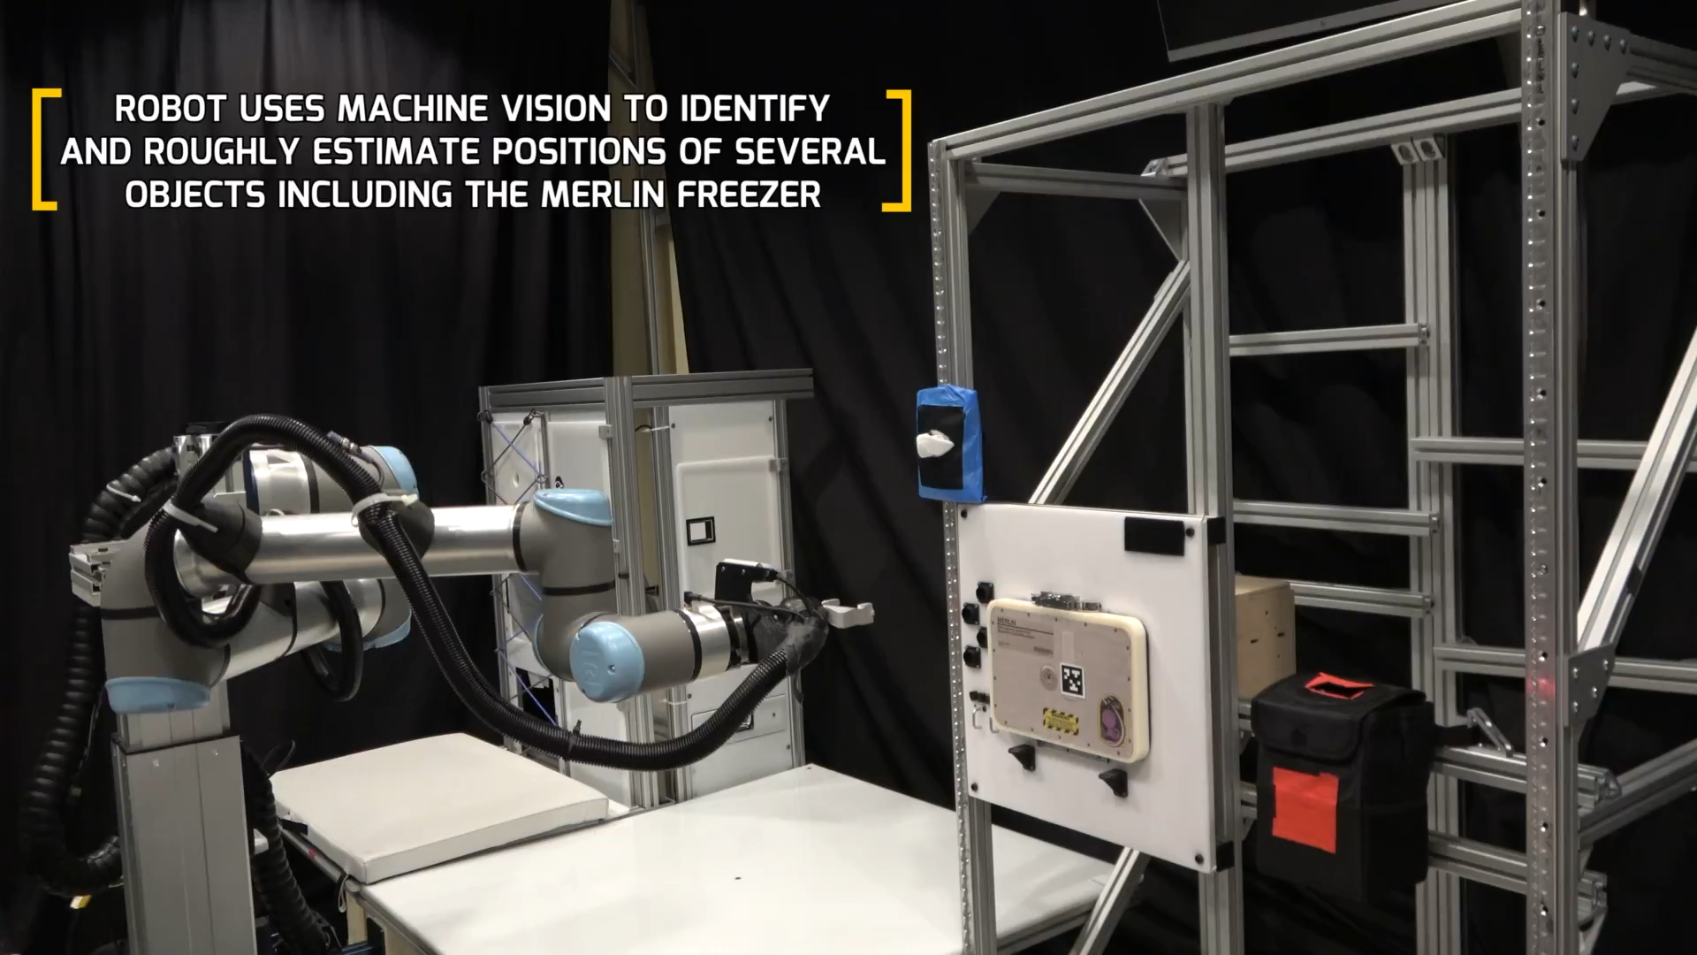
Notes:
https://ntrs.nasa.gov/citations/20240007666

Slide 14


Open Source Software
All NASA-developed iMETRO software is being released as open source
  Approved for open source – all mockup URDFs and supporting data
  Imminent approval expected (May 2025) – robot on rails, dual arm mobile IVR robot
    Hardware
    Kinematic Simulation
Releases will be containerized via docker
All source code will be available on NASA GitHub and listed in the NASA Software Catalog

Slide 15
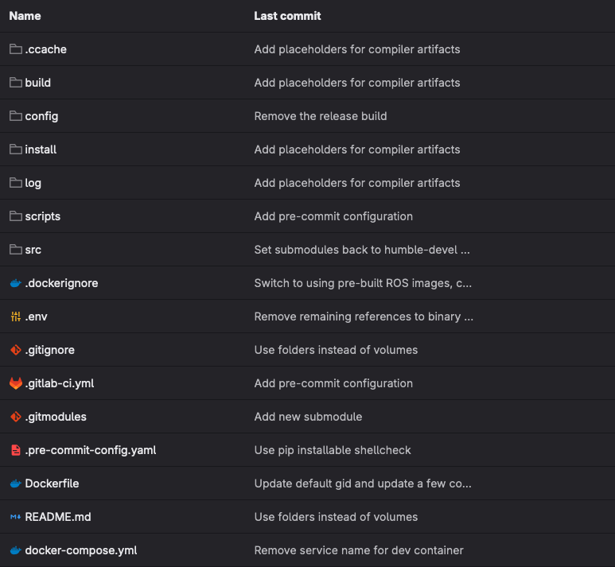
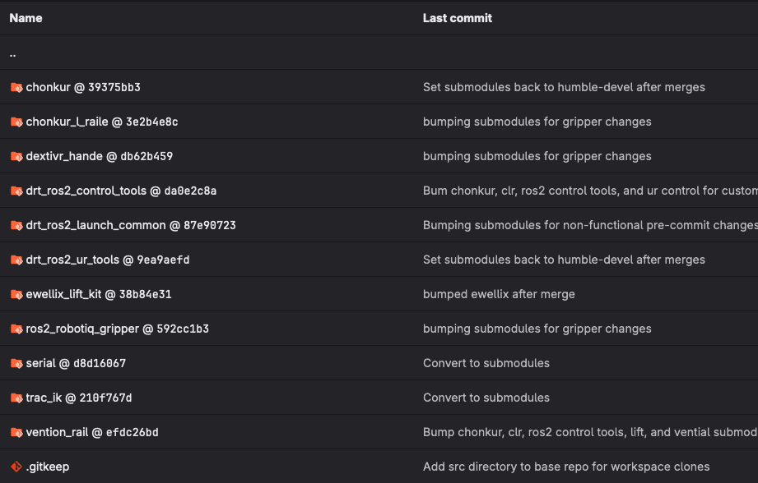
Configuration Management and Distribution
Robot docker container
Use submodules for workspace management

Slide 16
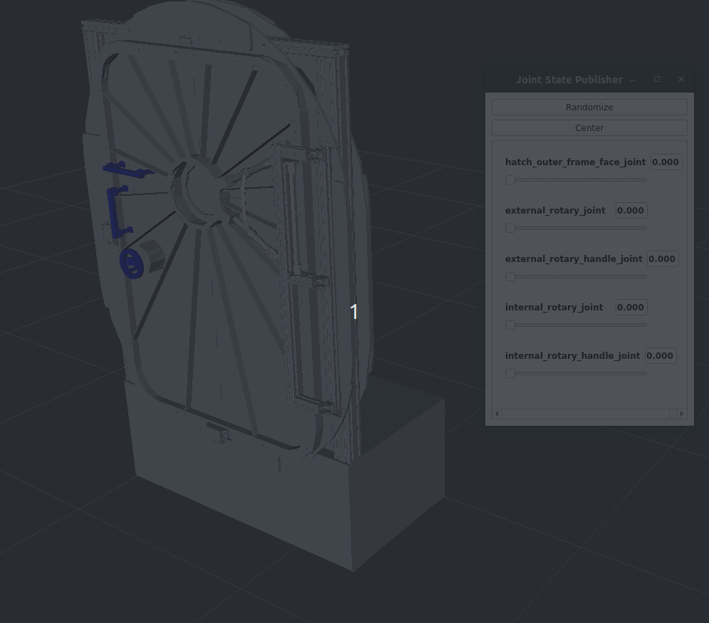
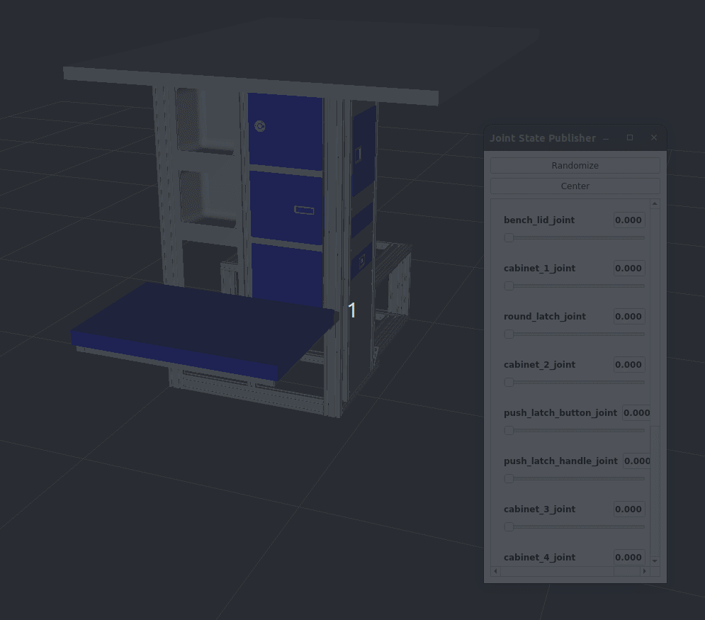
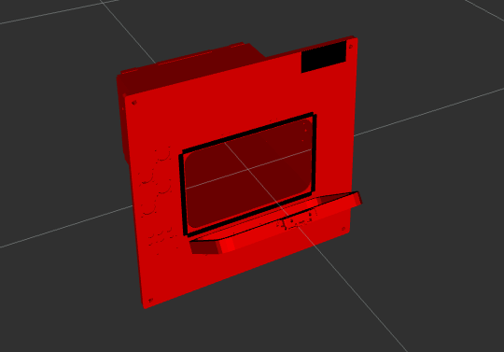
Mockups described via URDF

Slide 17
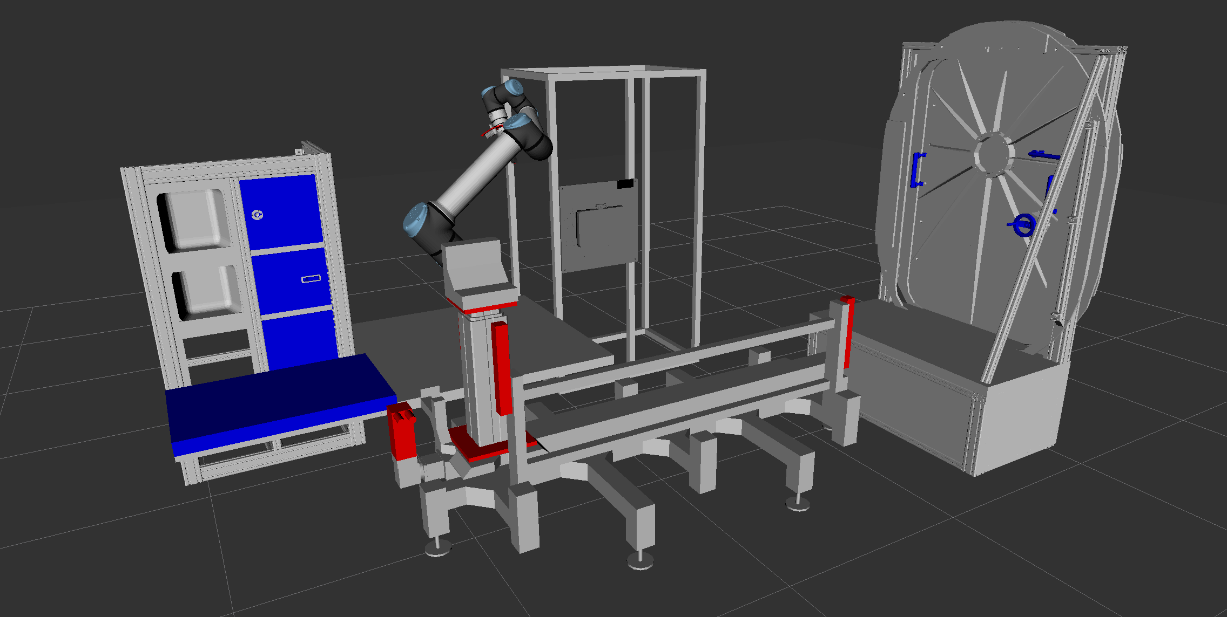
Kinematic Simulation

Slide 18



Next Steps: Dynamic Simulation Support
Focusing on the single arm on rail to start and the hatch mockup as initial assets
Exploring support for the three most common dynamic simulation environments:

Slide 19

iMETRO Contact Information
Emma Zemler
  emma.zemler@nasa.gov

Slide 20
Backup Slides

Slide 21
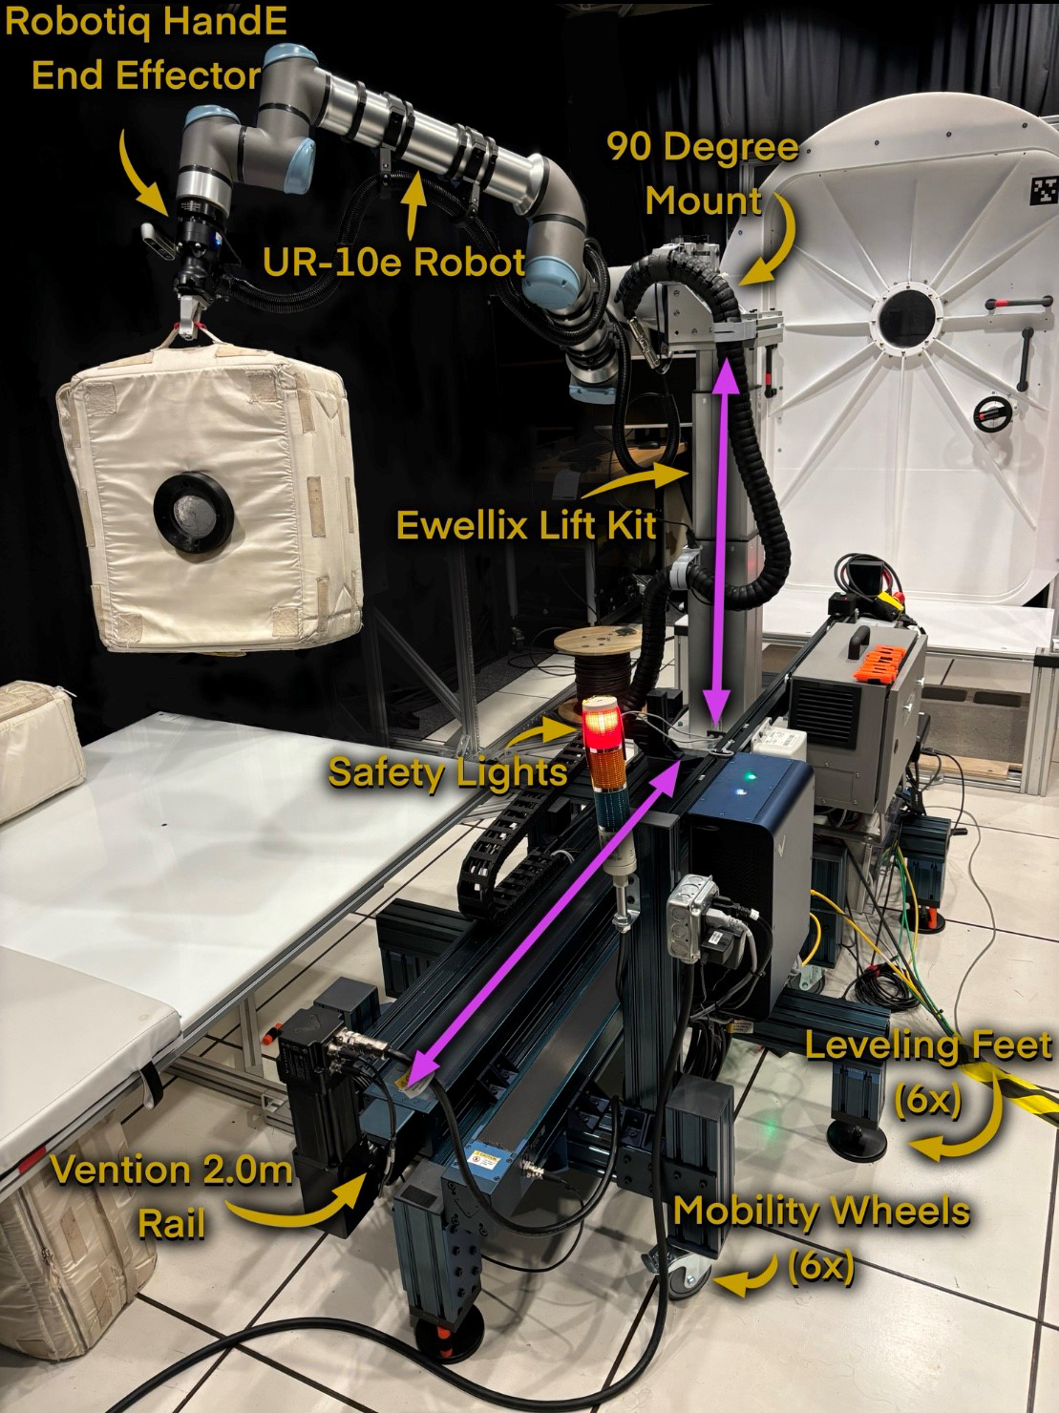
Single Arm on a Rail

Slide 22
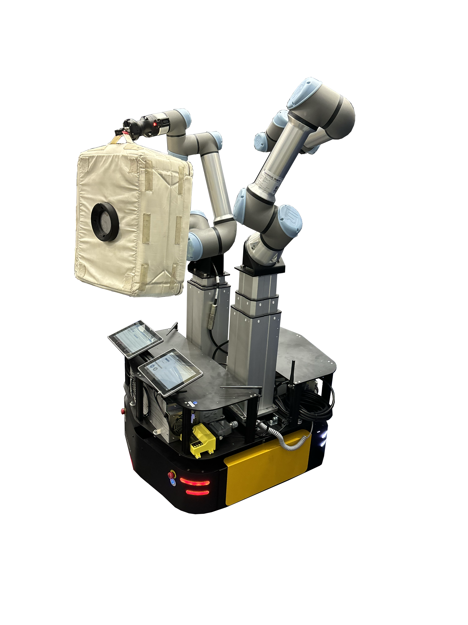
IVR Mobile Dual Arm System
Clearpath ridgeback
X2 Ewellix Liftkit 500mm stroke
X2 UR5e
X2 Robotiq Hand-E

Slide 23
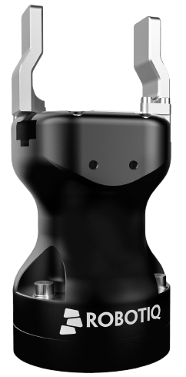
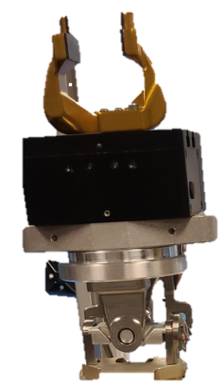
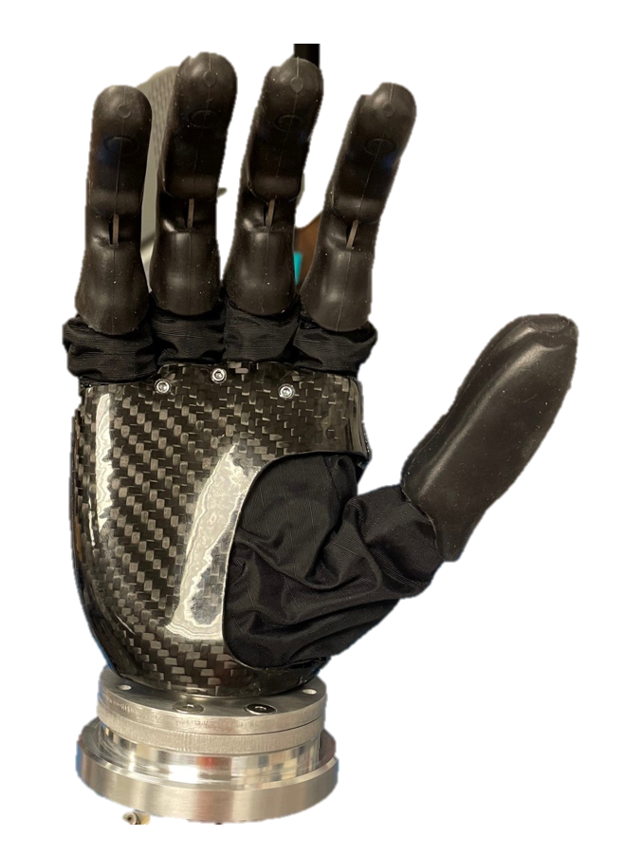
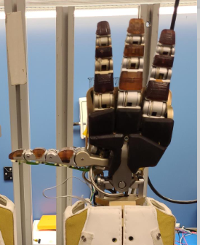
Modular End Effectors
Parallel Jaw Grippers
Non-backdrivable
More common for iMETRO applications
Higher pinch force maximum
Custom fingers
Dexterous Hands
Backdrivable and underactuated
More compliant
Force Controlled
Lower pinch force capability
More Robust
Less Robust

Slide 24
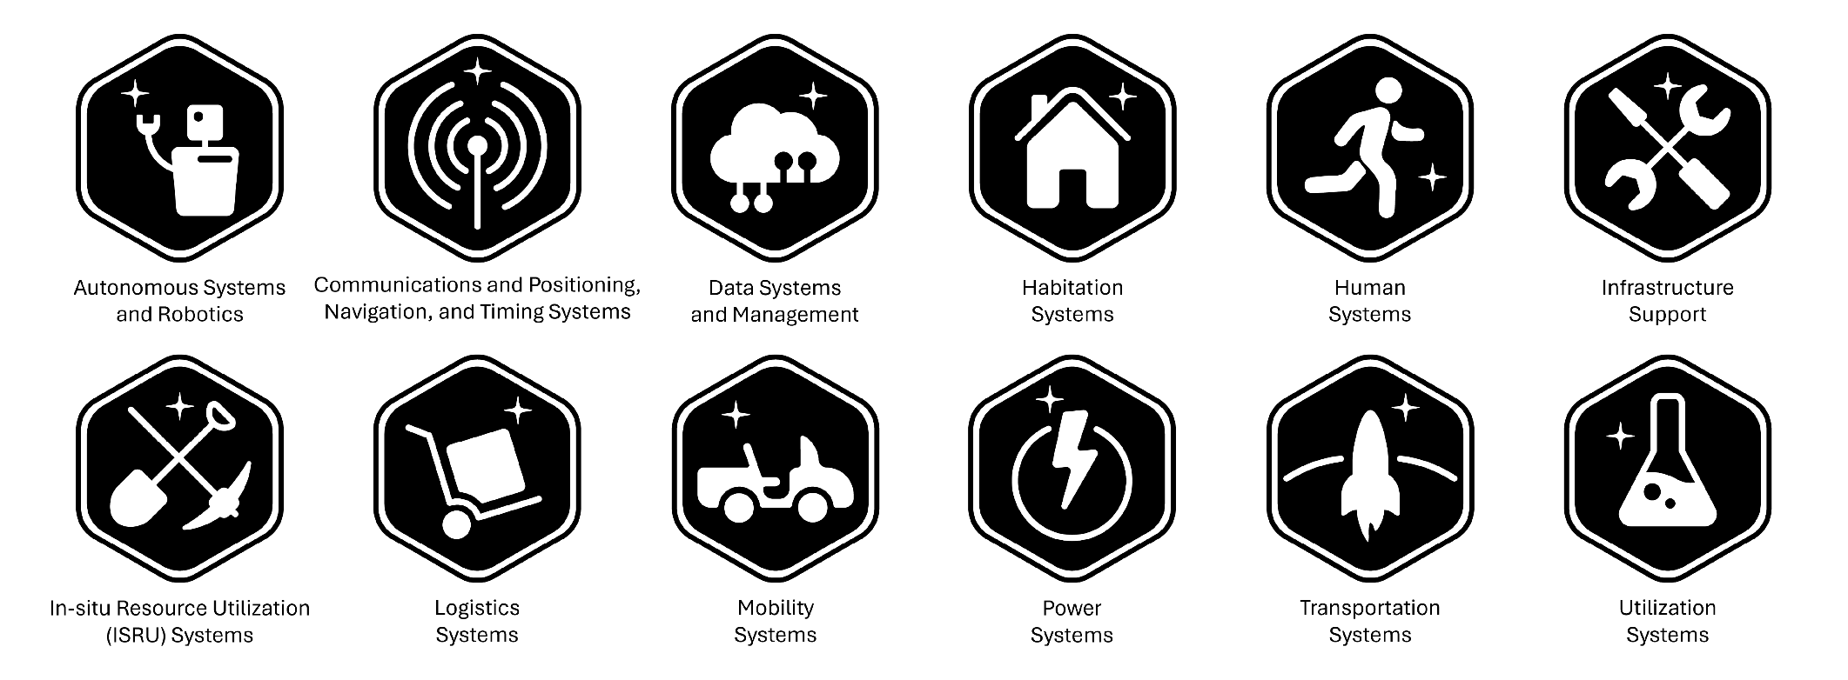
Moon to Mars Sub Architectures

Slide 25
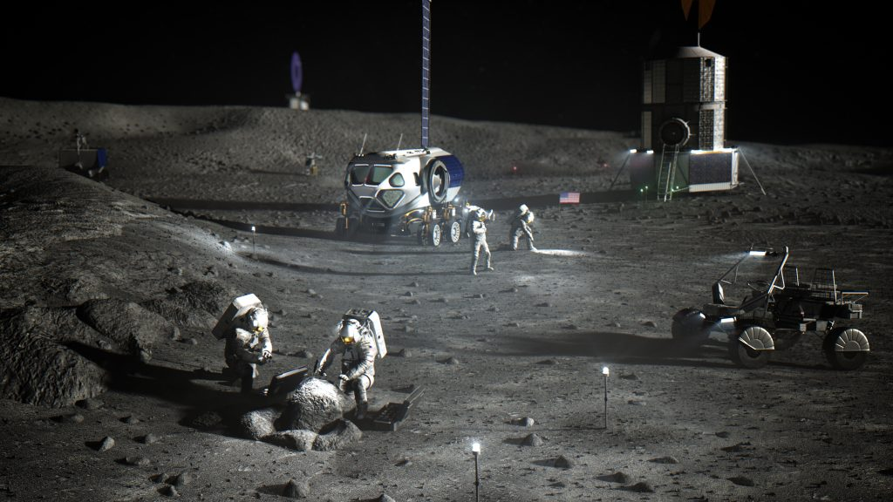
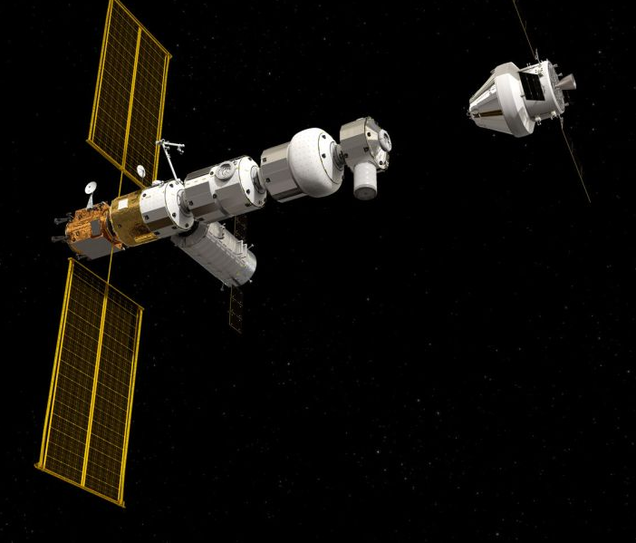
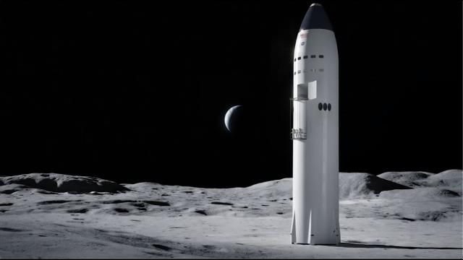
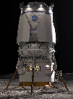
Artemis crews and autonomous systems will work in tandem to operate multiple Lunar surface elements on a single mission with each element designed by a different company or country with unique architectures, hardware, and interfaces.
Orion
Communication, Navigation & Timing
Gateway
ISRU, science experiments, payloads, lunar infrastructure, etc.
Human Landing System
Foundation Surface Habitat
Habitable Mobility Platform
Lunar Terrain Vehicle
Spacesuits & Tools
Near-term (Early Ops, Art II – IV)
Mid-term (Rovers, Art V – VII)
Long-term (Base Camp, Hab, Art VIII+)
[] LuCCI - NTRS
Notes:
Add reference

