Slide 1

MAESTRO: Airborne ML Estimates for Local Winds and Kinematics
and
Variable Geometry Aircraft Wing Supported by Struts and/or Trusses
NASA Ames Innovative Technologies Webinar (combined presentation)
John Melton, PhD
Aerospace Engineer
NASA Ames Research Center
04/30/23

Slide 2
MAESTRO: Airborne ML Estimates for Local Winds and Kinematics
NASA Ames Innovative Technologies Webinar
John Melton, PhD
Aerospace Engineer
NASA Ames Research Center
04/30/23

Slide 3

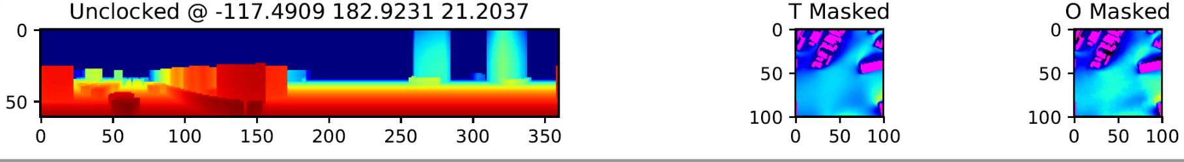
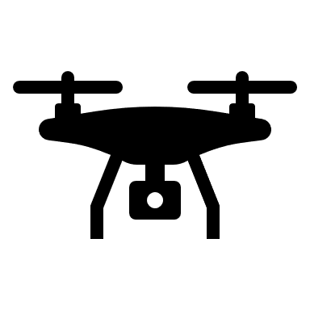


Airborne ML Estimates for Local Winds and Kinematics
Technology Overview/Why it was created
Urban UAS flight operations are complex
Urban winds influenced by building shapes
Cities are dynamic, and most city models are inaccurate
GPS/GNSS faces shadow and spoofing challenges
SWAP concerns limit airborne compute and sensor suit
MAESTRO: MAchine Learning ESTimates for URban Operations
Local “Depth” Scan
Urban UAS
Wind Field Estimate
Neural Network
Pilot / Path Planner / Autopilot
Applications
GPS/GNSS-free navigation
Air taxi operations at or below building height
Precision airdrop in urban areas
Shipboard UAS operations
UAS flight operations in complex terrains or cityscapes
Benefits
Realtime estimates of the surrounding wind field (not just at the aircraft position) improve collision avoidance, promote reduced energy path planning, and improve passenger comfort during urban operations
Provides accurate onboard positioning and kinematics backup estimates whenever GPS/GNSS is unavailable or unreliable

Slide 4
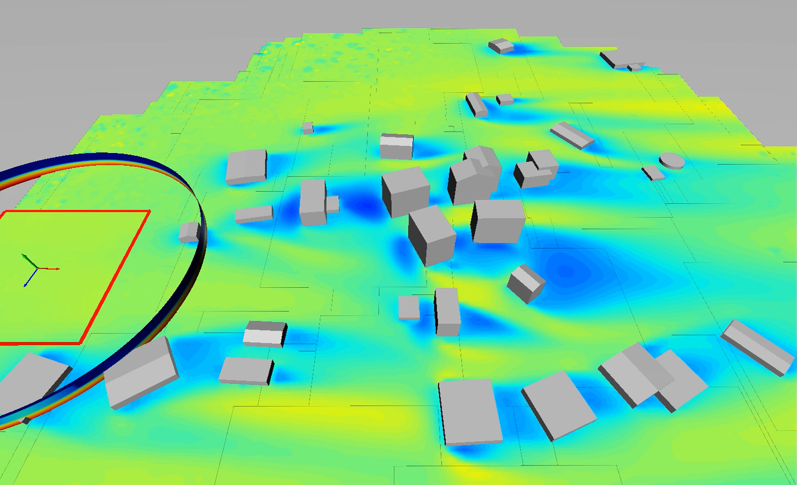
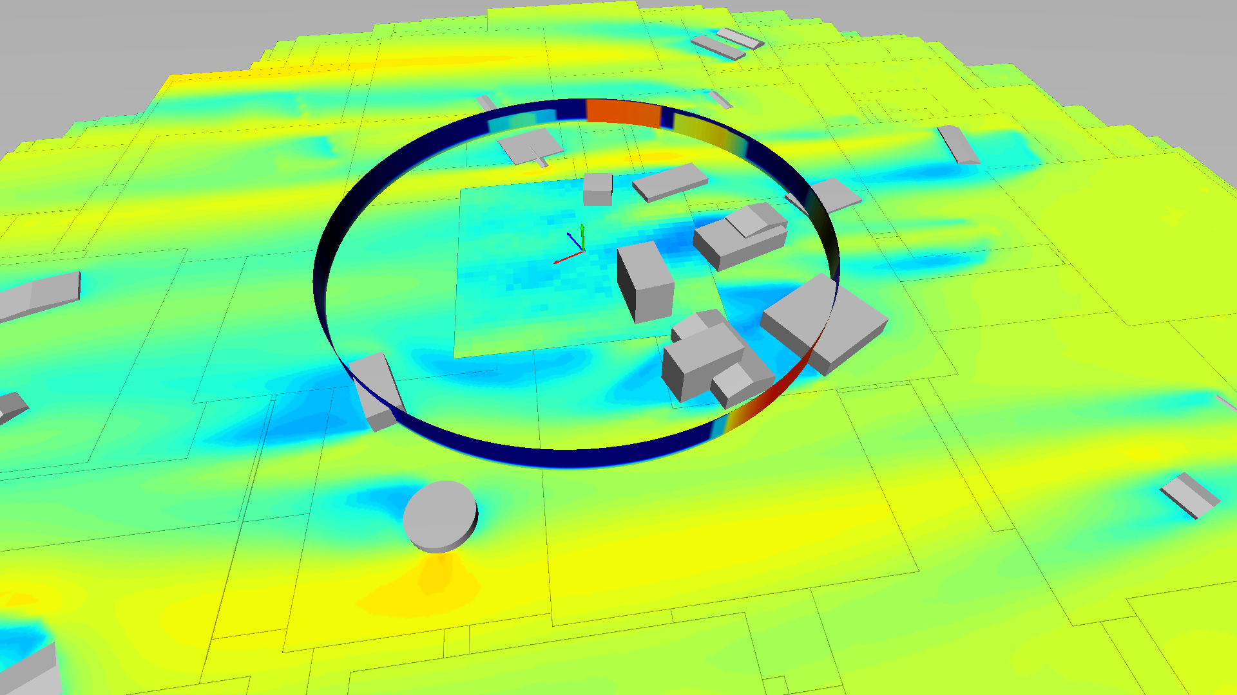
MAESTRO Synthetic Prototype
UAS with LiDAR
(at center of slice)
Cylinder at LiDAR sensing radius colored by distance to solid surface (NN input)
MAESTRO flow estimate (NN output)
Flow slices from CFD
(at or below UAS altitude)
Single neural network using CFD simulations for 8 randomized cities
Average time for each NN evaluation using desktop GPU: 0.08 secs

Slide 5
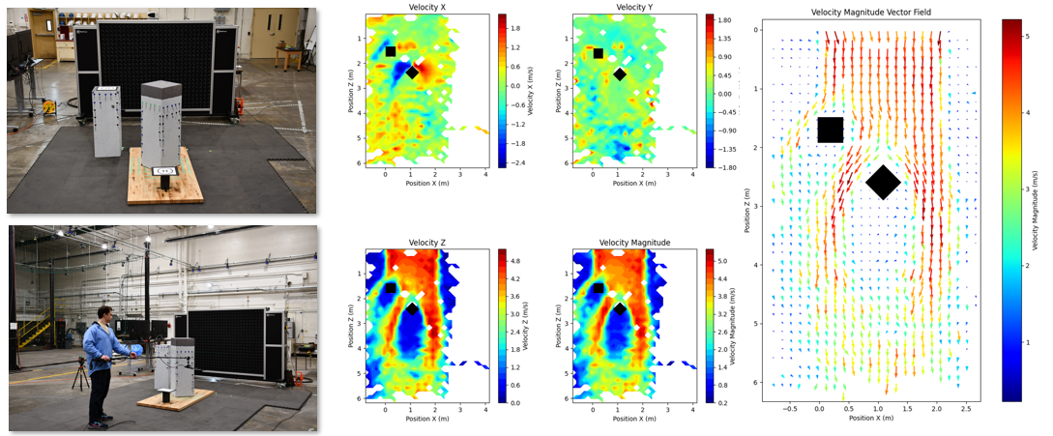

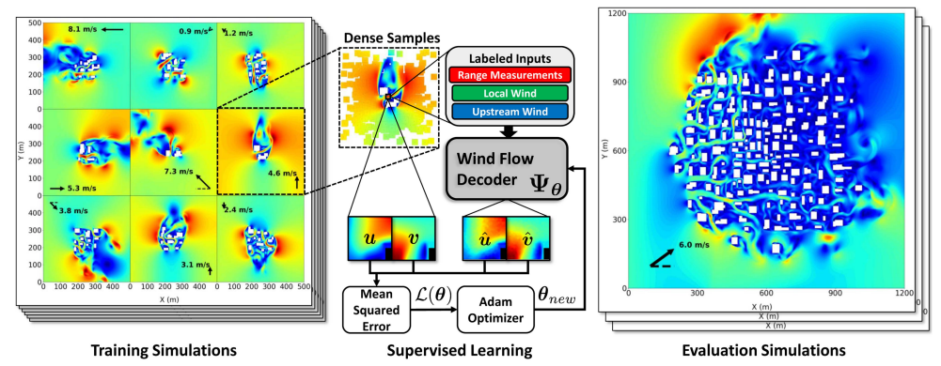
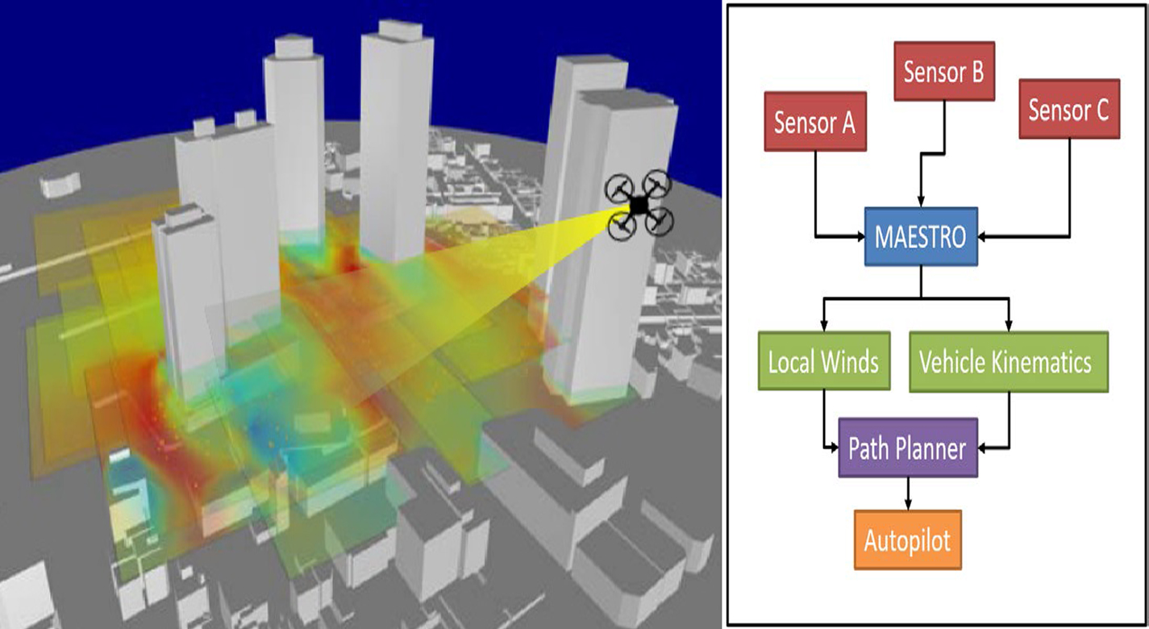
MAESTRO Papers and Patent
Towards Safe and Energy-Efficient Real-Time Motion Planning in Windy Urban Environments
Spencer Folk, John Melton, Benjamin W. L. Margolis, Mark Yim, and Vijay Kumar
IEEE International Conference on Robotics and Automation (ICRA), 2025
Learning Local Urban Wind Flow Fields From Range Sensing
Spencer Folk, John Melton, Benjamin W. L. Margolis, Mark Yim, and Vijay Kumar
IEEE Robotics and Automation Letters, 2024
Intelligent Trajectory Adviser System for Unmanned Aerial Vehicles in Complex Environments
Inventors: John Melton, Ben Nikaido
U.S. Patent No. 11,046,430

Slide 6
Variable Geometry Aircraft Wing Supported by Struts and/or Trusses
NASA Ames Innovative Technologies Webinar
John Melton, PhD
Aerospace Engineer
NASA Ames Research Center
04/30/23

Slide 7
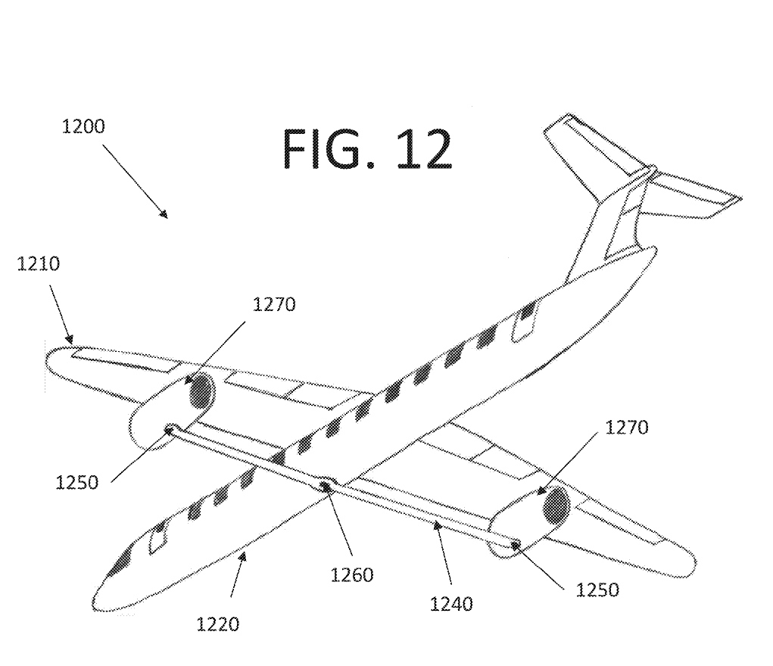
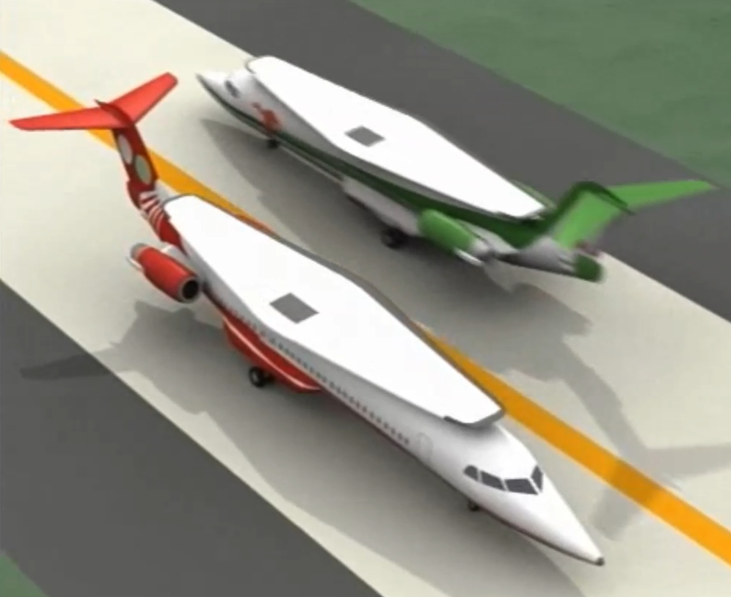
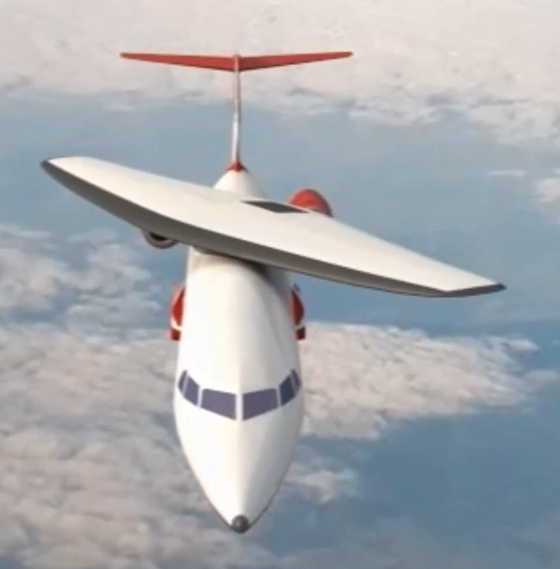
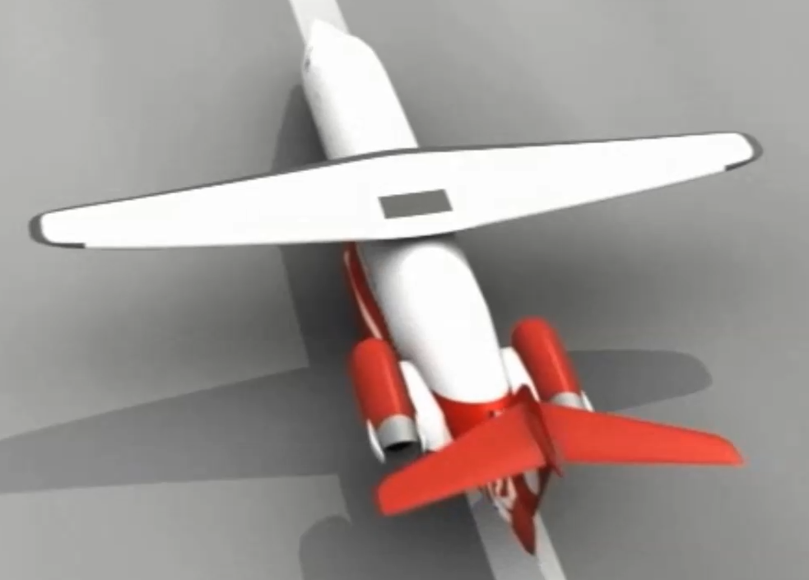
Variable Geometry Aircraft Wing with Strut
Technology Overview/Why it was created
Reduce airport and gate ‘footprint’ for B737-class aircraft
Improve aerodynamic efficiency over the entire flight envelope
Reduce landing speeds, eliminate complex multi-seg flaps
Improve climb rate while reducing thrust (and noise)
Reduce ground and taxiway collisions
Provide dual use for strut (structure and engine alignment)
Improve performance and market ‘right-sizing’ while retaining current construction techniques and materials
Taxi Cruise
Takeoff/Climb/Landing
Applications
B737 and smaller (ATR-class) aircraft
Longer range UAS requiring airborne ferry and/or ship deployment
Efficient transonic operations (Mach 0.8 to 1.3)
Bring larger aircraft into less-developed airports
RCS signature modulation and manipulation
Benefits
Fit more aircraft onto existing airport real estate
Modulate the sweep for best M*L/D throughout the entire flight
Improve fuel economy during ATM arrival spacing delays
Reduced community noise, improved emergency range
Eliminates weight of outer wing folds and complex flap systems
Retains economies of ‘tube-and-wing’ construction and operations for both airframers and airlines

Slide 8
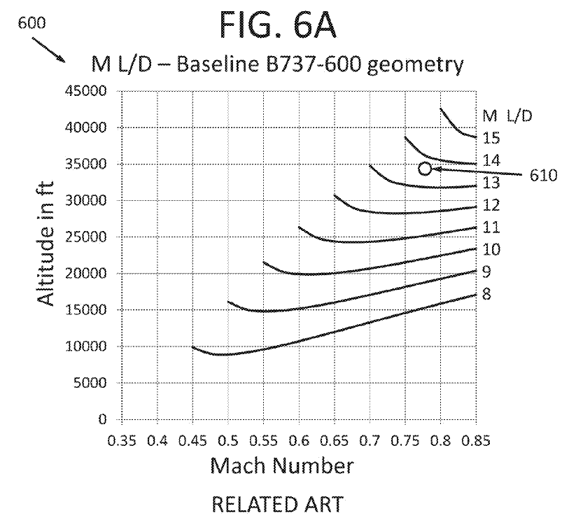
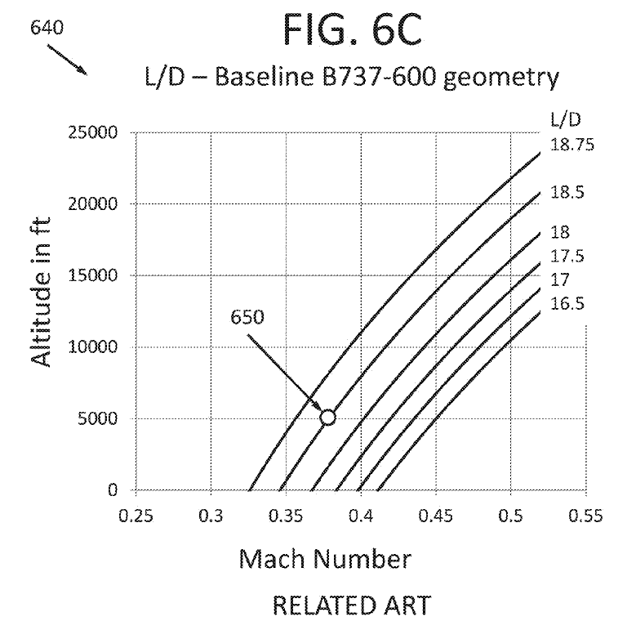
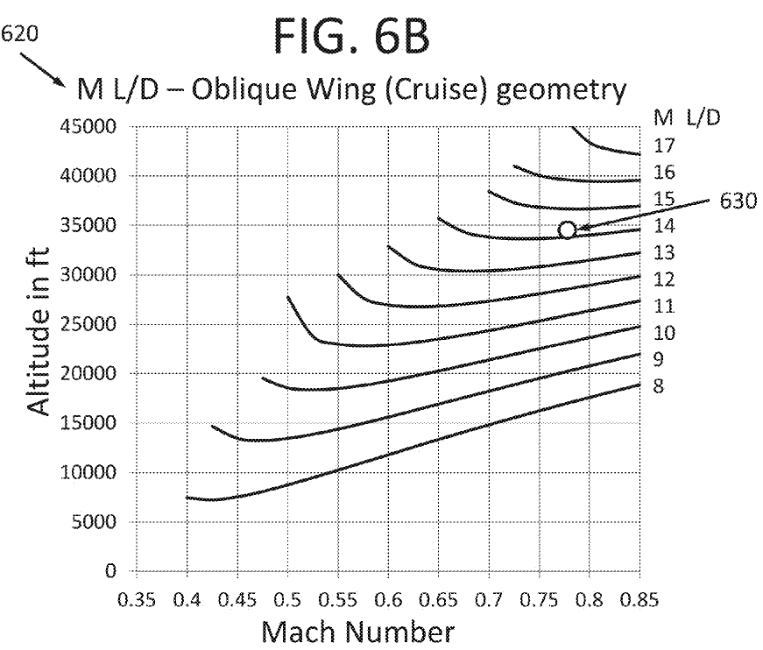
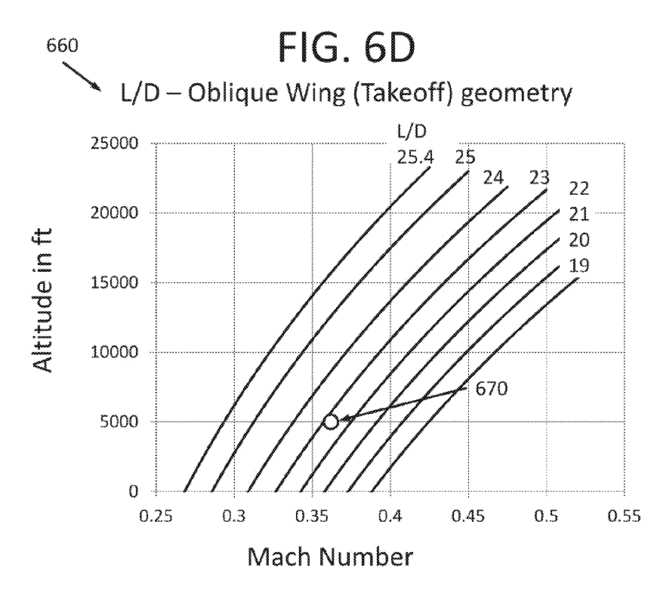
Variable Geometry Strut Patent
Cruise Takeoff and Landing
Variable Geometry Aircraft Wing Supported by Struts and/or Trusses
Inventors: John Melton, Michael Dudley
U.S. Patent No. 9,327,822
B737-600
VGA
Variable Geometry Aircraft (VGA) shows
aerodynamic advantage throughout entire flight

