Slide 1
Modular Assembled Radiators for NEP VehicLes (MARVL) Project - Update
Amanda Stark and Will Grier
Langley Research Center
Nuclear and Emerging Technology for Space (NETS) Conference
Huntsville, AL
May 6, 2025
47020_Stark_NETS2025
Notes:
Project goals
Why iSA
Three possible options downselected to two
Radiator design space
Modular unit options
Fluid loop routing
Next steps
end

Slide 2
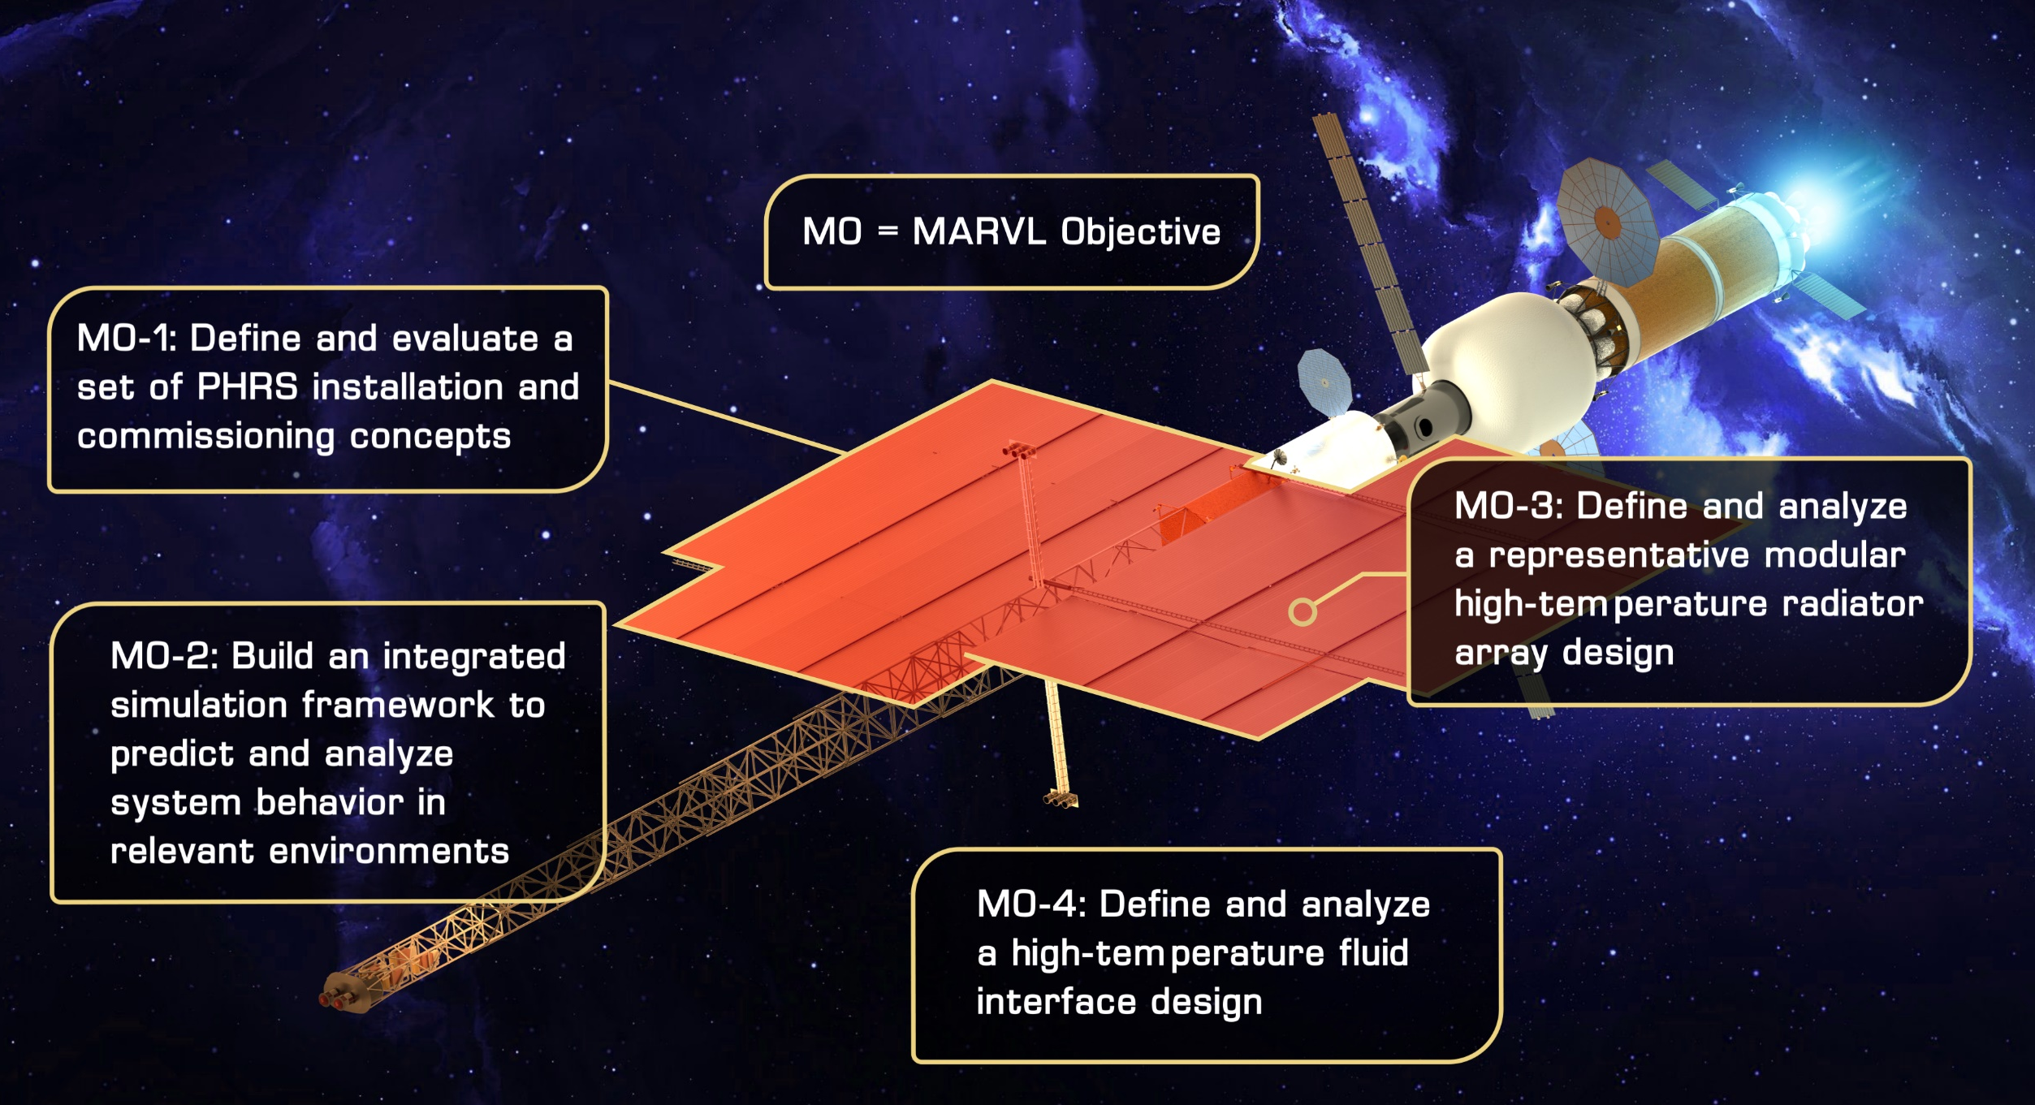
Project Goal and Objectives
Goal: Design and analyze a lightweight Primary Heat Rejection Subsystem (PHRS) targeting a Nuclear Electric Propulsion (NEP) capability.

Slide 3
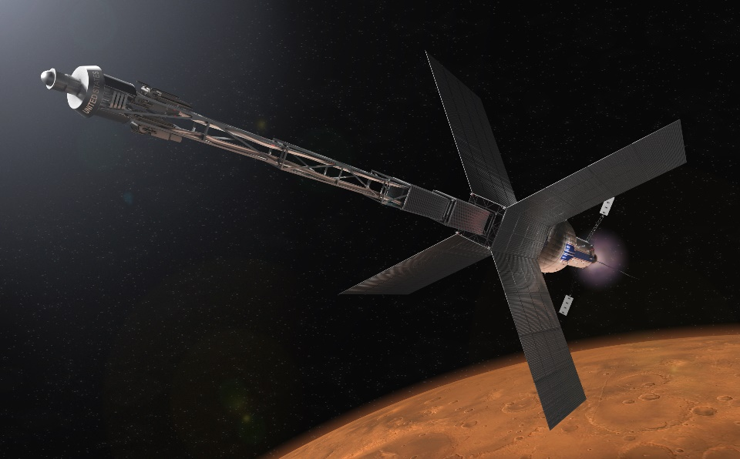
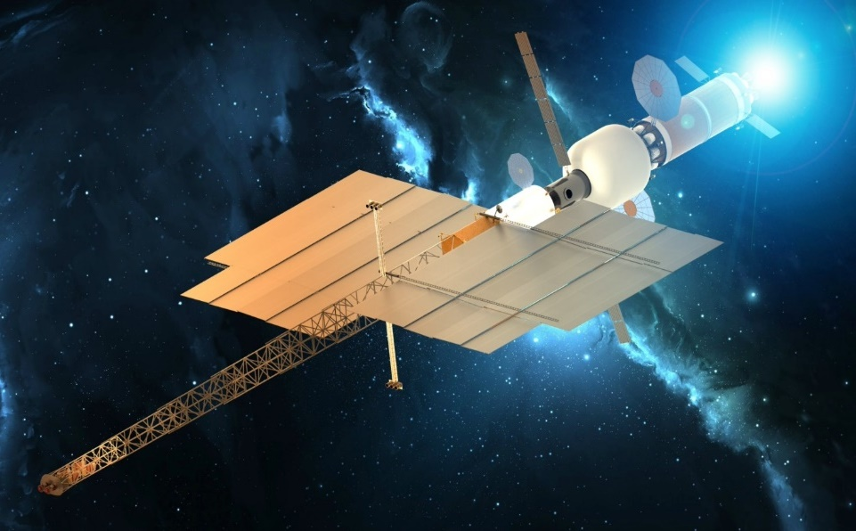
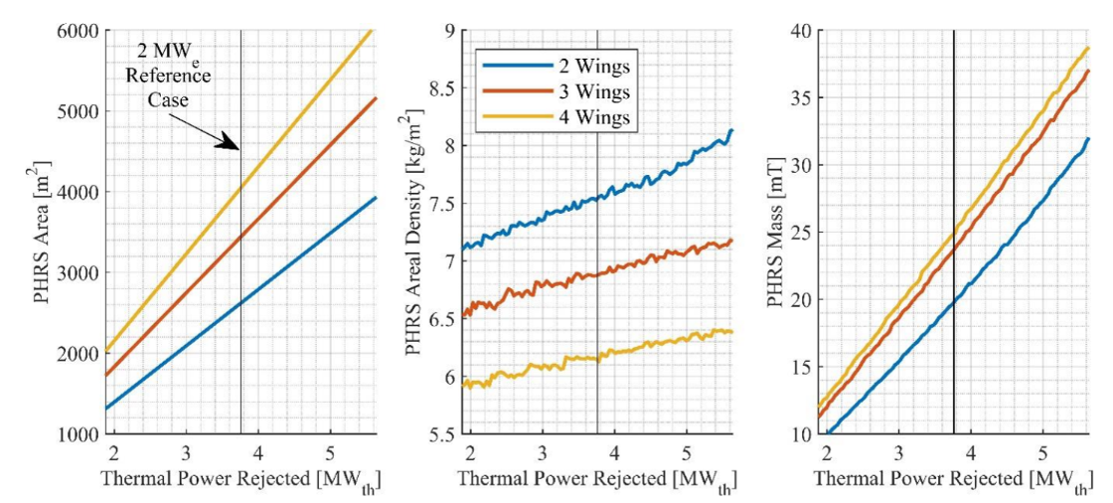
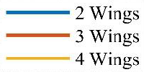
Incorporating in-Space Assembly
NEP Quad-Wing
NEP Bi-Wing
Vehicle | Vehicle Length | Radiator Area
NEP | ~100 to 150 m | ~3000 m²
MARVL
2 MWe
Reference Case
Flight orientation results in view factor losses which increases mass
~25% decrease in radiator mass due to reduced area from flying edge onto Sun.
Use of in-Space Assembly (iSA) in designing NEP modular radiators has the potential to improve overall vehicle performance while reducing mass, schedule, cost, and risk.
Enables (1) mass-efficient bi-wing design, (2) architectural flexibility, and (3) use of commercial launch vehicles
MARVL will investigate the current large radiator concepts while incorporating iSA for the PHRS in direct alignment with the TMP for NEP

Slide 4
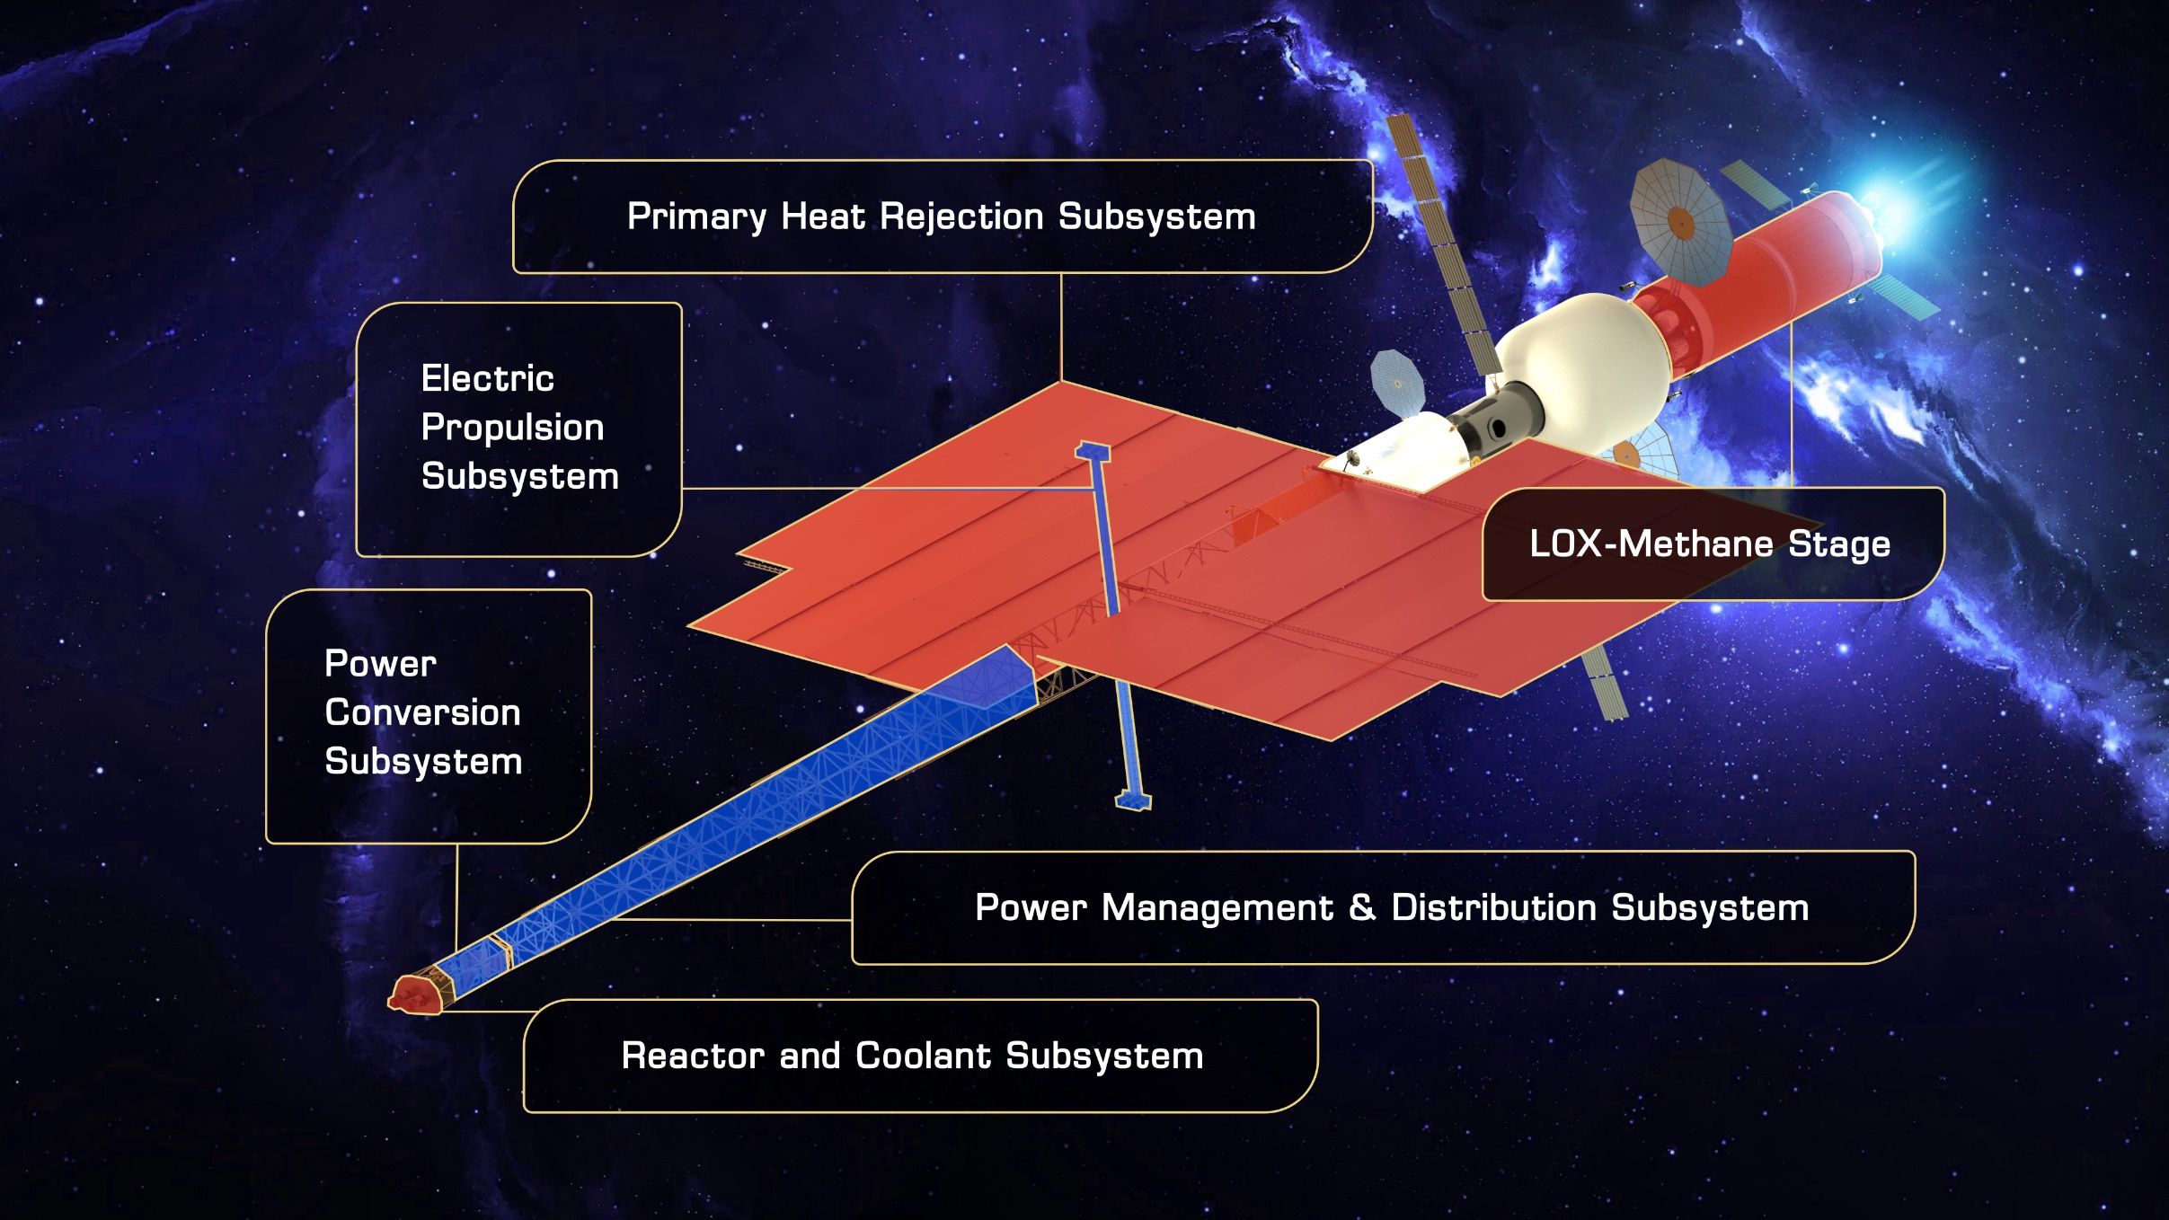
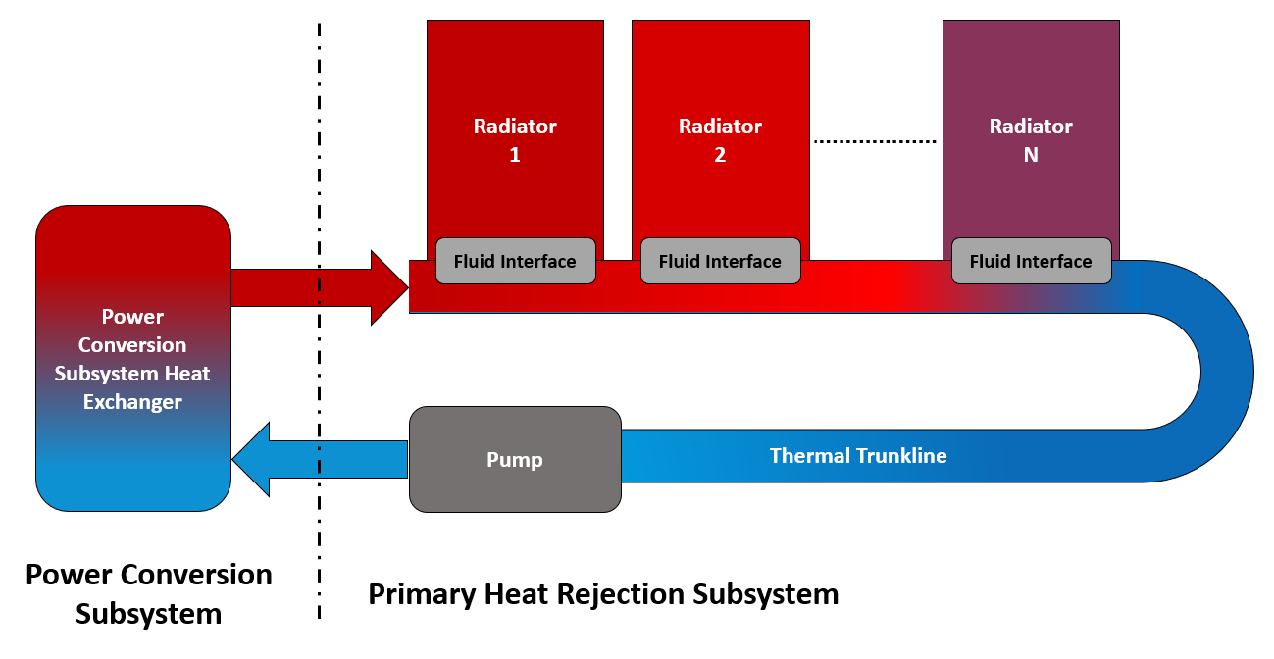
Primary Heat Rejection Subsystem
NEP contains five Critical Technology Elements (CTEs); significant uncertainty exists regarding each element’s contribution to overall system mass
The Primary Heat Rejection Subsystem (PHRS) is the largest and most massive NEP element due to the large amount of reactor waste heat:
  Radiative surface area greater than 3,000 m² (over half a football field)
  Constitutes 40% to 60% of the total NEP dry mass
Three key PHRS functions; (1) accept waste heat, (2) transport waste heat, and (3) radiatively reject waste heat to space
MARVL System of Interest (SoI): Fluid Trunkline, fluid interfaces between Trunkline and radiators panels, Radiator Panels
MARVL System of Interest

Slide 5
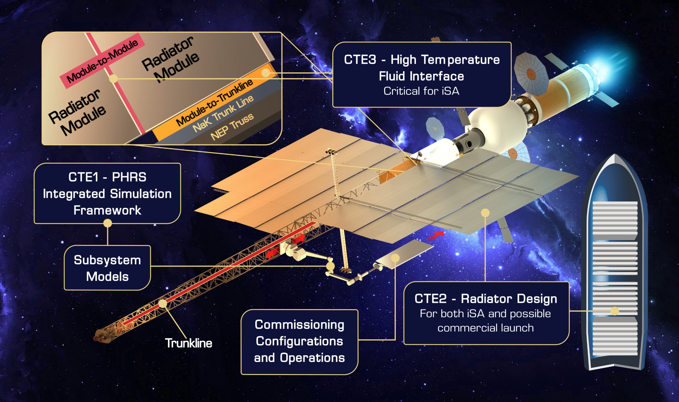
MARVL Critical Technical Elements

Slide 6
Design Space for the Required Radiator Area
Reactor shield cone angle/shape
  Drives mass of PHRS
  Provides the design area for the radiators, habitat/cargo hold, chem-stage, and other NEP vehicle elements
10 meters from the back side of the shield is where the radiator panels will start
  Takes into account the decrease in leaked nuclear radiation from the reactor
Will setup design space for the modular radiator units.
50° Area
40° Area
30° Area
20° Area
10 meters from Radiation shield
Reactor
Radiation Shield Angle options with Design Area Indicated

Slide 7
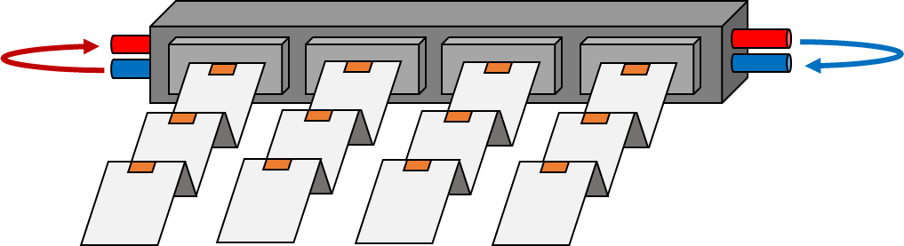
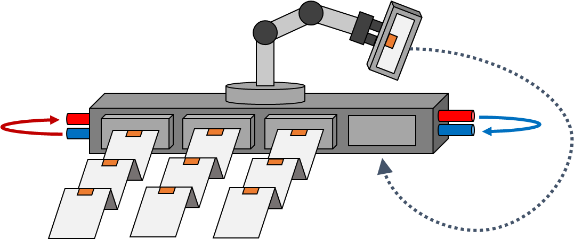
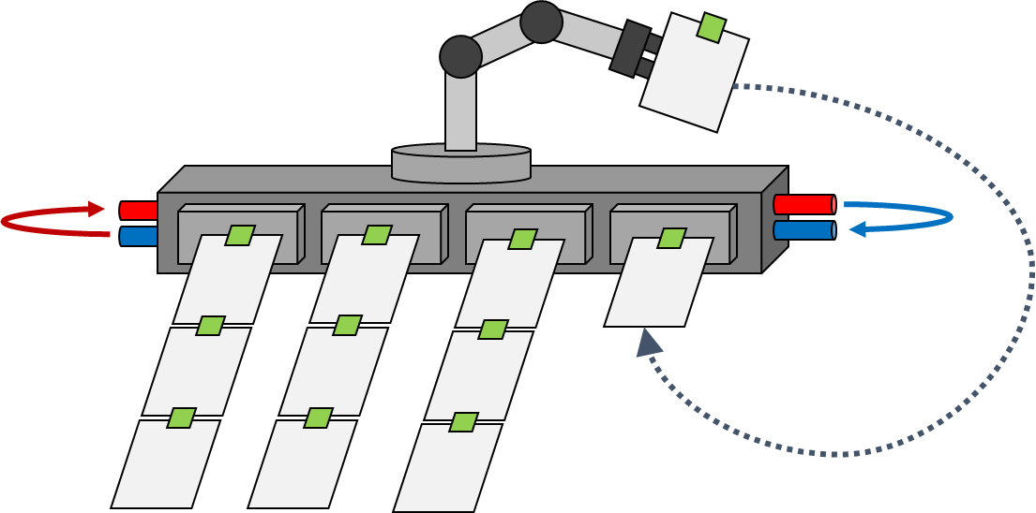
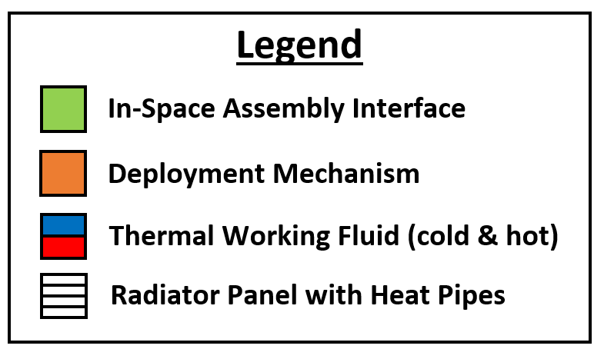
Three Potential Configurations
Full Deployment
Hybrid
Full Assembly
Trade Study Criteria:
Trade Study Criteria:
Trade Study Criteria:
ISS heritage mechanisms assumed
Single-launch
Enough volume on New Glenn, Starship, or SLS Cargo fairing with >>30% margin
Interface areal mass is an approximation
ISS heritage mechanisms assumed
One large, fixed robotic arm (most conservative curve fit based on ISAM State of Play)
Multi-launch
Interface areal mass is an approximation
One large, fixed robotic arm (most conservative curve fit based on ISAM State of Play)
Multi-launch
ISAM = In Space Assembly and Manufacturing ISS = International Space Station

Slide 8
Three Potential Configurations
Full Deployment
Hybrid
Full Assembly
Trade Study Criteria:
Trade Study Criteria:
Trade Study Criteria:
ISS heritage mechanisms assumed
Single-launch
Enough volume on New Glenn, Starship, or SLS Cargo fairing with >>30% margin
Interface areal mass is an approximation
ISS heritage mechanisms assumed
One large, fixed robotic arm (most conservative curve fit based on ISAM State of Play)
Multi-launch
Interface areal mass is an approximation
One large, fixed robotic arm (most conservative curve fit based on ISAM State of Play)
Multi-launch
ISAM = In Space Assembly and Manufacturing ISS = International Space Station

Slide 9

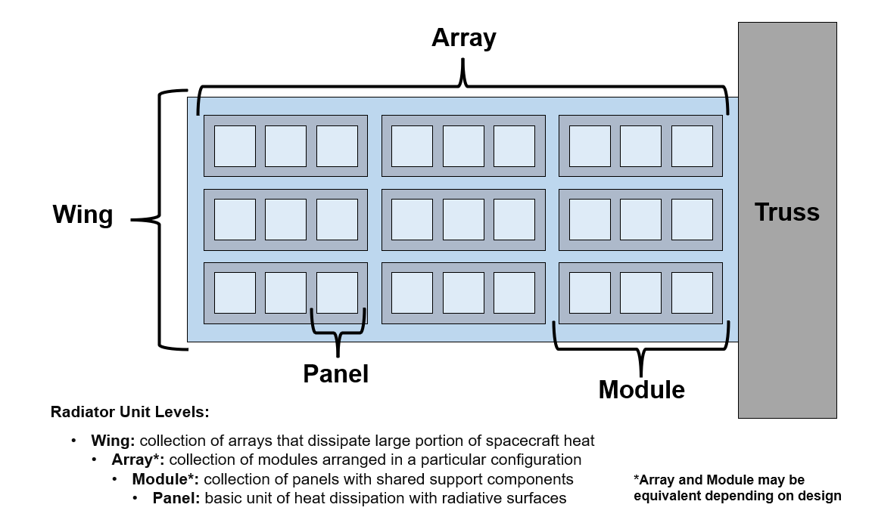
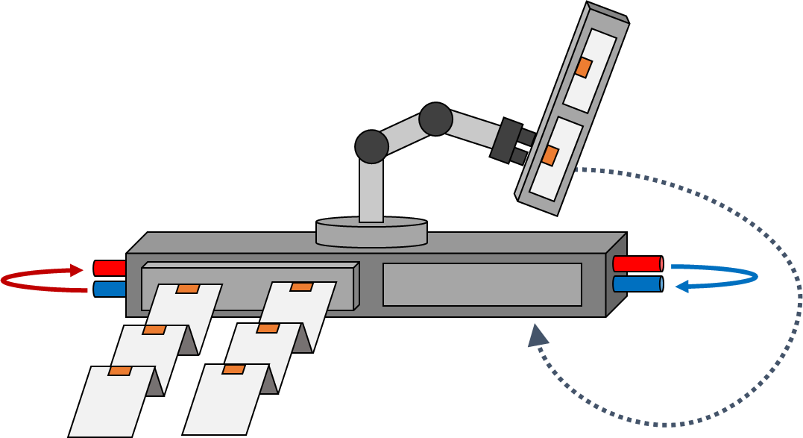
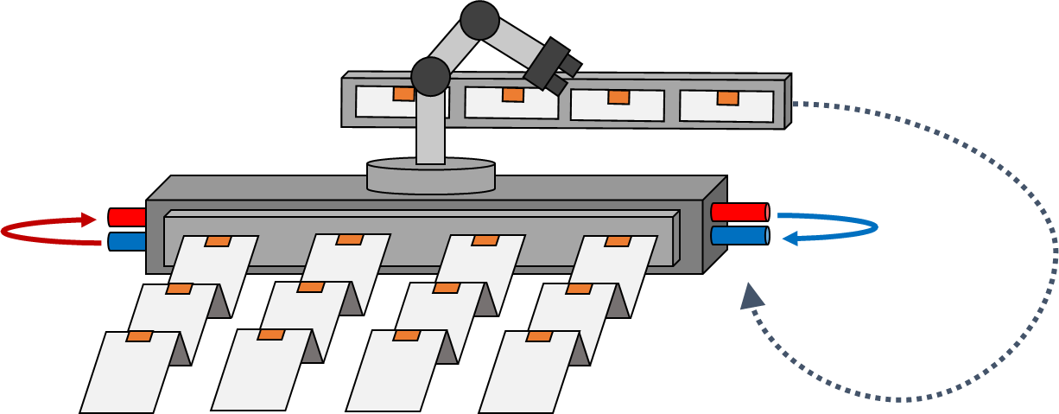
iSA Radiator Modular Units
Potential in-Space Assembly Considerations
In-Space Assembly opens the design space to consider what a modular unit could be
Radiator Panel
Radiator Module
Legend
In-Space Assembly Interface
Deployment Mechanism
Thermal Working Fluid (cold/hot)
Radiator Wing
Radiator Panel with Heat Pipes
Radiator Array
Radiator “Wing” Terminology for MARVL

Slide 10
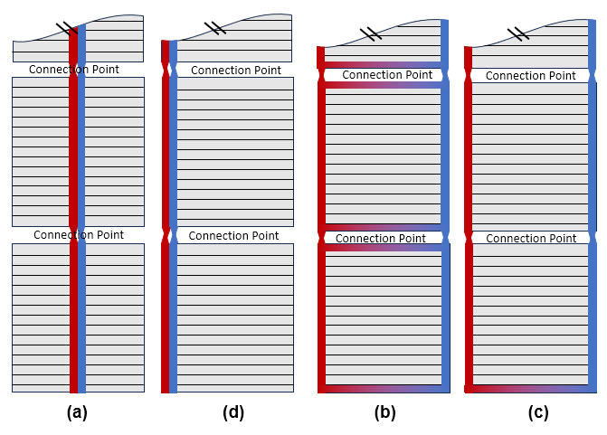
Fluid Loop for Waste Heat Transfer
Fluid Loop Path Options
Down center panel, split heat pipes
One side of panel, full length heat pipes
Hot and cold on opposite sides with connections on ends
Hot and cold on opposite sides
Current radiator panel design will use heat pipes
  Water as the working fluid
  Tech dev for panels in not in current project scope
Fluid loop working fluid will be NaK
  Consideration for how fluid loop interacts with heat pipes is being considered
    Overall design (hybrid/full assembled) will help make the decision

Slide 11
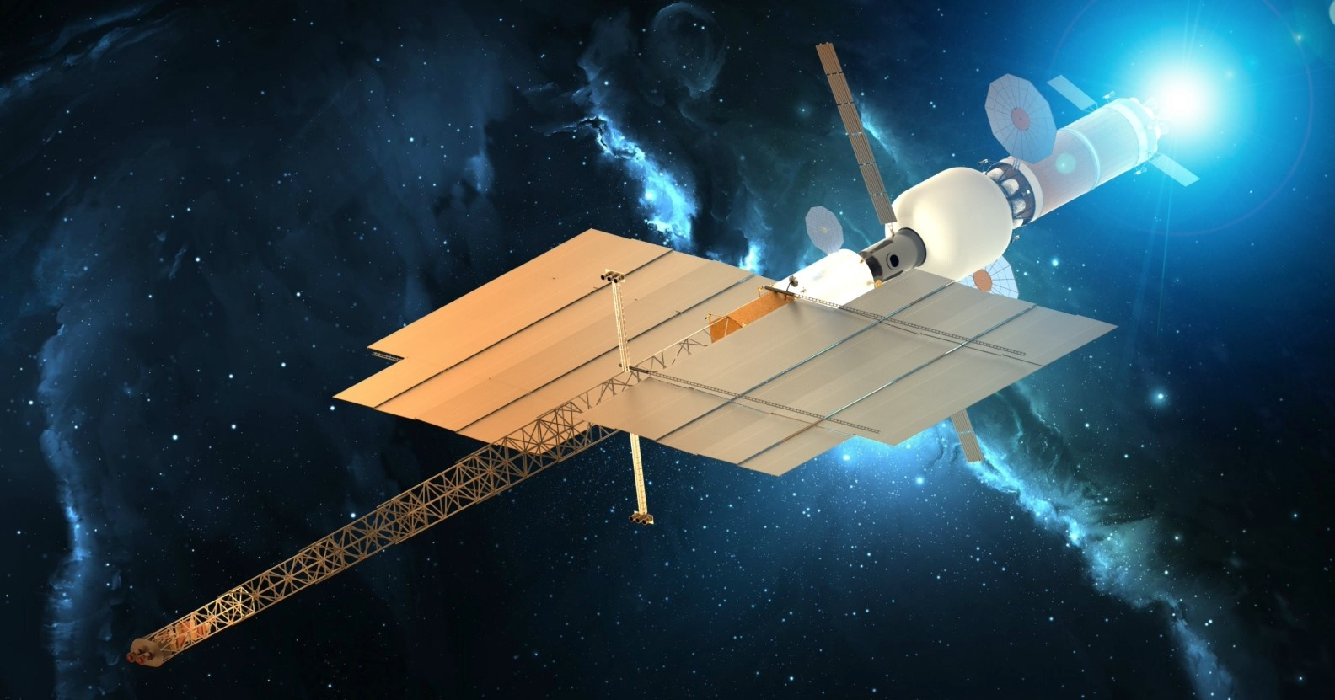

MARVL
Modular Assembled Radiators for NEP VehicLes
PI: Amanda Stark
amanda.stark@nasa.gov

