Slide 1
Digital Image Correlation Applications at NASA Langley Research Center (1990 to 2025)
David S. Dawicke
Analytical Services and Materials, inc.
May 7, 2025
Workshop on Novel and Emerging Uses of Sensor Technology in Mechanical, Fatigue, and Fracture Testing

Slide 2
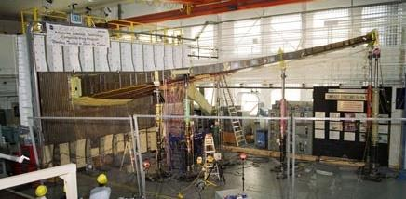
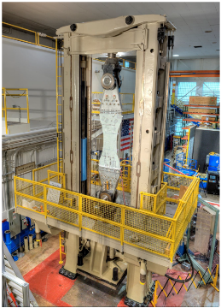
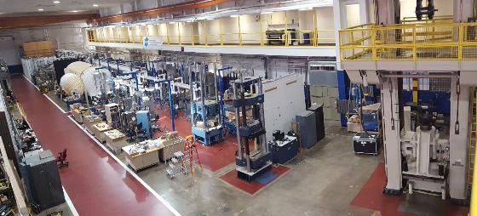
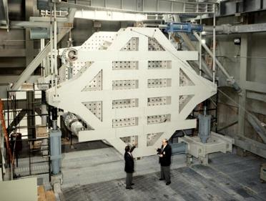
NASA LaRC James H. Starnes Structures Lab, B1148
Load Frame Test Machines
Focus on large static and combined load tests
~ 40 Load Frames: 5,000 lbs. to 1,000,000 lbs.
Environmental chambers: −320 to 600°F
Combined Loads Test System (COLTS)
  Combined pressure, axial, torsion, shear loading
  Test articles as large as 15 by 40 ft.
Backstop
1M lbs. Load Frame
B1148
COLTS

Slide 3
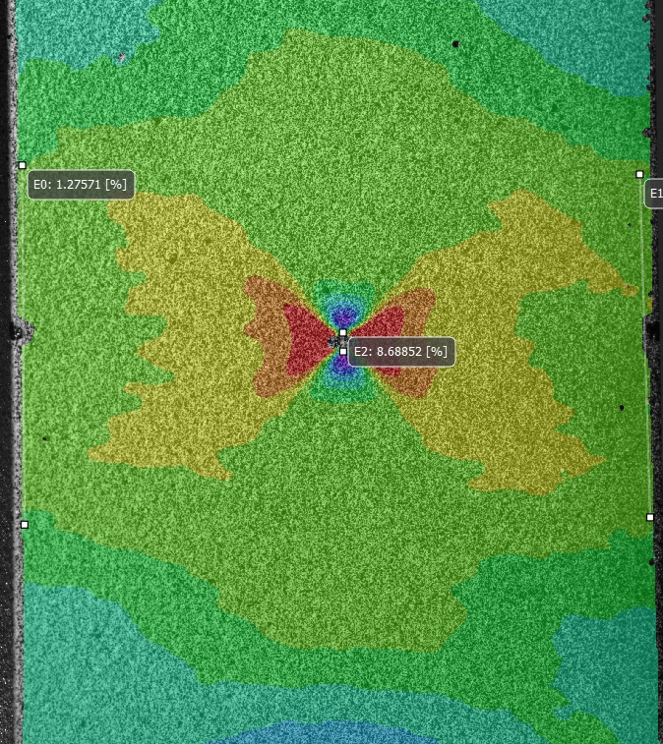
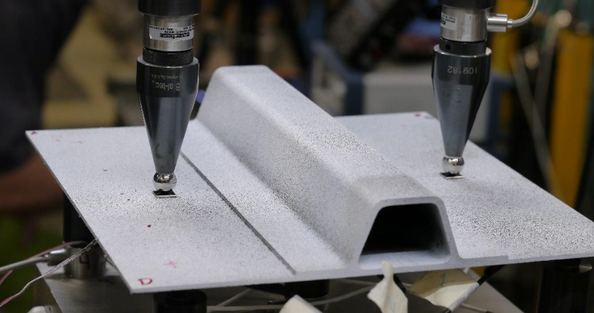
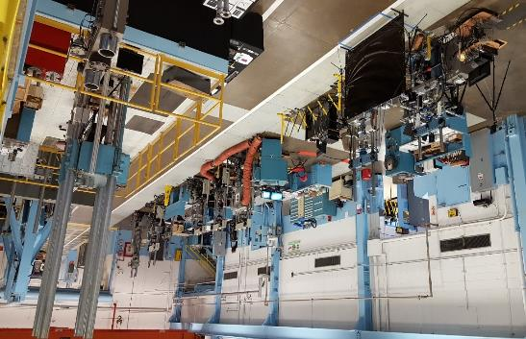
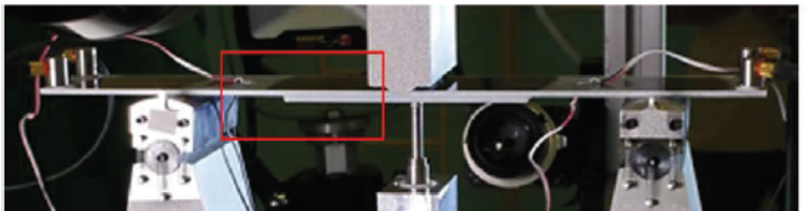
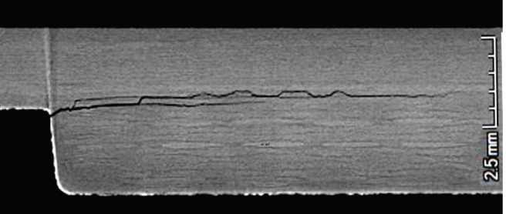
NASA LaRC Fatigue and Fracture Lab, B1205
Load Frame Test Machines
Focus on sub-component and material level tests
Environmental Chambers: −320 to 600°F
Load Frames: 5,000 to 400,000 lbs.
Cyclic and static loading
Fracture
Sub-component Level Testing
B1205
3-Point Bend Composite Fatigue Crack Growth

Slide 4
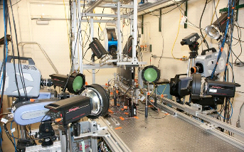
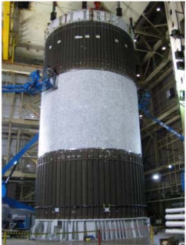
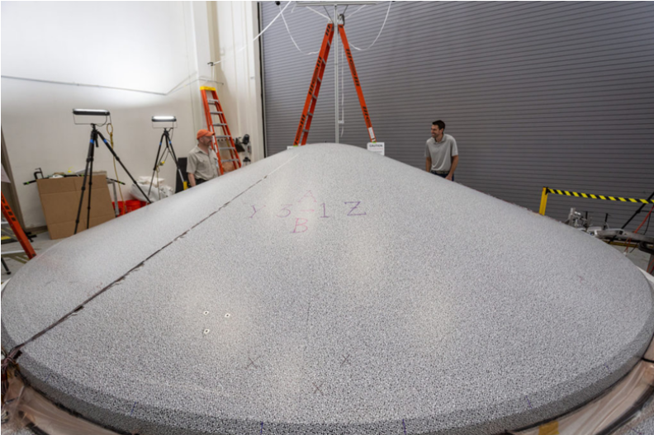
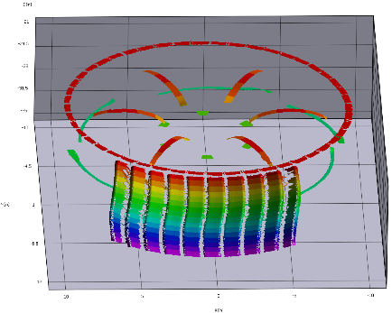
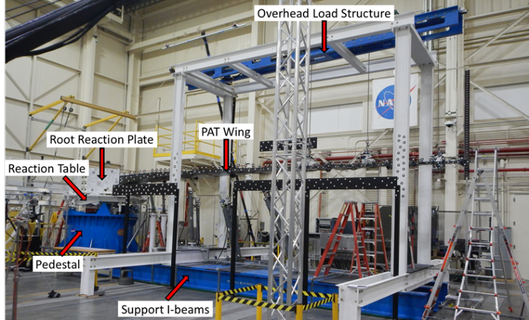
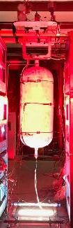
Other NASA and non-NASA Facilities Supported
NASA WSTF
NASA MSFC
Lockheed-Denver (NASA JPL)
-
-
Cimarron-Huntsville (NASA LaRC)
NASA AFRC
NASA JPL

Slide 5
LaRC B1148/B1205 DIC Team
Dave Dawicke 1993 (really 2004) to present
Patrick McNeill 2009 to 2012
Nate Gardner 2012 to 2021
Michael McNeill 2015 to present
Matlock Mennu 2021 to 2024
Jasmine Knowles 2024 to present
Many high school, undergraduate, and graduate student lab interns

Slide 6
1990’s – “What are all these dots for?”
  2D digital image correlation (DIC) for crack tip opening angle (CTOA)
  3D DIC for fracture of large panels

Slide 7
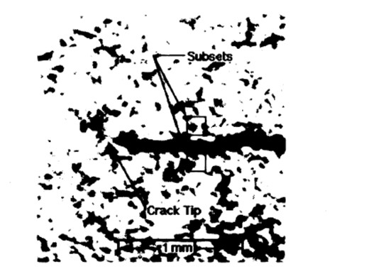
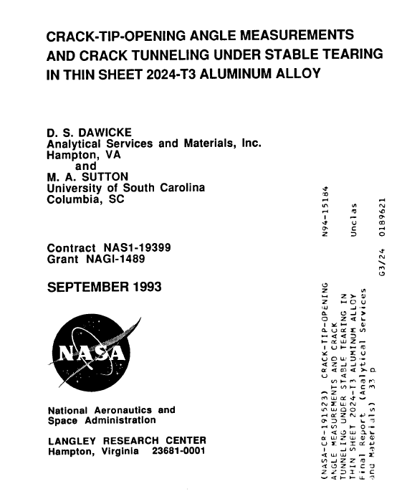
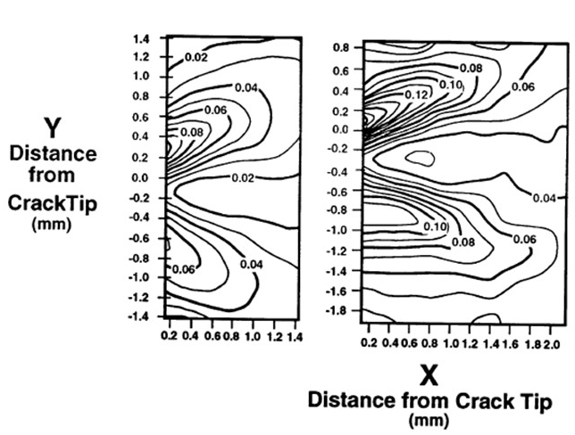
2D DIC for Measuring Crack Tip Opening Angle (1993)
Crack Tip Strain Fields
Δa = 0.80 mm
Δa = 2.55 mm

Slide 8
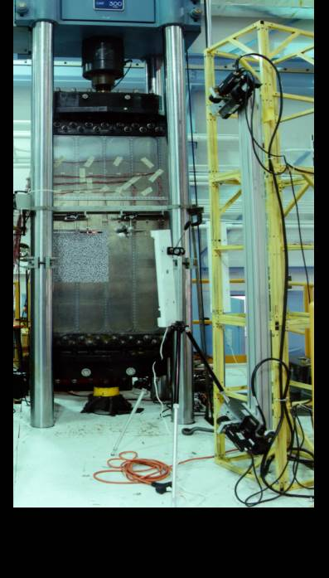
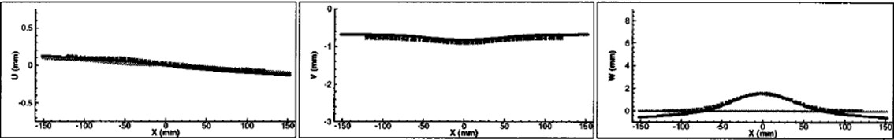
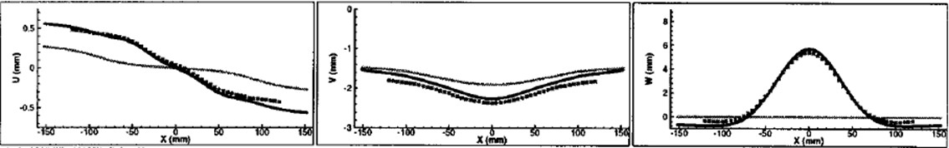
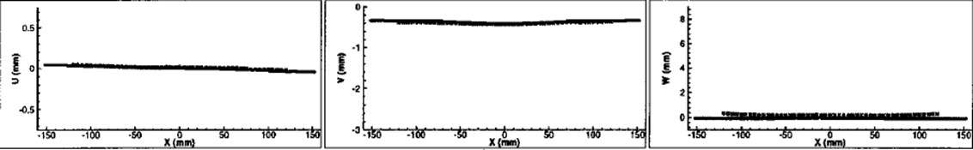
3D DIC for Structural Deformations and Strains (~1996)
J. D. Helm, M. A. Sutton, and S. R. McNeill
116 kN
58 kN
29 kN
y, v
x, u
u-Displacements
v-Displacements
w-Displacements
z, w
3D DIC Measurements
Finite Element Results

Slide 9
2000’s – Getting our Feet Wet
  Composite panel buckling and delamination
  Composite overwrapped pressure vessel (COPV) testing
  Large structure tests
  Cryogenic tests
  Test/model correlation
  Boundary conditions

Slide 10
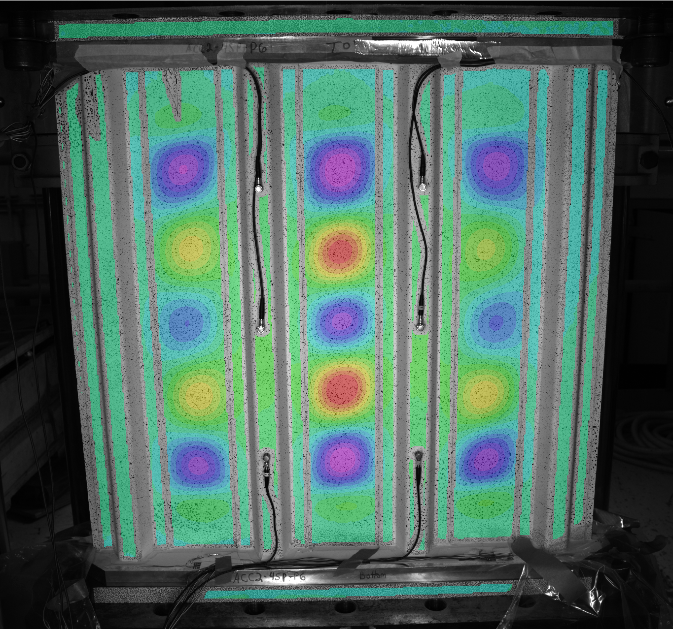
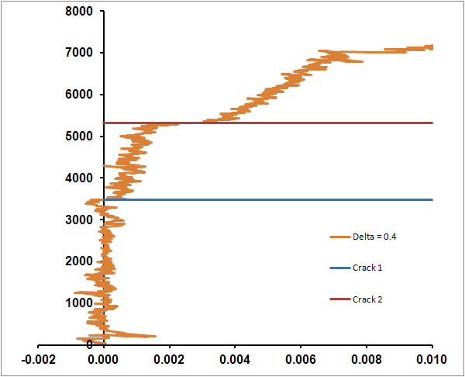
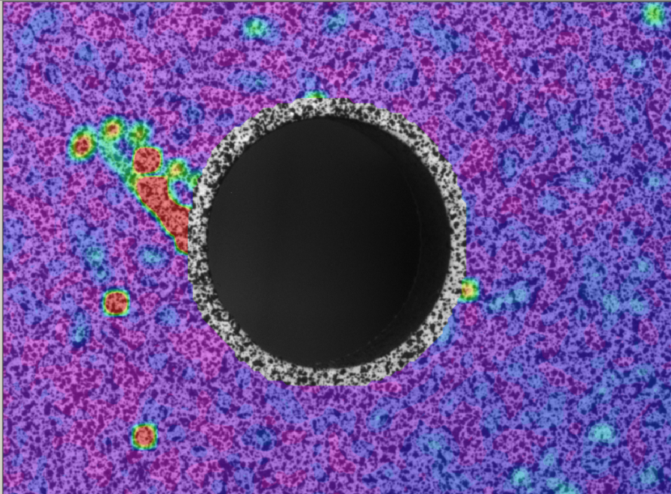
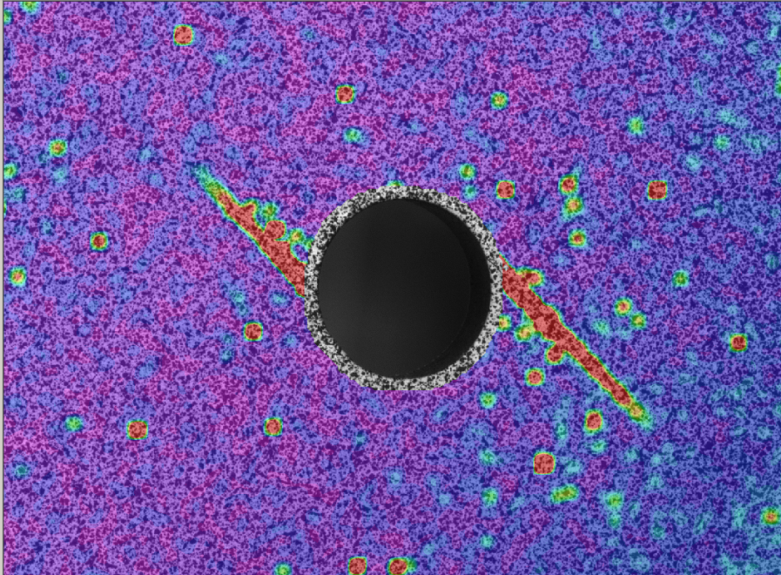
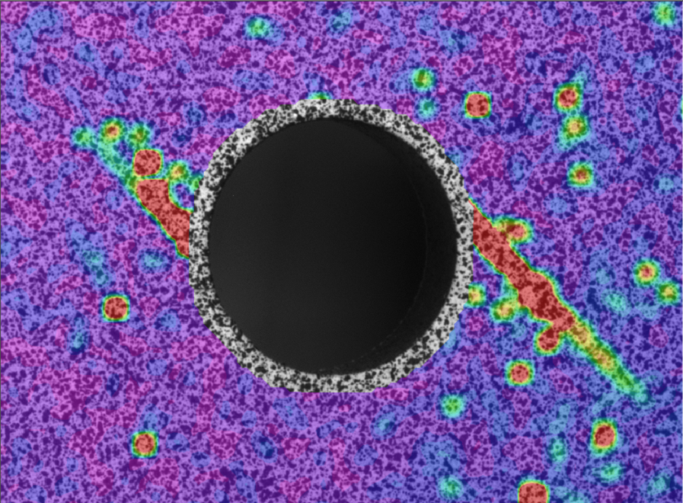
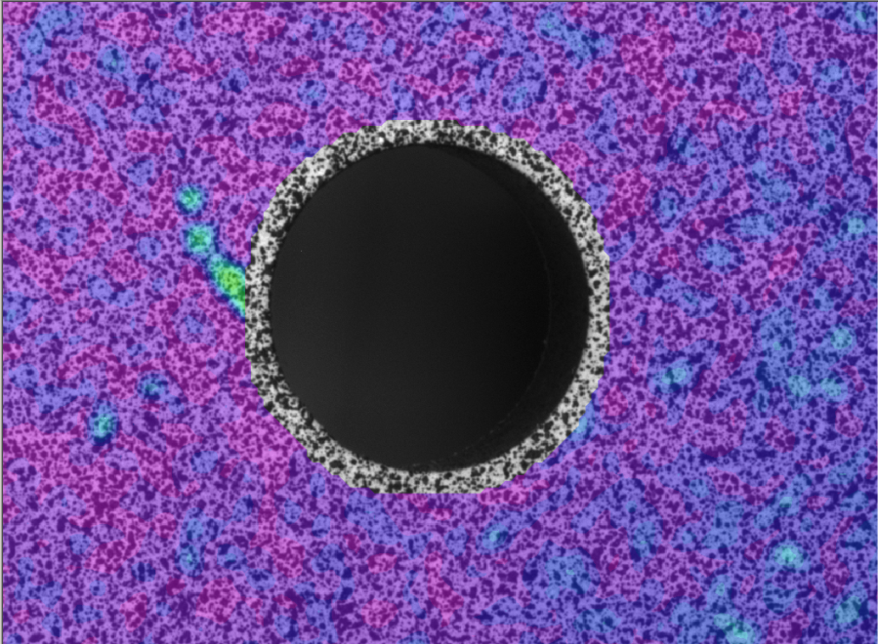
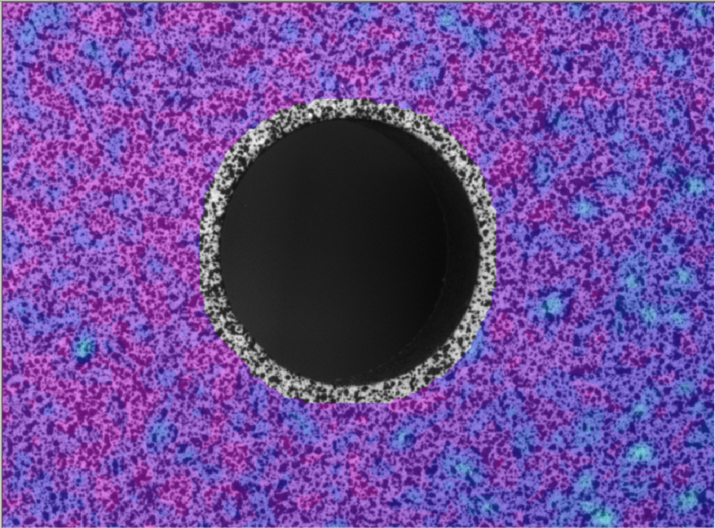
Composite Testing (2004 – 2008)
Frame 397
Frame 717
Frame 396
Frame 716
Load
(lbs)
0.4 inch
Δ
Load
Displacement
Δ v-Displacement at 0.4 inches
(inch)

Slide 11
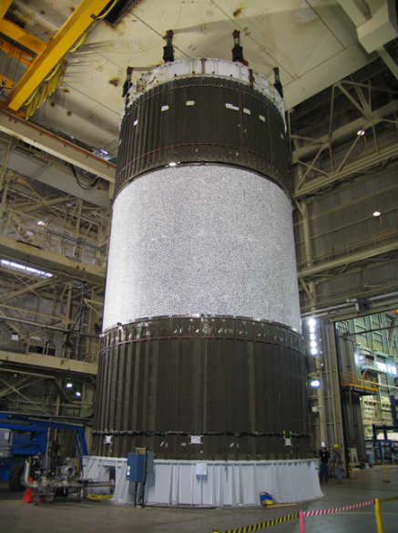
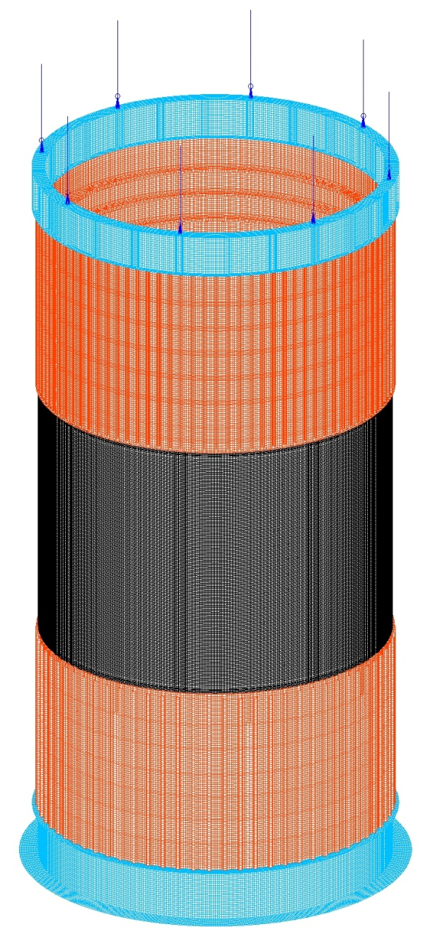
Shell Buckling Knockdown Factor (SBKF) (2007 – 2015)
Load Lines
10 ft
20 ft
Load Introduction
Cylinder
20 ft
70 ft
Test
Article
20 ft
Load Introduction
Cylinder

Slide 12
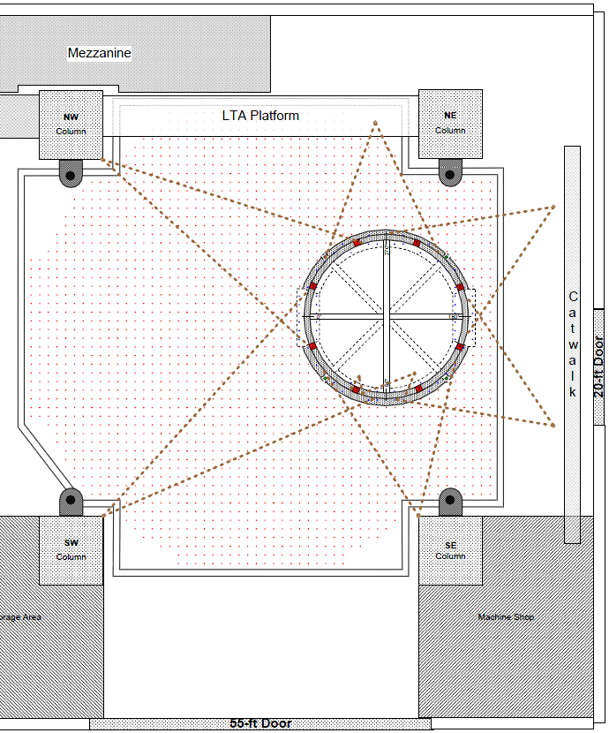
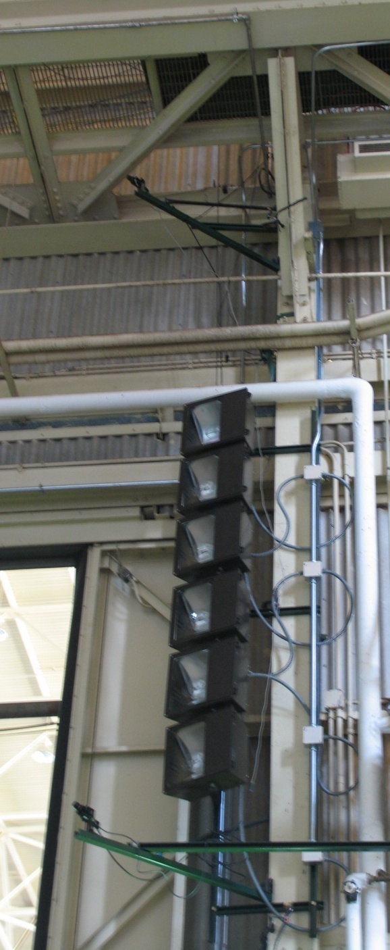
SBKD Large Test Camera Placement at NASA MSFC
Six (6) external 3-D camera systems
  Full circumferential coverage
  Minimum amount of overlap between adjacent systems: ~ 15° (Considering correlated areas)
  Locations determined by where systems could be mounted to part of the building structure
DIC System
Sys6 - N
Sys7 - NW
Sys5 - NE
Sys4 - E
Sys2 - SW
Sys3 - SE
Top view of 3-D DIC system layout

Slide 13
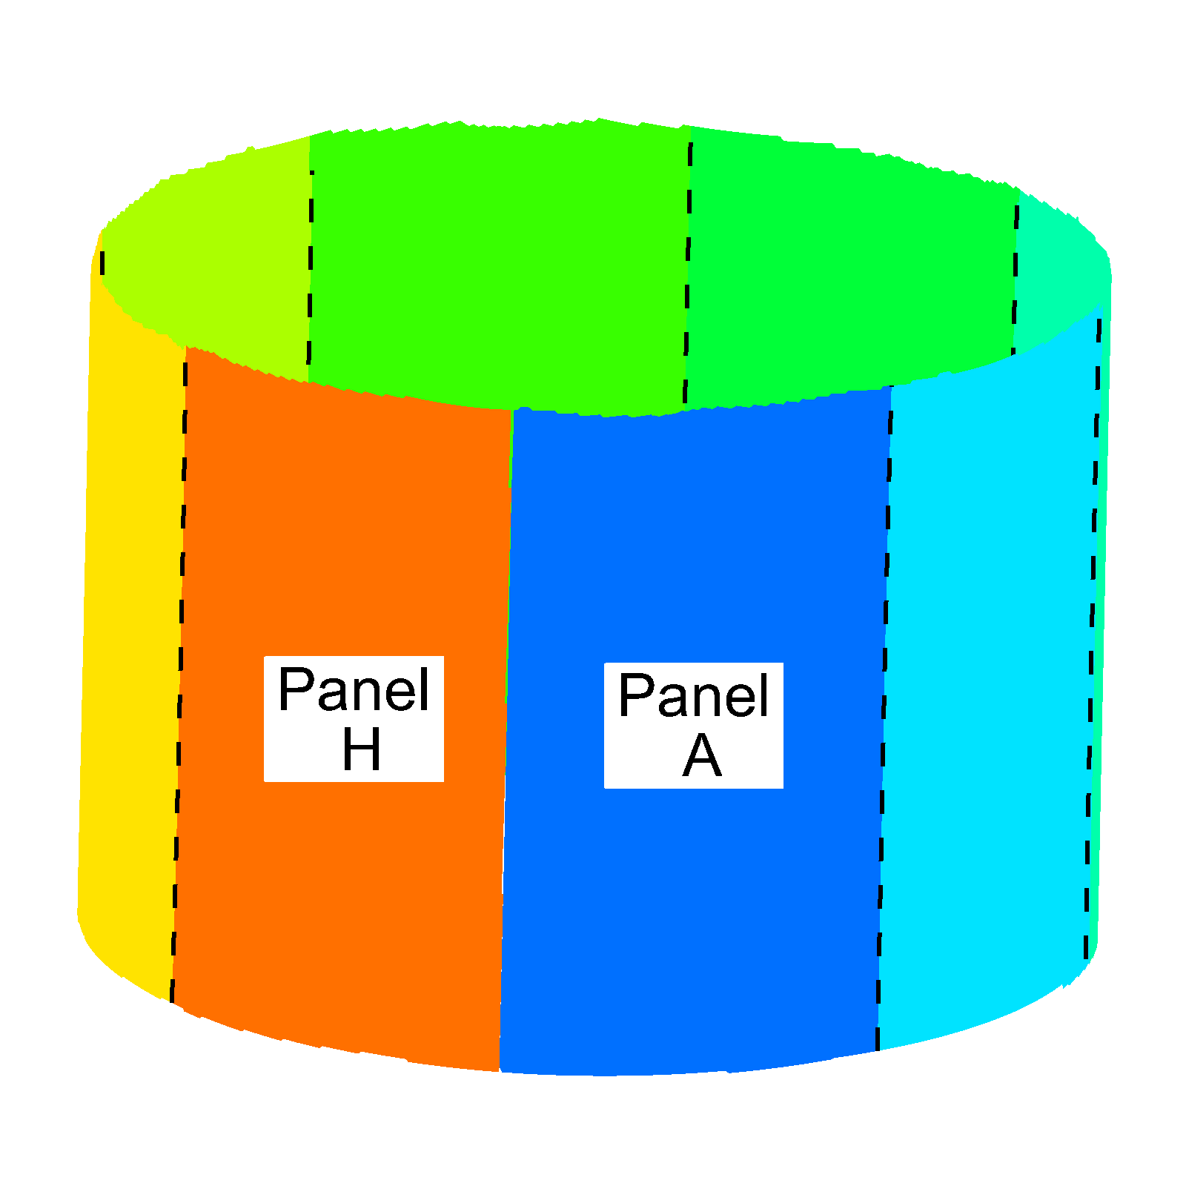
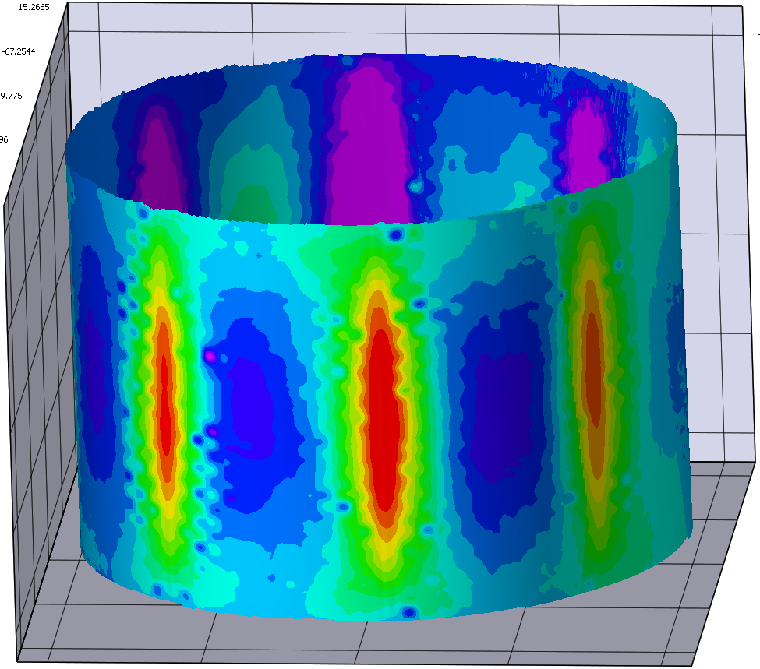
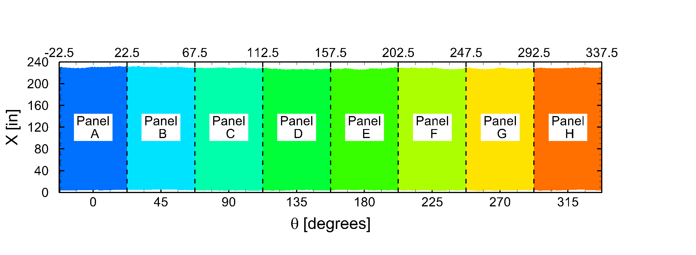
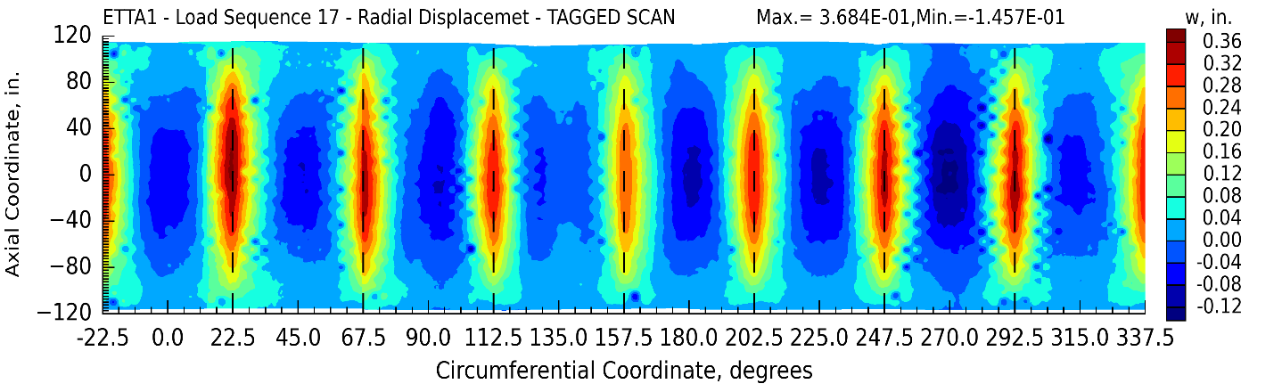
SBKF Data Visualization
VIC-3D Method of Stitching Multiple Camera Systems
Limited to 3-D plot and Cartesian coordinates only
Panel
G
Panel
H
Panel
A
Panel
B
Unwrapped cylinder with all systems plotted
[cylindrical coordinates]
Panel
A
Panel
B
Panel
G
Panel
H
ASTM Committees E08 on Fatigue and Fracture and E28 on Mechanical Testing

Slide 14
2010’s – Have Cameras, Will Travel
  Frangible joint explosive tests (ultra high-speed > 1,000,000 fps)
  Mars 2020 rover heat shield & rover wheel
  Composite wing
  More COPVs
  Wind tunnel testing (high-speed > 5,000 fps)
  More test/model correlation
  Grain orientation strain localization

Slide 15
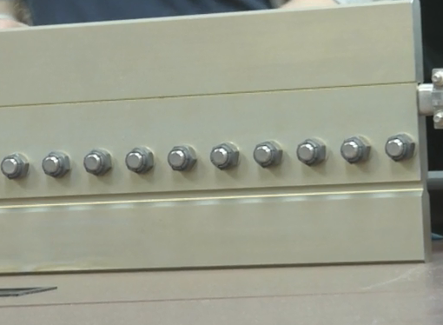
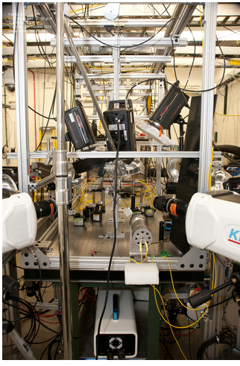
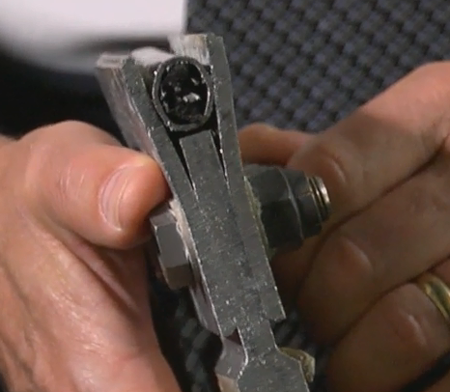
Frangible Joint (FJ) Explosive Tests (2014 – 2018)
Kirana (4 cameras)
  Resolution: 924 x 768
  Speed used: 1,000,000 to 5,000,000 fps
  Number of images: 180
Shimadzu HPV-X (4 cameras)
  Resolution: 400 x 250
  Speed used: 500,000 to 2,000,000 fps
  Number of images: 128
Photron SA-Z (2 cameras)
  Resolution: 256 x 128
  Speed used: 300,000 fps
  Number of images: >500
Notch
Confined
Explosive

Slide 16
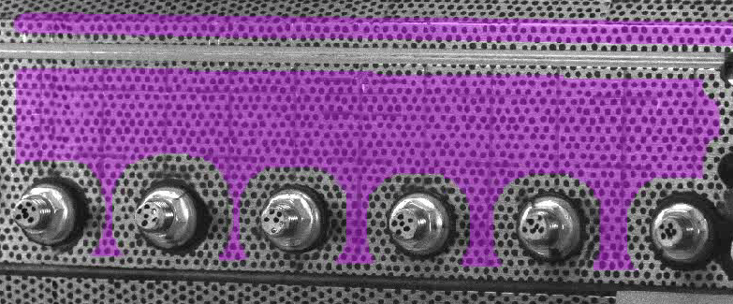
Example of FJ DIC (2,000,000 fps)
The contours identify constant values of out-of-plane displacement (w)

Slide 17
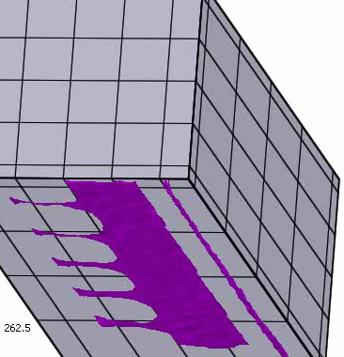
Example of FJ DIC (2,000,000 fps), shown in 3D
The contours identify constant values of out-of-plane displacement (w)

Slide 18
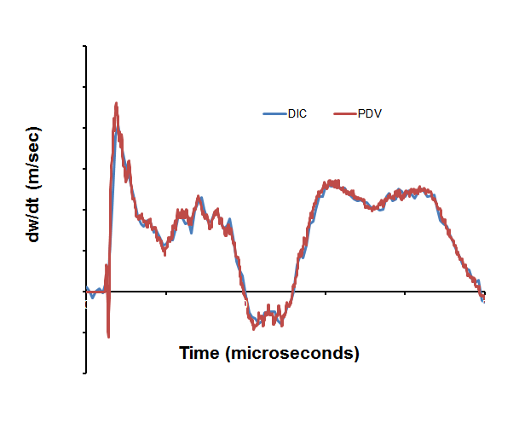
Comparison of Independent Measurement Methods
PDV: Photon Doppler Velocimetry
- Laser-based point velocity measurement technique
- PDV data acquisition rate < 0.5 μsec
- PDV data acquisition time > 1,000 μsec
- Laser point within the 3D DIC AOI
- DIC data extracted at the same location as the PDV laser point

Slide 19
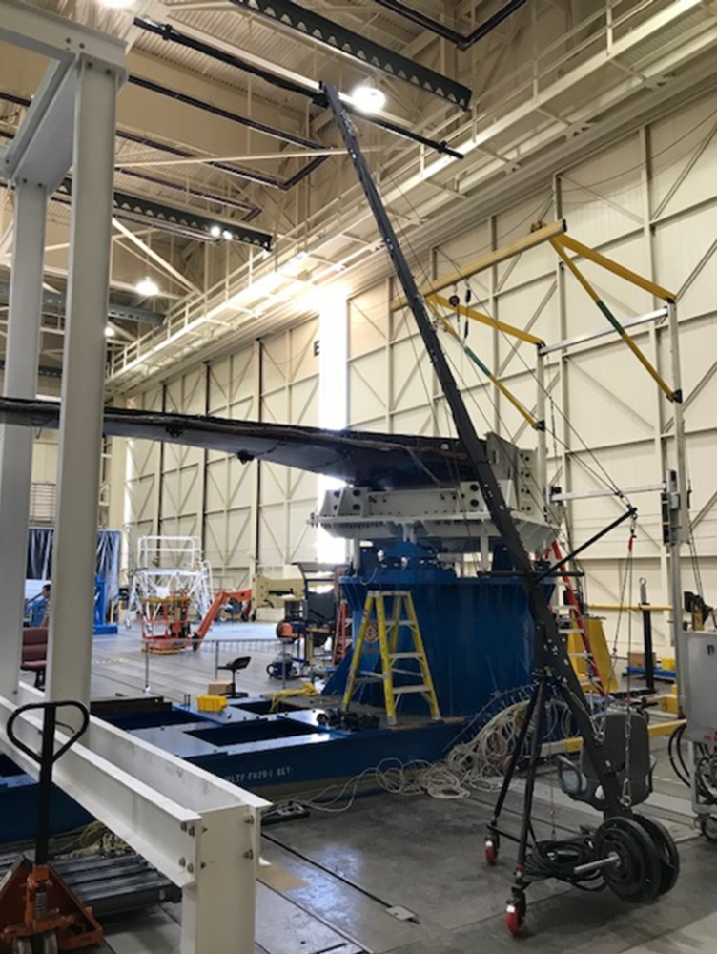
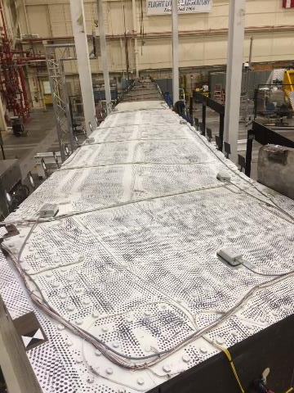
Passive Aeroelastic Tailored (PAT) Wing Test (2017)
Problem:
A full-scale composite wing (>40 feet) was tested in bending
Wing deformations needed for validation of structural analyses and composite designs
The rigidity of the boundary conditions was a concern, so characterization of support fixtures was required
Goals:
Quantify the wing deformations during upward and downward bending
Quantify the support fixtures to establish the boundary conditions for the structural analyses
Top View of Wing

Slide 20
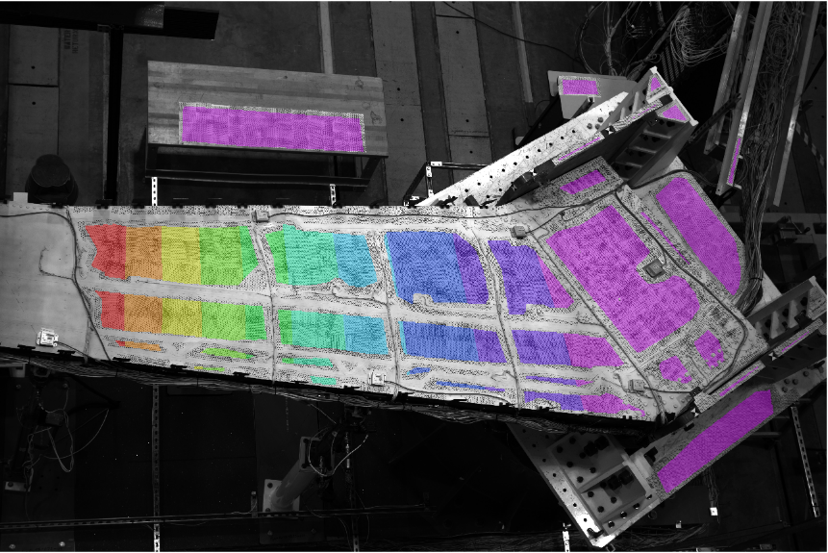
Top View Displacement (Rigid Body Motion Removed)
Side A – Trailing Edge
w-disp
(inch)
3
0
Side B – Leading Edge
ASTM Committees E08 on Fatigue and Fracture and E28 on Mechanical Testing

Slide 21
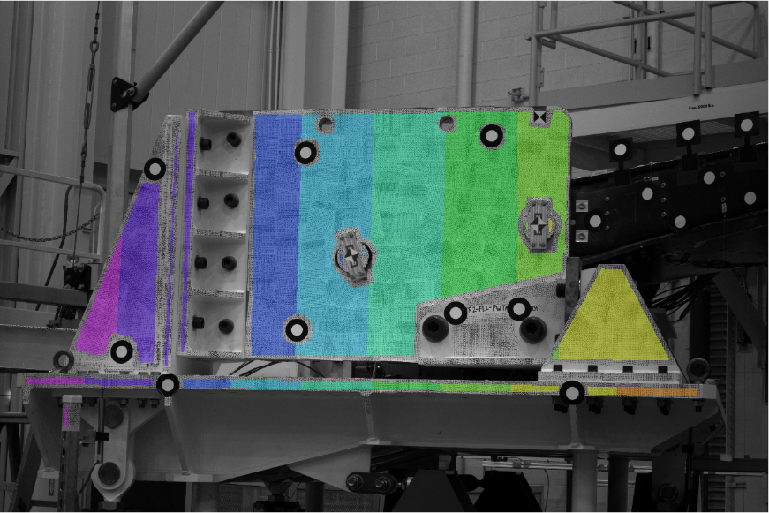
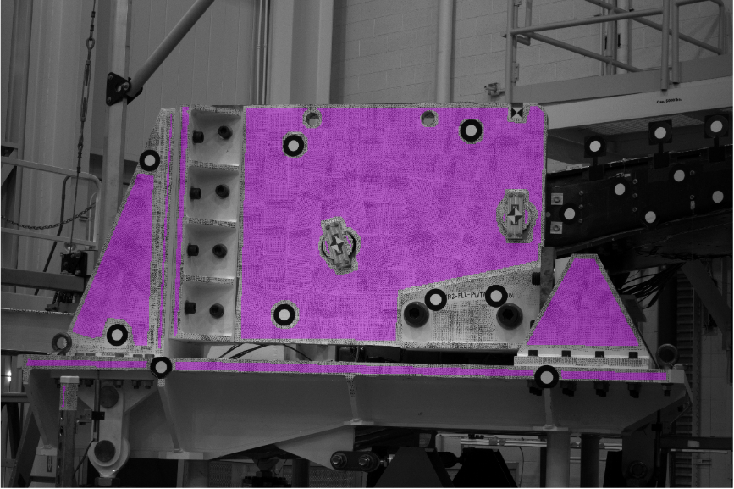
Fixture Movement
w-disp
(inch)
0.5
0.0

Slide 22
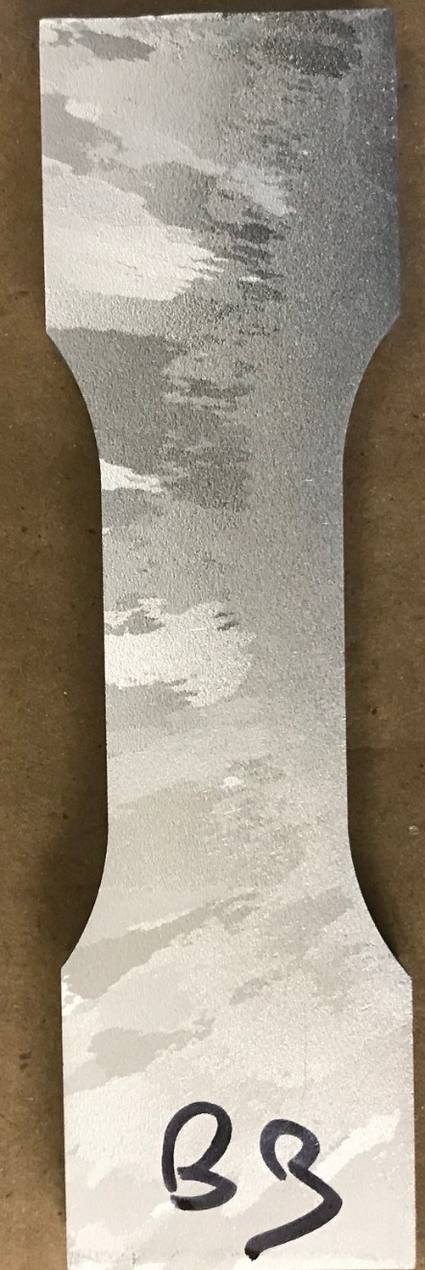
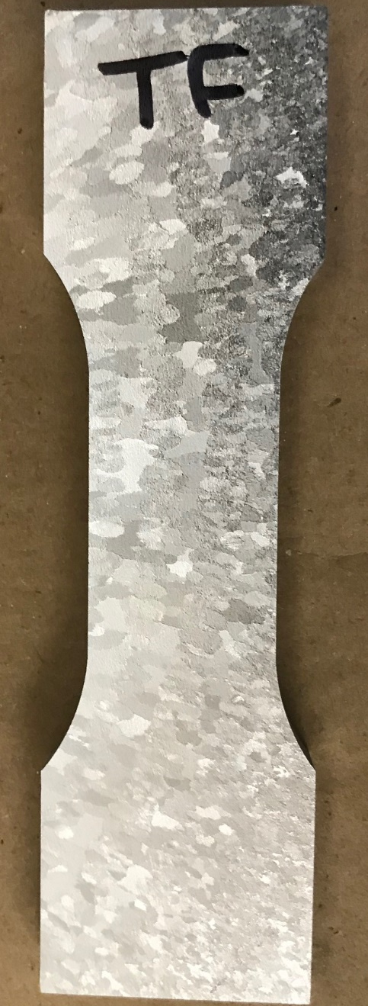
Damage Tolerance Testing of a Large Grain Material (2017 – 2019)
Etched Coupon
Back Surface
Front Surface
Problem:
A fracture critical space vehicle structure was found to have a large gradient in grain size (<0.001 inch to >0.2 inch) over a small area
Damage tolerance qualification was required to be demonstrated by test
The concerns:
  Tensile tests revealed large scatter in material properties
  The mismatch of adjacent large grains could create strain localization
  The location of the crack for damage tolerance testing is critical
Solution:
Use DIC to identify regions of strain localization to guide the placement of the fatigue crack

Slide 23




Strain Localization & Grain Structure
Axial Strain
(%)
2
1

Slide 24

Mars 2020 Rover Heat Shield (2018)
Problem:
The Mars 2020 rover heat shield (flight hardware) is required to have a ground proof test to 120% of the entry, descent, and landing loads
The first test performed in 2018 and the strain during loading was monitored with strain gages, but a fracture occurred away from the strain gages
The heat shield was redesigned for testing in 2019
A failure of the second proof test would likely cause a 2-year delay in the launch
Goals:
Perform full-field characterization of the entire heat shield in real-time during the proof test loading to prevent fracture by identifying any regions of elevated strain
Characterize the full-field strain distribution for validation of structural models
Space.com article from April 28, 2018

Slide 25

DIC Setup
Hardware/Software:
Three pairs of cameras (every 120 degrees)
  30MP AVT cameras 50mm lenses
  Overlapping areas of interest (AOI)
Cameras mounted on 80/20 supported by ladders
Hardware-synced systems
VIC3D-8TM with RealTime
Aperture, exposure time, and lighting optimized
DIC Configuration
AOI ~ 176 inch by 117 inch
Pixel Resolution ~ 36 pixels/inch
Speckle Size ~ 0.1 inch (printed on vinyl)
Subset Size 29 pixels and Step Size 7 pixels
Standoff Distance ~ 15 feet
Camera Angle ~ 22-degrees
Calibration grid: 12x9 70mm
Issues
Travel logistics (i.e., make sure we have everything we need)
Flight hardware (i.e., surface must be returned to pristine condition and not damage during testing)
Real-time monitoring (i.e., ~1 second refresh) during loading
High strain resolution (< 100 microstrain)
Limited floor space

Slide 26


Stitched DIC and Analysis Predictions at a Constant Pressure
Analysis Minimum Principal Strains
DIC Minimum Principal Strains
System 3
TBD\
System 1
System 2

Slide 27


Mars 2020 Rover Heat Shield Findings and Ramifications
The Mars 2020 Heat Shield passed the 120% qualification test without fracture or strains that exceed prediction limits
The DIC strain and displacement measurements were in good agreement with independent point measurements
Full-field strain measurements were extracted at finite element analysis nodal locations for direct comparison with predictions

Slide 28

Ascent Cover Separation System Test (2019)

Slide 29
2020’s – DIC Becomes Routine
  Residual strains due to welds
  More COPVs
  More frangible joints
  More test/model correlations
  Explosive tests

Slide 30



Hypergolic Engine Pressure Spike Simulation (2022)
Hypergolic engines experience pressure spikes/transients that present structural/material design, qualification, and operational concerns
Goal: characterize the material response during the initial pressure impact, expected response:
  Impulse duration ~ 4 to 8 μsec.
  Response duration < 250 μsec.
  Out-of-plane displacements < 0.25 inch
  Out-of-plane velocities < 5000 inches/sec.
  Strains < 50,000 microstrain
Goal: characterization of test conditions
  Measurement of the out-of-plane displacement
  Test/analysis correlation requires a detailed understanding of the boundary conditions
  Flanges could deform (elastically and plastically) during testing
  Detection of gas escape between flange and coupon
Outer
Flange
Inner
Flange
Disk Coupon

Slide 31

Computational Fluid Dynamics Modeling of Detonation Tube
Animation of static pressure on cut-plane through center of tube
Burst Disk
Pressure Transducer
(Camera Trigger)
Flanges and Disk Coupon
ASTM Committees E08 on Fatigue and Fracture and E28 on Mechanical Testing

Slide 32


DIC System
Two Shimadzu HPV-X cameras
  Synced images at 2,000,000 to 500,000 frames per second
  400x250 pixels
  128 images
  Triggered ~4 to 10 μsec. before impulse arrival
Flash lamp
  Triggered ~115 μsec. before impulse arrival
  800-μsec. duration
ASTM Committees E08 on Fatigue and Fracture and E28 on Mechanical Testing

Slide 33


DIC Displacement Measurements
3D View
(Rigid Body Motion Removed)
2D View
(Rigid Body Motion Removed)
w
(inch)
0.15
0
ASTM Committees E08 on Fatigue and Fracture and E28 on Mechanical Testing

Slide 34


Why Boundary Conditions are Important
3D View
2D View
w
(inch)
0
0.025
ASTM Committees E08 on Fatigue and Fracture and E28 on Mechanical Testing

Slide 35

Gas Escaping Between Flange and Disk
ASTM Committees E08 on Fatigue and Fracture and E28 on Mechanical Testing

Slide 36
Lessons Learned
Anticipate what is needed to be measured in addition to what is requested
Boundary conditions are critical
Follow the iDICs best practice guide for reporting results
(https://www.idics.org/guide/)

Slide 37
Contact Information
David S. Dawicke
Senior Scientist
Analytical Services and Material, Inc.
107 Research Dr.
Hampton, VA 23666
dave@asm-usa.com

