Slide 1
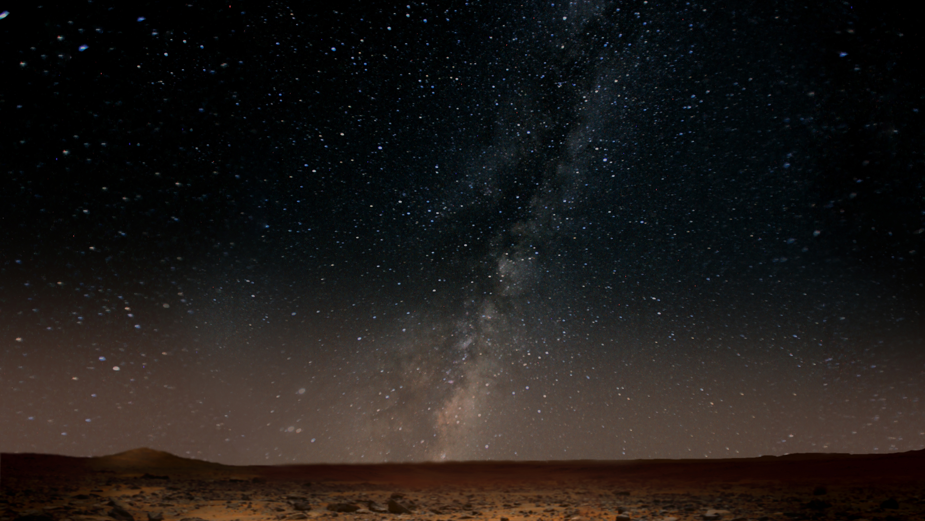
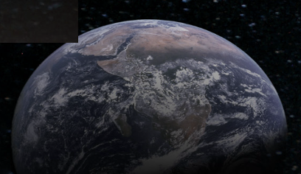



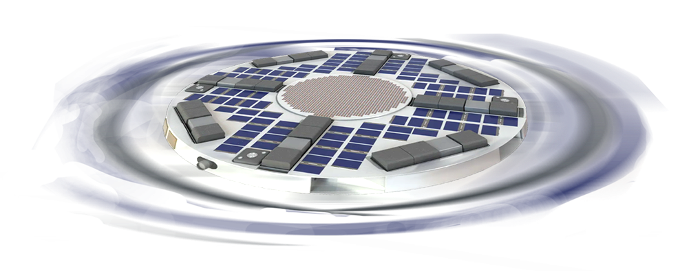

with The Aerospace Corp.
SpinSat:
A Novel Variable-Gravity-and-Radiation-Exposure Platform for
Deep-Space Science: Payload Development and Science Opportunities
Tony Ricco, Jessica Lee, Jay Bookbinder – NASA ARC
Mark Looper – The Aerospace Corp.
SpinSat Ideation and Implementation Teams

Slide 2
Driving Science & Tech Gaps, Challenges
Fundamental Science
Biological and physical scientists need access to combined deep-space radiation + planetary gravitation…
…to study basic processes and measure effects and impacts on biological and physical systems.
Human Health & Performance
Human health and accompanying biome effects are poorly understood for long-duration exposure to deep-space radiation & reduced gravity
beyond-LEO experiments needed to understand/manage/mitigate effects on health and performance, including impacts on/from relevant biomes.
Technology Development for Deep Space Missions
Environmental control & life support, food production, other systems must perform in novel, challenging environments
technology development and validation benefit from frequent access to relevant environments with controls
NASA needs access to deep-space radiation environments, those regions above the Van Allen Belts: https://www.nasa.gov/directorates/esdmd/hhp/space-radiation/

Slide 3
SpinSat Deep-Space Platform Concept
Develop innovative, low-risk platform to address critical science gaps and technology maturation needs for deep-space exploration:
Emulate planetary radiation-plus-gravitation environments for experiments
Key Objectives & Approach
Beyond-LEO deployment: lunar, transit-to-Mars, and Mars-surface radiation-plus-gravity environments
Multi-payload platform: science experiments, model validation, tech development, risk reduction
Technical approach (led by NASA/Ames, in cooperation with the Aerospace Corp.)
  Platform: Inspired by Aerospace’s (non-spinning) DiskSat, a rideshare-friendly cubesat alternative
  Avionics: high-TRL / off-the-shelf components + avionics heritage from NASA Ames’ BioSentinel spacecraft (deep space, now 63 Mkm from Earth, ~2.5 years operation to date)
  Artificial gravitation: spinning platform → 0.17xg and 0.38xg, along with 1xg controls
  Relevant radiation: tailored shielding → lunar or Mars-like environments, also deep space
  Up to 64U of payloads
NASA needs access to deep space radiation environments, those regions above the Van Allen Belts.
https://www.nasa.gov/directorates/esdmd/hhp/space-radiation/

Slide 4
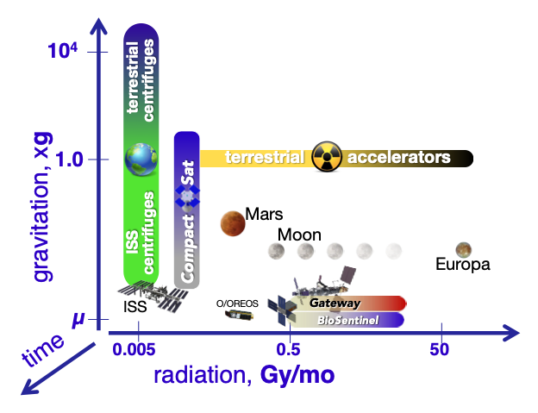
The Why of SpinSat
Current capabilities for combined radiation and gravity research are limited
  Terrestrial and ISS-based centrifuges do not operate in deep-space radiation environments
  ISS provides “noisy” microgravity and partial gravity, but durations and gravity levels may not meet many deep-space mission planning needs
  Terrestrial particle accelerators are 1xg and impractical for long-duration/chronic radiation exposure testing
    biological responses (and even some electronic component effects) are often dose-rate dependent, not just total dose

Slide 5
National Academies Echoes the Need…
US National Academies:
"...The research opportunities that are envisioned to exist within cis-lunar space are expected to be severely limited in volume and frequency. This sets an interesting conundrum where some critical research cannot be met with the current deep space platforms, yet they would richly inform human exploration beyond LEO during the Artemis missions."
… and SpinSat responds:
A range of combined partial gravity and deep-space radiation exposure experimentation in a low-cost platform with 1xg experimental controls can:
Increase relevant flight opportunities at lower cost for key experiments relative to platforms/destinations such as Gateway, lunar surface, Mars surface, etc.
Support both new and existing experimental designs and payload hardware
Provide a complement and partial successor to ISS’s LEO capabilities

Slide 6
SpinSat’s Responsive Design Objectives
O-1 | Simultaneous long-duration exposure (weeks → > 1 yr) to combined deep-space/lunar/ planetary radiation and gravitation (0 → 1xg) Spinning spacecraft provides artificial gravitation Custom shielding simulates lunar, Mars radiation environments
O-2 | Low cost per experiment Many experiments can be hosted on each platform flight Multiple experiment al replicates → enhanced statistical significance
O-3 | Frequent space access: Launch vehicle and orbit agnostic (beyond van Allen belts)
O-4 | Easy payload interfaces: highly familiar “Cubesat” type Other configurations supportable, not a priori precluded Power, data, comms, gravity, radiation, benign thermal environment PIs can focus on the experiment, not the spacecraft
O-5 | Easy payload integration and responsive access Stretch: “just-in time” loads for biology shortly prior to launch

Slide 7
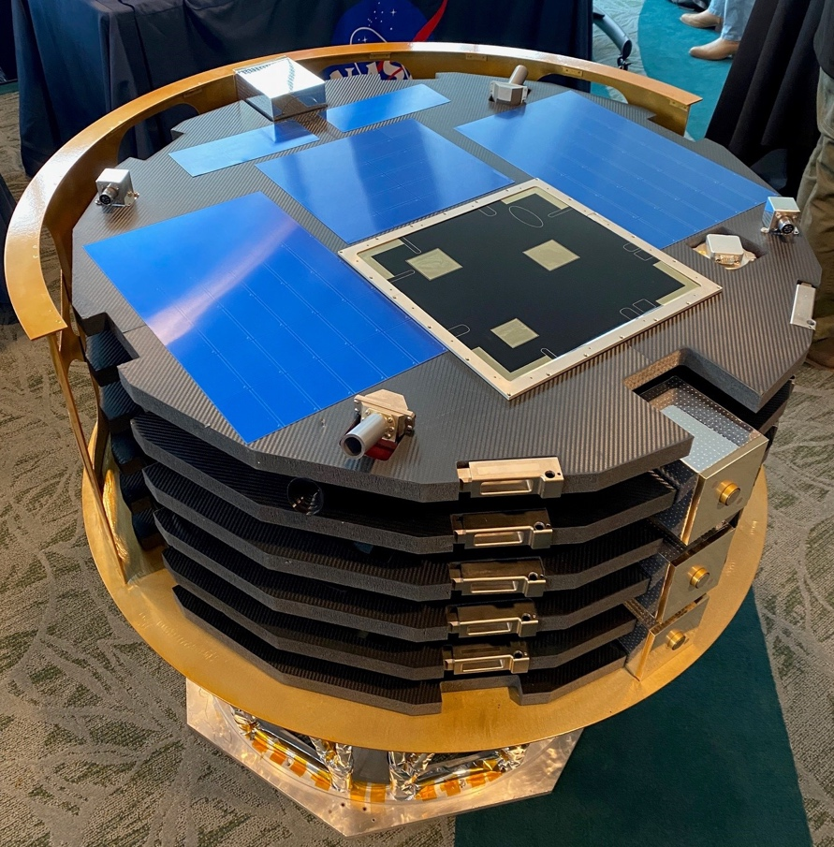
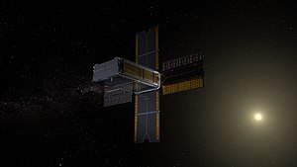
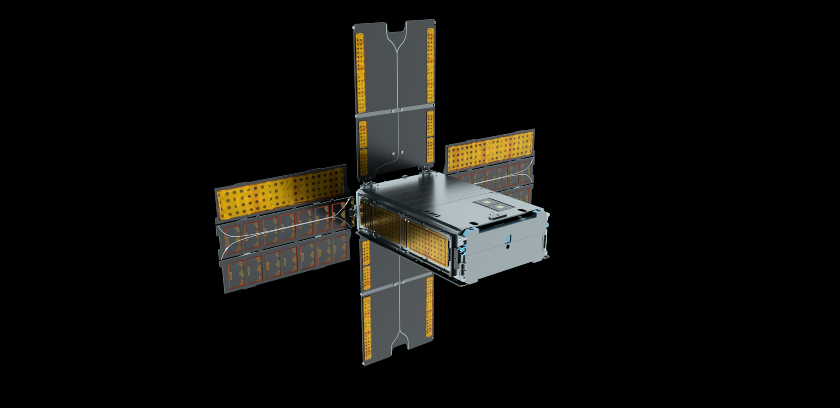
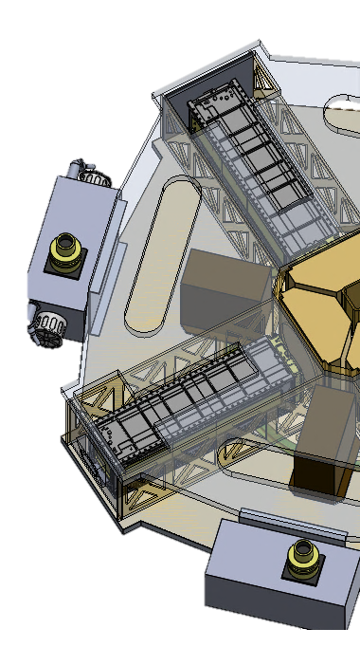
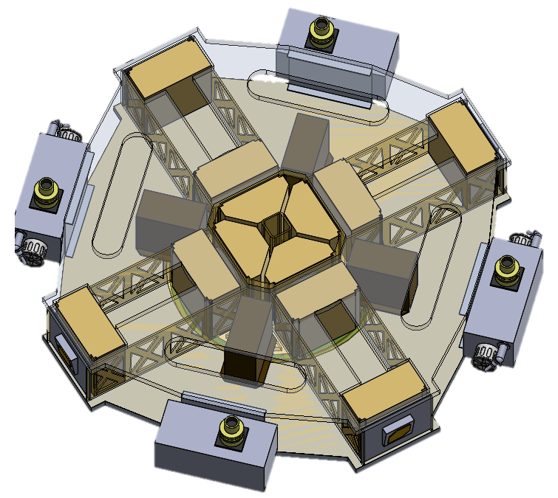
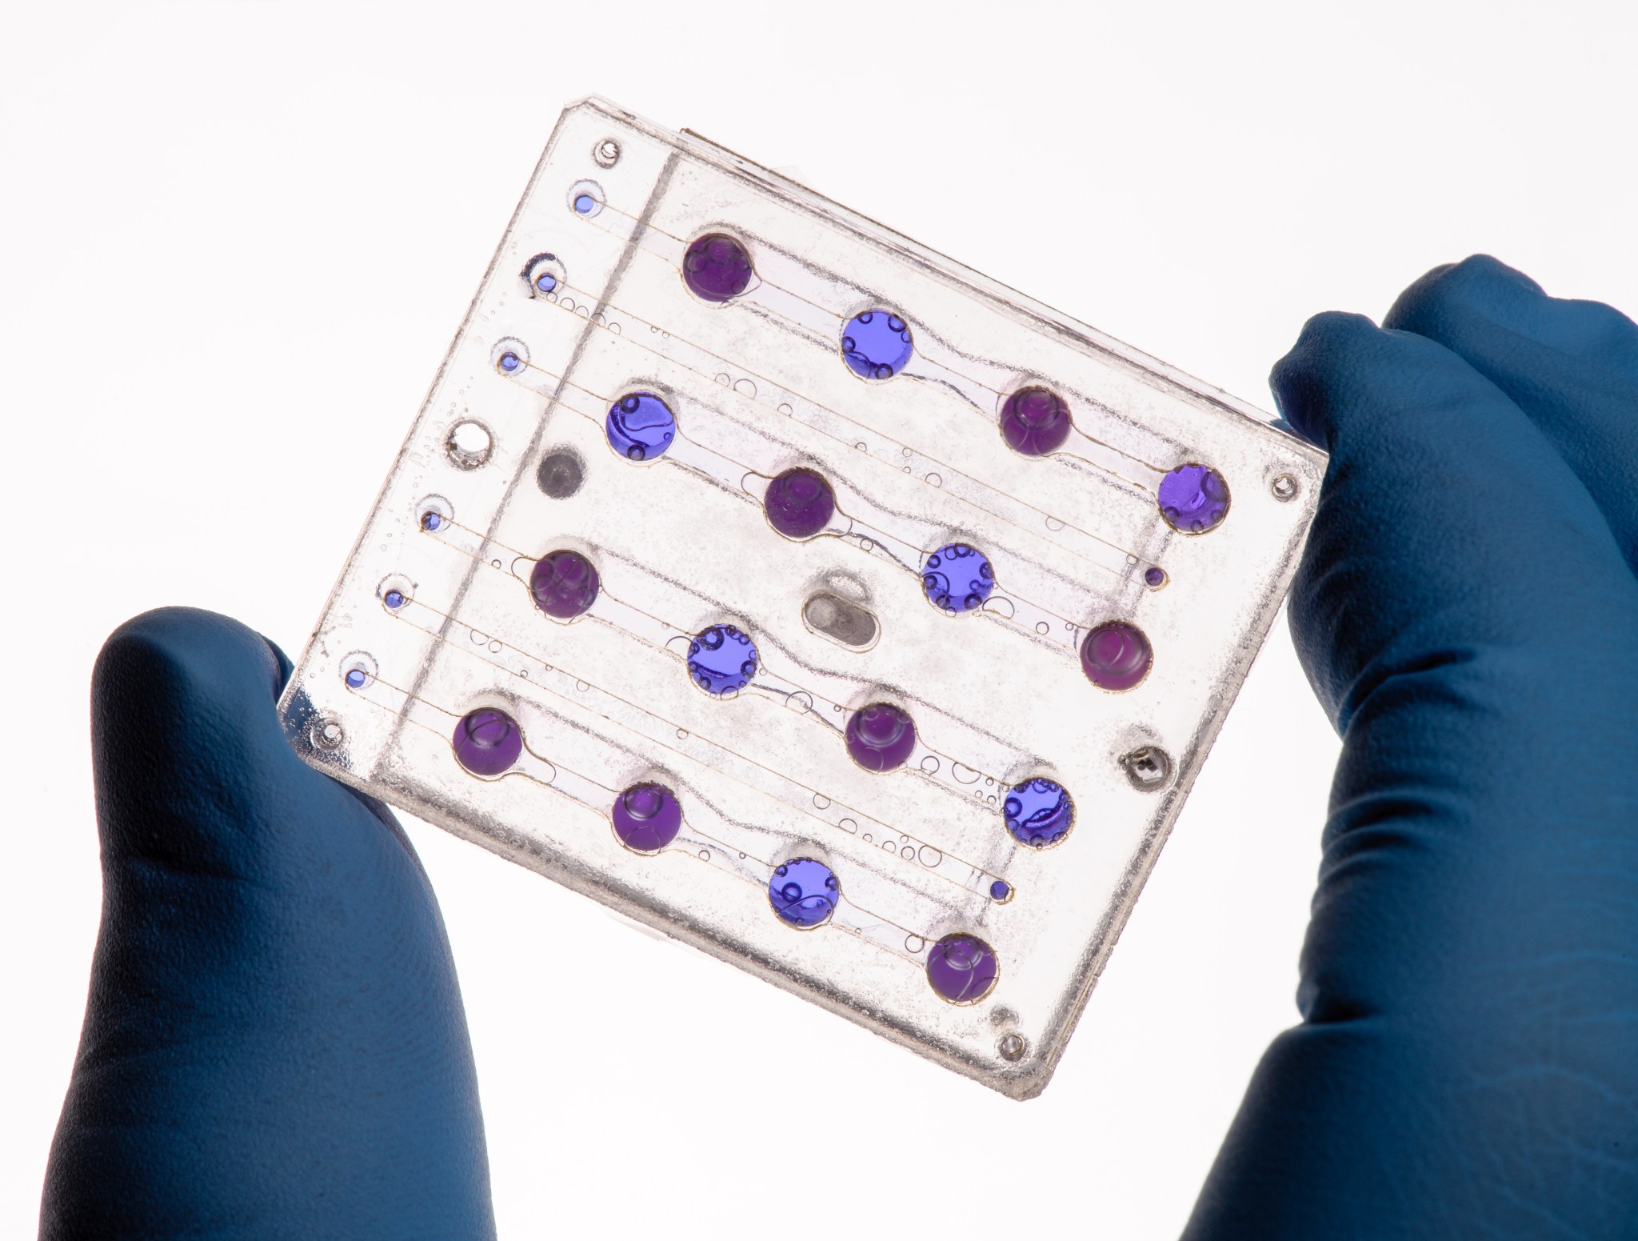
SpinSat Leverages NASA Investments
Platform architecture
Avionics, bio payload components & design
Platform enables more science per $
1x4U radial Payloads
2x2U “single-gravity” Payloads
BioSentinel: Proven design for deep-space biology missions: avionics, microfluidics, other science elements (NASA/Ames)
DiskSat: A new spacecraft form factor
(NASA SSTP/
Aerospace Corp.)
1 SpinSat = 16+ BioSentinel payloads in a variety of orientations
SpinSat platform provides experiments with all necessary infrastructure: power, thermal environment, data storage, communications, acceleration and radiation monitoring, etc.

Slide 8
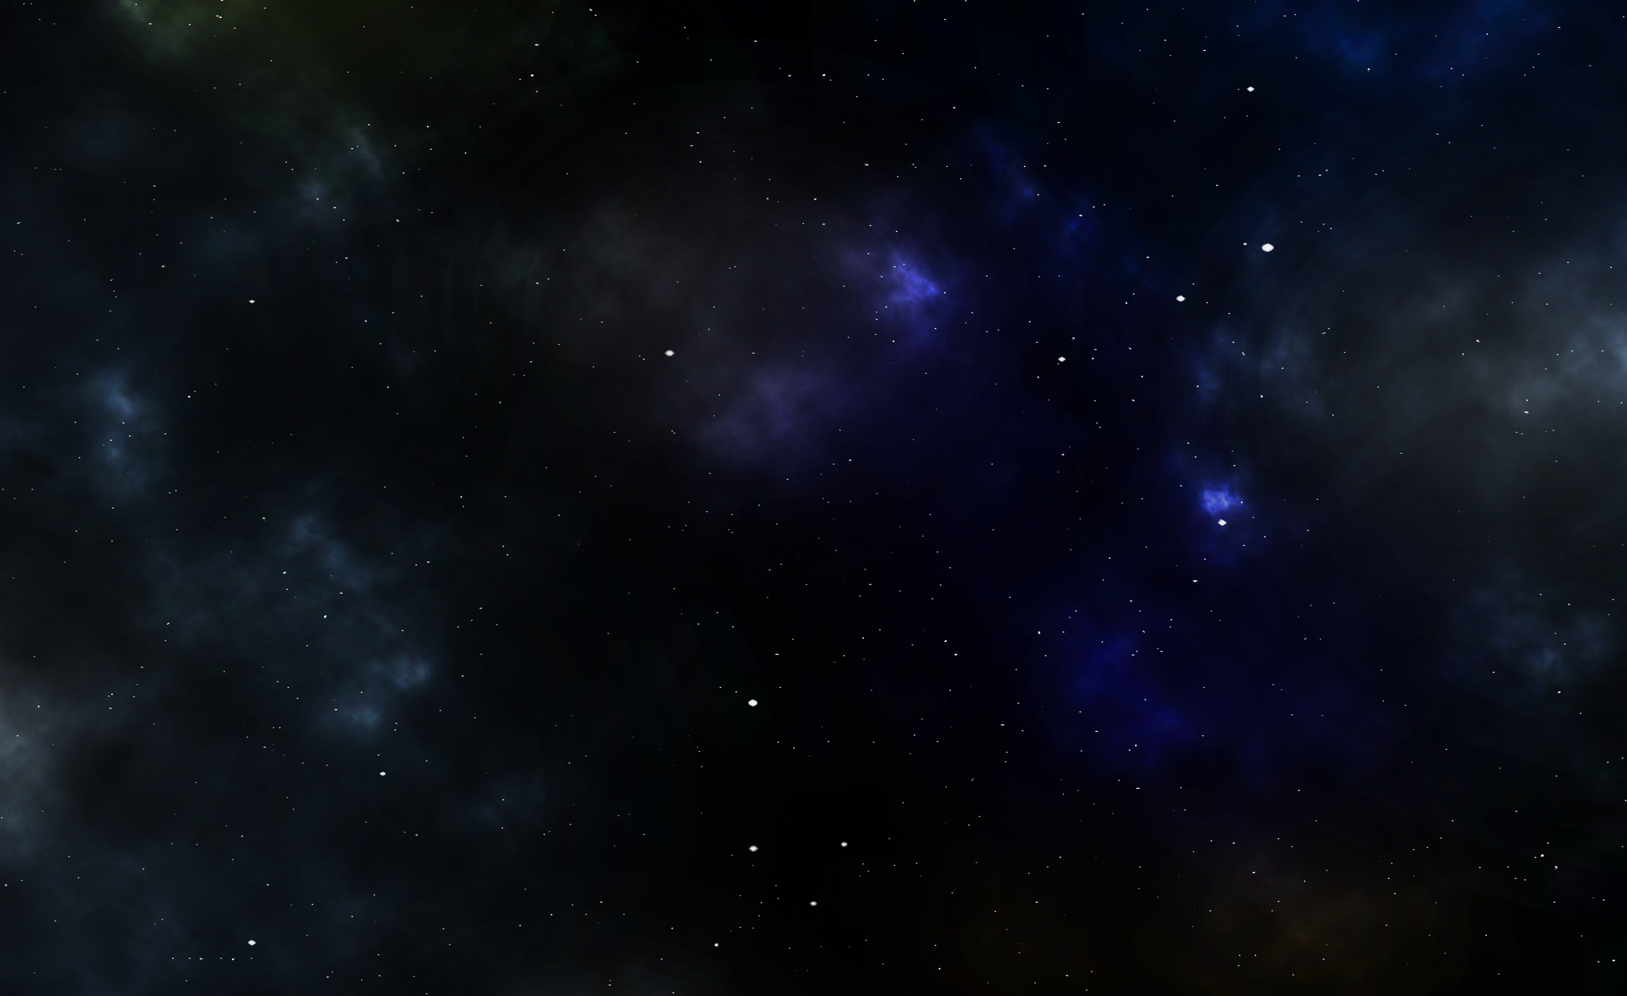

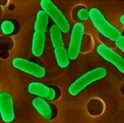
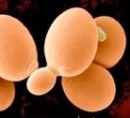
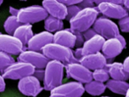
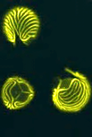
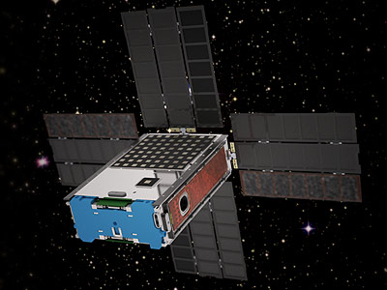
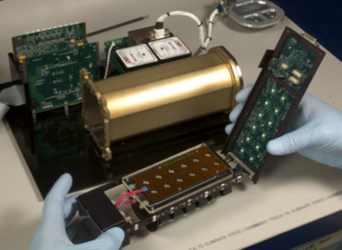
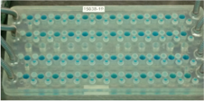
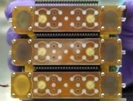
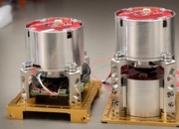
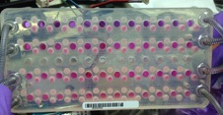
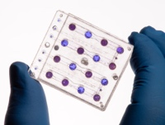
NASA/ARC Heritage and Precedents:
Smallsats & Biological Cubesats
GeneSat-1 (3U)
PharmaSat (3U)
O/OREOS (3U)
SporeSat-1 (3U)
EcAMSat (6U)
BioSentinel (6U)
2006
E. coli (bacterium)
Microgravity effects on gene expression
12-well fluidic card
LED-excited fluorescence for GFP expression, + LED light scattering for cell population
1st fully automated self-contained biological experiment on a cubesat
2009
S. cerevisiae (yeast)
Microgravity effects on antifungal response
48-well fluidic card
In-situ preparation of multiple drug dose levels from concentrate
3-color LED optical detection system
alamarBlue indicator dye
2010
B. subtilis (bacterium)
1st demo of 2 distinct experiment payloads on one autonomous satellite
Microgravity & LEO + radiation effects
3-LED optical detection; solar UV-vis spectrometer
1st time dried organisms rehydrated in orbit: enables multi-timepoint activation
2014
C. richardii (aquatic fern spores)
Variable gravity effects on spore germination via calcium ion transport
1st time artificial gravity capabilities in cubesat, 0 – 2x g
1st micro-centrifuges as well as Lab-on-Chip electrochemical sensors in a cubesat
Deployed by re-supply mission en route to ISS
2017
E. coli (uropathogenic bacterium)
Microgravity effects on antibiotic response
48-well fluidic card
3-LED optical detection; variable-dose drug delivery
6U format for 50% more solar power
1st bio cubesat deployed from ISS
2022
S. cerevisiae (yeast)
Microgravity & deep-space radiation effects on DNA damage/repair
1st use of monolithic multilevel fused manifolds
18 x 16-well cards: 288 samples
1st deep-space bio cubesat: 2° payload on Artemis-1
Onboard radiation spectrometer (LET)
8

Slide 9
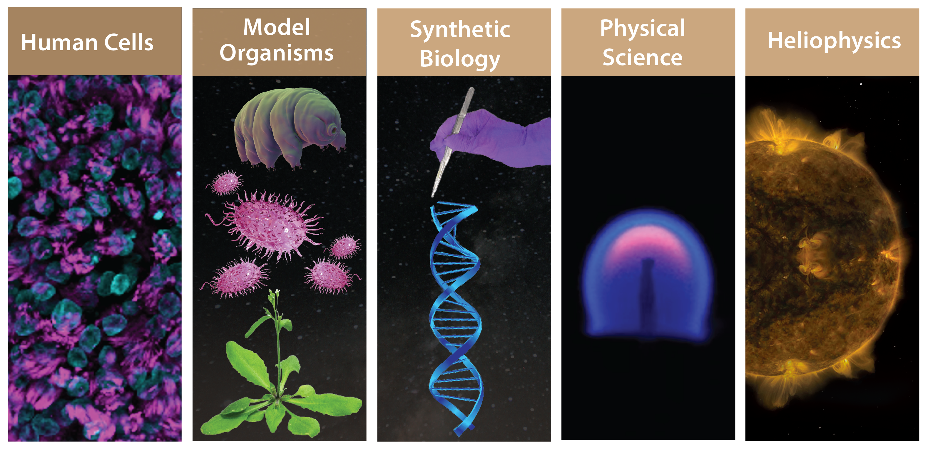
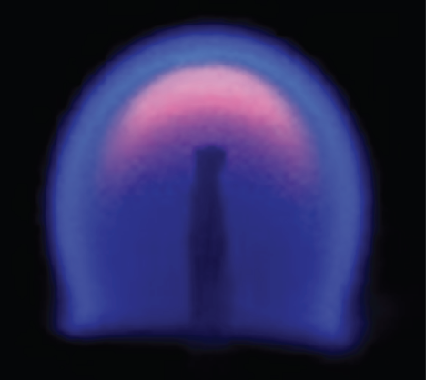
Science Opportunities
Samples Measurands Assessments .
Organoids Cancer cells Morphology
Tissue cultures Neurons/glia Metabolism
Stem cells Intestinal cells Gene/protein expression
Organ(s)-on-a-chip Bone cells Evolutionary changes
Microscopy
Optical / electro-
chemical assays
Bioassays:
proteins, genes, DNA damage, etc.
Sequencing, sizing:
molecules, particles
Cytometry
Biomass
Behavior
Mechanical / electrical / optical parameters
Bacteria, Fungi C. elegans Reproduction
Spores Tardigrades Germination, tropism,
Algae/cyanobacteria Small plants photosynthetic efficiency
Pharmaceuticals Yield, purity
Nutrients, vitamins Process reliability
Engineered materials Mat’ls. properties
Planetesimal accretion Size, kinetics, morphologies
Regolith transfer Process efficacy, reliability
Flame propagation Kinetics, stability
Electric fields observed from a spinning platform
The Sun Heliophysical
phenomena

Slide 10
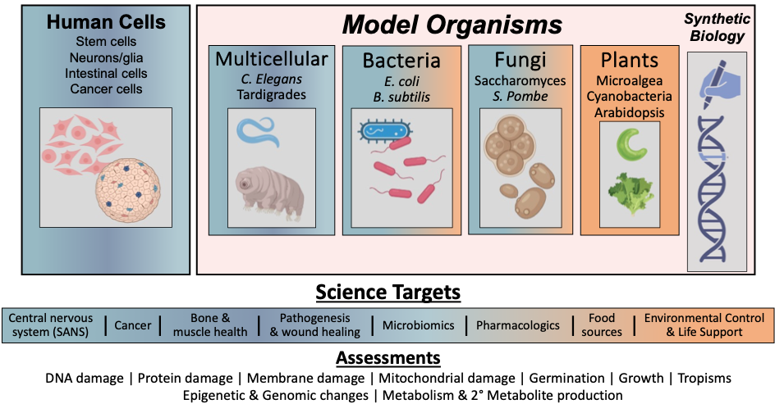
Biological Science Opportunities

Slide 11
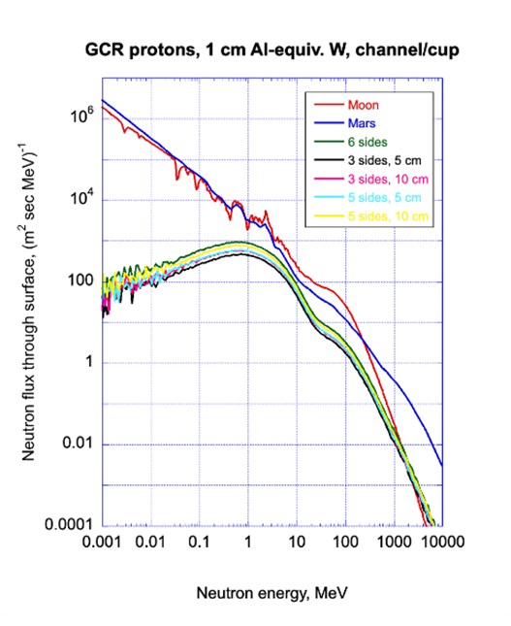
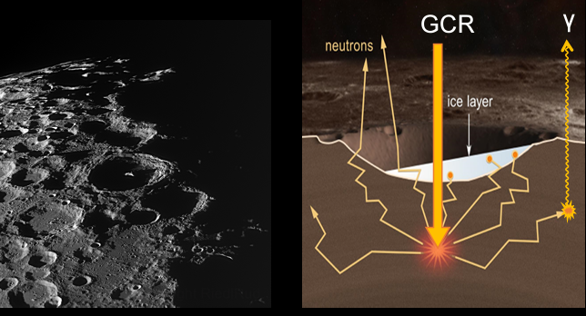
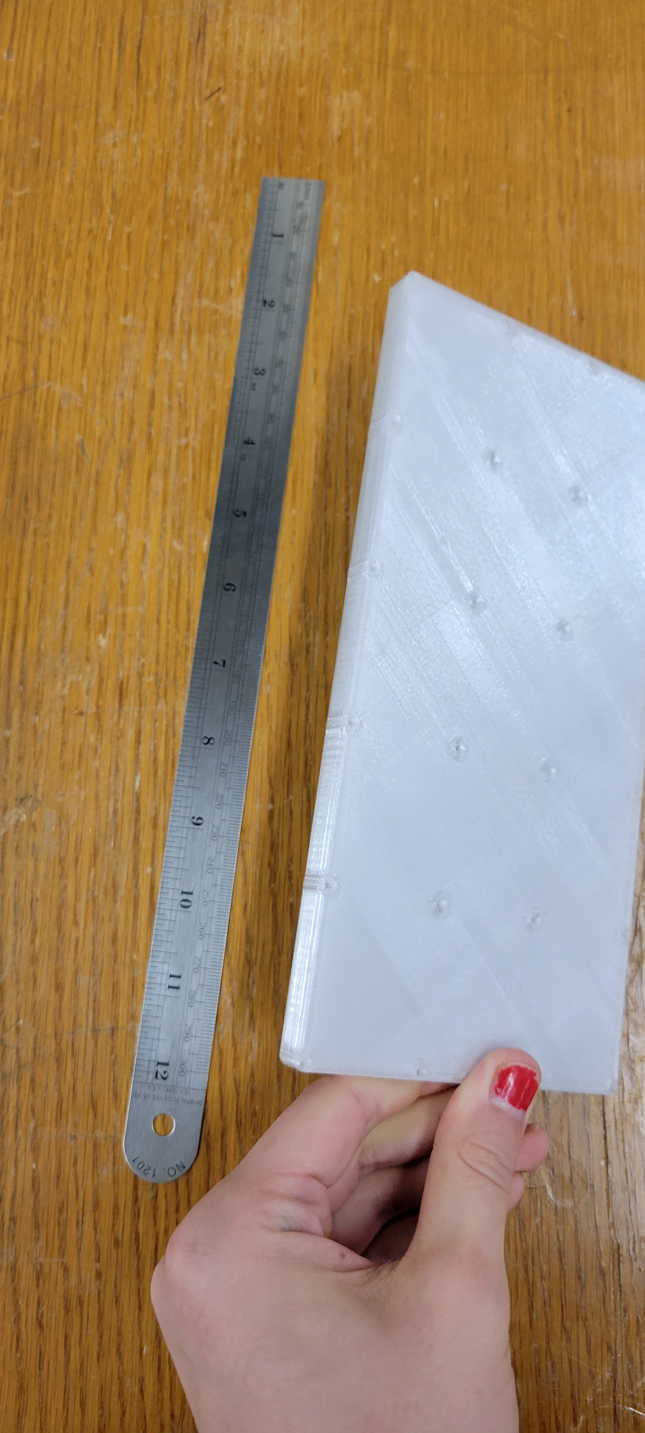
SpinSat Radiation Environments
  Simultaneous Mars/lunar gravity to 1xg+ accelerations simultaneously with deep-space, lunar, and/or Mars radiation environments
Aerospace conducted a detailed study on simulating Moon and Mars surface radiation environments:
Tungsten cube (6 mm) array in PETG matrix
Provides close approximation to Moon & Mars surface radiation in range of interest
Tailorable radiation flux via cube arrangement
Simple external mounting to payload housing
LEO re-entry/breakup safe
Biological concern
*PETG: Polyethylene terephthalate glycol – thermosetting polymer used for 3-D printing

Slide 12
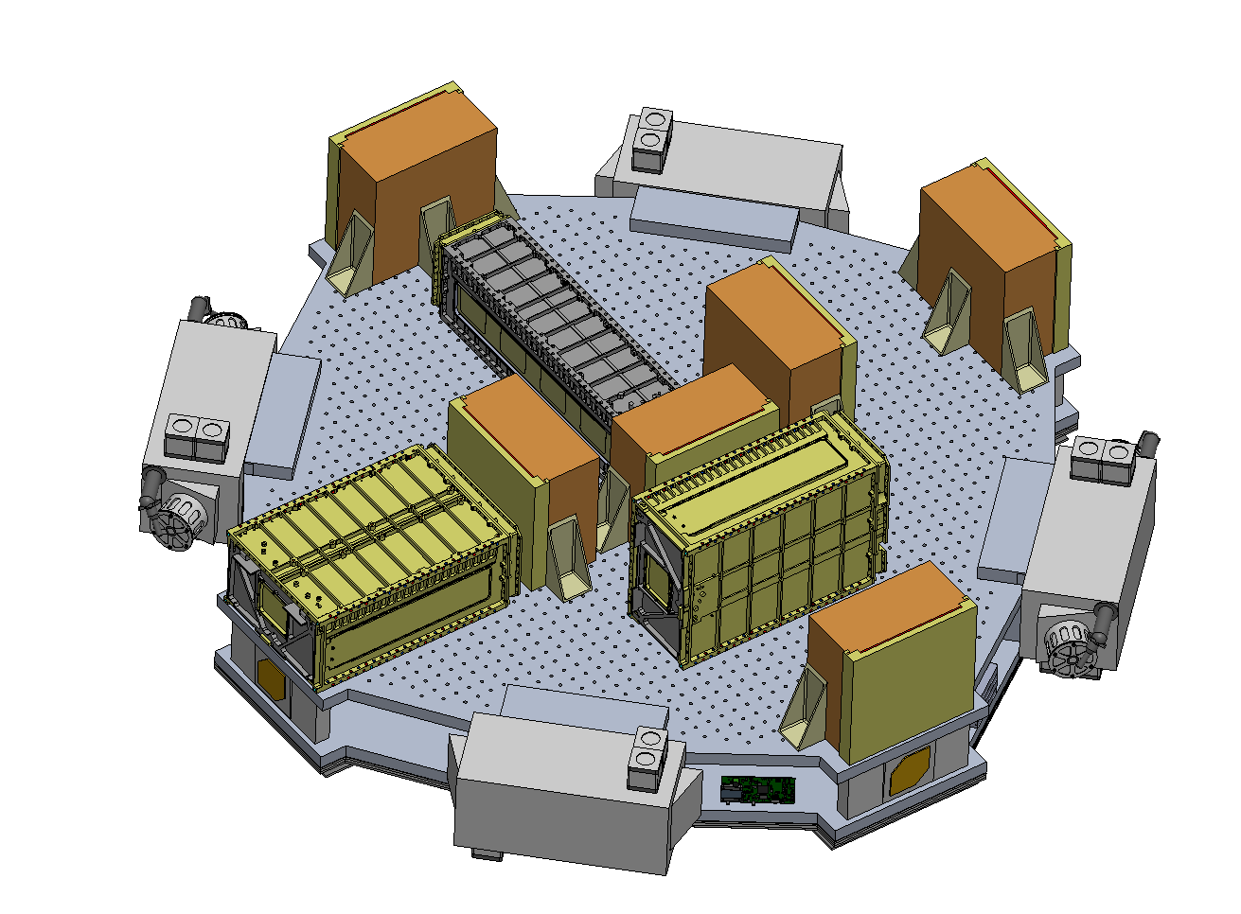
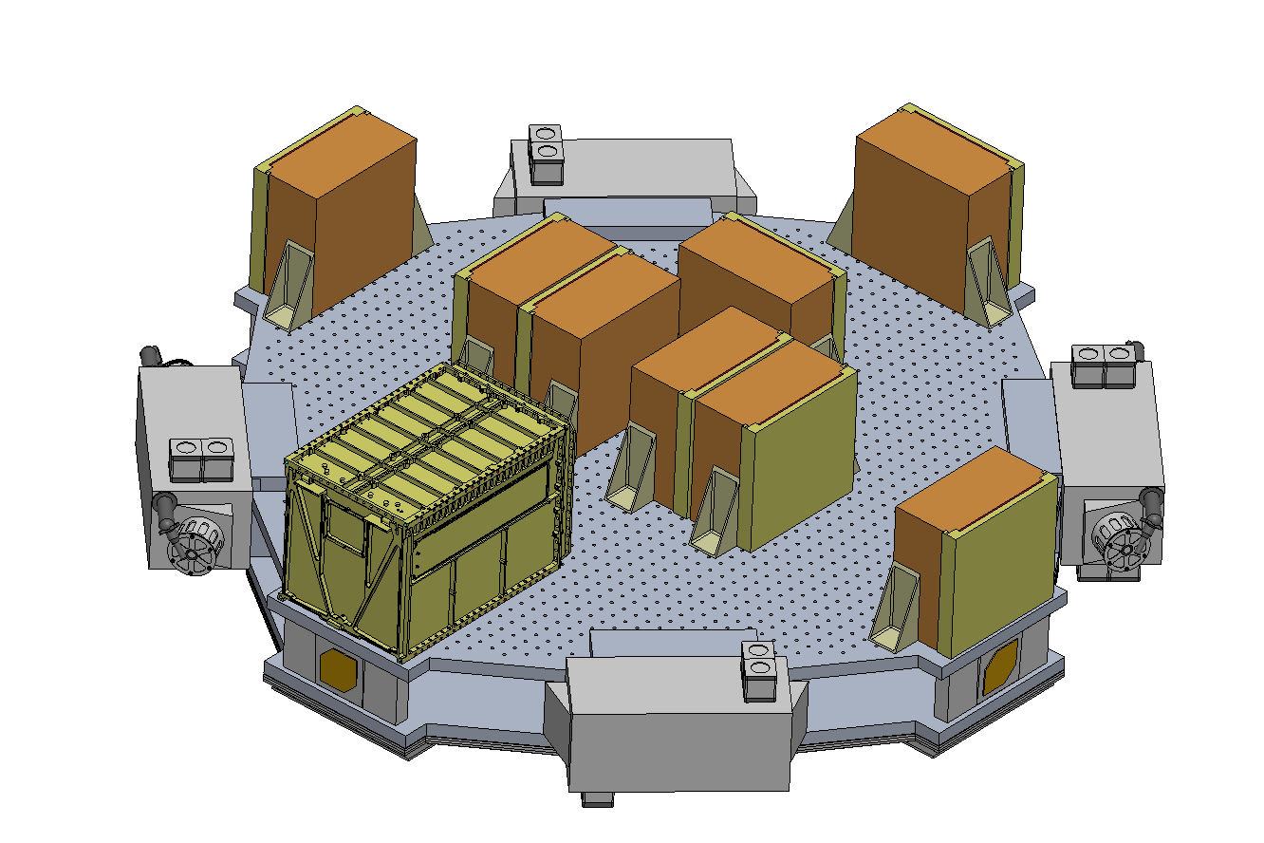
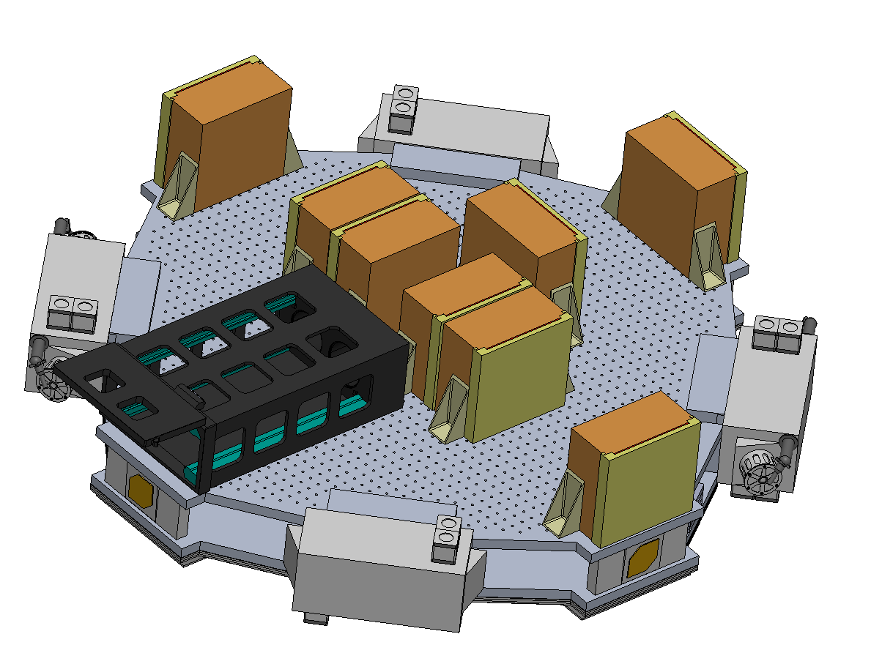
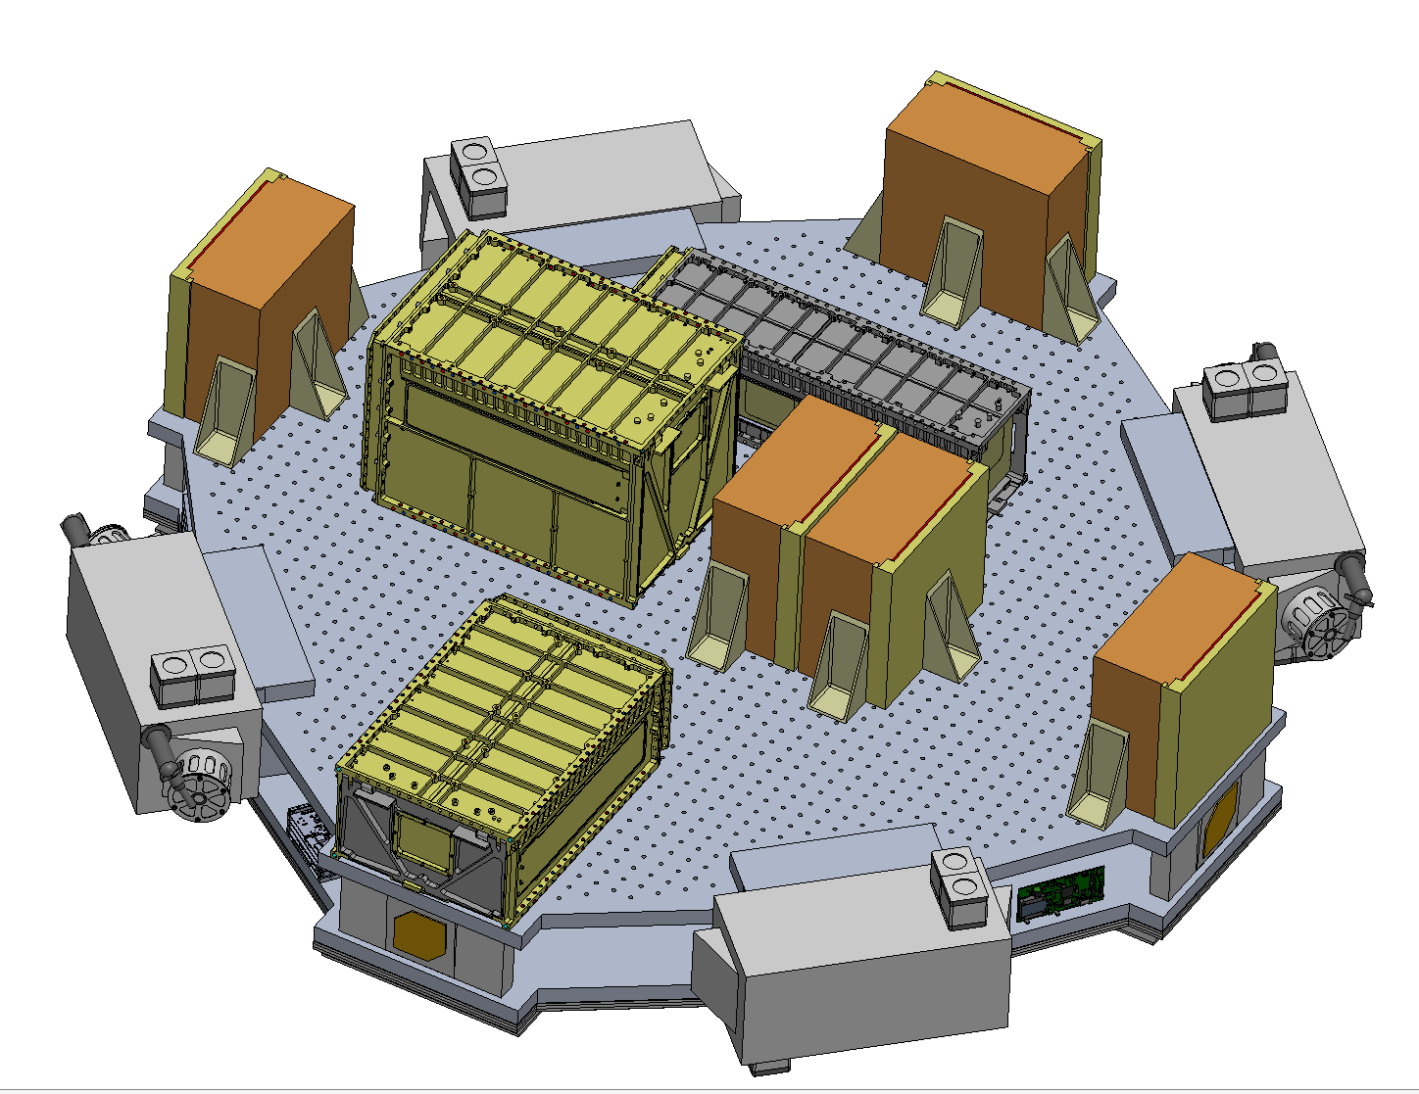
Flexible Payload Accommodations
Rocket Lab 6U
Rocket Lab 12U
EXOpod 8U (deployed)
Primary spacecraft structure composed of a dual deck sandwich design
  Top deck hosts payloads
  Bus avionics housed internally between decks
  Minimizes design changes needed for payloads across missions
Thermal management achieved by isolated sun-facing solar array structure
Propulsion uses Hall-effect thrusters for spin-up and electrospray thrusters for attitude control
Attitude-determination-and-control system based on flight-proven BioSentinel high-TRL components

Slide 13
SpinSat Path to Flight
Concept
Initial
science
concepts
DEFINE
Preliminary
spacecraft
req’ts.
Payload
science
workshop
REFINE
Spacecraft
design
study
Build
demo.
payloads
DEVELOP
Build
proto-
flight
Deliver and
integrate
demo. payloads
DEMONSTRATE
Launch/operate
protoflight
SpinSat
Commercial
payload
providers
COMMERCIALIZE
Qualified COTS
spacecraft
providers
Payload
dev. program
Frequent
Flyer
SpinSat
Science
2023 2024 Today 2026 2027 2028 2029 2030 2031
Notes:
Working collaboratively allows Directorates to:
Develop an integrated research plan
Leverage resources and results
Reach goals faster
Foster communications between directorates

Slide 14
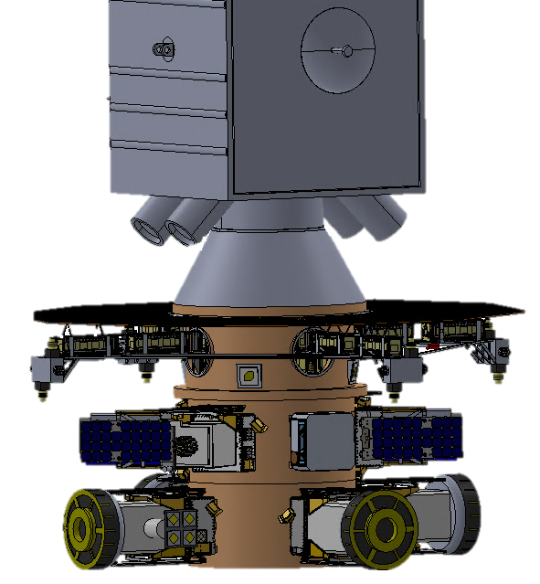
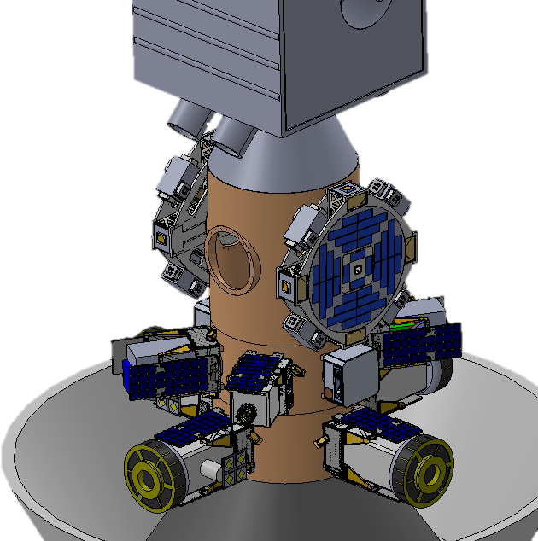
SpinSat Technical Approach
Technical Approach: Phased to enable rapid validation of overall strategy & execution of initial experiments, followed by refinement and larger platforms, while remaining cost effective:
Operational Demo (LEO/sun-sync. orbit):
Simultaneous Lunar, Mars, & Earth Gravity
Compatible with ESPA Grande Ring (610 mm ports)
1.3 m Diameter; > 300W
ESPA Port Mount: ~launch vehicle agnostic
Common Simple Data Interface
~12 month lifetime
Block 1: Production Design (Deep Space)
Up 64 ‘U’ of payloads in various configurations
Deep-space orbit or high-inclination sun-synchronous
~1 – 3 year lifetime
Block 2: Production Design (Deep Space)
3+m diameter, 2 kW, >300 ‘U’ payload volume
Deep space orbit (agnostic)
Block 1
Block 2
As an ESPA-port secondary, SpinSat accommodates up to 64 ‘U’ of experimental payloads (16x BioSentinel)
As an ESPA-stack secondary > 300 ‘U’ (75x BioSentinel), allowing for a robust program of biological experiments

Slide 15
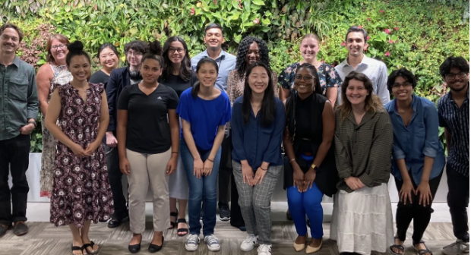
SpinSat as a Platform for Early Career Researchers
SpinSat can provide researchers a user-friendly platform for frequent and inexpensive Class D opportunities to continue technical innovation and to train the next generation of principal investigators & leaders.
Spinsat payloads are ideal for both NASA and international projects at a range of levels
Students from the 2023 Climate Change Research Initiative

Slide 16
SpinSat’s Powerful Ideation Team
Jay Bookbinder PI / Capture Manager Ames Research Ctr. (ARC)
Pascale Ehrenfreund Science Lead (COSPAR President, former DLR Science Director) GWU
Scott Richey Project Manager, programmatics ARC
Tony Ricco Payload instrument manager, biology, microfluidics ARC
Rob Ferl Science, programmatics (BPS Decadal Co-Chair) Univ. of Florida
Anna-Lisa Paul Science, plant molecular biology (NAS CBPSS) Univ. of Florida
Christine Mehner Human biology & Cancer Premier research
Thomas Paige Senior systems engineer Aerospace Corp.
Richard Welle Senior S/C systems engineer Aerospace Corp.
Alberto Arredondo S/C systems engineer Aerospace Corp.
Mark Looper Radiation scientist Aerospace Corp.
Jessica Lee Science, microbiology ARC
Bruce Yost Project management, programmatics ARC
Randii Wessen Capture Management ARC
Code R MDC Engineering (Mission Design Center) ARC
Funding from NASA’s Ames Research Center and the NASA Mars Campaign Office

