Slide 1
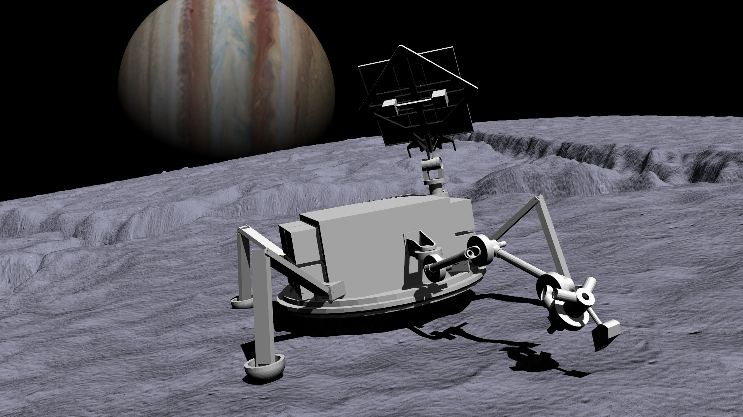
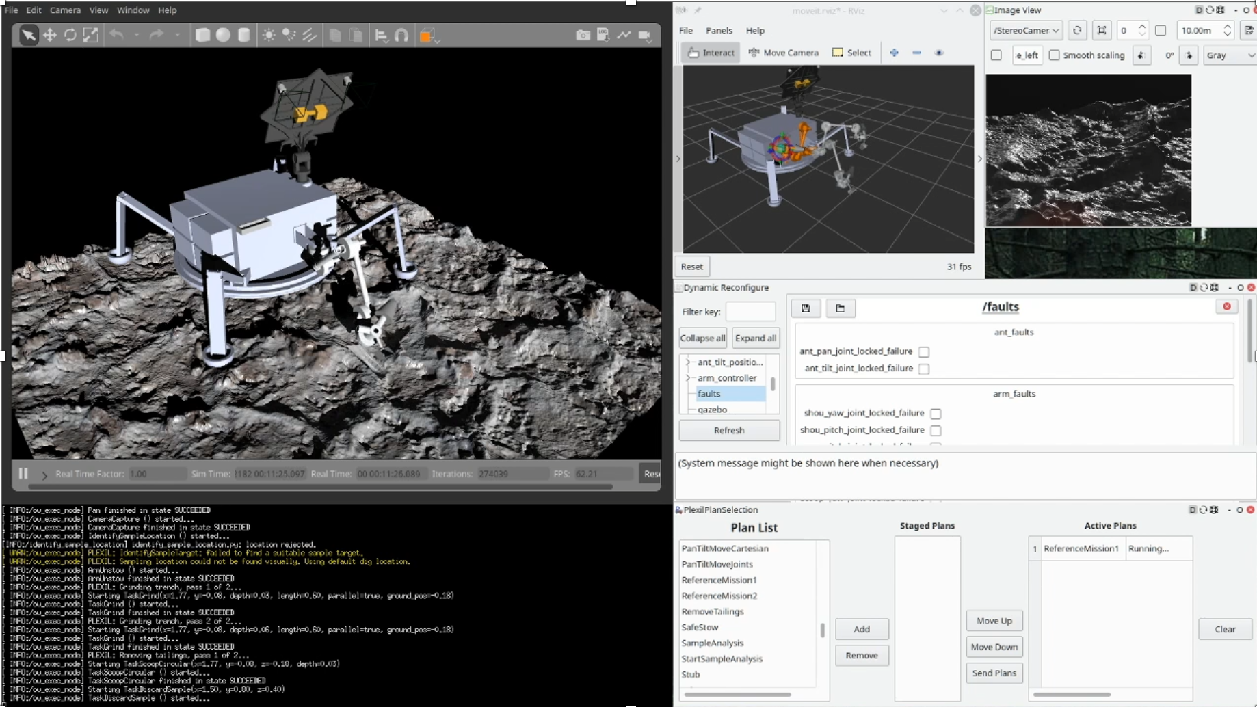
OceanWATERS
An Autonomy Testbed for Ocean World Surface Missions
OceanWATERS = Ocean World Autonomy Testbed for Exploration Research and Simulation
Open-source software for developing and testing autonomy for a simulated Europa lander
Presented by K. Michael Dalal, KBR Inc. at NASA Ames Research Center (michael.dalal@nasa.gov)
Software: github.com/nasa/ow_simulator

Slide 2
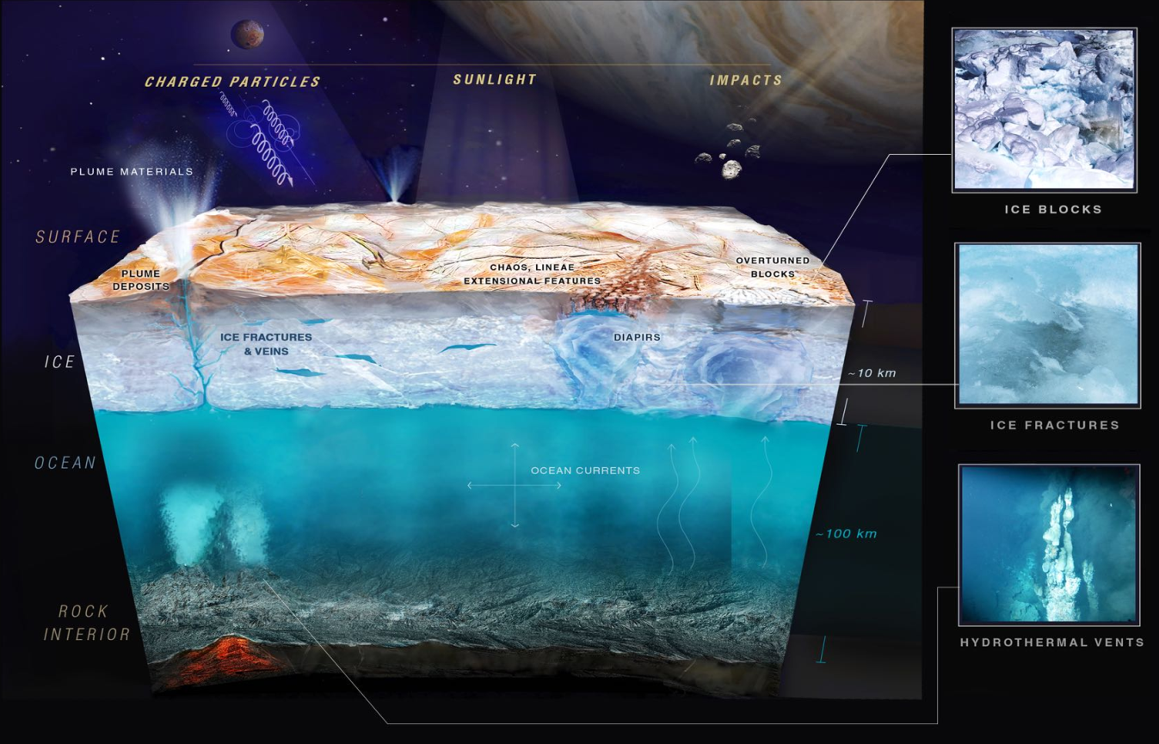
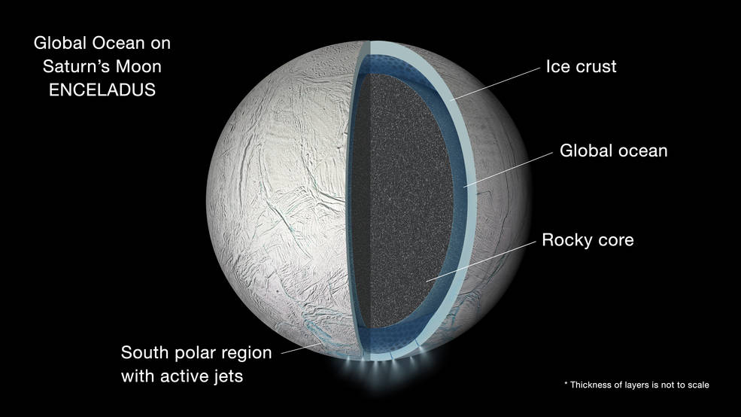
Motivation: develop autonomy for surface missions to Ocean Worlds

Slide 3
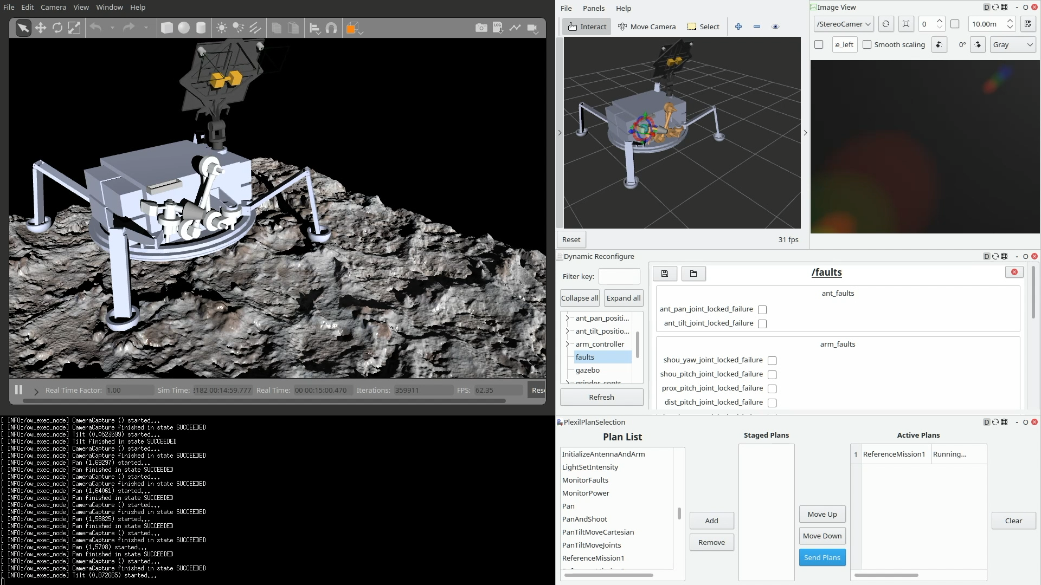
OceanWATERS demo: nominal sampling sequence

