Slide 1
Parametric Trade Space Investigation of Particle Bed Reactors for Nuclear Thermal Propulsion
Jacob Stonehill
Nuclear Systems Engineer, AMA
Supported by: Corey Smith (AMA), Daria Nikitaeva (AMA), and Matthew Duchek (AMA)

Slide 2
Acknowledgements
This work was supported by NASA’s Space Technology Mission Directorate (STMD) through the Space Nuclear Propulsion (SNP) Project
Contract No. 80LARC23DA003

Slide 3
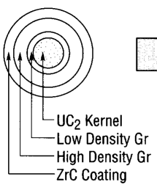
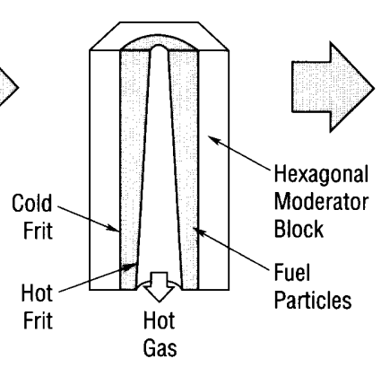
Overview of Particle Bed Reactors (PBR)
Promises high power density with lower pressure drop in the core.
Characterized by radial flow through particles packed in an annular bed.
Bed is enclosed by a cold frit and a hot frit.
Propellant is hydrogen.
Many previous design space investigations (SNTP) but they utilized HEU.
[1]
Can we modify the SNTP design to utilize HALEU fuel?

Slide 4
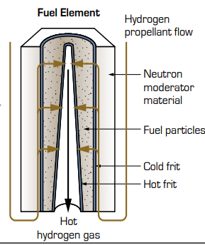
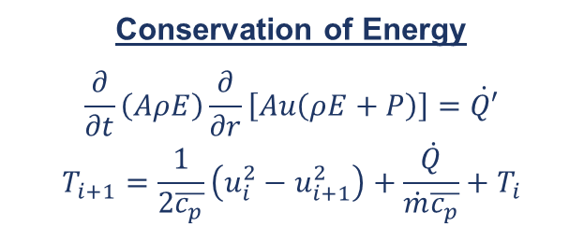
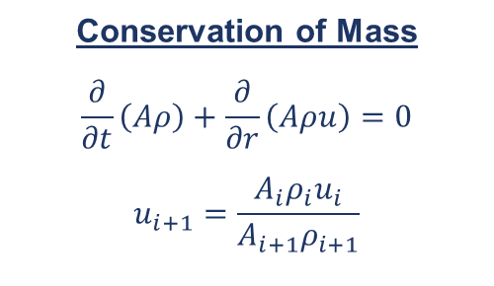
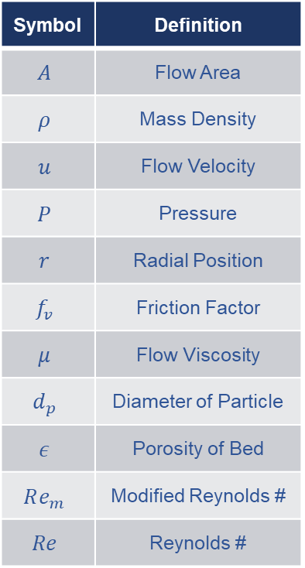
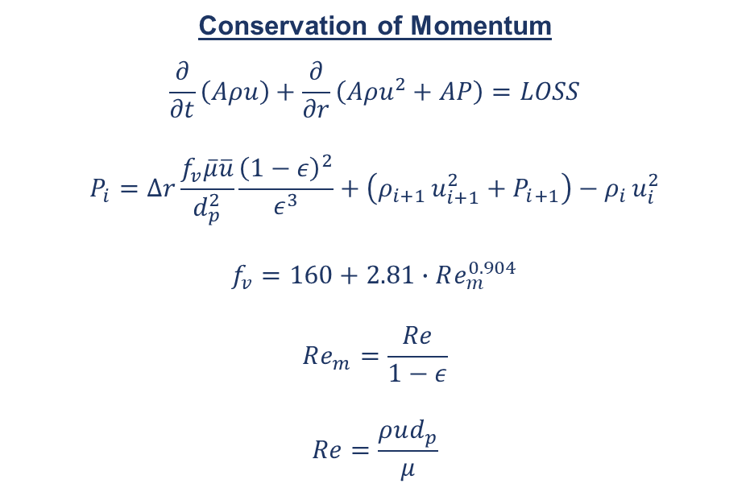
T/H Modeling Methodology
A simplified thermal model with porous media pressure drop.
Conservation of Mass
$$\frac{∂}{∂t}\left(Aρ\right)+\frac{∂}{∂r}\left(Aρu\right)=0$$
$$u_{i+1}=\frac{A_{i}ρ_{i}u_{i}}{A_{i+1}ρ_{i+1}}$$
Conservation of Momentum
$$\frac{∂}{∂t}\left(Aρu\right)+\frac{∂}{∂r}\left(Aρu^{2}+AP\right)=LOSS$$
$$P_{i}=Δr\frac{f_{v}\overline{μ}\overline{u}}{d_{p}^{2}}\frac{{\left(1−ε\right)}^{2}}{ε^{3}}+\left(ρ_{i+1 }u_{i+1}^{2}+P_{i+1}\right)−ρ_{i }u_{i}^{2}$$
$$f_{v}=160+2.81∙Re_{m}^{0.904}$$
$$Re_{m}=\frac{Re}{1−ε}$$
$$Re=\frac{ρud_{p}}{μ}$$
Symbol | Definition
$$A$$ | Flow Area
$$ρ$$ | Mass Density
$$u$$ | Flow Velocity
$$P$$ | Pressure
$$r$$ | Radial Position
$$f_{v}$$ | Friction Factor
$$μ$$ | Flow Viscosity
$$d_{p}$$ | Diameter of Particle
$$ε$$ | Porosity of Bed
$$Re_{m}$$ | Modified Reynolds #
$$Re$$ | Reynolds #
Conservation of Energy
$$\frac{∂}{∂t}\left(AρE\right)\frac{∂}{∂r}\left[Au\left(ρE+P\right)\right]=\dot{Q′}$$
$$T_{i+1}=\frac{1}{2\overline{c_{p}}}\left(u_{i}^{2}−u_{i+1}^{2}\right)+\frac{\dot{Q}}{\dot{m}\overline{c_{p}}}+T_{i}$$
1
2
1
2
E. Erdim, Ö. Akgiray, and İ. Demir, “A revisit of pressure drop-flow rate correlations for packed beds of spheres,” Powder Technology, vol. 283, pp. 488–504, Oct. 2015, doi: https://doi.org/10.1016/j.powtec.2015.06.017.
[2]

Slide 5
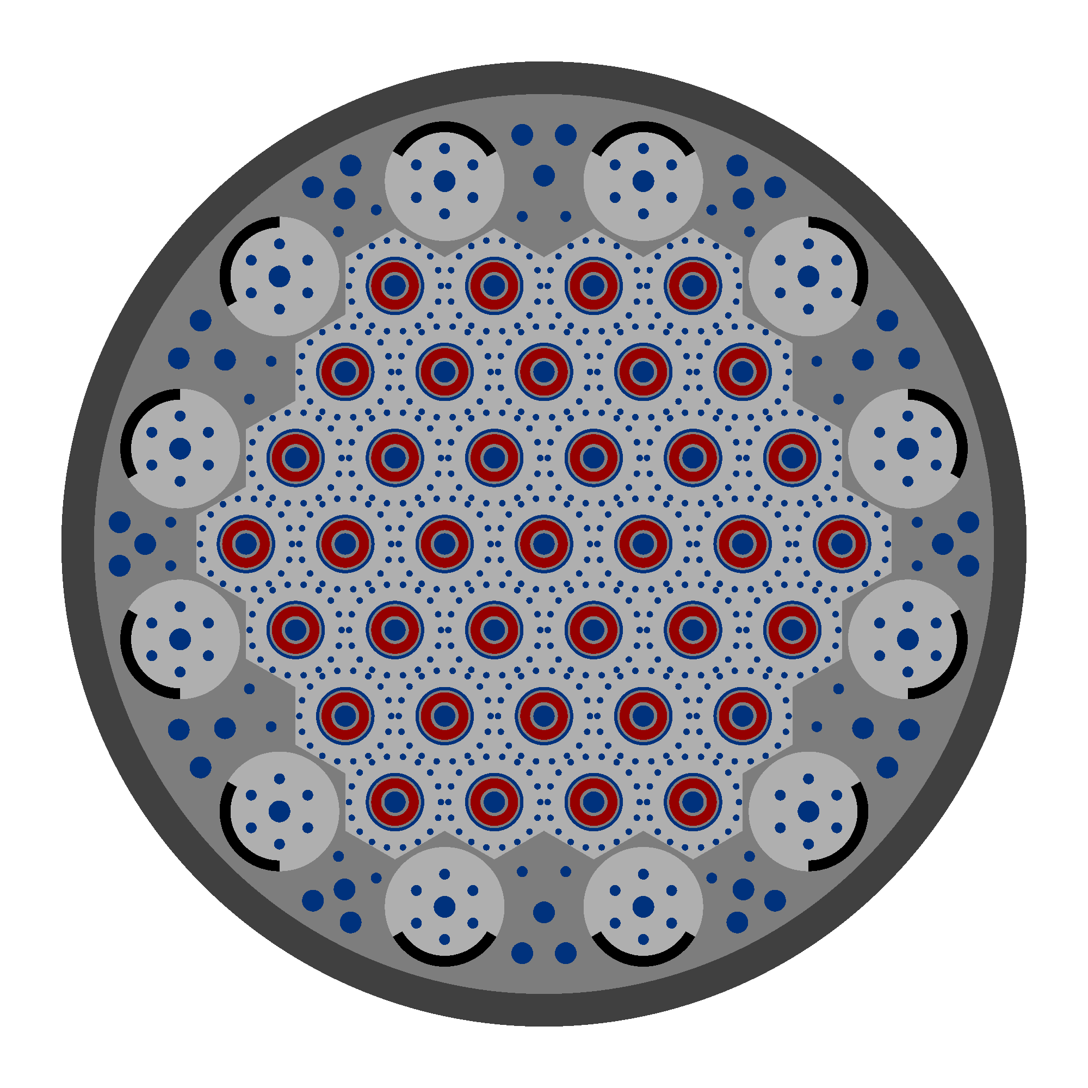
Neutronics Model
We used the same OpenMC generator methodology as previous work.
A neutronics model for the SNTP has been developed in OpenMC.
The default SNTP design is updated on the fly using CSV input files.
User only supplies variables they’d like to change relative to the default design.
Geometry and materials can be swapped for parametric studies.
Temperatures can be updated which allows for multiphysics coupling.

Slide 6
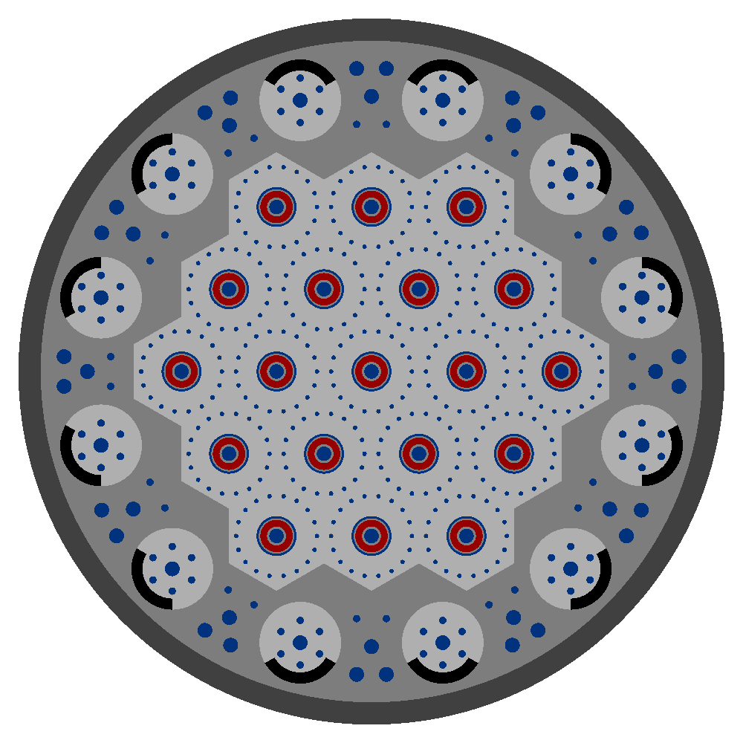
Neutronics Model
Designs are generated by simply modifying a single variable in the input file.
“Increase poison vane thickness.”
“Increase fuel pitch.”
“Remove 1 fuel ring.”
1
2
3

Slide 7
Global Level Coupling Routine
Physics models are solved iteratively to steady state, ensuring tightly coupled solution.
Get Next Set of Design Parameters
Save T/H & Neutronics to Output File
PBR T/H Code
OpenMC Generator
Yes
Calculate Power to Achieve Fuel Temperature Limit
No
Calculate Updated FA Power Fraction
FA Power Fraction Assumption
Is Converged?
Solve T/H
Build Neutronics

Slide 8
Initial Trade Space Investigation
Small investigation is complete, with more to come!
Current Status
Initial trade space investigation is complete.
  640 converged multiphysics cases.
  Solutions are stable.
    No cases diverged.
    Most cases converged in 3-5 multiphysics iterations.
  Avg ~10 minute run time to multiphysics convergence.
    Used 2 nodes on AMA’s computational cluster.
Key Takeaways
A critical reactor using HALEU fuel is possible.
Criticality is sensitive to core length and particle radius.
Mass is sensitive to core length, leaving particle radius as a promising parameter.
Parameter | Range
Core Length | 50 – 200 [cm]
Packing Fraction | 0.53 – 0.74
Mass Flow Rate | 5 – 20 [kg/s]
Particle Radius | 0.15 – 0.5 [mm]
Bed Modifier* | 0.25 – 1.0
  * Bed Modifier is a value multiplied to the fuel assembly inner channel radius and the hot frit outer radius. Effectively, as the bed modifier decreases, the particle bed thickness increases.

Slide 9
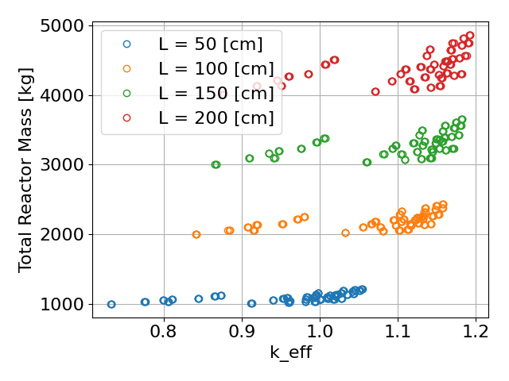
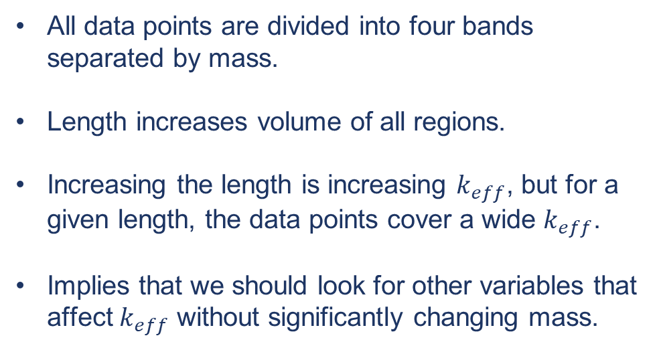
Total Reactor Mass
Total reactor mass is sensitive to reactor length.
All data points are divided into four bands separated by mass.
Length increases volume of all regions.
Increasing the length is increasing $k_{eff}$, but for a given length, the data points cover a wide $k_{eff}$.
Implies that we should look for other variables that affect $k_{eff}$ without significantly changing mass.
*Total Mass Calculation includes everything in-between “top” of fuel assembly
and “bottom” of fuel assembly:
INCLUDES: Fuel Particles, Frits, Moderator, Core Interface, Control Drums,
Poison Vanes, Reflector, and Pressure Vessel
DOES NOT INCLUDE: Shielding, Pressure Vessel Dome, Control Drum Motors,
or any Forward/Aft Components

Slide 10
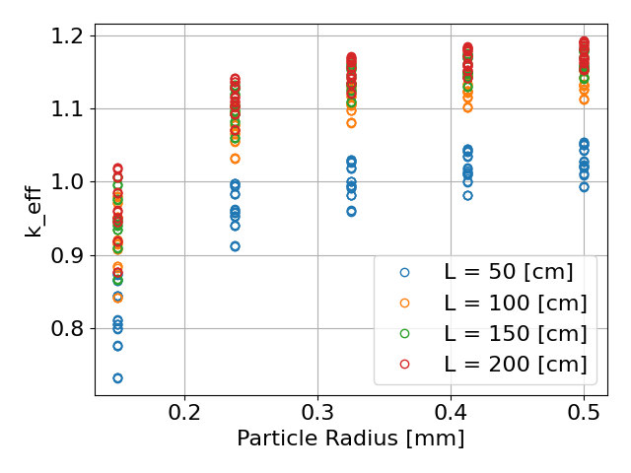
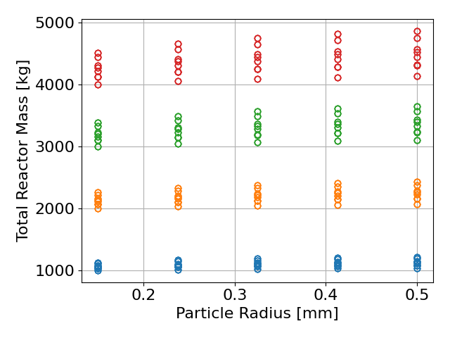
Impact of Particle Radius
Increasing particle radius can increase $k_{eff}$ without significantly increasing mass.

Slide 11
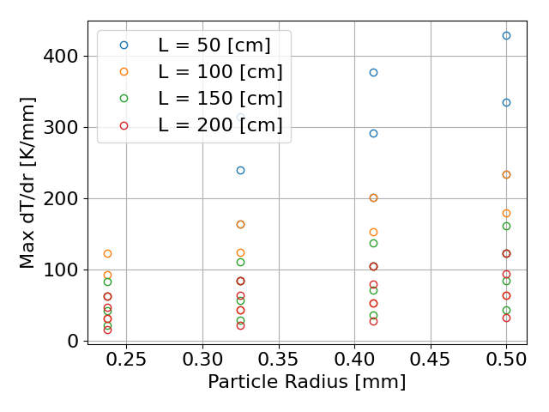
Conclusions & Forward Work
Higher fidelity models are needed to confirm conclusions.
Conclusions
Initial trade space shows that a HALEU-fueled reactor is possible.
Radial position impacts fuel assembly power deposition.
  For traditional cores, we can adjust volume loading.
  For PBRs, we need to vary some other parameter:
    Enrichment
    Bed Thickness
    Particle Radius
    Mass Flow Rate
Forward Work
2D T/H Model
  The 1D model is capturing general power balance trends, but we need to capture axial flow for better peak temperature modeling.
Larger Trade Space
  Wider Parameter Bounds.
  Different Materials.
  Radial Rings

Slide 12
References
[1] H. LUDEWIG, et. al., “Design of particle bed reactors for the space nuclear thermal propulsion program,” Progress in Nuclear Energy, 30, 1, (1996).
[2] M. HOUTS and S. MITCHELL, “Development and Utilization of Nuclear Thermal Propulsion,” Nuclear and Emerging Technologies for Space, Huntsville, (2016).
[3] E. ERDIM, O. AKGIRAY, and I. DEMIR, “A revisit of pressure drop-flow rate correlations for packed beds of spheres,” Powder Technology, 283, 488-504, (2015).
[4] S. ERGUN, “Fluid Flow through Packed Columns,” Chemical Engineering Progress, 48, 89-94, (1952).
[5] E. ACHENBACH, “Heat and flow characteristics of packed bed,” Experimental Thermal and Fluid Science, 10, 1, 17-27, (1995).
[6] P. ROMANO, et. al., “OpenMC: A State-of-the-Art Monte Carlo Code for Research and Development,” Ann. Nucl. Energy, 82, 90-97 (2015).
[7] M. B. CHADWICK, et. al., “ENDF/B-VII.1: Nuclear Data for Science and Technology: Cross Sections, Covariances, Fission Product Yields and Decay Data,” Nucl. Data Sheets, 112, (2011).
[8] J. STONEHILL, D. NIKITAEVA, C. SMITH and M. DUCHEK, "Coupled Reactor and Engine Nuclear Thermal Propulsion Modeling Methodology,“ Nuclear and Emerging Technologies for Space, Santa Fe, (2024).

Slide 13
Questions?
Jacob Stonehill
jacob.c.Stonehill@ama-inc.com

