Slide 1
Methane-based Nuclear Thermal Propulsion Engine Considerations
Daria Nikitaeva
Lead Aerospace Engineer, AMA
Supported by: Corey D. Smith (AMA) and Matthew Duchek (AMA)

Slide 2
Acknowledgements
This work was supported by NASA’s Space Technology Mission Directorate (STMD) through the Space Nuclear Propulsion (SNP) Project
Contract No. 80LARC23DA003

Slide 3
Why Methane NTP?
Trading Isp for Tank Mass: Where Methane Fits on the Propellant Spectrum
Objective: compare how propellant choice shifts engine performance, storage logistics, and mission suitability.
Methane offers a middle ground—higher density and easier cryogenics than hydrogen, yet better performance than storable ammonia.
Driver | H‑NTP (LH₂) | M‑NTP (LCH₄) | A‑NTP (LNH₃)
Isp @ 2700 K | ~900 s | 350 – 500 s | ~370 s
Storage & Density | 14–33 K, 71 kg m⁻³ → large, deep‑cryo tanks | 91–190 K, 657 kg m⁻³ → ~9× denser, “soft‑cryo” | 195–405 K, 730 kg m⁻³ → ambient storable
Cycle Changes | Baseline expander; needs boost pump | Same expander; drop boost pump, add pyrolysis heat margin | Serial pre‑heat loop, extra pumps, no boost pump
Ground Test / Safety | Highly flammable H₂; embrittlement issues | Moderate flammability; low leak hazard; coking manageable; pyrolysis products detonation risks | Toxic vapor, but non‑flammable; easy handling
Best‑Fit Missions | High‑ΔV crewed Mars transfers | Cislunar tugs, Mars cargo, reusable stages | Long‑dwell depots, low‑Isp cargo where simplicity rules
Methane cuts tank mass and cryo burden, yet its mid‑range Isp hinges on extra reactor power and strict mitigation of coking and pyrolysis‑detonation risks.

Slide 4
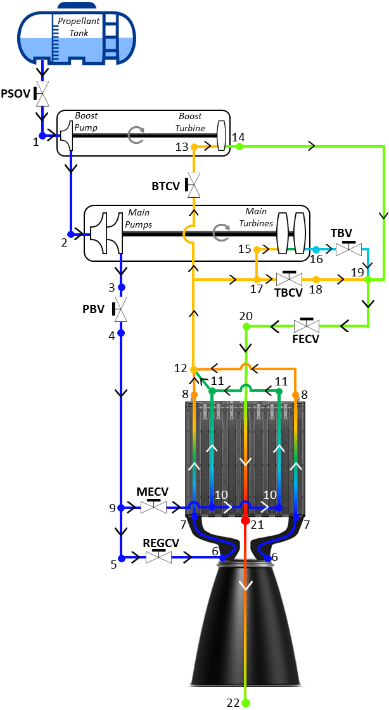
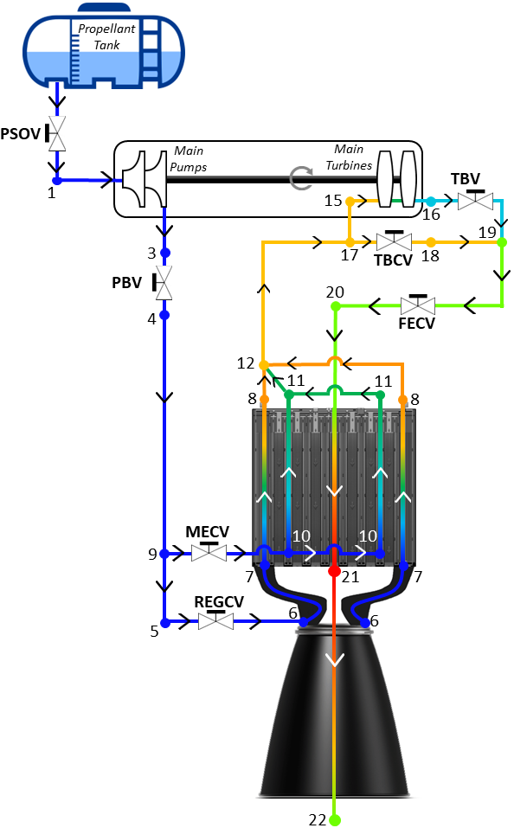
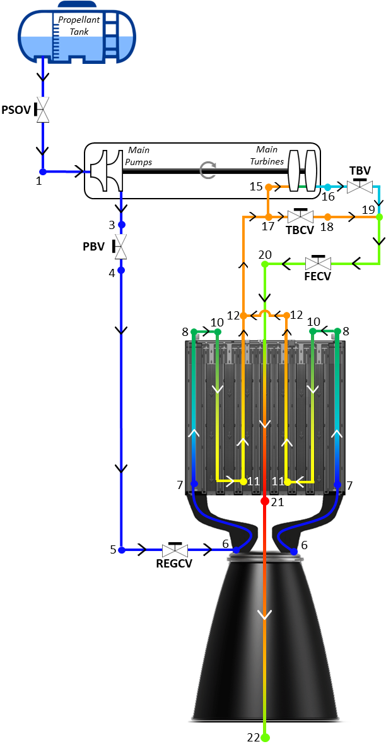
Engine Architecture Overview
How Propellant Choice Reshapes the NTP Expander Cycle
Boost Hardware: LH₂ needs a boost pump; CH₄ & NH₃ delete it, but NH₃ pays a pre‑heat penalty.
Super‑Critical Transition: LH₂ exits pumps already super‑critical (State 2); CH₄ crosses the line in reg‑cooling (State 6→7); NH₃ flows into pre‑heat, reaching super‑critical only near State 12.
Pre‑Heat / Routing: NH₃ adds serial pre‑heat rings; CH₄ keeps TRD’s parallel loops; LH₂ baseline remains unchanged.
Pump Sizing: NH₃’s density drives the largest mass‑flow pumps; CH₄ sits mid‑range; LH₂ runs high‑RPM, low‑flow.
Thermal & Power Load: LH₂ soaks heat but attacks walls; CH₄ needs extra reactor power for endothermic cracking; NH₃ needs added ΔT to clear its critical point.
Risk Focus: LH₂: hot‑hydrogen attack; NH₃: ΔP & pre‑heater stress; CH₄: channel coking, pyrolysis detonation, and truncated‑nozzle test uncertainty.
H-NTP
A-NTP
M-NTP
Switching to CH₄ trims pump/pre‑heat hardware but trades in higher reactor power and coking risks—lighter gear, not simpler ops.

Slide 5
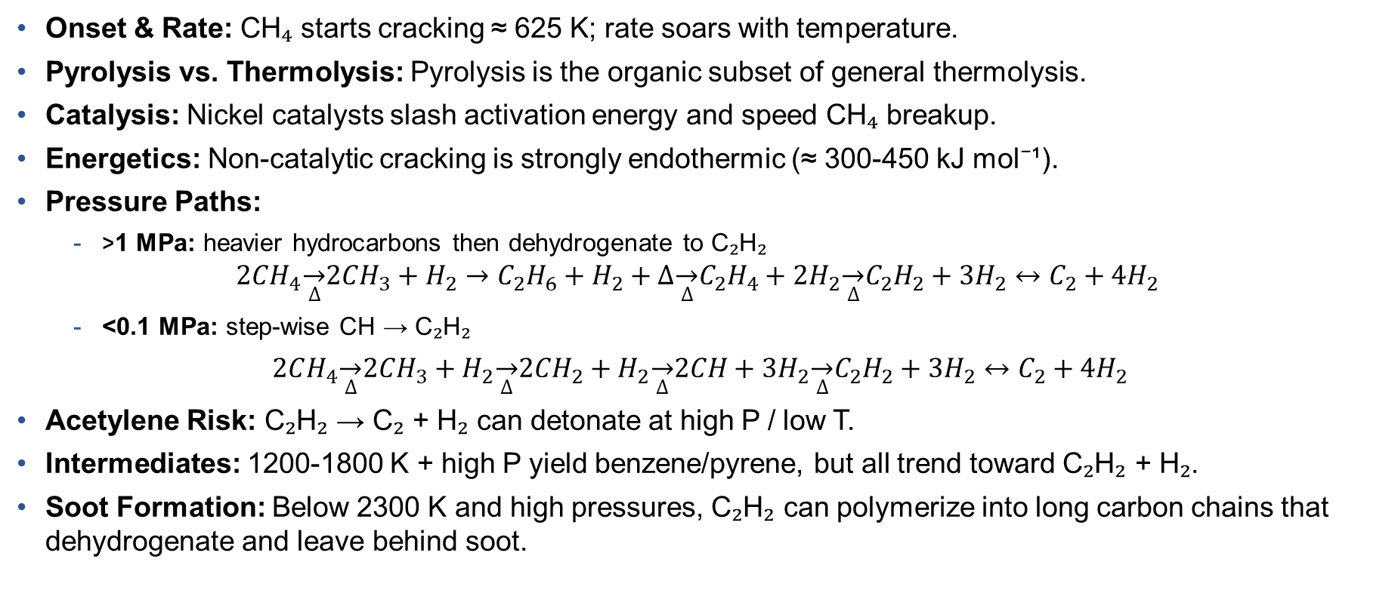
Methane Pyrolysis Landscape
Temperature‑pressure routes, catalytic boosts, and detonation‑soot pitfalls
Onset & Rate: CH₄ starts cracking ≈ 625 K; rate soars with temperature.
Pyrolysis vs. Thermolysis: Pyrolysis is the organic subset of general thermolysis.
Catalysis: Nickel catalysts slash activation energy and speed CH₄ breakup.
Energetics: Non‑catalytic cracking is strongly endothermic (≈ 300‑450 kJ mol⁻¹).
Pressure Paths:
  >1 MPa: heavier hydrocarbons then dehydrogenate to C₂H₂
  $$2CH_{4}\overset{→}{∆}2CH_{3}+H_{2}→C_{2}H_{6}+H_{2}+∆\overset{→}{∆}C_{2}H_{4}+2H_{2}\overset{→}{∆}C_{2}H_{2}+3H_{2}↔C_{2}+4H_{2}$$
  <0.1 MPa: step‑wise CH → C₂H₂
  $2CH_{4}\overset{→}{∆}2CH_{3}+H_{2}\overset{→}{∆}2CH_{2}+H_{2}\overset{→}{∆}2CH+3H_{2}\overset{→}{∆}C_{2}H_{2}+3H_{2}↔C_{2}+4H_{2}$
Acetylene Risk: C₂H₂ → C₂ + H₂ can detonate at high P / low T.
Intermediates: 1200‑1800 K + high P yield benzene/pyrene, but all trend toward C₂H₂ + H₂.
Soot Formation: Below 2300 K and high pressures, C₂H₂ can polymerize into long carbon chains that dehydrogenate and leave behind soot.
CH₄ cracking is strongly endothermic and pressure‑dependent; without ≥2300 K, acetylene & soot accumulate and can detonate—critical hazards that must be managed for M‑NTP viability.

Slide 6
Acetylene — The Critical Pivot in Methane Cracking
Stability, detonation, and polymerization windows across pressure–temperature space
Common Intermediate: Acetylene (C₂H₂) appears in virtually all hydrocarbon cracking and is thermally stable at high temperature and pressure.
Detonation Window: < 500 K + > 1 MPa in H₂ can trigger spontaneous C₂H₂ combustion.
Low‑Pressure Behavior (< 0.1 MPa):
  Stable to ~1300 K; begins C₂H₂ → C₂ + H₂ below 2300 K.
  C₂H₂ ⇌ C₂ + H₂ equilibrium above 2300 K; full C₂ → 2 C needs > 3000 K.
  Radicals CH and C₂H dominate residual species.
Industrial Note: Low pressure pyrolysis of C₂H₂ yields “acetylene black” carbon for batteries.
High‑Pressure Behavior (> 1 MPa):
  Low Temperature: Rapid exothermic detonation.
  High Temperature: Polymerizes to larger hydrocarbons, releasing H₂.
C₂H₂ is the inevitable mid‑product: safe below ~1 bar to 1300 K, but it detonates at > 1 MPa & < 500 K and soots/polymerizes above 2300 K—tight Pressure/Temperature control is mandatory to prevent explosions or carbon buildup in M‑NTP engines.

Slide 7
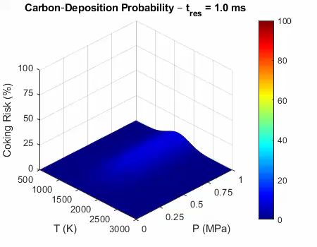
Coking Window in an M‑NTP Engine
Temperature–pressure map of where acetylene turns into solid carbon
C₂H₂ is the soot gatekeeper: forms readily during CH₄ cracking, then seeds solid carbon once wall temperature falls below ≈ 2300 K.
Two growth modes:
  Interstitial uptake—carbon diffuses into coatings until they saturate
  Surface filament accretion—layer‑by‑layer growth that eventually spalls off, entraining metal flakes in the plume.
Stick‑zone is narrow: peak carbon growth 1200–2000 K under high‑P, long‑residence flow; > 2500 K re‑gasifies deposits, < 500 K at > 1 MPa risks spontaneous C₂H₂ detonation.
Hot‑zone self‑cleans: fuel channels & throat (> 2600 K, < 1 ms wall‑time) stay above stick‑zone
Vulnerable surfaces: coking threat shifts to cooler, slower regions: channel exits & diverging nozzle
Mitigation cues: maintain wall > 2500 K or accelerate flow; small hydrocarbon bleed can curb metal mass‑loss but does not eliminate downstream soot.
Coking is a localized hazard: it occurs only in 1200–2000 K, high‑pressure, slow‑flow pockets (channel exits & diverging nozzle) while the ≥ 2600 K core/throat stay self‑clean—keep walls hot or flow fast to stay outside the stick‑zone.

Slide 8
M-NTP TRD Preliminary Performance Estimates
5–7 MPa champer pressures, divergent kinetics, coking zone, and after‑burn boost/threat
High‑pressure kinetics unknown: Existing models diverge 10X above 0.4 MPa; real plume could sit anywhere between the three bounding cases.
Performance vs hazard trade: Conditions that degrade Isp (polymerisation) also push the flow into the coking stick‑zone; best‑Isp scenario is thermally harder on the nozzle but carbon‑free.
Residence‑time lever: Reactor injector is 0.2–0.5 MPa above chamber pressure slows pre‑core flow, lengthening τ just where temperature is falling → highest deposition probability sits at channel exits & diverging cone.
Potential after‑burner effect: If C₂H₂ survives to low‑T (< 500 K)/high‑P pockets it can detonate in the nozzle, thus boosting thrust or shattering hardware; both outcomes are unquantified.
No millisecond‑scale data at 5–7 MPa: size hardware for ±150 s Isp, ±40 % ṁ, and diverging‑nozzle coking until high‑P, short‑τ CH₄/C₂H₂ tests close the gap.

Slide 9
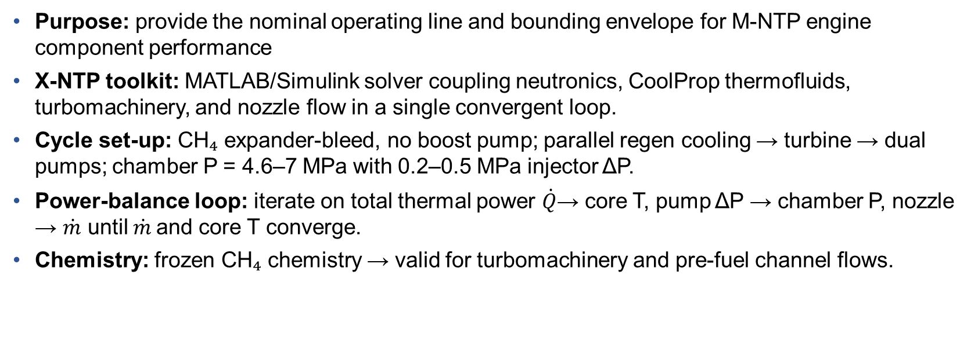
M-NTP Steady State Power Balance Model
Self‑consistent CH₄ baseline for sizing and trade studies
Purpose: provide the nominal operating line and bounding envelope for M‑NTP engine component performance
X‑NTP toolkit: MATLAB/Simulink solver coupling neutronics, CoolProp thermofluids, turbomachinery, and nozzle flow in a single convergent loop.
Cycle set‑up: CH₄ expander‑bleed, no boost pump; parallel regen cooling → turbine → dual pumps; chamber P = 4.6–7 MPa with 0.2–0.5 MPa injector ΔP.
Power‑balance loop: iterate on total thermal power $\dot{Q}$→ core T, pump ΔP → chamber P, nozzle → $\dot{m}$ until $\dot{m}$and core T converge.
Chemistry: frozen CH₄ chemistry → valid for turbomachinery and pre-fuel channel flows.
X‑NTP fixes the CH₄ expander‑bleed baseline—matching core heat, pump ΔP, and nozzle ṁ at 5–7 MPa—so hardware sizing and all chemistry/coking trades start from a single, self‑consistent point.

Slide 10
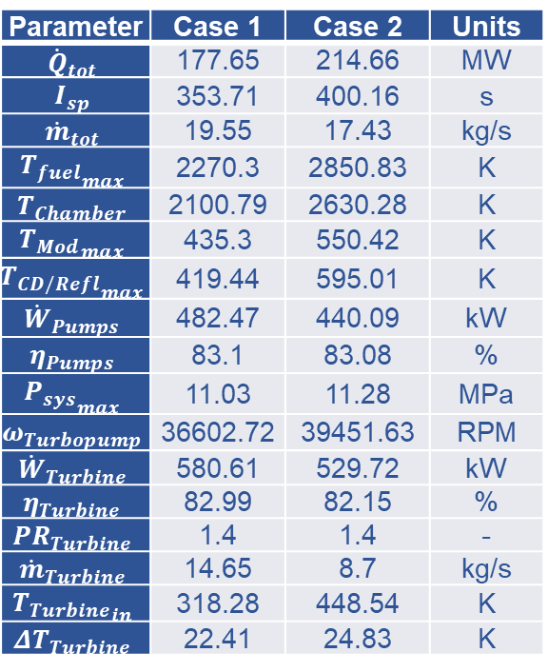
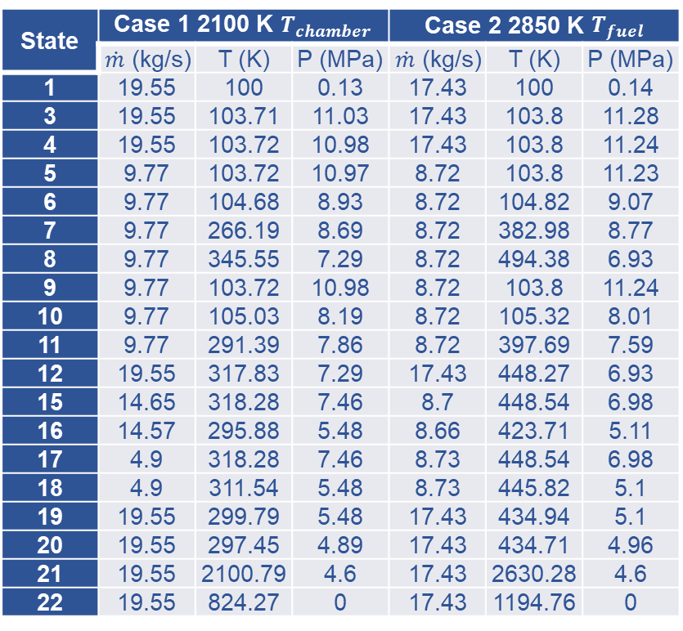
M-NTP TRD Informed PBM Results
Frozen‑chemistry baseline—conservative sizing, not final performance
M-NTP PBM
State | Case 1 2100 K $T_{chamber}$ |  |  | Case 2 2850 K $T_{fuel}$
 | $\dot{m}$ (kg/s) | T (K) | P (MPa) | $\dot{m}$ (kg/s) | T (K) | P (MPa)
1 | 19.55 | 100 | 0.13 | 17.43 | 100 | 0.14
3 | 19.55 | 103.71 | 11.03 | 17.43 | 103.8 | 11.28
4 | 19.55 | 103.72 | 10.98 | 17.43 | 103.8 | 11.24
5 | 9.77 | 103.72 | 10.97 | 8.72 | 103.8 | 11.23
6 | 9.77 | 104.68 | 8.93 | 8.72 | 104.82 | 9.07
7 | 9.77 | 266.19 | 8.69 | 8.72 | 382.98 | 8.77
8 | 9.77 | 345.55 | 7.29 | 8.72 | 494.38 | 6.93
9 | 9.77 | 103.72 | 10.98 | 8.72 | 103.8 | 11.24
10 | 9.77 | 105.03 | 8.19 | 8.72 | 105.32 | 8.01
11 | 9.77 | 291.39 | 7.86 | 8.72 | 397.69 | 7.59
12 | 19.55 | 317.83 | 7.29 | 17.43 | 448.27 | 6.93
15 | 14.65 | 318.28 | 7.46 | 8.7 | 448.54 | 6.98
16 | 14.57 | 295.88 | 5.48 | 8.66 | 423.71 | 5.11
17 | 4.9 | 318.28 | 7.46 | 8.73 | 448.54 | 6.98
18 | 4.9 | 311.54 | 5.48 | 8.73 | 445.82 | 5.1
19 | 19.55 | 299.79 | 5.48 | 17.43 | 434.94 | 5.1
20 | 19.55 | 297.45 | 4.89 | 17.43 | 434.71 | 4.96
21 | 19.55 | 2100.79 | 4.6 | 17.43 | 2630.28 | 4.6
22 | 19.55 | 824.27 | 0 | 17.43 | 1194.76 | 0
Parameter | Case 1 | Case 2 | Units
$${\dot{Q}}_{tot}$$ | 177.65 | 214.66 | MW
$$I_{sp}$$ | 353.71 | 400.16 | s
$${\dot{m}}_{tot}$$ | 19.55 | 17.43 | kg/s
$${T_{fuel}}_{max}$$ | 2270.3 | 2850.83 | K
$$T_{Chamber}$$ | 2100.79 | 2630.28 | K
$${T_{Mod}}_{max}$$ | 435.3 | 550.42 | K
$${T_{CD/Refl}}_{max}$$ | 419.44 | 595.01 | K
$${\dot{W}}_{Pumps}$$ | 482.47 | 440.09 | kW
$$η_{Pumps}$$ | 83.1 | 83.08 | %
$${P_{sys}}_{max}$$ | 11.03 | 11.28 | MPa
$$ω_{Turbopump}$$ | 36602.72 | 39451.63 | RPM
$${\dot{W}}_{Turbine}$$ | 580.61 | 529.72 | kW
$$η_{Turbine}$$ | 82.99 | 82.15 | %
$${PR}_{Turbine}$$ | 1.4 | 1.4 | -
$${\dot{m}}_{Turbine}$$ | 14.65 | 8.7 | kg/s
$${T_{Turbine}}_{in}$$ | 318.28 | 448.54 | K
$$ΔT_{Turbine}$$ | 22.41 | 24.83 | K
Case 1 & 2 anchor sizing, not performance; high pressure pyrolysis data and models are needed to refine.

Slide 11
M-NTP TRD Informed PBM Takeaways
How higher core temperature reshapes performance and hardware loads
Assumption: tables use frozen CH₄—no cracking, no coking—so ṁ and pump ΔP are high, Isp is the floor.
If CH₄ cracks: expect ↑ Isp, ↓ ṁ, new carbon/after‑burn risks; hardware loads shift.
Sizing criteria: Case 1 limits chamber temperature to 2100 K; Case 2 limits fuel to 2850 K, letting the chamber climb to 2630 K.
Performance shift: Case 2 gains ≈ +45 s Isp (400 s → 354 s) while total mass‑flow drops by ~2 kg s⁻¹ and reactor power rises by ~37 MW.
Pump‑turbine balance: Lower ṁ in Case 2 cuts pump work (440 kW vs 482 kW) but higher channel losses push system pressure to 11.3 MPa and turbopump speed to 39 k RPM.
Critical‑point crossing: Methane becomes super‑critical at regenerative cooling and moderator exits; equal branch flows keep the pressure split stable.
Simplified loop: No boost pump or turbine—states 2, 13, 14 are absent—reducing turbomachinery count but tightening pressure margins.
Elevating core temperature delivers a ~13 % Isp boost and lighter flow, yet demands higher reactor power and system pressure—revealing the core trade between performance and structural/thermal headroom.

Slide 12
Conclusions and Future Work
Path to a data‑driven, flight‑ready M‑NTP engine
Conclusions
Cycle viability: M-NTP runs without a boost pump; engine sees pure methane up to the core inlet.
Performance band: With frozen flow, M‑NTP sits between A-NTP and LH₂/LOx chemical engines; cracking can lift Isp but raises reactor power need.
Chemistry uncertainty: 5–7 MPa, τ < 30 ms kinetics remain unvalidated—models diverge 10X in C₂H₂ yield, driving ±150 s Isp and ±40% ṁ design spread.
Coking risk: Carbon deposition is confined to temperature of 1200–2000 K, high pressure, slow‑flow pockets (channel exits, diverging nozzle); core and throat self‑clean above ≈2600 K.
Future Work
High pressure, millisecond shock‑tube tests at 2500 – 300 K & 5–7 MPa to anchor CH₄ → C₂H₂ kinetics and after‑burn detonation boost/threat.
Reacting‑flow upgrade to X‑NTP—embed validated kinetics for coupled performance‑coking predictions.
Transient start‑up & shutdown studies to test turbine power margin and injector ΔP strategy.
Nozzle materials campaign targeting carbon/metal spall erosion in the diverging cone.
M‑NTP is promising but data‑limited: closing the high‑pressure pyrolysis gap is the next step to turn the broad design envelope into a flight‑ready engine.

Slide 13
References
[1] Robbins, W. H., and Finger, H. B., “An Historical Perspective of the NERVA Nuclear Rocket Engine Technology Program,” NASA Contractor Report NASA-CR-187154, Analytical Engineering Corporation, July 1991.
[2] Linstrom, P., “NIST Chemistry WebBook, NIST Standard Reference Database 69,” National Institute of Standards and Technology, 1997. https://doi.org/10.18434/T4D303
[3] Emrich, W., “Principles of Nuclear Rocket Propulsion,” Butterworth-Heinemann, an imprint of Elsevier, Oxford, United Kingdom, 2016.
[4] Gustafson, J., Kreicicki, M., Swanson, R., Zilka, B., and Witter, J. K., “Space Nuclear Propulsion Fuel and Moderator Development Plan Conceptual Testing Reference Design,” presented at the Nuclear Emerging Techologies for Space, Virtual Event, 2021.
[5] Nikitaeva, D., “Implications of Alternative In-Situ Propellants Used in Nuclear Thermal Propulsion Engines,” Dissertation. University of Alabama in Huntsville, Huntsville, AL, 2021.
[6] Nikitaeva, D., and Thomas, D. L., “Alternative Propellant Nuclear Thermal Propulsion Engine Architectures,” Journal of Spacecraft and Rockets, 2022, pp. 1–11. https://doi.org/10.2514/1.A35289
[7] Nikitaeva, D., Smith, C. D., and Duchek, M., “Engine Cycle Comparison for Alternative Propellant Nuclear Thermal Propulsion Engines,” presented at the ASCEND 2023, Las Vegas, Nevada, 2023. https://doi.org/10.2514/6.2023-4715
[8] Selcow, E. C., Davis, R. E., Perkins, K. R., Ludewig, H., and Cerbone, R. J., “Assessment of the Use of H2, CH4, NH3, and CO2 as NTR Propellants,” In Proceedings of the ninth symposium on space nuclear power systems, Vol. 246, Albuquerque, New Mexico (USA), 1992, pp. 721–727. https://doi.org/10.1063/1.41867
[9] Joyner, C. R., Eades, M., Horton, J., Jennings, T., Kokan, T., Levack, D. J. H., Muzek, B. J., and Reynolds, C. B., “LEU NTP Engine System Trades and Mission Options,” Nuclear Technology, Vol. 206, No. 8, 2020, pp. 1140–1154. https://doi.org/10.1080/00295450.2019.1706982
[10] Stephens, J., and Johnson, W., “Cryogenic Fluid Management - Technology Development Roadmaps,” Huntsville, AL, Apr 04 2017.
[11] Plooster, M. N., and Reed, T. B., “Carbon-Hydrogen-Acetylene Equilibrium at High Temperatures,” The Journal of Chemical Physics, Vol. 31, No. 1, 1959, pp. 66–72. https://doi.org/10.1063/1.1730338
[12] Holmen, A., Rokstad, O. A., and Solbakken, A., “High-Temperature Pyrolysis of Hydrocarbons. 1. Methane to Acetylene,” Industrial & Engineering Chemistry Process Design and Development, Vol. 15, No. 3, 1976, pp. 439–444. https://doi.org/10.1021/i260059a017
[13] Punia, A., Tatum, J., Kostiuk, L., Olfert, J., and Secanell, M., “Analysis of Methane Pyrolysis Experiments at High Pressure Using Available Reactor Models,” Chemical Engineering Journal, Vol. 471, 2023, p. 144183. https://doi.org/10.1016/j.cej.2023.144183
[14] Nativel, D., Shu, B., Herzler, J., Fikri, M., and Schulz, C., “Shock-Tube Study of Methane Pyrolysis in the Context of Energy-Storage Processes,” Proceedings of the Combustion Institute, Vol. 37, No. 1, 2019, pp. 197–204. https://doi.org/10.1016/j.proci.2018.06.083
[15] Weimer, A., Dahl, J., Buechler, K., Lewandowski, A., Pitts, R., Bingham, C., and Glatzmaier, G., “THERMAL DISSOCIATION OF METHANE USING A SOLAR COUPLED AEROSOL FLOW REACTOR,” NREL/CP-570-30535, University of Colorado, National Renewable Energy Laboratory, Peak Design, 2001.
[16] Mokashi, M., Bhimrao Shirsath, A., Lott, P., Müller, H., Tischer, S., Maier, L., and Deutschmann, O., “Understanding of Gas-Phase Methane Pyrolysis towards Hydrogen and Solid Carbon with Detailed Kinetic Simulations and Experiments,” Chemical Engineering Journal, Vol. 479, 2024, p. 147556. https://doi.org/10.1016/j.cej.2023.147556
[17] Gardiner, W. C., Owen, J. H., Clark, T. C., Dove, J. E., Bauer, S. H., Miller, J. A., and McLean, W. J., “Rate and Mechanism of Methane Pyrolysis from 2000o to 2700oK,” Symposium (International) on Combustion, Vol. 15, No. 1, 1975, pp. 857–868. https://doi.org/10.1016/S0082-0784(75)80353-5
[18] Napier, D. H., and Subrahmanyam, N., “Pyrolysis of Methane in a Single Pulse Shock Tube,” Journal of Applied Chemistry and Biotechnology, Vol. 22, No. 3, 1972, pp. 303–317. https://doi.org/10.1002/jctb.2720220303

Slide 14
References
[19] Daliah, R., “Technology Landscape: Key Players in Methane Pyrolysis,” Lux Research Inc., May 03 2021. https://luxresearchinc.com/blog/technology-landscape-key-players-in-methane-pyrolysis/#:~:text=Catalytic:%20In%20catalytic%20pyrolysis%2C%20methane,facility%20is%20unlikely%20before%202030.
[20] Lamarsh, J. R., and Baratta, A. J., “Introduction to Nuclear Engineering,” Pearson Education, Hoboken, 2018.
[21] Industrial Metal Supply Co., “Metal Melting Points,” Industrial Metal Supply Co., Oct 21 2019.
[22] Izhar, S., Kanesugi, H., Tominaga, H., and Nagai, M., “Cobalt Molybdenum Carbides: Surface Properties and Reactivity for Methane Decomposition,” Applied Catalysis A: General, Vol. 317, No. 1, 2007, pp. 82–90. https://doi.org/10.1016/j.apcata.2006.10.013
[23] Quinn, T. J., and Hume-Rothery, W., “The Equilibrium Diagram of the System Molybdenum-Cobalt,” Journal of the Less Common Metals, Vol. 5, No. 4, 1963, pp. 314–324. https://doi.org/10.1016/0022-5088(63)90068-7
[24] Doroshko, M. V., “QUALITATIVE AND QUANTITATIVE INVESTIGATION OF SHOCK TUBE THERMAL DECOMPOSITION OF ACETYLENE,” High Temperature Material Processes An International Quarterly of High-Technology Plasma Processes, Vol. 22, No. 4, 2018, pp. 259–271. https://doi.org/10.1615/HighTempMatProc.2018029316
[25] Miller, S. A., “Acetylene - Its Properties, Manufacture, and Uses: Volume One,” Academic Press Inc., New York, NY, 1965.
[26] Miller, S. A., “Acetylene - Its Properties, Manufacture, and Uses: Volume Two,” Academic Press Inc., New York, NY, 1966.
[27] Copenhaver, J., and Bigelow, M., “Acetylene and Carbon Monoxide Chemistry,” Reinhold Publishing Corporation, New York, NY, 1949.
[28] Zádor, J., Fellows, M. D., and Miller, J. A., “Initiation Reactions in Acetylene Pyrolysis,” The Journal of Physical Chemistry A, Vol. 121, No. 22, 2017, pp. 4203–4217. https://doi.org/10.1021/acs.jpca.7b03040
[29] Munson, M. S. B., and Anderson, R. C., “Vinylacetylene as an Intermediate in the Formation of Acetylenic Carbon,” Carbon, Vol. 1, No. 1, 1963, pp. 51–54. https://doi.org/10.1016/0008-6223(63)90009-5
[30] Aten, C. F., and Greene, E. F., “The High Temperature Pyrolysis of Acetylene 1400° to 2500° K,” Combustion and Flame, Vol. 5, 1961, pp. 55–64. https://doi.org/10.1016/0010-2180(61)90073-6
[31] Krestinin, A. V., Raevskii, A. V., and Kislov, M. B., “Growth Rate of Carbon Filaments during Methane Pyrolysis on an Iron Catalyst with Analysis Using a Kinetic–Thermodynamic Approach,” Carbon, Vol. 46, No. 11, 2008, pp. 1450–1463. https://doi.org/10.1016/j.carbon.2008.06.025
[32] Galtsov-Tsientsiala, M. S., Dudoladov, A. O., Grigorenko, A. V., and Vlaskin, M. S., “Study of Soot Deposits during Continuous Methane Pyrolysis in a Corundum Tube,” Applied Sciences, Vol. 13, No. 19, 2023, p. 10817. https://doi.org/10.3390/app131910817
[33] Shirsath, A. B., Mokashi, M., Lott, P., Müller, H., Pashminehazar, R., Sheppard, T., Tischer, S., Maier, L., Grunwaldt, J.-D., and Deutschmann, O., “Soot Formation in Methane Pyrolysis Reactor: Modeling Soot Growth and Particle Characterization,” The Journal of Physical Chemistry A, Vol. 127, No. 9, 2023, pp. 2136–2147. https://doi.org/10.1021/acs.jpca.2c06878
[34] Vlasov, P. A., Akhunyanov, A. R., and Smirnov, V. N., “Experimental Studies and Simulation of Methane Pyrolysis and Oxidation in Reflected Shock Waves Accompanied by Soot Formation,” Kinetics and Catalysis, Vol. 63, No. 2, 2022, pp. 141–156. https://doi.org/10.1134/S0023158422020124
[35] Guéret, C., Daroux, M., and Billaud, F., “Methane Pyrolysis: Thermodynamics,” Chemical Engineering Science, Vol. 52, No. 5, 1997, pp. 815–827. https://doi.org/10.1016/S0009-2509(96)00444-7
[36] Nikitaeva, D., “Seeding Hydrogen Propellant in Nuclear Thermal Propulsion Engines,” Thesis. University of Alabama in Huntsville, Huntsville, AL, 2019.
[37] Nikitaeva, D., Smith, C., D., and Duchek, M., “Effects of Heat Transfer Coefficient Variation on Nuclear Thermal Propulsion Engine Performance,” presented at the Nuclear Emerging Technologies for Space 2023, Idaho Falls, ID, 2023.

Slide 15
Questions?
Daria Nikitaeva
daria.d.nikitaeva@ama-inc.com

