Slide 1
Gen-1 NTP Ground Test Concept of Operations
Daria Nikitaeva
Lead Aerospace Engineer, AMA
Supported by: Matthew Duchek (AMA) and Corey D. Smith (AMA)

Slide 2
Acknowledgements
This work was supported by NASA’s Space Technology Mission Directorate (STMD) through the Space Nuclear Propulsion (SNP) Project
Contract No. 80LARC23DA003

Slide 3
Why Ground-Test NTP?
Re‑establishing test‑stand confidence before committing fissile hardware to flight
Enable Mars‑class missions: Nuclear thermal propulsion (NTP) delivers ≈ 900 s Isp—more than double the best chemical systems—cutting trip time and mass.
Validate engine safety on Earth: Full system characterization (power transients, turbopump dynamics, fission‑product retention) must be proven before any flight authority will clear launch with fissile material.
Bridge the 50‑year test gap: No reactor‑powered rocket has fired at rated thrust since the final NERVA XE‑Prime run in 1972; materials, regs, and analysis tools have all evolved.
Protect mission schedule and budget: Early ground discoveries of design or integration issues are far cheaper—and far less public—than on‑pad or in‑flight failures.
A first‑flight demo can’t be the proof‑point: regulations forbid launching un‑verified fissile hardware; real‑time exhaust sampling, full‑body neutron mapping, and fail‑safe SCRAM drills all demand controlled, recoverable ground conditions.
Ground testing is the only practical path to de‑risk, certify, and modernize NTP engines for Mars‑scale missions.

Slide 4
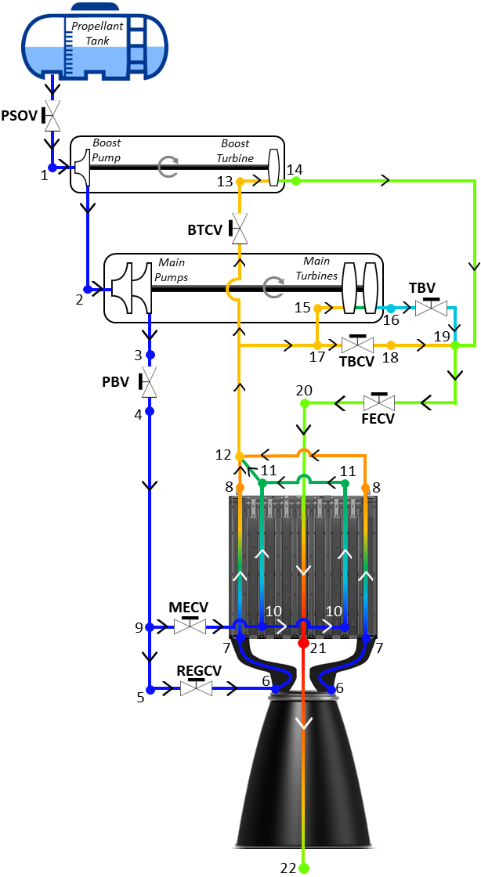
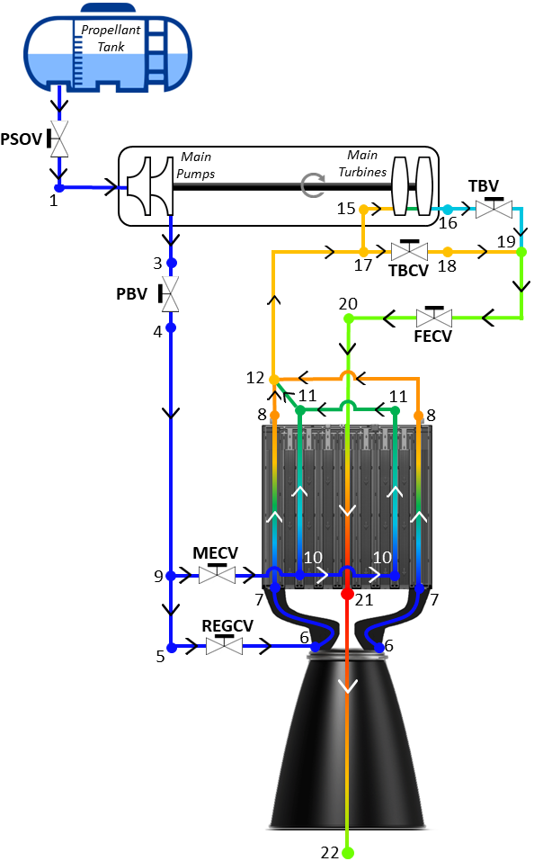
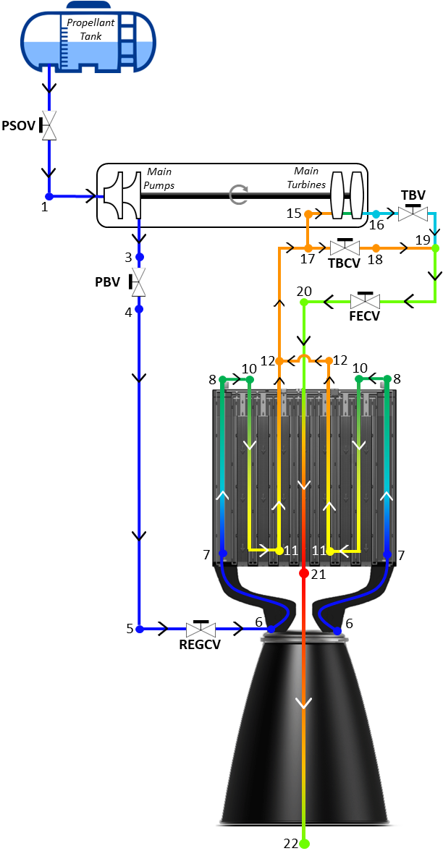
Gen-1 Engine Snapshot
Hydrogen, Ammonia & Methane—three propellant cycles, one Gen‑1 reactor
Shared baseline: Each option retains the LEU solid‑core reactor, regenerative cooling, and closed HPRT exhaust capture; only the propellant loop and pump topology differ. ​
H-NTP (H₂, 20 K): Dual boost + main pumps; ≈ 900 s Isp; very low density (71 kg m⁻³) demands the largest cryogenic tanks and super‑heavy‑lift fairings; presents the highest boil‑off and flammability hazard. ​
A‑NTP (NH₃, 200 K): Single‑pump cycle; ≈ 375 s Isp; ten‑fold density gain over H₂ slashes tank volume to fit 5 m fairings; no deep‑cryo equipment required, but toxicity and CFATS thresholds govern safety architecture. ​
M‑NTP (CH₄, 100 K): Single‑pump cycle; ≈ 400 to 650 s Isp; mid‑density (420 kg m⁻³) aligns with existing LOX infrastructure; lower boil‑off than H₂, moderate flammability, and potential coking in regenerative channels.
H-NTP
A-NTP
M-NTP
Multi‑propellant testing secures design and safety margins across the entire density‑hazard spectrum before final flight selection.

Slide 5
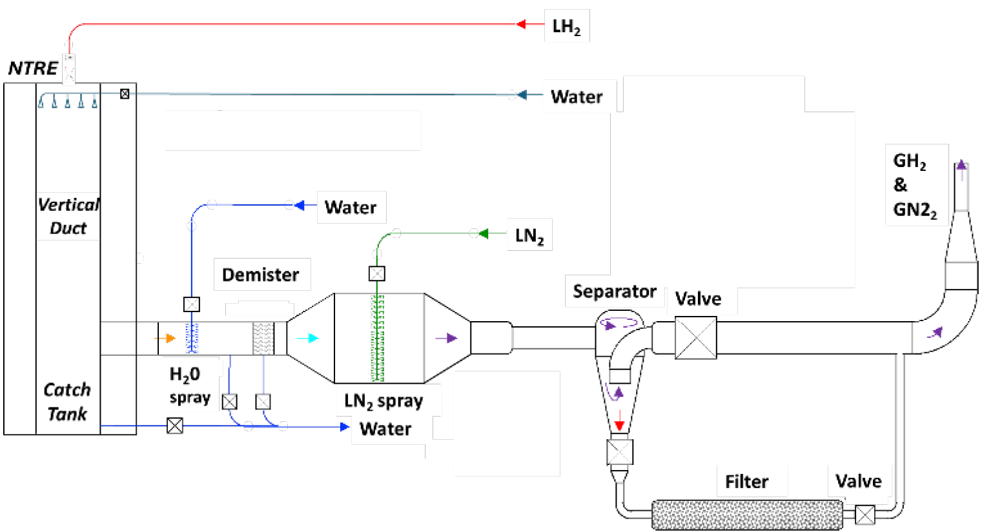
Contain and Clean Strategy
Closed‑loop exhaust capture and heat‑balance restoration within regulatory limits
Total exhaust containment: ≥ 20 kg/s propellant passed through closed High‑Pressure Recirc Test (HPRT) loop to retain fission products.
Enthalpy recovery: MW‑class electric pre‑heater replaces 1–10 MW lost with truncated nozzle, preserving turbine inlet conditions at test back‑pressure (1.7–2.0 MPa).
Four‑stage cleanup: Diffuser → high‑pressure particulate filter → catalyst bed → recombiner → monitored stack; removal efficiency ≥ 99.99 %.
Regulatory ceiling: Off‑site dose constrained to < 10 µSv yr⁻¹ (EPA 40 CFR 61 Subpart H) under design‑basis accident.
Multi‑propellant compatibility: H₂, CH₄, and NH₃ campaigns accommodated without hardware change; loop pressure kept above detonation limits during SCRAM blow‑down.
The integrated HPRT loop and electric pre‑heater together meet containment, enthalpy, and dose‑limit requirements, enabling flight‑representative NTP operation on the ground.

Slide 6
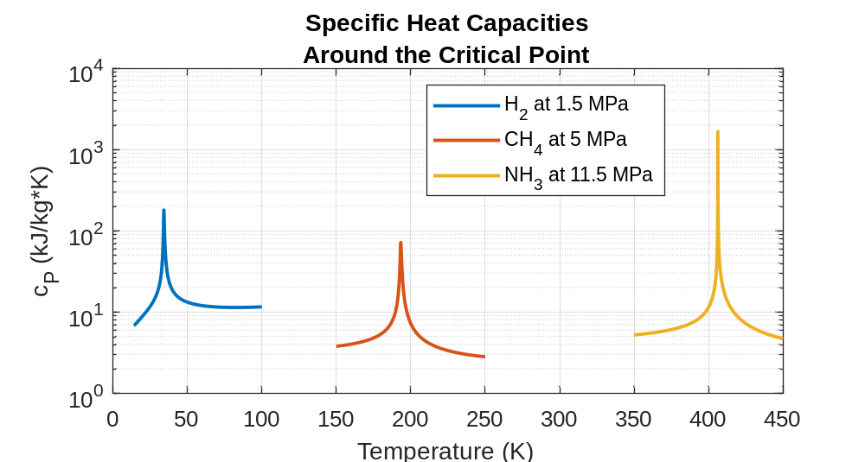
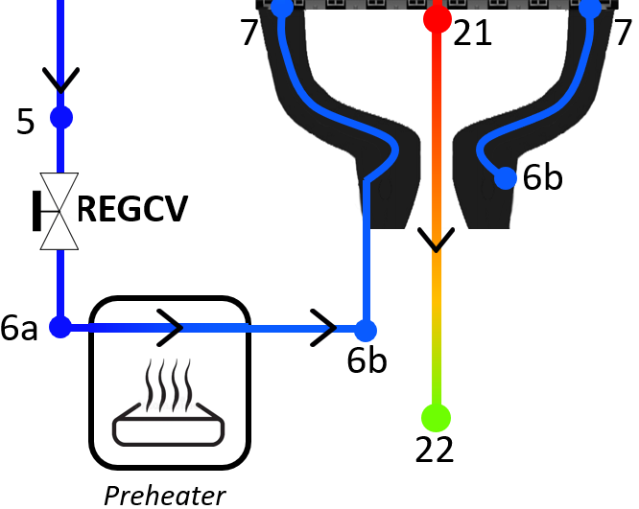
Impacts of Nozzle Truncation
Restoring flight‑level enthalpy for hydrogen, ammonia, and methane test campaigns
Truncated‑nozzle deficit: remove ≈ 1–9 MW of regenerative heat; a MW‑class electric Airtorch reinstates this enthalpy upstream of the nozzle.
Supplemental Heater Power: H‑NTP 4.6 MW, A‑NTP 1.2 MW,
M‑NTP 5.3 MW for the 15 klbf reference cases.
Performance impact: Heat restoration preserves internal state points although back‑pressure halves thrust and Isp (e.g., H₂ 903 s → 622 s).
Single hardware solution: A single modular heater architecture accommodates all three propellants, streamlining hardware certification.
One MW‑scale pre‑heater closes the enthalpy gap for H‑, A‑, and M‑NTP cycles, enabling direct, flight‑like turbomachinery ground comparison with a common test stand.

Slide 7
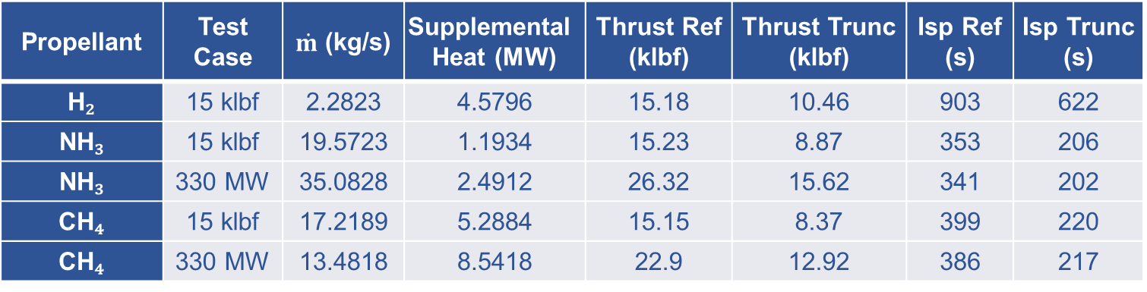
Supplemental Heat‑Load for Gen‑1 Ground Testing
Methane’s super‑critical transition fixes a 9 MW infrastructure design point
Supplemental heat span: 1 – 9 MW across cases; methane demands the peak load (5.3 MW at 15 klbf, 8.5 MW at 330 MW).
Underlying cause: methane reaches super‑critical conditions inside the regenerative cooling passages, sharply raising specific heat capacity and enthalpy deficit after nozzle truncation.
Facility implication: a ≥ 10 MW, high‑pressure Airtorch, medium‑voltage (≈ 13 kV) power feed, and upgraded heat‑rejection and fire‑safety systems must be installed; this worst‑case design envelope comfortably covers hydrogen and ammonia tests.
Propellant | Test Case | $\dot{m}$ (kg/s) | Supplemental Heat (MW) | Thrust Ref (klbf) | Thrust Trunc (klbf) | Isp Ref (s) | Isp Trunc (s)
H₂ | 15 klbf | 2.2823 | 4.5796 | 15.18 | 10.46 | 903 | 622
NH₃ | 15 klbf | 19.5723 | 1.1934 | 15.23 | 8.87 | 353 | 206
NH₃ | 330 MW | 35.0828 | 2.4912 | 26.32 | 15.62 | 341 | 202
CH₄ | 15 klbf | 17.2189 | 5.2884 | 15.15 | 8.37 | 399 | 220
CH₄ | 330 MW | 13.4818 | 8.5418 | 22.9 | 12.92 | 386 | 217
Methane’s super‑critical behavior sets the upper bound on pre‑heater power and thus dictates the electrical, cooling, and safety infrastructure for the Gen‑1 NTP ground‑test facility.

Slide 8
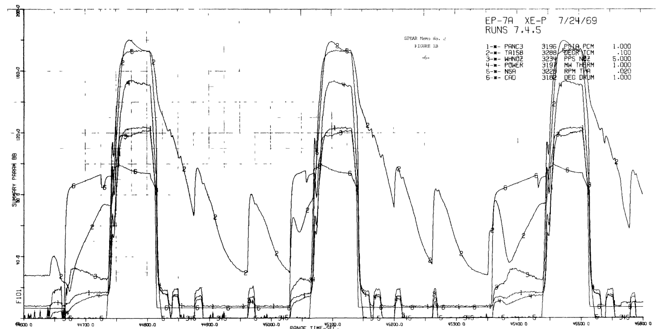
Facility Readiness → Phased Test Campaign
Linking SPEAR heritage and SMART data to the Gen‑1 Concept of Operations
Legacy instrumentation baseline: XE‑Prime (SPEAR) experience in turbomachinery bootstrapping, longevity, and restart defines today’s sensor suite and acceptance criteria for Gen‑1 validation ​
SMART subscale to full‑scale bridge: Prior component trials at the Subscale Maturation of Advanced Reactor Technologies facility feed into the new ground stand, which combines the HFS exhaust‑capture loop and MW‑class pre‑heater to satisfy modern safety regulations
Two‑engine strategy: Engine 1 executes Conservative → Balanced → Aggressive phases, is disassembled for forensics, and informs upgrades; Engine 2 performs flight‑like Full tests with multiple restarts ​
Structured risk‑retirement: Power, temperature, and flow are increased in four controlled steps, gathering flight‑representative data at each stage while keeping regulatory margins intact
Validated facility capabilities and historic test knowledge converge to support a four‑phase ConOps that incrementally qualifies the Gen‑1 NTP engine for flight readiness.

Slide 9
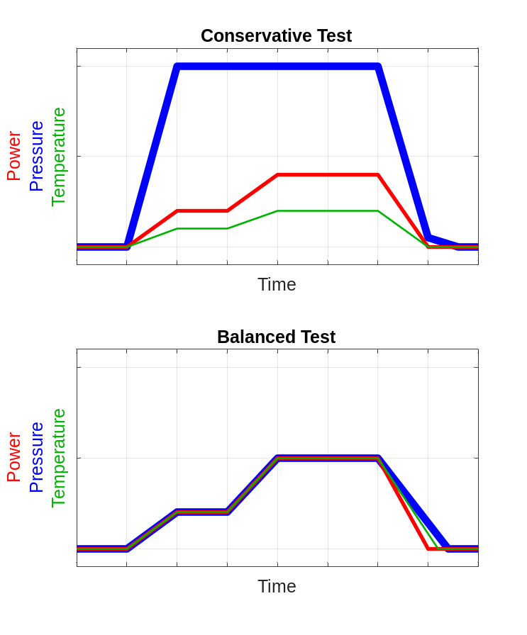
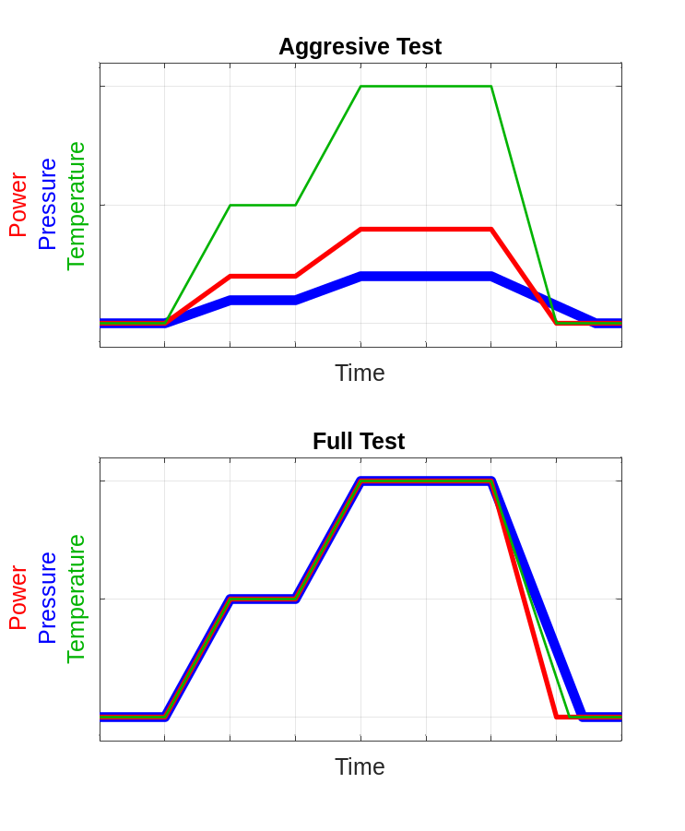
Illustrative Phased Ground‑Test ConOps
One possible phased sequence—not prescriptive.
Conservative test: low temperature, full flow, minimal power—basic functionality and sensor checkout with near‑zero hardware wear. ​
Balanced test: 50% power/pressure/temperature hold confirms turbomachinery start‑up and control logic while keeping fuel burn‑up low. ​
Aggressive test: full design temperature at SMART‑limited power and reduced flow intentionally stresses fuel and structure to map degradation limits. ​
Full test: 100 % flight point (optionally skip 50 % hold) delivers thrust, Isp, and restart data for final qualification. ​
Sequence: Conservative → Balanced → Aggressive → Full provides stepwise risk retirement; data from each phase feeds modifications before the next, protecting hardware and meeting safety margins.
This illustrative four‑step sequence incrementally raises test stressors to capture flight‑like data while maintaining safety margins; alternative ConOps can be tailored as program needs evolve.

Slide 10
Illustrative Two-Engine Test Campaign
Two engines, four phases—stepwise risk retirement to flight‑level proof.
First test engine undergoes a series of tests in a test campaign followed by disassembly:
The second series of tests is based on results and lessons learned from the previous test campaign.
Here, a series of multiple full burns are demonstrated along with multiple restarts to simulate the CONOPS during an actual mission.
Conservative
Balanced
Aggressive
Disassembly
Full Burn 1
Full Burn 2
Full Burn n
Retirement/ Disassembly
This two‑step, two‑engine campaign pairs early forensic insight with flight‑like validation, maximizing data quality while safeguarding schedule and hardware.

Slide 11
Conclusions and Future Work
Contained ground‑test concept—critical next steps to flight qualification
Conclusions
HPRT + Pre‑heater feasibility: The High‑Pressure Real‑Time exhaust loop, combined with a 1‑ 9 MW electric Airtorch, restores flight‑like enthalpy at 1.7–2 MPa while fully containing fission products.​
Propellant envelope: Hydrogen, ammonia, and methane expander cycles all meet ground constraints; methane sets the worst‑case 8.5 MW heat load owing to its super‑critical transition.​
Four‑phase ConOps: A Conservative → Balanced → Aggressive → Full sequence across two engines incrementally retires risk, echoing SPEAR heritage and informed by SMART sub‑scale data.​
Future Work
Finalize HPRT hardware: Select sorbate media for NH₃/CH₄, complete pressure‑drop and 10 MW electrical integration analyses.
Methane‑specific testing: Conduct regenerative‑channel heat‑transfer and pyrolysis experiments to pin down heater requirements.
Facility & schedule alignment: Advance SMART combined‑effects fuel tests in parallel with full ground‑stand build and refine the campaign decision matrix to maintain the flight‑demo timeline.​
An HPRT‑based, MW‑pre‑heated, four‑phase campaign offers a practical, regulation‑ready route to qualify hydrogen‑, ammonia‑, and methane‑ NTP engines for Mars‑class missions.

Slide 12
References
[1] Robbins, W. H., and Finger, H. B., “An Historical Perspective of the NERVA Nuclear Rocket Engine Technology Program,” NASA Contractor Report NASA-CR-187154, Analytical Engineering Corporation, July 1991.
[2] Kirk, W. L., “Nuclear Furnace-1 Test Report,” Technical Report LA5189MS, Los Alamos Scientific Laboratory, New Mexico, 1973.
[3] Haslett, R. A., “Space Nuclear Thermal Propulsion Program Final Report,” Final Report PL-TR-95-1064, Phillips Laboratory, Space and Missiles Technology Directorate, Air Force Materiel Command, Kirtland Air Force Base, New Mexico, May 1995.
[4] Sasmal, R., Holmes, L., Rector, J., and Neely, M., “Ground Test Technology Demonstration for Nuclear Thermal Propulsion Engines,” presented at the Nuclear and Emerging Technologies for Space (NETS 2023), Idaho Falls, ID, 2023. https://doi.org/10.13182/NETS23-41861
[5] Nikitaeva, D., Smith, C. D., and Duchek, M., “Engine Cycle Comparison for Alternative Propellant Nuclear Thermal Propulsion Engines,” presented at the ASCEND 2023, Las Vegas, Nevada, 2023. https://doi.org/10.2514/6.2023-4715
[6] Holmes, L., Neely, M., and Rector, James, “Nuclear Thermal Propulsion (CPT) Engine Ground Testing Status,” presented at the Nuclear Emerging Technologies for Space 2025, Huntsville, AL, 2025.
[7] NERVA Test Operations, Jackass Flats, Nev. (USA), “XE-Prime EP-5C Full Power Test. SPEAR Report,” NTO-R--0171, 4234540, June 1969, p. NTO-R--0171, 4234540. https://doi.org/10.2172/4234540
[8] Gustafson, J., Kreicicki, M., Swanson, R., Zilka, B., and Witter, J. K., “Space Nuclear Propulsion Fuel and Moderator Development Plan Conceptual Testing Reference Design,” presented at the Nuclear Emerging Techologies for Space, Virtual Event, 2021.
[9] Burns, D., Lenox, K., O’Brien, R., Rieco, I., Palomares, K., Searight, W., Todosow, M., Werner, J., Blood, M., and Hill, A., “Options for Subscale Maturation of Advanced Reactor Technologies Testing for Nuclear Thermal Propulsion,” INL/RPT-22-65557, Idaho National Laboratory, Idaho Falls, ID, 2022.
[10] Linstrom, P., “NIST Chemistry WebBook, NIST Standard Reference Database 69,” National Institute of Standards and Technology, 1997. https://doi.org/10.18434/T4D303
[11] Nikitaeva, D., “Implications of Alternative In-Situ Propellants Used in Nuclear Thermal Propulsion Engines,” Dissertation. University of Alabama in Huntsville, Huntsville, AL, 2021.
[12] Nikitaeva, D., and Thomas, D. L., “Alternative Propellant Nuclear Thermal Propulsion Engine Architectures,” Journal of Spacecraft and Rockets, 2022, pp. 1–11. https://doi.org/10.2514/1.A35289
[13] Nikitaeva, D., Smith, C., D., and Duchek, M., “Methane-Based Nuclear Thermal Propulsion Engine Considerations,” presented at the Nuclear Emerging Technologies for Space 2025, Huntsville, AL, 2025.
[14] Smith, C., Nikitaeva, D., Stonehill, J., and Duchek, M., “Reactor Parametric Assessments for Alternative Propellant Nuclear Thermal Propulsion Engines,” presented at the Nuclear and Emerging Technologies for Space (NETS 2023), Idaho Falls, ID, 2023. https://doi.org/10.13182/NETS23-41854
[15] Nikitaeva, D., Stonehill, J., and Smith, C. D., “MINI-NOZZLES FOR INDIVIDUAL FUEL ELEMENTS FOR NUCLEAR THERMAL PROPULSION SYSTEMS,” JANNAF Paper 2024–0001EM, JANNAF Interagency Propulsion Committee, Oklahoma City, OK, May 2024.
[16] Bell, I. H., Wronski, J., Quoilin, S., and Lemort, V., “Pure and Pseudo-Pure Fluid Thermophysical Property Evaluation and the Open-Source Thermophysical Property Library CoolProp,” Industrial & Engineering Chemistry Research, Vol. 53, No. 6, 2014, pp. 2498–2508. https://doi.org/10.1021/ie4033999
[17] Micropyretics Heaters International, “High-Pressure Electric Airtorch® Models. GTA and GVTA Models with High-Pressure Enclosures.,” Micropyretics Heaters International, Cincinnati, OH.
[18] Environmental Protection Agency, “Accident Prevention and Response Manual for Anhydrous Ammonia Refrigeration System Operators,” Environmental Protection Agency, 2024.
[19] Lutz, E., C., and Ames, D., E., “Space Nuclear Thermal Propulsion Critical Assembly Boron Worth Experiments,” Transactions of the American Nuclear Society, Vol. 125, No. 1, 2021. https://www.osti.gov/biblio/1878223

Slide 13
Questions?
Daria Nikitaeva
daria.d.nikitaeva@ama-inc.com

