Slide 1
Nuclear Thermal Propulsion Transient Reactor Modeling and Uncertainty Propagation
Eleni Mowery
Nuclear Engineering Intern, AMA
Supported by: Jacob Stonehill (AMA), Corey Smith (AMA), and Matthew Duchek (AMA)
Notes:
Development of a methodology for, and preliminary results of an approach to transient reactor modeling with uncertainty propagation for NTP systems

Slide 2
Acknowledgements
This work was supported by NASA’s Space Technology Mission Directorate (STMD) through the Space Nuclear Propulsion (SNP) Project
Contract No. 80LARC23DA003
Notes:
this work was funded through NASA's Space Technology Mission Directorate through the Space Nuclear Propulsion Project. Our supporting contract number is listed here as well for reference"

Slide 3
NTP Transient Modeling Capability Motivation
System-level transient modeling assesses time-dependent KPPs and informs mission design.
To inform Operational Effective I_{sp}:
Transient Rate (K/s or MW/s)
Average Cooldown I_{sp}
Model Capabilities
Fastest Ramps to Full Power
Time to Radiative Threshold
Effects of Instrumentation and Control (I&C) Limitations on Performance
Off-Nominal Transient Response
Uncertainty Analysis
Notes:
-A major component of the FY 24 Reactor Modeling Forward Plan was figuring out how to address time dependent KPP’s. → need transient modeling capability to address
-One of these: operational effective Isp
-Burns are short, startup transient rate and propellant used on cooldown have significant impacts on effective Isp.
Transient rate → Can be directly found with the model by simulating ramps to full power
Average cooldown Isp → Time to radiative threshold can be directly evaluated by the model for different control schemes and starting conditions
Other KPPs that can be addressed by this model: ramp up/down time, cooldown time, and restart time
Some other system behaviors can also be addressed by my model:
I’m going to spend the rest of this presentation diving deeper into how this model was developed, how it can be used to address KPPs and other useful transient scenarios and plans for its future development.

Slide 4
Reactor Transient Model Use Cases
Model determines KPP feasibility and informs requirements to meet on a system-by-system basis.
Key Performance Parameter | Model Function | Subsystem Requirements | Status
Startup Time | Steady Ramp Up / Down | I&C Signal Resolution I&C Signal Delay Control Drum (CD) Speed | Direct Output of Model
Shutdown Time | Manual CD Control | CD Speed | Informed by Model
Cooldown Mass / Impulse | Time to Radiative Threshold | CD Speed | Direct Output of Model
Effective I_{sp} and Thrust | Steady ramp up → manual CD control | I&C Signal Resolution I&C Signal Delay CD Speed | Direct Output of Model
Neutronic performance and thermal hydraulic operating conditions of the reactor can be simulated by the model, defining the requirements to achieve given KPPs.
Notes:
Here are 4 KPPs that can be informed directly or indirectly by the model via some of its functions
Being able to model these KPPs → inform subsystem requirements needed to meet them

Slide 5
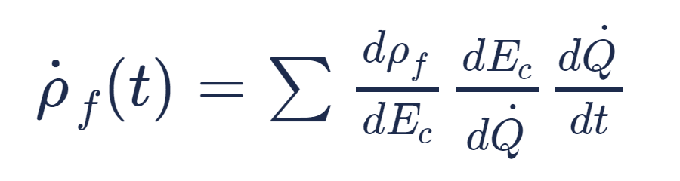

Background: Reactivity in NTP Systems
Full-system effects directly impact the time-dependent reactivity of the NTP reactor.
Time-dependent reactivity, 𝜌(𝑡), determines system power response
Influences on Reactivity
Reaction Rate Effects
Total Reactivity
For the sum of component effects ($E_{c}$) dependent on system power $\dot{(Q)}$, the rate of change of feedback reactivity with respect to time is:
Control Drum Position
Changes to Reaction Probabilities
Neutron Capture
Fission
Scattering (Moderation)
Material Temperatures
Propellant Density
This is integrated over each time step to continuously evaluate feedback reactivity with respect to full-system effects.
Notes:
Time dependent reactivity → backbone of transient modeling capability
Several factors in an NTP system influence reactivity: CD positions, temperatures of components, and propellant densities change relevant neutron reaction rates.
The effect of each of these factors on reactivity is found via neutronics simulation
One the effect of a factor on reactivity is known, as well as the factor’s power dependence, a rate of reactivity change with respect to time can be found and continuously integrated over each timestep.

Slide 6
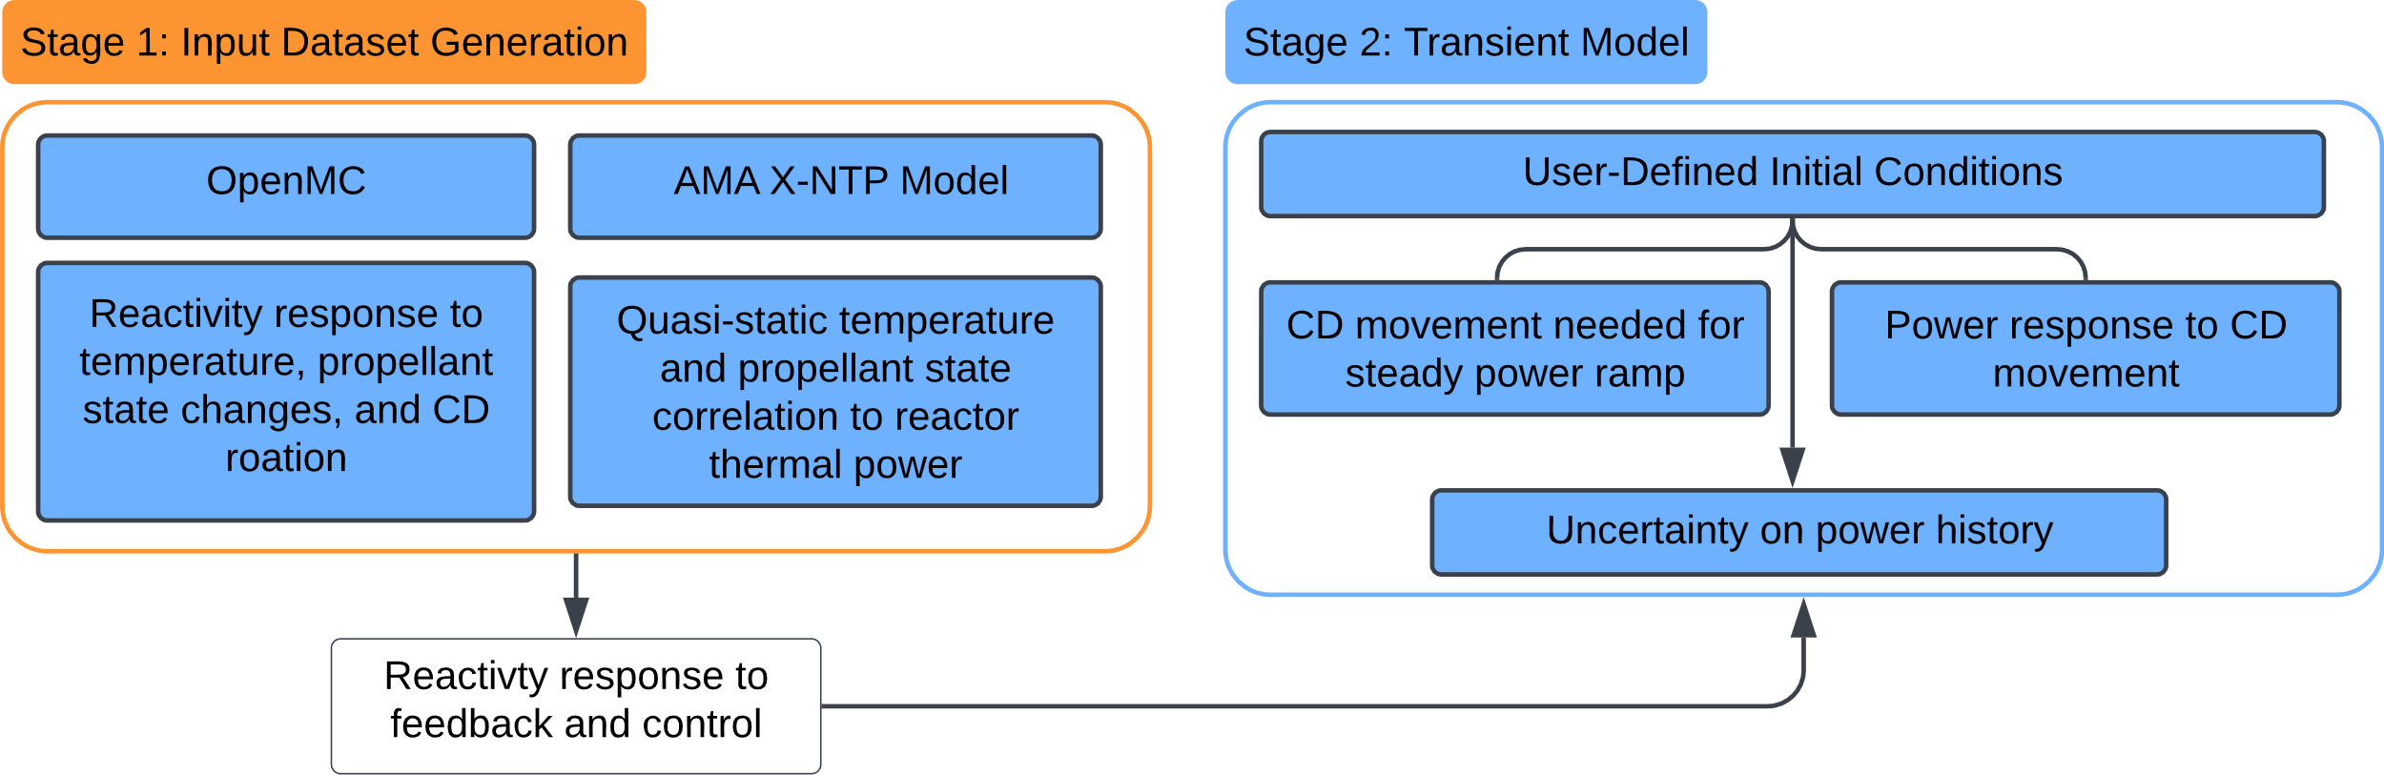
Overview: PRK-based Transient Model
A point reactor kinetics (PRK) methodology is developed to inform engine transient modeling.
Coupling of a Monte Carlo neutronics software with quasi-static state points allows for usage of the PRK to simulate engine performance for all proposed operating modes.
Notes:
Now that we know we need to characterize time dependent reactivity:
Stage 1: A model of the NTP reactor of interest is established in OpenMC, reactivity-effecting parameters are perturbed one at a time to determine reactivity effect at different states
AMA X-NTP model ties these states in with different reactor power levels using established correlations between reactor power level, propellant state, and component temperatures
Stage 2 is the transient model that ties these factors together with user-defined initial conditions, allowing transients to be simulated on milli-second level timesteps and return associated uncertainty as a function of time.

Slide 7

Stage 1: OpenMC Kinetics Data Generation
Single-call script runs ~350 OpenMC cases of a given reactor model to generate.
Single-call script runs ~350 OpenMC cases of a given reactor model to generate:
Tabulated data of reactivity vs. 8 different individually perturbed feedback effects and CD position
6 group reactor kinetics parameters $β,λ,Λ$
Feedback Effects Perturbed
Record reactivity vs. each effect in a CSV (10-20 points for each)
Fit splines to the reactivity data for each effect
Fuel Temperature
Moderator Temperature
Reflector Temperature
CD Poison Vein Temperature
CD Body Temperature
Fuel Channel Prop. Density
Mod. Channel Prop. Density
Reflector Channel Prop. Density
Notes:
Script structure modular → can determine what’s most impactful and in what ranges, and rerun-easily
Single script call → sets up and runs all OpenMC cases needed to generate:
-Feedback effects + Reactor kinetics parameters
Perturbed one at a time → I’ve seen some examples of work that uses correlations between states to get around this, but it wasn’t an obstacle with the computing resources we had
Splines are interpolated between when the transient model runs

Slide 8
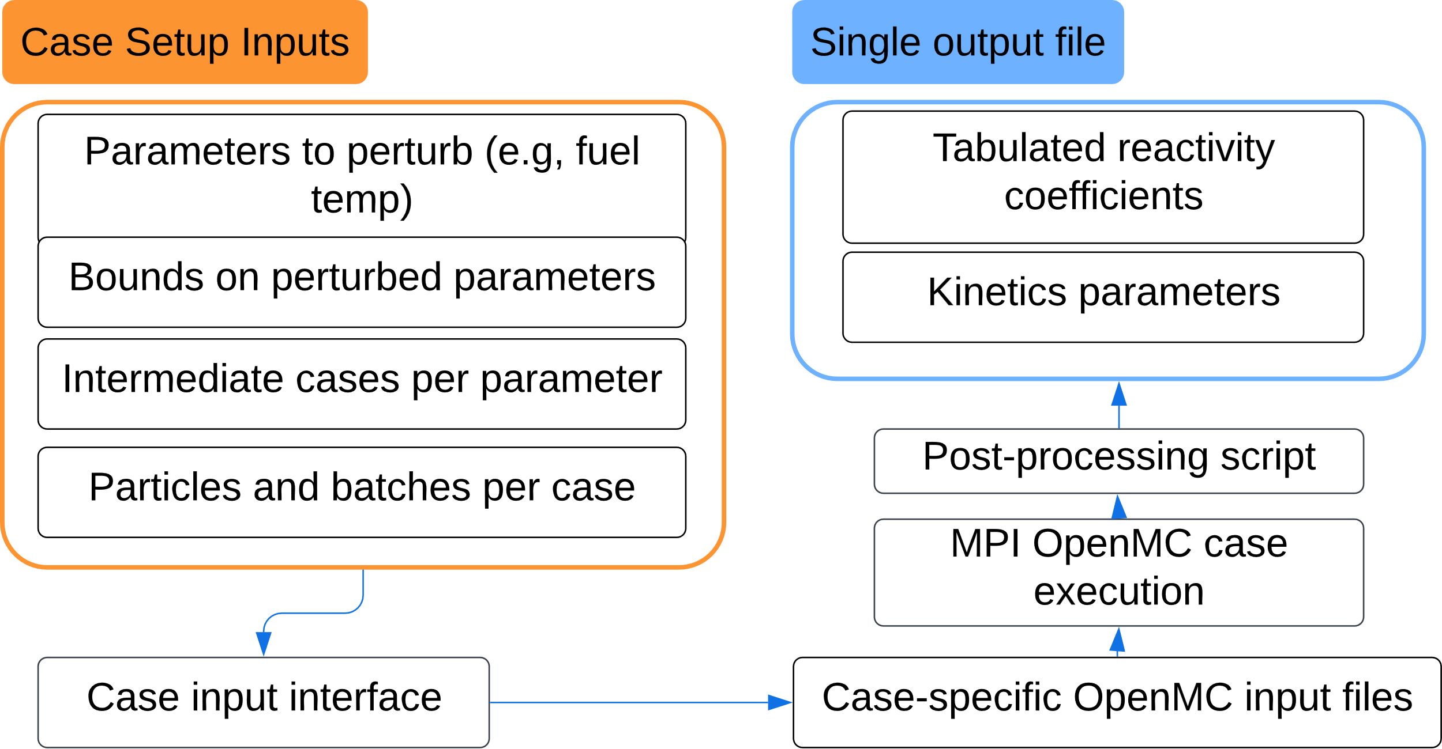
Stage 1: Workflow
Generic analysis methodology applied to the reference NTP reactor configuration.
Notes:
Deeper into OpenMC case generation: inputs are in a CSV file: what parameters to perturb, how much we want to perturb them
Generates all needed input files for OpenMC in separate folders
Can run these cases in parallel, post processes into a single output file of k_eff vs. the perturbed parameter value

Slide 9
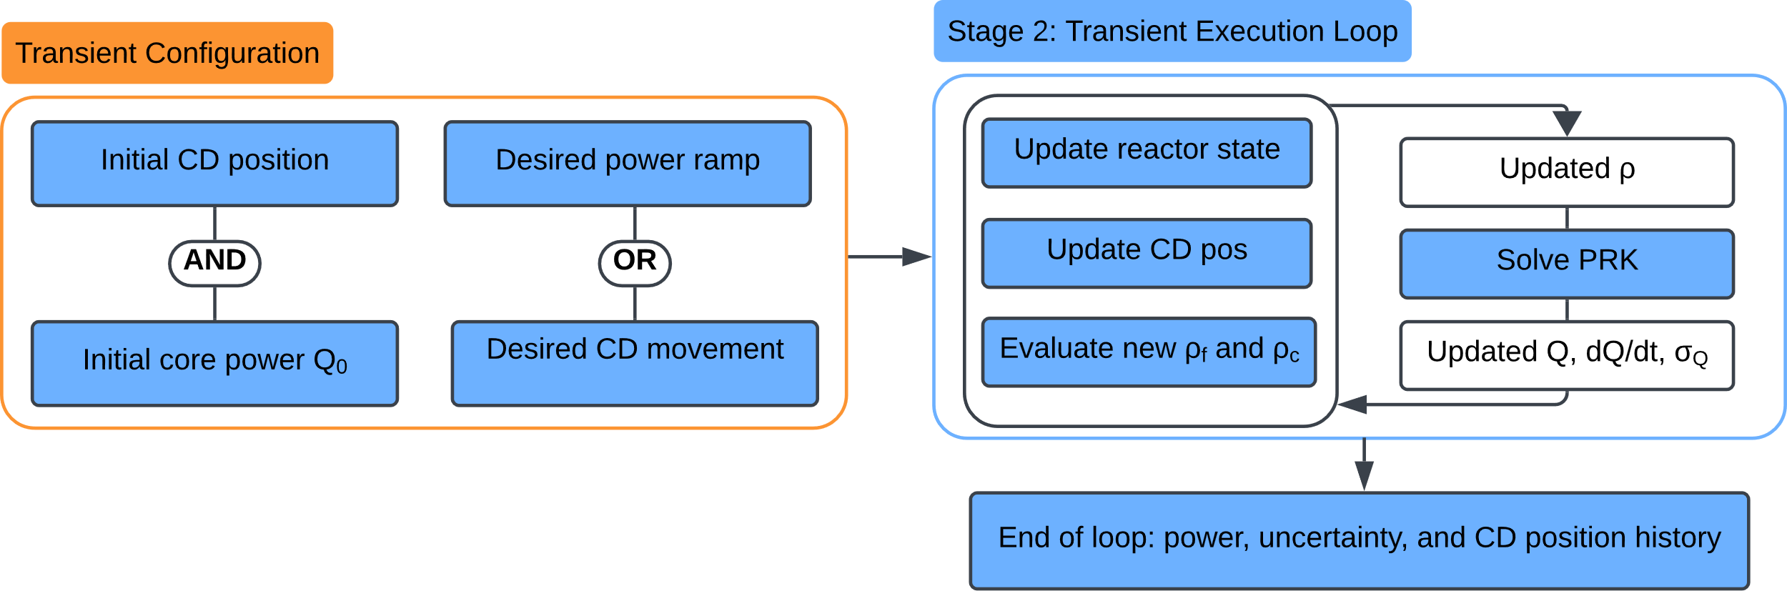
Stage 2: Transient Configuration
Iterative routine to converge on reactor operating conditions and drum position.
Notes:
Now that we have OpenMC data:
Configure transient
Run in a loop of very small timesteps: Update reactivity as a function of reactor state by evolving it forward using a Crank-Nicholson discretization scheme, solve the PRK, then update the reactor state until an end condition has been reached.

Slide 10
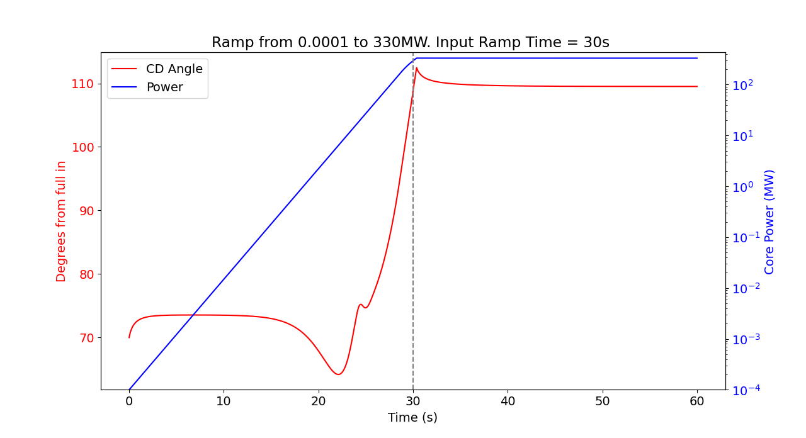
Transient Execution with PRK
Sample results for an NTP reactor transient with assumed I&C limitations and known ramp time.
Ramp from 1e-04 MW to SS Power. Input Ramp Time = 30s
9.2 s Total Runtime
3e-1
Slight deviation from desired trajectory
3e-2
3e-3
Fraction of SS Power
3e-4
3e-5
~0 to full operating power in 30 s
Fuel / Moderator Temp. Feedback Enabled
10°/s CD speed limit
1 ms signal → CD actuator delay
500 hz CD controller clock speed
Predicted ZPC position
Notes:
-This transient simulation moved control drums according to an adaptive control law developed for NTP in the 90s
-Here’s all effects considered + inputs
-Starting at predicted ZPC CD position → move dynamically until power reaches desired state
-In addition to reactor physics-induced feedback effects and propellant effects, control signal delays, CD speed limits (similar to those imposed on NERVA engines) and a maximum controller clock speed in line with that of rad-hard electronics capabilities was utilized.
-Slight deviation from desired trajectory due to these limitations.

Slide 11
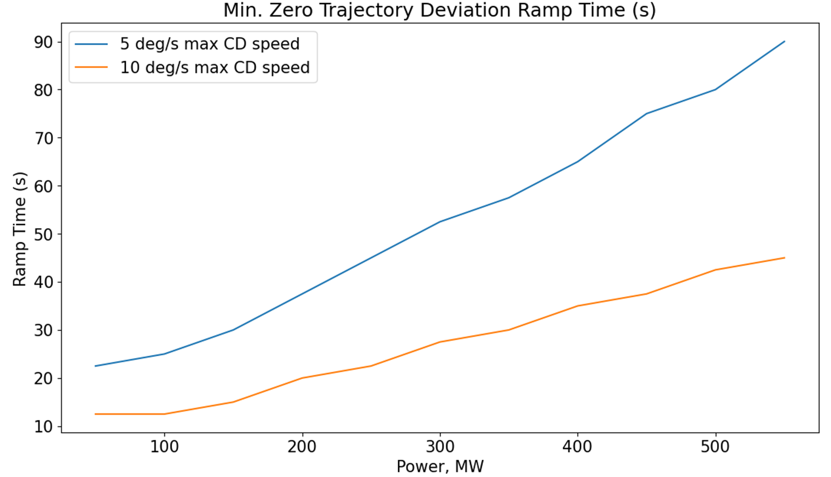
Implementation of Control Limits
Incorporation of hardware performance limits allows for more realistic modeling and simulation.
Current Capabilities
Variable CD speed limitation
Versatile Input Dictionary Structure
Parameter Sweeping Capability
Start-up KPPs Addressed
Starting to see how performance is limited by I&C
Notes:
How fast can we get to steady state power with different limitations imposed, while avoiding power trajectory limitations?
→ This is how start-up KPPs can be fully informed by I&C performance
Important: low temperature margins for overshoot.

Slide 12
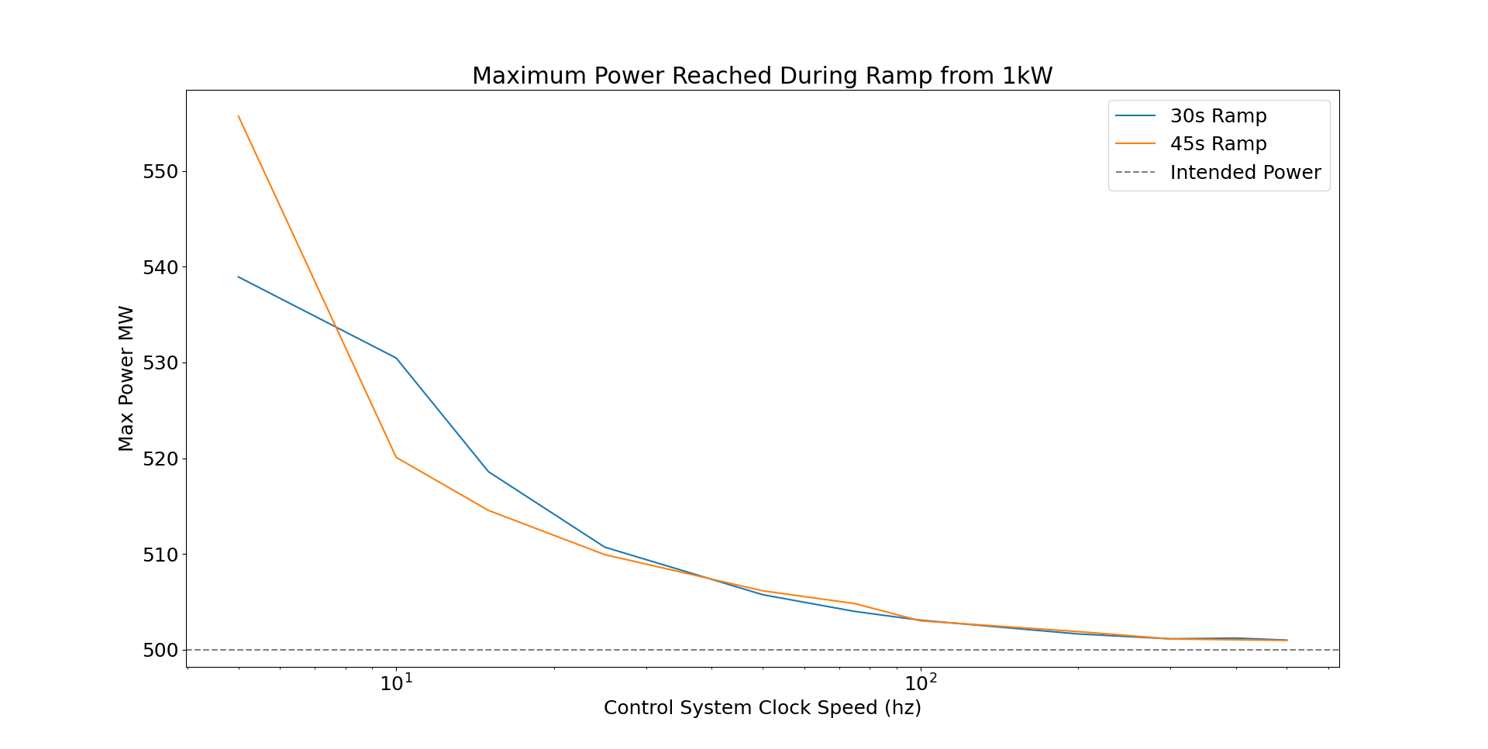
Controller Signal Limitations
Discussions with NASA and DOE prioritized realistic I&C effects within the suite.
Potential range of rad-hard electronics
Variable CD controller clock speed
Variable delay between CD actuator response and reactor power “signal”
Uncertainty in CD position

Slide 13
Uncertainty Analysis
Reactivity and kinetic parameters generated via Monte Carlo methods have inherent uncertainty.
Quantification of this uncertainty is needed to apply this code on a higher level
For any given PRK timestep executed by the code, system power evolution has a complex dependence on 15 parameters
Each of these parameters has an associated uncertainty
Reactivity (state-dependent) has uncertainty from both Monte Carlo randomness and continuously-evolving uncertainty on temperatures and densities within the core
Given this complexity, analytical methods of calculating uncertainty on power are not possible, even with external packages
This required the development of a Monte Carlo approach to uncertainty analysis
Notes:
Unumpy-like approaches don’t work → way too many parameters to consider, memory issues

Slide 14
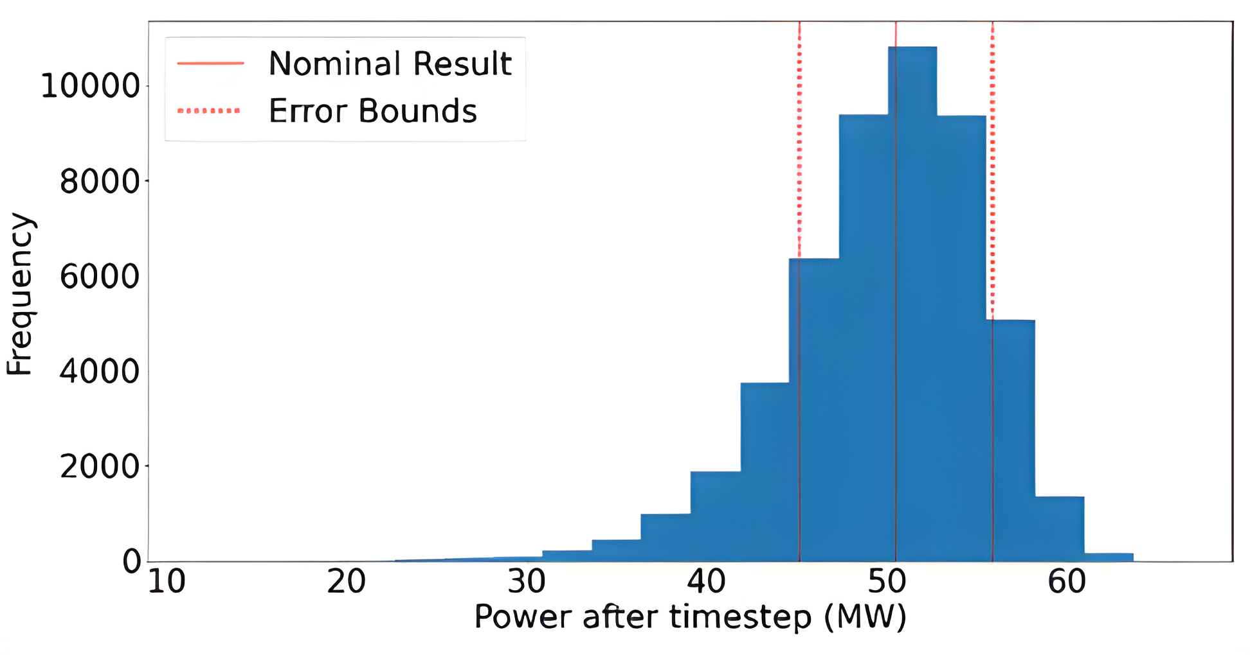
Uncertainty Analysis: Methodology
A Monte Carlo uncertainty propagation routine addresses variation in PRK-calculated power level.
Nominal result calculated
For > 1k iterations
15 PRK variables each randomly sampled from normal distribution
PRK executed with perturbed inputs
Spread used to find error on new power level

Slide 15
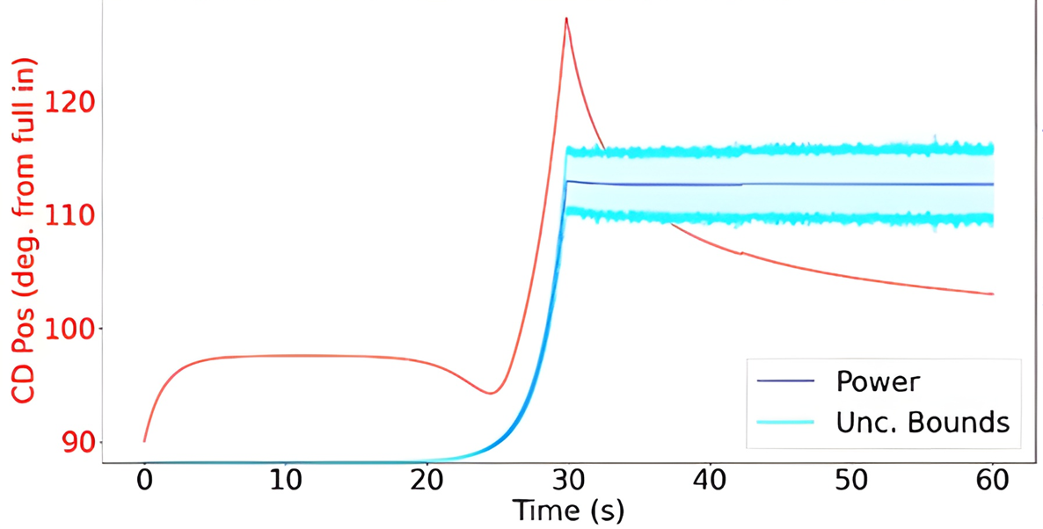
Uncertainty Propagation through Start-up
Introduction of uncertainty may lead to substantial deviations in expected power level.
Ramp from 5e-05 MW to SS Power. Input Ramp Time = 30s
Test Transient Parameters
Parameter | Value
Initial CD position | 90 ° from full in
Desired ramp time | 30 s
CD positional error | 0.3 °
Maximum CD speed | 12.5 ° / s
OpenMC particles / batch | 50,000
OpenMC batches / case | 50 active, 50 inactive
1.50
1.20
Fraction of SS Power
0.90
0.60
0.30

Slide 16
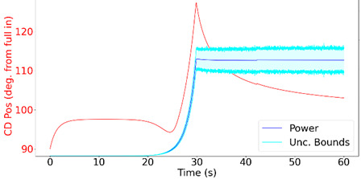
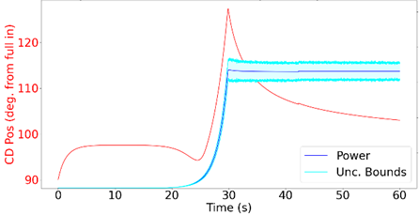
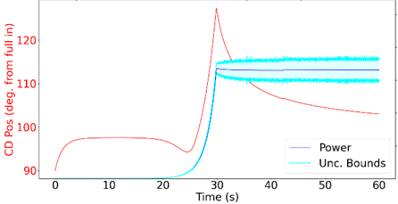
Relative Importance of Sources of Uncertainty
Each source leads to a varying magnitude of uncertainty on KPPs.
Ramp from 5e-05 MW to SS Power. Input Ramp Time = 30s
1.50
1.20
0.9
0.60
0.30
Fraction of SS Power
Input Data Contribution to Steady State Uncertainty
Source of Uncertainty | Uncertainty on Thermal Power | Uncertainty on Fuel Temperature
Reactivity Coefficients and Kinetic Parameters | +/- 41.7 MW | +/- 139 K
Reactivity Coefficients Only | +/- 23.9 MW | +/- 79.9 K
Kinetics Parameters Only | +/- 32.0 MW | +/- 107 K
Ramp from 5e-05 MW to SS Power. Input Ramp Time = 30s
1.50
1.20
0.9
0.60
0.30
Fraction of SS Power
Ramp from 5e-05 MW to SS Power. Input Ramp Time = 30s
1.50
1.20
0.9
0.60
0.30
Fraction of SS Power

Slide 17
Conclusions and Forward Work
The developed PRK methodology can be applied to an array of transient reactor analyses.
Conclusions
Given the small margin between expected operating conditions and material failure in NTP engines, it is important to minimize error when predicting thermal power and component temperatures through transient
When modeling a transient with inputs generated via a Monte Carlo transport simulation, both the stochastic uncertainty on calculated kinetic parameters and reactivity coefficients have a significant impact on the overall simulation uncertainty
Yields higher required particle counts than usually necessary for basic eigenvalue simulations
Simple modeling methodology presents opportunities for sensitivity studies
Forward Work
This methodology could be improved by establishing more accurate means of determining relationships between system power and component temperatures or propellant states
Thermal lag, short term transient effects
Results of this quasi-static approach could serve as the basis for comparison for a more sophisticated fully coupled transient model
Notes:
High total uncertainty on system power → OpenMC or MC generated input parameters must be very-well characterized
This tool enables one to identify which parameters contribute most to that uncertainty → selectively increase particle counts there

Slide 18
References
[1] United States Executive Office of the President, "Executive Order on Promoting Small Modular Reactors for National Defense and Space Exploration," Executive Order 13972, 86 FR 349 (2021).
[2] Romano, P. K., Horelik, N. E., Nelson, A. G., Forget, B., and Smith K., “OpenMC: A State-of-the-Art Monte Carlo Code for Research and Development,” Ann. Nucl. Energy, 82, 90-97 (2015).
[3] Chadwick, M. B., et. al., "ENDF/B-VII.1: Nuclear Data for Science and Technology: Cross Sections, Covariances, Fission Product Yields and Decay Data”, Nucl. Data Sheets 112 (2011) 2887.
[4] Boffie, J., Pounders, J. M., and Aghara, S. K., "Validating an adaptive time step scheme for the neutron diffusion equation with the UMass-Lowell Research Reactor kinetics data," Ann. Nucl. Energy, 132, 404-412 (2019).
[5] Gustafson, J., Kreicicki, M., Swanson, R., Zilka, B., and Witter, J. K., “Space Nuclear Propulsion Fuel and Moderator Development Plan Conceptual Testing Reference Design,” Virtual Event, 2021.
[6] J. Stonehill, D. Nikitaeva, C. Smith, and M. E. Duchek, "Coupled Reactor and Engine Nuclear Thermal Propulsion Modeling Methodology," Nuclear and Emerging Technologies for Space (NETS 2024), (2024).
[7] B. Verboomen, W. Haeck, and P. Baeten, "Monte Carlo calculation of the effective neutron generation time," Ann. Nucl. Energy, 33, 911-916 (2006).
[8] X. Peng, J. Liang, B. Forget, and K. Smith, "Calculation of adjoint-weighted reactor kinetics parameters in OpenMC," Ann. Nucl. Energy, 128, 231-235 (2019).
[9] D. Nikitaeva, C. D. Smith, and M. Duchek, "Engine Cycle Comparison for Alternative Propellant Nuclear Thermal Propulsion Engines," Conference Paper, ASCEND, Las Vegas, NV, Oct. 23-25, 2023, (2023).
[10] J. Bernard and D. Lanning, "Considerations in the Design and Implementation of Control Laws for the Digital Operation of Research Reactors," Nuclear Science and Engineering, 110, 425-444 (1992).

Slide 19
Questions?
Eleni Mowery
eleni.t.mowery@ama-inc.com

