Slide 1
Nodal Modeling of Sloshing in a Cryogenic Propellant Tank using a Multi-Node Approach
May 15, 2025
Bryan Hoffman – Fluid Dynamics Branch (MSFC-ER42)
Alok Majumdar – Thermal Analysis Branch (MSFC-ER43)
Andre Leclair – Thermal Analysis Branch (MSFC-ER43)
Jacob Brodnick – Fluid Dynamics Branch (MSFC-ER42)
S. Mostafa Ghiaasiaan – Georgia Institute of Technology

Slide 2
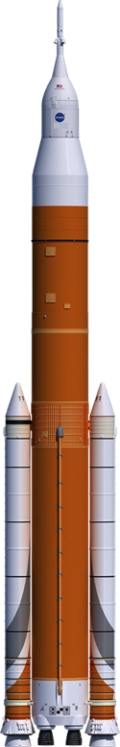
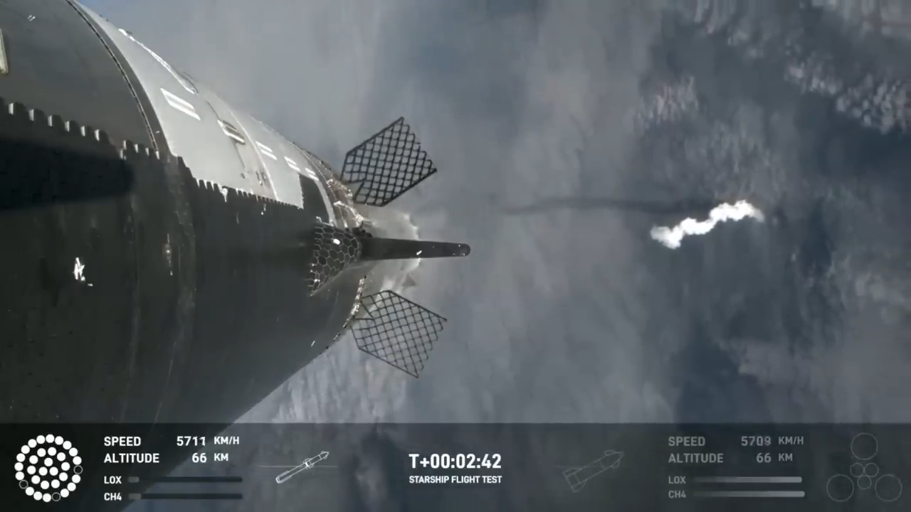
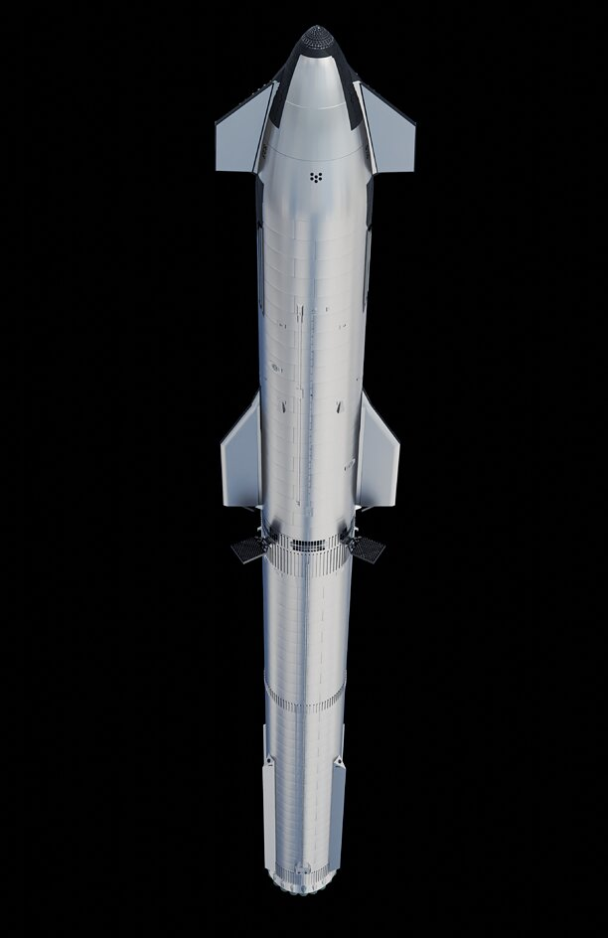


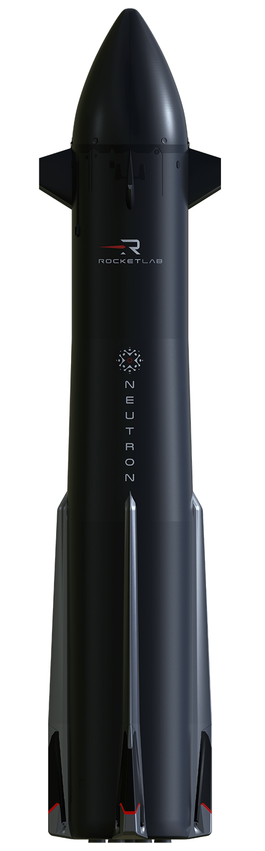







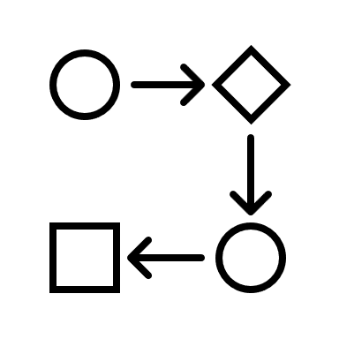
Motivation
Motivation
Methodology
Heat Transfer Model
K-Site Experiment
JAXA Experiment
Objective: Development of a reduced-order heat transfer model capable of rapidly simulating the thermodynamic impacts of cryogenic propellant motion
Why?
Increasing reliance on cryogenic propellants by launch providers
+More
Need for predictive ullage collapse modeling
  Complex vehicle maneuvers
  Pressure control
  Efficient resource management
Desire for rapid assessments of pressure dispersions
  High-fidelity computational fluid dynamics
  Iterative design of tank systems and concepts of operations

Slide 3
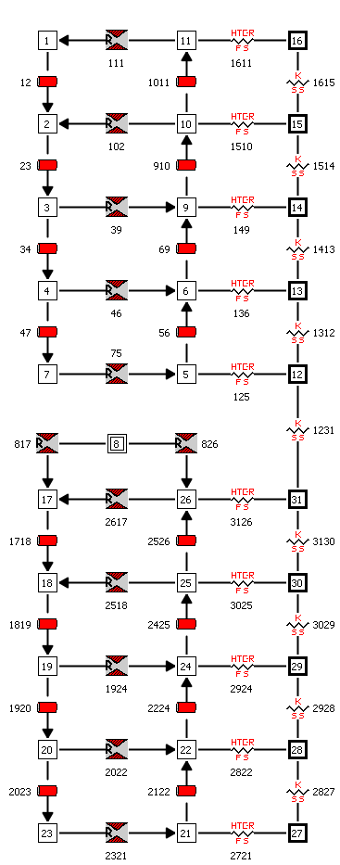

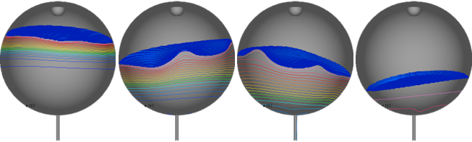
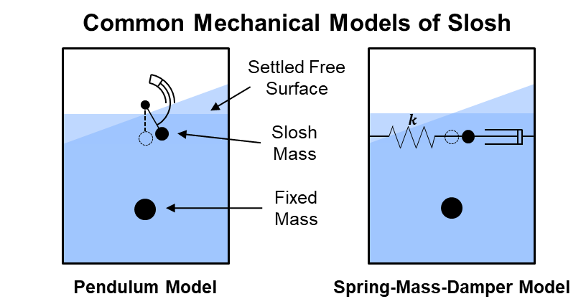
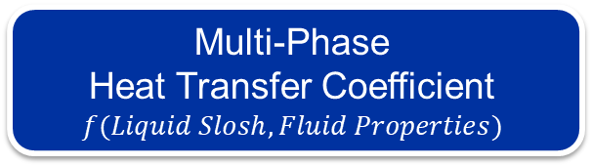
Methodology
Motivation
Methodology
Heat Transfer Model
K-Site Experiment
JAXA Experiment
Accelerations and Rotation Rates
Multi-Phase
Heat Transfer Coefficient
$$f(Liquid Slosh, Fluid Properties)$$
Slosh Model
Thermal-Fluid Nodal Mode
Tool: GFSSP
(Generalized Fluid System Simulation Program)
Low-Fidelity CFD
Tool: Loci/STREAM-VoF
OR
1-DOF Mechanical Model
Pressure
Ullage Collapse
Time

Slide 4

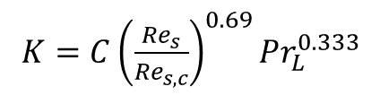




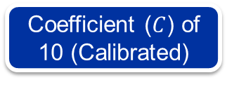



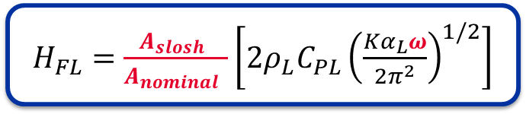



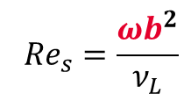
Heat Transfer Model
Motivation
Methodology
Heat Transfer Model
K-Site Experiment
JAXA Experiment
Phase Change
Heat Transfer Model [1]
Thermal Diffusivity Enhancement
$${\dot{Q}}_{UI}−{\dot{Q}}_{IL}=\dot{m}L_{v}$$
$H_{FL}=\frac{A_{slosh} }{A_{nominal} }\left[2ρ_{L}C_{PL}{\left(\frac{Kα_{L}ω}{2π^{2}}\right)}^{1/2}\right]$
$K=C{\left(\frac{{Re}_{s}}{{Re}_{s,c}}\right)}^{0.69}{Pr}_{L}^{0.333}$
$${\dot{Q}}_{IL}=H_{FL}\left(T_{saturated}−T_{liquid}\right)$$
$${Re}_{s}=\frac{ωb^{2}}{ν_{L}}$$
Coefficient ($C$) of 10 (Calibrated)
$$A_{nominal}$$
$$A_{slosh}$$
$$T_{ullage}$$
$${\dot{Q}}_{UI}$$
$$b$$
$$T_{saturated}$$
$$T_{liquid}$$
$${\dot{Q}}_{IL}$$
Variable Provided by CFD
$$ω=2π/∆t$$

Slide 5
K-Site Slosh and Drain
Run 29 [2]
Motivation
Methodology
Heat Transfer Model
K-Site Experiment
JAXA Experiment

Slide 6
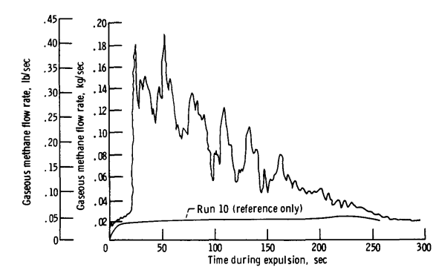
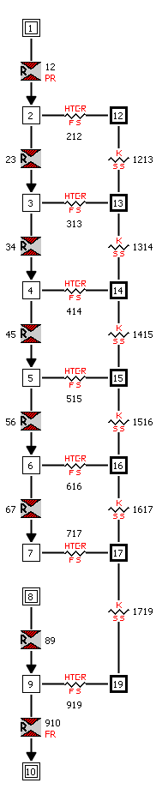
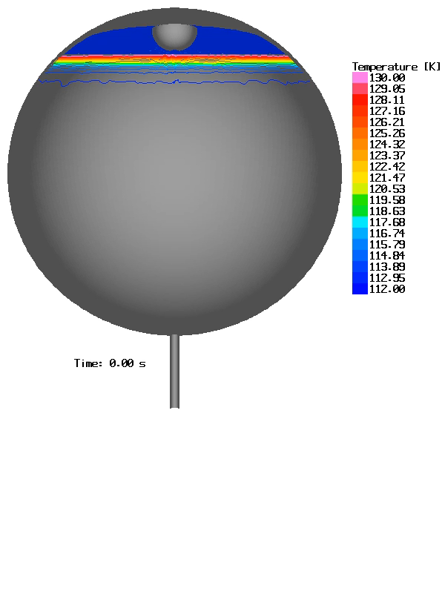
K-Site Run 29
Motivation
Methodology
Heat Transfer Model
K-Site Experiment
JAXA Experiment
Constant Ullage Pressure
Diffuser Inflow
Variable Gas Inflow Rate
Ullage
Tank Wall
Parameter | Value
Fluid | LCH4 / GCH4
Inlet Temperature (K) | 349
 | 3.34
Tank Pressure (bar)
Expulsion Time (s) | 296.3
Total GCH4 Added (kg) | 19.082
Validation of Loci/STREAM-VoF [3]
Liquid
Outflow

Slide 7
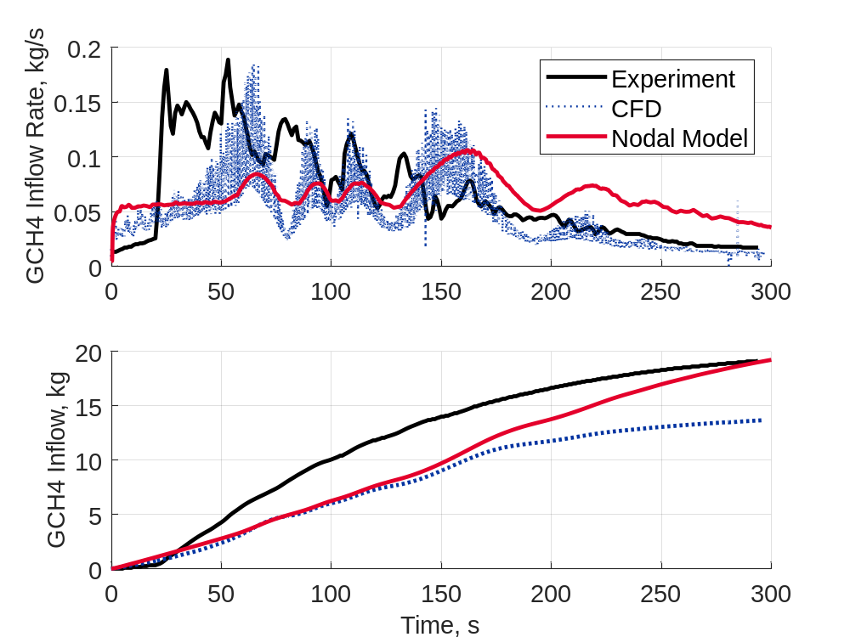
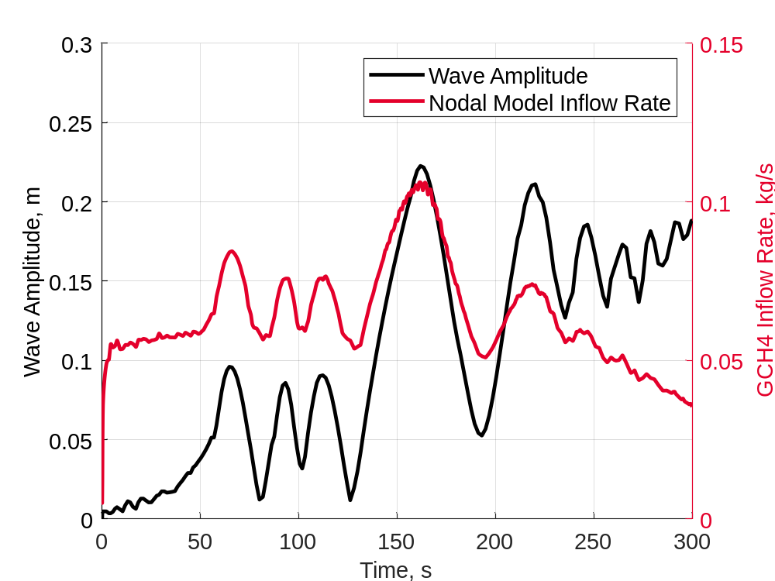
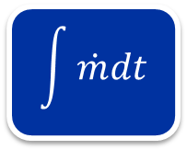
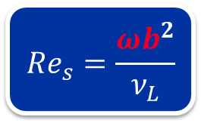
K-Site Run 29
Motivation
Methodology
Heat Transfer Model
K-Site Experiment
JAXA Experiment
$${Re}_{s}=\frac{ωb^{2}}{ν_{L}}$$
$$\int{\dot{m}dt}$$
CFD and the nodal model are well-aligned until 175 s
Wave amplitude appears to keep the condensation rate elevated until depleted

Slide 8
JAXA Cryostat Experiment
Case 1 [4]
Motivation
Methodology
Heat Transfer Model
K-Site Experiment
JAXA Experiment

Slide 9
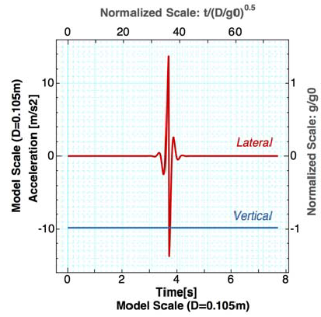
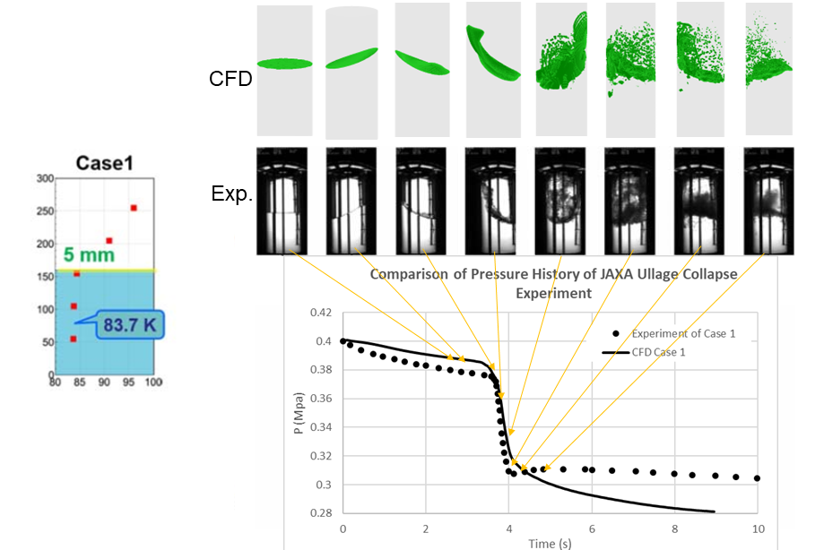
JAXA Cryostat Case 1
Motivation
Methodology
Heat Transfer Model
K-Site Experiment
JAXA Experiment
Parameter | Value
Fluid | LN2 / GN2
Initial Temperature (K) | 83.7 / 94
 | 4
Initial Tank Pressure (bar)
Initial Thermal Stratification (mm) | 5
Ullage
Tank Wall
Liquid
Validation of Loci/STREAM-VoF [5]

Slide 10
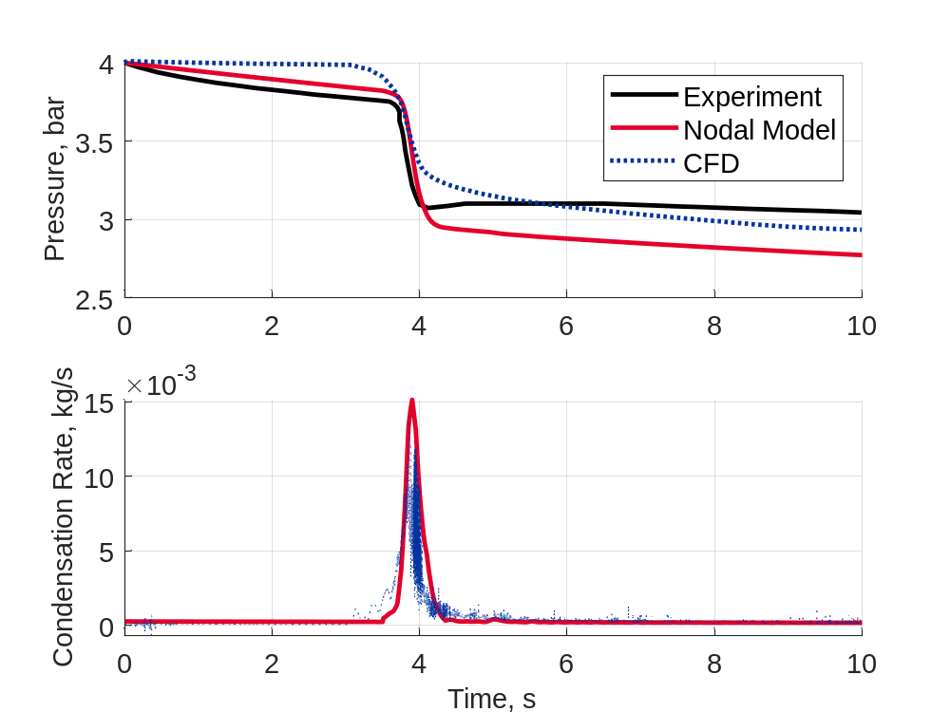
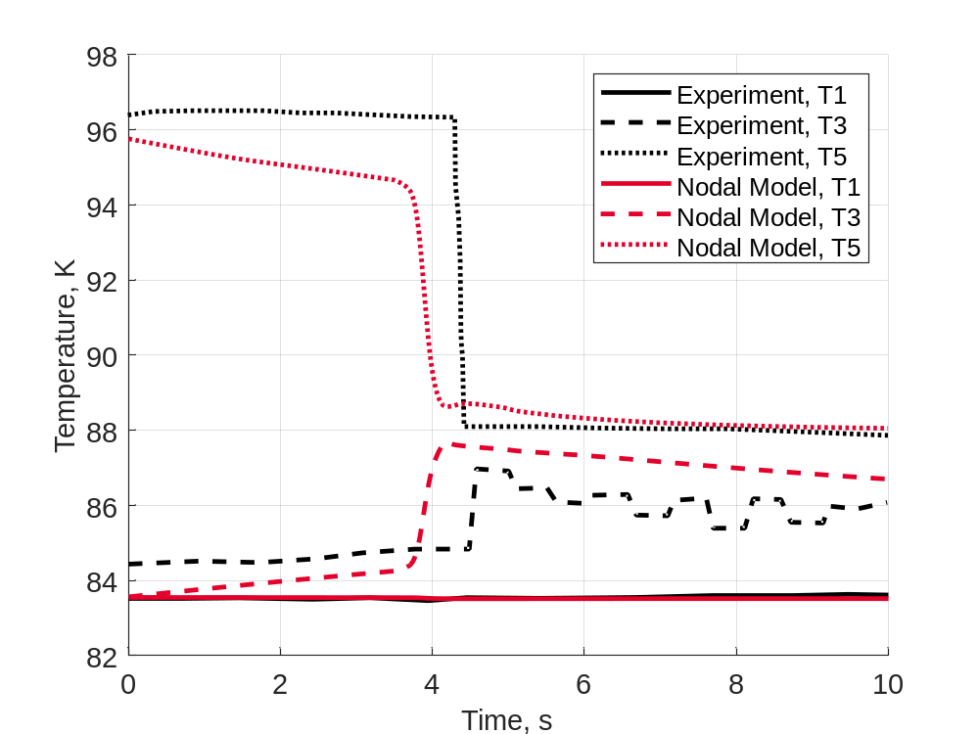
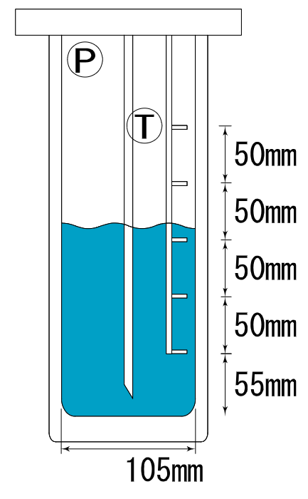



JAXA Cryostat Case 1
Motivation
Methodology
Heat Transfer Model
K-Site Experiment
JAXA Experiment
$$T5$$
$$T3$$
$$T1$$
Pressure results within 10% of experiment (4.4% mean absolute percentage error)
Good agreement with temperature sensor data

Slide 11
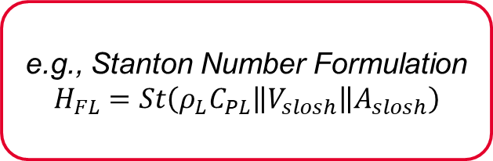
Future Work
Evaluation of Alternative Heat Transfer Models
e.g., Stanton Number Formulation
$$H_{FL}=St\left(ρ_{L}C_{PL}\left\|V_{slosh}\right\|A_{slosh}\right)$$
Validation with Additional Test and Flight Data
e.g., Ludwig Paper Experiments
Integration with 1-DOF Slosh Models
Potential for Analysis of Artemis I Core Stage using CFD and GN&C 1-DOF Slosh Models

Slide 12
References
S.M. Ghiaasiaan and P. Mehdizad, “Nodal Modeling for Cryogenic Fluid Management,” JPID-FY25-000095, Georgia Institute of Technology, Submitted to Structures, Design, and Thermal Analysis Propulsion Systems at NASA Marshall Space Flight Center, October 25, 2024.
R.L. DeWitt and T.O. McIntire, "Pressurant Requirements for Discharge of Liquid Methane from a 1.52-meter-(5-ft-) Diameter Spherical Tank Under Both Static and Slosh Conditions" NASA-TN-D-7638. 1974.
H.Q. Yang, C. Patel, and B. Williams, “Validation of Cryogenic Propellant Tank SelfPressurization”, AIAA SciTech 2023 Forum, 23-27 January 2023, National Harbor, MD, AIAA 2023-1411.
T. Himeno et al., “Investigation on Phase Change and Pressure Drop Enhanced by Violent Sloshing of Cryogenic Fluid,” AIAA Propulsion and Energy Forum, July 2018, Cincinnati, OH, AIAA 2024-0548.
H.Q. Yang and B. Williams, “Validation of Thermodynamic Behavior of Liquid Propellant under Sloshing and Draining,” AIAA SciTech 2024 Forum, 8-12 January 2024, Orlando, FL, AIAA 2018-4755.

