Slide 1
Planetary Surface Environment Testing: The Evolution of PLANET
MSFC Team:
Todd A. Schneider,
Erin G. Hayward,
Patrick Lynn,
Jason A. Vaughn,
Peter F. Bertone, &
Mary K. Nehls
NASA
Marshall Space Flight Center (MSFC)
Space Environmental Effects Team
Applied Space Environments Conference
ASEC 2025
League City, Texas
May 8, 2025
Notes:
Thank you for the opportunity to give a talk today, and thank you all for sticking around for the last talk of the conference! My name is Erin Hayward, and I’m a materials and test engineer at NASA Marshall Space Flight Center. Before I start, I’d like to acknowledge my coauthors and team members working on this chamber – Todd….
Today I’ll be talking about the design and thinking that went into one of our upcoming new test systems – PLANET, the Planetary, Lunar, and Asteroid Natural Environment Testbed. I’ll also mention some other capabilities we have at Marshall for lunar surface environmental testing in particular. And I want to point out early that all these capabilities I’ll be mentioning are available for you – we provide these environments to internal NASA projects, but also to other space agencies, commercial partners, and universities to help advance your technologies that are going to get us to space!

Slide 2

PLANET
Introduced by Erin Hayward at ASEC2023 In Huntsville, Alabama
PLANET is a new, high-fidelity, combined space environments laboratory at NASA’s Marshall Space Flight Center (MSFC)
Based on a 2-meter diameter x 3-meter-long cylindrical vacuum chamber
Significantly enhances NASA’s planetary surface simulation capabilities
PLANET = Planetary, Lunar, &
Asteroid Natural Environment Testbed
Notes:
PLANET is going to be our newest addition to the vacuum chamber family, and will significantly enhance our planetary surface simulation capabilities. With the Artemis program really spooling up to return us to the moon on a sustained basis, there’s a clear need for dusty and dirty chambers, and so we plan for lunar surface to be our immediate focus.
Right now, PLANET is still at the development and procurement stage, so I only have a rendering, not a real picture! The basis of the system is a 2m x 3m vacuum chamber, covered in lots of ports for bringing in different environments and equipment, and of course, we’ll have a large regolith simulant bed for doing dusty and dirty testing.

Slide 3
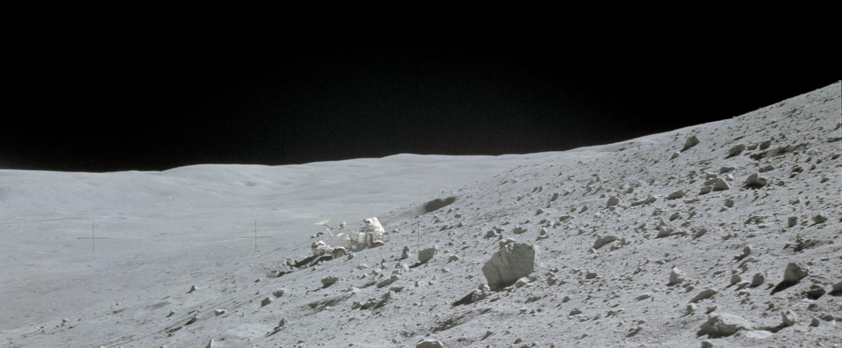

Full Lunar Surface Environment
High vacuum (${10}^{−7}$ Torr)
Low density plasma
Planetary atmosphere
Charged particle radiation
Electrons up to 100 keV
Protons up to 20 keV
Ultraviolet radiation
Near UV and Vacuum UV
Thermal extremes
Cryogenic to -180C/95K with LN2 system
Potential future upgrade to helium
Heating to >140C
Regolith simulant bed
Lunar mare or highlands, Martian up to 2,000 pounds
Notes:
Took the most important aspects of the planetary surface environment that are practical to apply at once
Note: there are a couple things we won’t have here… for example, our higher energy sources that can produce a total ionizing dose. But, they are in the same building, so we can do sequential exposures.

Slide 4
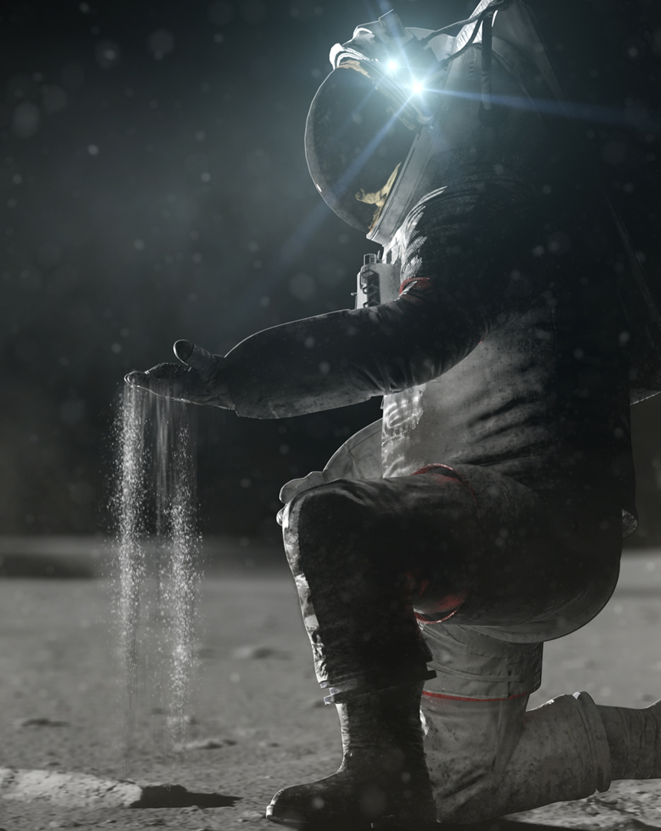
NU-LHT-5M: 1,000 kg of Highlands Simulant
Excerpts from:
DESIGN OF NU-LHT-5M AND -6M, LUNAR HIGHLAND SIMULANTS, 53rd Lunar and Planetary Science Conference (2022), Rickman et al.
It is difficult to make a general-purpose lunar highland simulant. Stoeser and Rickman [1] concluded that, in contrast to the Merriam Crater volcanic ash, which is the feedstock for the JSC-1 series of lunar mare simulants, no single terrestrial rock could be milled to produce a high quality, general use simulant of the lunar highland regolith.
Highlands simulants using natural analog materials (NU-LHT-5M) and fully synthetic materials (NU-LHT-6M).
NU-LHT-5M uses the Stillwater Complex of Montana rocks, and synthetic glass. The challenges would be to make the glass, and to do the milling and mixing of the disparate materials to match the target particle size distribution.
Image Credit: NASA
Notes:
Took the most important aspects of the planetary surface environment that are practical to apply at once
Note: there are a couple things we won’t have here… for example, our higher energy sources that can produce a total ionizing dose. But, they are in the same building, so we can do sequential exposures.

Slide 5
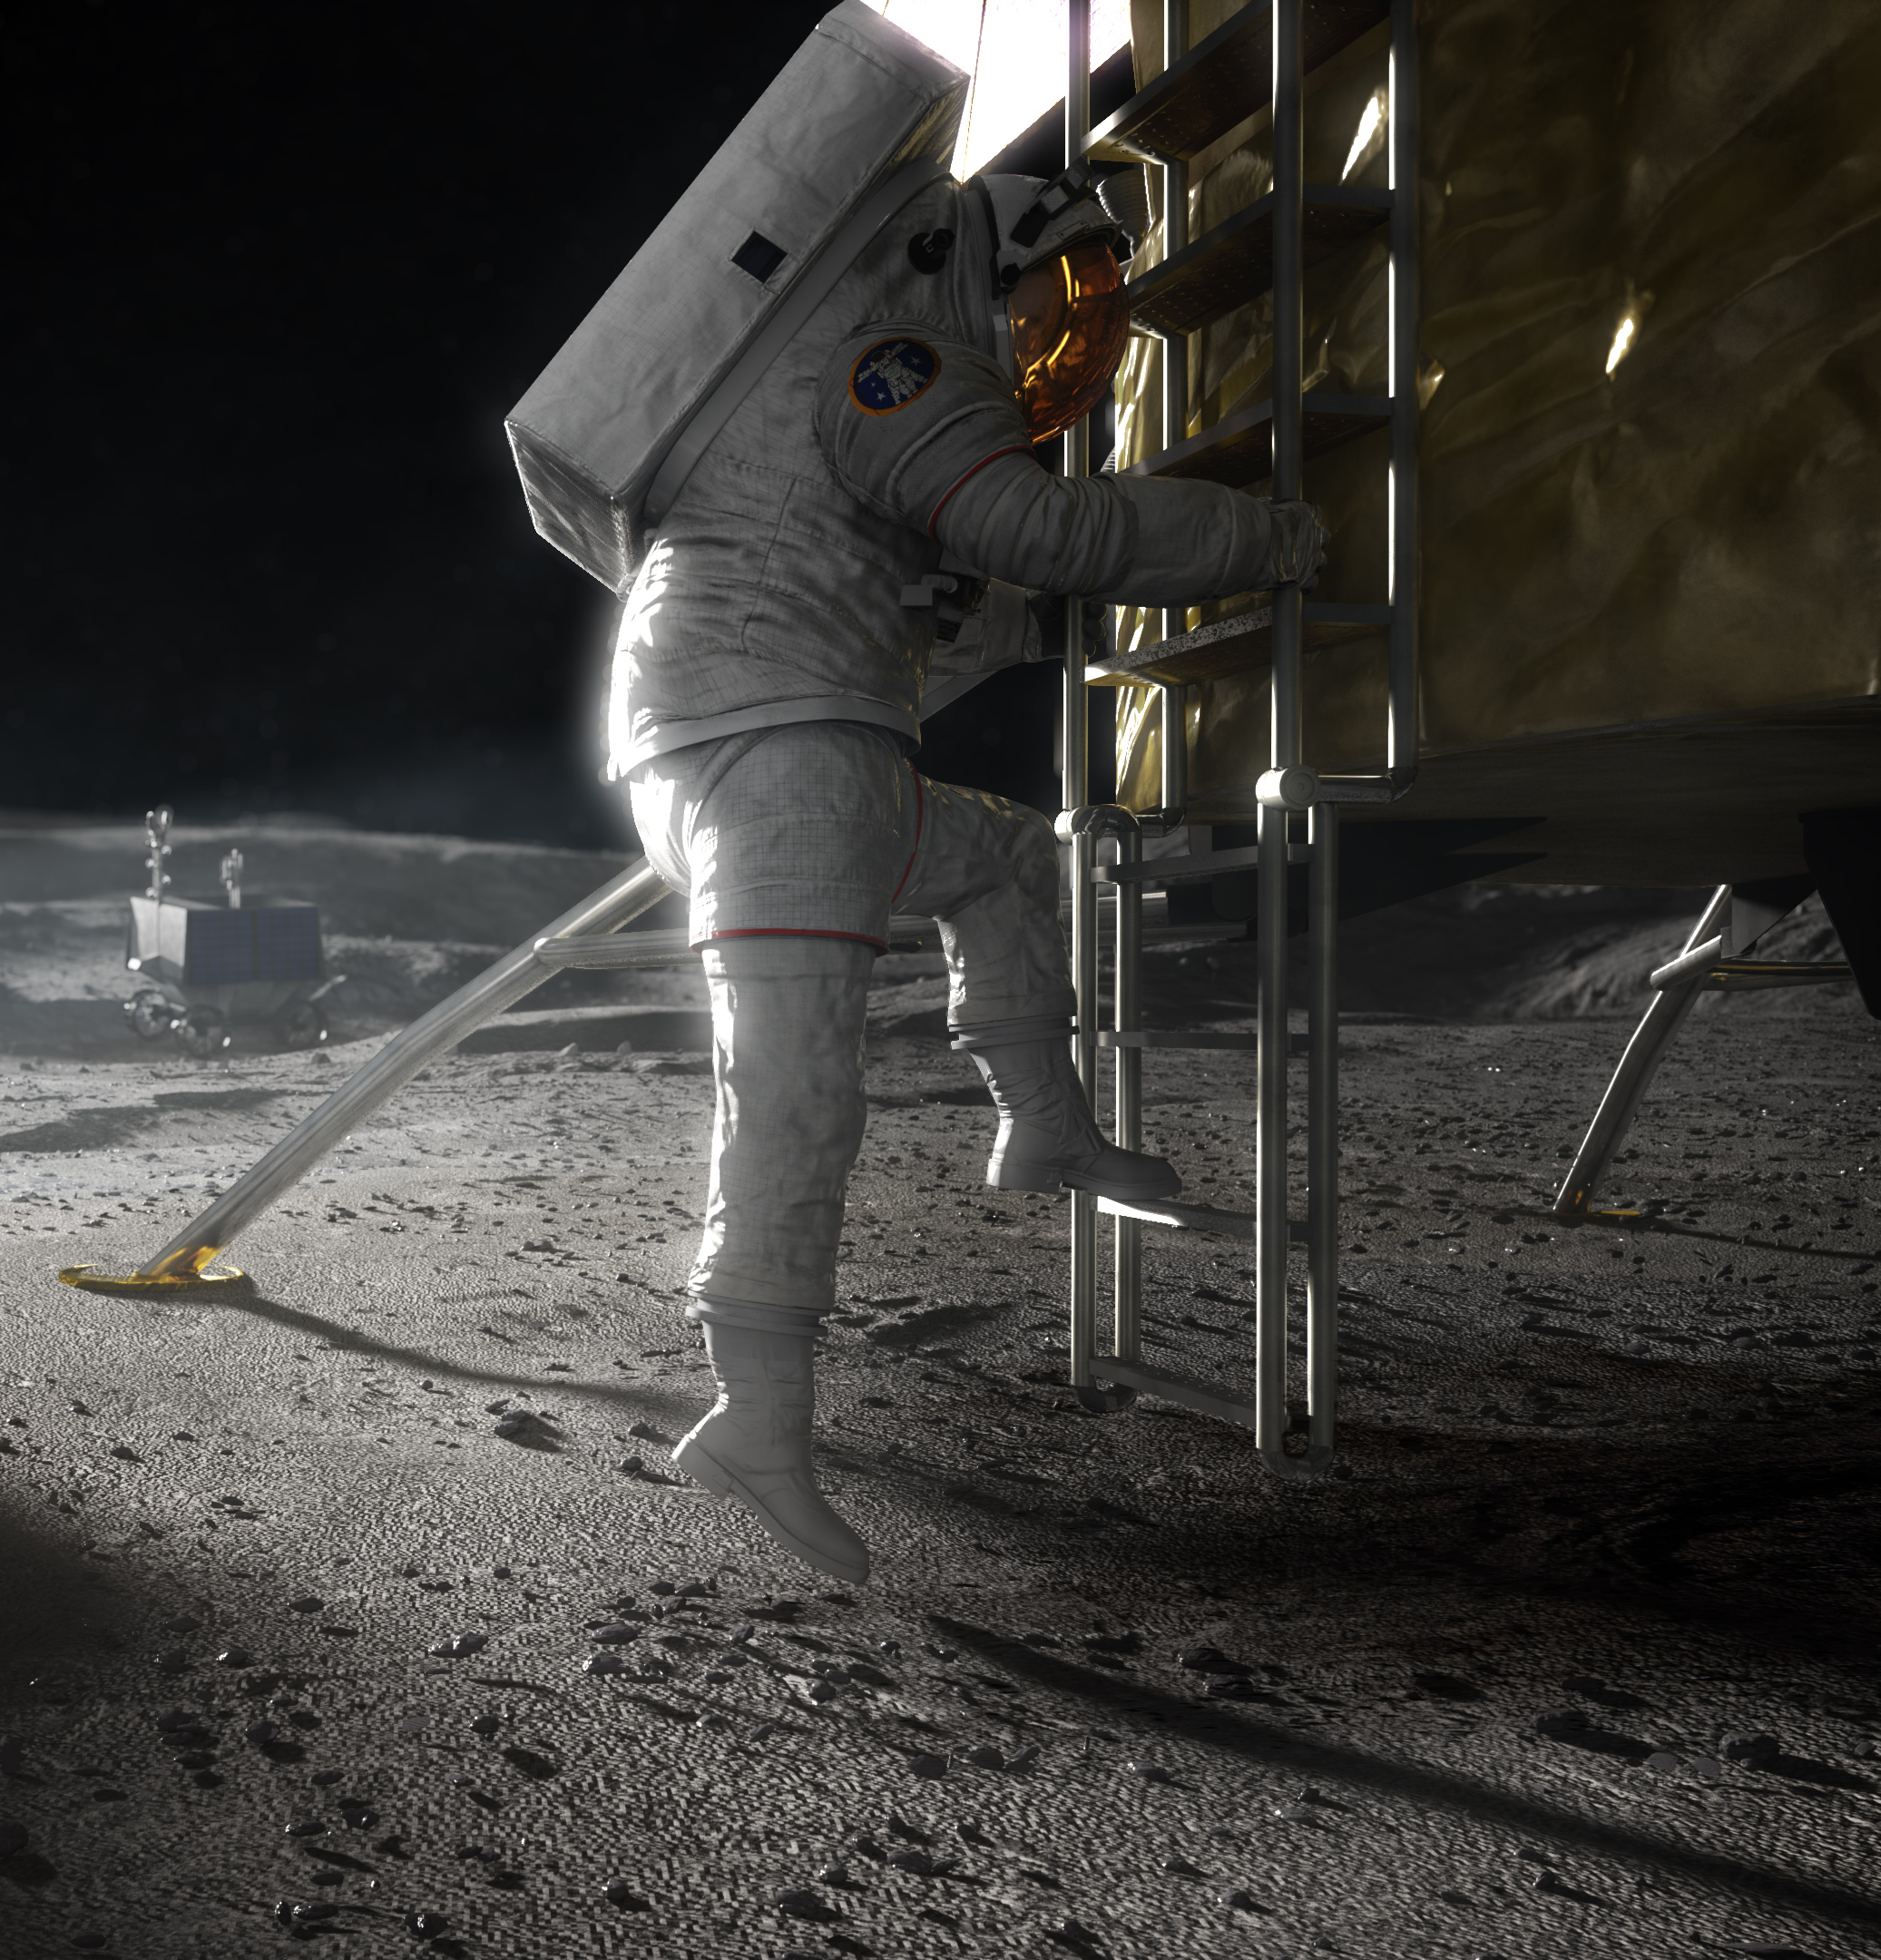
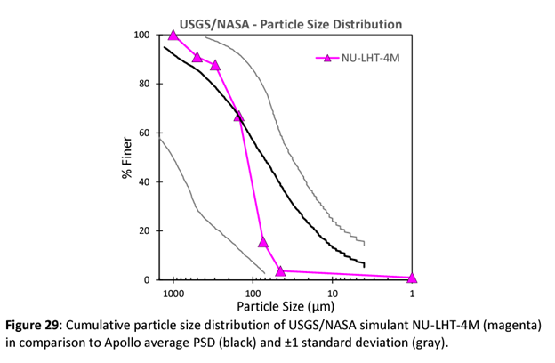
NU-LHT-4M Particle Size Distribution
Plot from: JHU-APL LSII REPORT: 2022 Lunar Simulant Assessment
Image Credit: NASA
Notes:
Took the most important aspects of the planetary surface environment that are practical to apply at once
Note: there are a couple things we won’t have here… for example, our higher energy sources that can produce a total ionizing dose. But, they are in the same building, so we can do sequential exposures.

Slide 6
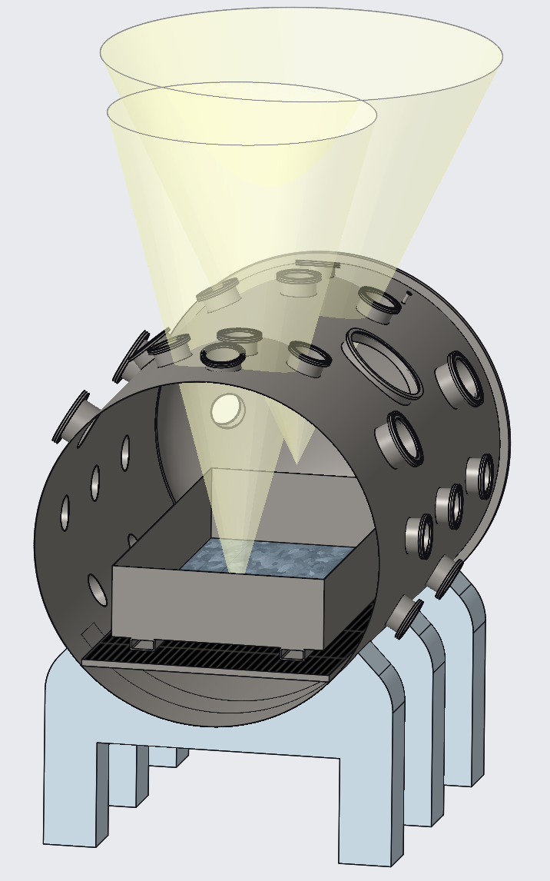
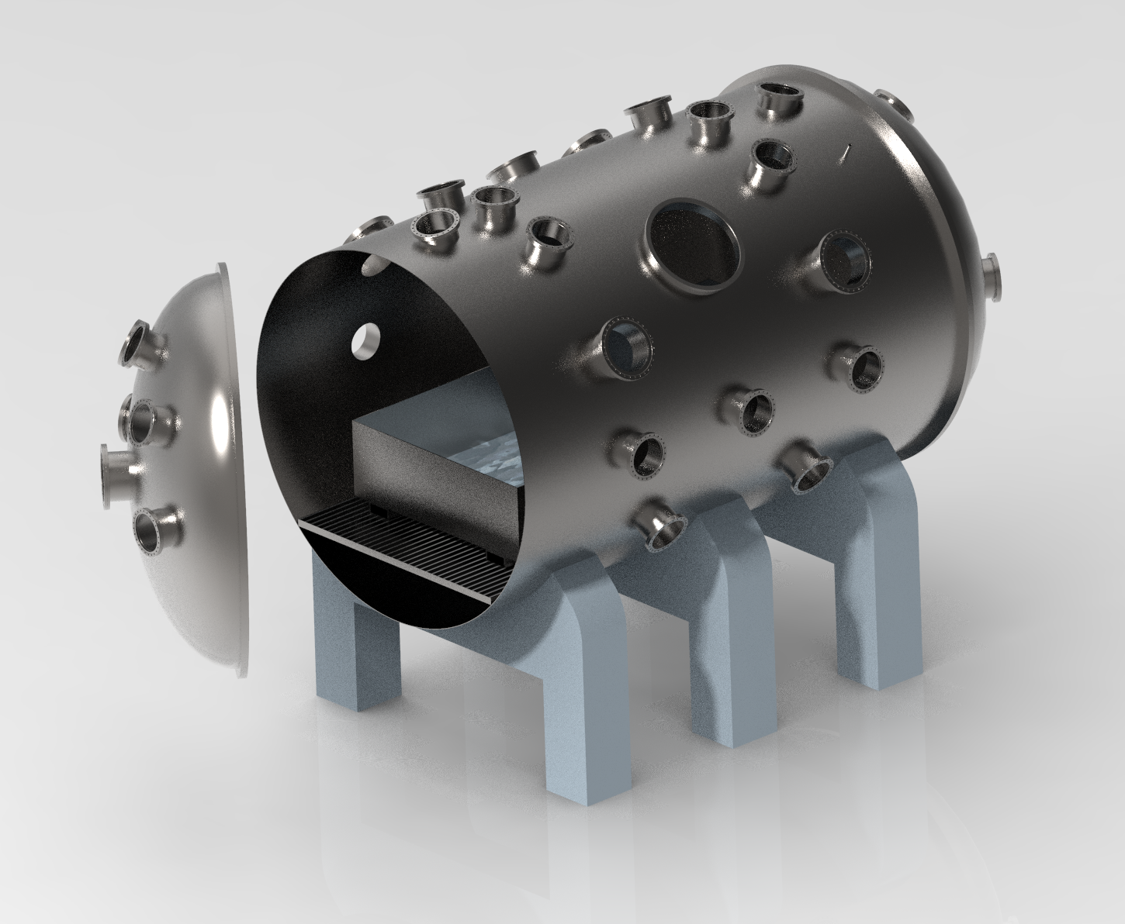
Full Surface Environment Delivered in Zones
2 Zones with different focal points
Regolith Bed or Beds
Large: 4-feet x 8-feet
Small(2X): 4-feet x 4-feet
Notes:
Bring in environments primarily from above
Additional Instrumentation – high speed cameras, RGAs, plasma diagnostic equipment, power supplies, thermocouples

Slide 7
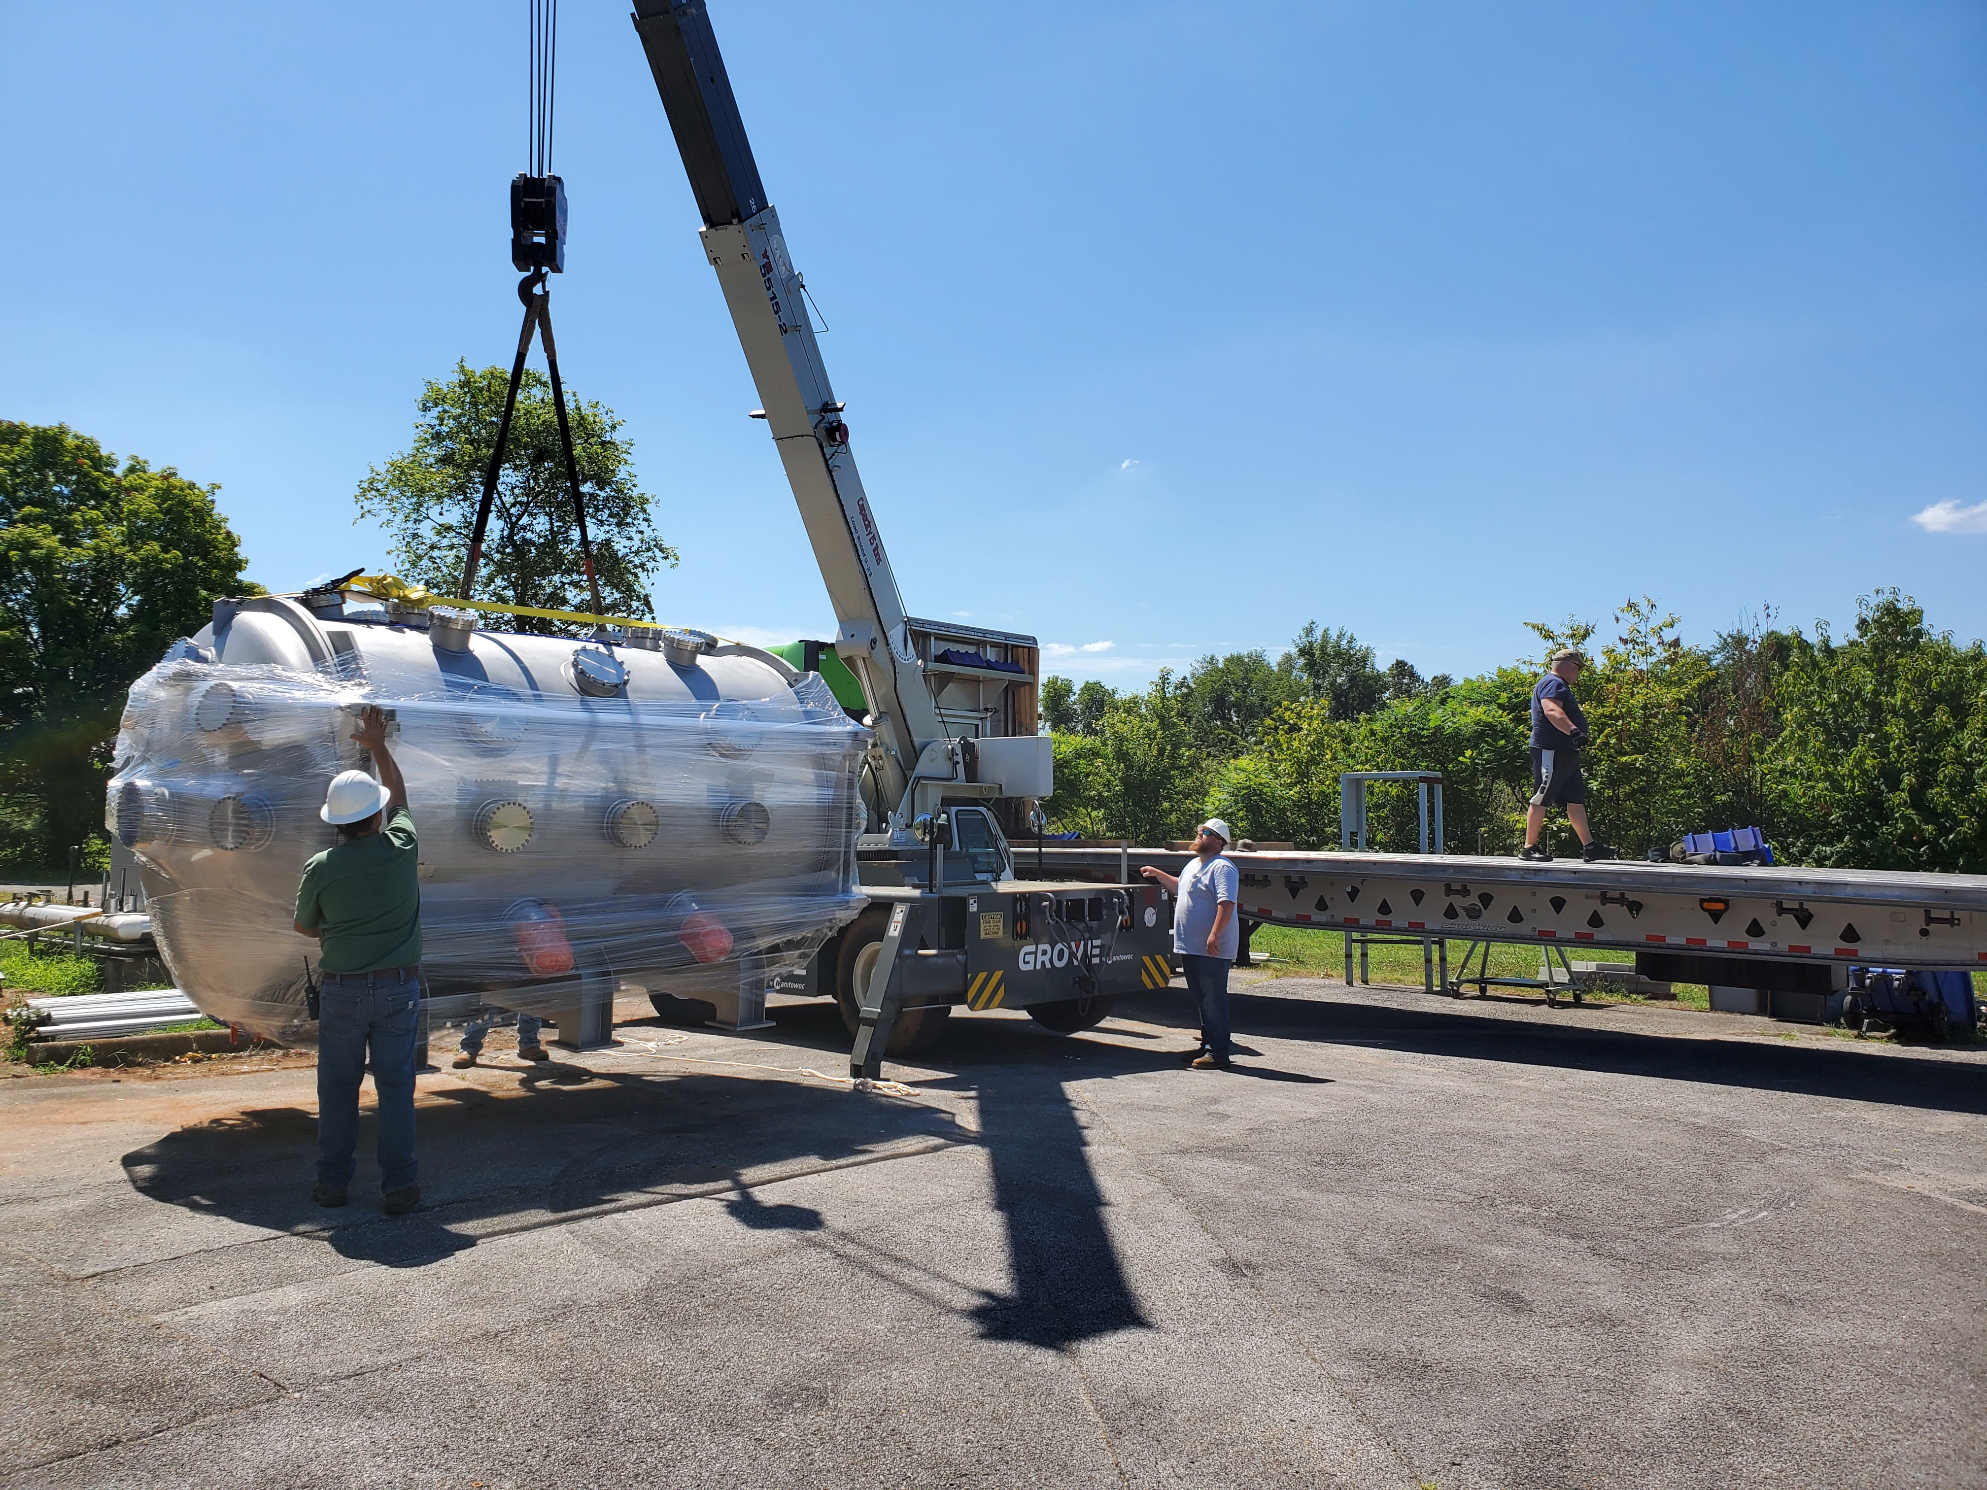
PLANET Vacuum Chamber
Delivery to MSFC
June 24, 2024
One of the hottest days of the year
Notes:
Bring in environments primarily from above
Additional Instrumentation – high speed cameras, RGAs, plasma diagnostic equipment, power supplies, thermocouples

Slide 8
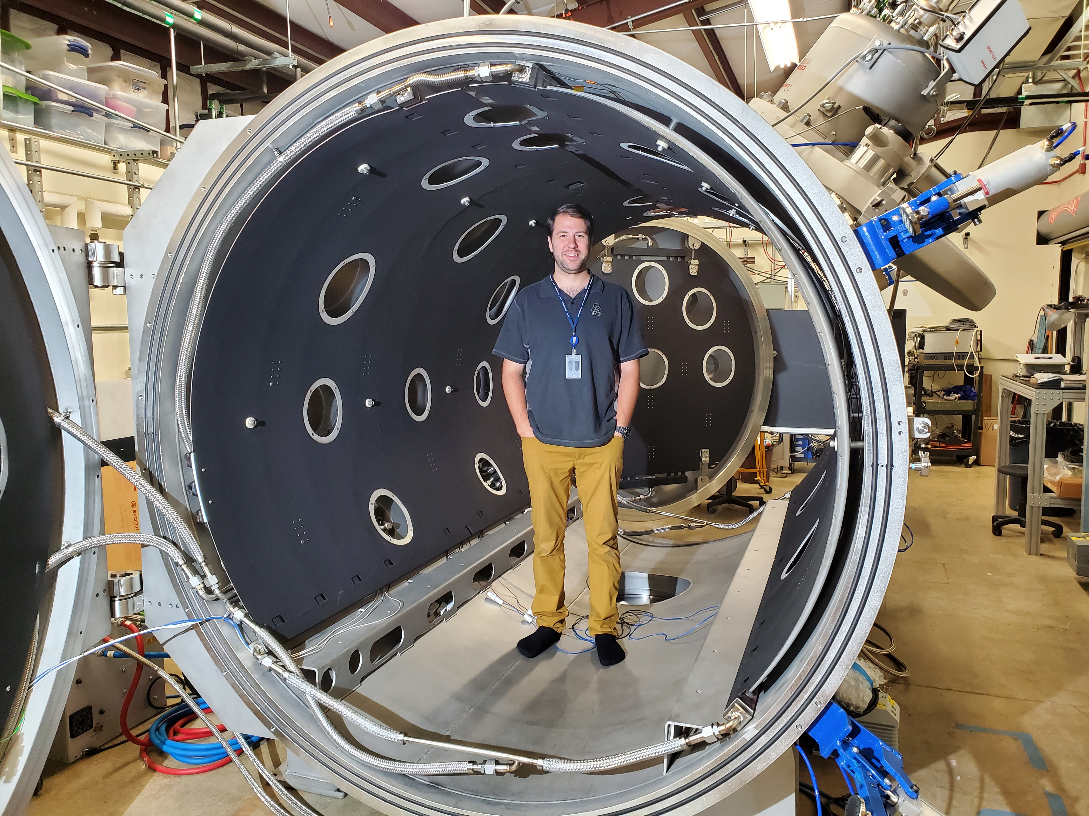
PLANET Vacuum System
View of Interior from South Door with North Door Open
Chamber Diameter = 6 feet (2m)
Chamber Length = 10 feet (3m)
Space Environmental Effects Team Member Patrick Lynn
(Modeling for Scale)
Fully Integrated Cryo Shroud (LN2) With Back-side Heaters for Control at Intermediate Temperatures
Provisions for regolith bed(s) of 3,000 lbs. (total weight)
Notes:
Bring in environments primarily from above
Additional Instrumentation – high speed cameras, RGAs, plasma diagnostic equipment, power supplies, thermocouples

Slide 9
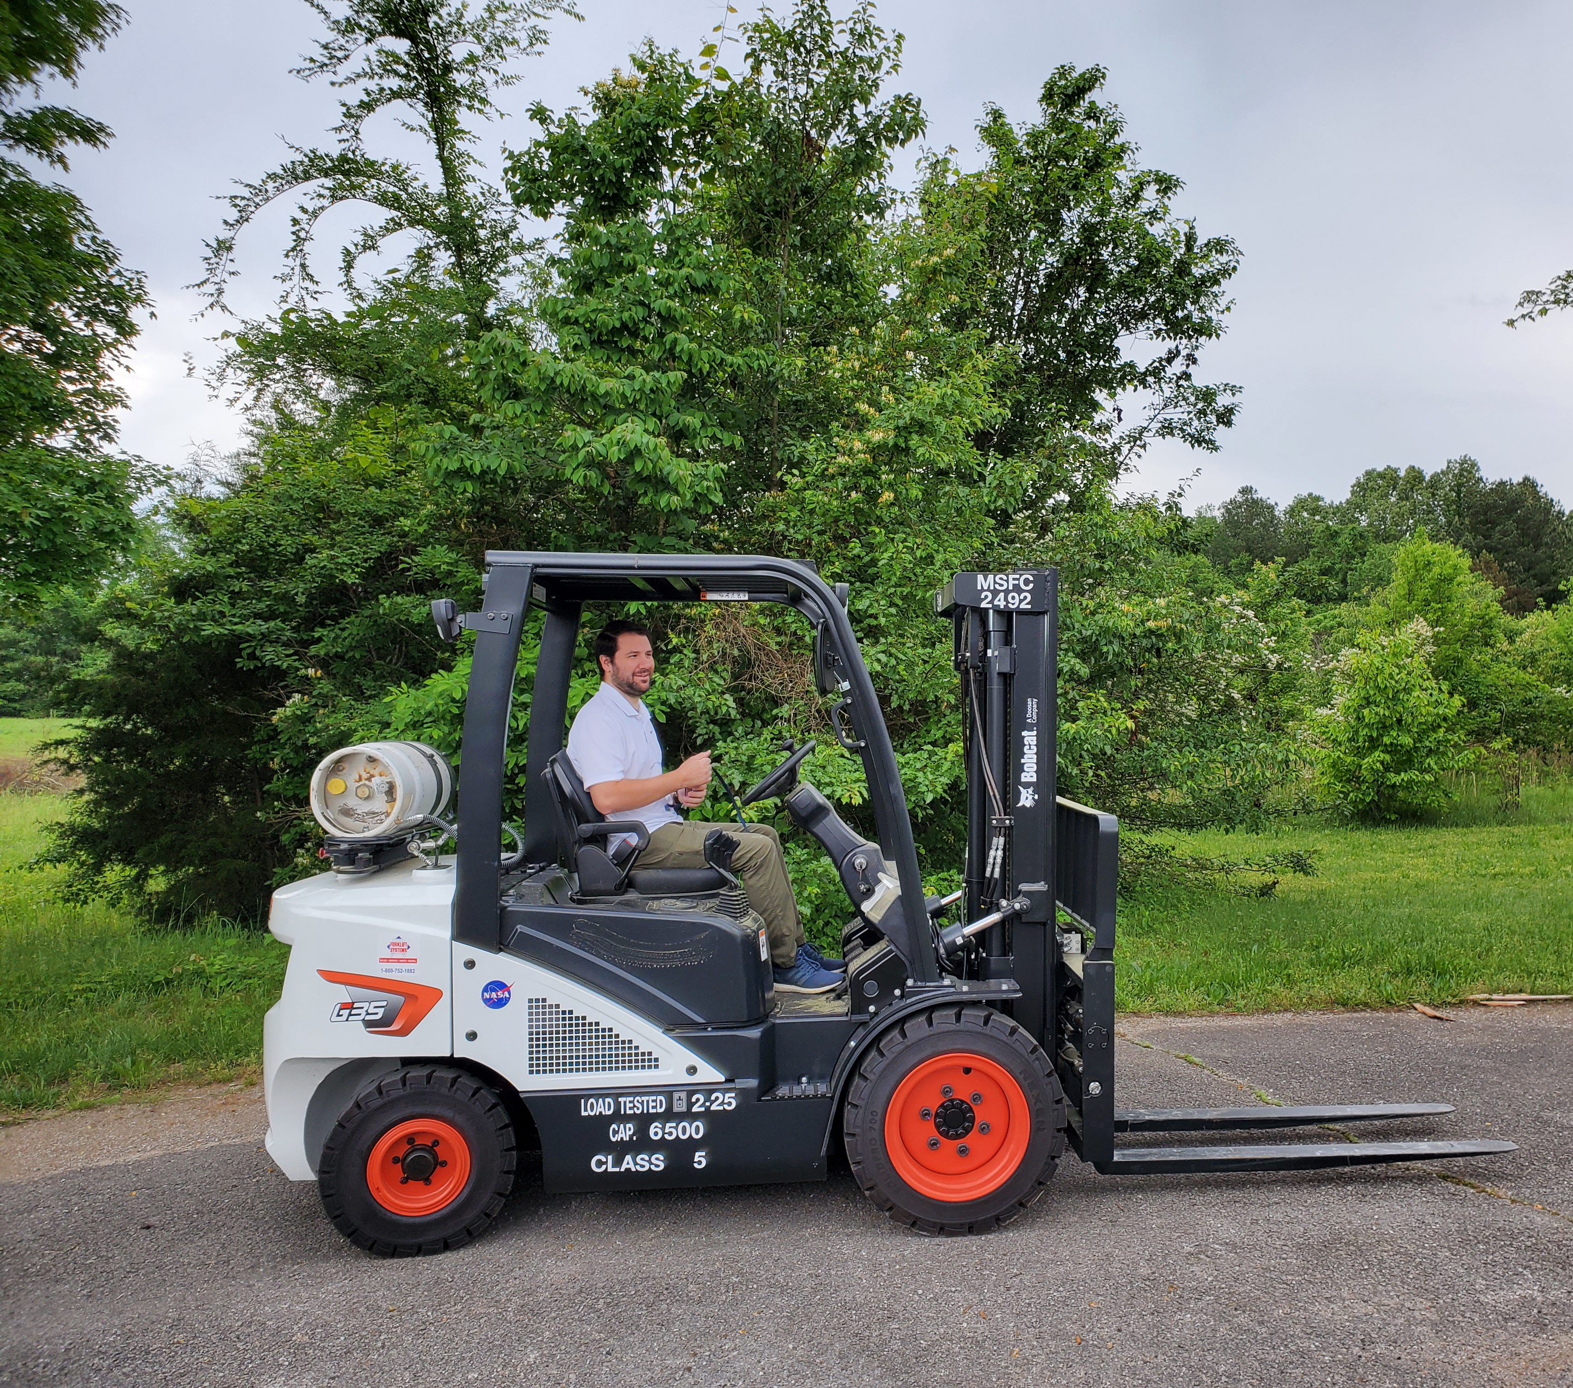
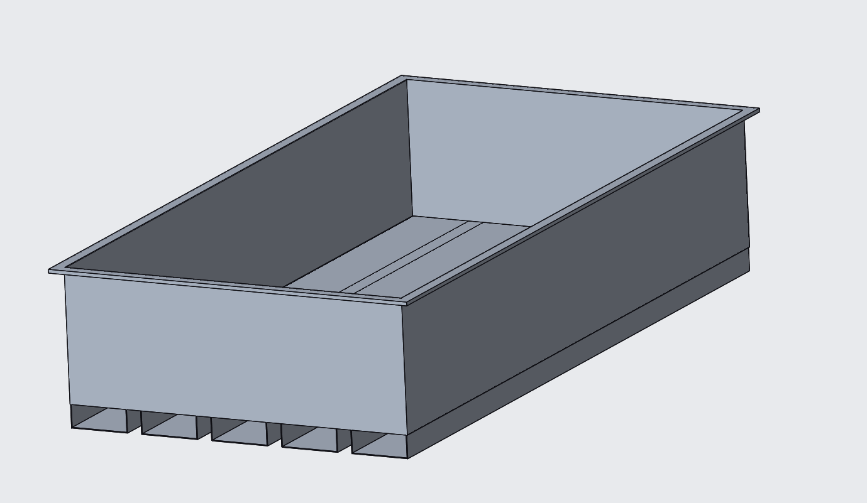
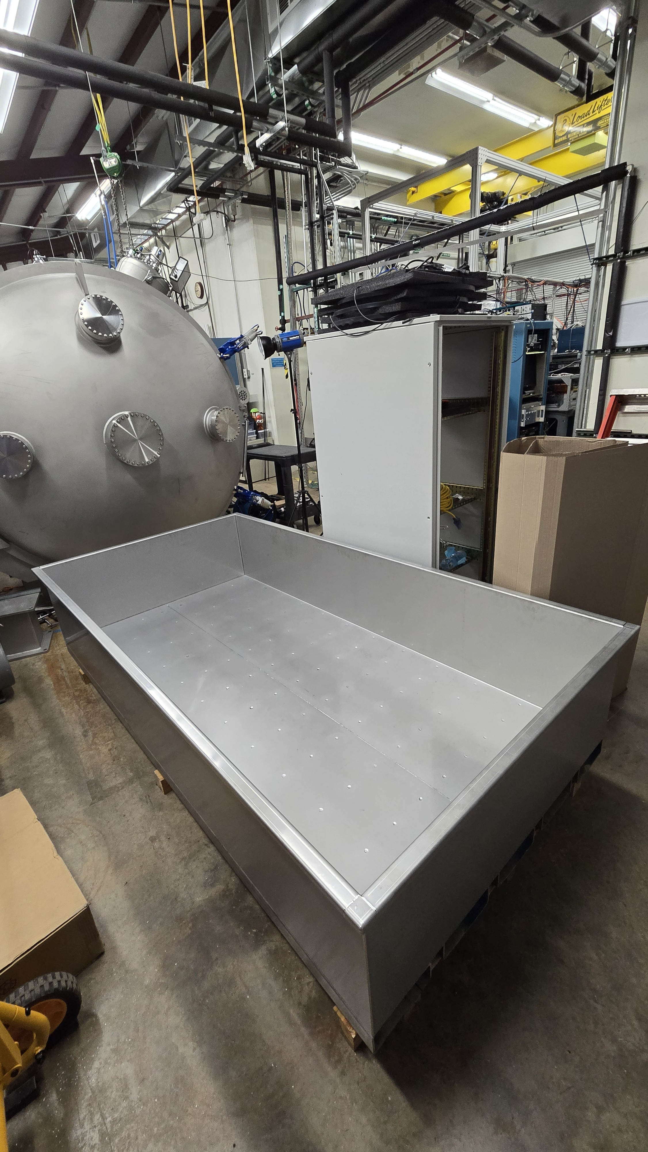
Regolith (Simulant) Bed 1.2m x 2.4m (4ft. X 8ft.)
New Dedicated Forklift
Check Of Bed Logistics In The Lab
Forklift Provisions Which Double As Strength Elements
Description
Notes:
Bring in environments primarily from above
Additional Instrumentation – high speed cameras, RGAs, plasma diagnostic equipment, power supplies, thermocouples

Slide 10
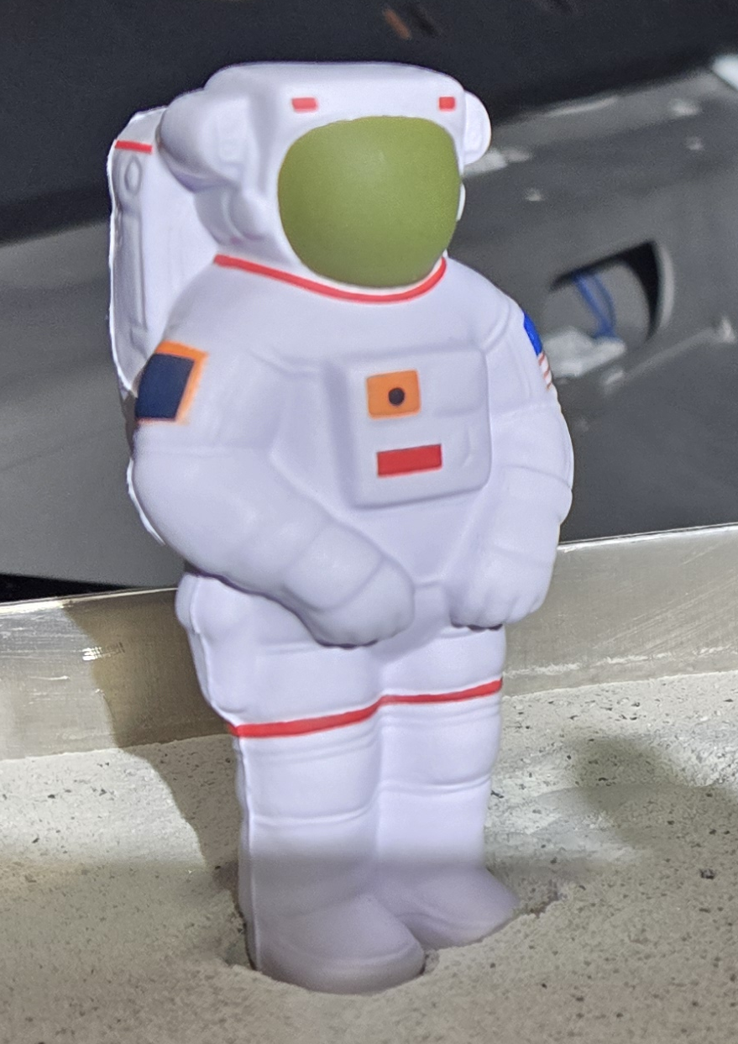
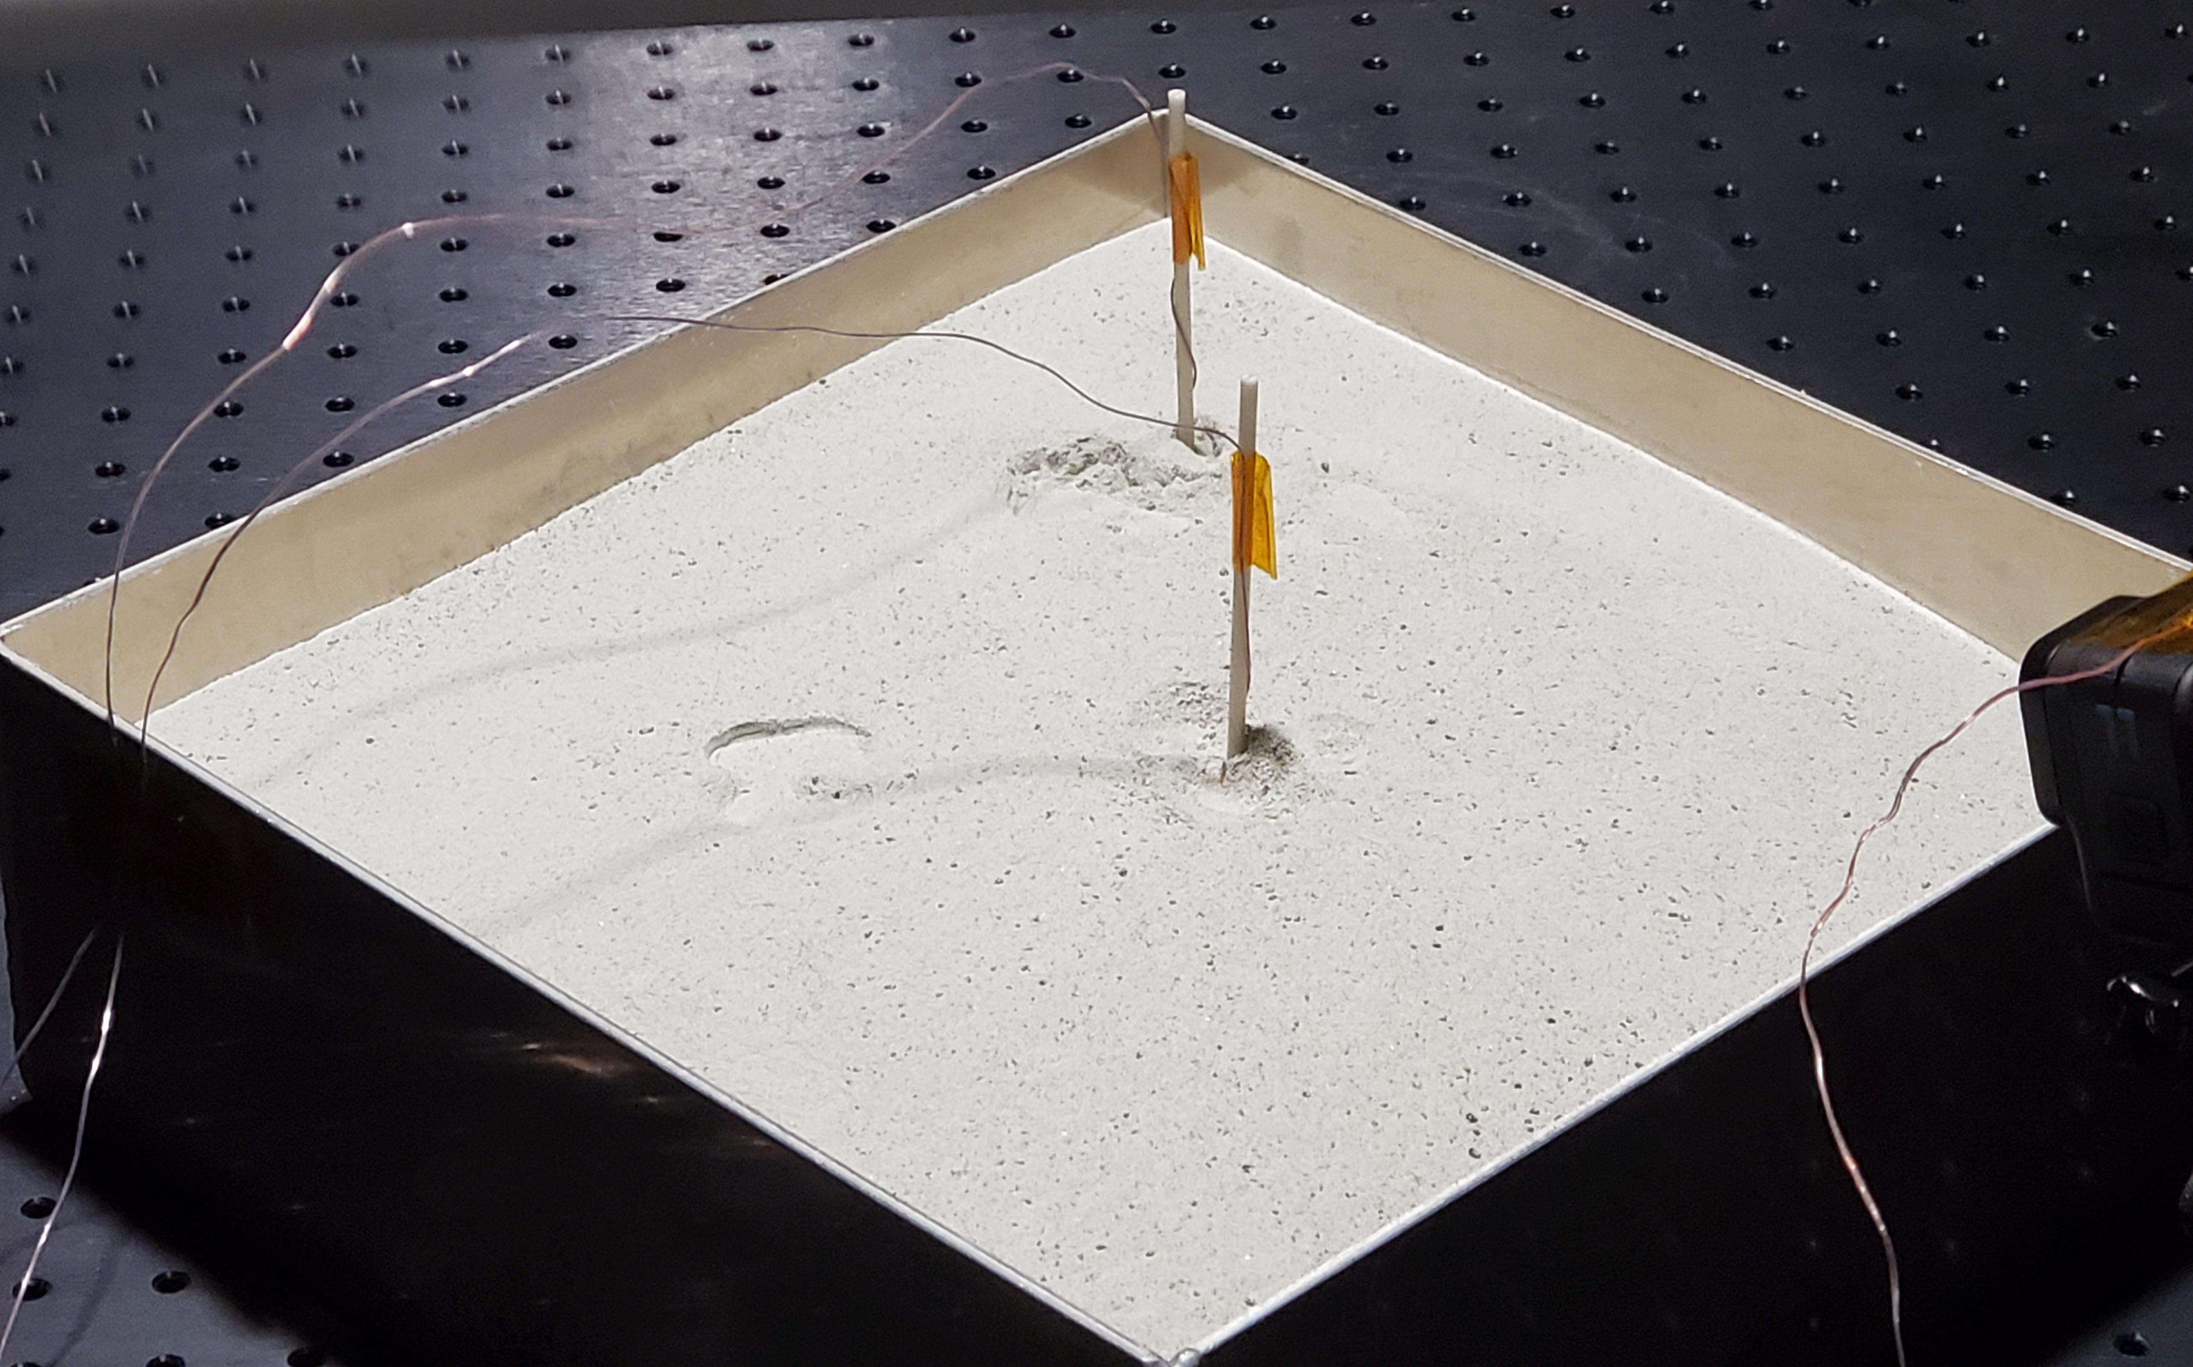
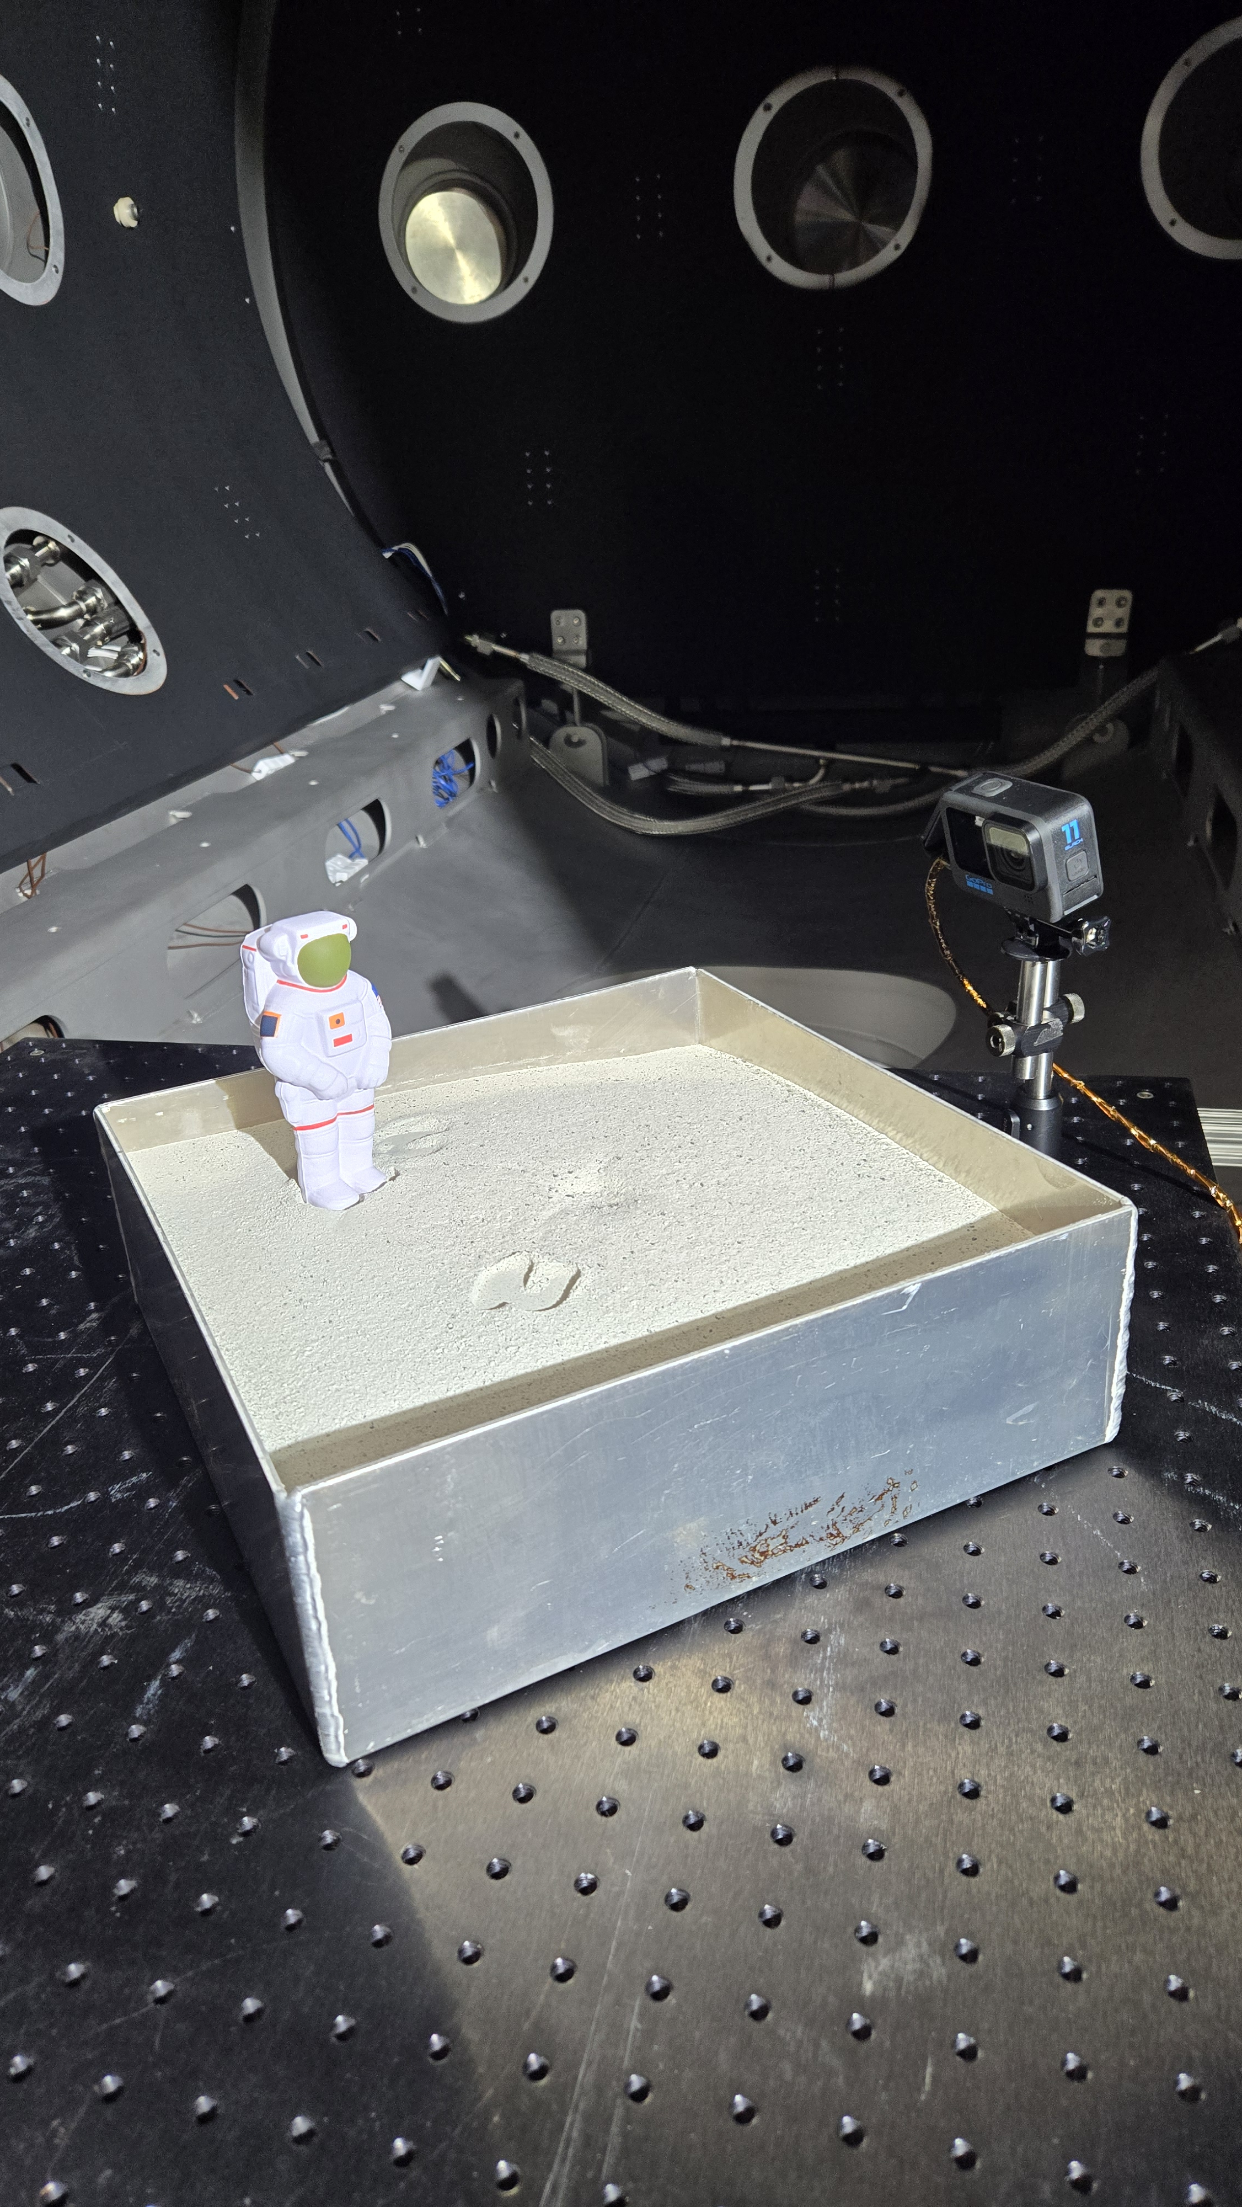
Boots on Simulant
October 2024 demonstration test in PLANET
Pump-down of 10kg (22 lbs.) of Highlands Simulant
Notes:
Bring in environments primarily from above
Additional Instrumentation – high speed cameras, RGAs, plasma diagnostic equipment, power supplies, thermocouples

Slide 11
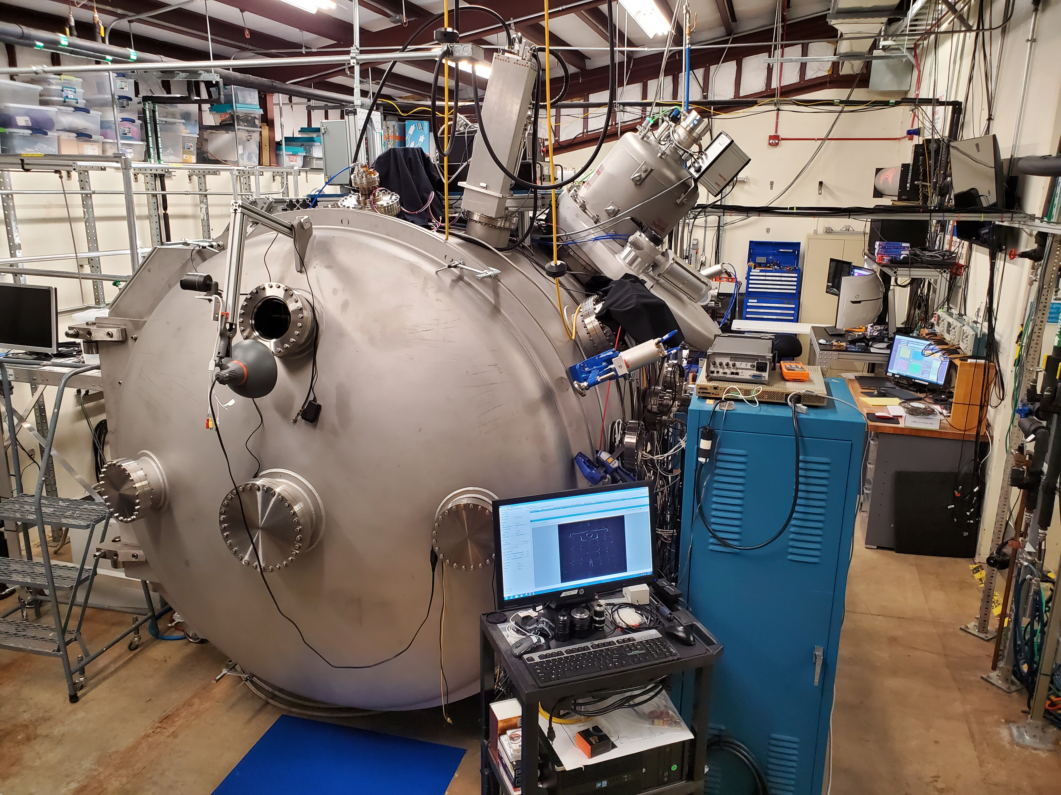
PLANET: Commissioning Complete – Ready for Testing
View of South End of Lab
Functional Test System:
Cryopump (10,000 l/s)
Multiple View Ports
High-Speed Camera
In-Vacuum Camera(s)
Electron Beam
Plasma Source
High-Voltage Feedthroughs
RF Feedthroughs (SMA)
LabVIEW Control Programs
Thermocouples (32)
12 Oscilloscope Channels
Notes:
Bring in environments primarily from above
Additional Instrumentation – high speed cameras, RGAs, plasma diagnostic equipment, power supplies, thermocouples

Slide 12
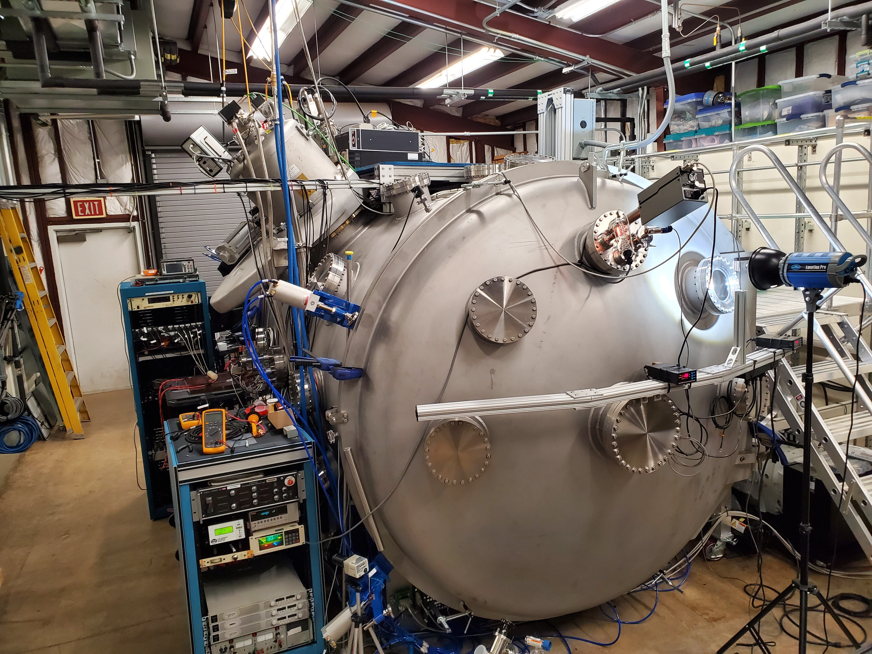
PLANET: Commissioning Complete – Ready for Testing
View of North End of Lab
Functional Test System:
Residual Gas Analyzer
High Intensity Light Source
Independent Pressure Gauges
AC Power Distribution Center
Trek Probe System
4-Axis Stage Control System
Staging Platform (top)
PID Controlled LN2 Flow
High Speed Roughing System (380 cfm)
16 Analog Input Channels
8 Analog Output Channels
Notes:
Bring in environments primarily from above
Additional Instrumentation – high speed cameras, RGAs, plasma diagnostic equipment, power supplies, thermocouples

Slide 13
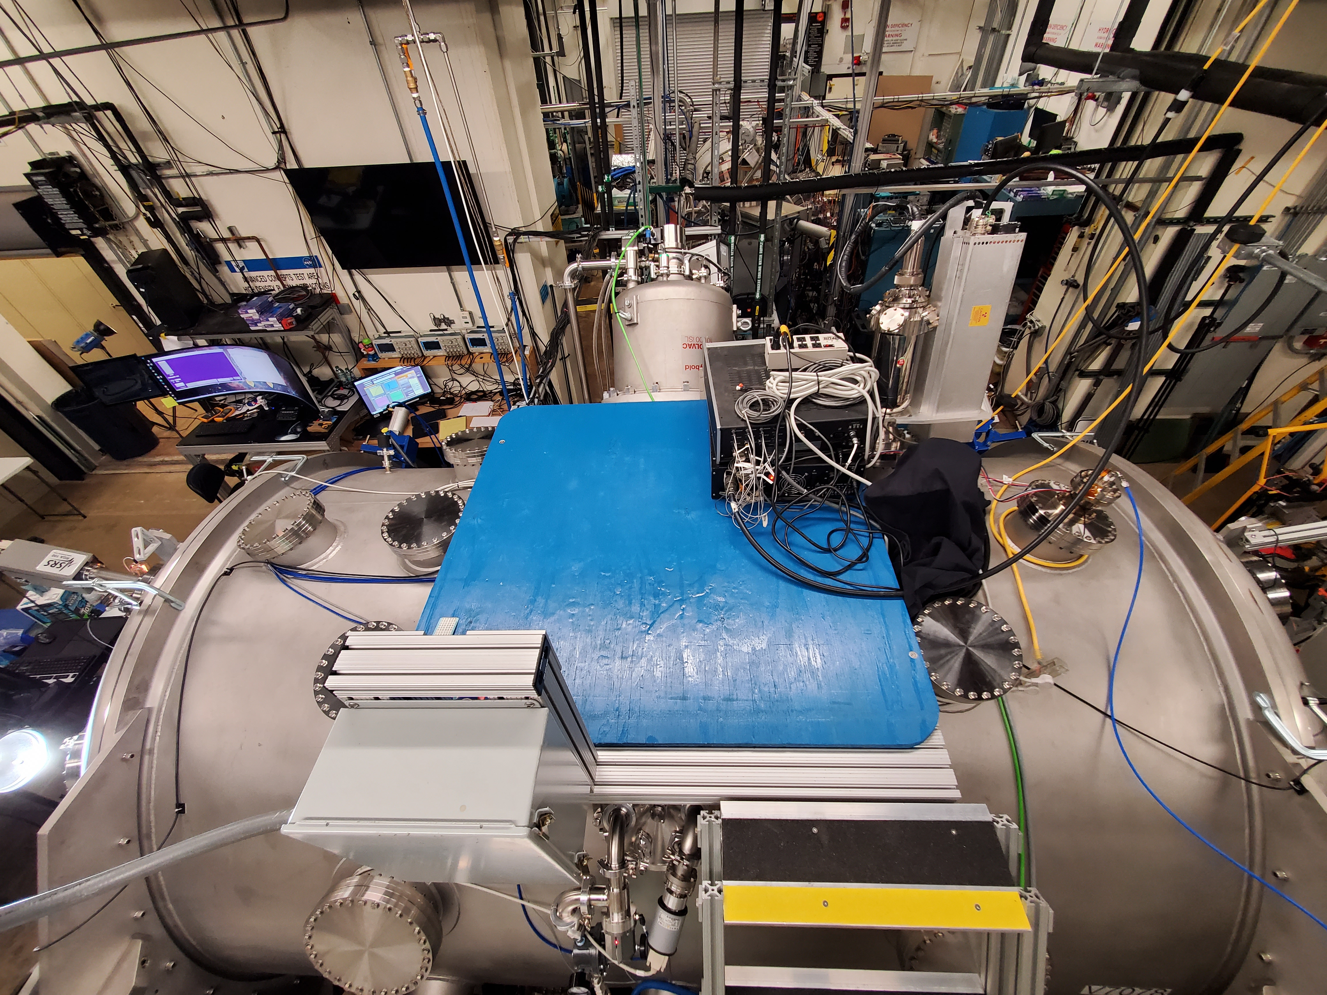
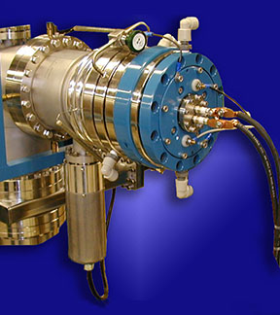
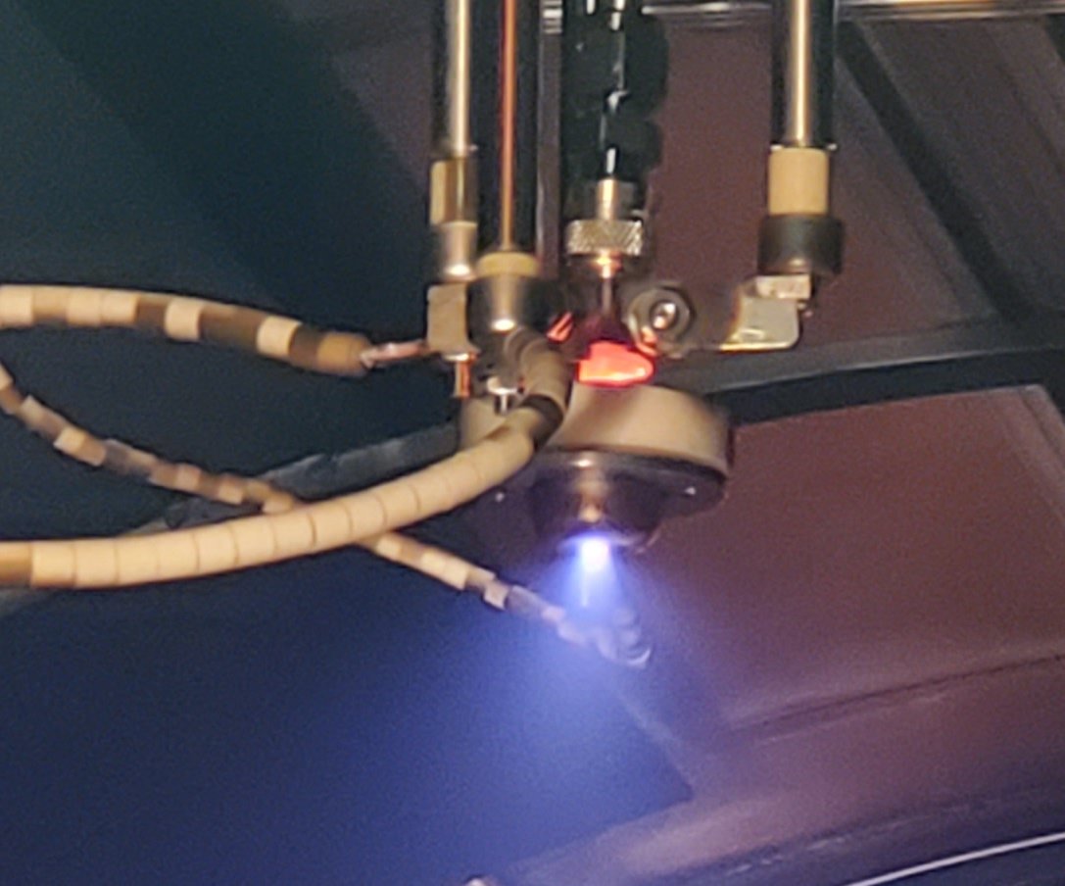
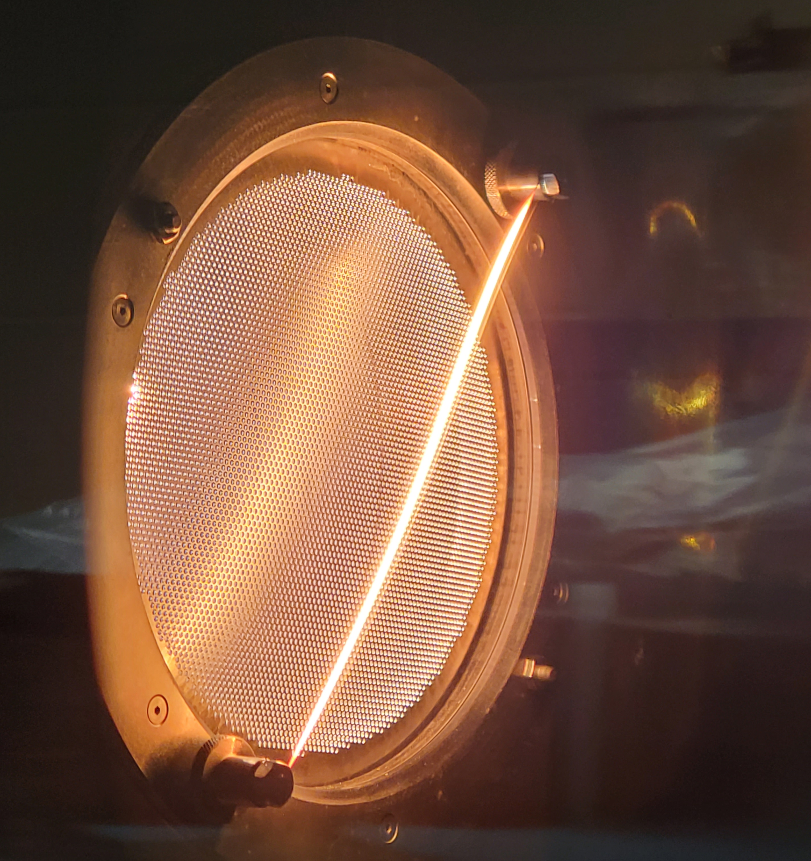
PLANET Space Environment Systems
Electron Gun (Installed)
Solar Simulator (Ready)
Proton Source (Aug. 2025)
Top View of PLANET
Plasma Source (Installed)
Ion Source (Ready)
Notes:
Bring in environments primarily from above
Additional Instrumentation – high speed cameras, RGAs, plasma diagnostic equipment, power supplies, thermocouples

Slide 14
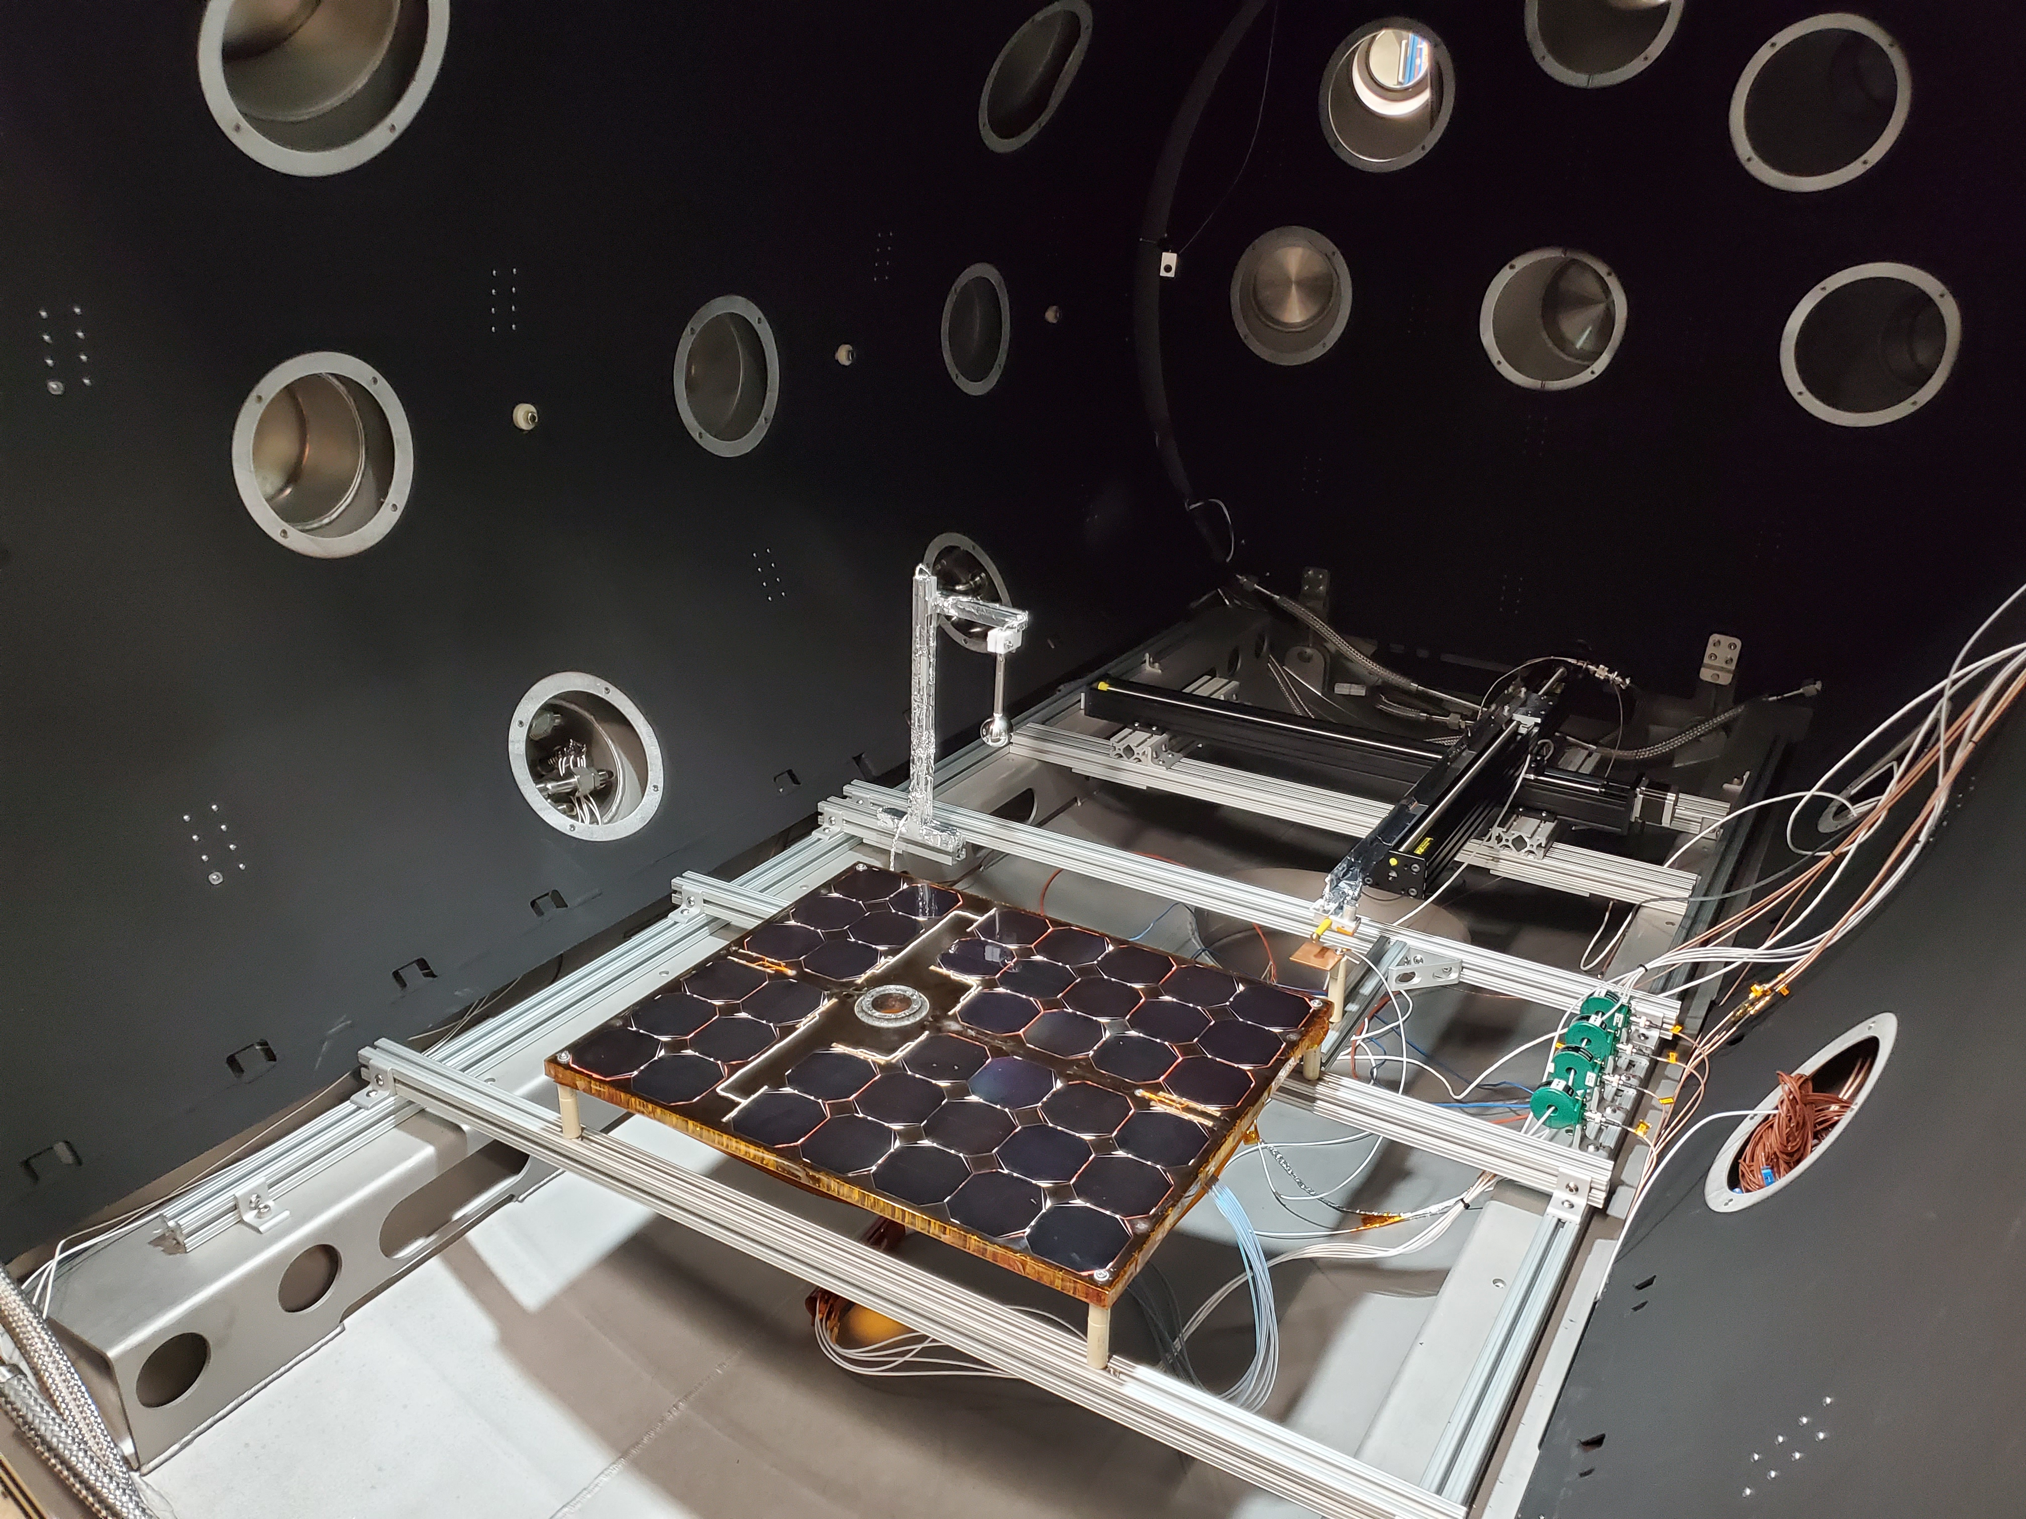
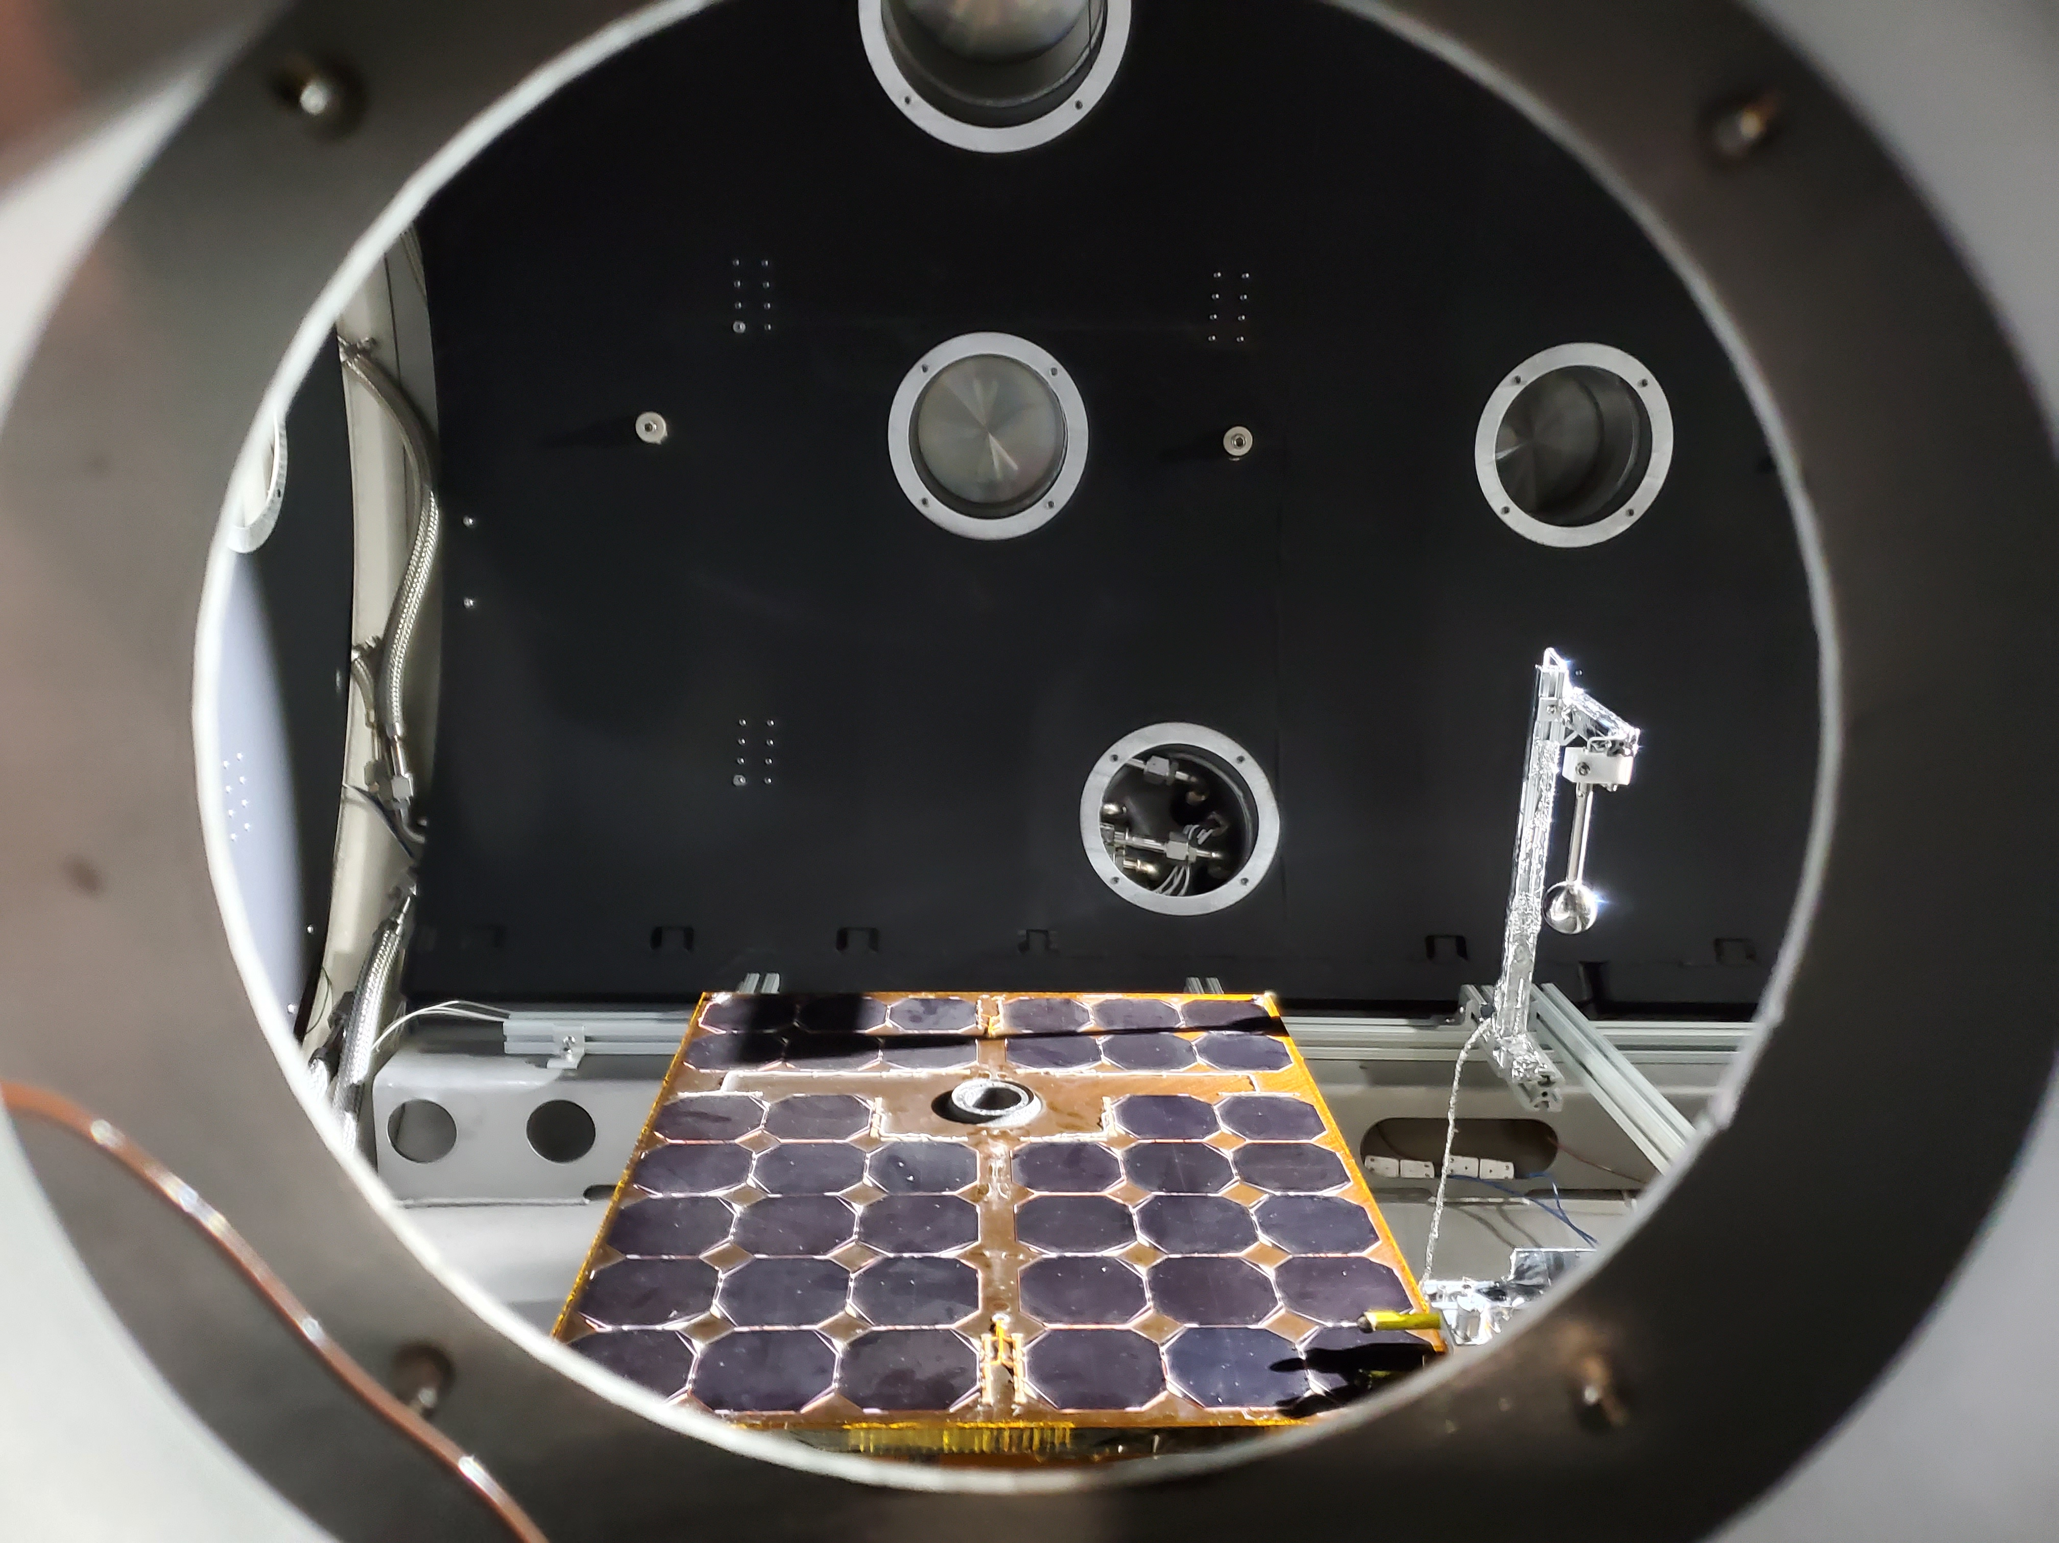
First Official Tests Underway – Solar Array Coupon Electrostatic Discharge (ESD)
Plasma Diagnostic
2D Motorized Stages
View of Test Coupon from Side Port
Trek Probe and Faraday Cup
Solar Array Coupon Under Test
View of Chamber Interior from South Door
Notes:
Bring in environments primarily from above
Additional Instrumentation – high speed cameras, RGAs, plasma diagnostic equipment, power supplies, thermocouples

Slide 15
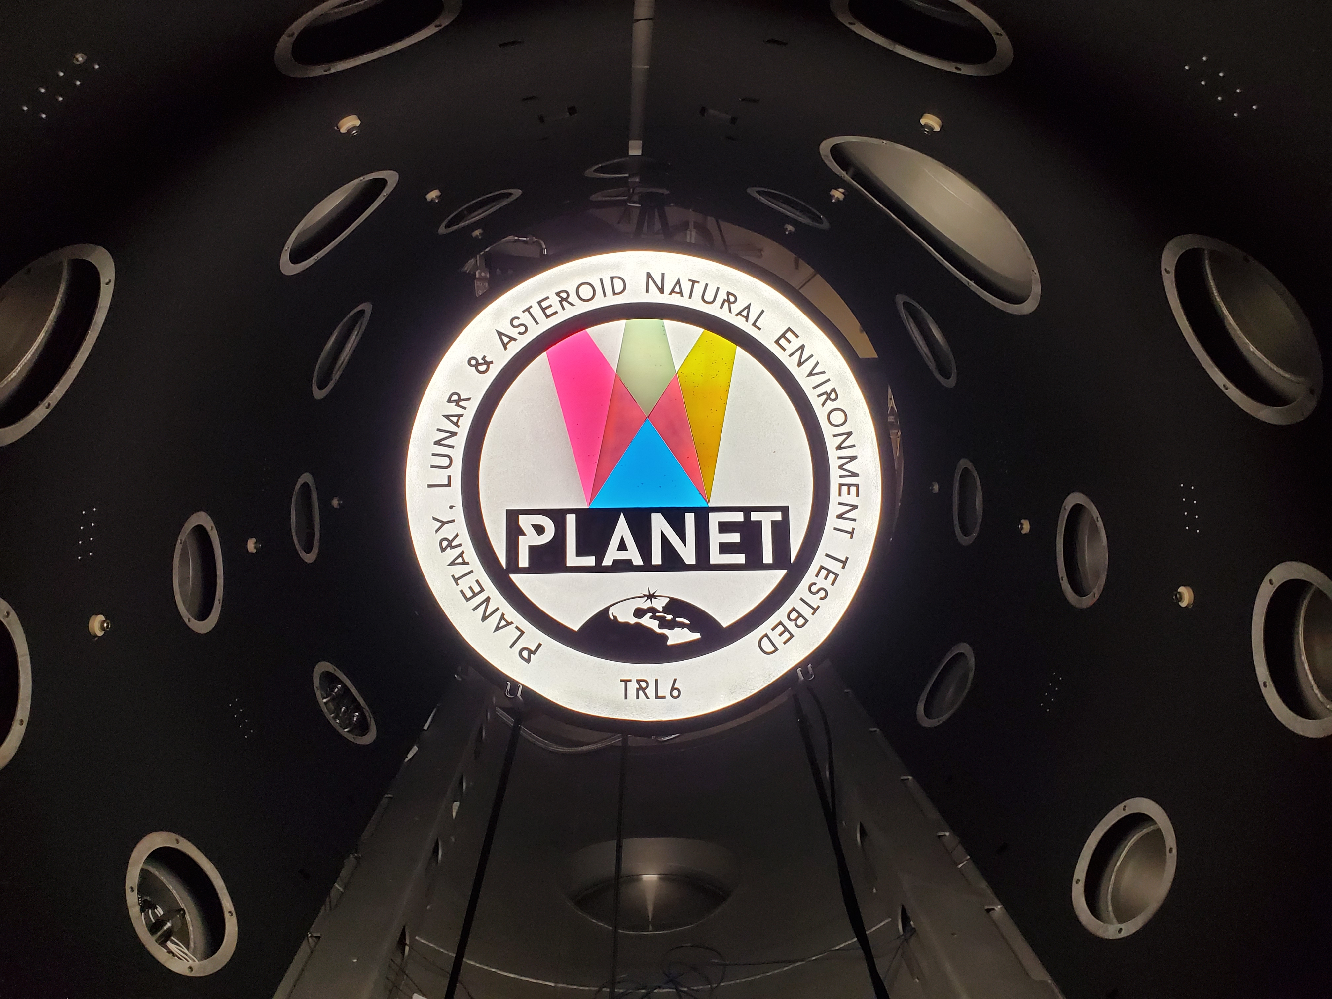
TRL-6 Testing Enabled
Planetary surface ConOps
Basic materials property changes & aging
Charging (and discharging!) behavior
Thermal balance, performance, cycling
Regolith and dust adherence in a space environment
Dusty mechanism operations and wear
Synergistic/combined effects
What kind of planetary surface testing capability does your technology need?

Slide 16
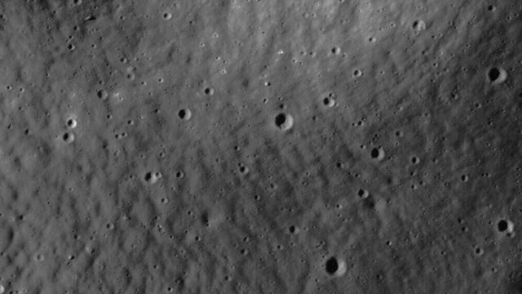
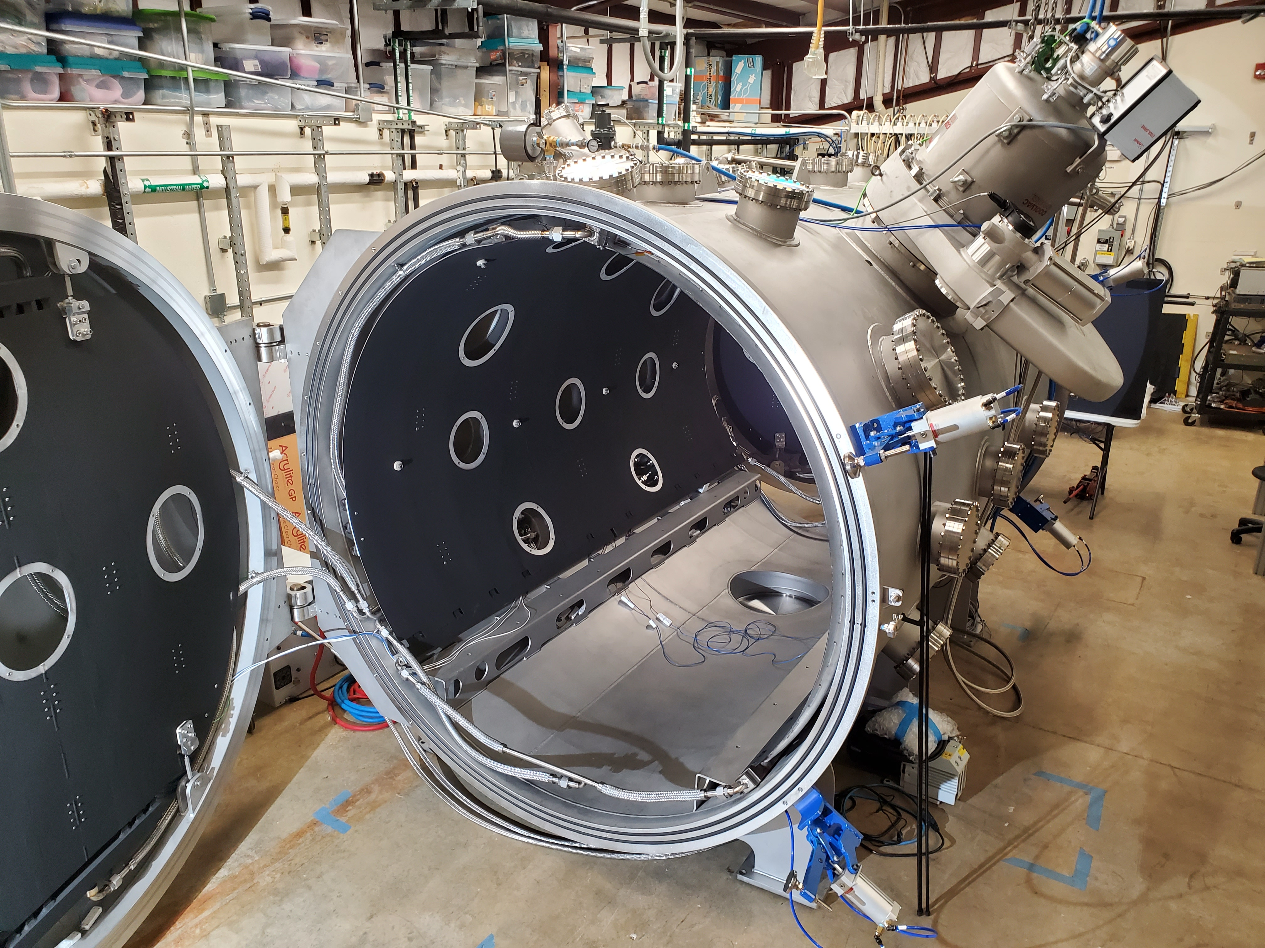
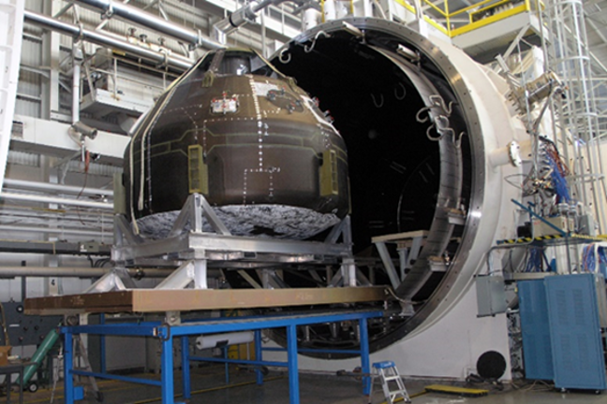
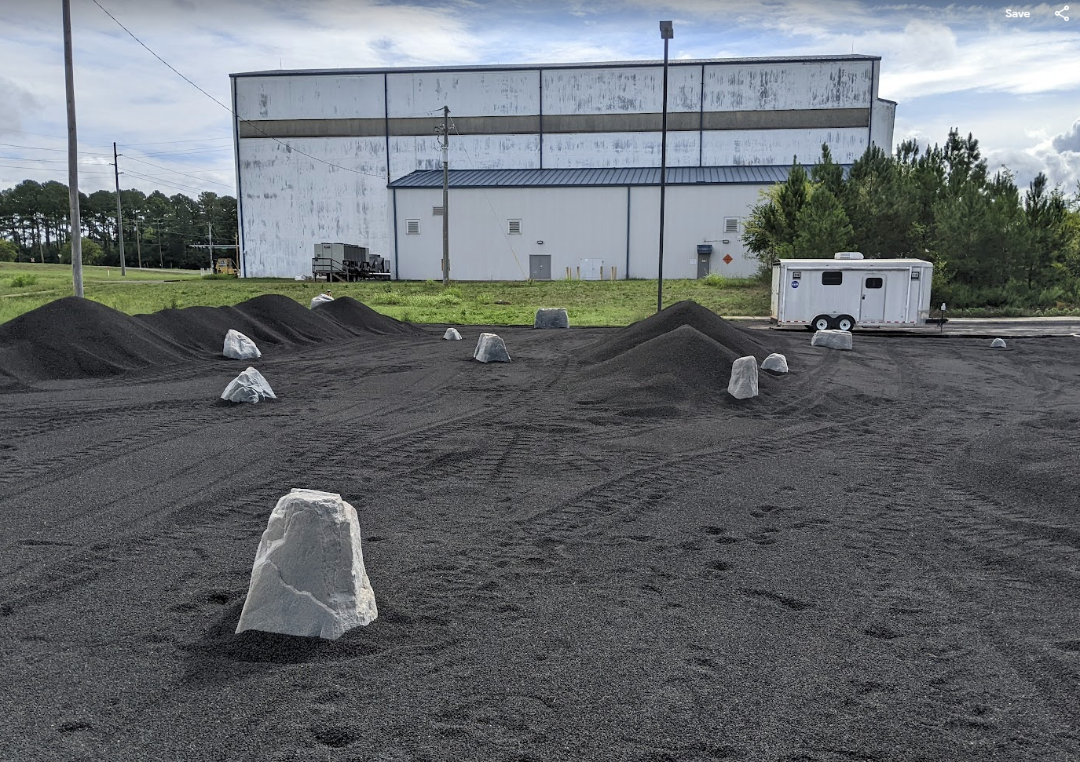

MSFC Lunar Testing Ecosystem
MSFC has multiple complementary planetary surface test capabilities, providing solutions for projects of different sizes, budgets, and development levels
V20
PLANET
Regolith Field

Slide 17

Contact Us to Help Develop Your Lunar Surface Technologies
Thanks
Contact us to discuss your testing needs:
Todd Schneider
todd.schneider@nasa.gov
Erin Hayward
erin.g.hayward@nasa.gov
Notes:
There are a lot of trades and considerations when designing a new chamber, especially one that is meant to be somewhat general purpose to suit lots of experiment types.
First, you need to consider what environments you need, and how those will be introduced to the chamber.
You also need to consider a lot of ancillary instrumentation – this includes diagnostic equipment like thermocouples, voltage meters, residual gas analyzers... Data cables for interacting with any controllers you might have… power supplies to feed heaters, and more. You can see a picture of one of our chambers here on the right. I intentionally did not choose a photo where everything is perfectly cleaned up and organized, because this one really gives you a much better sense of what an actual working lab set up looks like!
Chamber sizing determines the types of tests you can run,

