Slide 1
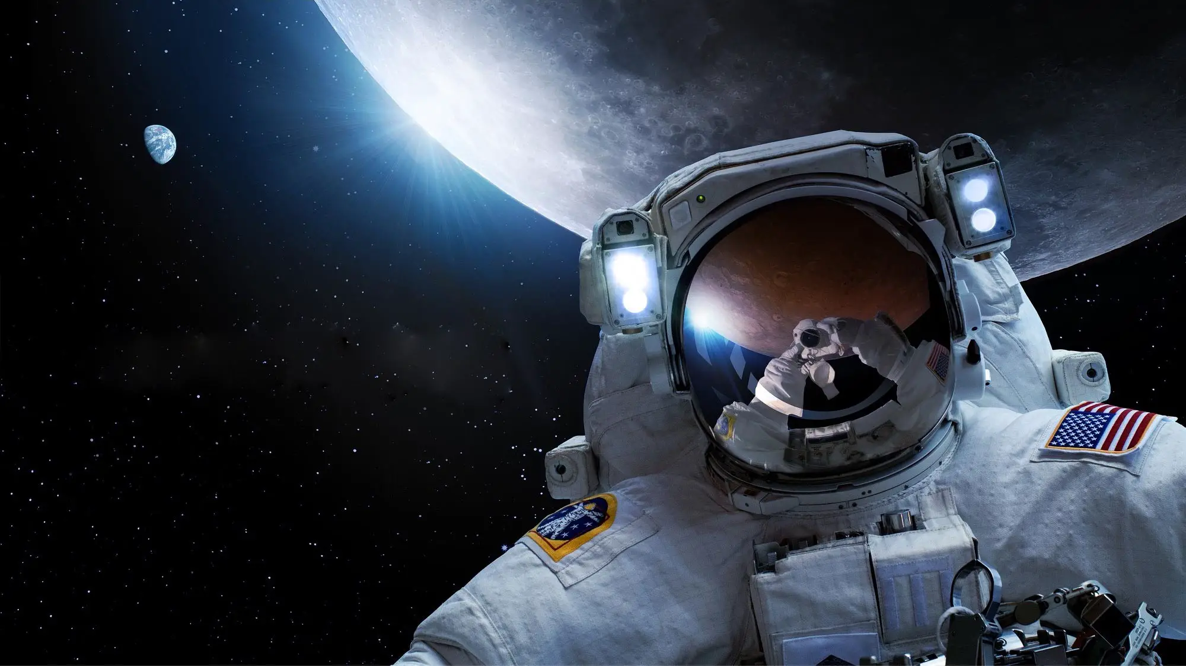


NASA EXPLORATION ATMOSPHERE TESTS 3 & 4: DEVELOPMENT AND VALIDATION OF PLANETARY EVA PREBREATHE PROTOCOLS FOR ALTERNATE ATMOSPHERES AND SUIT PRESSURES
Alejandro Garbino, MD, PhD, MPH, FAsMA
04 June 2025 - Atlanta
95th Annual AsMA Scientific Meeting
1
Alejandro Garbino, GeoControl Systems
Monica Hew-Yang, KBR
Patrick Estep, GeoControl Systems
Brett Siders, Aegis Aerospace
Karina Marshall-Goebel, NASA

Slide 2

Disclosure Information
95th Annual Scientific Meeting
Alejandro Garbino, MD, PhD, MPH, FAsMA
I have no financial relationships to disclose.
I will not discuss off-label use and/or investigational use in my presentation.
The opinions discussed are mine and mine alone, they do not
represent those of GeoControl, KBR, NASA or the federal government

Slide 3
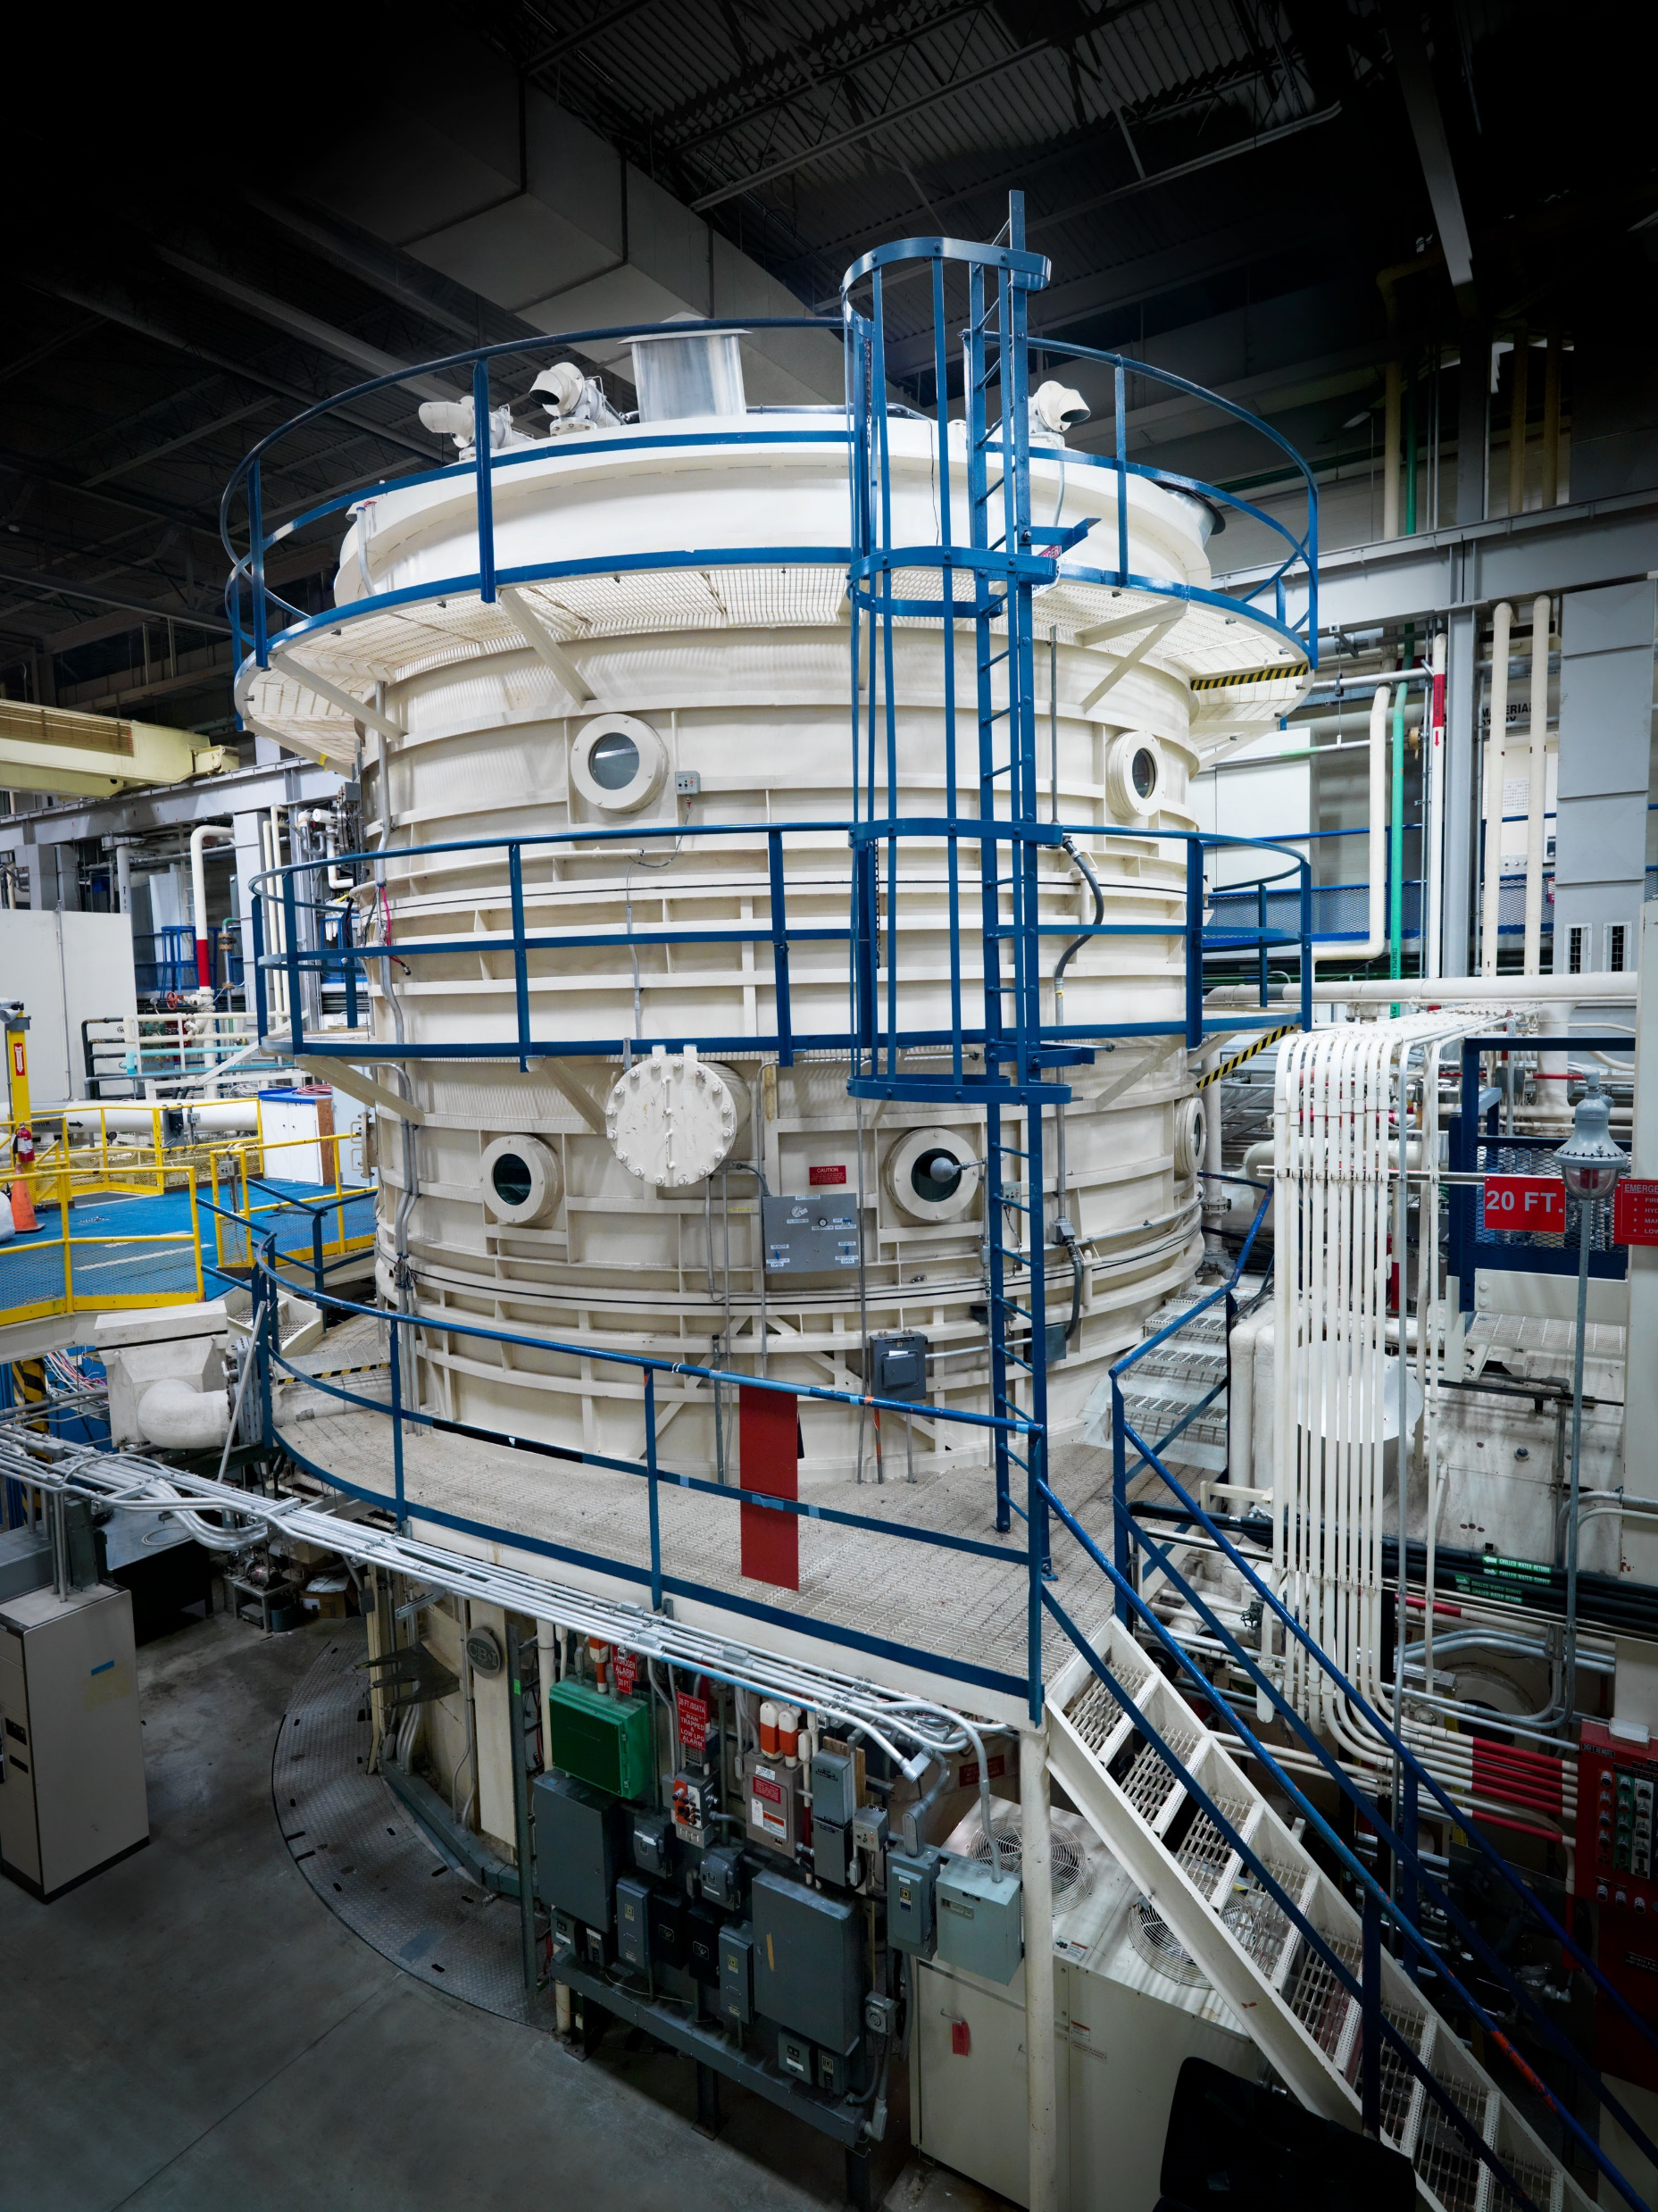

Summary
We previously validated a 20-min prebreathe protocol for an 8.2psi/34% O₂ habitat to 4.3psi EVA
Flammability concerns required a <30%O₂ option
  9.6psi/28.5%O₂
  We validated a 150-min protocol
    90-min failed
Timeline concerns required a <60min option
  Simulated a 5.2psia suit pressure
  We validated a 50-min protocol
    20-min failed

Slide 4
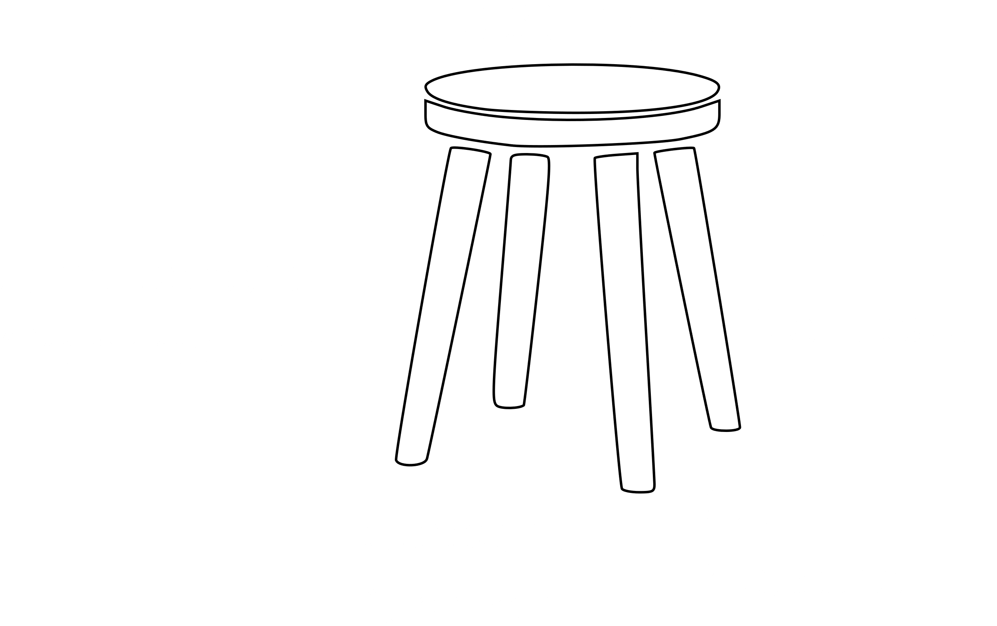
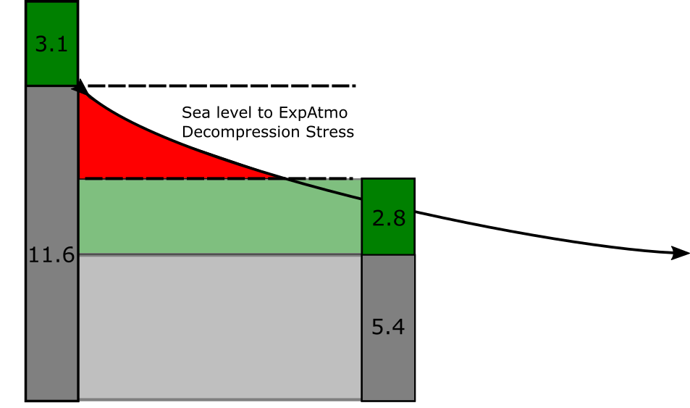
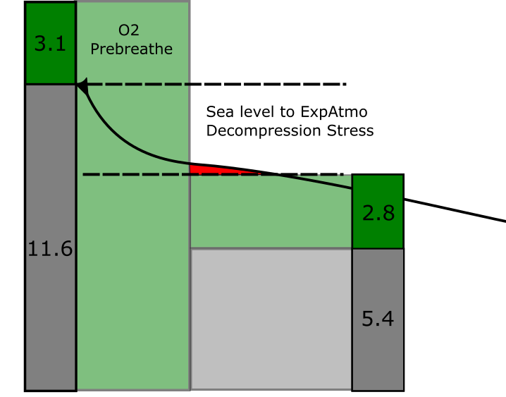
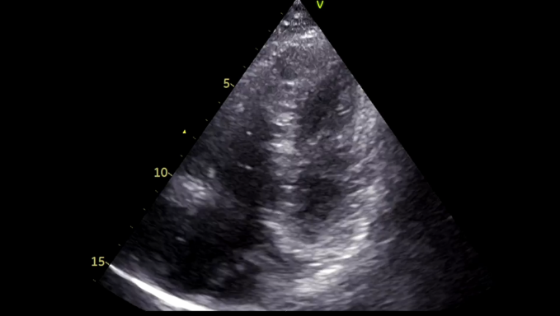
Fundamentals
↓pressure:
  tissues release nitrogen bubbles
  Too much bubbling: Decompression Sickness
    Type I DCS: Mild/Joint pain
    Type II DCS: Severe/life threatening
  Pre-EVA denitrogenation via oxygen prebreathe reduces DCS risk during EVA
High workload/ambulation = higher risk

Slide 5
High Grade VGE
{video}

Slide 6
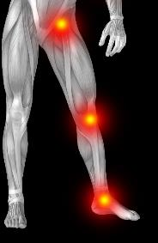
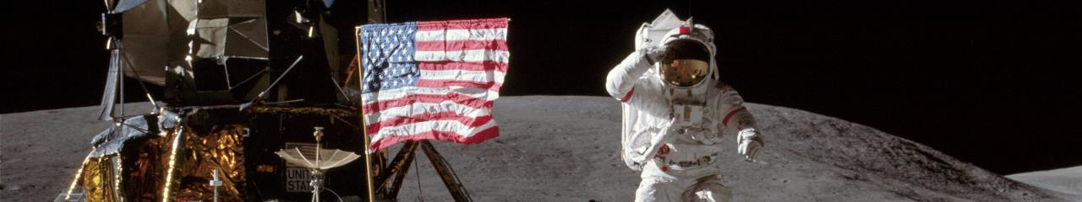
Why Exploration Atmosphere?
Significantly increased frequency of EVAs is expected during planetary ops vs. ISS
  Up to 24 hrs / person / week
DCS risk is increased by ambulation and physical activity vs microgravity^{[1]}
Current ISS prebreathe protocols would add significant timeline overhead and are NOT validated for planetary EVA
  Shuttle & ISS protocols are applicable to microgravity only
Apollo had 100% O₂ cabin and zero EVA prebreathe
¹Conkin J, et al. Venous gas emboli and ambulation at 4.3 psia. Aerosp Med Hum Perform. 2017; 88(4):370–376.

Slide 7
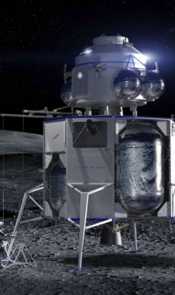
Rationale for Exploration Atmosphere
Saturation Atmosphere | Microgravity Prebreathe* (h:mm) | Planetary Prebreathe*
14.7 psi, 21% O2 | 4:00 (resting) | 6:30-7:00 ²
10.2 psi, 26.5% O2 | 0:40 | 3:00-3:30 ³
8.2 psi, 34% O2 | 0:00-0:15 | 0:00-0:30 ^{4,5}
5.0 psi, 100% O2 (Apollo, Gemini) | 0:00 | 0:00
“ISS”
“CAMPOUT”
EA-1/EA-2
(2022-2023)
*Assumes 6hr EVA @ 4.3 psia and approximately equal DCS risk level
Unvalidated estimates
(i.e., not yet available for flight use)
² Abercromby et al. Suited Ground Vacuum Chamber Testing Decompression Sickness Tiger Team Report, (2019) NASA Technical Report. NASA/TP-2019–220343
³ Abercromby et al. Using the Shuttle Staged Prebreathe Atmosphere and Variable Pressure Spacesuits for Exploration Extravehicular Activity, (2018) AsMA.
⁴ Abercromby et al. Modeling Oxygen Prebreathe Protocols for Exploration EVA Using Variable Pressure Suits, (2017) AsMA.
⁵ Abercromby et al. Modeling a 15-min extravehicular activity prebreathe protocol using NASA׳ s exploration atmosphere (56.5 kPa/34% O2). Acta Astronautica, 109 (2015), pp.76-87.
Notes:
We’ve previously published and presented here the model-predicted implications of the exploration atmosphere and variable pressure suits as well as different EVA durations and frequencies.
This table shows the approximate prebreathe durations for microgravity EVA as compared with planetary EVA given the same saturation atmospheres, spacesuit pressure, EVA durations, and approximately the same DCS risk level. As you can see, our model estimates show a significant penalty associated with the higher metabolic rates and ambulation of planetary EVA as compared with microgravity.
[ANIMATION]
But while we have ground validation data and flight experience to show that these microgravity protocols are safe and about as efficient as possible, we don’t have the data to validate these model estimates. And we’re not going to be able to do EVAs on the moon or Mars until we do.
[NEXT SLIDE]

Slide 8
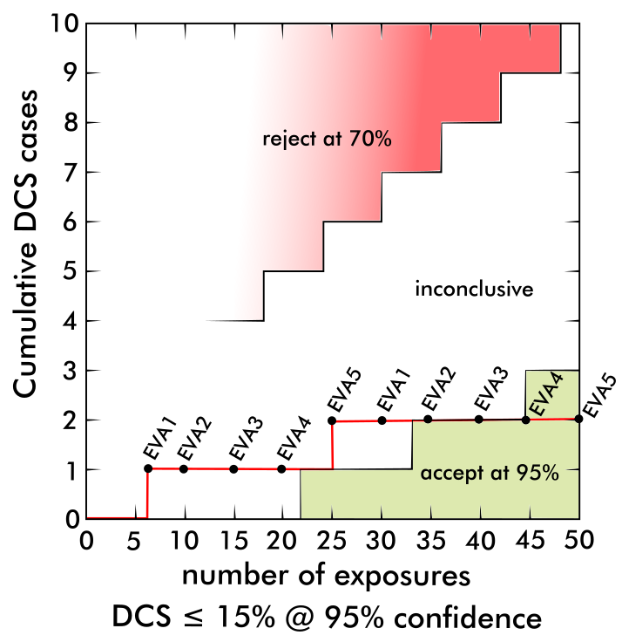
Summary – 8.2/34% Campaign (2021-2022)
Accept Criteria (per NASA-STD-3001):
  ≤ 15% incidence of Type I DCS (@95% CL)
  ≤ 20% incidence of Grade IV VGE (@95% CL)
  No Type II DCS
Observed:
  DCS Type I: 2/50 = 4% (1.1%-13.5%)
  DCS Type II: 0
  VGE IV: 0
    (EB Grade 7: 1/50)
No Type II Cases
Two Type I Cases (out of 50 exposures)
“Mission Accomplished”?

Slide 9
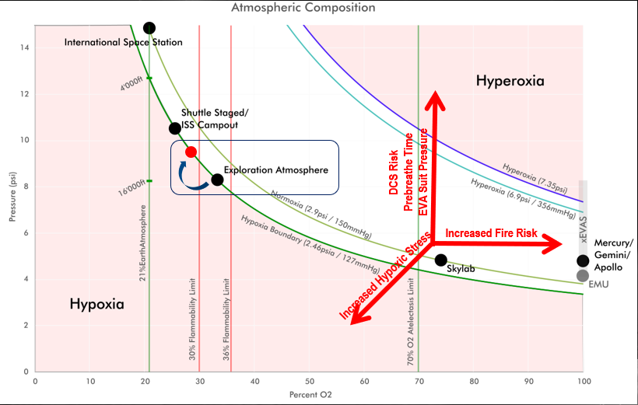
Flammability Risk: 36% 30% O₂ Limit

Slide 10
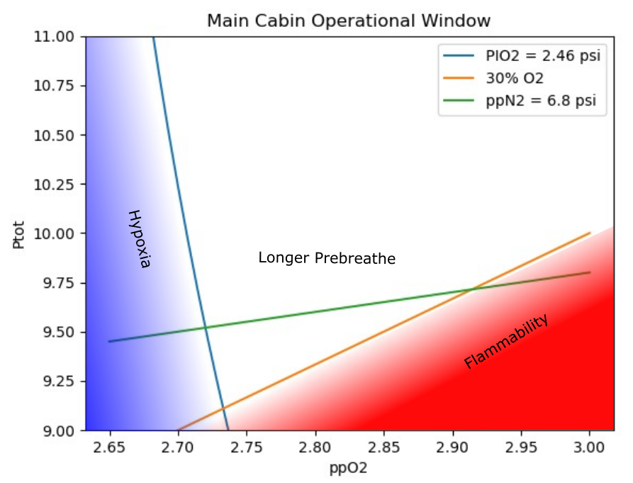
Cabin Atmosphere Operational Window
Operational window is bounded by three constraints:
  Flammability limit (must stay to the left of the orange 30% O₂ line)
  Hypoxia limit (must stay to the right of the blue P_{I}O₂ = 2.46 psi line)
  ppN2 limit (prefer to stay below green ppN2 = 6.8 psi, minimizes DCS risk)

Slide 11
How do we actually test?

Slide 12
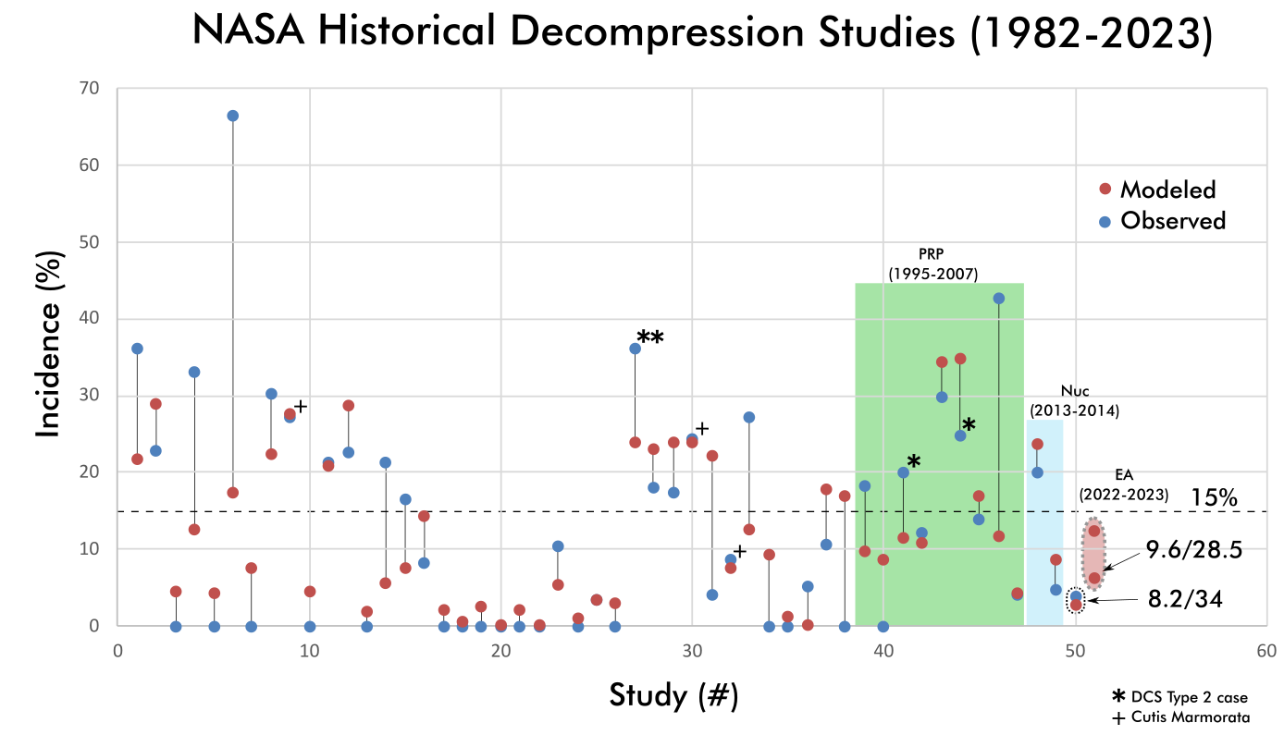
Human Decompression Exposures NASA Testing

Slide 13
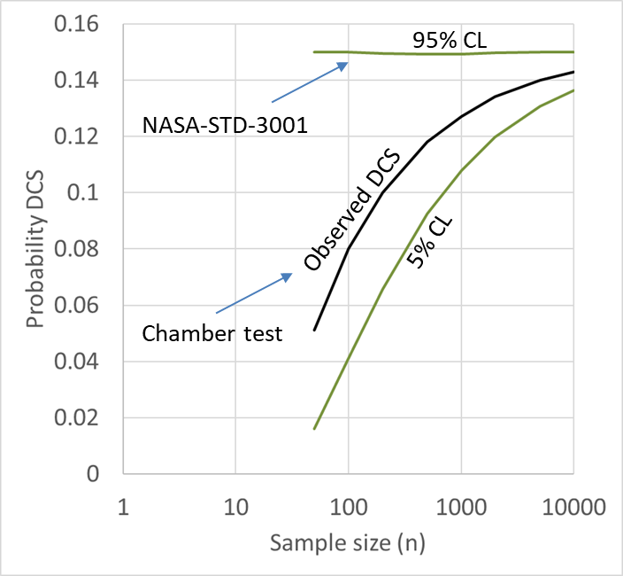
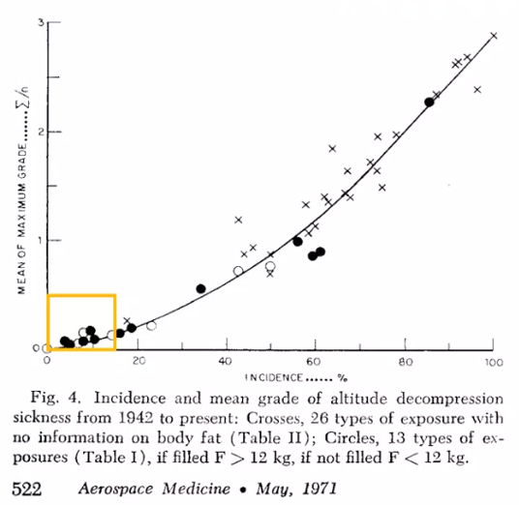
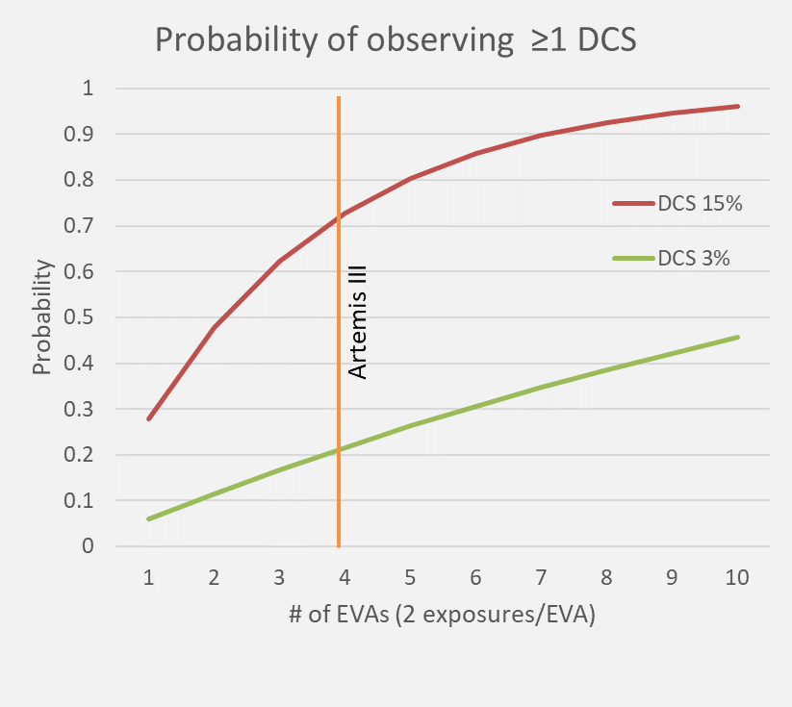

What is NASA-STD-3001
NASA-STD-3001 requires human testing to
  ≤ 15% incidence of Type I DCS (@95% CL)
  ≤ 20% incidence of Grade IV VGE (@95% CL)
  No Type II DCS
Prebreathe study yields:
          $$\frac{\# DCS cases}{\# of exposures}$$
Statistical conversion to:
  % DCS risk and Confidence Limits at 5%-95%
  Confidence limits are driven by N moreso than actual risk
  Thus, reaching 3001 req’ts is contingent on sample size
NASA-STD-3001 does NOT address Cumulative Risk:
Loss of EVA is a mission risk – determined by mission
Artemis does not currently have mission-wide DCS risk

Slide 14
Exploration Atmosphere Validation
Accept Criteria (per NASA-STD-3001):
  ≤ 15% incidence of Type I DCS (@95% CL)
  ≤ 20% incidence of Grade IV VGE (@95% CL)
  No Type II DCS
Reject Criteria
  > 15% incidence of Type I DCS (@70% CL)
  > 20% incidence of Grade IV VGE (@70% CL)
  Any Type II DCS
Neither
  Requires review and additional data
Accept
DSMB Review;
Modify Prebreathe
Test Series 1 (11 days)
Neither Accept nor Reject
Reject
Test Series 2 (11 days)
Reject
Neither Accept nor Reject
Additional Test Series
Reject
Validated Prebreathe Protocol
DSMB: Data Safety Monitoring Board

Slide 15
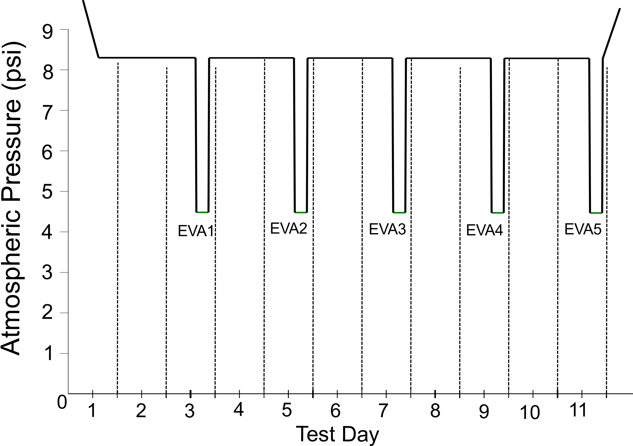
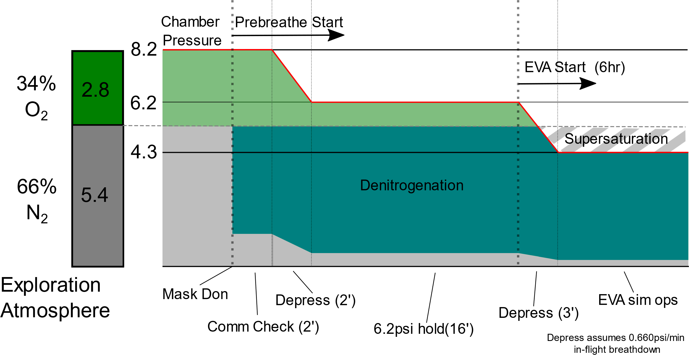
Prebreathe Validation Approach
What prebreathe is sufficient to meet NASA-STD-3001 standards in a Lunar/Mars environment?
  Equilibrate to Exploration Atmosphere: 9.6psi/28.5% O₂ for 48 hrs (after 3hr O₂ PB)
  Minimum prebreathe duration: 20 min ≥ 9.5psi
  Simulated EVA: 4.3psi/95% O₂
  Simulate EVA workload: 6 tasks for 6hrs across workload ranges

Slide 16
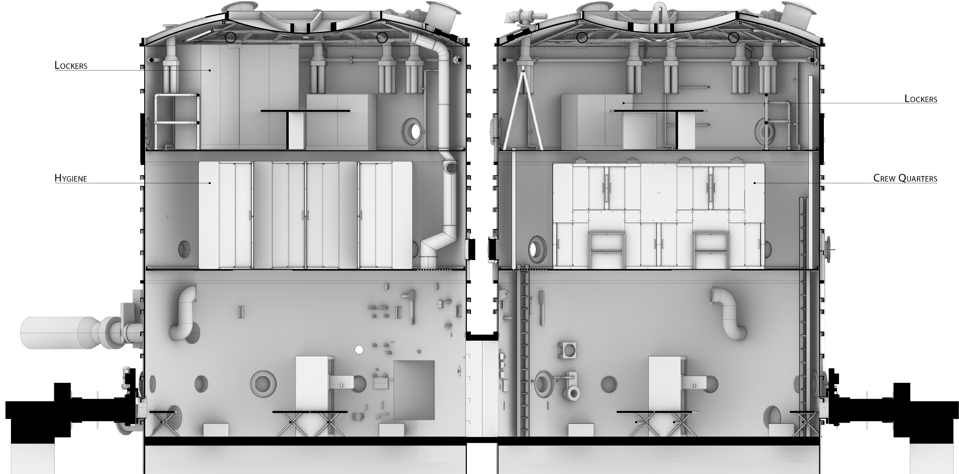
20FT Chamber Overview
1st Floor – Science & EVA Activities
2nd Floor – Crew Quarters & Hygiene
3rd Floor – Stowage & Media Center

Slide 17
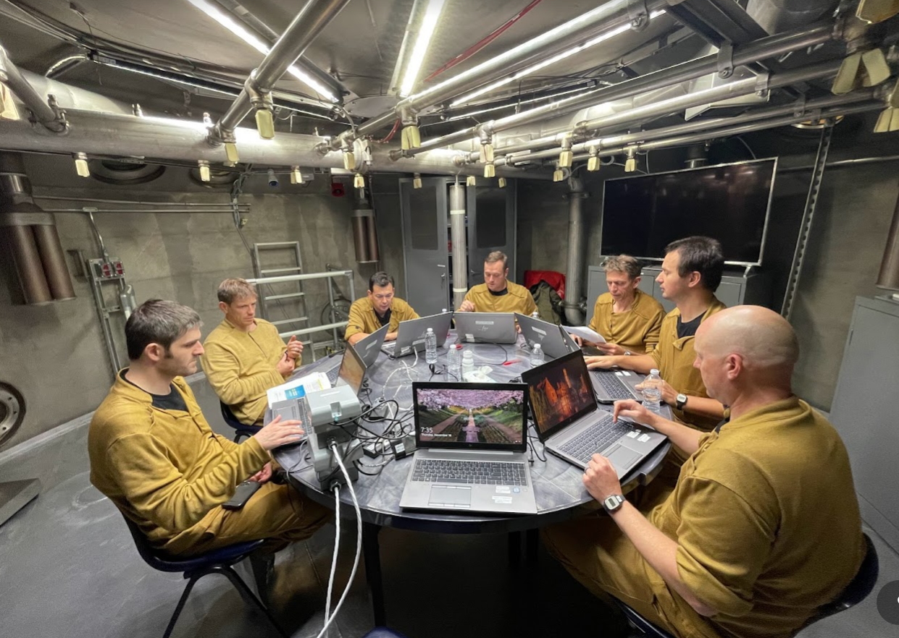
3rd Floor Configuration

Slide 18
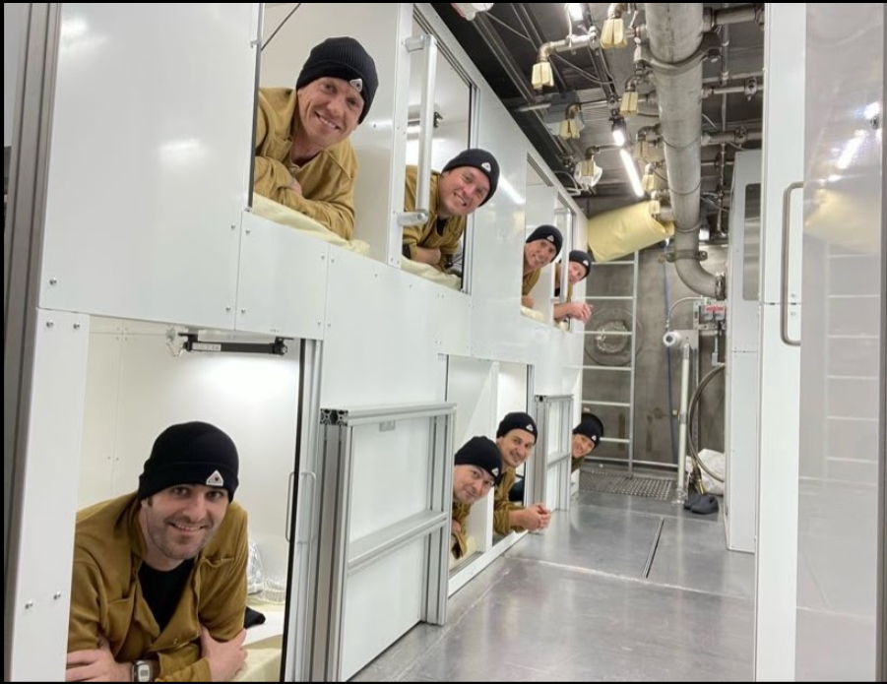
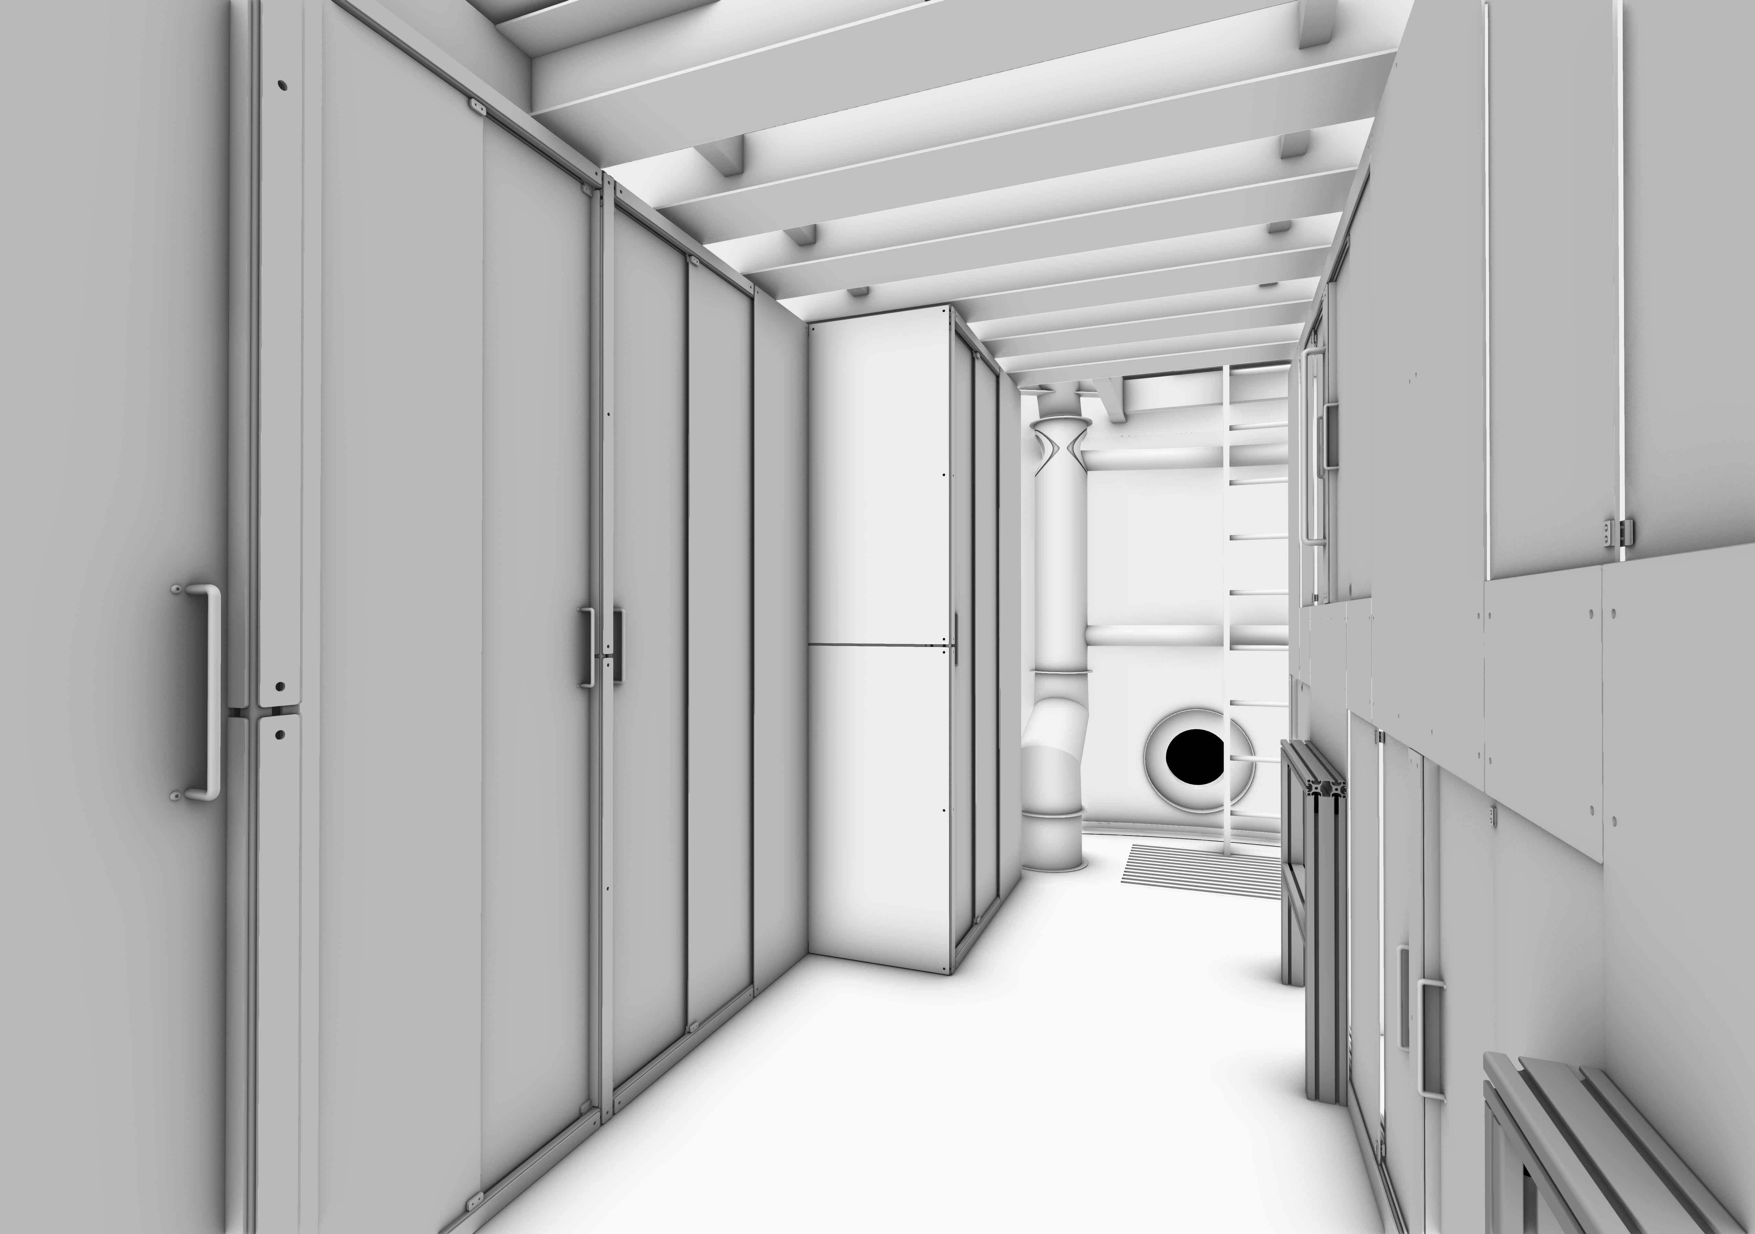
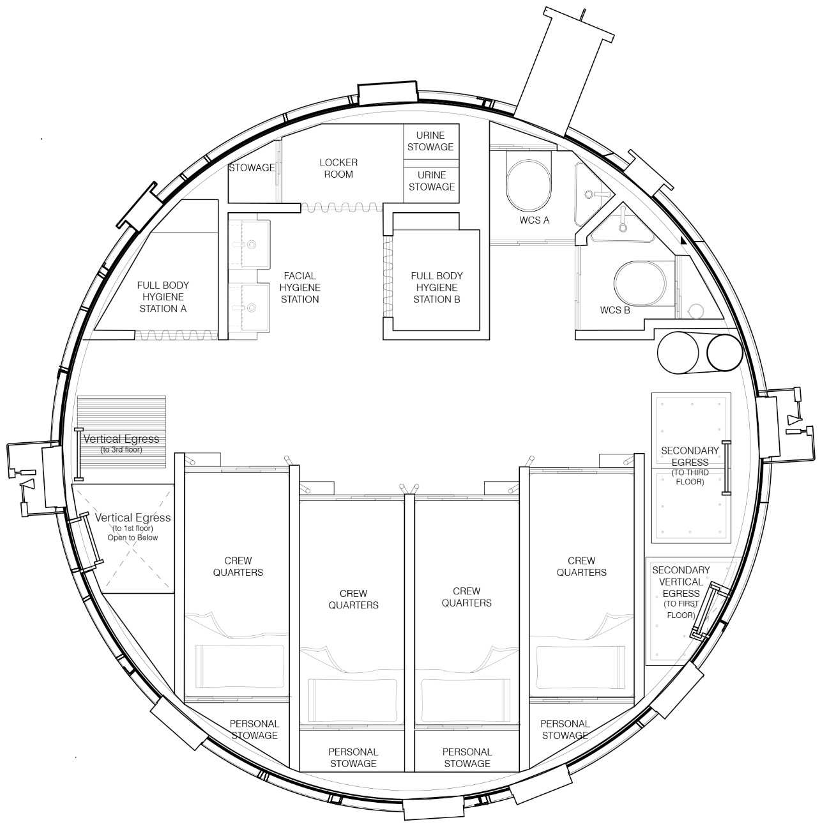
2nd Floor – Crew Quarter Layout

Slide 19
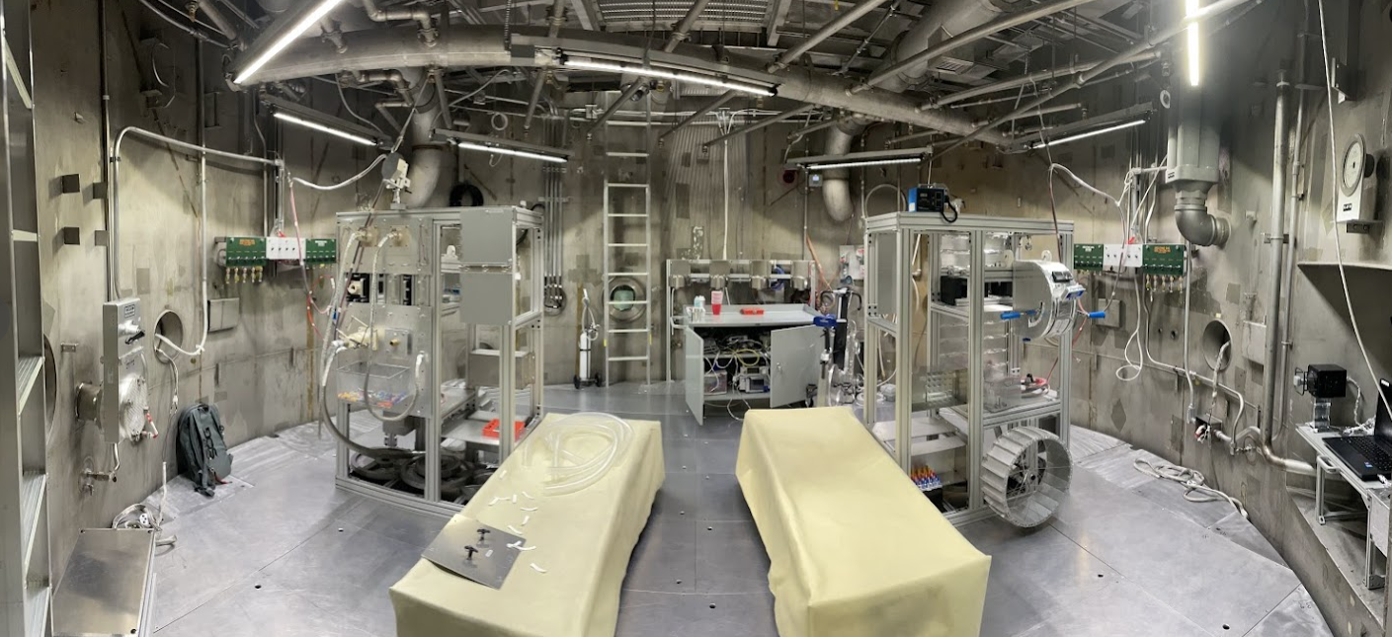
EVA Sim Stations

Slide 20
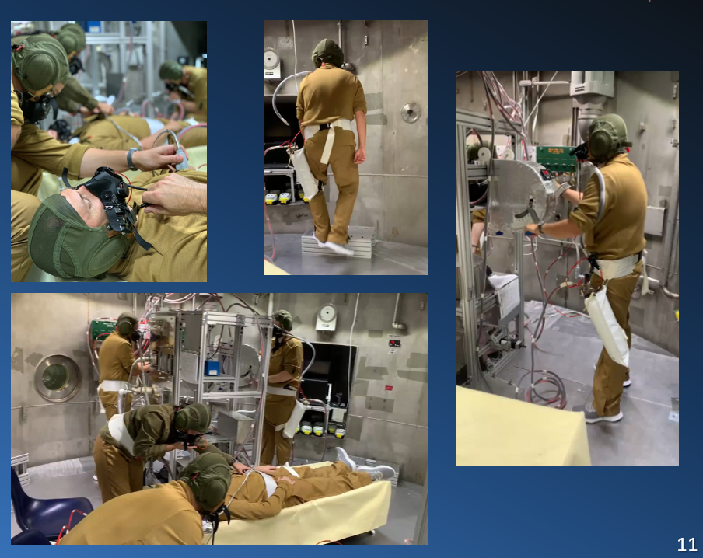
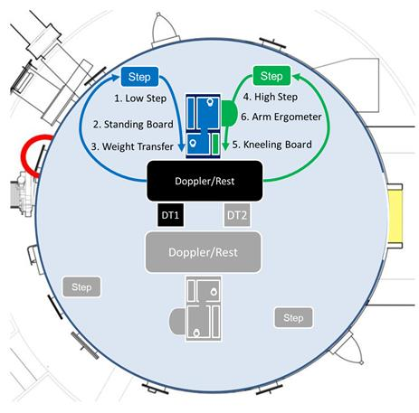
EVA Simulation
EVA Sim Presented at AsMA 2022
see Estep et al.

Slide 21
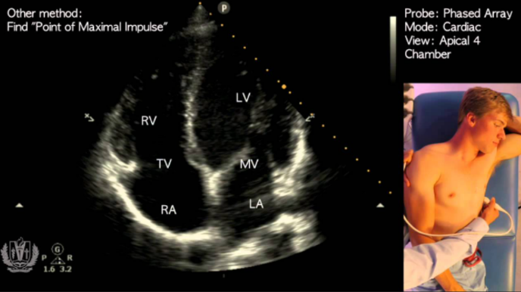
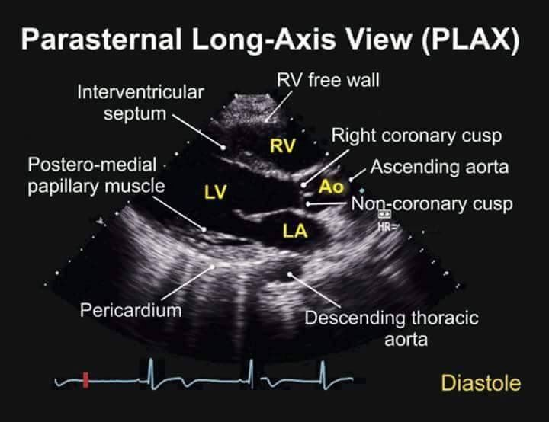
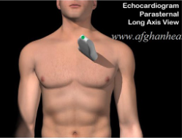
VGE Methods
Every 15 min:
  Subject lays on the cot in a left recumbent position
  The operator gels the Vivid iQ ultrasound probe and acquires an apical cross-section view of the heart and heart chambers (top)
    If the apical view is not easily visible, a parasternal long-axis view is imaged instead (bottom)
  Alternates with Doppler auscultation of L parasternal border

Slide 22
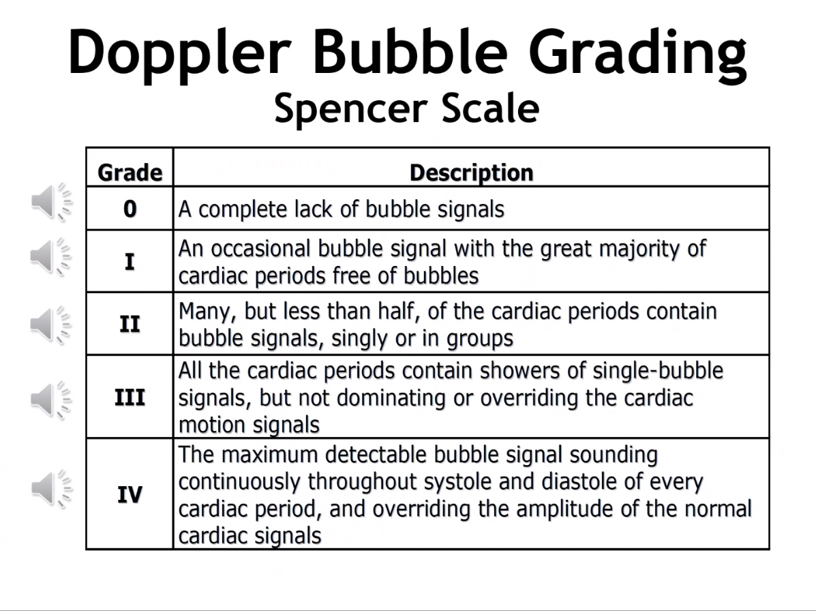
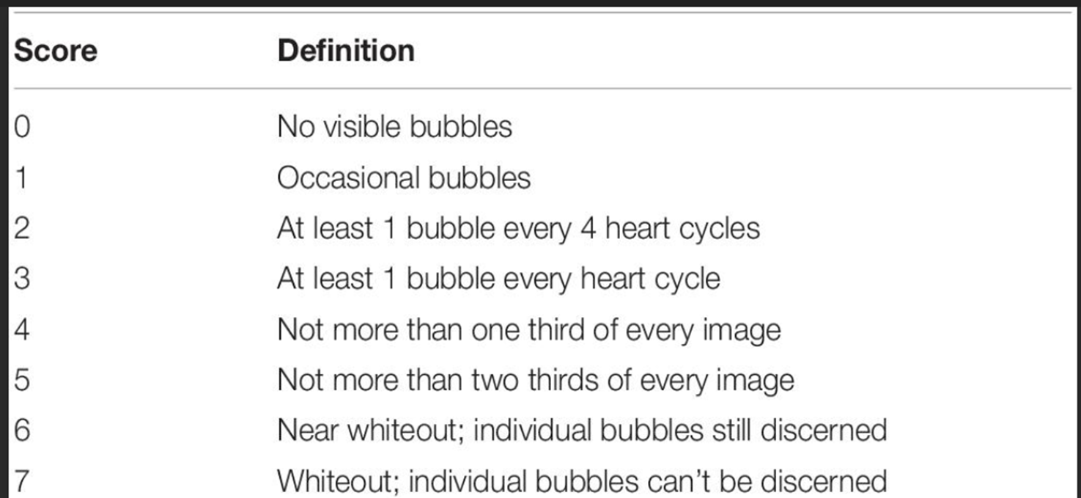
Analysis and Scoring Methods
Ultrasound and Doppler Scoring
Data Analysis / Graphs
Ultrasound videos were scored based on number of VGE / bubbles present during imaging over 10 cardiac cycles (Modified Eftedal Brubakk Score, right).
Doppler audios were scored based on ‘bubble signals’, or audible peaks in doppler waveforms (Spencer Scale, left).
Scores for rests and leg flexes – left and right – were acquired via Vivid iQ Ultrasound w/ doppler wave acquisition application.
Scores between cross-graders (n=3 to 4 per crew member at each time point) were averaged for the resting and flexing periods.
Max scores and average scores of resting and flexing periods were graphed.
Data is represented by mean ± standard deviation.

Slide 23
Results

Slide 24
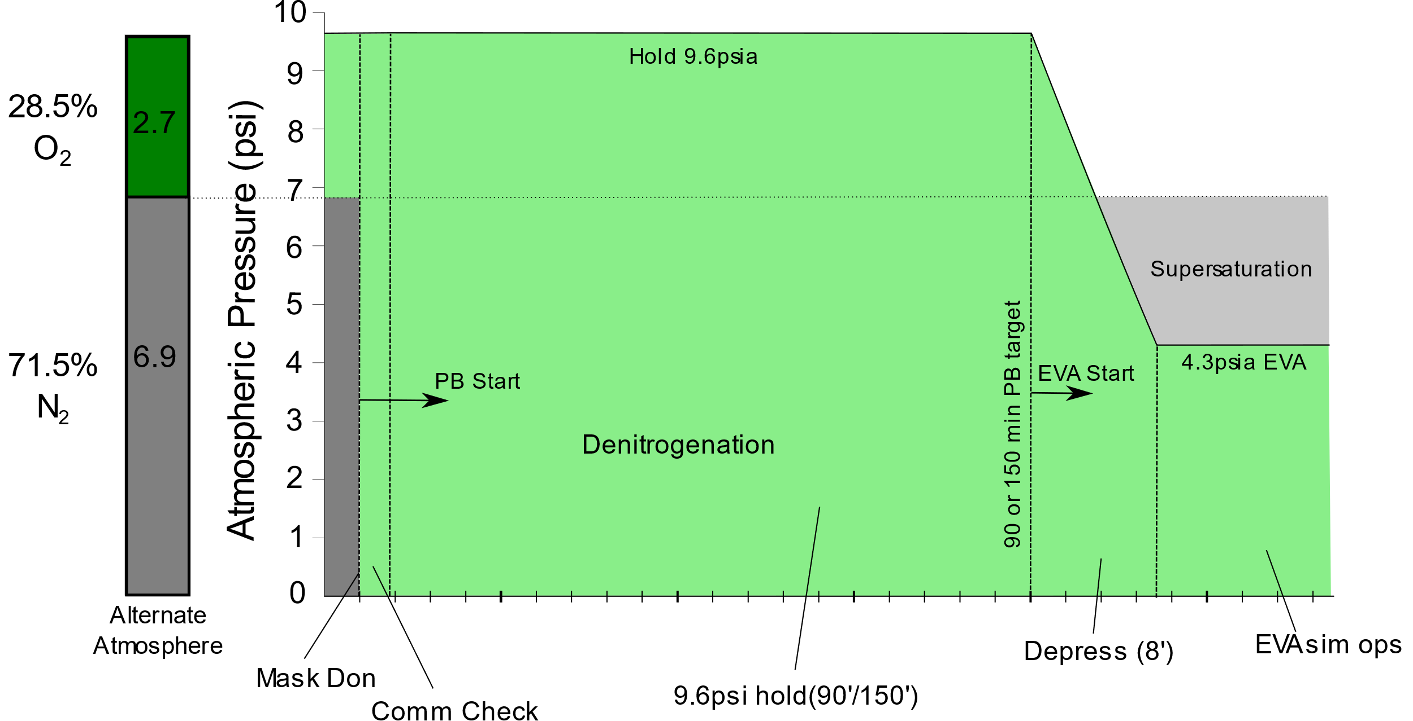
EA-3 EVA1: 90min/4.3psi protocol

Slide 25
EA-3 EVA1 Type II case
Subject developed peripheral tingling/decreased sensation
Removed from chamber
  On medical exam BUE weakness noted
Had TT6 with Full Resolution
Post test Transesophageal Echo showed Moderate PFO

Slide 26
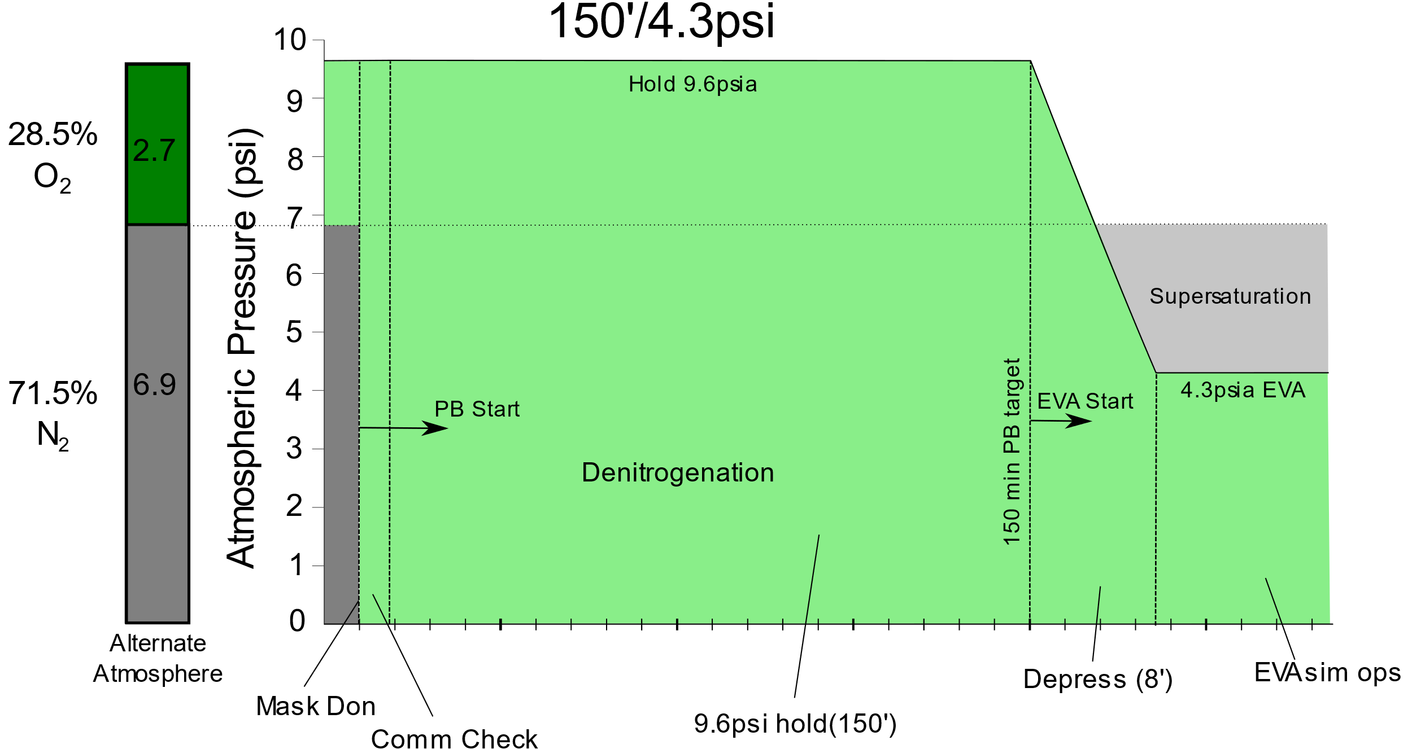
150min/4.3psi : Protocol in Detail

Slide 27
EA-3 EVA2-5 Outcomes
Doppler
Ultrasound

Slide 28
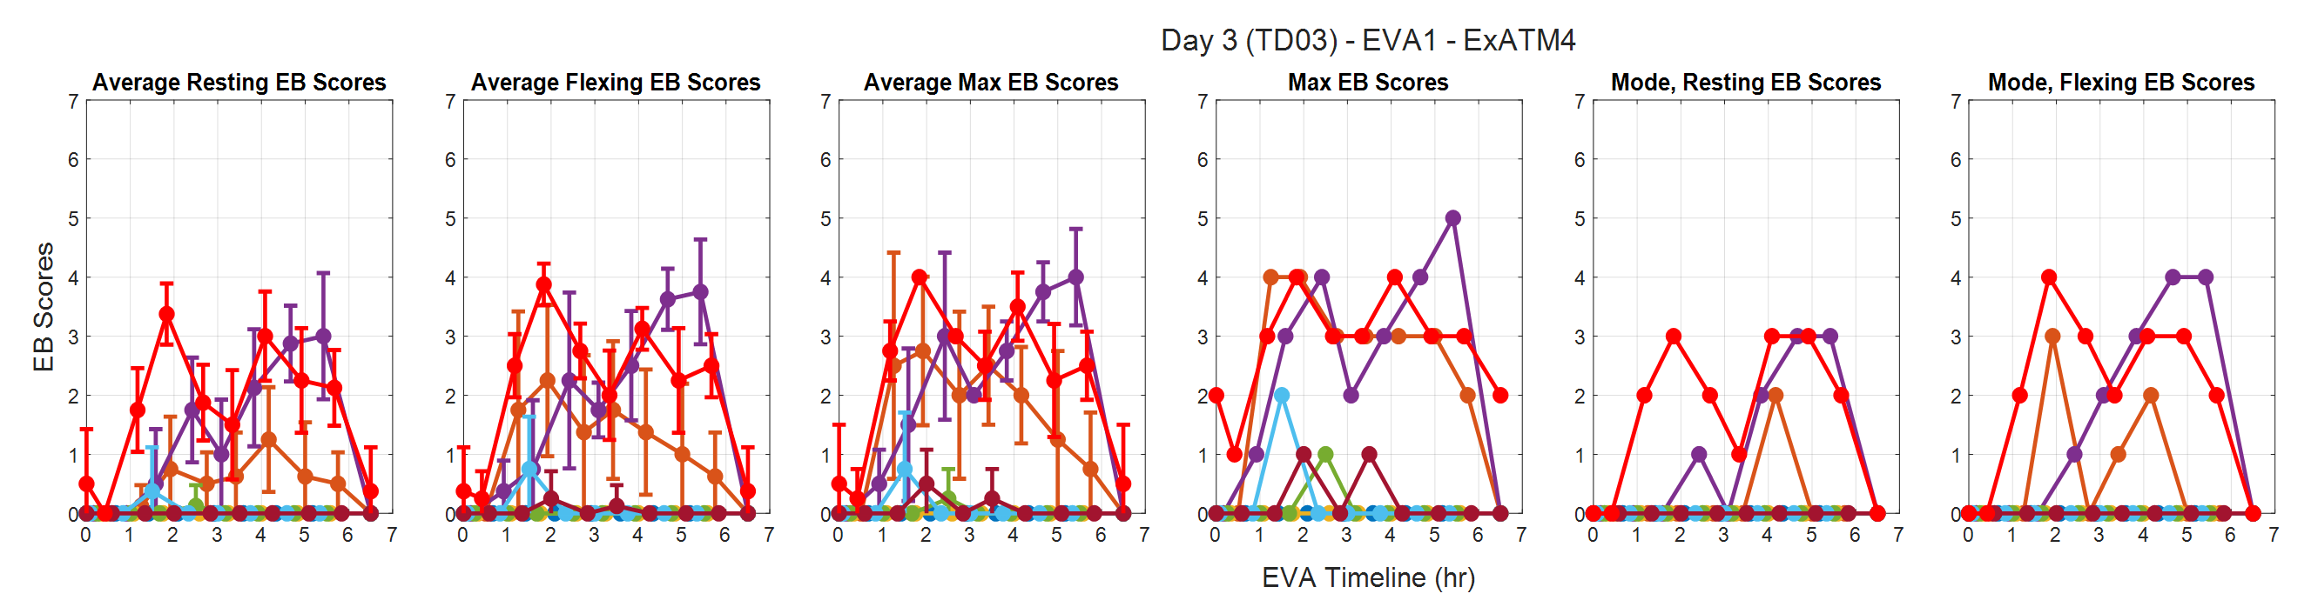
EA-4 EVA1 Outcomes
Doppler
Ultrasound

Slide 29
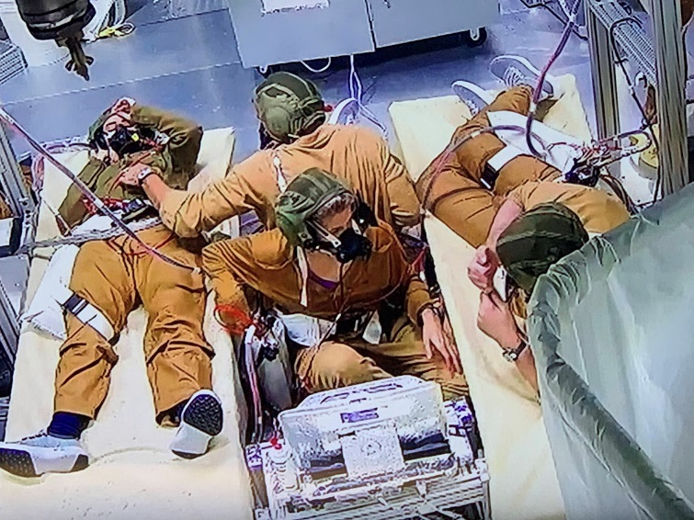
Total Exposures (9.6psi -> 4.3psi)
EA3 (Nov 2023):
90min/4.3psia:
  EVA 1: 5 subjects participated, 1 DCS II case
150min/4.3psia:
  EVA 2: 4 subjects participated, no DCS
  EVA 3: 4 subjects participated, no DCS
  EVA 4: 4 subjects participated, no DCS
  EVA 5: 4 subjects participated, no DCS
EA4 (Sep 2024):
150min/4.3psia:
  EVA 1: 8 subjects participated, no DCS
  Accepted Protocol
Mission Accomplished!....?

Slide 30
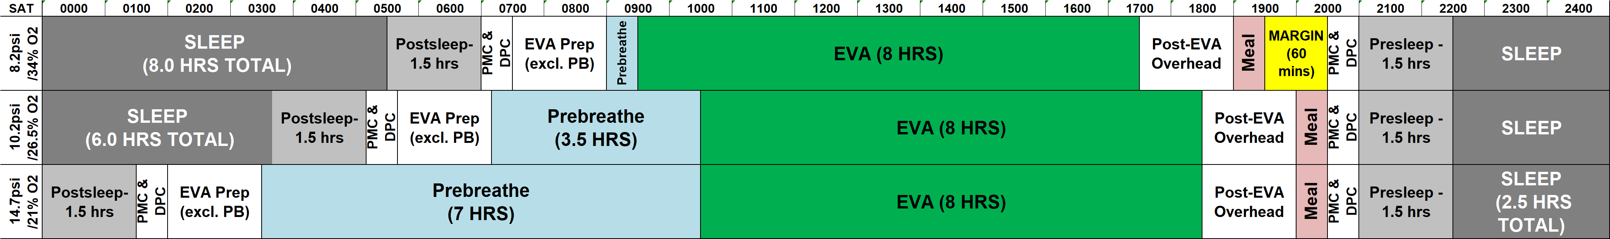
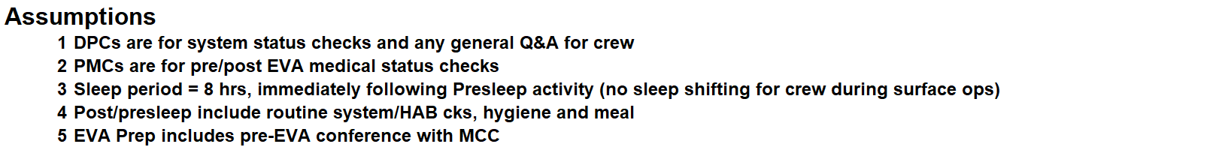
Long Prebreathe is not compatible with
High Tempo EVA
Operational Goal: < 60min prebreathe

Slide 31
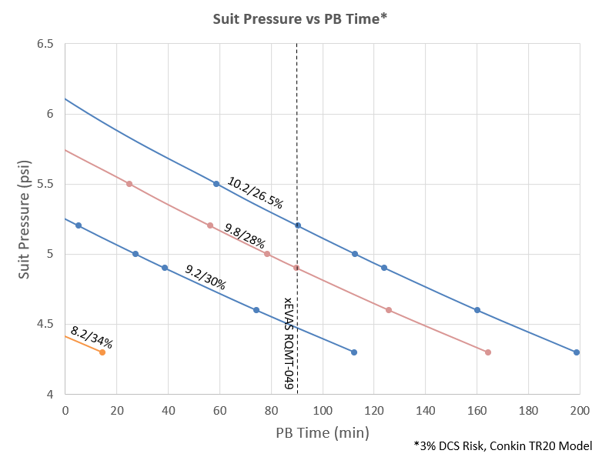
Suit Pressure can shorten prebreathe

Slide 32
Prebreathe Validation Approach
What prebreathe is sufficient to meet NASA-STD-3001 standards in a Lunar/Mars environment?
  Equilibrate to Exploration Atmosphere: 9.6psi/28.5% O₂ for 48 hrs (after 3hr O₂ PB)
  Minimum prebreathe duration: 20 min ≥ 9.5psi
  Simulated EVA: 5.2psi/95% O₂
  Simulate EVA workload: 6 tasks for 6hrs across workload ranges

Slide 33
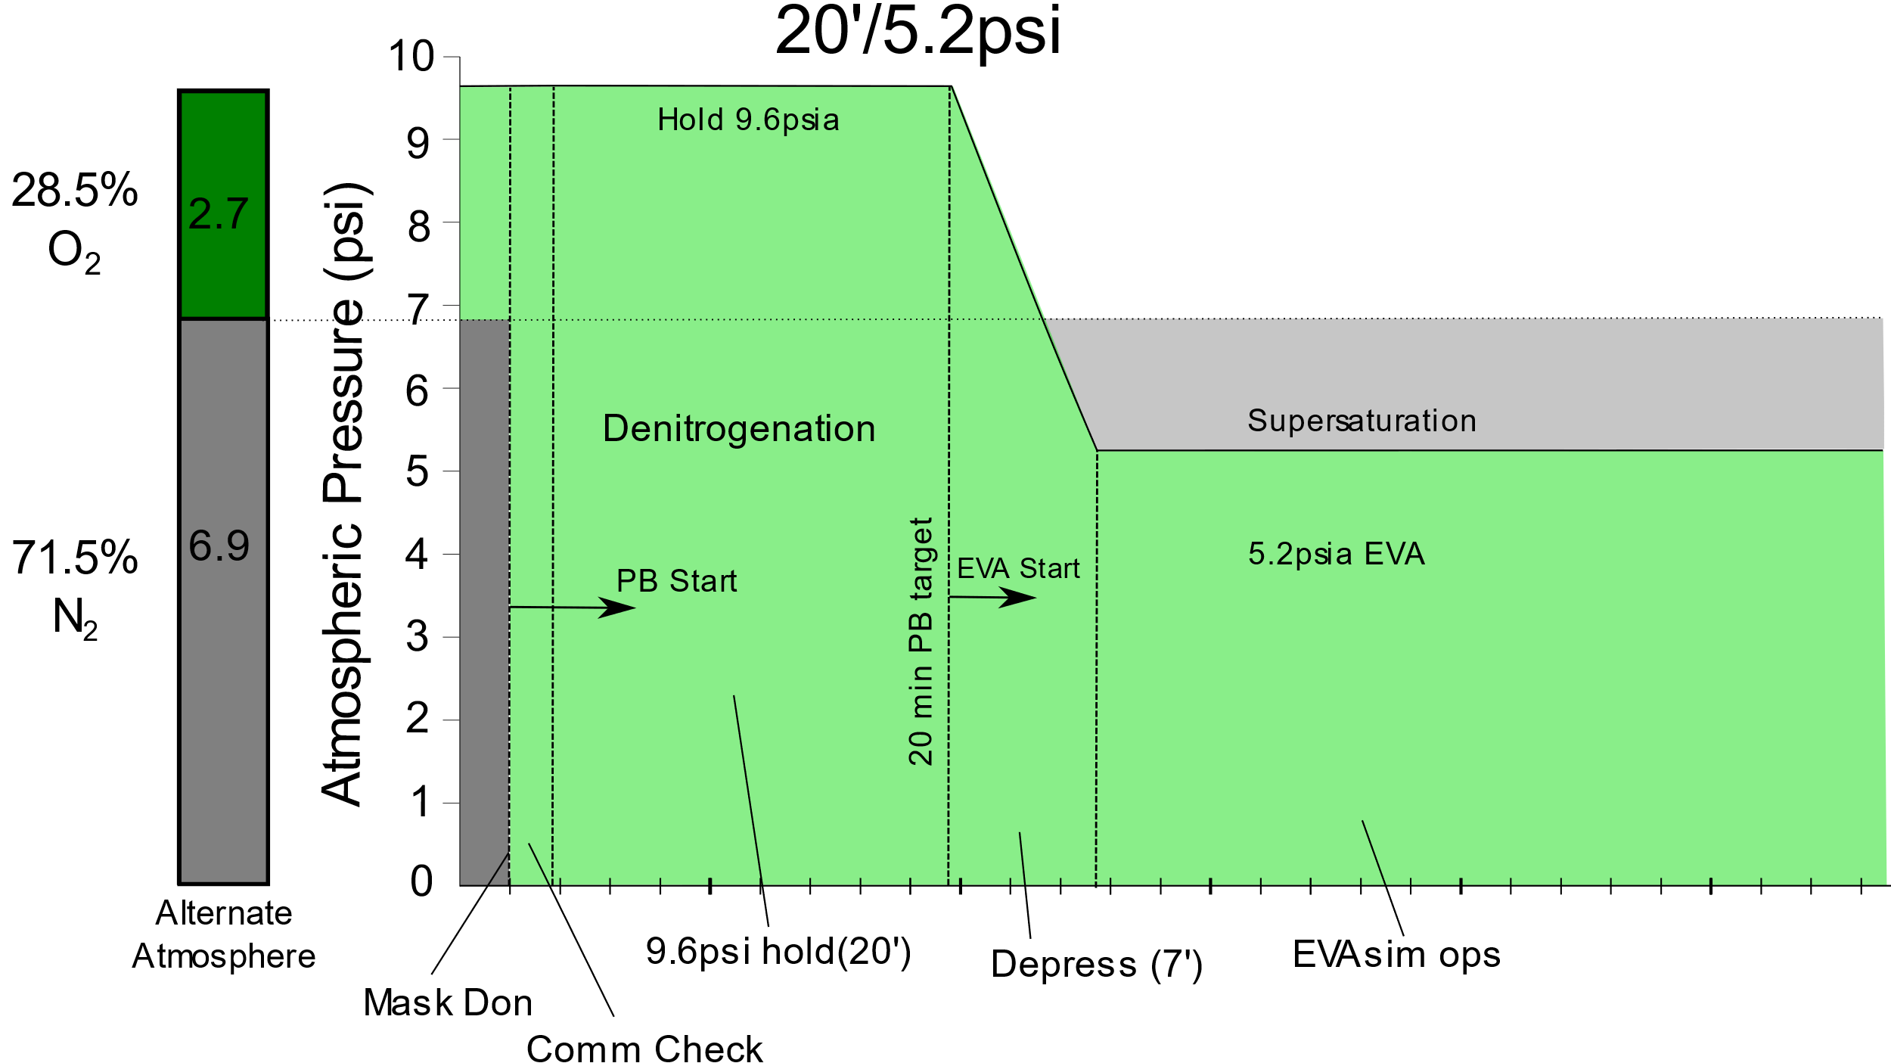
Protocols in Detail

Slide 34
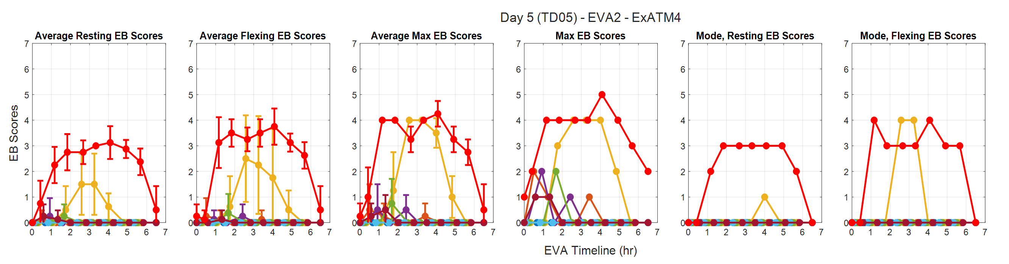
EA-4 EVA2 (20min) Outcomes
Doppler
Ultrasound

Slide 35
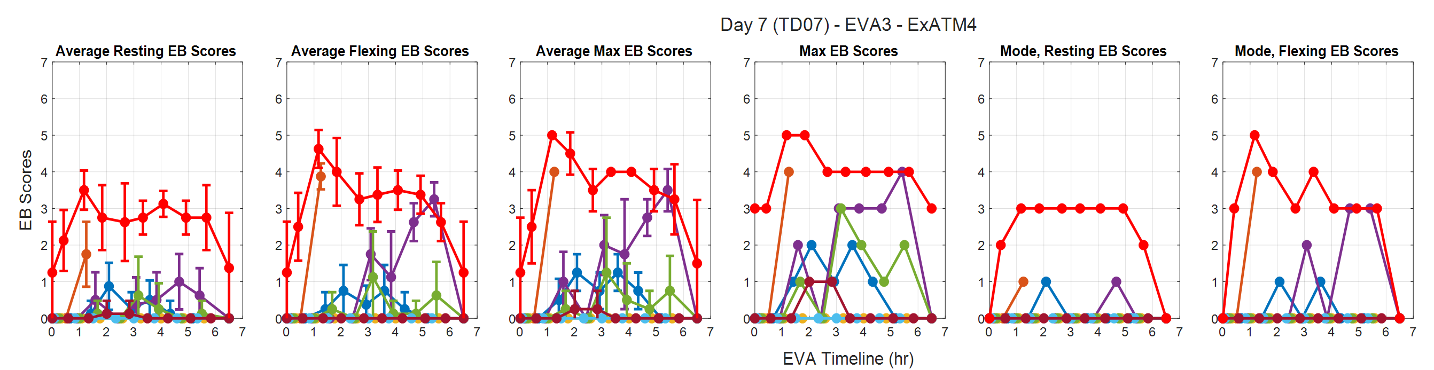
EA-4 EVA3 (20min) Outcomes
Doppler
Ultrasound

Slide 36
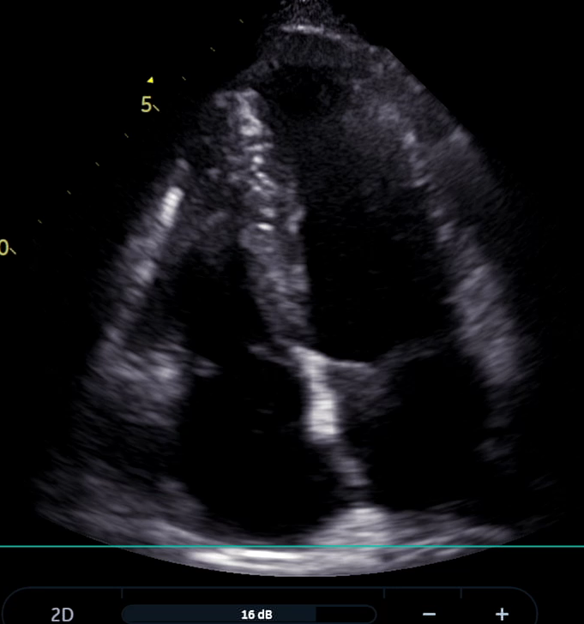
Type II “Subtle” DCS
Subject reported mild symptoms concerning for Type I DCS
  Removed from chamber – pain symptoms resolved
  However, mild CNS symptoms elicited on clinical exam (not reported by patient)
  Treated with USN TT6 -> complete resolution
  Diagnosis confirmed by DSSMB
    ‘1’ possible LVGE noted on review

Slide 37
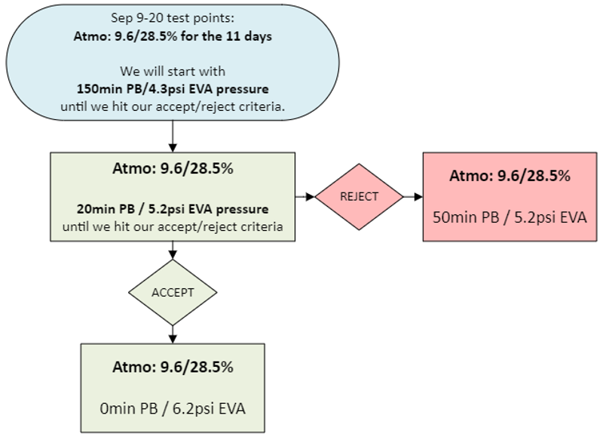
20min/5.2psi
Type II DCS
  DSSMB met to determine diagnosis within 24hr
  Rejected per 3001 criteria
  N = 8 (EVA2) + 8 (EVA3) = 16
Proceeded to 50min / 5.2

Slide 38
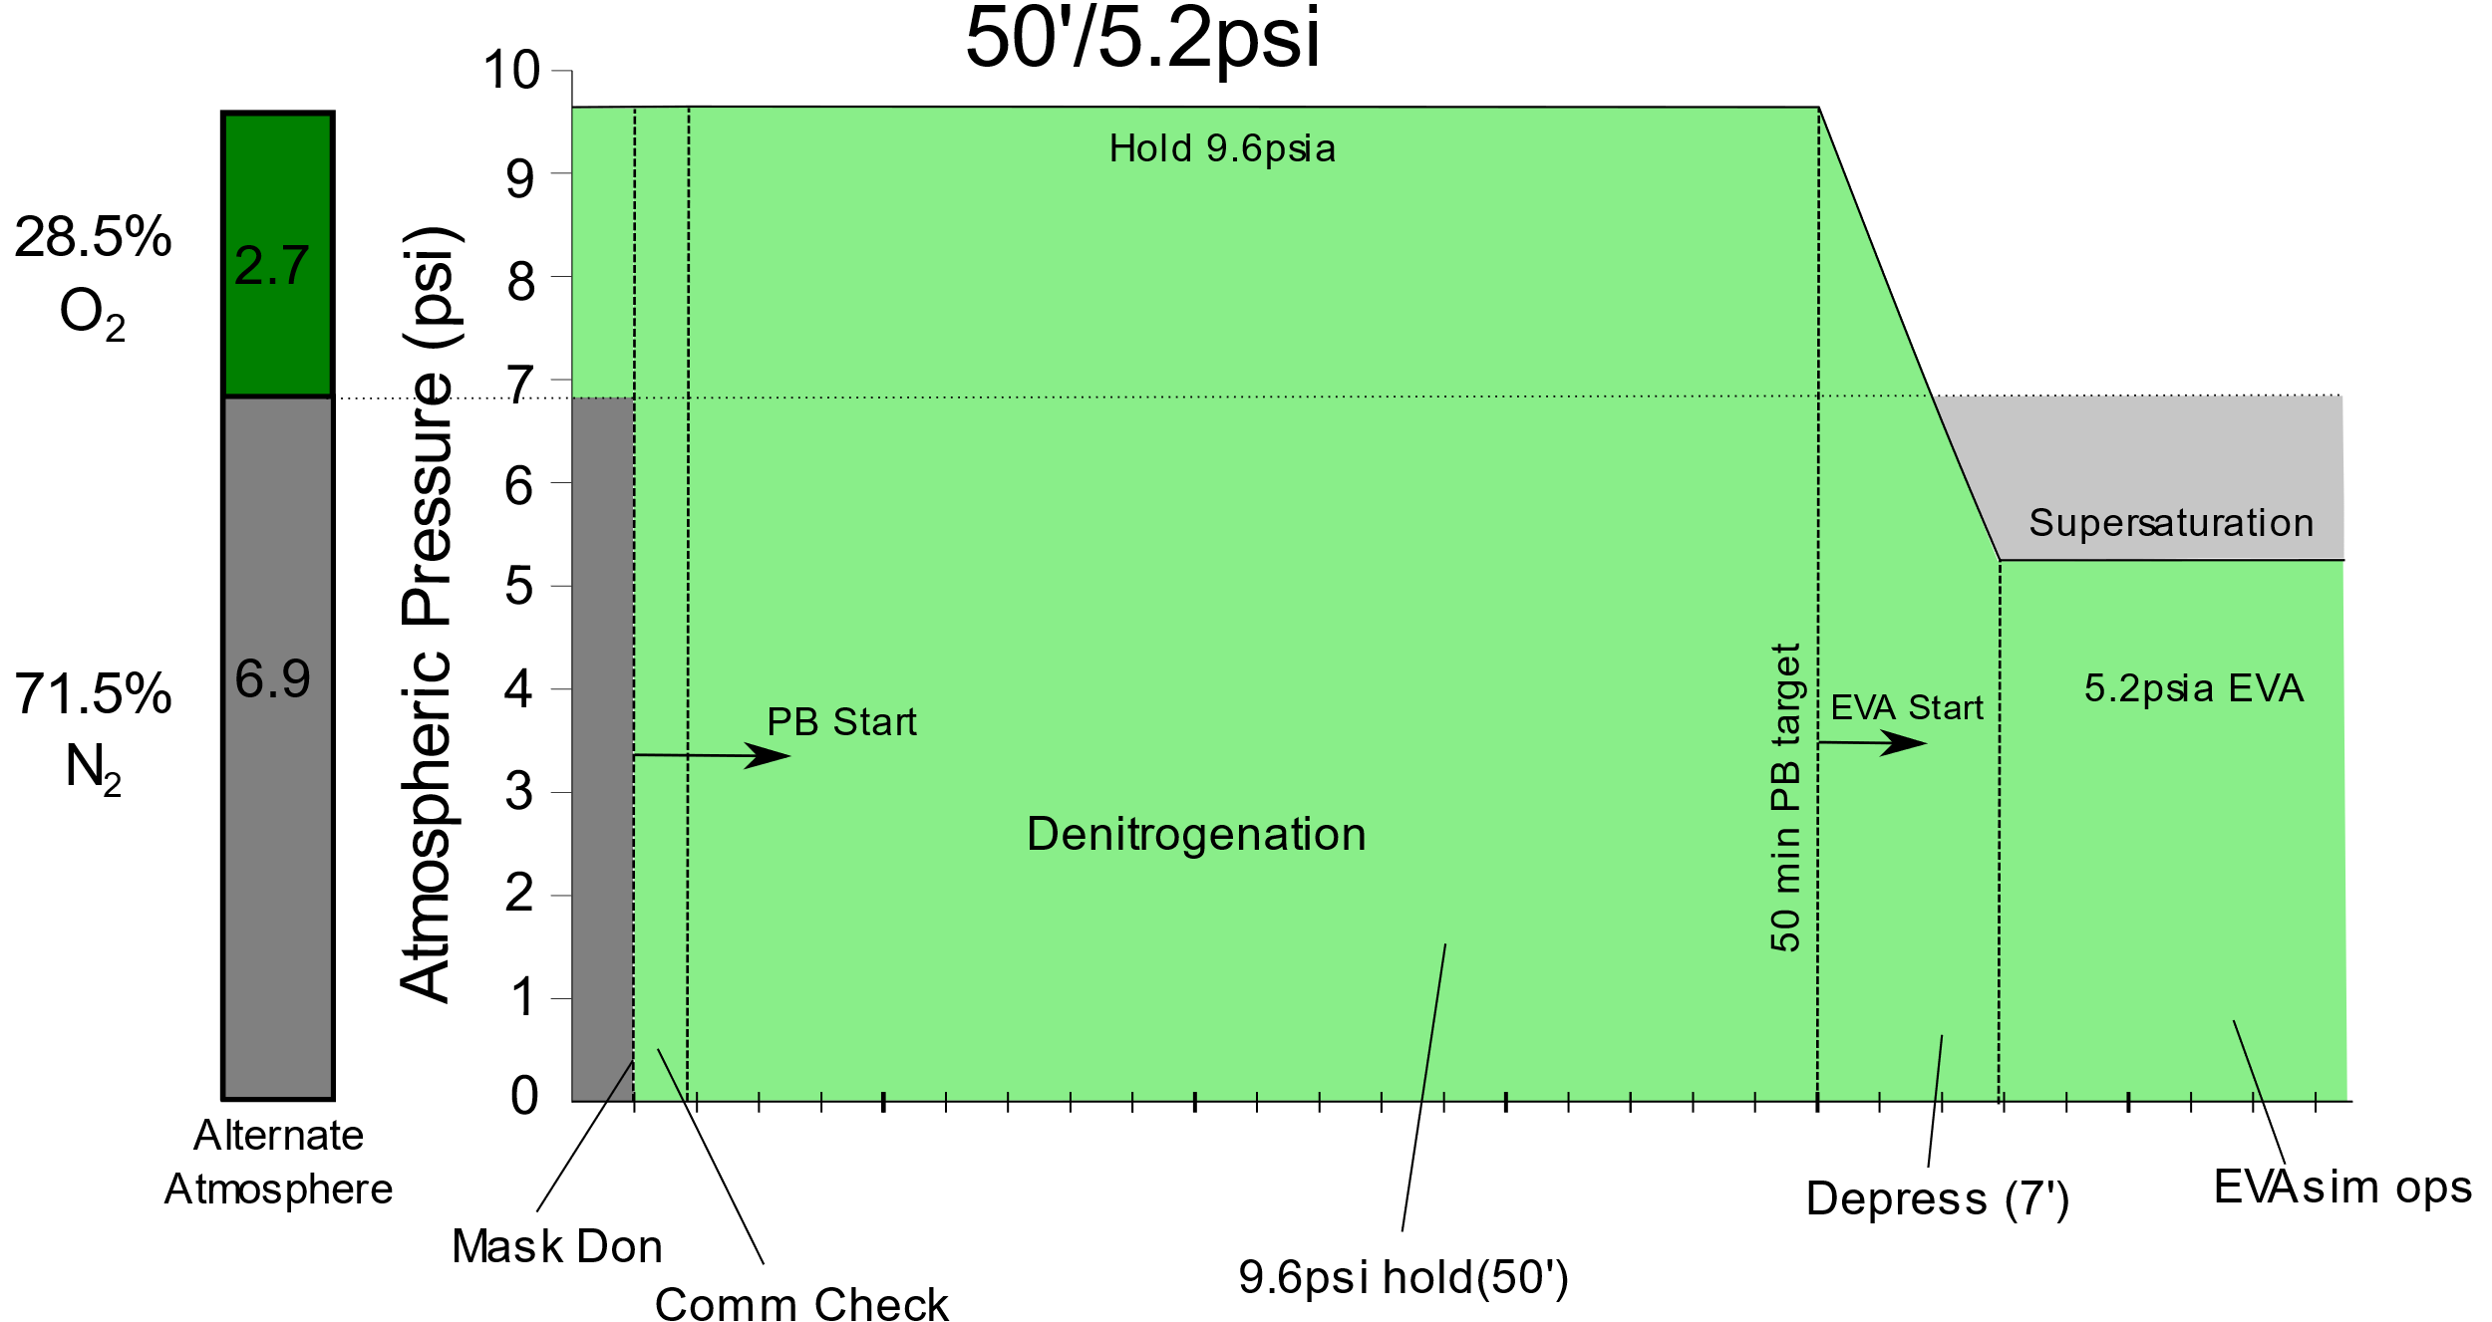
EA-4 EVA4/5 Protocol

Slide 39
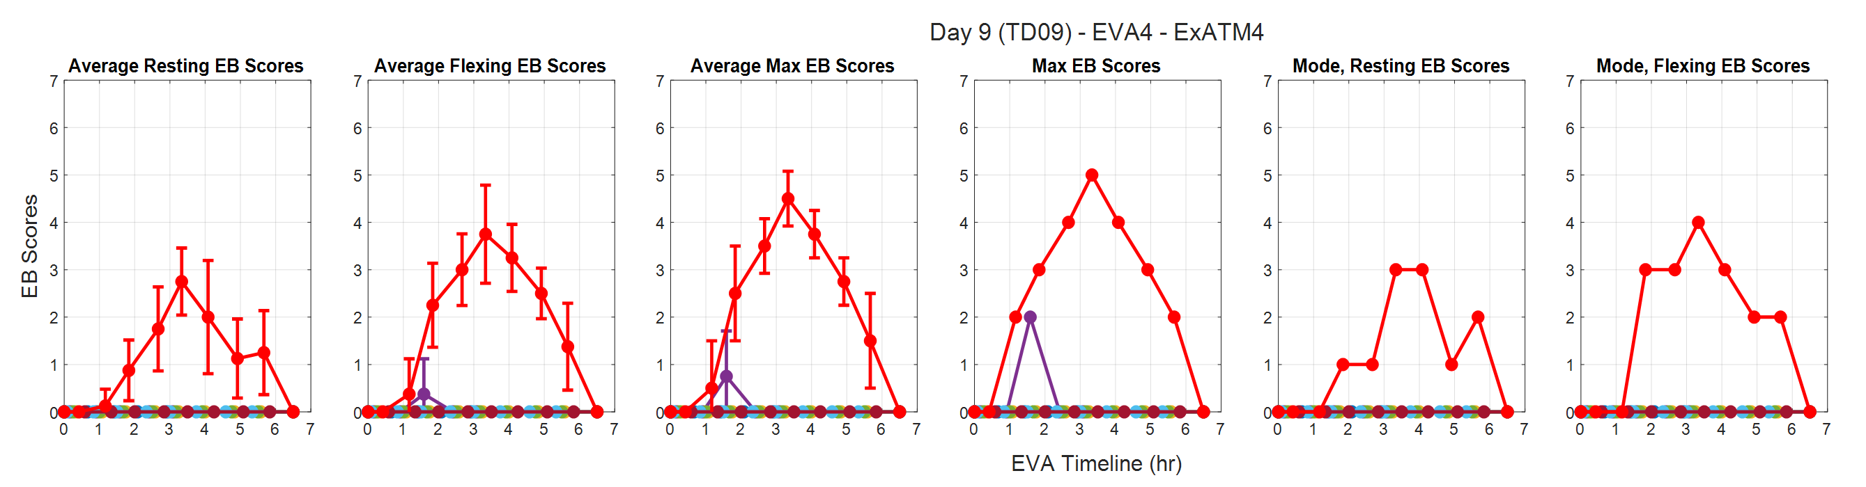
EA-4 EVA4 (50min) Outcomes
Doppler
Ultrasound

Slide 40
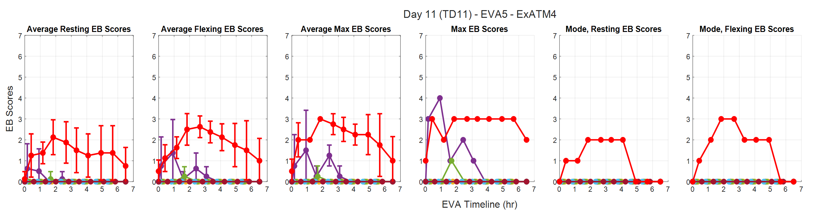
EA-4 EVA5 (50min) Outcomes
Doppler
Ultrasound

Slide 41
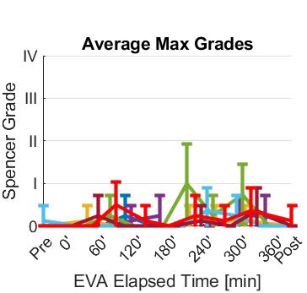
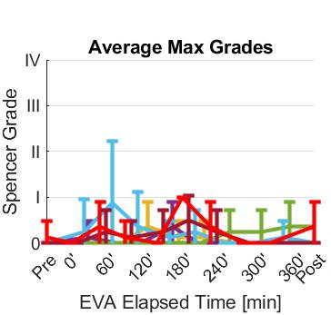
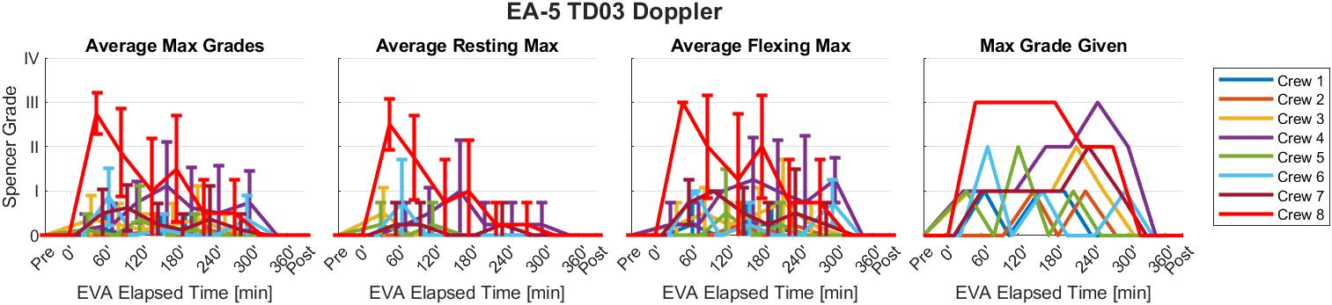
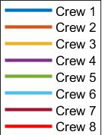



EA-4 EVA4-5; EA-5 EVA1 Outcomes (50min/5.2psia)
Doppler
Ultrasound

Slide 42


50min/5.2psi
EA-4 EVA 4:
  7 subjects started
    1 removed due to flank pain
    1 assisted in escorting patient to airlock and sea level
EA-4 EVA 5:
  6 subjects participated
EA-5 EVA 1:
  8 subjects participated
Met accept criteria
  [95% DCS Risk < 12.2%]
  Total N = 11 (EA-4) + 8 (EA-5) = 19 (16 minimum required)

Slide 43
Total Exposures – 5.2psia Suit Pressure
EA4 (Sep 2024):
20min/5.2psia:
  EVA 2: 8 subjects participated, no DCS
  EVA 3: 8 subjects participated, 1 DCS II case
50min/5.2psia:
  EVA 4: 7 subjects participated, no DCS
    1 drop out/1 escort; n=5
  EVA 5: 6 subjects participated, no DCS
EA5 (Feb 2025):
50min/5.2psia:
  EVA 1: 8 subjects participated, no DCS

Slide 44
Total Exposures (4.3/5.2psia)
EA3 (Nov 2023):
90min/4.3psia:
  EVA 1: 5 subjects participated, 1 DCS II case
150min/4.3psia:
  EVA 2: 4 subjects participated, no DCS
  EVA 3: 4 subjects participated, no DCS
  EVA 4: 4 subjects participated, no DCS
  EVA 5: 4 subjects participated, no DCS
EA4 (Sep 2024):
150min/4.3psia:
  EVA 1: 8 subjects participated, no DCS
  Accepted Protocol
20min/5.2psia:
  EVA 2: 8 subjects participated, no DCS
  EVA 3: 8 subjects participated, 1 DCS II case
50min/5.2psia:
  EVA 4: 7 subjects participated, no DCS
    1 drop out/1 escort; n=5
  EVA 5: 6 subjects participated, no DCS
EA5 (Feb 2025):
50min/5.2psia:
  EVA 1: 8 subjects participated, no DCS
  Accepted Protocol

Slide 45
Summary – 9.6/28.5% Campaign
Accept Criteria (per NASA-STD-3001):
  ≤ 15% incidence of Type I DCS (@95% CL)
  ≤ 20% incidence of Grade IV VGE (@95% CL)
  No Type II DCS
4.3 psia:
  90 min: DCS Type II (rejected)
  150min: 1 VGE IV (accepted)
5.2 psia:
  20min: DCS Type II (rejected)
  50min: 19 exposures (accepted)

Slide 46
Future Directions
Testing Alternate Cabin
Testing Elevated Suit Pressure (6.2psi)
HRP – AETHER Program (frequency, duration, etc)

Slide 47

Conclusion
A 150 min prebreathe from a 66.2 kPa (9.6 psi), 28.5% O₂ atmosphere meets NASA-STD-3001 for EVAs at 30kPa (4.3psia)
  90min – Type II DCS (too short?)
  The observed DCS risk is 0-14.3% (95% CL) per person per EVA
A 50 min prebreathe from a 66.2 kPa (9.6 psi), 28.5% O₂ atmosphere meets NASA-STD-3001 for EVAs at 30kPa (5.2psia)
  20min – Type II DCS (too short?)
  The observed DCS risk is 0-12.2% (95 % CL) per person per EVA
Elevated Suit Pressure will be a critical capability to meet Artemis DCS requirements

Slide 48
Backup/Reference

Slide 49


Doppler – Max Spencer Grade
EA1
EA2

Slide 50


Ultrasound – Max EB Score
EA1
EA2

Slide 51
Prebreathe Validation Approach
What prebreathe is sufficient to meet NASA-STD-3001 standards in a Lunar/Mars environment?
  Equilibrate to Exploration Atmosphere: 8.2psi/34% O₂ for 48 hrs (after 3hr O₂ PB)
  Minimum prebreathe duration: 20 min ≥ 6.2psi
  Simulated EVA: 4.3psi/85% O₂
  Simulate EVA workload: 6 tasks for 6hrs across workload ranges

Slide 52
Historical NASA Testing

Slide 53
Revised DCS Treatment Flow Diagram
START
Subj shows Sx during or after EVA Sim
Symptoms (sx) resolved by 14.7 psia
Subj placed on GLO Tx for 4+ hours.
Subj returns to main chamber after EVA Sim, misses next EVA. Subj held @ 14.7 outside chamber.
Subj moved to 100% O2.
DT puts Subj in lock @ 4.3, repress to 14.7 in Man Lock*.
Subj placed on GLO Tx with check for Sx resolution within 10min and remain resolved.
Subject starts 4+ hour GLO Tx, with MO monitoring for Sx recurrence.
Sx remain resolved
Subject completes 4+ hour GLO Tx. MO does ~30min prebreathe. MO + Subj depress to 8.2, Subj moved to SLO. MO evaluates Subj for Sx recurrence at 8.2.
MO evaluates Subj for DCS Sx resolution @ 14.7.
Sx not
resolved
Sx resolved by 10min
Sx remain resolved
over 4 hrs
*Subj. travels solo in lock
No improvement in Sx @ 10min
Sx recur within 4 hrs
Sx recur
Key:
Subj = Subject
Sx = Symptoms
DT = Doppler Tech
MO = Med Officer
SLO = Site-level O₂ (8.2psia)
GLO = Ground-level O₂ (14.7psia)
HBO = Hyperbaric O₂
DSSMB = Diver and Suited Subject Medical Board
Study continues with (n-1) subjects.
Type-I / None
Subj is removed from study, moved to hyperbaric chamber or Memorial Hermann for HBO Tx.
DCS diagnosis vetted by DSSMB within 36 hours.
Study is immediately stopped. Prebreathe protocol is re-assessed.
Type-II
Sx
Type-II

Slide 54


Slide 55


Slide 56

Timeline Implications
Timelines are notional and for purposes of comparison only
All prebreathe durations are model-based estimates [2-4]
Detailed depress profiles being worked with CX3
Exploration conops are incompatible with multi-hour prebreathe durations
² Abercromby et al. “Suited Ground Vacuum Chamber Testing Decompression Sickness Tiger Team Report”, 2018 NASA Technical Report
³ Abercromby, et al. “Using the Shuttle Staged Prebreathe Atmosphere and Variable Pressure Spacesuits for Exploration Extravehicular Activity”, 2018 AsMA.
⁴ Abercromby et al. “Modeling Oxygen Prebreathe Protocols for Exploration EVA Using Variable Pressure Suits”, 2017 AsMA.

Slide 57

EVA Simulation – Rationale for Tasks
61 exploration EVA tasks^{[2]} were decomposed into 126 subtasks then characterized by functional requirements of each subtask
Categories:
  Body Positioning: Seated, Kneeling, Standing, Mobile, etc.
  Muscle Groups: Whole/Both, Upper, Lower
  Ambulation: None, Walking, Walking (terrain), Walking (slopes), Crawling, Climbing
  Loading Bearing: None, Carrying, Pushing/Pulling, Attached to Suit
  Loads: None, Minimal (<5 lbs), Variable, Heavy (>30 lbs)
  Upper Body Reach (Workspace): None, Standard, Extended
  Hand Usage: None, Fine Motor Skills, Grip Strength, Vibration, Shock, Other/Combination
  Task Occurrence: Rare (<10% of EVAs), Some (~30%), Many (~50%), Most (~75%), Nearly All (>90%)
  Task Duration (expected)
  Task Frequency: 1-2 times per EVA, Every 2 hours during EVA, Every hour during EVA, 1-30 minutes during EVA
²Coan D. Exploration EVA System Concept of Operations. NASA TR, EVA-EXP-0042 RevB. 2020
Notes:
Patrick

Slide 58


Pilot Data - Results
The average %VO₂peak across all tasks was ~38% (1274 BTU/hr).
Avg = 38%

Slide 59

Was the prebreathe within parameters?
Prebreathe Times:
EVA1: 20min 14 sec
EVA2: 20min 21 sec
EVA3: 20min 01 sec
EVA4: 20min 04 sec
EVA5: 20min 10 sec
*Transition from 6.2 psi to 5.4 psi (supersaturation point) added ~80-90 sec

Slide 60

EB Score

