Slide 1
Fuel Cell-Based Hydrogen Aircraft Architecture
Vadim F. Lvovich, Douglas H. Perkins, Thomas M. Lavelle, Patrick A. Hanlon, Ian J. Jakupca, Wesley L. Johnson, Zhimin Zhong, David F. Koci
NASA Glenn Research Center, Cleveland, Ohio
Thomas Hallock
NASA Langley Research Center, Hampton, Virginia
Christopher L. Hartman
Analytical Mechanics Associates, Hampton, Virginia
May 22, 2025
2025 Cryogenic Engineering Conference & International Cryogenic Materials Conference

Slide 2
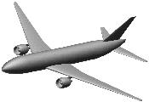


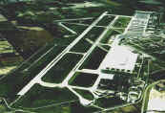
NASA Technology Development Focus in Aeronautics
Primary focus will be the aircraft
Single-aisle and larger is the ultimate long-term interest
Experience with smaller applications should be leveraged
Any propulsion systems using cryogenic fuels were within scope (gas-turbine, fuel cells, hybrid)
Aircraft
Overall Environmental Impact
Multiple Fuel Types?
Less focus will be devoted to non-aircraft considerations
Fuel Production
Airport Infrastructure
- Ground Handling
- Refueling
Fuel Transportation
Initial investment
Fuel cost/availability
Carbon Tax?, etc.
Nation, global energy policies
Not a direct part of NASA Scope

Slide 3
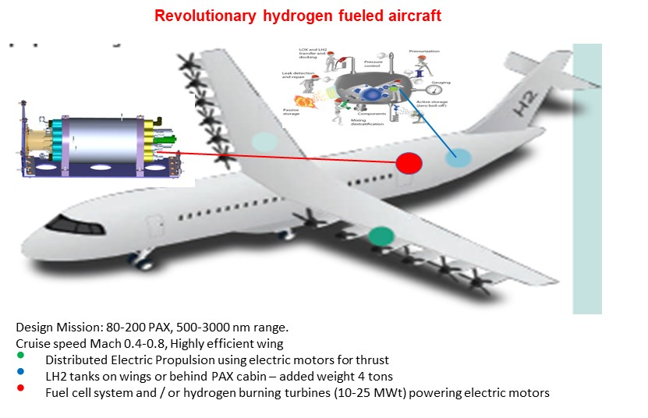
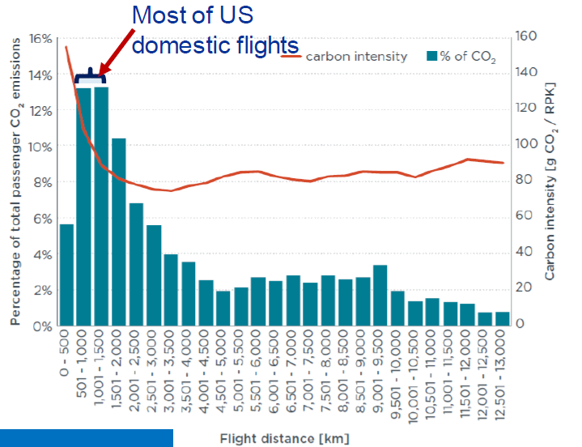
CH₂ARGE Project Scope and Direction
The Opportunity:
The main focus on efficient and low-emissions aviation. Hydrogen is leading
candidate fuel that can provide zero carbon emissions by 2050.
How can we make Hydrogen Aircraft work in commercially viable manner?
How to use the hydrogen most effectively on the aircraft and turn it into energy?
Determine the role of NASA in emerging hydrogen economy.
The Strategy:
Develop integrated conceptual and experimental methodology that enable industry-wide adoption of medium-range Hydrogen Aircraft. Allow for the methodology maturation and identify system level closure plans and technology development targets. Develop an integrated aircraft concept of operations, exploring opportunities such as non-active time frames to simplify aircraft lifecycle requirements. Develop critical roadmaps in aircraft architecture, thermal management, cryogenics and fuel cells.
Study the concepts' efficiency at scale and relative environmental impact.
Considerations:
The MAIN PRACTICAL GOAL is to increase specific energy of the whole aircraft by 2-3X
and will be achieved at the system level by synthesis of on-board lightweight, durable, safe
cryogenic hydrogen system, thermal management, hydrogen-air fuel cells / turbines and
distributed electric propulsion. This requires comprehensive system-specific studies and
practical solutions in identifying advanced materials, modeling tools, & evaluation criteria.
Capitalize on technology synergies and test facilities across multiple NASA centers.
CH₂ARGE exercises NASA’s role in H₂-fueled EAP, advances technology pathways and readiness, develops
workforce & capabilities, and leverages NASA space-side competencies in LH₂ technology & operations

Slide 4

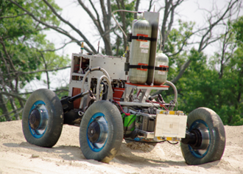
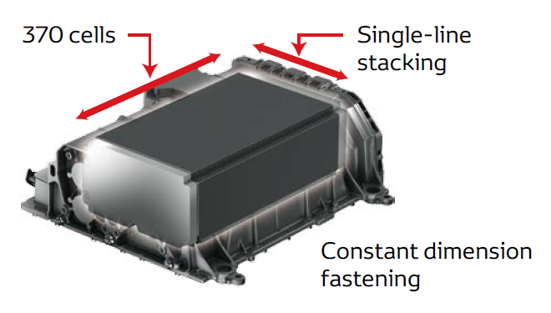
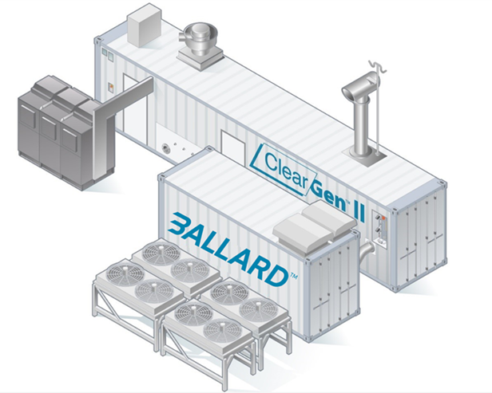
Fuel Cells for Future Aviation
NASA Historic Applications:
Gemini, Apollo, Space Shuttle
Two types of fuel cell using LH₂ & stoichiometric LO₂
UTC alkaline fuel cell for Space Shuttle (1981 ~ 2011)
3 X 12kW units; each 14” x 15” x 45”, 118 kgs
Produces all onboard electrical power, drinking water
Short service life
1kW NFT LT PEM module tested with ground vehicle
FUEL CELLS FOR FUTURE AVIATION:
Requirements:
Durability – 300,000 hrs of electrical power generation
Large scale – several MW size FC for a ~20 MW power system of Boeing 737
Safety – crashworthiness, reliability, maintainability, inspectability, passenger safety
Operations – rapid turn of power generation
Weight/Volume – KW/kg high volumetric power density / gravimetrical power density
Manufacturing Rate – number of aircraft/ month >> other FC applications
Technology Gaps:
Materials and Structures enabling solutions for scalable, durable, efficient, lightweight fuel cells
  High power and KW/kg energy density with 300,000 hours durability and cycle rate capability
  Introduction of High Temperature PEM FC
  Scale up approaches for MW fuel cell stacks
  Lightweight BOP, water and thermal management
Systems Analysis to assess new vehicle configurations
Space Shuttle FC
Automotive applications (LT-PEM):
Several years long service life in cars, trucks, busses
Powertrain: 100 kW (Toyota Mirai) ~ 400 kW (bus)
Mirai FC power density: 0.83 → 2.5 kW/kg since 2008
Standardized gas storage pressure 70 MPa: ~0.9 kWh/L (vs 1.2 for cryo)
Toyota Mirai FC
Stationary power generation (LT-PEM & SOFC):
1 MW containerized PEM FC system in Martinique, France for Hydrogène de France by Ballard is the latest
Typical SOFC <300 kW with heat & power cogeneration
Low power density, easy fuel storage, HC fuel for SOFC
LH₂ = liquid hydrogen; LO₂ = liquid oxygen; UTC = United Technologies Corporation; NFT = non-flow-through; cryo = cryogenic; HC = hydrocarbon
High thermal efficiency of fuel cells implies a fuel volume reduction of ~30%.
NASA experience with kW fuel cell systems for space missions can be leveraged for aviation.
Terrestrial fuel cell industry capabilities are limited to 100-500 kW range for heavy fuel cell systems and BOP.
It requires significant development to close gaps for introduction of fuel cell systems into aircraft.

Slide 5
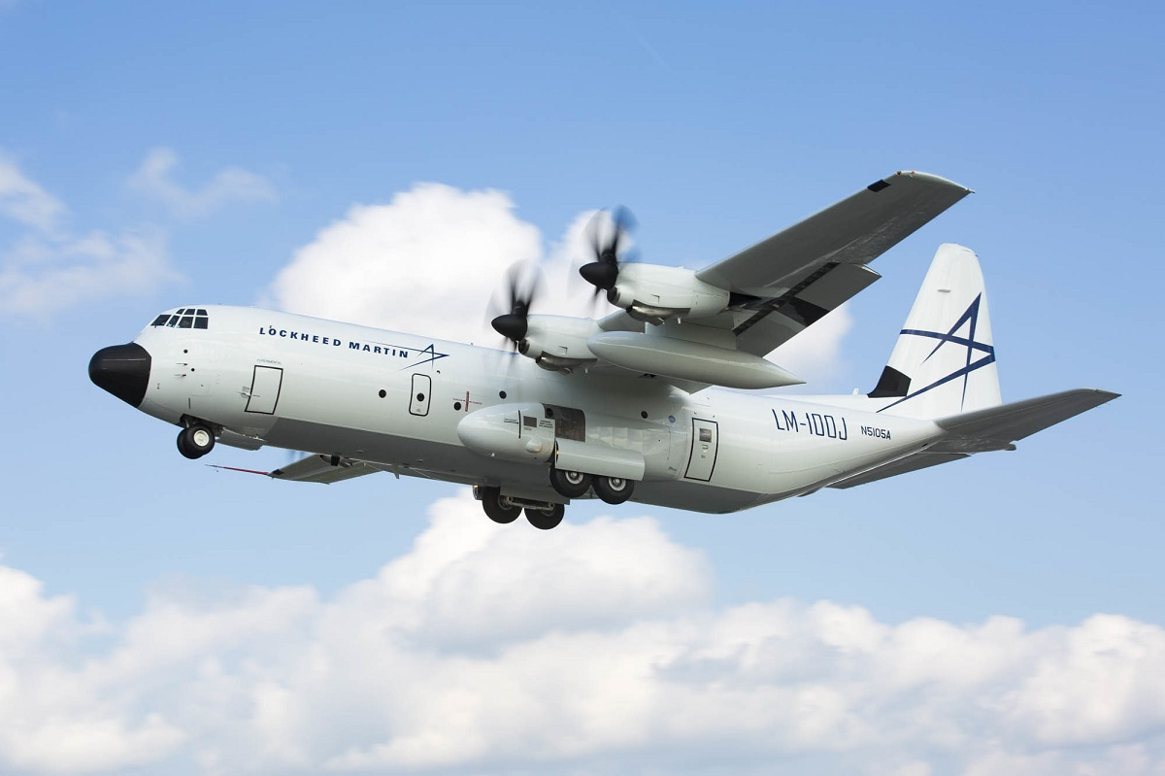
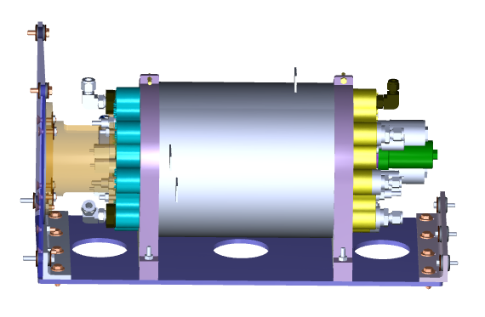
Fuel Cells as Enabling Technology for Hydrogen-Electric Aircraft
Multiple systems-level analyses by NASA CH₂ARGE Team and other technology and commercial development leaders in emerging electrified aviation have shown fuel cells to be enabling technologies for zero emission medium-range aircraft.
High thermal efficiency of fuel cells also implies a fuel volume reduction of ~30%.
BUT: The analyses demonstrated that SOA PEM fuel cell / gaseous hydrogen technology would result in heavier aircrafts having ¼ flight distance of similar sized jet fuel-powered aircrafts. New technology solutions are needed. High power density and efficient fuel cell system fuel cell technology remains “a tall pole in a tent” for a medium-size aircraft.
Performance metrics of 3X SOA need to be demonstrated at a total system level and at MegaWatt scale.
Addressing these challenges by increasing fuel cell operational temperature (SOA for PEM Fuel cell is 80 C) would result in:
higher electrochemical efficiency
higher grade heat and lightweight thermal management increased power density and efficiency at system level
simpler water management
Medium-range aircraft requires ~24 MegaWatt power source → 3 kW/kg high power density fuel cell
at >60% total system efficiency
generates ~15 MegaWatt waste heat
10 MegaWatt coming off the fuel cell system
For the same system-level power requirements, operating at lower current density / lower power increases efficiency, reduces H₂ storage requirements and supporting thermal system mass in exchange for larger (and heavier) stacks

Slide 6
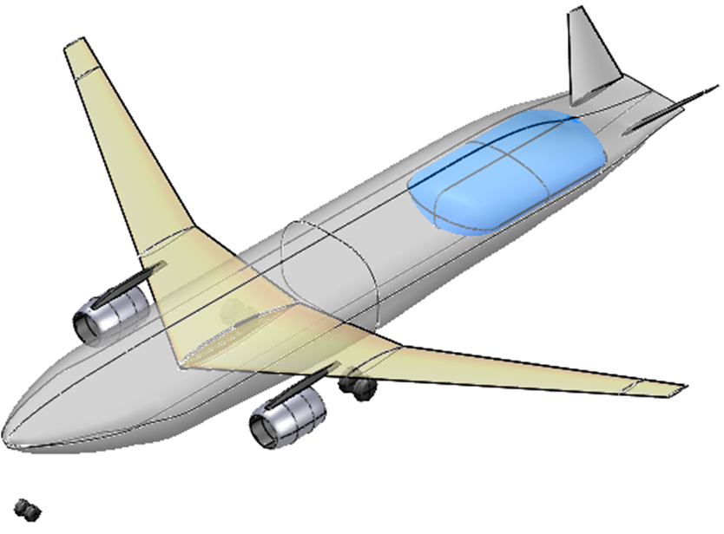
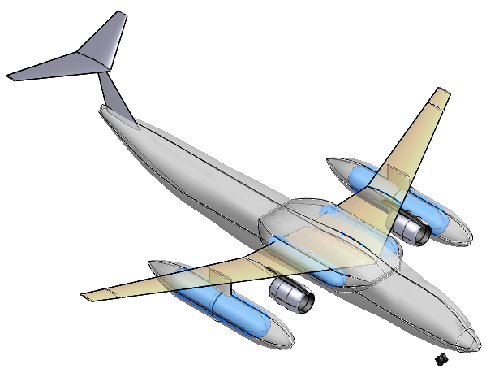
Aircraft Architecture and Fuel Cell Waste Heat Challenge
Internal LH2 carriage
  Better aero
  Reduced weight
External LH2 carriage
  Easier maintenance
  “Eliminates” leakage issues
  Greatly reduced Cg travel in flight
  Improved crash survivability
  Separable LH2 tanks
However, the “long pole in the tent” for moving forward with these concepts was heat rejection from the fuel cell stacks - waste heat that needs to be removed from the system:
  Only thing leaving the aircraft is the engine airflow → need to dump fuel cell waste heat there
  The only place where there is flow proportional to the heat produced by fuel cells would be in the fan duct → need big heat exchangers in the bypass duct
  Heat exchanger placement behind the fan was found to be better
  Hard to close the problem at takeoff → not much temperature delta between the fuel cell temperature and the bypass flow
  Technologies and tools currently under development:
    Developed Python-based analytical tool to trade off size, weight, and pressure drop of fan duct heat exchanger
    Increased fuel cell temperature → greater delta to drive heat transfer in the bypass duct
    Increased fuel cell efficiency → less waste heat, less coolant flow needed

Slide 7
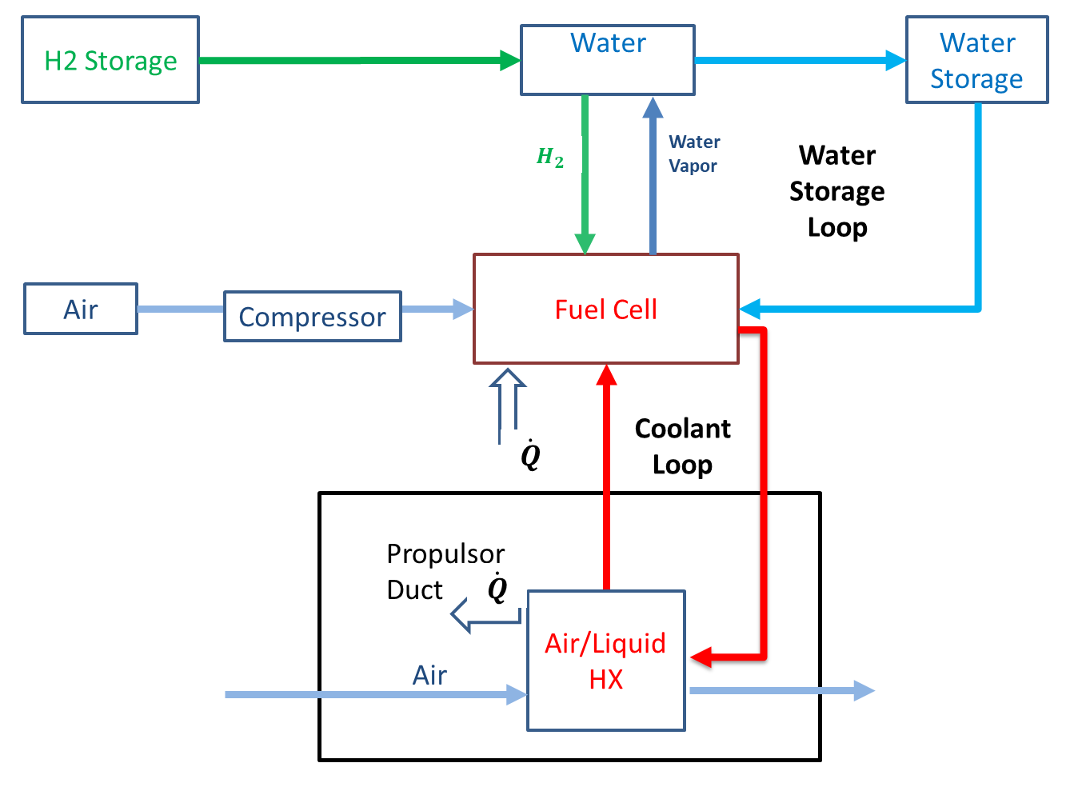

Thermal Management System Considerations
Python-based TMS sizing tool completed
Need to reject 40% to 60% of the fuel cell heat energy (~10 MWt)
Need to transition from LT PEM (80C) to HT PEM (200C) to achieve large temperature differential between coolant and airstream during takeoff and climb
Heat rejection must close at zero flight speed, necessitating the placement of the heat exchanger in the propulsor duct
At takeoff, the air is relatively hot, making heat transfer difficult
Potential solution is to include battery power for takeoff and initial climb to reduce heat rejection requirement
Currently working on heat exchanger conceptual design to get initial size and weight
Requirements
  $ΔT_{max}$ - High/Low Temp PEM
  Prescribed $T_{inlet},P_{inlet}$
  Prescribed ${\dot{m}}_{reactants}$
  Humidification & Water Storage
  Potentially its own coolant (interface HX w/ TMS)
  Multiple FC stacks across the aircraft

Slide 8
Power Architecture sizing
Adopted NASA GRC-developed Electrical Power System – Sizing and Analysis Tool (EPS-SAT) that enables analysis of hydrogen fuel cell electric aircraft propulsion systems and calculates system performance.
  Architecture/component sizing and trades
  Power system architecture studies and sensitivity analysis
  Estimates aerospace power system performance.
  Exposes strengths and weaknesses of designs.
GM Fuel Cell System Component Mass
4000
3793
3500
3182
k
3000
]
g
2500
[
s
s
a
2000
M
1500
AIAA Aviation 2024, Hanlon et al., “Modeling and Trade Space for Fuel Cell Powered Aircraft”
1000
806
653
605
458
574
500
28
0
l
l
C
e
r
r
r
l
l
e
D
l
e
t
e
t
o
t
a
e
l
C
C
/
C
a
b
e
a
k
v
e
r
M
o
T
o
F
u
u
e
D
r
n
t
2
F
B
I
m
p
o
n
e
n
H
C
o
Component

Slide 9
Conclusions
Advanced Fuel Cells, Thermal Management Systems and Cryogenic Hydrogen are on a critical path for development of next generation aviation as well as many terrestrial applications and space planetary exploration
Aircraft architecture studies advance across Government, Academia, Industry
Developing enabling materials for cryogenic and fuel cells systems remains a key
Fuel cell technology is both highly promising and enabling for Hydrogen-Electric Aircraft, but many problems remain with performance, maturity and scale-up
Heat rejection from the fuel cell stacks dictates new approaches to Thermal Management Systems, heat exchangers, and aircraft architecture synergies of major components and subsystems
Analytical tools are essential for the system design, sizing and performance analysis
Design, implement and test key components and full systems
Next steps in collaborations with industry, academic, government partners

Slide 10


Slide 11
