Slide 1
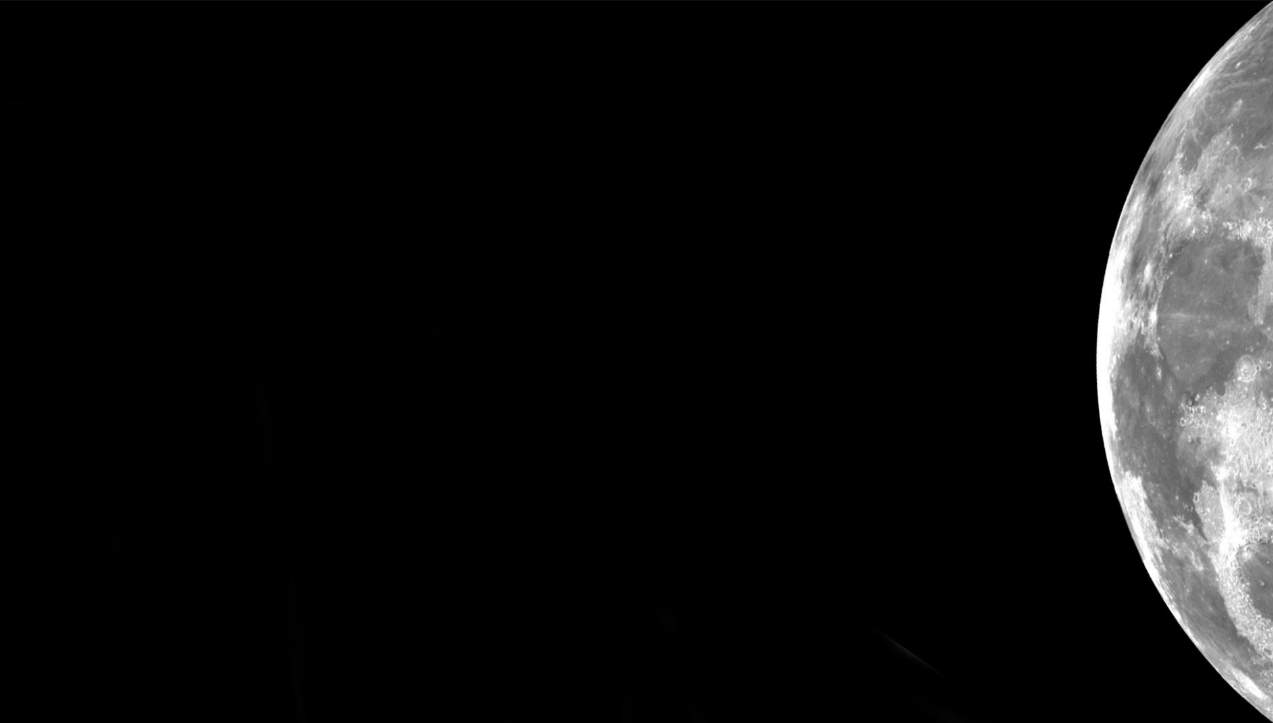

Electrodynamic Dust Shield (EDS) to the MOON!
PI: Dr. Charles Buhler
CO-PI: Dr. Joseph Toth
Electrostatics and Surface Physics Laboratory
NASA Kennedy Space Center, FL 32899
Krystal Acosta
Michael Baron
Carlos Calle
Michael Dupuis
Jeffrey Dyas
Chris Forney
Marty Grashik
Alexis Hongamen
Musashi Howe*
Jonathan Hsu
Lexis Mazerski*
Aaron Olson
James Phillips
Seth Rhodes**
Troy Toon
Jerry Wang
Jennifer Wilson
Melissa Young
*Aetos Systems Inc. **Bionetics Corp.

Slide 2
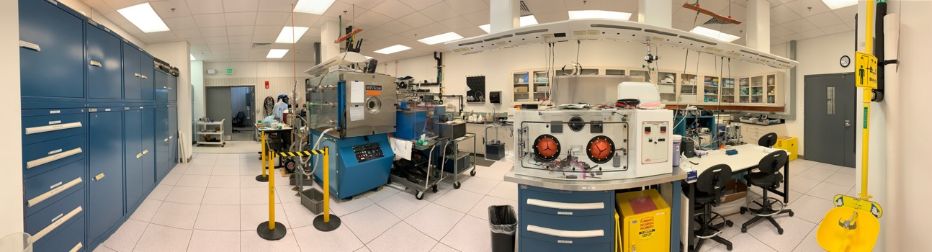
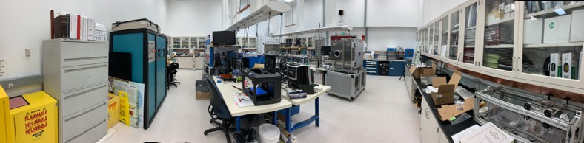
The Laboratory
Mission: investigate electrostatics and surface physics problems with application to space flight and planetary exploration
Founded in 1998
Perform electrostatic analysis and material characterization to assist in detection, mitigation and prevention of electrostatic charge generation on space flight hardware and ground support equipment.
Develop technologies for NASA’s planetary exploration missions.
  Dust mitigation technologies
  Instrumentation for planetary science
Lab Lead:
Dr. Charles R. Buhler
charles.r.buhler@nasa.gov

Slide 3
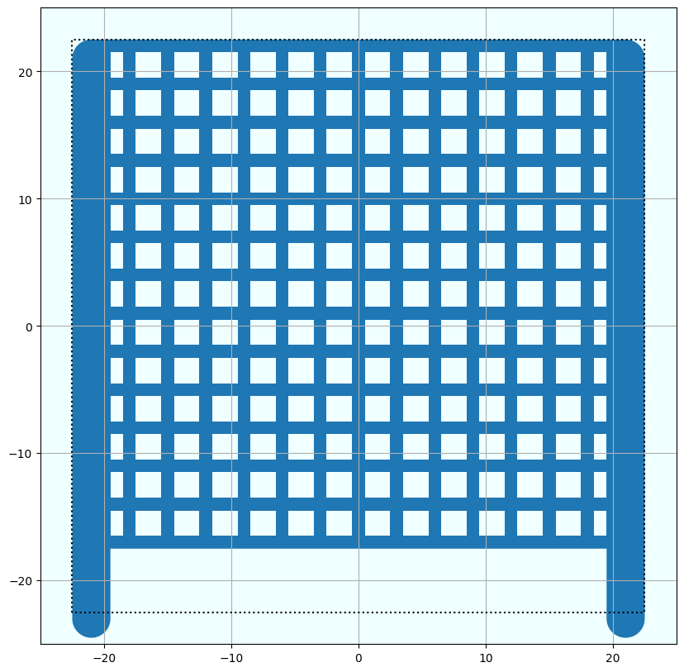
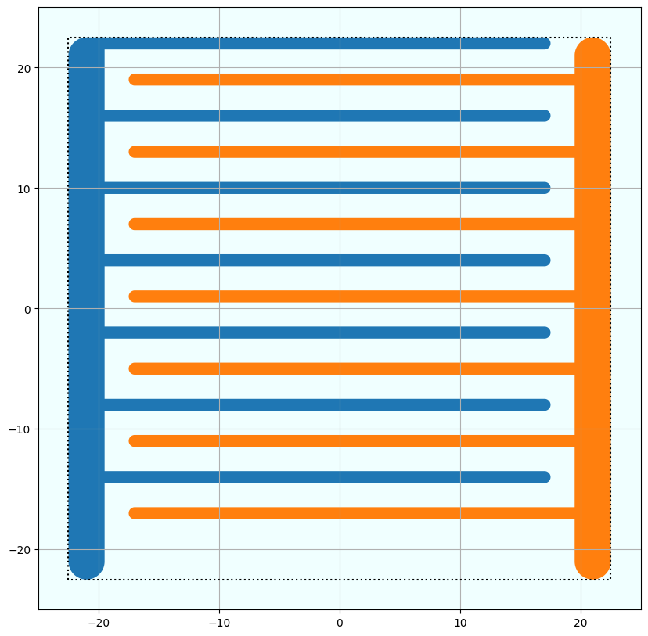
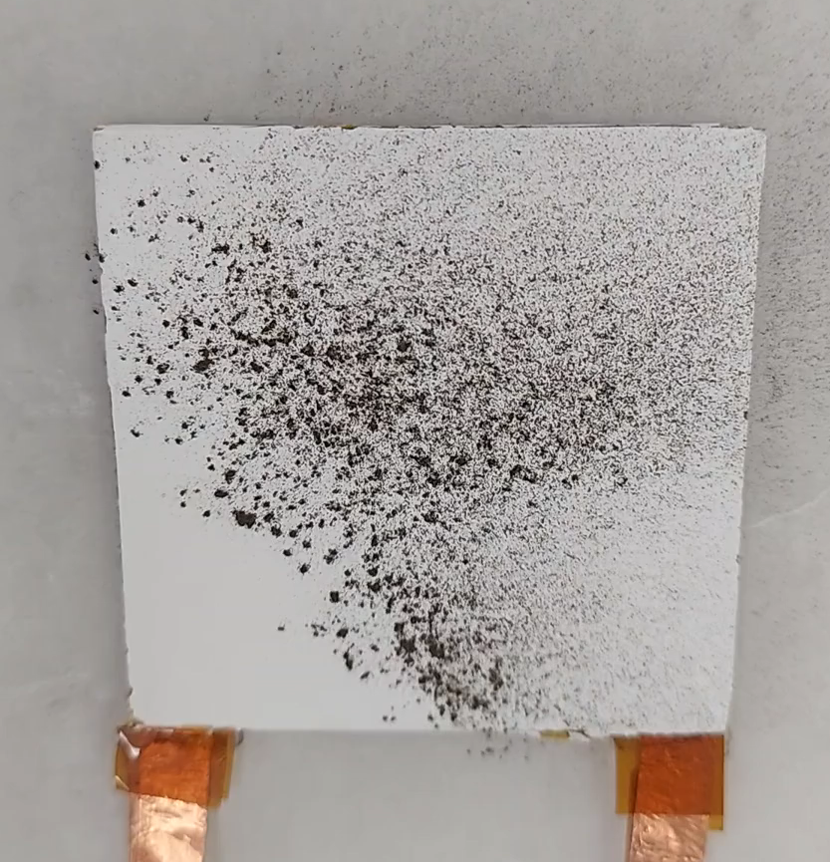
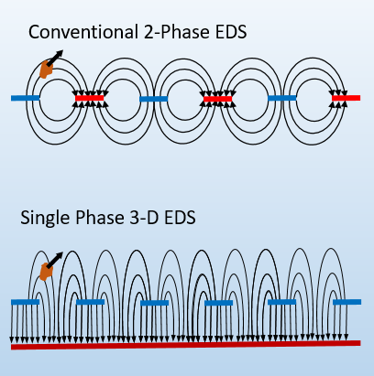
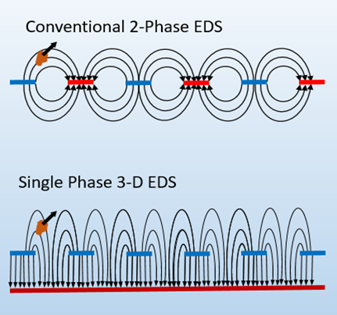
Electrodynamic Dust Shield
Out-of-Plane (3D) EDS:
In-Plane (2D) EDS:
Electrodes
Insulating layer
Insulating layer
Substrate
Electrodes
Adhesive
Substrate
Ground/ Other Phase
Apply a high-voltage square wave across the electrodes to clear dust

Slide 4
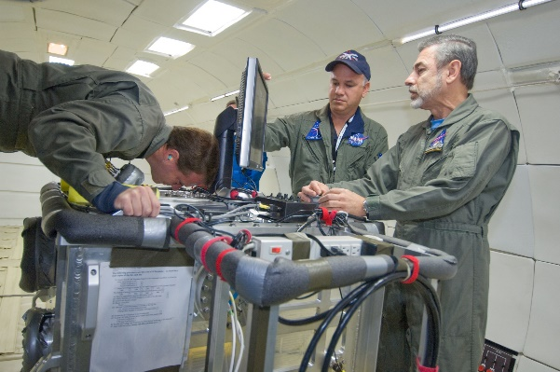
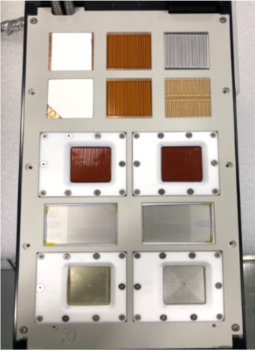
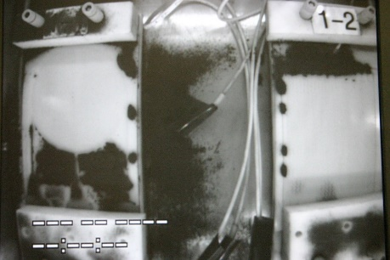
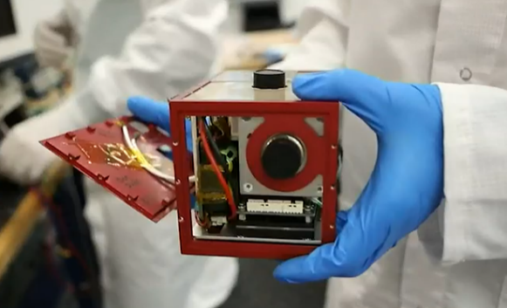
EDS Development
1960s – First studies into the electric curtain, precursor of the EDS
2002 – Development of the EDS for space application in the ESPL
2008 – Reduced gravity flight
  JSC-1A simulants and Apollo 16 highland samples
  Demonstrated EDS will work at lunar gravity and with actual lunar dust sample.
2020 and 2021 – MISSE-11 and MISSE-15 flights
  EDS material testing in space.
  Mature the EDS power supply design.
2020 – EDS Payload manifested onto CLPS 19D
  Small tech demo of the EDS on a lunar lander
2024 – Eagle Cam (2024) with ERAU [University led project] (IM1)
  Integrated a camera EDS on a CubeSat.
  Telemetry loss resulted in no EDS testing
2025 – Blue Ghost deployed the EDS payload onto the lunar surface (BGM1)
  Successfully demonstrated lunar dust removal.

Slide 5
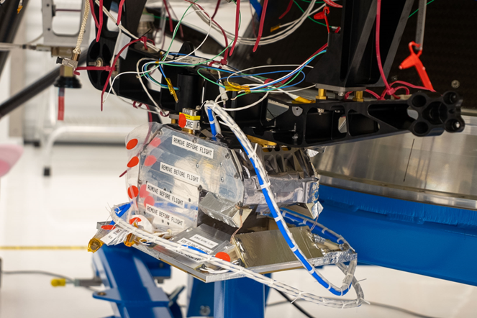
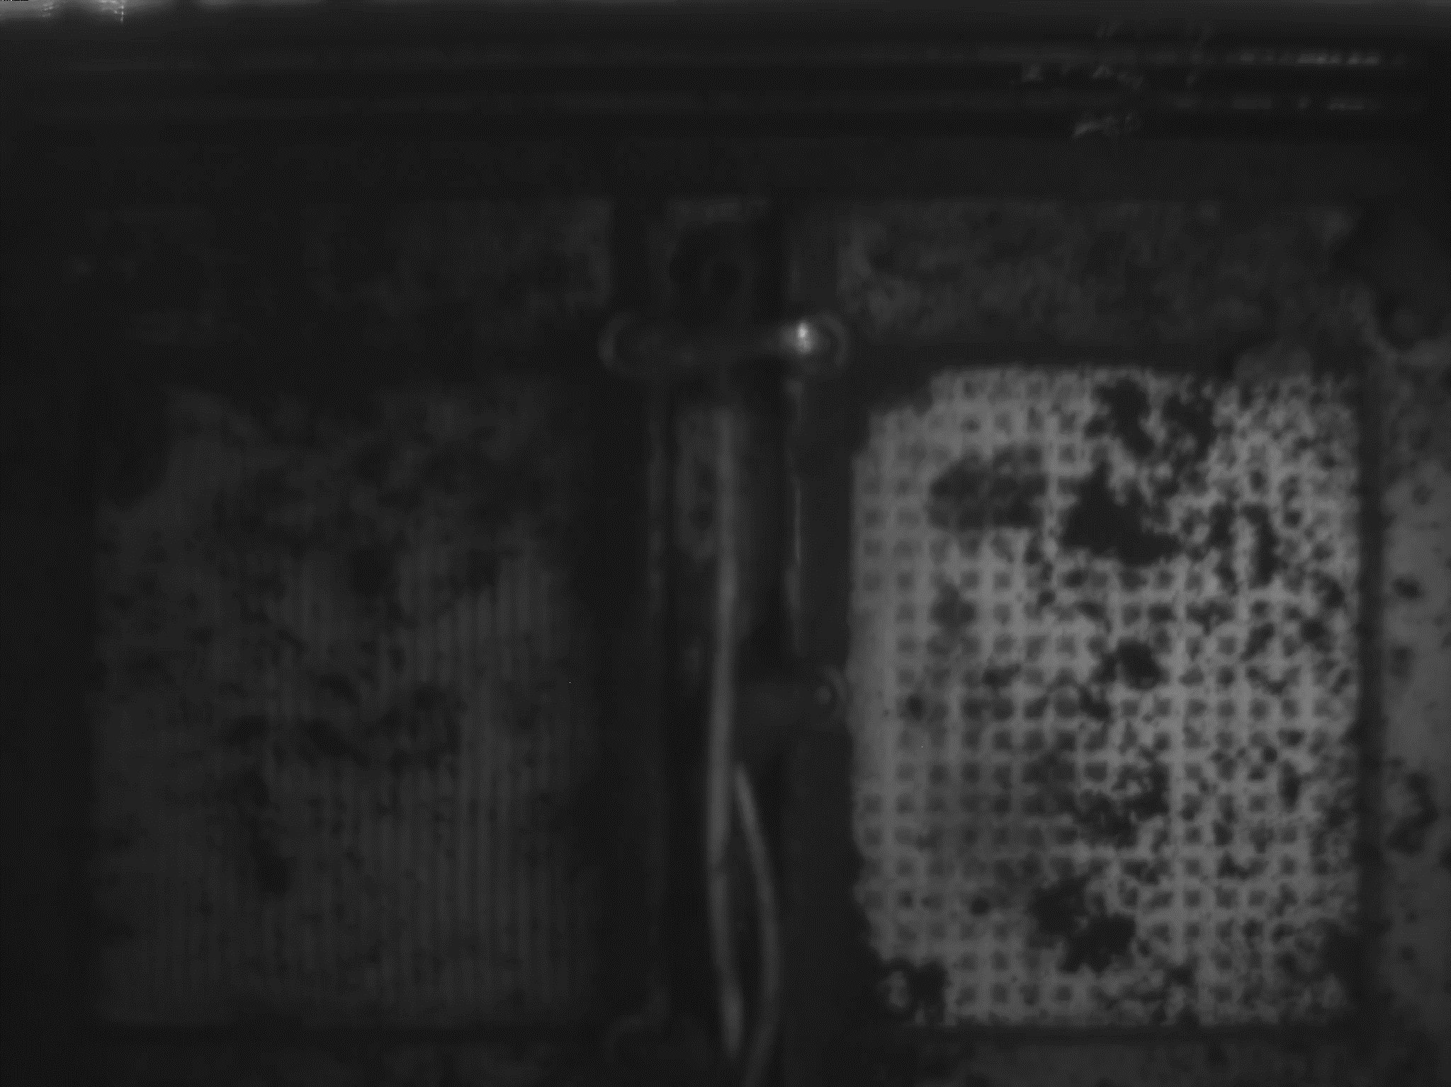
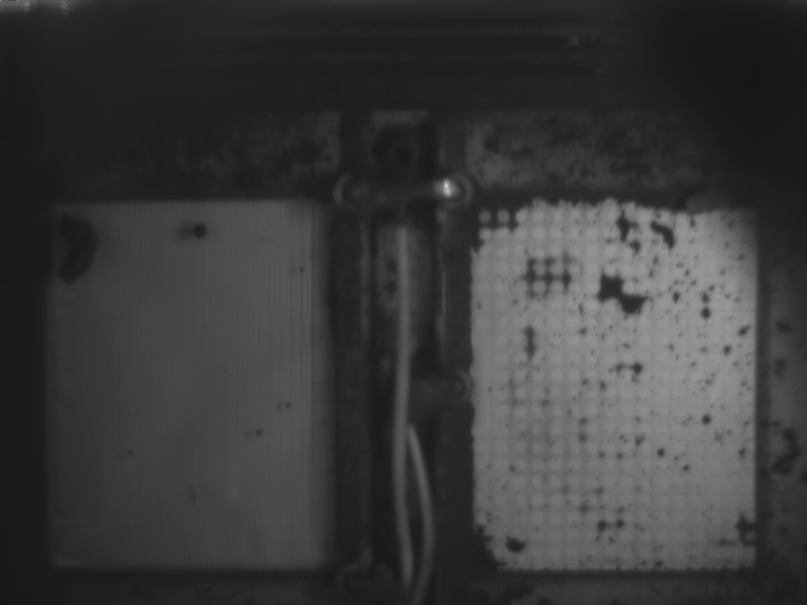
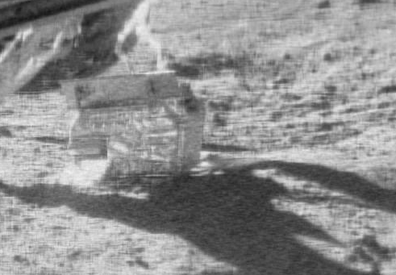
EDS on BGM1
EDS Payload on the moon
Glass EDS
Thermal Radiator EDS
96% dust removed
82% dust removed
Image credit: SCALPSS (LaRC)

Slide 6
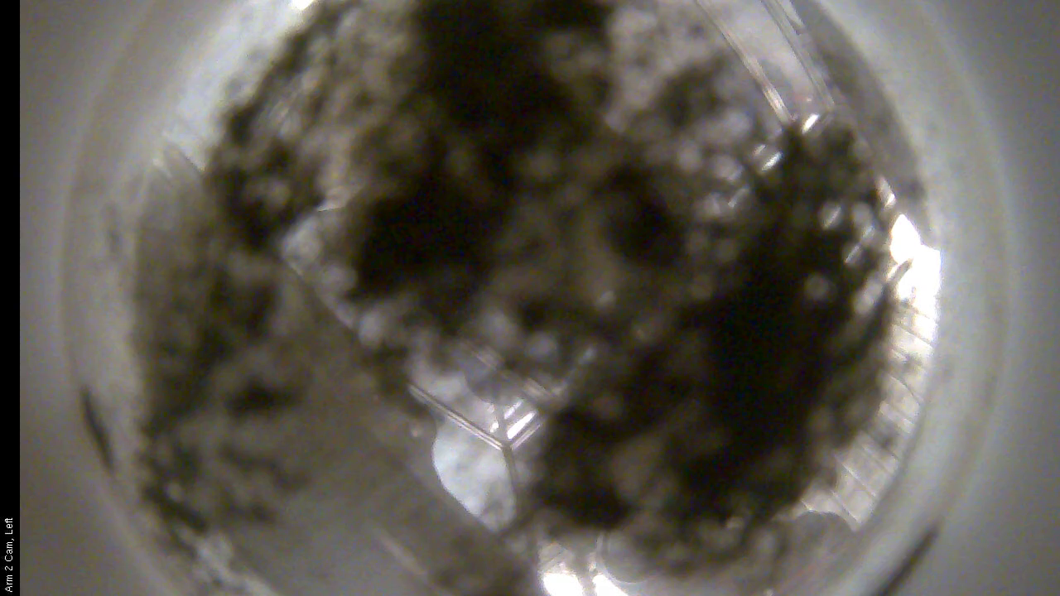
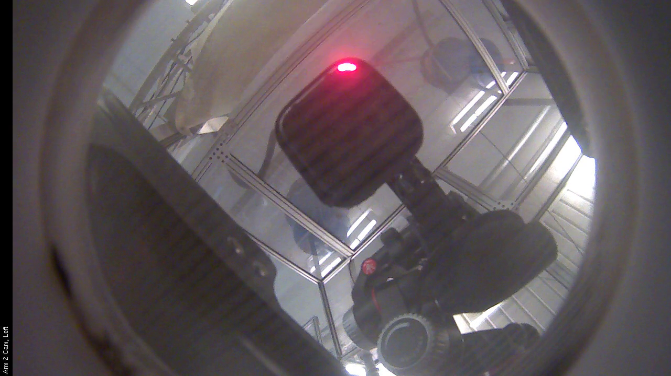
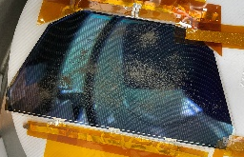
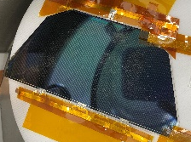
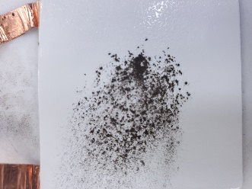
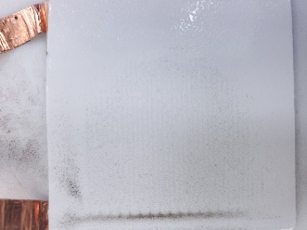
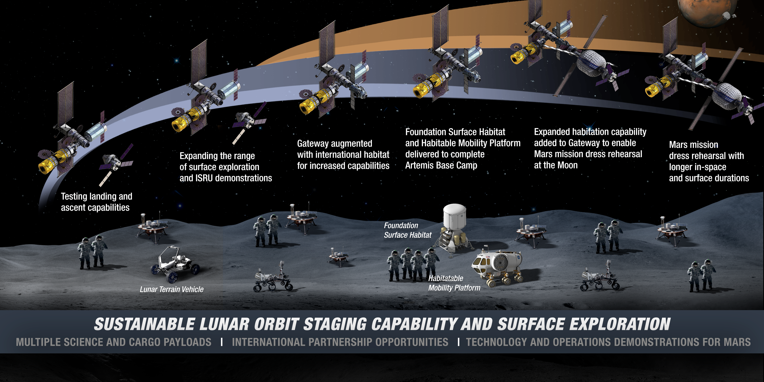
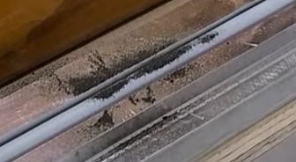
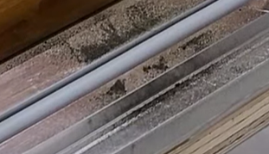
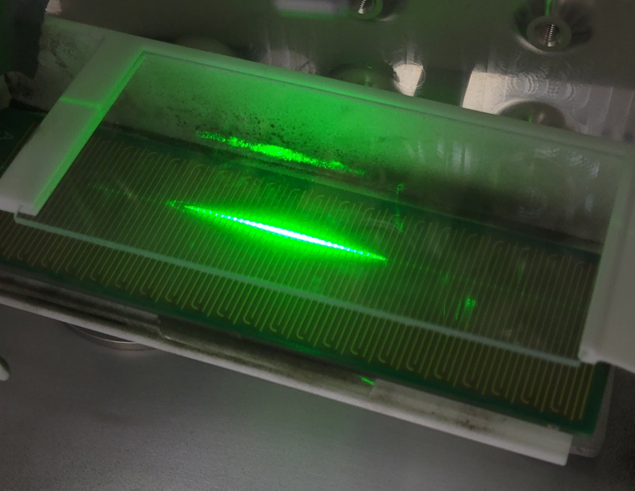
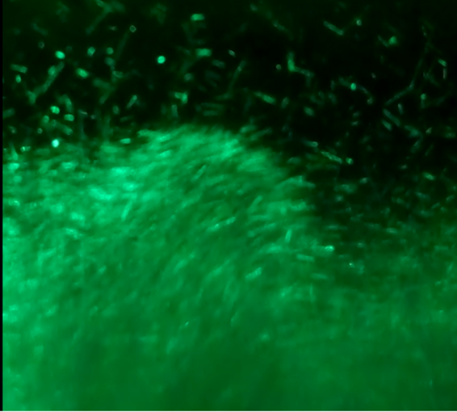
Next Steps for EDS
EDS Applications | Before | After
Camera systems
Photovoltaic cells
Thermal radiator
Door seals and gaskets
Regolith conveyor
The next step for EDS is to integrate it into dust sensitive systems on missions to planetary bodies.
Active Infusion Opportunities:
Lunar landers
Lunar vehicles
Lunar solar cell systems
Lunar rovers
Lunar habitats
Credit: nasa.gov

